Slide 1
Open Zone Network
Architectural Review
October 20, 2022
4

Slide 2
Problem Overview
Modernized border protections were put in place
Faculty/Researchers have collaborative machines
Individuals outside the University’s network require access to the machines
Not all of the individuals have credentials that permit VPN
The machines require access beyond standard “zone” access packages
SSH/SFTP
RDP
Etc.
The machines potentially increase attack vectors
The machines do not meet SciDMZ requirements

Slide 3
Logical Network Overview
Open Zone Network

Slide 4
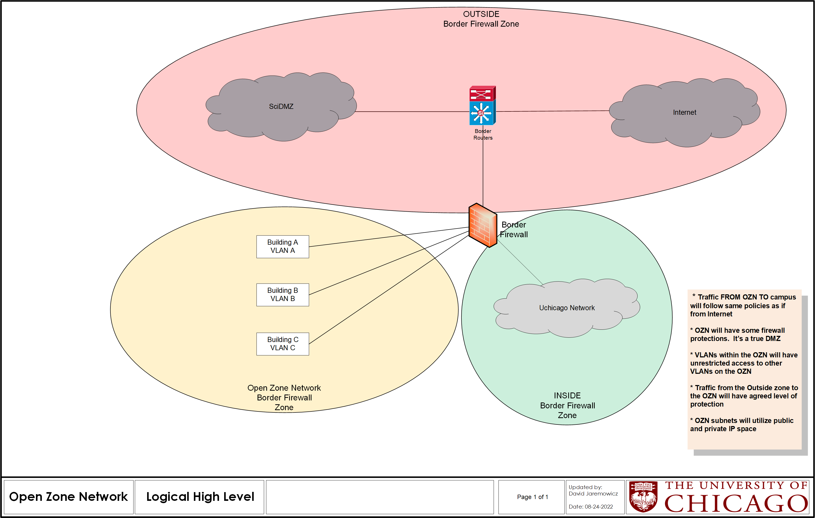

Slide 5
Network and Security Design Notes
Open Zone Network

Slide 6
Network Design
One zone on the border firewall for all OZN machines
Building rollout will be as needed
Onboarding will only be done after the approval process
IP addressing – DHCP reservation, public and private subnets

Slide 7
Security Design
There will be some basic protections in place for the OZN*
Machines will have security measures in place
There will be an onboarding approval process
There will be connectivity requirements (similar to SciDMZ requirements)
Notes:
*Baseline TBA

Slide 8
Workflow Basics
Detailed workflow will be available prior to rollout
Request process starts with submitting onboarding packet to IT Security
IT Security reviews request, approves, passes request to Networking
Networking configures OZN VLAN in building if not pre-existing
Networking assigns machine IP in OZN building subnet.
Networking configures the machine’s switch port with OZN VLAN

Slide 9
Additional Information Discussion
Open Zone Network

Slide 10
Questions?

