Slide 1
The Discovery of the Top Quark
Tony Liss
MelFest
May 20, 2023

Slide 2
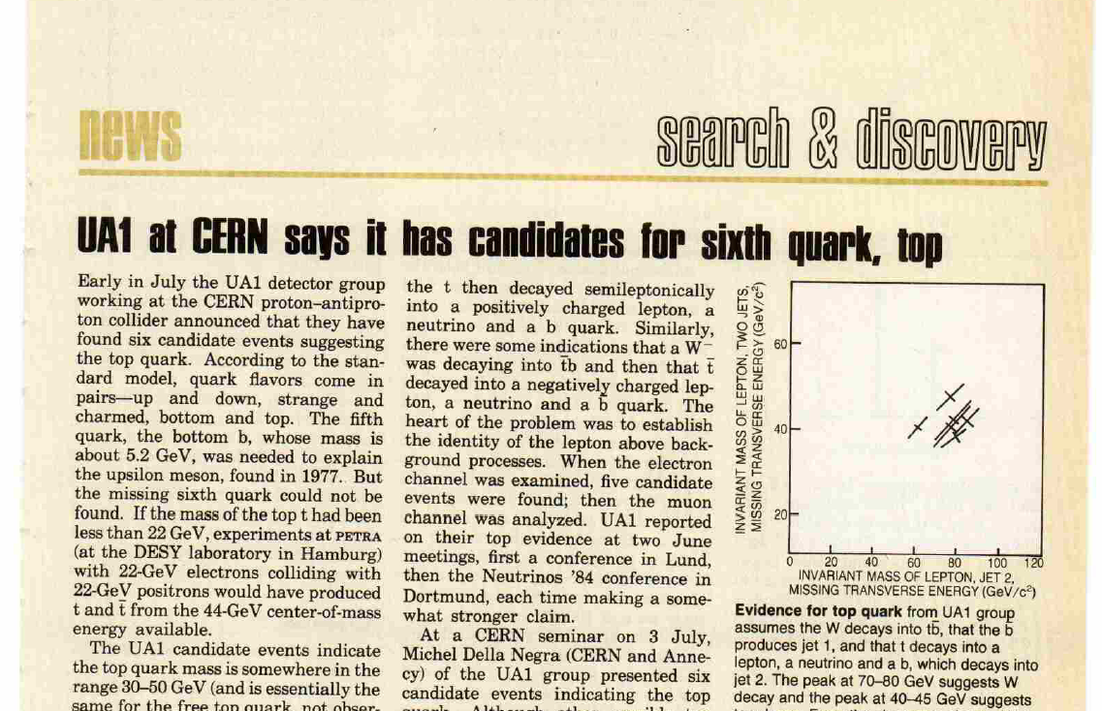
August 1984 Physics Today
Notes:
A few months after I joined CDF, UA1 discovered top

Slide 3
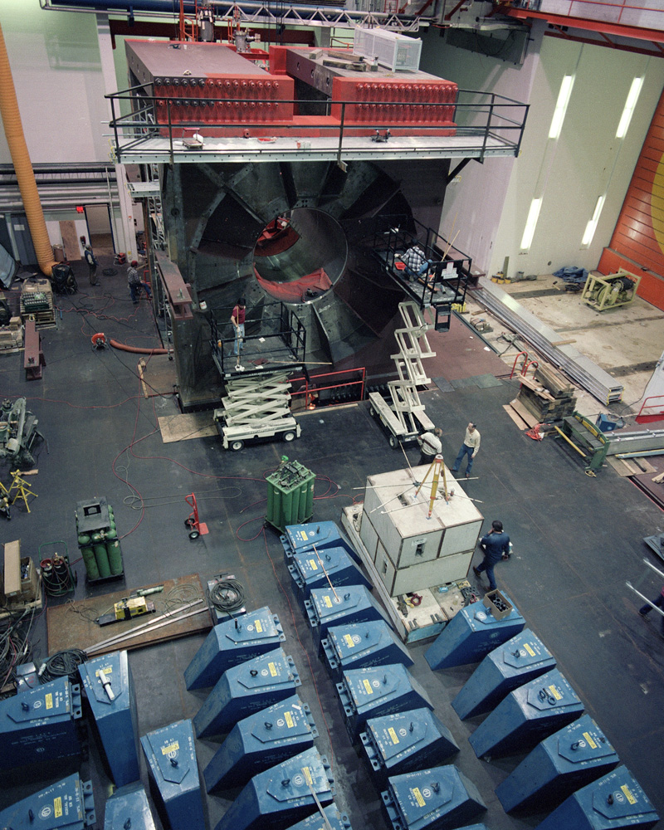
CDF looked like this

Slide 4
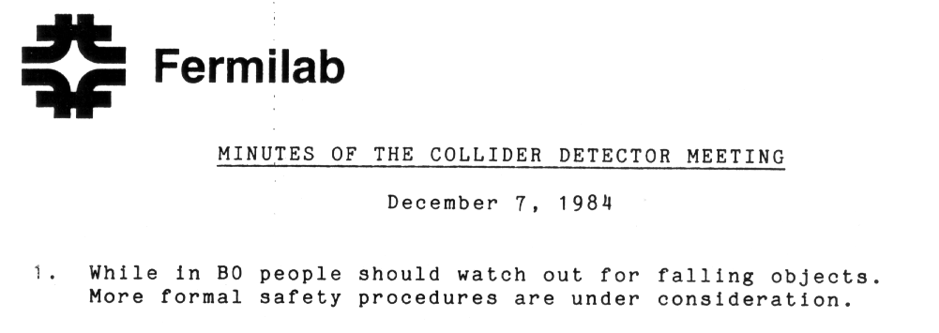
From Mel’s archives

Slide 5
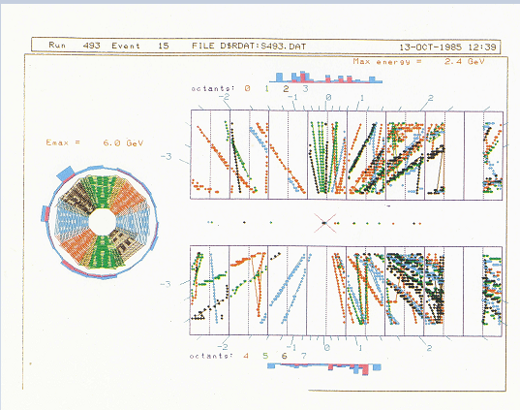
It all began one October night in 1985

Slide 6
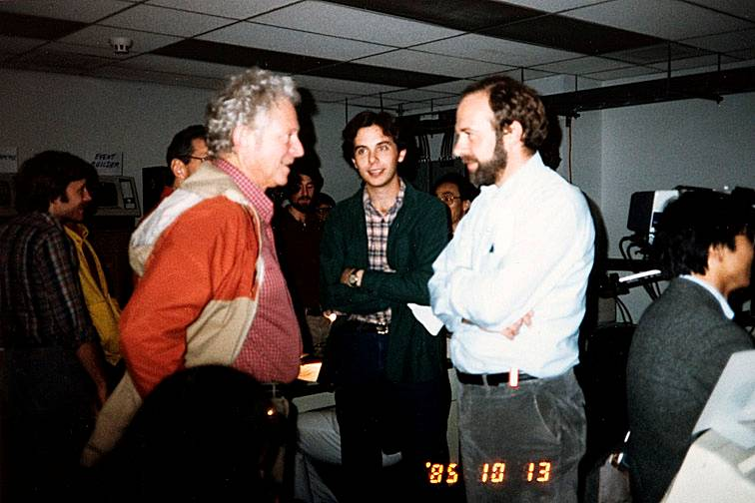
CCNY physics major with CCNY provost and Roy Schwitters
Notes:
Roy passed away in January

Slide 7
CDF Enters the Top Mass Limit Contest
Ultimately, UA1,2 published M_{top} limits in 1990 of 60, 69 GeV/c²
In 1990 CDF published a limit
M_{top}> 77 GeV/c²
This put UA1/UA2 out of business in the search for top

Slide 8
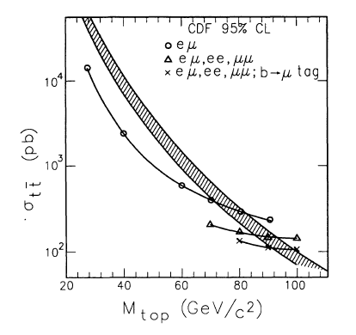
270 Physicists fail to find the top quark
By 1992 we knew the top quark was heavy enough to decay to a real W boson:
PRD 45 3921 (1992)
M_{top}>91 GeV/c² (“Run 0” 4.5 pb⁻¹!)
M_{top}>M_{W}+M_{b}
Also in 1992….
D0 begins to take data

Slide 9
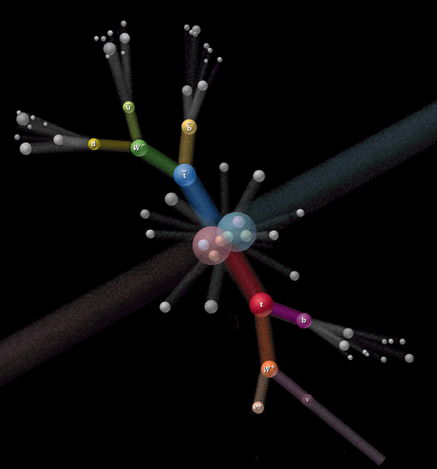
Top Search Primer
Notes:
Talk about cleanest channel and large BF channels

Slide 10
And then, in October 1992…

Slide 11
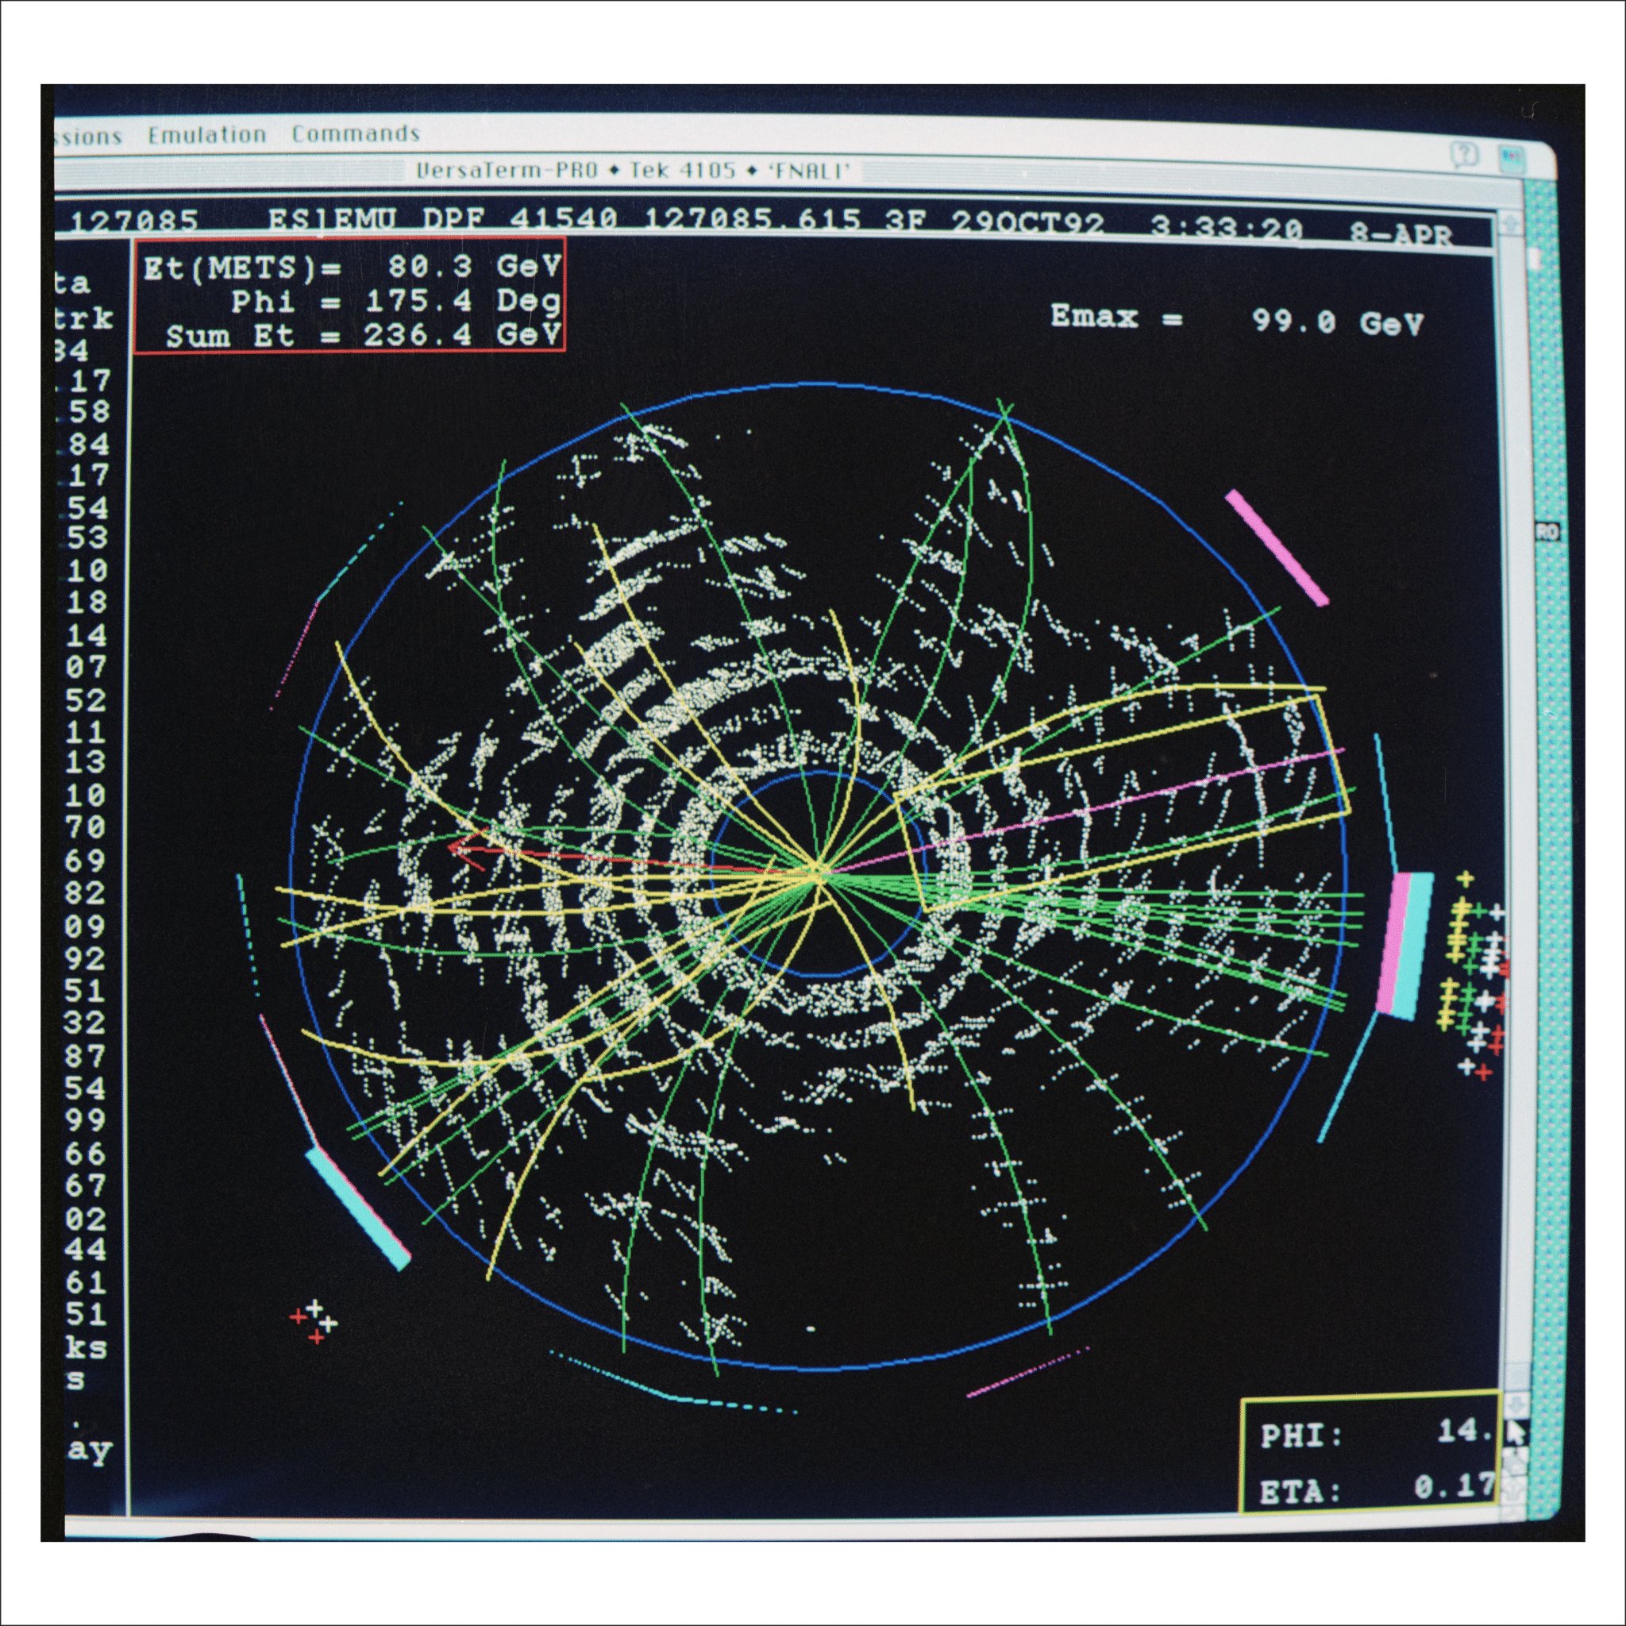
Congressman Foster’s Damn Fast Event Display

Slide 12
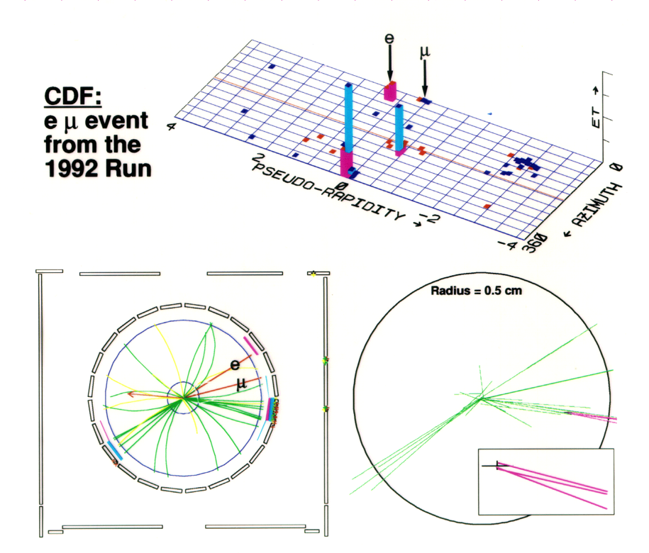
The eμ Event
After the 1992 paper, our limit-setting ability started to deteriorate
249.72

Slide 13
In November 1992…
Tevatron Run 1 started on August 31, 1992
Already, on October 29, we had a strong top candidate
Many more must be just around the corner!
D0 also had a strong dilepton candidate
Start your engines!
Much to the dismay of many of us, there was an agreement between CDF and D0 to provide two weeks notice before a major announcement.
But in the meantime….TOP SECRET!!
But we worried about pillow talk.

Slide 14
From Avi’s Top Turns Ten Talk

Slide 15
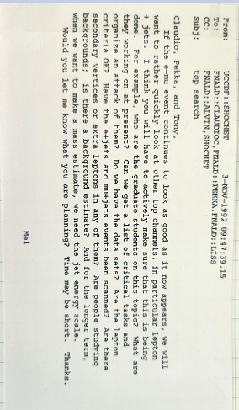
And then, for a long time, it was quiet
Notes:
First mention of TopParents in my notes, May 13, 1993

Slide 16
Limits
The CDF focus was firmly on discovery
The last mass limit paper was D0’s, on the eve of the Evidence paper

Slide 17
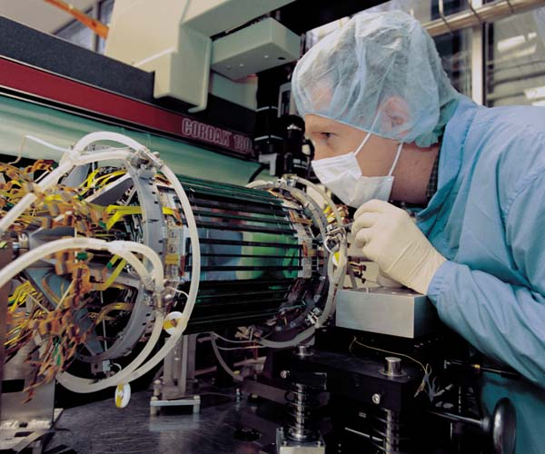
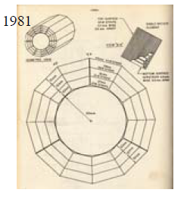
The CDF Superpower: The SVX (Si Vertex Detector)
Proposed by Italian colleagues when CDF was barely in the womb
Notes:
And then Luciano built the SVT that made CDF a b-physics powerhouse.

Slide 18
1992-1994
After DPF-like events failed to flood in, we went back to our separate top-signature corners
Di-lepton searching
Lepton+jets searching
SVX b-tagging (3 different algorithms)
Soft-lepton b-tagging
All-hadronic searching
Kinematic signatures
Top mass reconstruction techniques
Top group presentations were made, but most of us had blinders on for anything not directly relevant to what we were doing.

Slide 19
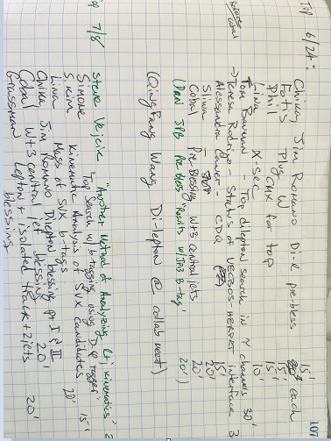
June 1993
Notes:
What’s interesting about this?

Slide 20
1992-1994
After DPF-like events failed to flood in, we went back to our separate top-signature corners
Di-lepton searching
Lepton+jets searching
SVX b-tagging (3 different algorithms)
Soft-lepton b-tagging
All-hadronic searching
Kinematic signatures
Top mass reconstruction techniques
In July 1993 there was a two-day CDF collaboration meeting in which everyone gave status reports
There were hints in the dilepton and the lepton+jets analyses, but since everyone had been working in semi-isolation, we had not looked at them side-by-side before
Paul Tipton was scheduled to present the top-search status at Lepton-Photon in August

Slide 21
“It was late in the day on Friday, the second day of a collaboration meeting, and…nobody paid much attention. My eyes opened up, and so did Alvin’s, and we looked at each other because we were counting.”
– Mel Shochet in “The Evidence for the Top Quark” by Kent W. Staley
2 dilepton events
6 SVX b-tagged events
7 SLT b-tagged events
Notes:
Alvin and Mel stopped me in the parking lot and said “What does Paul think he’s going to show at L-P?”

Slide 22
The October Massacre
The original (bone-headed) plan was to prepare four short papers for PRL
Results of the dilepton search
Results of the lepton+jets search with SVX b-tagging
Results of the lepton+jets search with SLT b-tagging
A summary paper with cross section and mass
We presented this plan at a collaboration meeting in October
It was not well received
The collaboration told us “These papers suck” – Paul Tipton in “The Evidence for the Top Quark” by Kent W. Staley

Slide 23
Plan B
One monster Physical Review D paper
Dileptons: 2 observed, 0.56 expected from backgrounds
Lepton+jets with SVX tag: 6 observed 2.3 expected from backgrounds
Lepton+jets with SLT tag: 7 observed 3.1 expected from backgrounds

Slide 24
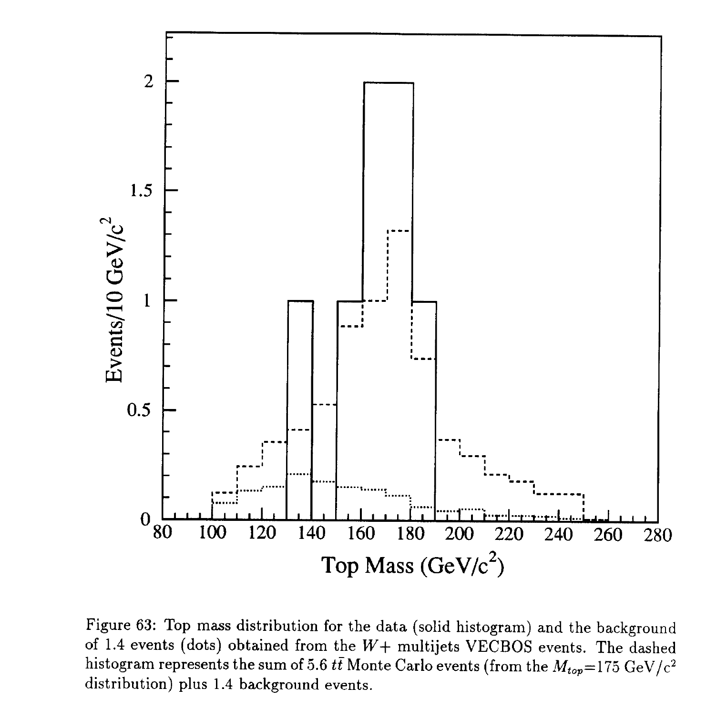
And there was this…
The reconstructed top mass from 7 tagged W+4 jet events
Notes:
We debated including this (somehow) in the significance, but were ever conservative and did not.

Slide 25
Meanwhile in December 1993
Run 1b starts
First PRD draft is a Christmas gift to the collaboration

Slide 26
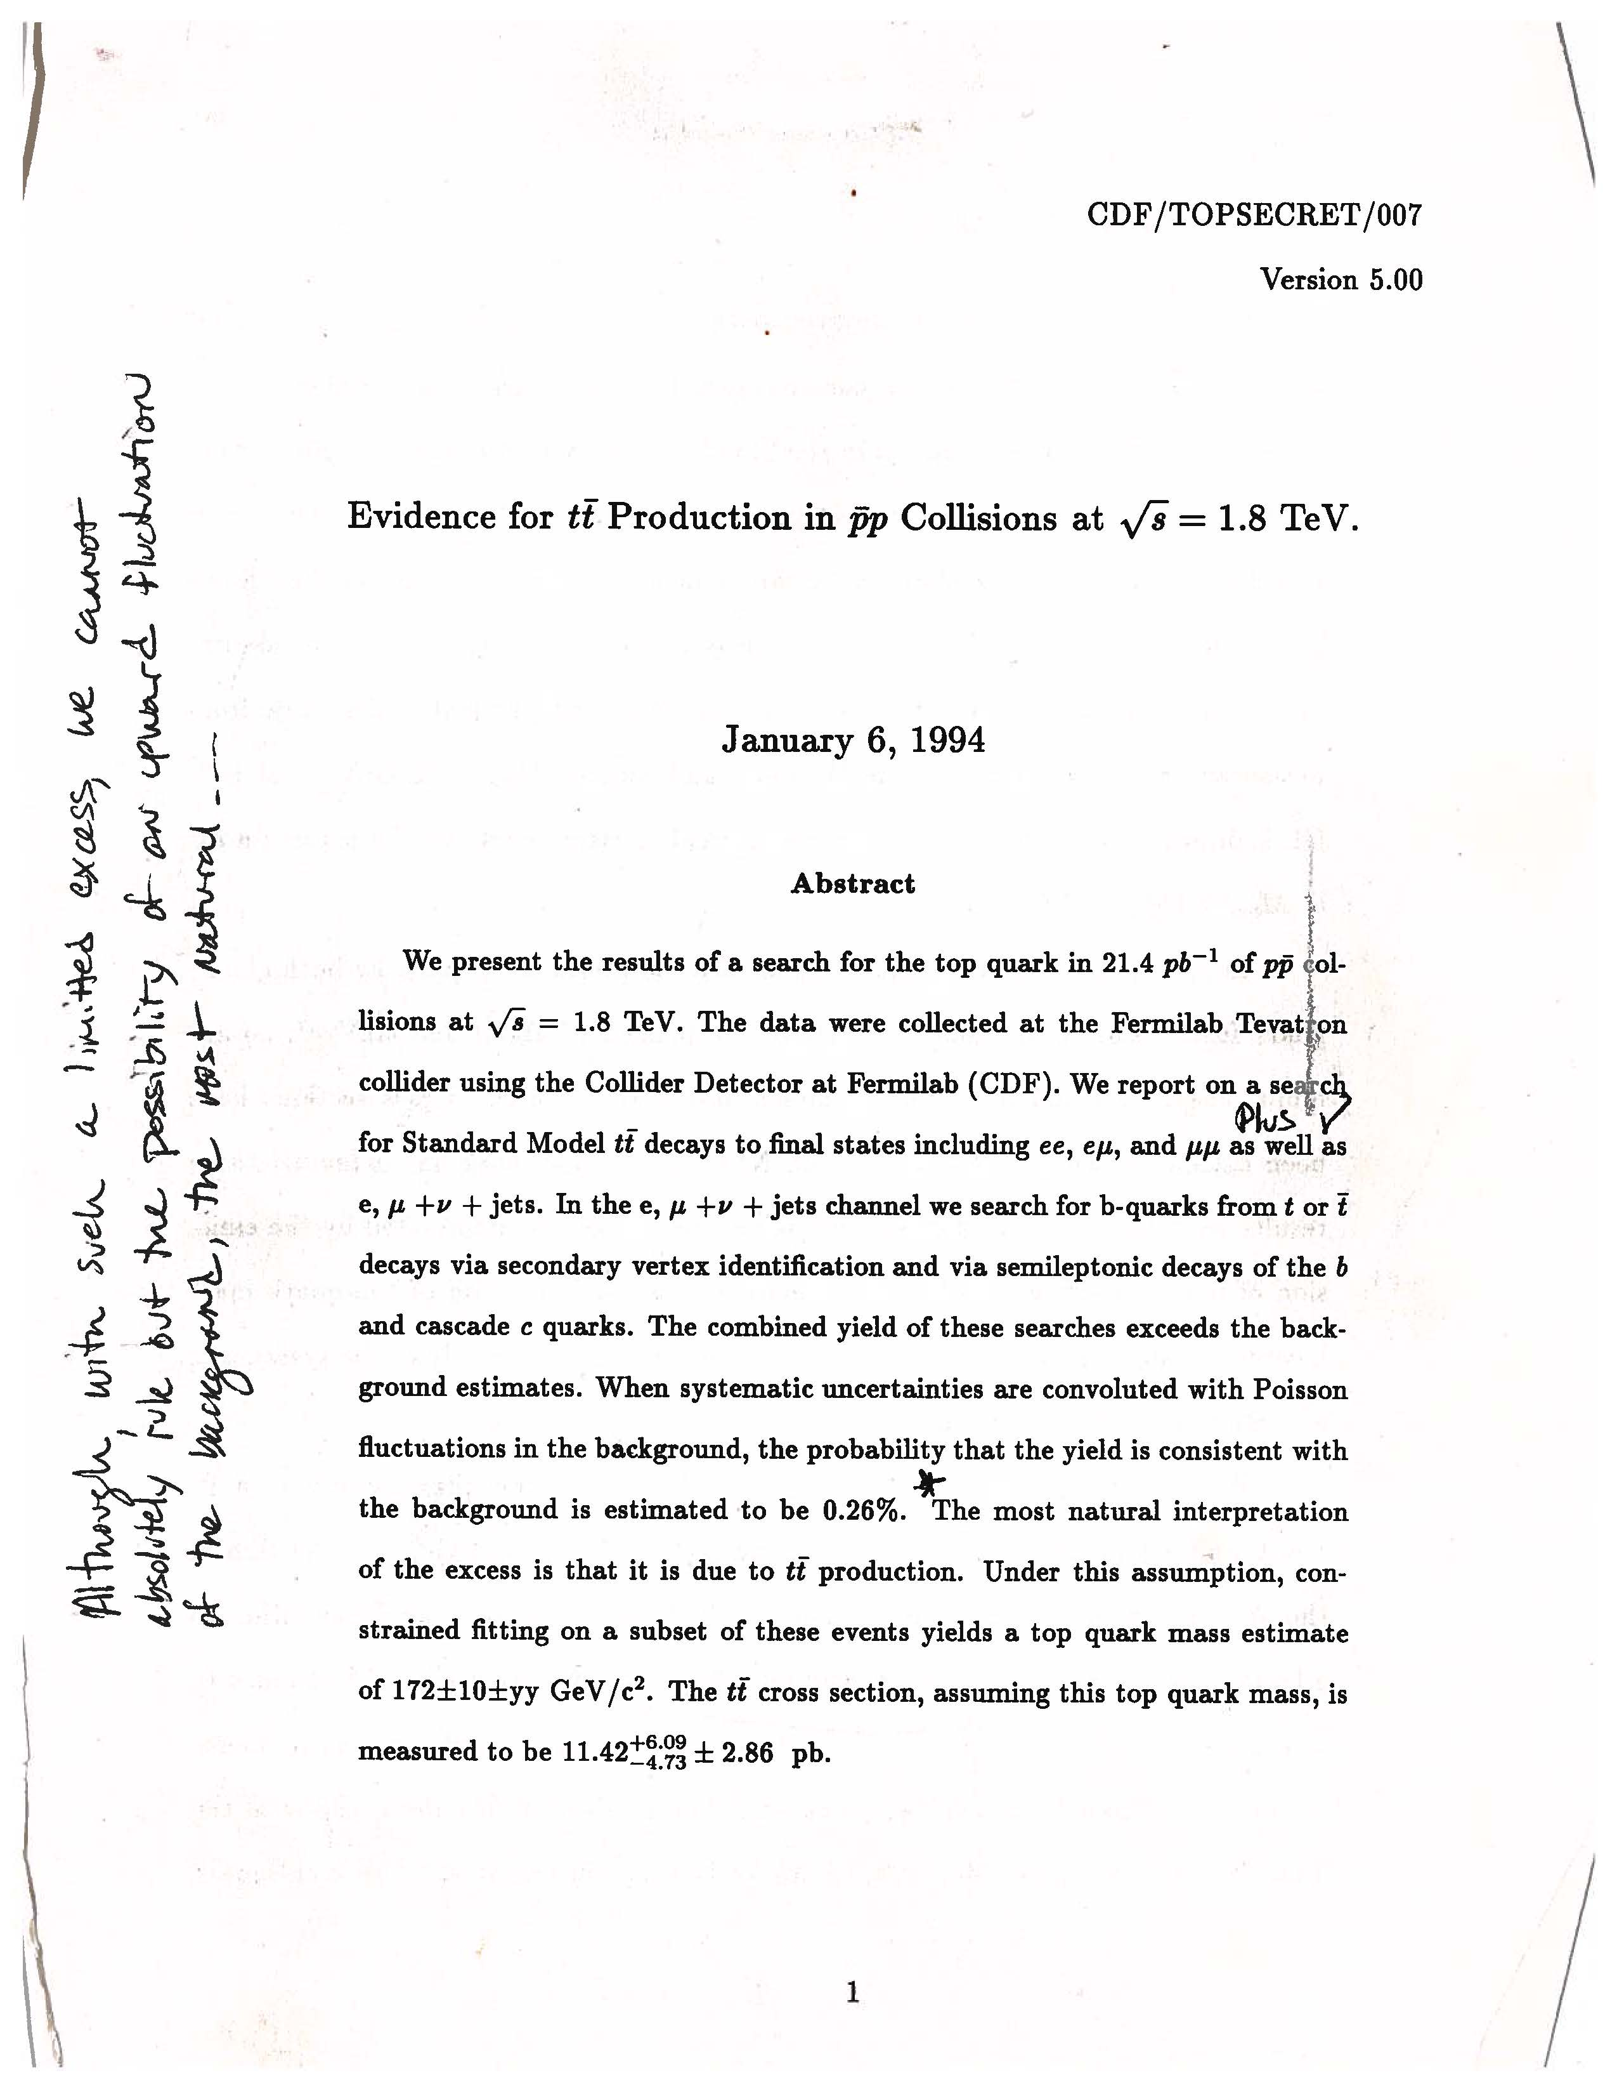
By January we were circulating close-to-final drafts, while debating how cautious to be in the conclusion.
Notes:
Talk about process of receiving comments and responding

Slide 27
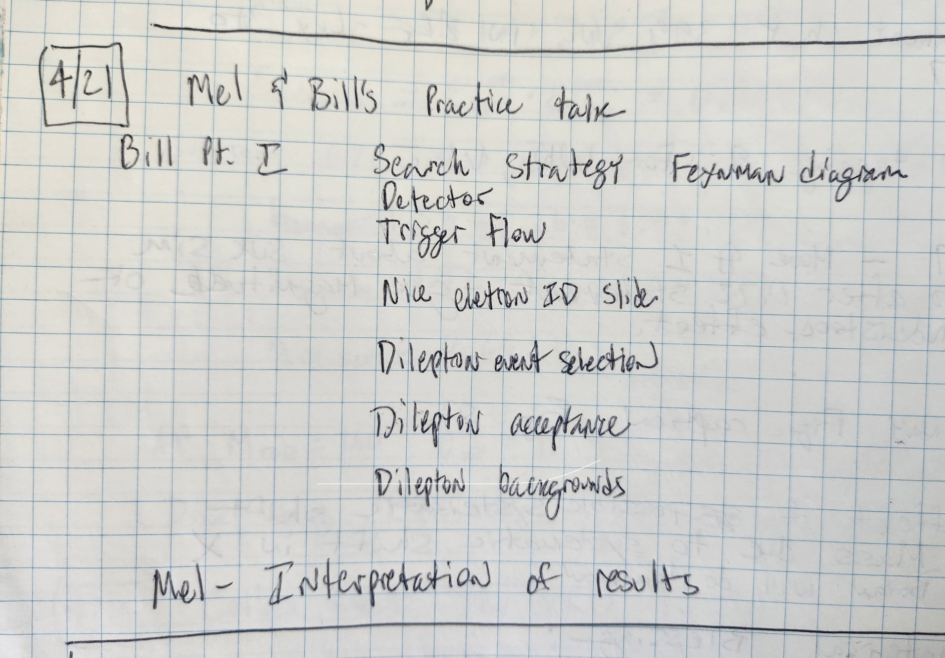
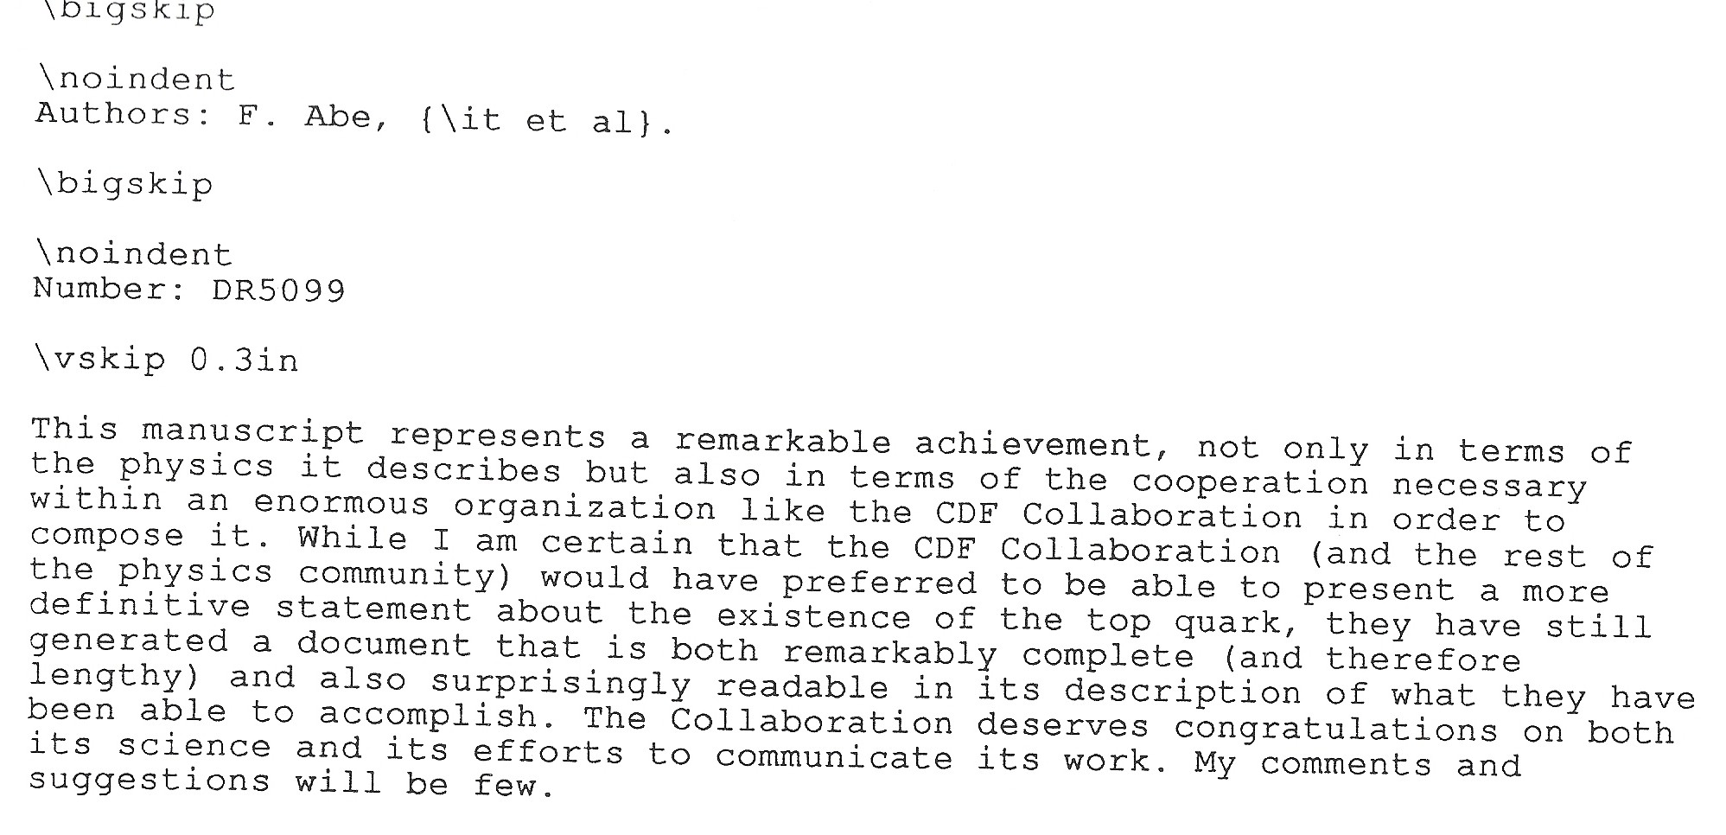
The Finish Line
Finally submitted to PRD on April 22, 1994
Referee #1, Phys. Rev. D
Notes:
Day before on the archive from theorists – prediction of our result.

Slide 28
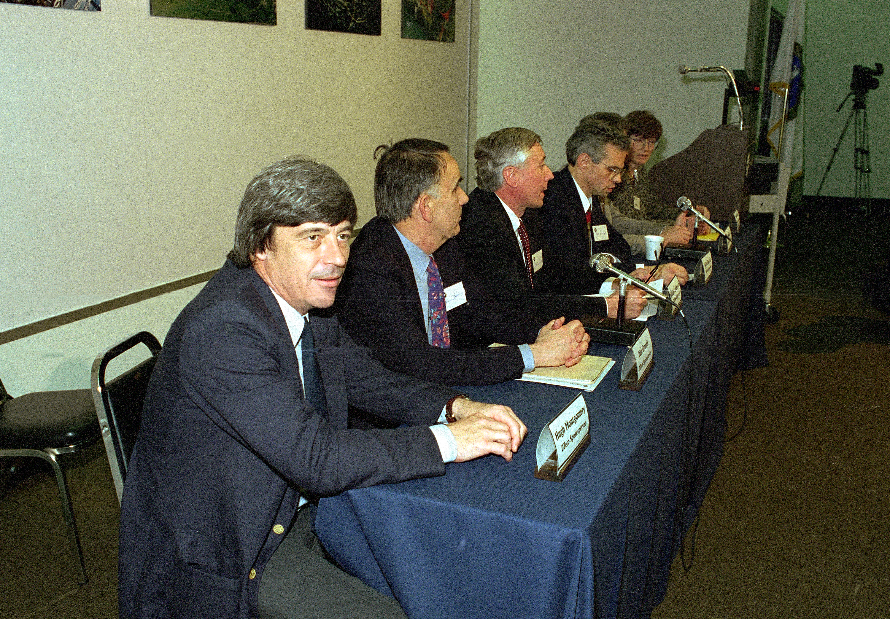

Slide 29
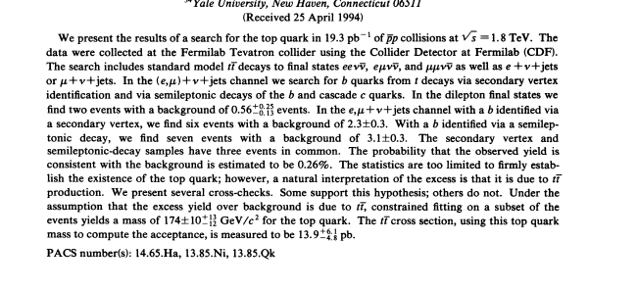
Evidence
I witnessed the awkward first stage of CDF evidence, when four short draft papers were by compromise merged into a very long paper. I even promised CDF collaborators to read the thing and did, carefully, beginning to end, and found it a classic—a masterful exhibit of how science results should (but seldom do) get reported. – BJ SLAC Beamline Vol 25, #3, Fall 1995
Counting experiment results almost unchanged from the 4 PRLs
Notes:
One poor schmoe took his name off. Current Mt=171.77±0.38 GeV (CMS). My experience at EPS (or whatever it was)

Slide 30
Run 1b and “Observation”
SVX
SVX’
CMX
Completed coverage
JETVTX
SECVTX
“Method 1”
“Method 2”
And then…it was bad for a while….until it wasn’t
Notes:
And other changes to techniques that caused suspicion

Slide 31
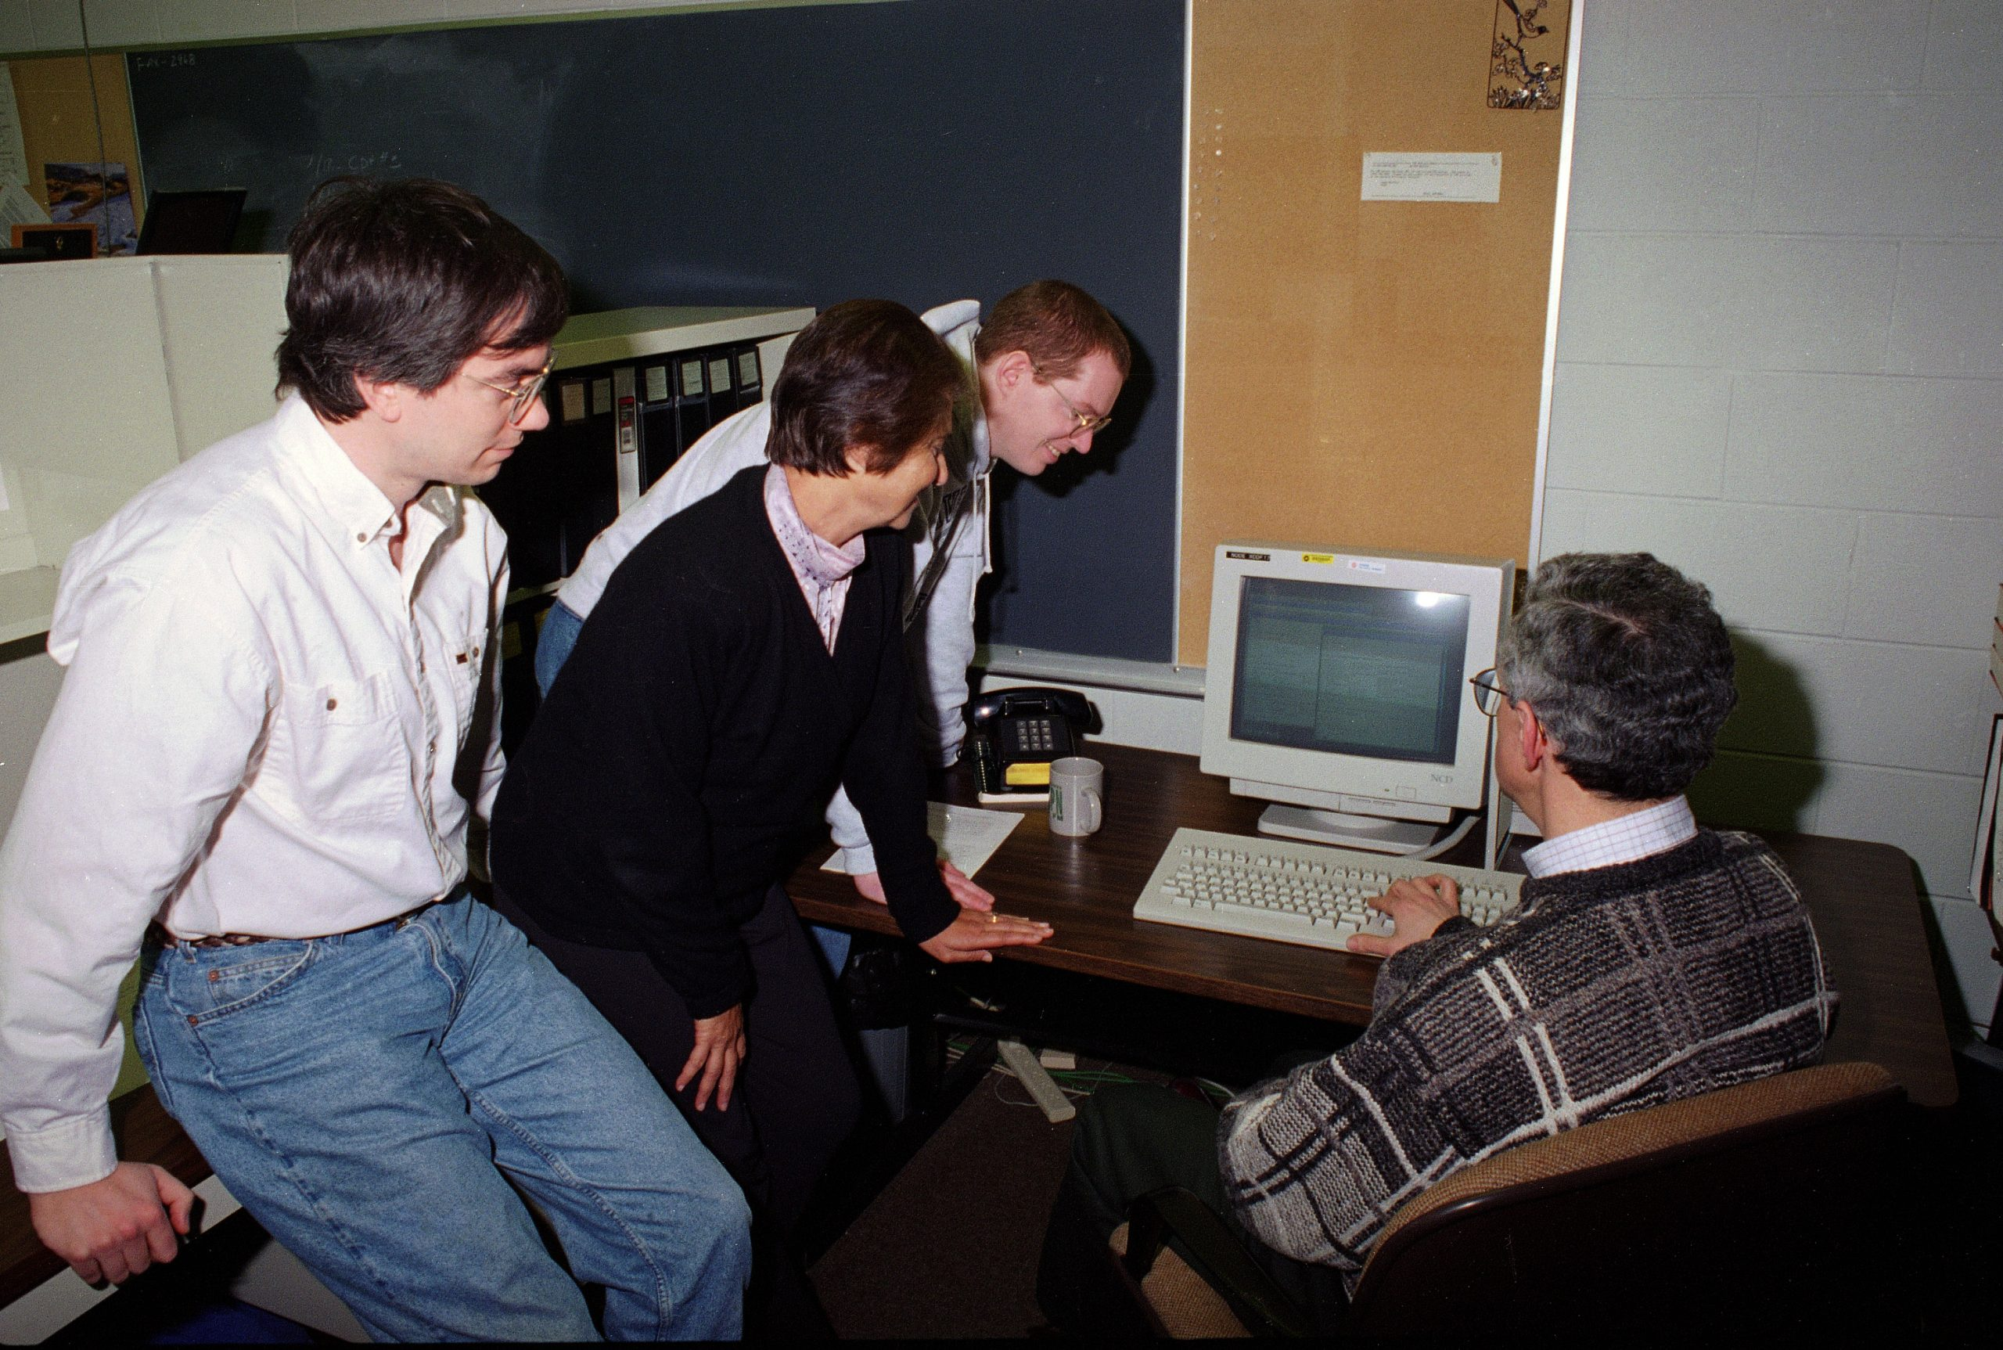
Mel presses The Button
Submitting the 1995 paper

Slide 33
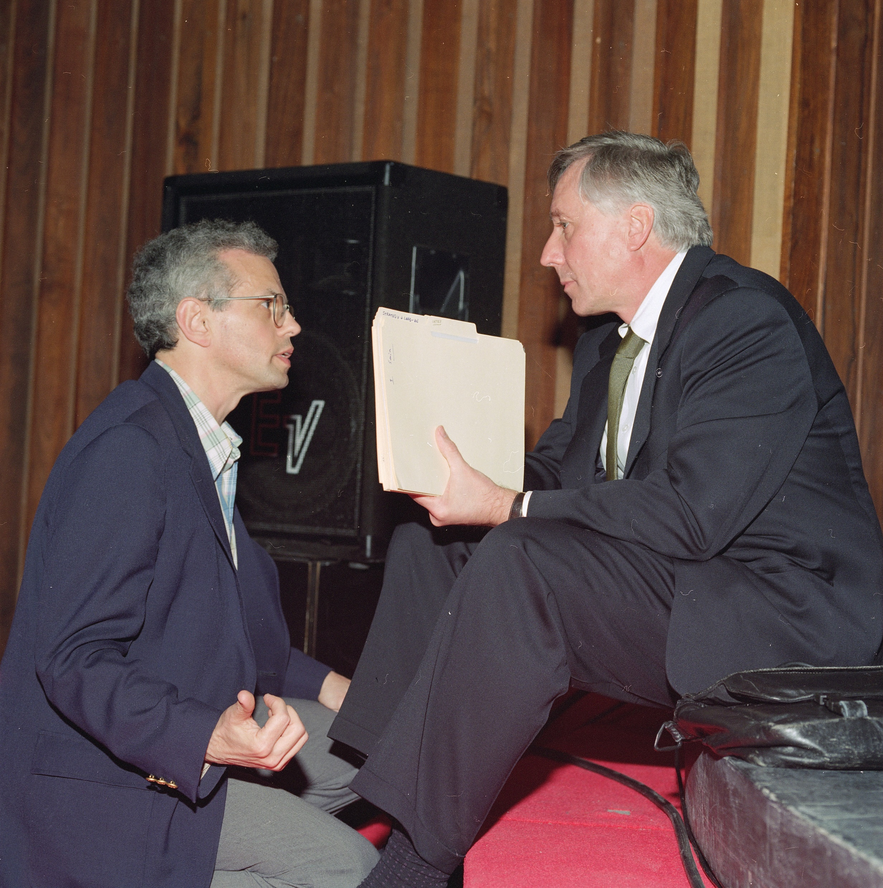
Notes:
Mel & Bill at the discovery announcement

Slide 34
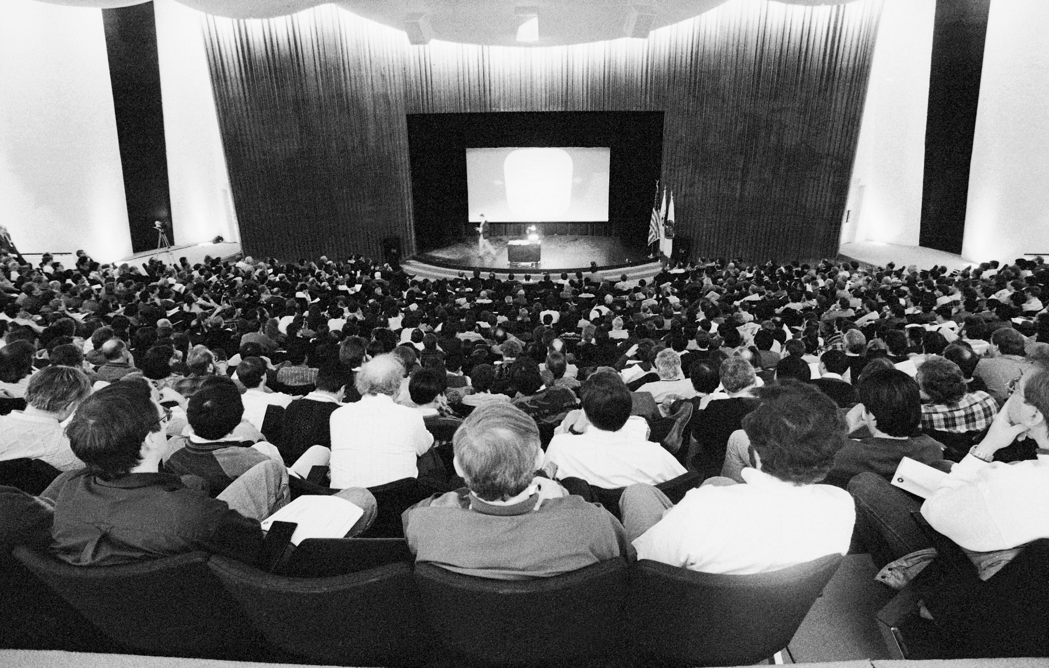

Slide 35
“Observation” vs. “Evidence”
 | Observation | Evidence
Integrated Luminosity | 48+19=67 pb⁻¹ | 19.3 pb⁻¹
SVX tags (expected background) | 27 (6.7±2.1) | 6 (2.3±0.3)
SLT tags (expected background) | 23 (15.4±2.0) | 7 (3.1±0.3)
Dilepton events (expected background) | 6 (1.3±0.3) | 2
Production cross section
Top mass
Significance (probability it’s all backgrounds) | incl. mass peak
Notes:
Including the mass peak reached the magic 5 sigma

Slide 36
The rest is history
Notes:
Search for Evidence for top quark production and you get nucleus-nucleus collisions
M=171.77±0.37 GeV from CMS

Slide 37
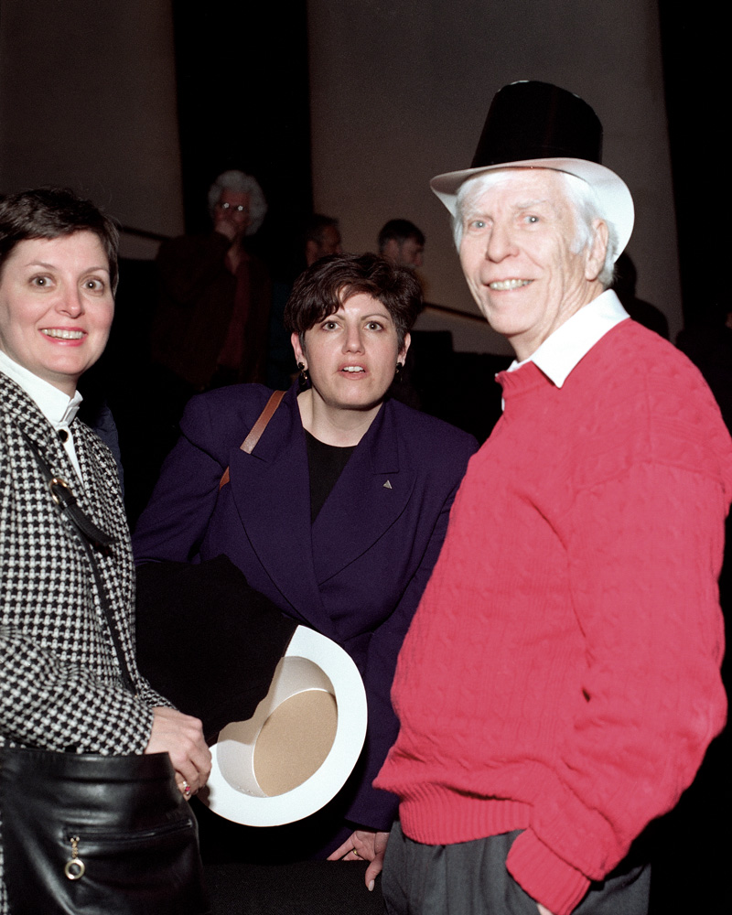
Thank you to Jaco Konigsberg & Avi Yagil for help with archival material
And thanks to Mel & Alvin for keeping us somewhat sane and reminding us that we were supposed to be having fun

