Slide 1
Searches for Ultraheavy Dark Matter in the Time Domain
Xuheng Luo
Johns Hopkins University
TeV Particle Astrophysics 2024

Slide 2

Gamma-Ray Bursts
Rate
Time Domain
Duration
$$0$$

Slide 3


Gamma-Ray Bursts
Rate
Time Domain
Fermi
Typical
GRBs
1 event/yr
Duration
$$0$$
$10$ μ$s$
$1$ $s$
Fermi dead time

Slide 4




Gamma-Ray Bursts
Rate
SGARFACE + VERITAS (6 hr)
(motivated by Hagedorn PBH)
${10}^{7}$ event/yr
Fermi
Not Explored
Typical
GRBs
${10}^{2}$ event/yr
New Discovery?
1 event/yr
Duration
$$0$$
$10$ μ$s$
$1$ $s$
Fermi dead time

Slide 5



Gamma-Ray Bursts
Rate
SGARFACE + VERITAS (6 hr)
(motivated by Hagedorn PBH)
${10}^{7}$ event/yr
This Work
(IACTs with new analysis & trigger)
Fermi
Typical
GRBs
${10}^{2}$ event/yr
This Work
(PANOSETI with new analysis & trigger)
1 event/yr
Duration
$$0$$
$10$ μ$s$
$1$ $s$
Fermi dead time

Slide 6
Gamma-Ray Bursts
Rate
SGARFACE + VERITAS (6 hr)
(motivated by Hagedorn PBH)
${10}^{7}$ event/yr
This Work
(IACTs with new analysis & trigger)
Fermi
Typical
GRBs
${10}^{2}$ event/yr
This Work
(PANOSETI with new analysis & trigger)
1 event/yr
Duration
$$0$$
$10$ μ$s$
$1$ $s$
Fermi dead time
neutron star radius

Slide 7
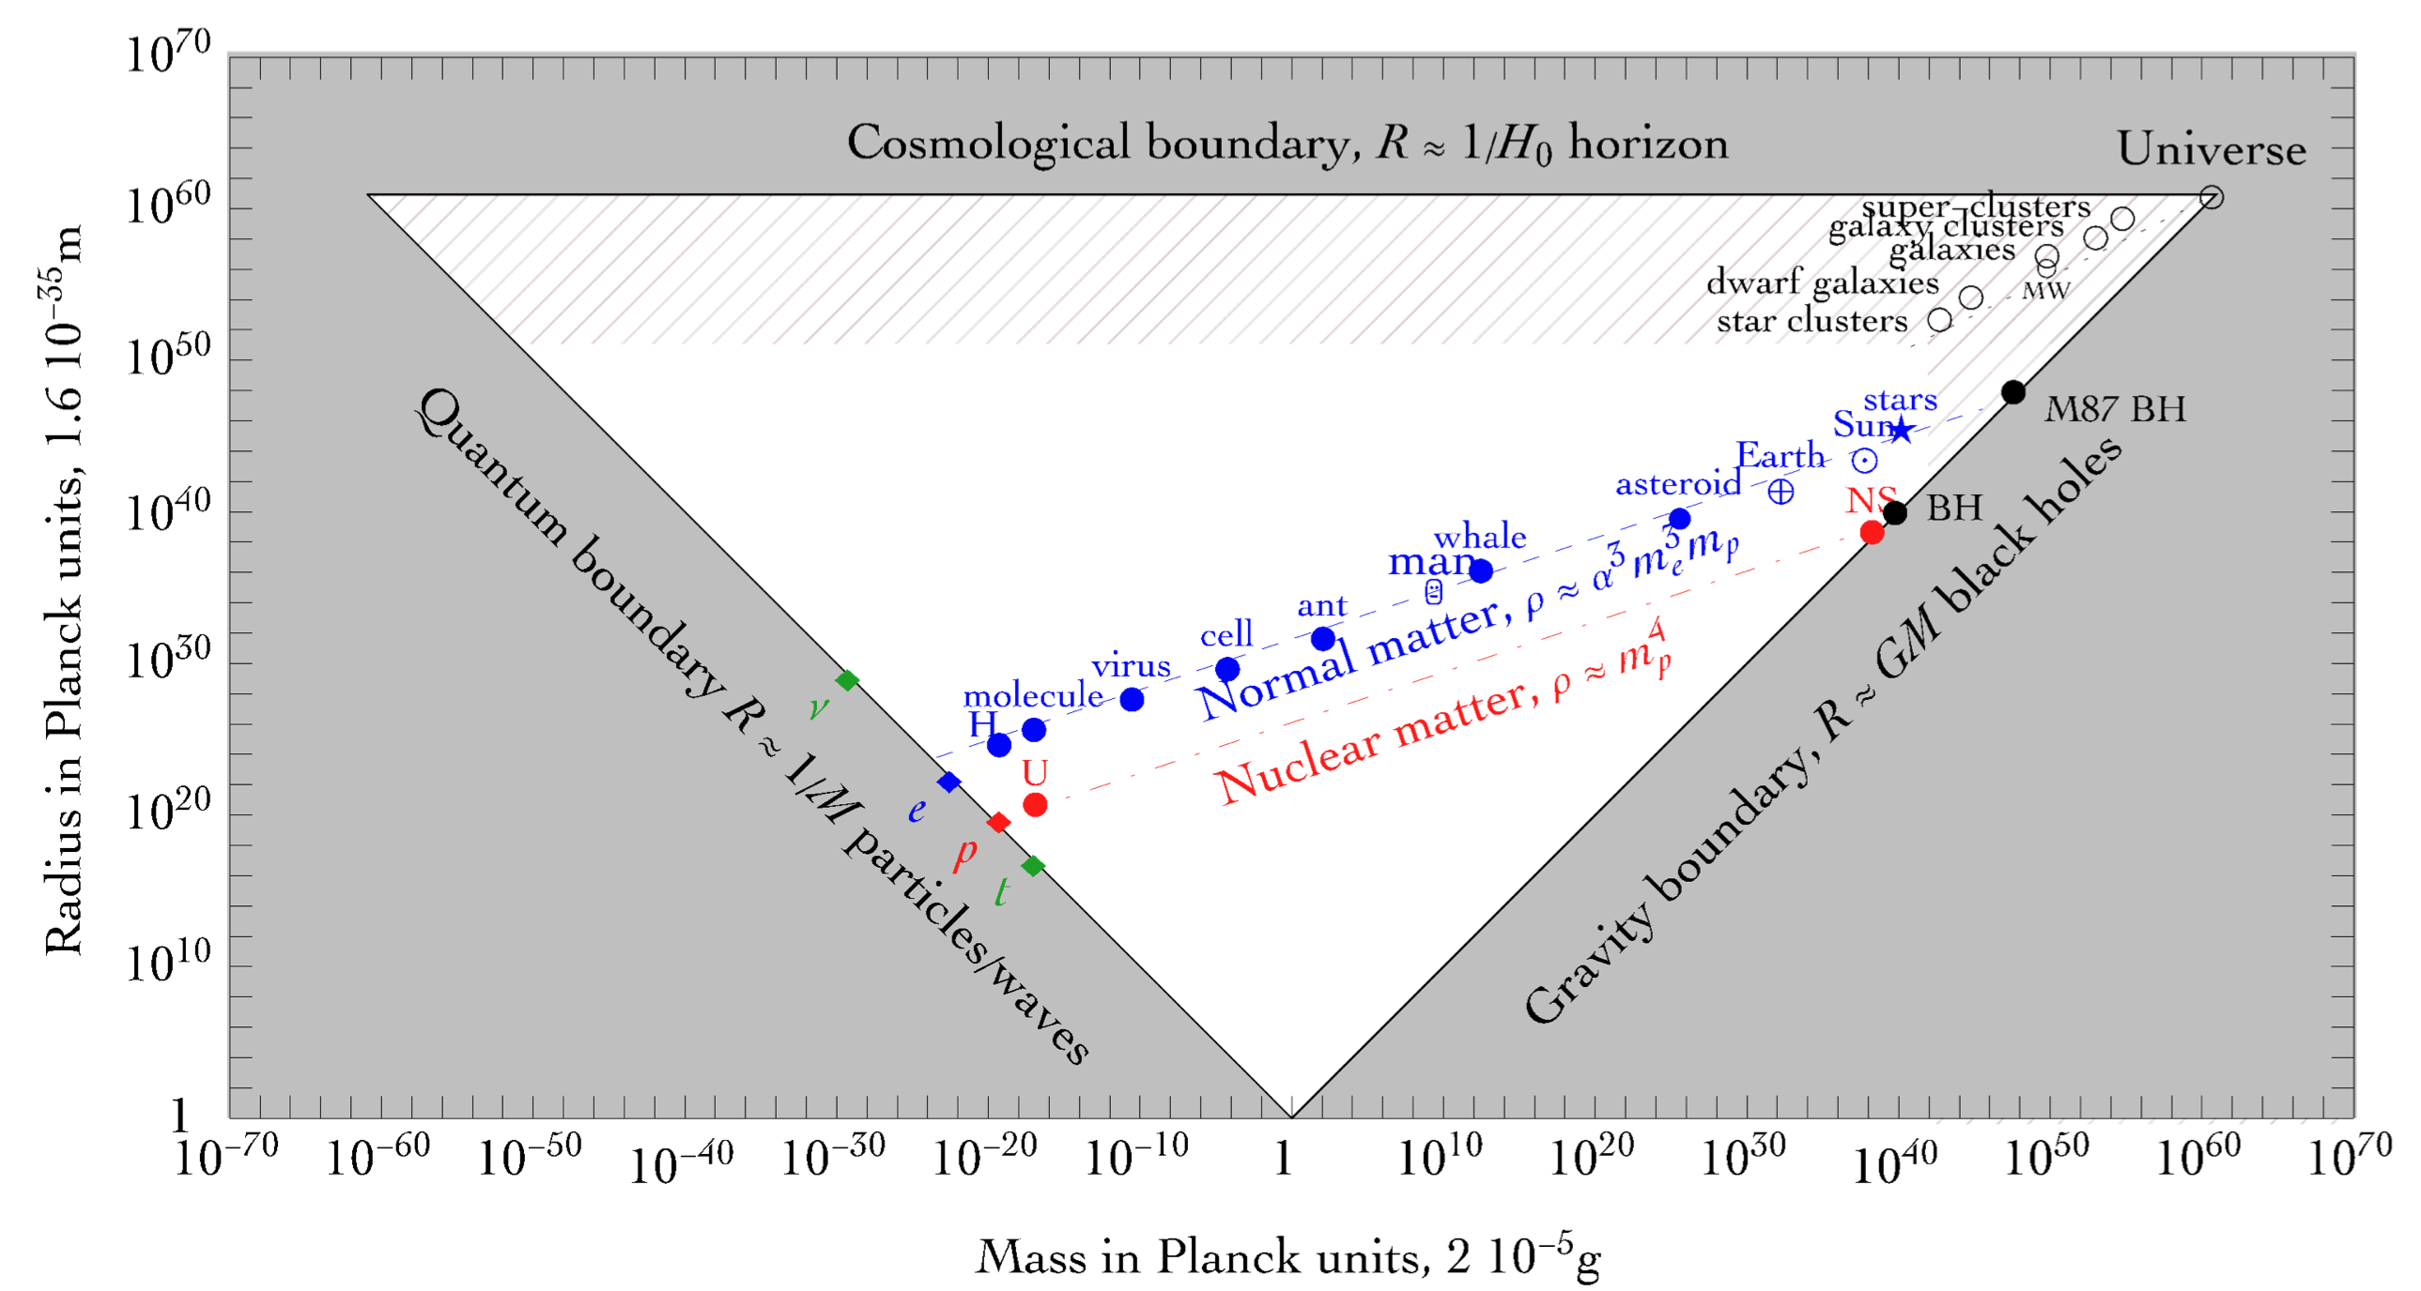

Radius/c >10 $μ$s
Dense stars
as source of GRB
Cirelli 2024

Slide 8
Radius/c >10 $μ$s
Dense stars
as source of GRB
Dark structure as source of GRB
Cirelli 2024

Slide 9
Ultraheavy Composite Dark Matter
(or macroscopic dark matter, blob …)
Dark sector is unknown
Self-interaction between dark matter → formation of bound states
  Long range self interaction: Domenech 2023, ….
  Strong self interaction: Hardy 2014, …
  First order phase transition: Bai 2018, …
particle dark matter annihilation → gamma ray photons
Composite bound states

Slide 10
Ultraheavy Composite Dark Matter
(or macroscopic dark matter, blob …)
Dark sector is unknown
Self-interaction between dark matter → formation of bound states
  Long range self interaction: Domenech 2023, ….
  Strong self interaction: Hardy 2014, …
  First order phase transition: Bai 2018, …
Composite bound states dark matter collisions → gamma ray burst
Composite bound states

Slide 11














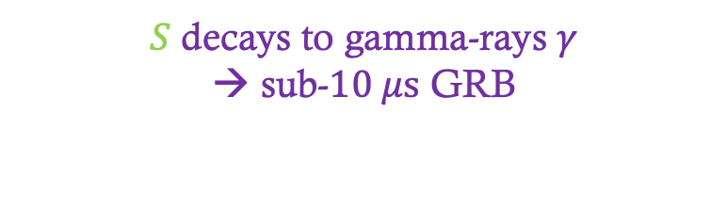






Dark Blob Collision
$$χ$$
$$χ$$
$$χ$$
$$χ$$
$$χ$$
$$χ$$
$$χ$$
$$χ$$
$$χ$$
$$χ$$
$$χ$$
$$χ$$
$$χ$$
$$χ$$
$$χ$$
$$χ$$
heavy scalar $S$production
$$S$$
$$γ$$
$$γ$$
$S$ decays to gamma-rays $γ$
→ sub-$10 μs$ GRB

Slide 12
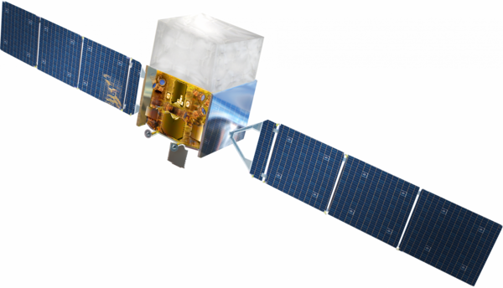


sub-$10 μs$ GRB
Fermi

Slide 13


one event
triggered
$$…$$
Fermi
$$…$$

Slide 14
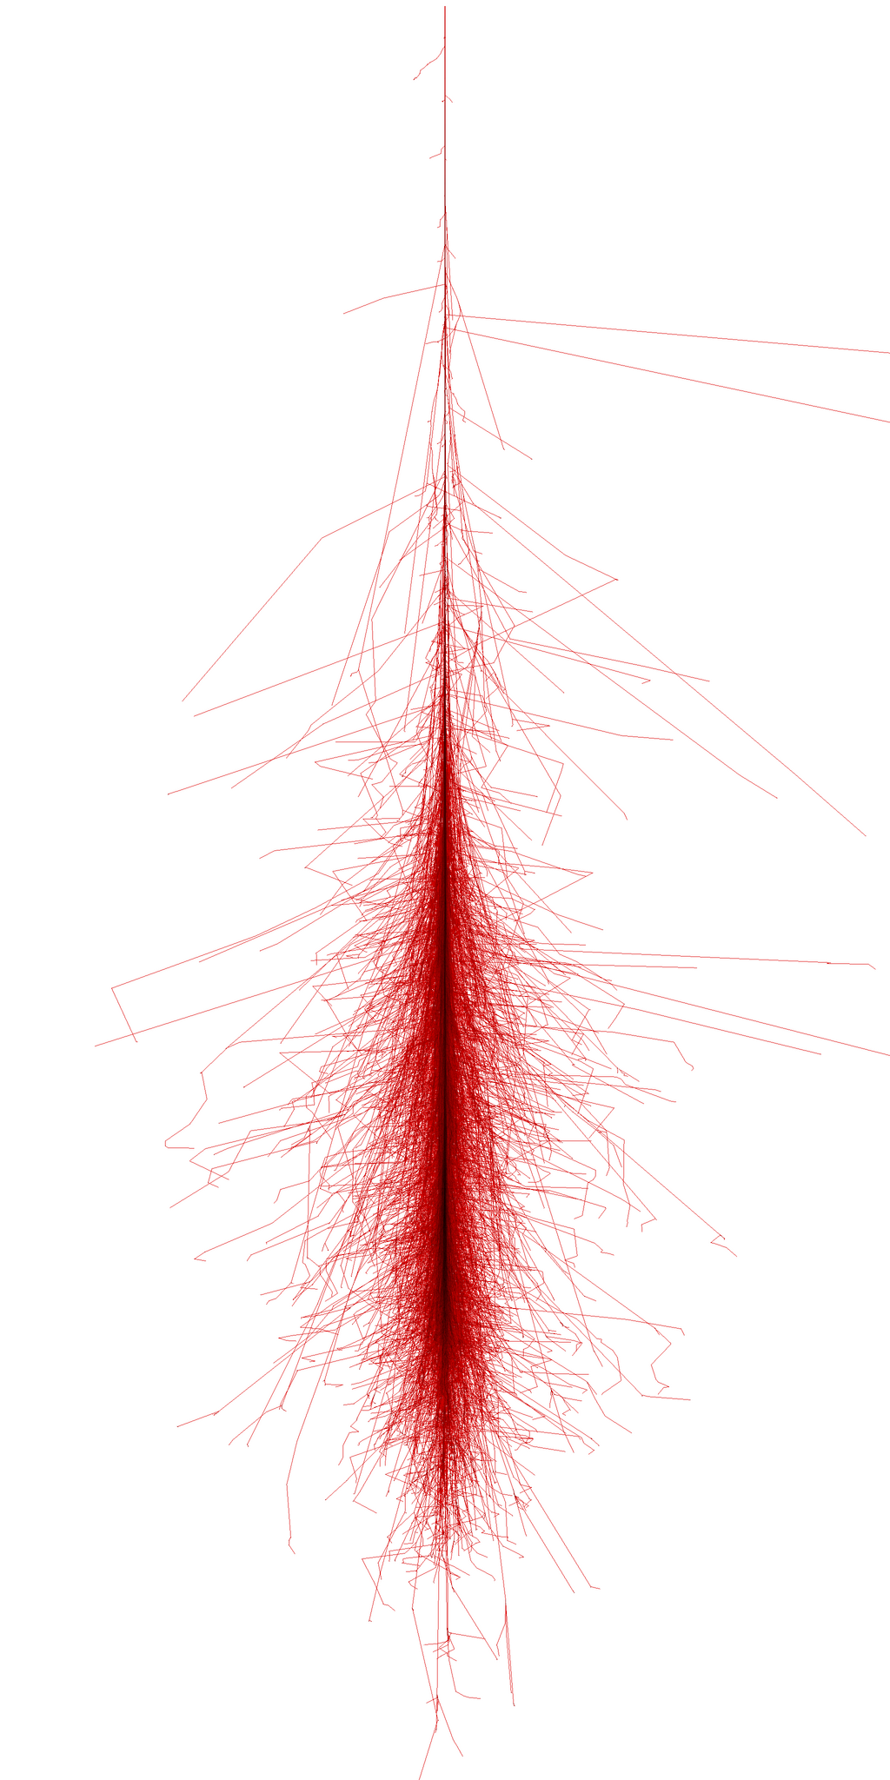
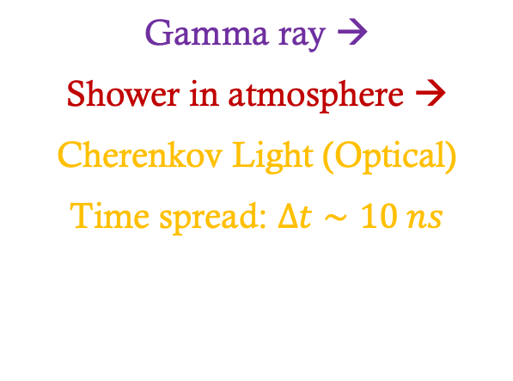

Gamma ray →
Shower in atmosphere →
Cherenkov Light (Optical)
Time spread: $Δt∼10 ns$
$$γγ→e^{+}e^{−}, ee→eeγ,…$$

Slide 15
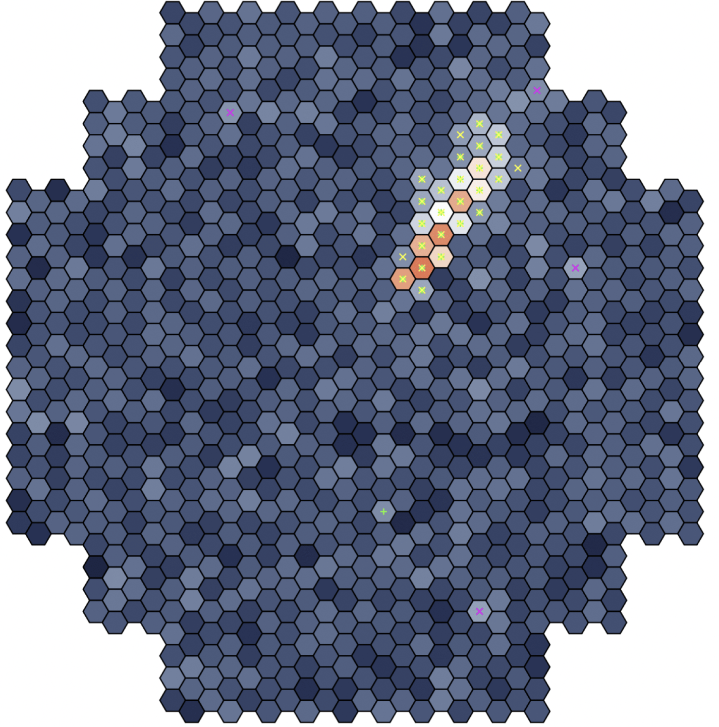


Imaging Air Cherenkov Telescopes (IACTs)
VERITAS, CTA (soon), etc
10 m mirror + PMTs with nanosecond time-resolution
$$∼1^{o}$$
Cherenkov Light (Optical)
2
1
2
1
single gamma-ray
$$∼100 m$$

Slide 16

$$…$$
gamma-ray wavefront
Numerous showers overlap
Gamma-rays detected collectively

Slide 17
Wavefront Technique
$$…$$
gamma-ray wavefront
Numerous showers overlap
Gamma-rays detected collectively
Porter & Weekes (1978);
Krennrich, LeBohec, Weekes (2000);
SGARFACE collaboration
multi gamma-ray
2
1
single gamma-ray

Slide 18
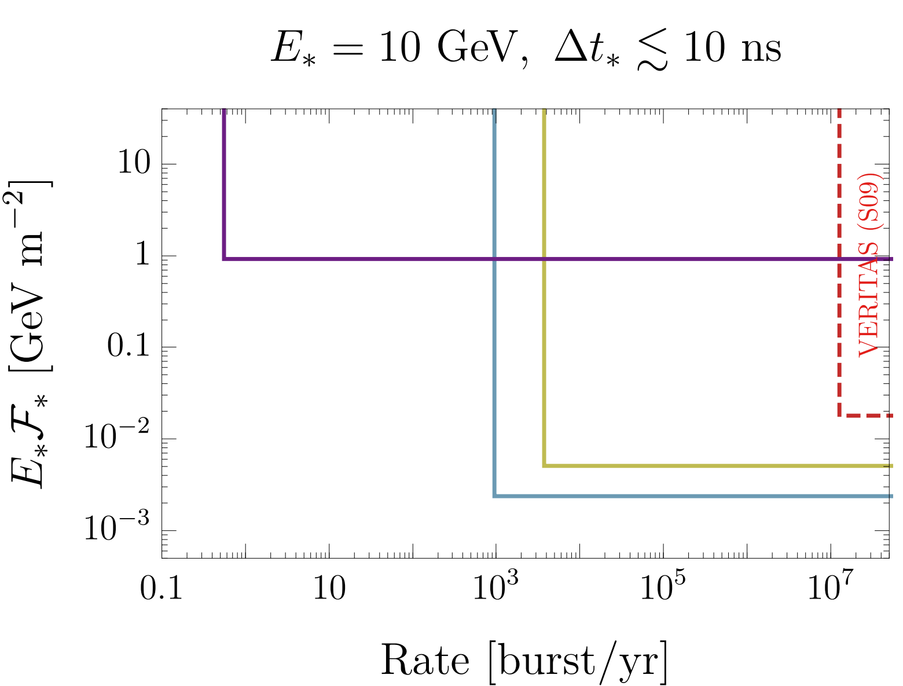
Projected Sensitivity (GRB)
Monochromatic & Instantaneous burst
PANOSETI
6 hr
The Pulsed All-sky Near-infrared Optical SETI
one decade
VERITAS
CTA

Slide 19
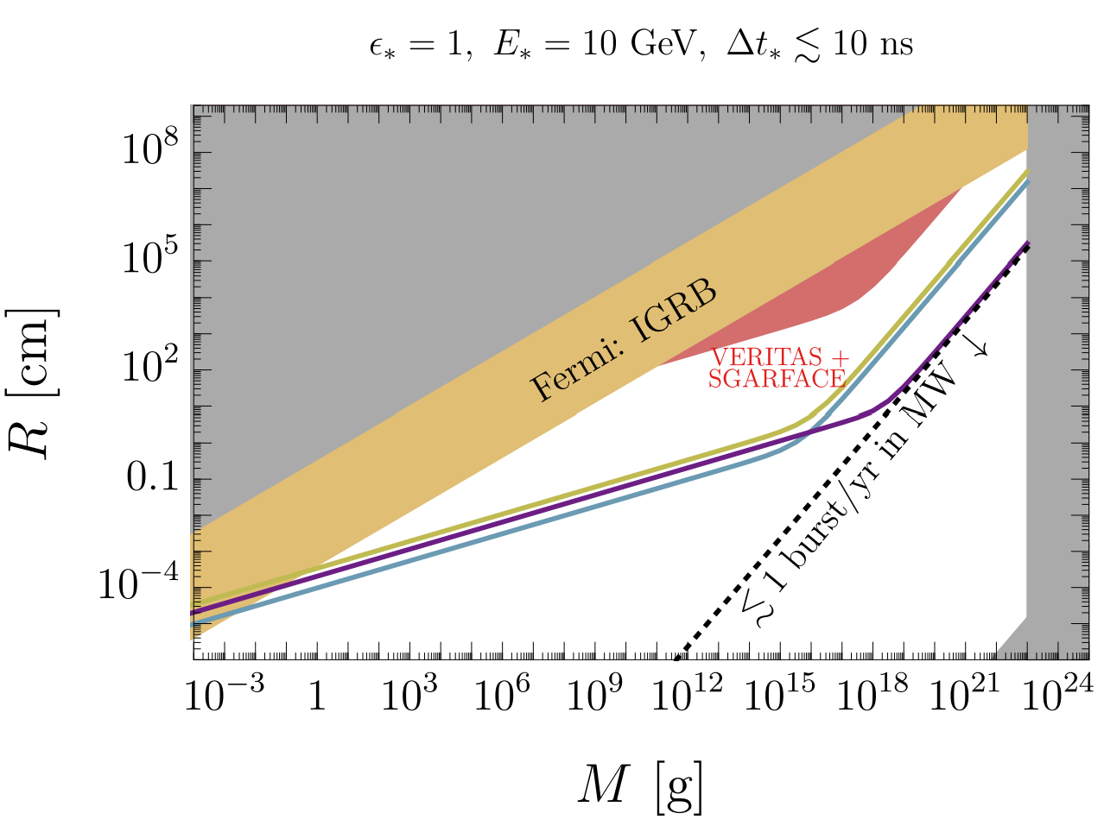
Projected Sensitivity (dm collision)

Slide 20
Summary and outlook
Rare and brief gamma-ray bursts are largely unprobed
Dark blob collisions may produce such signals
Imaging Air Cherenkov Telescopes can probe this GRB parameter space
Our next step: VERITAS archival data search with air shower simulation

Slide 21
Thank you!

Slide 22
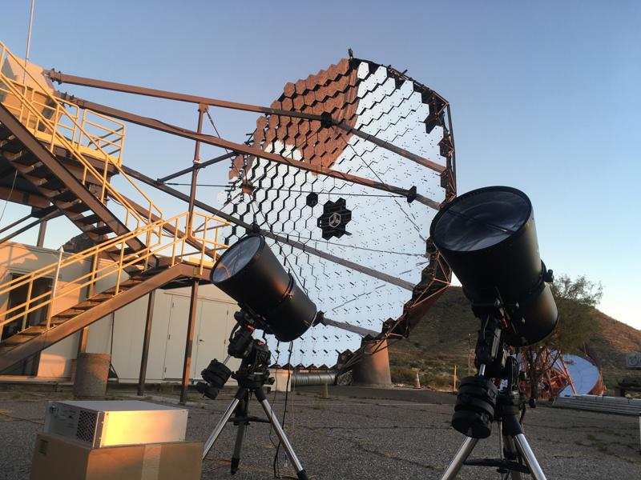
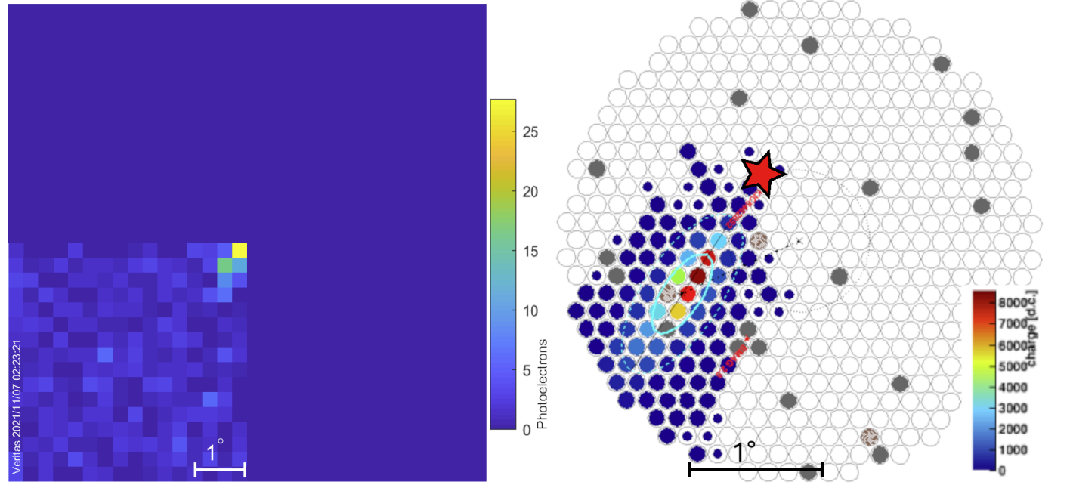

PANOSETI (The Pulsed All-sky Near-infrared Optical SETI) as Cherenkov Telescopes
Two prototypes running next to VERITAS
Detected gamma-rays from the Crab Nebula
PANOSETI
VERITAS
1 PANOSETI telescope = ${10}^{∘}×{10}^{∘}$ FoV
Cover $𝓞(1)$ of the sky eventually
Antonio et al. 2020, Korzoun et al. 2023

Slide 23
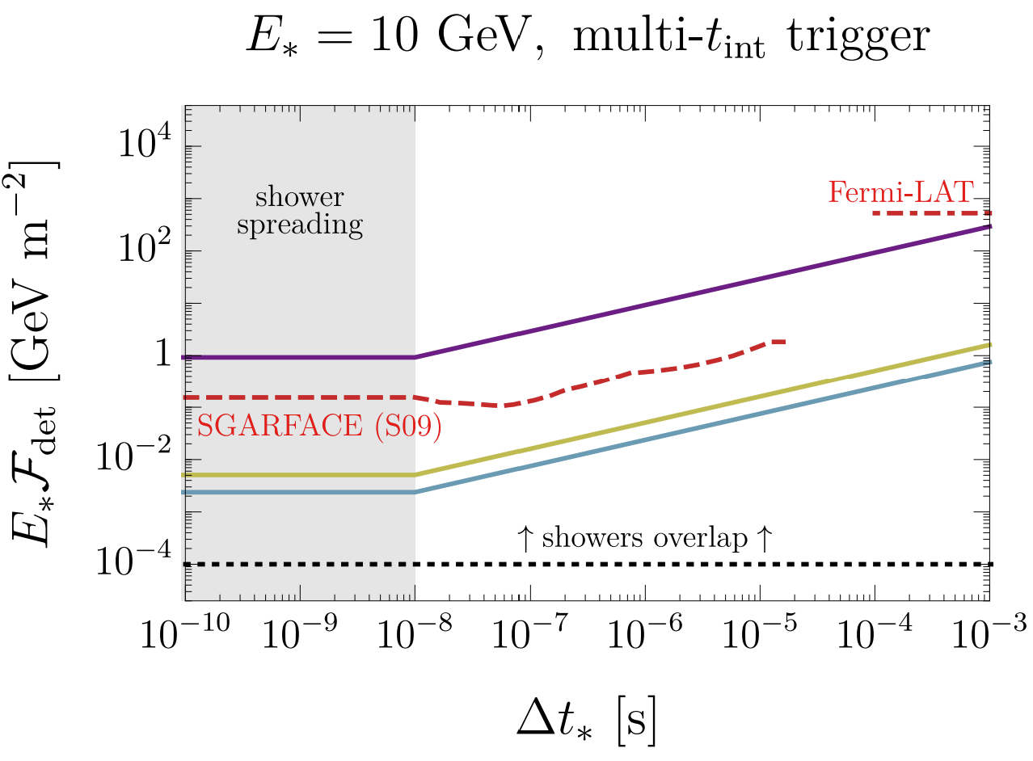
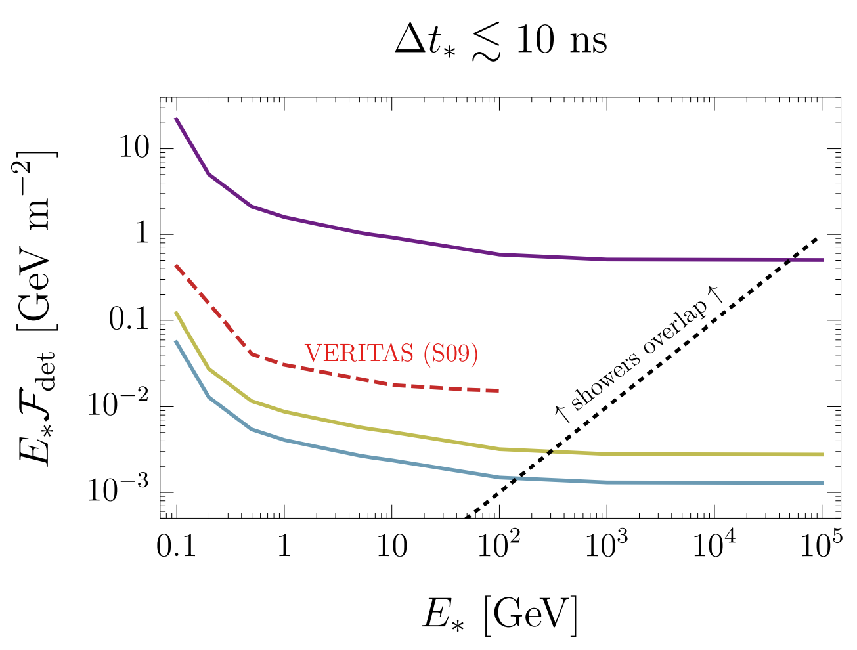
Projected Sensitivity
Monochromatic
Burst Duration
monochromatic spectrum

Slide 24
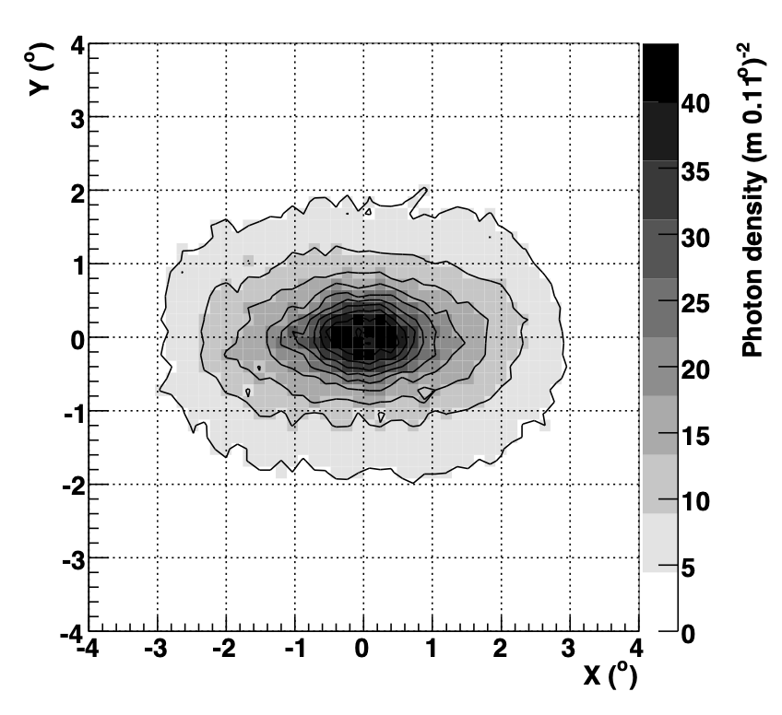
Cherenkov photon yield
Schroedter 2009

Slide 25
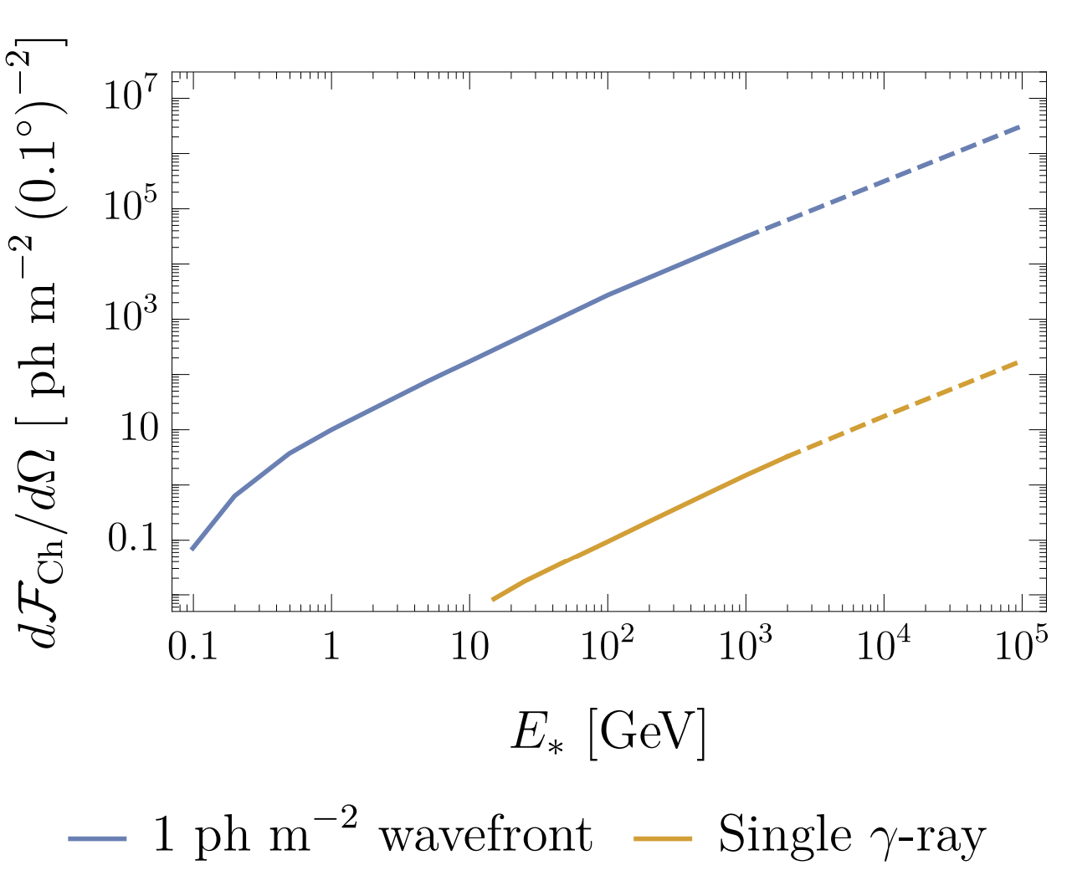
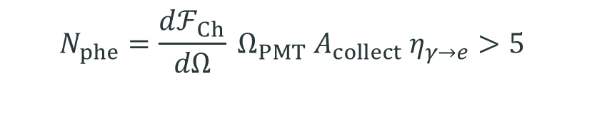
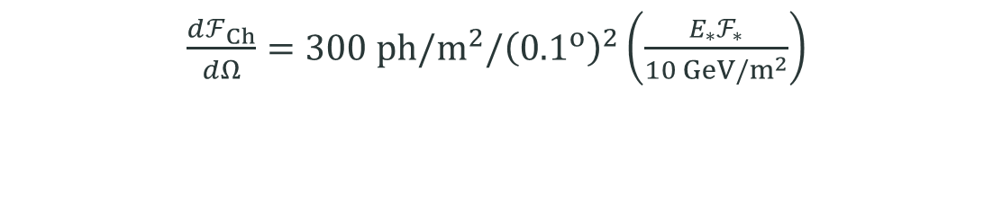
Energy Fluence Sensitivity
$$N_{phe}=\frac{dℱ_{Ch}}{dΩ} Ω_{PMT} A_{collect} η_{γ→e}>5$$
Cherenkov yield of a gamma-ray wavefront
$\frac{dℱ_{Ch}}{dΩ}=300 ph/m^{2}/{\left({0.1}^{o}\right)}^{2}\left(\frac{E_{∗}ℱ_{∗}}{10 GeV/m^{2}}\right)$

Slide 26
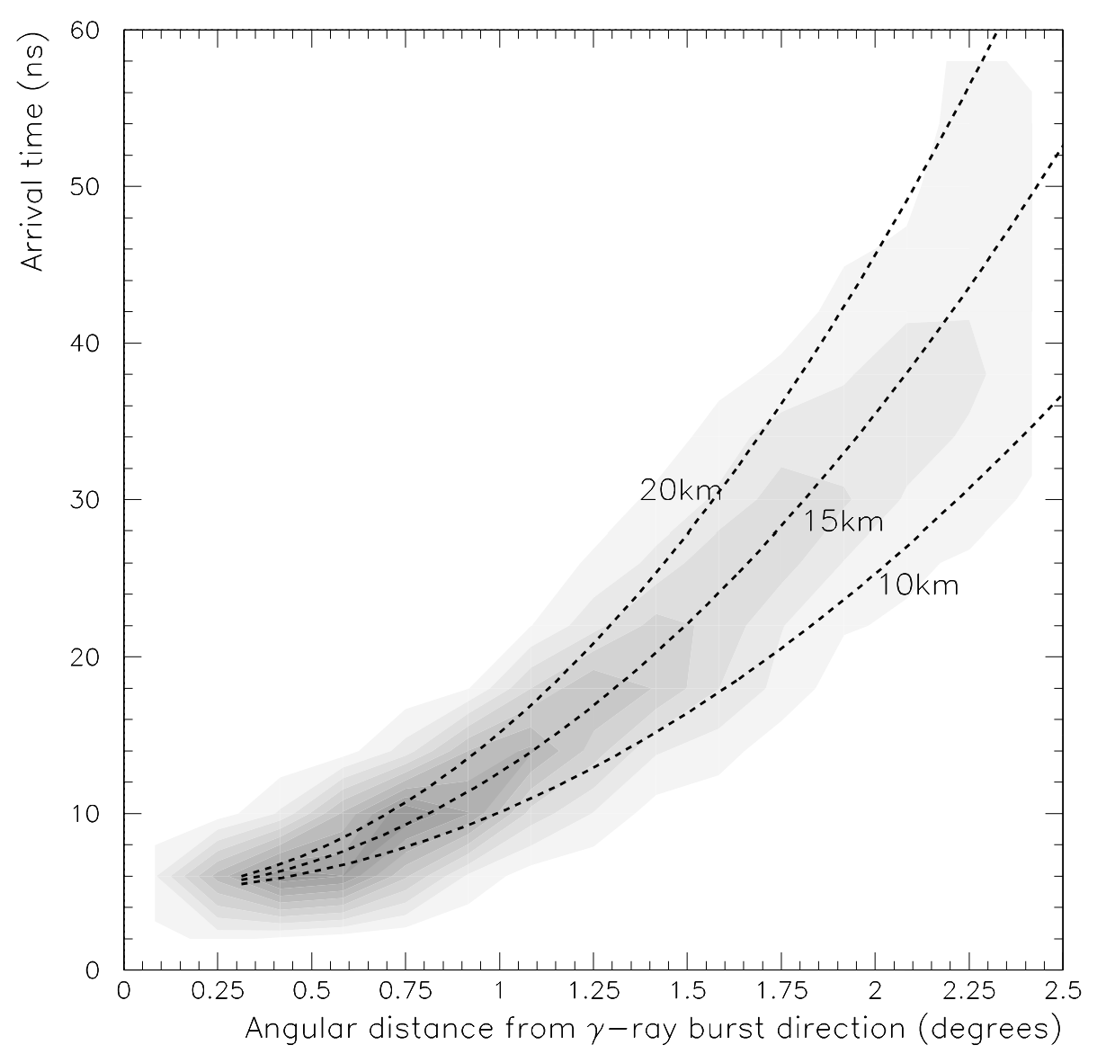
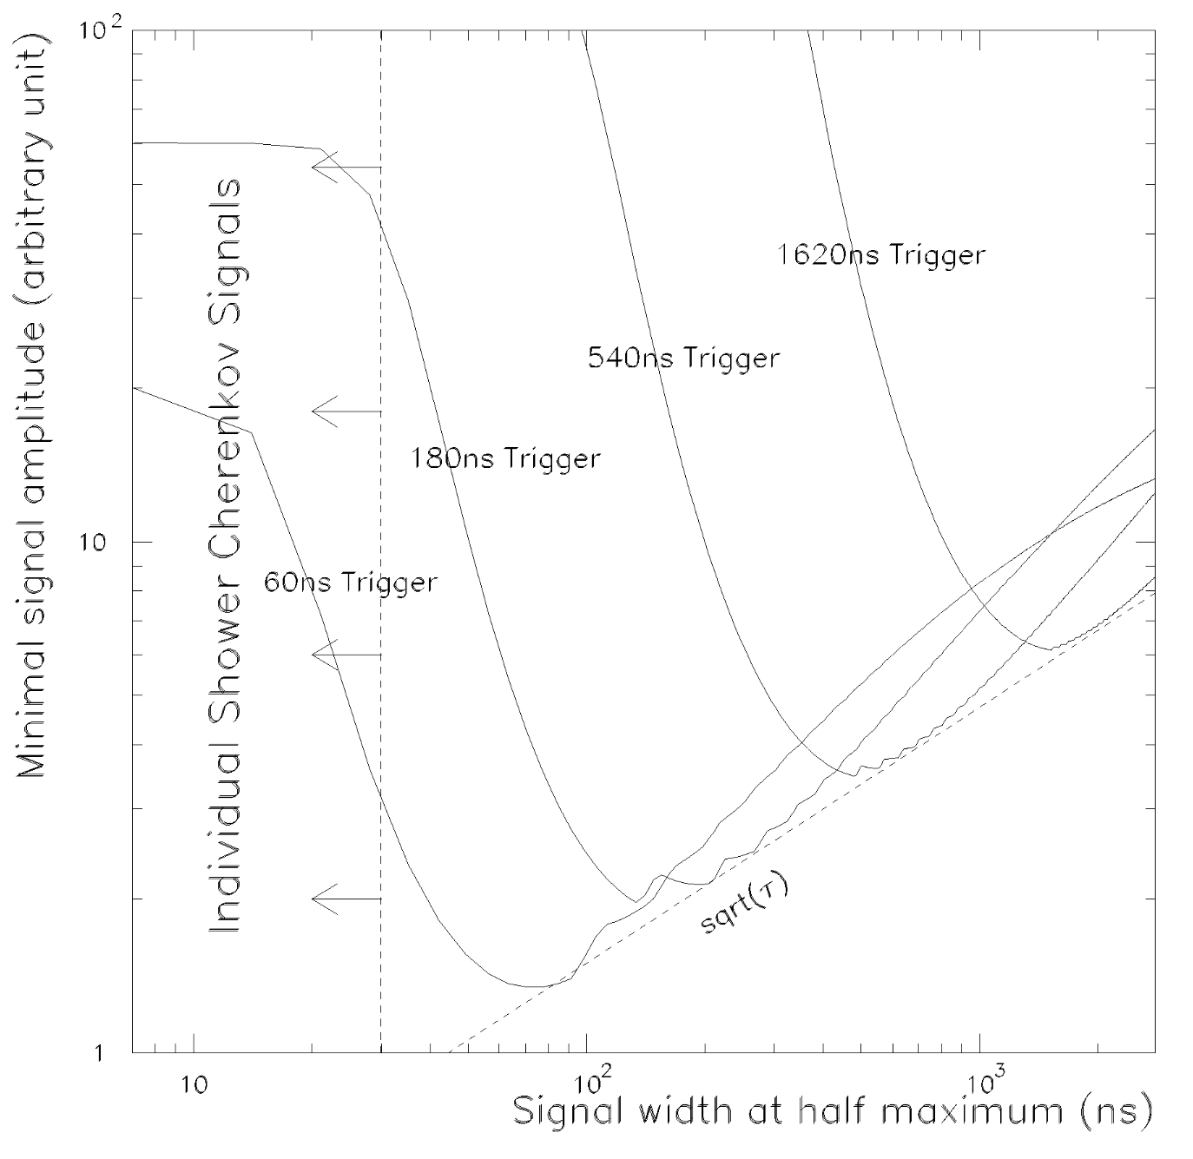
SGARFACE
LeBohec 2005

Slide 27
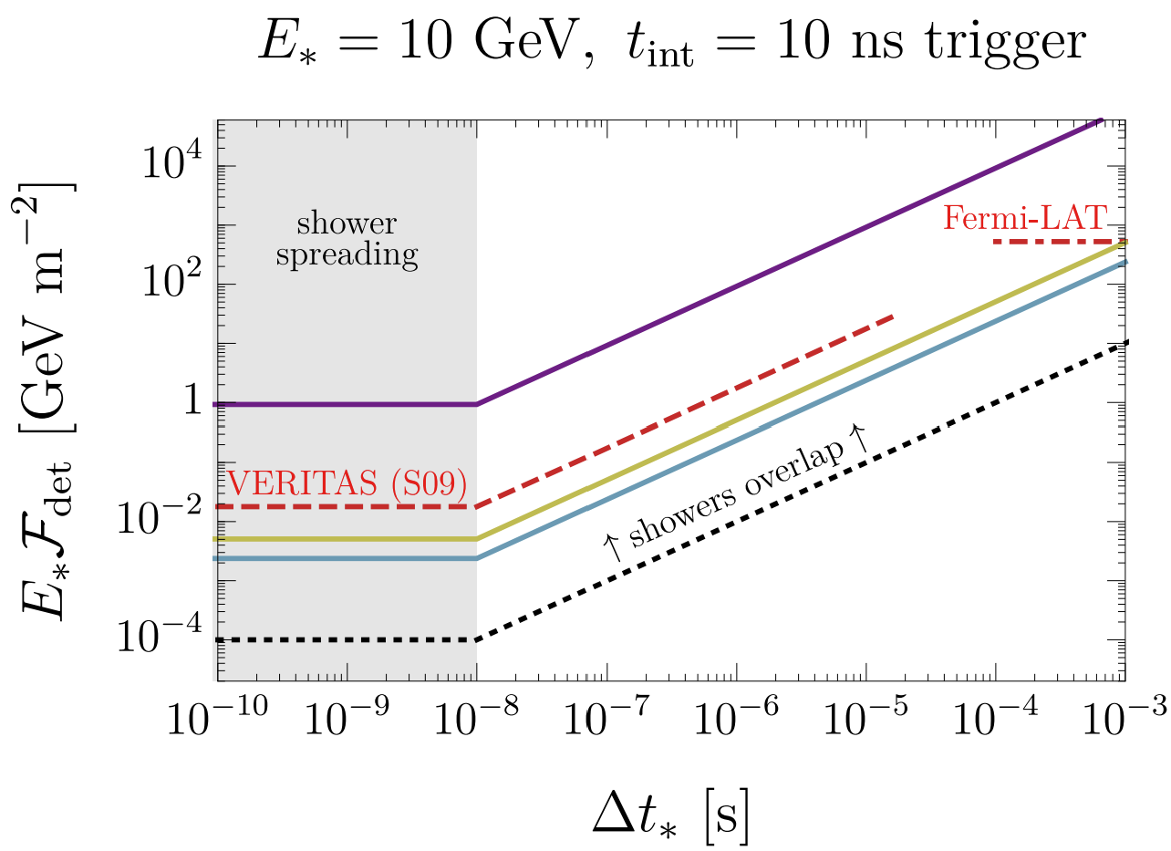


Burst Duration Sensitivity
Piggyback Trigger System
Standard IACT trigger uses $t_{int}=10 ns$
May catch only a fraction of the burst
Best SNR when $t_{int}=$ burst duration
Run signal copy through a multi-$t_{int}$ trigger

Slide 28
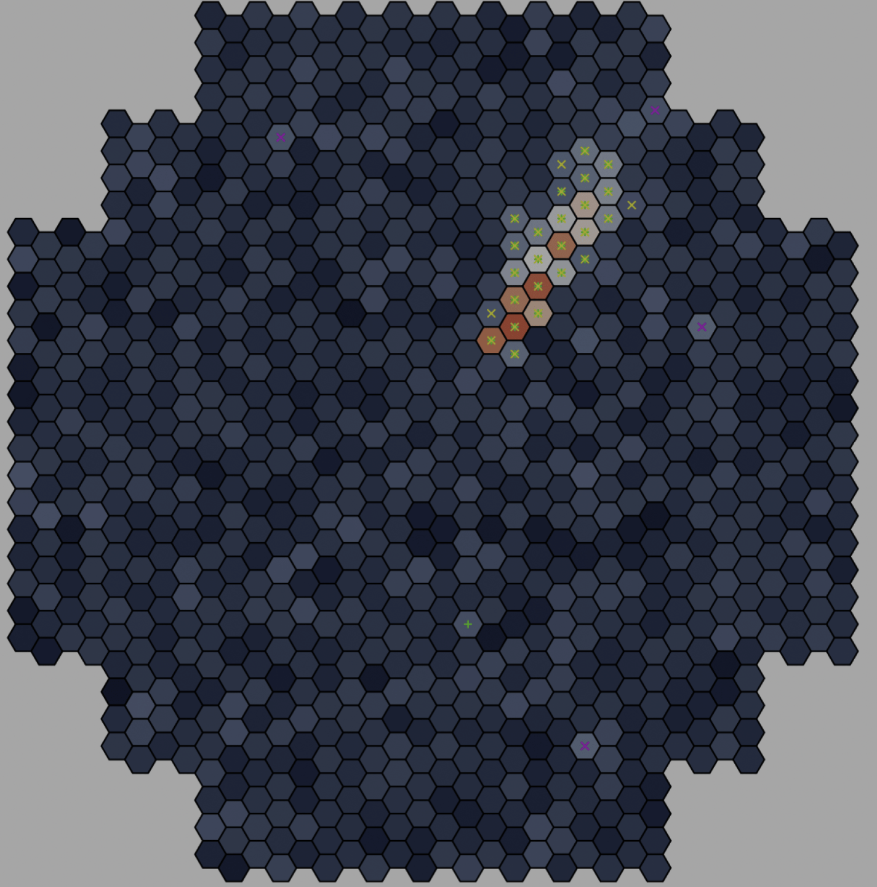
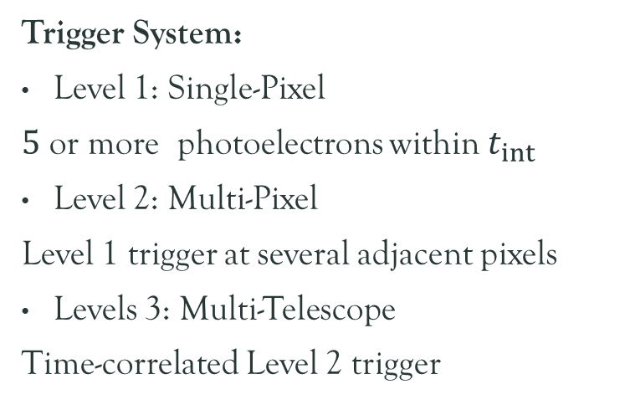

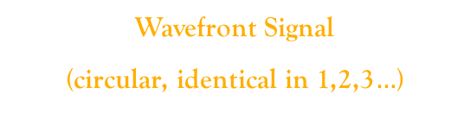
Signal-Background Separation
1
Trigger System:
Level 1: Single-Pixel
$5$ or more photoelectrons within $t_{int}$
Level 2: Multi-Pixel
Level 1 trigger at several adjacent pixels
Levels 3: Multi-Telescope
Time-correlated Level 2 trigger
2
Single Particle
(elliptical, parallactic)
Night Sky Background
(sporadic)
1, 2, 3 $…$
Wavefront Signal
(circular, identical in 1,2,3$…$)

Slide 29
Ultrashort GRB Sources
Dark blob: collisions (this work), decays, annihilation
Other dark structures: solitons?
SM? FRB counterparts (optical, gamma ray)

Slide 30

Parameterization
Blob parameters: blob mass $M$, blob radius $R$, consist of $𝓞(1)$ dark matter
  Microlensing constraints: $M ≲ {10}^{23} g$
  Bullet Cluster constraints: $\frac{R^{2}}{M} ≲ 1 cm^{2}/g$
  Not a black hole: $\frac{R}{M}≳ {10}^{−28} cm/g$

Slide 31
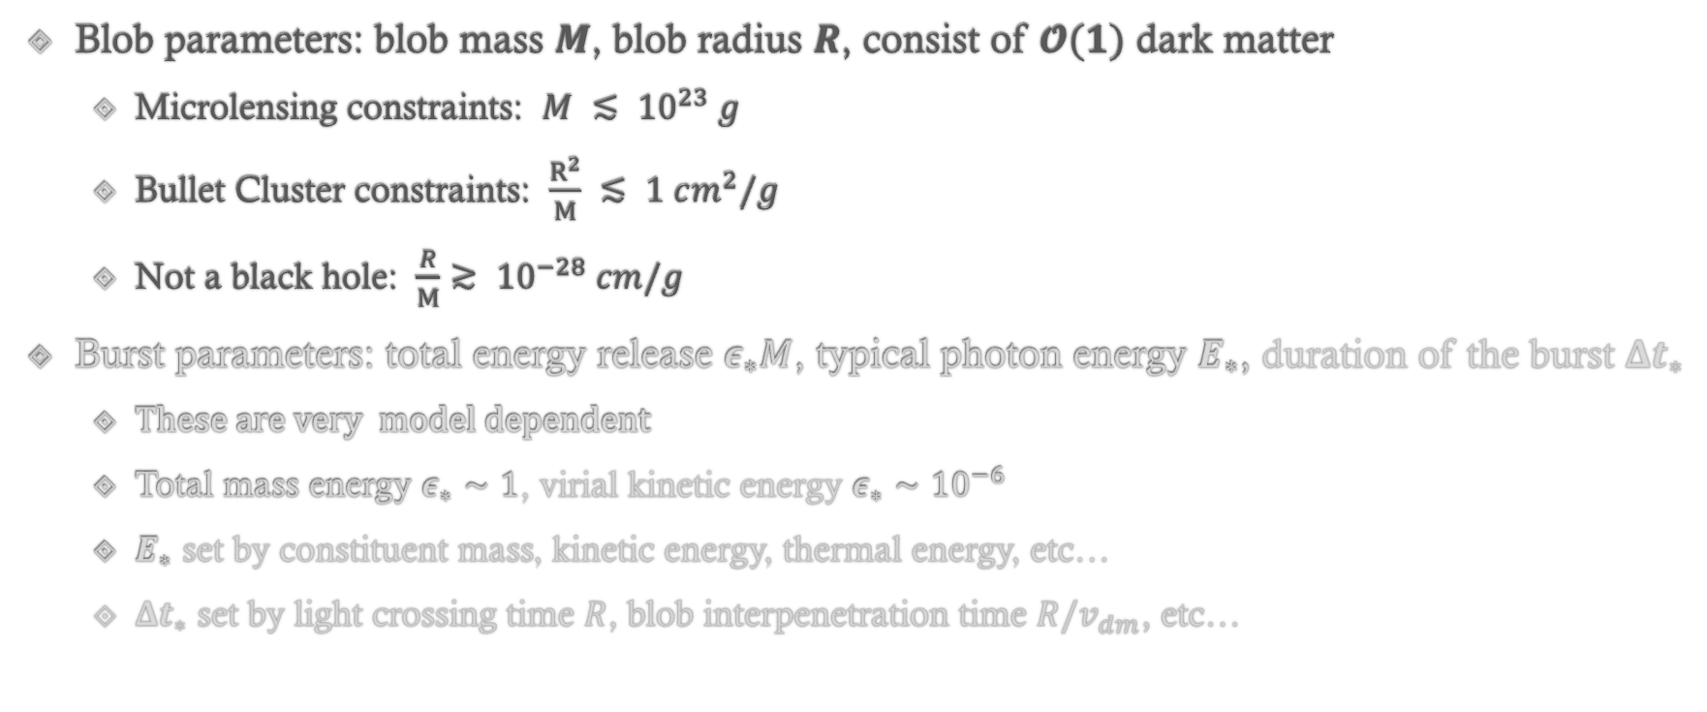
Parameterization
Blob parameters: blob mass $M$, blob radius $R$, consist of $𝓞(1)$ dark matter
  Microlensing constraints: $M ≲ {10}^{23} g$
  Bullet Cluster constraints: $\frac{R^{2}}{M} ≲ 1 cm^{2}/g$
  Not a black hole: $\frac{R}{M}≳ {10}^{−28} cm/g$
Burst parameters: total energy release $ε_{∗}M$, typical photon energy $E_{∗}$, duration of the burst $Δt_{∗}$
  These are very model dependent
  Total mass energy $ε_{∗}∼1$, virial kinetic energy $ε_{∗}∼{10}^{−6}$
  $E_{∗}$ set by constituent mass, kinetic energy, thermal energy, etc…
  $Δt_{∗}$ set by light crossing time $R$, blob interpenetration time $R/v_{dm}$, etc…

Slide 32

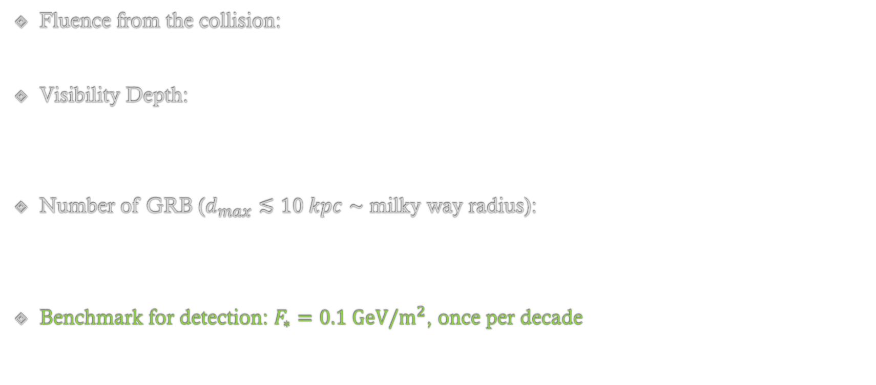

Gamma ray burst from blob collisions
Fluence from the collision:
Visibility Depth:
Number of GRB ($d_{max}≲10 kpc∼$ milky way radius):
Benchmark for detection: $F_{∗}=0.1 GeV/m^{2}$, once per decade
$$F_{∗}=\frac{1}{4πd^{2}}\frac{ε_{∗}M}{E_{∗}}$$
$$d_{max}=\sqrt{\frac{ε_{∗}M}{4πE_{∗}F_{det}\left(E_{∗}\right)}}$$
$$N_{GRB}∼{n_{blob}^{2}R^{2}v × d}_{max}^{3} × t_{obs}Ω_{obs}$$

Slide 33
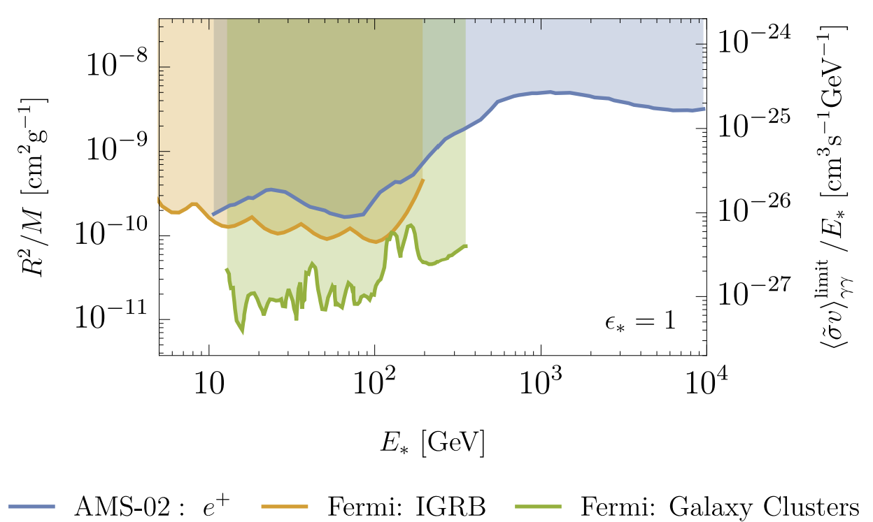

Diffused gamma rays from blob collisions
Blob collisions in the galaxy → burst-like signal
Blob collisions at cosmic distance → diffused background (searched in particle dark matter)
$$\frac{ε_{∗} R^{2}v_{DM}}{M} ↔ \frac{{\left\langle σv\right\rangle }_{χχ→γγ} }{E_{∗}}$$

Slide 34
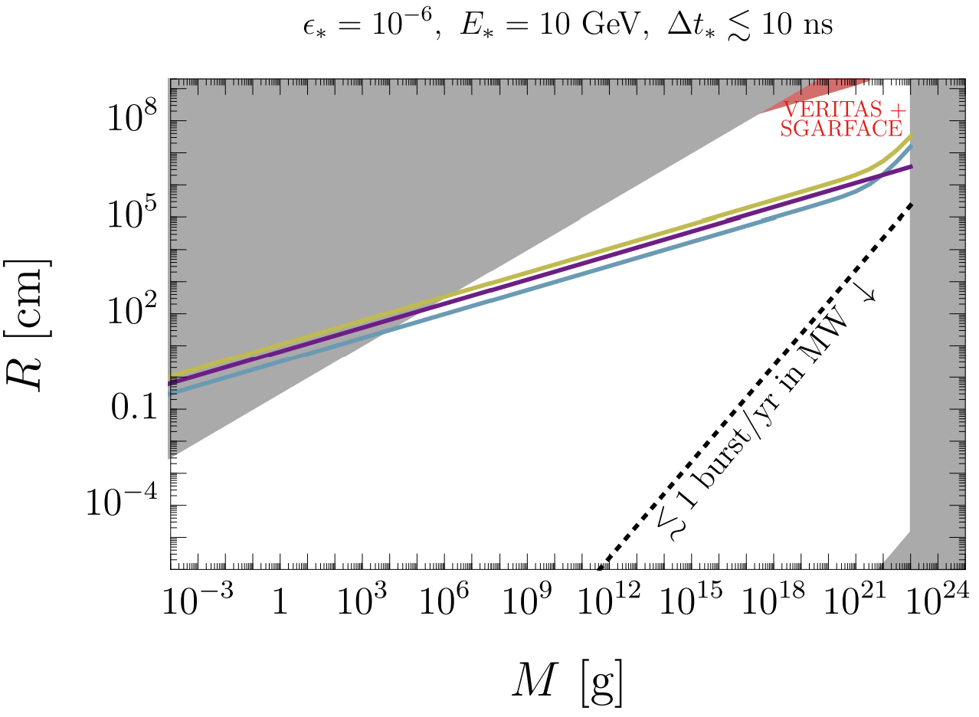
Blob Parameter Space

Slide 35

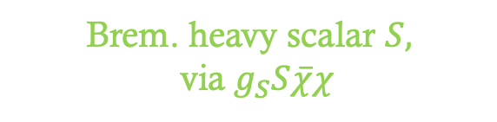

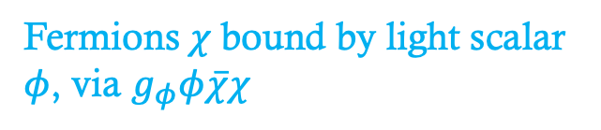
$$φ$$
$$χ$$
$$χ$$
$$χ$$
$$χ$$
$$χ$$
$$χ$$
$$χ$$
$$χ$$
$$χ$$
$$χ$$
$$χ$$
$$χ$$
$$χ$$
$$χ$$
$$χ$$
$$χ$$
Fermions $χ$ bound by light scalar $φ$, via $g_{φ}φ\overline{χ}χ$
Brem. heavy scalar $S,$via$g_{S}S\overline{χ}χ$
$$S$$
$$γ$$
$$γ$$
$S$ decays to gamma-rays $γ$, via $g_{Sγγ}F^{2}$

Slide 36






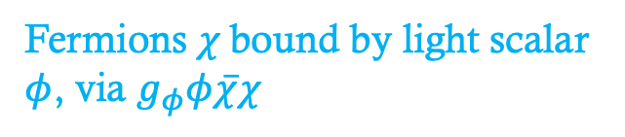

Dark Blob Model
Fermions $χ$ bound by light scalar $φ$, via $g_{φ}φ\overline{χ}χ$
$𝓛⊃g_{φ}φ\overline{χ}χ$ + $g_{S}S\overline{χ}χ$ + $g_{Sγγ}F^{2}$
$φ$ultralight, $m_{φ}^{−1}≳R$
$m_{S}≳$ 100 MeV to have short decay lifetime
$$φ$$
$$χ$$
$$χ$$
$$χ$$
$$χ$$
$$χ$$
$$χ$$
$$χ$$
$$χ$$
$$χ$$
$$χ$$
$$χ$$
$$χ$$
$$χ$$
$$χ$$
$$χ$$
$$χ$$
Brem. heavy scalar $S,$via$g_{S}S\overline{χ}χ$
$$S$$
$$γ$$
$$γ$$
$S$ decays to gamma-rays $γ$, via $g_{Sγγ}F^{2}$

Slide 37








Dark Blob Structure
Structure of the blob: asymmetric fermion bound states
Attractive $φ$ Yukawa force balance with degenerate pressure
Mass radius relation (Wise, Zhang 2014)
$$χ$$
$$χ$$
$$χ$$
$$m_{φ}^{−1}>R$$
$$χ$$
$$χ$$
$$χ$$
$$φ$$
$$χ$$
$$χ$$

Slide 38


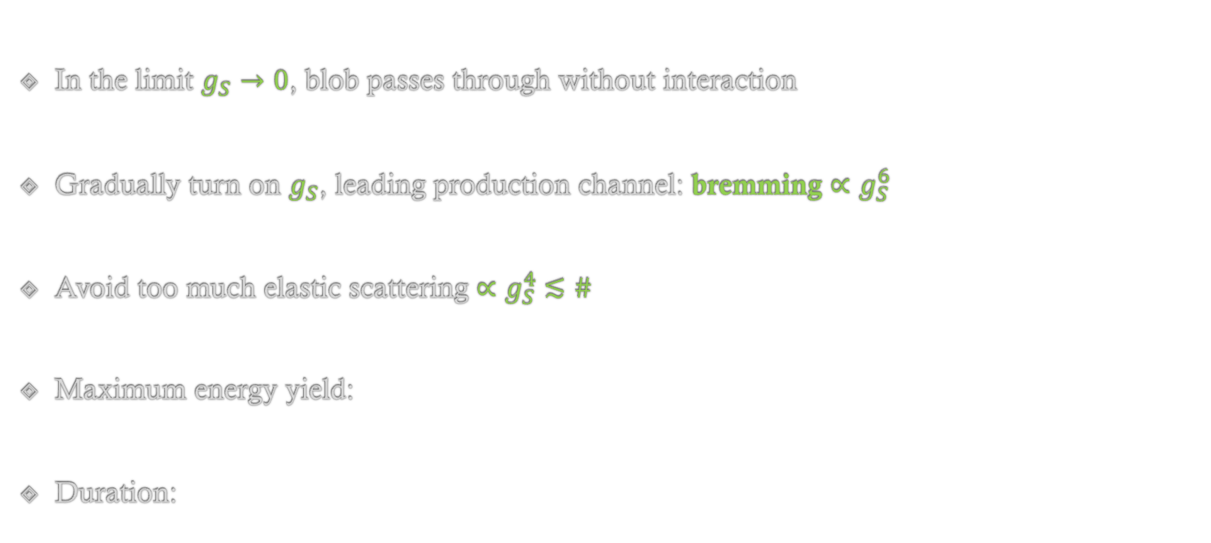









Dark Blob Collision
$$g_{S}$$
In the limit $g_{S}→0$, blob passes through without interaction
Gradually turn on $g_{S}$, leading production channel: bremming ${∝g}_{S}^{6}$
Avoid too much elastic scattering ${∝g}_{S}^{4} ≲\#$
Maximum energy yield:
Duration:
$$χ$$
$$χ$$
$$S$$
$$χ$$
$$χ$$
$$χ$$
$$χ$$
$$S$$
$$S$$
$$ε_{∗}∼𝓞(g_{s}^{2})$$
$$χ$$
$$χ$$
$$Δt_{∗}∼R/v$$

Slide 39
Gamma ray burst yield
Random collisions:
Binary blobs (Ali-Haimoud 2017):
$$N_{GRB}∼𝓞(10^{−7})$$
$$N_{GRB}∼𝓞(1)$$

Slide 40
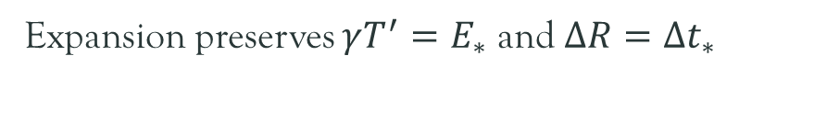

Fireball
thermalized, optically-thick, expanding plasma
Expansion preserves $γT^{′}=E_{∗}$ and $ΔR=Δt_{∗}$
photon decoupling
$$T_{0},{ R}_{0}$$

