Slide 1



ARA-Next: a new DAQ and trigger architecture for the Askaryan Radio Array
Pawan Giri, Ilya Kravchenko, Patrick Allison, Amy L. Connolly
University of Nebraska Lincoln, Ohio State University
(6/11/ 2024)
U.S. National Science Foundation-EPSCoR (RII Track-2 FEC, award #2019597)

Slide 2
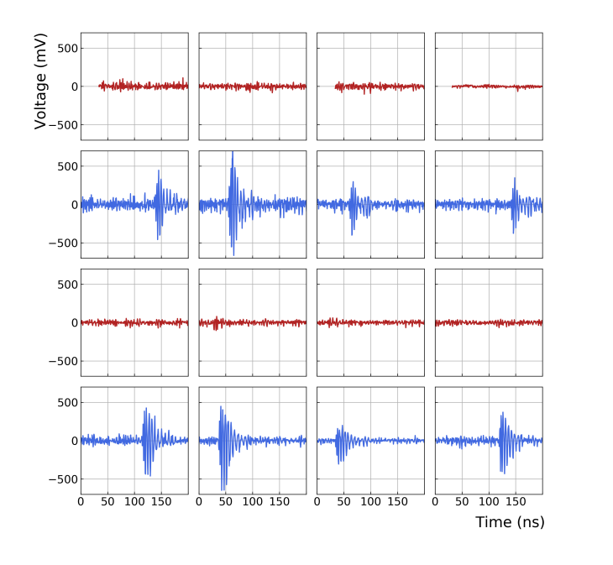
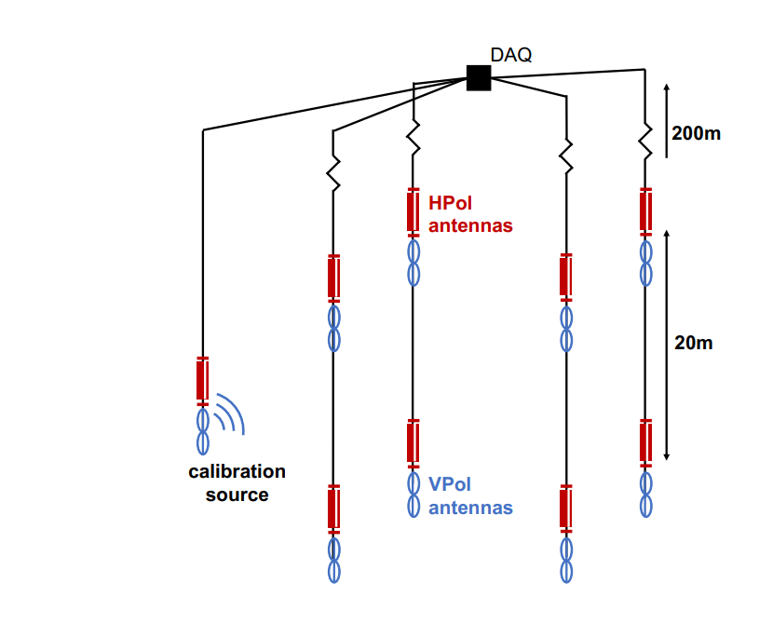
Askaryan Radio Array - Experiment
Neutrino detector based on Askaryan radiation principle
Traditional ARA station contains 16 receiving antennas(8 Vpols, 8 Hpols) and calibration pulser antennas
Why Radio detector?
- ice is low-loss to radio frequency and field attenuation length goes up kilometer
Schematic diagram of ARA station
Calibration event recorded on ARA2

Slide 3
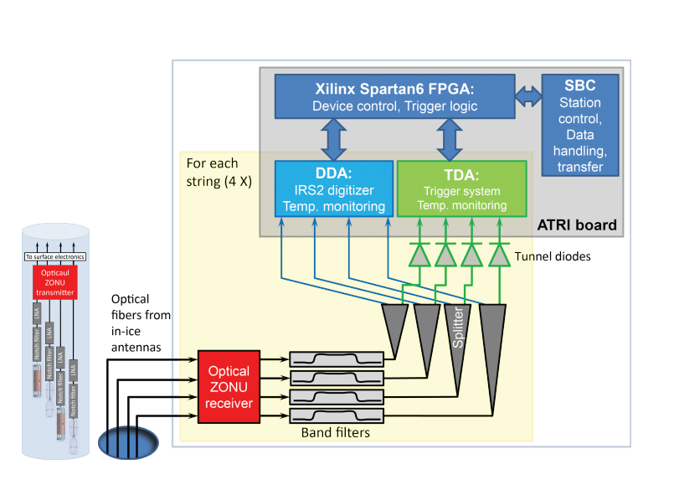
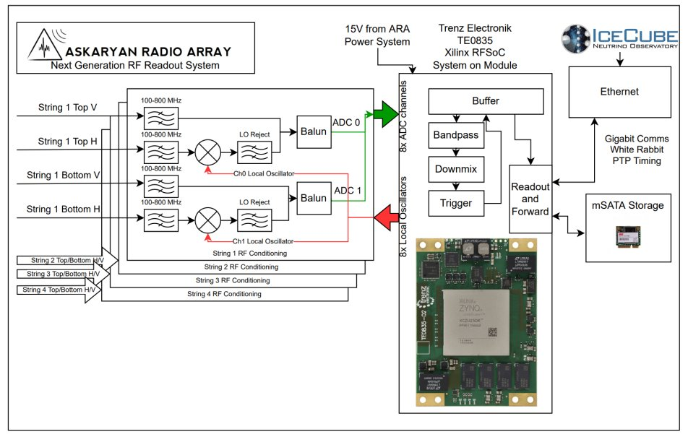
ARA DAQ Upgrade
Current DAQ:
Based on a custom motherboard ARA Trigger and Readout Interface(ATRI)
Each incoming string from ice carries signal from four channels
Signal goes into digitizer (DDA) and trigger (TDA) simultaneously via splitter
At FPGA, trigger logic is performed(3 hit logic)
ARA-Next DAQ will be based on RFSoC
Current ARA DAQ

Slide 4
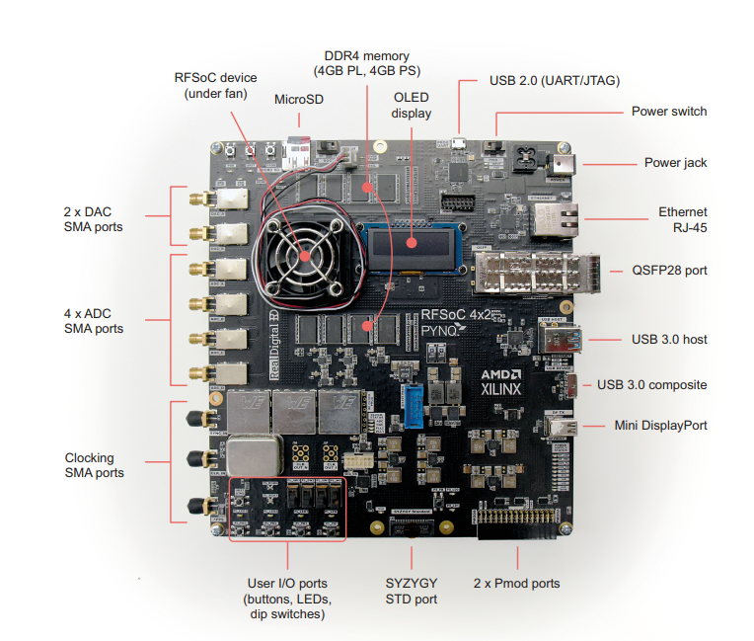
RFSoC Overview
Integrated circuit that combines an FPGA with ADCs and DACs on a single chip
RFSoC devices :
Highly flexible and programmable, rich in customization
Wide range of application
Development tools and programming languages
High speed signal processing
Can operate at low power levels
Fig : Radio Frequency System on Chip(RFSoC)

Slide 5
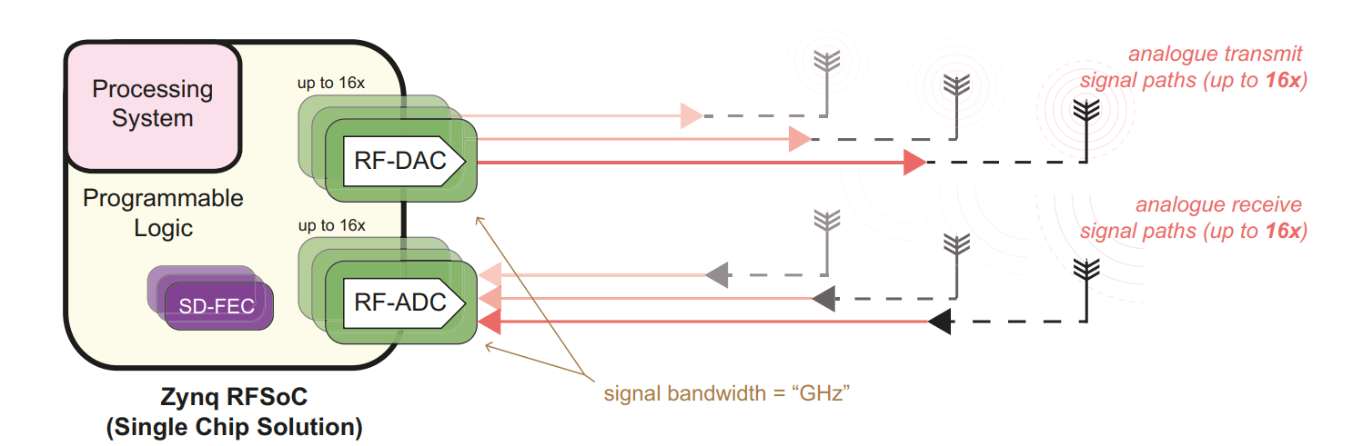
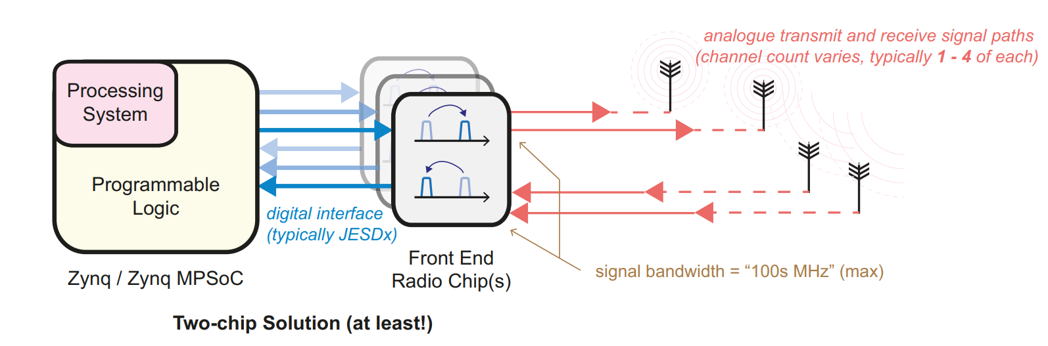
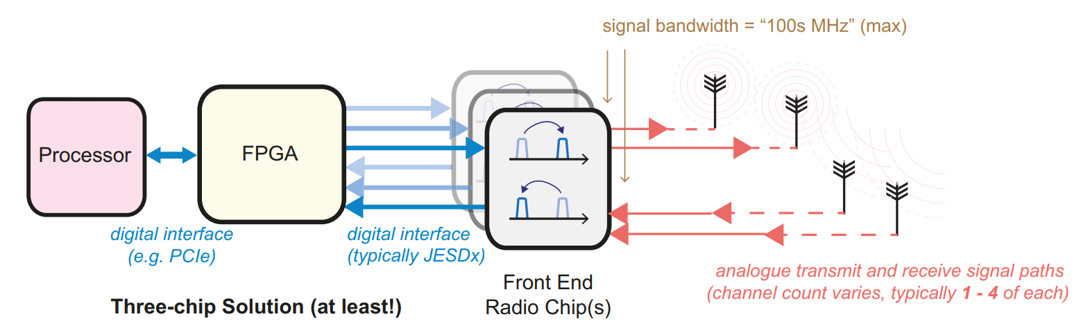
RFSoC Vs Other Alternatives
No more need of traditional Front end radio chips
All the radio components available in a single device
Faster than traditional radio receiver/transmitter
Lesser the radio components, less the power loss

Slide 6
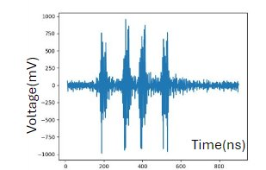
Complex trigger ideas
Trigger with 3 hits among all 16 channels (no longer only HPols or VPols)
  ARA has observed power split in VPol and HPol receivers for a signal coming from a distant VPol pulser (Birefringence : previous talk by Alan S. Gomez)
New DAQ will be flexible to record waveforms of variable length
  We can optimize the trigger to search for the "double-bang" signature of tau neutrinos
ARA can take advantage of multi-messenger astronomy
  Keeping an eye on known astrophysical sources from other experiments
Tag or reject/veto anthropogenic events
  Unusually long radio pulses ("fish tails"), multiple pulses in a small-time window, pointing towards the ice surface, etc..​

Slide 7
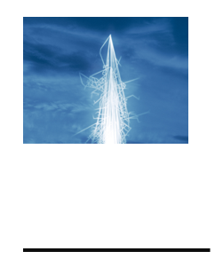
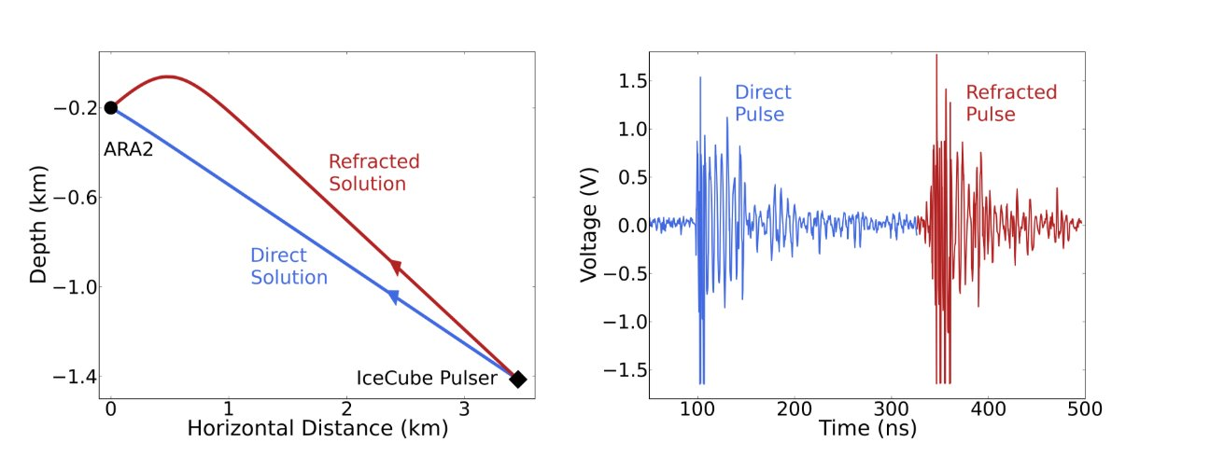
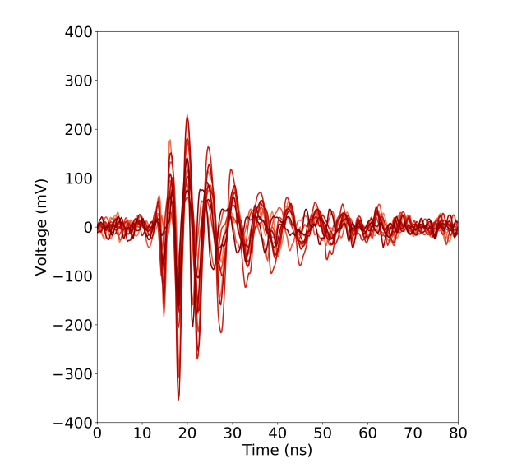

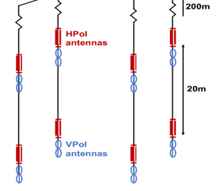
Complex trigger ideas ..
Tag events with a physical time sequence of hits
- This will make sure non-physical events discarded at trigger level
Tag events with double pulses (n out of N channels having double pulses)​
- Potential deep-ice neutrino event ​
Tag events with possible cosmic ray pulses ​​
- Unique waveform shape from cosmic ray interaction
Pawan Giri (UNL)

Slide 8
Goals with ARA-Next ..
We will explore the potential of machine learning algorithms at the trigger level
Recently, RNO-G studied and concluded that CNNs can be implemented on FPGAs, which should be easier on RFSoC
Implementation of new threshold techniques in addition to or in place of the existing 3-hit technique in ARA:
- This will lower the threshold value for stations/channels, increasing the likelihood of detecting weaker neutrino signals from larger distances
- This ultimately increases the effective volume and enhances ARA's sensitivity as a radio neutrino detector
- Several possibilities exist for this, such as cross-correlating waveforms with neutrino templates from simulations
Not only ARA and RNO-G, but IceCube-Gen2 is also exploring the potential use of RFSoC for data acquisition
Pawan Giri (UNL)

Slide 9
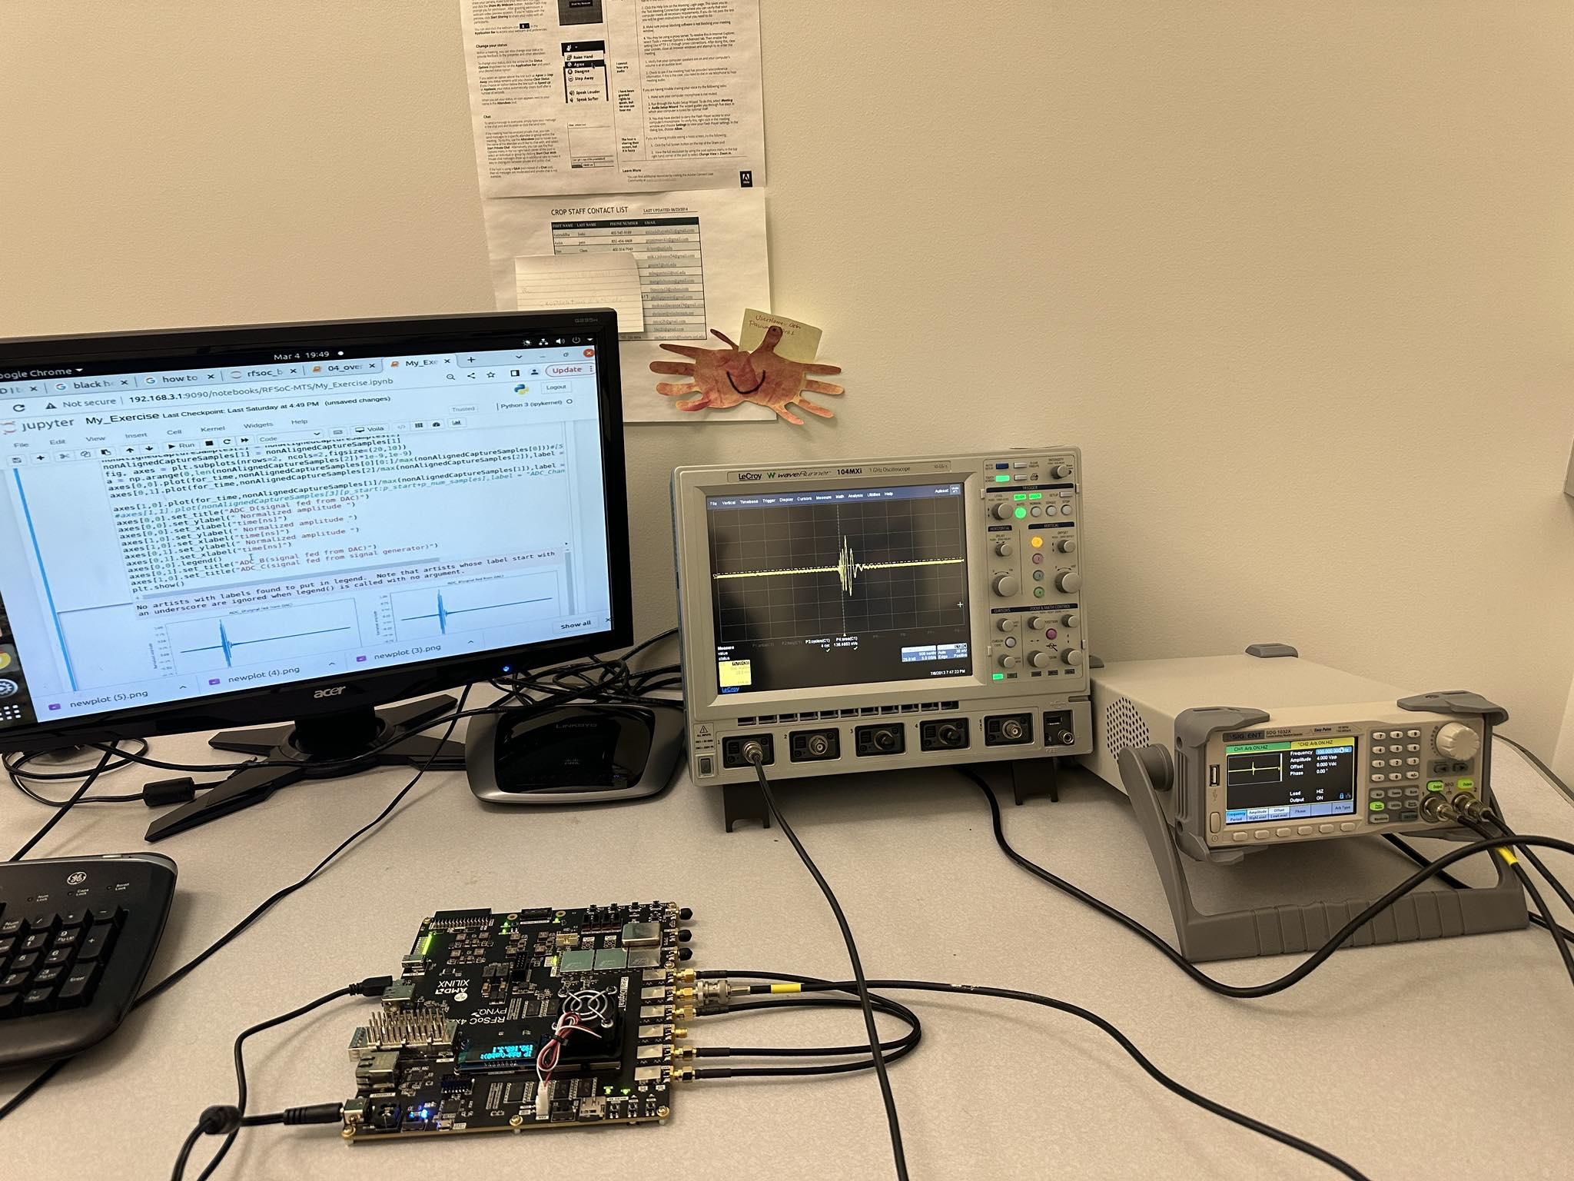
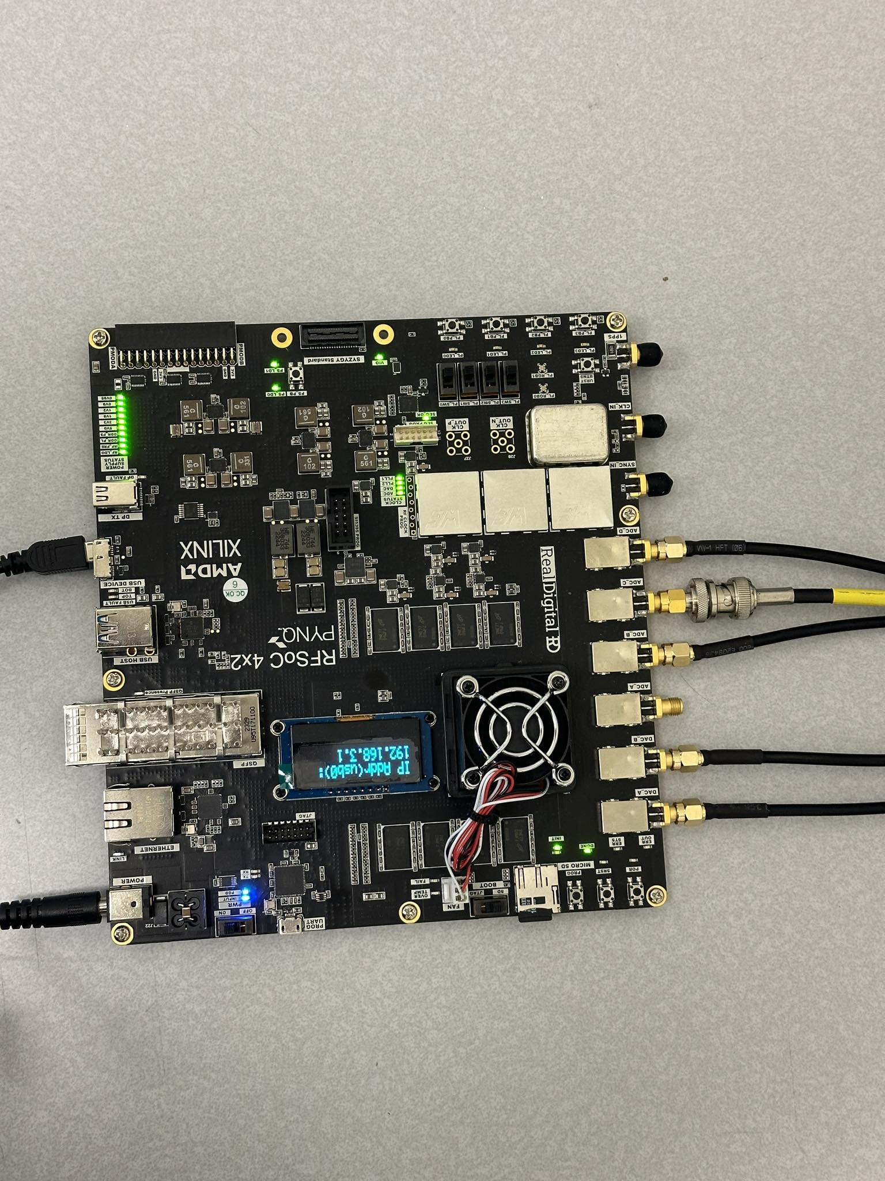
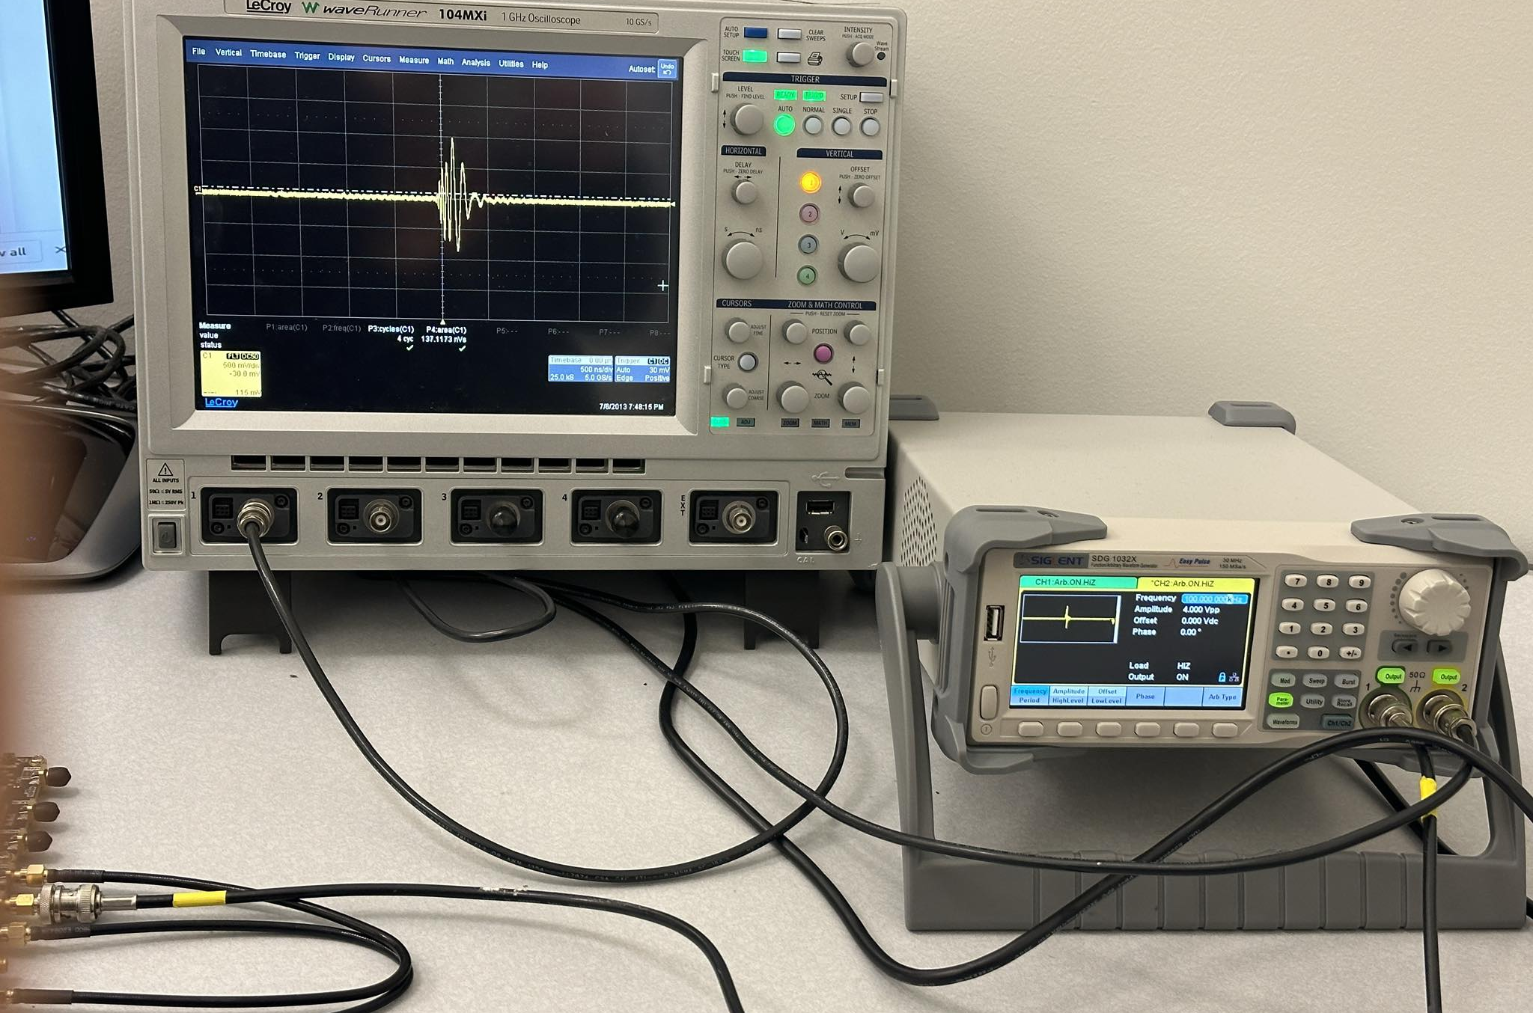
RFSoC testbench at UNL
Pawan Giri (UNL)

Slide 10
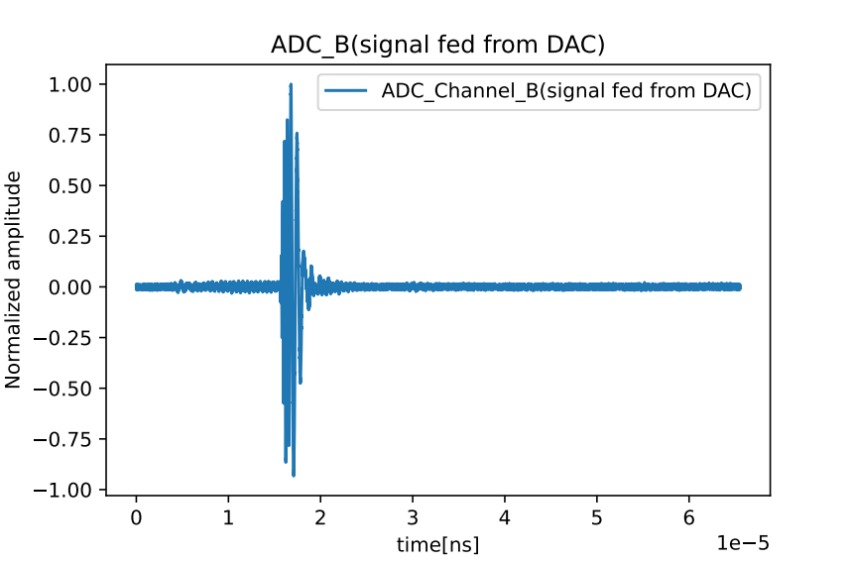
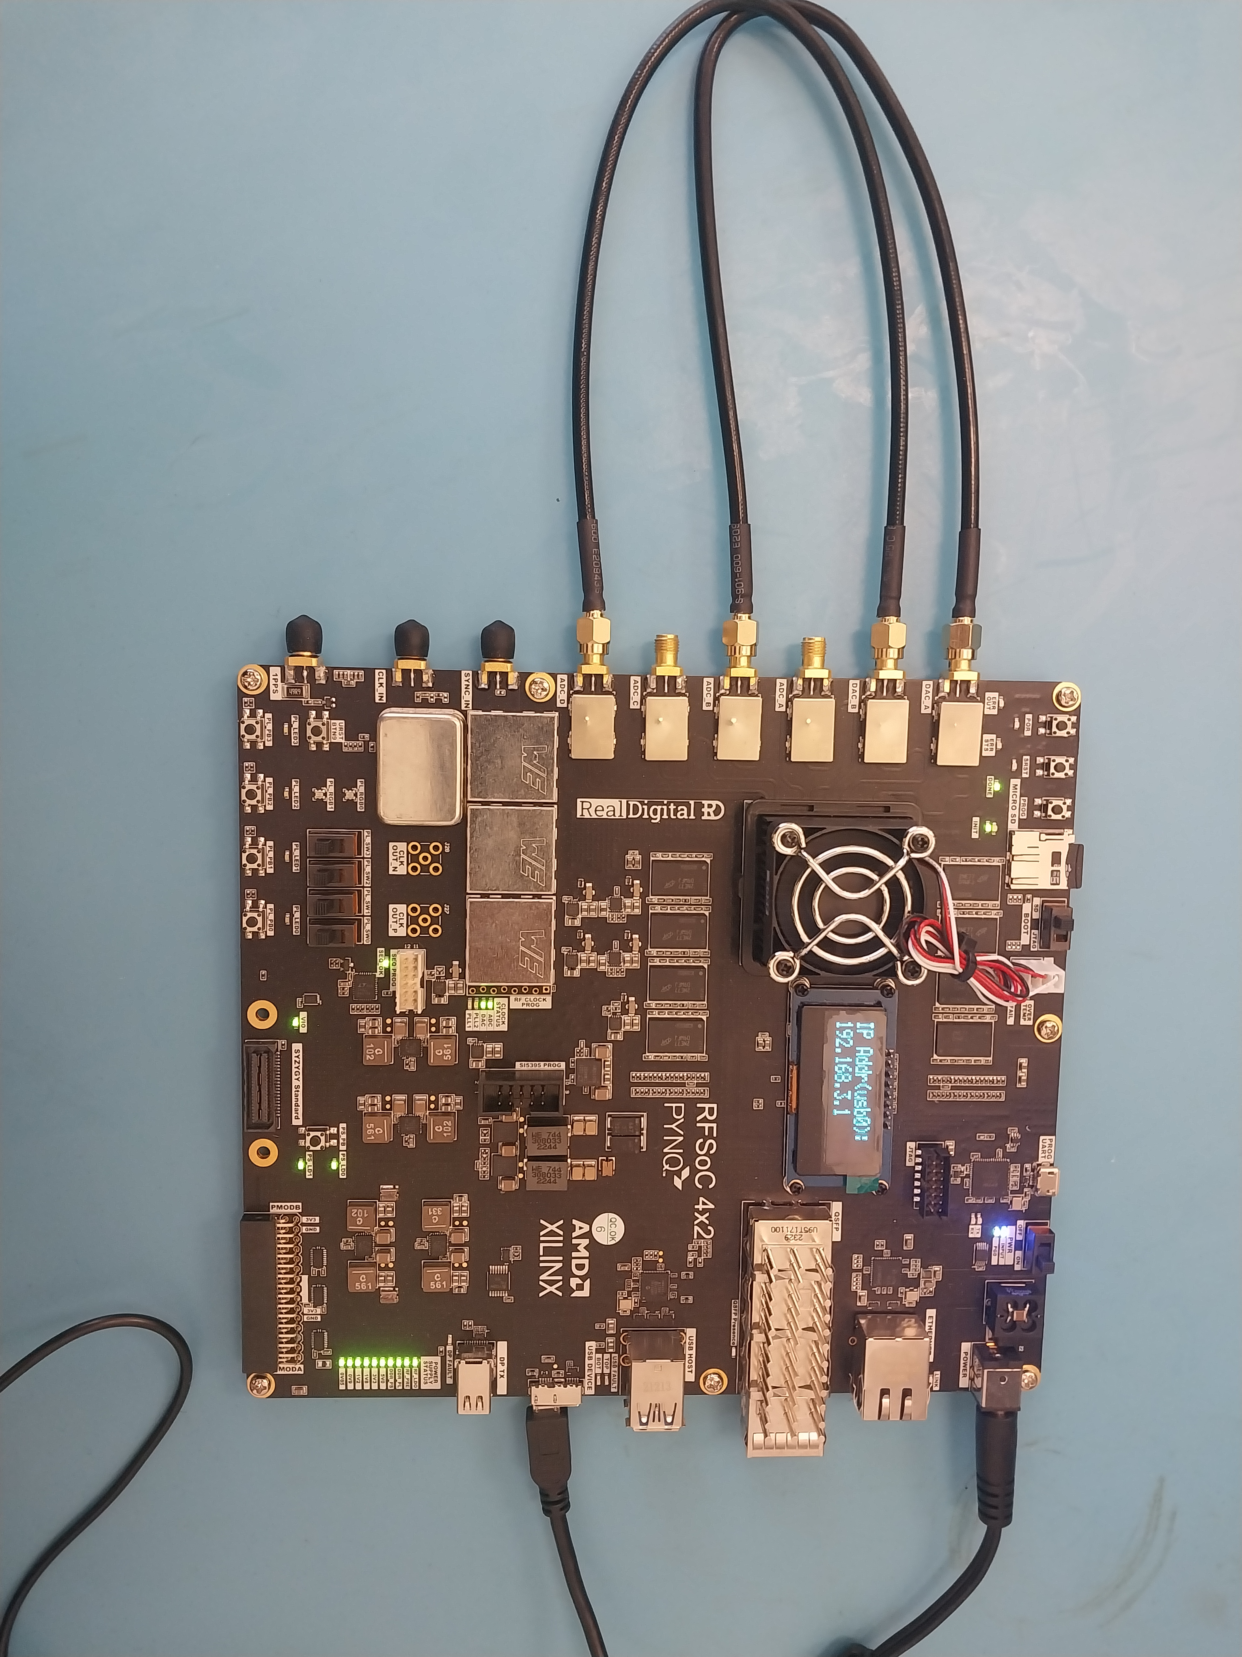
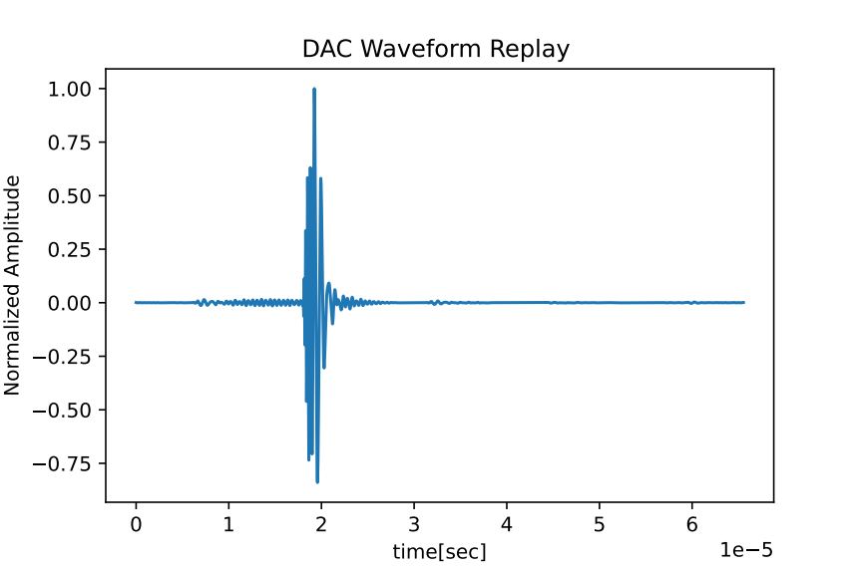
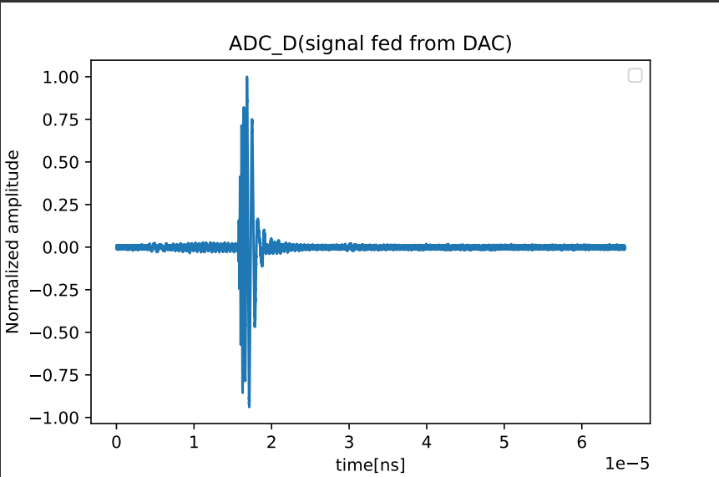
Test waveforms in RFSoC
Used a signal pattern originally used by Jakob Henrich (RNOG from DESY) for RADIANT board testing
time[sec]
Pawan Giri (UNL)
time[sec]

Slide 11
Summary
ARA-Next will be more advanced, significantly enhancing ARA's sensitivity
With RFSoC, we will be able to add numerous new features to the ARA DAQ, such as:
- Designing a new trigger system
- Adding more tags and event classifications​
- Rejecting surface events​
- Identifying known traces at the trigger level​
ARA plans to upgrade at least one station's DAQ with ARA-Next DAQ in the coming pole season
Exploration of RFSoC and development of the ARA-Next DAQ are ongoing
Dr. Patrick Allison (OSU) is working on the optimal development of the hardware configuration for ARA-Next DAQ
Pawan Giri (UNL)

Slide 12
Thank you !

