Slide 1

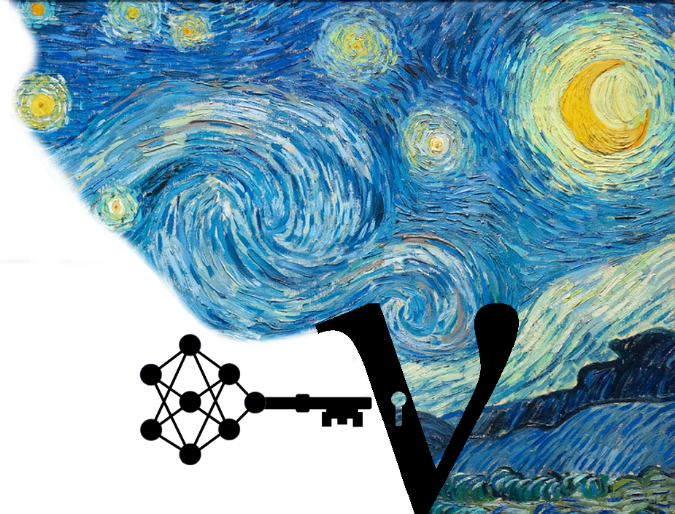
Deep Learning
Reconstruction of in-ice
Radio Neutrino Signals
ARENA 2024, Chicago
Nils Heyer, Thorsten Glüsenkamp, Christian Glaser

Slide 2
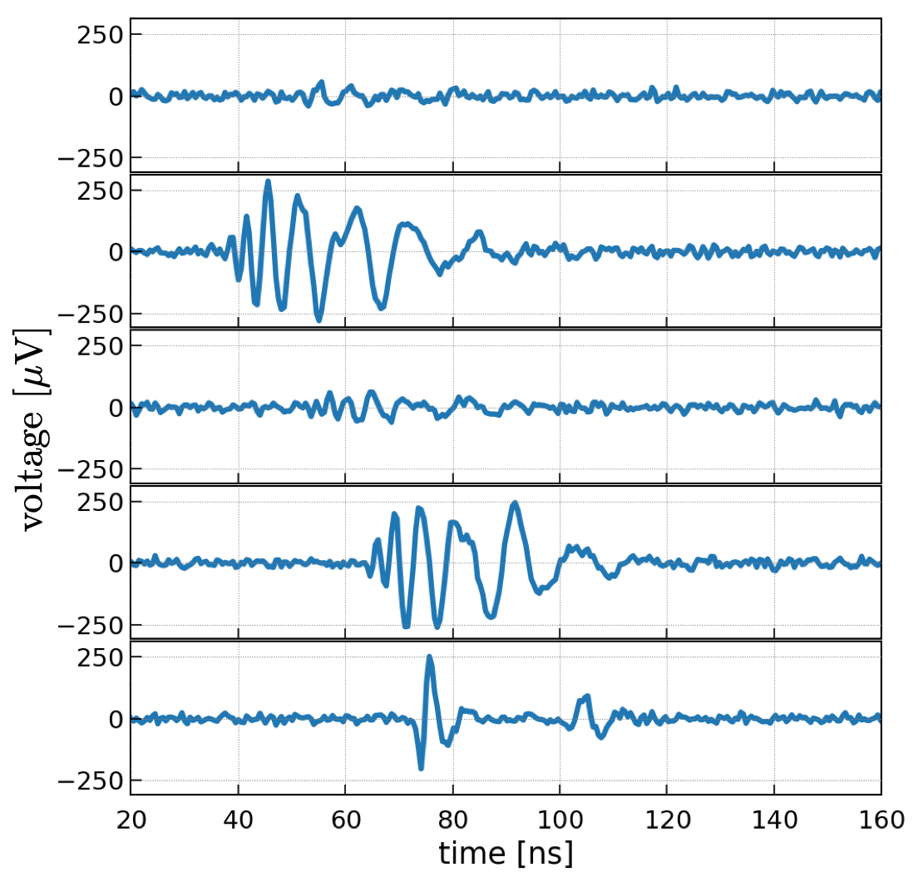
What will we do after measuring the first neutrino?
raw traces

Slide 3
What will we do after measuring the first neutrino?
raw traces
reconstruction algorithm

Slide 4
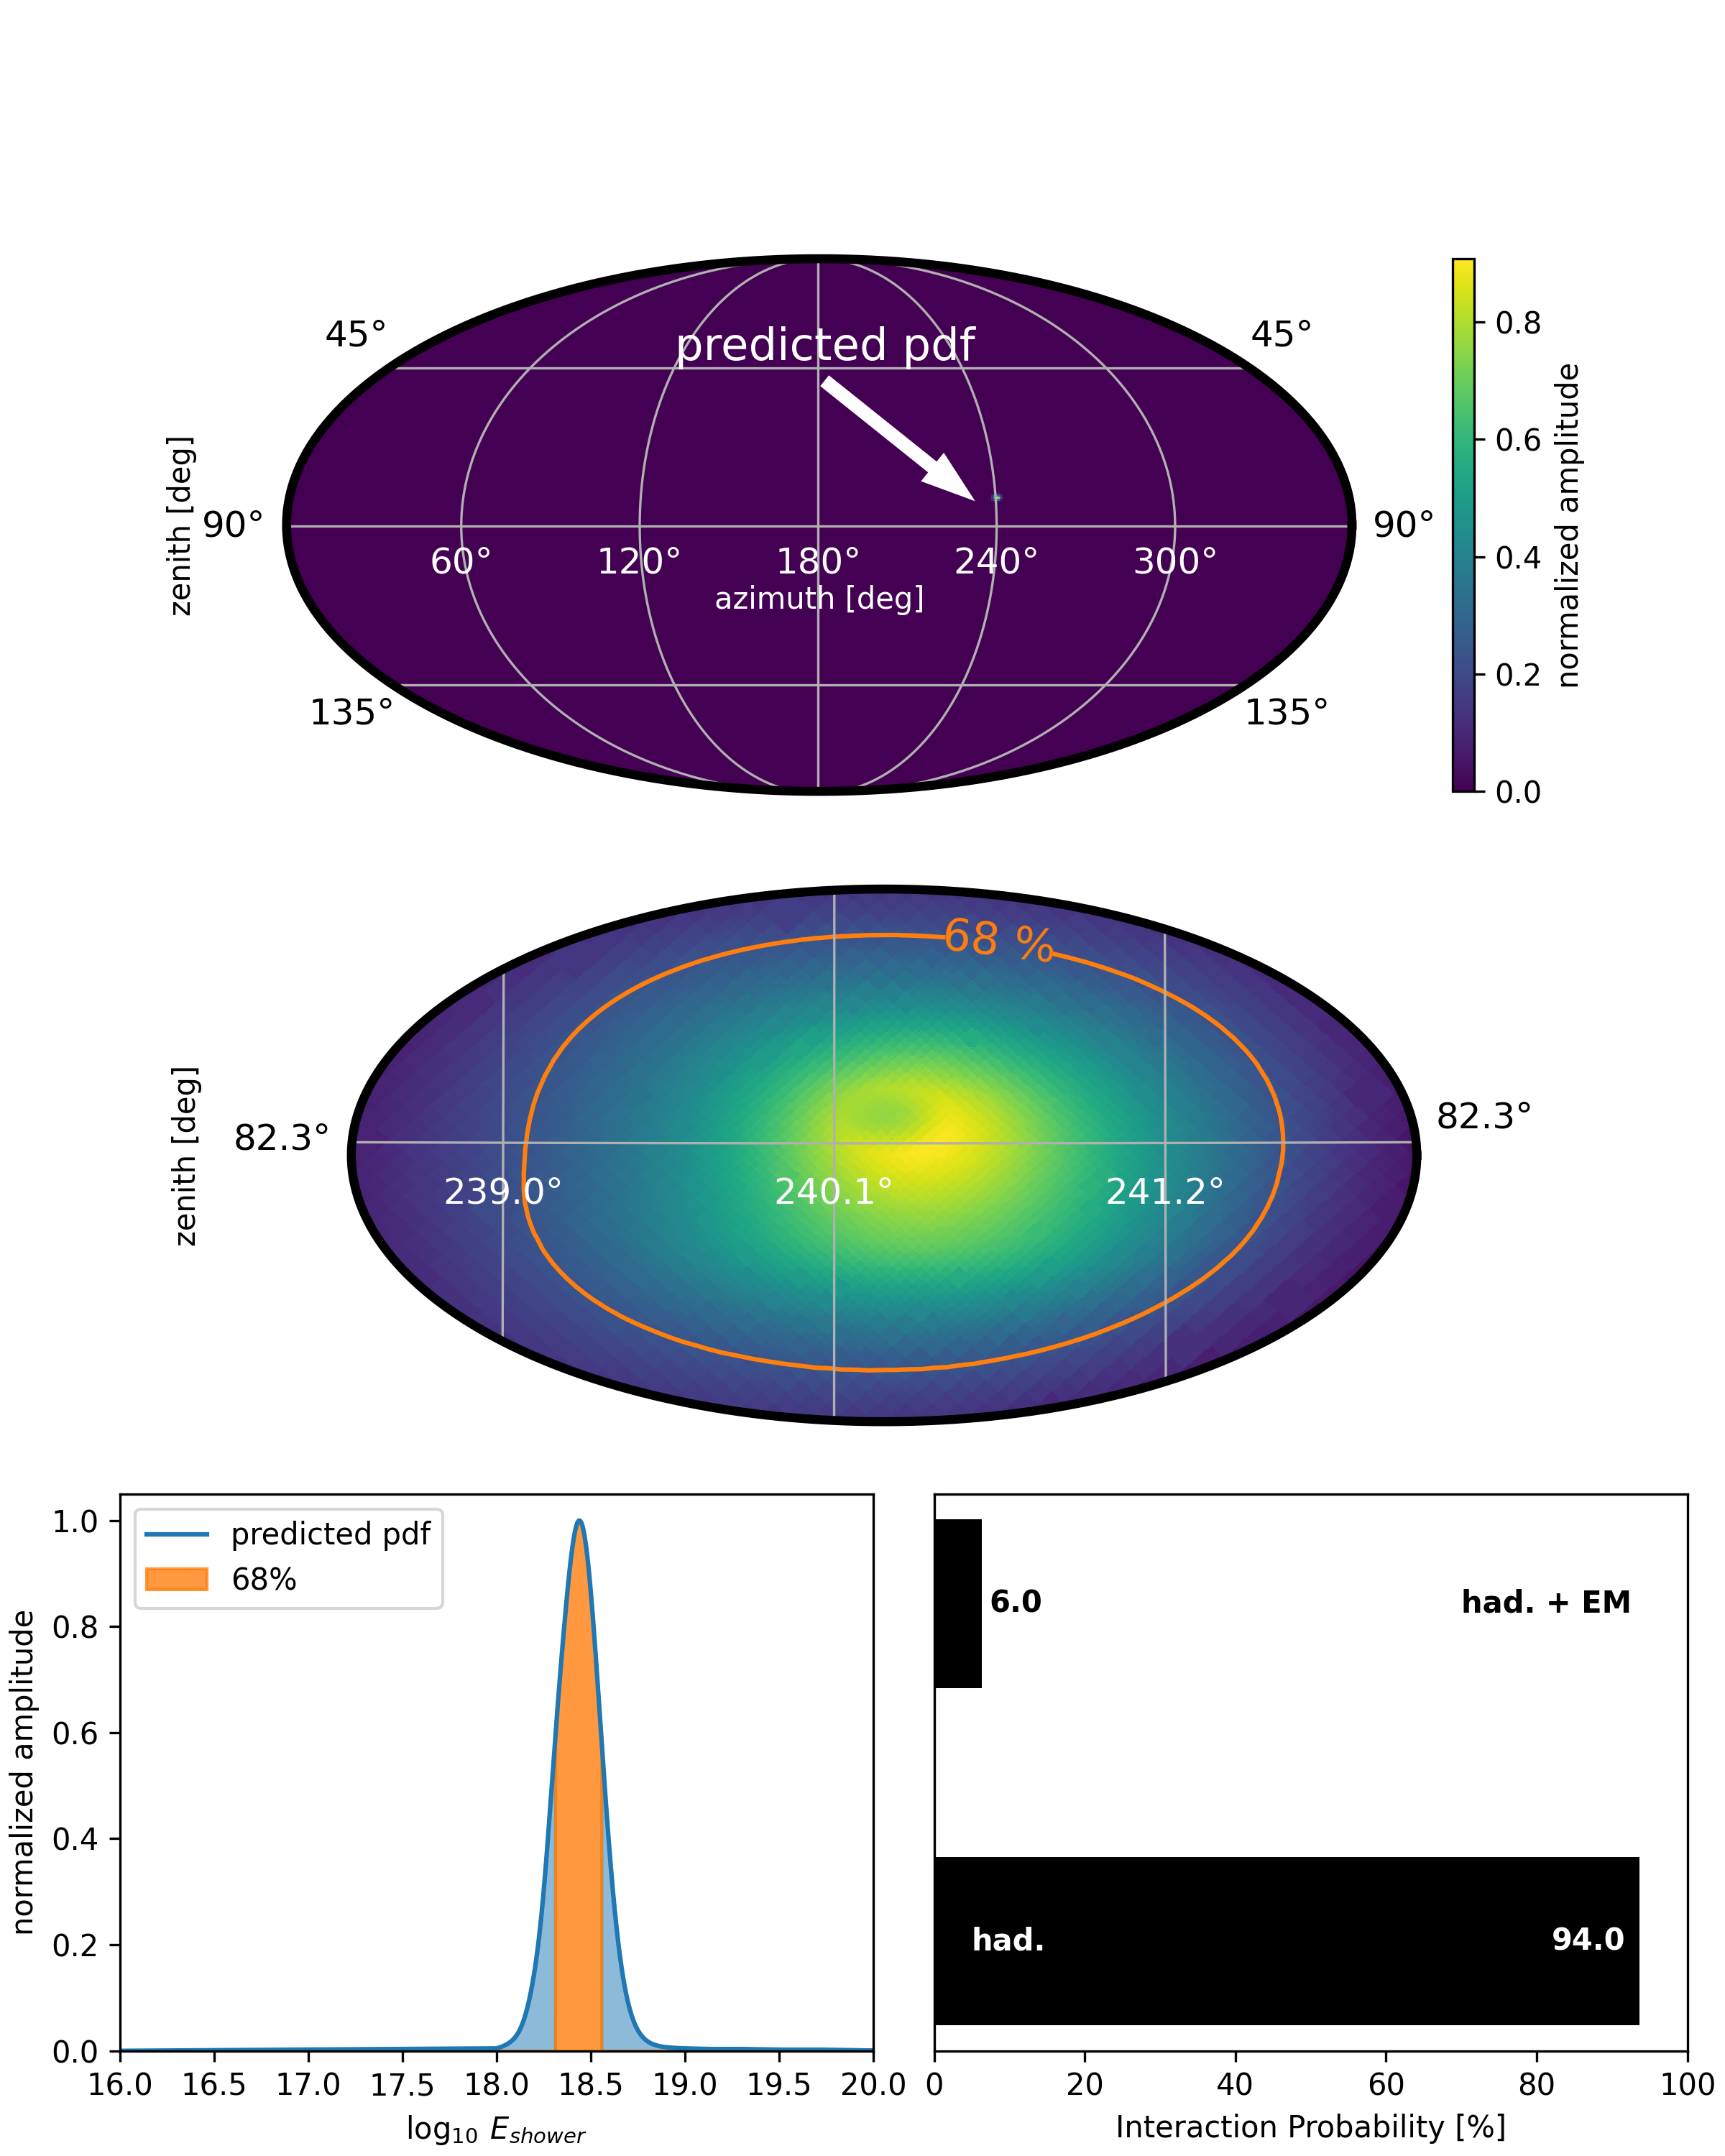
What will we do after measuring the first neutrino?
Single Event Reconstruction
direction
raw traces
reconstruction algorithm

Slide 5
What will we do after measuring the first neutrino?
Single Event Reconstruction
direction
raw traces
reconstruction algorithm

Slide 6
What will we do after measuring the first neutrino?
Single Event Reconstruction
direction
raw traces
reconstruction algorithm
energy

Slide 7
What will we do after measuring the first neutrino?
Single Event Reconstruction
direction
raw traces
reconstruction algorithm
energy
flavor

Slide 8
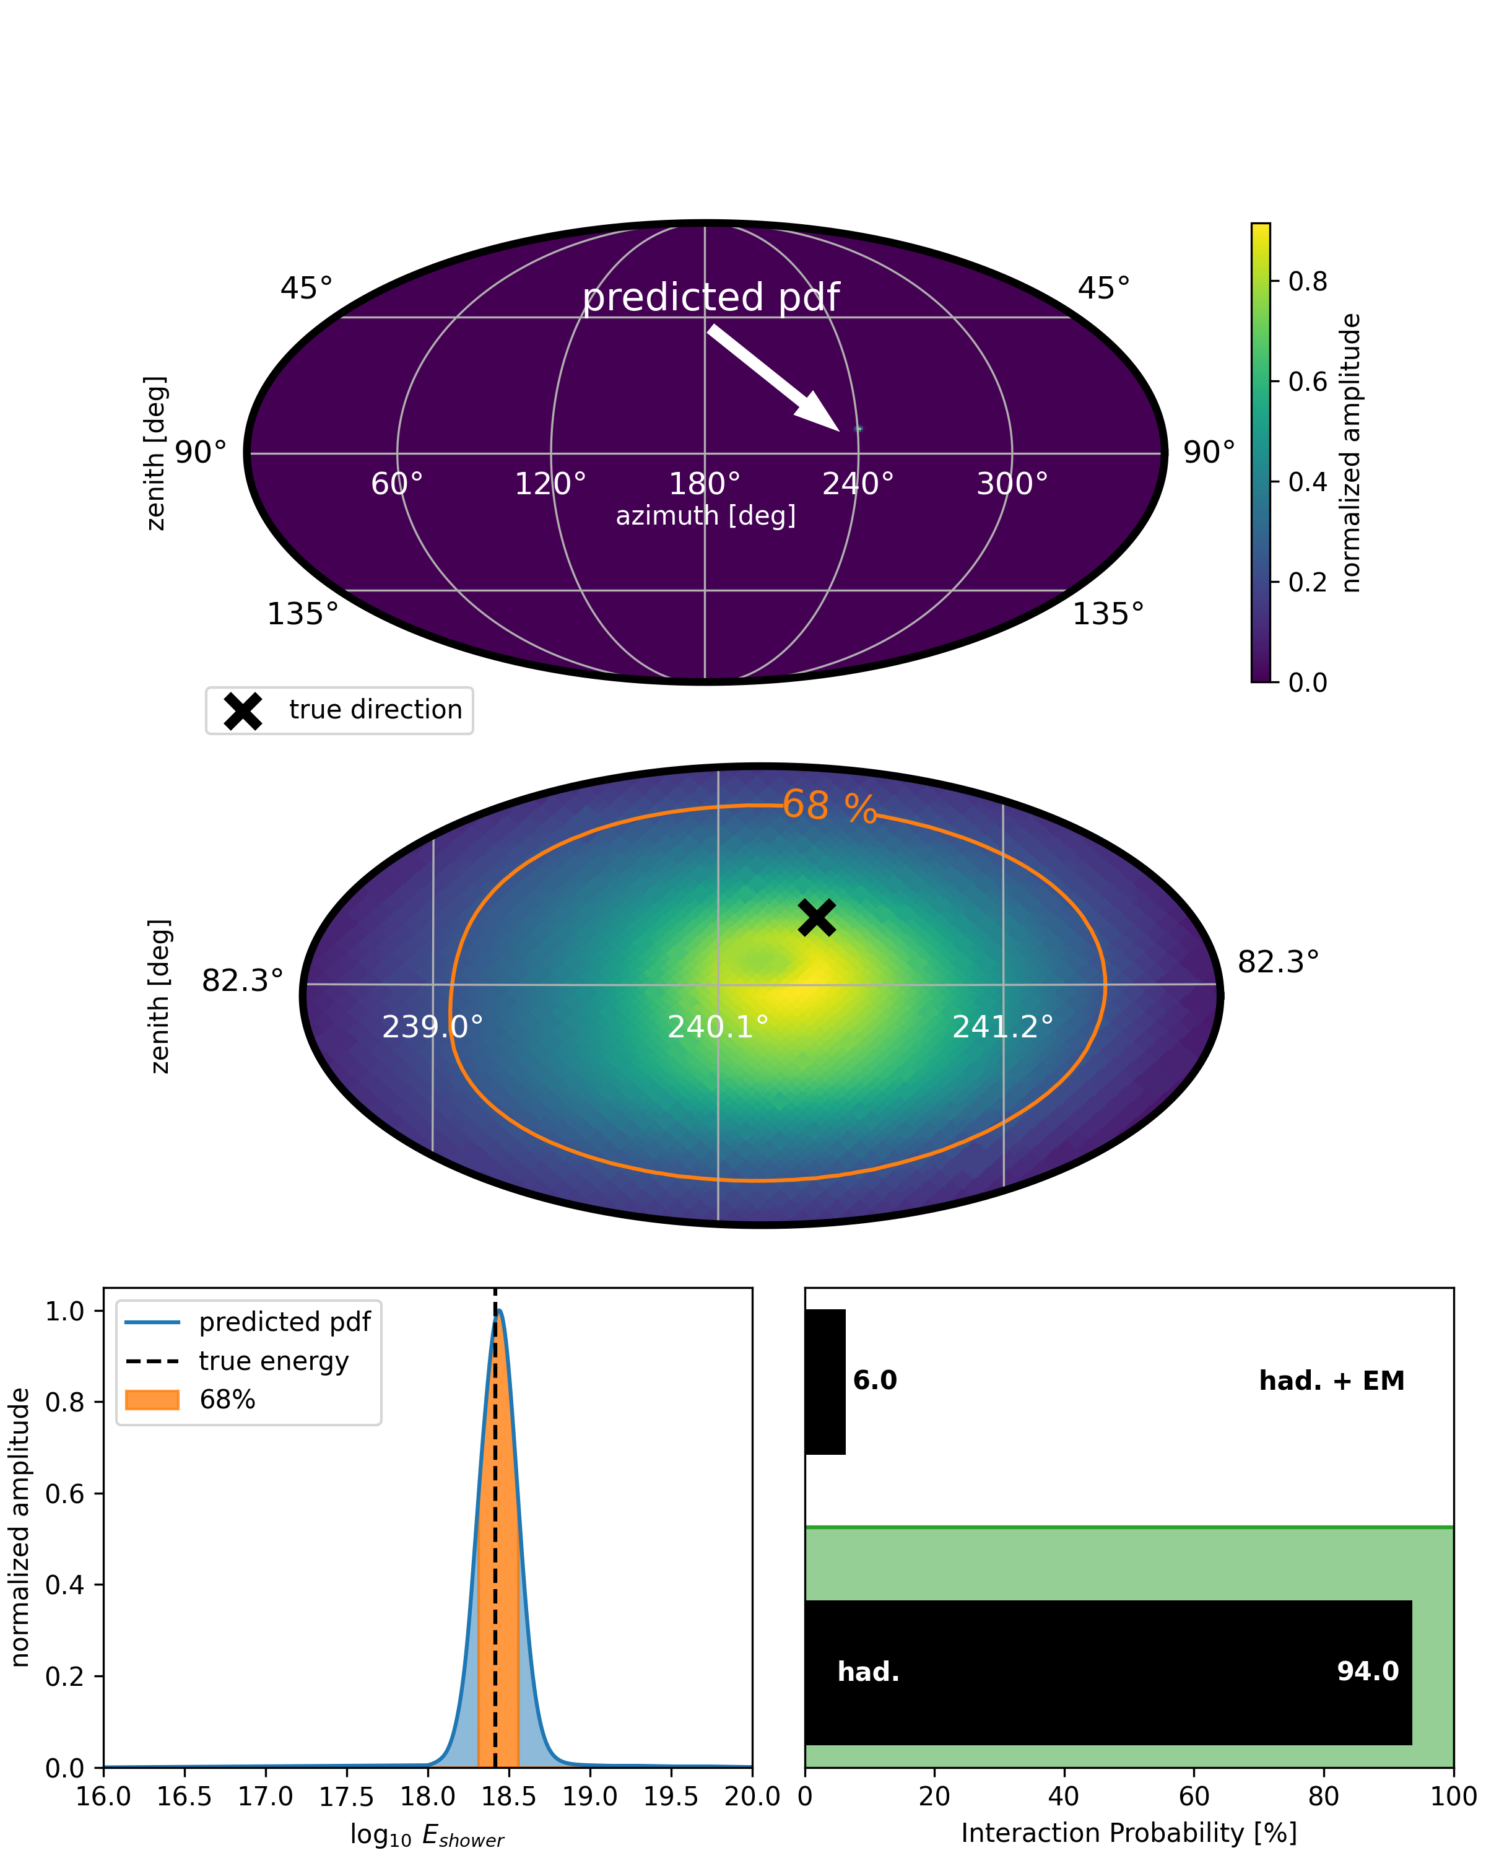
What will we do after measuring the first neutrino?
Single Event Reconstruction
direction
raw traces
reconstruction algorithm
energy
flavor

Slide 9
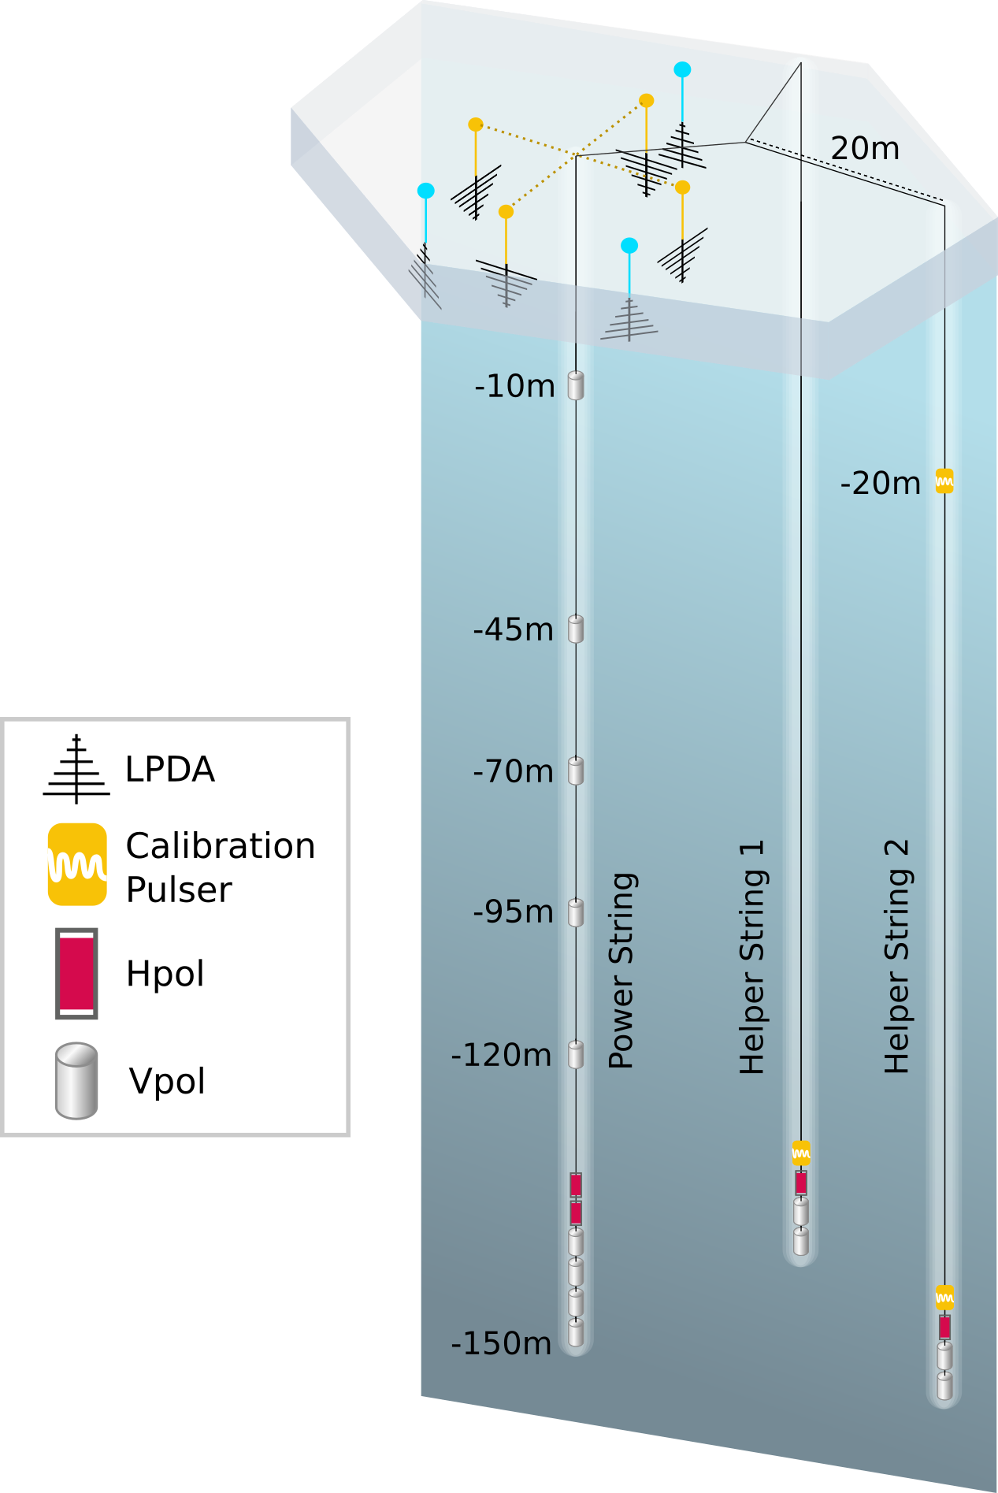



Simulating Neutrino Events
NuRadioMC generated events for a single station @ South Pole
The events have a uniform shower energy distribution
Single station event topologies:
  Hadronic shower ( , )
  Hadronic shower + EM shower ( )
The current IceCube Gen2 station:
  Shallow – 5 antennas - 100 Hz 2/4 LPDA trigger
  Deep – 16 antennas - 100 Hz phased array trigger
  2.1 million neutrino events for each station layout
$$ν_{e, μ, τ}−NC$$
$$ν_{μ, τ}−CC$$
$$ν_{e} −CC$$
IceCube Gen2, TDR, 2023

Slide 10
Simulating Neutrino Events
Shallow station
NuRadioMC generated events for a single station @ South Pole
The events have a uniform shower energy distribution
Single station event topologies:
  Hadronic shower ( , )
  Hadronic shower + EM shower ( )
The current IceCube Gen2 station:
  Shallow – 5 antennas - 100 Hz 2/4 LPDA trigger
  Deep – 16 antennas - 100 Hz phased array trigger
  2.1 million neutrino events for each station layout
$$ν_{e, μ, τ}−NC$$
$$ν_{μ, τ}−CC$$
$$ν_{e} −CC$$
IceCube Gen2, TDR, 2023

Slide 11
Simulating Neutrino Events
Shallow station
NuRadioMC generated events for a single station @ South Pole
The events have a uniform shower energy distribution
Single station event topologies:
  Hadronic shower ( , )
  Hadronic shower + EM shower ( )
The current IceCube Gen2 station:
  Shallow – 5 antennas - 100 Hz 2/4 LPDA trigger
  Deep – 16 antennas - 100 Hz phased array trigger
  2.1 million neutrino events for each station layout
$$ν_{e, μ, τ}−NC$$
$$ν_{μ, τ}−CC$$
$$ν_{e} −CC$$
Deep station
IceCube Gen2, TDR, 2023

Slide 12
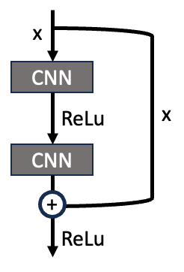
Important Deep Learning Concepts
ResNet
Developed for image classification
Allows for very deep networks without vanishing gradients
Previously used for GW detection

Slide 13
Important Deep Learning Concepts
ResNet
Developed for image classification
Allows for very deep networks without vanishing gradients
Previously used for GW detection
Normalizing Flow
A function that maps a gaussian PDF to a non-Gaussian target PDF
Parameters of the flow can be learned by a neural network
Can model complex PDF shapes
base
f1
f2
f3
…
fn
target

Slide 14
Model architecture
Model Shallow:
1 x 5 x 512
Model Deep:
1 x 16 x 2046
…

Slide 15
Model architecture
CNN2
4x 1d-conv
kernel (1 x 16),
256 filter
CNN1
4x 1d-conv
64 filter
kernel (1 x 16),
average pooling
Model Shallow:
1 x 5 x 512
256 x 5 x 256
Model Deep:
1 x 16 x 2046
256 x 16 x 256
…
CNN1 4x 1d-conv, 32 filter, kernel (1 x 16), average pooling
CNN2 4x 1d-conv, 64 filter, kernel (1 x 16), average pooling
CNN3 4x 1d-conv, 128 filte, kernel (1 x 16), average pooling
CNN4 4x 1d-conv, 256 filter, kernel (1 x 16)

Slide 16
Model architecture
ResNet Block
CNN2
4x 1d-conv
kernel (1 x 16),
256 filter
CNN1
4x 1d-conv
64 filter
kernel (1 x 16),
average pooling
He et. al, 2015
Nousi et. Al, 2023
Model Shallow:
1 x 5 x 512
256 x 5 x 256
Down sampling
256 x 16 x 16
Down sampling
128 x 32 x 32
Down sampling
512 x 8 x 8
Max Pooling
64 x 64 x 64
64 x 128 x128
Adaptive Pooling - 512
Reshape
ResNet-1
1x conv, 64 filter
Stride 2
kernel (7 x 7)
ResNet-2
3x ResNet Block
64 filter
kernel (3 x 3)
ResNet-5
3x ResNet Block
512 filter
kernel (3 x 3)
Model Deep:
1 x 16 x 2046
ResNet-3
4x ResNet Block
128 filter
kernel (3 x 3)
256 x 16 x 256
ResNet-4
6x ResNet Block
256 filter
kernel (3 x 3)
…
CNN1 4x 1d-conv, 32 filter, kernel (1 x 16), average pooling
CNN2 4x 1d-conv, 64 filter, kernel (1 x 16), average pooling
CNN3 4x 1d-conv, 128 filte, kernel (1 x 16), average pooling
CNN4 4x 1d-conv, 256 filter, kernel (1 x 16)

Slide 17
Model architecture
ResNet Block
Classifier – Shower type
Sigmoid activation
CNN2
4x 1d-conv
kernel (1 x 16),
256 filter
CNN1
4x 1d-conv
64 filter
kernel (1 x 16),
average pooling
He et. al, 2015
Nousi et. Al, 2023
Model Shallow:
1 x 5 x 512
256 x 5 x 256
Down sampling
256 x 16 x 16
Down sampling
128 x 32 x 32
Down sampling
512 x 8 x 8
Max Pooling
64 x 64 x 64
64 x 128 x128
Adaptive Pooling - 512
Reshape
ResNet-1
1x conv, 64 filter
Stride 2
kernel (7 x 7)
ResNet-2
3x ResNet Block
64 filter
kernel (3 x 3)
ResNet-5
3x ResNet Block
512 filter
kernel (3 x 3)
Model Deep:
1 x 16 x 2046
ResNet-3
4x ResNet Block
128 filter
kernel (3 x 3)
256 x 16 x 256
ResNet-4
6x ResNet Block
256 filter
kernel (3 x 3)
…
CNN1 4x 1d-conv, 32 filter, kernel (1 x 16), average pooling
CNN2 4x 1d-conv, 64 filter, kernel (1 x 16), average pooling
CNN3 4x 1d-conv, 128 filte, kernel (1 x 16), average pooling
CNN4 4x 1d-conv, 256 filter, kernel (1 x 16)

Slide 18
Model architecture
ResNet Block
Classifier – Shower type
Sigmoid activation
CNN2
4x 1d-conv
kernel (1 x 16),
256 filter
CNN1
4x 1d-conv
64 filter
kernel (1 x 16),
average pooling
He et. al, 2015
Nousi et. Al, 2023
Model Shallow:
1 x 5 x 512
256 x 5 x 256
Down sampling
256 x 16 x 16
Down sampling
128 x 32 x 32
Down sampling
512 x 8 x 8
Max Pooling
64 x 64 x 64
Normalizing Flow – Shower energy
64 x 128 x128
Posterior PDF over the energy distribution
Gaussian- ization Flow
Adaptive Pooling - 512
Reshape
ResNet-1
1x conv, 64 filter
Stride 2
kernel (7 x 7)
ResNet-2
3x ResNet Block
64 filter
kernel (3 x 3)
ResNet-5
3x ResNet Block
512 filter
kernel (3 x 3)
Model Deep:
1 x 16 x 2046
ResNet-3
4x ResNet Block
128 filter
kernel (3 x 3)
256 x 16 x 256
ResNet-4
6x ResNet Block
256 filter
kernel (3 x 3)
…
CNN1 4x 1d-conv, 32 filter, kernel (1 x 16), average pooling
CNN2 4x 1d-conv, 64 filter, kernel (1 x 16), average pooling
CNN3 4x 1d-conv, 128 filte, kernel (1 x 16), average pooling
CNN4 4x 1d-conv, 256 filter, kernel (1 x 16)

Slide 19
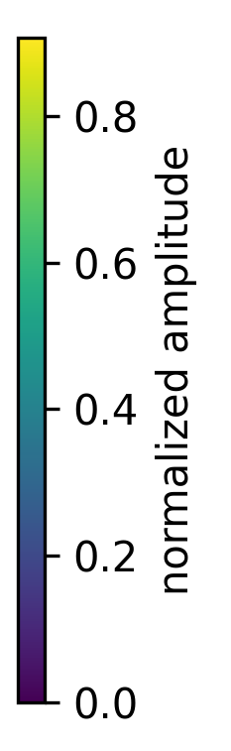
Model architecture
ResNet Block
Classifier – Shower type
Sigmoid activation
CNN2
4x 1d-conv
kernel (1 x 16),
256 filter
CNN1
4x 1d-conv
64 filter
kernel (1 x 16),
average pooling
He et. al, 2015
Nousi et. Al, 2023
Model Shallow:
1 x 5 x 512
256 x 5 x 256
Down sampling
256 x 16 x 16
Down sampling
128 x 32 x 32
Down sampling
512 x 8 x 8
Max Pooling
64 x 64 x 64
Normalizing Flow – Shower energy
64 x 128 x128
Posterior PDF over the energy distribution
Gaussian- ization Flow
Adaptive Pooling - 512
Reshape
ResNet-1
1x conv, 64 filter
Stride 2
kernel (7 x 7)
ResNet-2
3x ResNet Block
64 filter
kernel (3 x 3)
ResNet-5
3x ResNet Block
512 filter
kernel (3 x 3)
Model Deep:
1 x 16 x 2046
ResNet-3
4x ResNet Block
128 filter
kernel (3 x 3)
Normalizing Flow – Neutrino Direction
256 x 16 x 256
ResNet-4
6x ResNet Block
256 filter
kernel (3 x 3)
…
Spherical Spline Flow
Posterior PDF over the direction distribution
CNN1 4x 1d-conv, 32 filter, kernel (1 x 16), average pooling
CNN2 4x 1d-conv, 64 filter, kernel (1 x 16), average pooling
CNN3 4x 1d-conv, 128 filte, kernel (1 x 16), average pooling
CNN4 4x 1d-conv, 256 filter, kernel (1 x 16)

Slide 20
Model architecture
ResNet Block
Classifier – Shower type
Sigmoid activation
CNN2
4x 1d-conv
kernel (1 x 16),
256 filter
CNN1
4x 1d-conv
64 filter
kernel (1 x 16),
average pooling
He et. al, 2015
Nousi et. Al, 2023
Model Shallow:
1 x 5 x 512
Improvements to previous reconstructions:
One model (per station type) to predict all parameters
Normalizing flows return full posterior PDFs allowing for event-by-event uncertainties (Glüsenkamp, EPJ-C, 2024)
The model has no prior knowledge of the shower type
No analysis cuts are needed – all neutrino events can be used
256 x 5 x 256
Down sampling
256 x 16 x 16
Down sampling
128 x 32 x 32
Down sampling
512 x 8 x 8
Max Pooling
64 x 64 x 64
Normalizing Flow – Shower energy
64 x 128 x128
Posterior PDF over the energy distribution
Gaussian- ization Flow
Adaptive Pooling - 512
Reshape
ResNet-1
1x conv, 64 filter
Stride 2
kernel (7 x 7)
ResNet-2
3x ResNet Block
64 filter
kernel (3 x 3)
ResNet-5
3x ResNet Block
512 filter
kernel (3 x 3)
Model Deep:
1 x 16 x 2046
ResNet-3
4x ResNet Block
128 filter
kernel (3 x 3)
Normalizing Flow – Neutrino Direction
256 x 16 x 256
ResNet-4
6x ResNet Block
256 filter
kernel (3 x 3)
…
Spherical Spline Flow
Posterior PDF over the direction distribution
CNN1 4x 1d-conv, 32 filter, kernel (1 x 16), average pooling
CNN2 4x 1d-conv, 64 filter, kernel (1 x 16), average pooling
CNN3 4x 1d-conv, 128 filte, kernel (1 x 16), average pooling
CNN4 4x 1d-conv, 256 filter, kernel (1 x 16)

Slide 21
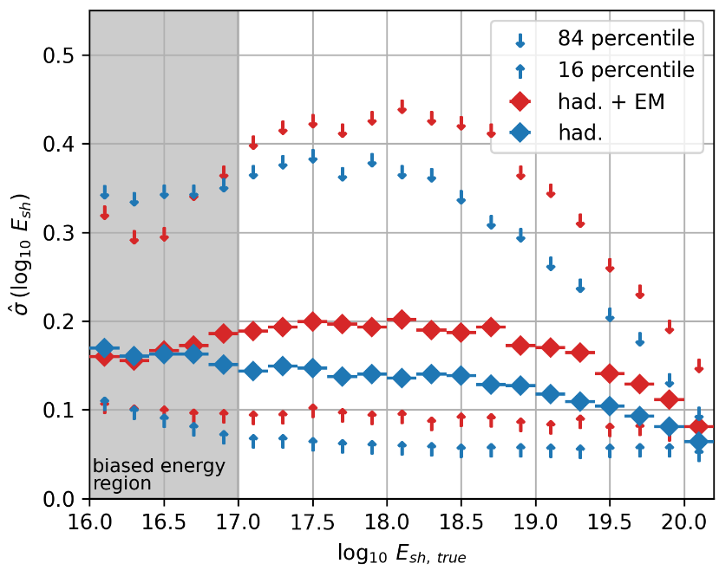
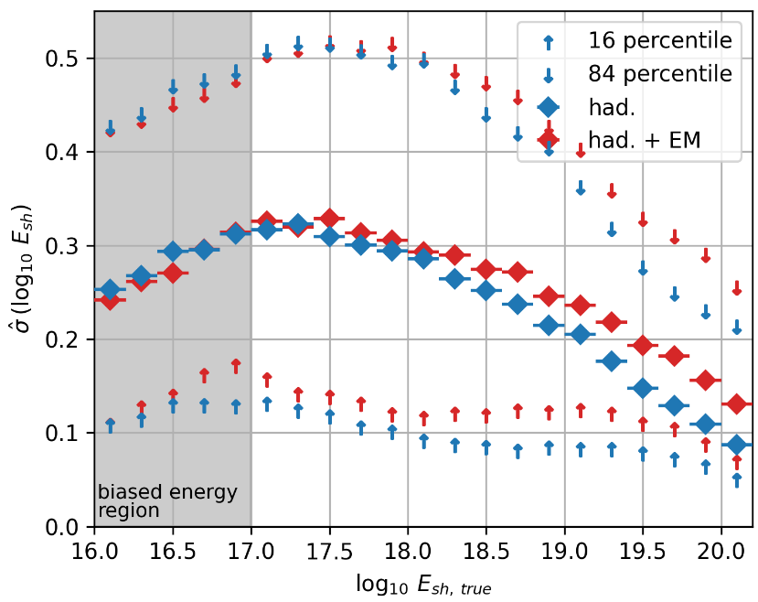
Results – Shower Energy
deep station
Median uncertainty at 1EeV shower energy
  Deep: ~0.15 log E (~0.2 log E ) for had. (+EM)
  Shallow: ~0.3 log E (~0.3 log E ) for had. (+EM)
Substantial improvement to previous reconstructions
  Deep: Improved resolution without quality cuts (RNO-G, EPJ-C, 2022)
  Shallow: Reduction in bias from ±0.4 log E to ±0.03 log E (Glaser et al., Astroparticle Physics, 2022)
Well-understood edge effect at low energies
shallow station

Slide 22
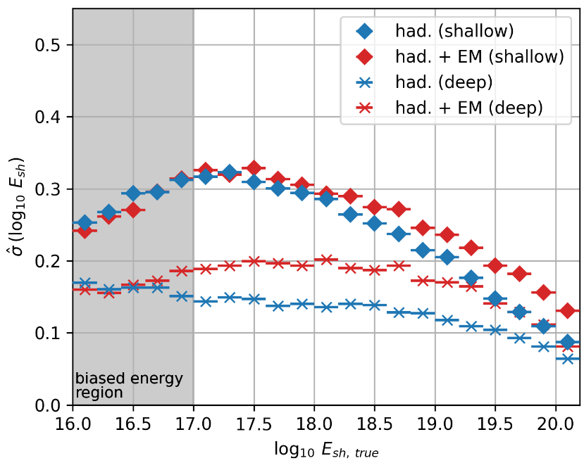
Results – Shower Energy
shallow station
Median uncertainty at 1EeV shower energy
  Deep: ~0.15 log E (~0.2 log E ) for had. (+EM)
  Shallow: ~0.3 log E (~0.3 log E ) for had. (+EM)
Substantial improvement to previous reconstructions
  Deep: Improved resolution without quality cuts (RNO-G, EPJ-C, 2022)
  Shallow: Reduction in bias from ±0.4 log E to ±0.03 log E (Glaser et al., Astroparticle Physics, 2022)
Well-understood edge effect at low energies
deep station

Slide 23
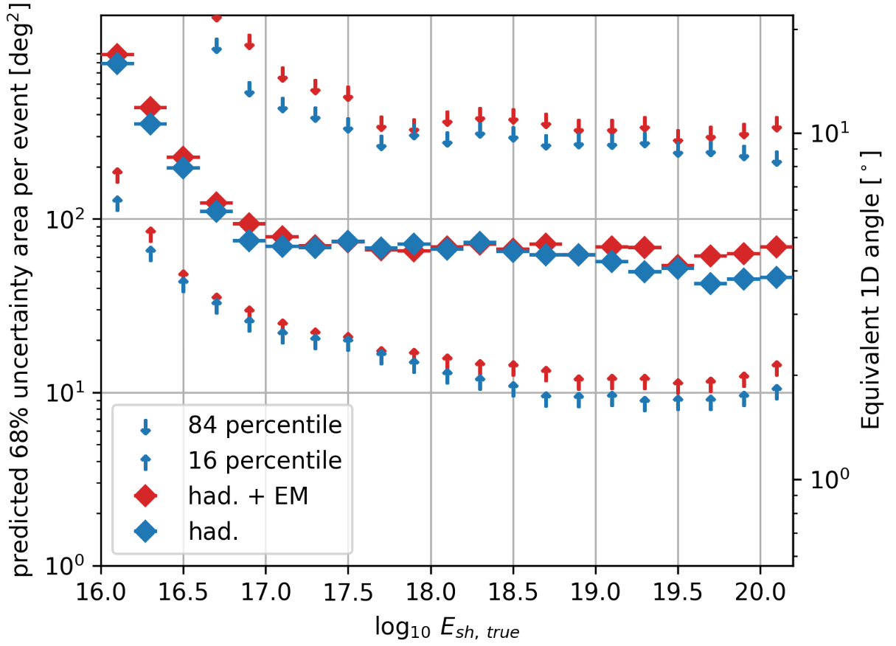
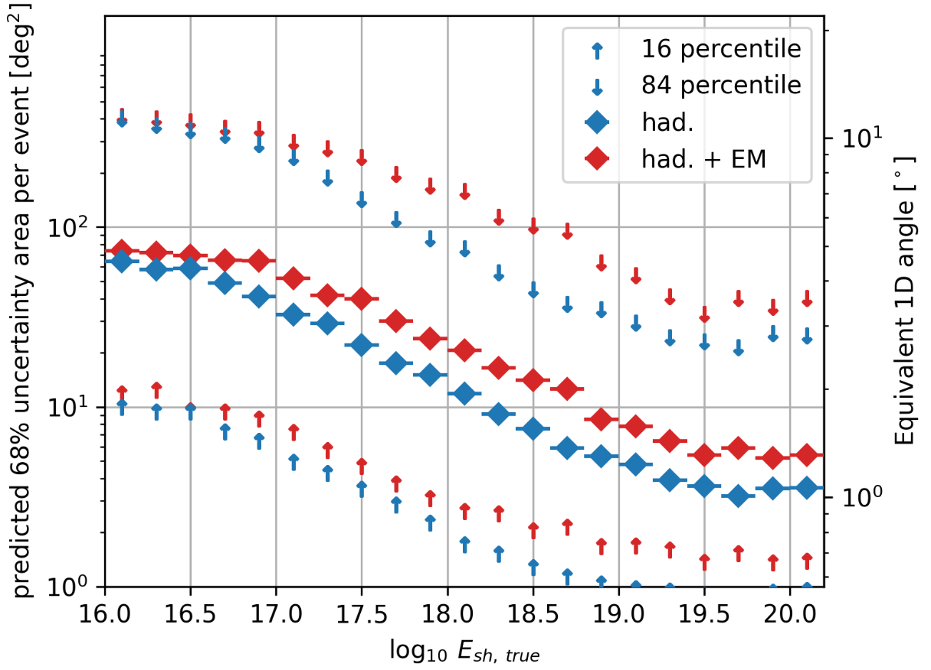
Results – Neutrino Direction
deep station
Median uncertainty area at 1EeV shower energy
  Deep: ~70 deg² (~70 deg² ) for had. (+EM)
  Shallow: ~10 deg² (~20 deg² ) for had. (+EM)
Substantial improvement to previous reconstructions
  Deep: ~10x reduction in uncertainty area (IceCube Gen2, PoS, 2023; Plaisier et al., EPJ-C, 2023)
  Shallow: ~2° reduction in uncertainty (Glaser et al., Astroparticle Physics, 2022)
shallow station

Slide 24
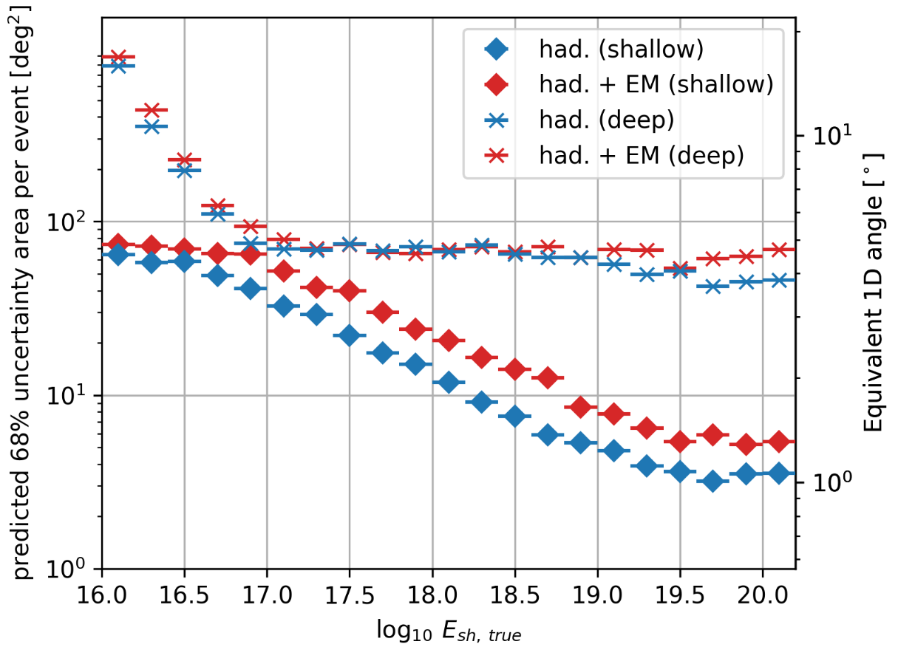
Results – Neutrino Direction
Median uncertainty area at 1EeV shower energy
  Deep: ~70 deg² (~70 deg² ) for had. (+EM)
  Shallow: ~10 deg² (~20 deg² ) for had. (+EM)
Substantial improvement to previous reconstructions
  Deep: ~10x reduction in uncertainty area (IceCube Gen2, PoS, 2023; Plaisier et al., EPJ-C, 2023)
  Shallow: ~2° reduction in uncertainty (Glaser et al., Astroparticle Physics, 2022)
deep station
shallow station

Slide 25
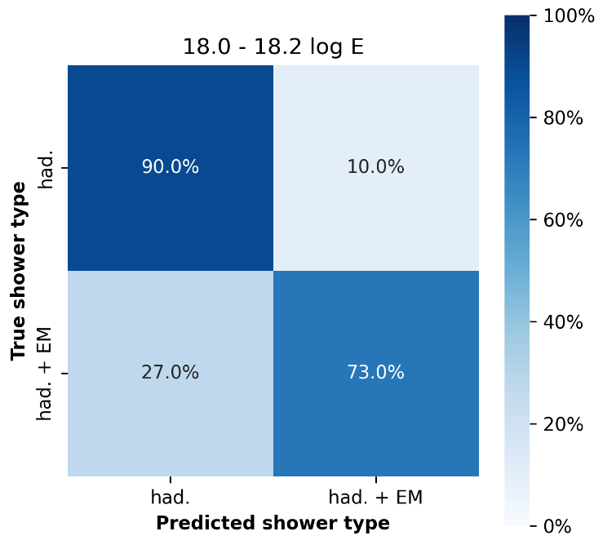
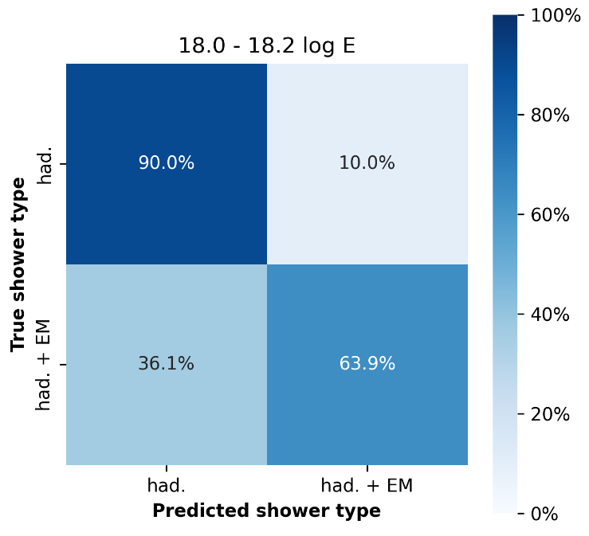
Results – Shower Type
deep station
Correctly identified had. + EM showers (true positive) at 1EeV shower energy
  Deep: ~73 % at 10% false positive rate
  Shallow: ~64 % at 10% false positive rate
Classification improves with energy due to the LPM effect
Comparable performance to previous results (Ericsson, Thesis, 2021)
The information about the shower type can be used to constrain the flavor ratio at earth/sources (Coleman et. al, arXiv, 2024)
shallow station

Slide 26
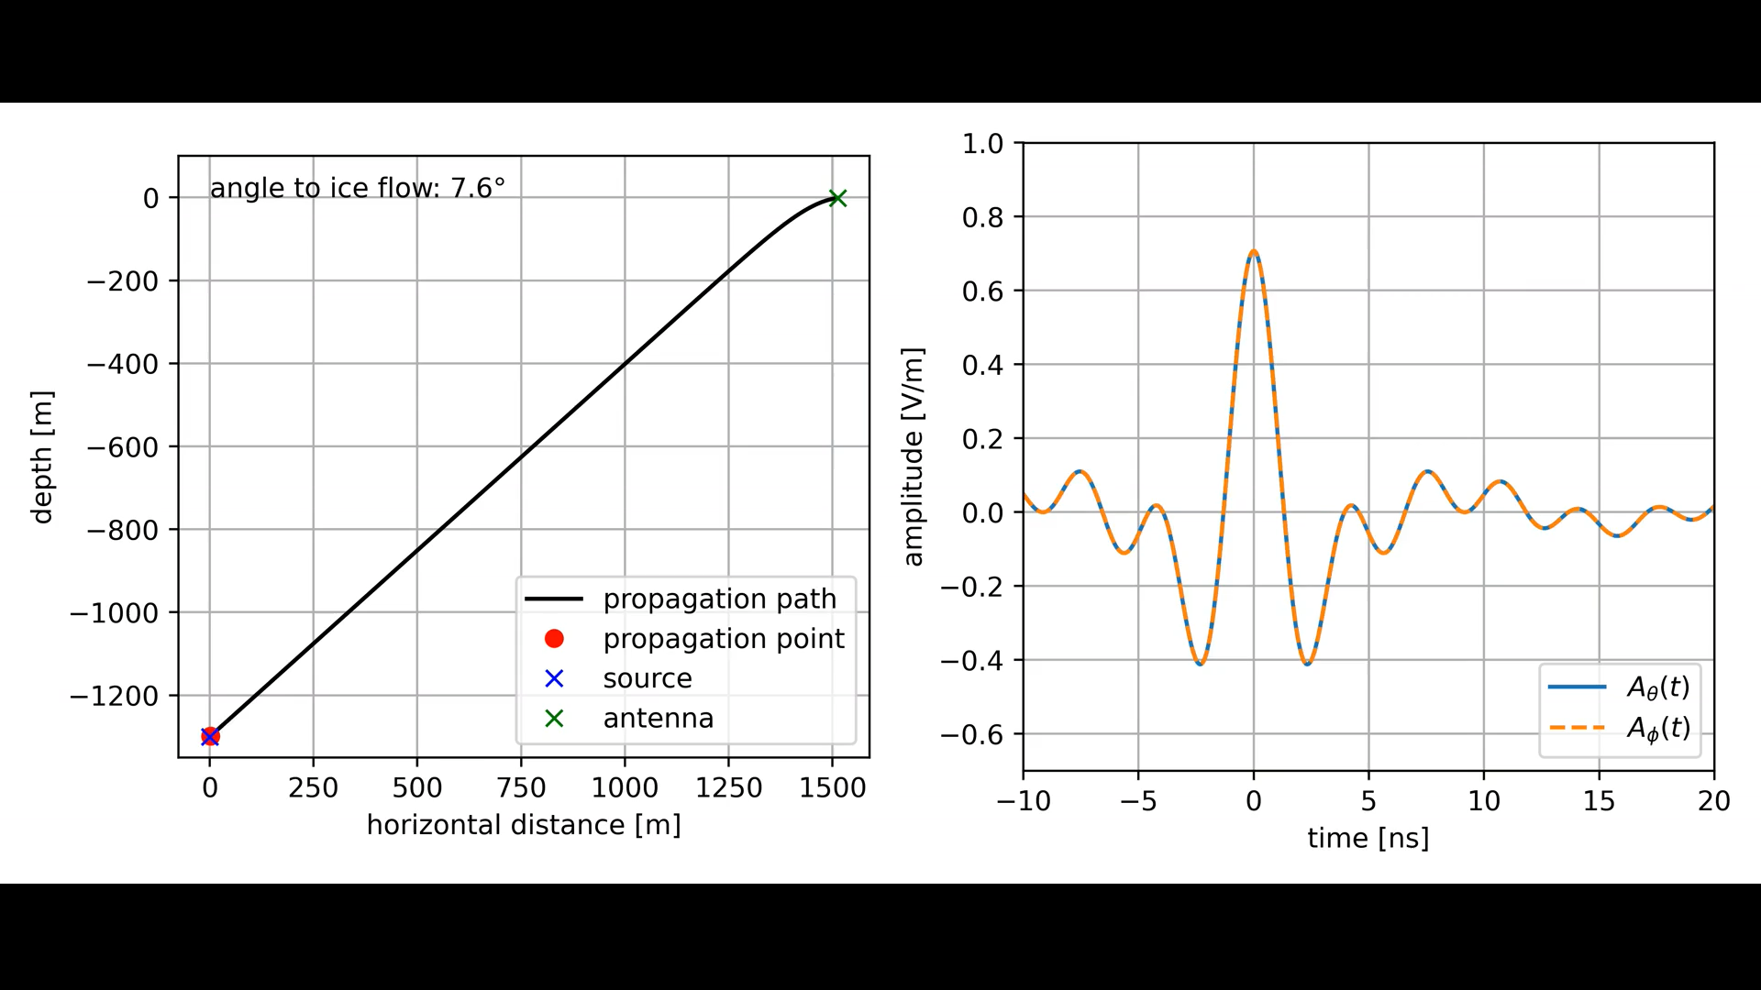
Birefringence Affecting Reconstruction
Birefringence model calculated from 1st principles
Fully integrated into NuRadioMC
Re-simulated all events with birefringence and repeated the reconstruction
Re-simulation introduces a bias which was evaluated to be small
Heyer & Glaser, EPJ-C, 2023; Heyer & Glaser, ARENA-PoS, 2022
Two significant changes to the pulse shape:
  A time delay between theta and phi components
  A changing pulse polarization

Slide 27
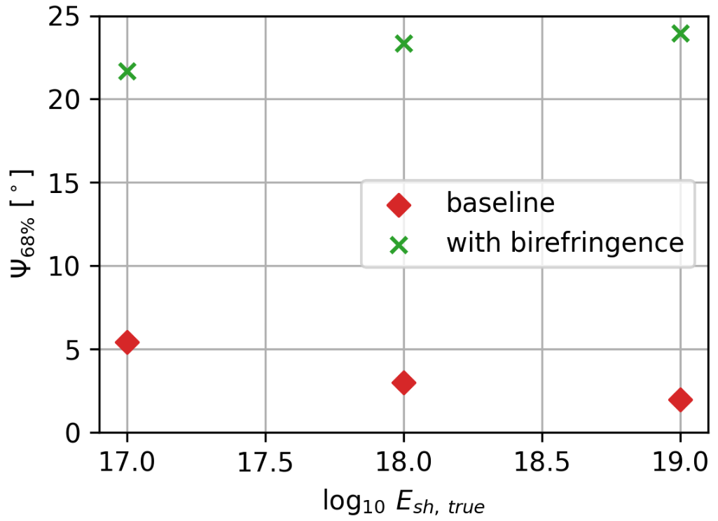
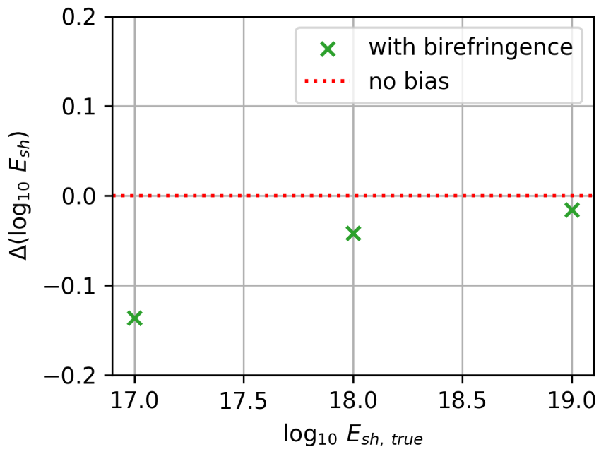
Birefringence Affecting Reconstruction
Testing the reconstruction on data that includes the birefringence effect
→ large direction uncertainty and energy bias
energy bias of up to 0.15 log(E)
direction uncertainty of up to 25°

Slide 28
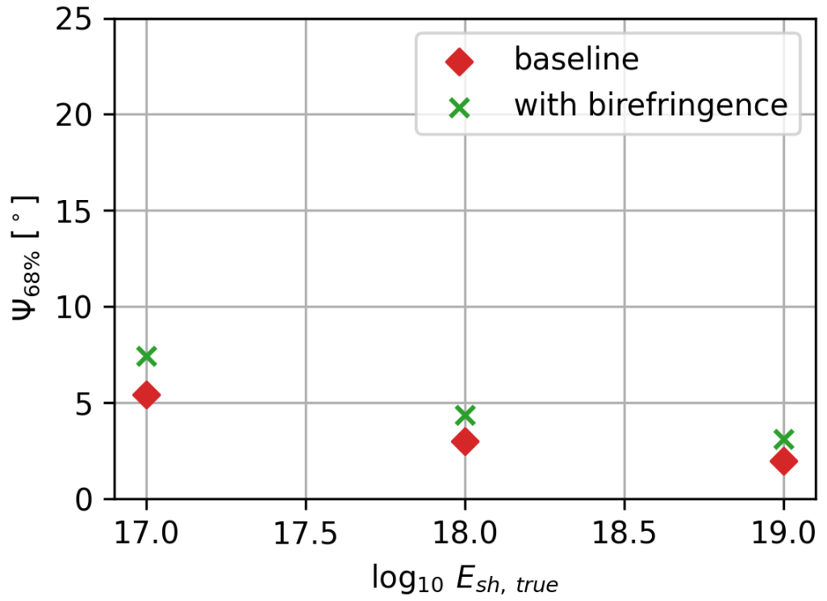
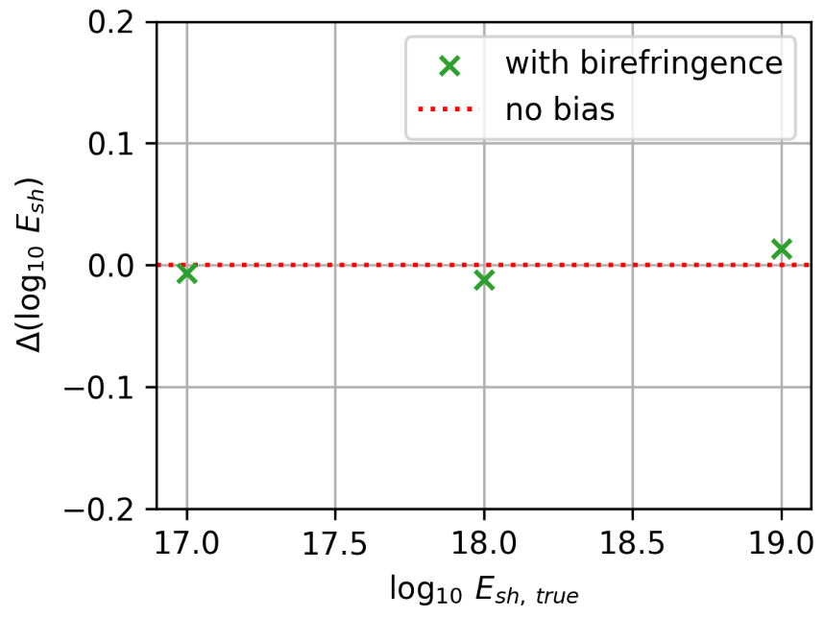
Correcting for Birefringence
Testing the reconstruction on data that includes the birefringence effect
→ large direction uncertainty and energy bias
Training & Testing the reconstruction on data that includes the birefringence effect
→ small direction uncertainty and no energy bias
energy bias of up to 0.15 log(E)
energy bias negligible
direction uncertainty of up to 25°
direction uncertainty of about to 2°

Slide 29
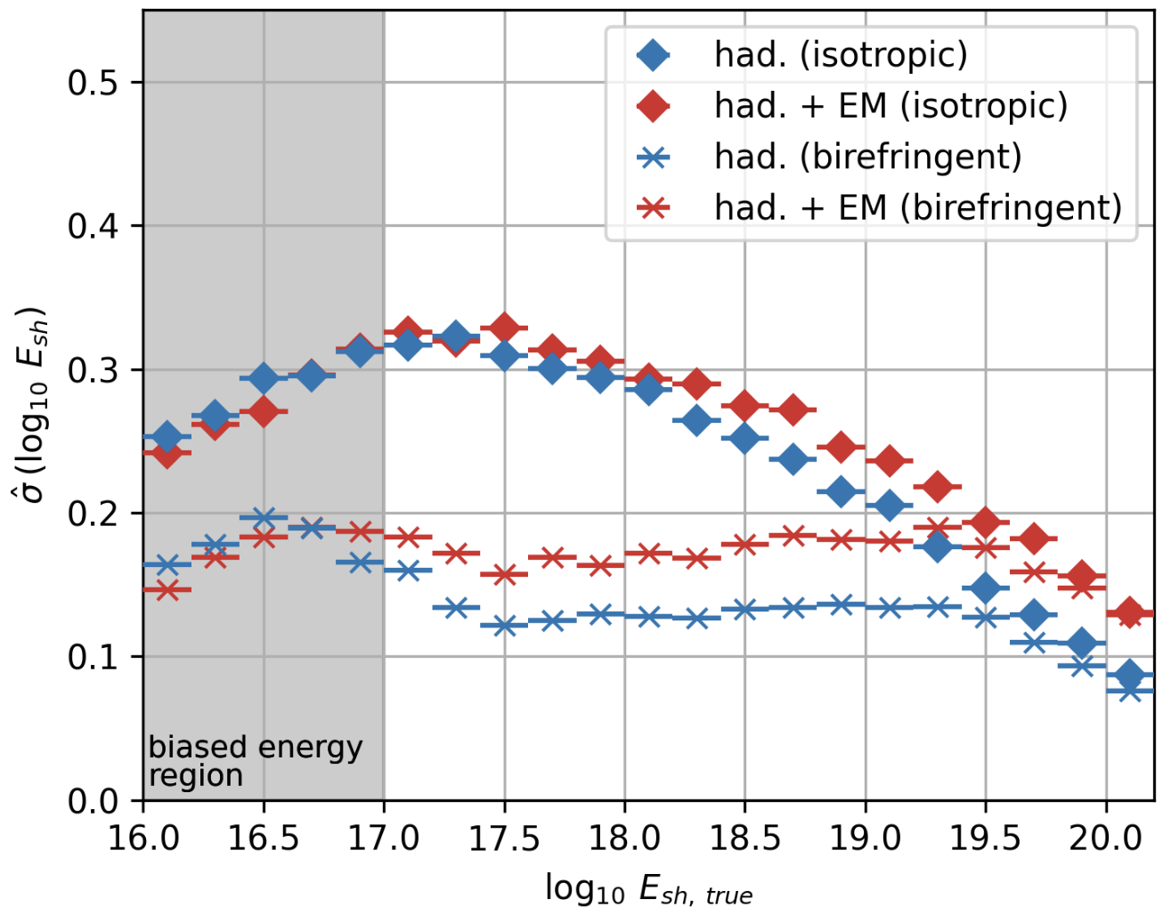
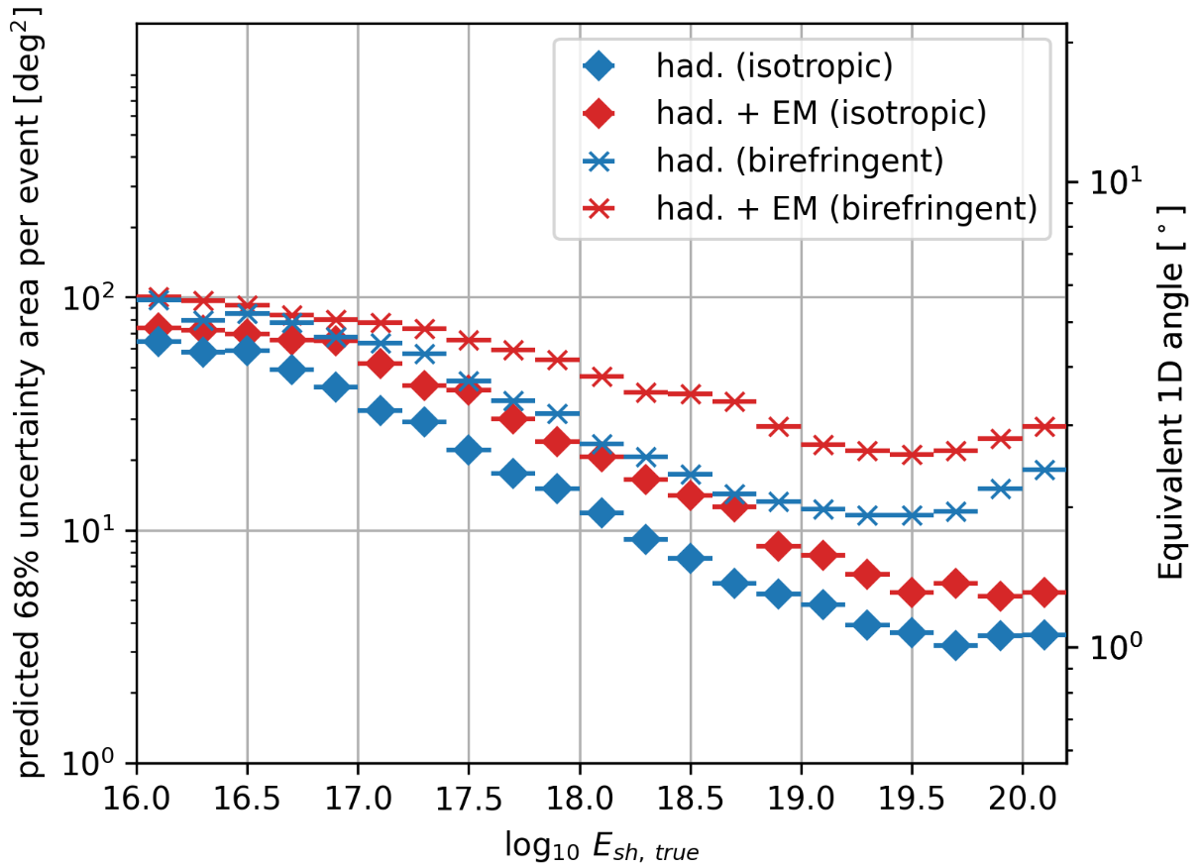
Correcting for Birefringence
shallow station
isotropic
Median uncertainty at 1EeV shower energy
  Energy: ~0.13 log E (~ 0.18 log E ) for had. (+EM)
  Direction: ~20 deg² (~50 deg² ) for had. (+EM)
The energy resolution improves by a factor of 2
  points to a better vertex reconstruction from the birefringence time delay
The direction resolution worsens by a factor of 2-3
birefringent
shallow station
birefringent
isotropic

Slide 30
Summary
One model (per station type) to predict all parameters
Prediction of the full posterior PDF → event-by-event uncertainties
Substantial improvement over previous work
Resolution at 1EeV shower energy:
The effect of birefringence on the reconstruction was studied
  Has a large effect when neglected in the reconstruction
  Can be corrected for by including it in the training data
Resolution at 1EeV (had.) | Shallow Station | Deep Station
68% Uncertainty size | ~10 deg² | ~70 deg²
Shower Energy | 0.3 log E | 0.15 log E

Slide 31
Backup

Slide 32
Outlook
Better performance is possible with further hyperparameter tuning
Study the impact of systematics and birefringence on a deep station
In principle it is possible to make the model robust against systematics
  Would require an order of magnitude more simulations
  For every simulated event we sample for every antenna position, ice model parameter, amplifier response, … (with potential correlations)
  The resulting predicted uncertainty contours would not only include statistical uncertainties but systematic uncertainties too
The model is fully differentiable -> can allow for a systematic optimization of the station layout via gradient descent

Slide 33
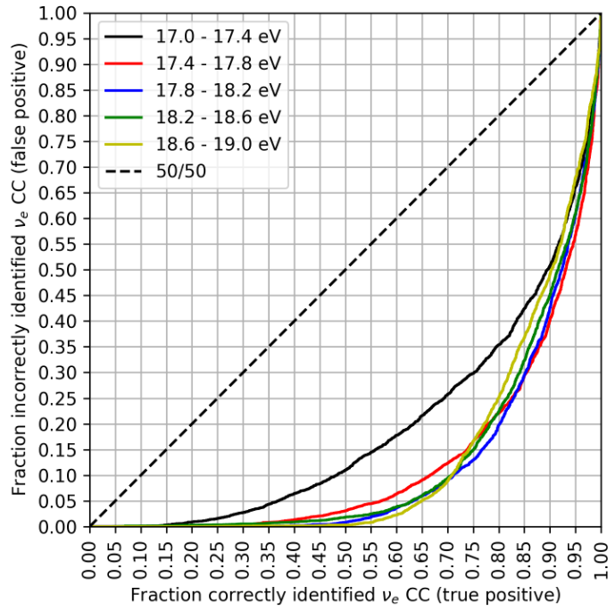
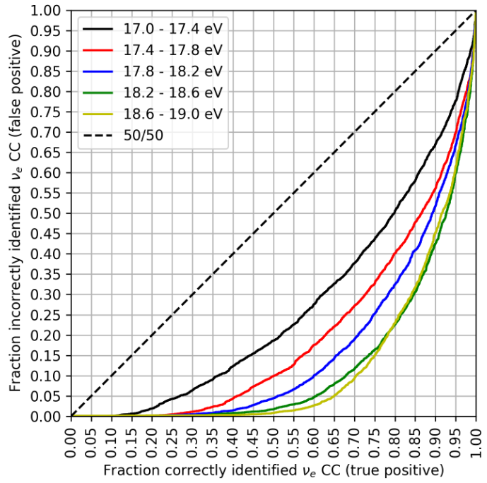
Results – Shower Type
deep station
Correctly identified had. + EM showers (true positive) at 1EeV shower energy
  Deep stations: ~70 % at 10% false positive rate
  Shallow stations: ~60 % at 10% false positive rate
Classification improves with energy due to the LPM effect
Comparable performance to previous results (Ericsson, 2021)
The information about the shower type can be used to constrain the flavor ratio at earth/sources (Coleman et. al, 2024)
shallow station

Slide 34
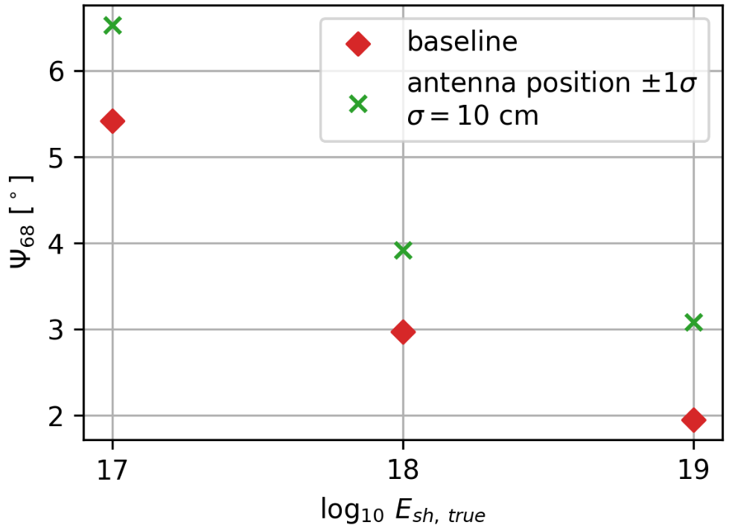
Estimation of Systematic Uncertainties
So far the systematic uncertainties have only been studied for shallow stations
To test systematics with a deep learning model the test data has to incorporate systematic changes in the simulation.
Preliminary Results
Systematic change | Direction uncertainty (1EeV) | Log Energy bias (1EeV)
1% ice model parameters | 0.5° | 0.3
5% ice model parameters | 9° | 0.5
3 cm antenna positions | 0° | 0.01
10 cm antenna positions | 1° | 0.02
10 MHz frequency response shift | 30° | 0.3
10% change in VEL | 0.2° | 0.05

Slide 35
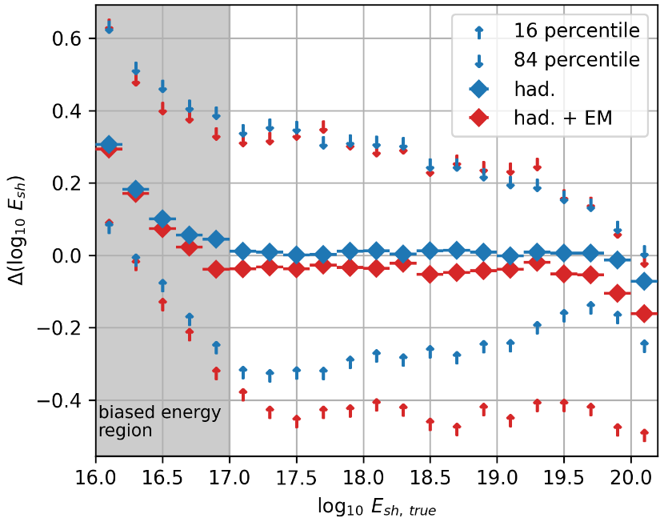
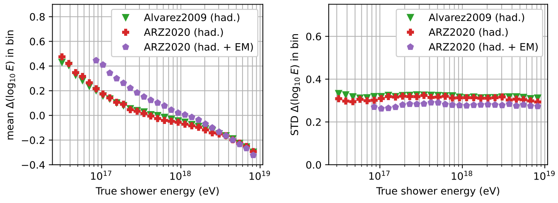
Results – Shower Energy
Shallow Station vs. Previous Results
The previous analysis assumed perfect knowledge of the interaction type of an event
The previous reconstruction did not have event-by-event uncertainties
The previous analysis used 40 times for data but with a non-uniform energy spectrum
Careful when comparing the plots as the x-axis shows slightly different things
  For had. +EM events the shower energy is equal to the neutrino energy
CC events | 0.1 EeV | 1 EeV | 10 EeV
New analysis | Bias = -0.03 std = 0.35 | Bias = -0.03 std = 0.4 | Bias = -0.03 std = 0.4
Previous analysis | Bias = 0.4 std = 0.28 | Bias = 0.03 std = 0.28 | Bias = -0.4 std = 0.28
Glaser et. al, 2022

Slide 36
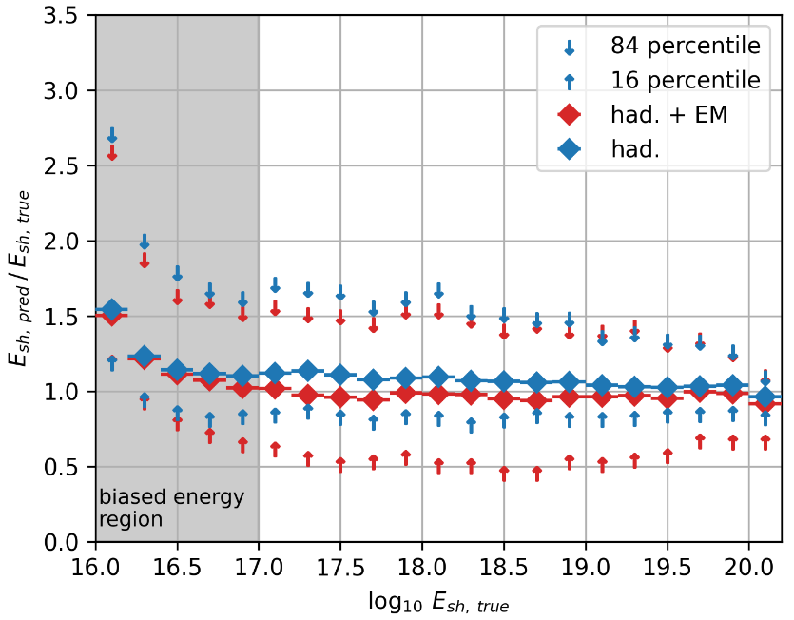
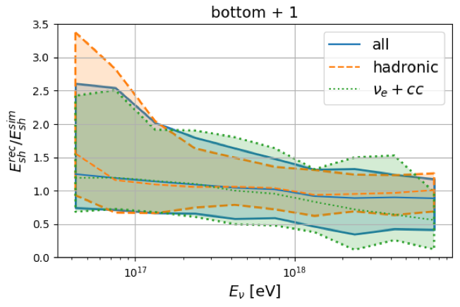
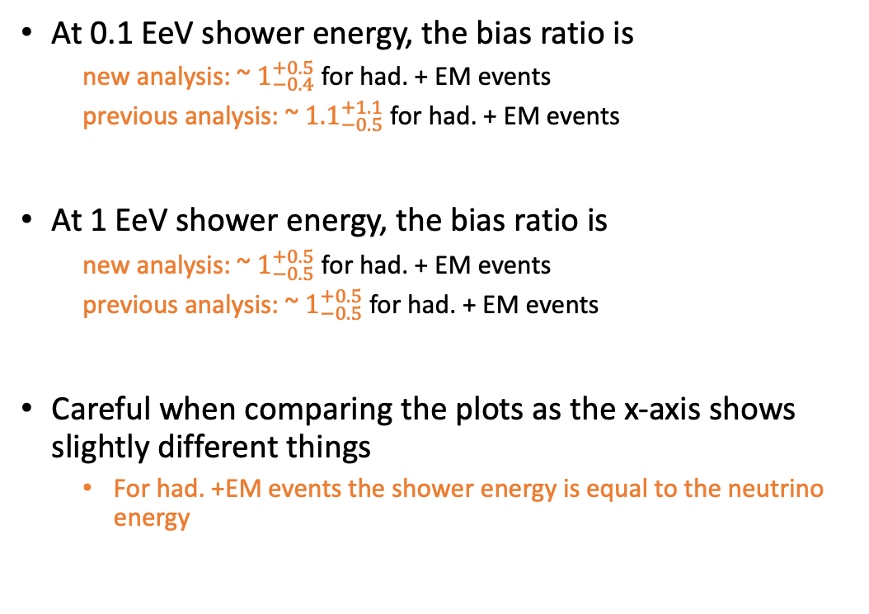
Results – Shower Energy
Deep Station vs. Previous Results
At 0.1 EeV shower energy, the bias ratio is
  new analysis: ~ $1_{−0.4}^{+0.5}$ for had. + EM events
  previous analysis: ~ ${1.1}_{−0.5}^{+1.1}$ for had. + EM events
At 1 EeV shower energy, the bias ratio is
  new analysis: ~ $1_{−0.5}^{+0.5}$ for had. + EM events
  previous analysis: ~ $1_{−0.5}^{+0.5}$ for had. + EM events
Careful when comparing the plots as the x-axis shows slightly different things
  For had. +EM events the shower energy is equal to the neutrino energy
RNO-G, 2022

Slide 37
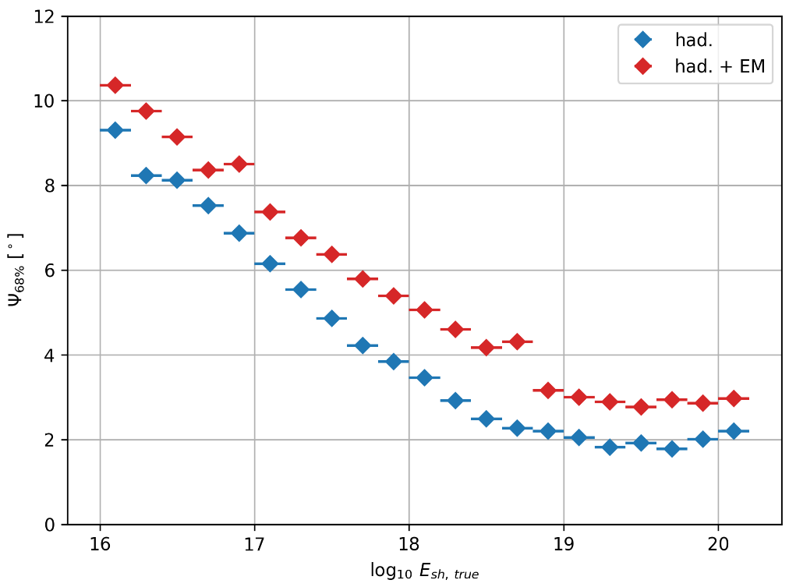
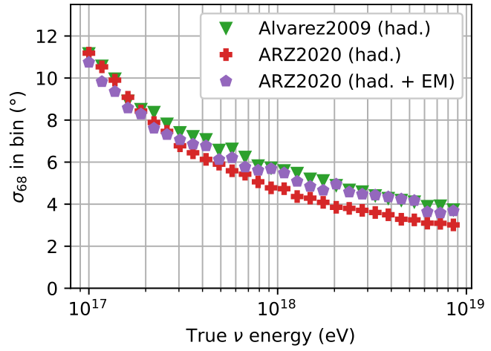
Results – Neutrino Direction
Shallow Station vs. Previous Results
At 1EeV shower energy, the space angle difference is
  new analysis: ~5° for had. +EM events
  previous analysis: ~6° for had. +EM events
The previous analysis assumed perfect knowledge of the interaction type of an event
The previous reconstruction did not have event-by-event uncertainties
The previous analysis used 40 times for data but with a non-uniform energy spectrum
Careful when comparing the plots as the x-axis shows slightly different things
  For had. +EM events the shower energy is equal to the neutrino energy
Glaser et. al, 2022

Slide 38
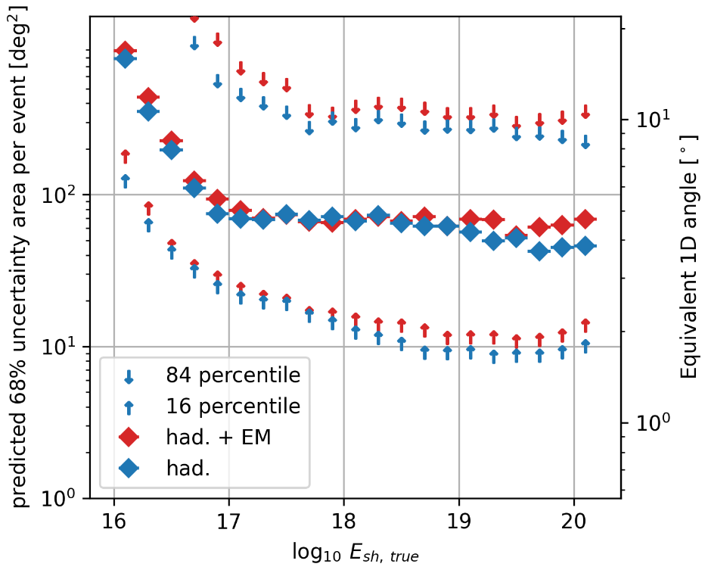
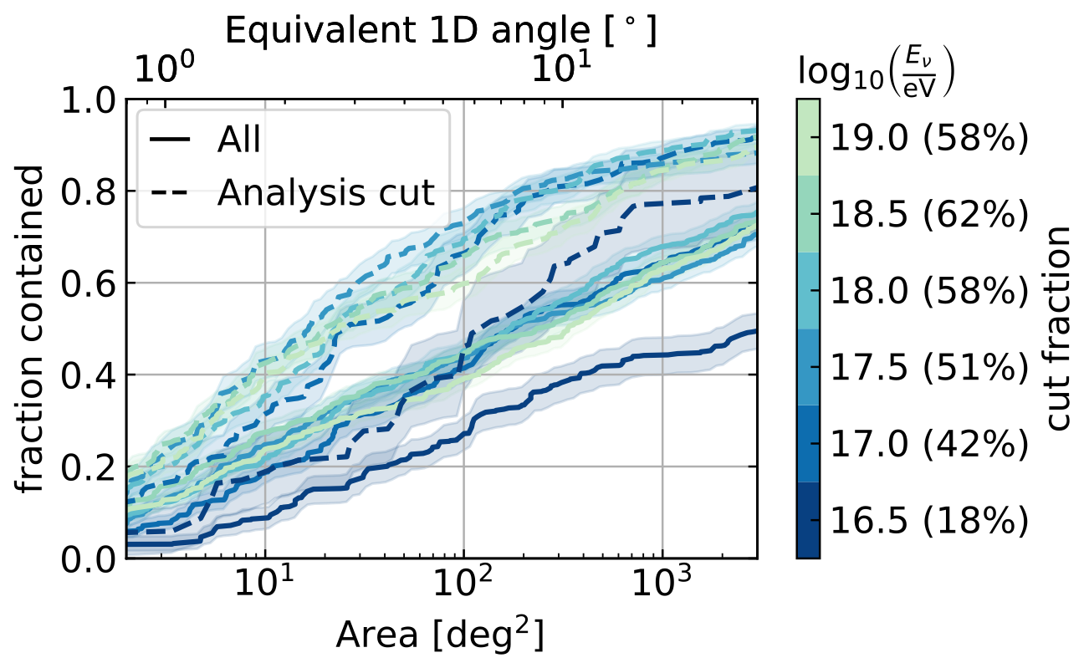
Results – Neutrino Direction
Deep Station vs. Previous Results
Careful when comparing these!
New analysis:
  median 68th percentile contour
  Uses the shower energy (same as neutrino energy for had. + EM events)
  ~70 deg² for deep stations for events at 1EeV
Previous analysis:
  68th percentile reconstruction error
  Uses the neutrino energy (same as shower energy for had. + EM events)
  ~1000 deg² for deep stations for events at 1EeV
IceCube Gen2, 2023

Slide 39
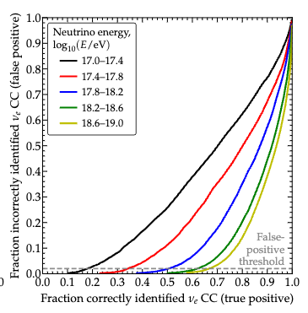
Results – Flavor
Shallow Station vs. Previous Results
At 1EeV shower energy, the true positive rate is
  new analysis: ~60 % at 10% false positive rate
  previous analysis: ~65 % at 10% false positive rate
The previous analysis used 40 times for data but with a non-uniform energy spectrum
The overall ‘area-under-the-ROC-curve’ is smaller for the new analysis but the previous analysis was better at low false positive rates
  This can be attributed to the different energy spectrum used
Coleman et. al, 2024

Slide 40
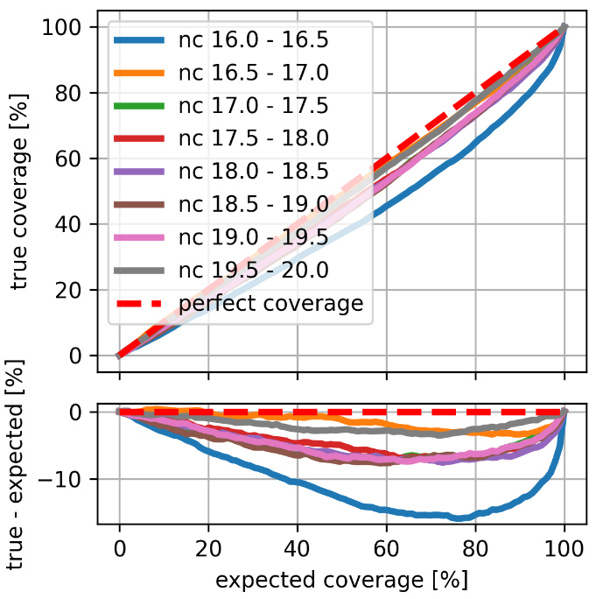
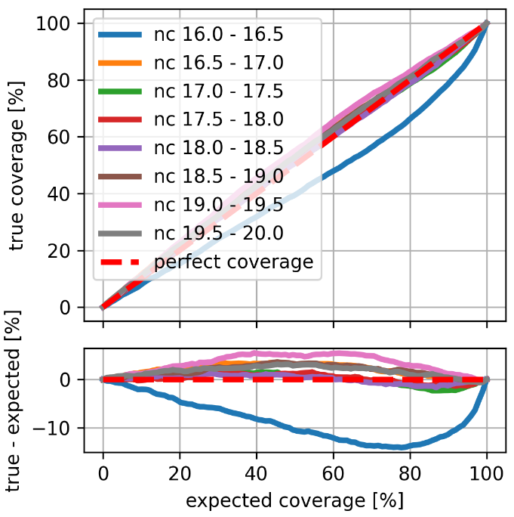
Coverage
- Shower Energy Reconstruction
Shallow Deep

Slide 41
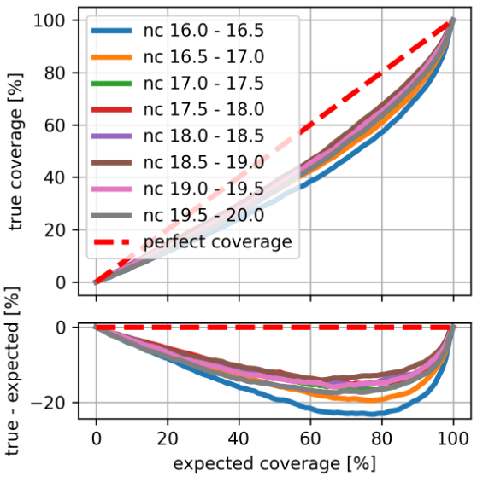
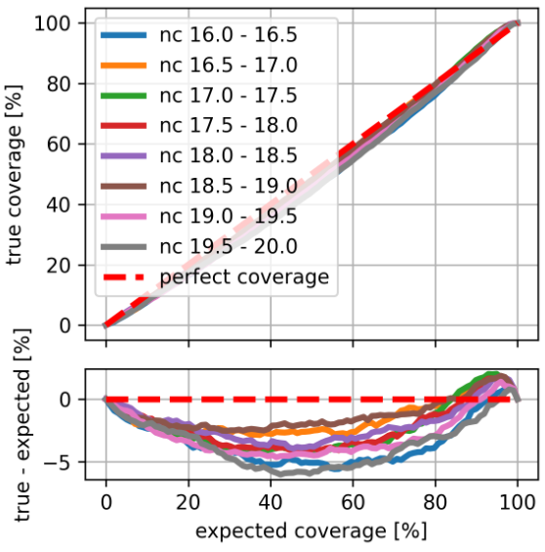
Coverage
- Neutrino Direction Reconstruction
Shallow Deep

Slide 42
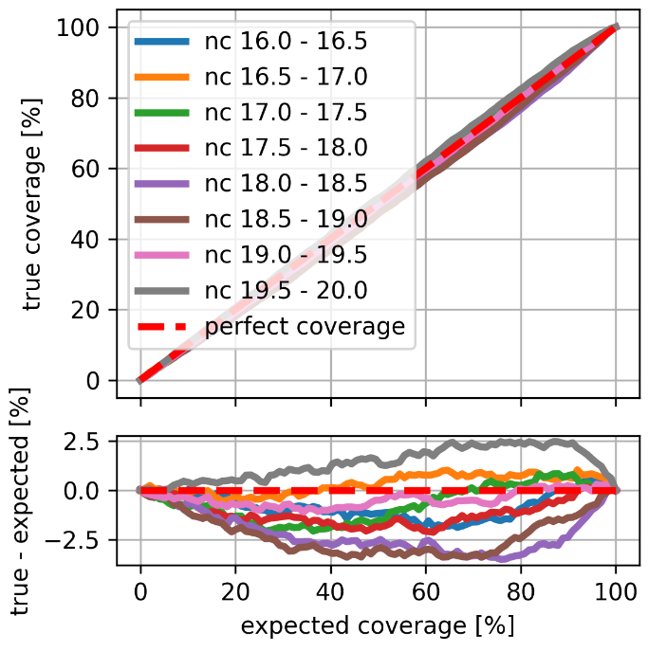
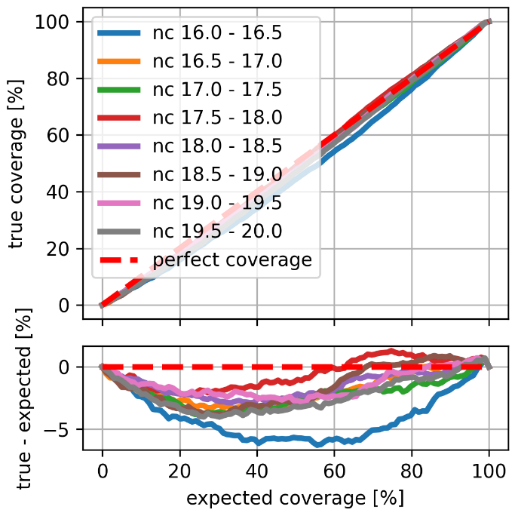
Coverage Birefringence
Energy Direction

Slide 43
Birefringence Affecting Reconstruction
Birefringence model calculated from 1st principles
Fully integrated into NuRadioMC
Re-simulated all events with birefringence and repeated the reconstruction
Re-simulation introduces a bias which was evaluated to be small
Heyer & Glaser, EPJ-C, 2023; Heyer & Glaser, ARENA-PoS, 2022
Two significant changes to the pulse shape:
  A time delay between theta and phi components
  A changing pulse polarization

Slide 44
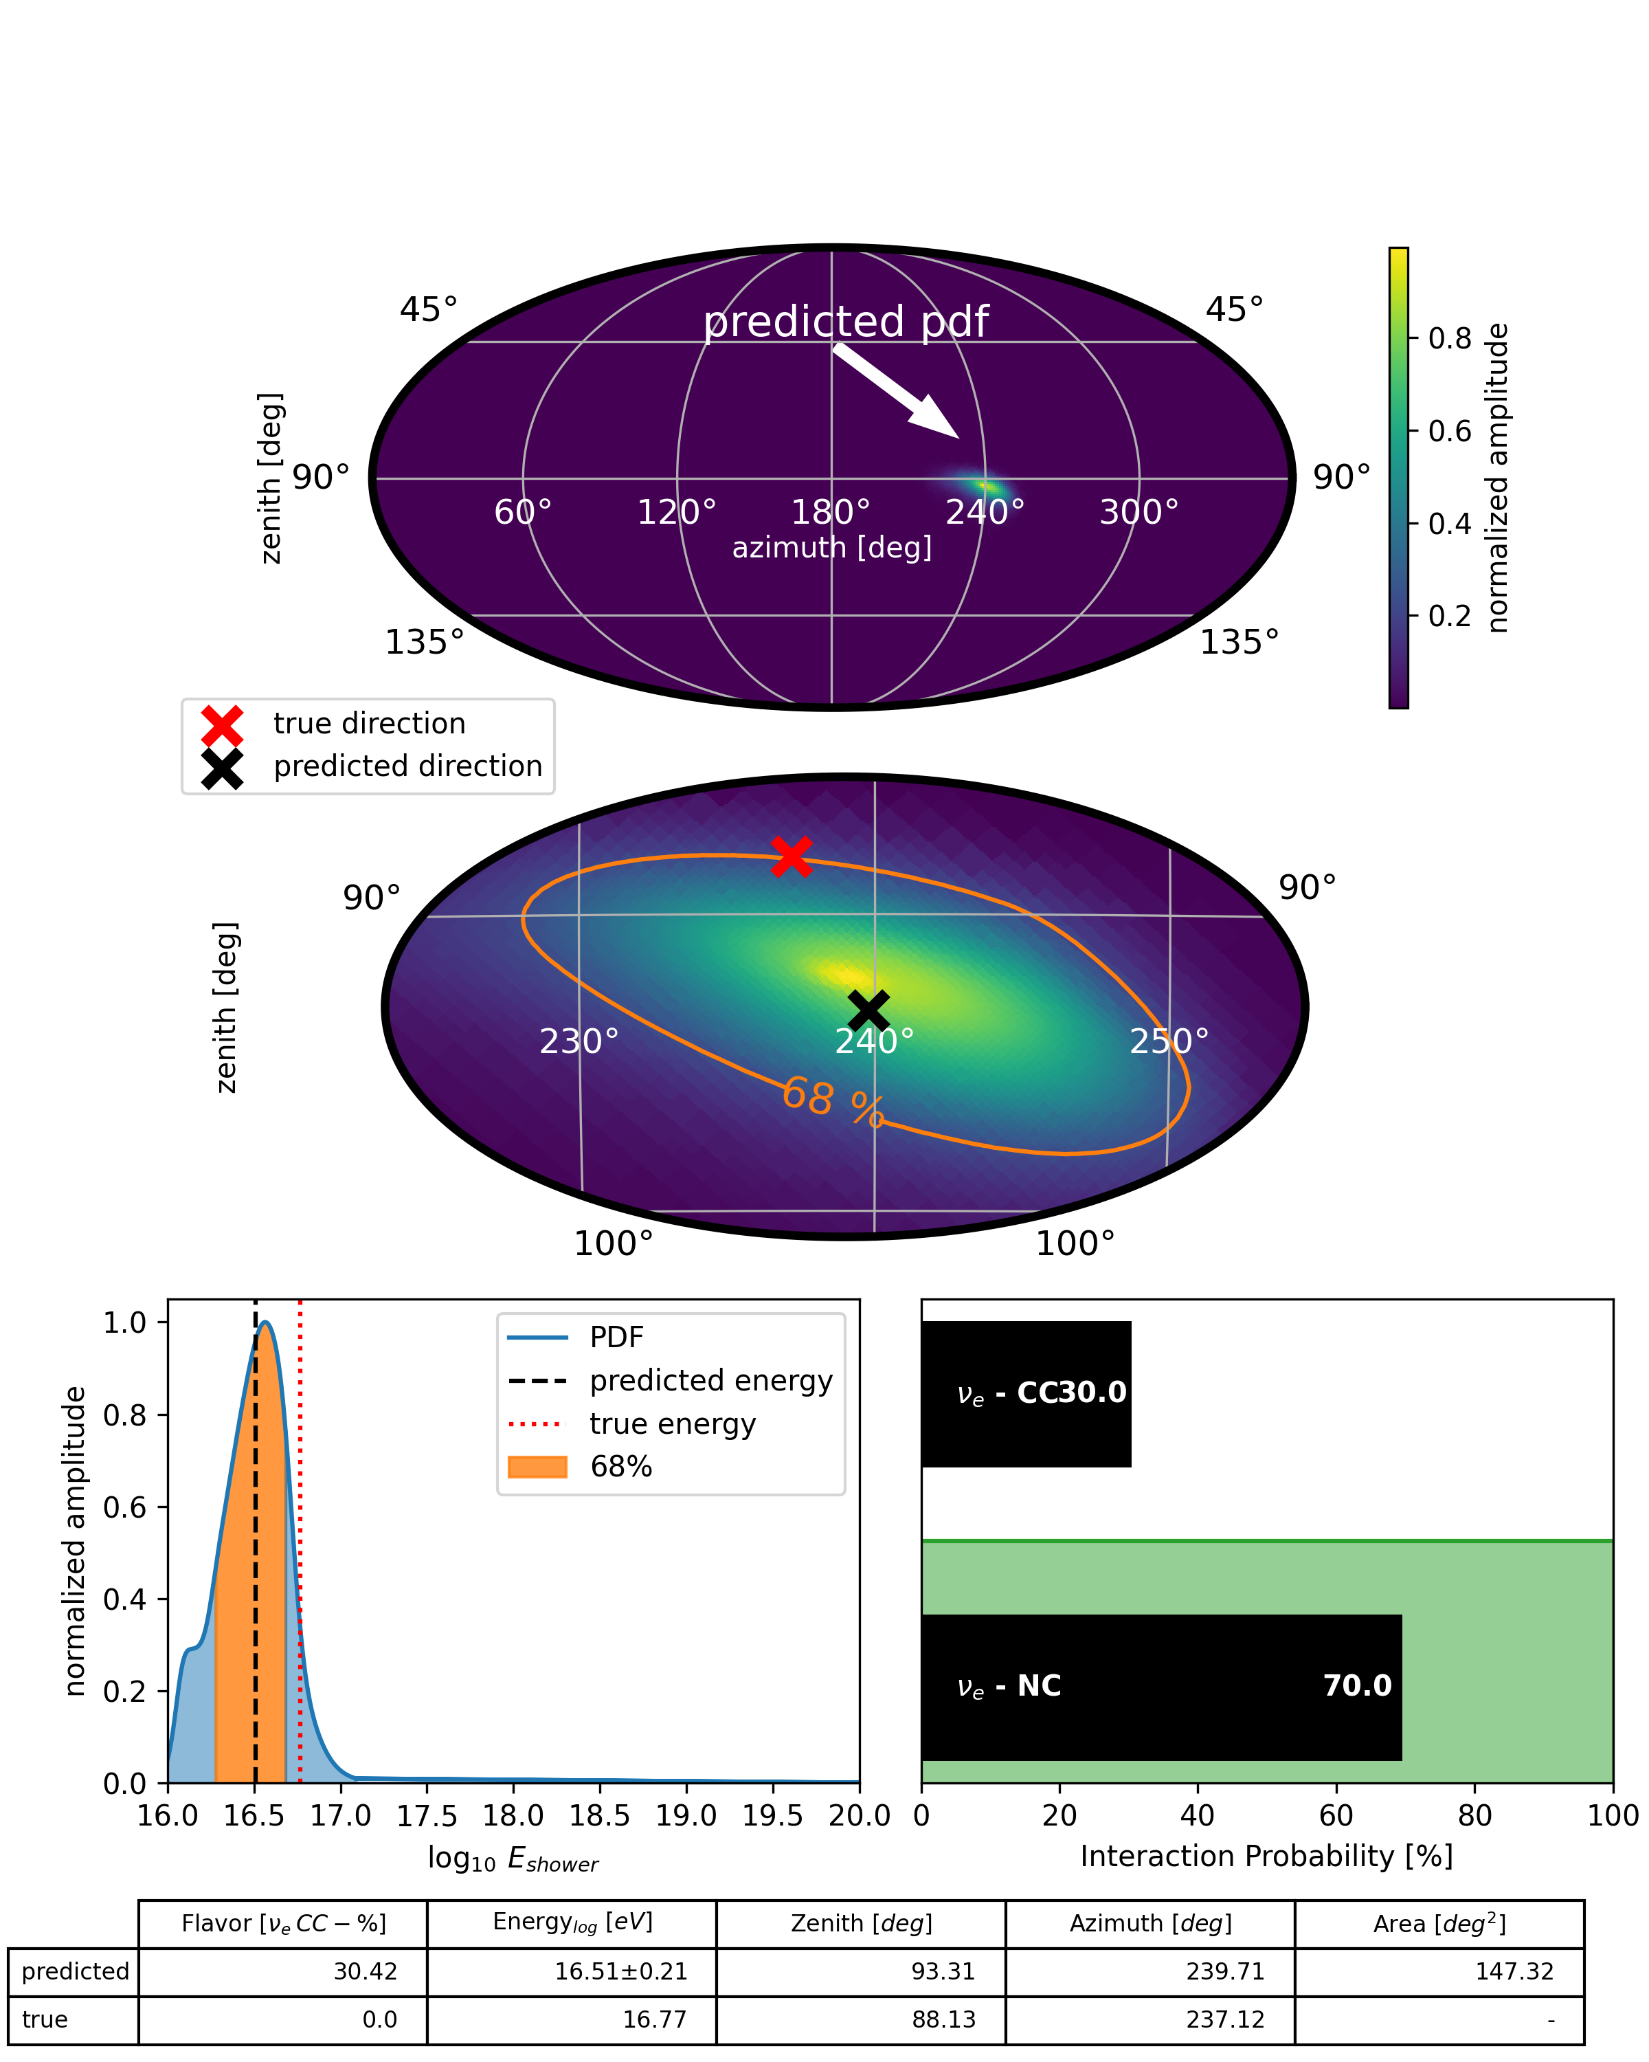
What will we do after measuring the first neutrino?
Single Event Reconstruction
direction
raw traces
reconstruction algorithm
energy
flavor
Glaser et. al, 2022

