Slide 1


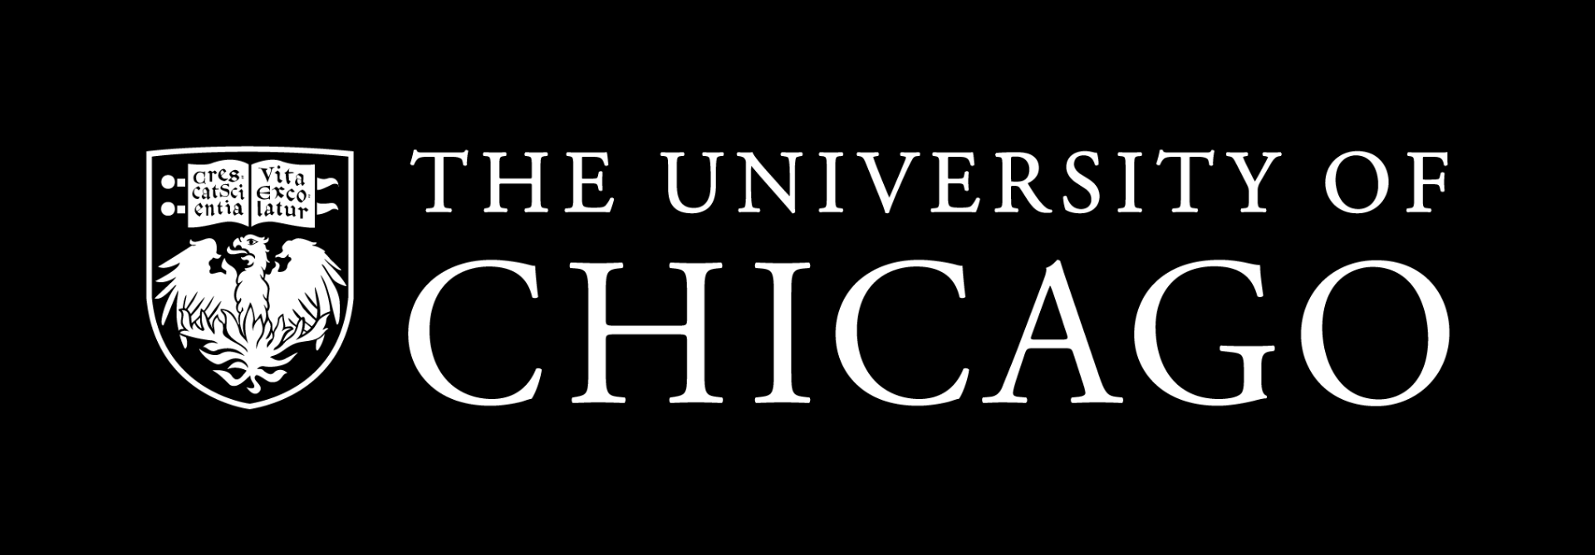
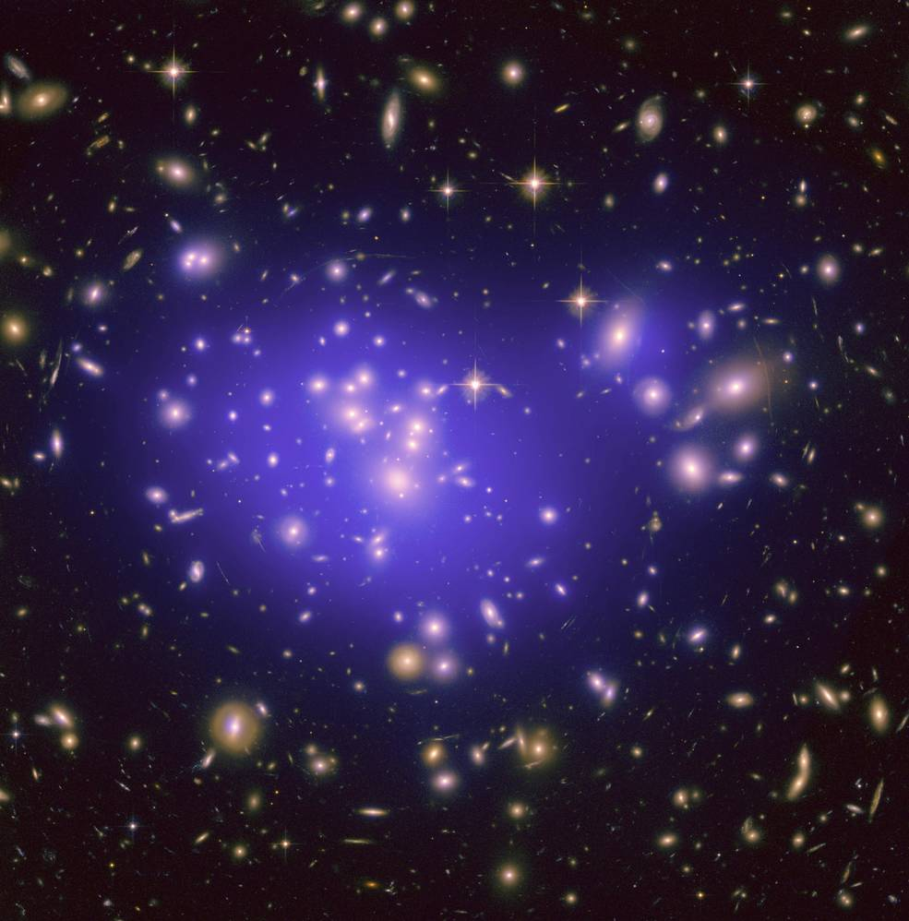
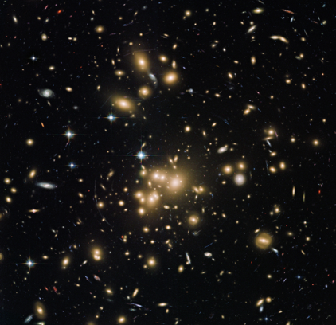
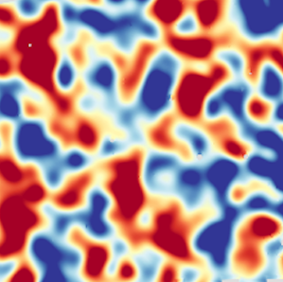
Cosmological constraints from joint analyses of clusters, galaxies, and weak lensing
Chun-Hao To
and DES cluster working group
Schmidt Fellow at the University of Chicago
2503.13631 / 2503.13632 (PRD accepted)
Notes:
This talk I will talk about how galaxy clusters, the largest virialized structure on the sky, can be used to understand our universe and how we can combine their information with other cosmological probes in DES.

Slide 2
Why measure cosmic structure?
Cosmic structure forms as a result of gravitational collapse competing with the expansion of the universe.
Amplitude of cosmic structure depends on
  The laws of gravity
  The energy content of the universe and their interactions
  (e.g. dark matter, neutrinos, etc.)

Slide 3
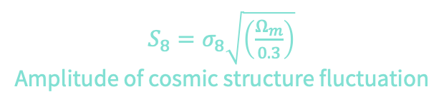

Current status on structure measurement
Measurement
Model ($Λ$CDM)
Cosmic Shear
Galaxy clustering + galaxy—galaxy lensing
Cosmic Shear + Galaxy clustering + galaxy—galaxy lensing
Redshift-space clustering
Galaxy cluster abundance
$S_{8}=σ_{8}\sqrt{\left(\frac{Ω_{m}}{0.3}\right)}$
Amplitude of cosmic structure fluctuation
Notes:
Let’s take a look of the current attempts to answer this question.
First we have measurement of the cosmic microwave background from the Planck satellite. We can use those measurements and the standard cosmological model LCDM to make a predictions of the amplitude of cosmic structure fluctuation today. Currently the value is around 0.83.

Slide 4
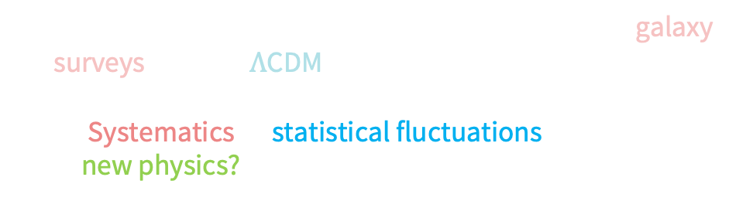
Current status on structure measurement
Measurement
Model ($Λ$CDM)
Hints of tension between structure measured in galaxy surveys and the $Λ$CDM prediction.
→ Systematics or statistical fluctuations or
  new physics?
$S_{8}=σ_{8}\sqrt{\left(\frac{Ω_{m}}{0.3}\right)}$
Amplitude of cosmic structure fluctuation
Notes:
Most of the measurement is ~ 1-2$σ$ lower than CMB,
including lensing, clustering, and cluster abundances.
Systematics or new physics?

Slide 5
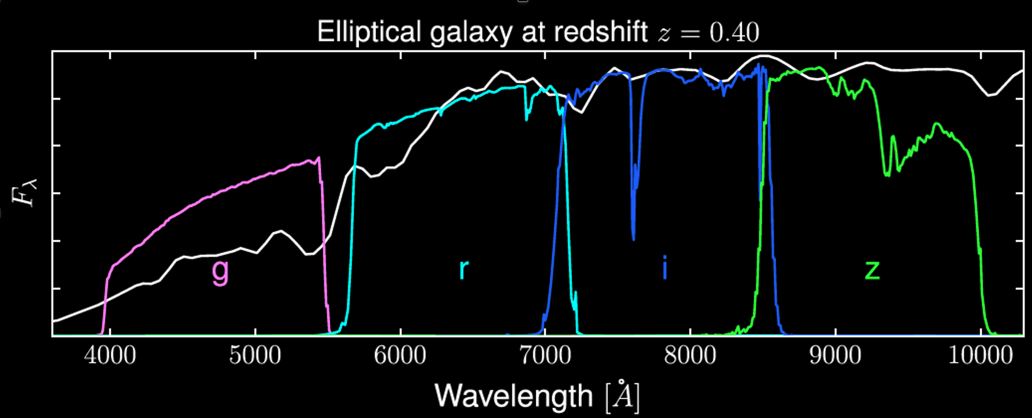
Current status on structure measurement
Systematics or statistical fluctuations or new physics?
The Dark Energy Survey is uniquely positioned to answer this question.
5 color filters used to estimate photo-zs
Wide survey: 5000 sq degrees, ~23 i-magnitude
Notes:
The Dark Energy Survey is uniquely positioned because it has multiple probes.
Each of this probe has similar constraining power and has different systematics

Slide 6
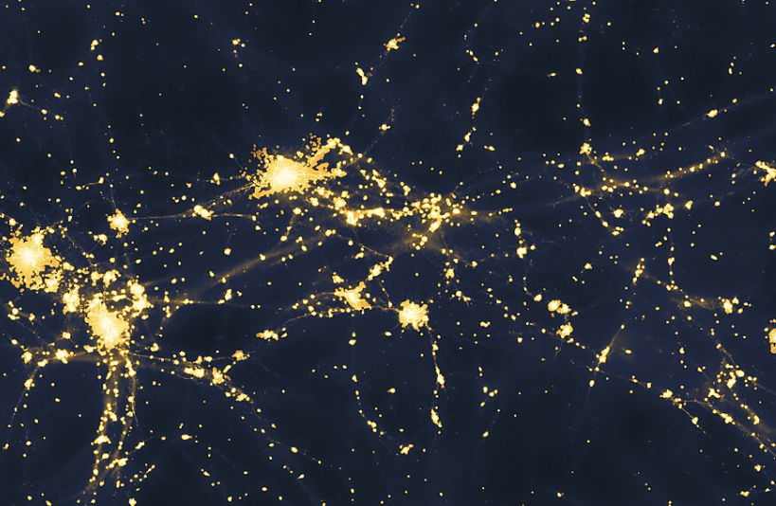
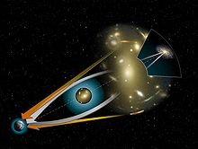
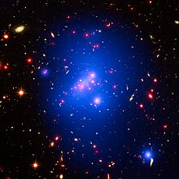
Current status on structure measurement
Measurement
Model ($Λ$CDM)
Systematics or statistical fluctuations or new physics? The Dark Energy Survey has multiple probes:
  1. Consistency check between probes
  2. Joint analyses of different probes
Galaxy clustering
Weak lensing
Galaxy clusters
$S_{8}=σ_{8}\sqrt{\left(\frac{Ω_{m}}{0.3}\right)}$
Amplitude of cosmic structure fluctuation
Notes:
The Dark Energy Survey is a unique experiement.
We can compare these probes to check the systematics or we can combine them to improve the statistical precisions

Slide 7
Current status on structure measurement
Measurement
Model ($Λ$CDM)
Systematics or statistical fluctuations or new physics? The Dark Energy Survey has multiple probes:
  1. Consistency check between probes
  2. Joint analyses of different probes
Galaxy clustering
Weak lensing
Galaxy clusters
$S_{8}=σ_{8}\sqrt{\left(\frac{Ω_{m}}{0.3}\right)}$
Amplitude of cosmic structure fluctuation
Notes:
We can compare them to check the

Slide 8
Current status on structure measurement
Measurement
Model ($Λ$CDM)
Systematics or statistical fluctuations or new physics?
The Dark Energy Survey has multiple probes:
  1. Consistency check between probes
  2. Joint analyses of different probes
Galaxy clustering
Weak lensing
Galaxy clusters
This talk
$S_{8}=σ_{8}\sqrt{\left(\frac{Ω_{m}}{0.3}\right)}$
Amplitude of cosmic structure fluctuation

Slide 9
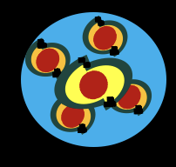
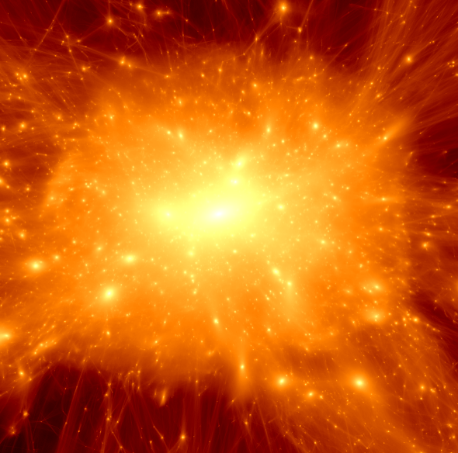
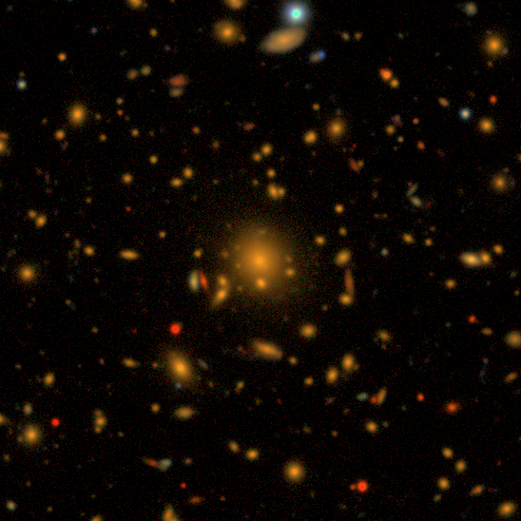
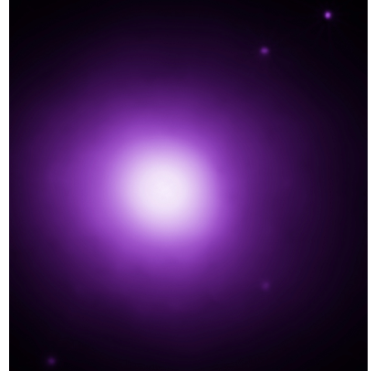

DES Probes of cosmic structure: galaxy clusters
Galaxy clusters: multi-component objects
Dark Matter Halo
→ $∼{5×10}^{14}M_{⊙}$
Red galaxies
~ 2% of the mass
Hot gas
~ 10 % of the total mass
Notes:
Before we dive into the analysis, let’s first review what galaxy clusters are
It is largest virialized structure in the universe.
4:50s

Slide 10
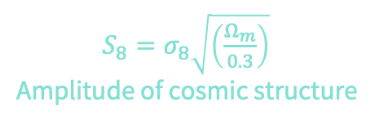
DES Probes of cosmic structure: galaxy clusters
Galaxy clusters: multi-component objects
Dark Matter Halo
→ $∼{5×10}^{14}M_{⊙}$
Red galaxies
~ 2% of the mass
Hot gas
~ 10 % of the total mass
Shine in X-ray and Millimeter sky
$S_{8}=σ_{8}\sqrt{\left(\frac{Ω_{m}}{0.3}\right)}$
Amplitude of cosmic structure
Notes:
And clusters detected from those wavelength have delivered competitive cosmological constraints.

Slide 11
DES Probes of cosmic structure: galaxy clusters
Galaxy clusters: multi-component objects
Dark Matter Halo
→ $∼{5×10}^{14}M_{⊙}$
Red galaxies
~ 2% of the mass
Hot gas
~ 10 % of the total mass
Shine in X-ray and Millimeter sky
$S_{8}=σ_{8}\sqrt{\left(\frac{Ω_{m}}{0.3}\right)}$
Amplitude of cosmic structure
Notes:
In DES we can also detect galaxy clusters by looking for overdensity of red galaxies

Slide 12
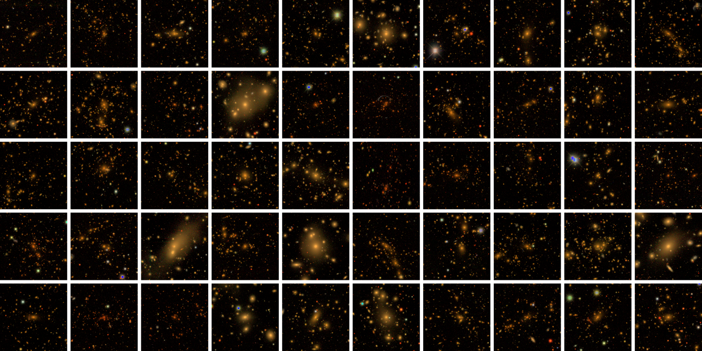
>16 K optically identified galaxy clusters
Notes:
We have identified more than 16 k galaxy clusters in our data. This is the largest cluster sample used for cosmological analysis to date.
Here are just a few examples of them.

Slide 13
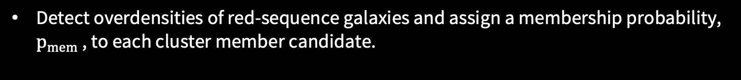

How are DES clusters selected?
Detect overdensities of red-sequence galaxies and assign a membership probability, $p_{mem}$ , to each cluster member candidate.
Mass tracer: richness ($λ$) = $∑p_{mem}$ .

Slide 14
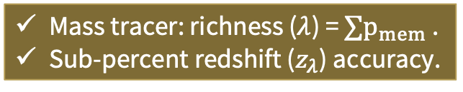
DES cluster sample is well validated
Detect overdensities of red-sequence galaxies and assign a membership probability, $p_{mem}$ , to each cluster member candidate.
Mass tracer: richness ($λ$) = $∑p_{mem}$ .
Sub-percent redshift ($z_{λ}$) accuracy.
DES+25
Notes:
The accurate red sequence model leads to sub-percent redshift accuracy.
Around 25% of our sample has spectrascoic redshift so we can use that to validate our redshift accuracy.
In the plot I am showing you a comparison of photometric redshift and spectroscopic redshift.

Slide 15

DES cluster sample is well validated
Detect overdensities of red-sequence galaxies and assign a membership probability, $p_{mem}$ , to each cluster member candidate.
Selection function is well-validated:
  X-ray: Kelly+24, Upsdell+ 23
  Millimeter: Grandis+ 25
Mass tracer: richness ($λ$) = $∑p_{mem}$ .
Sub-percent redshift ($z_{λ}$) accuracy.
$$σ\left(\ln{T|λ}\right)≅0.22$$
DES+25
Kelly+24
Notes:
DES cluster samples is well validated

Slide 16
DES clusters probe a unique range of mass and redshift
DES+25

Slide 17
Galaxy clusters as a cosmology probe
Galaxy clusters: multi-component objects
Dark Matter Halo
→ $∼{5×10}^{14}M_{⊙}$
Red galaxies
~ 2% of the mass
Hot gas
~ 10 % of the total mass
More structure, More clusters
Cluster abundances:
The abundance of clusters is sensitive to the amount of structure in the universe.

Slide 18
Galaxy clusters as a cosmology probe
Galaxy clusters: multi-component objects
Dark Matter Halo
→ $∼{5×10}^{14}M_{⊙}$
Red galaxies
~ 2% of the mass
Hot gas
~ 10 % of the total mass
Shine in X-ray and Millimeter sky
More structure, More clusters
Cluster abundances:
The abundance of clusters is sensitive to the amount of structure in the universe.

Slide 19


Cluster cosmology: weak lensing mass calibration
Source
galaxies
Lens
galaxies
Cluster lensing
z
Dark matter
Galaxy clusters
Courtesy: Yuuki Omori
Notes:
In practice, we can correlate the shape distortion of galaxy and cluster position. The correlation function is called cluster lensing.

Slide 20
Cluster cosmology: cluster lensing and cluster abundance
Cluster lensing
Similar to SPT and eROSITA
Cluster abundances

Slide 21
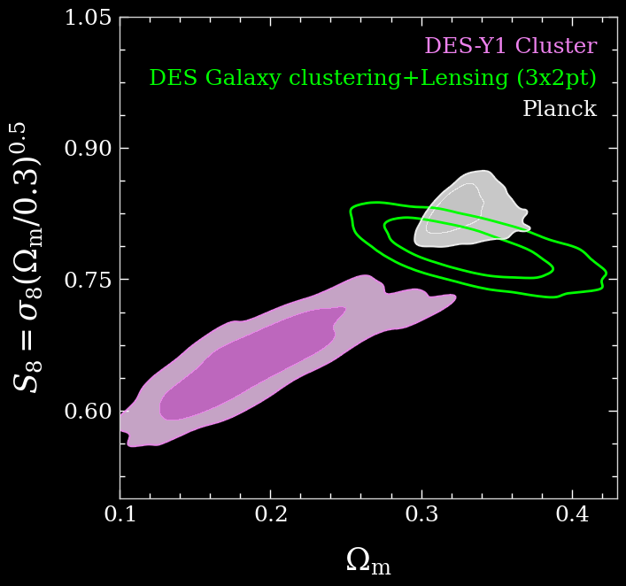
Big surprise in the analysis of the first year of DES data
Cosmic Structure
Cluster lensing
Cluster abundances
DES+20
Matter density
Notes:
With many years of work in DES, it seems the best candidate to explain this result is that optically selected clusters suffer from projection effect.

Slide 22
Optically selected clusters suffer from projection effect
Notes:
Here is a example cluster in our DES image

Slide 23
Optically selected clusters suffer from projection effect
Photo-z uncertainty at z=0.2 ~= 100 Mpc/h
Notes:
If we have the ability to look at the cluster from the side, we will get the top figure.
We are looking through the large-scale structure.

Slide 24
Optically selected clusters suffer from projection effect
Photo-z uncertainty at z=0.2 ~= 100 Mpc/h
Photo-z uncertainty at z=0.2 ~= 100 Mpc/h

Slide 25
Optically selected clusters suffer from projection effect
Photo-z uncertainty at z=0.2 ~= 100 Mpc/h
Optical clusters suffer from the projection effect: Chance alignments of line-of-sight structure.
Photo-z uncertainty at z=0.2 ~= 100 Mpc/h
Notes:
Because of photometric redshift uncertainties, we cannot distinguish between galaxies residing in the target halo and those located in other projected halos.
Chances alignment of the line-of-sight structure, whose galaxies misidentified as cluster members.

Slide 26
Optically selected clusters suffer from projection effect
Photo-z uncertainty at z=0.2 ~= 100 Mpc/h
Optical clusters suffer from the projection effect: Chance alignments of line-of-sight structure.
→ Additional modulation on cluster-related correlation functions (To+21, Wu+ 22, Zhang+ 23)
To+ 25

Slide 27
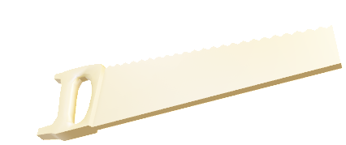
Optically selected clusters suffer from projection effect
Photo-z uncertainty at z=0.2 ~= 100 Mpc/h
Optical clusters suffer from the projection effect: Chance alignments of line-of-sight structure.
→ Additional modulation on cluster-related correlation functions (To+21, Wu+ 22, Zhang+ 23)
Simple projection model
To+ 25

Slide 28
A new paradigm for optical cluster cosmology analysis
Only large-scale information is used.
    Benefits:
      Simple projection effect model.
      Bypass several small-scale systematics.
    Drawbacks:
      Loss of signal to noise
Notes:
Mis-centering, baryonic effect, boost factor, etc.
How can we proceed?

Slide 29
Cluster cosmology data vector: cluster lensing
Source
galaxies
Lens
galaxies
Cluster lensing
z
Dark matter
Galaxy clusters
Courtesy: Yuuki Omori

Slide 30
Clusters are part of the large-scale structure
Source
galaxies
Lens
galaxies
Galaxies
z
Cluster lensing
Dark matter
Galaxy clusters
Courtesy: Yuuki Omori

Slide 31
Cluster cosmology data vector: clustering
Cluster clustering
Source
galaxies
Lens
galaxies
Cluster-galaxy correlations
Galaxies
z
Cluster lensing
Dark matter
Galaxy clusters
Courtesy: Yuuki Omori

Slide 32
A new paradigm for optical cluster cosmology analysis
Only large-scale information is used.
    Benefits:
      Simple projection effect model.
      Bypass several small-scale systematics.
    Drawbacks:
      Loss of signal to noise
        rescued by including more correlation functions: cluster clustering, galaxy—cluster correlations and galaxy clustering.
Notes:
Mis-centering, baryonic effect, boost factor, etc.

Slide 33
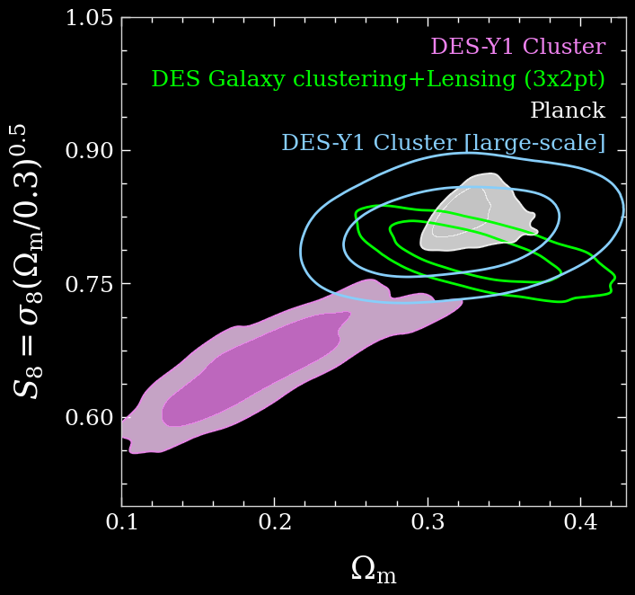
Re-analysis of DES-Y1 results in a consistent cosmology
DES Y1
DES Y1
Large-scale re-analysis
Avoid several small-scale systematics and have similar constraining power.
To&Krause + 21

Slide 34
From DES-Y1 to DES-Y6
Expansion of area by ~3 times.
Weak lensing noise decreased by ~30%.
Great statistical power requires great control of systematics!
    19 astrophysical parameters describing connection of measurements and matter fluctuations (linear galaxy bias, intrinsic alignments, mass—observable relations, and projection effects)
    12 observational parameters describing observational systematics (photometric redshift and shear measurement)
Notes:
So our pathfinder study is quite promising but we have to apply this to the full DES data.
Following a unified validation procedure and systematic control standard.
We have necessarily sophisticated model
15min

Slide 35
A comprehensive test of systematic for cluster cosmology
None of the nine tested systematics will bias our cosmological constraints by more than 0.3 of the statistical uncertainty.
Bias in structure
Bias in matter density
To+ 25
Notes:
We have performed a comprehensive test of systematic for cluster cosmology
The result is shown in the plot.

Slide 36
From DES-Y1 to DES-Y6: obstacles
None of the nine tested systematics will bias our cosmological constraints by more than 0.3 of the statistical uncertainty.
Bias in structure
Bias in matter density
To+ 25

Slide 37
From DES-Y1 to DES-Y6: obstacles
We have tested the robustness of our model with nine different systematics.
    Are there additional systematics?
Notes:
19 mins

Slide 38
From DES-Y1 to DES-Y6: obstacles
We have tested the robustness of our model with nine different systematics.
    Are there additional systematics?
      → Simulation validation.

Slide 39
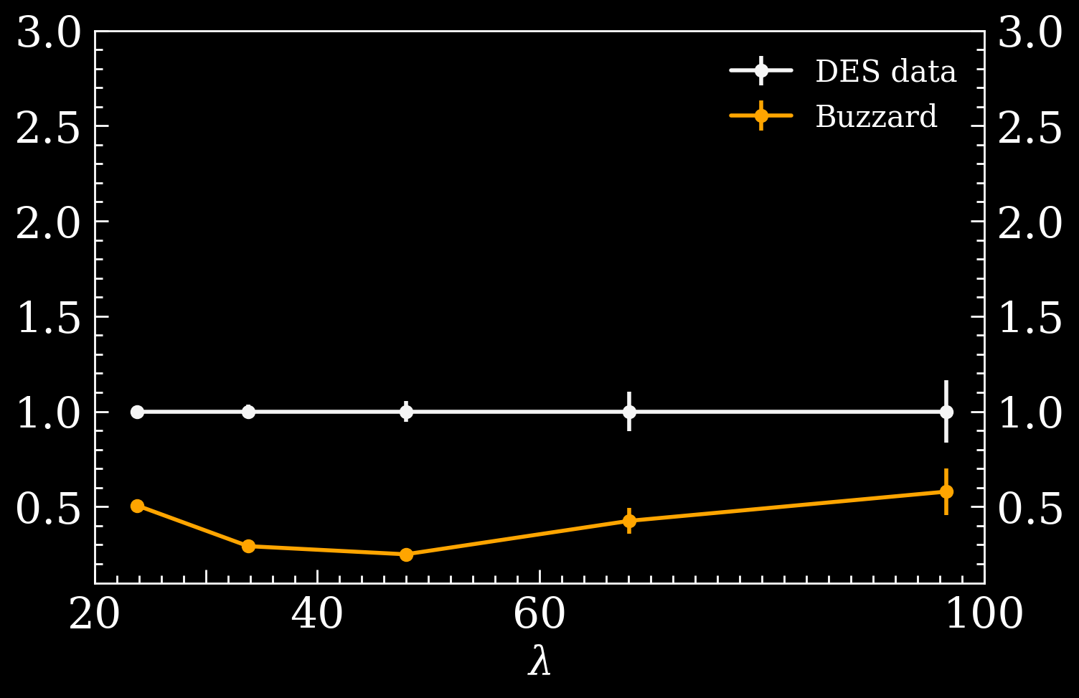
Simulation validation: Problem
Cluster abundance in the old simulation is only half of the data.
Ratio of cluster abundances in simulations and data
Perfect match
Sims used in previous analyses
To+ 24
Cluster mass tracer

Slide 40
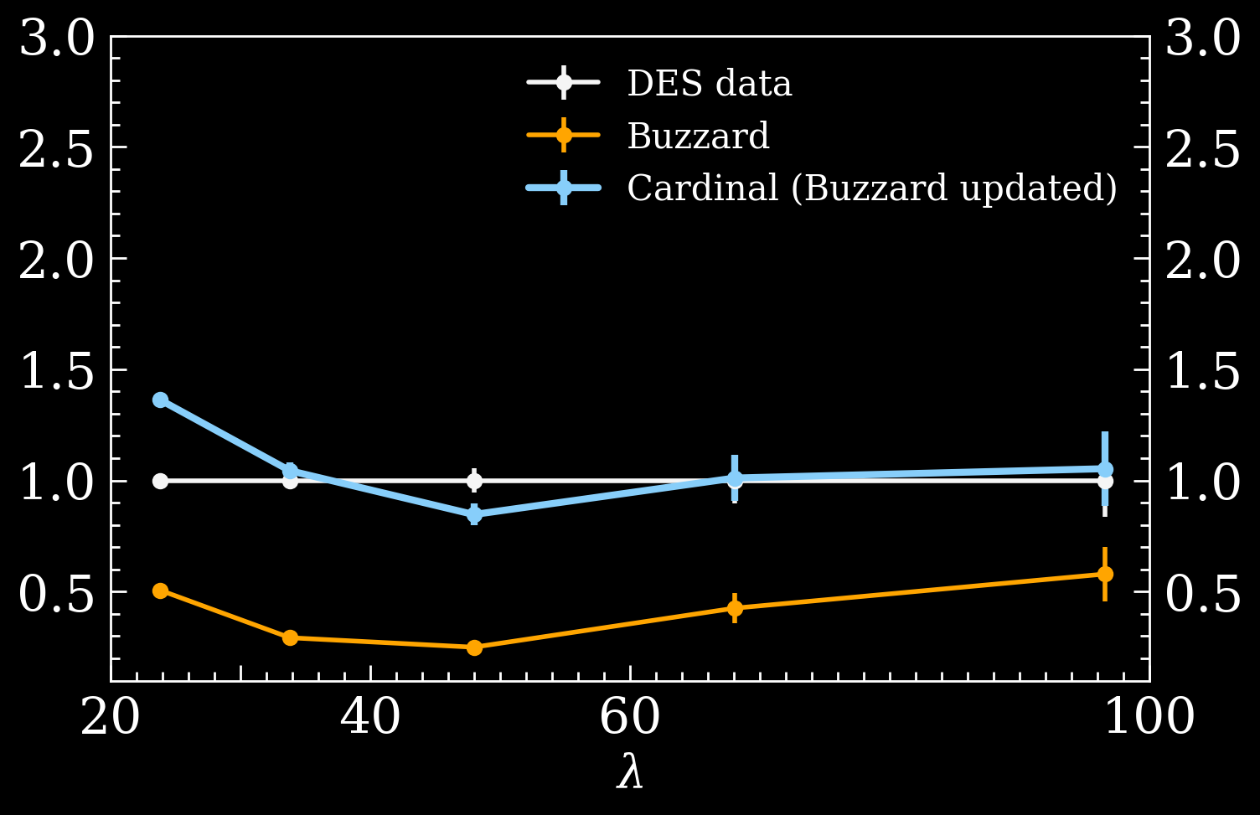
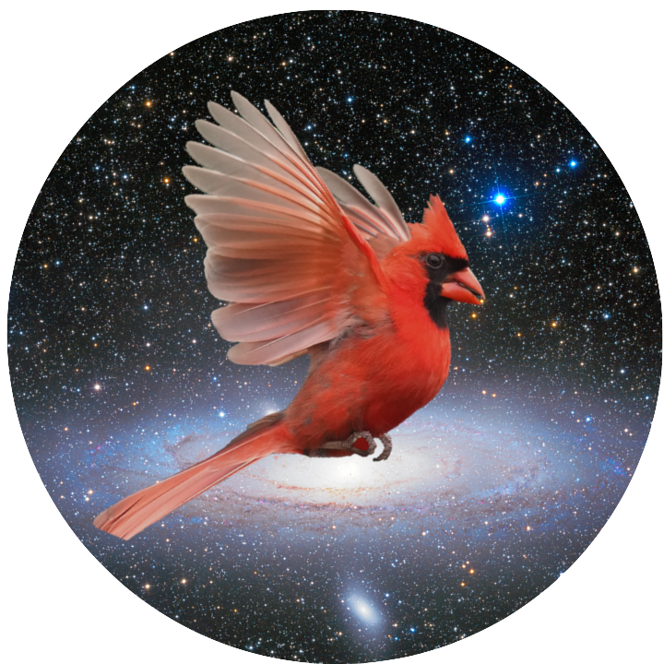
New simulations (Cardinal) solve the long-standing mis-match problem
This is achieved with 12 major modeling improvements.
Ratio of cluster abundances in simulations and data
Perfect match
Updated sims
Sims used in previous analyses
To+ 24
Cluster mass tracer
Notes:
The plot here shows the ratio of cluster abundacnes in simulation and data.

Slide 41
Comprehensive tests of the cluster finding algorithm
Five different levels of complexity to test the performance of the cluster finder.
Cosmic Structure
Cosmological parameters used to generate simulations
Matter density
To+ 25
Notes:
Employ with the new simulation, we can stringently test our analysis pipeline.
Specifically we make five different versions of the mock universe, each with a different realism.
The differences range from whether the cluster finder knows the position and redshift of the halos.
Whether the galaxies have true redshift
Whether we have magnification effect.
We perform our analyses in all five mock universe and the result is shown in the plot.
In all cases, our analysis pipeline can recover true cosmology parameters used to generate the simulation

Slide 42
Application on DES-Y3 data
Notes:
20:30

Slide 43
DES Y3 cluster constraints
DES cluster cosmology constraints (CL+GC):
    Cluster abundance
    Cluster lensing
    Cluster clustering
    Cluster-galaxy correlations + galaxy clustering
In addition to 9 modeling systematics, we pass an additional 9 null tests.
→ We unblind!
Cosmic Structure
Matter density
DES+ 25

Slide 44
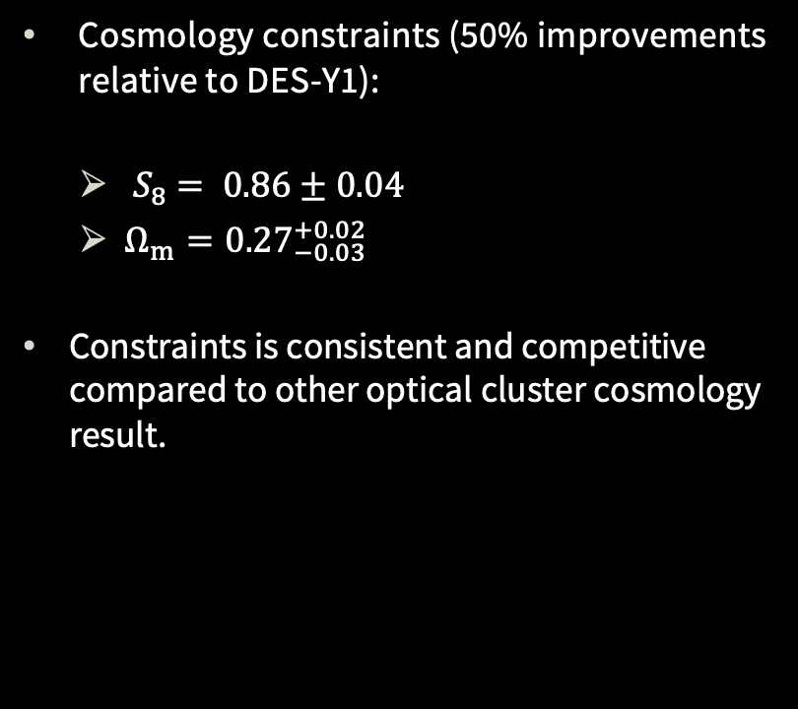
Cluster constraints: optical clusters
Cosmology constraints (50% improvements relative to DES-Y1):
    ${ S}_{8} = 0.86±0.04$
    $Ω_{m}={0.27}_{−0.03 }^{+0.02}$
  Constraints is consistent and competitive compared to other optical cluster cosmology result.
DES+ 25

Slide 45
Cluster constraints: Multiwavelength
 | DES | SPT | eROSITA
Detection | Red galaxies | Hot gas
Mass and redshift | Low-mass High z | High mass | Low-mass Low z
Analysis method | Large-scale two-point functions | Small-scale cluster lensing
DES+ 25
Notes:
We can compare our cluster cosmology constraints with with results from clusters detected in different wavelength, such as SPT shown in white and erosita shown in pink.
We see that they are consistent with each other within 1-2 sigma.
I should that these analyses differ in many different aspects.
The fact that they are all consistent with each other within 1-2 sigma, indicating that clusters with mass calibrated by weak lensing a robust cosmological probe.

Slide 46
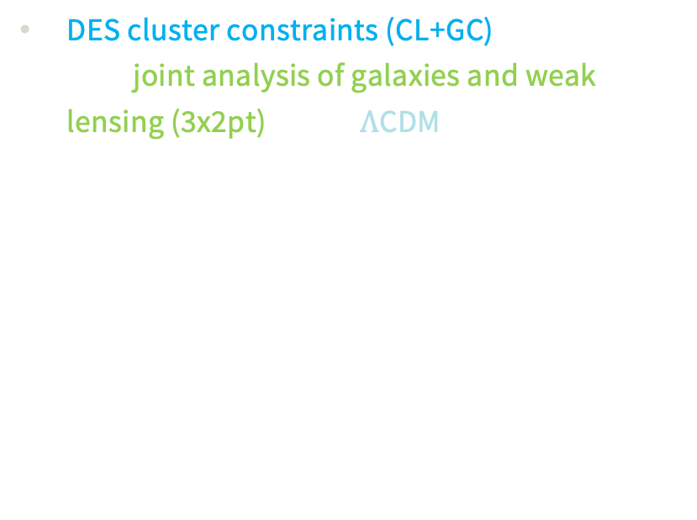
Consistency of the individual DES constraints in $Λ$CDM
DES cluster constraints (CL+GC) is consistent with joint analysis of galaxies and weak lensing (3x2pt) under $Λ$CDM.
DES+ 25
Notes:
To quantify the tension is non-trivial etc.

Slide 47
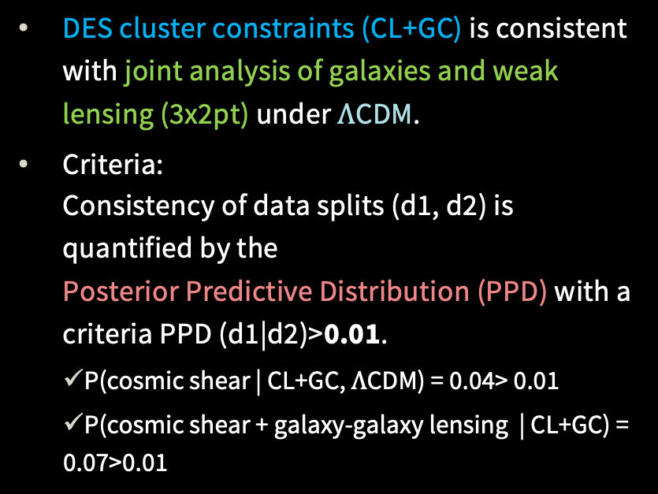
Consistency of the individual DES constraints in $Λ$CDM
DES cluster constraints (CL+GC) is consistent with joint analysis of galaxies and weak lensing (3x2pt) under $Λ$CDM.
Criteria:
Consistency of data splits (d1, d2) is quantified by the
Posterior Predictive Distribution (PPD) with a criteria PPD (d1|d2)>0.01.
    P(cosmic shear | CL+GC, $Λ$CDM) = 0.04> 0.01
    P(cosmic shear + galaxy-galaxy lensing | CL+GC) = 0.07>0.01
DES+ 25

Slide 48
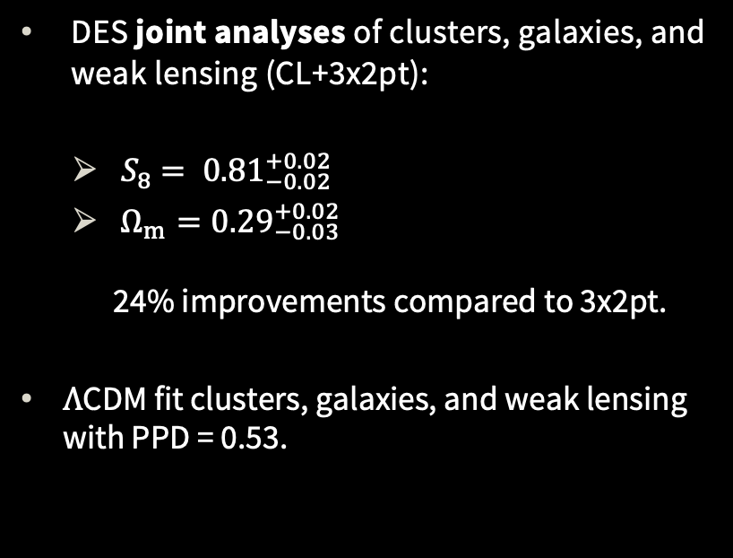
Joint analysis of clusters, galaxies, and weak lensing
DES joint analyses of clusters, galaxies, and weak lensing (CL+3x2pt):
    ${ S}_{8} = {0.81}_{−0.02}^{+0.02}$
    $Ω_{m}={0.29}_{−0.03}^{+0.02}$
    24% improvements compared to 3x2pt.
  $Λ$CDM fit clusters, galaxies, and weak lensing
  with PPD = 0.53.
DES+ 25
Notes:
Empty face!

Slide 49
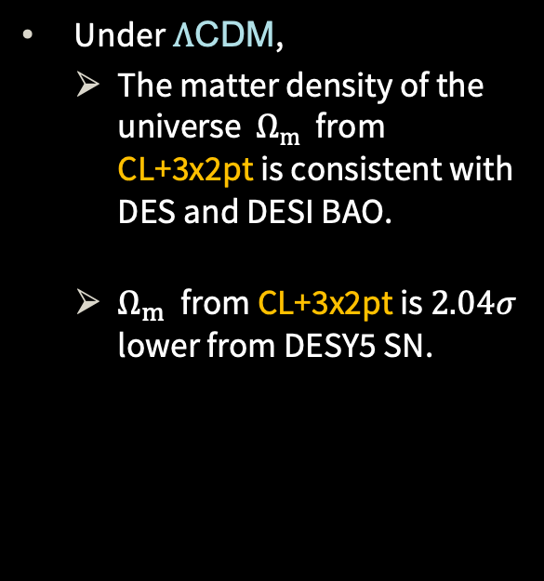
Comparison of matter density from different DES probes
Under $Λ$CDM,
    The matter density of the universe $Ω_{m}$ from CL+3x2pt is consistent with DES and DESI BAO.
    $Ω_{m}$ from CL+3x2pt is $2.04σ$ lower from DESY5 SN.
DES+ 25

Slide 50
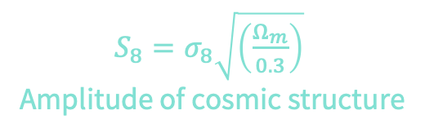
Is the matter distribution in the late-time universe consistent with predictions based on initial conditions constrained by the Cosmic Microwave Background?
Measurement
Model ($Λ$CDM)
$S_{8}=σ_{8}\sqrt{\left(\frac{Ω_{m}}{0.3}\right)}$
Amplitude of cosmic structure
Notes:
the question we posed

Slide 51
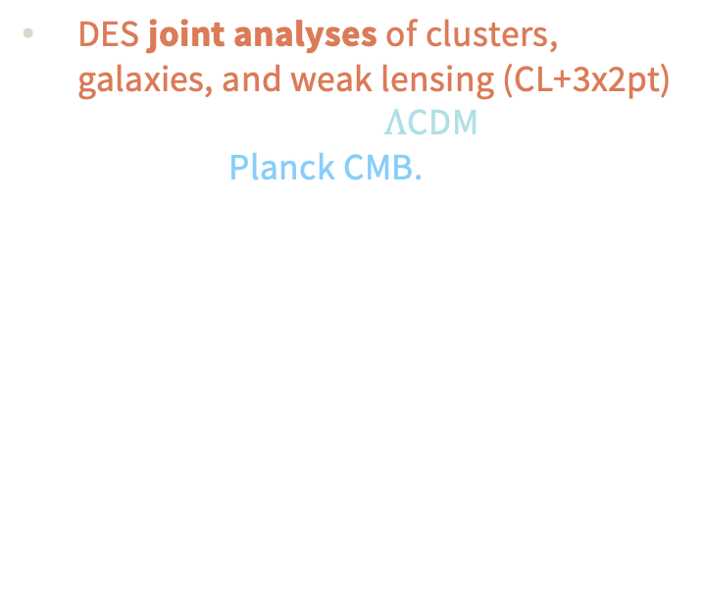
Is the matter distribution in the late-time universe consistent with predictions based on initial conditions constrained by the Cosmic Microwave Background?
Measurement
Model ($Λ$CDM)
DES joint analyses of clusters, galaxies, and weak lensing (CL+3x2pt) are consistent with $Λ$CDM predictions based on Planck CMB.
New DES Result
$S_{8}=σ_{8}\sqrt{\left(\frac{Ω_{m}}{0.3}\right)}$
Amplitude of cosmic structure

Slide 52
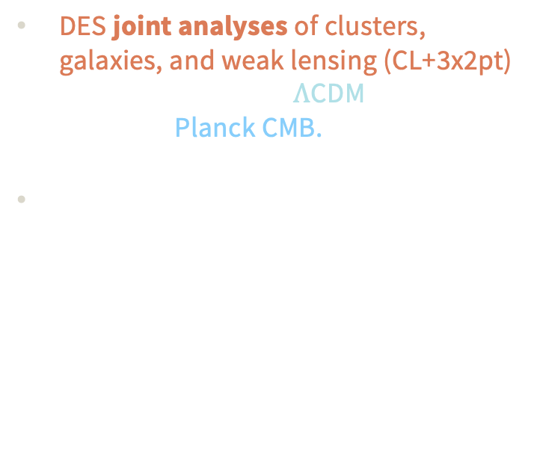
Is the matter distribution in the late-time universe consistent with predictions based on initial conditions constrained by the Cosmic Microwave Background?
Measurement
Model ($Λ$CDM)
DES joint analyses of clusters, galaxies, and weak lensing (CL+3x2pt) are consistent with $Λ$CDM predictions based on Planck CMB.
Multi-dimensional tension metric:
DES CL+3x2pt and Planck are consistent at 0.8 $σ$ level or p=0.6
New DES Result
$S_{8}=σ_{8}\sqrt{\left(\frac{Ω_{m}}{0.3}\right)}$
Amplitude of cosmic structure

Slide 53
Outlook: beyond cluster cosmology
DES+25
Peak of lensing efficiency for the highest redshift bin in DES WL

Slide 54

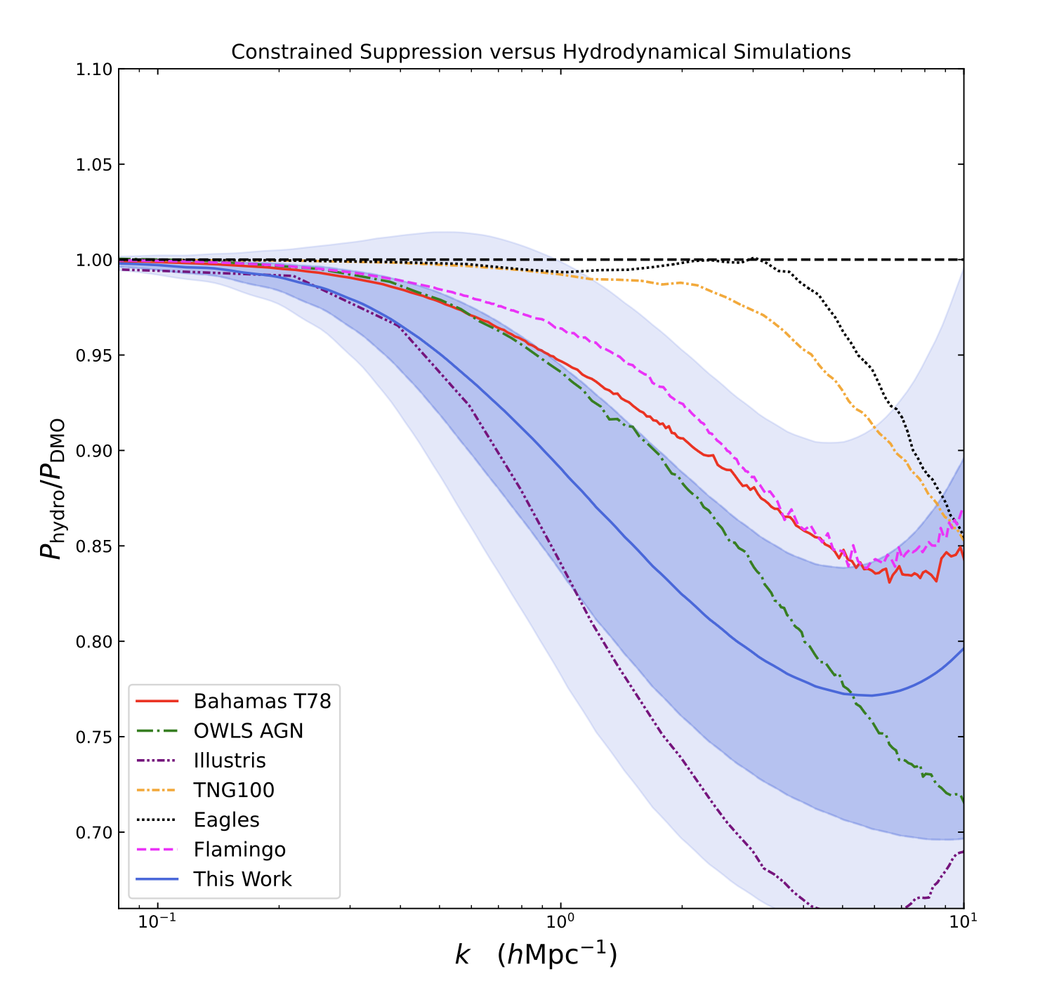
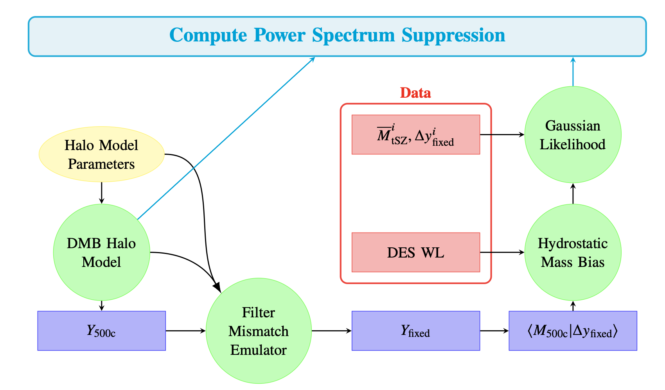
Pathfinder study on using the tSZ information around galaxy clusters to study baryonic feedback
Nihar Dalal at OSU
ACT and DES
Preliminary
To be submitted in few weeks

Slide 55
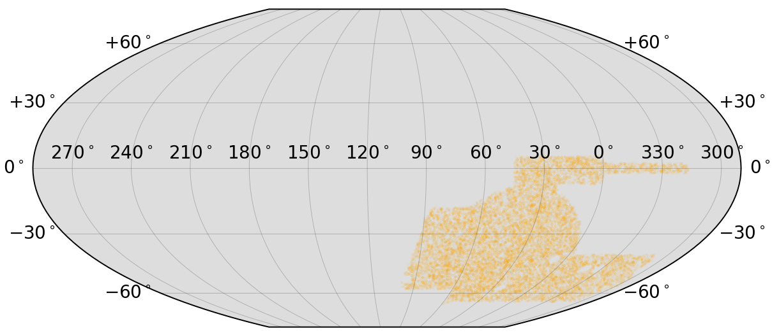
Outlook: Clusters used in this analysis
Declination
Right Ascension

Slide 56
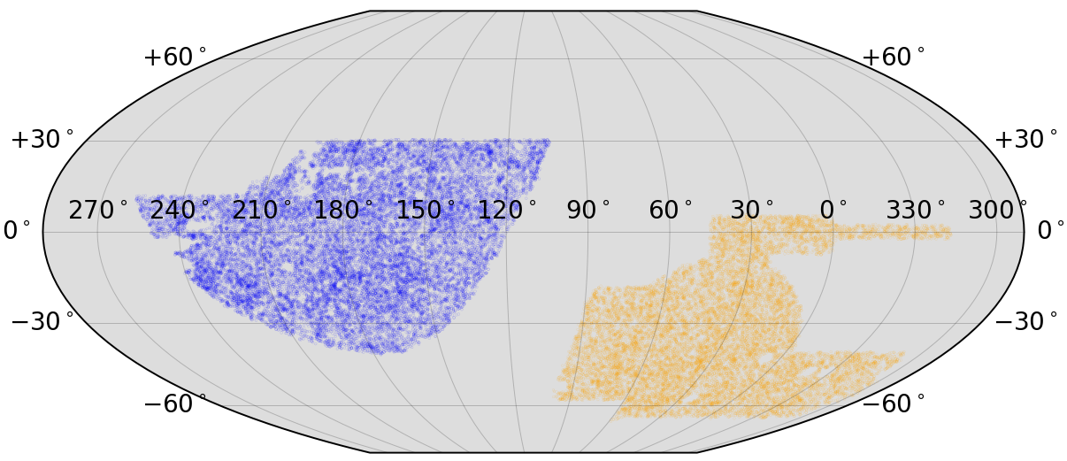
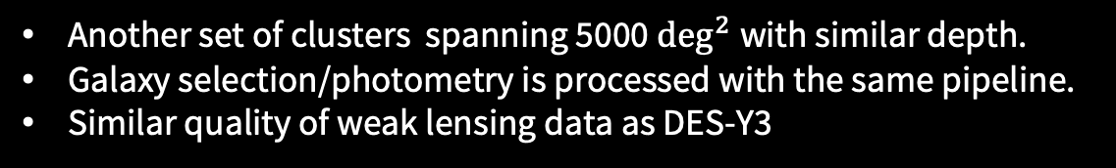
DECADE dataset: Lots of clusters on the disk
Another set of clusters spanning 5000 $\deg^{2}$with similar depth.
Galaxy selection/photometry is processed with the same pipeline.
Similar quality of weak lensing data as DES-Y3
Declination
Right Ascension

Slide 57
Conclusions
We have developed an analysis framework to jointly model three key probes in the Dark Energy Survey:
Galaxy cluster abundances, galaxy clustering and weak lensing.
Analysis prioritizes robust inference:
    Forgoes small-scale information which is more sensitive to systematics.
    Accuracy validated for full DES precision:
      Robust against 9 different possible model mis-specifications.
      Recover true cosmology in newly developed simulations.

Slide 58

Conclusions
We have applied this method on DES-Y3 and find
    Galaxy cluster abundances, galaxy clustering and weak lensing are internally consistent under $ΛCDM$.
    Joint analyses of all three probes lead to constraints on the amplitude of cosmic structure consistent with Planck CMB within 1$σ.$
  We will soon improve the analysis with DES-Y6 and Decade data and conduct a comprehensive test of the cosmological model.
  The associated ~16k cluster samples are publicly available at https://des.ncsa.illinois.edu/releases/y3a2/Y3key-cluster.
Notes:
Parallel analyses on DES-Y3 data
27mins 04es

Slide 59
Backup slides

Slide 60

Outlook: DES-Y6 analyses
Combining DES 3x2pt+CL+SN is expected to constrain:
    $$σ w_{0}=0.1$$
    $$σ w_{a}=0.5$$
Expected

