Slide 1
SLICK Simulations for Line-Intensity Mapping
Karolina Garcia
CAPS Postdoctoral Fellow
NCSA/University of Illinois

Slide 2
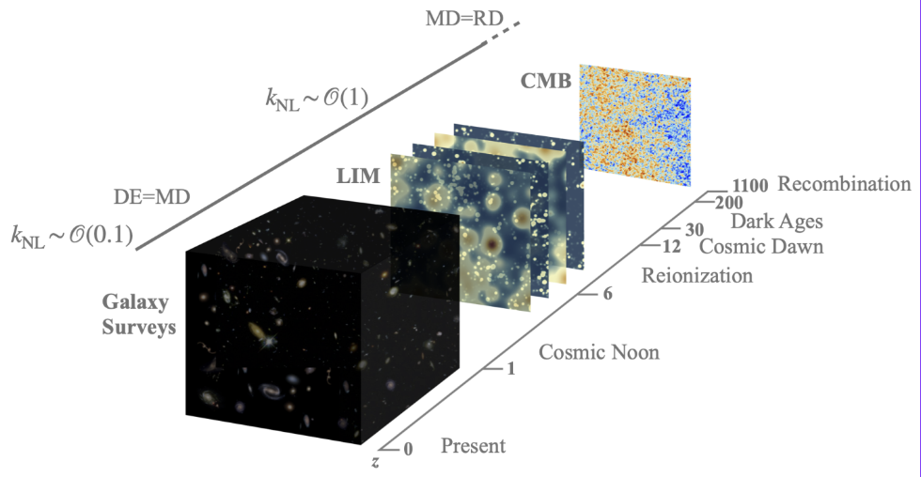
Line-Intensity Mapping
Bernal & Kovetz 2022
Line-intensity mapping (LIM) of molecular line luminosities (such as CO and [CII]) trace molecular gas and SFR in different times of the universe history, and their large-scale maps will potentially constrain cosmology from unexplored cosmic eras.

Slide 3
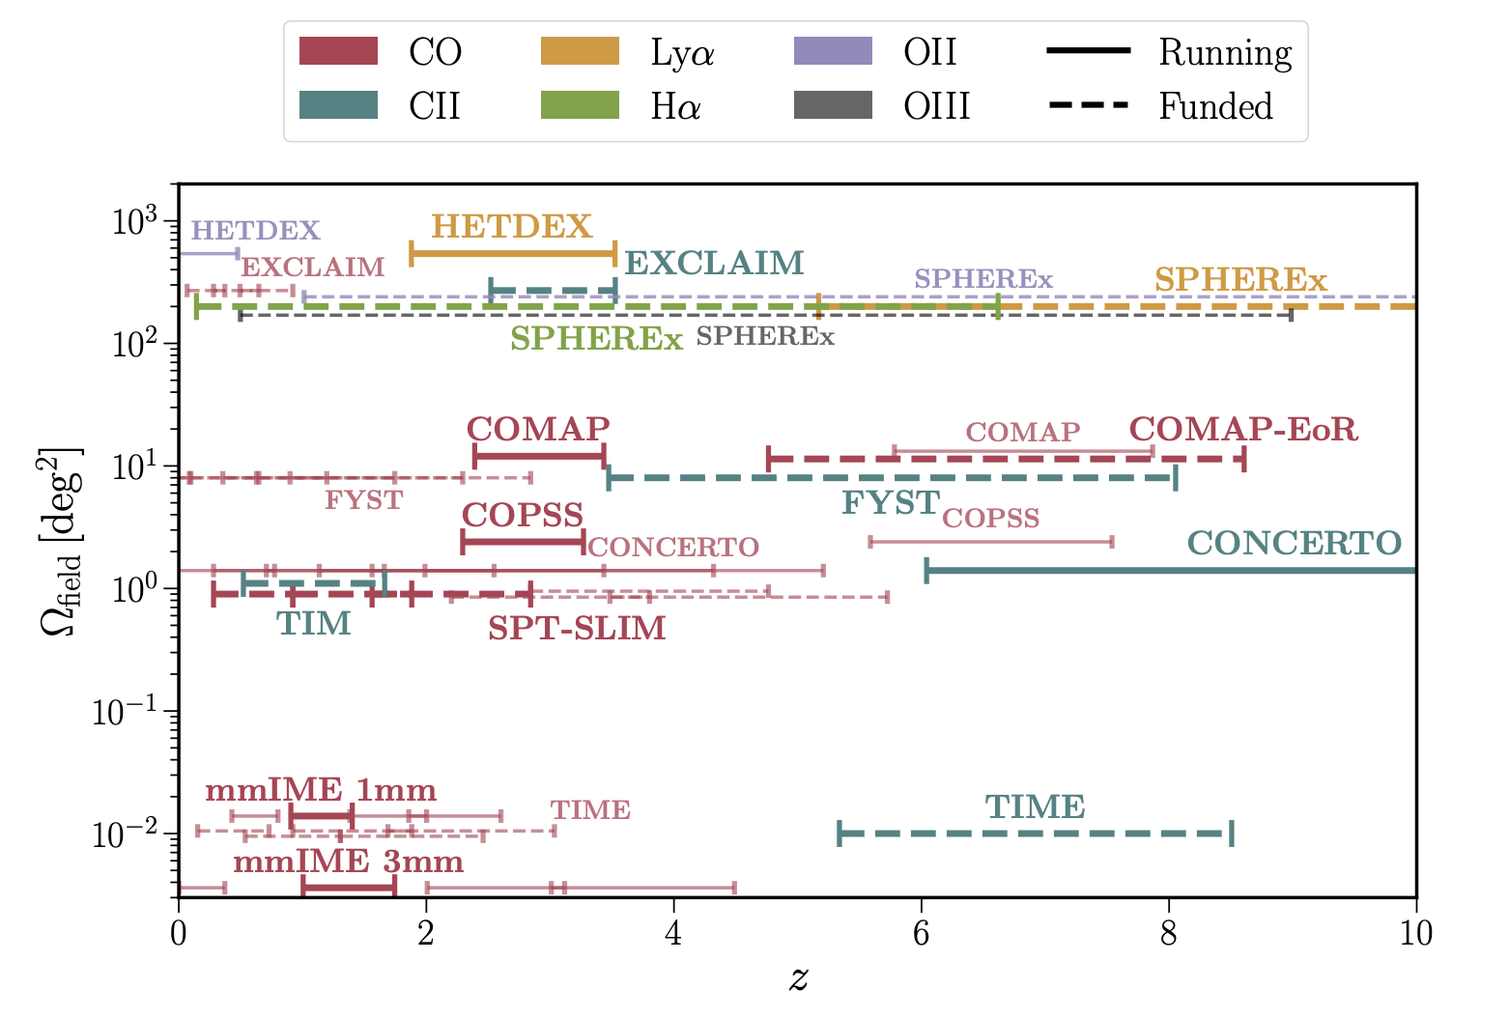
Line-Intensity Mapping

Slide 4
Line-Intensity Mapping
FYST
[CII] at Cosmic Dawn, CO at Cosmic Noon

Slide 5
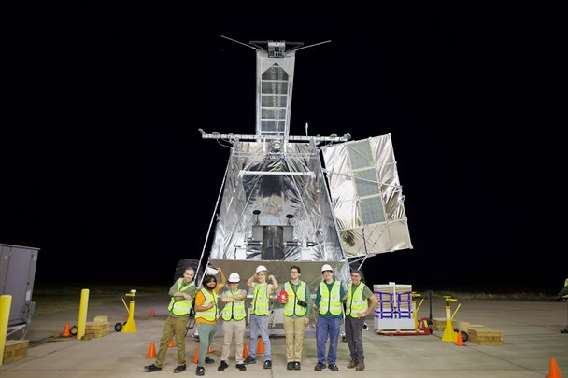
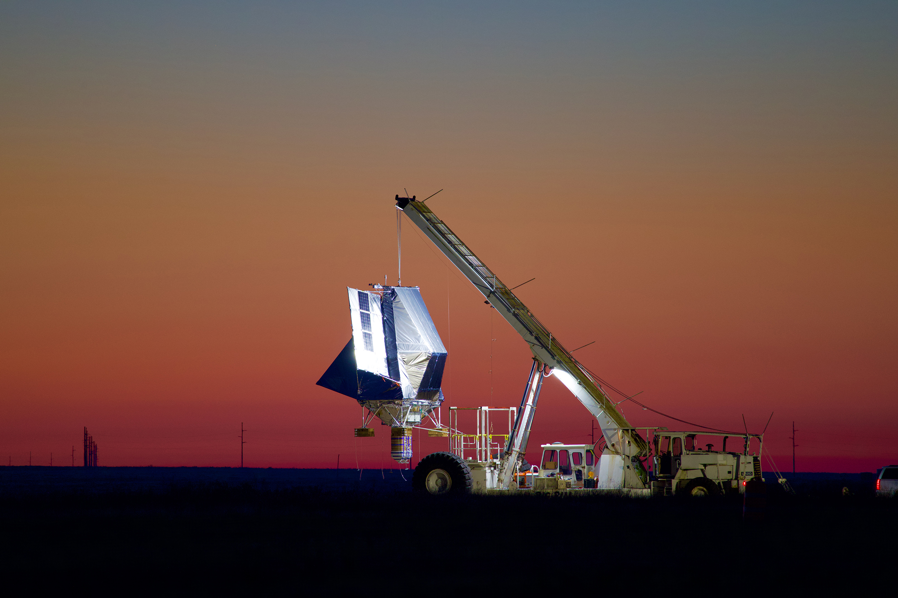
Line-Intensity Mapping
TIM: [CII] at Cosmic Noon
FYST
[CII] at Cosmic Dawn, CO at Cosmic Noon

Slide 6
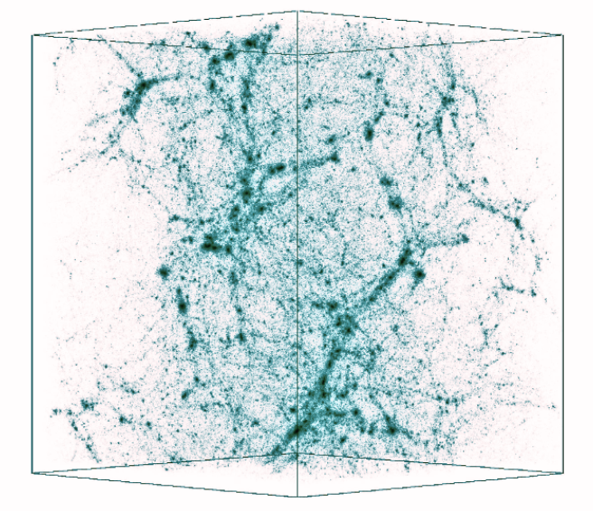
LIM Modeling with Hydrodynamical Simulations
Bernal & Kovetz 2022

Slide 7
Limitations of Cosmological Simulations for LIM
🧊 Resolution Limits
Can’t resolve individual clouds;
Gas temperature and density averaged over
🔬 Missing Small-Scale Physics
No ISM chemistry, turbulence, or dust;
Need models to predict line emission
💫 Feedback (and other astrophysical) Models
Tunable recipes for AGN and SN effects
📏 Size Limit
Computationally expensive
🎲 One Box per Redshift
Set parameters; cosmic variance

Slide 8
Limitations of Cosmological Simulations for LIM
🧊 Resolution Limits
Can’t resolve individual clouds;
Gas temperature and density averaged over
🔬 Missing Small-Scale Physics
No ISM chemistry, turbulence, or dust;
Need models to predict line emission
💫 Feedback (and other astrophysical) Models
Tunable recipes for AGN and SN effects
📏 Size Limit
Computationally expensive
🎲 One Box per Redshift
Set parameters; cosmic variance
Can we develop a physically motivated method that is scalable, flexible, and easy to interpret, while effectively addressing these challenges?

Slide 9
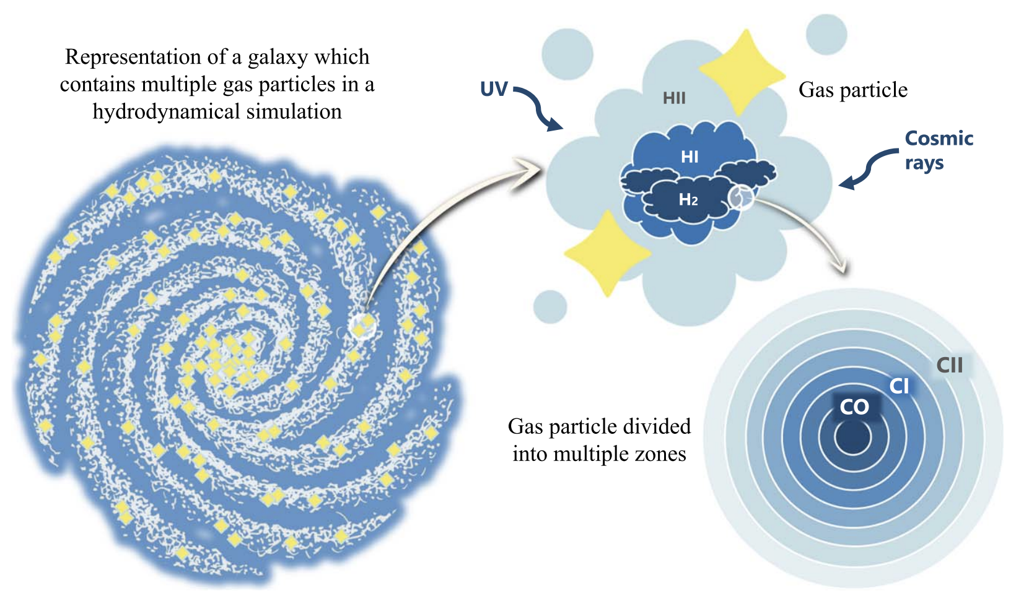
SLICK: Scalable Line Intensity Computation Kit
Garcia, Narayanan, Popping, Anirudh, Kaasinen
Input Simulations:
SIMBA, IllustrisTNG, and CAMELS
🌫️ Sub-resolution modeling of clouds based on Popping et al. (2019)
🔁 DESPOTIC (radiative transfer code) is run in each cloud zone to compute line emission ([CII], CO, CI, etc).
🔆 Environment-dependent radiation field is used to model UV/CR effects
✨ Produces cloud-level and galaxy-integrated molecular line luminosities
Garcia et al. 2024

Slide 10
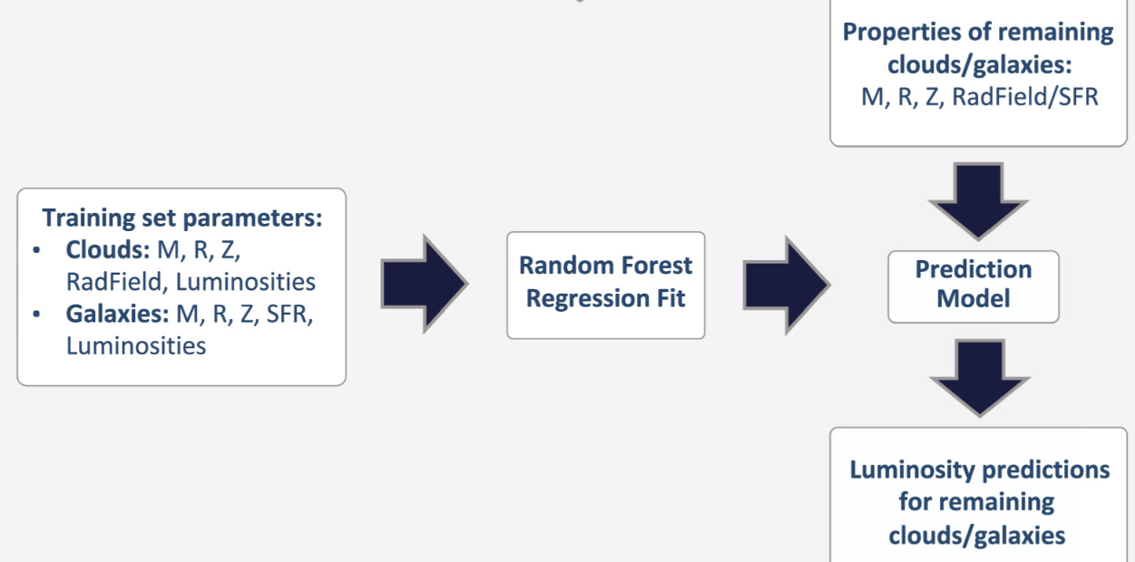
SLICK: Scalable Line Intensity Computation Kit
Garcia, Narayanan, Popping, Anirudh, Kaasinen
Garcia et al. 2024

Slide 11
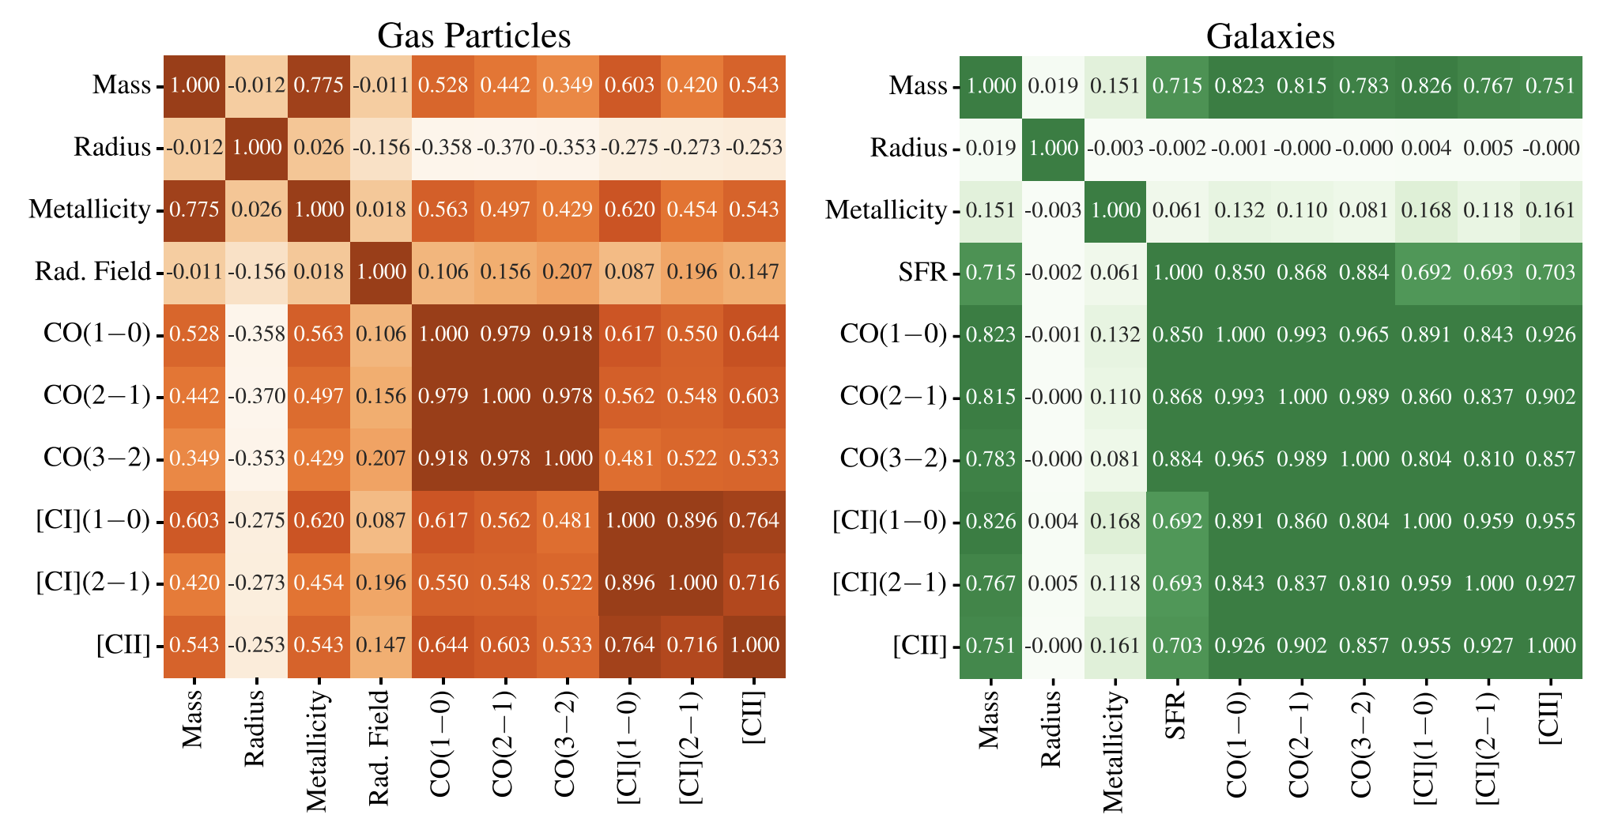
Molecular lines’ sensitivity to cloud/galaxy properties
Garcia et al. 2024

Slide 12
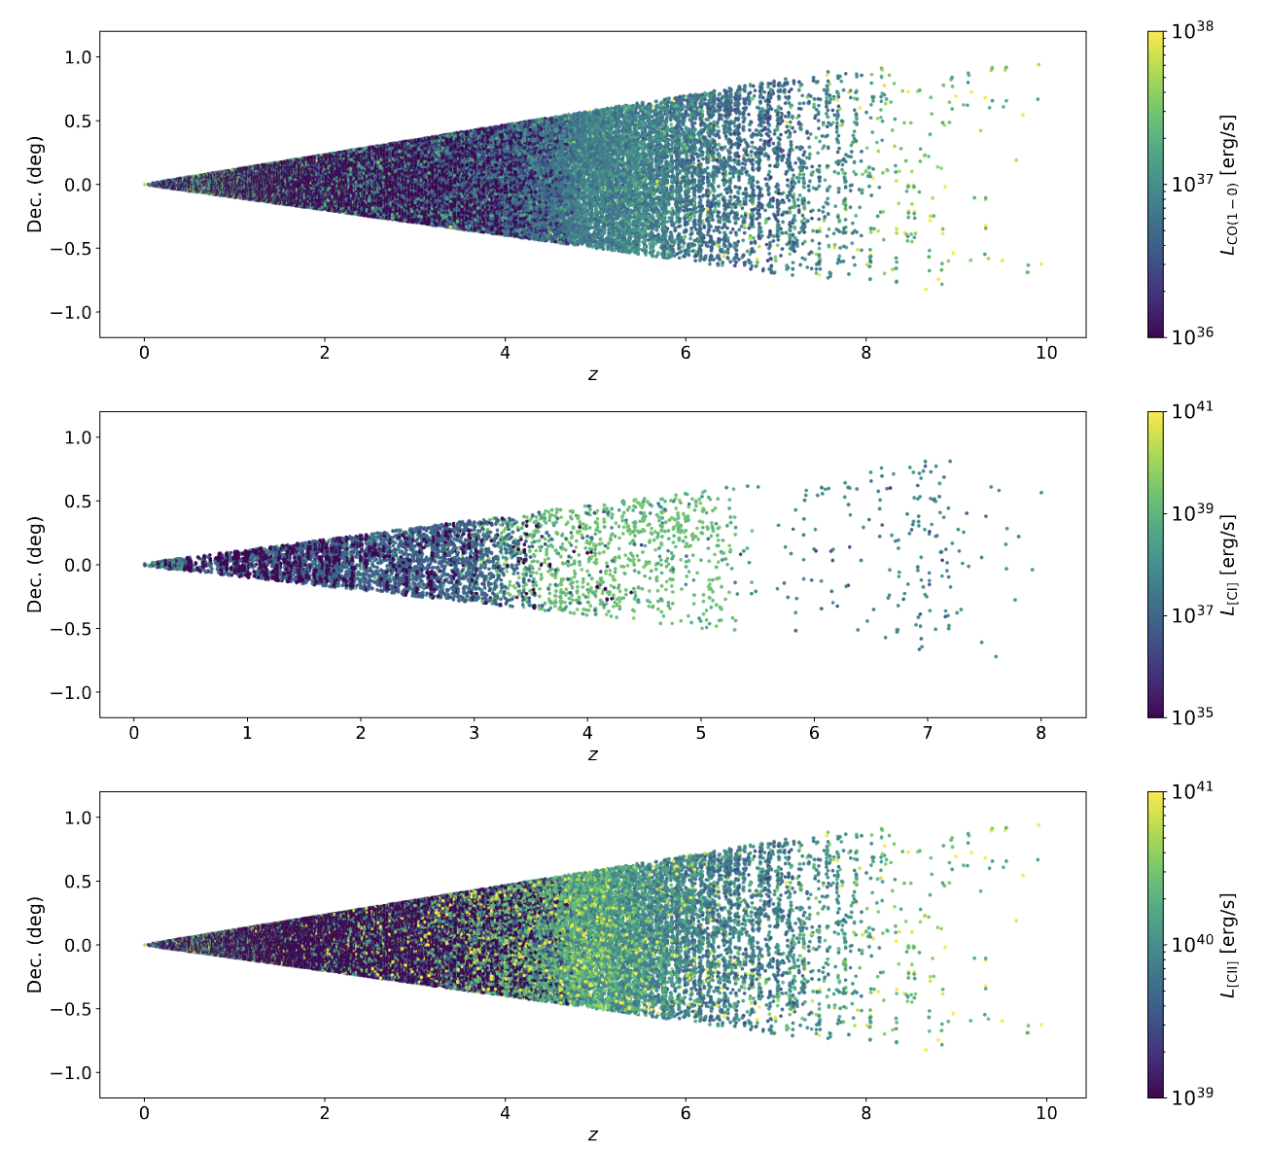
Molecular Line Luminosities from z=0 to z=10!
CO(1-0)
[CI](1-0)
[CII]
Garcia et al. 2024

Slide 13
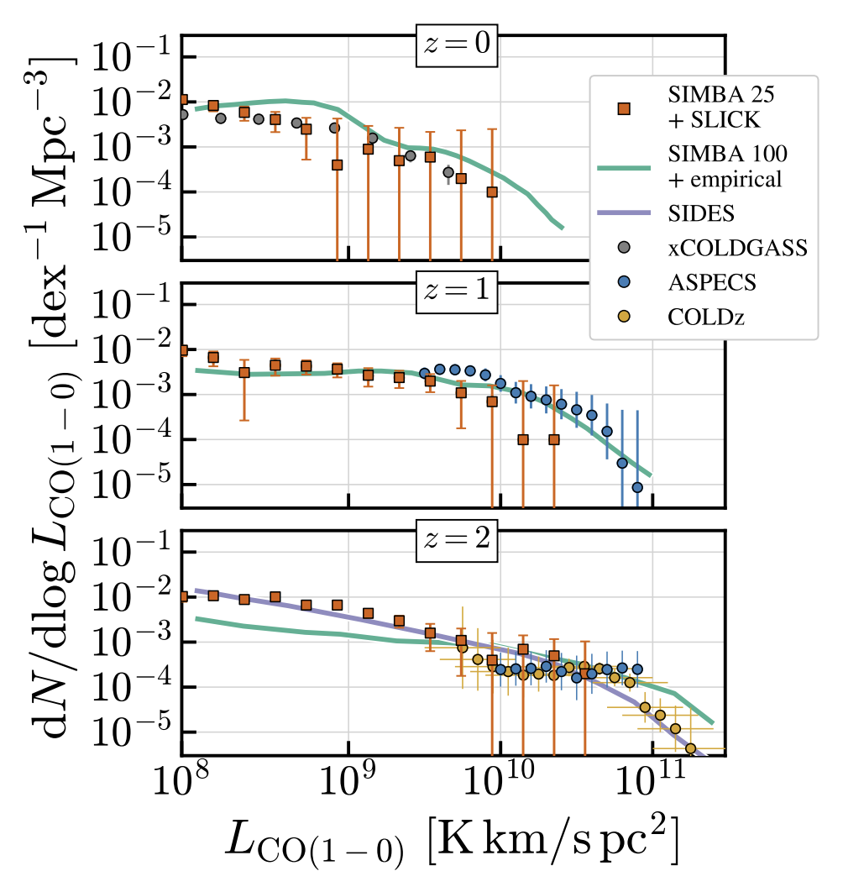
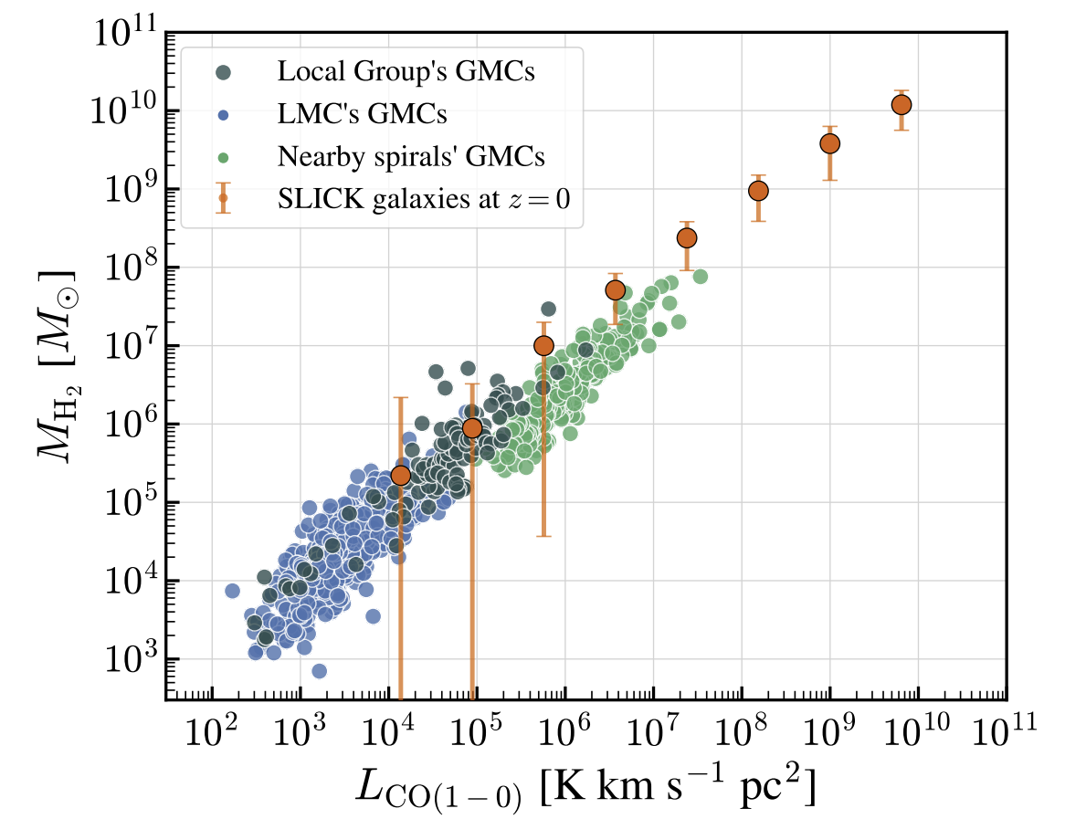
CO(1-0) on SLICK SIMBA 25
Garcia et al. 2024

Slide 14
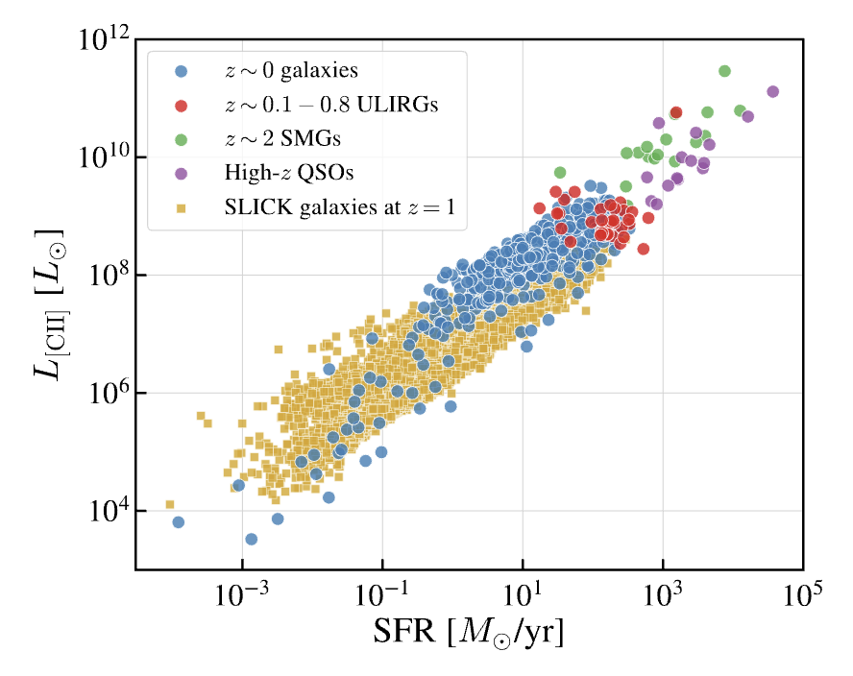
[CII] x SFR on SIMBA100
Garcia et al. in prep

Slide 15
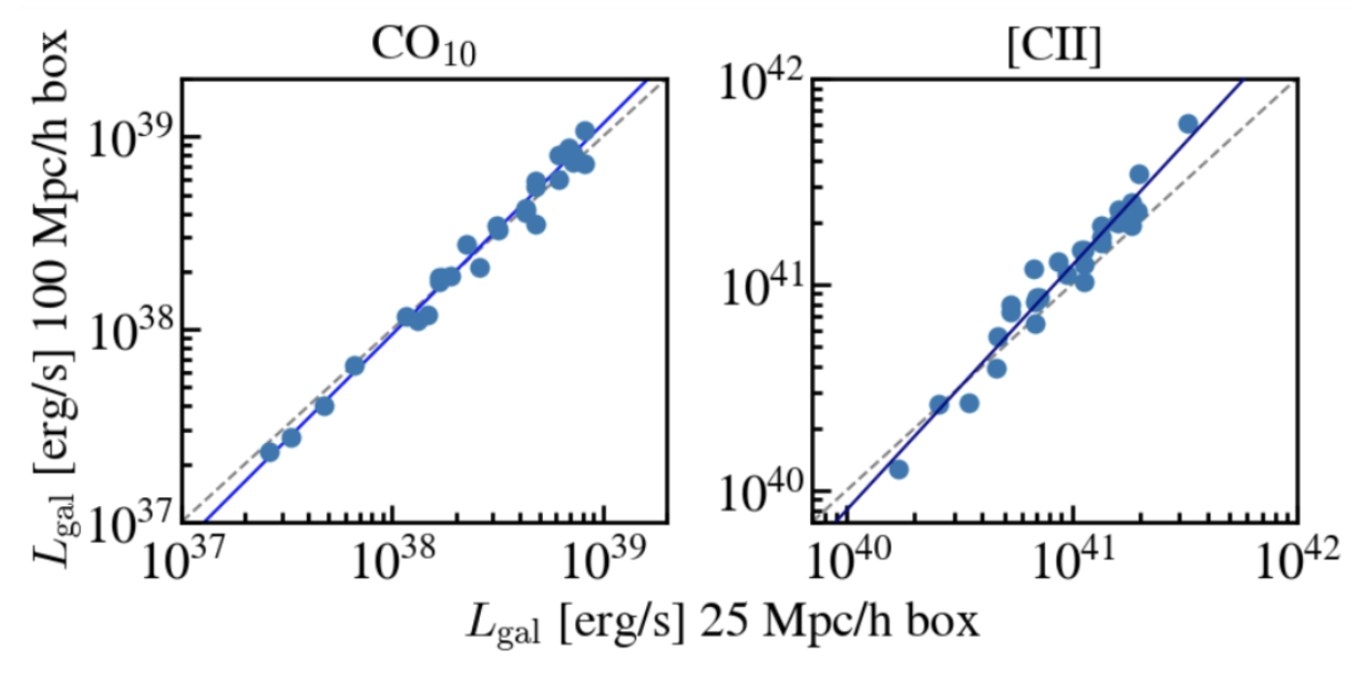
Testing SLICK on different volumes
Garcia et al. in prep

Slide 16
Cosmological Simulations Overview
SIMBA
IllustrisTNG
50 Mpc
50 Mpc/h
100 Mpc/h
100 Mpc
300 Mpc
25 Mpc/h

Slide 17
Cosmological Simulations Overview
SIMBA
IllustrisTNG
50 Mpc
50 Mpc/h
100 Mpc/h
100 Mpc
300 Mpc
25 Mpc/h
CAMELS
25 Mpc/h

Slide 18
Cosmological Simulations Overview
SIMBA
IllustrisTNG
50 Mpc
50 Mpc/h
100 Mpc/h
100 Mpc
300 Mpc
25 Mpc/h
CAMELS
Sets that I’m using:
First set: Extreme combinations of AGN + SN
Second set: Varies one parameter at a time
Third set: Same physics, different realizations → cosmic variance
Why?
Identifies which parameters matter most
Helps marginalize over uncertainty in modeling
25 Mpc/h

Slide 19
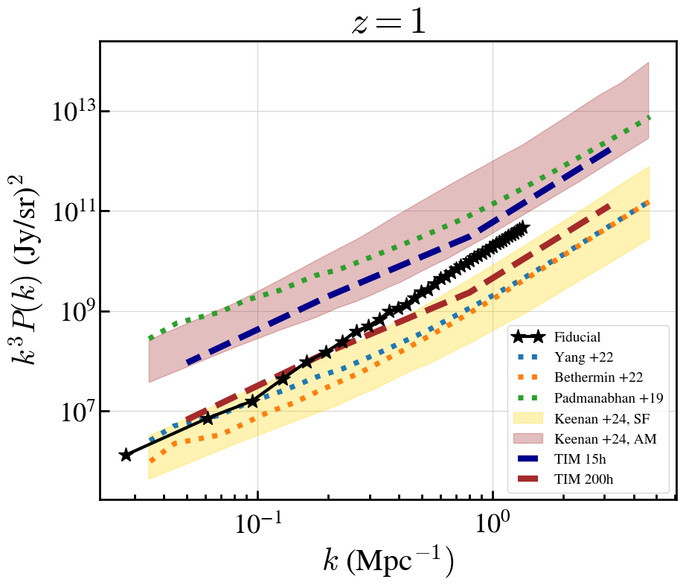
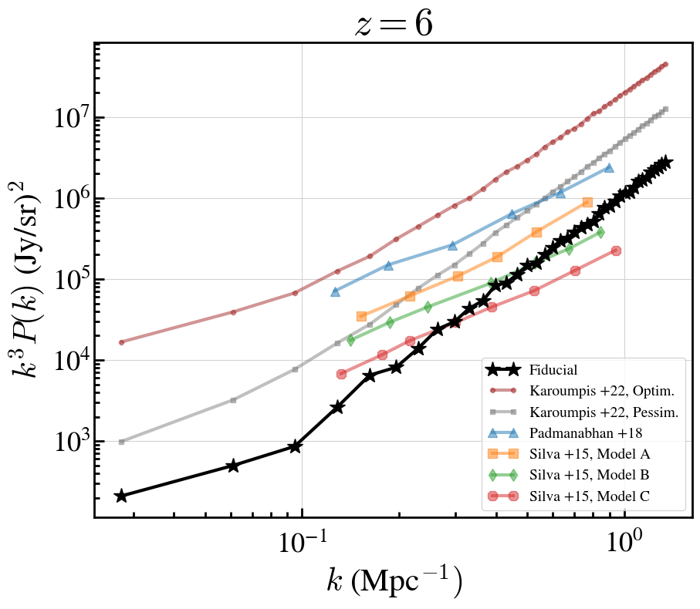
SLICK + CAMELS Fiducial [CII] Power Spectrum
PRELIMINARY

Slide 20
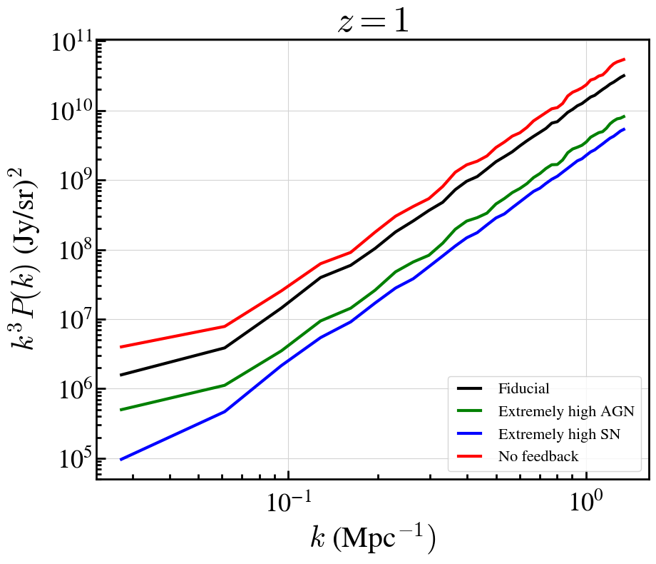
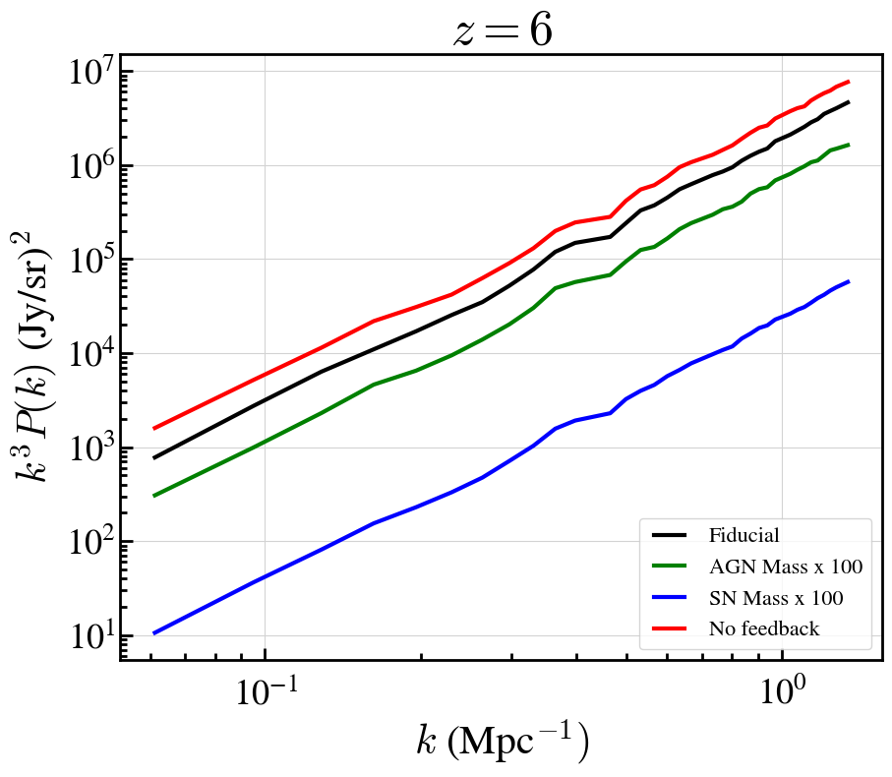
[CII] Power Spectrum for Extreme SN/AGN Models
PRELIMINARY

Slide 21
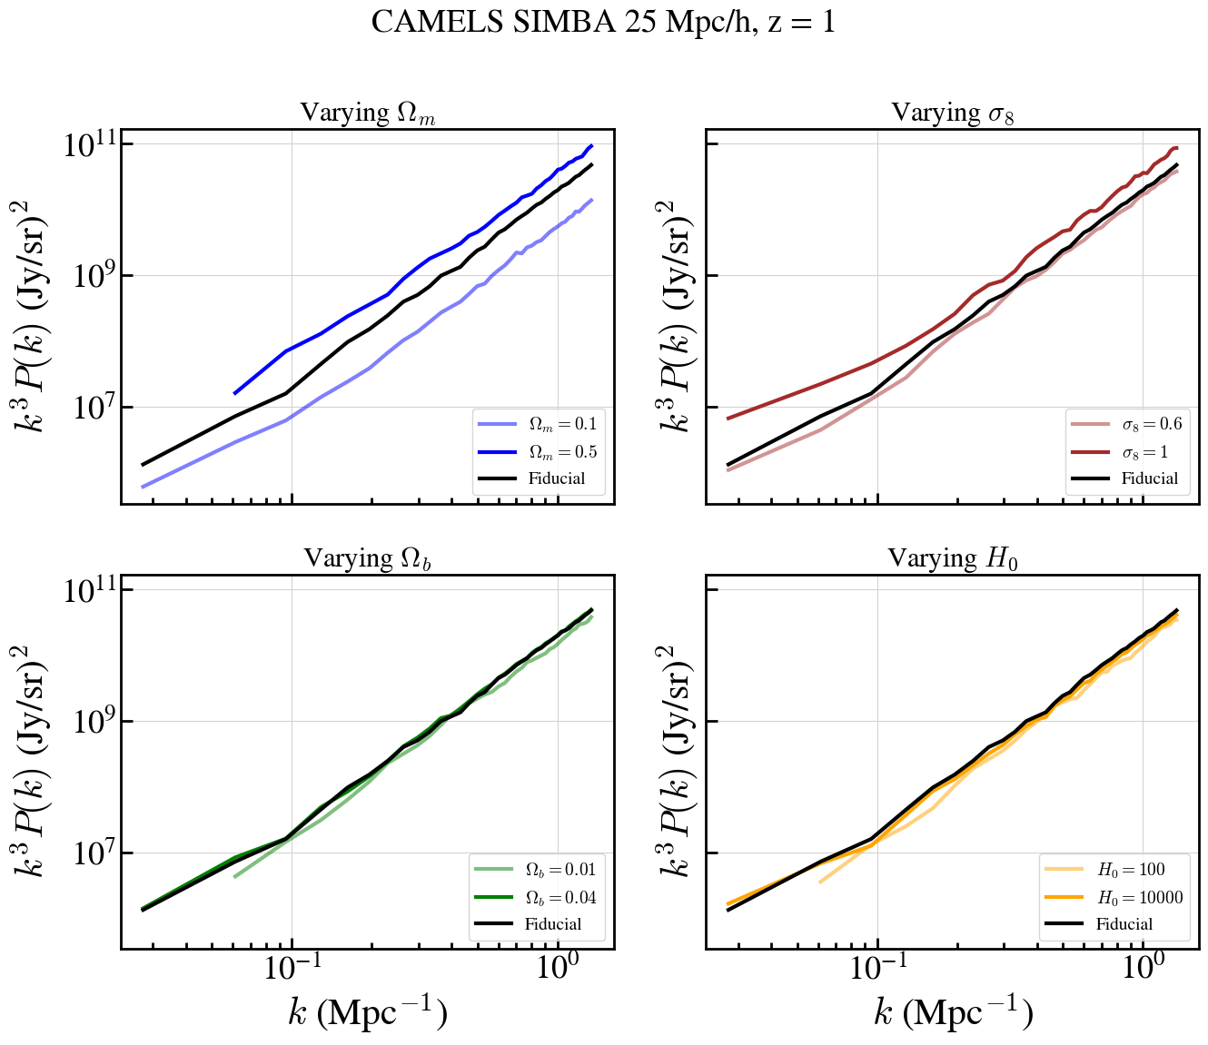
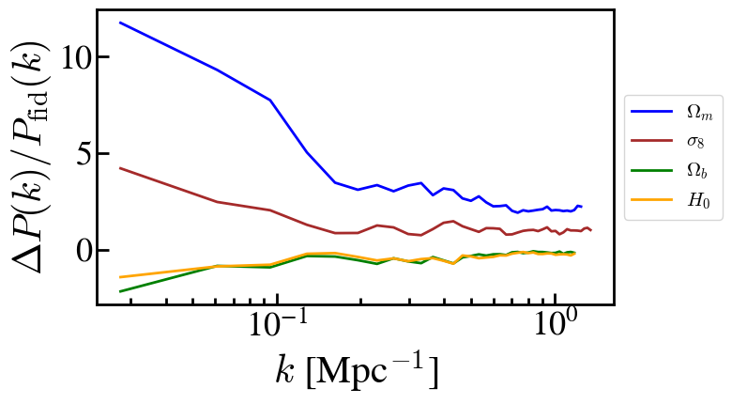
[CII] Power Spectrum for Varying Cosmological Parameters
PRELIMINARY

Slide 22
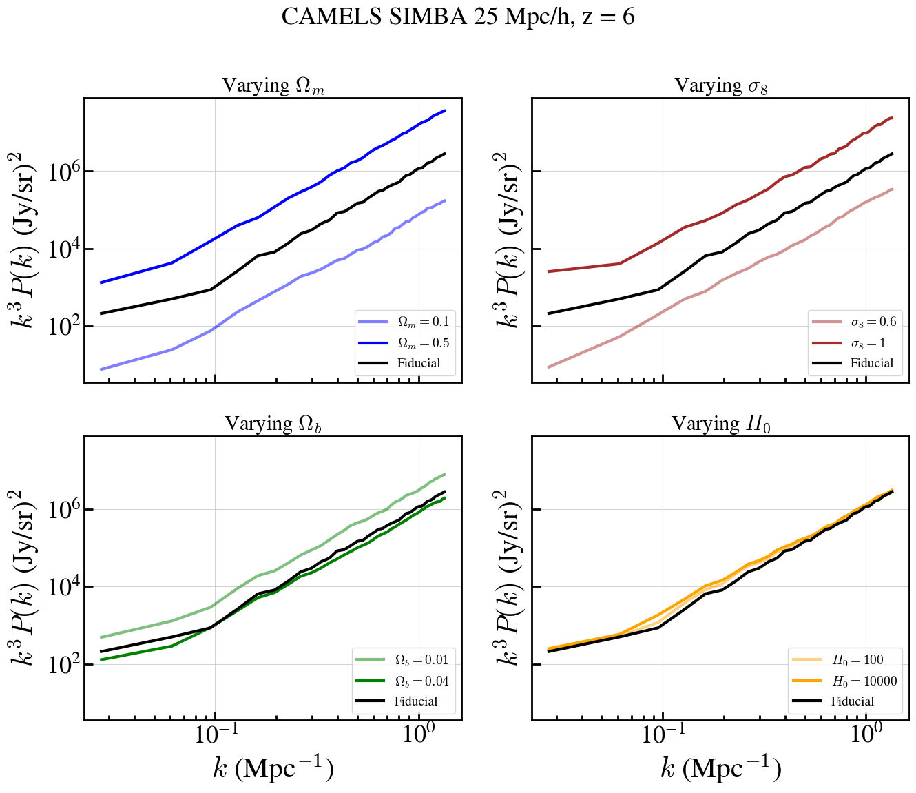
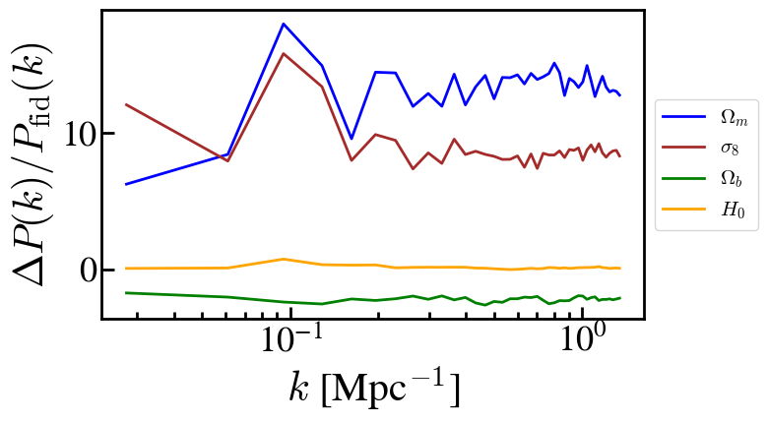
[CII] Power Spectrum for Varying Cosmological Parameters
PRELIMINARY

Slide 23
Limitations of Cosmological Simulations for LIM
🧊 Resolution Limits
Can’t resolve individual clouds;
Gas temperature and density averaged over
🔬 Missing Small-Scale Physics
No ISM chemistry, turbulence, or dust;
Need models to predict line emission
💫 Feedback (and other astrophysical) Models
Tunable recipes for AGN and SN effects
📏 Size Limit
Computationally expensive
🎲 One Box per Redshift
Set parameters; cosmic variance

Slide 24
LIM Modeling with Hydrodynamical Simulations
Bernal & Kovetz 2022

Slide 25
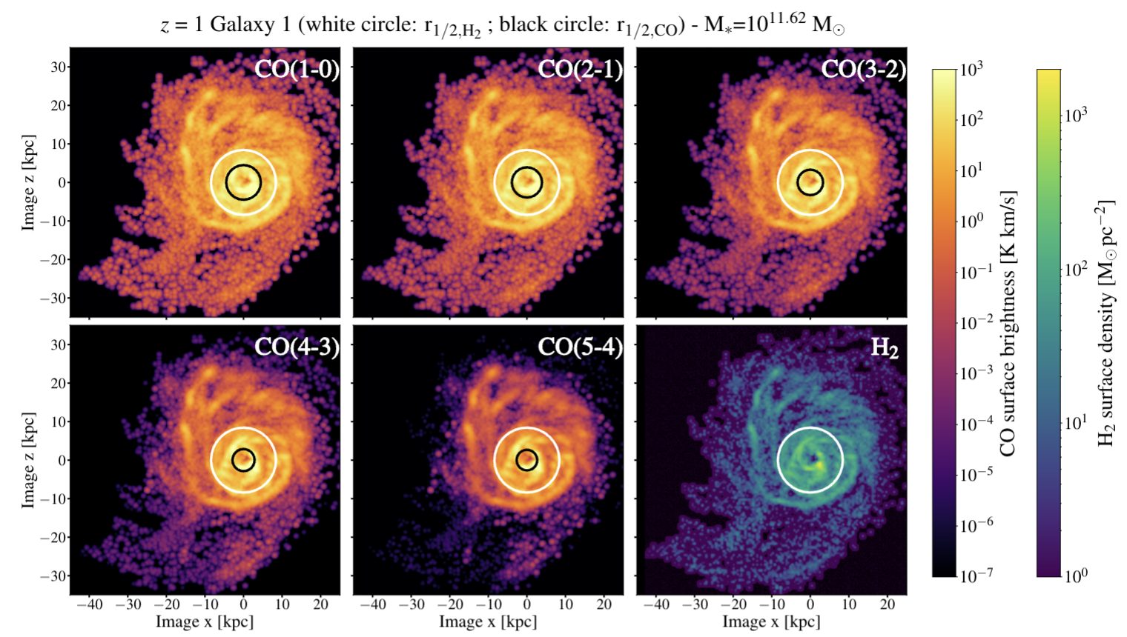
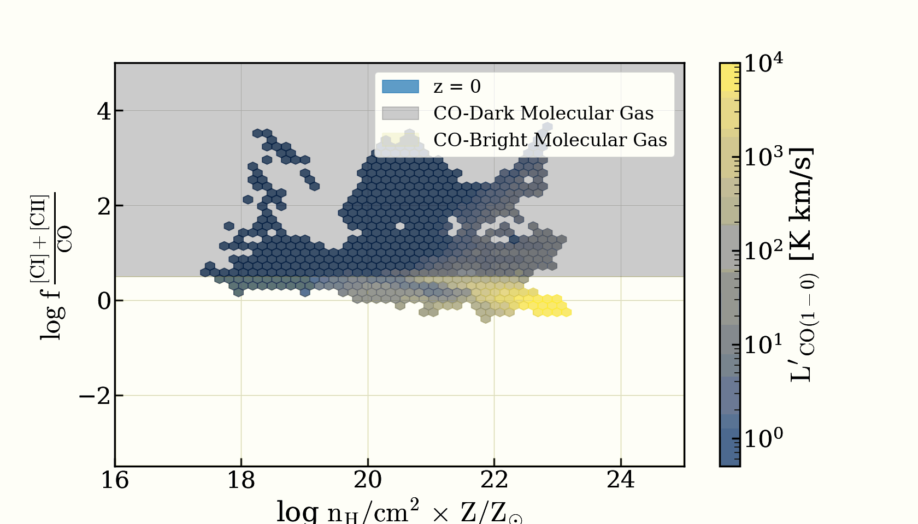
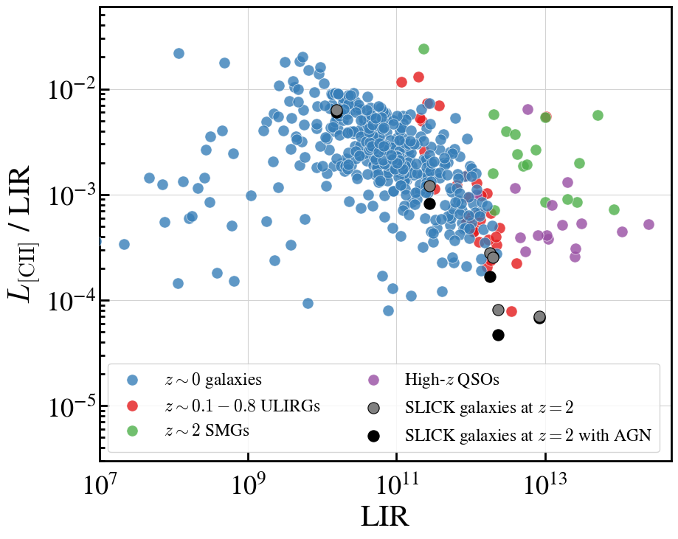
Other amazing SLICK projects
Anirudh (IISER/MPIA), Popping (ESO), Kaasinen (ANU)
→ Resolved CO transitions in galaxies
→ Accepted to A&A
PRELIMINARY
PRELIMINARY
Valentin-Martínez (UF), Narayanan (UF)
Dark-CO studies
Patil, Petric, Rowlands (Johns Hopkins University/STScI)
→ Impact of AGNs on molecular line luminosities

Slide 26
Conclusions
Line-Intensity Mapping experiments will be crucial for measuring the evolution of astrophysics and cosmology at a wide range of redshifts.
Cosmological hydrodynamic simulations are powerful tools for LIM studies, but capturing the complex physics of galaxy formation in small-scale processes that impact large-scale observables is challenging.
SLICK addresses this by combining PDR-based modeling of the ISM with machine learning, offering both physical interpretability and computational efficiency.
SLICK has been used by multiple groups worldwide to investigate CO transitions in galaxies, quantify the abundance of dark CO in the universe, assess the impact of AGN on molecular lines, and explore a variety of other projects on galaxy evolution and line intensity mapping cosmology.
Feedback processes and other astrophysical/cosmological assumptions can significantly impact LIM observables. SLICK+CAMELS helps us quantify these effects and develop strategies to marginalize over theoretical uncertainties.

