Slide 1
A search for millimeter-wave transient sources in the Galactic Plane with SPT-3G
Yujie Wan
+SPT-3G Collaboration
yujiew2@illinois.edu
University of Illinois Urbana-Champaign, NCSA CAPS Fellow
mm Universe, 06/26/2025

Slide 2
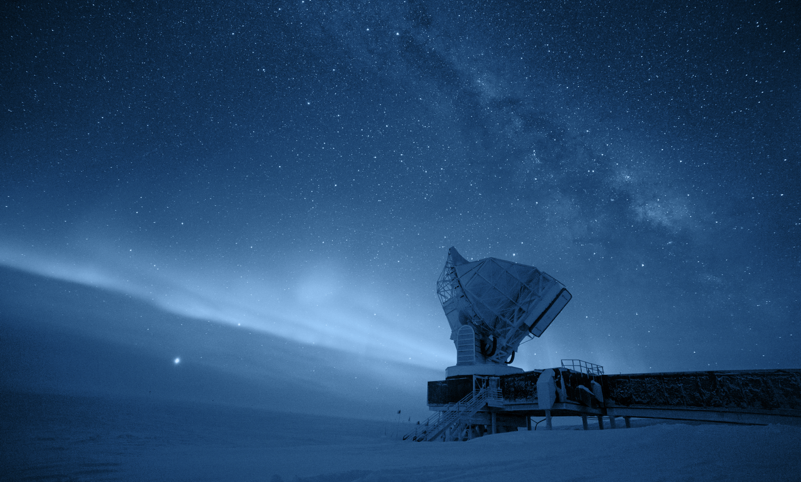
Mm-wave transient search with SPT
South Pole Telescope (SPT) is a 10 meter diameter, wide field telescope located at Amundsen-Scott South Pole Station in Antarctica.
Observing Strategy: repeated observations of the same patch of sky for multiple years with cadence between 2-20 hours.
Observing bands: 90GHz, 150GHz, and 220GHz.
Angular resolution: ~ 1’.
FoV: 1.88 deg.
Talks earlier this week: overview (Gil Holder); galaxy clusters (Lindsey Bleem; Sebastian Bocquet; Kayla Kornoelje; Matthew Young); source catalogs (Joaquin Vieira; Melanie Archipley); Lensing (Yuuki Omori; Fei Ge); AGN (Aidan Simpson, John Hood); Cosmology (Wei Quan; Etienne Camphuis); LIM (Adam Anderson); etc.
Photo credit: Daniel Michalik

Slide 3
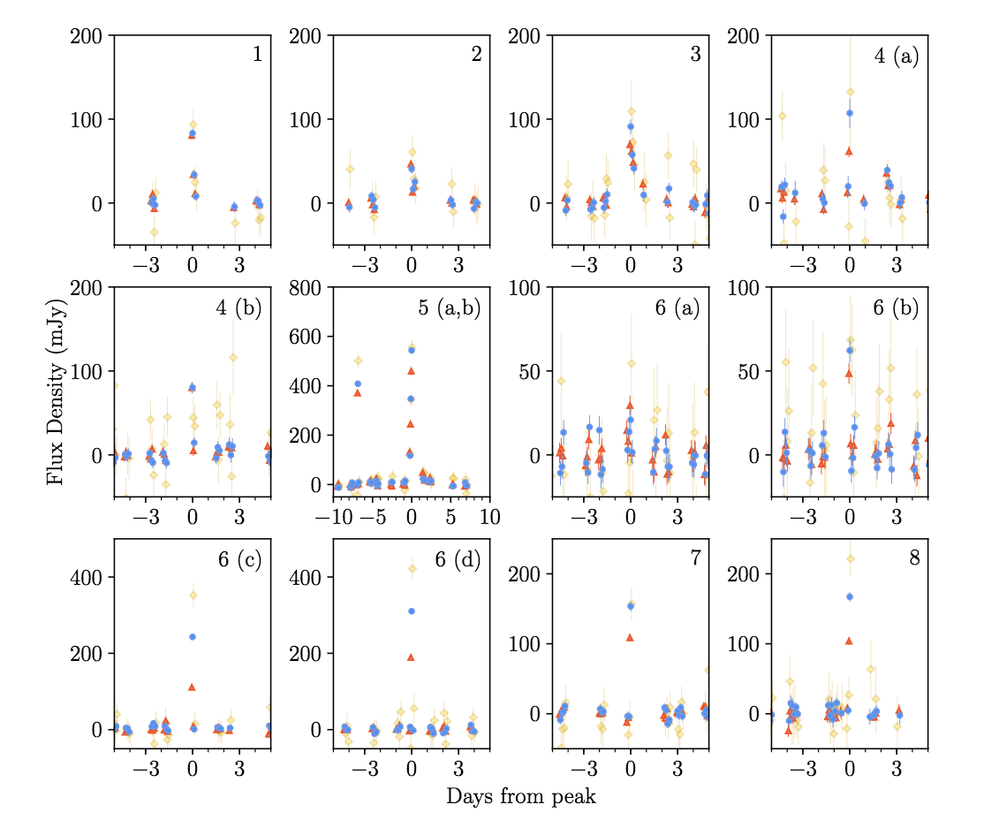
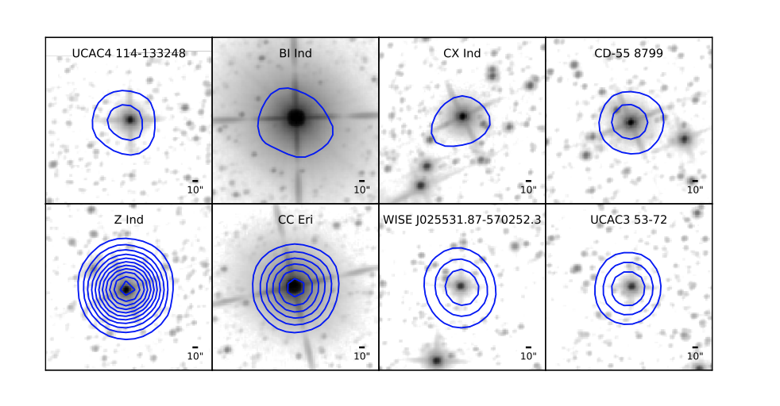
First systematic transient search with SPT-3G
Transient survey using one year of data covering 1500 square degrees with SPT-3G
Detect 15 transient events: 13 stellar flares from 8 stars and 2 extragalactic events.
Guns et al. 2021
Associated stars with WISE
Blue contours: SPT 150GHz
Grayscale image: WISE W1(3.6µm)
Guns et al. 2021
SPT lightcurves for all the detected stellar flares
90GHz 150GHz 220GHz

Slide 4
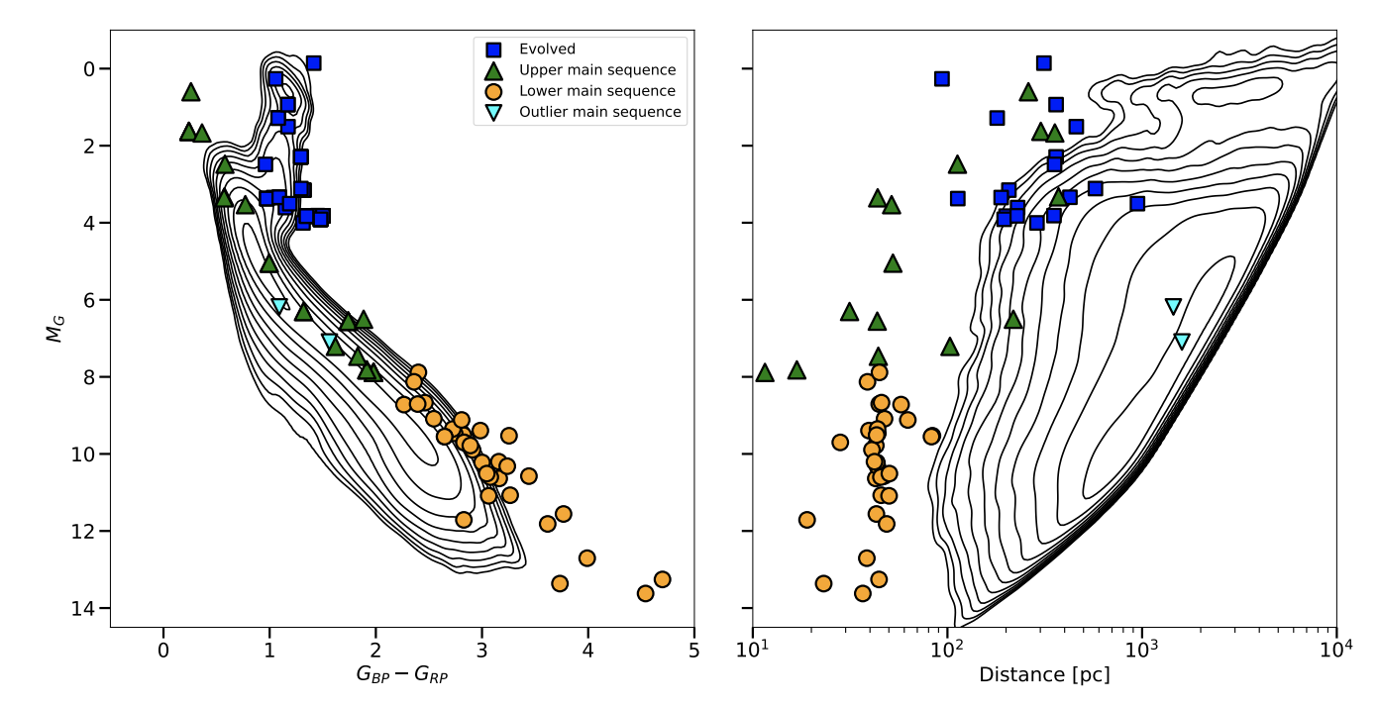
Stellar flare catalog
Stellar flare catalog from 4 year of survey data with SPT-3G, containing 111 stellar flares from 66 stars.
Tandoi et al. 2024

Slide 5
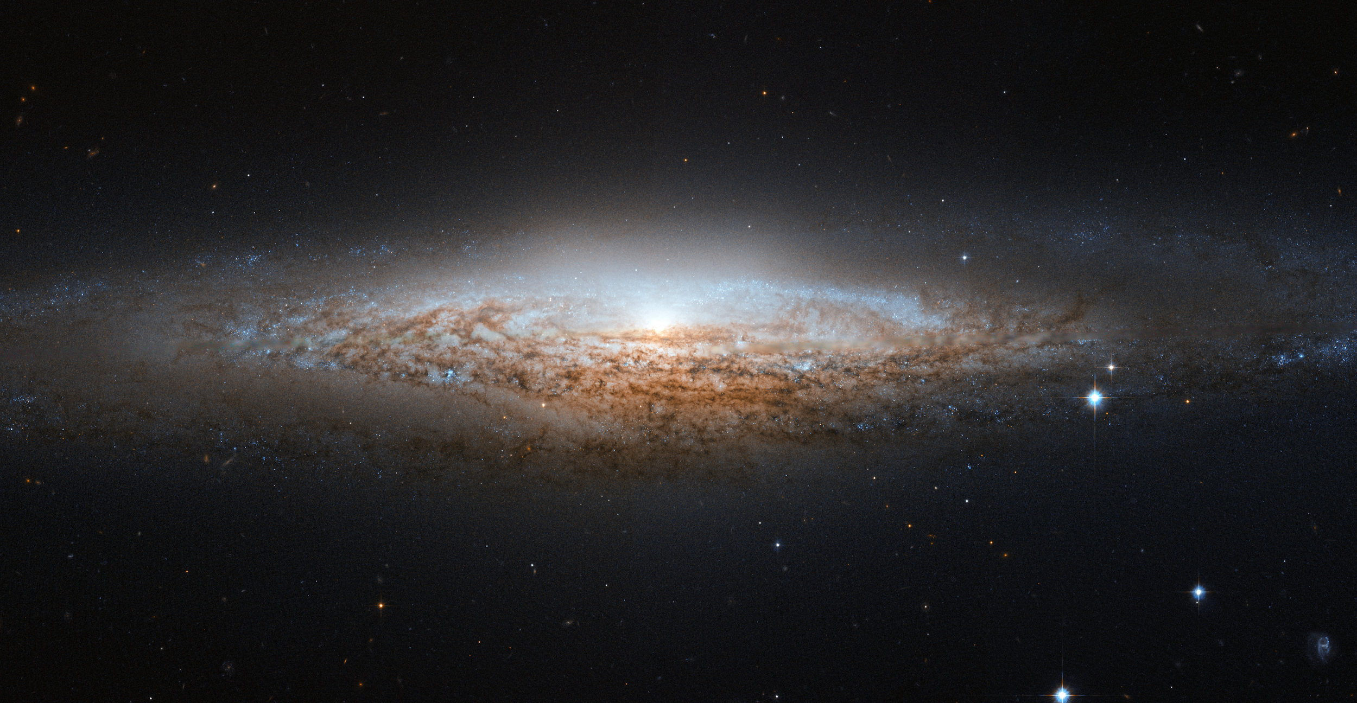
Motivation for the Galactic Plane transient survey
Previous surveys avoided the Galaxy, and mostly found Galactic flaring stars.

Slide 6
Motivation for the Galactic Plane transient survey
If we look towards the plane of the Galaxy, we can see tons of stars and other interesting objects

Slide 7
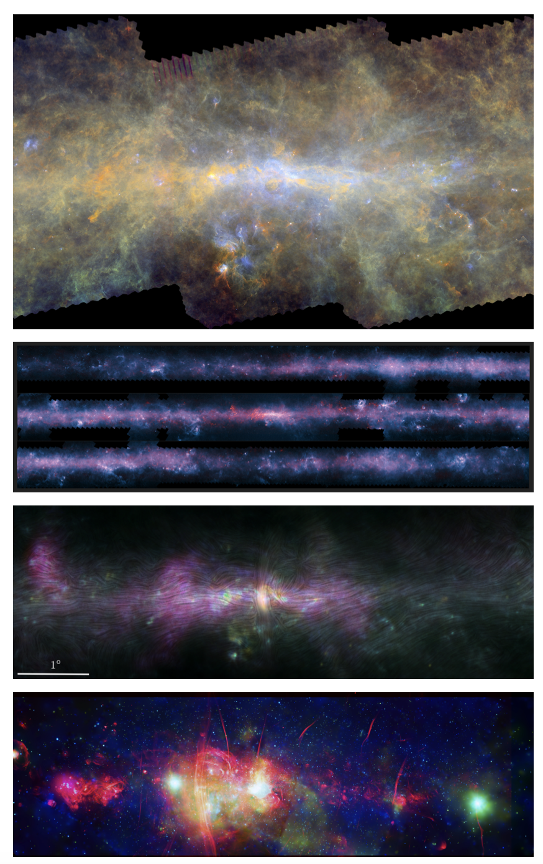
Long wavelength Galaxy surveys
Hi-GAL, the Herschel infrared Galactic Plane Survey: 70, 160, 250, 350 and 500 um in T over ~12 deg²; photometric maps and compact source catalogues. (Malinari et al. 2016)
MeerKAT observed 6.5 deg² at 1.3GHz (Heywood et al. 2022)
ACTpol observed 32 deg² in T and P in 2019 (Guan et al. 2021)
APEX/LABOCA ATLASGAL observed 400 deg² at 870um from 2017-2010 (Schuller et al. 2009, Contreras et al. 2013, Csengeri et al. 2014)
These were all static continuum surveys
Not time-domain

Slide 8
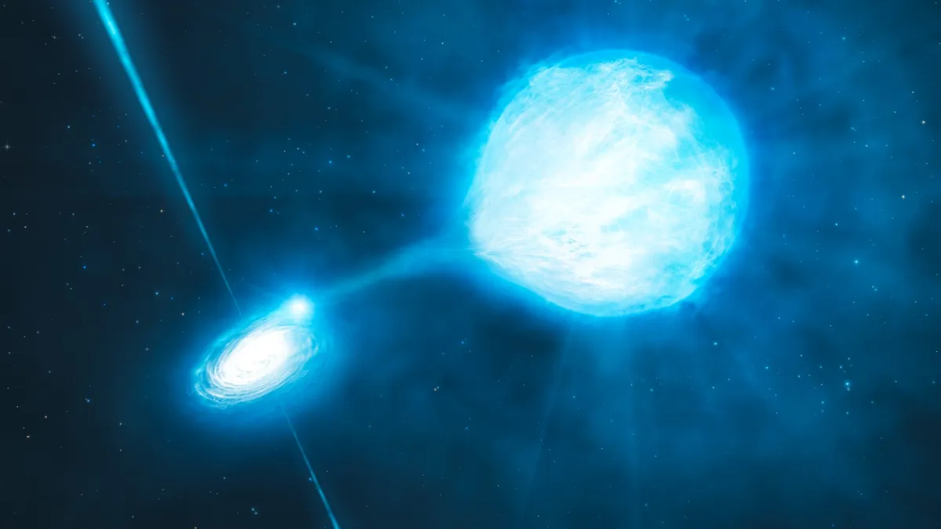
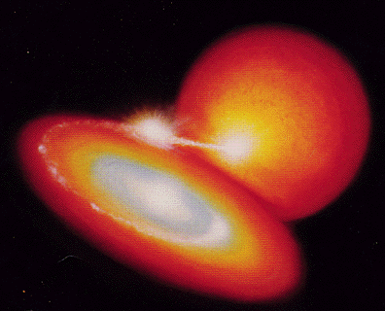
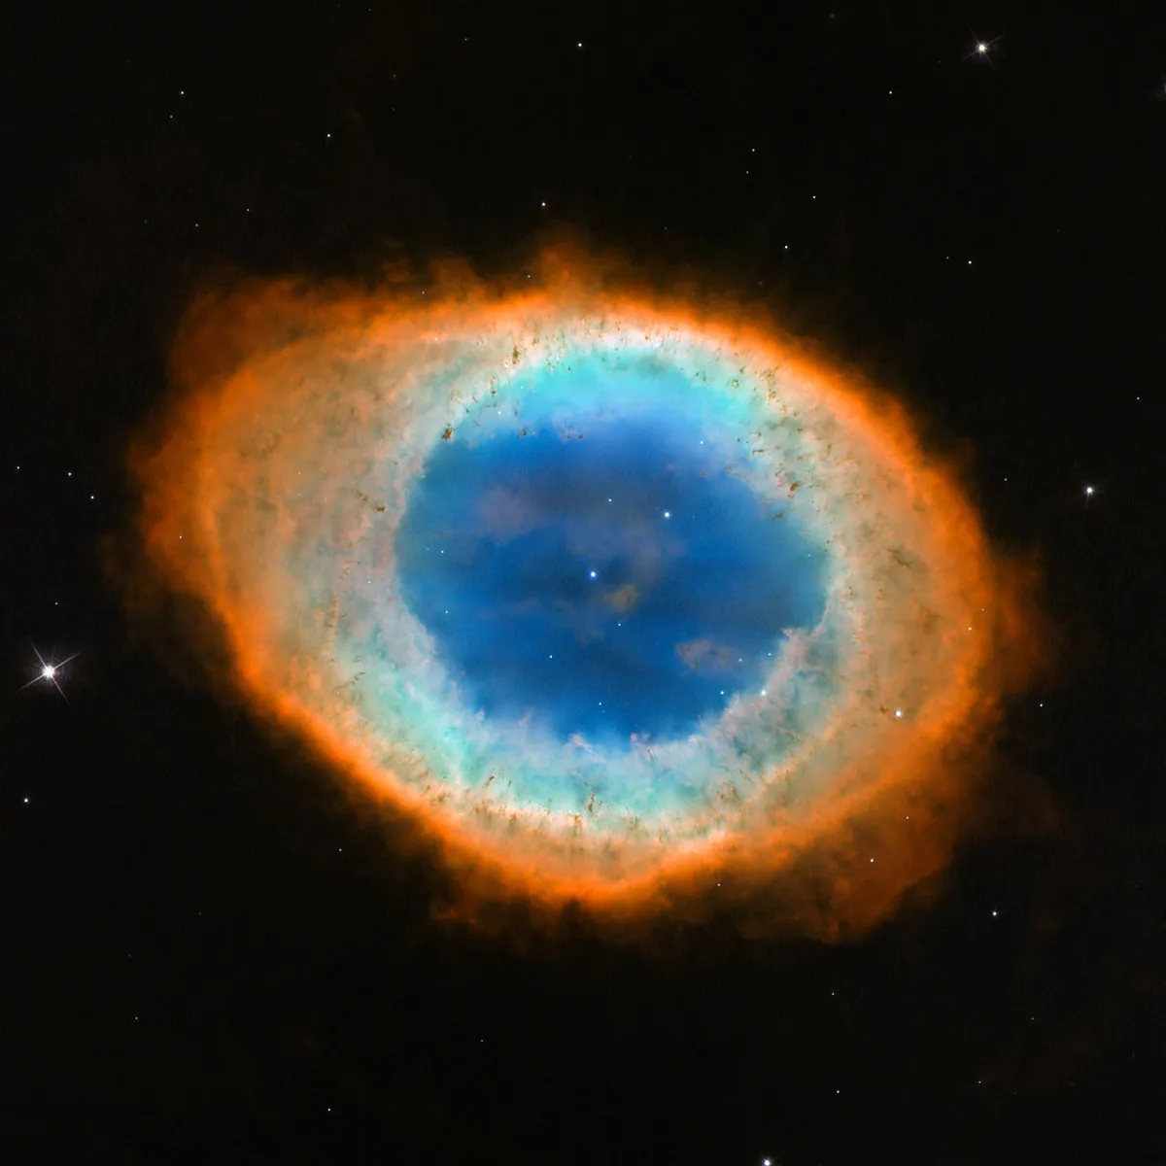
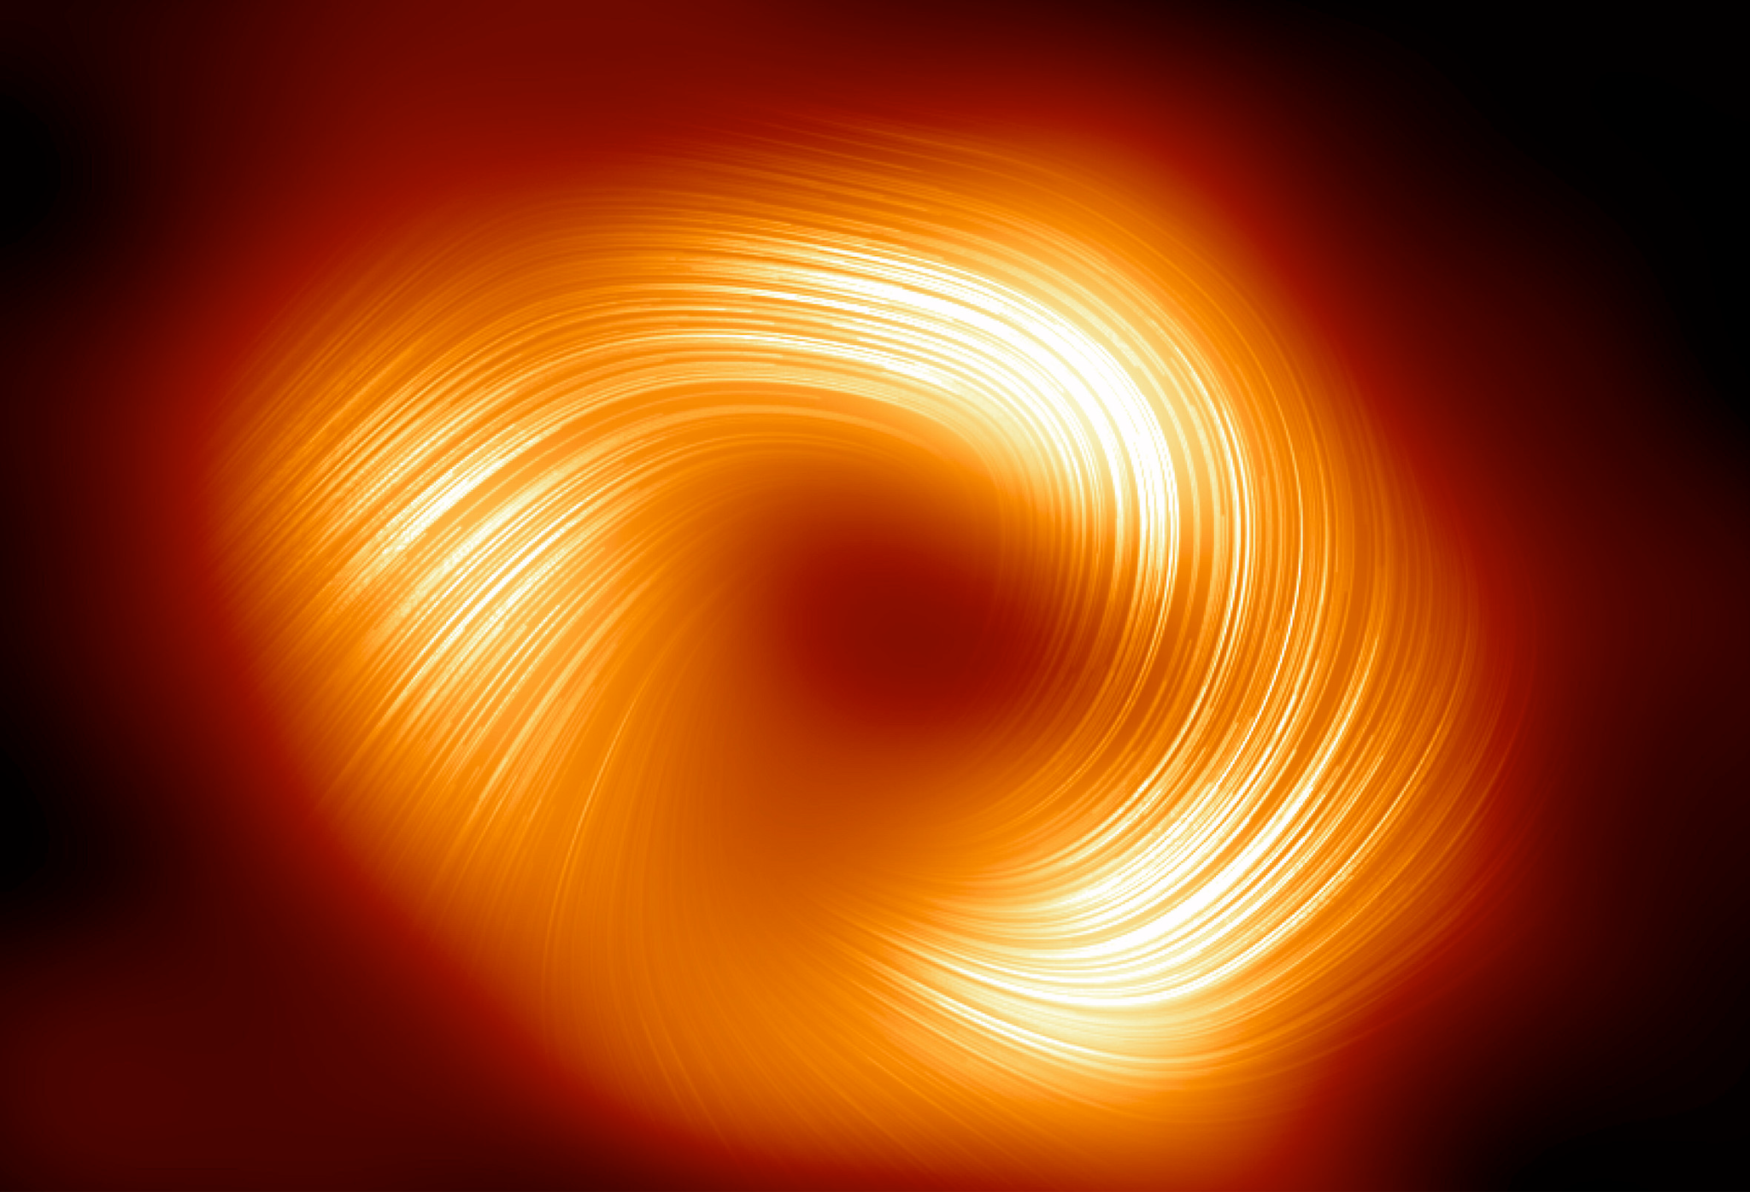
Science Cases
Stellar flare
X-ray binary
Accreting white dwarf
Credit: S. Dagnello, NRAO/AUI/NSF
Credit: ESO/L. Calçada/M.Kornmesser
Credit: Dana Berry, STScI
Planetary Nebula
Magnetar
Sgr A*
Credit: NASA, ESA and the Hubble Heritage (STScI/AURA)-ESA/Hubble Collaboration
Credit: Carl Knox, OzGrav
Credit: EHT Collaboration

Slide 9
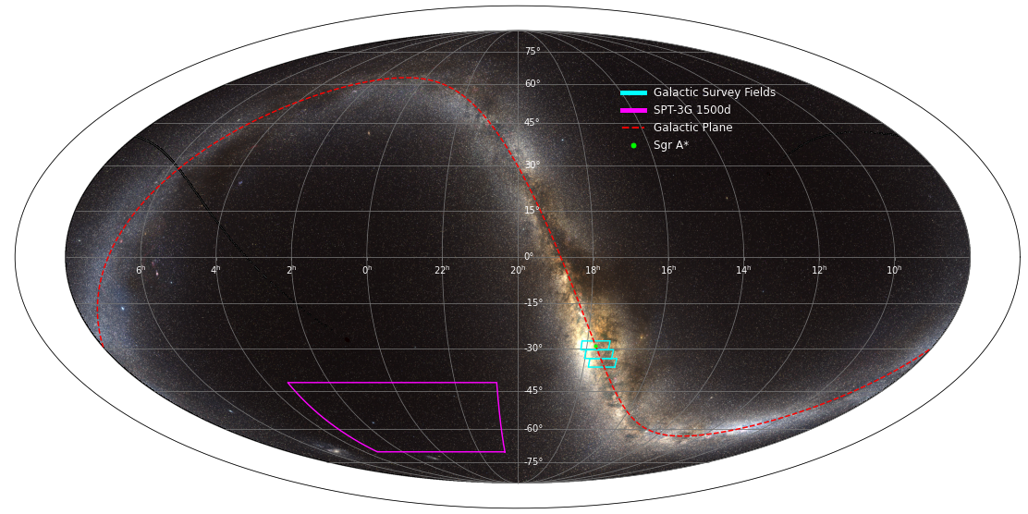
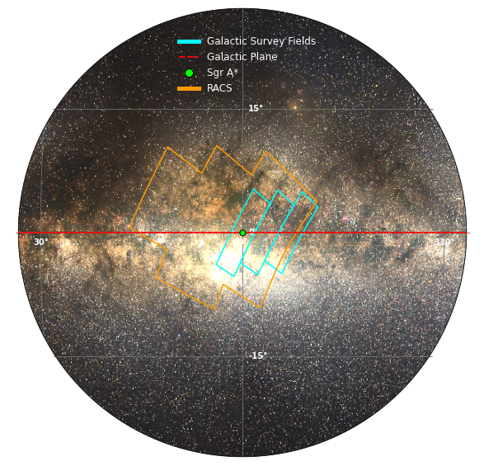
The Galactic Plane transient survey
Images Credit: Paul Chichura
Location: The Galactic Plane
Time: Roughly one month every year starting from 2023

Slide 10
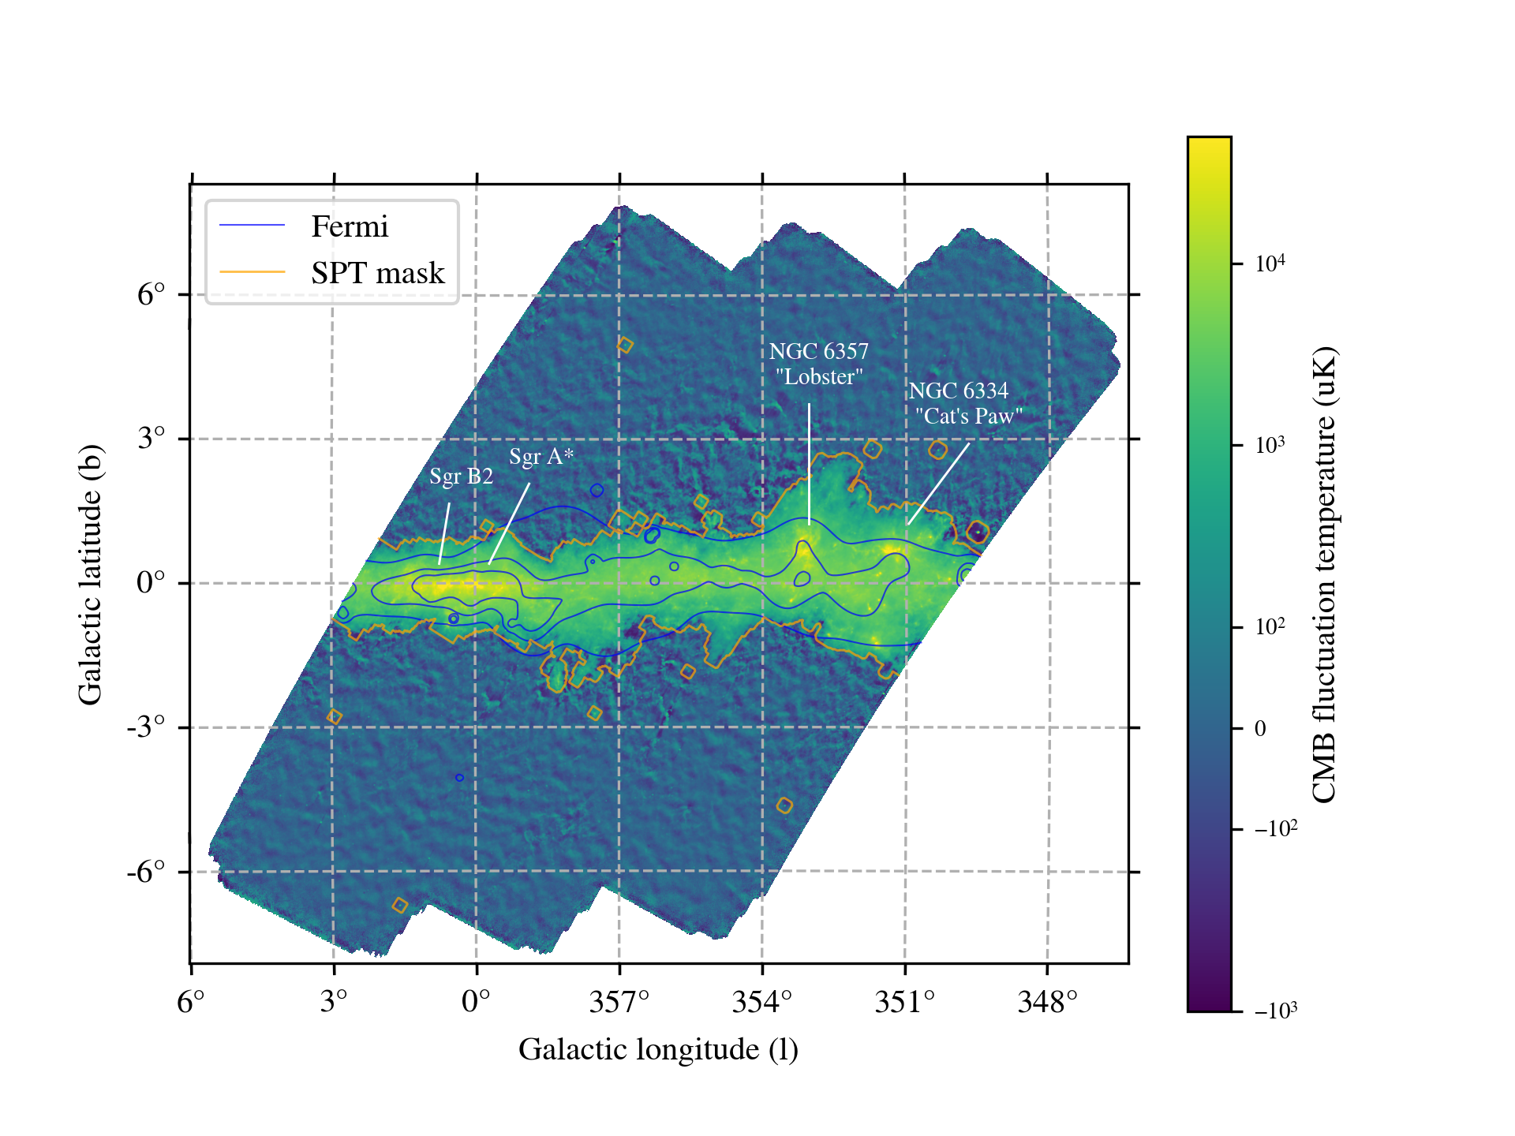
The Galactic Plane transient survey
Total area: ~98 deg²
Number of obs: ~500
Observing bands: 90, 150, and 220 GHz
Coadded depth: 5.6, 6.8 and 23uK-arcmin at 90, 150 and 220GHz
16 deg
3 deg

Slide 11
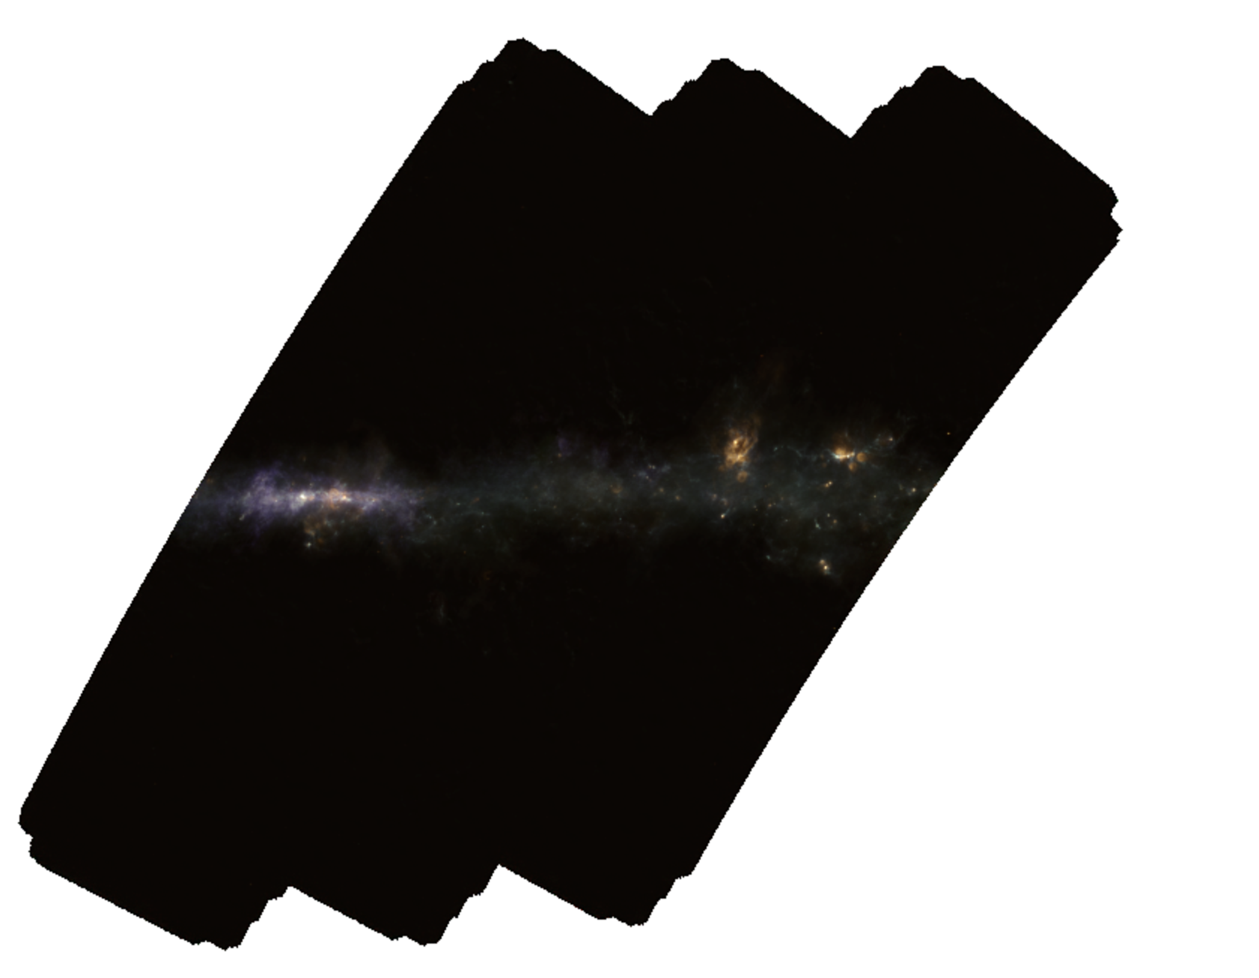
The Galactic Plane transient survey
90GHz/3mm 150GHz/2mm 220GHz/1.4mm

Slide 12
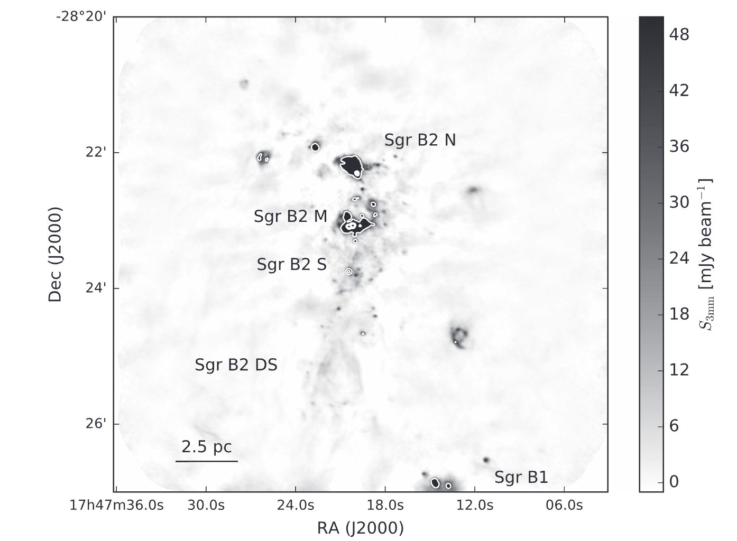
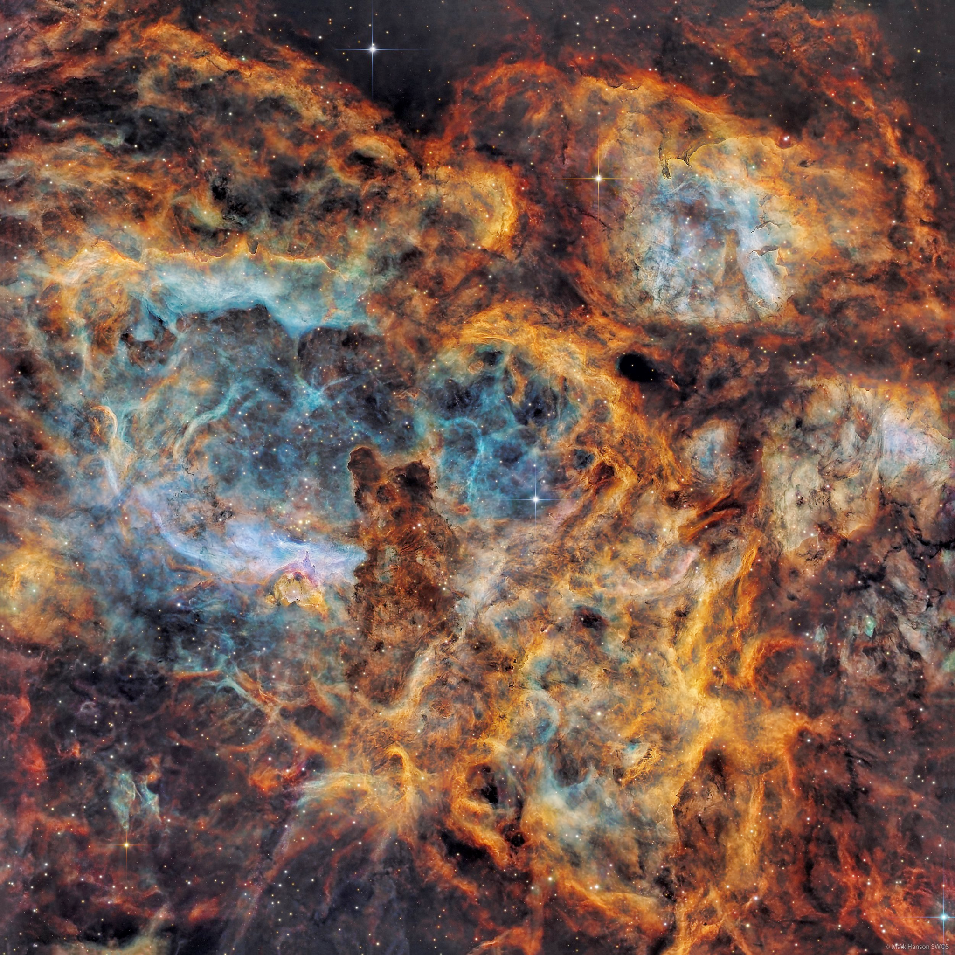
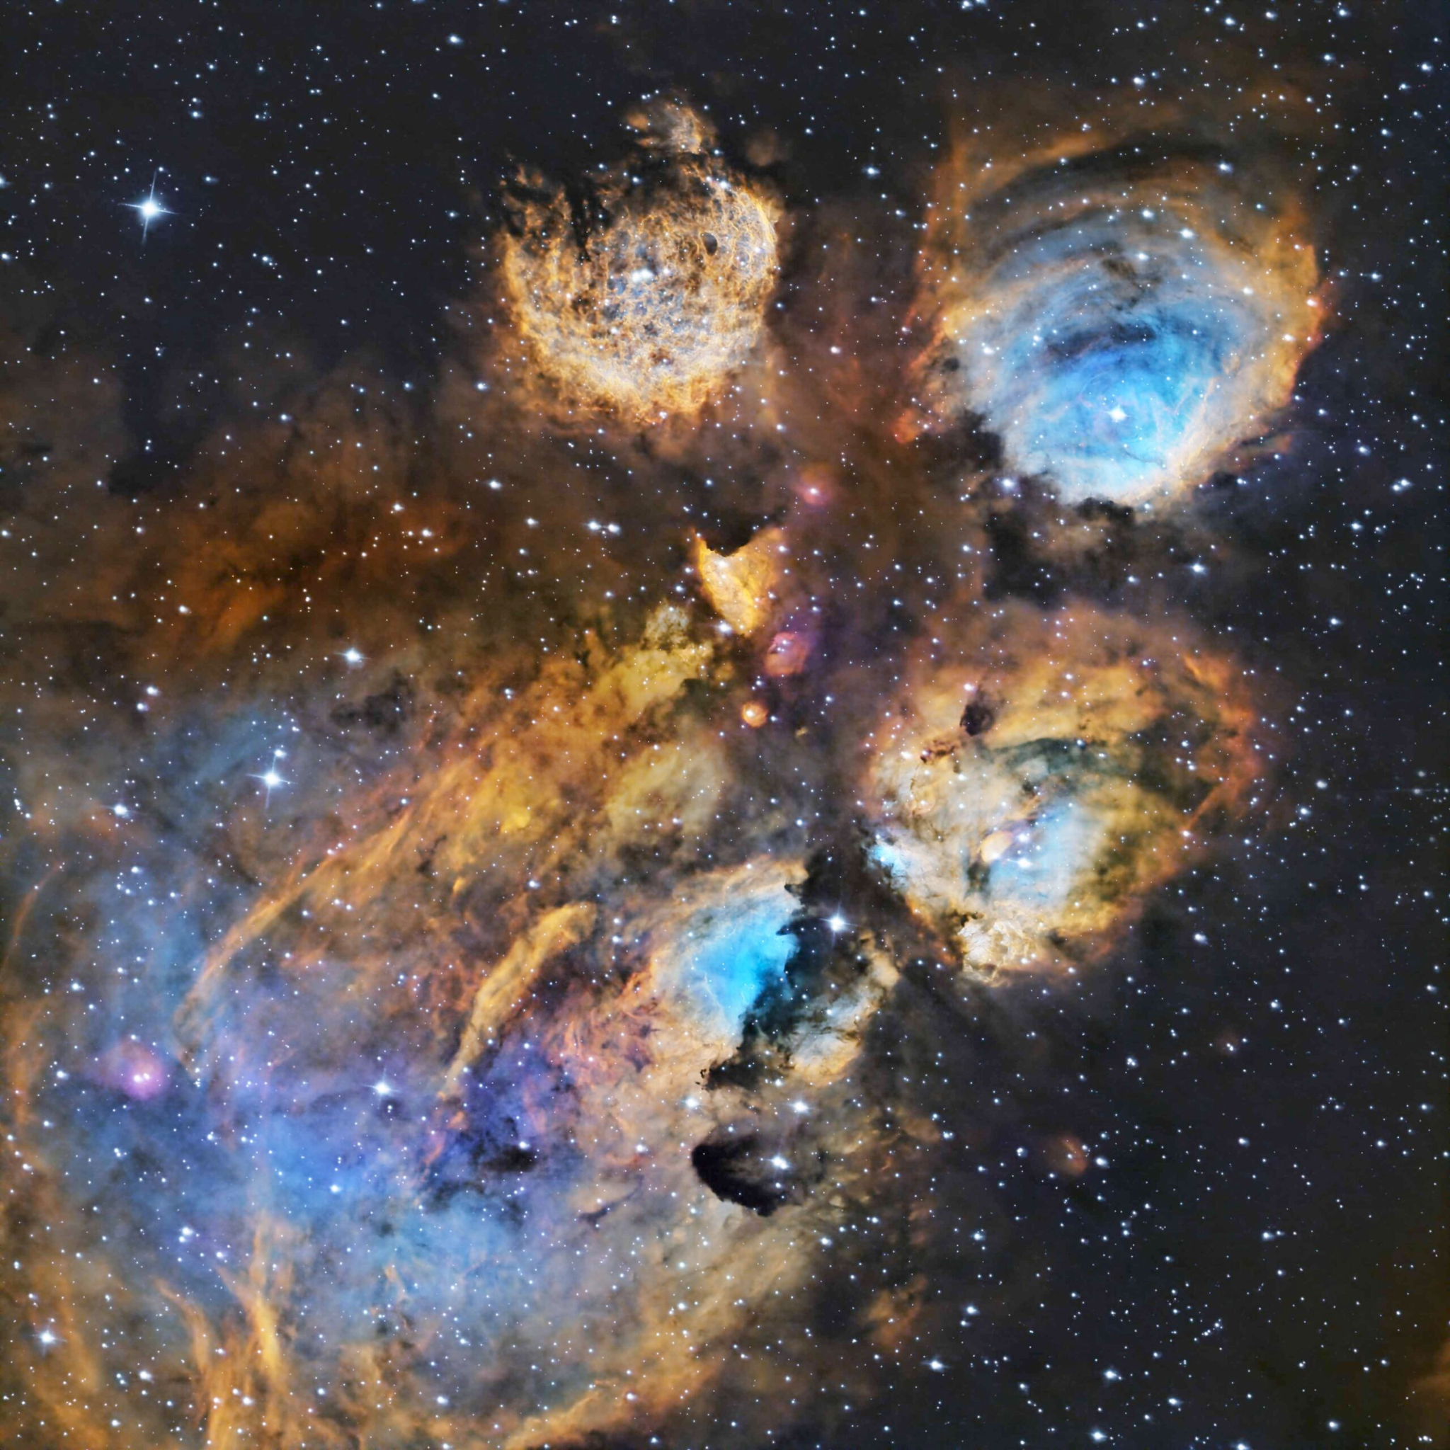
The Galactic Plane transient survey
Ginsburg et al. 2018
Credit: EHT Collaboration
Image credit: Mark Hanson
Image credit: Daniel Stern
NGC 6357
“Lobster”
NGC 6334
“Cat’s Paw”
Sgr B2
Sgr A*
90GHz/3mm 150GHz/2mm 220GHz/1.4mm

Slide 13
Workflow for transient detection
Time ordered data
Mapmaking pipeline
Individual maps
Combine all individual maps together
Average map
Subtract the average map from the individual maps
Difference Maps
Transient detection pipeline
Lightcurve for transient events

Slide 14
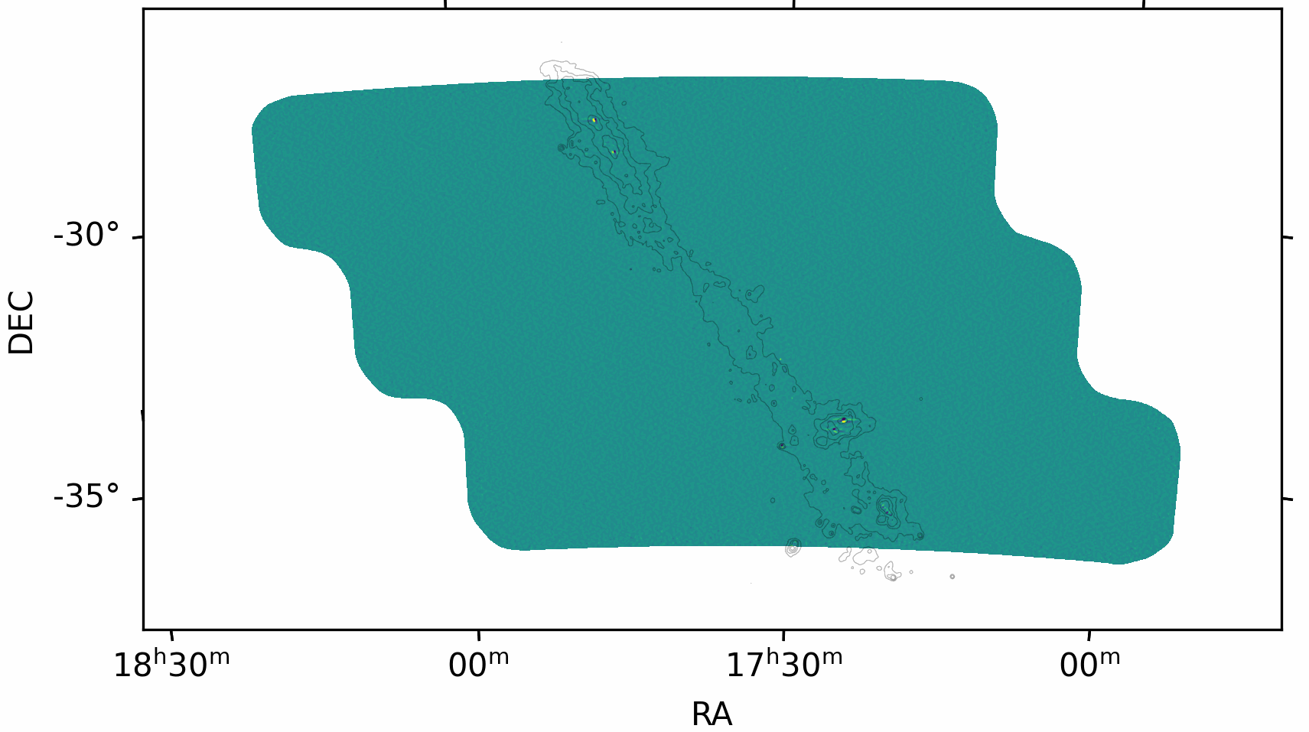
Transient detection
Run through all difference maps in the same subfield in each year
Mask bright sources
Find outlier pixels (5 sigmas in both 90 and 150GHz simultaneous in one observation)
Extract lightcurve for outlier pixels
Sgr B2
Sgr A*
NGC 6357 ‘Lobster’
NGC 6334 ‘Cat’s Paw’

Slide 15
Results

Slide 16
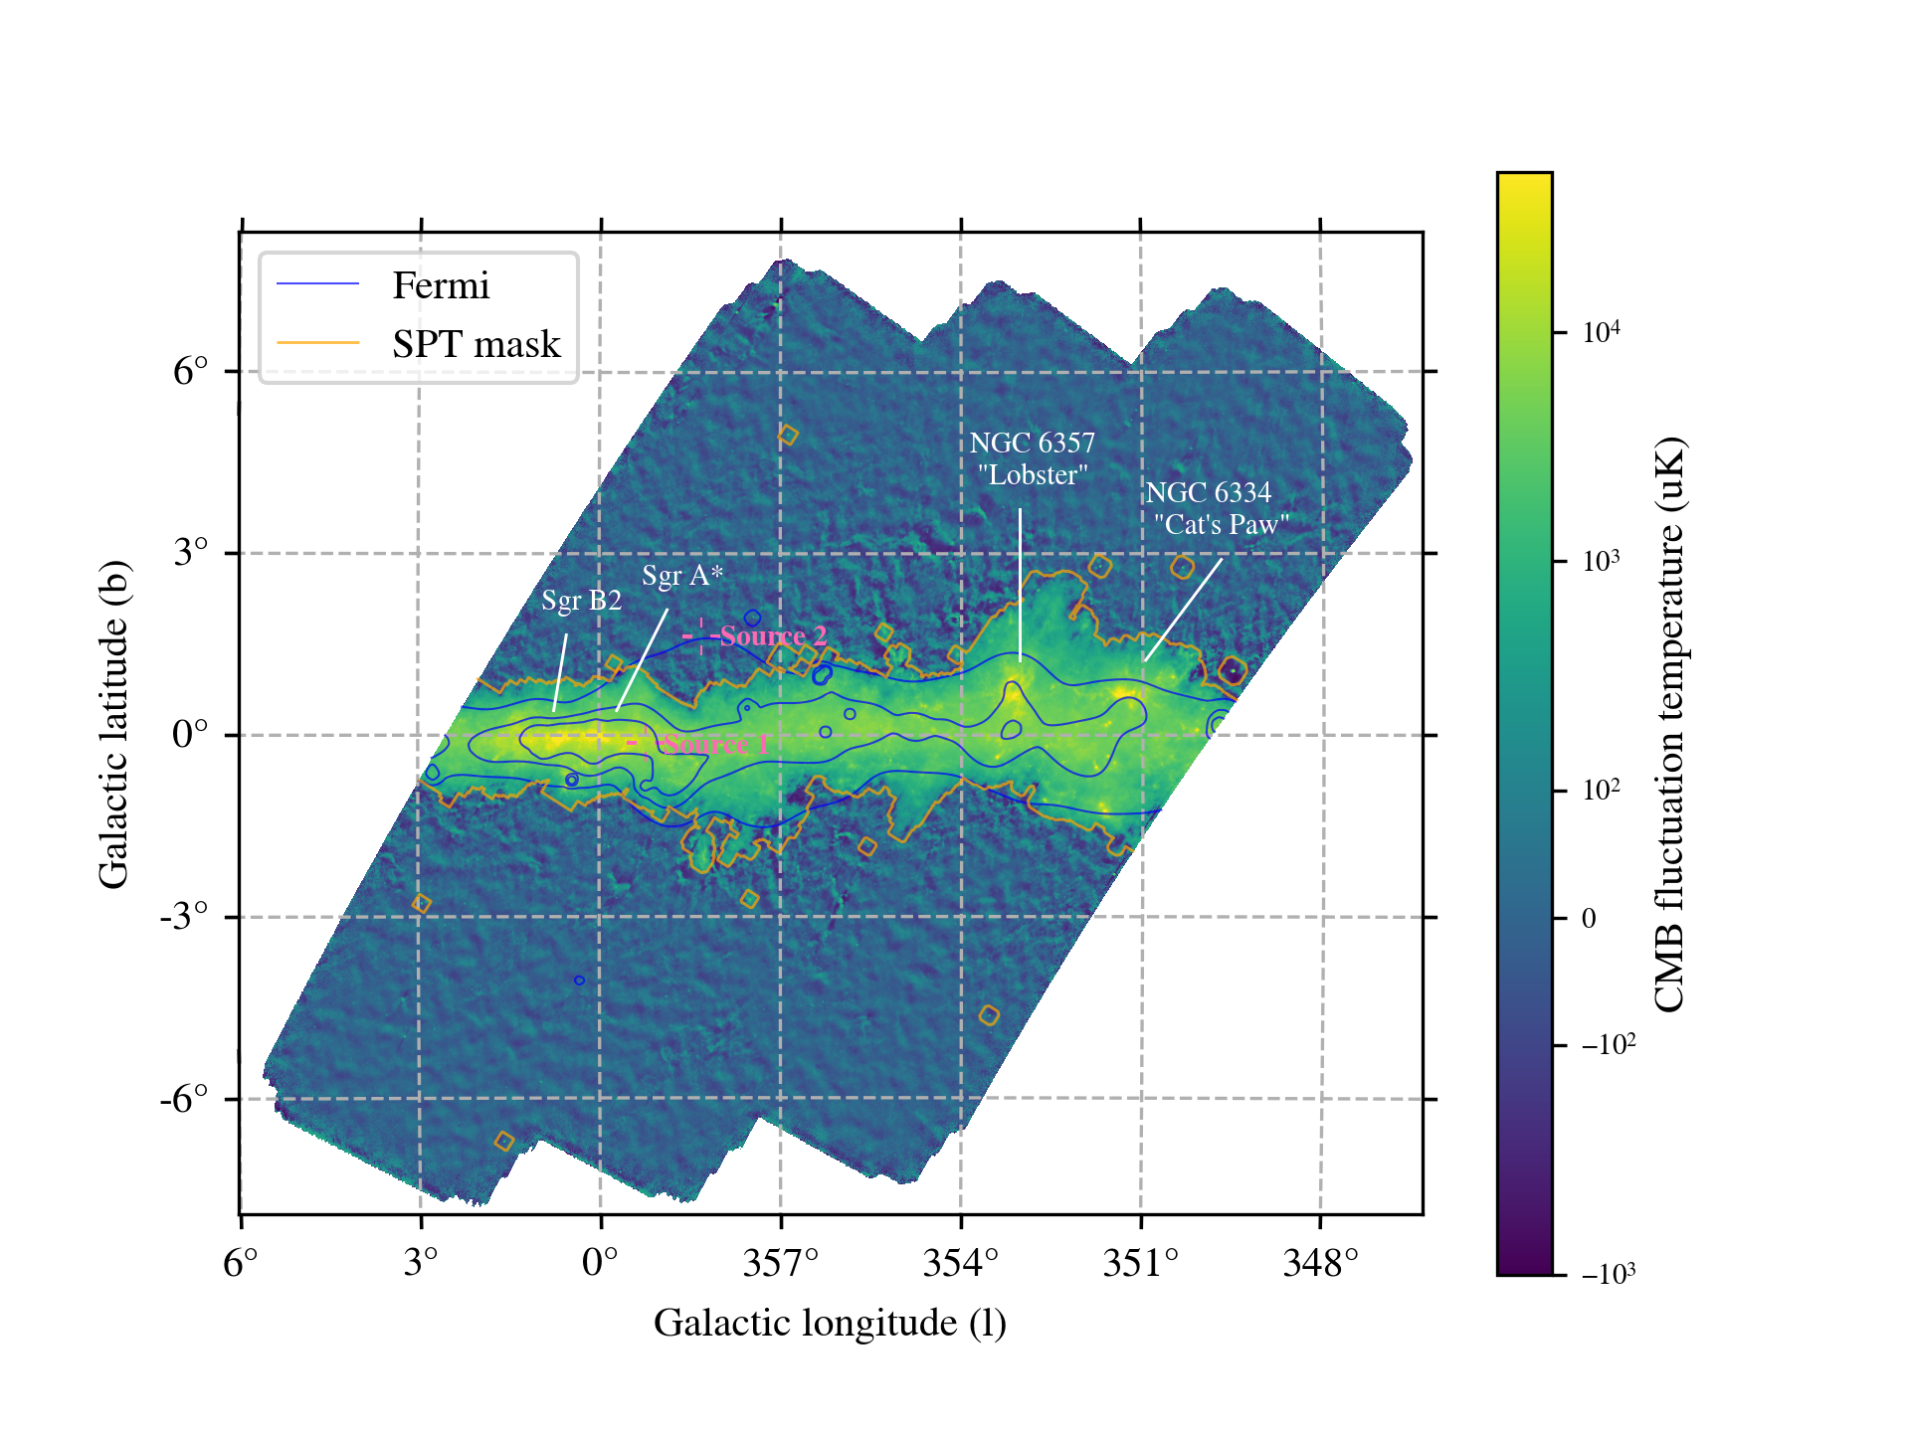
Results
We have found at least two transients during 500 hours of observations in 2023 and 2024 in the Galactic Plane with SPT-3G!

Slide 17
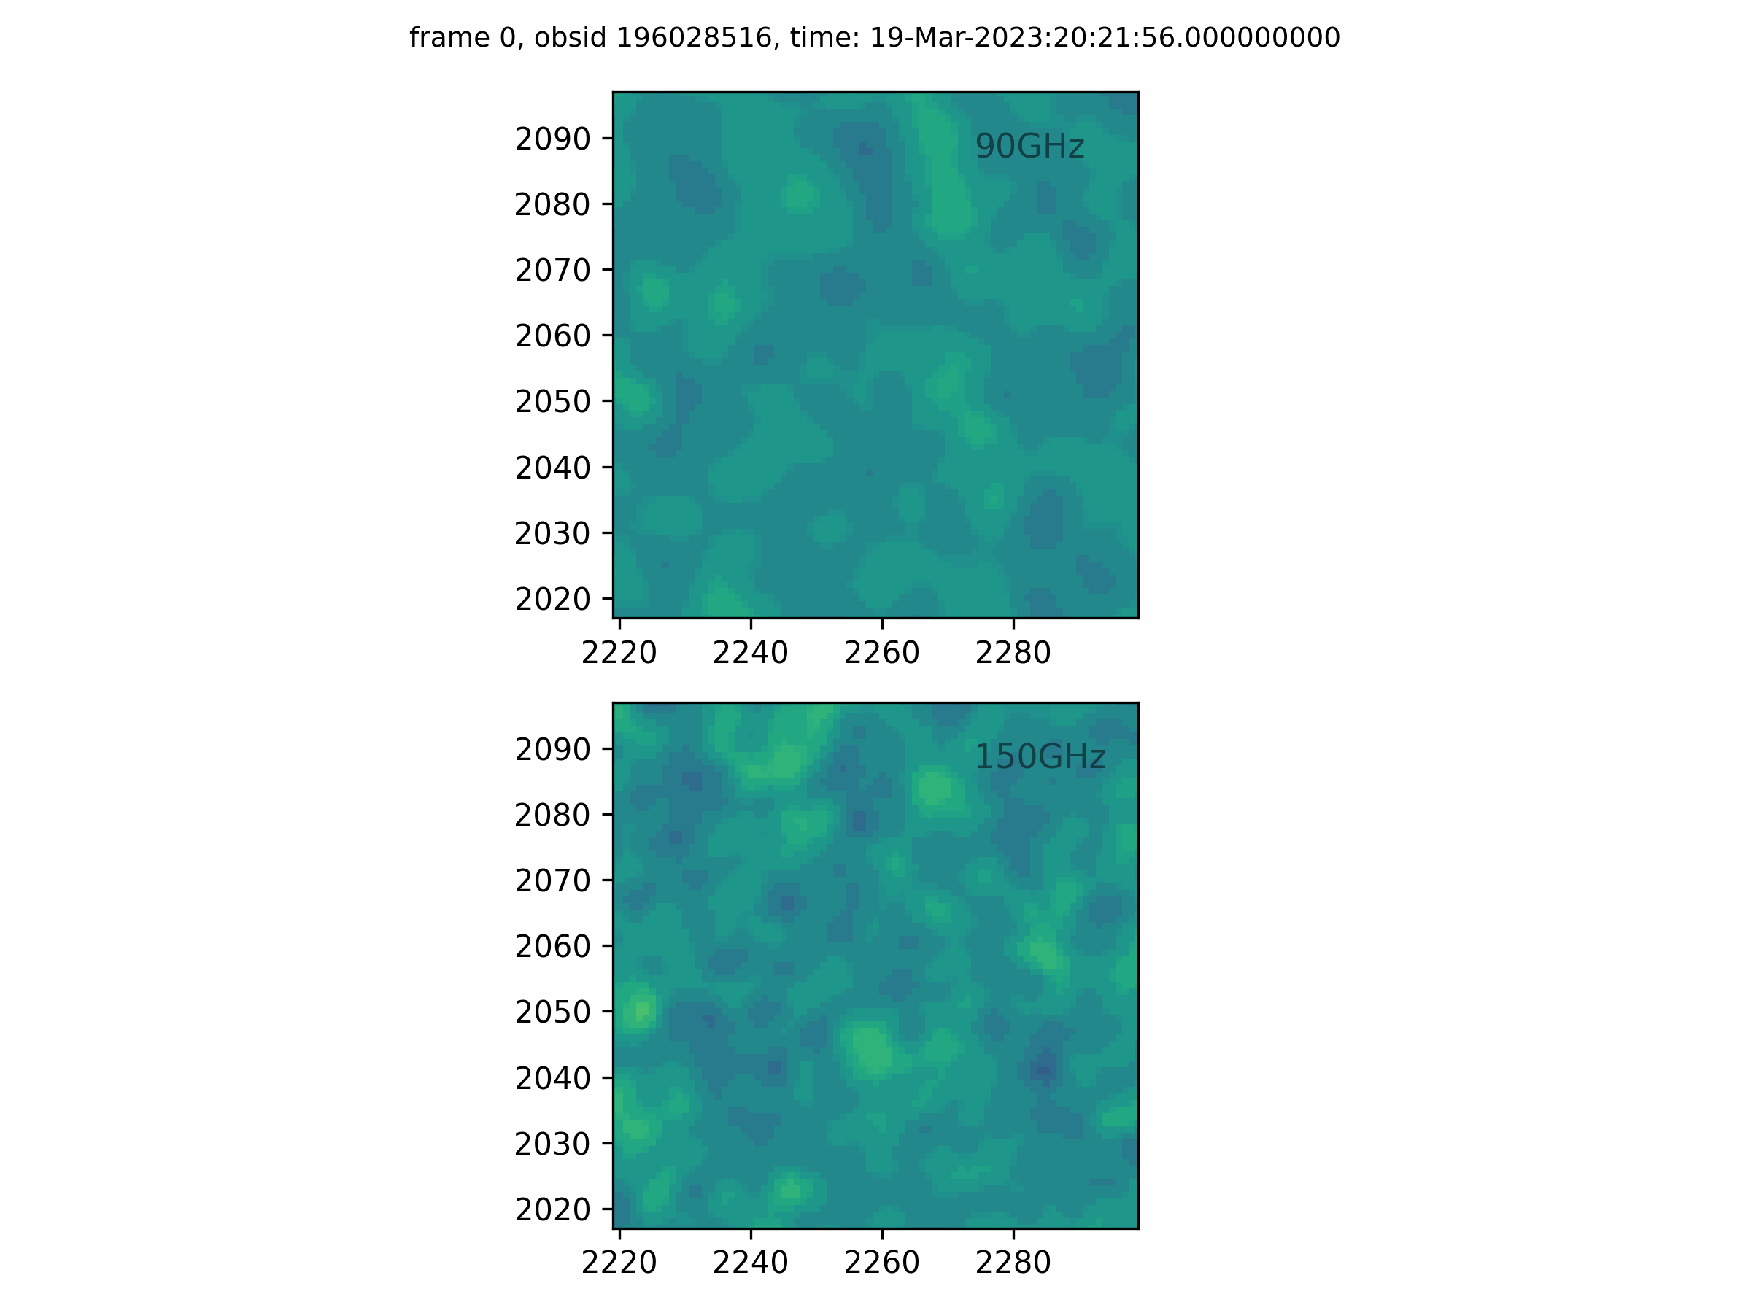
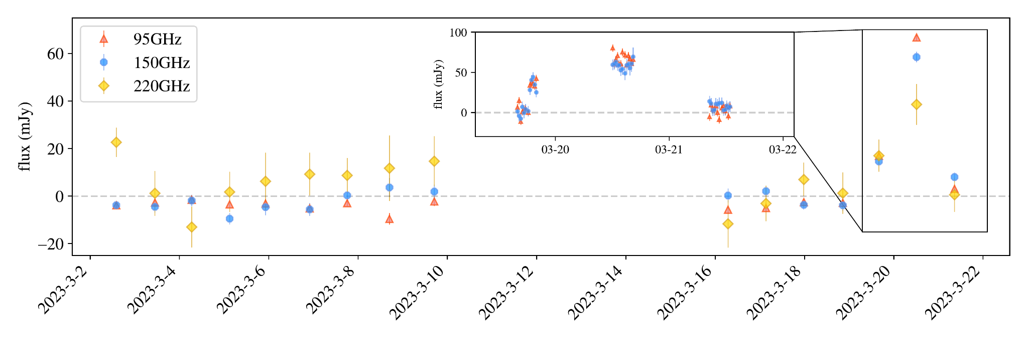
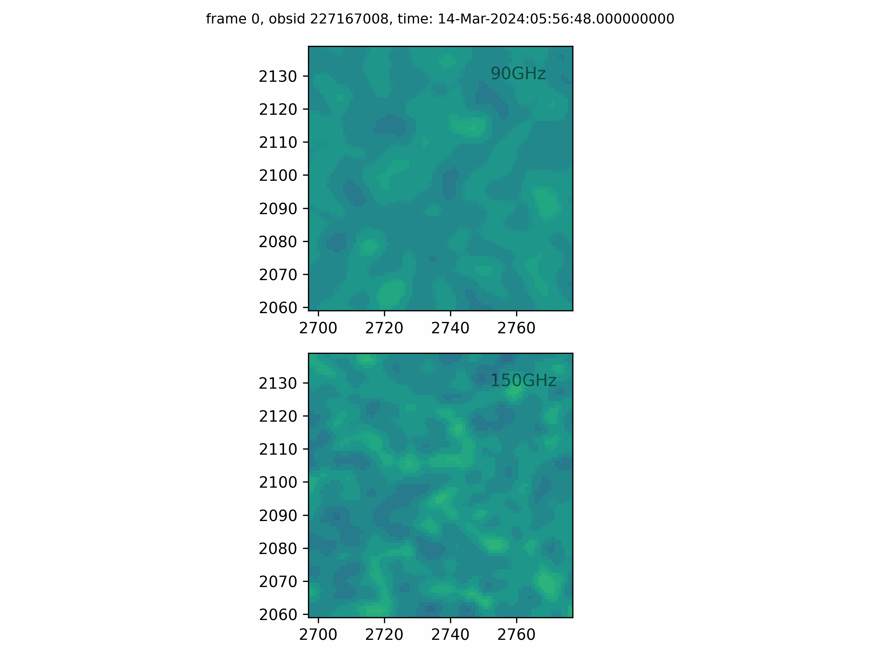
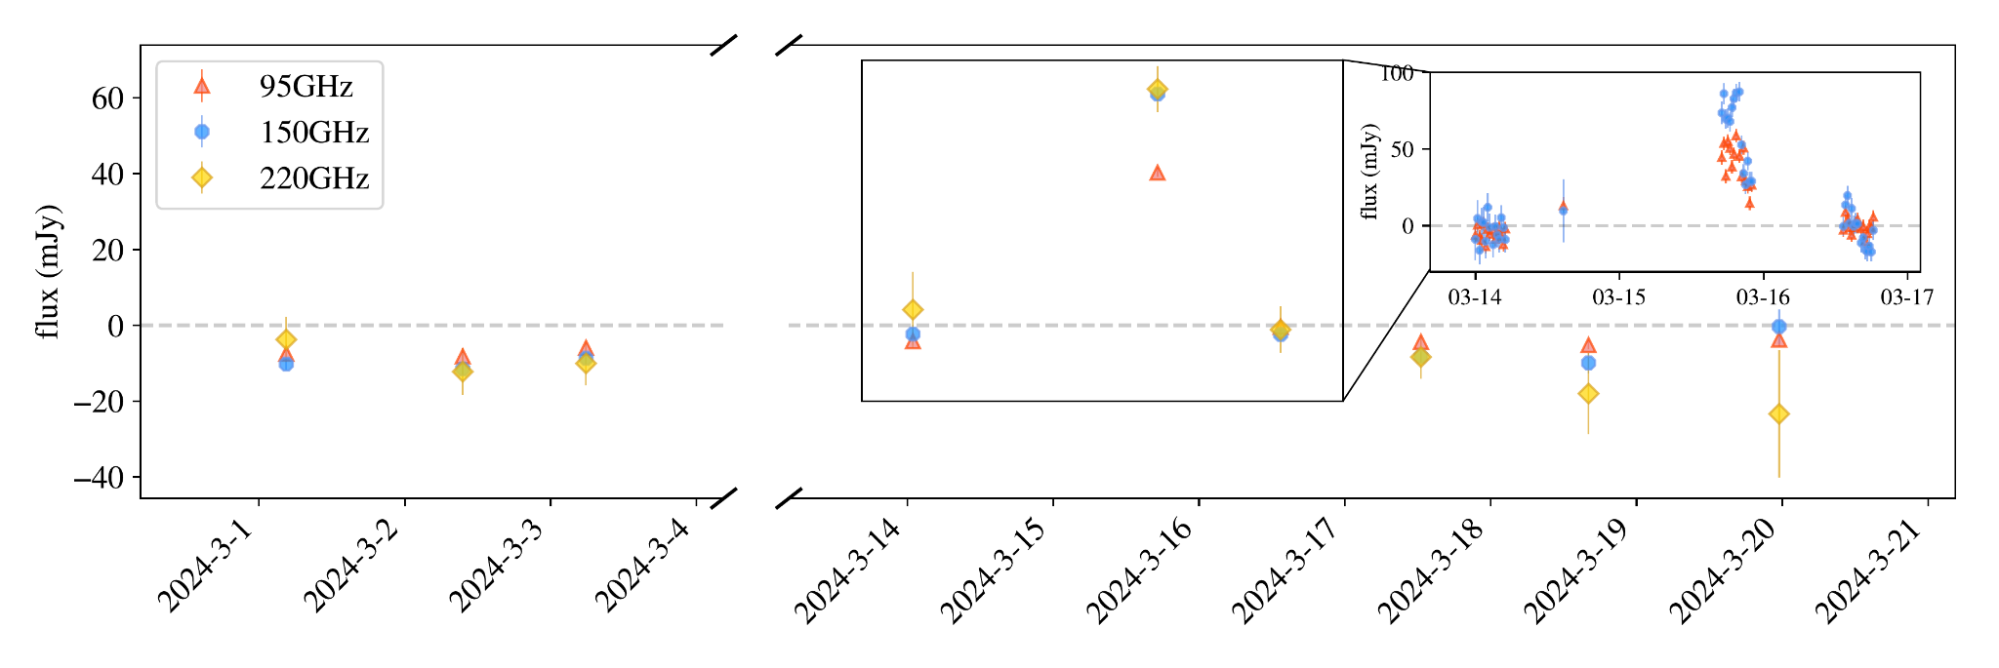
SPT lightcurves and thumbnails
Source 1
Source 2

Slide 18
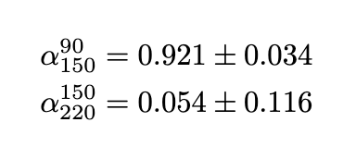
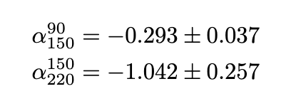
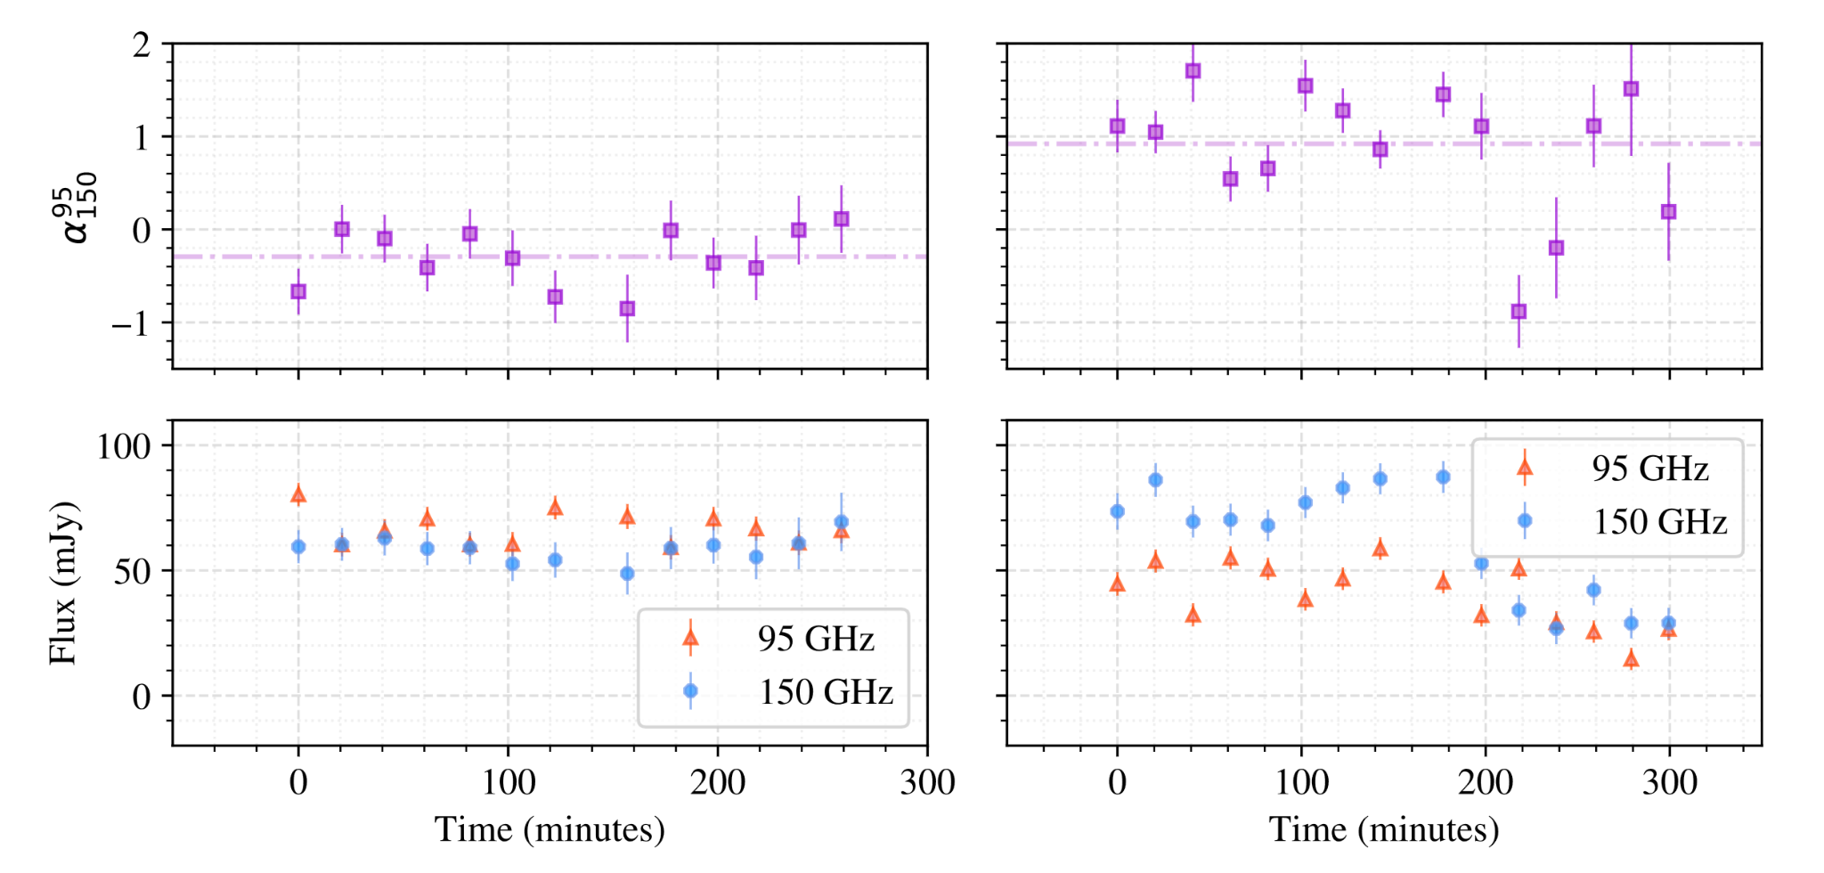
Spectral index by observations
Source 1
Source 2
Falling spectrum
Rising to flat spectrum

Slide 19
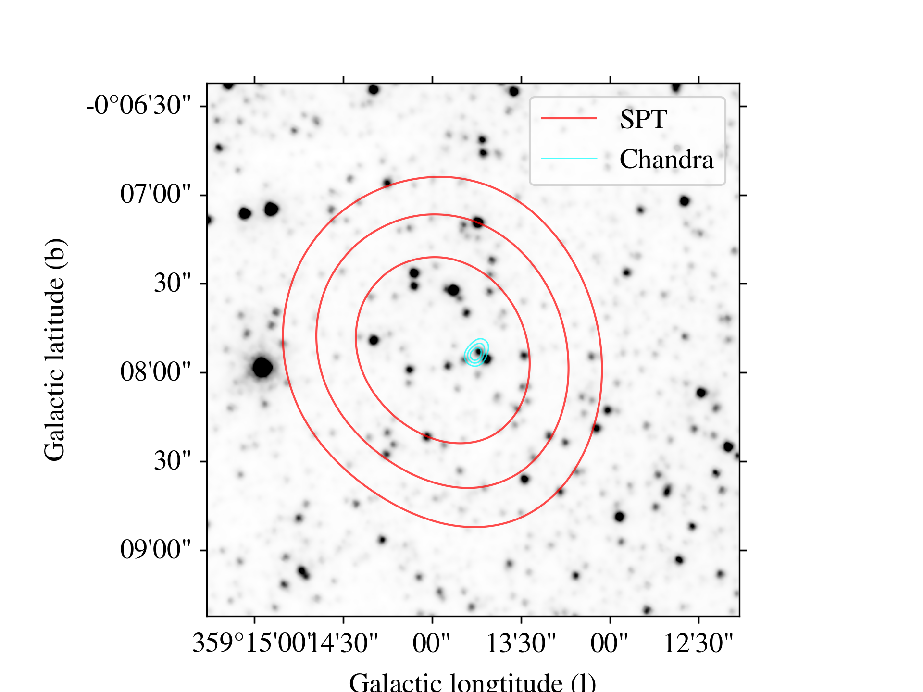
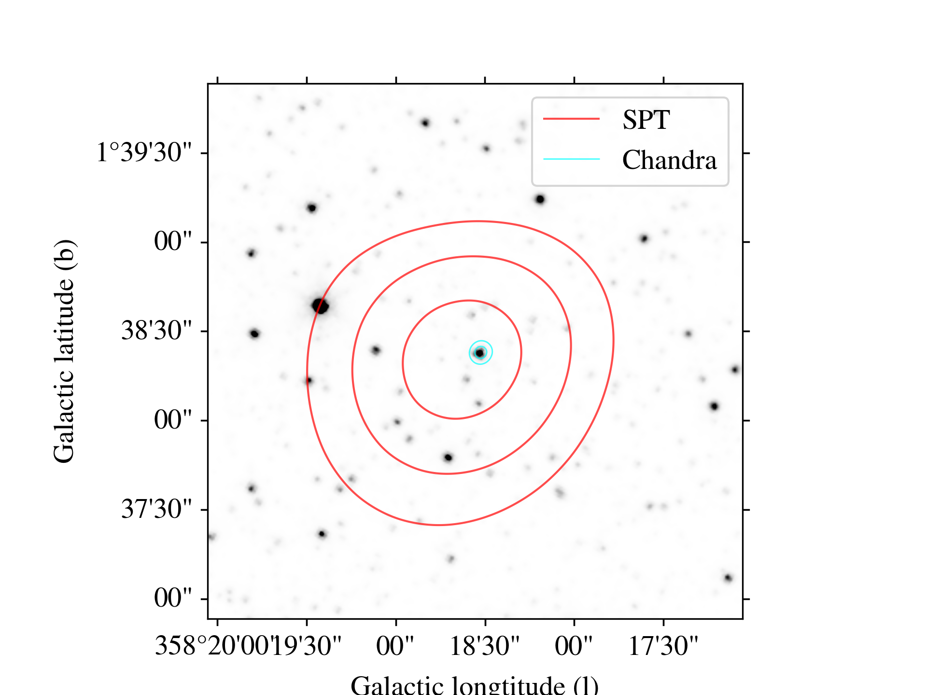
Crossmatch with other surveys
Source 1
Source 2
Red contours: SPT 150GHz
Blue contours: Chandra/ACIS(0.2-7.0keV)
Grayscale image: Spitzer/IRAC(3.6um)
We found counterparts in other surveys, such as Chandra, Gaia, 2MASS, and etc
Both sources are accreting white dwarfs – source 1 has a subgiant companion and source 2 has a giant companion.

Slide 20
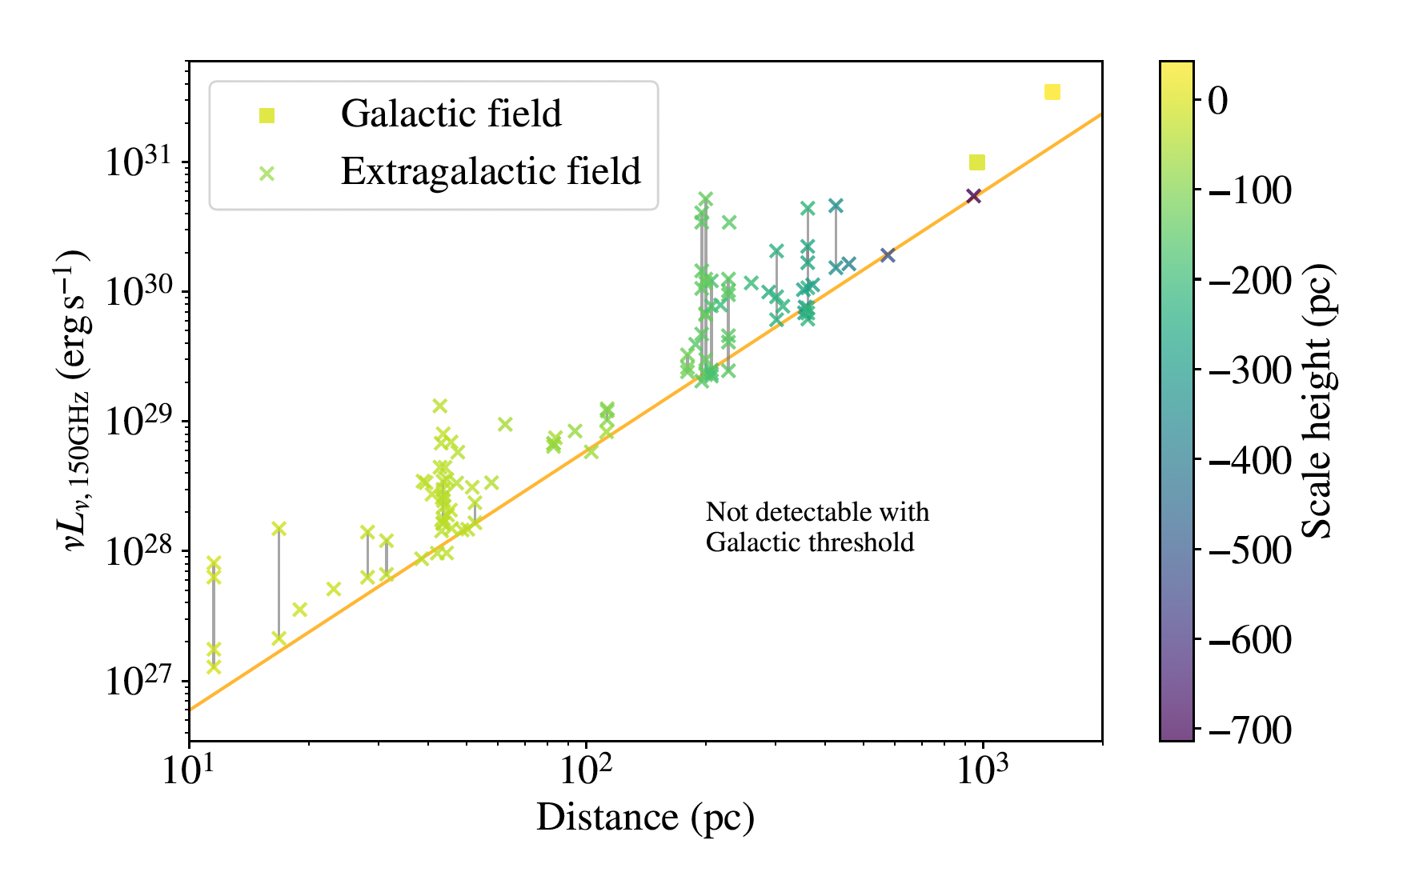
Comparison with previous results
We find sources that are further away and have higher luminosities with the SPT-3G Galactic Plane Survey compared to main field survey.

Slide 21
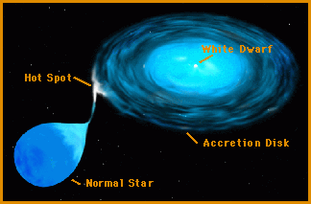
Interpretation
The emission mechanism for the mm flares is likely partially self-absorbed synchrotron emission.
The flare likely originates from the accretion disks. (Hayashi et al. 1996) (i.e. if the flare comes from the stars, we would expect more detections with RS CVn systems.)
Image credit: NASA

Slide 22
Future
This is the first results from the SPT-3G Galactic Plane Survey with high snr threshold (5 sigma at 90 and 150GHz bands simultaneously). We plan to:
Lower the snr threshold to 3 sigma
Enable single band detection
Increase the time resolution by investigating single-scan lightcurves.
Incorporating new data after 2024.
Future surveys such as CMB-S4 and SO will cover the Galactic Plane so this study can serve as a pathfinder.

Slide 23
Conclusion
We conduct the SPT-3G Galactic Plane survey:
The survey field is ~100 deg² towards the Galactic Plane
We observe the field for roughly one month per year since 2023
We have ~500 observations in 2023 and 2024
We have found two transient events so far:
Both events have timescales of approximately one day
They are not detected in the coadded map.
Both are associated with accreting white dwarfs
The mm flares likely originate from self-absorbed synchrotron emission
Paper in collaboration review and coming soon!!

Slide 24
Back up slides

Slide 25
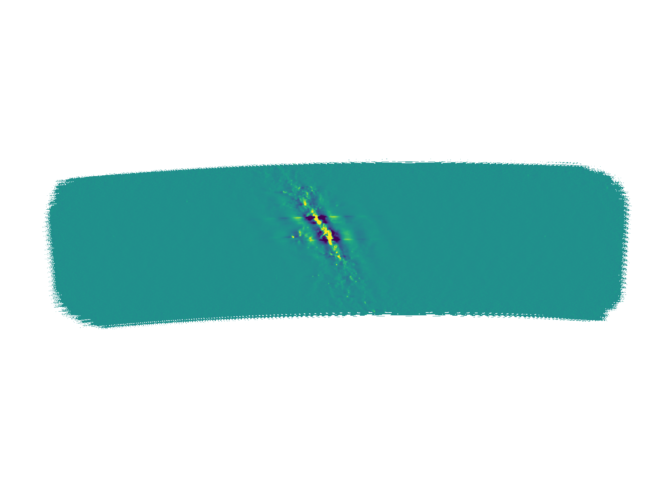
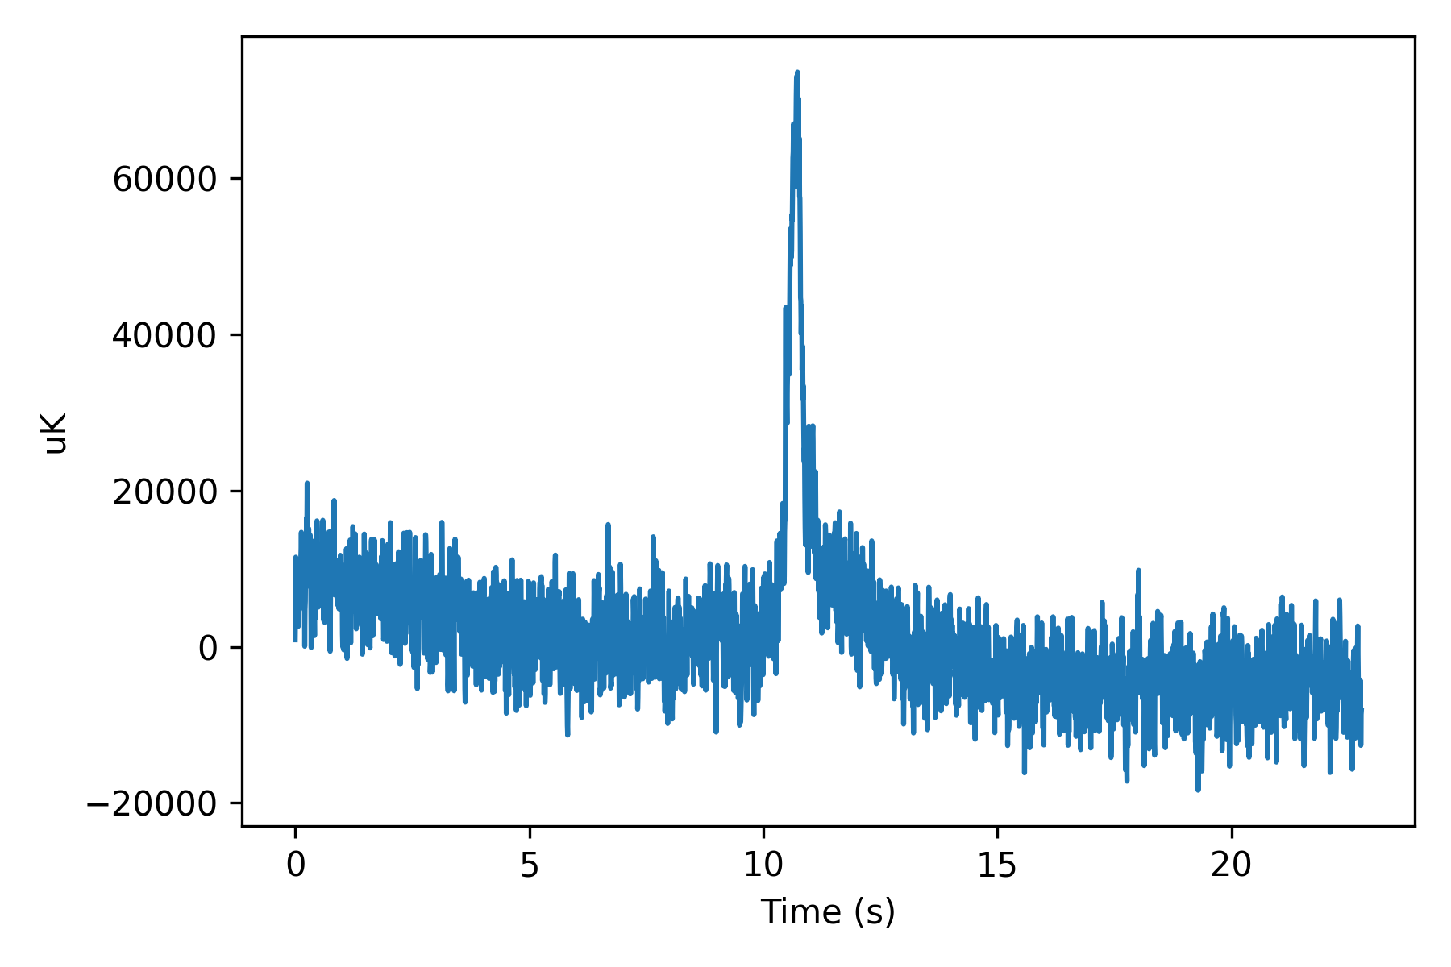
Mapmaking pipeline
Mapmaking pipeline converts time-ordered data to maps
Time-ordered data for a single detector in a single scan for a single observation
Individual observation map

Slide 26
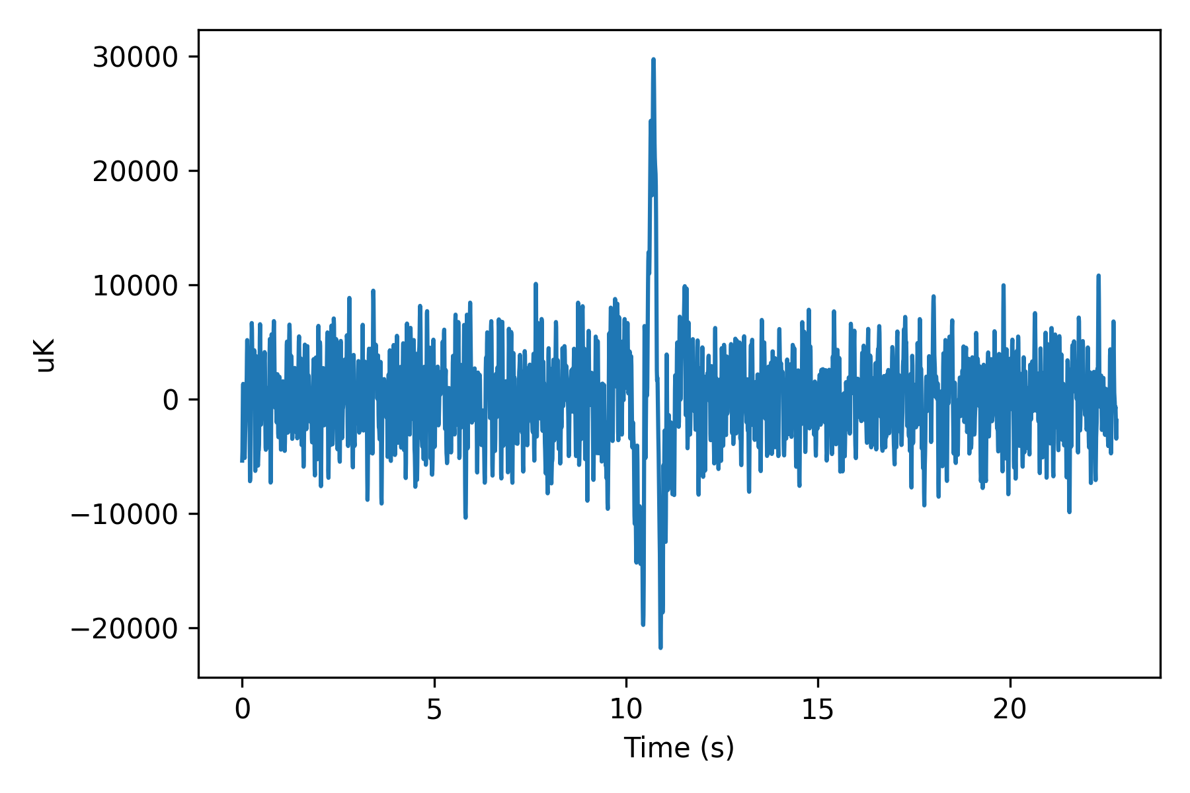
Mapmaking pipeline
Many filtering steps are applied on TODs to reduce noise:
Common mode filter: atmosphere (with mask)
Polynomial filter: atmosphere, 1/f noise (with mask)
High pass filter: atmosphere (without mask)
Low pass filter: noise on scale smaller than the pixel size (without mask)
mask
filtering
Filtering wings
TOD
Filtered TOD

Slide 27
Mapmaking pipeline
We then weight and bin the TODs from all the detectors in all the scans in one observation to form the individual observation map.
binning
Filtered TOD
Individual observation map

Slide 28
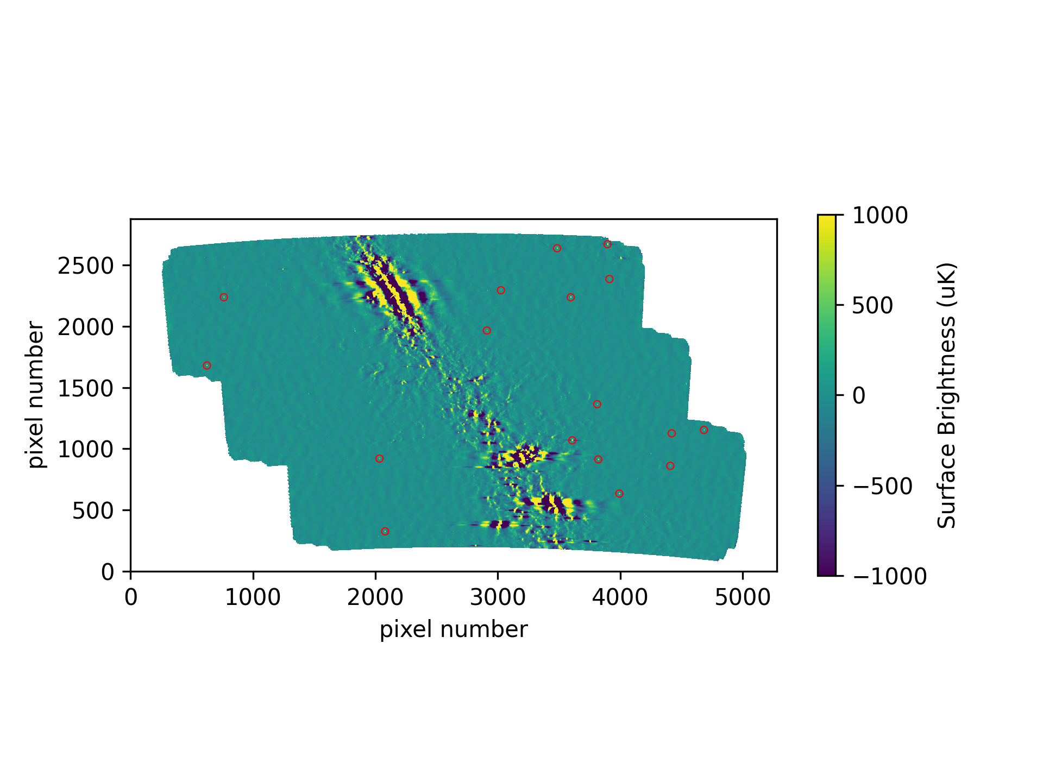
Pointing Correction
We apply online pointing correction during mapmaking pipeline, which corrects pointing to ~10 arcseconds.
We apply offline pointing correction using Australia Telescope 20GHz Survey (AT20G) catalog, which brings us to pointing precision of a few arcseconds.

Slide 29
Gain calibration
In each subfield, we pick several static point sources as reference.
For the top subfield, we only use Sgr B2 as reference because we know it is very stable in mm wavelength.

Slide 30
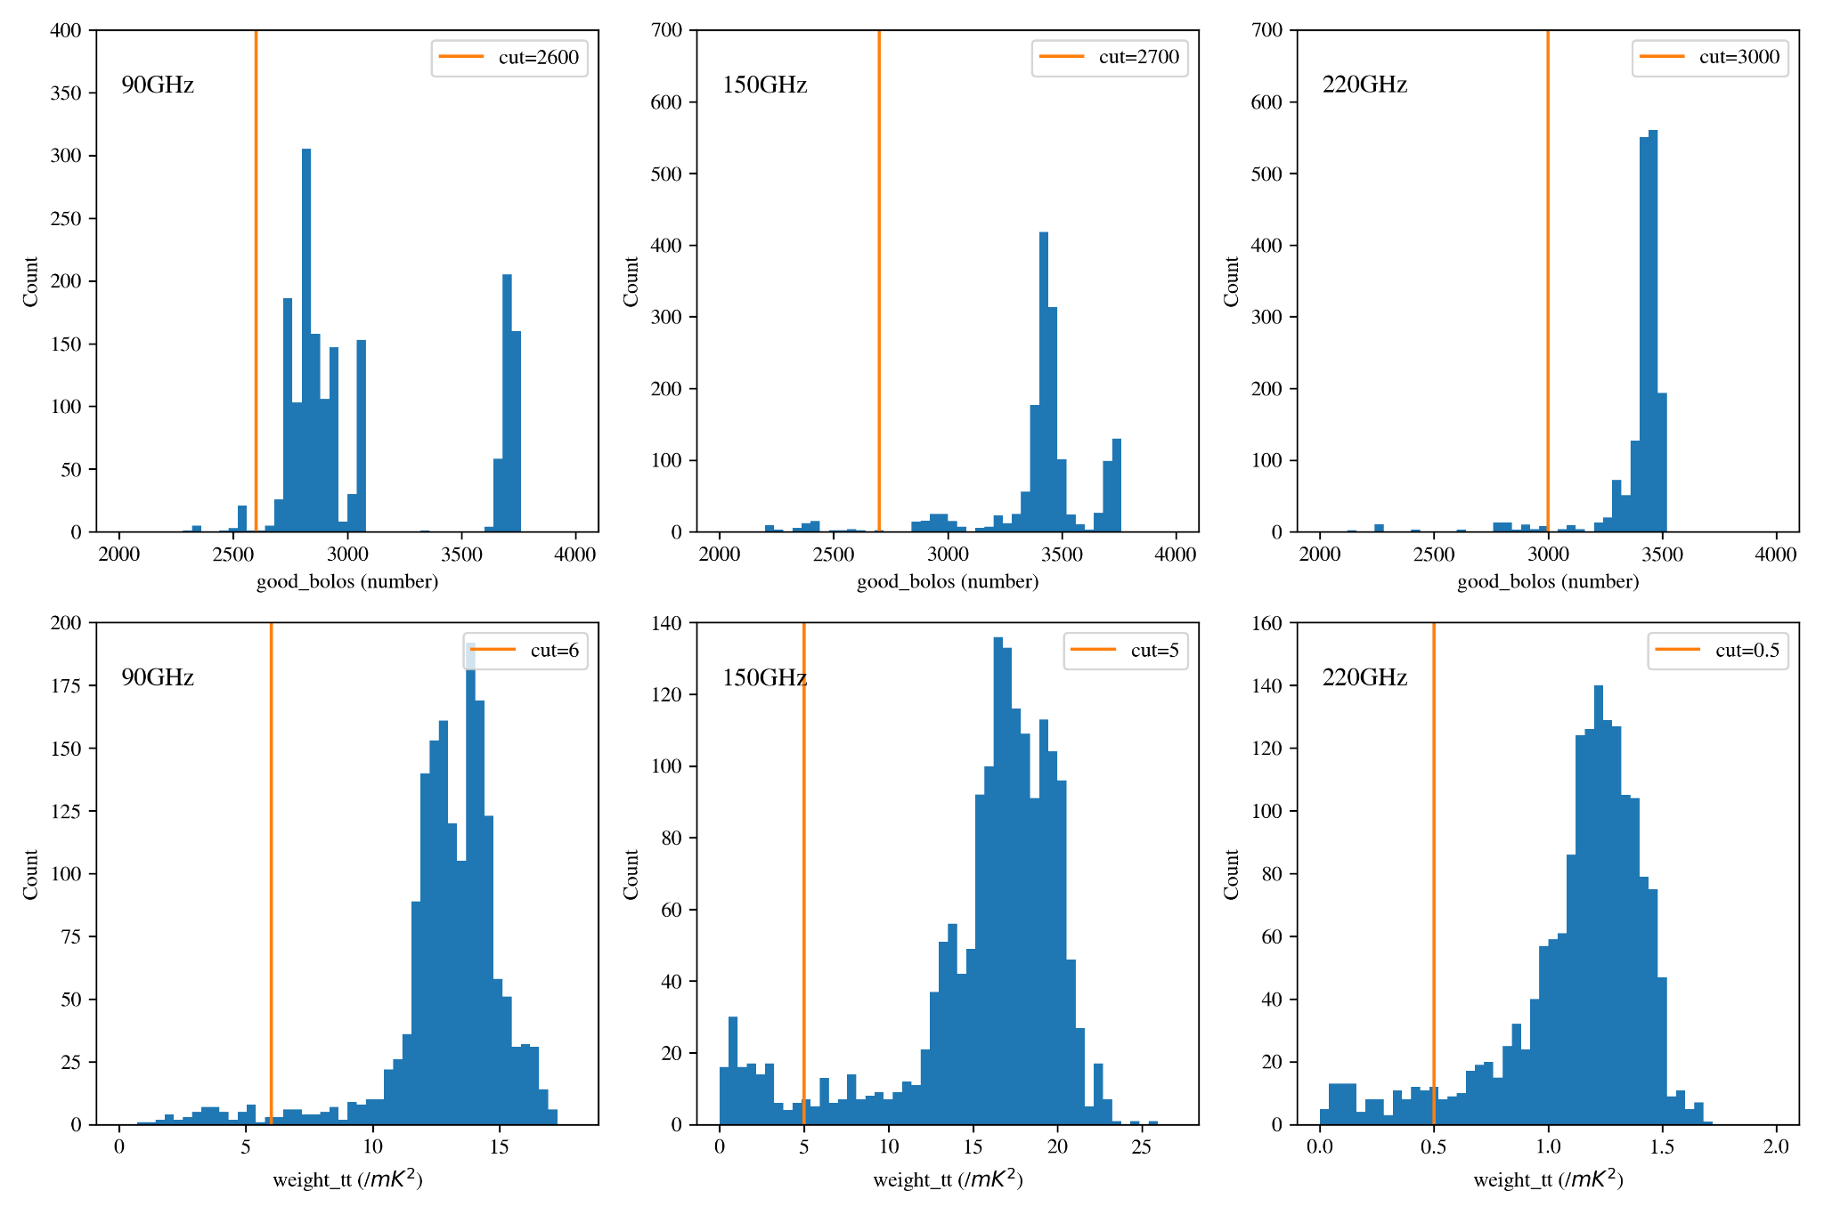
Map cuts
We want to exclude low-quality maps for transient analysis.
Good_bolos: The number of functioning bolometers (detectors) during the observation.
Weight_tt: The weight of the temperature map.

Slide 31
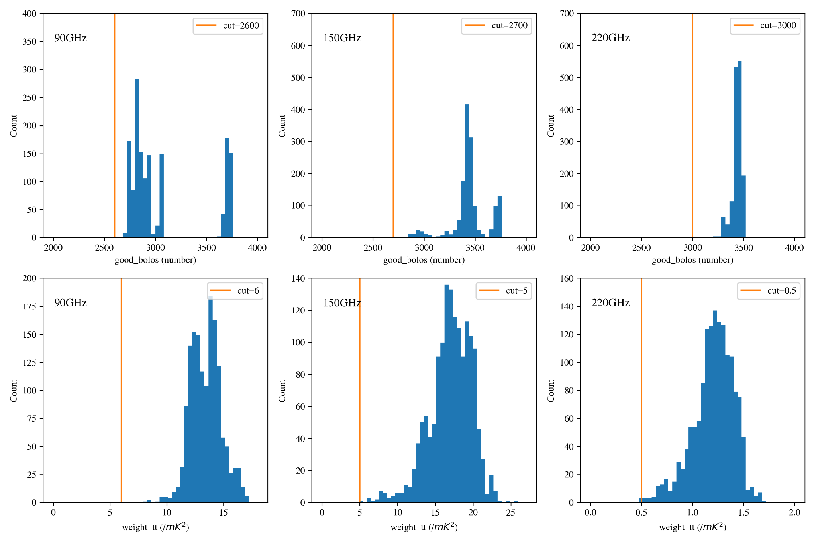
Map cuts
We want to exclude low-quality maps for transient analysis.
Good_bolos: The number of functioning bolometers (detectors) during the observation.
Weight_tt: The weight of the temperature map.
Cut 186 maps from a total of 1692 maps, leaving 1506 maps in the analysis.

Slide 32
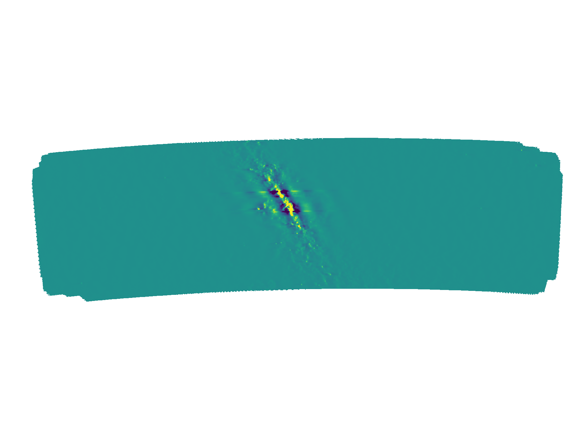
Average map
We then calculate a weighted average for all the remaining individual maps.
Average map for the top subfield

Slide 33
Difference maps
Difference map is made by subtracting the average map from the individual map.
Differencing removes CMB background and bright point sources.
We then apply a convolutional filter to maximize sensitivity to point sources.
Signal leakage
Example of a difference map for one observation

Slide 34
Summary
Generate individual observation map using the mapmaking pipeline

Slide 35
Summary
Generate individual observation map using the mapmaking pipeline
Make coadded map from all the observations

Slide 36
Summary
Generate individual observation map using the mapmaking pipeline
Make coadded map from all the observations
Generate difference map by subtracting coadded map from each observation map

Slide 37
Summary
Generate individual observation map using the mapmaking pipeline
Make coadded map from all the observations
Generate difference map by subtracting coadded map from each observation map
Transient filter the difference map

Slide 38
Transient detection Pipeline
Run through all difference maps in the same subfield in each year

Slide 39
Transient detection Pipeline
Run through all difference maps in the same subfield in each year
Mask bright sources

Slide 40
Transient detection Pipeline
Run through all difference maps in the same subfield in each year
Mask bright sources
Find outlier pixels (5 sigmas in both 90 and 150GHz simultaneous in one observation)

Slide 41
Transient detection Pipeline
Run through all difference maps in the same subfield in each year
Mask bright sources
Find outlier pixels (5 sigmas in both 90 and 150GHz simultaneous in one observation)
Extract lightcurve for outlier pixels

Slide 42
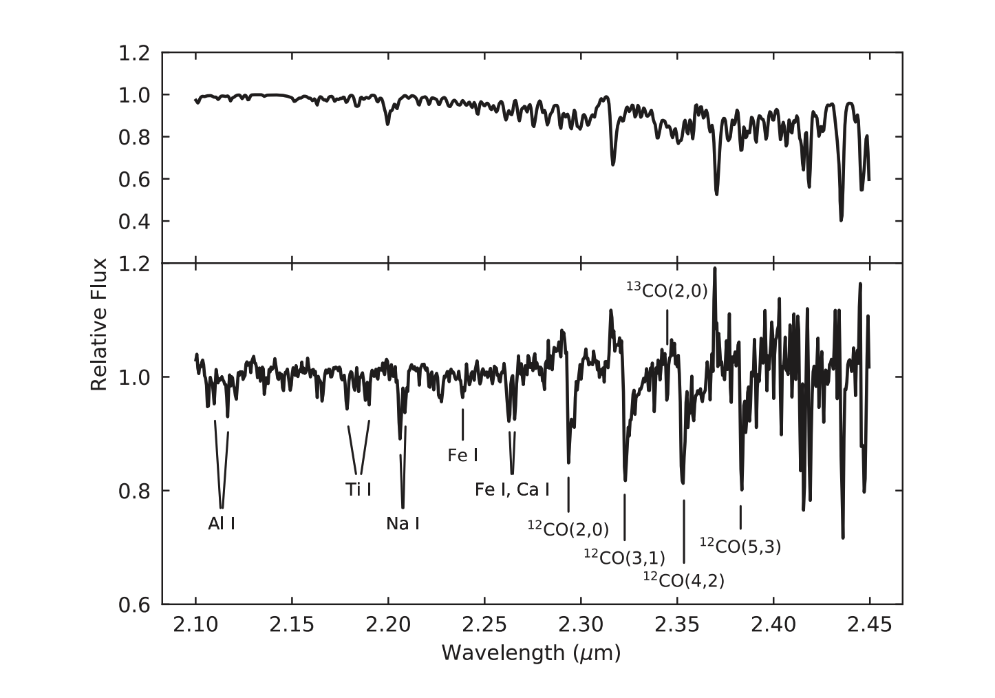
Source 1
ASAS-SN folded lightcurve
The spectrum suggests that the donor star might be a subgiant (class IV).
The spectrum also suggests that the primary star is probably a white dwarf accretor.
VLT/SINFONI spectra

Slide 43
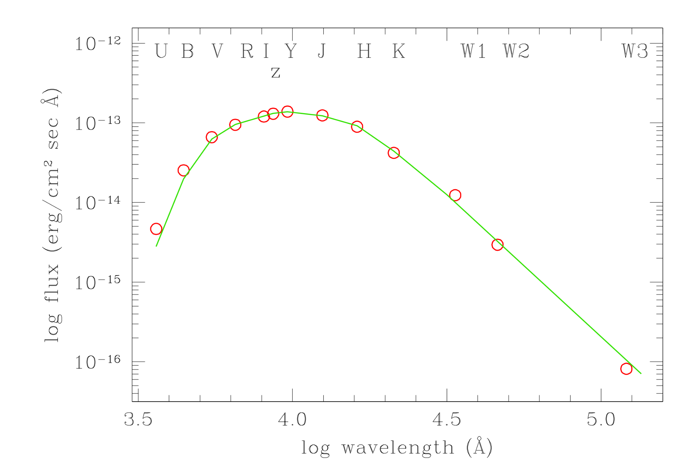
Source 2
ASAS-SN folded lightcurve
The energy distribution matches well with a K4III star.
Emission in Halpha and excess in U band probably suggest direct emission from the accretion disk.
The conclusion is that this source is a symbiotic star (white dwarf with a giant).
SED fitting

