Slide 1
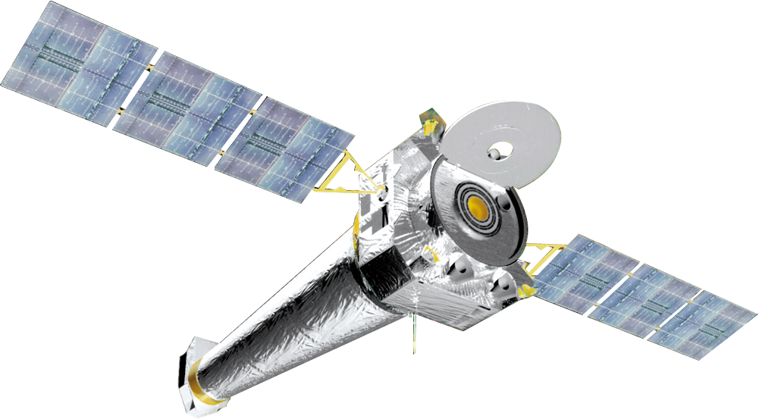
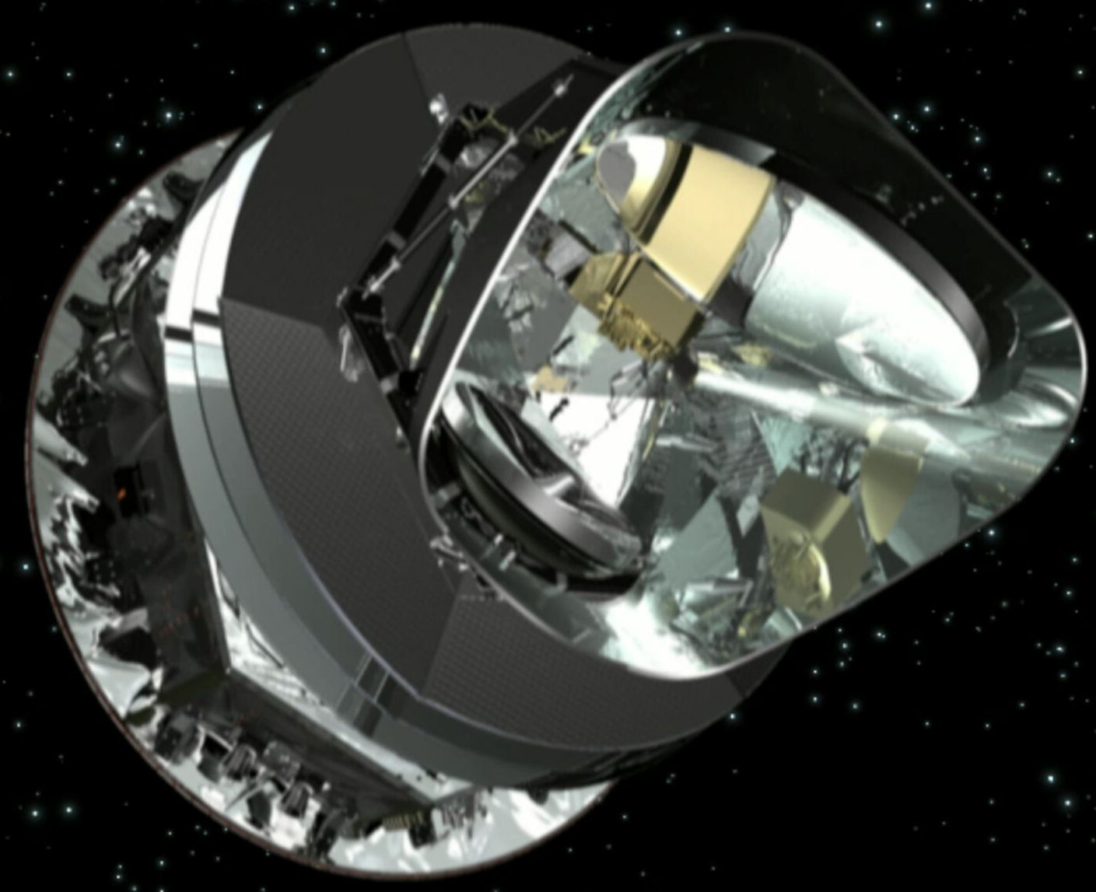
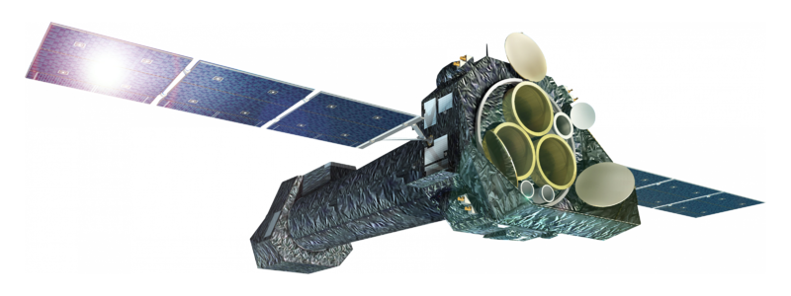
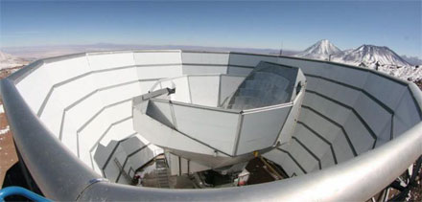
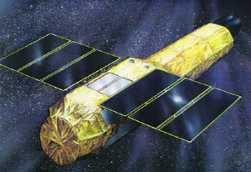
Tracing feedback in the circumgalactic medium with tSZ effect and X-ray
Sanskriti Das
Hubble Fellow
Stanford University, USA
snskriti@stanford.edu
With Abigail Pan, Adam Mantz, Anjali Gupta, Fabrizio Nicastro, Nhut Truong, Smita Mathur, Steven Allen, Yair Krongold, Yi-Kuan Chiang (in alphabetical order)

Slide 2
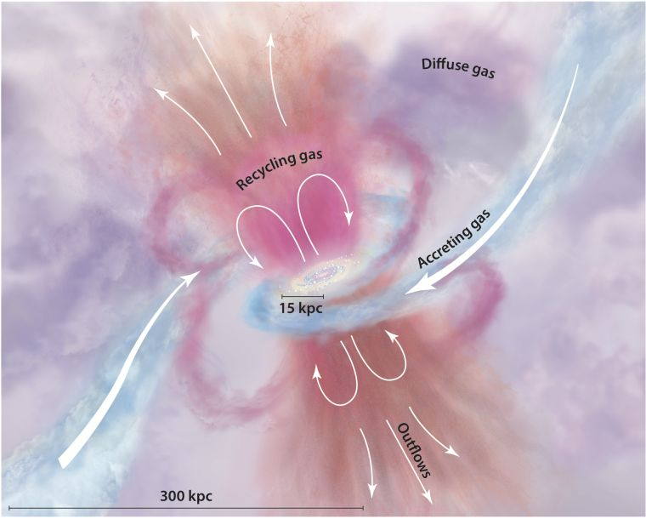
What is circumgalactic medium (CGM)?
CGM is the active mediator between intergalactic medium (IGM) and interstellar medium (ISM)
CGM is the fuel tank, waste dump, and recycle hub of a galaxy, all at the same time
Density and temperature both span more than two orders-of-magnitude range (but mostly hot)
Tumlinson+17, ARA&A
Lower-density, metal-poor, virialized shock-heated gas during gravitational collapse (that has not cooled and fallen to the stellar disk yet)
Denser, metal-enriched, hotter (super-virial) galactic outflow from AGN and stellar feedback
+

Slide 3
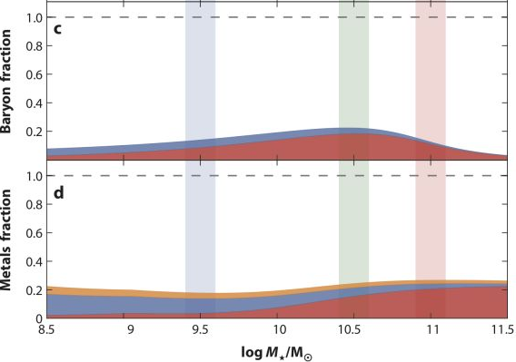
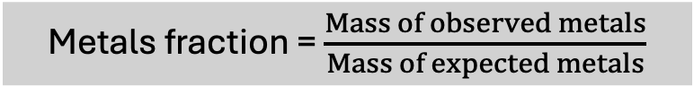
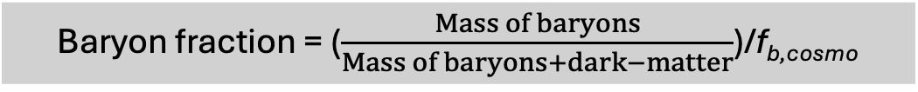
Why is studying the (hot) CGM important?
1. Missing galactic baryons problem
Baryon fraction = ($\frac{Mass of baryons}{Mass of baryons+dark−matter}$)/f_{b,cosmo}
3. Missing feedback problem. Where does the energy from galactic winds go?
Interstellar medium
Stars
2. Missing metals problem
Metals fraction = $\frac{Mass of observed metals}{Mass of expected metals}$
Stars
Interstellar dust
Interstellar gas
Tumlinson+17, ARA&A

Slide 4
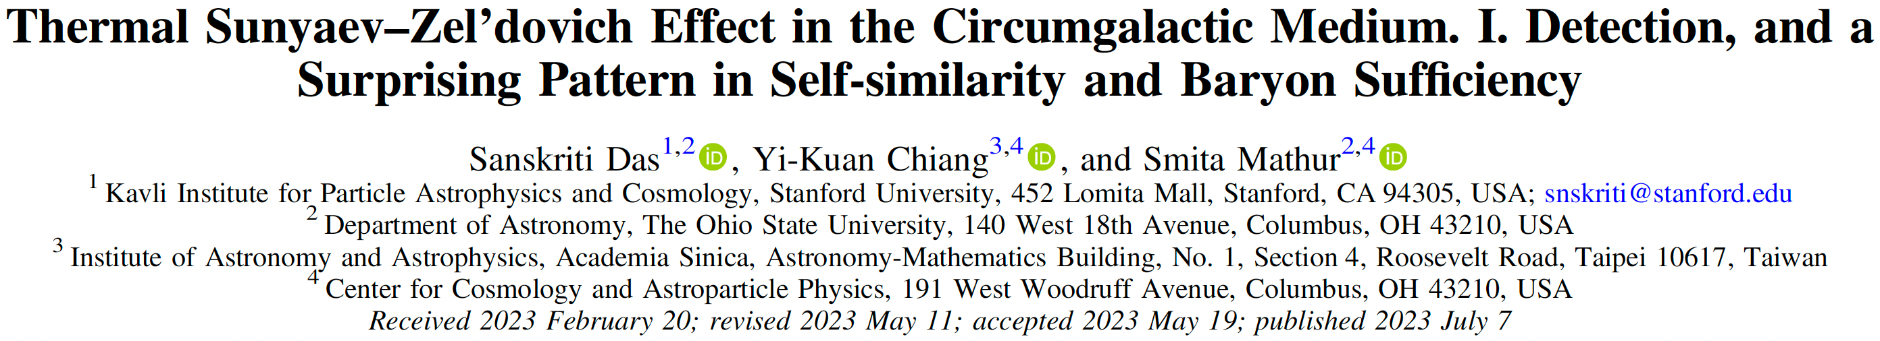
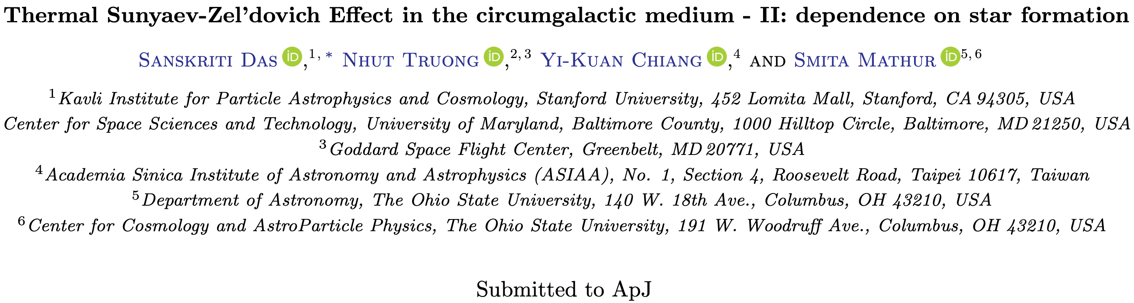
1. CGM in tSZ effect (stacked halos)

Slide 5
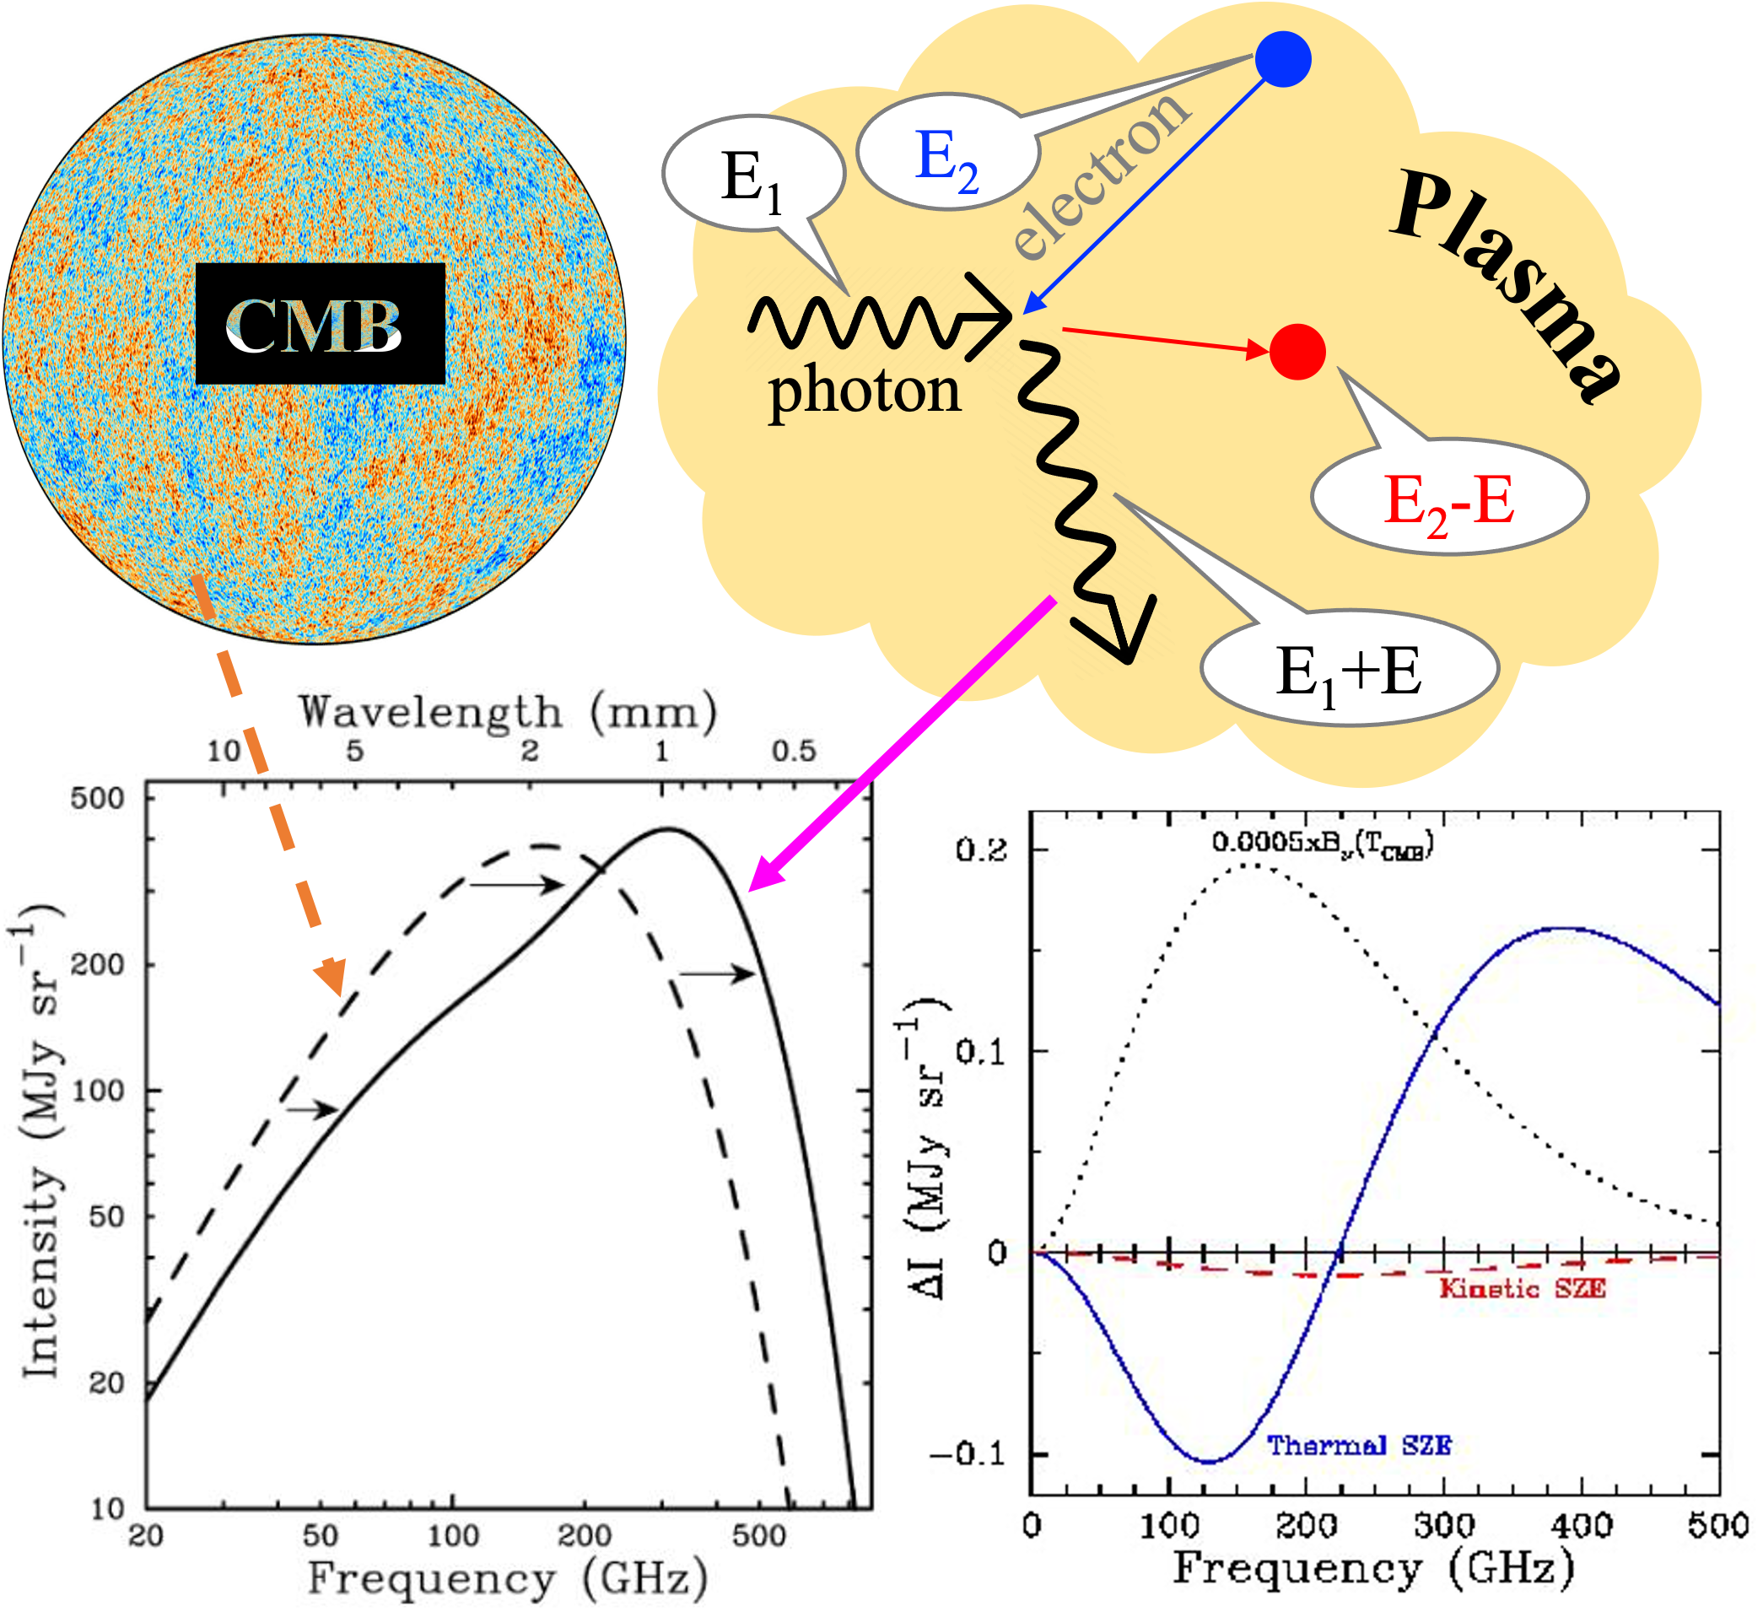
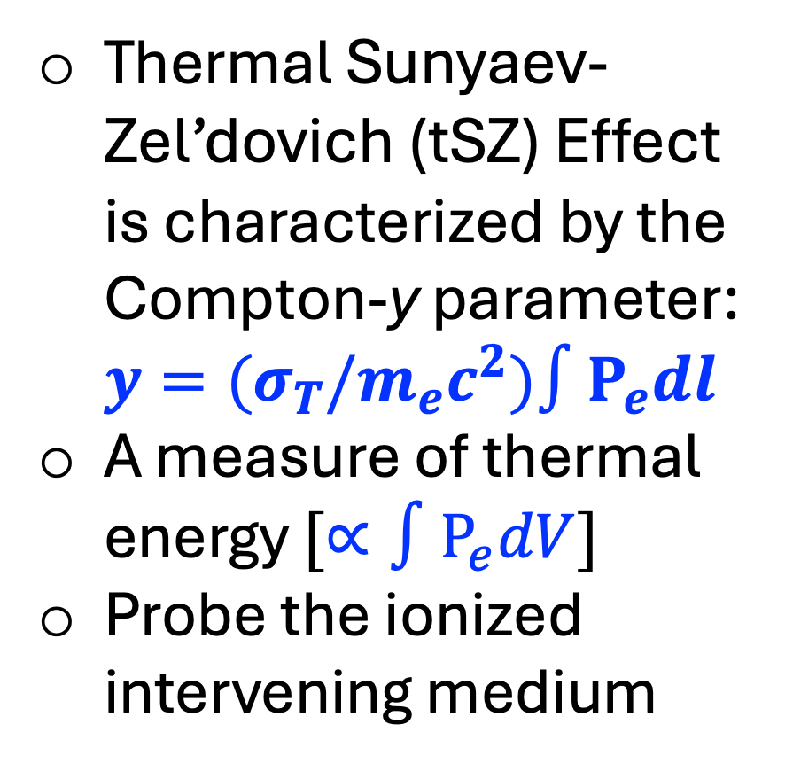
Thermal Sunyaev-Zel’dovich (tSZ) Effect is characterized by the Compton-y parameter: $y={{(σ}_{T}/m}_{e}c^{2})∫P_{e}dl$
A measure of thermal energy $[∝∫P_{e}dV]$
Probe the ionized intervening medium
Sunyaev & Zel’dovich 1969, Nature, 223, 721

Slide 6
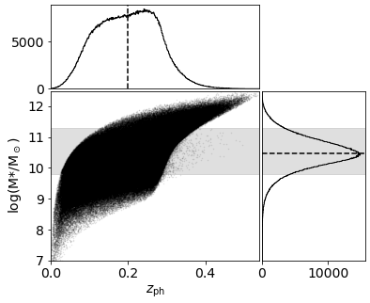
WISExSuperCosmos galaxy catalog (Bilicki+2016)
x
Atacama Cosmology Telescope + Planck Compton-y map (Madhavacheril+2020)
0.63 million z≈0-0.3 M*=10^{9.8-11.3} M_{sun} galaxies
Only field galaxies (to avoid intra cluster medium)
Exclude radio-loud and W1-W2>0.8 galaxies (so that the rest are unlikely to host AGN)
Corrected for cosmic dust (standard)
Removed regions of high Galactic extinction
Masked galaxy clusters out to their virial radii
Masked compact radio sources
Das, Chiang & Mathur, 2023, ApJ, 951, 125

Slide 7
1.
Preparing the y-map for stacking
1. Correct for the Cosmic Infrared Background (CIB)
Das, Chiang & Mathur, 2023, ApJ, 951, 125

Slide 8
1.
Preparing the y-map for stacking
2.
1. Correct for the Cosmic Infrared Background
2. Correct for Galactic dust
Das, Chiang & Mathur, 2023, ApJ, 951, 125

Slide 9
1.
Preparing the y-map for stacking
2.
3.
1. Correct for the Cosmic Infrared Background
2. Correct for Galactic dust
3. Mask R₂₀₀ regions around galaxy clusters
Das, Chiang & Mathur, 2023, ApJ, 951, 125

Slide 10
1.
Preparing the y-map for stacking
2.
3.
1. Correct for the Cosmic Infrared Background
2. Correct for Galactic dust
3. Mask R₂₀₀ regions around galaxy clusters
4.
4. Mask affected regions around point radio sources
Stack at a fixed fraction of virial radius up to 8R₂₀₀ (instead of fixed angular size)
Das, Chiang & Mathur, 2023, ApJ, 951, 125

Slide 11
Cross-correlation with 0.63 million WISExSuperCosmos galaxies
$y_{tot}=y_{1h}+A_{2h}y_{2h}+y_{zp}; y_{1h}$= P_{e}(r |M₅₀₀,z)⊛beam_{ACT}
Das, Chiang & Mathur, 2023, ApJ, 951, 125
P_{e} from Nagai+2007, Arnaud+2010
2-halo term from Vikram+2017

Slide 12
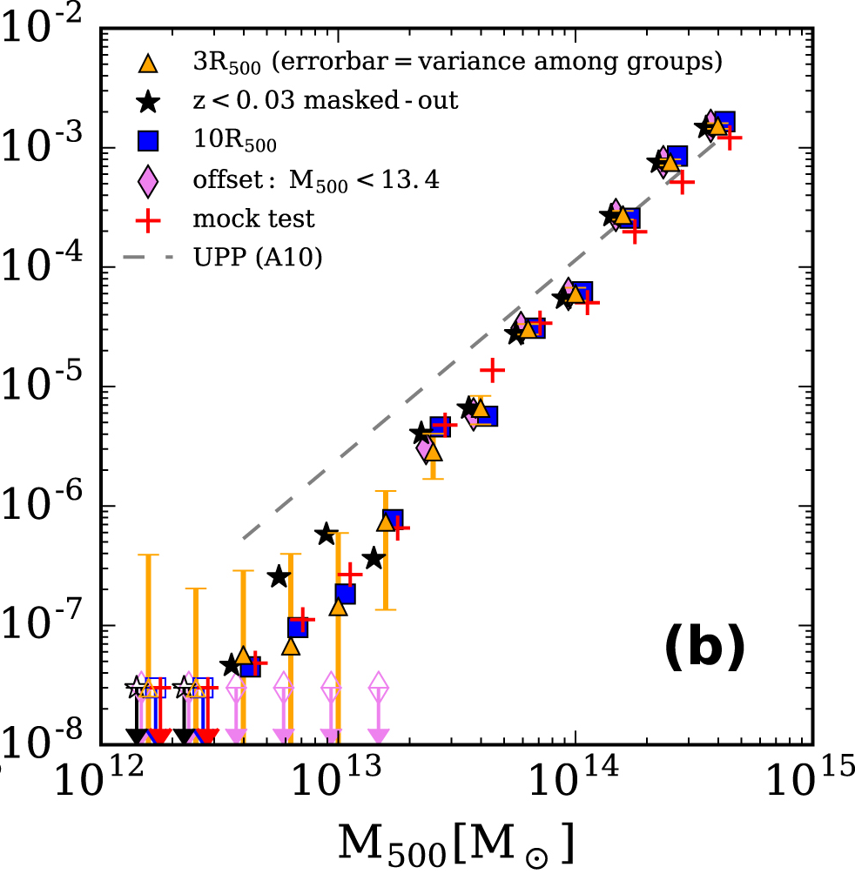
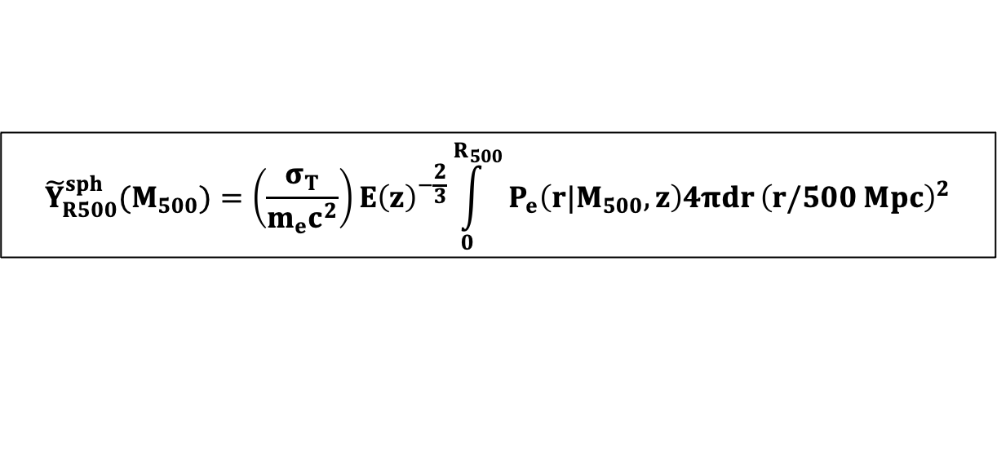
Thermal energy
$${\tilde{Y}}_{R500}^{sph}(M_{500})=\left(\frac{σ_{T}}{m_{e}c^{2}}\right)E{\left(z\right)}^{−\frac{2}{3}}\int_{0}^{R_{500}}{P_{e}\left(r|M_{500},z\right)4πdr}{\left(r/500 Mpc\right)}^{2}$$
Detection→
← Non-detection
expected from groups
expected from clusters
Lim+2018
Das, Chiang & Mathur, 2023, ApJ, 951, 125

Slide 13
Cross-correlation with 2.5 million WISExDESI galaxies
(0.7 million quiescent and 1.8 million star-forming)
Das, Truong, Chiang & Mathur 2025 (under review)

Slide 14
Standard GNFW profile is good enough to explain the data (a flatter/steeper profile is not required)
Das, Truong, Chiang & Mathur 2025 (under review)

Slide 15
Standard GNFW profile is good enough to explain the data
Quiescent galaxies are consistent with self-similarity of thermal energy
Star-forming galaxies are not
Das, Truong, Chiang & Mathur 2025 (under review)

Slide 16
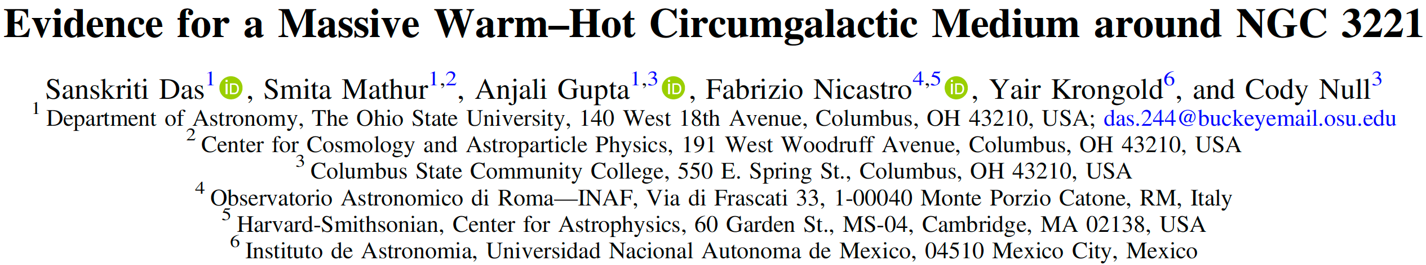
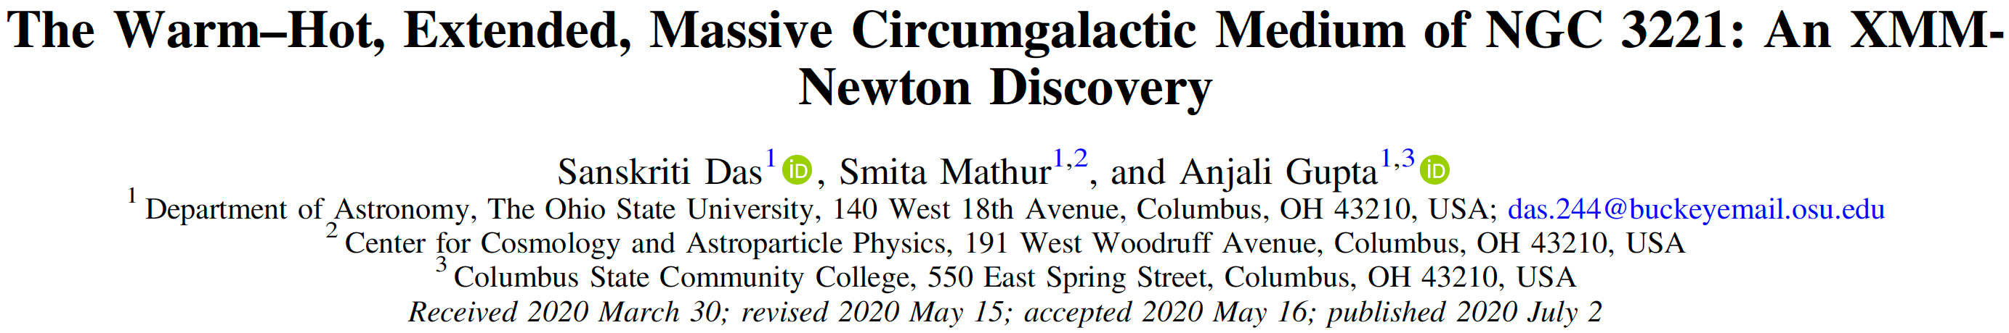
2. CGM in X-ray emission (individual galaxies)

Slide 17
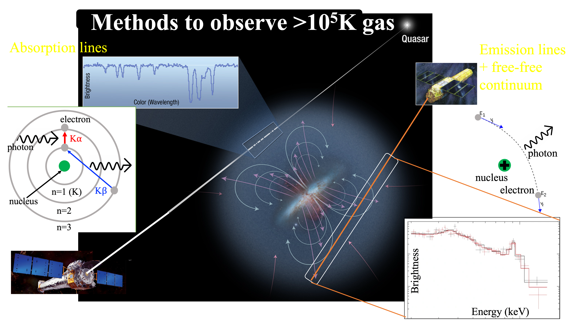

Slide 18
~90-95% of the total soft X-ray emission is soft X-ray background (SXB) consisting of
Photon
  Solar Wind Charge eXchange: f(sky, time)
  Local Hot Bubble: f(sky)
  Virial phase in Galactic Halo: f(sky)
  Super-virial phase in Galactic Halo: f(sky)
  Undetected unresolved point sources (CXB)
  Fluorescent OI: f(time)
Particle
  Electronic noise: f(time)
  High energy (>MeV) cosmic ray-induced background in unexposed regions of the field-of-view (FOV): f(time)
  Soft Proton Background in exposed regions of the FOV: f(detector plane, time)
Extragalactic signal detection is extremely sensitive to how we deal with the background
High S/N blank-sky data (exposure time 1.3 Ms)
Das et al. 2019c, ApJ, 887, 257

Slide 19
Our target – NGC 3221
10 ks Chandra, 50 ks XMM, 120 ks Suzaku data
M* = 9x10¹⁰ M_{sun}
M₂₀₀ = 3x10¹² M_{sun} (R₂₀₀ ≈275 kpc)
SFR = 9.92 M_{sun} yr⁻¹
Field galaxy
l = 214º, b = 56º; z = 0.0134
FoV of XMM/EPIC
FoV of Suzaku/XIS
Novel data analysis – split signal detection, identification, and characterization into three separate steps. Confirm convergence of detection with two independent methods
Background extraction region
Das et al. 2019b, ApJ, 885, 108 (Suzaku) and Das et al. 2020, ApJ, 897, 63 (XMM)

Slide 20
Advanced spectroscopy – simultaneous and conditional Bayesian fitting of the on-source spectrum and the (photon & particle) background spectrum instead of subtracting the background
Detected with Suzaku (left) at 3.6σ out to ≈ 0.55 $R_{200}$ and with XMM (right) at 4.0σ out to ≈ 0.75 $R_{200}$
This is the first (and only) external spiral galaxy with such a detection so far
Das et al. 2019b, ApJ, 885, 108 (Suzaku) and Das et al. 2020, ApJ, 897, 63 (XMM)

Slide 21

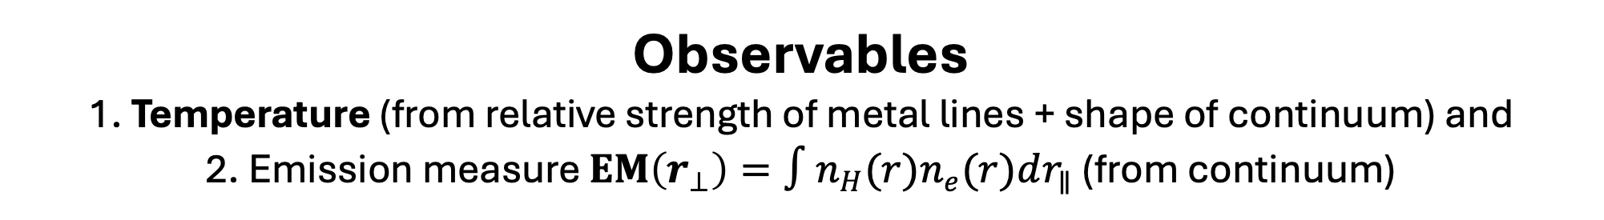
Observables
1. Temperature (from relative strength of metal lines + shape of continuum) and
2. Emission measure $EM\left(r_{⊥}\right)=∫n_{H}(r)n_{e}(r)dr_{∥}$ (from continuum)
A. Detection
1. Seclusive: Is the “extra signal” required in the spectrum to obtain a statistically better fit?
Yes, at >99.6% confidence beyond 0.55 R₂₀₀
2. Cumulative: Where does the detection significance of the continuum of the “extra signal” saturate and at what value?
S/N increases to 4.0 out to 0.75 R₂₀₀ without saturation
(Total S/N is ≈3.5 times larger)
Confidence = 1 - p_{null}
Significance = $\frac{EM}{δ_{EM}}$
Das et al. 2019b, ApJ, 885, 108 (Suzaku) and Das et al. 2020, ApJ, 897, 63 (XMM)

Slide 22
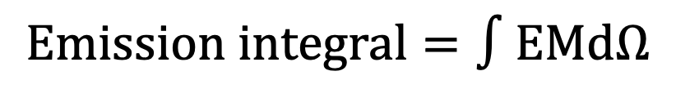
B. Identification
$$Emission integral=∫EMdΩ$$
Is the “extra signal” from an intervening medium? No.
Is the detected signal strength radially correlated with projected distance from NGC3221? Yes! It is consistent with a shallow power-law profile
Is the “extra signal” from the Milky Way? No.
(Working on 450 ks new XMM data of NGC 3221 to characterize the density and temperature profiles: Pan, Das, Allen et al. 2025, in prep.)
Das et al. 2019b, ApJ, 885, 108 (Suzaku) and Das et al. 2020, ApJ, 897, 63 (XMM)

Slide 23
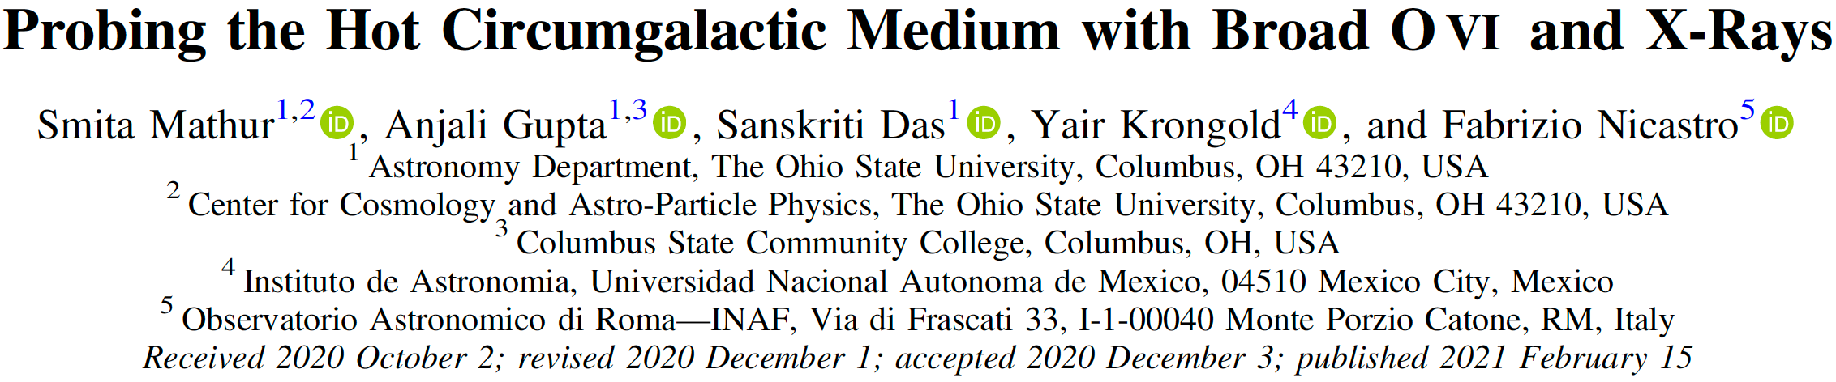
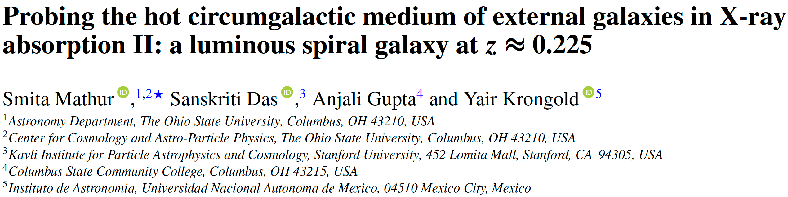
3. CGM in X-ray absorption (individual galaxies)

Slide 25
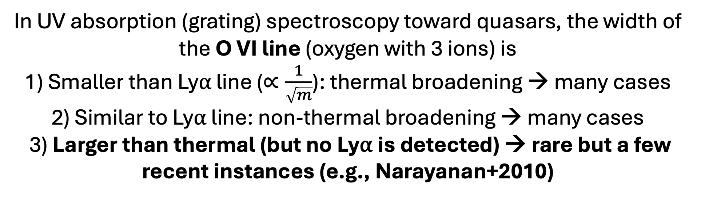
In UV absorption (grating) spectroscopy toward quasars, the width of the O VI line (oxygen with 3 ions) is
1) Smaller than Ly⍺ line ($∝\frac{1}{\sqrt{m}}$): thermal broadening → many cases
2) Similar to Ly⍺ line: non-thermal broadening → many cases
3) Larger than thermal (but no Ly⍺ is detected) → rare but a few recent instances (e.g., Narayanan+2010)

Slide 26
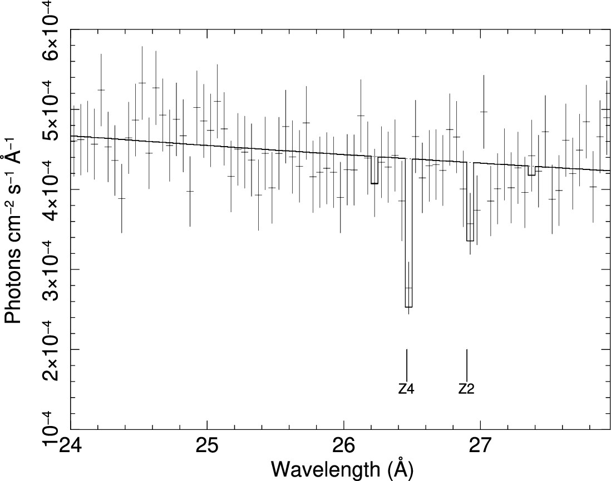
Look for O VII (oxygen with 2 ions) absorption at the same redshift as the “unusually broad” O VI absorption
1. PKS0405-123
2. H1821+643
z= 0.167
z₄ = 0.225
HRC (black); ACIS (red)
HRC/LETG
O VII absorption is detected at large impact parameter (>100 kpc): hot CGM is extended
N(OVII) is large (≈10¹⁵ cm⁻²): hot CGM is massive
These are the first 2 (and only 2) detections so far
1. Mathur, Gupta, Das et al. 2021, ApJ, 908, 69; 2. Mathur, Das et al. 2023, MNRAS L, 525, 11

Slide 27
How well are simulations doing?
Plot from a proposal that got rejected in the last 7 cycles ☹
Das, Truong, Chiang & Mathur 2025 (under review)

Slide 28
Summary
tSZ effect from the hot CGM of stacked galaxies
  is detectable (down to M₂₀₀ ≈ 10^{12.3} M_{sun})
  does not require a pressure profile flatter than standard GNFW
  does not follow the trends of galaxy clusters or massive groups
  is different for quiescent and star-forming galaxies
  mm telescopes with <1’ angular resolution is crucial for CGM science in tSZ
X-ray emission from the hot CGM of individual spiral galaxies
  is detectable (with a rigorous spectroscopic modeling)
  is extended out to ≈150 kpc (0.7 R₂₀₀)
  We should utilize CCDs of XMM/XRISM for CGM science in X-ray emission
X-ray absorption by the hot CGM of individual galaxies
  is detectable (at a priori known redshift)
  is extended out to >100 kpc impact parameter
We should utilize gratings of XMM/Chandra for CGM science in X-ray absorption

