Slide 1





Colliders – Lecture VS2:
Collective Effects (BB, SC, etc)
Incoherent Effects (halo, cool)
Vladimir Shiltsev, Northern Illinois University
part of the “Colliders” class by V.Shiltsev, J.Eldred and B. Simmons
Muon Collider School · Aug. 04 – Aug 07, 2025 · U. Chicago

Slide 2
Important Beam Effects
Beam-beam effects
Space-charge effects
Instabilities
Collimation
Cooling
Diffusion and Intrabeam scattering
Beamstrahlung
Polarization
Synchrotron radiation
etc etc etc (20 – 40 topics at USPAS/CAS)

Slide 3
Beams as Moving Charges
Beam is a collection of charges
Represent electromagnetic potential for other
charges
Forces on itself (space-charge, wake-fields/impedances) and opposing beam (beam-beam effects)
  Main limit for present and future colliders
  Important for high density beams, i.e. high intensity and/or small beams = for high luminosity !

Slide 4

EM Forces in Beams: self fields B_{θ}=βE_{r}
same charges repel each other (opp attract) F=eE
same currents attract each other (opp repel) F=βeB=-β²eE
Qualitatively: Balance of These Forces
+Q
beam-beam
+Q
space-charge
+Q
induced fields
+J
+J
+J
1
1
1
R
-Q
+J
+J
δ
2
conducting surface
2
1
F_{E}=(+Q,-Q) attracts
F_{E}=(+Q,+Q) repels
-J
-Q
F_{B}=(+J,+J) attracts
F_{B}=(+J,+J) attracts
F_{E}=(+Q,-Q) attracts
+Q
F_{B}=(+J,-J) repels
-J
Total F_{E} - F_{B} repels
= F_{E} - β ²F_{E} = F_{E} /γ²
2
Diff F_{E} - F_{B} attracts,
eg skin-eff ΔF ~ F_{E}
both F_{E} F_{B} repel
$$\frac{δ}{R}$$

Slide 5
BEAM-BEAM (1)

Slide 6
Beam-Beam Effects
A beam acts on particles like an electromagnetic lens, but:
  Does not represent simple form, i.e. well-defined multipoles
  Very non-linear form of the forces, depending on distribution
  Can change distribution as result of interaction (time dependent forces ..)
Results in many different intensity dependent effects and problems:
  unstable betatron oscillations
  growth of beam sizes
  particle losses

Slide 7
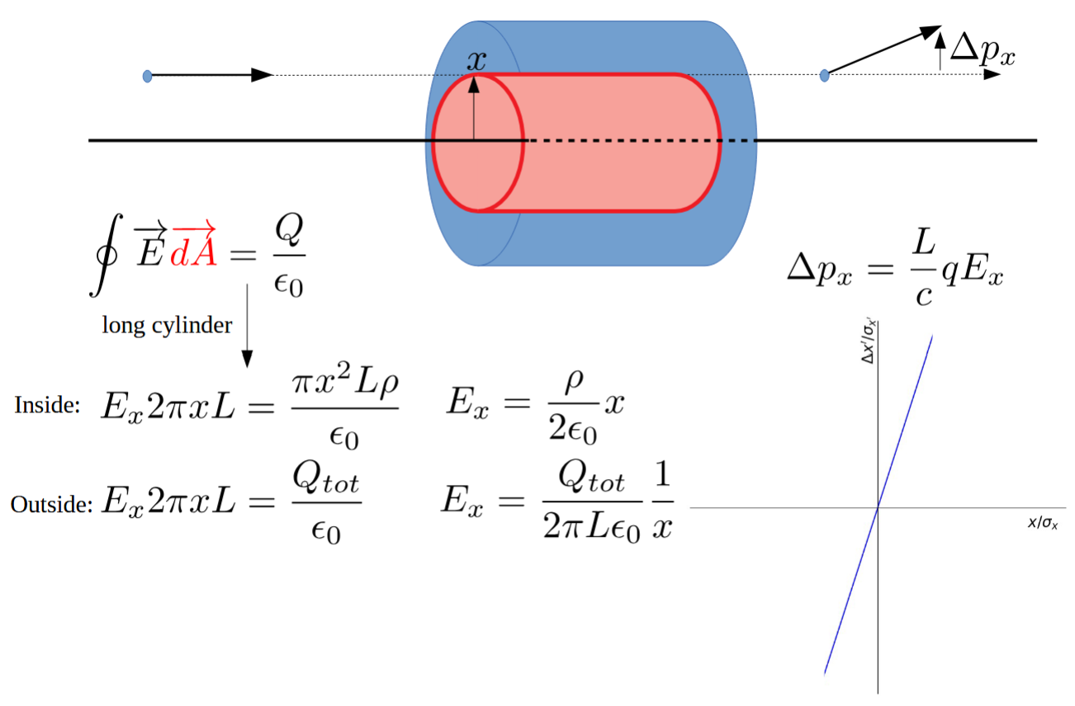
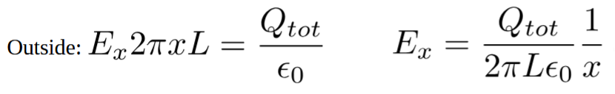
Beam-Beam Fields: Start with a Cylinder
i.e. force is linear inside, nonlinear outside

Slide 8
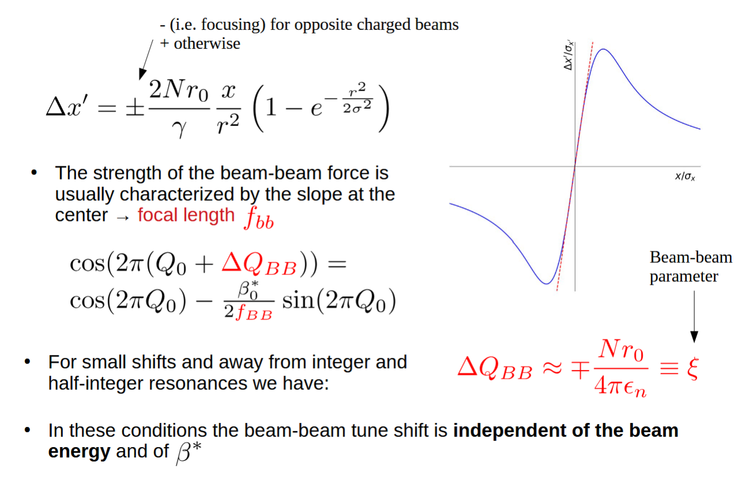

Kick from a Round Gaussian Beam

Slide 9
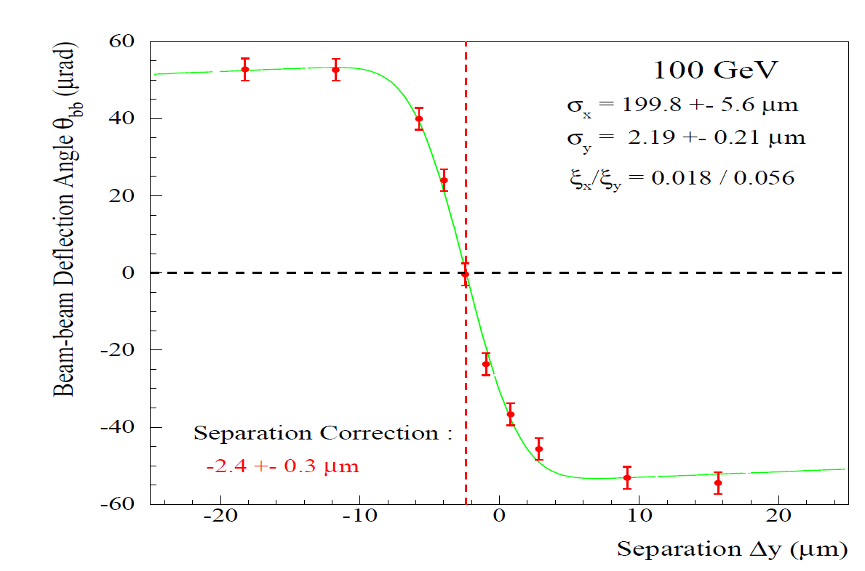
Beam-beam kick in reality
Deflection scan (LEP measurement)
  linear inside
  const outside

Slide 10
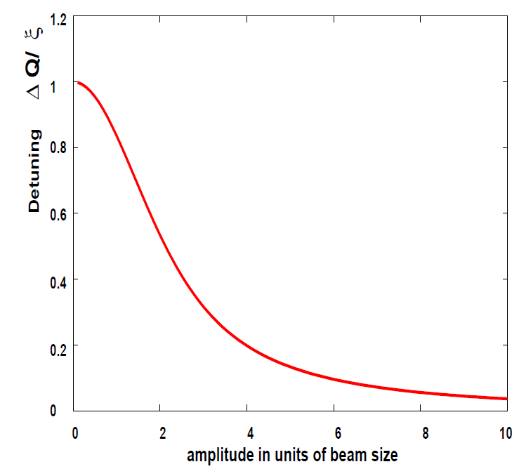
Beam-beam Detuning with Amplitude
Non−linear force →
tune depends on the amplitude of betatron oscillations
large effect for A<sigma
small effect for A>>sigma

Slide 11
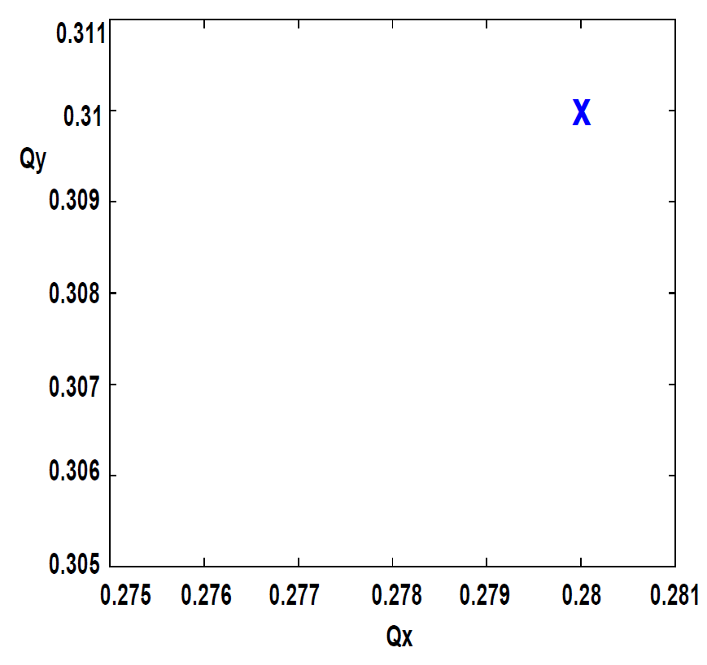
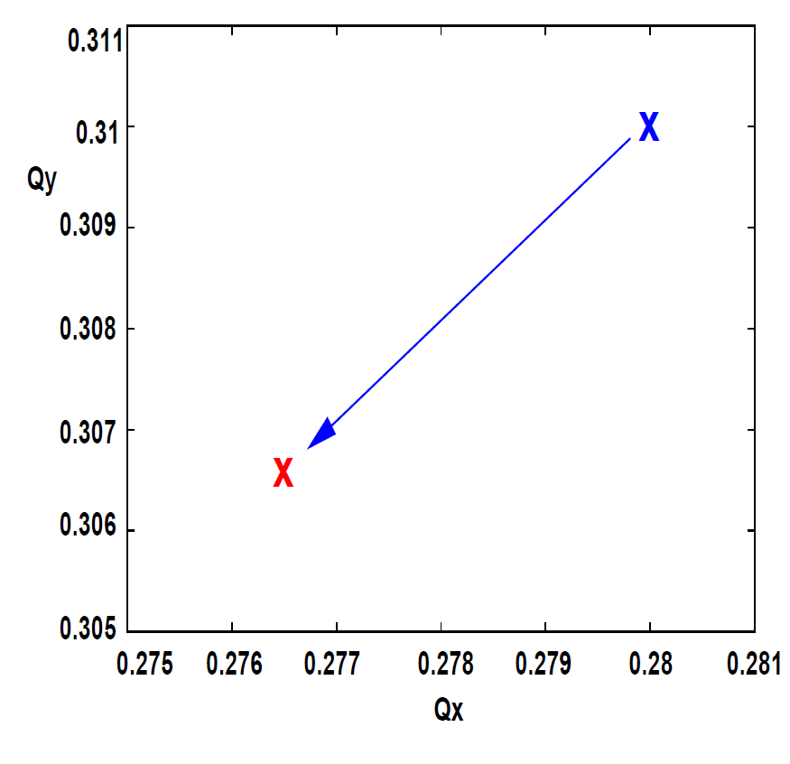
Linear tune shift - two dimensions
“bare lattice” tune + linear shift due to beam-beam (=core particles)
“bare lattice” tune

Slide 12
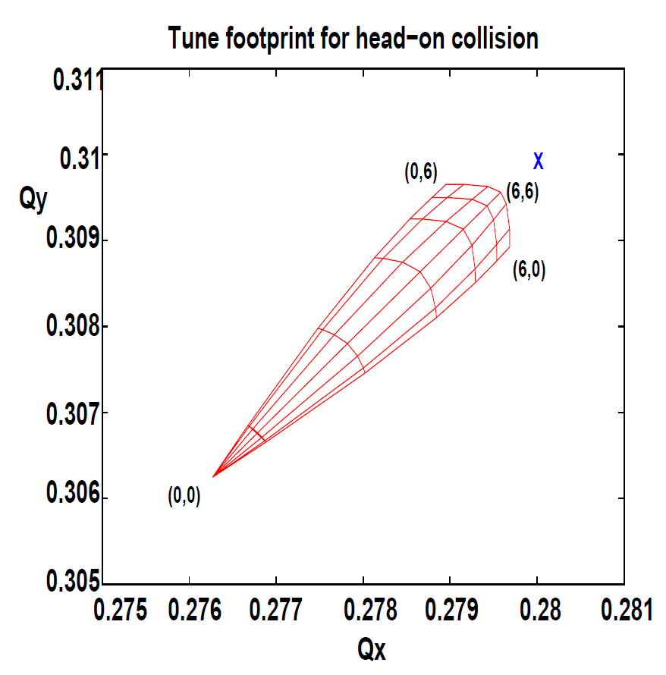
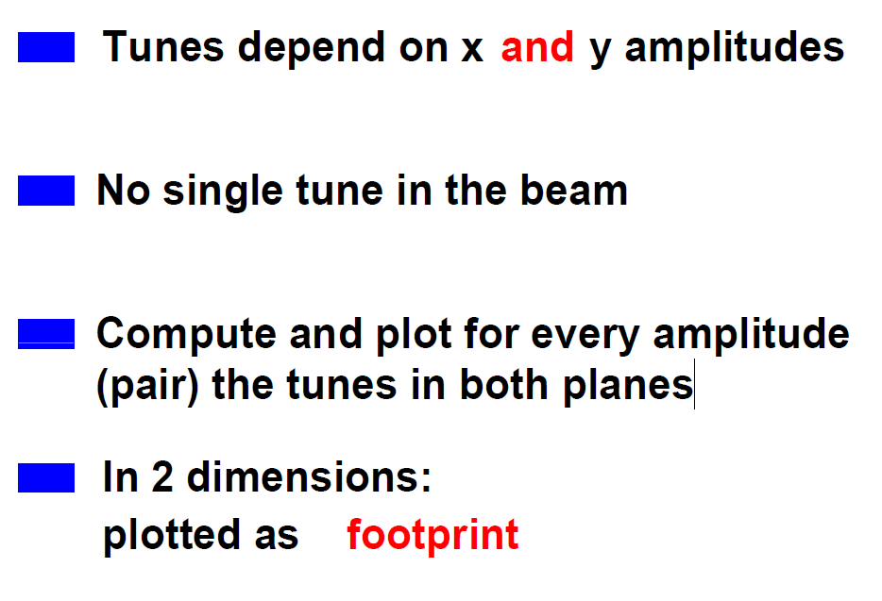
Non-linear tune shift in two dimensions
halo
core

Slide 13
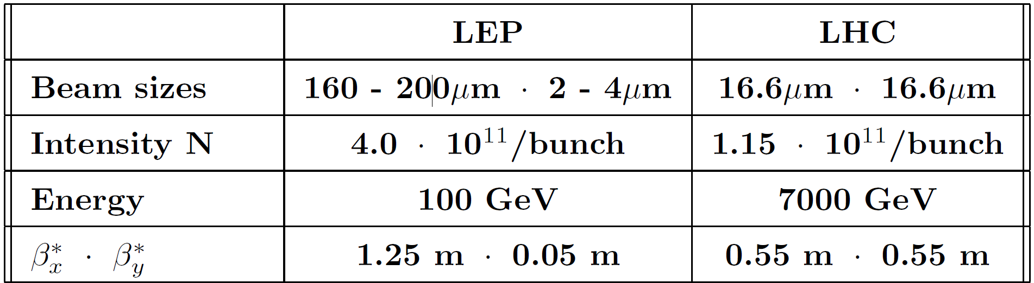
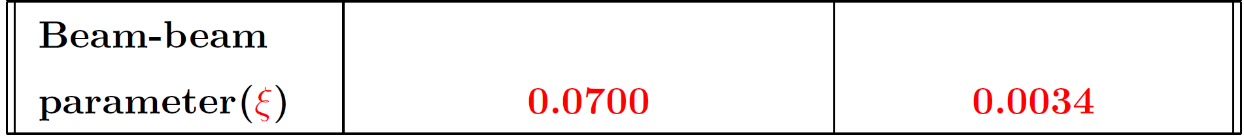
e+e- LEP vs p-pbar collider Tevatron
Tevatron
30
30
3
3
980
0.28
0.28
0.012 x2 IPs

Slide 14
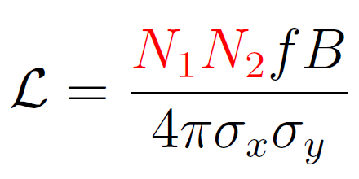
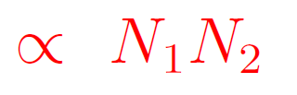
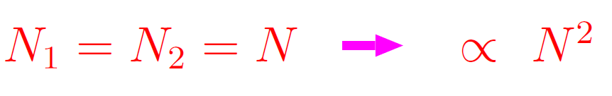
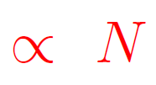
Observations (Reality of Beam-Beam)
Remember:
Luminosity should increase
for:
Beam-beam parameter should increase
But:

Slide 15
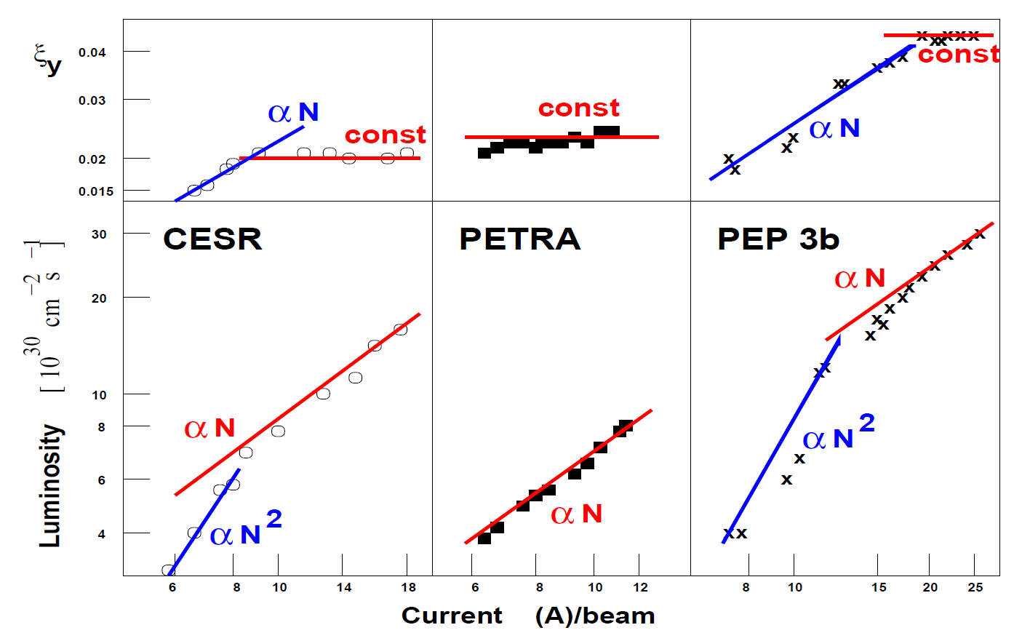
Beam-Beam Limits : e+e- Colliders

Slide 16
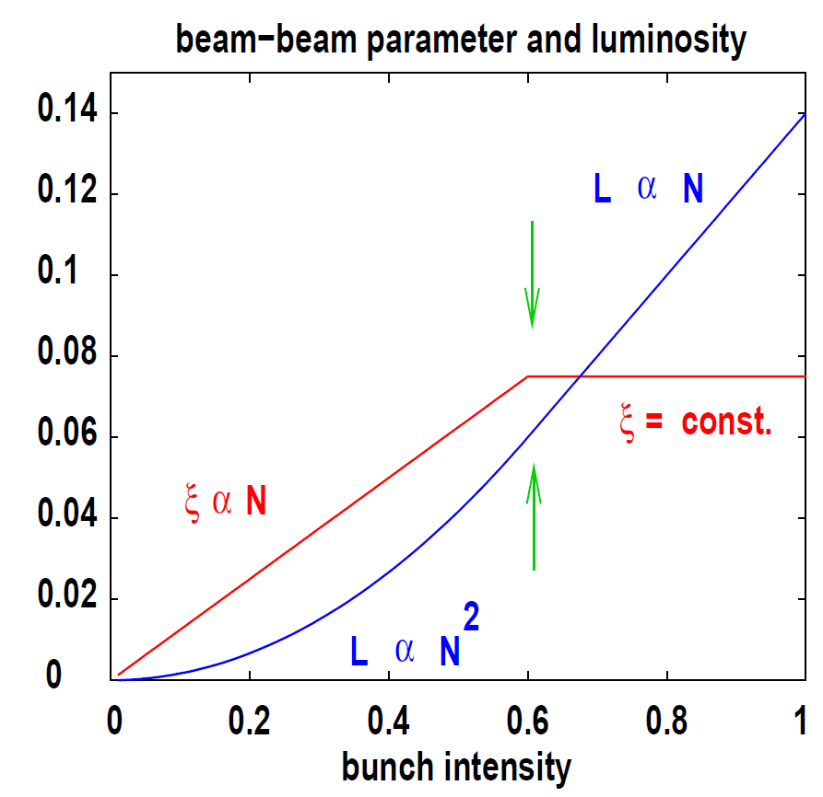
Beam-beam Limit on Luminosity
First - Beam−beam parameter increases linearly with intensity
Saturation above some intensity
Then – luminosity increases only linearly with N above the so−called
beam−beam limit

Slide 17
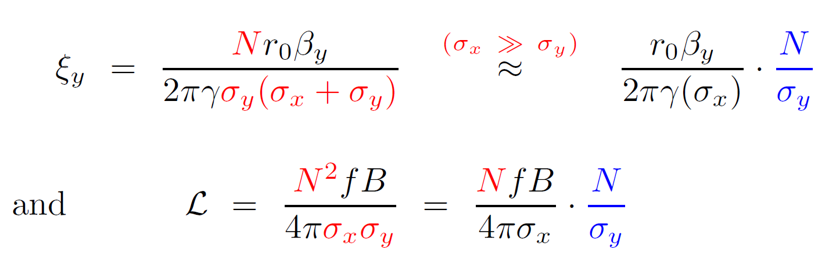


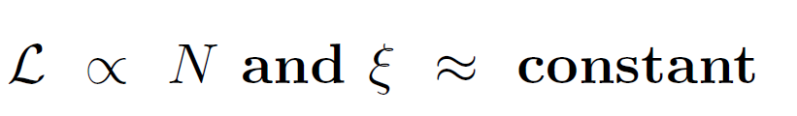
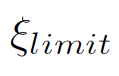
What’s happening?
Above beam-beam limit: σ_{y} increases when N increases
  to keep constant → equilibrium emittance !
Therefore:
is NOT a universal constant !
  depends on tunes/WPs, damping rates, etc
  difficult to predict exactly for hadron machines

Slide 18
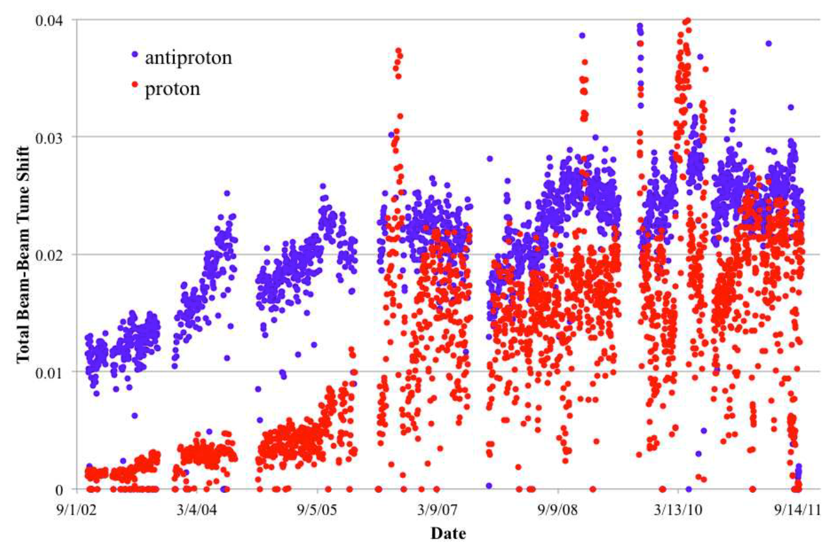

Beam-Beam Limits: pp/pbar Colliders
Tevatron Collider Run II

Slide 19
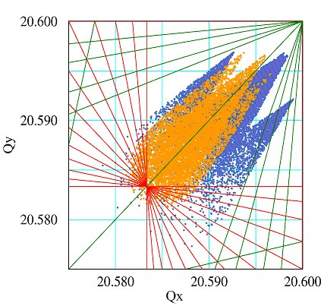
Tevatron Tune Footprint “Confinement”
5th order resonances:
Q=3/5=0.600 –
EMITTANCE BLOWUP
pbar
protons
antiprotons
12th order resonances:
Q=7/12=0.583 -
BAD BEAM LIFETIME
p
7th order resonances:
Q=4/7=0.571 -
HIGH LOSSES

Slide 20
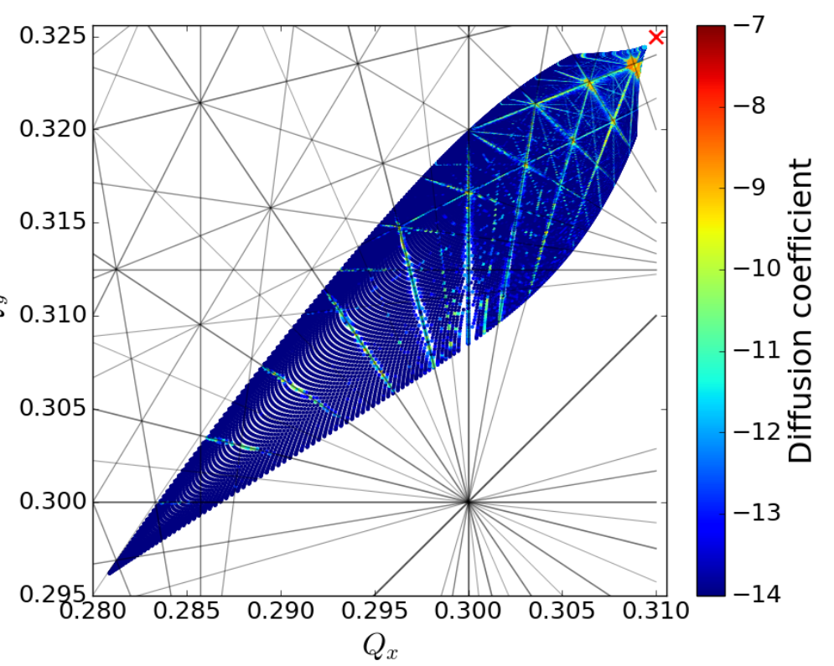
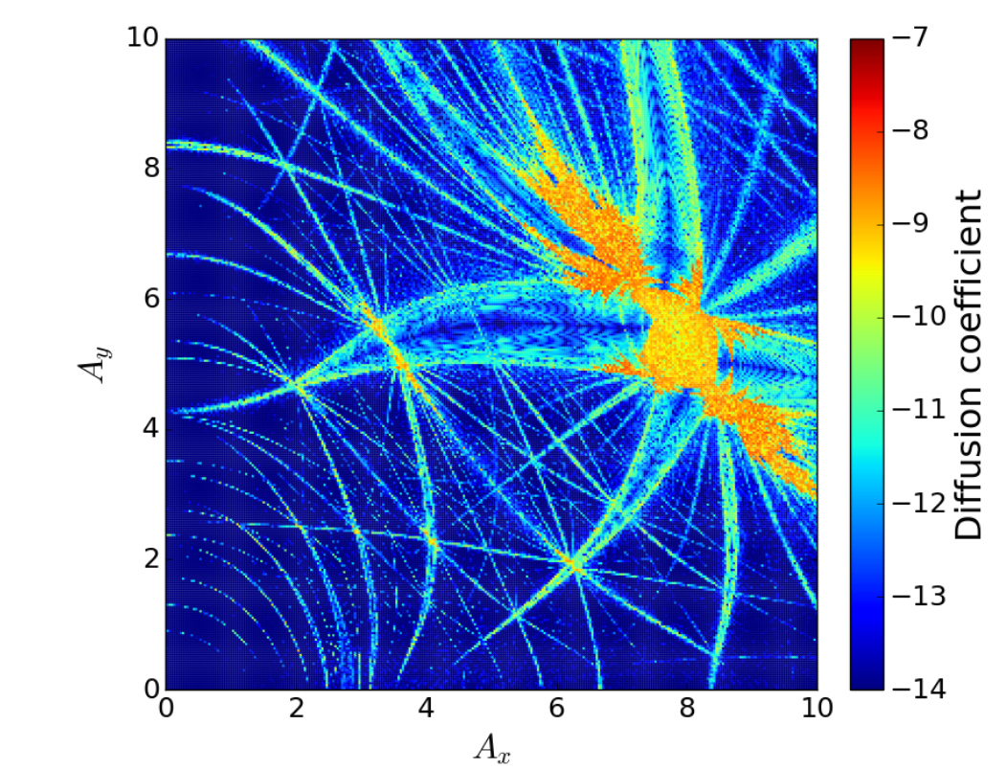
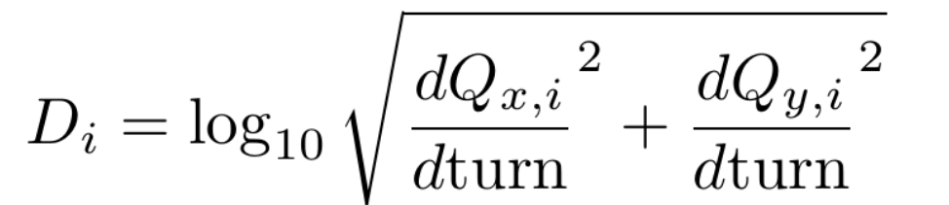
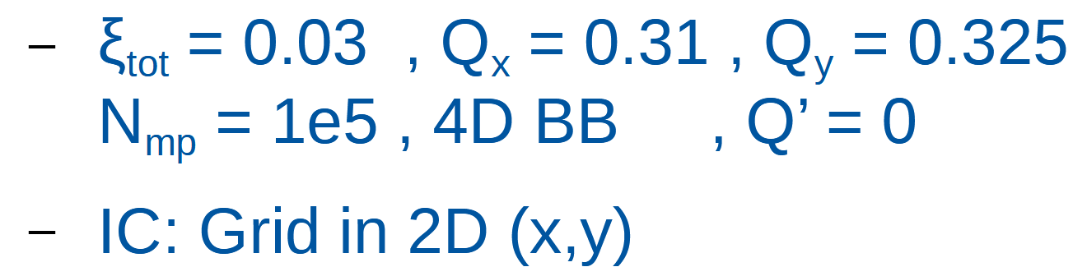
Resonances matter! … Diffusion
Tune map: LHC (simul)
Shown resonances up to order 20
Amplitude map: LHC (simul)
Shown diffusion rates vs Ax/Ay
Measure tune of a particle based on (here) 4096 turns -Calculate linear change over 10 measurements, separated by 10k turns

Slide 21
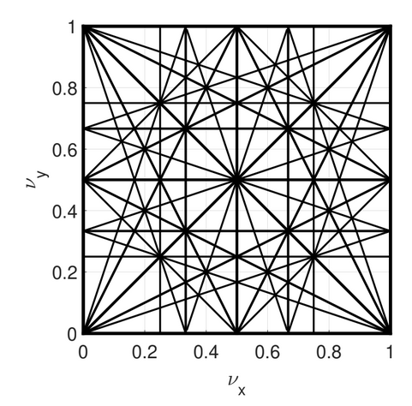
Non-linear Resonances
harmonics of
ω_{x}
ω_{y}
ω₀
Nonlinear terms in the force F(x,y,t)~x^l y^p δ(t-kT) lead to appearance of driving terms oscillating with frequencies mQ_{x}+nQ_{y}, and therefore open opportunities for nonlinear resonances if
mQ_{x}+nQ_{y}=p
|m|+|n| is order
of the resonance
i.e. resonance diagram up to
fourth order; importance of the resonance depends on the force shape and order (low order = more serious; often longitudinal deviations matter if mQ_{x}+nQ_{y} +lQ_{s} =p

Slide 22
How to control beam-beam effects?
Find 'lenses' to correct beam-beam effects
Head on effects: force is ~r
  Linear "electron lens" to shift tunes
  Non-linear "electron lens" to reduce spread
  Successful e-lenses at FNAL and RHIC
Long range effects:
  At very large distance: force is ~1/r
  Same force as a wire !
Overall - success with active compensation

Slide 23
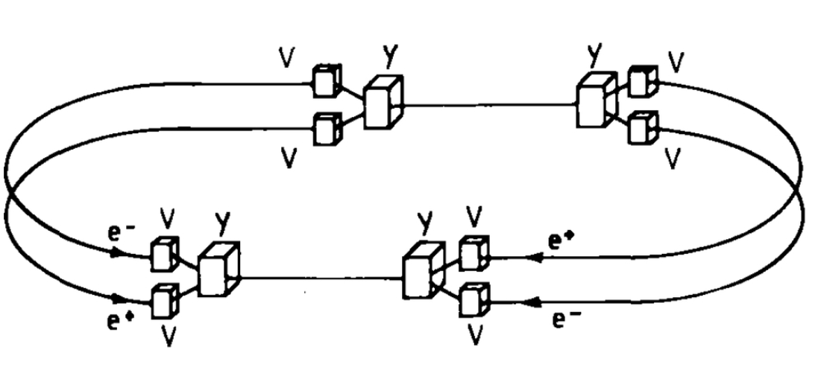
Attempt #1: Four beams e-e+ e-e+
four-beam collider Dispositif de Collisions dans l’Igloo (DCI, 1970s) at Orsay with two 0.8 GeV electron beams and two positron beams of the same energy, all meeting at the same interaction point (J.LeDuff et al)
Q1+Q2+Q3+Q4=0
J1+J2+J3+J4=0
E=B=0

Slide 24
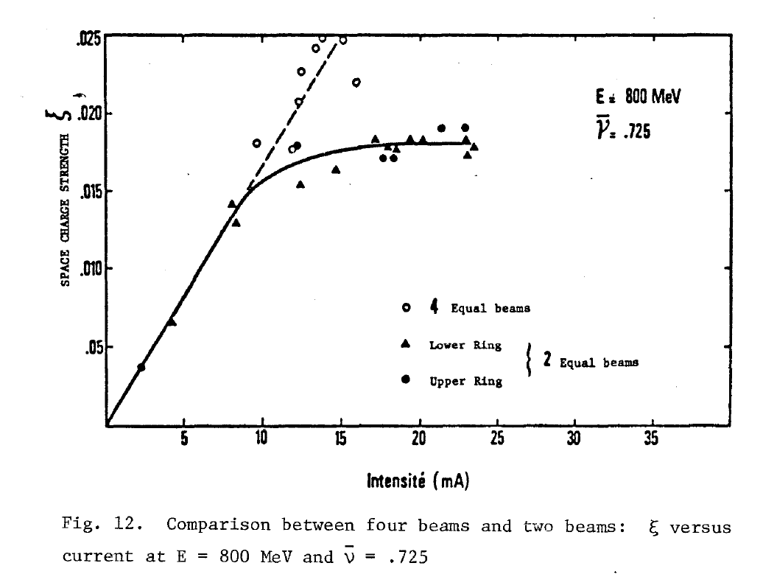
Attempt #1: Four beams compensation
No improvement of performance was obtained in the four-beam configuration compared to collisions of just two beams of electrons and positrons.
A transverse dipole feedback as well as a
detuning of the two rings did not help.
The compensation is believed to be unsuccessful due to the loss of beam stability, both for dipole and higher order modes of coherent motion.

Slide 25

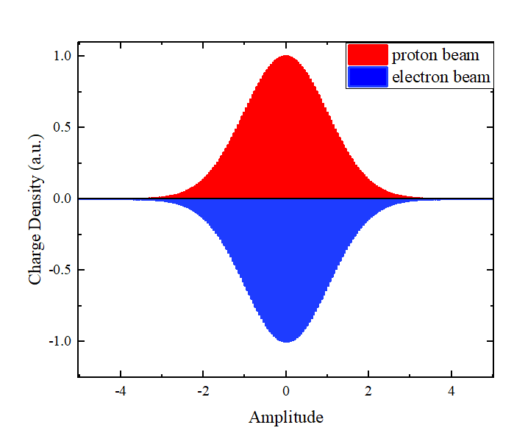
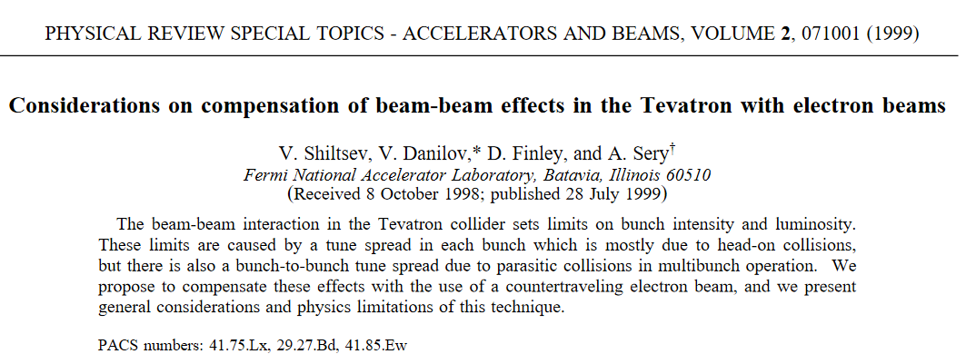
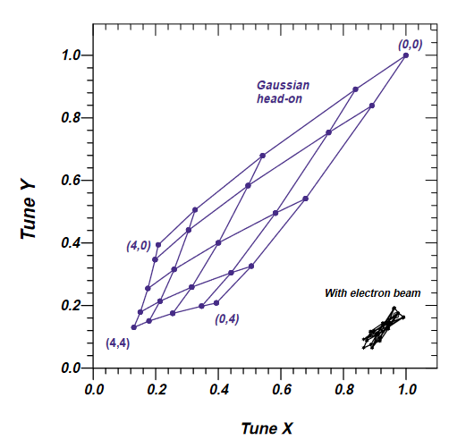
Approach #2: Electron lens
Protons focus pbars +
Electrons defocus
Net effect = zero
Footprint compressed
e- profile same as p+
(V.Shiltsev et al)

Slide 26
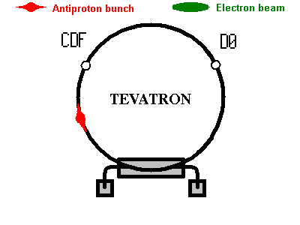
Electron Lens Compensation
electron beam
“…to compensate (in average) space charge forces of positively charged protons acting on antiprotons in the Tevatron by interaction with a
negative charge of a low energy high-current electron beam “ (V.Shiltsev, 1997)

Slide 27
Some Facts on Electron Lenses
~4 mm dia 2 m long very straight beam of ~10kV ~1A electrons (~10¹²) immersed in 3T solenoid
generates strong radial electric field E ~ 0.3MV/m

Slide 28
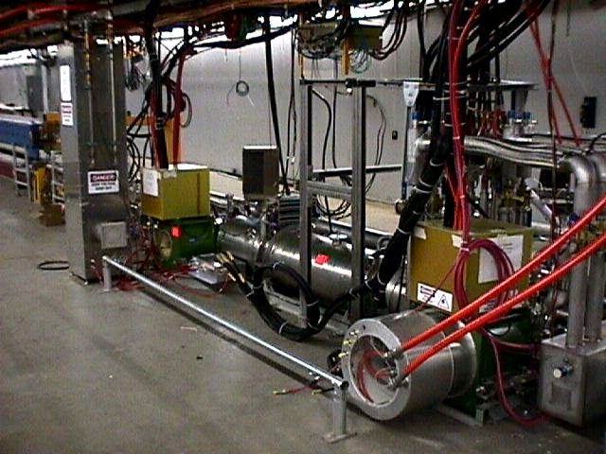
Tevatron Electron Lens #1 (F48)

Slide 29
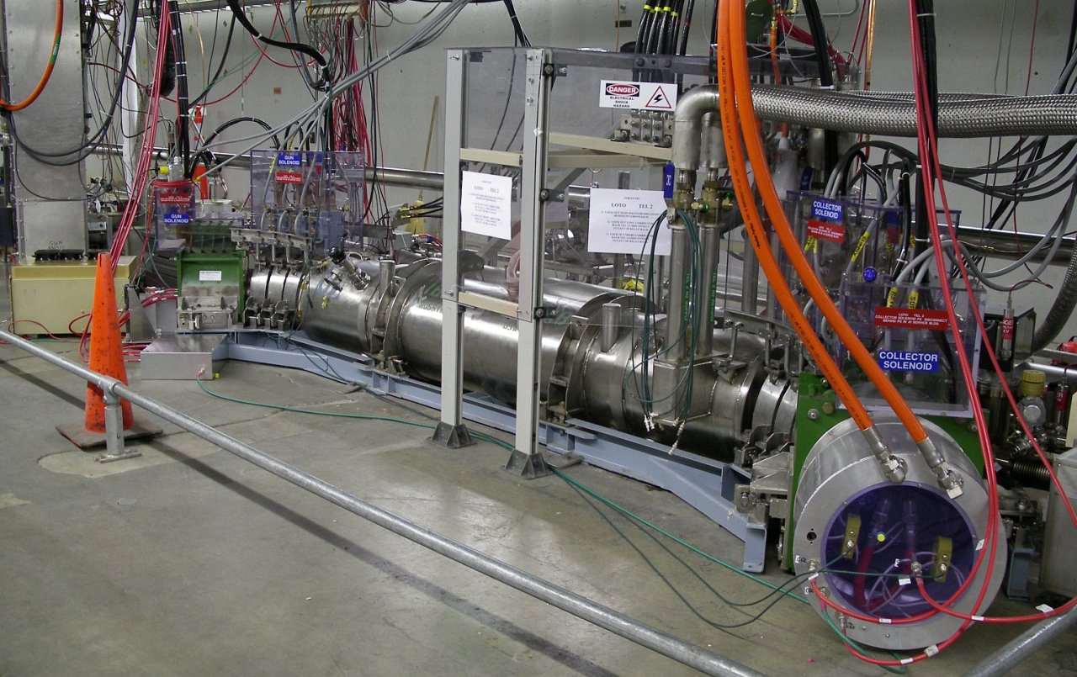
TEL2 in the Tevatron Tunnel (A11)

Slide 30
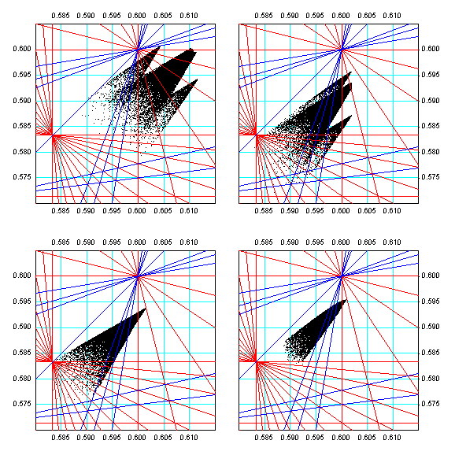
Compensation with Two TELs
Yu.Alexahin
Tev Run II: 36x36 bunches in 3 trains
compensate beam-beam tune shifts
  a) Run II Goal
  b) one TEL
  c) two TELs
  d) 2 nonlinear TELs
requires
  1-3A electron current
  stability dJ/J<0.1%
  e-pbar centering
  e-beam shaping
a
b
c
d

Slide 31
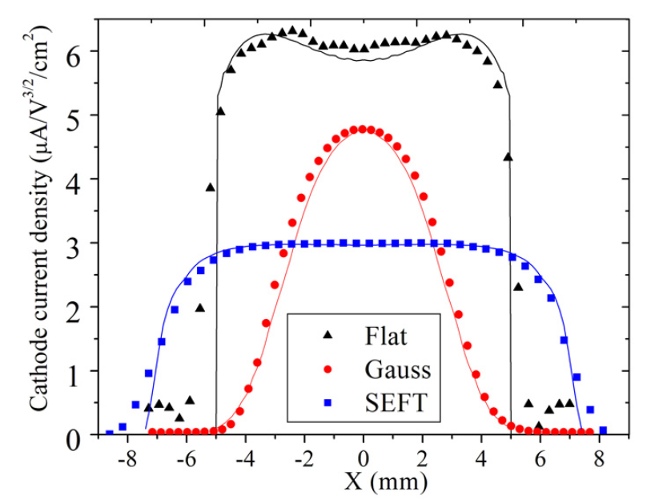
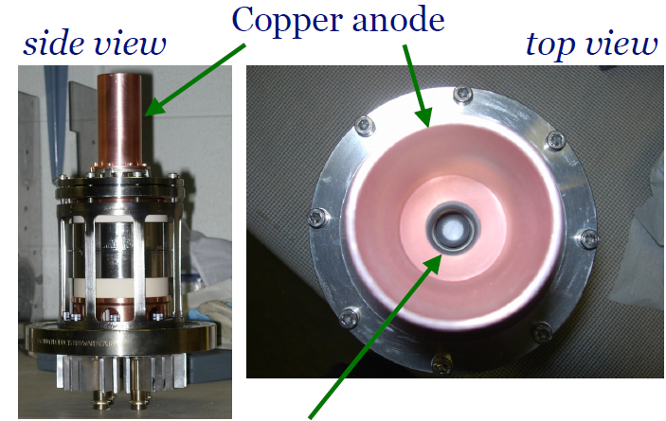
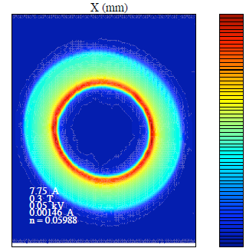

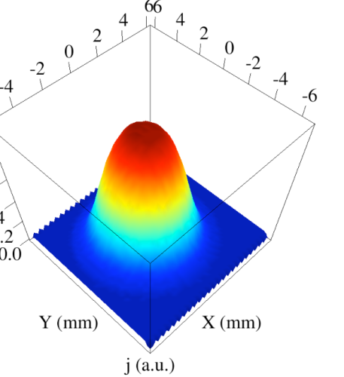
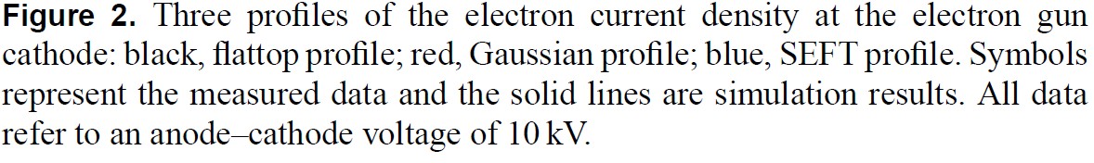
Electron Charge Distribution
Electron gun
Shiltsev et al., PRL 99, 244801 (2007). Shiltsev et al., NJP 10, 043042 (2008).
G. Stancari, et al., (2011)
Phys. Rev. Lett. 107, 084802

Slide 32
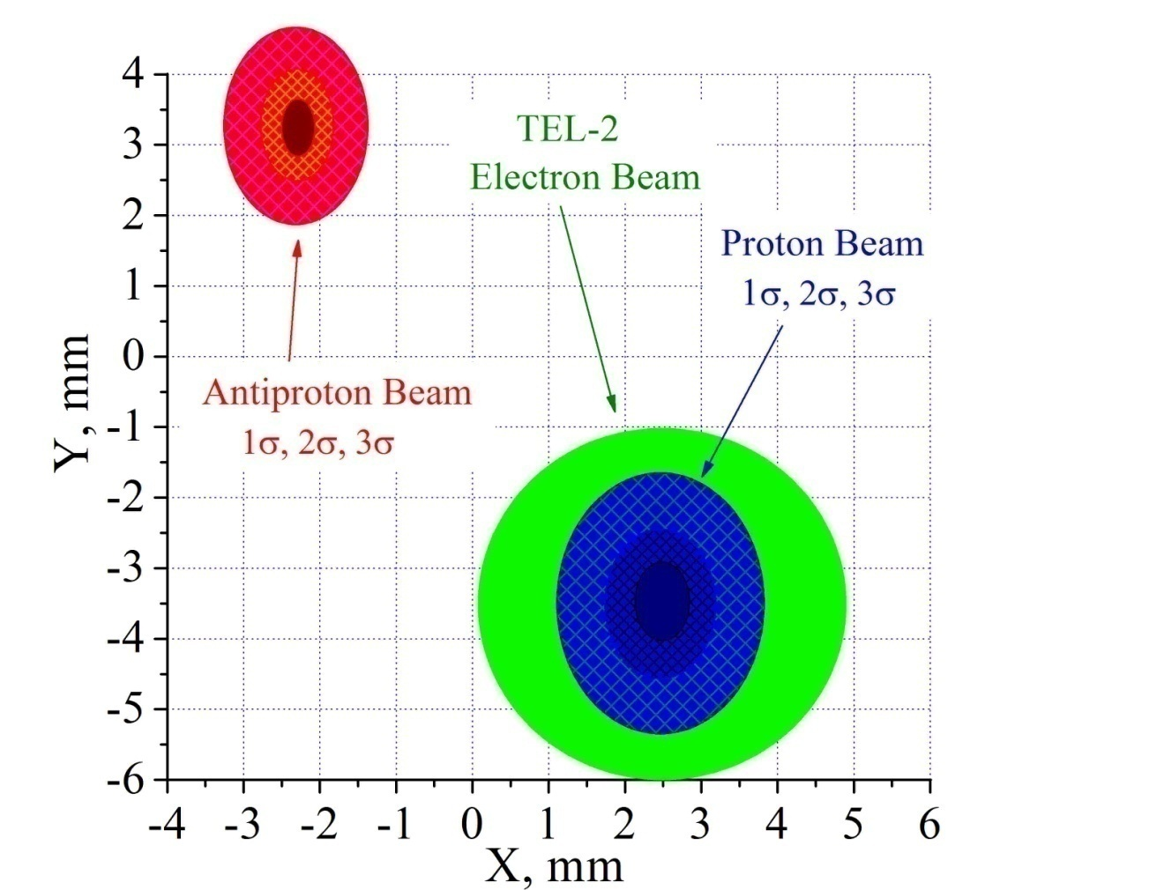
TEL e-beam aligned and timed on protons
in space
in time
TEL
P12
A24
P9
P10
P11
Transverse e-p alignment is very important for minimization of noise effects and optimization of positive effects due to e-beam. Timing is important to keep protons on flat top of e-pulse – to minimize noise and maximize tune shift.

Slide 33
Tevatron Electron Lenses (2001-2011)
Technology proven, tune shift ~0.01 demo’d
First successful active compensation
Head on effects compensation:
  Reduced emittance growth of a PACMAN antiproton bunch (“scallops” effect)
Long range effects compensation:
  Significant (x2) improvement of the lifetime of most affected proton bunches
    By shifting tunes of otherwise unfavorable bunch away from resonances

Slide 34
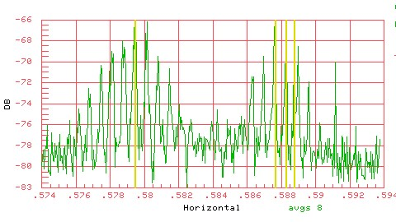
Tuneshift dQ_{hor}=+0.009 by TEL
Three bunches in the Tevatron, the TEL acts on one of them

Slide 35
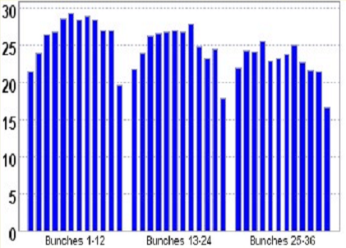
“Scallops” in Pbar Bunch Emittances
Too close to
Qy=0.6
95% normalized vertical emittance, pi mm mrad
Bunch #

Slide 36
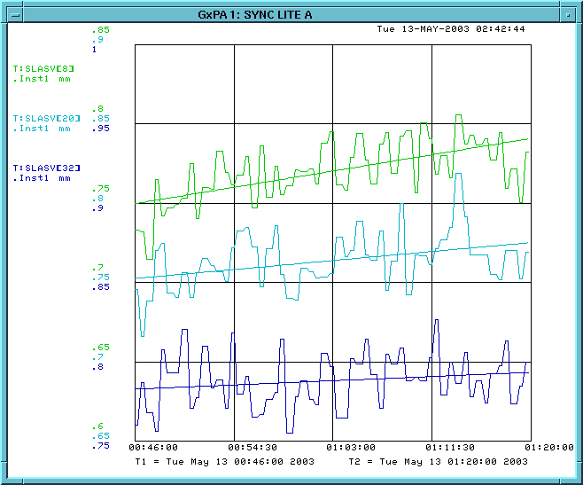
Emittance Growth of A33 Suppresed by TEL
Store #2540
May 12, ‘03
A9
4.1 π mm mrad/hr
A21
2.2 π mm mrad/hr
A33
1 π mm mrad/hr
-TEL on it

Slide 37
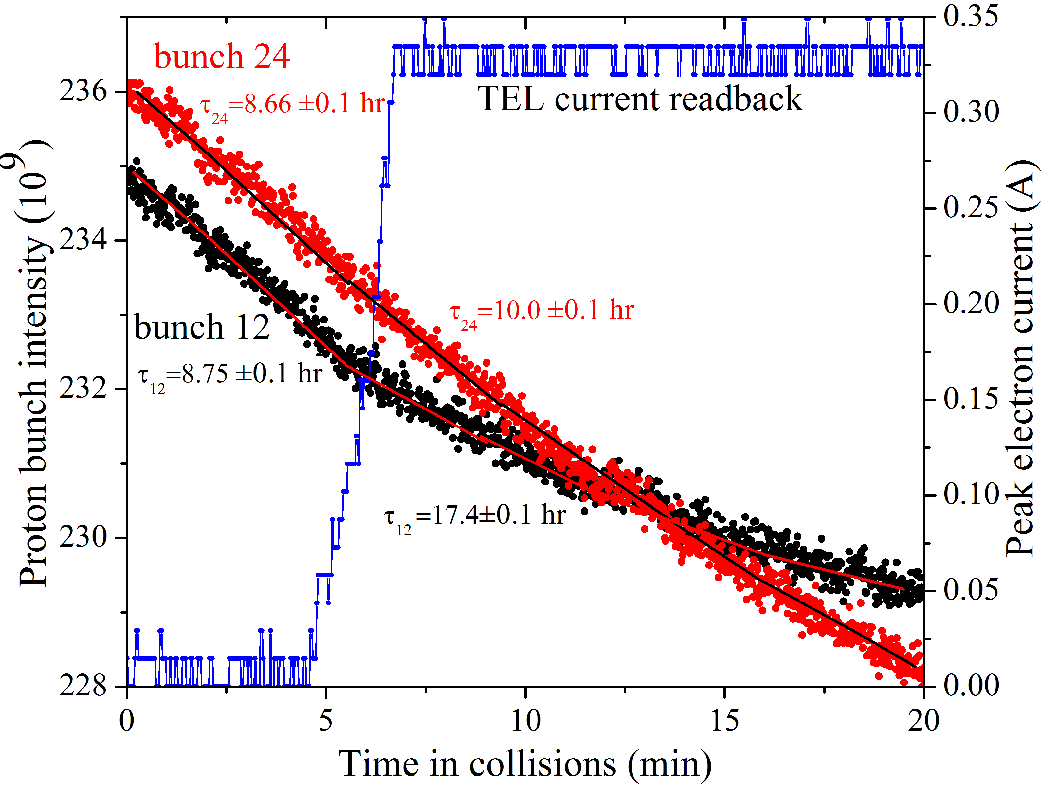
TEL2 on One Proton Bunch P12
When TEL off:
bunches #12 and #24
have same lifetime of
8.7 hrshrs=11%/hr loss
When TEL on:
bunch #12 lifetime
is ~2x #24 lifetime:
17.4 hrs vs 10.0 hr

Slide 38
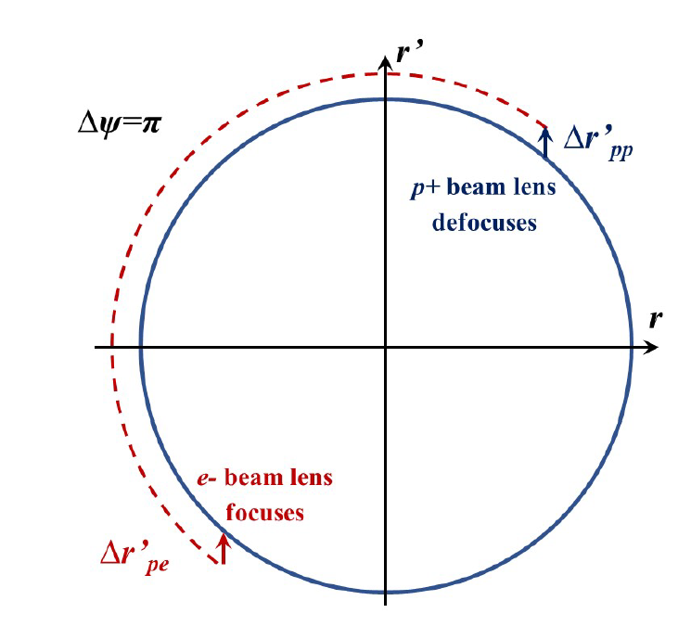
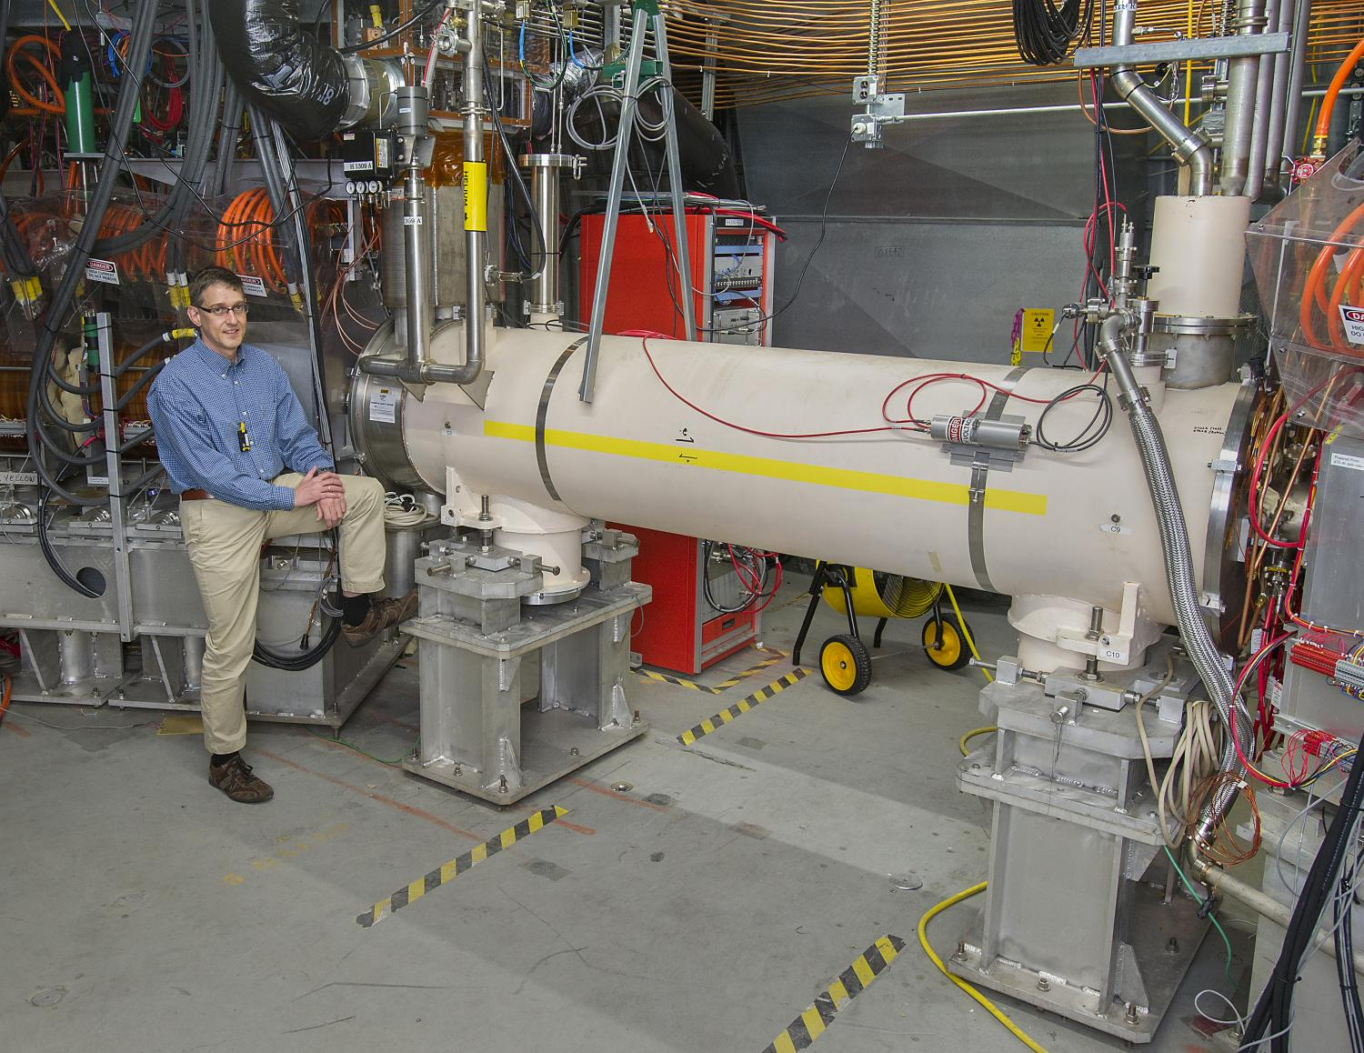
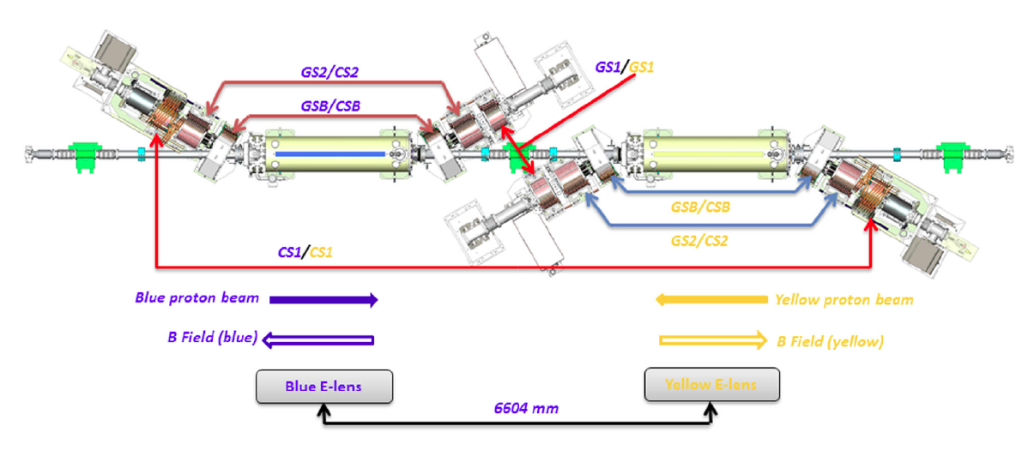
Approach #3: Head-On Comp’n in RHIC
(W.Fischer et al)
With e-lens, one can compensate Head-On effect: not only the tune footprint, but also the resonant driving terms if elens is placed 180 degrees (betatron phase) away from the main IP (one IP compensation)

Slide 39
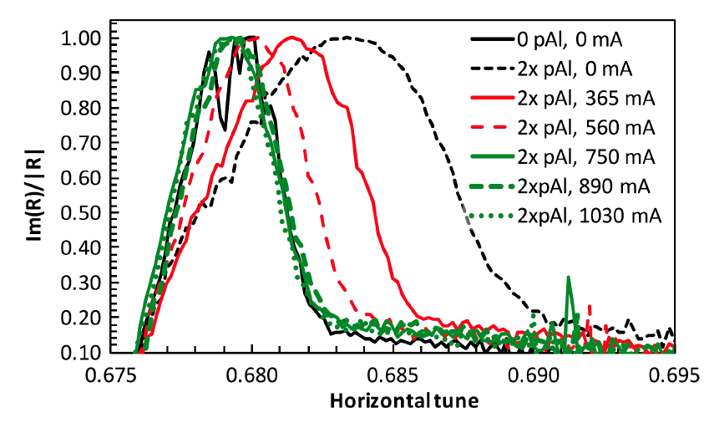

RHIC pp 2015 elens Success

Slide 40


RHIC pp 2015 elens in Ops
With 0.6A, 2.1m long, 5 kV e-beam, essentially:
- one out of 2 IP head-on effect cancelled,
max allowed beam intensity increased by ~40%,
peak average lumi ~tripled, averaged lumi ~ doubled

Slide 41


Approach #4 : Wire Compensation of Long Range Beam-Beam Interactions
Fields of separated p+ beam:
E~N_{IPs} N_{p} /d
B = E
Field of separated conductor (wire):
E=0
B~2J_{e} /d
Combined effects of p+ beam + e- beam will cancel out if
wire is placed at the same d
wire kick Jxlength matches N_{IPs}N_{p}
(J.P.Koutchouk, G.Sterbini et al)

Slide 42

Wire Compensation in the LHC (2018)
Proton losses in collisons are due to:
Luminosity burn up dN/dt=-Lx80 mbarn
and beam-beam effects -
different for regular and PACMAN bunches
So, plotted is dN/dt/Lumi
for regular and PACMAN bunches

Slide 43
Beam-beam topics also include…
Beam-beam effects in linear colliders
Beamstrahlung
Asymmetric beams
Synchrobetatron coupling
Crabbed and crab-waist schemes
Monochromatization
Beam-beam simulation codes
... etc.

Slide 44
BREAK (!...?)
SPACE-CHARGE EFFECTS

Slide 45
Intense Beams : Forces and Losses (1)
eE
Electric Force Repels
p+
eB(v/c)=eE(v/c)²
Magnetic Force Attracts
p+
Net Force: Repels
eE-eE(v/c)² =eE (1- β²)=eE/γ²

Slide 46
Intense Beams : Forces and Losses (2)
Defocusing Force is Non-linear
N
F
F_{max}~eN/σ²γ²
r
Space-charge effects (emittance growth, losses):
proportional to current (N)
scale inversely with beam size (σ)
scale with time at low energies (γ)
Linacs 5-20 MeV/m
Rings 0.002-0.01 MeV/m

Slide 47


47
Space-charge: Core vs Tail
S. Lund
47
J. Eldred Transverse Dynamics Accelerators
Notes:
47
47
47

Slide 48




Space-charge effects: Proton Rings
SC tune shift

Slide 49



Space-charge Tune-spread & Betatron Resonances
G. Franchetti et al.
PRSTAB 2017
JPARC MR:
M. Friend
49
Notes:
49
49
49
49

Slide 50


Max SC tuneshift Achieved: -0.2…-0.5

Slide 51

Ways to Increase “Protons Per Pulse”
Increase the injection energy:
  Gain about N_{p}~ βγ², need (often - costly) linacs
Flatten the beams (using 2nd harm, RF) :
  Makes SC force uniform, N_{p}~ x2
“Painting” beams at injection:
  To linearize SC force across beams N_{p}~x1.5
Better collimation system beams:
  From η~80% to ~95% N_{p}~x1.5
Make focusing lattice perfectly periodic:
  Eg P=24 in Fermilab Booster, P=3 in JPARC MR → N_{p}~ x1.5
(to be tested) Introduce Non-linear Integrable Optics :
  May reduce the losses and allow N_{p}~ x 1.5-2
(tbt) Space-Charge Compensation by electron lenses :
  Electrons to focus protons, may allow N_{p}~x1.5 - 2

Slide 52




Beams Document 6790-v1 FNAL
Space-Charge Compensation R&D

Slide 53


IOTA: Integrable Optics Test Accelerator @ FNAL
E-Lens
OSC insert
NL Magnet
Kickers
RF
Lambertson
Octupoles
C=40 m
150 MeV/c e- and 70 MeV/c p+
injected beam

Slide 54
(COHERENT BEAM)
INSTABILITIES

Slide 55
Instabilities
Beam instabilities are driven by the electromagnetic interaction with the accelerator environment (-> wakefields/impedances) and by electron clouds.
Above a certain intensity threshold the beam’s oscillation amplitude increases exponentially and the beam is either lost at the wall (transverse instabilities) or from the RF bucket (longitudinal) and/or the emittance increases.
Presently, heat loads and instabilities are one of the main beam quality and intensity limitation in particle accelerators for high intensity and brightness !
Finding “cures” for instabilities is one of the major challenges in beam physics and accelerator technology for future machines.
High energy beams: Beam instabilities are a ‘current effect’. However, synchrotron radiation, photoelectrons or other high energy effects affect instability thresholds.

Slide 56


Maxwell’s equations and Lorentz Force
EM forces due to : a) wake fields and impedances, b) electron cloud, c) beam-beam, d) etc
See more in USPAS lectures

Slide 57

Wake-fields

Slide 58





Wake-fields - Examples
Wake fields behind a bunch generated at a step-out transition from a small to a larger beam pipe

Slide 59

What if we have many particles
Wake-functions

Slide 60




Even “simple” resistive wall leaves wakes
“Skin-effect” – EM field
penetration
depth
Key points: a) longitudinal wakefield leads to particle energy loss and pipe heating; b) transverse wake is defocusing for vacuum beam pipe (focusing in case of electron cloud)

Slide 61



Consequences: two-particle model
In linacs: Beam-break up (BBU) instability
In rings: Head-tail instability (aka TMCI = Transverse Mode Coupling Instability)

Slide 62
Intensity Limits and Cures
Beampipe heating is important for cryo – may limit on N_{b} I_{b}
Instabilities severely limit either single bunch current I_{b} or total beam current N_{b} I_{b}
Cures employed so far:
Reduce wakes/impedances – no discontinuities in beam pipe, better conducting materials, etc
In linacs – BNS damping= introduce energy difference btw head and tail of the bunch (RF phase choice) leading to slight difference in the betatron oscillation frequencies
In rings
  Feedback dampers (might not work for single bunch instabilities)
  introduce betatron frequency spread via chromaticity dQ=Q’(dP/P) (does not always work) or octupoles dQ~Oct*σ² (mostly worked so far) or electron beams for Landau damping (next gen colliders)

Slide 63


Intensity Limits and Cures
168 LHC octupoles for Landau Damping
Concern is that these octupolse are so nonlinear that they reduce Dynamic Aperture of the collider → affect lifetime

Slide 64

Landay Damping by Electron Lenses

Slide 65



Collimation
To protect from enormous beam power (and power density) of high energy accelerators and colliders – events and processes:
  Injection errors
  Instabilities
  Losses due to beam-beam, beam-gas, intrabeam scattering, etc
  Synchrotron radiation photons
Protect magnets, RF and detectors !

Slide 66

Collimators
Damage to E03 1.5m Collimator
Tevatron 12 collimators:
  Hor and Vert
  Proton and antiproton
  4 primaries
    5 mm W
  8 secondaries
    1.5 m stainless steel
    Flat to <25 micron
    As close as few mm to the
Efficiency 95-99%
  reduction of background in CDF and D0 detectors x20-100
Protons
  see lectures NM1-4

Slide 67

(Most Sophisticated) LHC Collimation
Efficiency > 99.99%
i.e. <0.01% escapes
dedicated absorbers

Slide 68



Collimation Challenges and Cures
Too many, too close to beams → large wakefields/impedance
Can be damaged/destroyed …. NEW METHODS
Bent crystal collimation Hollow e-beam collimation
Few mm Si (100)
100’s of μrad
Few Amperes, few mm dia, few m long e-beam
Makes bigger deflection → better interception of scattered particles
Tested at the Tevatron and LHC
Soft “penetrable” & fast diffusor → undamageable. Tested at the Tevatron and being built for LHC

Slide 69



Aperture and Dynamic Aperture
Physical beam pipe ~60-100 mm …10’s-100’s σ
Often coated (eg TiN) and/or grooved (ecloud)
Collimators - losest to beam – 5-10’s of σ
Often coated (eg TiN) and/or grooved (ecloud)
SKEKB
90mm
The dynamic aperture is the stability region of phase space in an accelerator – dependent on nonlinearities and chromatic effects
For proton machines - stability over O(1e9) turns
For electron/muon machines - stability over O(1e3) turns

Slide 70


Beam Cooling
Beam Phase Space Density Increase
As needed for a collider
Forbidden by the Liouville theorem in non-dissipative systems
x’,y’,dP/P
x,y,t
100 MeV electrons in IOTA ring
Ideally - “6D-Cooling”

Slide 71





Diffusion and Cooling (1)
Diffusion equation for beam distribution function f(J,t), J- action variable
In the presence of cooling:
where for example:

Slide 72





Beam Cooling Methods to Date
Synchrotron Radiation Damping – since 1960’s
common in all e+/e- rings
Electron Cooling – since 1970’s
Widely used to cool ions and antiprotons
0.1 - 8 GeV/n (50 keV – 4 MeV electrons DC)
Stochastic Cooling – since 1970’s
Widely used to cool ions and antiprotons
0.1-100 GeV/n (up to 10 GHz feedback BW)
Laser Cooling – since 1990’s
Works for some highly charged ions
0.1-0.5 GeV/n, deep cooling, spectroscopy
Lectures VL13-14
100 MeV electrons in IOTA ring

Slide 73






Recent Beam Cooling Breakthroughs
2019 - Ionization cooling of muons (140 MeV/c, RAL, UK)
2020 – “Bunched” electron cooling of ions (γ~5, BNL)
MICE
~10% in one pass
RHIC
RF e-gun
2025 – Coherent Electron cooling of ions (26.5 GeV/n, RHIC) – ongoing PoP exp’t at BNL
THz bandwidth
2021 – Optical Stochastic cooling e- (100 MeV, FNAL)
IOTA
THz bandwidth

Slide 74
  Thanks for Your Attention !
Questions !?

Slide 75
Literature
W.Herr, CAS school
https://cds.cern.ch/record/941319/files/p379.pdf
V.Lebedev, V.Shiltsev, Tevatron Book Ch.8
https://indico.cern.ch/event/774280/attachments/1758668/2915590/2014_Book_AcceleratorPhysicsAtTheTevatro.pdf
Proc. 2013 ICFA mini-workshop on "Beam-Beam Effects in Hadron Colliders"
https://indico.cern.ch/event/189544/
Past schools :
  A. Chao, The beam-beam instability, SLAC-PUB-3179 (1983).
  L. Evans, The beam-beam interaction, CAS Course on proton-antiproton
  colliders, in CERN 84-15 (1984).
  L. Evans and J. Gareyte, Beam-beam effects, CERN Accelerator School, Oxford
  1985, in: CERN 87-03 (1987).
  A. Zholents, Beam-beam effects in electron-positron storage rings, Joint
  US-CERN School on Particle Accelerators, in Springer, Lecture Notes in
  Physics, 400 (1992).

Slide 76
Comprehensive JUAS-book (2371 pages – all topics!)
https://doi.org/10.23730/CYRSP-2024-003.
Instabilities:
A.Chao, Physics of collective beam instabilities in high energy accelerators (1993) https://www.slac.stanford.edu/~achao/wileybook.html
Many useful articles:
S.Myers, H.Schopper Accelerators and Colliders
(2013, open access)
https://link.springer.com/book/10.1007/978-3-030-34245-6

Slide 77


Can also be used for Long-Range Beam-Beam Compensation
vary the currents bunch-by-bunch in two e-lenses installed at β_{x}≠ β_{y}
I_{e}[A]
TEL1
TEL2
n_{bunch}
e-beam p-bars

Slide 78

Beam-Beam Effects
Remember:
Overview: which effects are important for
present and future machines (LEP, PEP,
Tevatron, RHIC, LHC, ...)
Qualitative and physical picture of the effects

Slide 79

Fields and Forces (1)
Start with a point charge q and integrate over the particle distribution.
In rest frame only electrostatic field: E≠0 while B=0
Transform into moving frame and calculate
Lorentz force
Note that F≈0 if velocities are collinear

Slide 80



Fields and Forces (2)
Derive potential U(x, y, z) from Poisson equation:
The fields become:
Example Gaussian distribution:

Slide 81

A Common Example: Gaussian
For 2D case the potential becomes:
Can derive E and B fields and therefore forces
Also easy for uniform distribution: E and B scale linear with r for r<a, and 1/r for r>a… easy for simple easily integrable axisymmetric distributions
For arbitrary distribution (non-Gaussian):
  difficult (or impossible, numerical solution required)

Slide 82



Further Simplification: Round Gaussian
Round beams:
Only components Er and B are non-zero
Force has only radial component, i.e. depends only on distance r from bunch center, i.e.

Slide 83




Beam-Beam Kick
Kick : - angle by which the particle is deflected during the passage
Derived from force by integration over the collision assume:
    → Newton’s law

Slide 84

Beam-Beam Kick
Using the classical particle radius:
we get radial kick and in Cartesian coordinates:

Slide 85

Beam-Beam Kick
Kick(force) varies strongly with amplitude:
  linear inside → like quadrupole → tune shift amplitude independent at << sigma
  1/r outside the beam core → amplitude dependent tune shift
Highly nonlinear btw 1 and 3 sigma:
  contains many high order multipoles

Slide 86



Beam-beam strength parameter → tuneshift
Slope of force at zero amplitude → proportional to (linear) tune shift from beam-beam interaction
This defines: beam-beam parameter
For head-on interactions we get:
so far: only an additional “quasi-quadrupole” BUT non-linear part of beam-beam force scales with
Note that for flat beams σ_{x} >>σ_{y} ξ_{y} >> ξ_{x}

Slide 87


Tune Spectra: with/w.o. Beam-Beam
simulations
simulations
Linear force →
all particles have same tune → one line in the spectrum of transverse oscillations
Non−linear force →
particles with different amplitudes
have different frequencies (tunes)
We get frequency (tune) spectra
Width of the spectra: ~ξ

Slide 88


In Reality – Even More Complex
Tevatron 980 GeV p and
980 GeV antiprotons (pbars)
Colliding with ξ~0.028
Force is focusing → tuneshift is positive
Measured with 21MHz Schottky monitors
RHIC 100 GeV p + 100 GeV p
Colliding with ξ~0.020
Force is de-focusing → tuneshift
is negative
Measured with BTF (beam transfer function) monitor
…more on that later

Slide 89
Complications : Strong-Strong vs Weak-Strong
Both beams are very strong (strong-strong):
  Both beam are affected and change due to beam-beam interaction
  Examples: LHC, LEP, RHIC, ...
One beam much stronger (weak-strong):
  Only the weak beam is affected and changed due to beam-beam interaction
  Examples: SPS collider, Tevatron (early in Run II) , ...

Slide 90
Incoherent vs Coherent Beam-Beam Effects
Incoherent (single particle effects):
  Single particle dynamics - treat as a particle passing through a static electromagnetic lens
  Basically, non-linear dynamics effects:
    unstable and/or irregular motion (“chaos”)
    beam size blow up or bad lifetime
    Very bad: unequal beam sizes (studied at SPS, HERA, Tevatron)
Coherent (bunches affected as a whole):
  Collective modes
  Bunch-by-bunch differences in:
    Orbits
    Tunes
    Chromaticities

Slide 91

Coherent Beam-Beam: Modes
Coherent mode: two bunches are "locked" in a coherent oscillations
  0-mode is stable (Mode with NO tune shift)
  π-mode can become unstable (Mode with LARGEST tune shift)

Slide 92



Coherent Beam-Beam: Modes
LEP
Two modes clearly visible
Can be distinguished by phase relation, i.e.
sum and dierence signals

Slide 93

Coherent Beam-Beam: Flip-Flop
Bunch sizes get bigger or smaller out of phase
(PEP-II, VEPP-2000, etc)
The intensity threshold for the flip-flop depends on:
asymmetry in beam intensities
x-y coupling
3D Flip-Flop effects triggered by non-linearities of lattice. π-mode on 1/5 resonance. The effect have shown a strong sensitivity to X-Y coupling, beta unbalance and bunch length → main limitation in VEPP 2000.

Slide 94

Multi-Bunch Operation: Need and Issues
How to collide many bunches (for high L) ??
Must avoid unwanted collisions !! Otherwise ξ→2Bξ
Separation of the beams:
  Pretzel/helix scheme (SPS,LEP,Tevatron)
  Bunch trains (LEP, PEP)
  Crossing angle (LHC)

Slide 95

Tevatron: 36 proton x 36 antiproton
Same beam pipe and
magnetic fields →
same orbits →
72 IPs
396 ns bunch
separation
→ 59 m btw IPs
Need only 2
→ separate at 70
→ Electric field

Slide 96


Tevatron High Voltage Electrostatic Separators
300 kV over 50 mm gap; 3 m ; 24 of them (H/V)

Slide 97

Tevatron Helix
24 electrostatic
separators are used
size 12-15 mm
at 150 GeV
6-8 mm
at collisions

Slide 98

All beam indicators become bunch dependent due to long-range beam-beam effects
Orbits
Tunes, couplings
Chromaticities
In both – protons and pbars
Have 3-fold symmetry (trains of 12)

Slide 99


Long-range B-B Seen at Low-Beta (980 GeV)
Synchrotron light monitors show 40 micron b-by-bunch hor pbar orbit variation along the bunch train with 3-train symmetry (4 microns for protons)
Also indicate coupling differences →
Bunch #1 Bunch #8

Slide 100

Antiproton Vertical Orbit
In general – very good agreement btw simulations and measured Q, orbits, Q’s

Slide 101

Pbar Bunch Tunes in Collisions

Slide 102

Pbar Bunch Chromaticity in Collisions

Slide 103



In the LHC
15+15 long range interactions (6-12 σ)
2808 p bunches in each beam, every 25 ns
Two beams in separate beam pipes except in common chamber around 4 experiments
Local separation via two horizontal and two vertical crossing angles

Slide 104



Parasitic Beam-beam Kicks
For horizontal separation d:
In LHC 15 collisions on each side, 120 in total!
Effects depend on separation, eg tuneshift

Slide 105

PAMCMAN bunches due to gaps
Average orbit and tune variations can be corrected, but:
LHC bunch filling not continuous: holes for injection, extraction, dump ..
“Only” 2808 of 3564 possible bunches circulate ! 1756 "holes"
"Holes" meet "holes" at the interaction point - But not always ...

Slide 106

Effect of PACMAN bunches (end of train)
Some bunches can meet a hole/holes (at beginning and end of bunch train) →
They see fewer unwanted interactions in total: between 120 (max) and 40 (min) long range collisions → Different integrated beam-beam effect for different bunches
LHC

Slide 107

Tune Spread - too large for safe operation

Slide 108





108
Transverse Interaction of Co-Moving Charges
Electric Repulsion:
Magnetic Attraction:
Weakened Repulsion with Acceleration:
108
J. Eldred Transverse Dynamics Accelerators
Notes:
108
108
108

Slide 109


109
Space-charge Core vs Tail
Transverse space-charge forces much stronger than longitudinal space-charge.
Transverse and Longitudinal charge distribution can be written as separable functions:
Relativistic Distortion of EM Fields
“Pancake-ification”
Gaussian cylinder for a line-charge:
109
J. Eldred Transverse Dynamics Accelerators
Notes:
109
109
109

Slide 110



Tune Diagrams
110
J. Eldred Transverse Dynamics Accelerators
Notes:
110
110
110
110

Slide 111
Summary
The linear transverse dynamics of a particle accelerator are governed by Hill’s Equation, which is a time-varying harmonic oscillator.
We calculate the trajectory of individual particles through the many individual magnets of a particle accelerator using transfer matrices.
Transfer matrices are also used for the beam size and oscillation phase, which are represented by Courant-Snyder parameters.
There are chromatic effects, resonances, and space-charge effects that complicate the process of designing and operating a particle accelerator.
Some backup slides on longitudinal dynamics.
111
J. Eldred Transverse Dynamics Accelerators
Notes:
111
111
111
111

