Slide 1





Colliders – Lecture VS1:
Introduction: Accelerators
Technologies and History
Luminosity
Vladimir Shiltsev, Northern Illinois University
part of the “Colliders” class by V.Shiltsev, J.Eldred and B. Simmons
Muon Collider School · Aug. 04 – Aug 07, 2025 · U. Chicago

Slide 2
Day 1: General
Lecture 1 Colliders - V.Shiltsev (NIU)
Lecture 2 Beam Optics – J.Eldred (FNAL)
Lecture 3 Beam Dynamics – V.Shiltsev
Homework: ~1 hrs in groups + 2 hrs together - V.Shiltsev, J.Eldred, B.Simmons (NIU)

Slide 3
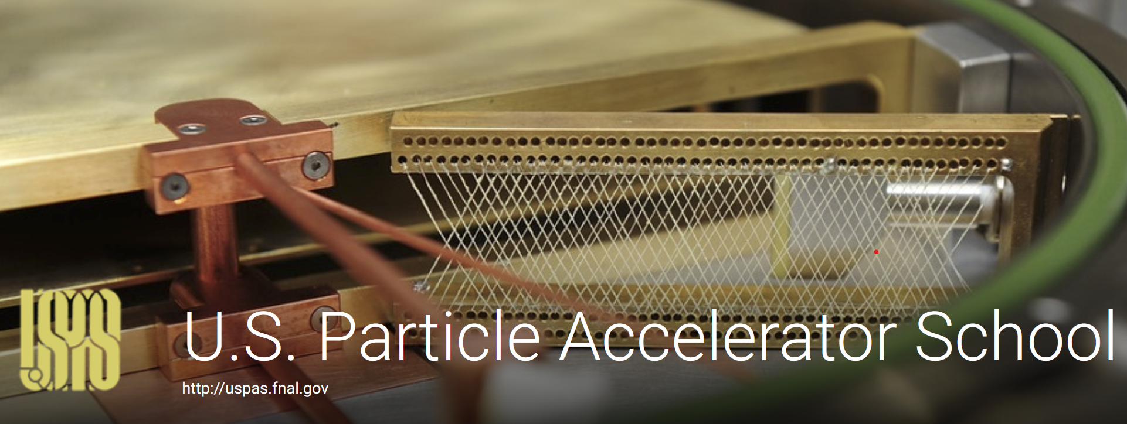

This School is “Just About Concepts”
…by no means even a comprehensive intro
US PAS : US Particle Accelerator School
https://uspas.fnal.gov/
CAS: CERN Accelerator School
https://cas.web.cern.ch/
Even better: sign up for undergrad/grad programs in accelerators (>10 in the US Univ.)

Slide 4
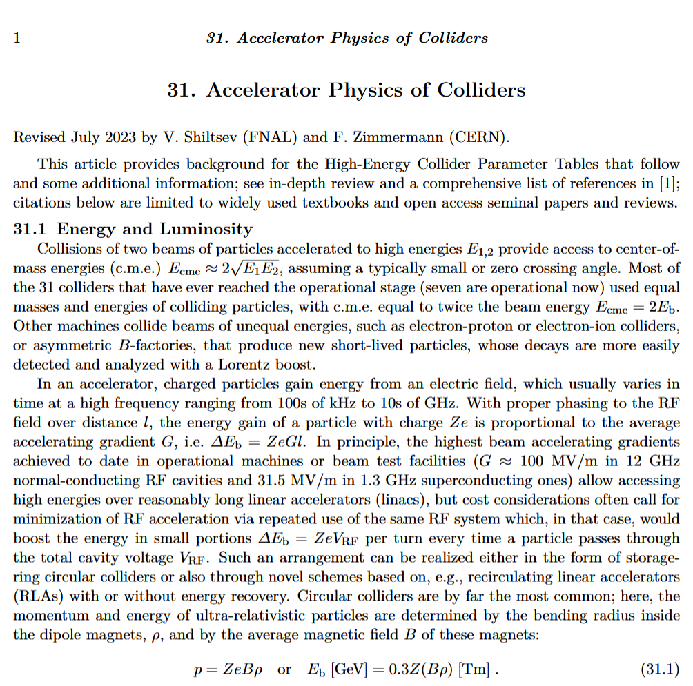

This lecture

Slide 5
Acceleration: Increase of Energy
Energy gain is F[force] x L[distance]
Forces: Strong/nuclear [local]
Electromagnetic [used widely]
Weak [??]
Gravitational [see next slide]

Slide 6
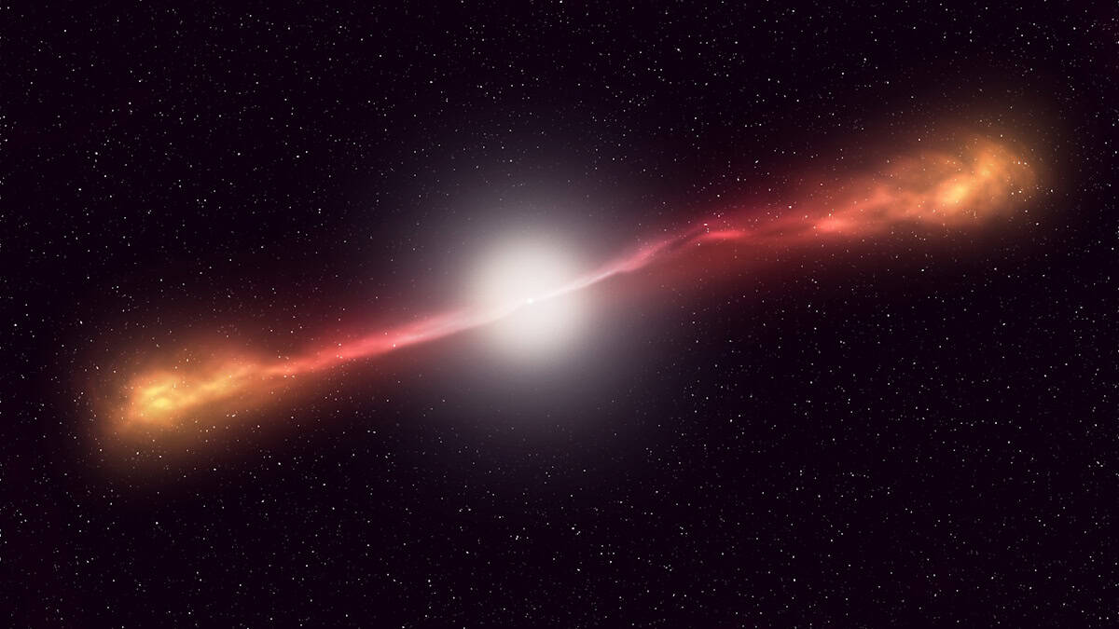
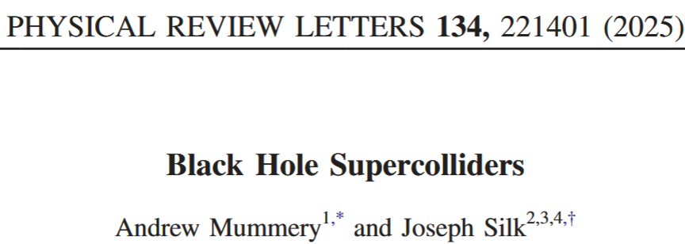
Acceleration by the Fields of Gravity
…collisions between particles free falling from infinity and a disk of material plunging off the retrograde innermost stable circular orbit of a near-extremal Kerr black hole… → result in rest-frame energies at the level of 1 to 100’s of TeV (or more).

Slide 7
ENERGY: Ideas / Breakthroughts
#1 Electrostatic E [10keV – 10 MeV ]
#2 Resonant/RF E [0.1 GeV – 1 TeV]
#3 Colliders E_{cm} [1 GeV- 14 TeV]
#4 Heavy leptons E_{pcm} [10 - 100 TeV]
#5 Plasma Wakes E [0.1- 1 PeV]

Slide 8
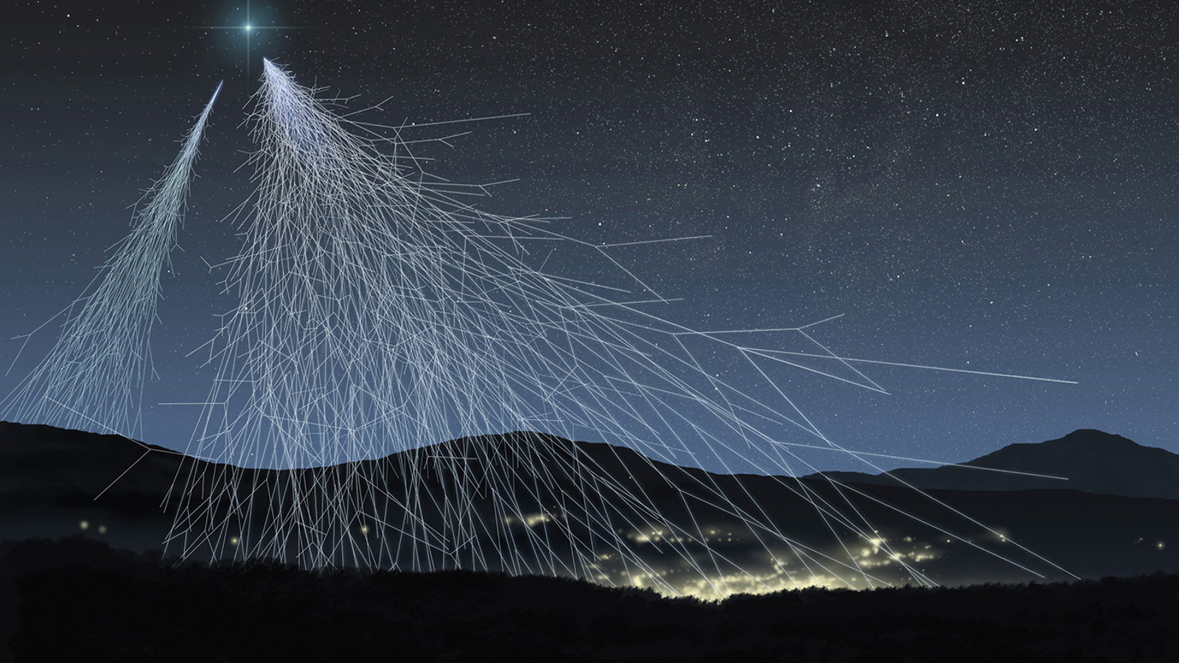
ACCELERATORS vs COSMOS
LHC
10 ⁴⁰
~8 orders of magnitude in energy
10 ³⁰
10 ²⁰
Flux (m² sr s GeV)⁻¹
~45 orders of
magnitude in flux
10 ¹⁰
1
10 ⁻¹⁰
“Oh-My-God Particle”
(1991, Utah)
Spectrum of Cosmic Rays
10 ⁻²⁰
1
10 ³
10 ⁶
10 ⁹
10 ¹²
Energy (GeV)

Slide 9
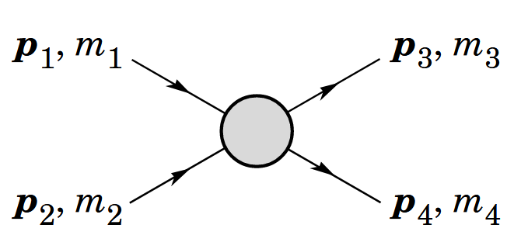
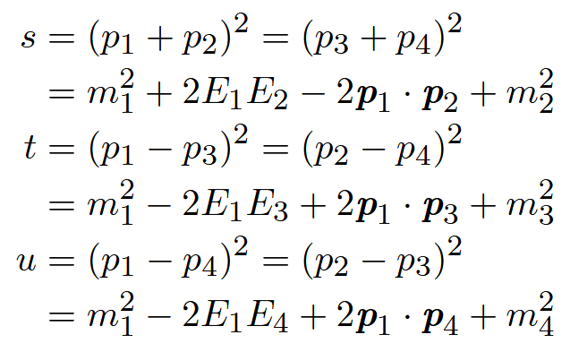
Lorentz-Invariant Mandelstam Variables
s=E ²_{cme}

Slide 10
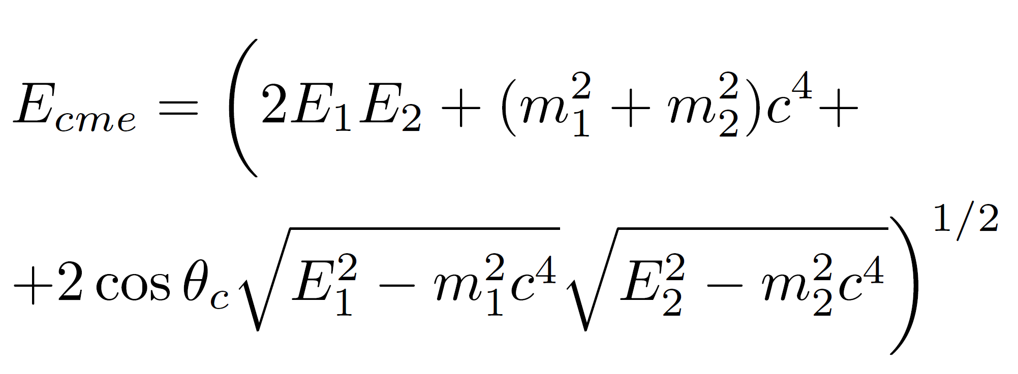
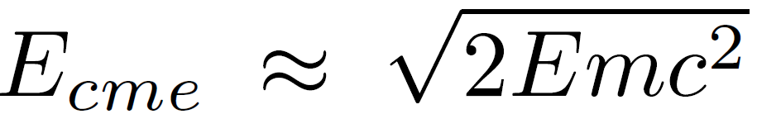
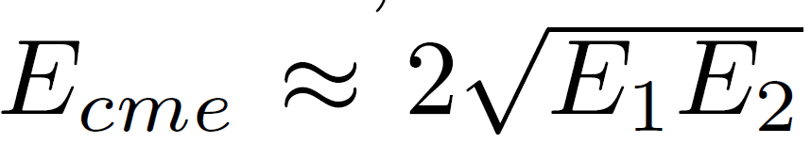
Kinematics of collisions
Two particles (E_{1,2} , m_{1,2}) collide at angle θ_{c}
One particle stationary (E₂ =m₂ c²)
Both particles move (E_{1,2} >>m_{1,2} c²)
Gain for (E= 6500 GeV, m=0.936 GeV) is ~120 times (0.11 vs 13 TeV)

Slide 11
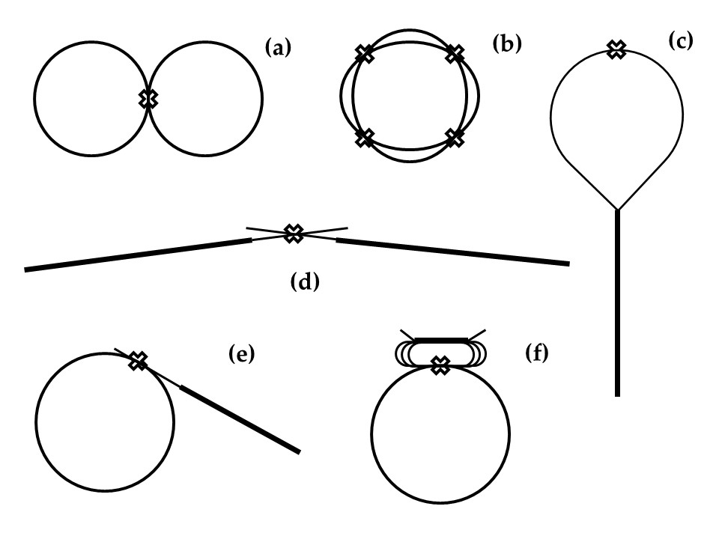
Types of colliding beam facilities

Slide 12
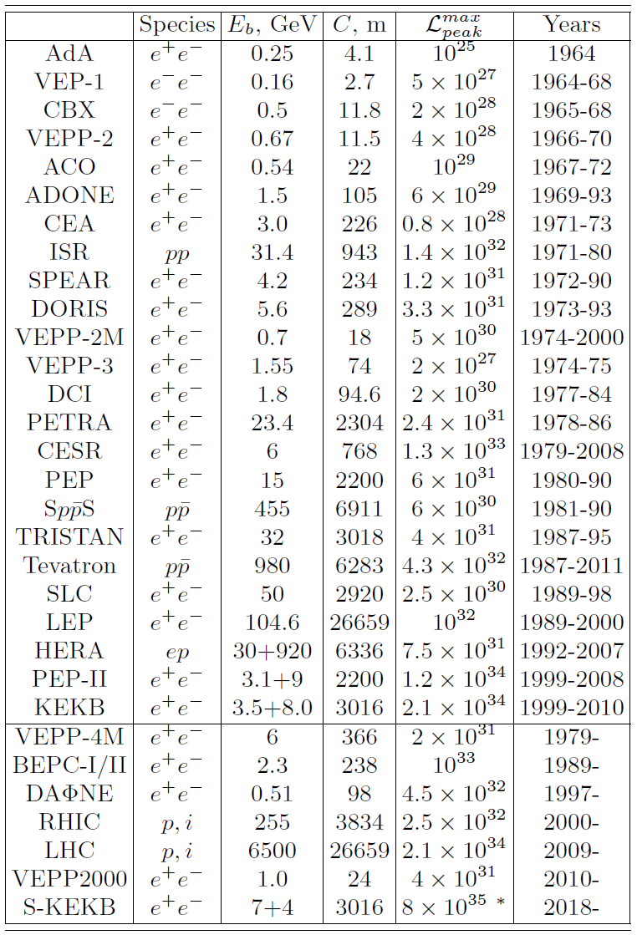
Colliders Landscape
61 years since 1st collisions
Spring 1964 AdA and VEP-1
31 operated since
(see RMP review)
7 in operation now
see next slides
2 under construction
NICA (2025) and EIC (2032)
At least 2 more types needed
Higgs/Electroweak factories
Frontier E >> LHC

Slide 13
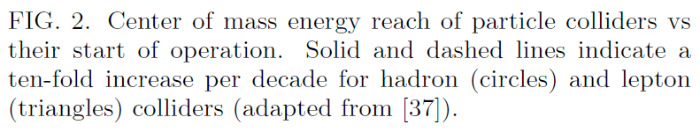
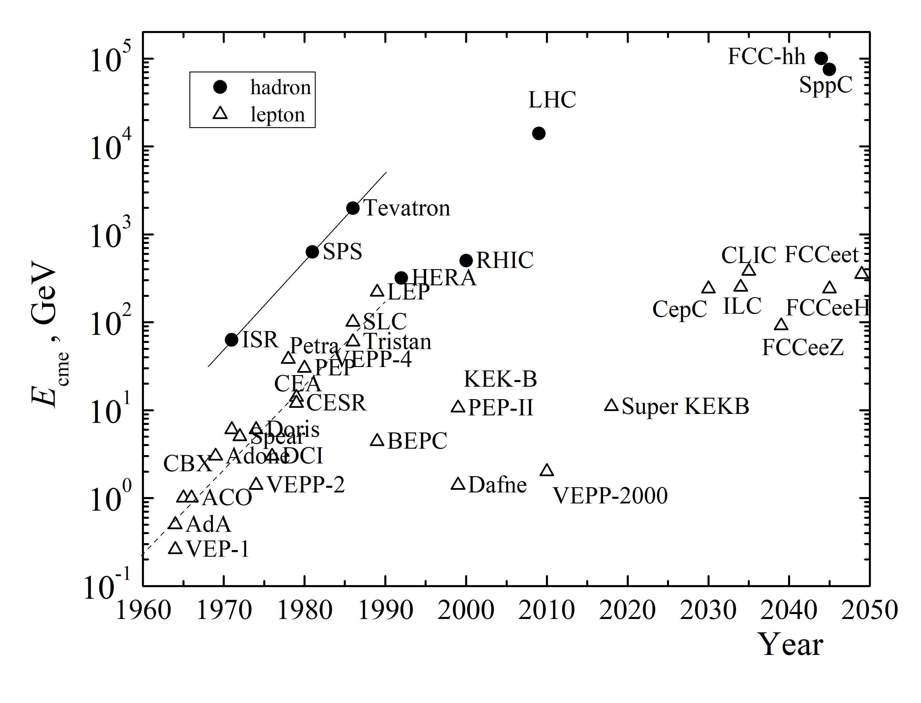
Colliders: Energy

Slide 14
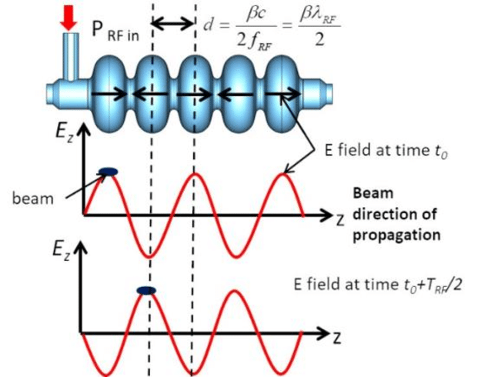

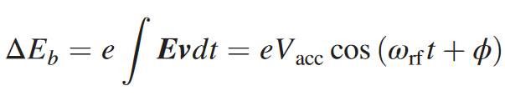
Only Electric Field Boosts Energy

Slide 15
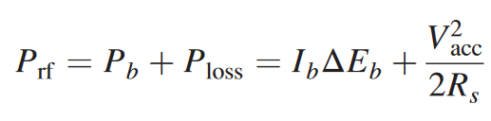

How much power is needed
Where “shunt impedance”:
“Quality factor”
~10^4 for Copper 300K
10^(9-10) for SC Nb cavities
“R/Q” cavity geometry factor
~100 for “open” elliptic cavities
196 Ohm for “pillbox” cvavity

Slide 16
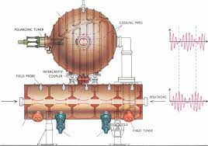
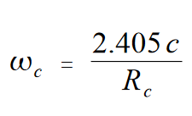
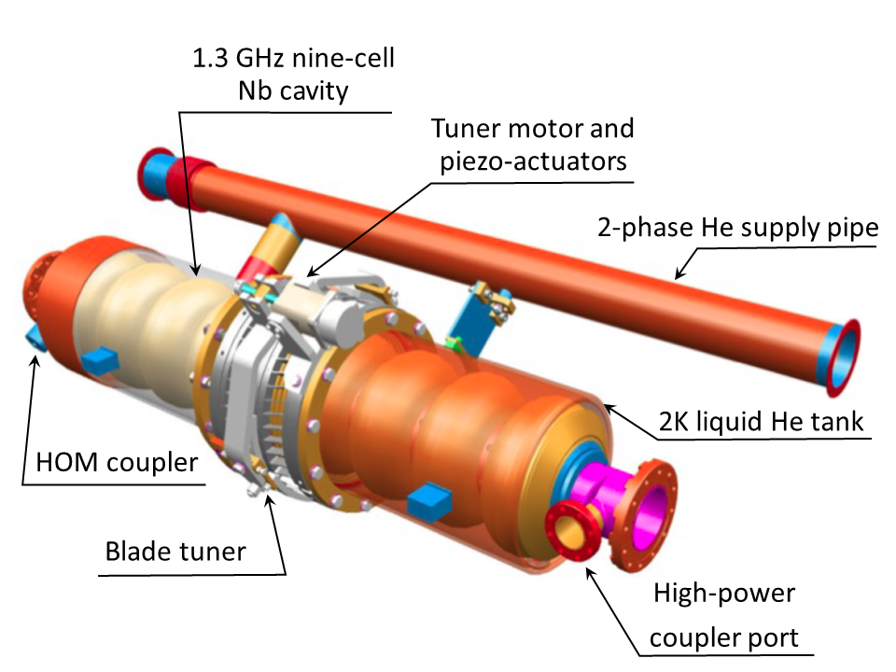
RF Cavities
LEP-I 352 MHz
Resonant cavity, eg “pill-box”:
R=10cm at f_{RF}=1.14 GHz
Max gradient/voltage per cavity:
Is determined by RF power and shunt impedance
Is limited by breakdown or dark current radiation or loss of superconductivity
  depends on frequency, CW or pulse duration, geometry, material, temperature, etc
Max ~100 MV/m in normal-conducting cavities at 12 GHz
Max ~31.5 MV/m SRF cavities 1.3GHz
ILC 1300 MHz

Slide 17
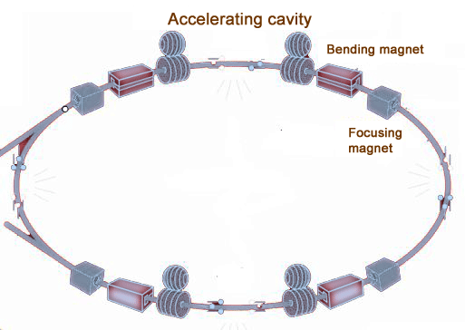
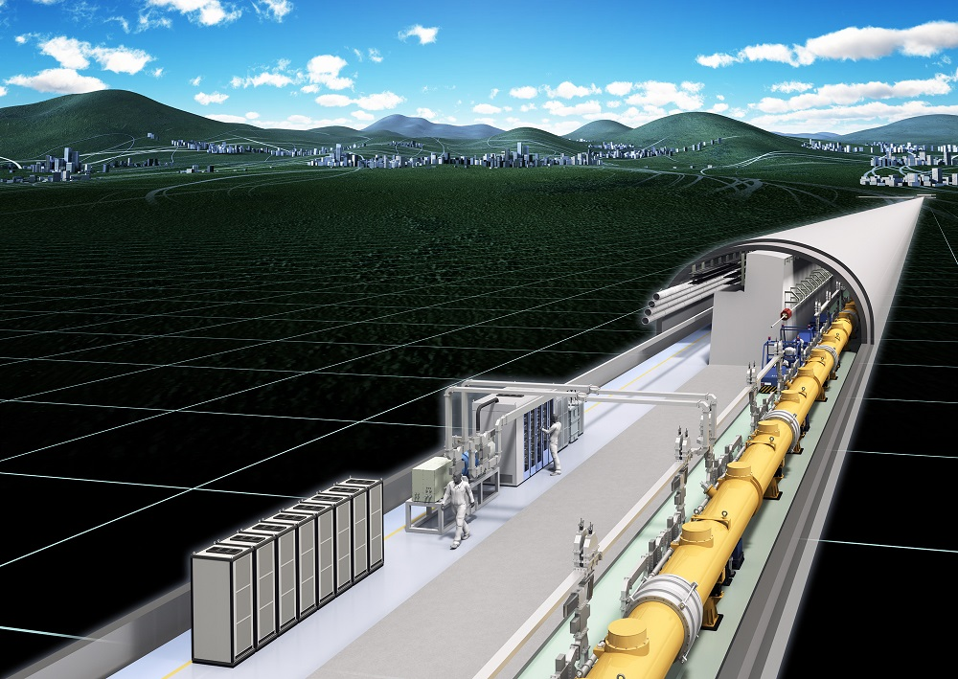
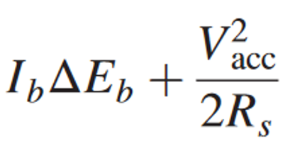
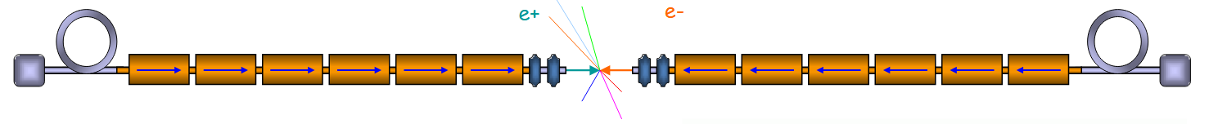
Rings vs
Linacs
lower V_{acc} if you can

Slide 18
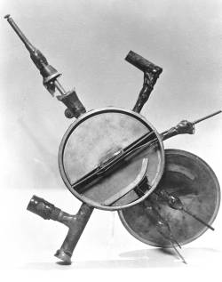
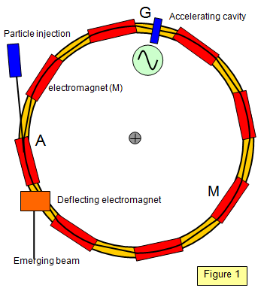
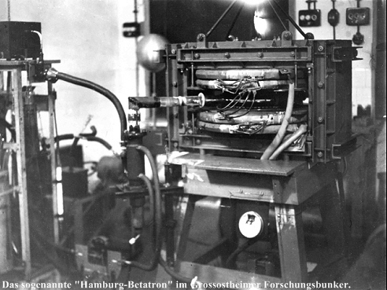
Types of Circular Accelerators
Synchrotrons (Tevatron, LHC, MuColl)
Cyclotrons – 1930-40’s
  E.O.Lawrence (UCB)
E[GeV]=0.3 B[T] R[m]
R is fixed [4.24km LHC]
Betatrons – 1940-50’s
  D.Kerst (UI)

Slide 19
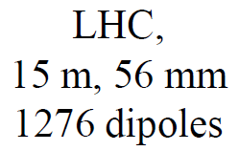
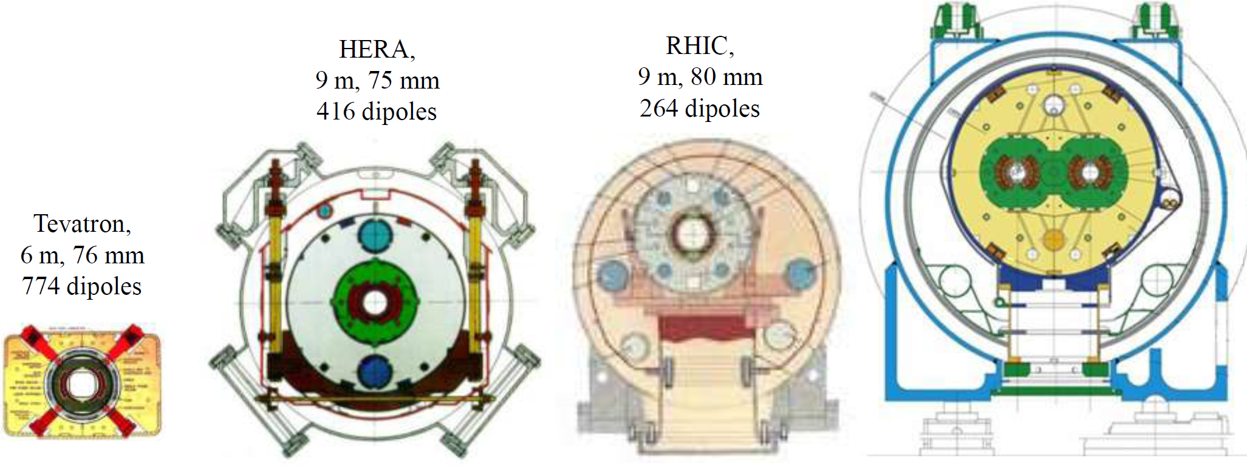
Highest Energy = Highest Field SC Magnets
8.3T
4.5T
5.3T
3.5T
4.5 K He, NbTi
+ warm iron small He-plant
NbTi cable
cold iron
Al collar
NbTi cable
simple &
cheap
NbTi cable
2K He
two bores

Slide 20
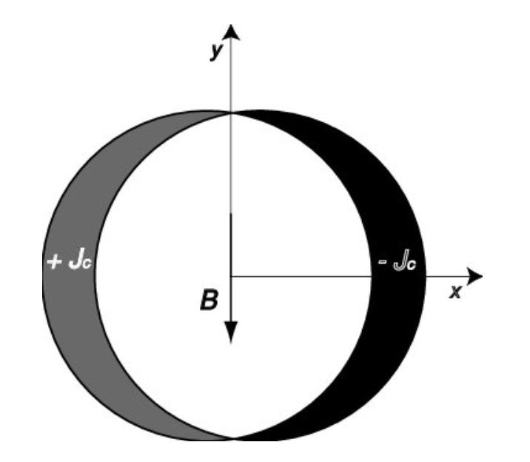
Key for Magnets: Current Density
Scaling: B_{max}~ J/Aperture
(assume all A is filled by conductor)
J~j(current density) x A^2
B_{max}~j x A
but Cost ~A^2 (cost of needed conductor) x length ~ A^2/B ~ ~A/j
Therefore, high(est) current density is needed to maxizmize B-field and
minimize Cost
  For room temperature copper j~(1-10) A/mm^2
  For superconductors → kA/mm^2
Generation of a pure dipole
by a cos θ current distribution

Slide 21
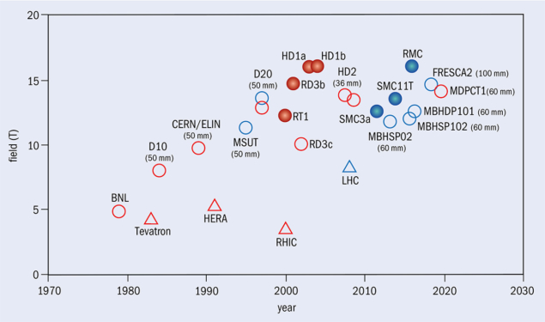
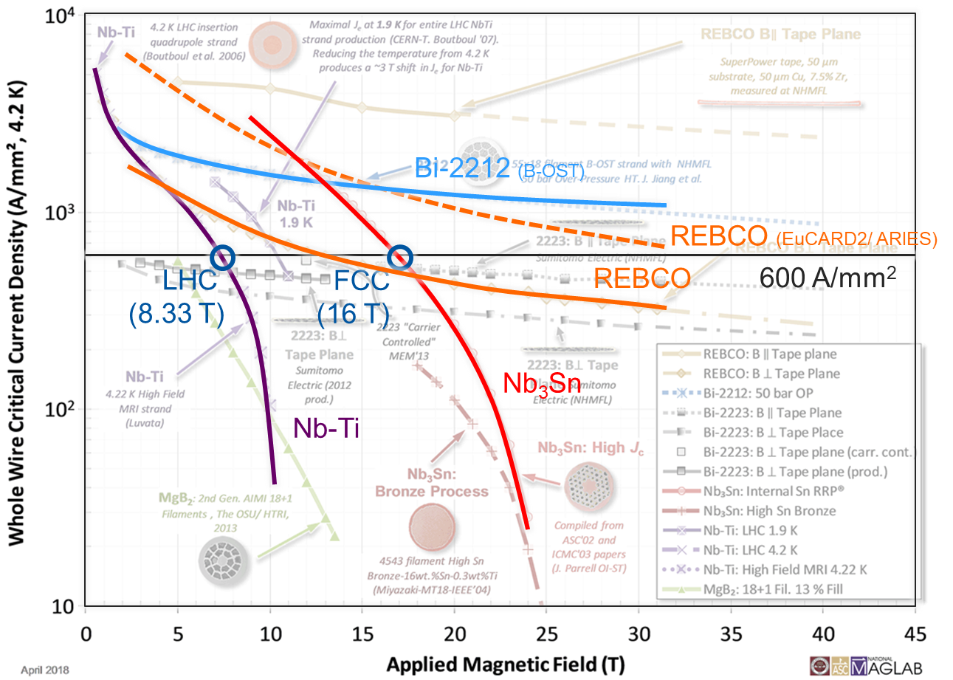
SC Magnets: Fields and Current Densities
Superconducting wire critical current density versus magnetic field: three main materials Nb-Ti, Nb₃Sn, HTS
Nb₃Sn
P. Lee
Nb-Ti
L. Bottura
HTS
Record fields attained with dipole magnets of various configurations and dimensions, and either at liquid (4.2 K, red) or superfluid (1.9 K, blue) helium temperature.
Nb₃Sn
Nb-Ti

Slide 22
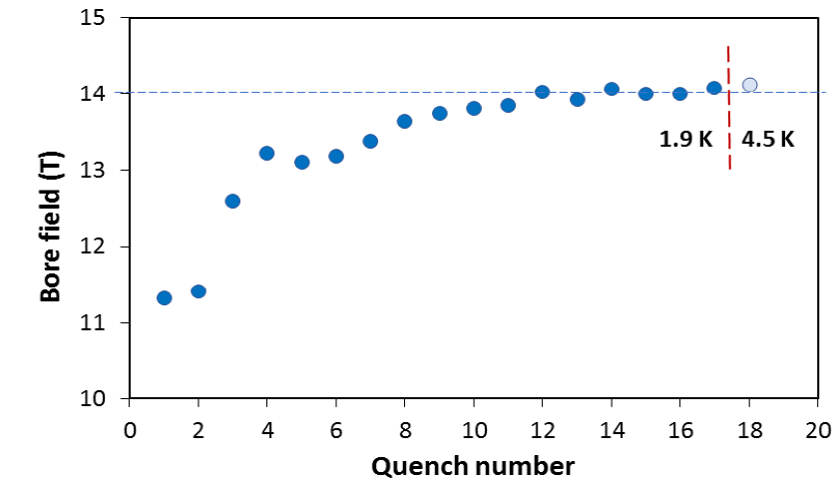
SC Accelerator Magnets: Current Record 14.5T
84% on the laodline at 1.9 K
92% on the loadline at 4.2 K
60-mm aperture
4-layer graded coil
15 T dipole demonstrator
Staged approach: In first step pre-stressed for 14 T
Second test in June 2020 with additional pre-stress reached 14.5 T
cosθ dipole

Slide 23
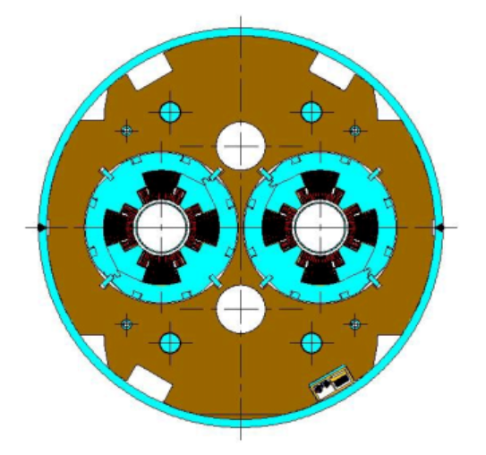
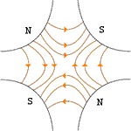
Focusing Beams with Quadrupole Magnets
Vertical Plane:
Horizontal Plane:
Luckily…
…pairs give net focusing in both planes! -> “FODO cell”

Slide 24
Betatron Oscillations, Tune
Particle trajectory
As particles go around a ring, they will undergo a number of betatron oscillations ν (sometimes Q) given by
This is referred to as the “tune”
Ideal orbit
We can generally think of the tune in two parts:
64.31
Integer : magnet/aperture optimization
Fraction: Beam Stability
see Jeff’s lecture

Slide 25
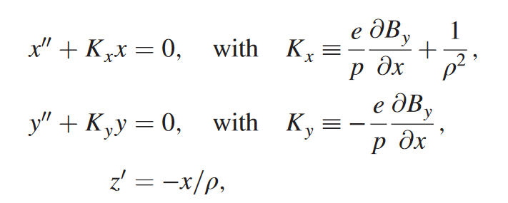
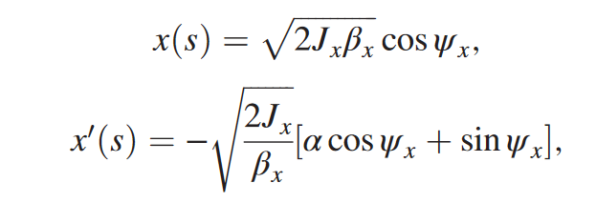

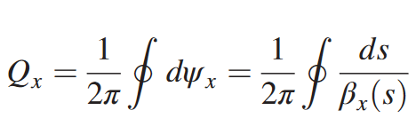
Particle Equations of Motion (1)
Solution:
So, tune:
see Jeff’s lecture

Slide 26
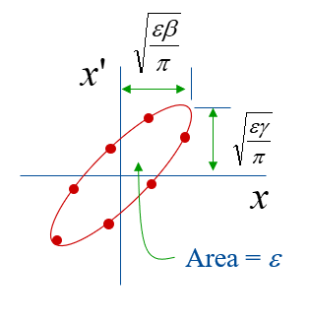
Key beam parameter: Emittance
β,γ, α - Twiss parameters
For an ensamble of particles:
Product size x angle X_rms x X’_rms is called emittance
Normalized emittance = emittance x gamma is an adiabatic invariant
Luminosity (tbd) ~ 1/ε
Area = ε
As a particle returns to the same point on subsequent revolutions, it will map out an ellipse in phase space – more in Jeff’s lecture

Slide 27
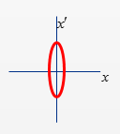
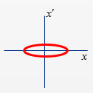
Squeezed in ATLAS/CMS
Most Important Equations
normalized emittance
rms beam size
rms beam
angular spread
Numerical Example: LHC
Ɛ_{n} = 1.8 mm·mrad
Final Focus quads
~100 m from IPs
Regular LHC locations
in “arcs”
β* | Sigma*
25 cm | 8 um
β_{triplet} | Sigma triplet
~5 km | 1.1 mm
β | Sigma
~200 m | 0.23 mm
σ’=32μrad
σ’=0.14μrad
σ’=0.67μrad
Image courtesy John Jowett

Slide 28

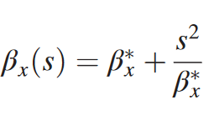
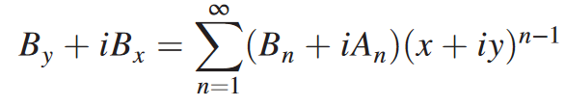
Particle Equations of Motion (2)
Beta-functions are defined by
Eg symmetric solution in free space (K=0):
Also, note that nonlinear fields on beam orbit add complexity:
n=1 dipole
n=2 quadrupole
n=3 octupole
n=4,5,6…
especially at resonant frequencies
More in Jeff’s lecture

Slide 29
Collider Spot Size
low-beta
quadru-
pole
to decrease the beam size
at the collision point we
can reduce either β* or ε
beam
envelope
s~β*
l
σ_{z}
bunch
β*:
must remain larger than σ_{z} (‘hourglass effect’)
quadrupole aperture must be respected

Slide 30
Longitudinal Motion: Phase Stability
Particles are typically accelerated by radiofrequency (“RF”) structures. Stability depends on particle arrival time relative to the RF phase. Note: the speed is fixed = speed of light , so time of arrival depends only on the energy (in the bunch – energy deviation wrt “reference central particle”)
Particles with lower E arrive earlier and see greater V.
Nominal Energy
see Jeff’s lecture

Slide 31
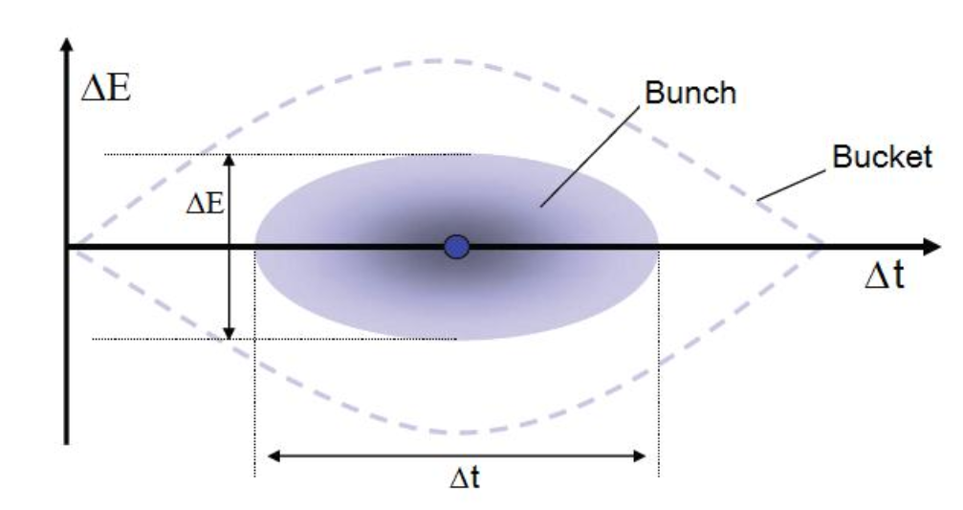
Example: LHC
RF Frequency 400 MHz
(35640 times revolution frequency)
RF Voltage = 8 cavities x 2 MV = 16 MV / turn (max)
In collisions dE/dn= 0 V/turn (synchronouse phase ~0)
Slow energy-position oscillations (23 Hz or ~500 turns)
rms energy spread 1.3e-4 (1GeV) rms bunch length ~ 8cm

Slide 32
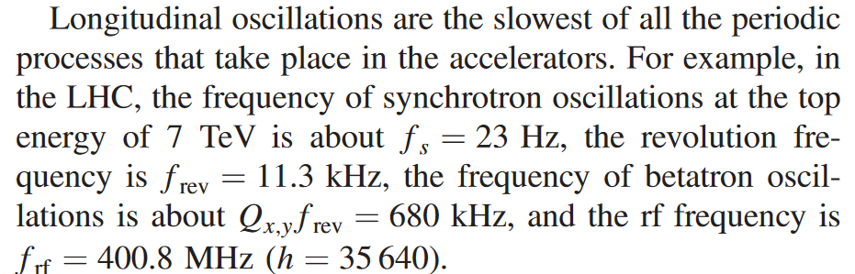
Scales of Time-scales/Frequencies
…even slower might be operational processes :
injection/extraction (1/sec… 1/min… 1/hr … 1/day)
beam cooling (sometimes - hours)
luminosity decay (min… days)

Slide 33
BREAK (!...?)

Slide 34

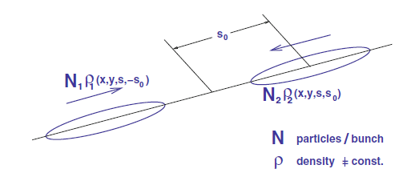
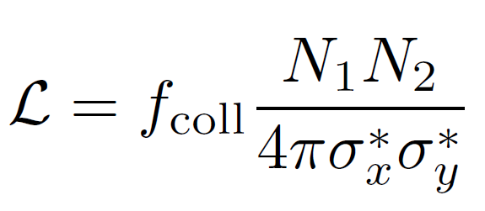
Luminosity
For (same size) Gaussian bunches:

Slide 35
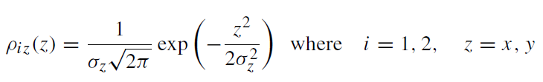
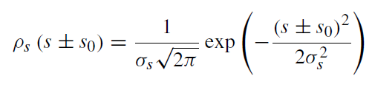
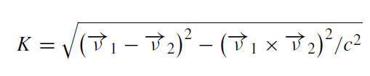


Luminosity: Unequal Bunches
yields:

Slide 36







Correction for Crossing Angle and Offset
Offset d₁-d₂≠0
where:
≈1

Slide 37

“Crab Crossing” Collisions
Head-tail rotation by RF dipole deflectors (eg HL-LHC)
Note: either the crossing angle or amplitude of the crabbing affect instantaneous luminosity → can be used for “luminosity leveling”

Slide 38








Hour-Glass Effect
Same for
beam size
σ_{z} << β*
σ_{z} > β*

Slide 39







Luminosity Reduction Due to Hourglass
For round beams, equal beta’s and no crossing angle, H-factor
In reality, beta* is often constant and bunchlength can grow leading to small decay of luminosity

Slide 40

Luminosity Summary : Key Factors
Want it higher either smaller rings = higher B
or high rep linear collider (= power)
High E helps
This factor comes from adiabatic reduction of the rms beam size for the same emittance
Higher intensity drives L note that N(bunch) comes squared while # of bunches linear; sometimes N is limited by beam-beam, often n_{b}N is limited → try to put all charge in one bunch
Smallest emittance that’s where most of beam physics goes to – cooling to stop heating, noises, dyna-mics in injectors, etc etc etc
Minimize beta need stronger focusing = larger aperture and stronger LB quads
Keep H under control keep bunch length and beta* more or less matched, be aware of the crossing angle (sometimes need it → crabs)

Slide 41


Colliders: Luminosity
1ab⁻¹/yr

Slide 42

Colliders: Need More Luminosity vs Energy
future colliders
future
colliders

Slide 43



Luminosity evolution
Factors change in time
Therefore, the lifetime

Slide 44

LHC Lumi Lifetime (~7 hrs) and Integral

Slide 45
Colliders : Most Important Topics/Effects
Engineering of magnets, RF, PSs, vacuum, sources, targets, diagnostics, collimators, etc
  Exciting science: new acceleration techniques/plasma
Beam physics
  One particle: beam optics, long-term stability, resonances, losses, noises, diffusion/emittance growth, etc
  One beam: instabilities, synchtrotron radiation, beam-induced radiation deposition, intrabeam scattering, cooling, space-charge effects and compensation
  Two-beams: beam-beam effects and compensation, beamstrahlung, machine-detector interface, etc
Assuming particle physics interest → choice of accelerator scheme depends on
  Readiness, cost and power consumption vs E, L reach → MuColl

Slide 46
BREAK (!...?)
Muon Colliders

Slide 47

Colliding Leptons vs Hadrons
Protons
E=γmc²
E=γmc²
E_{CM partons}≈ 2E × 0.1
Leptons
e+
μ+
τ+
e-
μ-
τ-
E_{CM leptons}=2E

Slide 48

Muon Colliders in the US
circular
compact
low(er)cost
low(est) power consumption
Muons decay quickly 2.2μs×γ
→ Fast production, cooling (size reduction)& acceleration
Muon Collider eg at FNAL μ+μ-
Circumference ~10 km, E_{cm} =3…10 TeV
NC+SC magnets and SRF
Cost ~12-18 B$ (ITF’21) 17±4 BCHF (IMCC’25)
20 yrs of R&D
Fermilab site: about 3 x 4 miles, 6,800 acres
*no labor, escalation, or contingency

Slide 49
Muon Colliders: Main Challenges
Muons are not stable particles
  Muon lifetime at rest (mc^2=0.105 GeV) is 2.2 microseconds
  Muon lifetime at 5 TeV (collider γ≈50000) is 100 milliseconds
  Muon can be made available only as secondary or tertrially particle, products of reactions like
    p(beam)+p(target)→ K,π → μ
    e+e- → μ+μ-
    γ + Ze → μ+μ-
That usually results in large emittance (large angular spread) muon beams and requires deep cooling for high Luminosity
Therefore, major challenges for High Luminosity MC are:
  Muon production
  Fast muon cooling
  Fast muon acceleration
  Neutrino flux hazard

Slide 50


Muon Collider Parameter Table under development by the International Muon Collider Collaboration
RAST, Vol 10, No. 01, pp. 189-214 (2019)

Slide 51

Average Luminosity of Muon Collider
NB: each muon makes ~300B[T] turns in a ring with average field B
scales with B, the total beam power Pb, and the beam brightness (the third factor above is the beam-beam ξ)
The beta-function at the two IPs scales as β*~1/γ within certain range of energies, giving overall scaling Lumi ~ γ² with other limiting parameters fixed. The main challenges to luminosity achievement with decaying particles are related to production and fast cooling and acceleration of O(10¹²) muons per bunch without emittance degradation.

Slide 52

(Explanatory to Previous slide)

Slide 53

O(14 TeV) Muon Collider Sub-Systems (approx. to scale)

Slide 54
Muon Collider Subsystems
(i) a high power proton driver (SRF 4 GeV 2-4 MW H- linac);
(ii) pre-target accumulation and compressor rings, in which high-intensity 1-3 ns long proton bunches are formed;
(iii) a liquid mercury target for converting the proton beam into a tertiary muon beam with energy of about 200 MeV;
(iv) a multi-stage ionization cooling section that reduces the transverse and longitudinal emittances and, thereby, creates a low emittance beam;
(v) a multistage acceleration (initial and main) system --- the latter employing a series recirculating rapid cycling synchrotrons (RCS) to accelerate muons in a modest number of turns up to 3-7 TeV using high gradient superconducting RF cavities;
(vi) about 8.5 km diameter collider ring located some 100 m underground, where counter-propagating muon beams are stored and collide over the roughly 1000--2000 turns corresponding to the muon lifetime.
* From the point of beam physics, complexity of a Muon Collider is
closer to that of the Tevatron (higher) than to that of the LHC (lower)

Slide 55


Muon Production: 1-4 MW proton driver needed
see lectures by J.Eldred and D.Neuffer Tue

Slide 56



MERIT Experiment – Demo of 4-8 MW Proton Targetry
At CERN PS
1e13 protons 24 GeV (115kJ/pulse)
Liquid Mercury target 20 m/s
15 T Solenoid
see R.Zwaska lecture Wed
Measured disruption length = 28 cm

Slide 57

The Need for Muon Cooling
Muon Phase Space After Target
vs What’s Needed for Collider
x'
y'
dP/P
x
y
t
Need “6D-Cooling”

Slide 58

Fast Cooling of Muon Beams
• The desired 6D emittance for a MC is 5-6 orders of magnitude less from the emittance of the beam at the target
• How that can be done before muons decay? → ionization cooling: ionization loss along momentum followed by RF acceleration (restore energy) along longitudinal axis only (like in the Synchr Rad damping)
• Requires rf cavities to compensate for lost longitudinal energy
• Use strong B-fields to confine beams
see K.Yonehara lecture Tue

Slide 59


Equation:
(1st) Cooling term ~ (dE/ds) – larger the better
(2nd) Heating/ scattering term ~ beta-function at the absorber and 1/radiation length of the material (a low-Z preferred, Liquid Hydrogen, Li, LiH, Be)
Energy of muons

Slide 60


Longitudinal DoF: rms E spread
cooling term
fluctuations of ionization
energy losses
Cooling requires that d(dEμ/ds)/dEμ > 0. But at energies below about 200 MeV, the energy loss function for muons, dEμ/ds, is decreasing with energy and there is thus heating of the beam. Above 400 MeV the energy loss function increases gently, thus giving some cooling, though not sufficient for fast cooling application (see previous slide).
The “struggling” term
increases as γ^2, and the cooling system size scales as γ → cooling at low energies is desired.
Energy spread can also be reduced by artificially increasing d(dEμ/ds)/dEμ by placing a transverse variation in absorber density or thickness at a location where position is energy dependent, i.e. where there is dispersion (= emittance exchange long→ transverse)

Slide 61




MICE: Muon Ionization Cooling Experiment = 1 “cell”
ISIS 800 MeV
proton
synchrotron
@ RAL (UK)

Slide 62


Muon 4D Cooling: MICE Results (2024)
https://doi.org/10.1038/s41567-024-02547-4
Fig. 3 | Transverse emittance change measured by MICE. Emittance change between the TKU and TKD reference planes, Δε⊥, as a function of emittance at TKU for 140 MeV/c beams crossing the LH2 MICE absorbers. Results for the empty cases, namely, No absorber and Empty LH2, are also shown. The measured effect is shown in blue, whereas the simulation is shown in red. The corresponding semitransparent bands represent the estimated total standard error. The error bars indicate the statistical error and for some of the points, they are smaller than the markers. The solid lines represent the approximate theoretical model defined by equation (10) (Methods for the absorber (light blue) and empty (light pink) cases. The dashed grey horizontal lines indicate a scenario where no emittance change occurs.

Slide 63

6D Ionization Cooling
Initial beam is narrow with some momentum spread
  Low transverse emittance and high longitudinal emittance
Beam follows curved trajectory in dipole
  Higher momentum particles have higher radius trajectory
  Beam leaves wider with energy-position correlation
Beam goes through wedge shaped absorber
  Beam leaves wider without energy-position correlation
  High transverse emittance and low longitudinal emittance
(Do transverse 4D cooling… and repeat the cycle)

Slide 64




Rectilinear Ionization Cooling Channel
6D emittance reduction by 5 orders of magnitude
(between point 2 to 5).
Length ~ 900 m
Final cooling section design requires ~30 T solenoids (point 5 to 6)

Slide 65

Full Ionization Cooling & Demonstrator
MC ionization cooling channel consists of ~800 muon cooling cells
The cooling of muons requires very compact assembly of normal conducting RF cavities, superconducting solenoids, and either liquid hydrogen or LiH absorbers
Large bore solenoids: from 2 T (D=1 m) to 20+ T (D=0.05 m)
RF cavities (300-800 MHz) must operate in multi-Tesla fields
Wedge-shaped absorbers must and large muon beam intensities
https://doi.org/10.1140/epjc/s10052-023-11889-x
Schematic of the muon cooling demonstrator
 | Muon mom. MeV/c | Total length, m | Total # of cells | Total RF voltage, MV | B_max, T | 6D emm. reduction | Beam loss, %
Full scale MC | 200 | ~980 | ~820 | ~15,000 | 2-14 | x 1/10⁵ | ~70%
Demonstrator | 200 | 48 | 24 | ~260 | 0.5-7 | x 1/2 | 4-6%
The Muon Ionization Cooling Demonstrator Experiment:
■ Timeline: 2029-2034 ■ Location: Fermilab or CERN ■ Cost: 300 ? M$
see D.Stratakis lecture Wed

Slide 66







Acceleration and Collider Ring ~75% of the MC Cost
Options (high→ low cost):
Linac (very costly!)
Recirculating linear accelerator (RLA)
Fixed field alternating gradient (FFA)
Pulsed synchrotrons
~14T Large Aperture
Collider Magnets
Alexahin et al 2018 JINST 13 P11002
CBETA FFA at Cornell/BNL arXiv1706.04245

Slide 67

The Idea of Pulsed Muon RCS
Rapid cycling synchrotron (RCS)
  Potentially larger acceleration range at affordable cost
  Could use combination of static superconducting and ramping normal-conducting or HTS magnets
  But have to deal with energy in fast pulsing magnets
Of course, circumference of the RCS will be larger than that of collider as AVERAGE max B-field in RCS < AVERAGE (static) B-field collider ring

Slide 68


Need pulsed magnets dB/dt ~1000T/s
Fermilab, 2021
Approach to an economical magnet
is to use HTS tape: very low AC losses
in superconductor

Slide 69

Neutrino Flux (Muons decay to e+ν ν )
Collider Ring design - see lecture of E.Gianfelice-Wendt on Wed

Slide 70



Neutrino Radiation Dose & Control
~ 1 m
<1 mSv/yr mitigation ideas:
depth
few mm vertical collider orbit variation (next slide)
few cm magnet positions float (next slide)
less muons… =smaller emittance to keep L
Cone gets narrower with energy
Cross section grows with energy

Slide 71
On Required R&D: μ-Coll Costs and Risks
 | Approx. % of the Total Cost | Approx. Luminosity Risk Factor
Proton Driver & Targetry | 15 - 20 % | 10 ¹ ⁻ ²
Muon Cooling | 10 - 15 % | 10 ^{3 – 4}
Acceleration | 30 - 60 % | 10 ^{1 – 2}
Collider | 25 - 40 % | 10 ^{0 – 1}
TOTAL | 12 - 18 B$ ^{*ITF?} | 10 ⁵ ⁻ ⁹

Slide 72

Ultimate Colliders Luminosity vs Energy
μμ circ.
pp circ.
10 ab⁻¹/yr
linear lepton
μ⁺μ⁻ Circular
1 ab⁻¹/yr
pp Circular
0.1 ab⁻¹/yr
LHC
e⁺e,⁻μ⁺μ⁻ Linear
Main Limits:
Power… 3 TWh/yr
Cost….. 3 xLHC
0.01 ab⁻¹/yr
1 fb⁻¹/yr
Tevatron
1 TeV
10 TeV
100 TeV
1 PeV
10 PeV
Parton CME
V.Shiltsev, “Ultimate Colliders” (Oxford Encyclopedia, 2023);
DOI: 10.1093/acrefore/9780190871994.013.118

Slide 73
  Thanks for Your Attention !
Questions !?

Slide 74
Literature
V.Shiltsev, F.Zimmermann, Modern and Future Colliders (Rev.Mod.Phys., 2021)
https://journals.aps.org/rmp/abstract/10.1103/RevModPhys.93.015006
V.Lebedev, V.Shiltsev, Tevatron Book
https://indico.cern.ch/event/774280/attachments/1758668/2915590/2014_Book_AcceleratorPhysicsAtTheTevatro.pdf
W.Herr, CAS school
https://cds.cern.ch/record/941319/files/p379.pdf
Proc. 2013 ICFA mini-workshop on "Beam-Beam Effects in Hadron Colliders"
https://indico.cern.ch/event/189544/
Comprehensive JUAS-book (2371 pages – all topics!)
https://doi.org/10.23730/CYRSP-2024-003.

Slide 75


ENERGY: Brute Force Approaches
Particle Energy Increase
ΔE = Electric Field Gradient x Length
#1 Increase length = linac
(linear accelerator)
#2 Accelerate in a ring (N_{turns} ΔE) increase circumference as E=0.3BR
(synchrotrons)

Slide 76

CCC=CERN Control Center
Over 100,000 signals are generated by the cryogenics, machine protection and beam monitoring systems.

Slide 77

Further Reading on Accelerator Physics
An Introduction to Particle Physics High Energy Accelerators, D. Edwards and M. Syphers (John Wileyand Sons, Inc, 1993)
Accelerator Physics, S.Y. Lee (World Scientific, 1999)
Hand Book of Accelerator Physics and Engineering – Eds. A. Chao and M. Tinger , World Scientific (1999)
CAS CERN Accelerator, Accelerator Physics Courses http://cas.web.cern.ch/
Accelerator Physics at the Tevatron Collider - by V.Lebedev and V.Shiltsev, Springer (2014)

Slide 78
Luminosity and Burn-Up
The relationship of the beam to the rate of observed physics processes is given by the “Luminosity”
Rate
Cross-section (“physics”)
“Luminosity”
Standard unit for Luminosity is cm⁻²s⁻¹
Example: total p-p inelastic+elastic cross section at 13 TeV cme is ~110 mbarn (58 inel+ 12 ssd+40 el not seen)→
~60 interactions per crossing x
40,000,000 collision/sec= 2.4e9 protons leave each beam every second
Beam lifetime due to such “Burn up” T=N/(dN/dt)= 2.8e14 protons/(2.4e9/s) =32 hours

Slide 79






26 658.883 m
6.5 TeV x 2

Slide 81

Squeeze in ATLAS/CMS
Numerical Example: LHC (γ »1, β=v/c ≈1)
Ɛ_{n} = 1.8 mm·mrad
β* | Sigma*
25 cm | 8 um
σ’=32μrad
β_{triplet} | Sigma triplet
~5 km | 1.1 mm
σ’=0.14μrad
in the arcs:
β~200m, σ≈0.23mm
Image courtesy John Jowett

Slide 82
Luminosity Lifetime and Integral
Take into account two IPs (ATLAS, CMS and 3% LHCb) 1/32+1/32 hrs⁻¹
Take into account beam gas 1/110hrs⁻¹ and that Lumi~N^2 → x2
2x(1/32+1/32 + 1/110) hrs⁻¹
=14%/hr (7 hrs lifetime)

Slide 83
(Very) Brief History of Colliders
Notable machines and most notable effects/discoveries/breakthroughs
Note that we later will consider in detail:
  LEP, KEK-B and Super-KEKB (lecture VS6)
  Tevatron (lecture VS7)
  LHC and HL-LHC (lecture VS8)
  RHIC and EIC (lecture VS9)
  SLC and linear colliders (lecture VS12)

Slide 84

Collider Patent R.Wideroe Sept. 8, 1943

Slide 85



First Colliders
AdA (Frascati/Orsay)
e+e- 500 MeV, ~May1964
CBX (Stanford/Princeton)
e+e- 1050 MeV, ~Mar1965
VEP-1 (Novosibirsk)
e-e- 320 MeV, May 19, 1964

Slide 86
The First “Trio” of Colliders
Technological challenges addressed:
  development of nano-second-fast injector kickers
  attainment of an ultrahigh vacuum of about a micropascal or better
  reliable luminosity monitoring and other beam diagnostics
Beam physics advances:
  Touschek effect (low energy beam losses due to particle scattering inside beam leading to e+e- gettinbg out of RF buckets)
  luminosity degradation due to beam-beam effects at ξ_{x;y} ∼ 0.02–0.04
  complex beam dynamics at non-linear high-order resonances
  coherent instabilities due to resistive vacuum pipe walls

Slide 87




1970s-80s “small” e+e- (C=20…200 m)
ADONE (INFN, Frascati)
SPEAR (SLAC, Stanford)
VEPP-2 (INP, Novosibirsk)
DORIS (DESY, Hamburg)

Slide 88

1970s-80s “small” e+e-
Technological challenges addressed:
  longitudinal phase feedback system developed and installed (ADONE)
  7.5 T SC wiggler to decrease the damping time (VEPP-2M)
Beam physics advances:
  Luminosity scaling in SR dominated beams (ADONE)
  Sokolov-Ternov effect: the buildup of electron spin polarization through synchrotroton radiation (VEPP-2 and ACO)
  CEA: first time a low-beta insertion optics with a small β_{y} ≈ 2.5 cm
  SPEAR: Transverse horizontal and vertical head-tail instabilities
  were observed and suppressed a positive chromaticity Q’>0
  DCI: first four-beam compensation attempt (limited success)
  dE/E~10⁻⁵ resolution via resonant depolarization method (VEPP-2M)
  Multibunch, e.g. 480 bunches in each ring in DORIS

Slide 89




1980s-90s “large” e+e- (C=2…27 km)
PETRA (DESY, Hamburg)
SLC (SLAC, Stanford)
TRSITAN (KEK, Japan)
LEP (CERN)

Slide 90
1980s-90s “large” e+e-
Technological challenges addressed:
  SLC: first ever (and only) linear collider – many subsystems
  pioneer SRF technology - TRISTAN: 508 MHz 0.4 GV/turn; LEP 352 MHz SC niobium-on-copper cavities, 3.5 GV/turn
  High current positron sources, incl. 80% polarized e- (SLC)
Beam physics advances:
  LEP: losses via e+/e- scattering off thermal photons in RT beampipe
  LEP single-bunch current limited by TMCI at injection energy
  LEP: beam-beam record tune shift 4xξy=0.33
  SLC : BNS (Balakin-Novokhatsky-Smirnov) damping of BBI
  SLC: ~x2 increase of luminosity due to disruption enhancement @IP

Slide 91





2000s-now “factories” e+e- (Φ-, Charm-, B-meson)
VEPP-2000 (BINP, Novosibirsk)
BEPC (Beijing)
CESR (Cornell)
KEK-B → SuperKEKB (KEK, Japan)
PEP-II (SLAC, Stanford)
DAΦNE (INFN, Frascati)

Slide 92
2000s-now “factories” e+e-
Technological challenges addressed:
  HV electrostatic orbit separation for e+e- (CESR)
  Efficient SRF for Ampere-class currents, HOM damping
  Asymmetric rings – KEK-B, PEP-II, Super-KEKB
  Tight detector background control - vacuum and collimation
  Since PEP-II/KEKB: top-up injection mode of operation
Beam physics advances:
  Advanced optics for tight vertical focusing with βy ~1cm – few mm
  VEPP2000 : “round beams” concept ξ ∼ 0.25
  (less successful) CESR “Moebius ring” collider scheme (x-y flips)
  DAΦNE : “crab waist” focusing optics, demo “wire b-b compensation”
  KEK-B: crab crossing (limited success) → nonobeams (Super-KEKB)

Slide 93




1970s-2010s Hadron Colliders (C=1…7 km)
Tevatron (FNAL, Batavia)
ISR (CERN)
HERA (DESY, Hamburg)
SPPS (CERN)

Slide 94
1970s-2000’s Hadron Colliders (1)
Technological challenges addressed:
  ISR: world’s first pp collider (and pp Lumi record holder for >20 yrs)
  SC NbTi magnets 4-8 T (Tevatron → HERA→ RHIC → LHC)
  SPPS, &Tevatron: technology of antiproton production & scienc of stochastic (Nobel prize) and electron cooling (up to 4 MeV e-)
  Tevatron: permanent magnets (3.3 km 8 GeV Recycler)
  Two-stage collimation systems (HERA, Tevatron)
Beam physics advances:
  Longitudinal manipulations : momentum stacking (ISR), slip-stacking and momentum mining (Tevatron)
  Tevatron: beam-beam record at ξ_{x;y} ∼ 0.025, first successful demo b-b compensation by electron lenses, hollow e-lens collimation
  HERA: first e-p collider, transversely polarized e- & spin rotators to l

Slide 95


2000s-now Hadron Colliders (C=4…27 km)
RHIC (BNL, Brookhaven)
LHC (CERN)

Slide 96
2000s-now Hadron Colliders (2)
Technological challenges addressed:
  First use of Nb3Sn SC magnets (HL-LHC)
  Three (4) stage 99.99% efficient collimation system (LHC)
  Ions sources and ion-ion, ion-p collisions (RHIC, LHC)
  Sophisticated polarization control along the chain (55% in RHIC)
Beam physics advances:
  RHIC: bunched beam stochastic cooling, bunched beam electron cooling
  RHIC: head-on beam-beam compensation with electron lenses
  LHC: sophisticated control of electron-cloud and other instabilities
  LHC: novel achromatic telescopic squeeze optics to lower beta*
  LHC: demo wire compensation of long-range beam-beam effects

Slide 97





Super-Colliders That Were Not (1990’s)
SSC (Waxahachie, TX)
UNK (IHEP, Protvino)

Slide 98



Colliders That Will Be
NICA (JINR, Dubna)
EIC (BNL, Brookhaven)
BINP C/Tau-Factory
(Novosibirsk)

Slide 99









Colliders That Might Be :
Higgs factories proposals
CepC/FCCee
100 km
100MW RF
CLIC NCRF 72 MV/m
11 km
ILC SRF 31.5 MV/m
21 km

Slide 100





Far-Future High Energy Collider Concepts/Proposals
CLIC e+e- 3 TeV, 100 MV/m 50 km
pp 100 km : SPPC 75 TeV, 12 T magnets, FCChh 100/16 T
μ+μ- 10-14 TeV cme
10-14 km, 16 T magnets

Slide 101


Luminosity Demand : Leptons
need L ~ s ~ E²

Slide 102


Hadron Cross Sections – Inclusive vs Parton

