Slide 1
1
1
Accelerator Physics Basics
Jeffrey Eldred
for US Muon Collider Accelerator School
University of Chicago, August 3-6th 2025
Notes:
1
1
1
1
1
1

Slide 2
Learn more at US Particle Accelerator School (USPAS)
Free Recorded Classes:
- Eric Prebys’ online course:
“Fundamentals of Accelerator Physics”
- Huang & I’s online course:
“Mechanics & Electromagnetism for Accelerator Physics”
Textbook:
“An Introduction to the Physics of High Energy Accelerators”
Syphers and Edwards
Sign up for Live USPAS classes: website
- Two-week full-time sessions every June and January.
- Equivalent to graduate-level college-semester course!
- January 2023 session will be back to in-person (deadline Sept 15)
I took many USPAS classes as a graduate student, and now I regularly teach at USPAS.
2
J. Eldred Transverse Dynamics Accelerators
Notes:
2
2
2
2

Slide 3
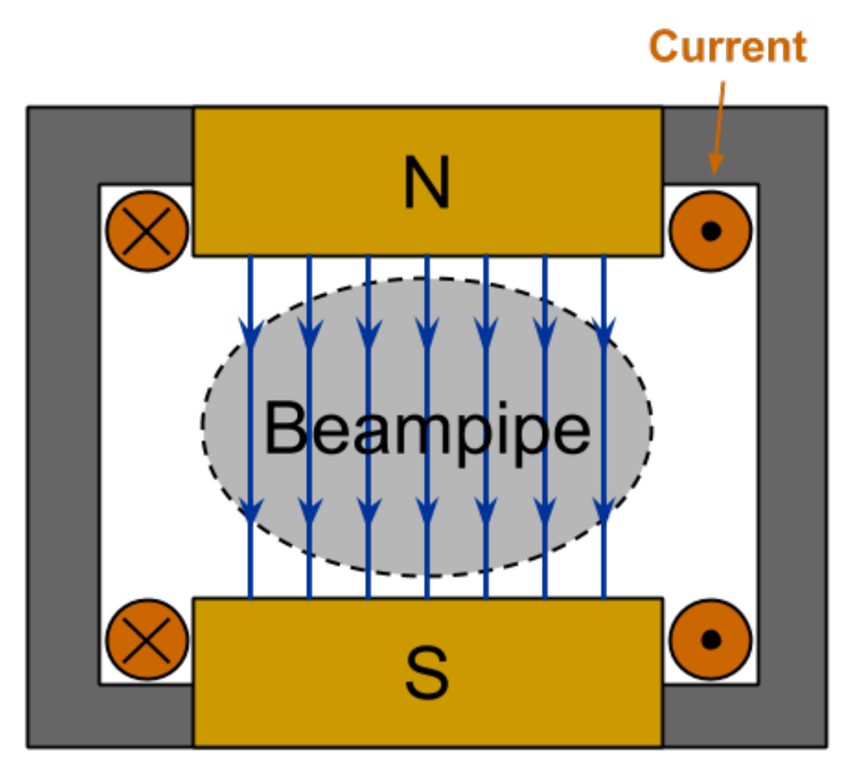
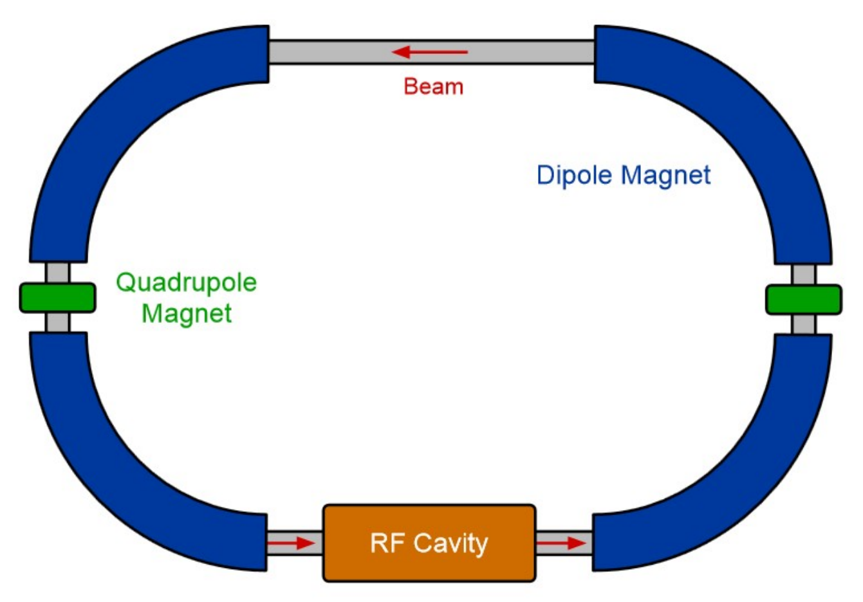
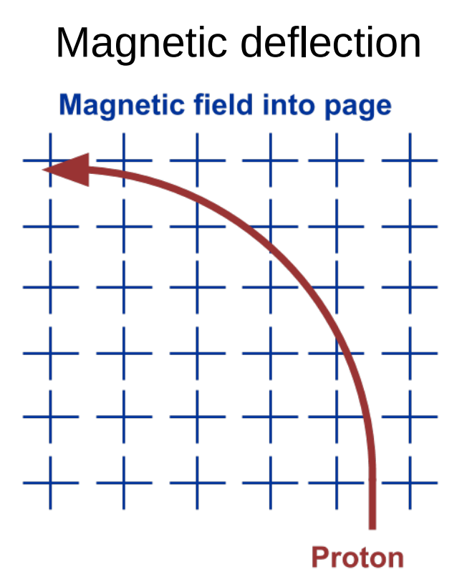
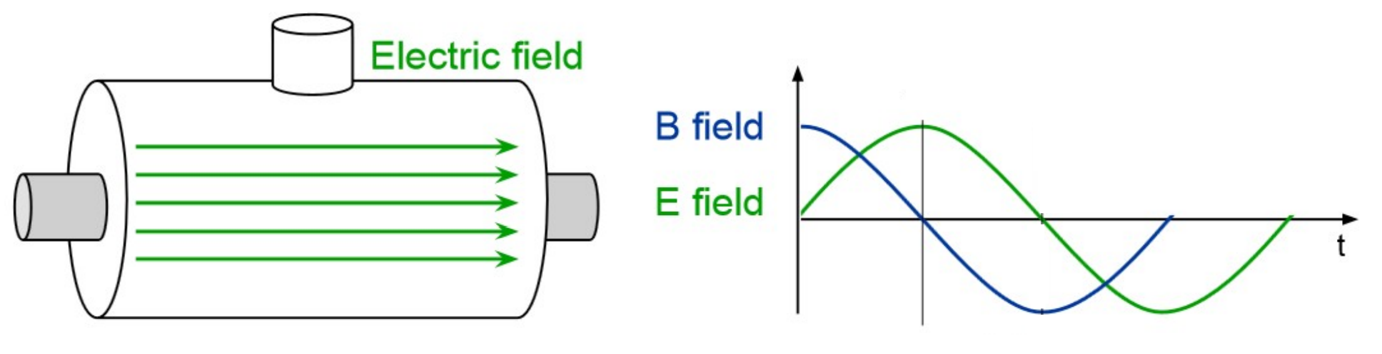
3
Simplified Particle Accelerator
D. Barak, B. Harrison, A. Watts, Concepts Rookie Book,
special thanks A. Watts
3
J. Eldred Transverse Dynamics Accelerators
Notes:
3
3
3

Slide 4
4
4
Dipole Magnets
for Bending
4
J. Eldred Accelerator Overview for FNAL CCI Program
Notes:
4
4
4
4
4
4

Slide 5
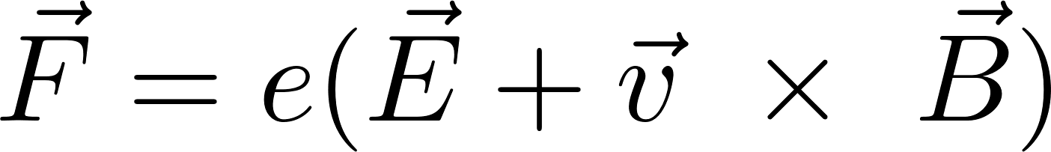
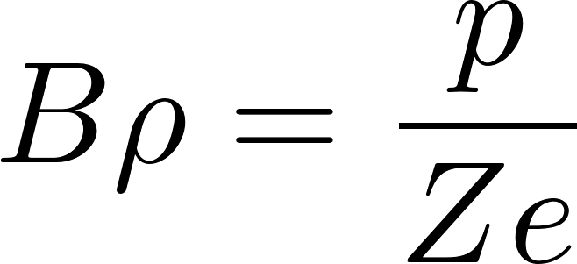
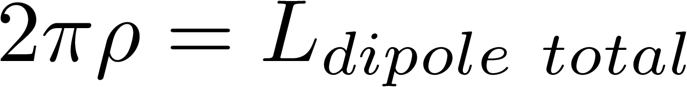
5
Maximum Dipole Field -> Maximum Proton Energy
Lorentz Force:
Bending Radius in a constant dipole field:
“Beam rigidity” Bρ in units of Tm
Total bending for a ring is always 2π:
particle momentum
particle charge
Dipole field
Bending radius
5
J. Eldred Transverse Dynamics Accelerators
Notes:
5
5
5

Slide 6
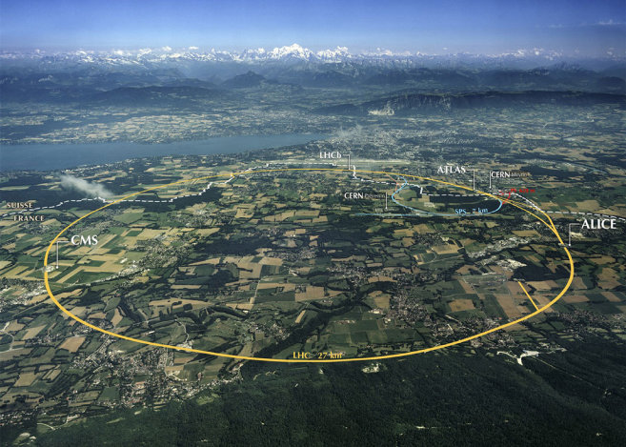
6
Maximum Proton Energy – LHC Example
The LHC has 1232 dipoles, each 15m long but effectively 14.3m long.
- 18.5 km of the 26.7 km circumference is dipole magnet.
- We say “circumference” even though the LHC is a 1232-sided polygon.
- 1232*14.3/2π = 2800 m magnetic bending radius ρ.
For a dipole field B of 7.7 T, we can calculate the equivalent energy:
- 2800*7.7 / 3.3357 = 6,500 GeV/c proton
- 6.5 TeV per beam
- 13 TeV colliding energy
To go to higher energy:
- dig a longer tunnel
- and/or build a better dipole magnet:
- superconductors have a critical
temp, critical field, critical current.
- manufacturing and reliability
are part of dipole design as well.
6
J. Eldred Transverse Dynamics Accelerators
Notes:
6
6
6

Slide 7
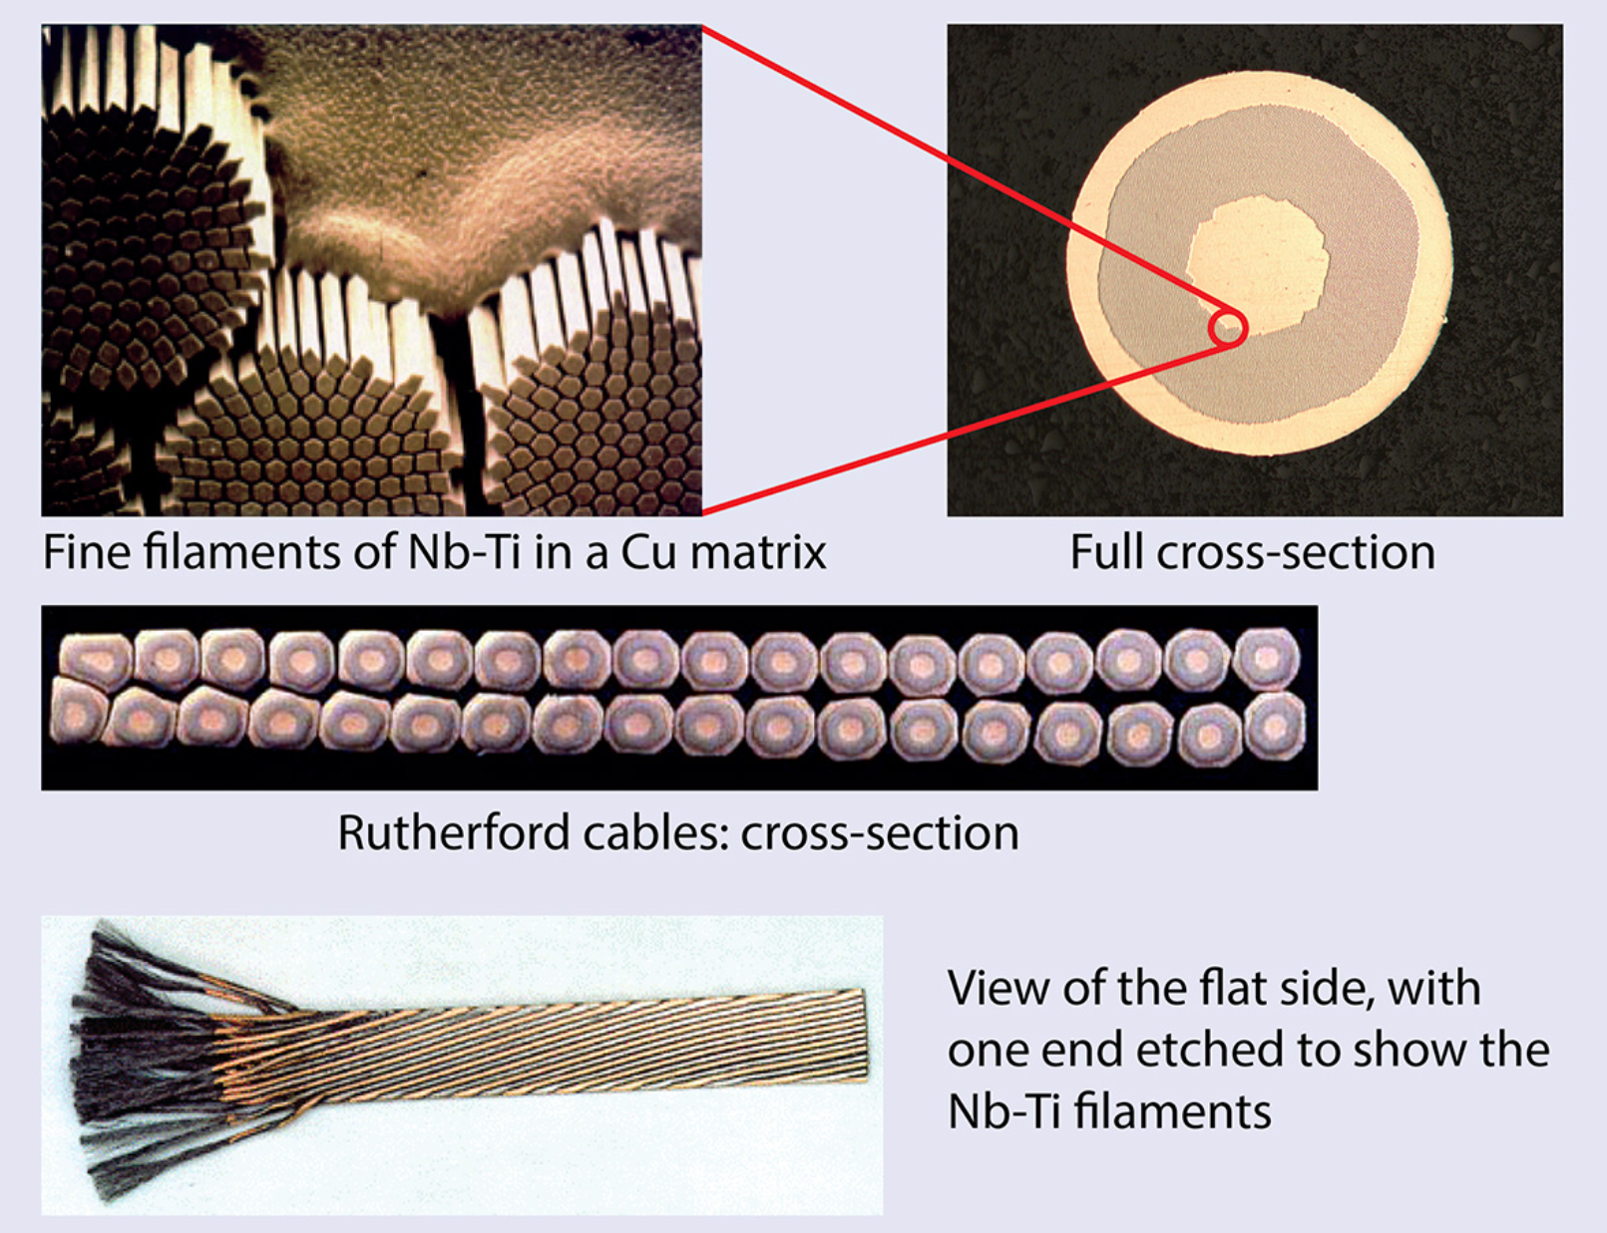
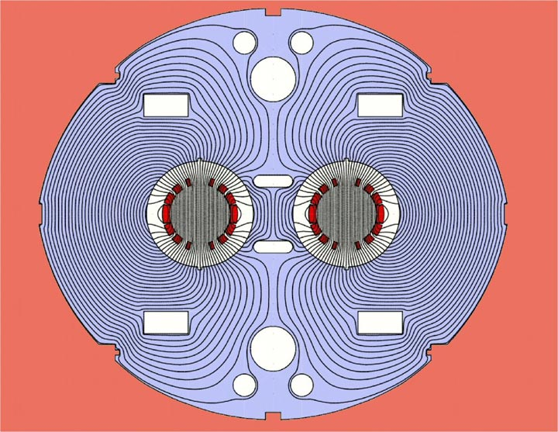
7
LHC Superconducting Dipoles
Normal
Conducting
Dipole
LHC Superconducting Dipole
CERN Courier
7
J. Eldred Transverse Dynamics Accelerators
Notes:
7
7
7

Slide 8
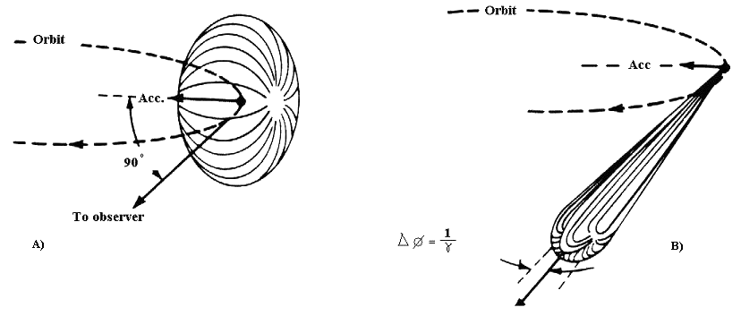
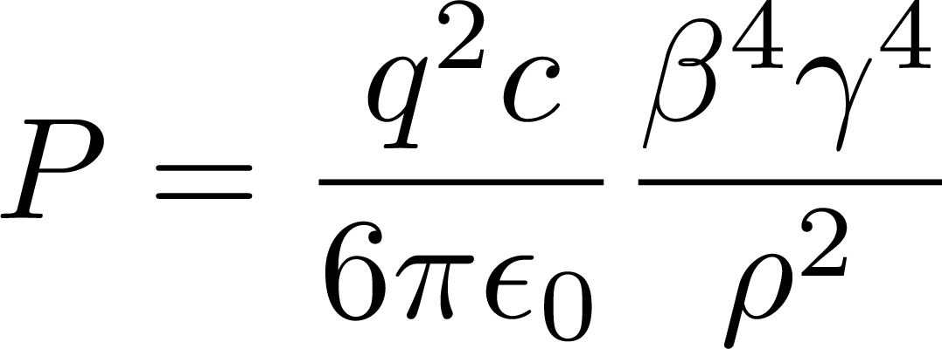
8
Radiation Loss -> Maximum Electron Energy
Circular electron colliders are limited instead by radiation.
Any relativistic charged particle will give off synchrotron radiation.
θ ~ 1/γ
The magnitude of radiation is usually negligible in hadron machines, but is a dominant feature of electron machines.
Relativistic βγ factors
Bending radius
Power radiated
Physical constants
The maximum acceleration rate sets the maximum power loss.
For x2 the energy, the same power loss occurs at x4 the bending radius.
8
J. Eldred Transverse Dynamics Accelerators
Notes:
8
8
8

Slide 9
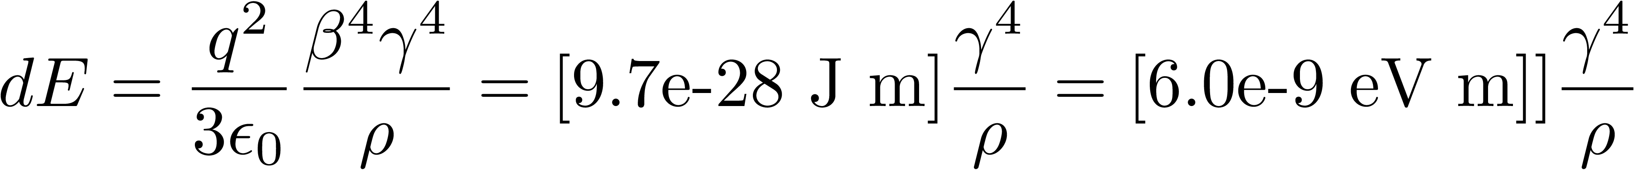
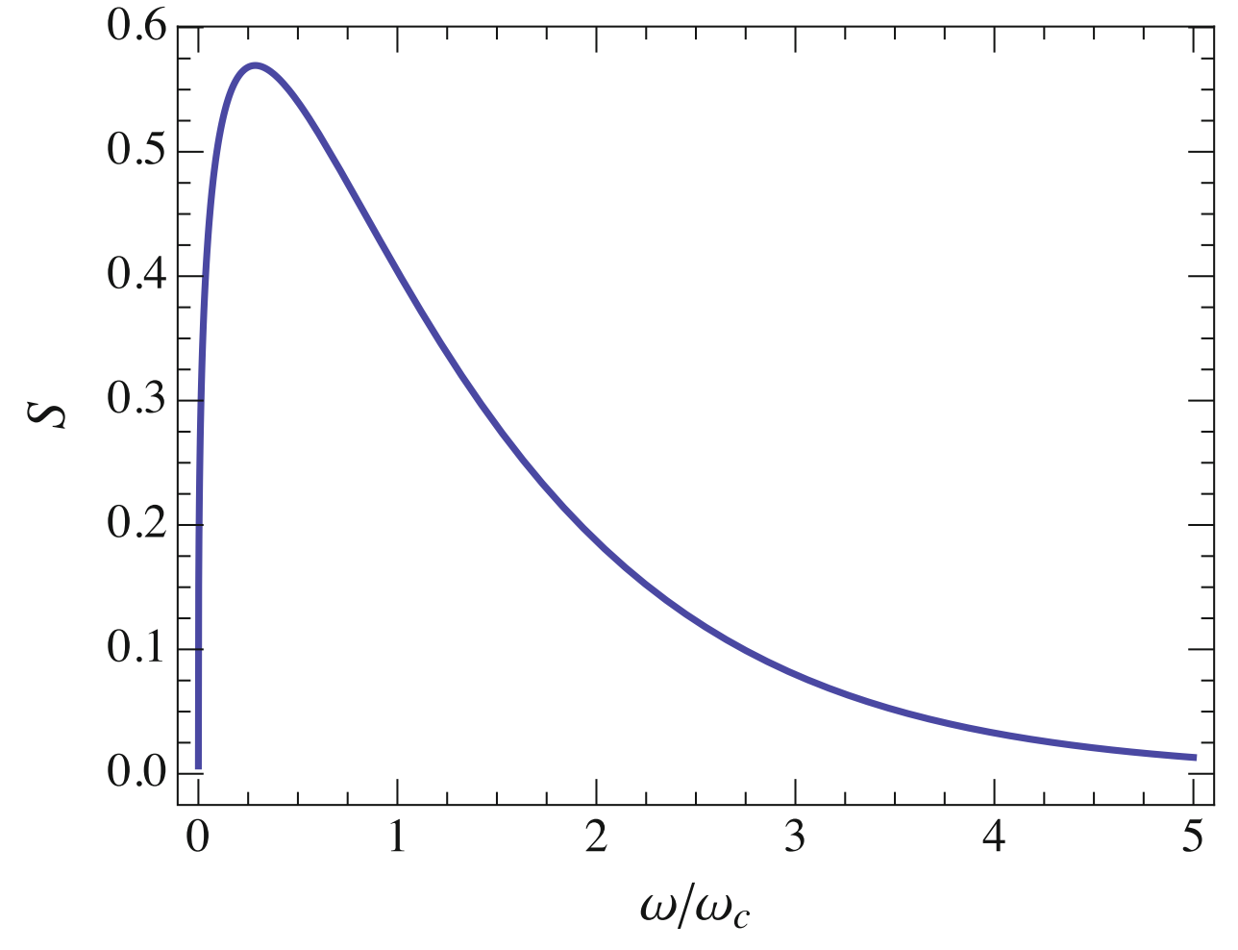
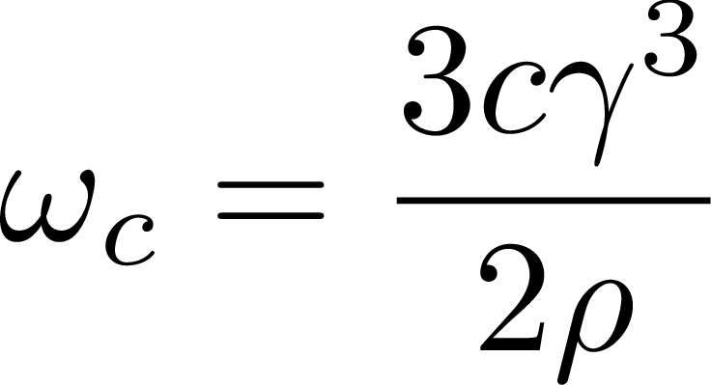
Power Radiated from Accelerating Charge
Power Radiated (per particle):
Energy Loss per revolution (per particle):
Critical Frequency:
9
Classical Mechanics and Electromagnetism | January 2021 USPAS
Critical Frequency:
Notes:
9
9
9
9

Slide 10
10
10
RF Cavities
for Acceleration
(and Synchronization)
10
J. Eldred Accelerator Overview for FNAL CCI Program
Notes:
10
10
10
10
10
10

Slide 11
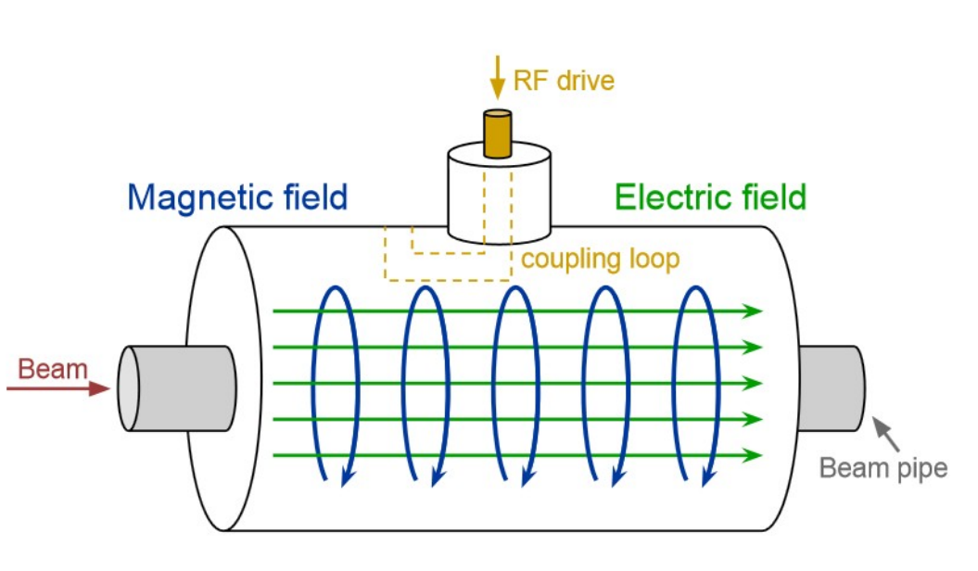
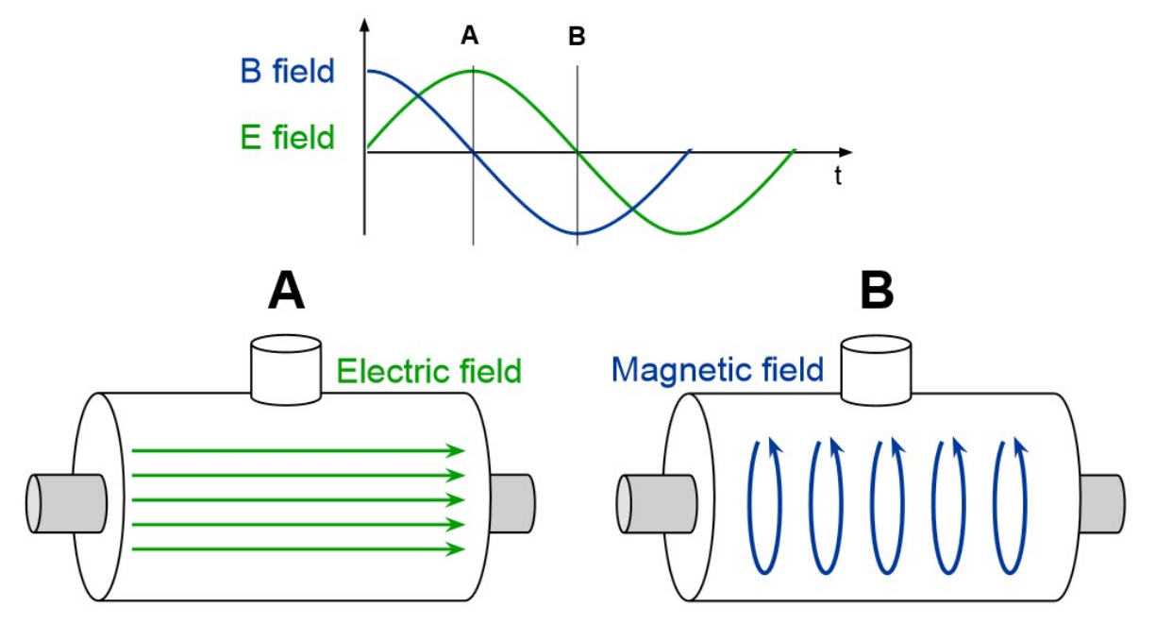
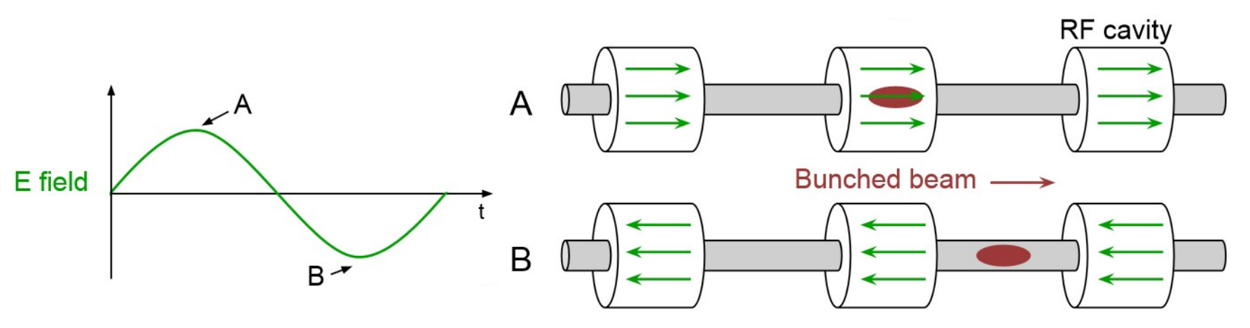
11
RF Accelerating Cavity
We use resonating radiofrequency (RF) cavities to efficiently trap an electromagnetic wave which accelerates the beam.
A. Watts, Concepts Rookie Book
The beam must arrive in synchronized bunches to be accelerated.
11
Jeffrey Eldred | Present & Future Particle Accelerators at Fermilab
Notes:
11
11
11

Slide 12
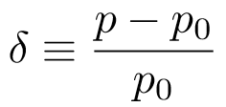

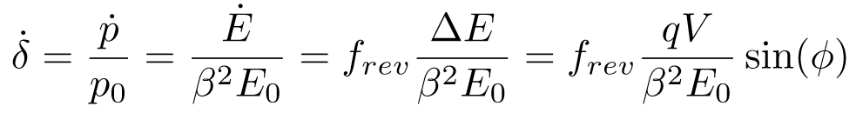
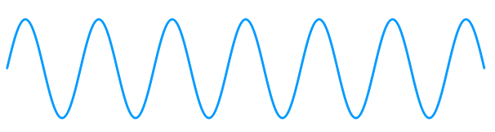
Change in Momentum
Fractional Momentum:
RF Acc. Per Pass:
Change Momentum per unit time:
Sinesoidal potential:
12
J. Eldred Accelerator Overview for FNAL CCI Program
Notes:
12
12
12
12

Slide 13
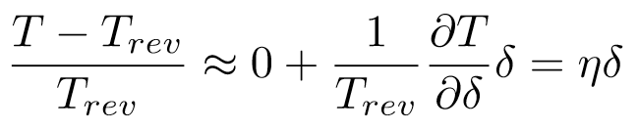
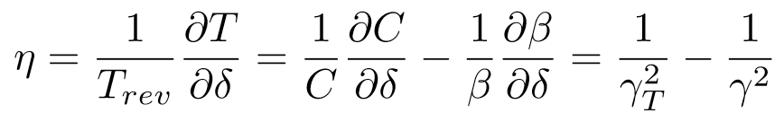
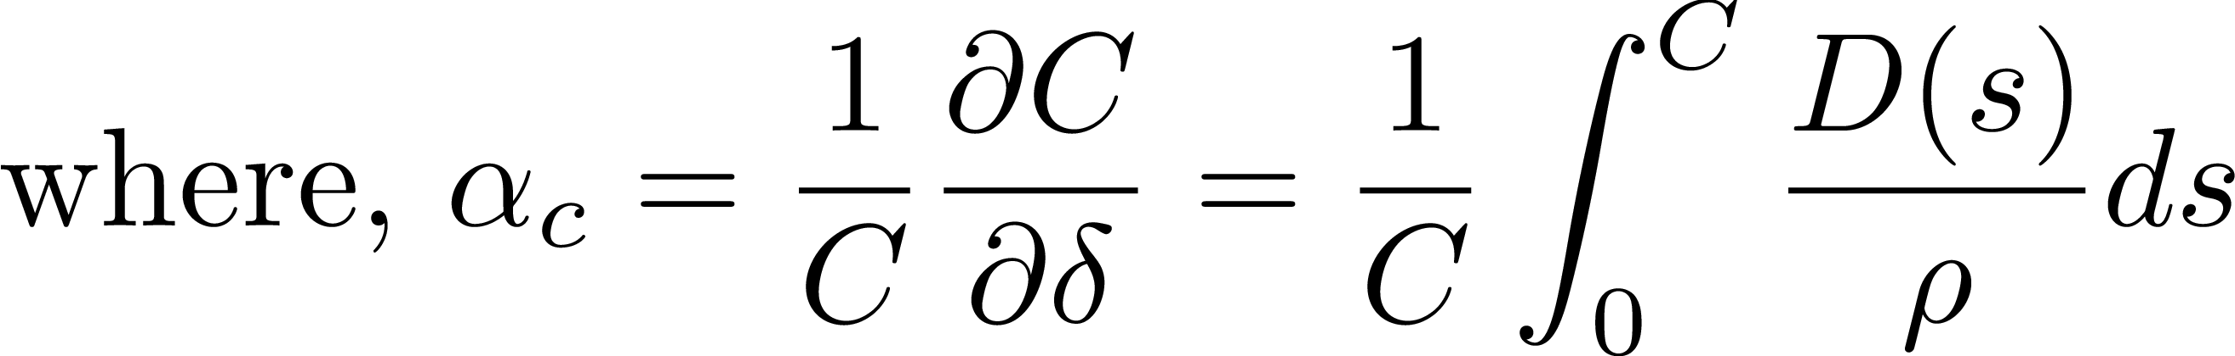
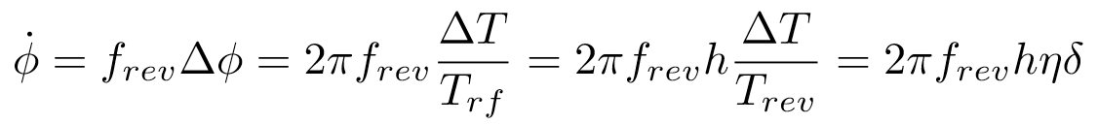

Phase-Slip Factor η
The arrival time of the particle depends on the momentum:
Higher momentum particles may arrive earlier or later than lower momentum particles:
We can write the change in phase per unit time using the phase-slip factor:
Momentum compaction factor:
13
J. Eldred Accelerator Overview for FNAL CCI Program
Notes:
13
13
13
13

Slide 14
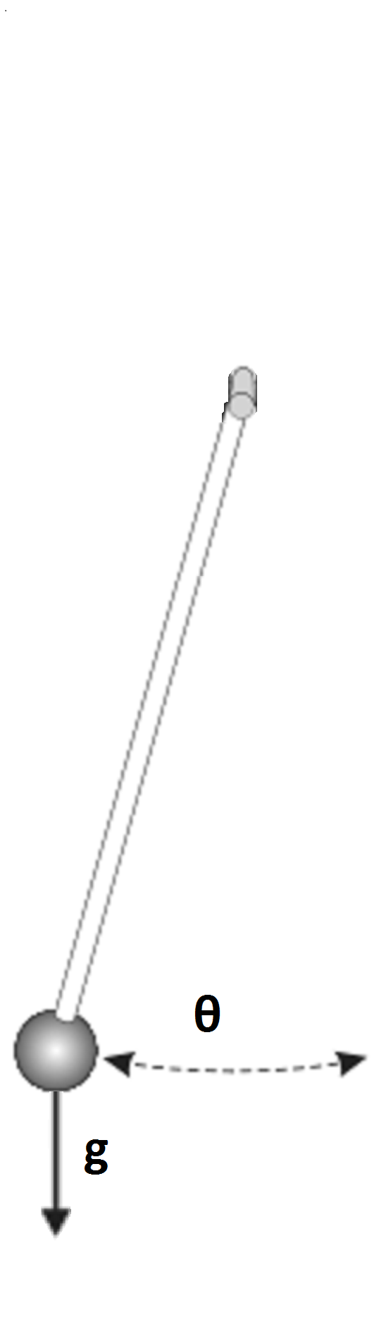
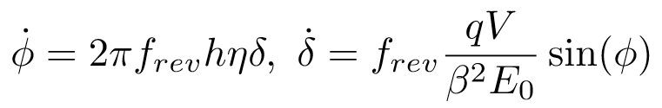
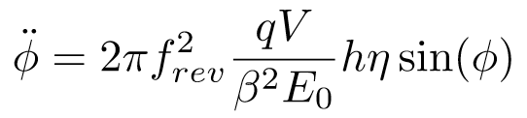
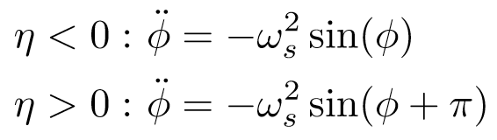
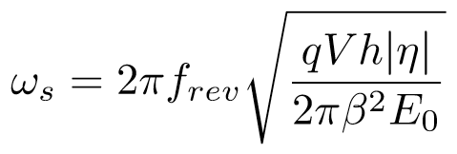
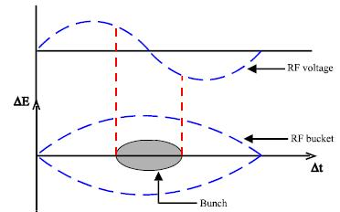
Longitudinal Focusing
Synchrotron Tune
14
J. Eldred Accelerator Overview for FNAL CCI Program
Notes:
14
14
14
14

Slide 15
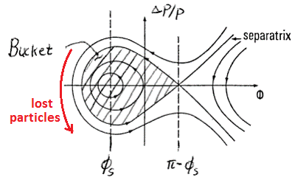
RF Acceleration
A fixed frequency beam longitudinally focuses the beam into a several beam “bunches” in individual RF “buckets”.
Particles in the bucket can be accelerated by adiabatically changing the RF frequency, the other particles are lost.
15
J. Eldred Accelerator Overview for FNAL CCI Program
Notes:
15
15
15
15

Slide 16
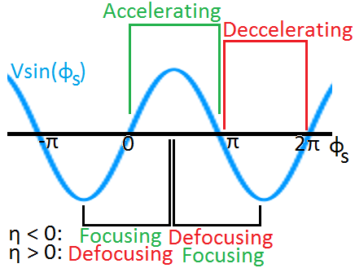
Phase-Focusing & Acceleration
16
Classical Mechanics and Electromagnetism | June 2018 USPAS at MSU
Notes:
16
16
16
16

Slide 17
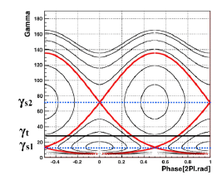
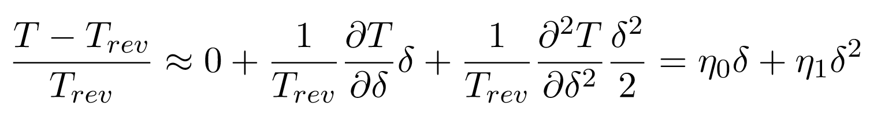
Phase-space at Transition
17
Classical Mechanics and Electromagnetism | June 2018 USPAS at MSU
Notes:
17
17
17
17

Slide 18
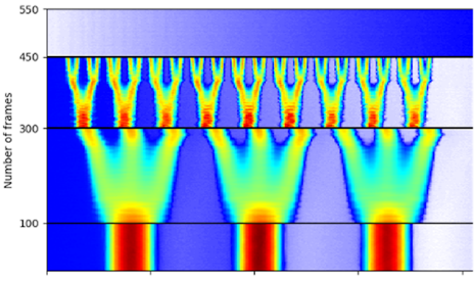
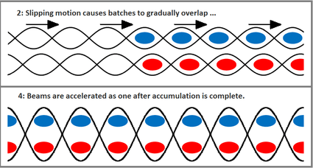
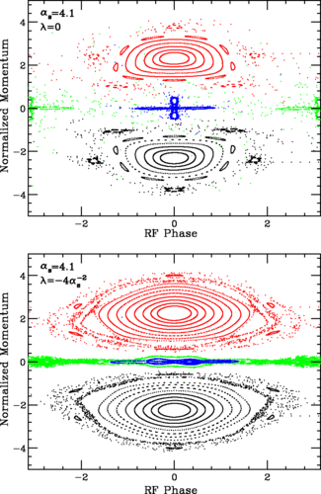
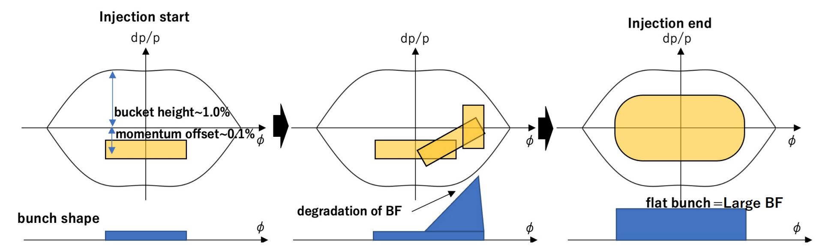
Longitudinal Dynamics is itself a rich topic…
Bunch Splitting:
“Slip-stacking”
Accumulation
Bunch Flattening
& Longitudinal Painting:
18
Classical Mechanics and Electromagnetism | June 2018 USPAS at MSU
Notes:
18
18
18
18

Slide 19
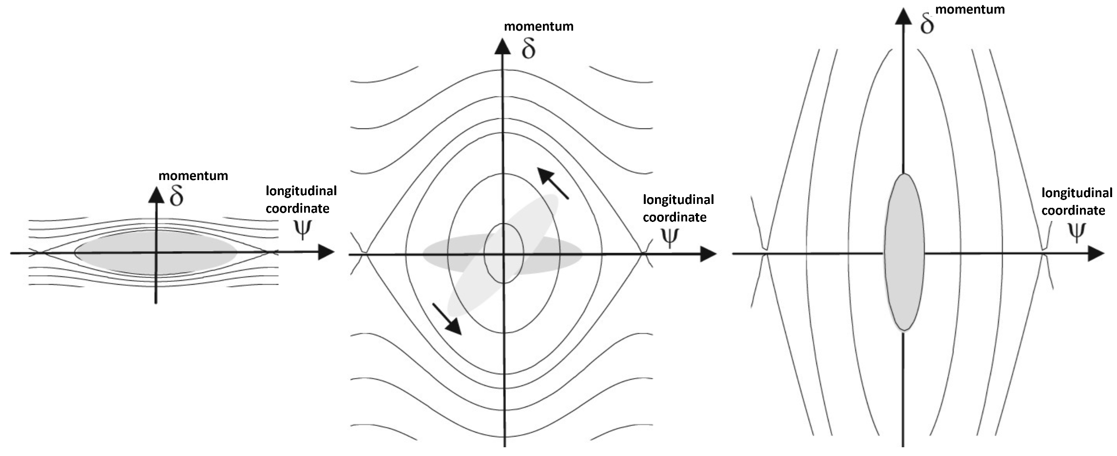
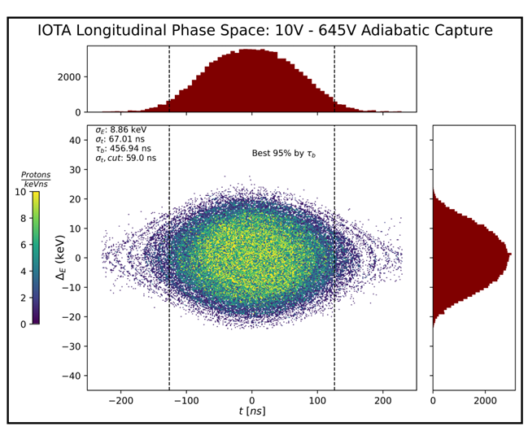
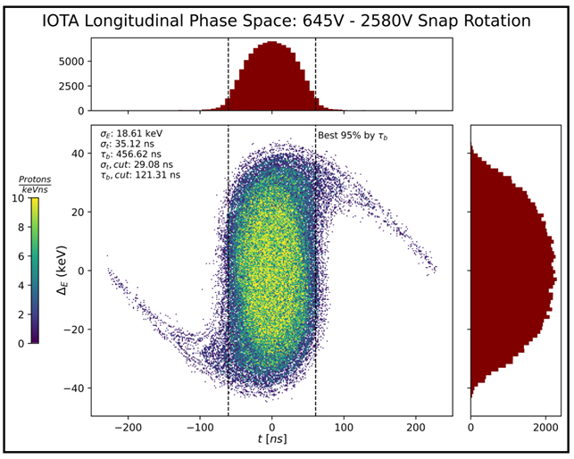
Bunch Rotation is Critical for Muon Collider
Low momentum spread exchanged for low temportal spread!
Wiedemann Textbook
Ben Simons Simulation
19
Classical Mechanics and Electromagnetism | June 2018 USPAS at MSU
Notes:
19
19
19
19

Slide 20
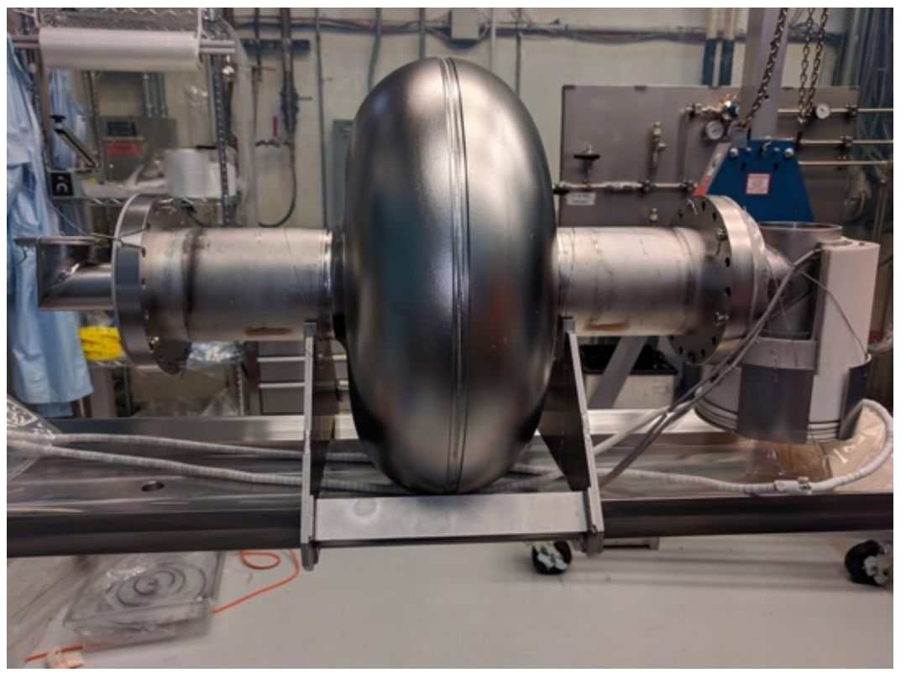
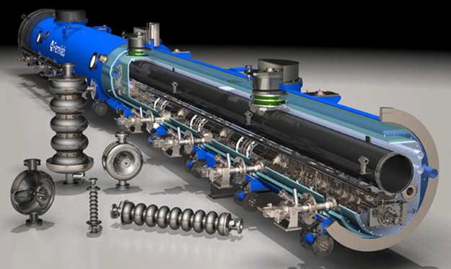
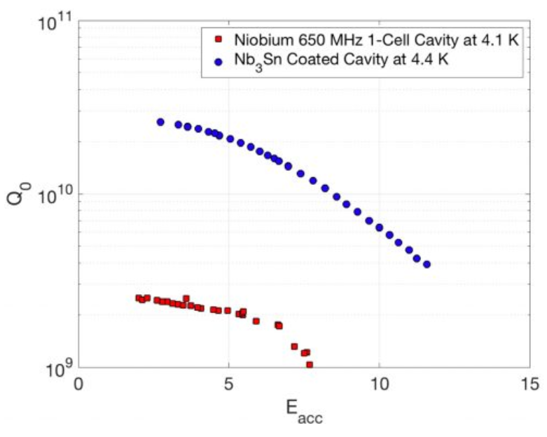
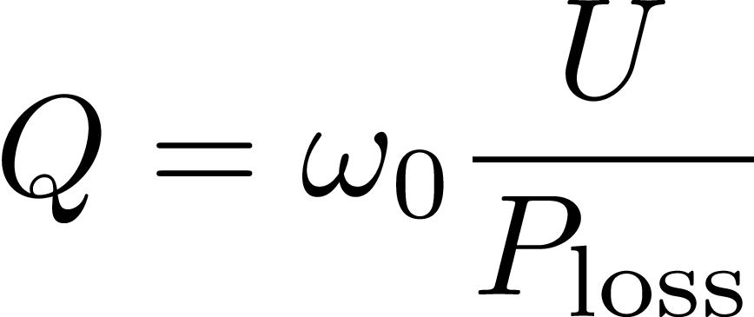
20
Superconducting RF R&D
S. Posen, 2018
Pictures from FNAL PIP-II SRF.
Optimize Q-factor and Eacc (MV/m)
Stored energy
RF Power loss
20
Jeffrey Eldred | Present & Future Particle Accelerators at Fermilab
Notes:
20
20
20

Slide 21
21
21
Quadrupole Magets
for Transverse Focusing
21
J. Eldred Accelerator Overview for FNAL CCI Program
Notes:
21
21
21
21
21
21

Slide 22
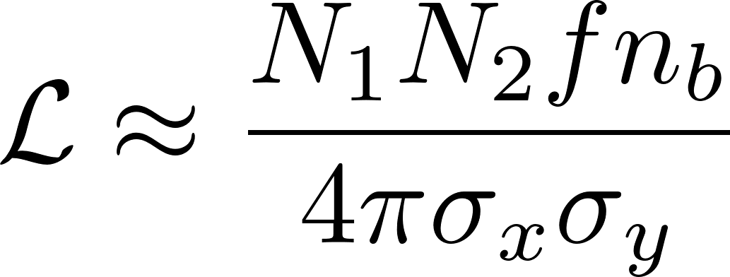
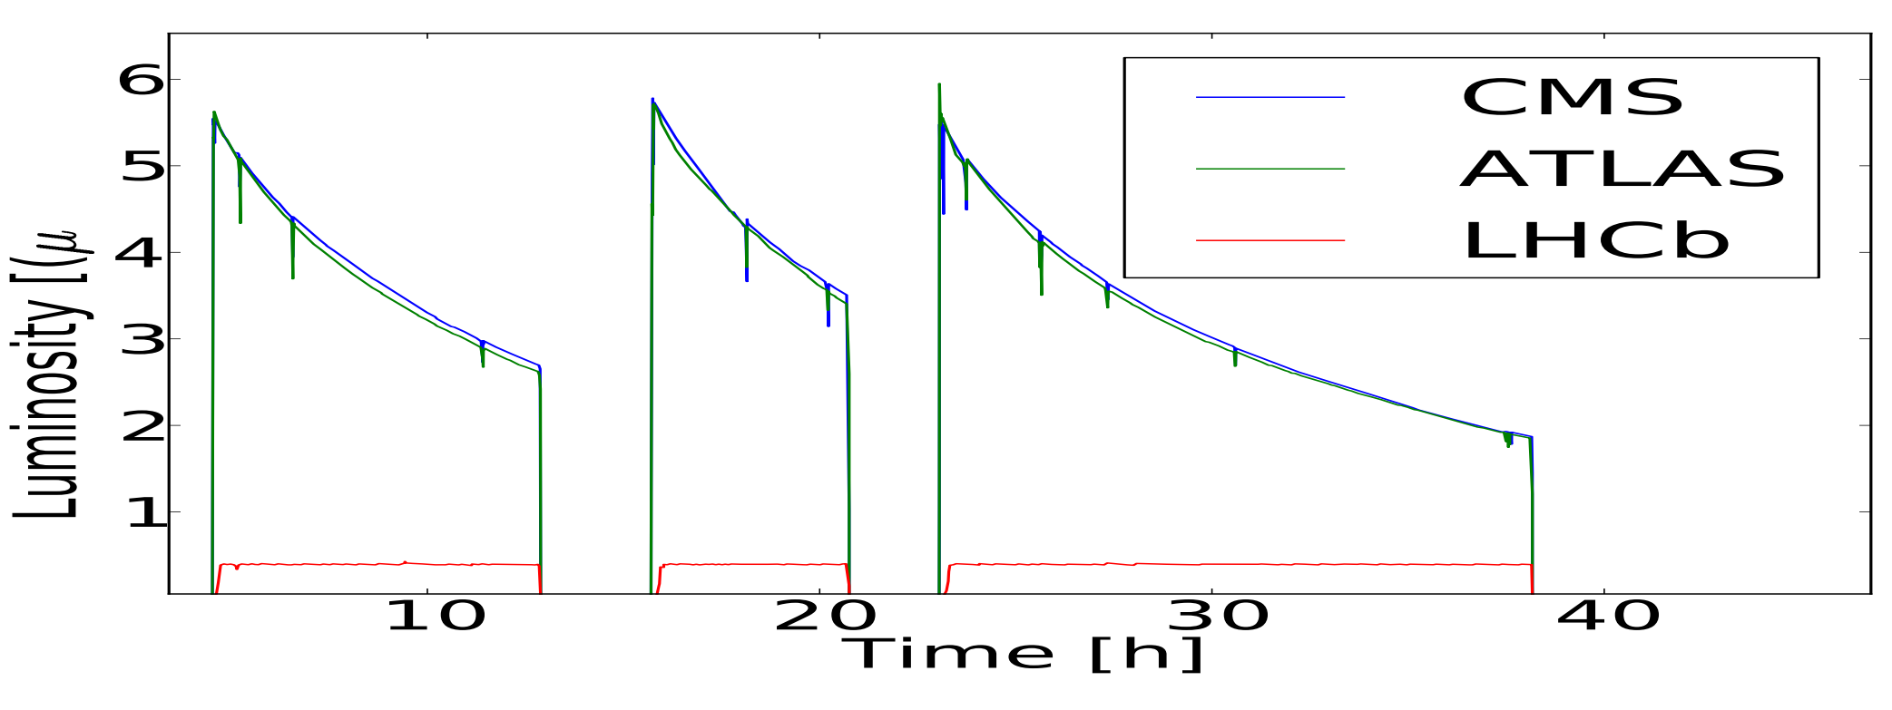
22
Luminosity
Luminosity is proportional to the number of particle interactions in colliding beams, which (to lowest order) is given by:
Luminosity benefits from achieving the highest possible particle density in the beams, transversely and longitudinally.
Luminosity typically degrades over time.
Particles per bunch
Rate of bunch crossing
Luminosity
Horz, Vert beam sizes
X. Buffat
22
J. Eldred Transverse Dynamics Accelerators
Notes:
22
22
22

Slide 23
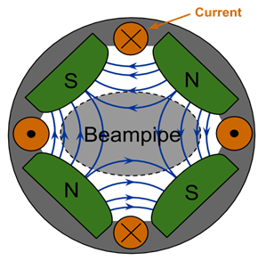
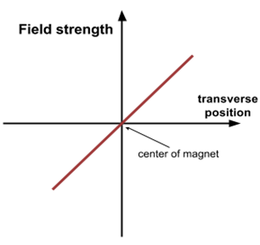

23
Quadrupole Magnets for Transverse Focusing
Quadrupole Magnet:
Linear Restoring Force:
D. Barak, B. Harrison, A. Watts, Concepts Rookie Book,
special thanks A. Watts
Alternating Focusing Magnets:
23
Jeffrey Eldred | Present & Future Particle Accelerators at Fermilab
Notes:
23
23
23

Slide 24
24
24
Transverse “Betatron” Motion
24
J. Eldred Transverse Dynamics Accelerators
Notes:
24
24
24
24
24
24

Slide 25



Harmonic Oscillator
Hamiltonian:
Equations of motion:
Phase-space diagram:
25
J. Eldred Transverse Dynamics Accelerators
Notes:
25
25
25
25

Slide 26



Harmonic Oscillator
Hamiltonian:
Equations of motion, with action:
Phase-space diagram:
26
J. Eldred Transverse Dynamics Accelerators
Notes:
26
26
26
26

Slide 27






Linear Focusing
We can solve the linear Hill’s equation:
27
J. Eldred Transverse Dynamics Accelerators
Notes:
27
27
27
27

Slide 28





Transfer Matrices
The final position and slope is a linear combination of the initial position and initial slope. We can use matrices:
28
J. Eldred Transverse Dynamics Accelerators
Notes:
28
28
28
28

Slide 29


Example: FODO Cell
The transfer matrix for a sequence of elements can be obtained by multiplying the matrices for the components.
This is good for tracking particles, but how can we make sense of what is happening to the beam as a whole?
29
J. Eldred Transverse Dynamics Accelerators
Notes:
29
29
29
29

Slide 30


Horizontal and Vertical Motion
Horizontally focusing quadrupoles are vertically defocusing.
Horizontally defocusing quadrupoes are vertically focusing.
In general the combined effect can be written as a 4x4 matrix:
When there are skew quads (quads rotated 45 degrees) or magnets with longitudinal magnetic fields (like solenoids),
Those off-diagonal blocks might be nonzero.
30
J. Eldred Transverse Dynamics Accelerators
Notes:
30
30
30
30

Slide 31




Solenoid Field
In the body of a solenoid we have:
Recall…
Larmor radius
31
J. Eldred Transverse Dynamics Accelerators
Notes:
31
31
31
31

Slide 32




Solving Hill’s Equation (via Floquet method)
Hill’s Equation:
If we write:
This is a solution if we also require that:
32
J. Eldred Transverse Dynamics Accelerators
Notes:
32
32
32
32

Slide 33

Amplitude & Beta function
J_{x} φ₀ specific to one particle, independent of accelerator location.
β_{x} ΔΦ_{x} same all particles, depends on accelerator location.
Bartolini
33
J. Eldred Transverse Dynamics Accelerators
Notes:
33
33
33
33

Slide 34


Amplitude & Beta function
RMS Beam size:
Wille
34
J. Eldred Transverse Dynamics Accelerators
Notes:
34
34
34
34

Slide 35

Transverse Phase-space
35
J. Eldred Transverse Dynamics Accelerators
Notes:
35
35
35
35

Slide 36

Betatron Motion
Bartolini
36
J. Eldred Transverse Dynamics Accelerators
Notes:
36
36
36
36

Slide 37


Normalized Coordinates
We can “normalize” these coordinates
by a scale-skew transformation:
normalization
37
J. Eldred Transverse Dynamics Accelerators
Notes:
37
37
37
37

Slide 38


Betatron Oscillation
Using these continuous forms of motion:
Relating this to the matrices, see any general transfer matrix can be parameterized and decomposed:
An inverse transformation, a rotation, and transformation.
38
J. Eldred Transverse Dynamics Accelerators
Notes:
38
38
38
38

Slide 39



Courant-Snyder (TWISS) Parameters
The transfer matrix for a general transfer matrix:
Transfer matrix for an entire ring, impose β₁ = β₂, α₁ = α₂:
These α, β are known as Courant-Snyder or TWISS parameters. We can think of them either as parameterization of the transfer matrix or as functions which solve the Hill’s equation.
39
J. Eldred Transverse Dynamics Accelerators
Notes:
39
39
39
39

Slide 40





Courant-Snyder (TWISS) Parameters
The transfer matrix for an entire ring
For example, we can calculate TWISS for a repeating FODO ring:
40
J. Eldred Transverse Dynamics Accelerators
Notes:
40
40
40
40

Slide 41





Question – Where is this the beta function for?
Matrix order:
Similarity transform:
41
J. Eldred Transverse Dynamics Accelerators
Notes:
41
41
41
41

Slide 42

Computed Calculation of TWISS Plots
42
J. Eldred Transverse Dynamics Accelerators
Notes:
42
42
42
42

Slide 43

Stability over many revolutons
The ring transfer matrix at location s₁:
This is the “one-turn map”, the effect on the beam as starts at s₁, travels around the ring, and returns to s₁.
The effect of N turns:
The eigenvalues of M are:
they must be unimodular reciprocals.
ν_{x} or Q_{x}, the betatron tune.
43
J. Eldred Transverse Dynamics Accelerators
Notes:
43
43
43
43

Slide 44

LHC IP5 TWISS Plot
R Calaga, Long-range beam-beam experiments in the relativistic heavy ion collider
44
J. Eldred Transverse Dynamics Accelerators
Notes:
44
44
44
44

Slide 45


LHC IP5 TWISS Plot (cont.)
Jaime Maria Coello, Dissertation
Horz: Q_{D} Q_{F} Q_{D} Q_{D} Q_{F} Q_{D}
Vert: Q_{F} Q_{D} Q_{F} Q_{F} Q_{D} Q_{F}
45
J. Eldred Transverse Dynamics Accelerators
Notes:
45
45
45
45

Slide 46

Collider Optics
In any drift section, the beta function is given by:
where β* is the minimum beta, and s* is the location of that minimum. Interaction points (IPs) are typically placed in drifts with the beam tightly focused to a minimum value in both planes and from a large beta value on both sides.
Horz: Q_{D} Q_{F} Q_{D} Q_{D} Q_{F} Q_{D}
Vert: Q_{F} Q_{D} Q_{F} Q_{F} Q_{D} Q_{F}
46
J. Eldred Transverse Dynamics Accelerators
Notes:
46
46
46
46

Slide 47
47
47
Collimators and Phase-Advance
47
J. Eldred Accelerator Overview for FNAL CCI Program
Notes:
47
47
47
47
47
47

Slide 48


Two Beam Position Monitor Measurement
The correlation between X₁ and X₂, can be used to see the betatron phase advance between those points.
SY Lee
48
J. Eldred Transverse Dynamics Accelerators
Notes:
48
48
48
48

Slide 49

Machine Protection through Collimation
CERN Courier
49
J. Eldred Transverse Dynamics Accelerators
Notes:
49
49
49
49

Slide 50






Betatron Phase Advance
Kick amplitude after π/2:
50
J. Eldred Transverse Dynamics Accelerators
Notes:
50
50
50
50

Slide 51
51
51
Off-Momentum Particles
& Sextupole Magnets
51
J. Eldred Transverse Dynamics Accelerators
Notes:
51
51
51
51
51
51

Slide 52





Dispersion
Dispersion:
Spot Size:
Barletta
52
J. Eldred Transverse Dynamics Accelerators
Notes:
52
52
52
52

Slide 53





Chromaticity
Change in tune with momentum:
Chromaticity:
Barletta
53
J. Eldred Transverse Dynamics Accelerators
Notes:
53
53
53
53

Slide 54



Sextupoles & Chromaticity Correction
Dispersion is position offset dependence on momentum.
Chromaticity is tune dependence on momentum.
Sextupoles provide tune-shift depending on position offset.
FNAL Rookie Book
54
J. Eldred Transverse Dynamics Accelerators
Notes:
54
54
54
54

Slide 55



Average Lattice Parameters
For a typical FODO-like lattice we can estimate some parameters
Natural Chromaticity:
Average Betas:
Average Dispersion:
Transition gamma:
where
55
J. Eldred Transverse Dynamics Accelerators
Notes:
55
55
55
55

Slide 56

IMCC EU Muon Collider Parameters
Full list of parameters here (2023 EU): here
56
J. Eldred Transverse Dynamics Accelerators
Notes:
56
56
56
56

Slide 57
Summary
The linear transverse dynamics of a particle accelerator are governed by Hill’s Equation, which is a time-varying harmonic oscillator.
We calculate the trajectory of individual particles through the many individual magnets of a particle accelerator using transfer matrices.
Transfer matrices are also used for the beam size and oscillation phase, which are represented by Courant-Snyder parameters.
There are chromatic effects, resonances, and space-charge effects that complicate the process of designing and operating a particle accelerator.
Some backup slides on longitudinal dynamics.
57
J. Eldred Transverse Dynamics Accelerators
Notes:
57
57
57
57

Slide 58
58
58
Betatron Resonances
58
J. Eldred Transverse Dynamics Accelerators
Notes:
58
58
58
58
58
58

Slide 59

Discrete Sampling
Depending on the ratio between betatron frequency the revolution frequency, the phase of oscillation with each passage of the beam may fall under regular patterns.
Betatron Tune:
59
J. Eldred Transverse Dynamics Accelerators
Notes:
59
59
59
59

Slide 60


Betatron Tune Resonance
Perturbation will accumulate if tune is a fraction corresponding to the symmetry of the applied fields.
Dipole-Integer Resonace:
Quadrupole Resonace:
SY Lee
60
J. Eldred Transverse Dynamics Accelerators
Notes:
60
60
60
60

Slide 61

Tune Diagrams (by magnet-type)
The tune is carefully picked to avoid resonances.
The tune for the beam occupies a finite space:
- space-charge tune spread.
- nonlinear magnets.
- chromaticity.
61
J. Eldred Transverse Dynamics Accelerators
Notes:
61
61
61
61

Slide 62

Every Magnet Contributes to the Resonance
Examples of resonance calculations:
The magnetic multipole, multiplied by a corresponding amplitude and phase.
Generically, there will be many resonances and the lowest order resonances will be the strongest.
However, by carefully designing the overall accelerator structure with symmetries, many resonances can be cancelled simultaneously.
62
J. Eldred Transverse Dynamics Accelerators
Notes:
62
62
62
62

Slide 63

Tune Diagrams (by magnet-type)
Sextupole configuration
without resonances
63
J. Eldred Transverse Dynamics Accelerators
Notes:
63
63
63
63

Slide 64




Phase-space Distortions
64
J. Eldred Transverse Dynamics Accelerators
Notes:
64
64
64
64

Slide 65

Nonlinear Decoherence
Injection errors, instabilities, and sudden lattice changes may cause a phase-space mismatch.
Tune spread causes the beam to fill-out along the phase-space contours.
65
J. Eldred Transverse Dynamics Accelerators
Notes:
65
65
65
65

Slide 66
66
66
Space-charge
66
J. Eldred Transverse Dynamics Accelerators
Notes:
66
66
66
66
66
66

Slide 67





67
Transverse Interaction of Co-Moving Charges
Electric Repulsion:
Magnetic Attraction:
Weakened Repulsion with Acceleration:
67
J. Eldred Transverse Dynamics Accelerators
Notes:
67
67
67

Slide 68


68
Space-charge Core vs Tail
Transverse space-charge forces much stronger than longitudinal space-charge.
Transverse and Longitudinal charge distribution can be written as separable functions:
Relativistic Distortion of EM Fields
“Pancake-ification”
Gaussian cylinder for a line-charge:
68
J. Eldred Transverse Dynamics Accelerators
Notes:
68
68
68

Slide 69


69
Space-charge Core vs Tail
S. Lund
69
J. Eldred Transverse Dynamics Accelerators
Notes:
69
69
69

Slide 70



Tune Diagrams
70
J. Eldred Transverse Dynamics Accelerators
Notes:
70
70
70
70

Slide 71



Space-charge Tune-spread & Betatron Resonances
G. Franchetti et al.
PRSTAB 2017
JPARC MR:
M. Friend
71
J. Eldred Transverse Dynamics Accelerators
Notes:
71
71
71
71

