Slide 1
1
1
Proton Driver Design
Jeffrey Eldred
for US Muon Collider Accelerator School
University of Chicago, August 3-6th 2025
Notes:
1
1
1
1
1
1

Slide 2
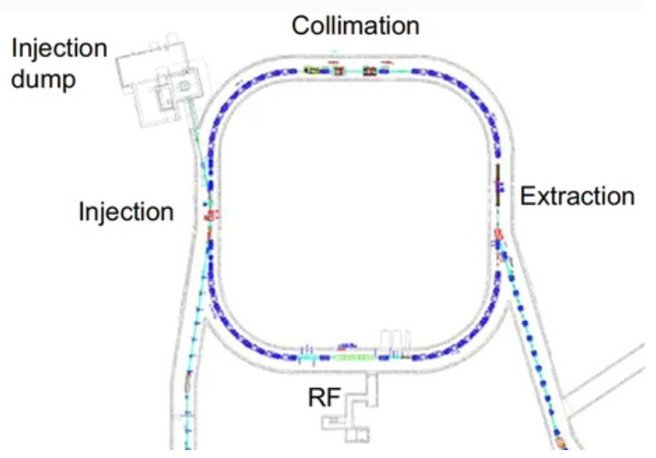
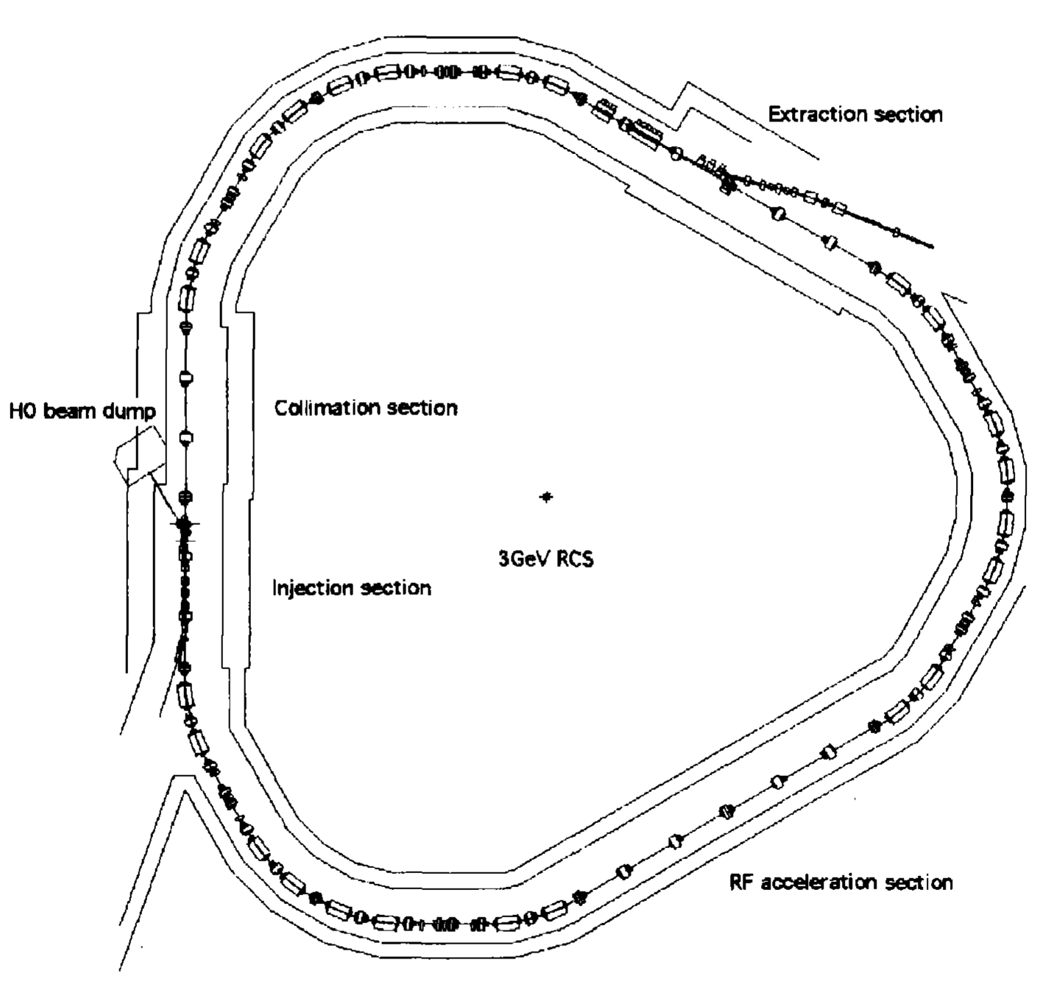
Existing Proton Machines (~2007)
1) Oak Ridge SNS
Neutron Spallation Source
1.0 GeV AR, ~1.4MW
1.3-GeV AR, -> 2.8MW
2) J-PARC RCS
Meson/Muon Production
0.2-3 GeV RCS, ~0.5MW
0.4-3 GeV RCS, -> 1.4MW
Both MW-class facilities that serve as a model for proton driver…
Except we need 2-4MW, 5-12 GeV, 1-3ns pulses (from ~us).
2
J. Eldred Transverse Dynamics Accelerators
Notes:
2
2
2
2

Slide 3
Proton Driver as Muon Collider R&D Topic
Candidly, proton driver design is not biggest factor for technical risk, muon collider performance, or overall cost.
- Closest to existing technology and operational experiences.
So why study proton driver as a muon collider R&D topic?
- We are still working towards a self-consistent baseline scenario.
- Any technical risk that we can offload onto the proton driver we will be highly cost-effective.
- Proton driver is chronologically first by virtue of being upstream. For the hypothetical Gantt chart of building a Muon Collider, it needs the highest level of technical readiness.
- Proton drivers present opportunities for HEP staging.
3
J. Eldred Transverse Dynamics Accelerators
Notes:
3
3
3
3

Slide 4
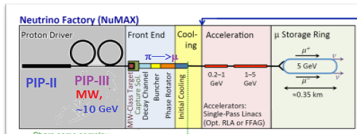
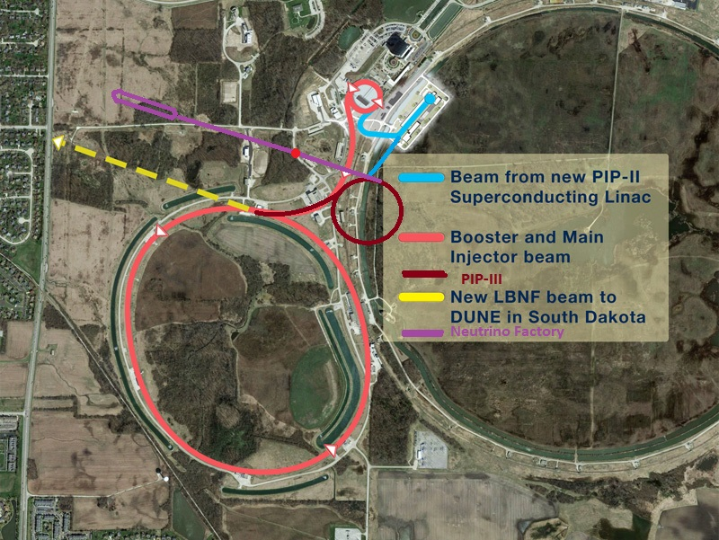
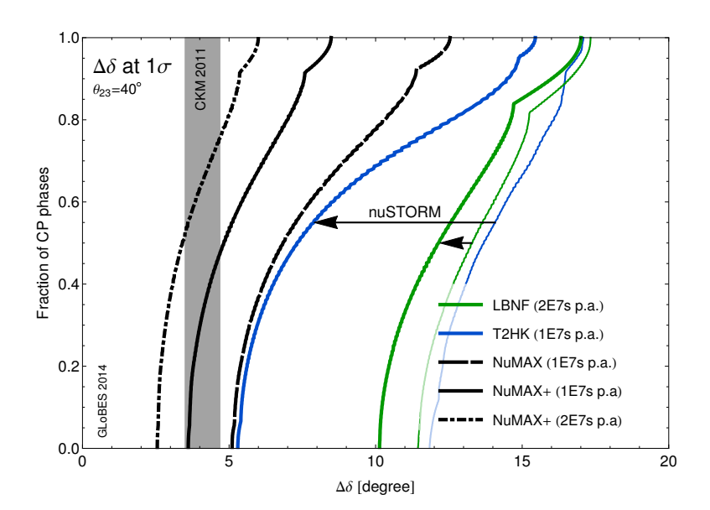
Possible Proton Driver HEP Staging
1) Built Proton Driver
2) Built separate muon ring for
neutrino program.
3) Continue MC construction.
Vastly improves δ_{CP} resolution.
Unitarity tests of PMNS matrix.
4
J. Eldred Transverse Dynamics Accelerators
Notes:
4
4
4
4

Slide 5
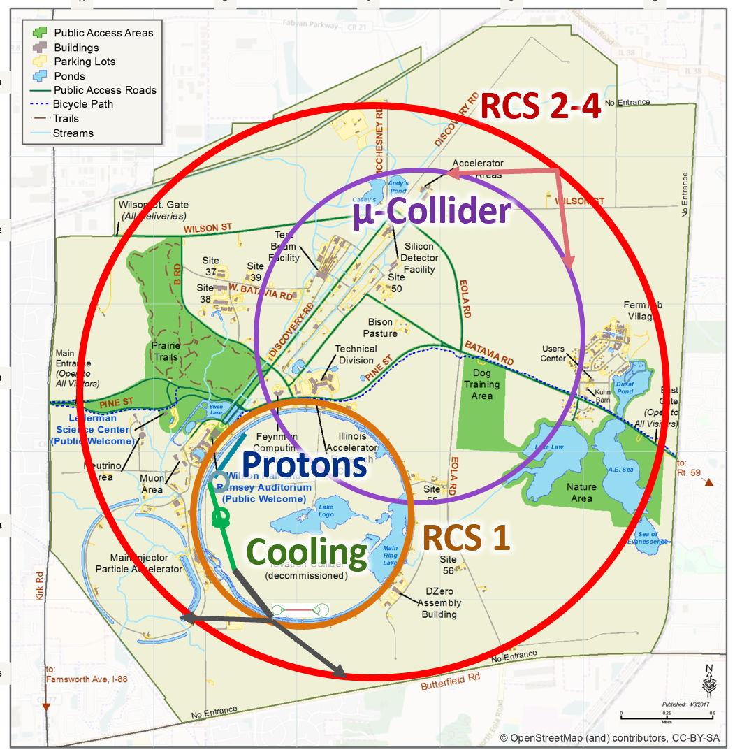
Proton Driver on the MAP
The Proton Driver determines the proton energy, pulse intensity, beam power, spot size on target, bunch length on target for muon production stage.
There in turn feed in the x, y, and t phase-space of the initial cooling stage, muon rate, and pulse repetition rate.
By the end, just luminosity and rep. rate.
5
J. Eldred Transverse Dynamics Accelerators
Notes:
5
5
5
5

Slide 6
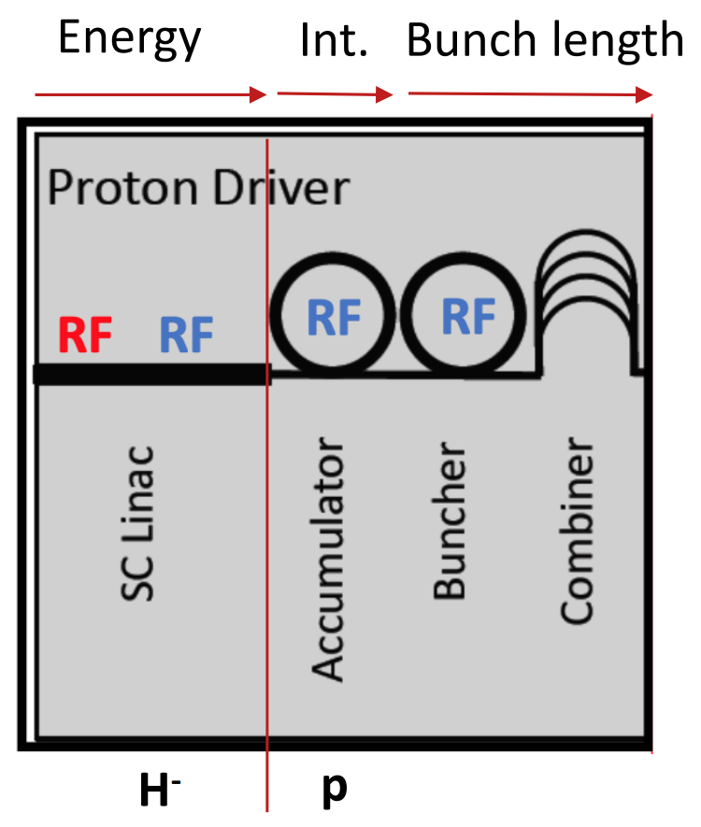
Proton Driver Overview
H- Linac, accelerates up to 5-12 GeV
Accumulation Ring (AR), collects H⁻ ~3e14 particles and paint into stable bunches.
Compressor Ring (CR), performs bunch rotation to extract 1-3ns bunches.
Combiner, ensures that all (typically 1-6) bunches converge on the target simultaneously.
6
J. Eldred Transverse Dynamics Accelerators
Notes:
6
6
6
6

Slide 7
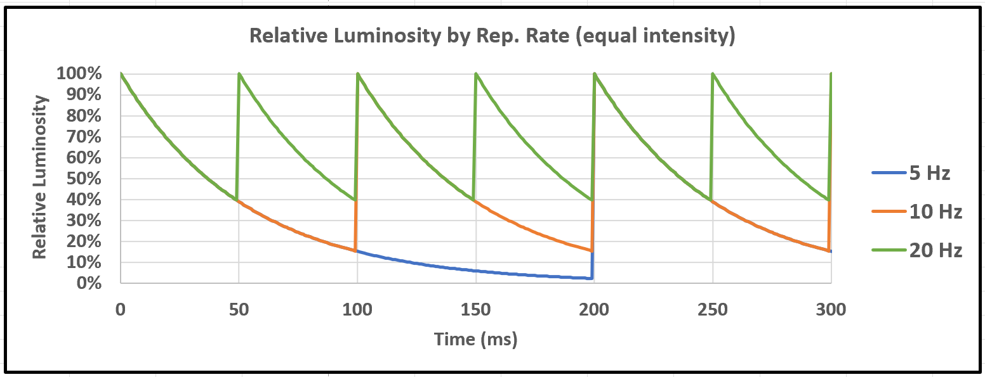
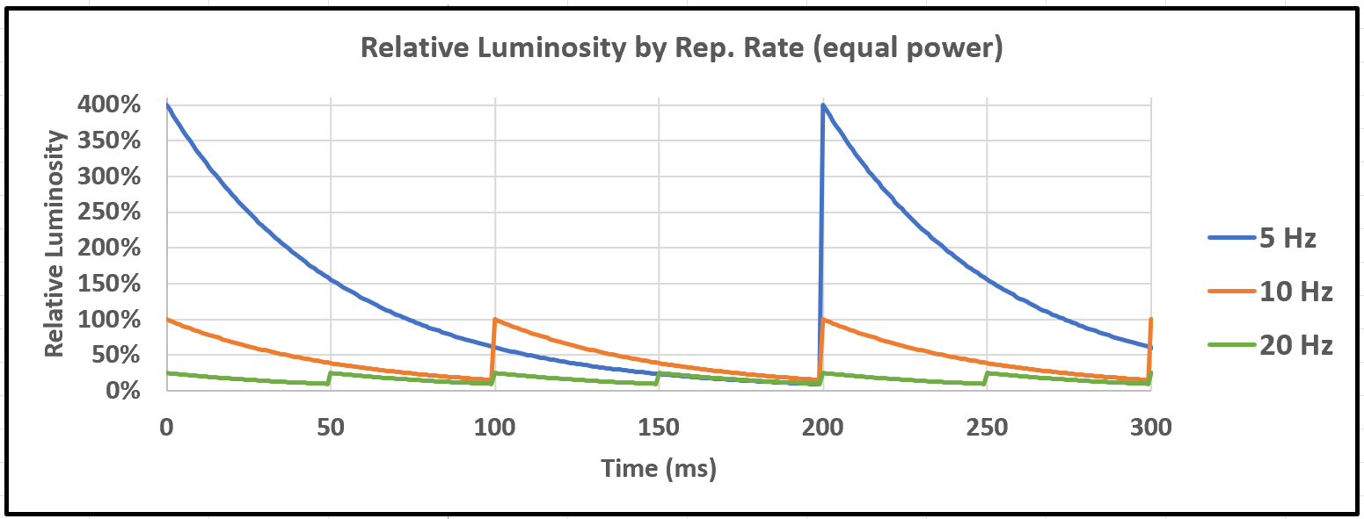
7
Muon Collider Proton Driver Parameters
Rep Rate 5-10 Hz: At 5 TeV beams, muon decay time is 0.1s in the lab frame. Luminosity depends on bunch intensity squared (neglecting beam quality losses).
Higher rep rates are better, given the same number of particles per pulse.
Above 20 Hz, diminishing returns for luminosity.
However, lower rep rates are better for a fixed beam power, because each pulse is more intense.
10 Hz may be a good balance of considerations.
7
Jeffrey Eldred | ACE to MuC-PD (Colliders of Tomorrow)
Notes:
7
7
7

Slide 8
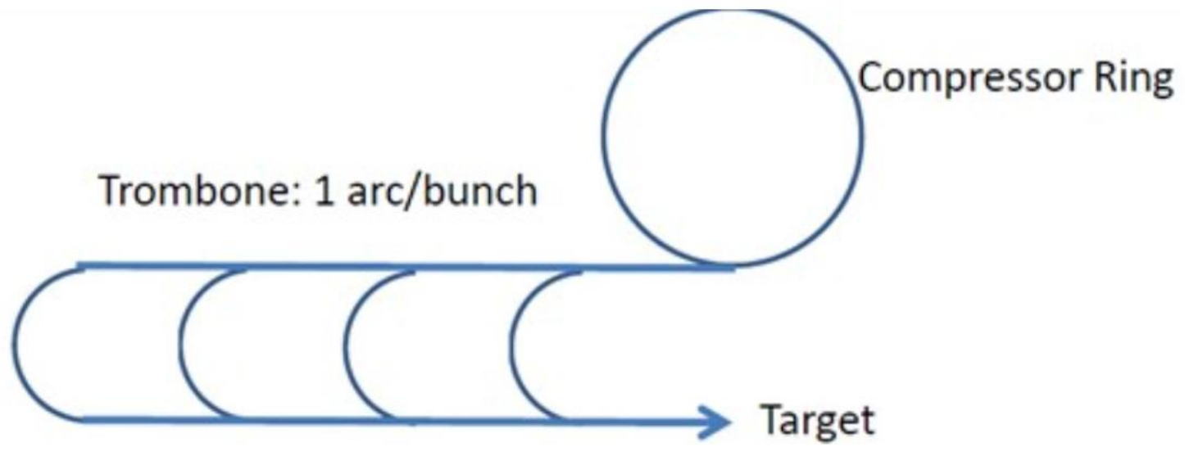
8
Muon Collider Proton Driver Parameters
Beam Energy 5-12 GeV: Muon yield per kW on target is relatively flat from 5-10 GeV, smaller beyond that. Using Fermilab 8 GeV is a reasonable choice.
Bunch Length 1-3 ns: The time structure of the proton beam gets largely passed on to the pion/muon beam produced for the target, so 1-3ns bunch length alleviates the 6D cooling requirements as much as possible.
Proton Beam Power 1-4 MW: To achieve overall luminosity goals (20e34 cm⁻²s⁻¹). At 8-GeV and 10 Hz, the corresponding proton pulse is 80-320e12 protons.
However, split among four bunches sent to combiner, 20-80e12 protons/bunch.
Combiner
8
Jeffrey Eldred | ACE to MuC-PD (Colliders of Tomorrow)
Notes:
8
8
8

Slide 9
9
9
Linac & H- Injection
9
J. Eldred Accelerator Overview for FNAL CCI Program
Notes:
9
9
9
9
9
9

Slide 10
Linac Macropulse Structure
For a pulsed linac klystrons are used for RF sources and for a continuously operating linac solid state amplifiers are used.
Pulsed power is much more affordable and much closer to what the linac needs to deliver 160-320e12 every 5-20 Hz.
Recent FNAL ACE design exercise for an 8-GeV Linac
- Injector chain begins with PIP-II linac with a beam current upgrade.
- 10 Hz x 5 mA x 2 ms x 8 GeV = 0.8 MW
- 1.3 GHz ILC style cavity, LCLS-II style cryomodule, E-XFEL style klystron RF power sources 1.5-2ms.
- Use higher linac current of 6-25mA, that becomes 1-4 MW.
- Might be better to let PIP-II serve 2mA CW users, and build new injector.
10
J. Eldred Transverse Dynamics Accelerators
Notes:
10
10
10
10

Slide 11
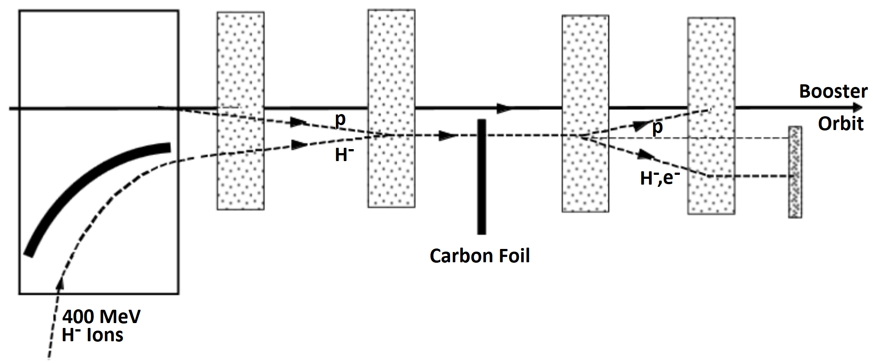
Charge Exchange Injection
1) Carbon foil strips the two electrons from the proton.
2) Proton beam accumulates in the ring.
3) Unstripped H- ions are sent to an absorber.
Linac current is concentrated 100s to 1000s times over!
11
J. Eldred Transverse Dynamics Accelerators
Notes:
11
11
11
11

Slide 12
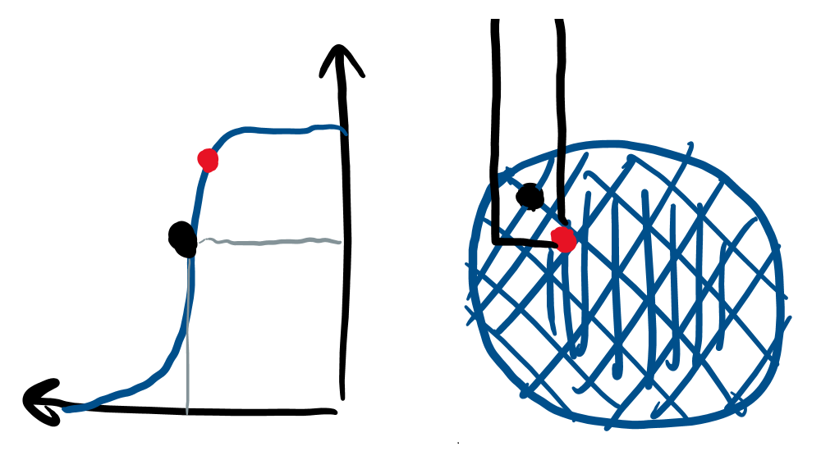
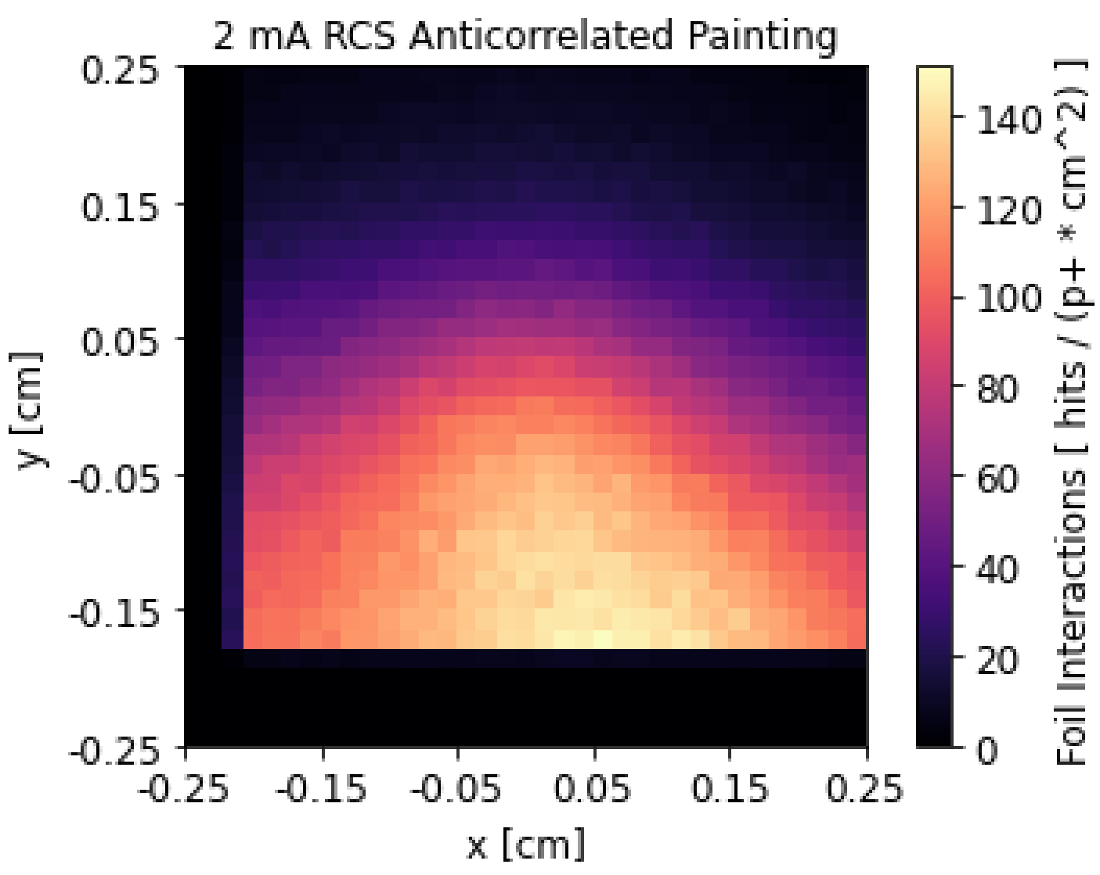
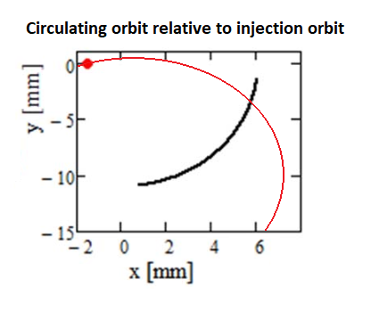
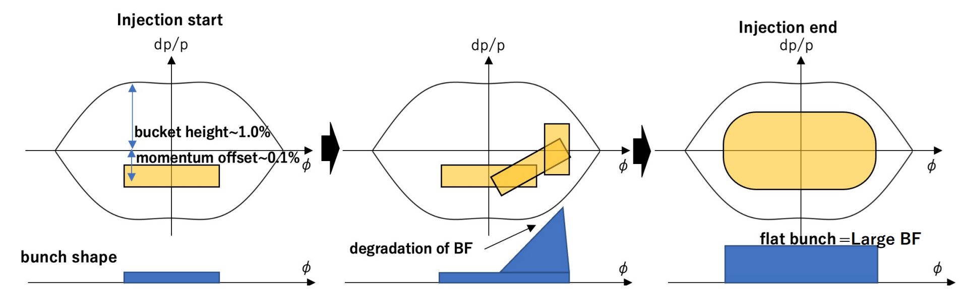
Longitudinal & Transverse Painting
Beam Distribution during Injection
Foil Interaction Distribution
Anti-correlated Painting Injection
Longitudinal Painting
12
J. Eldred Transverse Dynamics Accelerators
Notes:
12
12
12
12

Slide 13
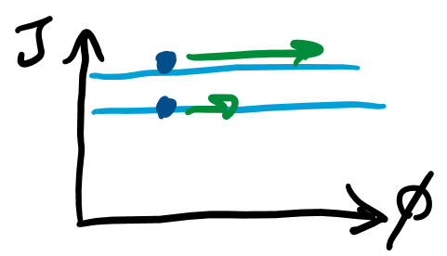
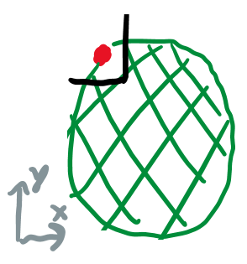
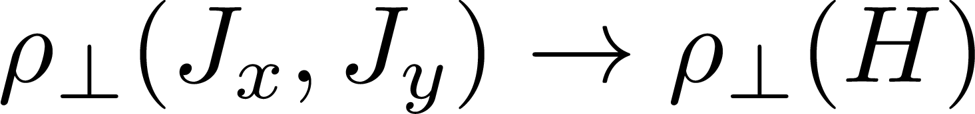
13
Equilibrium Charge Distributions
Due to nonlinear decoherence effects, particles tend to become uniformly distributed on surfaces of constant action Jx and Jy.
Due to nonlinear coupling effects (inseparable transverse degrees of freedom), particles may also become uniformly distributed on equipotential surfaces of the Hamiltonian H.
In the limit of weak space-charge, we can write down the single-particle Hamiltonian, consider space-charge as a perturbation, find an equilibrium.
In general however, writing a self-consistent space-charge distribution, not already at equilibrium is challenging.
One special case is the KV distribution, which is an important case study.
13
Classical Mechanics and Electromagnetism | January 2021 USPAS
Notes:
13
13
13

Slide 14
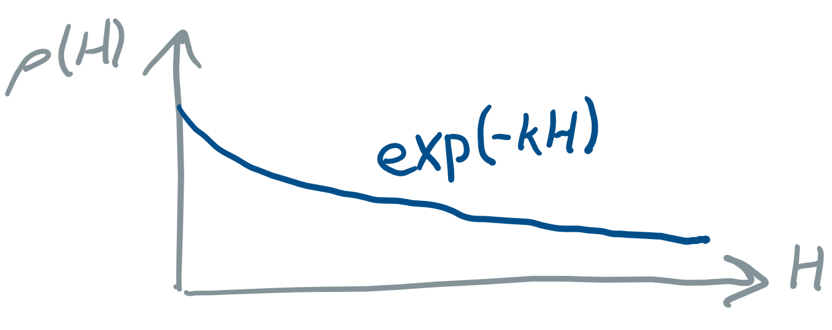
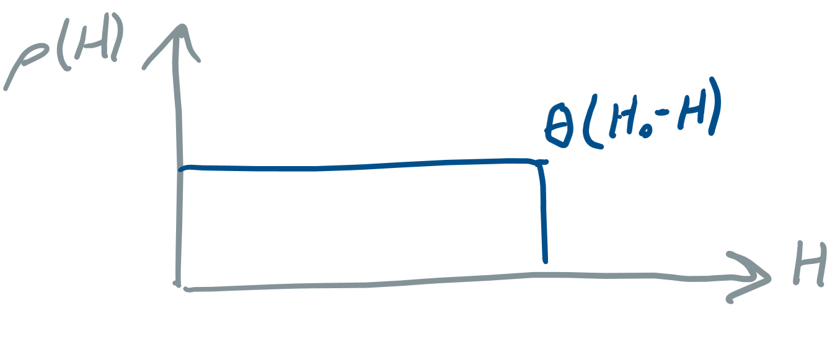
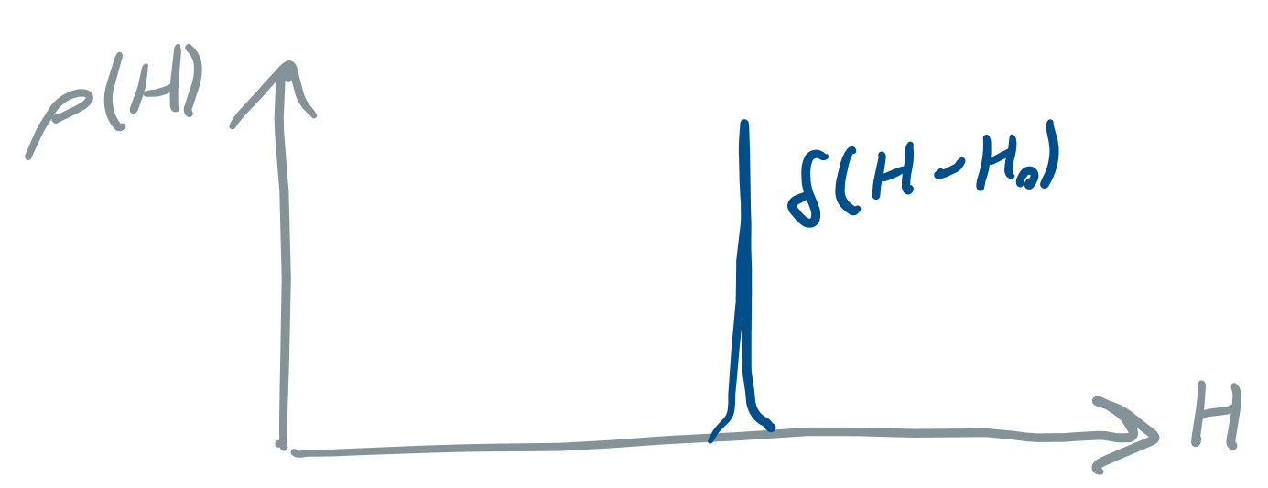
Some Particle Distributions
Gaussian:
Waterbag:
KV:
14
Classical Mechanics and Electromagnetism | January 2021 USPAS
Notes:
14
14
14
14

Slide 15
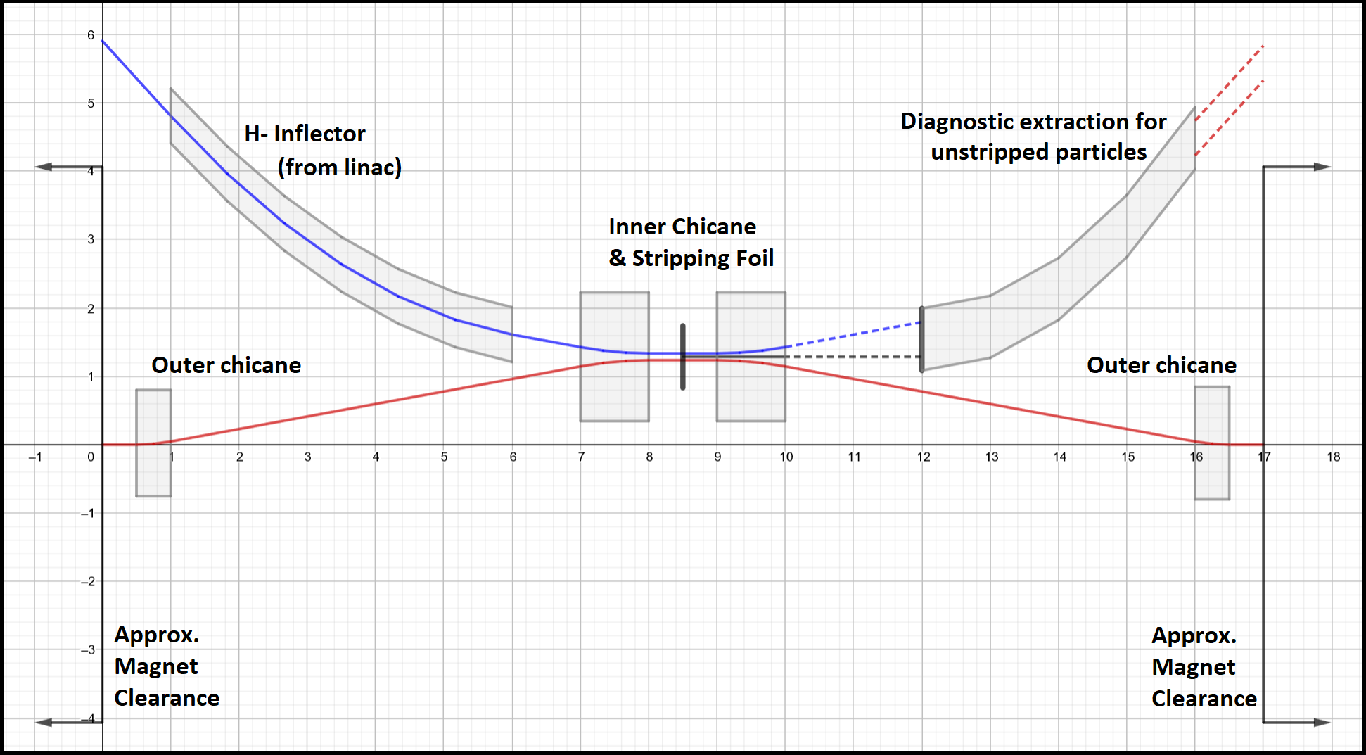
H- Injection Foil Challenges
Long Injection Chicane to avoid early H- stripping, worse with energy.
Extraction to absorber, to remove unstripped H-/H0 particles
Foil Failure due to beam heating, Foil failure at 2000-2300 K
Circulating Proton Beam Scatters off Injection Foil, hard to absorb
At GeV-scale energy helps, but at higher energy it hurts.
- Proton scattering persists, absorbing particles is much are harder.
15
J. Eldred Transverse Dynamics Accelerators
Notes:
15
15
15
15

Slide 16
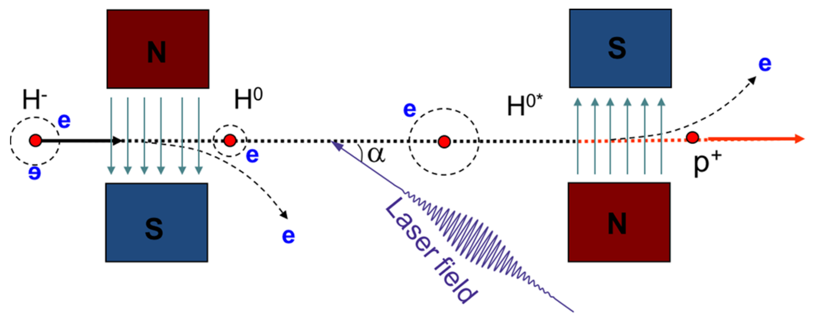
Laser Stripping injection for H- Injection
Is foil stripping even feasible for a 4MW proton driver AR?
In laser-assisted charge-exchange (LACE), H- is Lorentz-stripped to H0, H0 excited with a laser, and then H0* stripped to proton with a second magnet.
If laser stripping efficiency is 95%, 200 kW is being directed to a beam dump!
This technology is being developed at SNS and J-PARC
16
J. Eldred Transverse Dynamics Accelerators
Notes:
16
16
16
16

Slide 17
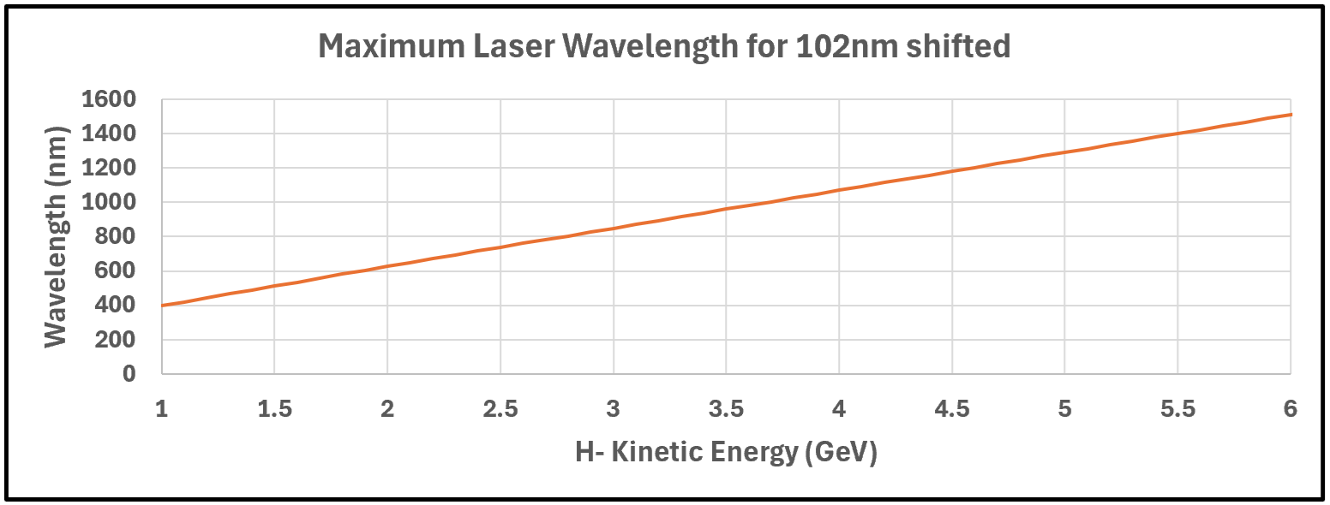
Energy Dependence on H- Laser Stripping injection
Laser wavelength is Doppler-boosted to target Lyman series
n=1 -> n=3, λ₀ = 102 nm line.
Changing the angle, any shorter wavelength laser can still be used at higher energies.
Above ~4 GeV, essentially the full range of laser technology and optics.
Nd:YAG
Ruby
Ti:Sapphire
GaN
17
J. Eldred Transverse Dynamics Accelerators
Notes:
17
17
17
17

Slide 18
18
18
Accumulator Ring & Compressor Ring
18
J. Eldred Accelerator Overview for FNAL CCI Program
Notes:
18
18
18
18
18
18

Slide 19
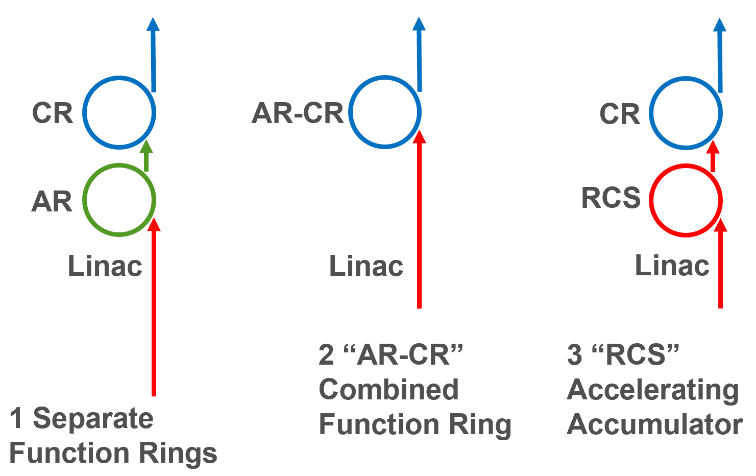
Architecture
Can the CR accumulate without losing compression performance?
Can the AR accelerate without losing accumulation performance?
For now keep the rings separate when in reality they may be the same…
19
Classical Mechanics and Electromagnetism | January 2021 USPAS
Notes:
19
19
19
19

Slide 20
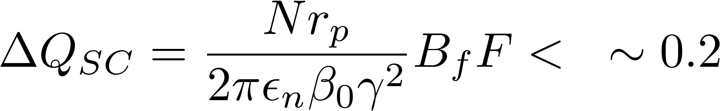
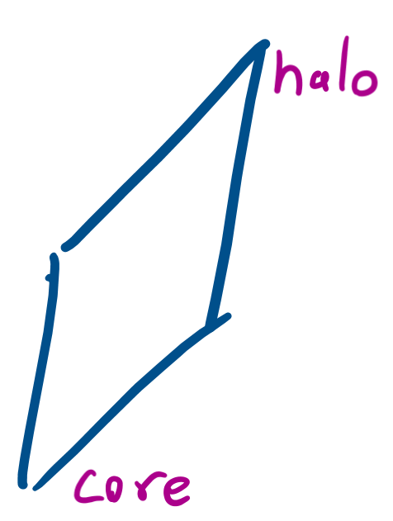
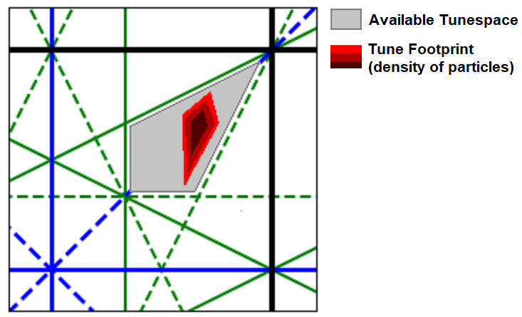
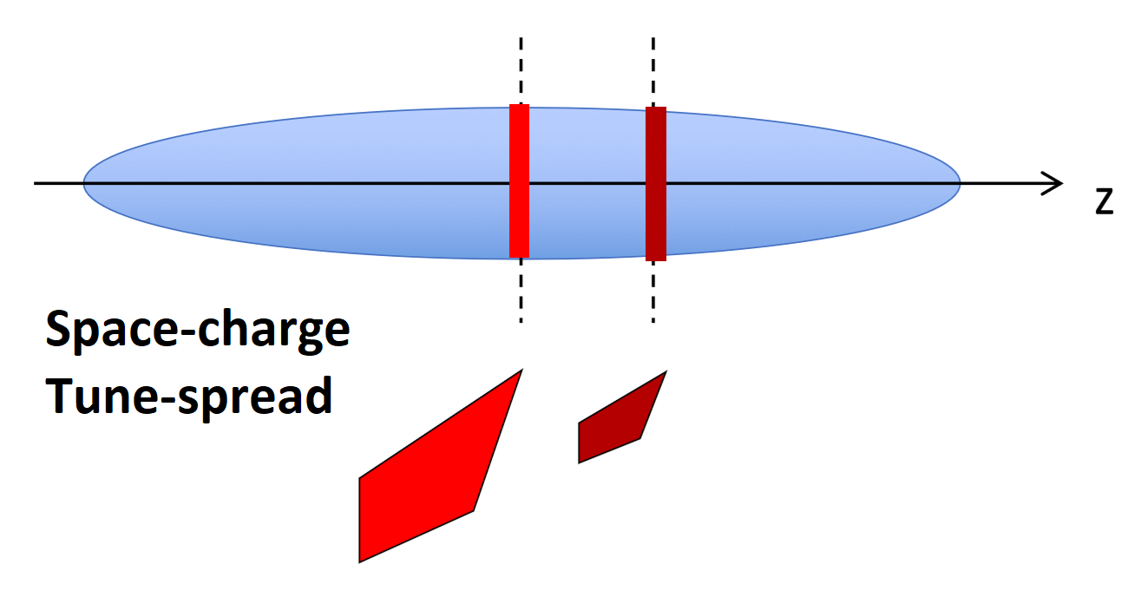
Space-charge Limit
Number of particles
Bunching factor
(inverse to bunch length)
Laslett Spacecharge
Tuneshift parameter:
Form factor
(deviation from round gaussian)
Transverse emittance
(prop to beam-size squared)
Relativistic β,γ factors
20
J. Eldred Transverse Dynamics Accelerators
Notes:
20
20
20
20

Slide 21
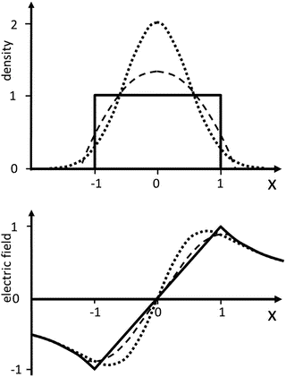
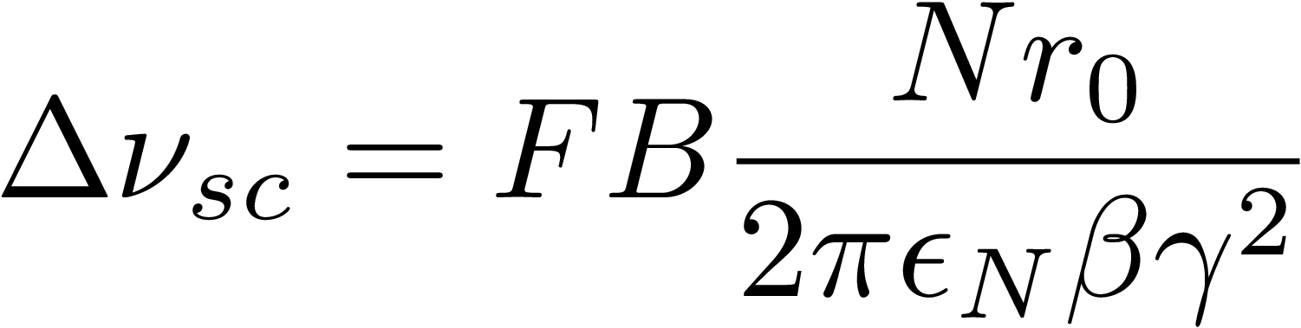
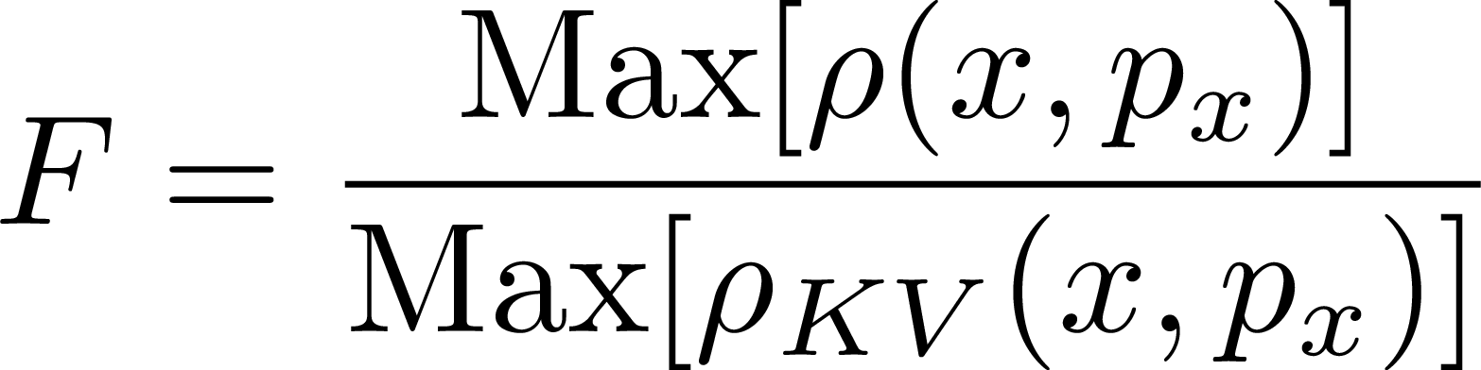
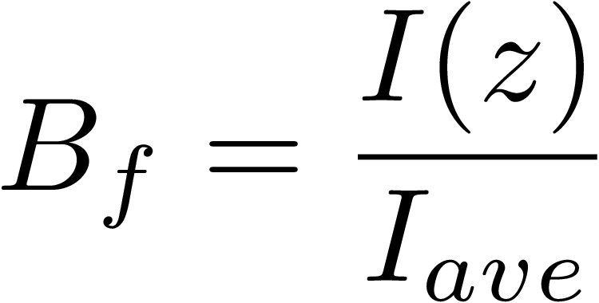
Space-charge Tune-shift for other Round Beams
“Laslett” Space-charge Tune-shift:
Form Factor F:
For a KV beam, F = 1, gauss F=1/2.
Bunching Factor B:
For a DC beam, B = 1.
For a partially filled ring, divide by fill factor.
21
Classical Mechanics and Electromagnetism | January 2021 USPAS
Notes:
21
21
21
21

Slide 22
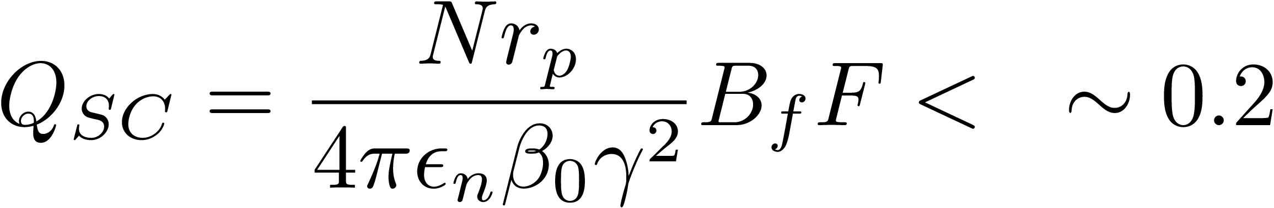
Space-charge Limit
Number of particles
Bunching factor
(inverse to bunch length)
Laslett Spacecharge
Tuneshift parameter:
Form factor
(deviation from round gaussian)
Transverse emittance
(prop to beam-size squared)
Relativistic β,γ factors
Bunching factor B_{f} means that the smaller the bunch length the more intense the space-charge force! Going from 2us to 2ns a major challenge
However also scales with γ² , so accumulating at 5-10 GeV instead of at 0.4-1 GeV helps counterbalance.
Increasing emittance ε_{N} is effective, but not cost-free for AR/CR design. Furthermore, we can’t support an arbitrarily large spot size or divergence on muon production target.
More compact ARs and CRs are more effective, but can we use superconducting magnets in a messy charge-dominated ring?
22
J. Eldred Transverse Dynamics Accelerators
Notes:
22
22
22
22

Slide 23
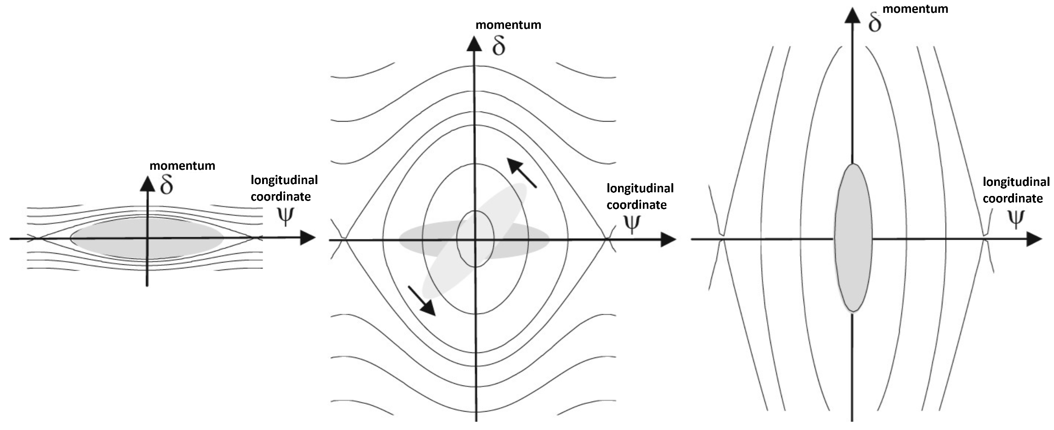
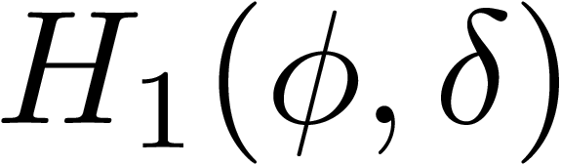
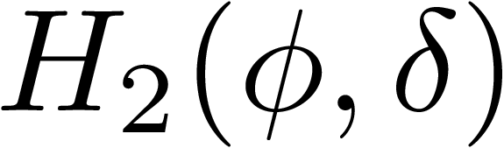
Snap Bunch Rotation in Phase-Space
1) Start with as low as momentum spread beam as possible.
2) Jump up the voltage as high as possible as quickly as possible.
3) Particles follow new phase-space contours to rotate 1/4 synch period.
Only the particles near the center full rotate, RF flattening may help.
There are also resonant schemes (modulate voltage at 1/2 synch period).
23
J. Eldred Transverse Dynamics Accelerators
Notes:
23
23
23
23

Slide 24
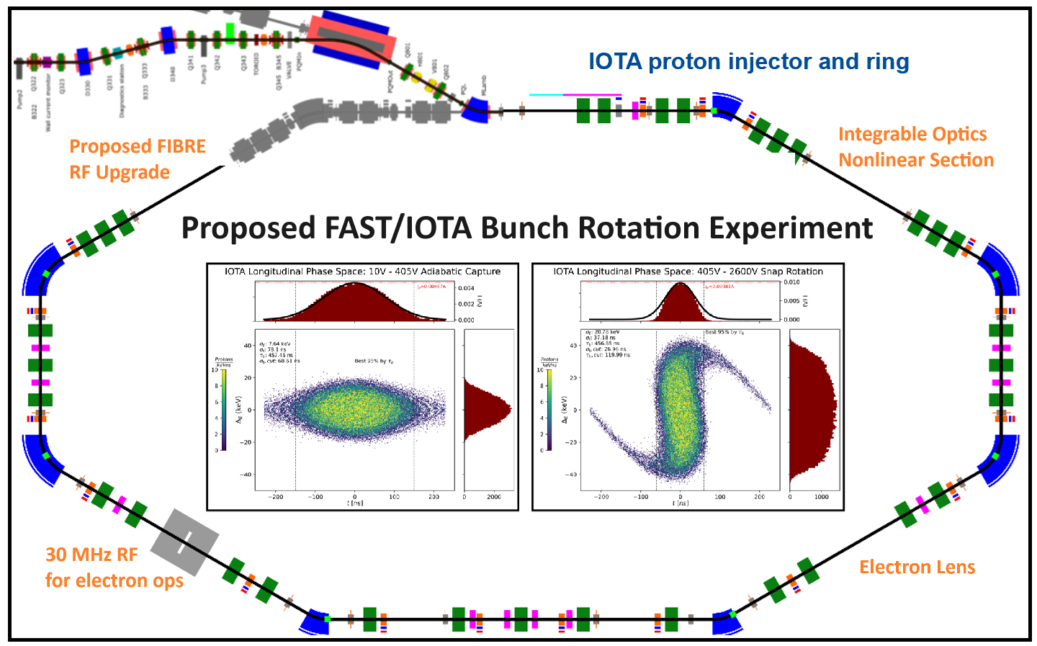
Bunch Rotation & Strong Space-charge (R&D)
Proposed FAST/IOTA Bunch Rotation Experiment (FIBRE)
- Space-charge R&D is a primary purpose of IOTA.
- Optimize bunch rotation in an extreme space-charge environment.
- Just needs a ~10 kV ~2.2 MHz RF cavity.
See poster from Ben Simons (NIU) for FAST/IOTA.
Other facility options … ORNL SNS, RAL ISIS, FNAL Booster, GSI SIS…
Talk from Austin Hoover (ORNL) in Muon Collider meeting.
- They have the RF, MW beams, new HEP application for BES facility.
24
J. Eldred Transverse Dynamics Accelerators
Notes:
24
24
24
24

Slide 25
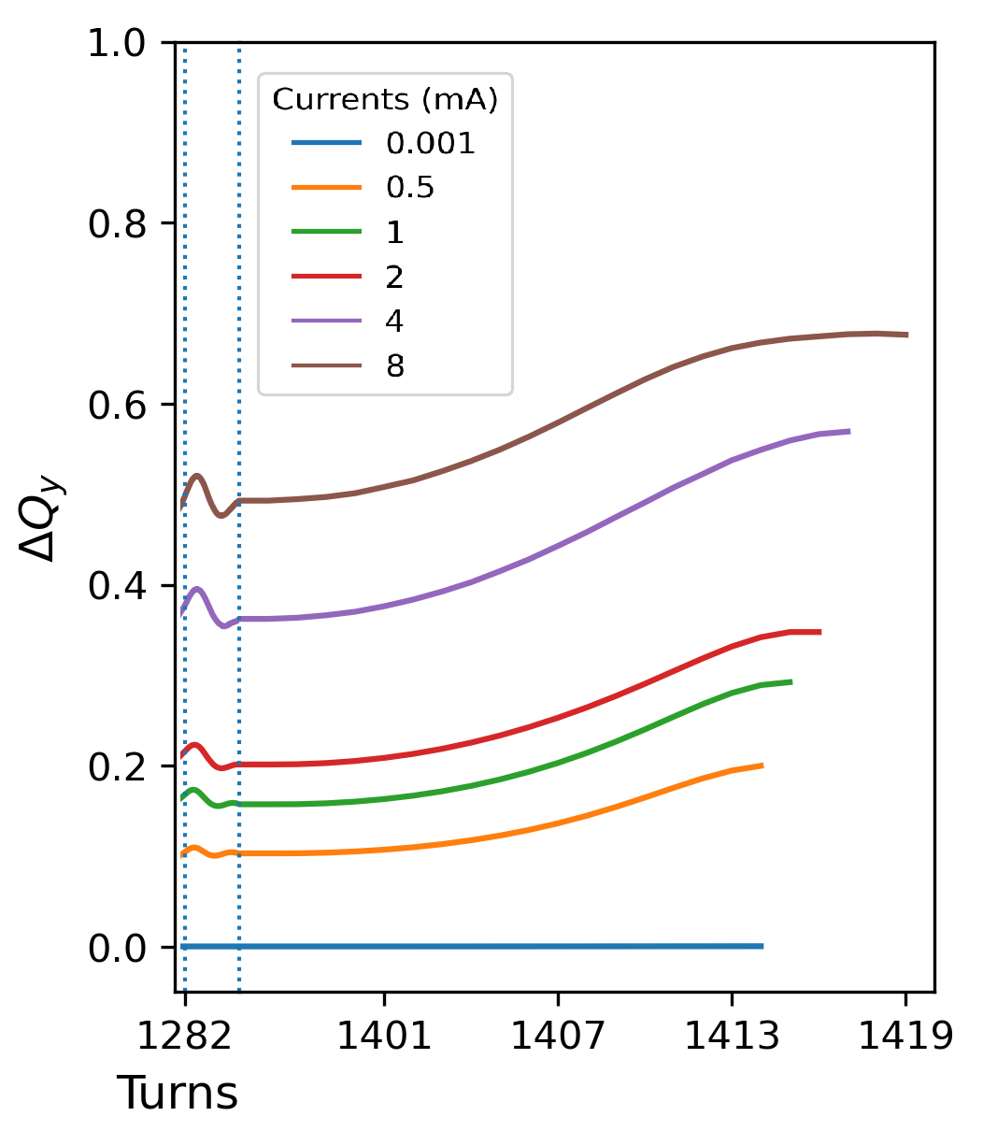
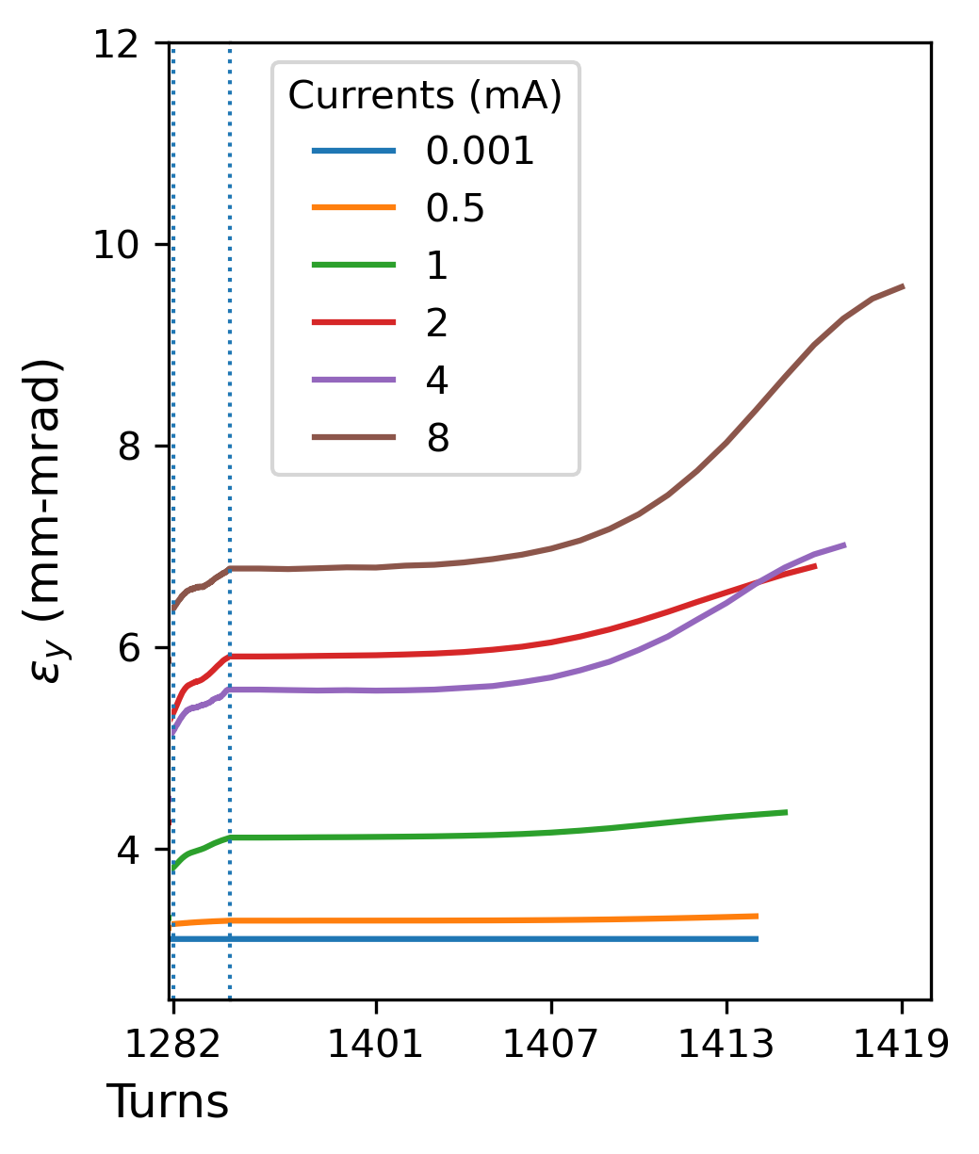
Bunch Rotation & Strong Space-charge (Simulation)
Preliminary Results! Simons 2025
Can push the Laslett parameter into extreme values with manageable impact on transverse emittances. Rotation occurs in tens of us!
25
J. Eldred Transverse Dynamics Accelerators
Notes:
25
25
25
25

Slide 26
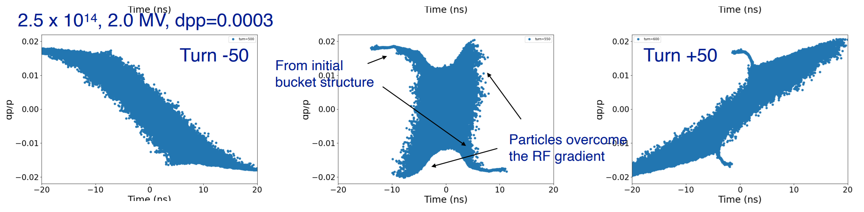
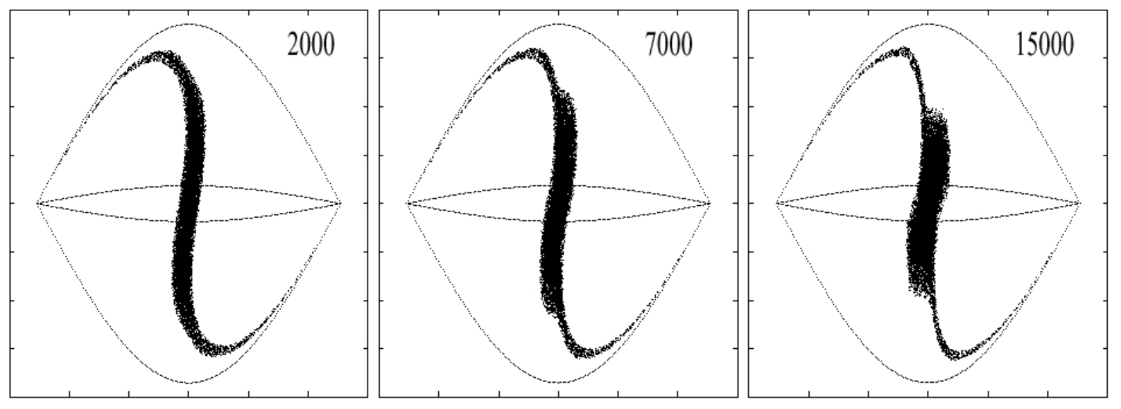
Bunch Rotation & Longitudinal SC
Shinji Machida, Proton Driver simulation 2025
Ng Simulation of IUCF in 2001
26
J. Eldred Transverse Dynamics Accelerators
Notes:
26
26
26
26

Slide 27
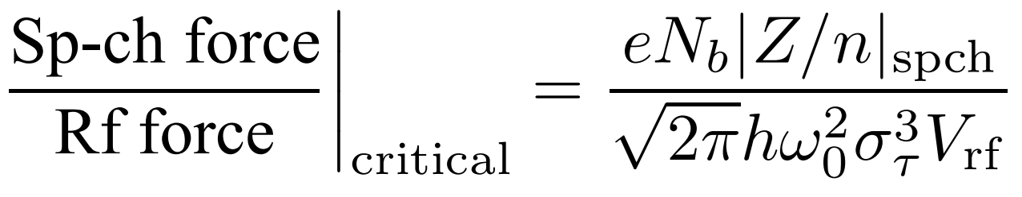
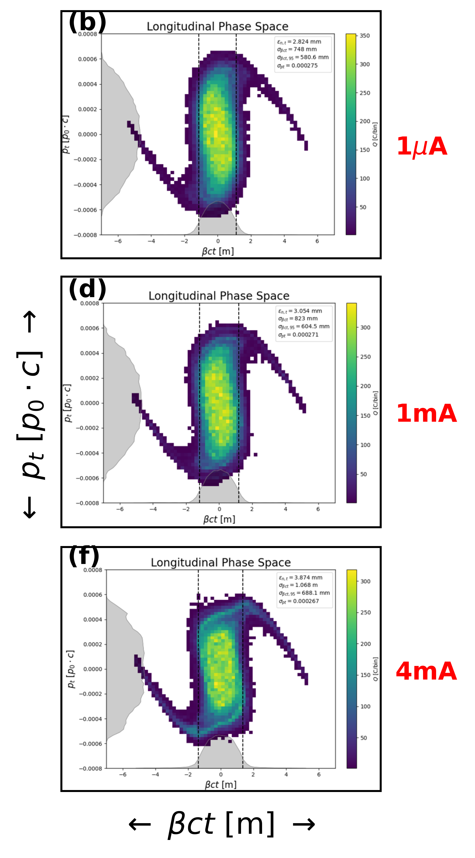
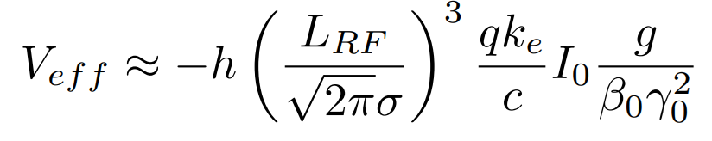
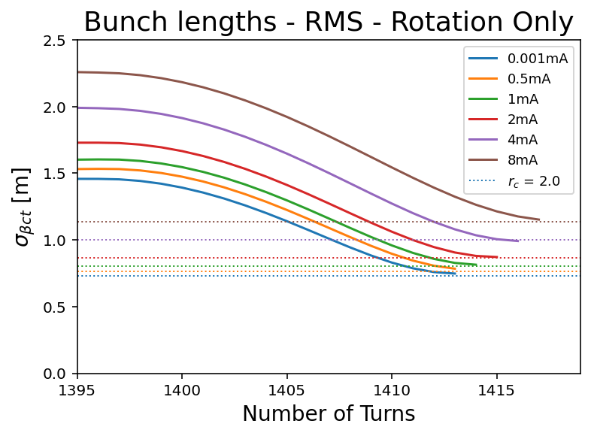
Bunch Rotation & Longitudinal SC
Effective Longitudinal Focusing/defocusing
Simons 2025
27
J. Eldred Transverse Dynamics Accelerators
Notes:
27
27
27
27

Slide 28
Bunch Rotation & Phase-slip factor
Should the phase-slip factor of the CR be large or small?
Large η
- Most extreme SC occurs briefly.
- Mode-coupling instabilities are suppressed
- Higher voltage requirements allow more extreme bunch compression, needs more RF.
- Less bunch compression requiremes more of Linac/AR.
Small η
- Beam should be SC stable.
- Wake effects accumulate from head to tail of bunch.
- Lower voltage requirements allow more extreme bunch compression given RF power
- More bunch compression relaxes requirements on Linac/AR
My conclusion? We will need to keep studying both.
If the gains of larger η can be realized, it is worth it.
28
J. Eldred Transverse Dynamics Accelerators
Notes:
28
28
28
28

Slide 29
29
29
Combiner & Target
29
J. Eldred Accelerator Overview for FNAL CCI Program
Notes:
29
29
29
29
29
29

Slide 30
Combiner Geometry
The combiner puts each bunch on a different path, so that the time of flights have all bunches coincide
Each arc is roughly half the circumference C/2 of the AR/CR.
Then if N bunches fill up roughly f of the circumference, then the straight sections of the combined must each by fC/2.
So the total length of all transfer lines is NC/2 + fC.
For modest numbers f =0.25, C=300m, N=4, that’s 675m of accelerator.
Not much RF needed, but more than double the magnet/tunnel costs.
It will be worth if it can lower the linac or the CR/AR costs, or improve overall performance.
30
J. Eldred Transverse Dynamics Accelerators
Notes:
30
30
30
30

Slide 31
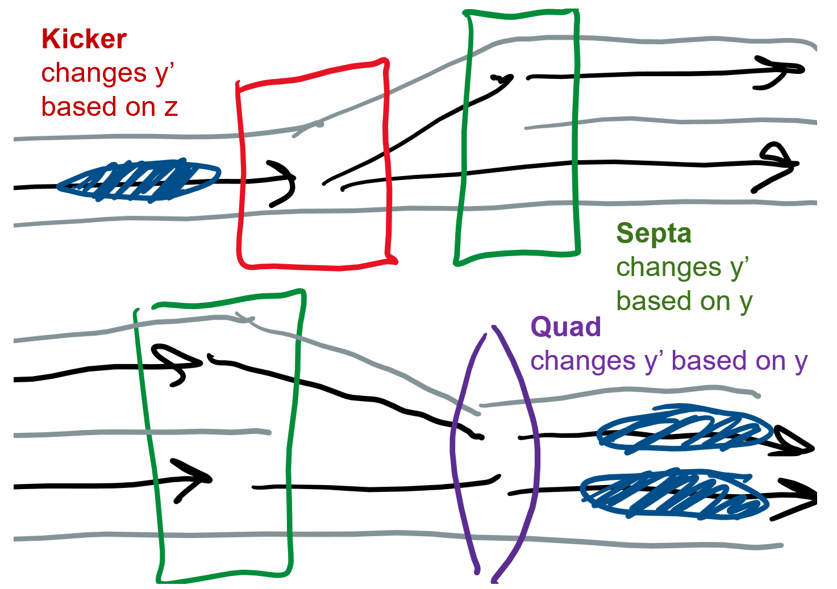
Combiner Transverse Optics
31
J. Eldred Transverse Dynamics Accelerators
Notes:
31
31
31
31

Slide 32
Impact of Multiple Bunches
You cannot use a combiner to cheat Louiville’s theorem, so the implications of using more bunches is that each bunch is narrower.
What are the implication of using many bunches in a combiner?
- Technical complexity and cost of combiner line.
- Emittance growth from combining bunches.
- Transverse aperture in CR and AR smaller, lower costs.
- Less SC during bunch compression process.
- Linac beam injects into a large azimuth of AR, which means that a smaller bunch charge for the same macropulse average current.
My Conclusion? More bunchest may help, but don’t use any more than you have to do in order to achieve performance goals.
32
J. Eldred Transverse Dynamics Accelerators
Notes:
32
32
32
32

Slide 33
33
33
Summary & Questions
33
J. Eldred Accelerator Overview for FNAL CCI Program
Notes:
33
33
33
33
33
33

