Slide 1
2025 Summer School μ⁺-μ⁻ Collider Front End
David Neuffer

Slide 2
0utline
Muon Collider Front End
  General introduction
    Muon Collider scenarios
    Early versions → MAP → IMCC →
  Capture and decay from target
  Bunching and φ-E rotation
  Match into Initial Cooling

Slide 3
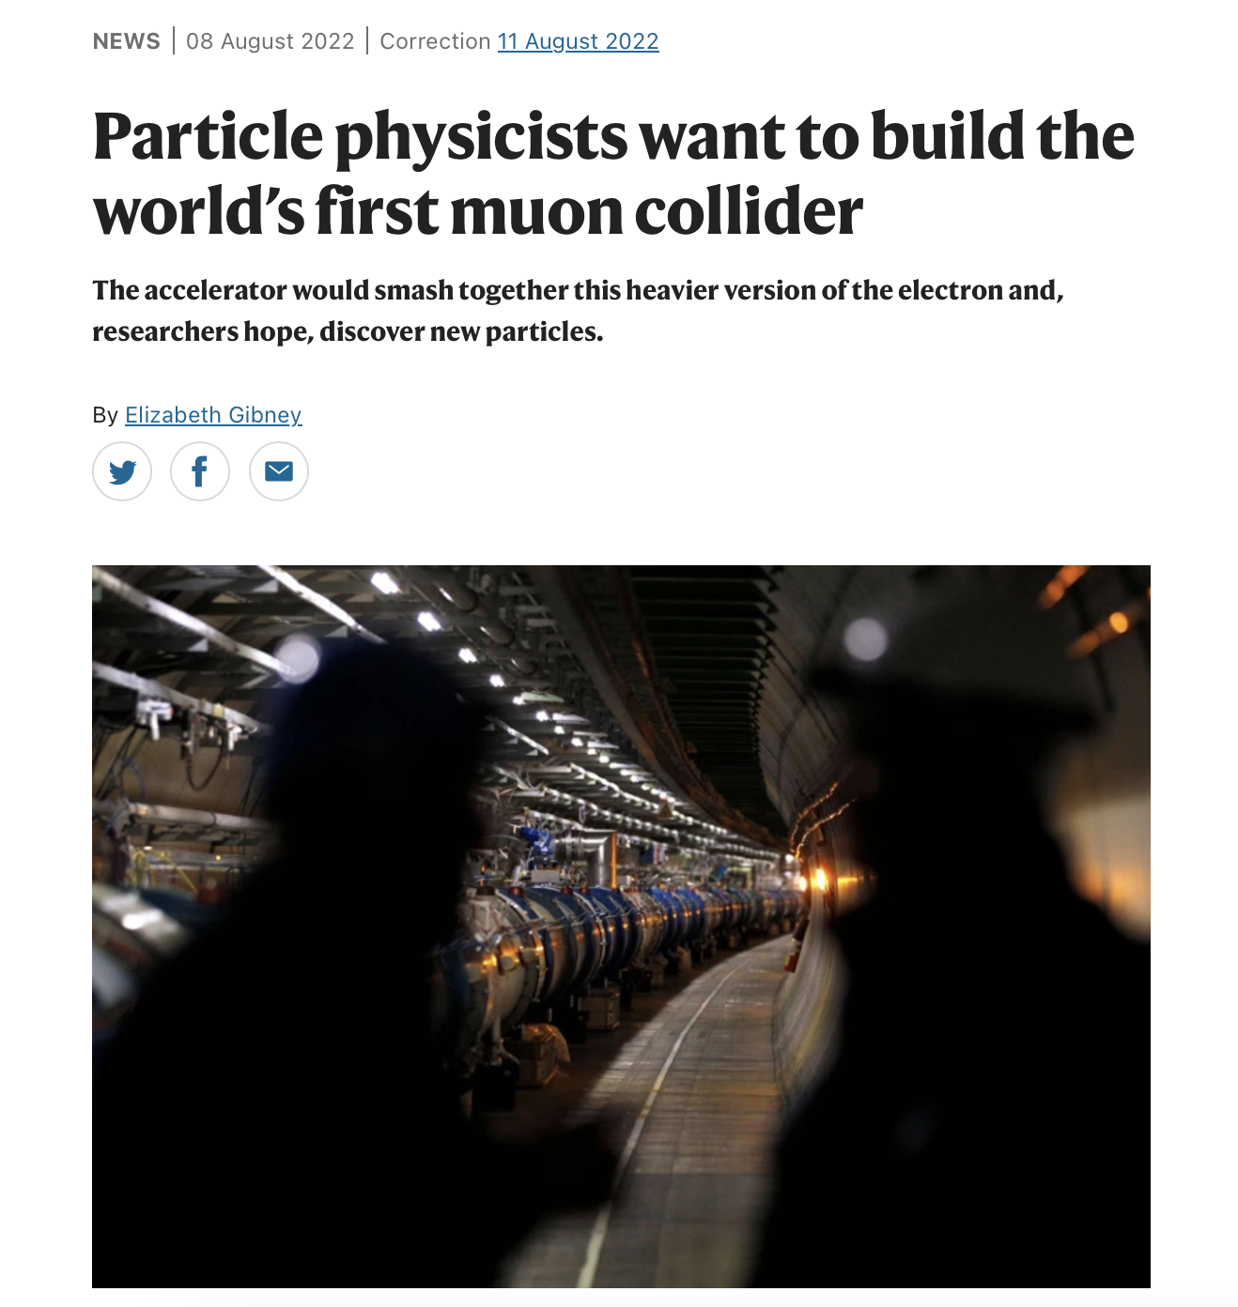


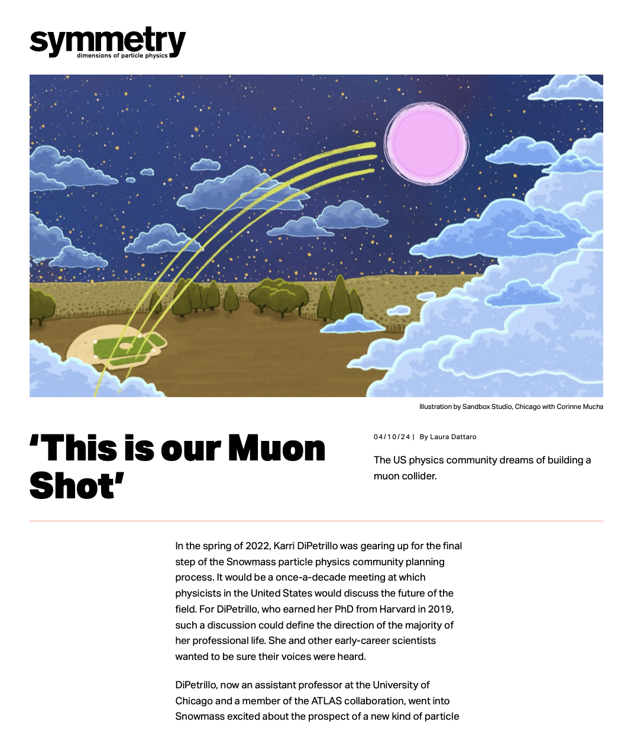
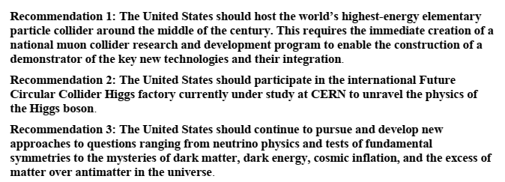
2023 P5 Report – 2025 NAS recommendation
Muon Fever ?

Slide 4
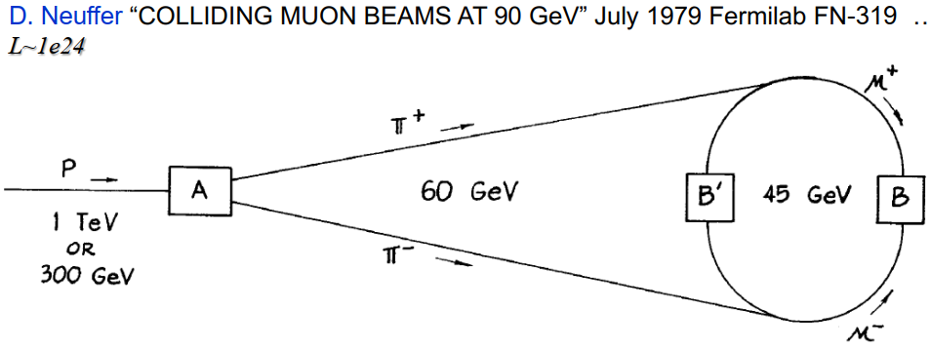
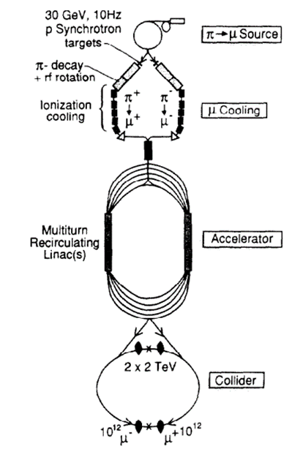
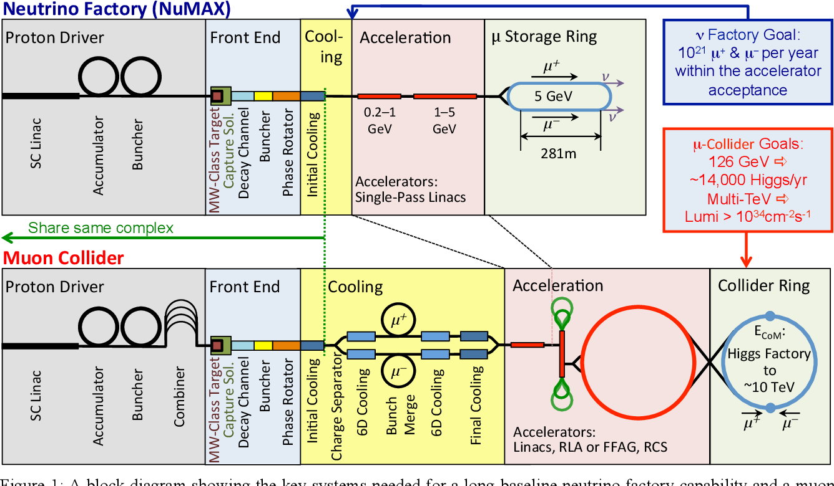
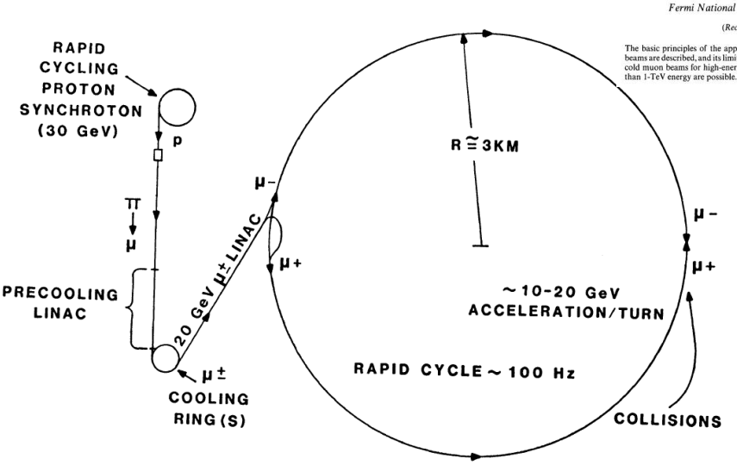
Muon Collider Evolution 1979-2015
“difficult but perhaps not impossible”

Slide 5
Collider development
1983→1994→2014 (MAP)
Proton Driver
  RCS → Linac + Storage rings
Front End & Cooling
Li lens -> solenoids
> ring coolers > rectilinear
Acceleration
  RCS →
  Recirculating Linacs →
  Rapid Cycling Hybrid Synchrotrons→
Collider
  4 TeV → 10 TeV
    8T → ~16 T

Slide 6
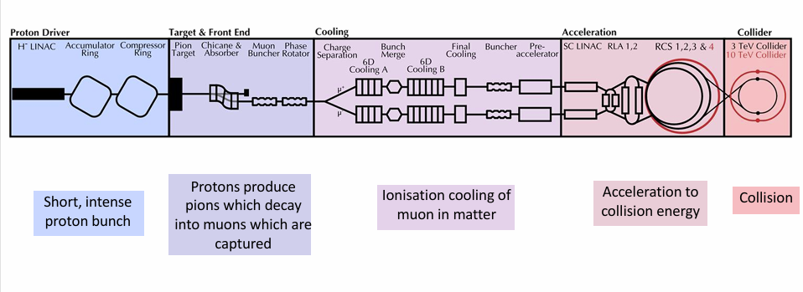
MAP → IMCC versions
Front End –protons → captured muon bunches

Slide 7
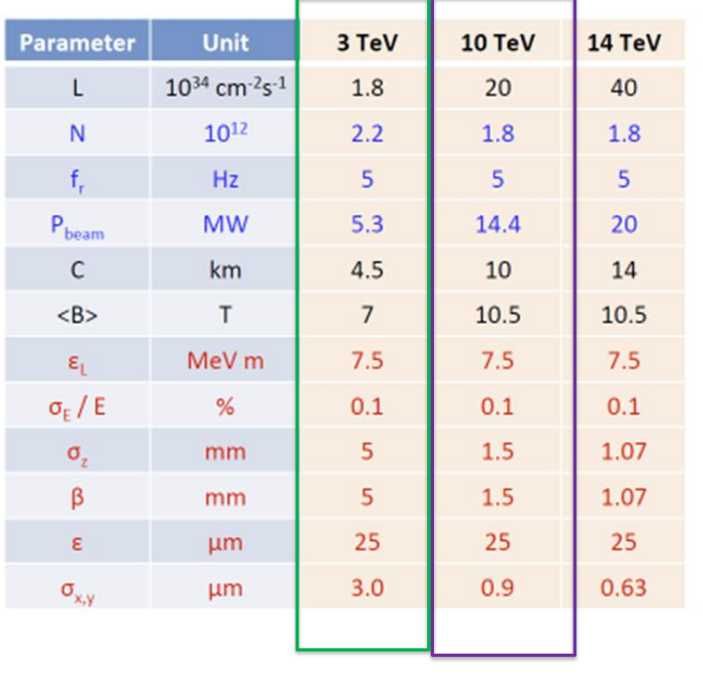

Slide 8
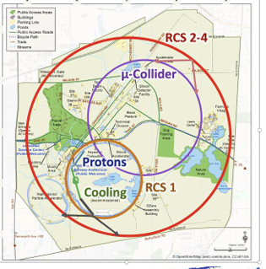
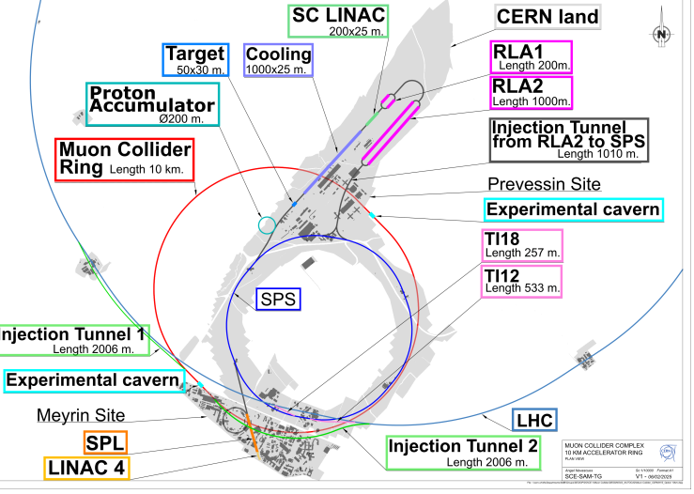
Muon Collider Layouts
~3—10 TeV

Slide 9
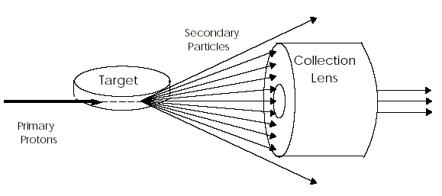
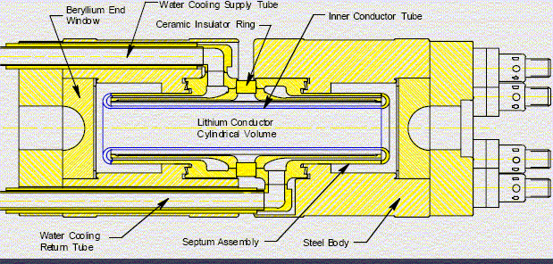
π capture from target
Protons on target produce large number of π’s
  Broad energy range (0 to 10+GeV)
  More at lower energies
  Transverse momentum
  (up to ~0.3GeV/c)
Capture beam from target
Options:
  Li lens
  Magnetic horn
  Magnetic Solenoid

Slide 10
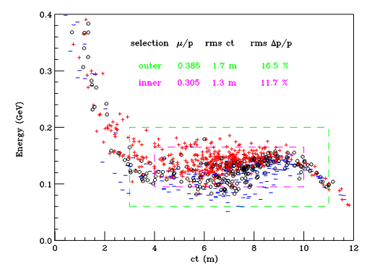
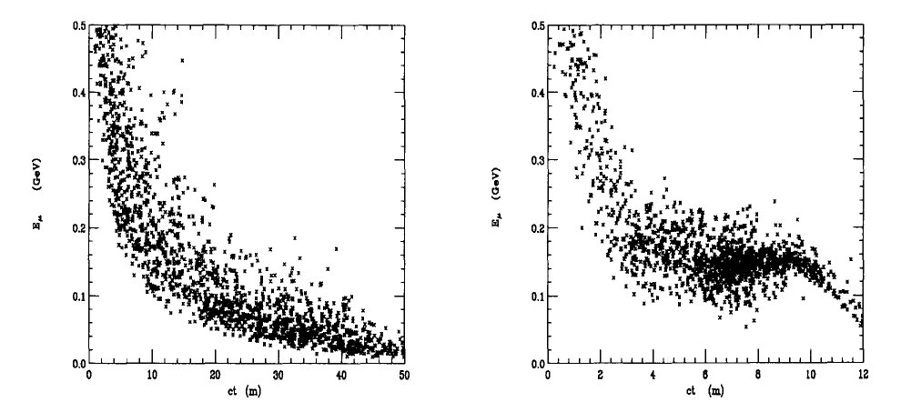
Front end goal
Take Broad π distribution from target
  Capture transversely
    Transverse focusing
  Capture longitudinally
    Start with short proton bunch
    Drift to develop z-E correlation (π→μ + ν)
    Use “RF” to reduce Energy Spread
    30 MHz

Slide 11
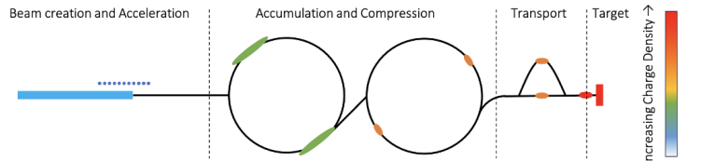
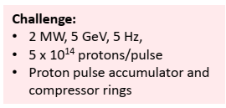
Proton Driver
Intense proton bunches (L < ~1 m)
PIP-II Fermilab or CERN SPL
RCS solutions possible
  J-PARC can deliver similar bunch intensities
5--10 GeV H⁻ Linac

Slide 12
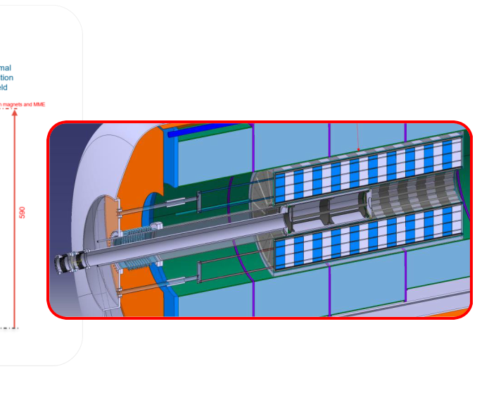
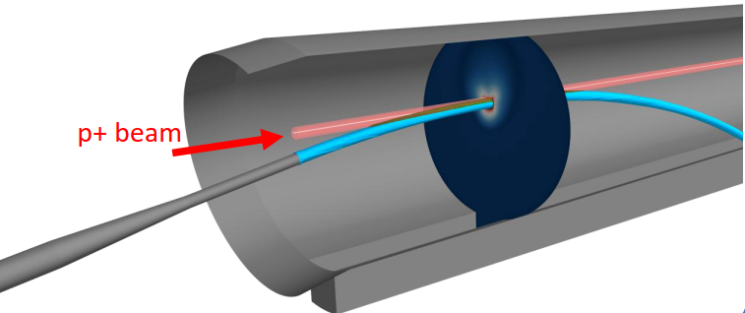
Target needed (Zwaska)
Target must accept ~ 2 -4 MW beam at 5—10 Hz
  ~0.5 MJ pulses
Target Options
  C – Graphite targets
    He cooled ?
  Heavy Liquid Metal (Pb/Hg/?) & fluidized W targets
  Or ???

Slide 13
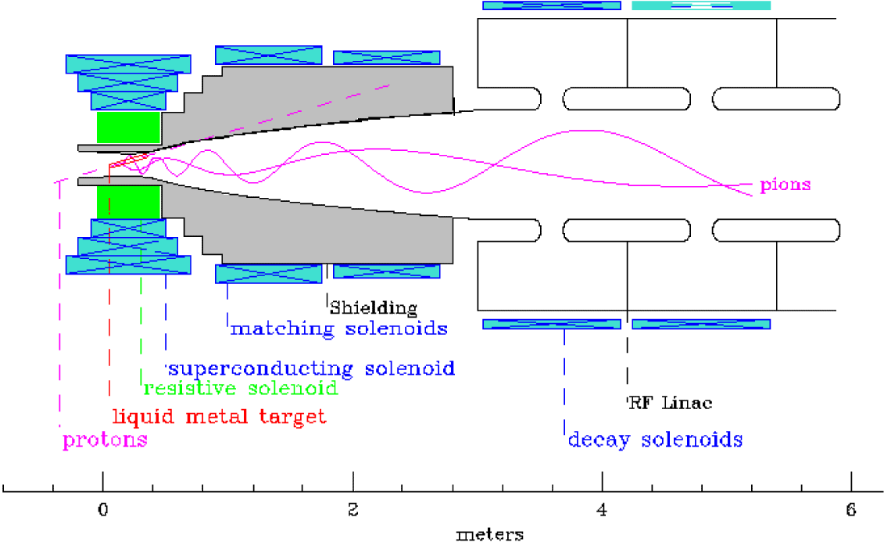
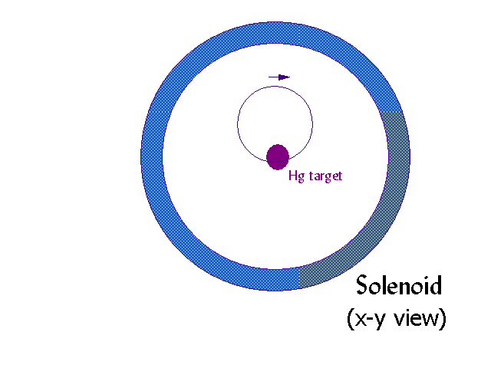
Solenoid lens capture
Target is immersed in high field solenoid
Particles are trapped in Larmor orbits
  Produced with p = p‖, p⊥
  Spiral with radius r = p⊥/(0.3 B_{sol})
  Particles with p⊥ < 0.3 B_{sol}R_{sol}/2 are trapped
  p_{⊥,max} < 0.225 GeV/c for B=20T, R_{sol} = 0.075m
  Focuses both + and - particles

Slide 14
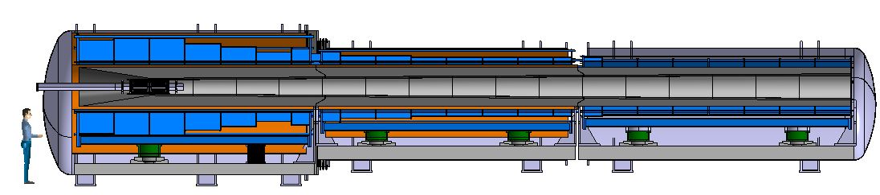
Solenoid transport
Magnetic field adiabatically decreases along the transport
Transverse momentum decreases
  Busch’s theorem: B rorbit² is constant
  B=20T→2T (r=3.75cm →= 12cm)
  P⊥ = 0.225→0.07GeV/c
Emittance = ~σx σpx/105.66
  ~6cm×35 MeV/c/105.66≅0.02m
P remains constant (P‖ increases)
Transport designed to maximize π→μ acceptance

Slide 15
Homework problem
How many 10 GeV protons per second are in a 4 MW beam? With 5 Hz bunches, how many protons/bunch?
If beam of 10 GeV protons produces, on average, one pion pair per proton with mean momentum of 250 MeV/c (per pion), what percentage of the proton beam kinetic energy is converted to pions?
If the target is surrounded by a 20T solenoid with a 5 cm radius aperture, what maximum transverse momentum of pions is accepted?
If B is adiabatically reduced to 2.5T what is the resulting transverse momentum and beam orbit size?

Slide 16
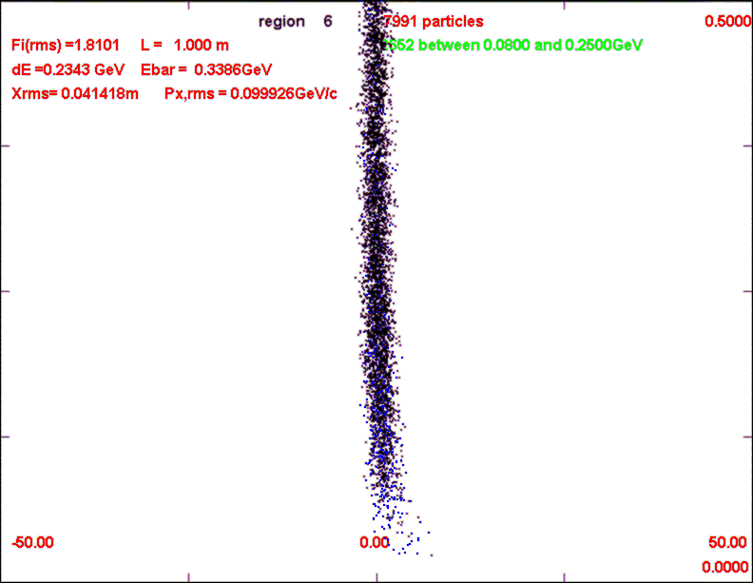
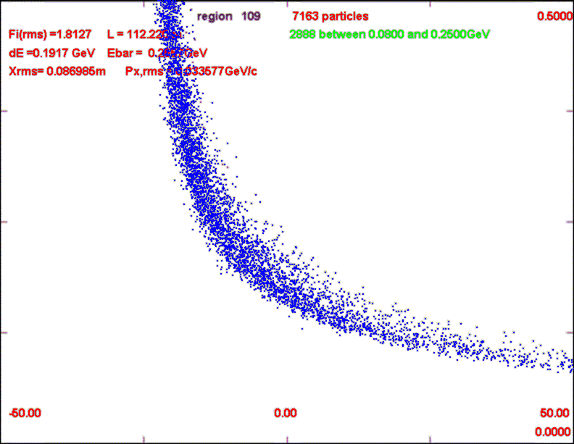
Longitudinal Capture
Phase-energy rotation
Beam is initially short in length
  Bunch on target is 1 to 3 ns rms length
As Beam drifts down beam transport, energy-position (time) correlation develops:
Goal:
  Accelerate “low-energy tail”
  Decelerate “high-energy head:
  Obtain long bunch
    with smaller energy spread
Requires rf
  Single bunch – low-frequency rf 10MHz
  Multi bunch high-frequency rf
0.5GeV/c
L=1m
0
L=112m
rf
-50m
δL
50m

Slide 17
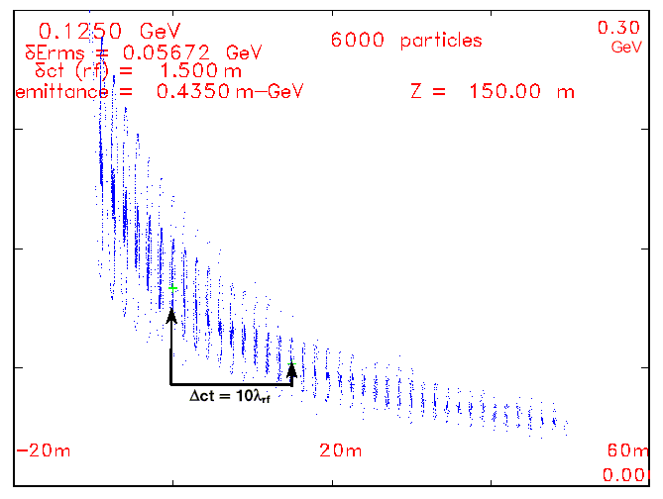
Adiabatic Buncher overview
Want rf phase to be zero for reference energies as beam travels down buncher
Spacing must be N λ_{rf} ⇒λ_{rf} increases (rf frequency decreases)
Match to λ_{rf}= ~1.5m at end:
Gradually increase rf gradient
(linear or quadratic ramp):
Example: λrf : 0.90→1.5m

Slide 18
Adiabatic Buncher example
Adiabatic buncher (z=90→150m)
Set T₀, δ(1/β):
  125 MeV (205.04 MeV/c), 0.01
In buncher:
Match to λ_{rf}=1.5m at end:
zero-phase with 1/β at integer intervals of δ(1/β) :
Adiabatically increase rf gradient:
λrf : 0.90→1.5m

Slide 19
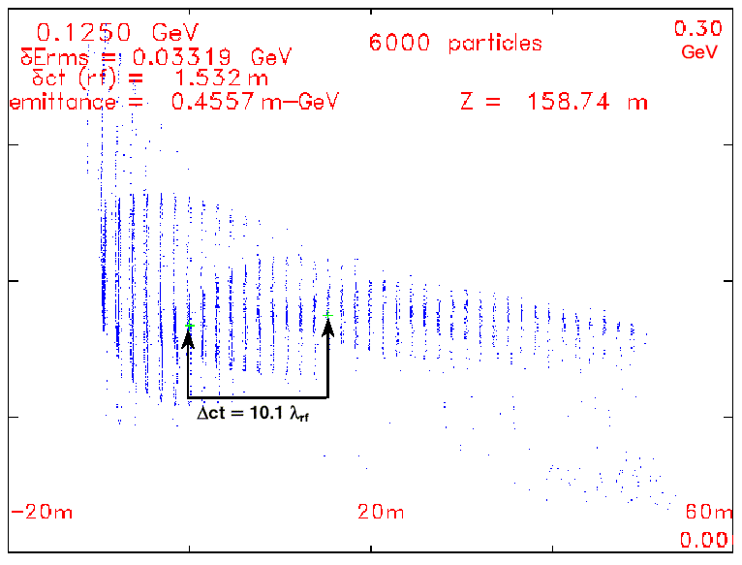
φ−δΕ Rotation
At end of buncher, change rf to decelerate high-energy bunches, accelerate low energy bunches
Reference bunch at zero phase, set λ_{rf} less than bunch spacing
(increase rf frequency)
Place low/high energy bunches at accelerating/decelerating phases
Can use fixed frequency (requires fast rotation) or
Change frequency along channel to maintain phasing “Vernier” rotation –A. Van Ginneken

Slide 20
Fast “Vernier” φ−δΕ Rotation
At end of buncher, choose:
  Fixed-energy particle T₀
  Second reference bunch T_{N}
  Vernier offset δ
Example:
  T₀ = 125 MeV p=205 MeV/c
  Choose N= 10, δ=0.1
  T₁₀ starts at 77.28 MeV p=150MeV/c
  Along rotator, keep reference
  particles at (N + δ) λ_{rf} spacing
  φ₁₀ = 36° at δ=0.1
  Bunch centroids change:
Use E_{rf} = 10MV/m; L_{Rt}=8.74m
  High gradient not needed …
  Bunches rotate to ~equal energies.
λrf : 1.485→1.517m in rotation;
λrf = Δct/10 at end
(λrf → 1.532m)
Nonlinearities cancel:
T(1/β) ; Sin(φ)

Slide 21
“ICOOL” Adiabatic φ−δΕ Rotation
At end of buncher, choose:
  reference particle T₀
  Reference bunch T_{N} (N bunches from 0)
  V’ rf gradient, offset δN
Example:
  T₀ = 125 MeV
  Choose N= 10, δN=0.1
    T₁₀ starts at 77.28 MeV
In ICOOL
  T₀ = T₀ + E₀'z…
  T_{N} =T_{N} + E_{N}' z
  Rotate until T₀ ≅ T_{N}
Along rotator, keep reference particles at (N + δN) λ_{rf} spacing
  E_{N}' ≅eV' sin(2πδ)
λ_{rf} ~1.4 to 1.5 m over rotation
~Adiabatic
Particles remain in bunches as bunch centroids align
Match into 201.25 MHz Cooling System

Slide 22
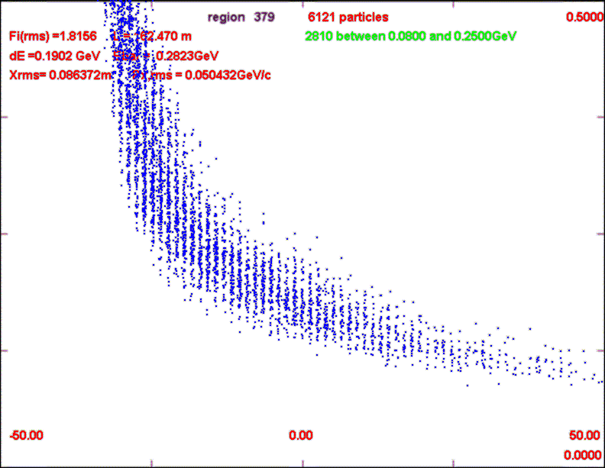
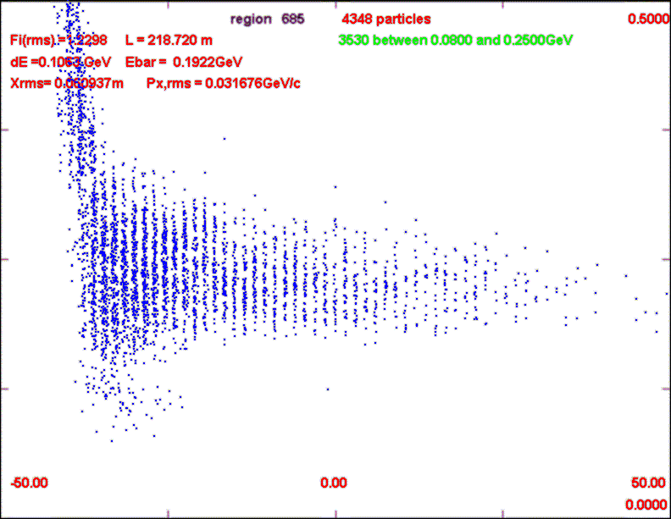
Simulation results
0.5
GeV/c
0
-50m
50m

Slide 23
High-frequency Buncher + φ−δΕ Rotation(2011)
p
π→μ
FE Target
Solenoid
Drift
Buncher
Rotator
Cooler
18.9 m
~60.7 m
~33m
42 m
~80 m
Drift (80m)
  Allows π→μ beam to decay;
  beam develops φ−δΕ correlation
Buncher (~333→230MHz)
  Bunching rf with E₀ = 125 MeV, δ(1/β) = 0.01 { L × δ(1/β) =~1.5m at L_{tot} = 150m}
  V_{rf} increases gradually from 0 to ~6 MV/m
φ−δΕ Rotation (~233→200MHz)
  Adiabatic rotation
  V_{rf} =~10 MV/m
Cooler(~100m long) (~200 MHz)
  fixed frequency transverse cooling system
Replaces Induction Linacs with medium-frequency rf (~200MHz) !
Captures both μ⁺ and μ⁻ !!

Slide 24
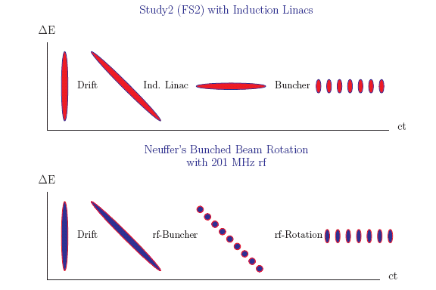
MAP-325 MHz System
Drift
  20T→ 2T
Buncher
  P_{o}=250MeV/c(1/β = 1.08564)
  P_{N}=154 MeV/c(1/β= 1.2127); N=12
  V_{rf} : 0→ 15 MV/m
  f_{RF} : 490→ 365MHz
Rotator
  V_{rf} : 20MV/m
    (2/3 occupied)
  N=12.045
  P_{0,} P_{N}→245 MeV/c
Cooler
  FOFO, 325 MHz, 25 MV/m
  2 1.5 cm LiH absorbers
  /0.75m

Slide 25
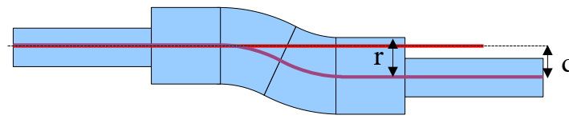
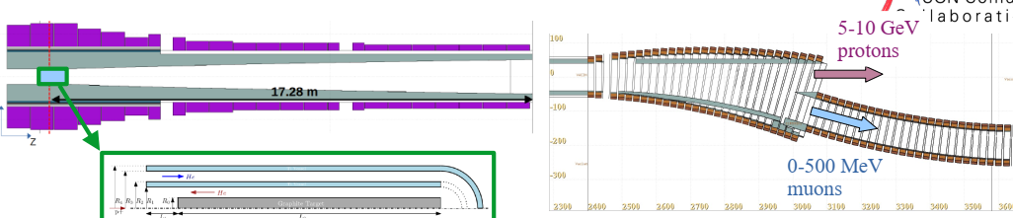
Variation to control losses
Initial front end was open from target to cooler
  Accepts μ⁺, μ⁻ at ~250 MeV/c
  Also accepts everything else
  - p, e⁺⁻
Introduce chicane + absorber to filter out unwanted particles (C. Rogers, et al.)
  Chicane cuts out P > 500 MeV/c
  Absorber stops protons, electrons, pi, ….
    10 cm Be
absorber

Slide 26
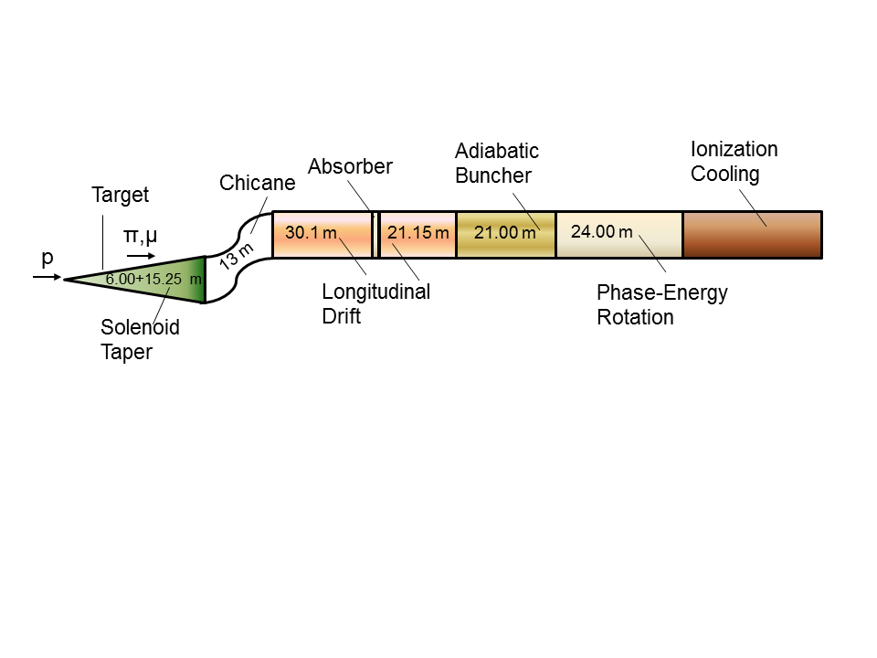
325 “Collider “ w Chicane/Absorber
Chicane + Absorber
Readjust parameters to correct for chicane/absorber
Add 30 m drift after chicane
  *6.5m → +21.67°,-21.67º
Add chicane + absorber
    particle 1-283 MeV/c, particle 2-194 MeV/c
  absorber at 54m
    10cm Be
    particle 1-250 MeV/c, particle 2-154 MeV/c
  Bunch (N=12) 0→15 MV/m :490→ 365 MHz
  Rotate (N=12.045 )– 20MV/m : 365 → 326.5 MHz
  Cool -325MHz -25 MV/m
    p_{ref}=245 MeV/c

Slide 27
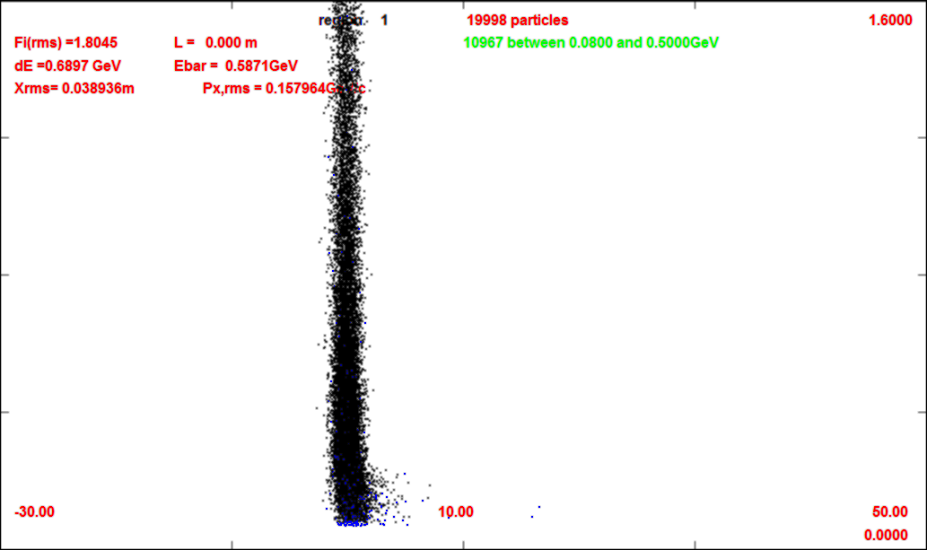
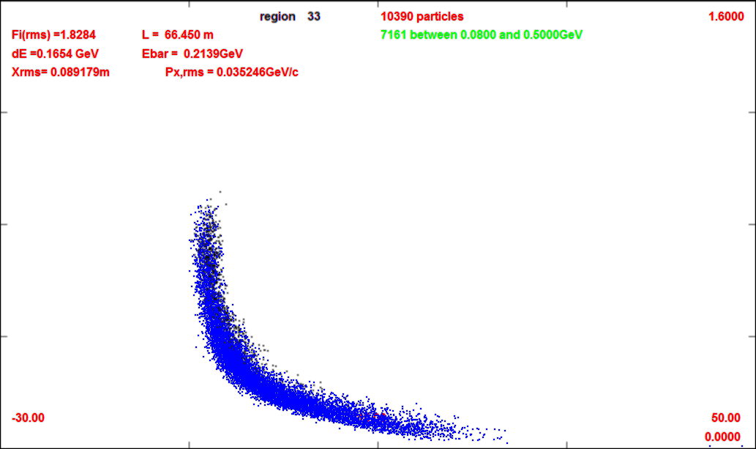
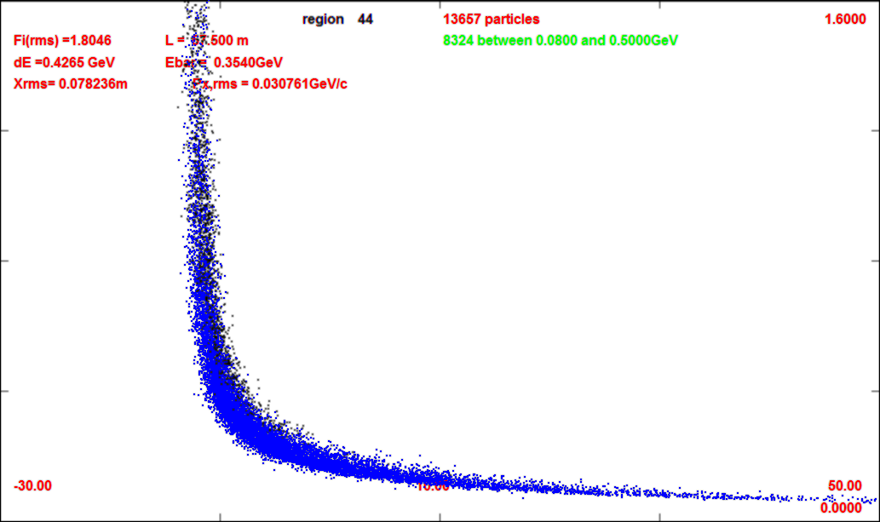
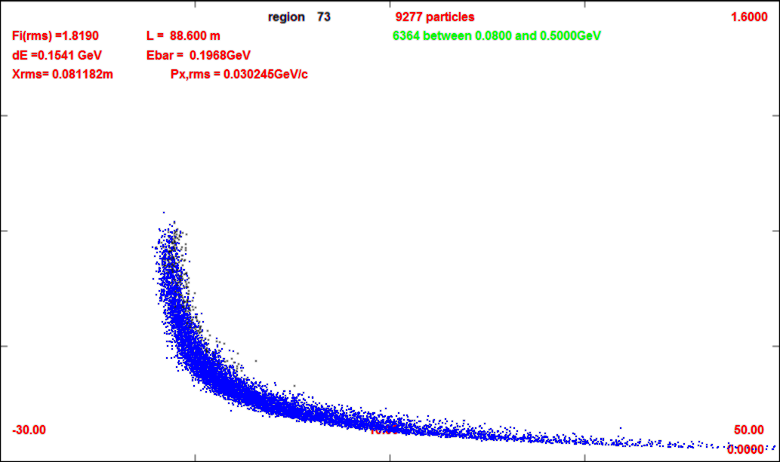
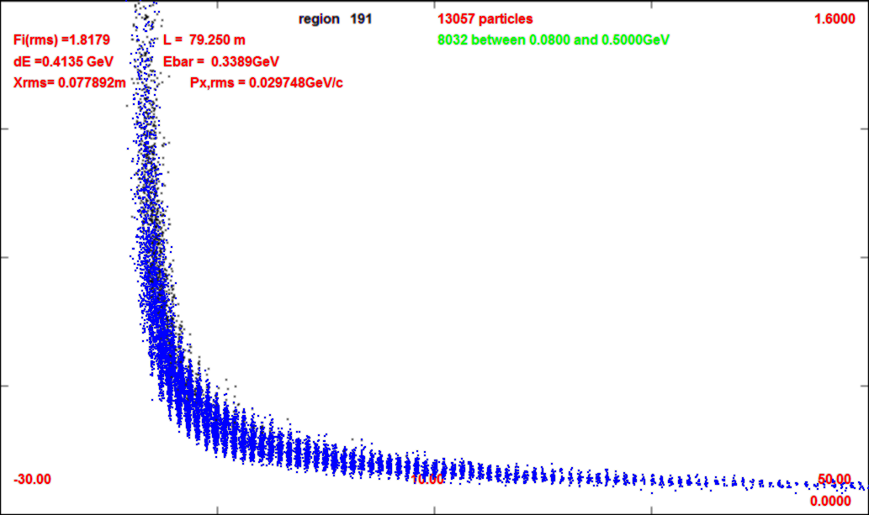
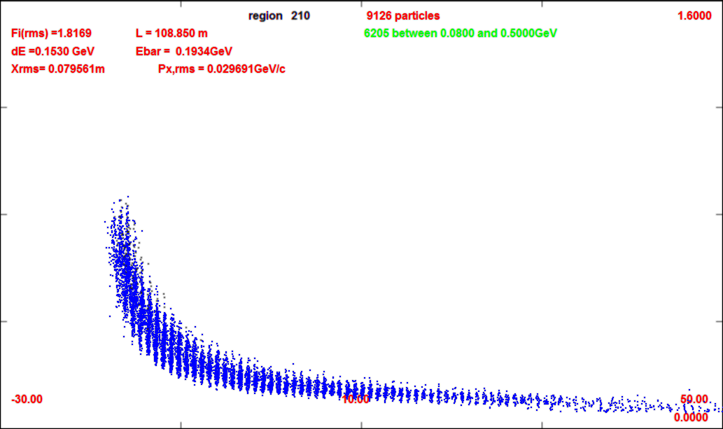
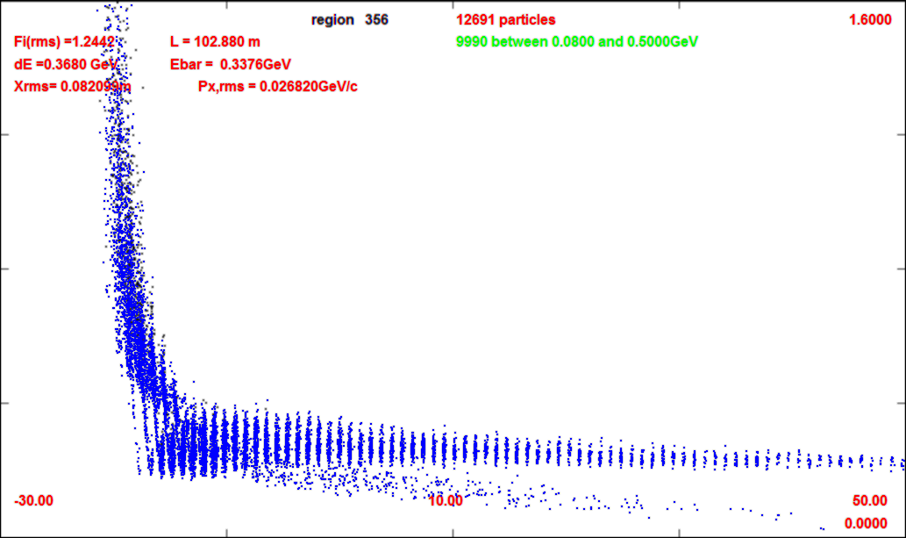
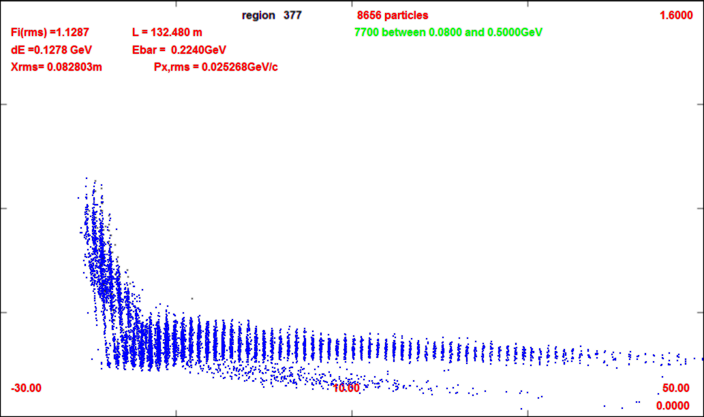
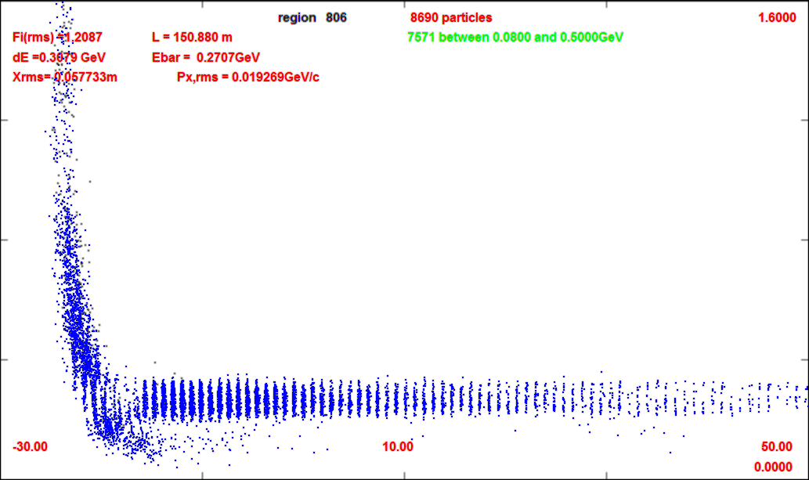
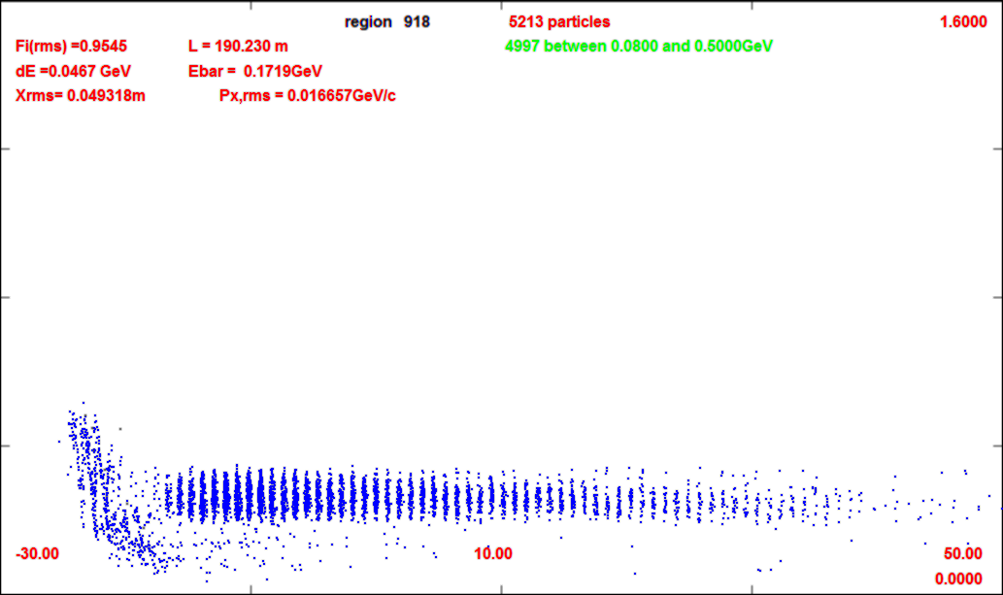
Compare without/with chicane
0m (production target)
-30m
-50m
1600 GeV/c
0m
66m (after chicane/absorber)
1600 GeV/c
0 GeV/c
57m
88m (after drift)
0 GeV/c
109m (after buncher)
79m
102m
-30m
132m (after rotator)
50m
21 bunches for Collider
152m
190m (after cooling)

Slide 28
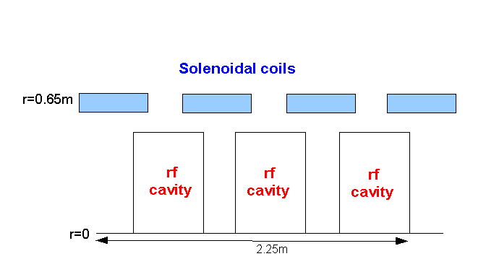
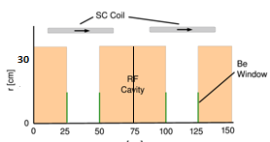
Rf Buncher/Rotator requirements
Buncher -21m
  37 cavities (14 frequencies)
  13 power supplies (~1—3MW)
RF Rotator -24m
  64 cavities (16 frequencies)
  20 MV/m, 0.25m
  ~2 MW (peak power) per cavity
Cooling System – 325 MHz
  200 0.25m cavities (75m cooler), 25MV/m
  ~4MW /cavity
Front End section | Length | #rf cavities | frequencies | # of freq. | rf gradient | rf peak power requirements
Buncher | 21m | 42 | 484 to 365 | 14 | 0 to 16 | 0—1.34 MW/cavity
Rotator | 24m | 56 | 364to 326 | 16 | 20 | ~2.4 MW/cavity
Cooler | 75m | 200 | 325 | 1 | 25 MV/m | ~3.7MW/cavity
Total df+bxr+rttr | ~134m | 93 |  | 30 | ~500MV | 140MW
6-D cooler | 126m | 360 | 325 MHz | 1 | 25 MV/m | ~3.7 MW

Slide 29
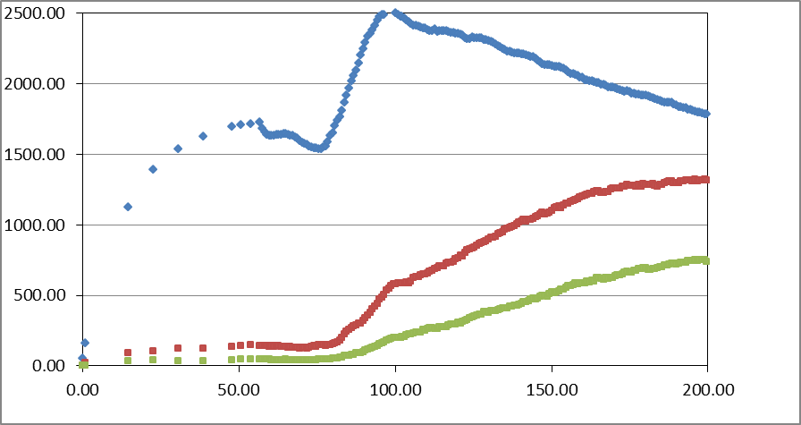
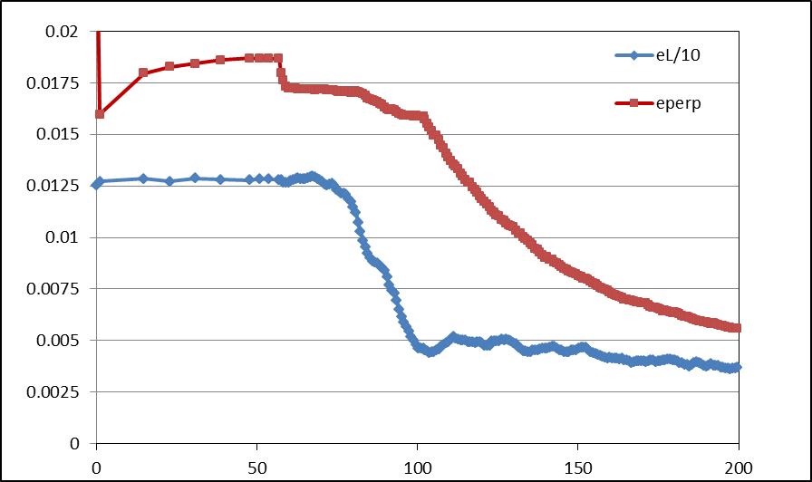
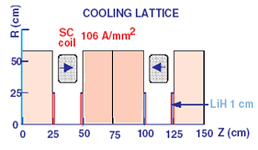
Simulation Results
Simulation obtains
  ~0.12 μ/p within acceptances
FOFO cooling
  Cools transversely
  By factor of 3
    ~10× in 6-D
N :0.15<P<0.35 GeV/c
N: ε_{T}<0.03; A_{L}<0.2
N: ε_{T}<0.015; A_{L}<0.2
Useful
cooling

Slide 30
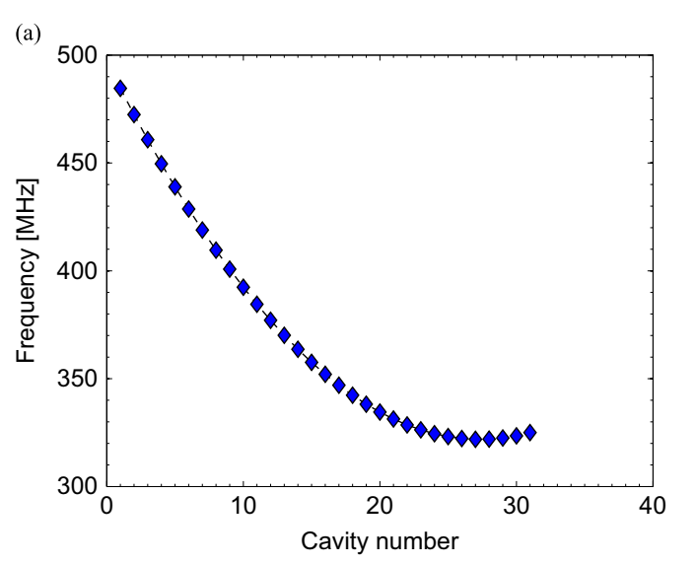
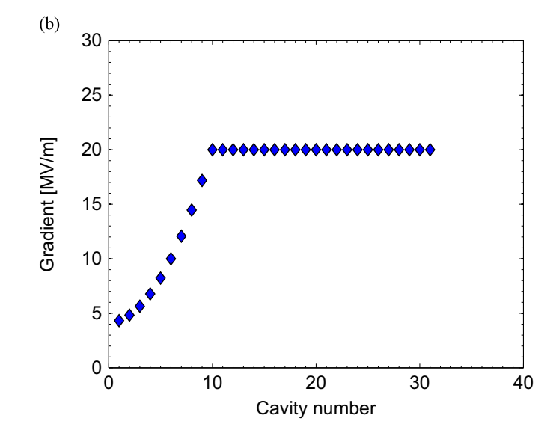
Optimization (H. Kamal Sayed)
H. Kamal Sayed, NIM A 794 (2015) 193–199
Buncher +Rotator-31 cavity sets
  Changed frequency, rf gradient
Optimized using NERSC supercomputer using evolutionary optimization algorithm, 100’s of simulations
  Increase E_{rf} in Buncher
    By ~4 MV/m
    Higher gradient better
  Rf reaches 325 MHz faster …
    Could use shorter system ?
    Could start further downstream
Rotator
Buncher

Slide 31
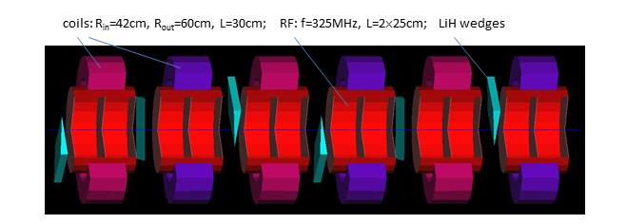


4-D→6-D cooler
Initial version had transverse-only cooler
  FOFO 4-D cooler
Alternative:Helical FOFO snake
  Alternating tilted solenoids
126 m long
  2 cavities every 0.7m
  160 0.25m cavities 25 MV/m
Cools longitudinally and transversely
  ε_{L} × 1/3, ε₁ × 1/6 , ε₂× 1/5
  ~1/100 × (6-D cooling)
Cools both μ⁺ and μ⁻

Slide 32
Summary Front End Design
Buncher/Rotator scenario parameters developed semiempirically
  Guided by simulations, extrapolation, intuition
  Some optimization
IMCC design uses Buncher-Rotator
  Has not been reoptimized and rematched in current scenario
Needs reassessment and optimization

Slide 33
Update for IMCC, US MCC
Has not yet been reoptimized for IMCC
  352, 704 MHz cooling system
  Front end: 325 MHz → 352 MHz
    Smaller apertures ?? –start at ~500 MHz
  Consider 176 MHz Front end ? (C. Rogers)
    Initial cooling at 176 MHz ?
Has not been optimized in General
  2015 optimizations not yet implemented
  US MCC version ?

Slide 34

Thank you
for your attention

Slide 35
Scenario Construction
Parameters available in ICOOL constrain method
Start with final rf frequency
  325 MHz
Select 2 reference particles
  Initial momentum 250 MeV/c / 180 MeV/c ➔(δ(1/β))
Select number of bunches, end of drift
  n = 12, L_{o}= 60 m?
Buncher length, rf gradients
  21 m 0→16 MV/m
Rotator length, rf gradient
  N =12.05, 24m, 20 MV/m
  Icool parametrization not ideal
    Ref particle accelerations → 245 MeV/c
Adjust lengths to match
Match to cooling

Slide 36

325MHz System for Collider”
Drift
  20T→ 2T
Buncher
  P_{o}=250MeV/c
  P_{N}=154 MeV/c; N=12
  V_{rf} : 0→ 15 MV/m
  f_{RF} : 493→ 365MHz
Rotator
  V_{rf} : 20MV/m
  f_{RF} : 364→ 326MHz
  P_{0,} P_{N}→245 MeV/c
Cooler
  245 MeV/c
  325 MHz
  25 MV/m
  2 1.5 cm LiH absorbers
  /0.75m

Slide 37

Summary slide

