Slide 1
Ionization Cooling for Muon Beams
August 5, 2025
Katsuya Yonehara
USMCC Summer School at University of Chicago

Slide 2
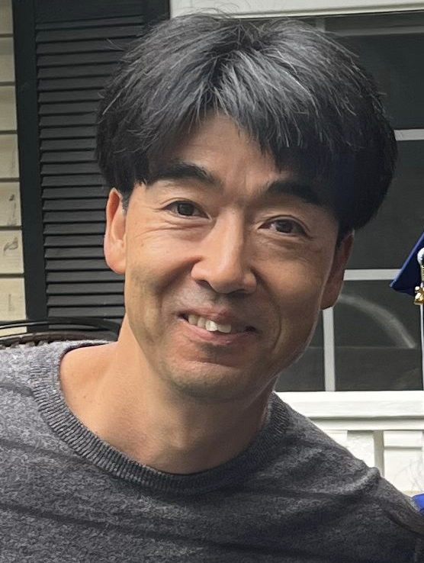
My profile
Katsuya Yonehara
Senior Scientist at Fermilab
Experimental physicist
Accelerator and Particle Physics
During the MAP era, I contributed to the development of the Helical Cooling Channel concept
I am currently working on high-power targetry for neutrino facilities such as NuMI and LBNF (Stay tuned for the MC targetry discussion on Thursday!)
You can contact me through
During the lecture
Email to yonehara@fnal.gov
USMCC Slack chat

Slide 3
Scope of the lecture
My goal is to convey our past studies and accumulated knowledges related to muon colliders and cooling desings to the new generation
Target audience: Lecture materials are being prepared for graduate students, engineers, and researchers who has a basic knowledge of accelerator physics, mechanical dynamics, and electromagnetism
Contents:
  Overview of the muon collider
  Emittance evolution and stability conditions
  Introduction of solenoid base cooling channel

Slide 4
Recommended paper and textbook
"Particle Accelerator Physics", Helmut Wiedemann, Textbook
"Accelerator Physics", SY Lee, Textbook
“Betatron motion with coupling of horizontal and vertical degrees of freedom”, V.A. Lebedev and S.A. Bogacz, FERMILAB-PUB-10-383-AD, 2012
“Method of beam optics”, F. Willeke and G. Ripken, DESY 88-114, 1988
“Transverse linear dynamics in an axisymmetric ionization cooling channel”, G. Dugan, PRSTAB 4 104001, 2001

Slide 5
Overview of Muon Collider Design
Quickly go through the design concept of muon colliders

Slide 6
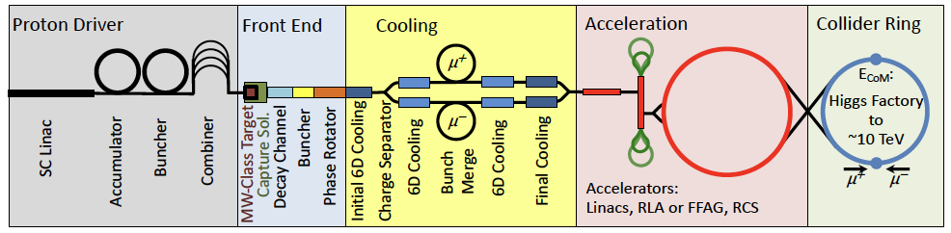
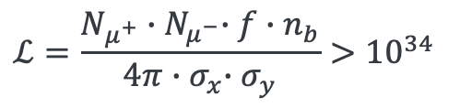
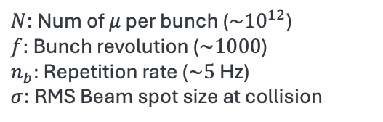
Overview of Muon Collider
Proton beam-based muon collider
Our story starts from luminosity…
Number of particles cross at an Interaction Point (IP) per second
$N$: Num of $μ$ per bunch ($\sim {10}^{12}$)
$f:$ Bunch revolution ($\sim 1000$)
$n_{b}:$ Repetition rate ($\sim 5$ Hz)
$σ$: RMS Beam spot size at collision
$$ℒ=\frac{N_{μ^{+}}{∙N}_{μ^{−}}∙f∙n_{b}}{4π{∙σ}_{x}∙σ_{y}}>{10}^{34}$$
cm⁻² s⁻¹
Beam crossing area at IP

Slide 7
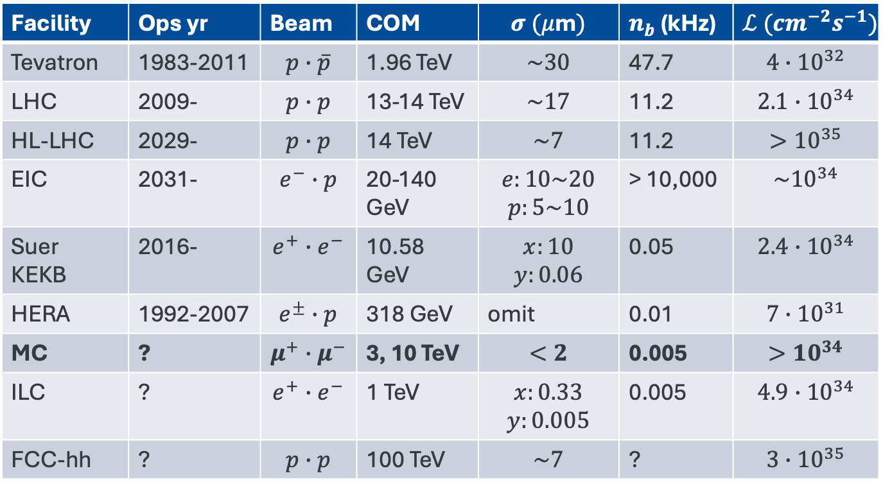
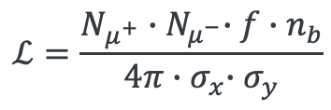
Collider Luminosities
$$ℒ=\frac{N_{μ^{+}}{∙N}_{μ^{−}}∙f∙n_{b}}{4π{∙σ}_{x}∙σ_{y}}$$
At the present time
Facility | Ops yr | Beam | COM | $$σ (μ\text{m})$$ | $n_{b}$ (kHz) | $$ℒ ({cm}^{−2}s^{−1})$$
Tevatron | 1983-2011 | $$p∙\overline{p}$$ | 1.96 TeV | $$\sim 30$$ | 47.7 | $${4∙10}^{32}$$
LHC | 2009- | $$p∙p$$ | 13-14 TeV | $$\sim 17$$ | 11.2 | $$2.1∙{10}^{34}$$
HL-LHC | 2029- | $$p∙p$$ | 14 TeV | $$\sim 7$$ | 11.2 | $${>10}^{35}$$
EIC | 2031- | $$e^{−}∙p$$ | 20-140 GeV | $$e:10\sim 20$$ $$p:5\sim 10$$ | > 10,000 | $${\sim 10}^{34}$$
Suer KEKB | 2016- | $$e^{+}∙e^{−}$$ | 10.58 GeV | $$x:10$$ $$y:0.06$$ | 0.05 | $${2.4∙10}^{34}$$
HERA | 1992-2007 | $$e^{±}∙p$$ | 318 GeV | omit | 0.01 | $${7∙10}^{31}$$
MC | ? | $$μ^{+}∙μ^{−}$$ | 3, 10 TeV | $$<2$$ | 0.005 | $${>10}^{34}$$
ILC | ? | $$e^{+}∙e^{−}$$ | 1 TeV | $$x:0.33$$ $$y:0.005$$ | 0.005 | $$4.9∙{10}^{34}$$
FCC-hh | ? | $$p∙p$$ | 100 TeV | $$\sim 7$$ | ? | $$3∙{10}^{35}$$

Slide 8
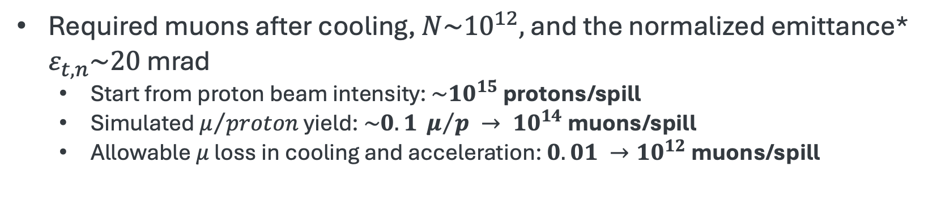
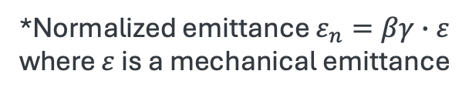
Overview of Muon Collider
Proton beam based muon collider
Required muons after cooling, $N\sim {10}^{12},$ and the normalized emittance* $ε_{t,n}\sim 20$ mrad
  Start from proton beam intensity: $\sim {10}^{15}$ protons/spill
  Simulated $μ/{proton}$ yield: $\sim 0.1 μ/p → {10}^{14}$muons/spill
  Allowable $μ$ loss in cooling and acceleration: $0.01 →{10}^{12}$muons/spill
*Normalized emittance $ε_{n}=βγ∙ε$
where $ε$ is a mechanical emittance

Slide 9
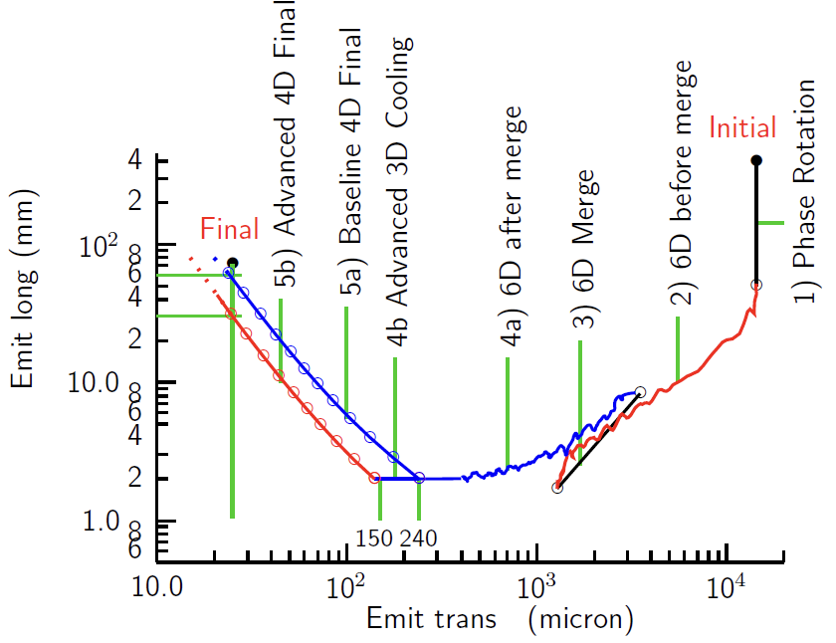
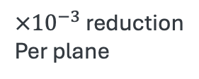
Emittance evolution resulting cooling simulations
Final transverse emittance
20 μm rad
Initial transverse emittance
20 mm rad
$×{10}^{−3}$ reduction
Per plane

Slide 10

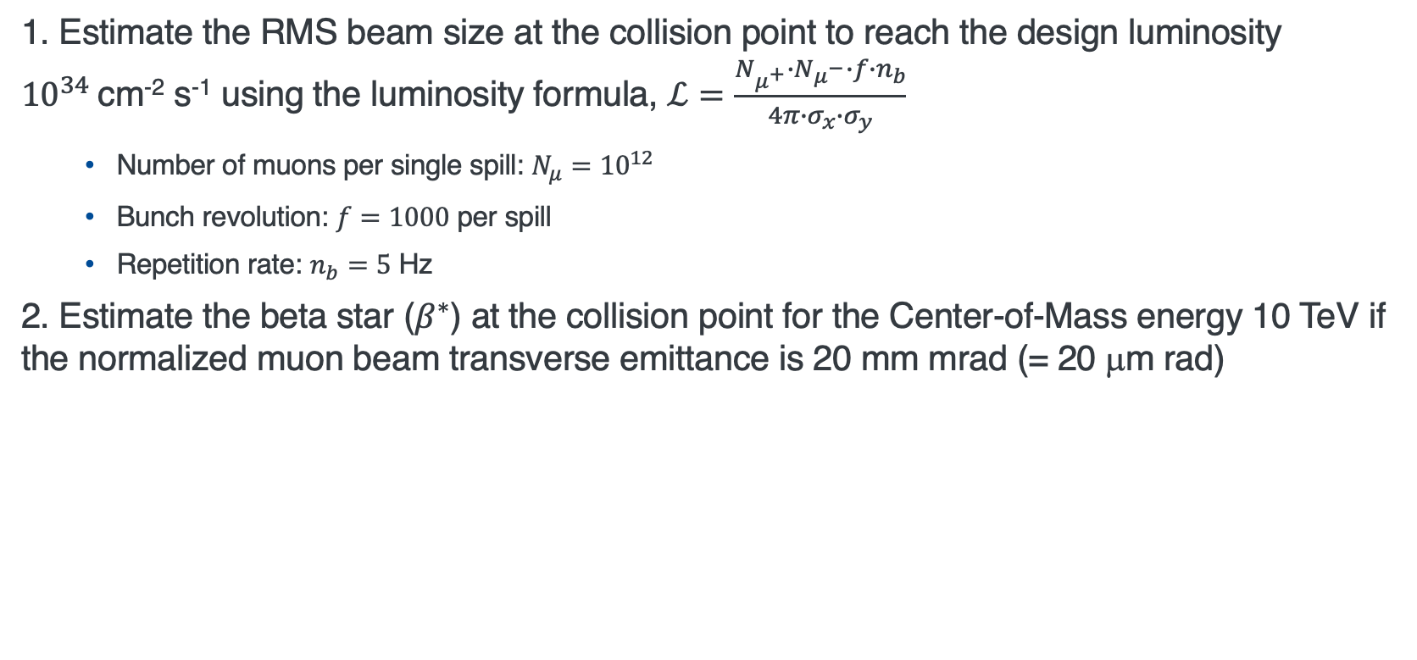
Question 1
1. Estimate the RMS beam size at the collision point to reach the design luminosity ${10}^{34}$cm⁻² s⁻¹ using the luminosity formula, $ℒ=\frac{N_{μ^{+}}{∙N}_{μ^{−}}∙f∙n_{b}}{4π{∙σ}_{x}∙σ_{y}}$
  Number of muons per single spill: $N_{μ}={10}^{12}$
  Bunch revolution: $f=1000$ per spill
  Repetition rate: $n_{b}=5$ Hz
2. Estimate the beta star ($β^{∗}$) at the collision point for the Center-of-Mass energy 10 TeV if the normalized muon beam transverse emittance is 20 mm mrad (= 20 μm rad)
$β^{∗}$: beta function at the collision point

Slide 11
Emittance reduction via cooling
Estimate the initial muon phase space and discuss the emittance reduction mechanism

Slide 12

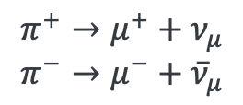


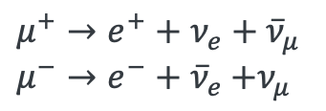


Initial Muon Phase Space in Preparation stage
Intense proton beam strikes pion production target
Hadronic interaction is probabilistic
→ Resulting pion phase space is distributed
$$p+A→π^{±}+A′$$
Pions are eventually decayed
Decay processes is inherently stochastic
→ Increasing muon phase space
$$π^{+}→μ^{+}+ν_{μ}$$
$$π^{−}→μ^{−}+{\overline{ν}}_{μ}$$
NB
Pion lifetime
$τ=26γ$ns
$→τ∙c=7.8$ m ($γ=1$)
Muons are eventually decayed as well
$$μ^{+}→e^{+}+ν_{e}+{\overline{ν}}_{μ}$$
$μ^{−}→e^{−}+{\overline{ν}}_{e}$ $+ν_{μ}$
NB
Muon lifetime (approximately 100 times lom=nger than pions)
$τ=2.2γ μ$s
$→τ∙c=659.5$ m ($γ=1$)

Slide 13
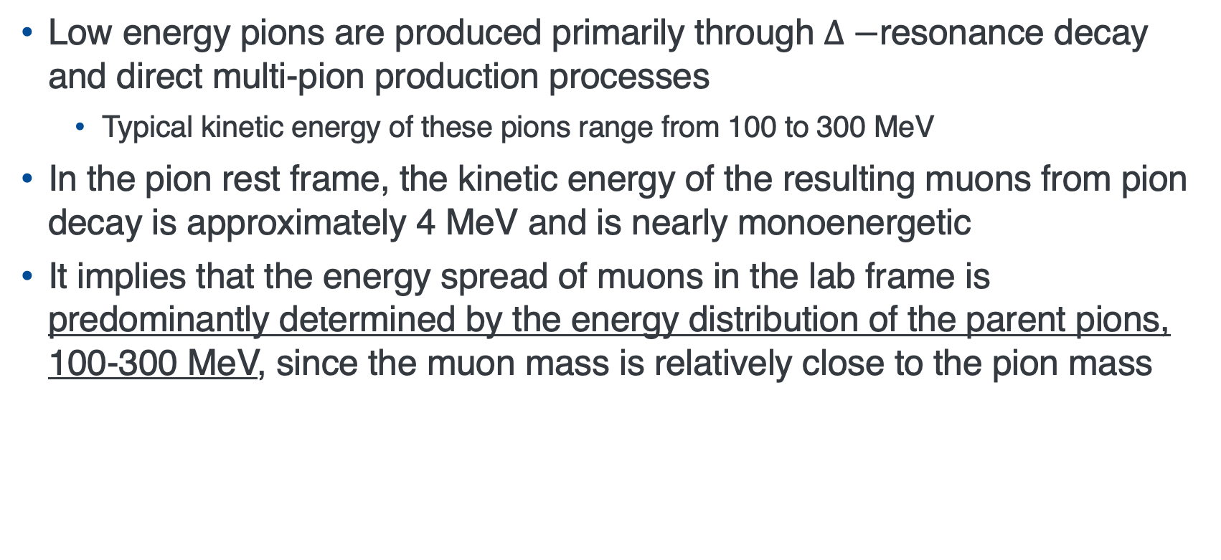
Initial muon energy spread
Low energy pions are produced primarily through $Δ−$resonance decay and direct multi-pion production processes
  Typical kinetic energy of these pions range from 100 to 300 MeV
In the pion rest frame, the kinetic energy of the resulting muons from pion decay is approximately 4 MeV and is nearly monoenergetic
It implies that the energy spread of muons in the lab frame is predominantly determined by the energy distribution of the parent pions, 100-300 MeV, since the muon mass is relatively close to the pion mass
NB
Pion mass = 139 MeV
Muon mass = 105 MeV
NB
A smaller pion phase space reduces the extent of muon cooling required. However,
Pions can strongly interact with material
Pions have a short lifetime

Slide 14
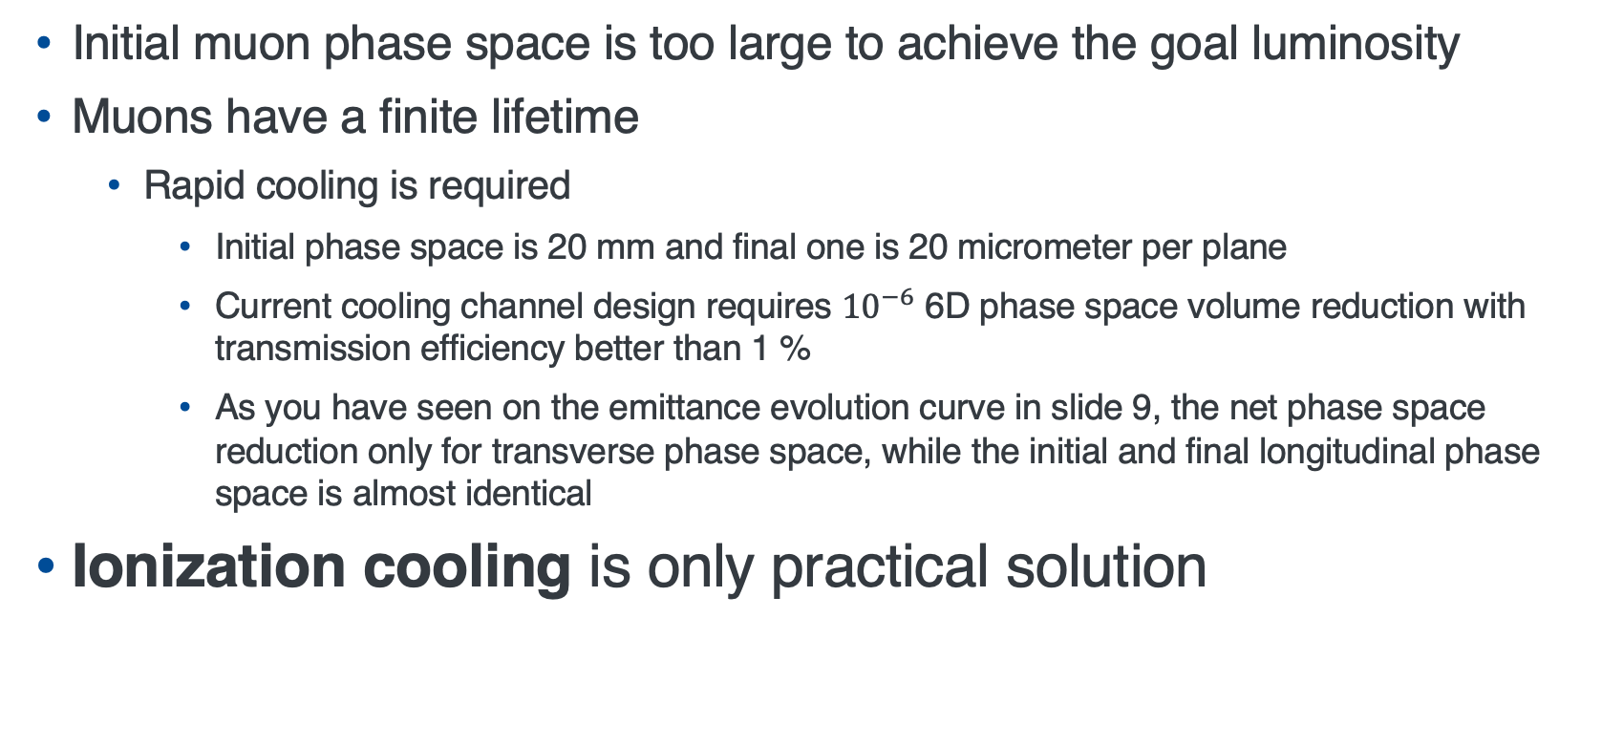
Challenge in producing low emittance muon beam
Initial muon phase space is too large to achieve the goal luminosity
Muons have a finite lifetime
  Rapid cooling is required
    Initial phase space is 20 mm and final one is 20 micrometer per plane
    Current cooling channel design requires ${10}^{−6}$ 6D phase space volume reduction with transmission efficiency better than 1 %
    As you have seen on the emittance evolution curve in slide 9, the net phase space reduction only for transverse phase space, while the initial and final longitudinal phase space is almost identical
Ionization cooling is only practical solution

Slide 15
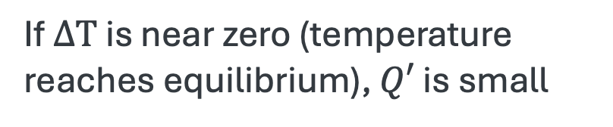

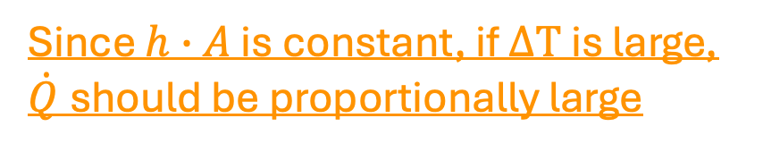

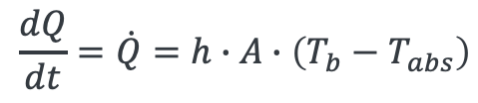




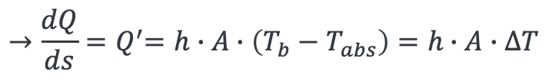
Beam cooling (Intuitive picture)
Heat flows from warm object to cold object
Heat flows
Heat flows when
$$T_{b}$$
$$T_{abs}$$
$$T_{b}>T_{abs}$$
$$Q′$$
Equilibrium condition
$$T_{b} \sim { T}_{abs}$$
Key concept of designing cooling channel
$$\frac{dQ}{dt}=\dot{Q}=h∙A∙\left(T_{b}−T_{abs}\right)$$
Since $h∙A$ is constant, if $∆T$ is large, $\dot{Q}$should be proportionally large
Heat transfer rate
$${→\frac{dQ}{ds}=Q}^{′}=h∙A∙\left(T_{b}−T_{abs}\right)=h∙A∙ΔT$$
$s$ is a path length
If $∆T$ is near zero (temperature reaches equilibrium), $Q′$ is small

Slide 16

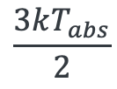



Beam cooling
Beam temperature flows into absorber temperature
Beam
Absorber
Heat flows when
q (momentum)-transfer
via coulomb interaction
$$\frac{3kT_{abs}}{2}$$
$$T_{b}>T_{abs}$$
$$\frac{∆p_{⊥}^{2}}{m}=kT_{b}$$
Equilibrium condition
$$T_{b} \sim { T}_{abs}$$
$∆p$: Momentum in CM frame
Entropy $∆S∝ln\left(\frac{T_{final}}{T_{initial}}\right)$
Beam phase space squeezes adiabatically → Beam temperature becomes high
$∆T$ becomes high
This process is equivalent to the beam focusing using beam magnets

Slide 17
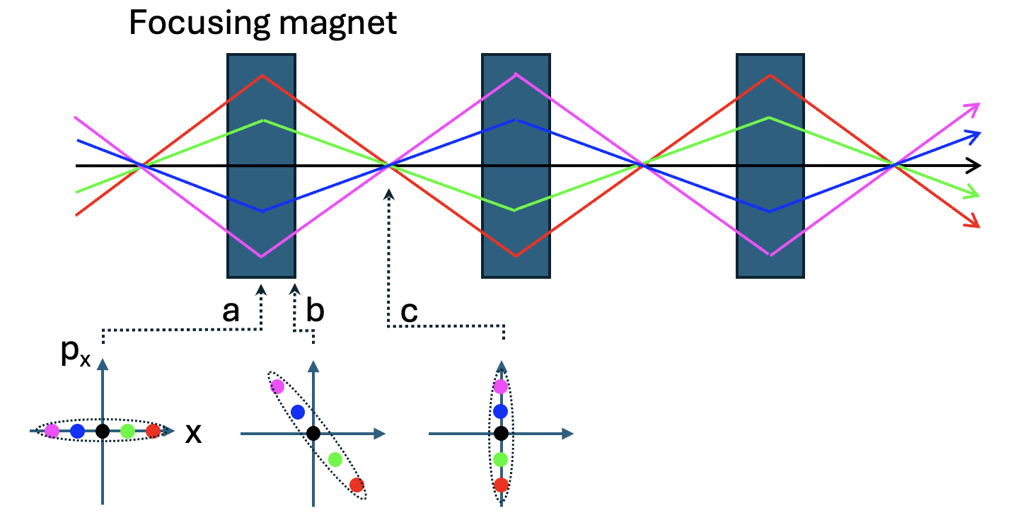
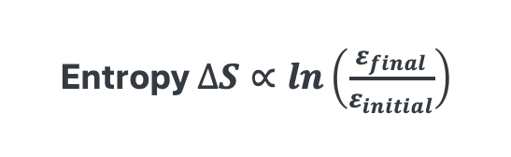
Beam cooling
Beam temperature flows into absorber temperature
Beam
Absorber
Heat flows when
q (momentum)-transfer
via coulomb interaction
$$\frac{3kT_{abs}}{2}$$
$$T_{b}>T_{abs}$$
$$\frac{∆p_{⊥}^{2}}{m}=kT_{b}$$
Equilibrium condition
$$T_{b} \sim { T}_{abs}$$
Put absorber at point “c”
a: maximum beta function
c: minimum beta function
Transverse phase space is rotated along beam path
Entropy $∆S∝ln\left(\frac{ε_{final}}{ε_{initial}}\right)$

Slide 18
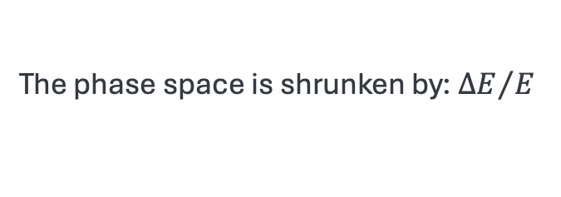




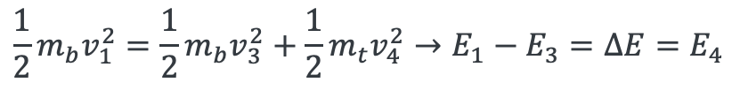


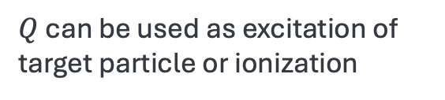
Energy transfer process via Coulomb scattering
$$μ$$
$$v_{1}$$
$$v_{3}$$
$$v_{2}=0$$
$$v_{4}$$
Energy transfer in an elastic scattering:
$$\frac{1}{2}m_{b}v_{1}^{2}=\frac{1}{2}m_{b}v_{3}^{2}+\frac{1}{2}m_{t}v_{4}^{2}→E_{1}−E_{3}=∆E=E_{4}$$
This is a transferred energy
The phase space is shrunken by: ${∆E}/E$
Inelastic case: $E_{1}−E_{3}=∆E=E_{4}+Q$
$Q$ can be used as excitation of target particle or ionization

Slide 19

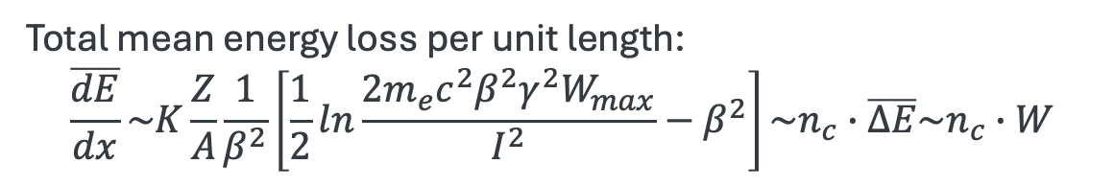










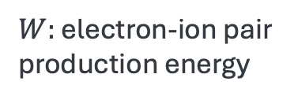
Energy transfer in ionization cooling
(intuitive approach)
Electron looks to be a free particle
Beam direction
$$μ$$
$$e^{−}$$
$$e^{−}$$
$$∆E_{2}$$
$$∆E_{3}$$
$$∆E_{5}$$
$$∆E_{4}$$
$$e^{−}$$
$$e^{−}$$
$$e^{−}$$
$$∆E_{1}=I+δE$$
Total mean energy loss per unit length:
$$\overline{\frac{dE}{dx}}\sim K\frac{Z}{A}\frac{1}{β^{2}}\left[\frac{1}{2}ln\frac{2m_{e}c^{2}β^{2}γ^{2}W_{max}}{I^{2}}−β^{2}\right]\sim n_{c}∙\overline{∆E}\sim n_{c}∙W$$
$W:$ electron-ion pair
production energy
NB: The Bethe’s equation expresses the energy loss per unit length, analogous to a “Damping force” acting on individual particles

Slide 20
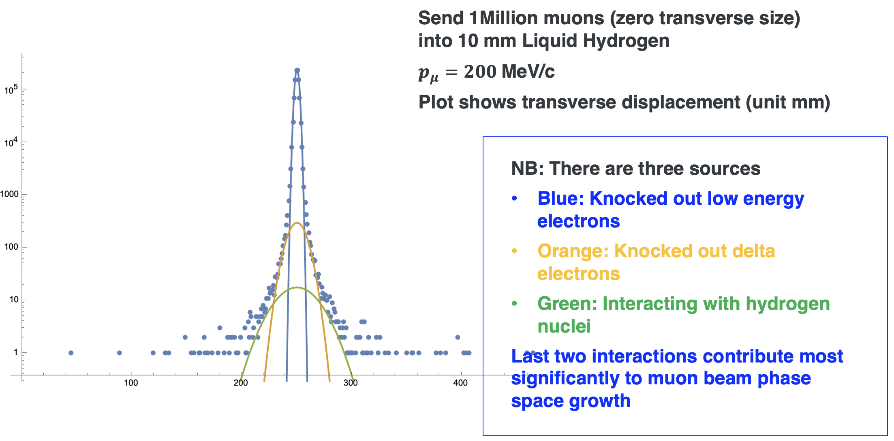
Phase space heating due to recoil processes
Multiple scattering (Stochastic process → Increasing entropy) causes transverse spreading of the beam, leading to transverse phase space heating
Beam space spread by multiple scattering
The recoil energy is also stochastic, contributing to longitudinal phase space heating

Slide 21
Emittance evolution
Break Liouville’ theorem

Slide 22
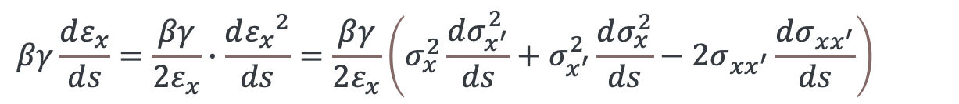
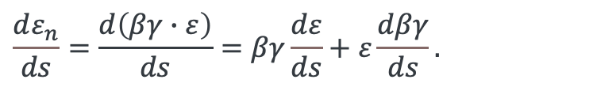
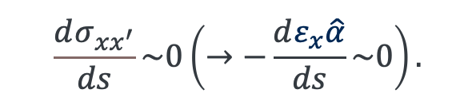
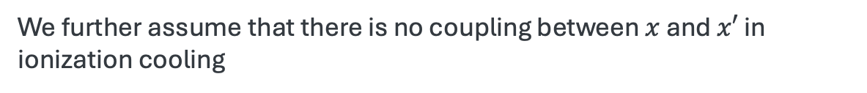
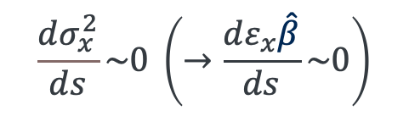
Emittance evolution (Transverse)
$$\frac{dε_{n}}{ds}=\frac{d\left(βγ∙ε\right)}{ds}=βγ\frac{dε}{ds}+ε\frac{dβγ}{ds}.$$
First term,
$$βγ\frac{dε_{x}}{ds}=\frac{βγ}{2ε_{x}}∙\frac{d{ε_{x}}^{2}}{ds}=\frac{βγ}{2ε_{x}}\left(σ_{x}^{2}\frac{dσ_{x^{′}}^{2}}{ds}+σ_{x^{′}}^{2}\frac{dσ_{x}^{2}}{ds}−2σ_{xx^{′}}\frac{dσ_{xx^{′}}}{ds}\right)$$
Assume there is no beam spot size variation
$$\frac{dσ_{x}^{2}}{ds}\sim 0 \left(→\frac{dε_{x}\hat{β}}{ds}\sim 0\right)$$
NB: We assume that Liouville's theorem is adiabatically preserved during ionization cooling
We further assume that there is no coupling between $x$ and $x′$ in ionization cooling
$$\frac{dσ_{xx^{′}}}{ds}\sim 0\left(→−\frac{dε_{x}\hat{α}}{ds}\sim 0\right).$$

Slide 23
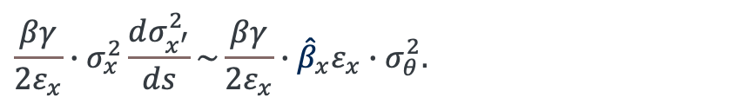
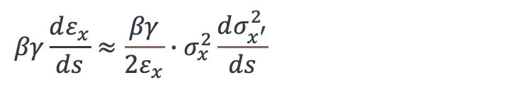


Emittance evolution (Transverse)
Residual term
$$βγ\frac{dε_{x}}{ds}≈\frac{βγ}{2ε_{x}}∙σ_{x}^{2}\frac{dσ_{x^{′}}^{2}}{ds}$$
We involve multiple scattering process,
$$\frac{βγ}{2ε_{x}}∙σ_{x}^{2}\frac{dσ_{x^{′}}^{2}}{ds}\sim \frac{βγ}{2ε_{x}}∙{\hat{β}}_{x}ε_{x}∙σ_{θ}^{2}.$$
NB: Multiple scattering
(Stochastic process → Increasing entropy)
$$σ_{θ}^{2}\sim {\left(\frac{13.8 MeV}{βcp}\right)}^{2}\frac{z^{2}}{L_{R}}.$$
Thus, we finally gain
$$βγ\frac{dε_{x}}{ds}\sim \frac{βγ}{2ε_{x}}∙{\hat{β}}_{x}ε_{x}∙{\left(\frac{13.8 MeV}{βcp}\right)}^{2}\frac{z^{2}}{L_{R}}.$$

Slide 24
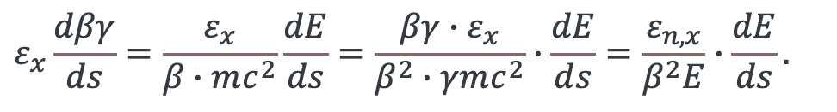
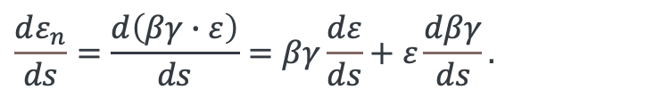
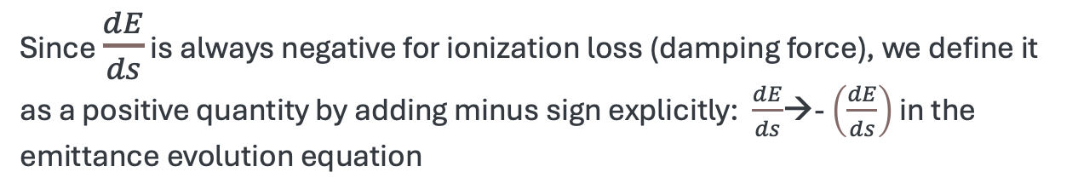
Emittance evolution (Transverse)
$$\frac{dε_{n}}{ds}=\frac{d\left(βγ∙ε\right)}{ds}=βγ\frac{dε}{ds}+ε\frac{dβγ}{ds}.$$
Second term,
$$ε_{x}\frac{dβγ}{ds}=\frac{ε_{x}}{β∙mc^{2}}\frac{dE}{ds}=\frac{βγ∙ε_{x}}{β^{2}∙γmc^{2}}∙\frac{dE}{ds}=\frac{ε_{n,x}}{β^{2}E}∙\frac{dE}{ds}.$$
Since $\frac{dE}{ds}$ is always negative for ionization loss (damping force), we define it as a positive quantity by adding minus sign explicitly: $\frac{dE}{ds}$→- $\left(\frac{dE}{ds}\right)$ in the emittance evolution equation

Slide 25
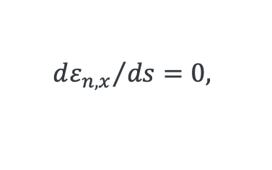
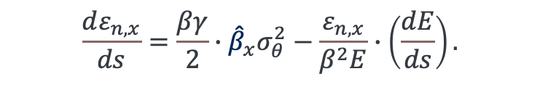

Emittance evolution (Transverse)
Final form is
$$\frac{dε_{n,x}}{ds}=\frac{βγ}{2}∙{\hat{β}}_{x}σ_{θ}^{2}−\frac{ε_{n,x}}{β^{2}E}∙\left(\frac{dE}{ds}\right).$$
The equilibrium emittance is obtained from this,
$${dε_{n,x}}/{ds=0, }$$
$$ε_{n, x,eq}=\frac{\frac{βγ}{2}{\hat{β}}_{x}σ_{θ}^{2}}{β^{2}E∙\left(\frac{dE}{ds}\right)}=\frac{{\hat{β}}_{x}{\left(13.6 MeV\right)}^{2}∙z^{2}}{2βmL_{R}∙\left(\frac{dE}{ds}\right)}$$
NB: To reach low emittance: low${\hat{β}}_{x}$, large $\left(\frac{dE}{ds}\right),$and long $L_{R}$

Slide 26
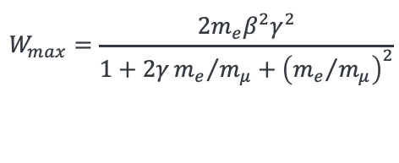
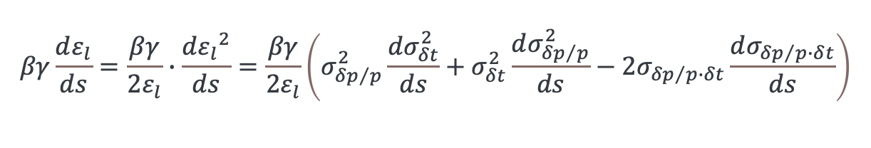

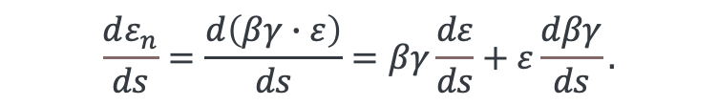
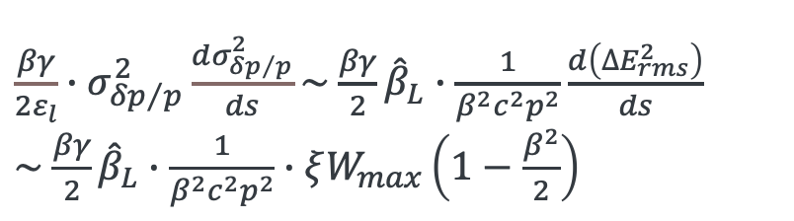
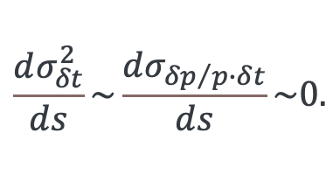
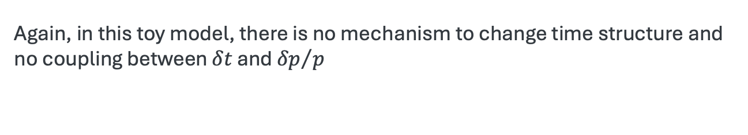
Emittance evolution (Longitudinal)
$$\frac{dε_{n}}{ds}=\frac{d\left(βγ∙ε\right)}{ds}=βγ\frac{dε}{ds}+ε\frac{dβγ}{ds}.$$
First term for longitudinal,
$$βγ\frac{dε_{l}}{ds}=\frac{βγ}{2ε_{l}}∙\frac{d{ε_{l}}^{2}}{ds}=\frac{βγ}{2ε_{l}}\left(σ_{{δp}/p}^{2}\frac{dσ_{δt}^{2}}{ds}+σ_{δt}^{2}\frac{dσ_{{δp}/p}^{2}}{ds}−2σ_{{δp}/p∙δt}\frac{dσ_{{δp}/{p∙δ}t}}{ds}\right)$$
Again, in this toy model, there is no mechanism to change time structure and no coupling between $δt$ and ${δp}/p$
$$\frac{dσ_{δt}^{2}}{ds}\sim \frac{dσ_{{δp}/{p∙δ}t}}{ds}\sim 0.$$
NB: We assume neither timing growth nor energy-timing coupling.
While the energy straggling effect is included,
${\frac{βγ}{2ε_{l}}∙σ}_{{δp}/p}^{2}\frac{dσ_{{δp}/p}^{2}}{ds}\sim$ $\frac{βγ}{2}{\hat{β}}_{L}∙\frac{1}{β^{2}c^{2}p^{2}}\frac{d\left({∆E}_{rms}^{2}\right)}{ds}$
$\sim$ $\frac{βγ}{2}{\hat{β}}_{L}∙\frac{1}{β^{2}c^{2}p^{2}}∙ξW_{max}\left(1−\frac{β^{2}}{2}\right)$
$$ξ=153.4\frac{z^{2}}{β^{2}}\frac{Z}{A}$$
keV g/cm²
$$W_{max}=\frac{2m_{e}β^{2}γ^{2}}{1+2γ{m_{e}}/{m_{μ}+{\left({m_{e}}/{m_{μ}}\right)}^{2}}}$$

Slide 27
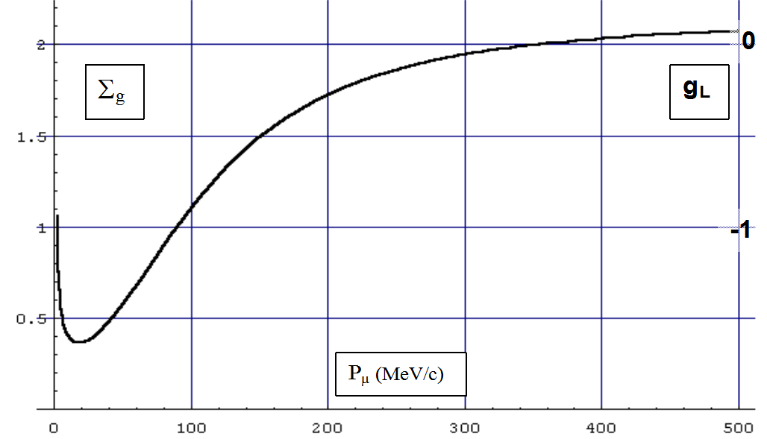

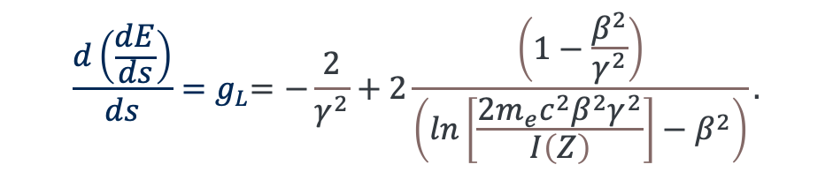

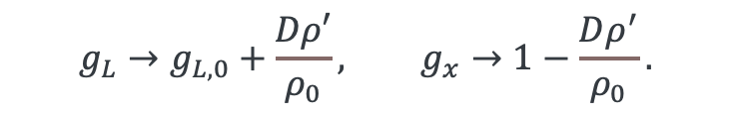


Emittance evolution (Dispersion coupling)
Add coupling parameters $g_{x,y}$and $g_{L}$
$$\frac{dε_{n,x,y}}{ds}=−\frac{g_{x,y}∙ε_{n,x,y}}{β^{2}E}∙〈\frac{dE}{ds}〉+\frac{{\left(13.6 MeV\right)}^{2}β_{x,y}}{2m_{μ}Eβ^{3}L_{R}},$$
$$\frac{dε_{n,L}}{ds}=−\frac{g_{L}∙ε_{n,L}}{β^{2}E}∙〈\frac{dE}{ds}〉+\frac{βγ}{2}{\hat{β}}_{L}∙\frac{1}{β^{2}c^{2}p^{2}}∙ξW_{max}\left(1−\frac{β^{2}}{2}\right)$$
$g_{x,y}$ and $g_{L}$ also referred a partition number
$$\frac{d\left(\frac{dE}{ds}\right)}{ds}{=g}_{L}=−\frac{2}{γ^{2}}+2\frac{\left(1−\frac{β^{2}}{γ^{2}}\right)}{\left(ln\left[\frac{2m_{e}c^{2}β^{2}γ^{2}}{I\left(Z\right)}\right]−β^{2}\right)}.$$
$g_{L,0} at p\sim 350$MeV/c
where $g_{L}=0$
To compensate positive $g_{L,0}$, dispersion + wedge absorber
$$g_{L}→g_{L,0}+\frac{Dρ′}{ρ_{0}}, g_{x}→1−\frac{Dρ^{′}}{ρ_{0}}.$$
NB: This represents that the dispersion induces coupling between transverse and longitudinal phase spaces
$$Σ_{g}=g_{x}+g_{y}+g_{L}=2+g_{L, 0}.$$

Slide 28



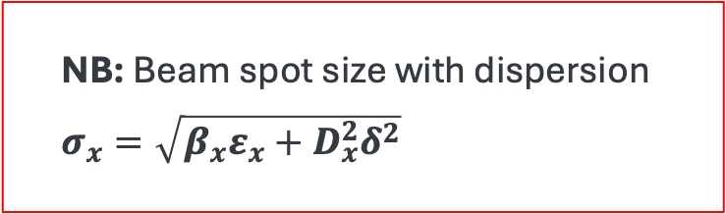






$g_{x,y}$ and $g_{L}$ with Dispersion (I)
Beam momentum is translated into beam position by dipole magnet
$$m\frac{v^{2}}{ρ}=qv×B→\frac{p}{ρ}=qB$$
for uniform dipole field
$$→\frac{p+δp}{ρ+δρ}=qB=const$$
$$→\frac{p}{ρ}\left(1+\frac{δp}{p}\right)\left(1−\frac{δρ}{ρ}\right)=\frac{p}{ρ}$$
$$→1+\frac{δp}{p}−\frac{δρ}{ρ}=1$$
$$→\frac{δp}{δρ}=\frac{p}{ρ}$$
in a uniform dipole field
$$D=p\frac{dρ}{dp}=p\frac{ρ}{p}=ρ$$
NB: Beam emittance is not exchanged without absorber
$$ρ−δρ$$
$$p−δp$$
$$ρ$$
Particle position is distributed by ${δp}/p$
$$p$$
$$p+δp$$
$$ρ+δρ$$
Top view of dipole magnet
This phenomenon is called dispersion
NB: Beam spot size with dispersion
$σ_{x}=\sqrt{β_{x}ε_{x}+D_{x}^{2}δ^{2}}$
$$D=p\frac{dρ}{dp}$$

Slide 29












$g_{x,y}$ and $g_{L}$ with Dispersion (II)
$p−δp$ particle traverses with
shorter path length than reference in wedge absorber
$$α$$
$$−δx$$
$p$ particle is a reference particle
$$l= 2w\left(1−\frac{dp}{wp}D\right)\tan{\frac{α}{2}}$$
$$w$$
$$l=2w\tan{\frac{α}{2}}$$
$$+δx$$
$p−δp$ particle traverses with
longer path length than reference in wedge absorber
$$l=2w\left(1+\frac{dp}{wp}D\right)\tan{\frac{α}{2}}$$
Wedge absorber
$δp$ becomes smaller after passing wedge absorber
→ Longitudinal cooling
Dave’s definition: $g_{x,y}=1−D\frac{ρ′}{ρ}$
$$→g_{x,y}=1−\frac{D}{w}$$

Slide 30








Dispersion, Momentum compaction and Slip factor
For individual dipole, a particle position is varied by its momentum
$$ds_{0}=ρdθ→ds=\left(ρ+x\right)dθ$$
Dispersion is given
$$dl=ds−ds_{0}$$
$$\frac{ds−ds_{0}}{ds_{0}}=\frac{x}{ρ}=\frac{D}{ρ}\frac{dp}{p}→D=x\frac{p}{dp}$$
In circular periodic motion,
(see slide 15, where $x=dρ$ )
$$ΔC=\oint{dl=\oint{x∙dθ=\oint{x∙\frac{ds_{0}}{ρ}=\oint{x∙\frac{p}{dp}∙\frac{dp}{p}\frac{ds_{0}}{ρ}}}=\oint{D∙\frac{dp}{p}\frac{ds_{0}}{ρ}}}}$$
$$α_{c}=\frac{p}{C}\frac{dC}{dp}=\frac{1}{C}\oint{D∙\frac{ds_{0}}{ρ}→\frac{1}{C}\sum_{i}{{\overline{D}}_{i}∙θ_{i}}}$$
${\overline{D}}_{i}$: Average dispersion
per beam element

Slide 31





Dispersion, Momentum compaction and Slip factor
Number of revolutions
$$f_{r}=\frac{v}{2πR}=\frac{βγ}{2πR}→\frac{df_{r}}{f_{r}}=\frac{dβ}{β}−\frac{dR}{R}=\frac{dβ}{β}−α_{c}\frac{dp}{p}$$
$$p=βγmc→\frac{dp}{p}=\frac{dβ}{β}+\frac{dγ}{γ}=γ^{2}\frac{dβ}{β}$$
$$\frac{df_{r}}{f_{r}}=\frac{dβ}{β}−α_{c}\frac{dp}{p}=\frac{1}{γ^{2}}\frac{dp}{p}−α_{c}\frac{dp}{p}=\left(\frac{1}{γ^{2}}−α_{c}\right)\frac{dp}{p}$$
(Phase) Slip factor
NB: We use a circulator motion to introduce the momentum compaction factor and slip factor, but those can be defined for any periodic channel, e.g. $R$ and $f_{r}$ are a Larmor radius and Larmor frequency, respectively
$$η=\left(\frac{1}{γ^{2}}−α_{c}\right)$$

Slide 32











Interpret momentum compaction and slip factor
$$α_{c}=\frac{p}{C}\frac{dC}{dp}$$
Reference particle
for $η<0$
C
$$\frac{dC}{dp}>0→α_{c}>0$$
Reference particle
for $η>0$
$$\frac{dC}{dp}<0→α_{c}<0$$
p
$$\frac{df_{r}}{f_{r}}=\left(\frac{1}{γ^{2}}−α_{c}\right)\frac{dp}{p}=η\frac{dp}{p}$$
$η=0:$Transition, isochronous
$η>0$: Below transition, higher momentum particle revolute faster
$η<0$: Above transition, higher momentum particle revolve slower
$$f_{r}$$
$$\frac{df_{r}}{dp}>0→η>0$$
$$\frac{df_{r}}{dp}<0→η<0$$
p

Slide 33






Longitudinal phase space
2nd order differential equation in longitudinal phase space:
$$\frac{d}{dt}\left[\frac{R_{s}p_{s}}{hηω_{rs}}\frac{dφ}{dt}\right]+\frac{e\hat{V}}{2π}\left(sin\left(φ\right)−sin\left(φ_{s}\right)\right)=0$$
$$\ddot{φ}+\frac{Ω_{s}^{2}}{cos\left(φ_{s}\right)}\left(sin\left(φ\right)−sin\left(φ_{s}\right)\right)=0$$
$→$ $\ddot{φ}+$ $Ω_{s}^{2}φ=0$ (if $\left(φ\right)$ is small)
Synchrotron oscillation:
$$Ω_{s}^{2}=\frac{hηω_{rs}e\hat{V}cos\left(φ_{s}\right)}{2πR_{s}p_{s}}$$
NB: Stability condition when $Ω_{s}$ is real→$η∙cos\left(φ_{s}\right)>0$
Longitudinal beta function is
$${\hat{β}}_{L}=\sqrt{\frac{λ_{rf}β^{3}Eα_{c}}{2πeV^{′}cos\left(φ_{s}\right)}}$$
NB: Longitudinal beta function represents the longitudinal focusing strength; Shorter ${\hat{β}}_{L}$ when $V^{′}$(rf accelerating gradient) is large

Slide 34





Emittance evolution
Constant term
$$\frac{dε_{n,x,y}}{ds}=−\frac{g_{x,y}∙ε_{n,x,y}}{β^{2}E}∙〈\frac{dE}{ds}〉+\frac{{\left(13.6 MeV\right)}^{2}β_{x,y}}{2m_{μ}Eβ^{3}L_{R}},$$
$$\frac{dε_{n,L}}{ds}=−\frac{g_{L}∙ε_{n,L}}{β^{2}E}∙〈\frac{dE}{ds}〉+\frac{βγ}{2}{\hat{β}}_{L}∙\frac{1}{β^{2}c^{2}p^{2}}∙ξW_{max}\left(1−\frac{β^{2}}{2}\right)$$
$$\frac{dε_{n}}{ds}={−c}_{1}∙ε_{n}+c_{2}$$
$$→ε_{n}\left(s\right)=\left(ε_{n,0}−ε_{n,eq}\right)∙exp[−λ_{x,y,z}^{−1}∙s]+ε_{n,eq}$$
$$ε_{n,eq}=\frac{c_{2}}{c_{1}}$$
$λ^{−1}=$ $c_{1},$
LH2
Plot shows that the required cooling channel length is < 100 m in LH2 if the equilibrium emittance is 10⁻⁶ (initial emittance is 1.0) unit is arbitrary in this discussion
$λ^{−1}=0.18$m⁻¹

Slide 35


Question 2
1. Establish the emittance evolution formula
  Mean muon momentum 200 MeV/c
  Liquid H2 absorber, no dispersion ($D=0$)
    Radiation length of LH2: $L_{R}=$ 890.4 cm
  Beta function $β_{x,y}$ are 40, 20, and 5 cm and initial normalized emittance are 5.1, 2.4 and 0.7 mm, respectively
2. If the absorber is wedge shape
  If $w=10$ cm and dispersion is 5.2 cm, what is $g_{x,y}$?
  Right plot shows $Σ_{g}\sim$1.7 at $p$ = 200 MeV/c, what is $g_{L}$?

Slide 36
Solenoid base beam optics
X and Y motions and their beta functions are coupled

Slide 37


Eigen emittance (I)
6-dimensional particle point (like in particle tracking simulation)
$$\overline{z}=\left\{x,p_{x},y,p_{y},s−cβ_{0}t,\frac{\left(γ−γ_{0}\right)}{{β_{0}}^{2}γ_{0}}=δ\right\}$$
Canonical momentum:
$P_{x}=\left(p_{x}+\frac{e}{c}A_{x}\right)/p_{0}$
where $A_{x}$ is the vector potential at the particle position
First moment (mean value):
$$\overline{a}=\frac{1}{N}\sum_{k=1}^{N}{{\overline{z}}^{(k)}}$$
Second moment (Covariance matrix):
$$Σ_{ij}=\frac{1}{N}\sum_{k=1}^{N}{ζ_{i}^{(k)}ζ_{j}^{(k)}}, {\overline{ζ}}^{(k)}={\overline{z}}^{(k)}−\overline{a}$$
NB: For solenoid magnet
$$A_{x}=−\frac{B_{z}y}{2}$$
$$A_{x}=\frac{B_{z}x}{2}$$
$$A_{s}=0$$

Slide 38




Eigen emittance (II)
Separatrix matrix $S$* is
  $$S=\left(\begin{matrix}0 & 1 \\ −1 & 0\end{matrix}\right)⊕\left(\begin{matrix}0 & 1 \\ −1 & 0\end{matrix}\right)⊕\left(\begin{matrix}0 & 1 \\ −1 & 0\end{matrix}\right)$$
Eigen emittance is given
$$\det\left(Ω−λI\right)=0$$
where $Ω=S∙Σ^{−1}$
Besides, the eigen vector is given
$$ξ=V\overline{ζ}$$
It should be noted that the eigen vector must satisfies
$$V^{T}SV=S$$
$$ε_{m}=−\frac{i}{λ_{2m−1}}=\frac{i}{λ_{2m}}$$
*Separatrix is used for the canonical condition:
$$\frac{d}{ds}x=+\frac{∂H}{∂p_{x}}; \frac{d}{ds}p_{x}=−\frac{∂H}{∂x}$$
$$\frac{d}{ds}y=+\frac{∂H}{∂p_{y}}; \frac{d}{ds}p_{y}=−\frac{∂H}{∂y}$$
$$\frac{d}{ds}\overline{z}=S∙\frac{∂H}{∂\overline{z}}$$

Slide 39


Twiss parameter for eigen vector
$Ω_{1,1}$, $Ω_{3,3}$, and $Ω_{5,5}$ are the beam spot size
Thus, the beta function is
$β_{m}=\frac{Ω_{2m−1,2m−1}}{ε_{m}},$
The alpha is
$$α_{m}=\frac{Ω_{2m−1,2m}}{ε_{m}\sqrt{β_{m}}}$$
Then the gamma is given
$$β_{m}∙γ_{m}−α_{m}^{2}=1$$
$$m=1,2,3$$

Slide 40

Dispersion
$V$ is the sum of 6 eigen vectors representing the 6D hyper space
$V=\{{\hat{v}}_{1}^{′},−{\hat{v}}_{1}^{′′},{\hat{v}}_{3}^{′},−{\hat{v}}_{3}^{′′},{\hat{v}}_{5}^{′},−{\hat{v}}_{5}^{′′}\}$, where $\hat{v}={\hat{v}}^{′}+i{\hat{v}}^{′′}$ and $\hat{v}′$ is a real and $\hat{v}′′$ is an imaginary parts
Dispersion $D_{x}=\frac{V_{16}V_{55}−V_{15}V_{56}}{V_{66}V_{55}−V_{65}V_{56}}$,${ D}_{y}=\frac{V_{36}V_{55}−V_{35}V_{56}}{V_{66}V_{55}−V_{65}V_{56}}$

Slide 41

RMS emittance
RMS emittance is other possible phase space function
  The angular momentum is often negligible for sign-flipped solenoid channel
  But it is much simpler, and the results sometimes close to the eigen emittance
Use covariance matrix
$\left\langle x^{2}\right\rangle =σ_{x,x}$, $\left\langle y^{2}\right\rangle =σ_{y,y}$, $\left\langle {P_{x}}^{2}\right\rangle =σ_{P_{x},P_{x}}=\left\langle p_{x}^{2}\right\rangle −K^{2}$, $\left\langle {P_{y}}^{2}\right\rangle =σ_{P_{y},P_{y}}$
$\left\langle p_{x}y\right\rangle =K^{2}\left\langle x^{2}\right\rangle$, $\left\langle p_{y}x\right\rangle =K^{2}\left\langle y^{2}\right\rangle$
$$K=\frac{B_{z}}{2Bρ}$$
Then, the RMS emittance is
$$ε_{1,2}=\sqrt{σ_{P_{x}P_{x}}∙σ_{P_{y}P_{y}}}∙\sqrt{σ_{xx}∙σ_{yy}}\left(1+2K^{2}β_{⊥}^{2}±2|K|β_{⊥}\sqrt{1+K^{2}β_{⊥}^{2}}\right)$$
$$β_{⊥}=\frac{\sqrt{σ_{xx}∙σ_{yy}}}{\sqrt{σ_{P_{x}P_{x}}∙σ_{P_{y}P_{y}}}}$$

Slide 42






MAP/IMCC method
The transverse covariance matrix adding canonical angular momentum,
$$L_{canonical}=2mcε_{n}∙ℒ$$
New term in phase advance
$$ε_{n}^{4D}=\frac{\sqrt[4]{det(M)}}{m}$$
$$M_{1,1}=mcε_{n}^{4D}\frac{β_{⊥}}{Pz}$$
$$M_{1,2}=mcε_{n}^{4D}\left(−α_{⊥}\right)$$

Slide 43





Hamiltonian for x and y beta coupling channel
$$H=\frac{p_{x}^{2}+p_{y}^{2}}{2}+\left(K_{x}^{2}+k+\frac{R^{2}}{4}\right)\frac{x^{2}}{2}+\left(K_{y}^{2}−k+\frac{R^{2}}{4}\right)\frac{y^{2}}{2}+Nxy+\frac{R}{2}\left(yp_{x}−xp_{y}\right)$$
$$G=y\frac{∂B_{y}}{∂x}=x\frac{∂B_{x}}{∂y}$$
$$K_{x,y}=\frac{eB_{y,x}}{Pc}, k=\frac{eG}{Pc}, N=\frac{eG_{s}}{Pc} and R=\frac{eB_{s}}{Pc};$$
This equation is combined of dipole, quadrupole, skew-quadrupole, and solenoidal components (see eq. (2.50a) in Ripken’s paper)
Tilted solenoid coils induce multiple magnetic components
If the strength of each component is known, $K_{x}, K_{y}, k, R$ and $N$ should be determined
In the case of a straight solenoid channel, the Hamiltonian is
$$H=\frac{p_{x}^{2}+p_{y}^{2}}{2}+\frac{R^{2}x^{2}}{8}+\frac{{R^{2}y}^{2}}{8}+\frac{R}{2}\left(yp_{x}−xp_{y}\right)$$

Slide 44





FOFO (Solenoid+Drift+Solenoid+Drift) channel
If use a thin lens approximation,
phase advance
$$cos\left(μ\right)=1−\frac{d}{2f}$$
It is known that a focusing length for a of solenoid lens is
d
$$f=\frac{4p^{2}}{e^{2}B_{0}^{2}L}$$
single solenoid coil configurations
Estimate when the phase advance is set $π$ ,
$$cosπ=−1=1−\frac{d}{2f}→p_{π}^{2}={\left(\frac{eB_{0}}{4}\right)}^{2}Ld$$
This suggests that the particle momentum should be $p≥p_{π}$

Slide 45




Introduce Mathieu equation
The radial equation of motion on the Larmor frame (or eliminate canonical momentum in alternate solenoid channel) is
$$\ddot{r}+\frac{r}{4}{\left(\frac{eB_{z}}{mcγβ}\right)}^{2}=0$$
This does not work for the FOFO channel!
Since the solenoid magnet is periodic, we assume that the solenoidal field can be presented with a sinusoidal function
$$B_{z}→B_{0}sin\left(kz\right)$$
$$→\ddot{r}+r{\left(\frac{eB_{0}}{2mcγβ}\right)}^{2}\sin^{2}\left(kz\right)=0$$
This equation can be transformed into the canonical form of the Mathieu equation,
$$\frac{d^{2}y}{dυ^{2}}+\left[a−2qcos\left(2υ\right)\right]y=0$$

Slide 46







Introduce Mathieu equation
$\ddot{r}=k^{−2}r′′$ where $k=\frac{2π}{λ}$
$$r′′+k^{2}\left[a−2qcos\left(2kz\right)\right]r=0$$
$$→r′′+k^{2}\left[a−2q\left\{1−2\sin^{2}\left(kz\right)\right\}\right]r=0$$
If we set the parameter $a=2q$
$$→r^{′′}+k^{2}\left[2q−2q\left\{1−2\sin^{2}\left(kz\right)\right\}\right]r=r^{′′}+4k^{2}q\sin^{2}\left(kz\right)∙r=0$$
We obtain
$$\ddot{r}+r{\left(\frac{eB_{0}}{2mcγβ}\right)}^{2}\sin^{2}\left(kz\right)=0$$
$$q→\frac{1}{{4k}^{2}}{\left(\frac{eB_{0}}{2mcγβ}\right)}^{2}={\left(\frac{eB_{0}λ}{8πp}\right)}^{2}$$
$$→r′′+r∙q\sin^{2}\left(kz\right)=0$$
This equation is related as Mathieu equation

Slide 47






Introduce Mathieu equation
Stop band is identified as a function of $q$
Solution from Mathieu equation of FOFO
Using $q={\left(\frac{eB_{0}λ}{8πp}\right)}^{2}→p=\frac{eB_{0}λ}{8π\sqrt{q_{M}}}$
$B_{0}=2.78$ T, $λ=2$ m, $e=0.3$ GeV/Tm

Slide 48


Introduce Mathieu equation
Plot shows simulated ${\hat{β}}_{min}$ and ${\hat{β}}_{max}$ from simualtion
This stop band structure appears in a periodic channel
Ferow suggests to design cooling channels at $p>p_{π}$ and $∆p_{2}$ range
This is a basic concept of the rectilinear channel: Initial rectilinear channel is a range $p>p_{π}$ while the later channel is designed in the range $∆p_{2}$

Slide 49


Design FOFO channel
FOFO magnet design
(black: $B_{z}$, red: $\hat{β}$, pink: RF, gray: absorber)
Fernow evaluated the stop band with 4 different magnet configurations with numerical simulation
A cooling performance was evaluated→ They suggests to use the polarity flipping which can eliminate accumulation of a canonical angular momentum
Solenoid polarity flipped
Solenoid polarity flipped

Slide 50



Question 3 (Optional)
Evaluate FOFO channel (use my input file if you have g4beamline)
Coil length L
Fernow’s coil (referred from PRSTAB 10, 064001 (2007)
Coil length = 400 mm
Coil inner radius = 400 mm
Coil thickness = 100 mm
Current = $±$100 Amp/mm2
Period = 1000 mm
Coil inner radius a
Coil thickness t
Flipping solenoid coil

Slide 51



Question 3
Demonstrate stop band
Demonstrate maximum and minimum beta functions for Fernow’s four different channels (see slide 55)
Transmission efficiency
Our simulation
(agreed very well)
0.73 m
Stop band
$p$(GeV/c)
0.13 m

Slide 52





Follow-up for Question 3
fofostudy_fernow_fig1a_05280140.nb
x’ (rad)
Filamentation due to mismatching
x’ (rad)
x (mm)
x (mm)
Red: Initial phase space
Red: Initial phase space
$$ε_{⊥}=4.5 mm$$
$$β_{max}=0.70 m$$
$$ε_{⊥}=5.0 mm$$
$$β_{max}=0.13 m$$

Slide 53





Follow-up for Question 3
fofostudy_fernow_fig1b_05280150.nb
x’ (rad)
x’ (rad)
Red: Initial phase space
x (mm)
x (mm)
Red: Initial phase space
$$ε_{⊥}=2.1 mm$$
$$β_{max}=0.13 m$$
$$ε_{⊥}=2.1 mm$$
$$β_{max}=0.73 m$$

Slide 54





Follow-up for Question 3
fofostudy_fernow_fig1c_05290160.nb
x’ (rad)
x’ (rad)
x (mm)
x (mm)
Red: Initial phase space
Red: Initial phase space
$$ε_{⊥}=1.6 mm$$
$$β_{max}=1.08 m$$
$$ε_{⊥}=1.6 mm$$
$$β_{max}=0.18 m$$
54

Slide 55




Follow-up for Question 3
fofostudy_fernow_fig1d_05280170.nb
x’ (rad)
x’ (rad)
x (mm)
x (mm)
Red: Initial phase space
Red: Initial phase space
$$ε_{⊥}=1.6 mm$$
$$β_{max}=0.97 m$$
$$ε_{⊥}=1.6 mm$$
$$β_{max}=0.18 m$$

