Slide 1
Ionization Cooling for Muon Beams
Q & A
August 5, 2025
Katsuya Yonehara
USMCC Summer School at University of Chicago

Slide 2

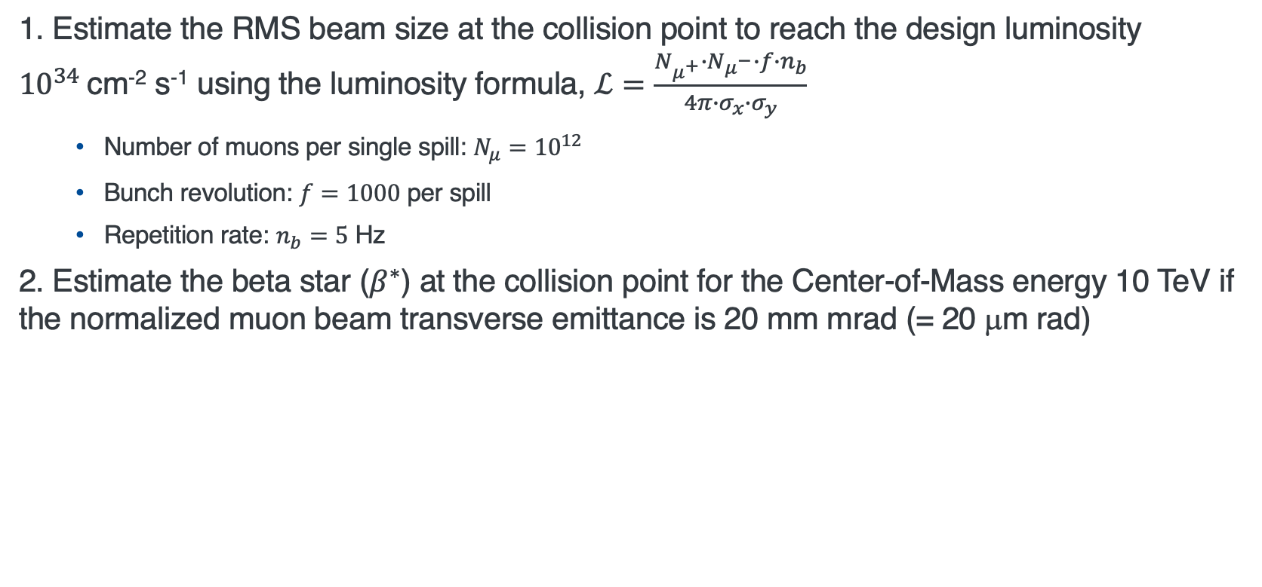
Question 1
1. Estimate the RMS beam size at the collision point to reach the design luminosity ${10}^{34}$cm⁻² s⁻¹ using the luminosity formula, $ℒ=\frac{N_{μ^{+}}{∙N}_{μ^{−}}∙f∙n_{b}}{4π{∙σ}_{x}∙σ_{y}}$
  Number of muons per single spill: $N_{μ}={10}^{12}$
  Bunch revolution: $f=1000$ per spill
  Repetition rate: $n_{b}=5$ Hz
2. Estimate the beta star ($β^{∗}$) at the collision point for the Center-of-Mass energy 10 TeV if the normalized muon beam transverse emittance is 20 mm mrad (= 20 μm rad)
$β^{∗}$: beta function at the collision point

Slide 3
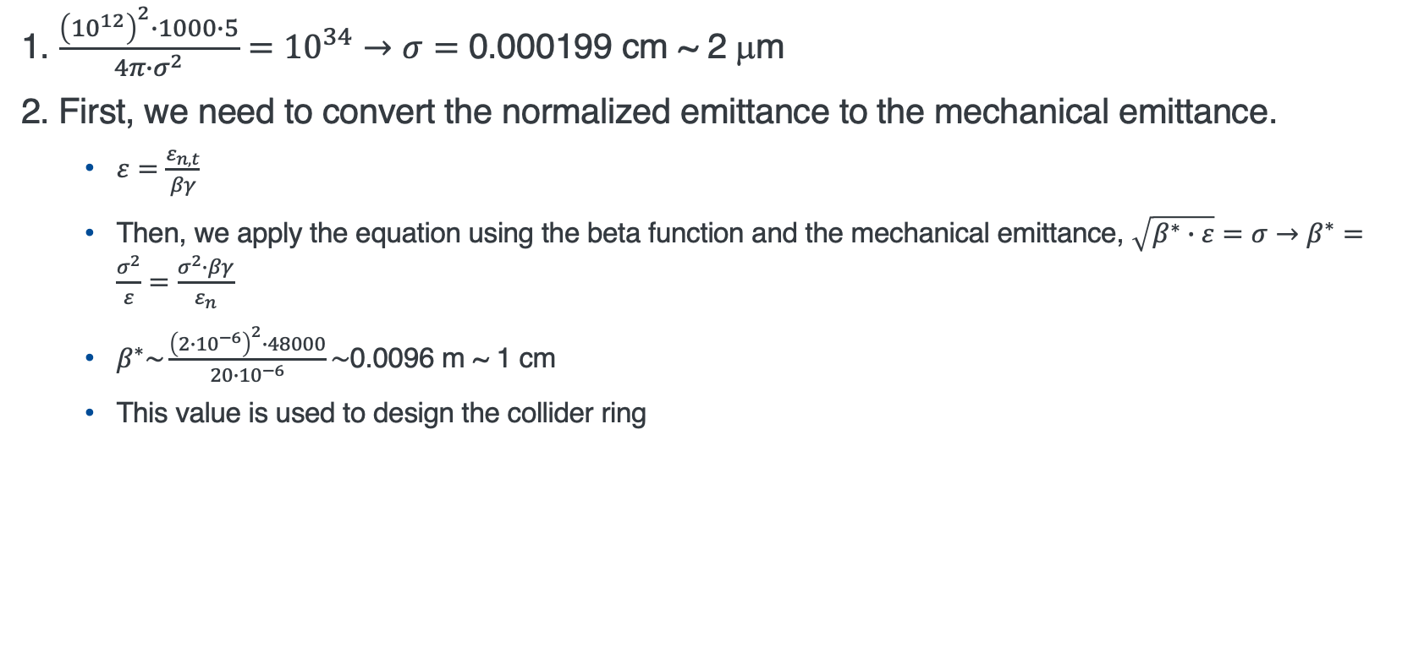
Answer for Question 1
1. $\frac{{\left({10}^{12}\right)}^{2}∙1000∙5}{4π∙σ^{2}}={10}^{34}→σ=$ 0.000199 cm ~ 2 μm
2. First, we need to convert the normalized emittance to the mechanical emittance.
  $ε=\frac{ε_{n,t}}{βγ}$
  Then, we apply the equation using the beta function and the mechanical emittance, $\sqrt{β^{∗}∙ε}=σ→β^{∗}=\frac{σ^{2}}{ε}=\frac{σ^{2}∙βγ}{ε_{n}}$
  $β^{∗}\sim \frac{{\left(2∙{10}^{−6}\right)}^{2}∙48000}{20∙{10}^{−6}}\sim$0.0096 m ~ 1 cm
  This value is used to design the collider ring
Y. Alexahin et al., arXiv:1806.08717

Slide 4

Follow up for Question 1 (I)
Can we achieve $ℒ≥{10}^{34}$?
  Achieve a final emittance than $ε_{t,n}≤20$ μm
  Improve transmission efficiency beyond 1 % and/or enhance proton-to-muon conversion to increase $N_{μ}$
Why not increase $n_{b}$ or $f$?
  Initial proton beam is already at the power limit (~Mega-Watt)
  Number of revolutions per collider ring is constrained by the muon lifetime

Slide 5
Follow-up for Question 1 (II)
Current achievable final emittance is approaching the threshold where space charge effects become significant
  Beam composed of the same charged particles, naturally experiences repulsive Coulomb forces
  Moving charged particles generate magnetic fields, which reduce electrostatic repulsion →
  Thus, higher energy beams exhibit reduced space charge effect
Our luminosity formula does not consider the muon lifetime
  The mean luminosity is lower than 10³⁴ cm-2 s-1
Influence of longitudinal phase space at collision point
  Luminosity is reduced if the beam bunch length is too long
    So called hourglass effect

Slide 6
Emittance evolution
Break Liouville’ theorem

Slide 7
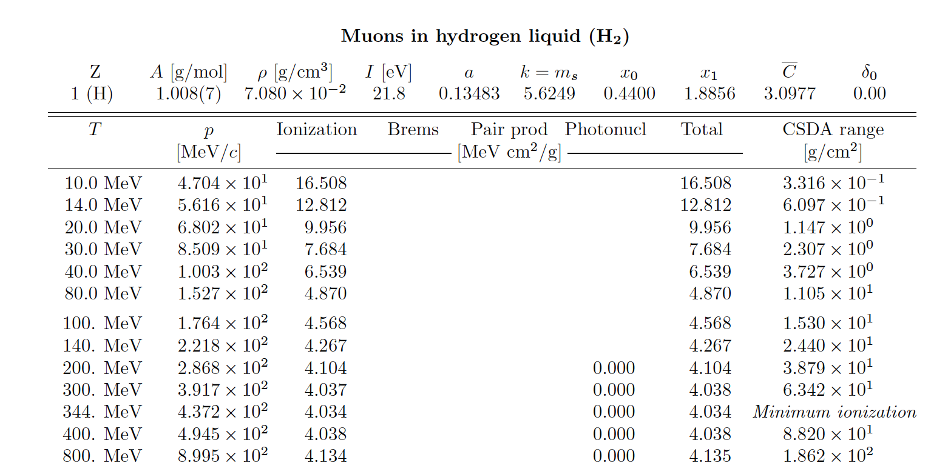
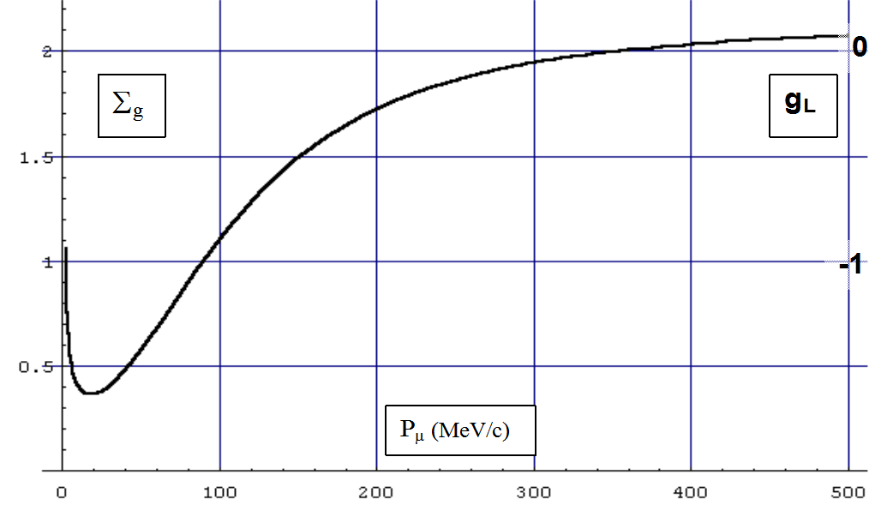
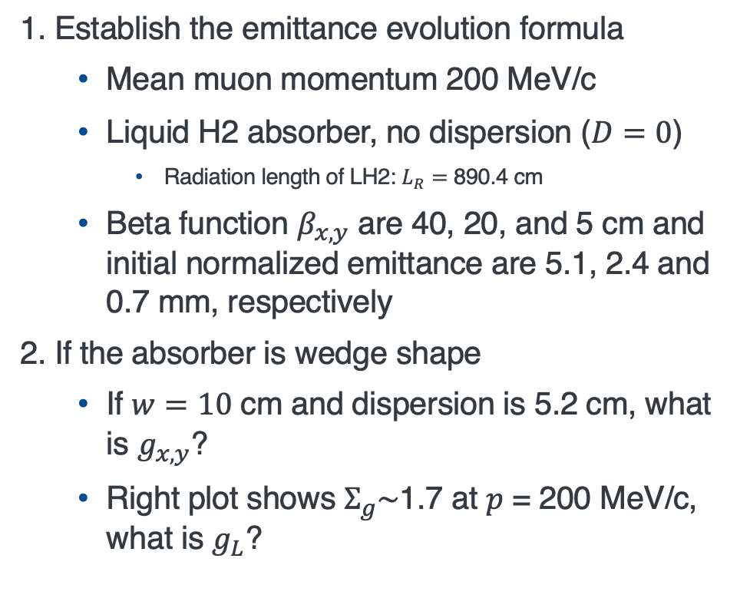
Question 2
1. Establish the emittance evolution formula
  Mean muon momentum 200 MeV/c
  Liquid H2 absorber, no dispersion ($D=0$)
    Radiation length of LH2: $L_{R}=$ 890.4 cm
  Beta function $β_{x,y}$ are 40, 20, and 5 cm and initial normalized emittance are 5.1, 2.4 and 0.7 mm, respectively
2. If the absorber is wedge shape
  If $w=10$ cm and dispersion is 5.2 cm, what is $g_{x,y}$?
  Right plot shows $Σ_{g}\sim$1.7 at $p$ = 200 MeV/c, what is $g_{L}$?

Slide 8
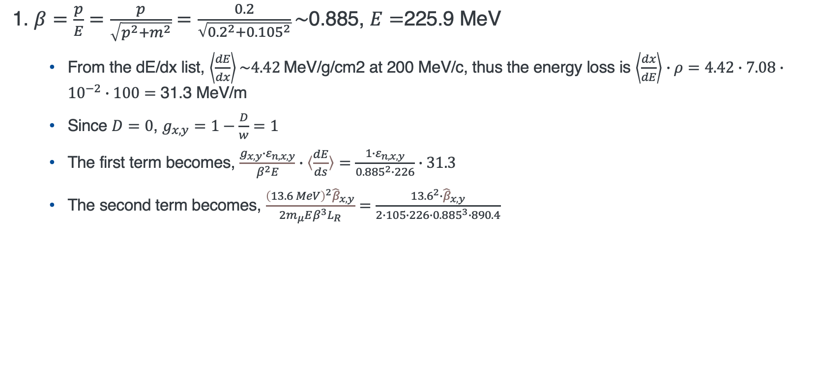
Answer for Question 2 (I)
1. $β=\frac{p}{E}=\frac{p}{\sqrt{p^{2}+m^{2}}}=\frac{0.2}{\sqrt{{0.2}^{2}+{0.105}^{2}}}\sim$0.885, $E=$225.9 MeV
  From the dE/dx list, $\left\langle \frac{dE}{dx}\right\rangle \sim 4.42$MeV/g/cm2 at 200 MeV/c, thus the energy loss is $\left\langle \frac{dx}{dE}\right\rangle ∙ρ=4.42∙7.08∙{10}^{−2}∙100=$ 31.3 MeV/m
  Since $D=0$, $g_{x,y}=1−\frac{D}{w}=1$
  The first term becomes, $\frac{g_{x,y}∙ε_{n,x,y}}{β^{2}E}∙〈\frac{dE}{ds}〉=\frac{1∙ε_{n,x,y}}{{0.885}^{2}∙226}∙31.3$
  The second term becomes, $\frac{{\left(13.6 MeV\right)}^{2}{\hat{β}}_{x,y}}{2m_{μ}Eβ^{3}L_{R}}=\frac{13.6^{2}∙{\hat{β}}_{x,y}}{2∙105∙226∙{0.885}^{3}∙890.4}$

Slide 9
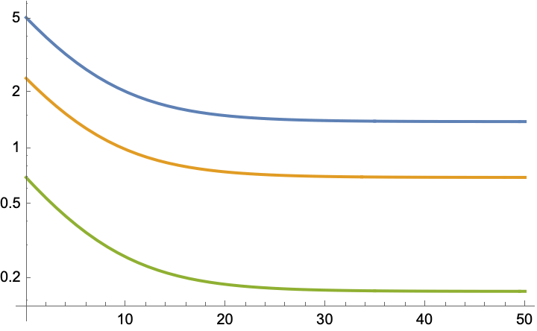
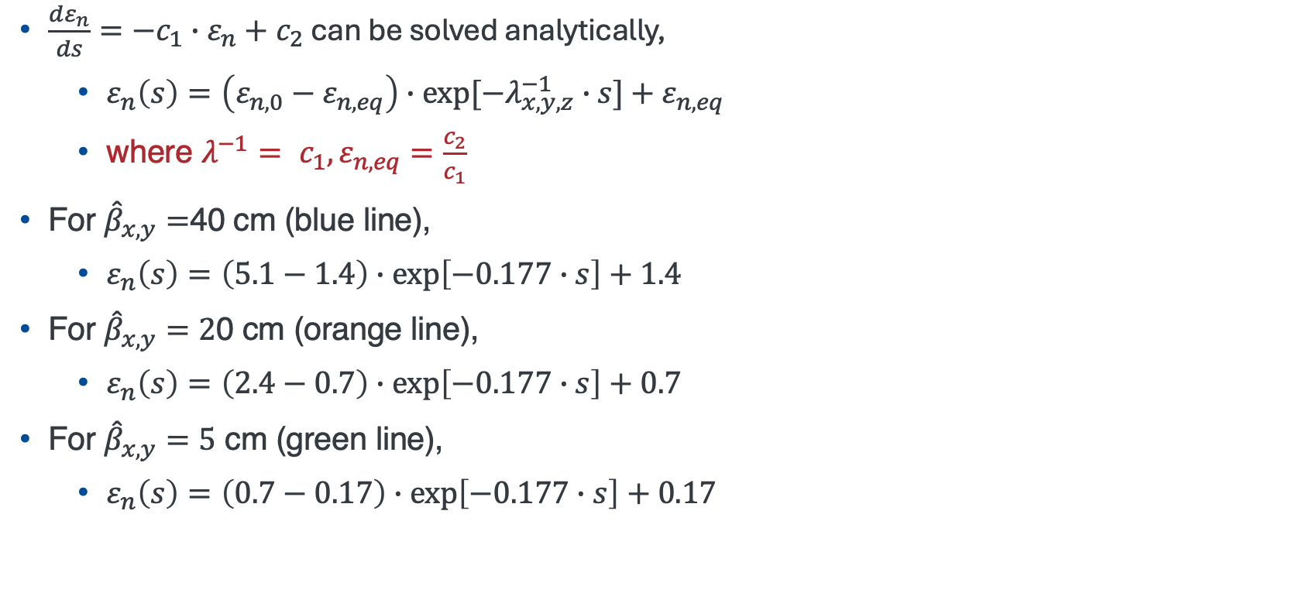
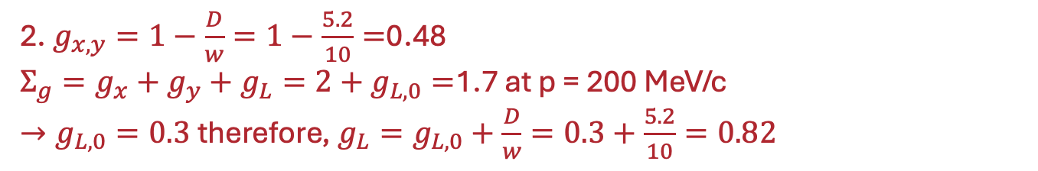

Answer for Question 2 (II)
$\frac{dε_{n}}{ds}={−c}_{1}∙ε_{n}+c_{2}$ can be solved analytically,
  $ε_{n}\left(s\right)=\left(ε_{n,0}−ε_{n,eq}\right)∙exp[−λ_{x,y,z}^{−1}∙s]+ε_{n,eq}$
  where ${λ^{−1}= c_{1},ε}_{n,eq}=\frac{c_{2}}{c_{1}}$
For ${\hat{β}}_{x,y}=$40 cm (blue line),
  $ε_{n}\left(s\right)=\left(5.1−1.4\right)∙exp\left[−0.177∙s\right]+1.4$
For ${\hat{β}}_{x,y}=2$0 cm (orange line),
  $ε_{n}\left(s\right)=\left(2.4−0.7\right)∙exp\left[−0.177∙s\right]+0.7$
For ${\hat{β}}_{x,y}=5$ cm (green line),
  $ε_{n}\left(s\right)=\left(0.7−0.17\right)∙exp\left[−0.177∙s\right]+0.17$
$ε_{n,x,y}$ [mm]
s [m]
2. $g_{x,y}=1−\frac{D}{w}=1−\frac{5.2}{10}=$0.48
$Σ_{g}=g_{x}+g_{y}+g_{L}=2+g_{L, 0}=$1.7 at p = 200 MeV/c
$→g_{L,0}=0.3$ therefore, ${g_{L}=g}_{L,0}+\frac{D}{w}=0.3+\frac{5.2}{10}=0.82$

Slide 10
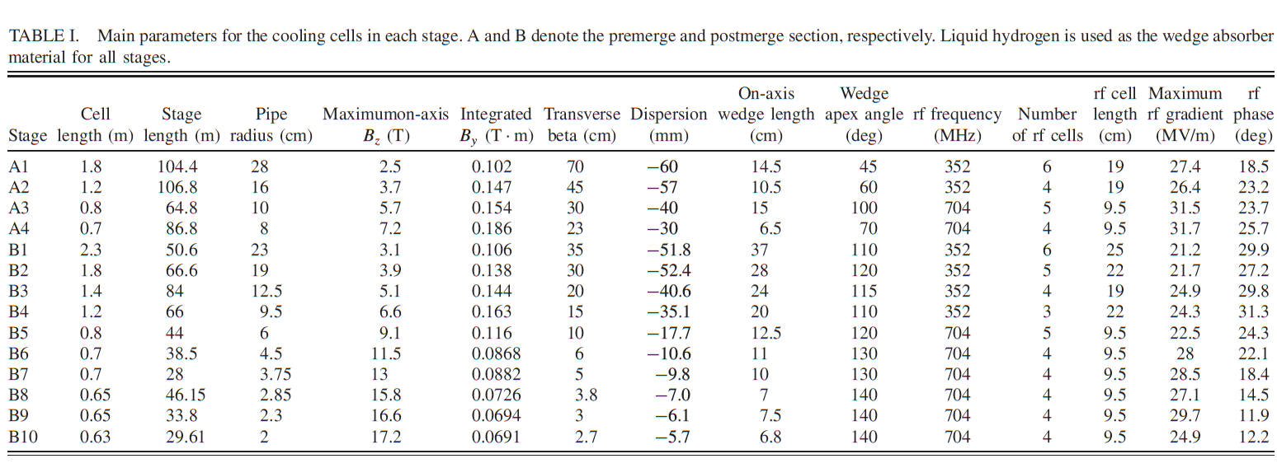
Follow-up for Question 2
Current cooling design is a step structure
  Individual channels is a fixed magnetic field
In practice, the channel should be connected smoothly
R. Zhu et al., PRAB 28 041003 (2025)

Slide 11
Solenoid base beam optics
X and Y motions and their beta functions are coupled

Slide 12
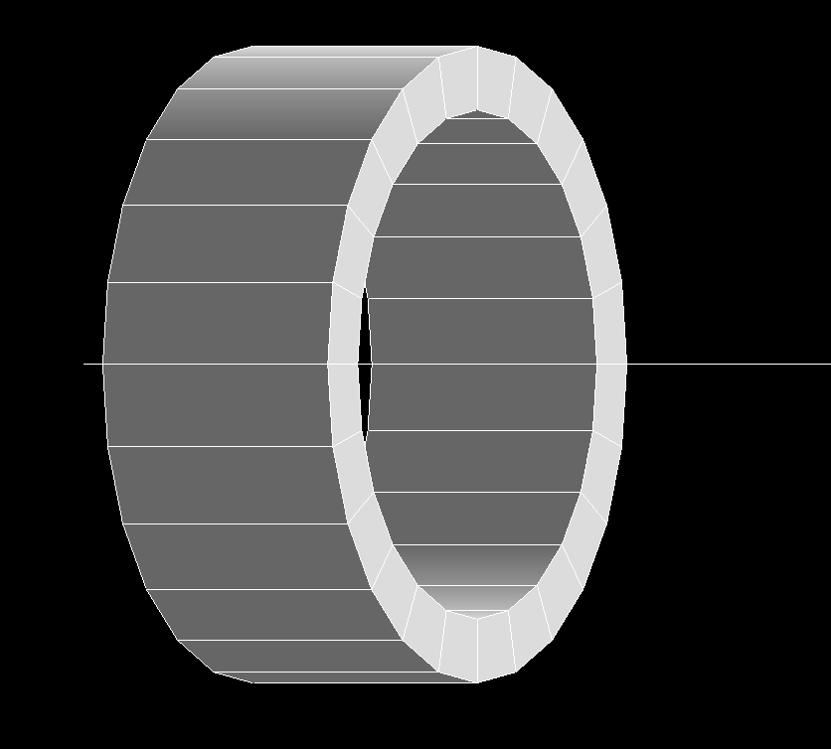
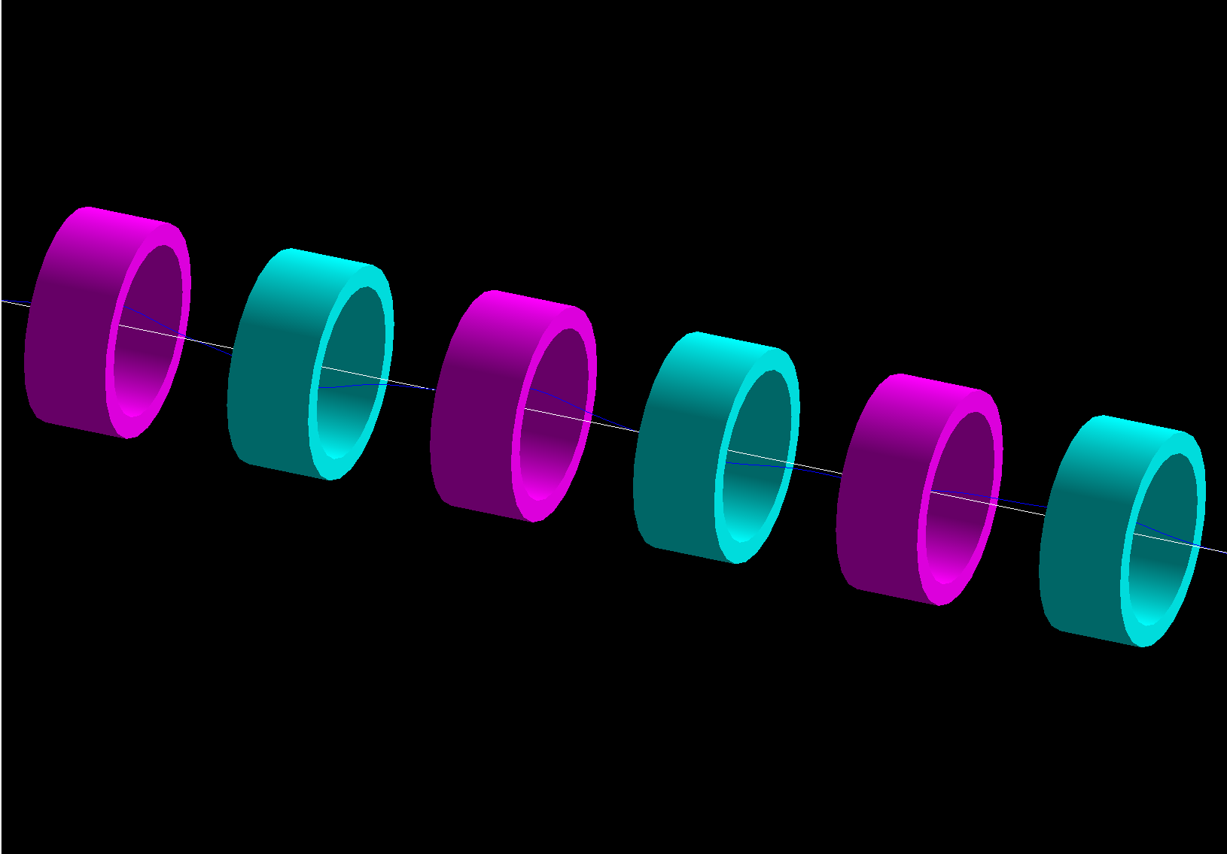

Question 3 (Optional)
Evaluate FOFO channel (use my input file if you have g4beamline)
Coil length L
Fernow’s coil (referred from PRSTAB 10, 064001 (2007)
Coil length = 400 mm
Coil inner radius = 400 mm
Coil thickness = 100 mm
Current = $±$100 Amp/mm2
Period = 1000 mm
Coil inner radius a
Coil thickness t
Flipping solenoid coil

Slide 13
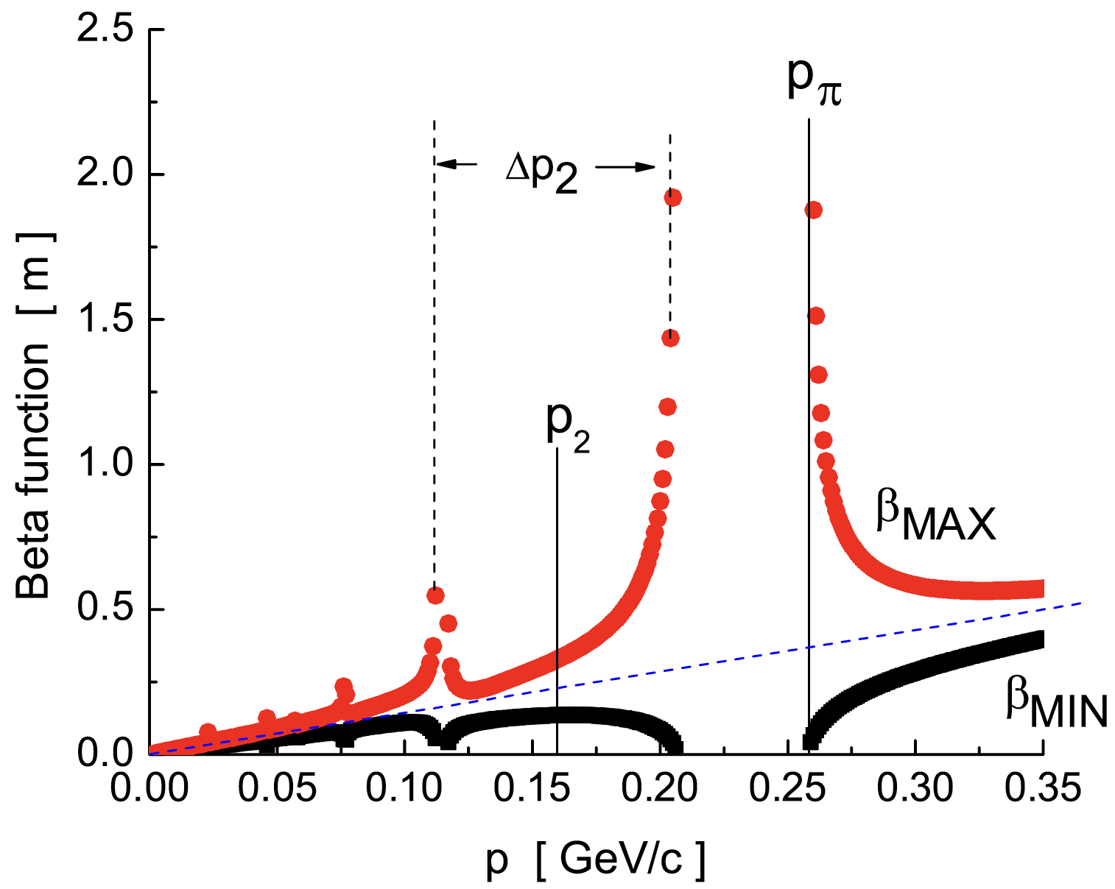
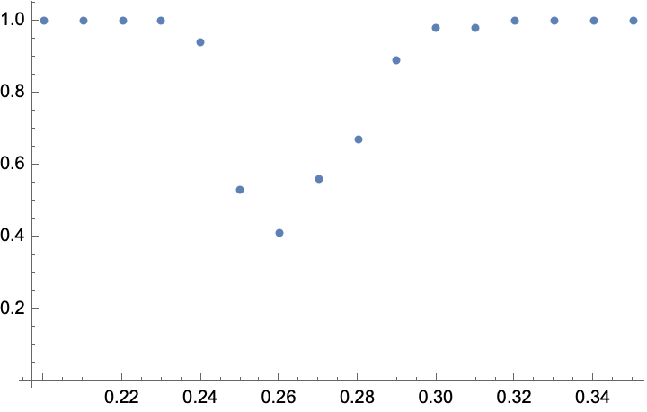
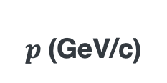
Question 3
Demonstrate stop band
Demonstrate maximum and minimum beta functions for Fernow’s four different channels (see slide 55)
Transmission efficiency
Our simulation
(agreed very well)
0.73 m
Stop band
$p$(GeV/c)
0.13 m

Slide 14
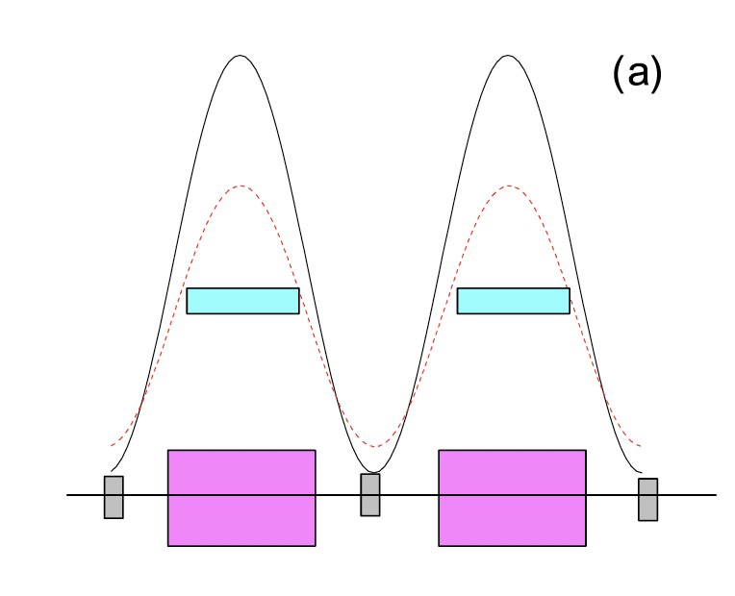
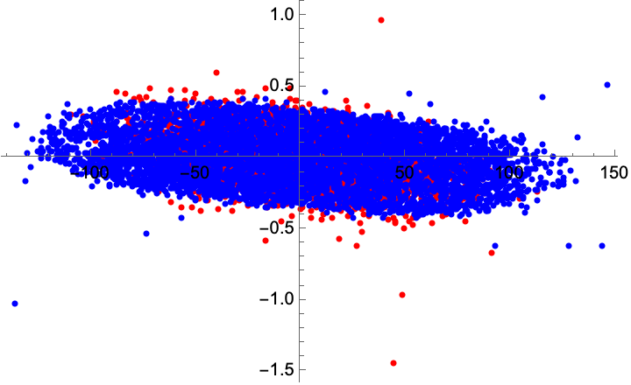
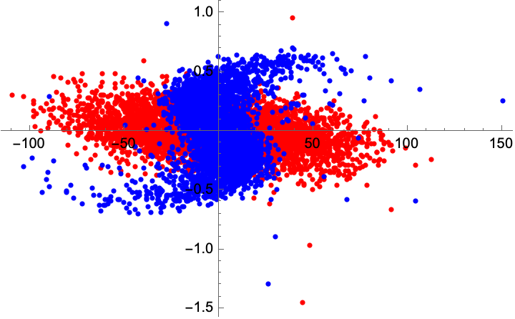


Follow-up for Question 3
fofostudy_fernow_fig1a_05280140.nb
x’ (rad)
Filamentation due to mismatching
x’ (rad)
x (mm)
x (mm)
Red: Initial phase space
Red: Initial phase space
$$ε_{⊥}=4.5 mm$$
$$β_{max}=0.70 m$$
$$ε_{⊥}=5.0 mm$$
$$β_{max}=0.13 m$$

Slide 15
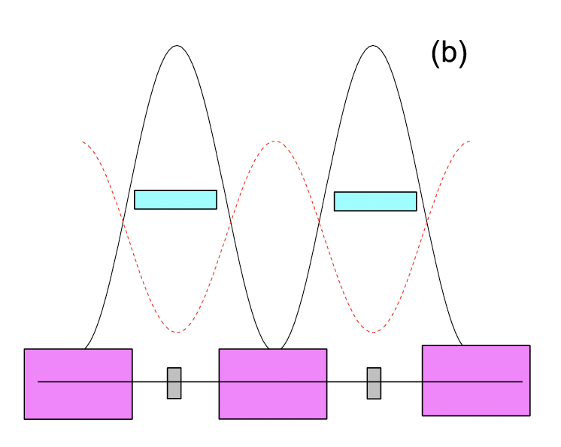
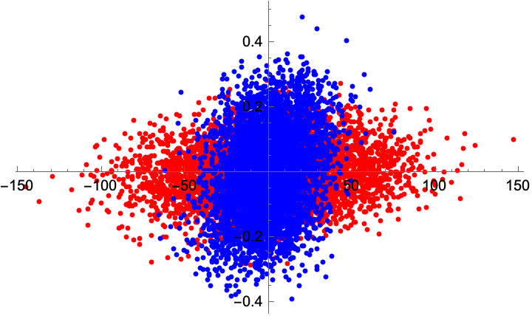
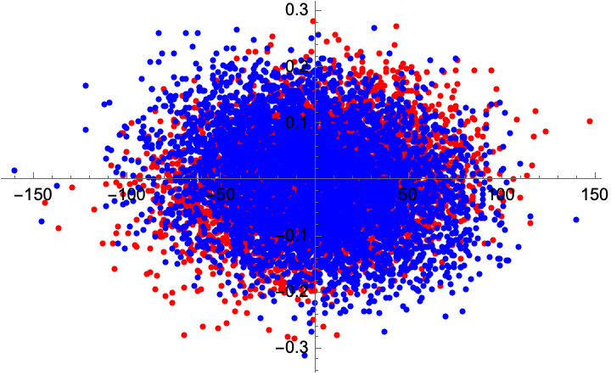


Follow-up for Question 3
fofostudy_fernow_fig1b_05280150.nb
x’ (rad)
x’ (rad)
Red: Initial phase space
x (mm)
x (mm)
Red: Initial phase space
$$ε_{⊥}=2.1 mm$$
$$β_{max}=0.13 m$$
$$ε_{⊥}=2.1 mm$$
$$β_{max}=0.73 m$$

Slide 16
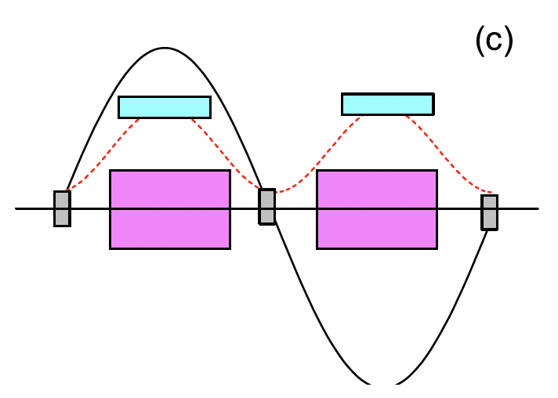
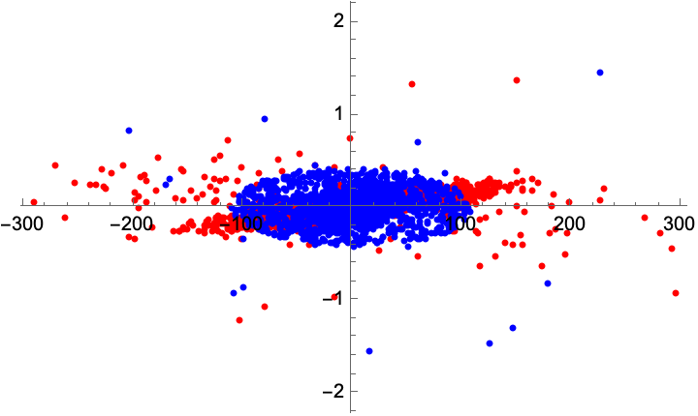
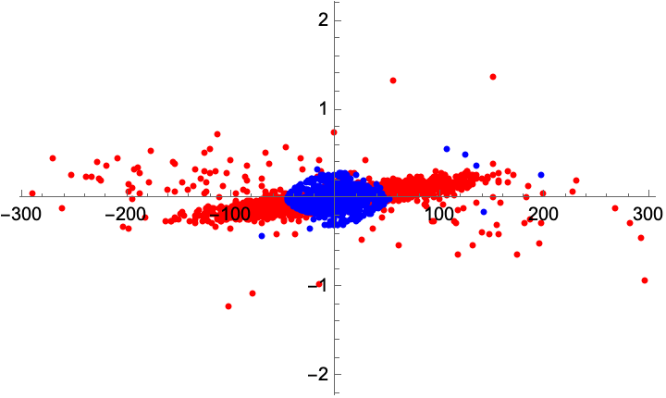


Follow-up for Question 3
fofostudy_fernow_fig1c_05290160.nb
x’ (rad)
x’ (rad)
x (mm)
x (mm)
Red: Initial phase space
Red: Initial phase space
$$ε_{⊥}=1.6 mm$$
$$β_{max}=1.08 m$$
$$ε_{⊥}=1.6 mm$$
$$β_{max}=0.18 m$$
16

Slide 17
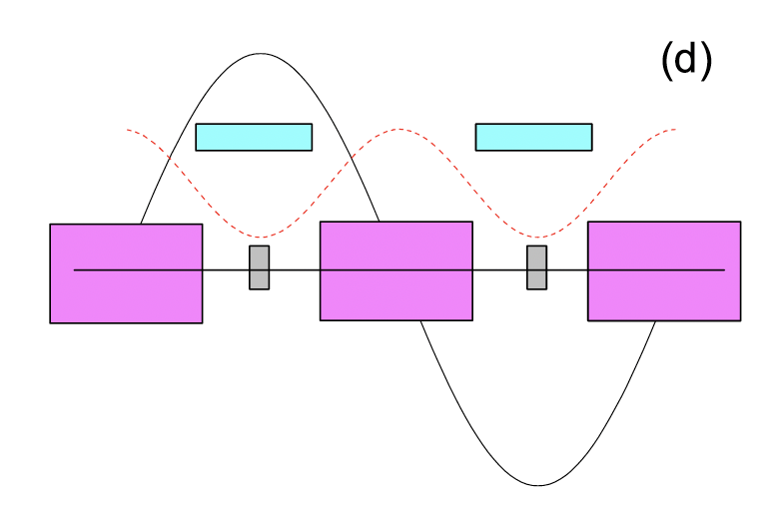
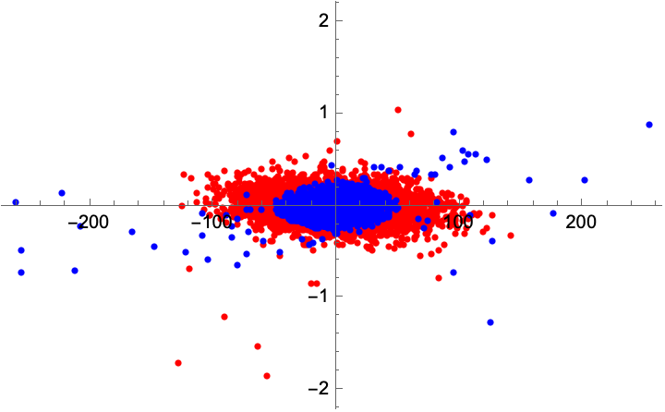
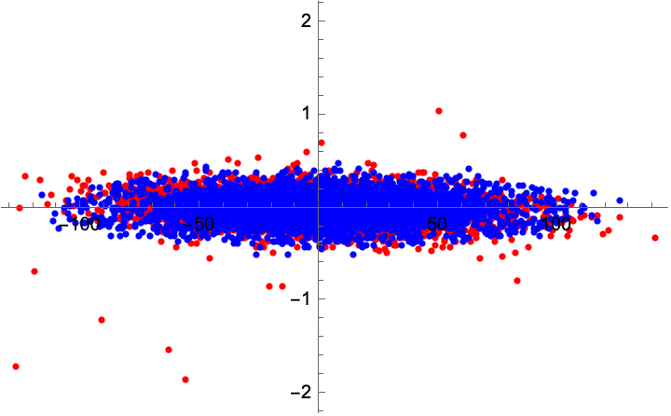

Follow-up for Question 3
fofostudy_fernow_fig1d_05280170.nb
x’ (rad)
x’ (rad)
x (mm)
x (mm)
Red: Initial phase space
Red: Initial phase space
$$ε_{⊥}=1.6 mm$$
$$β_{max}=0.97 m$$
$$ε_{⊥}=1.6 mm$$
$$β_{max}=0.18 m$$

