Slide 1
Target Technology
Robert Zwaska, Fermilab
Muon Collider Accelerator School
6 August 2025

Slide 2
Fermilab Makes Neutrinos and Muons
Particle accelerators provide the raw material in terms of the kinetic energy stored in the high-power beams
Target Stations convert the kinetic energy into new fundamental particles that are the subject of experiments
  We do this by building devices (targets) that provide reaction material for the matter-creating collisions, focusing devices to maximize the intensities of our beams, and the numerous additional devices and system to manage these beams
This talk: example of making a neutrino beam:
  Interest in neutrinos
  The accelerators provide the raw energy
  The target converts the energy to new matter
  The beamline defines the beam towards detectors
  Neutrinos go forward (inexorably)
A little of the challenges of neutrino beams
Neutrino beams around the world
An introduction to high-power targetry

Slide 3
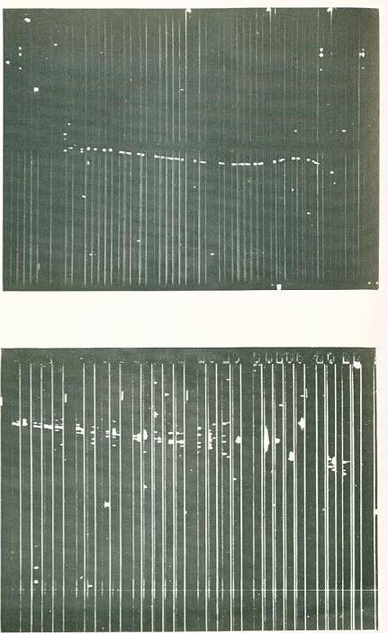
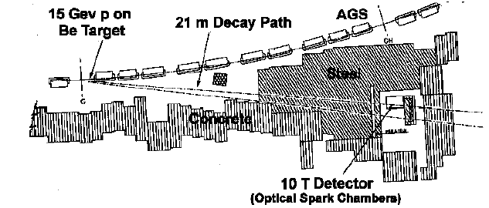
The First Neutrino “Beam”
Saw lots of…
In 1957, Brookhaven AGS and CERN PS first accelerators intense enough to make ν beam
  p + Be → π⁺ + X, π⁺ → μ⁺ ν
1962: Lederman, Steinberger, Swartz propose experiment to see
ν_{μ} + N→ μ⁻ + X (Phys.Rev.Lett. 9, 36 (1962))
ν
ν_{μ} + N→ μ⁻ + X
Saw none of…
ν
ν_{e} + N→ e⁻ + X

Slide 4
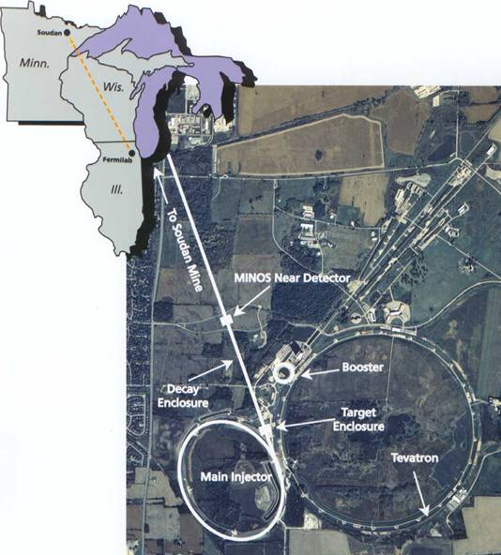
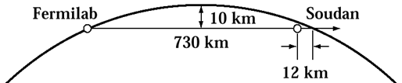
The NuMI Facility
“Neutrinos (ν –> Nu) at the Main Injector”
Intense muon-neutrino beam directed towards Minnesota
Main Injector supplies 25 – 50
trillion 120GeV protons every
1.4 seconds
  Operating regularly above 900 kW
Each pulse produces about 2x10¹⁴ ν _{μ}
  ~ 20,000,000 Pulses per year
Direct beam 3º down
On-site and off-site experiments
Different types of neutrino beams
Beam is 10s of kilometers wide at exit
“Long-baseline”
Neutrino beam
Near Detector: 980 tons
Far Detector: 5400 tons
5

Slide 5
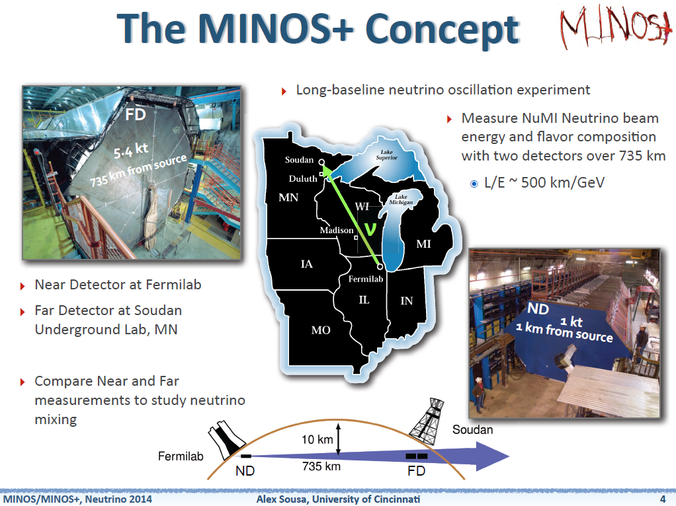
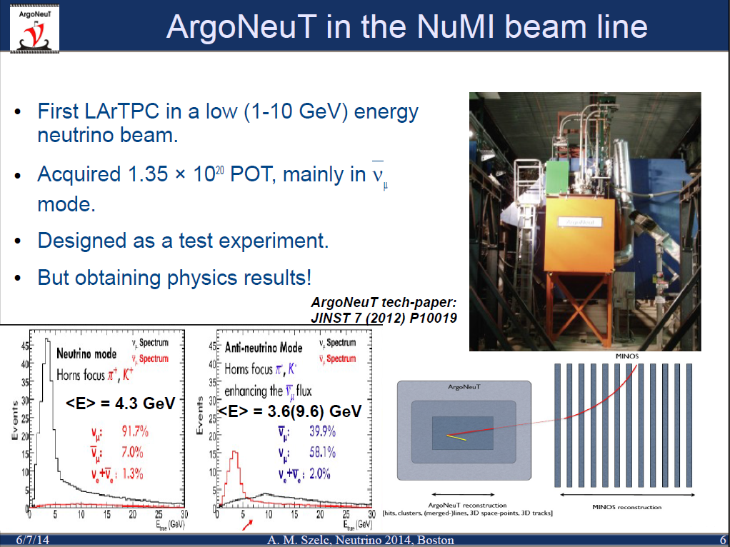
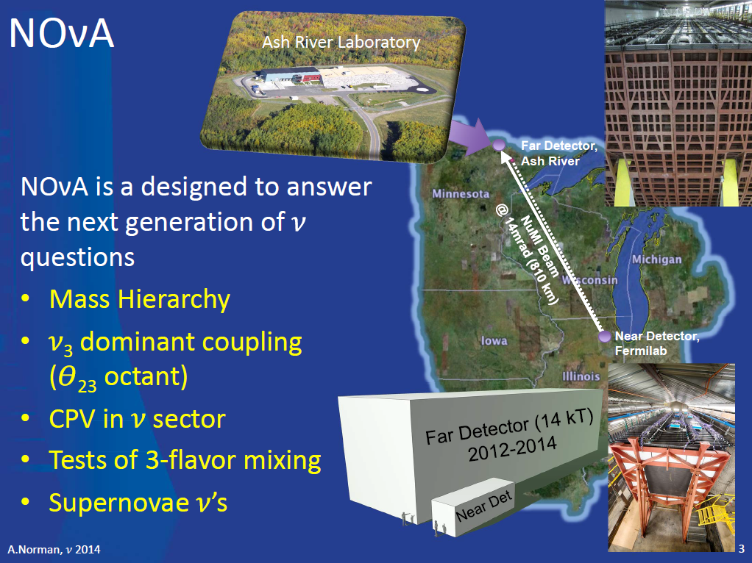
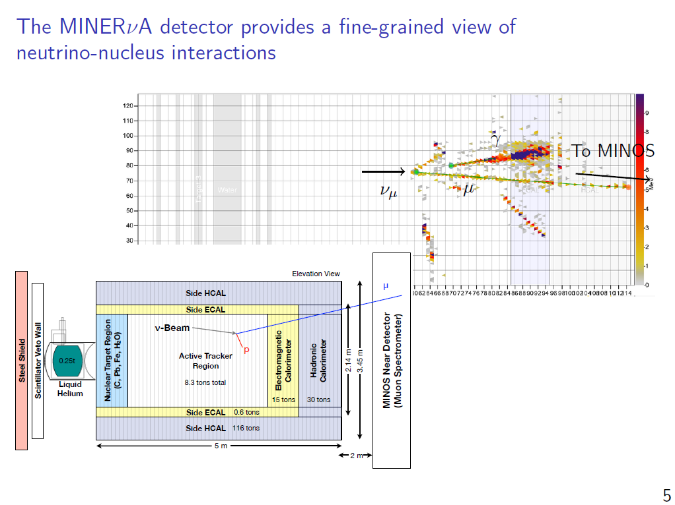
Multiple Experiments in the NuMI Beam
Long-baseline oscillation experiments
Neutrino scattering experiments

Slide 6
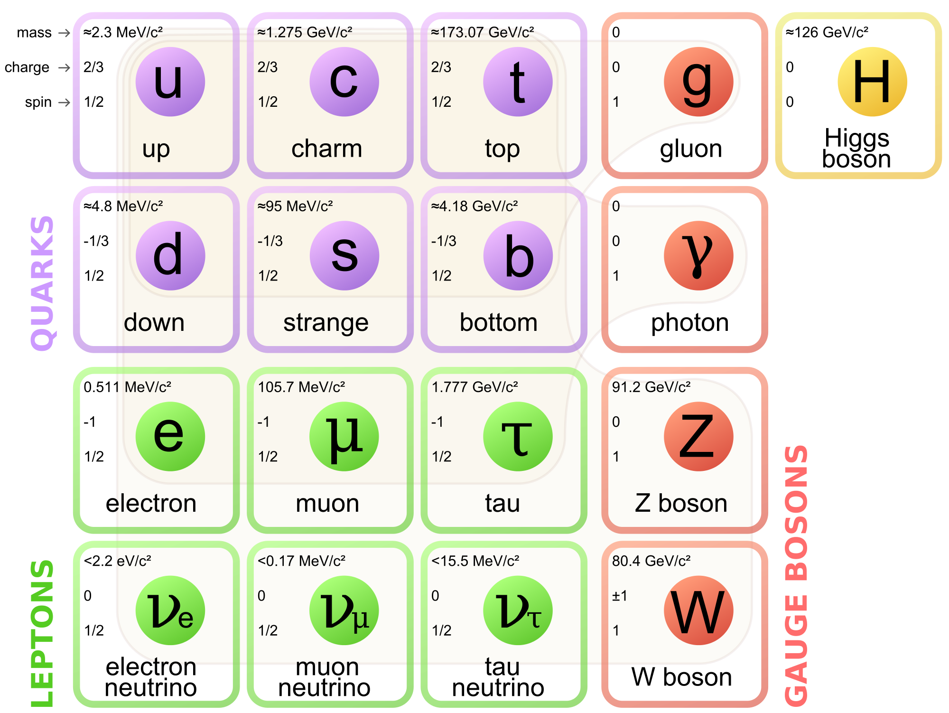
Pion Decay!
Most all of our neutrinos come from pion decays
Two quarks, bound together by gluons, convert into a neutrino and muon
A “simple” decay (at first)
  Pion mass ~ 140 MeV/c², Muon mass ~ 105 MeV/c²

Slide 7
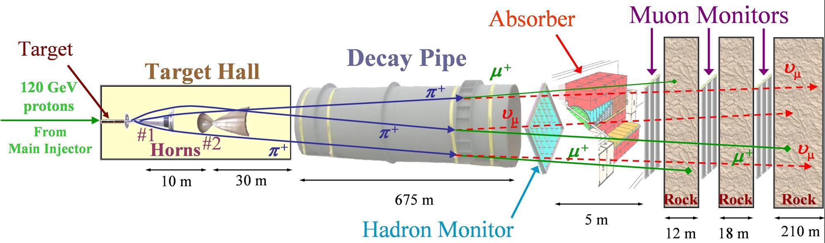
The NuMI Beam “Neutrinos at the Main Injector”
Absorbs ~ 40 % of beam power
Allows high-energy muons to penetrate
2 m diameter
Roughly decay length for 10 GeV π⁺
He-filled
1 meter long, C target
Produces π⁺, K⁺ mesons
400 kW design average power
700 kW upgrade for NOvA
1 Megawatt Upgrade 2021
σ ∼ 1 mm
Pulsed focusing horns
Toroidal magnetic field
Parabolic inner conductor profile
Focus meson momentum band
Measure hadron & muon fluxes
Arrays measure distributions

Slide 8
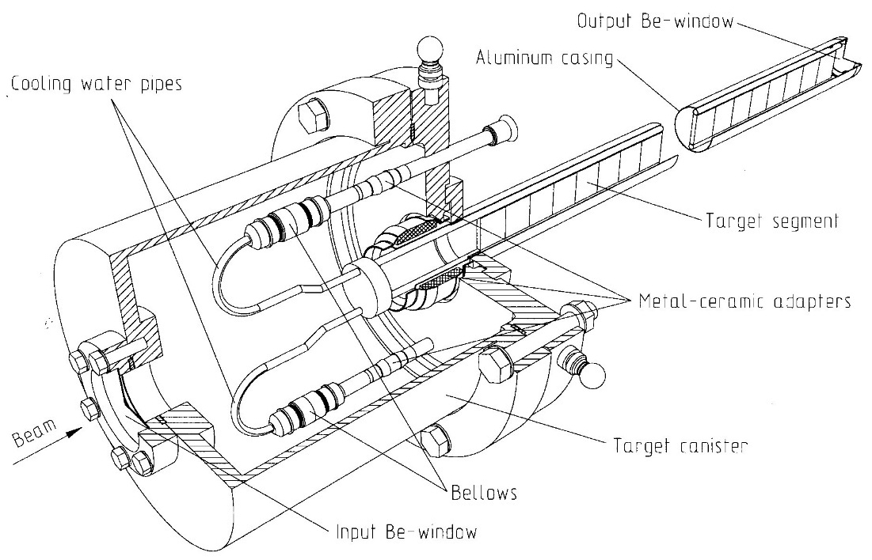
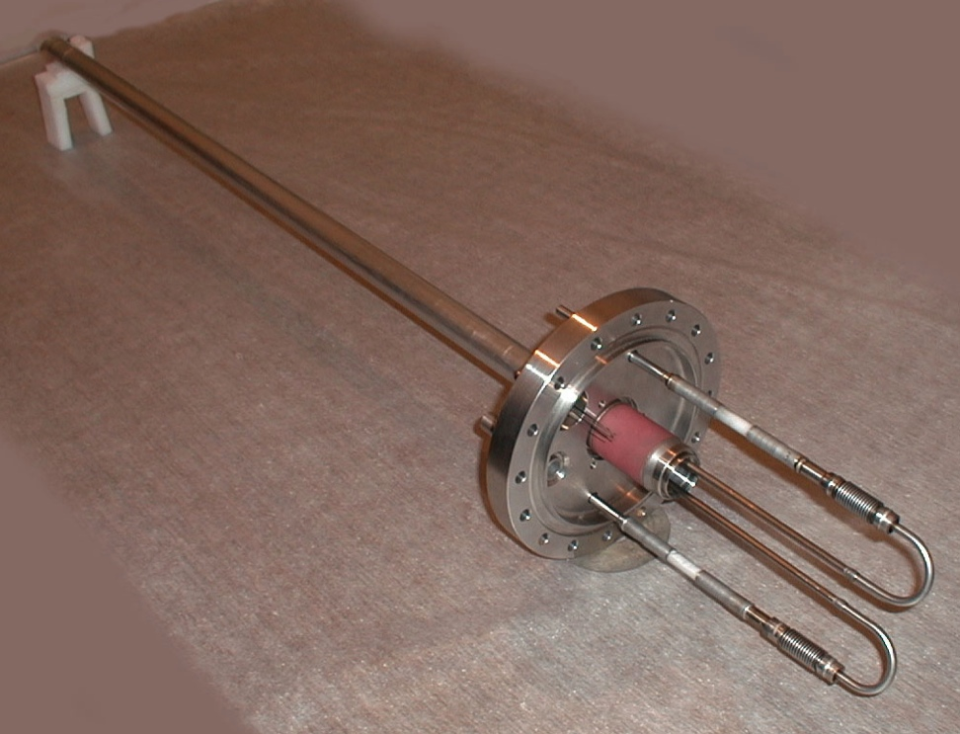
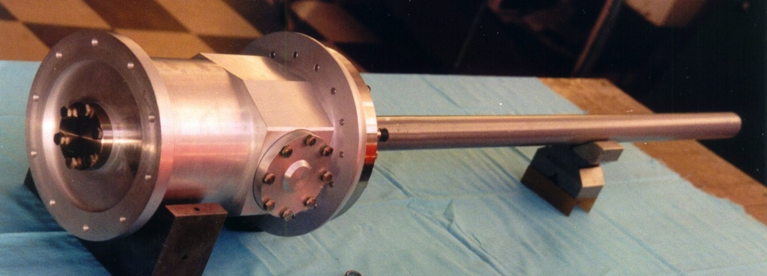
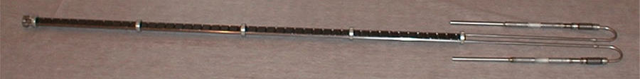
The MINOS Target
~ 4 kW beam power
deposited in target
Encased in
vacuum / helium can
with beryllium windows
Water cooled
graphite core

Slide 9
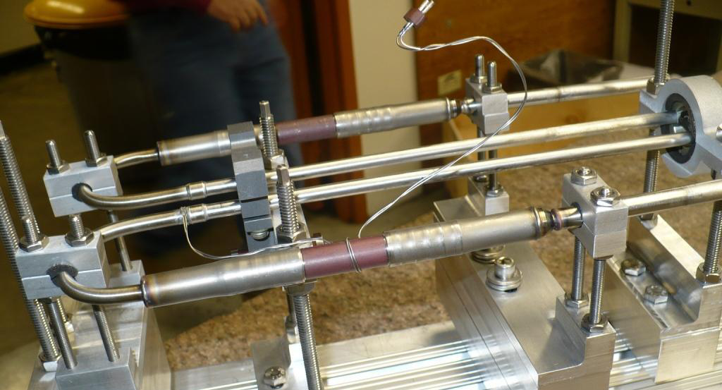
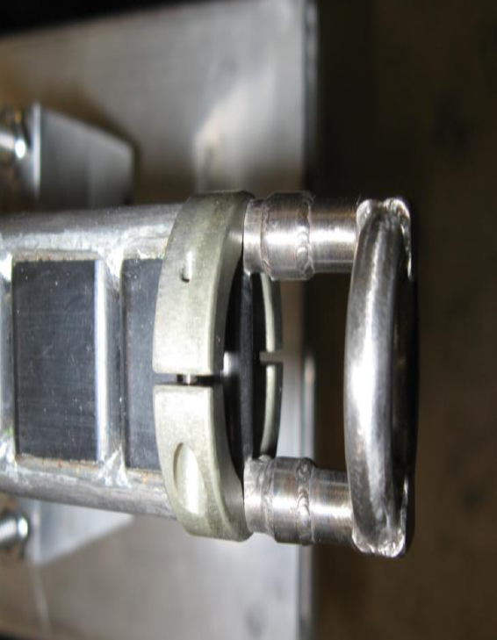
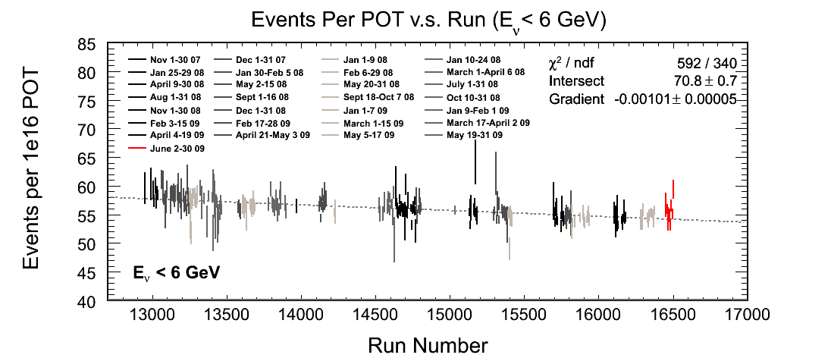
Target Issues
Common failure mode was water cooling
  Also, an issue for horns
  Many lessons were learned in design and in quality control
NOvA target is more robust in its design
  Made possible by being outside of the horn.
  LBNF Design returns to inside the horn
Graphite degradation was observed on one target
  May ultimately limit the performance of the target

Slide 10
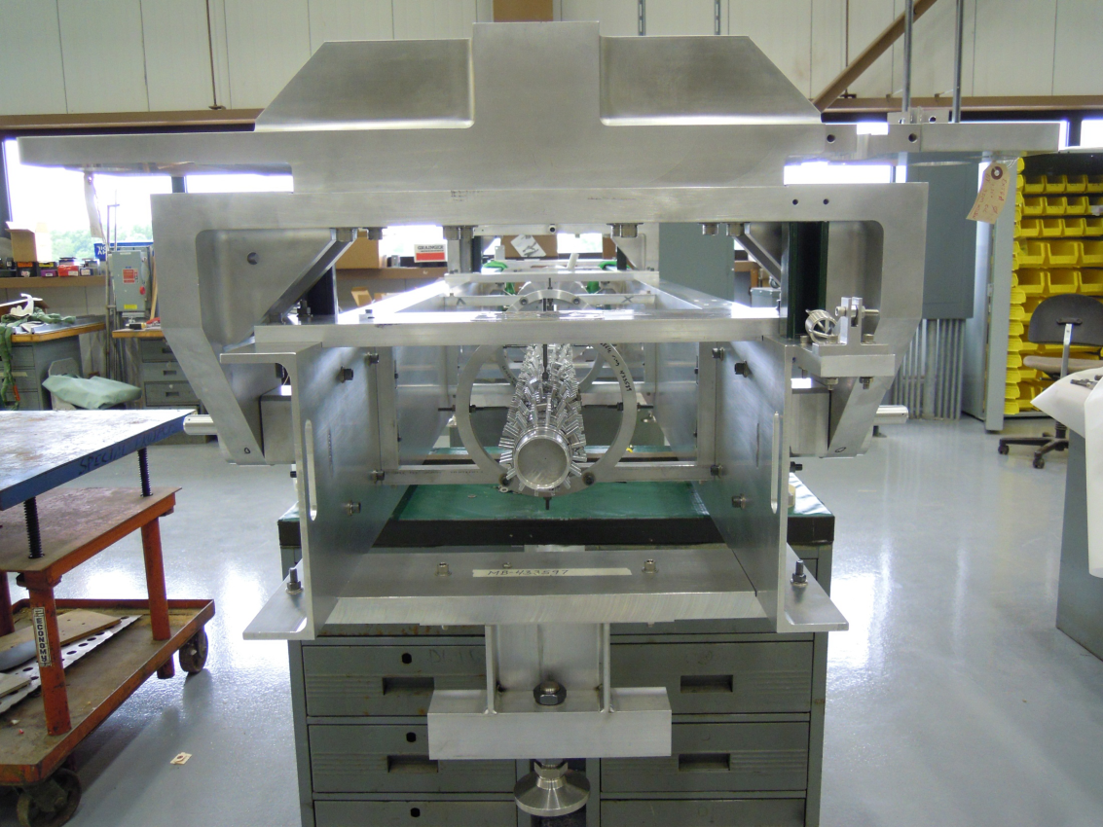
NOvA Target
Graphite fins: 50 x 24 mm; 7.4 – 9.0 mm wide
Helium atmosphere
Beryllium windows
Water cooled aluminum pressing plates
Water cooled outer vessel
Initially designed for 700 kW, now upgraded to 1 MW
IHEP Protvino (Russia) initial design
STFC-RAL / FNAL final design and construction

Slide 11
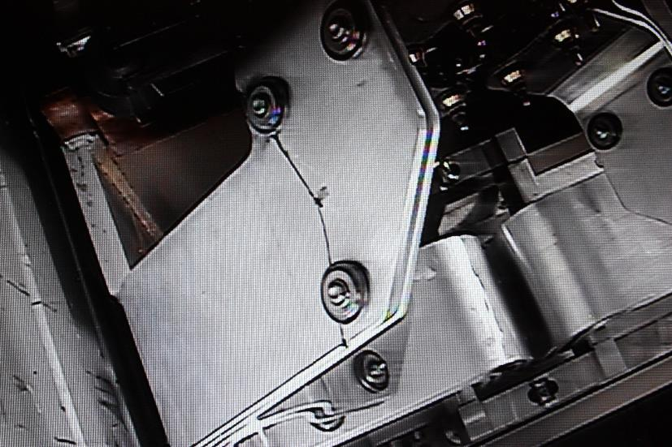
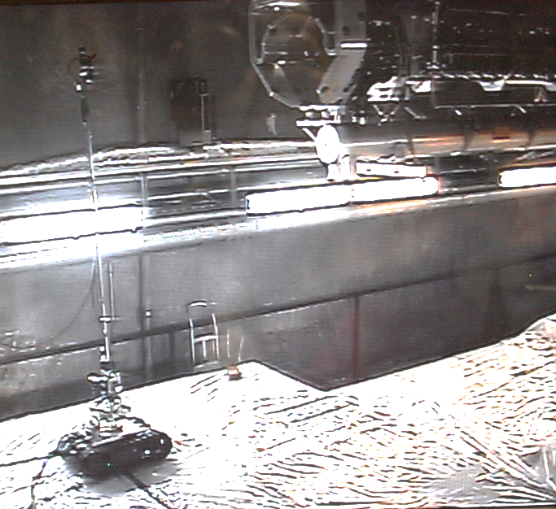
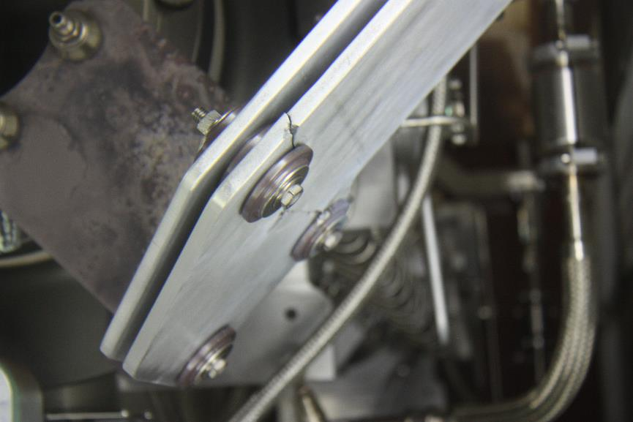
Challenging Environments
Replaced NuMI Horn summer 2015 due to failed stripline
  First 700 kW capable horn, in service since Sept. 2013, accumulated ~ 27 million pulses
Failure was due to fatigue, likely enhance by vibrations

Slide 12

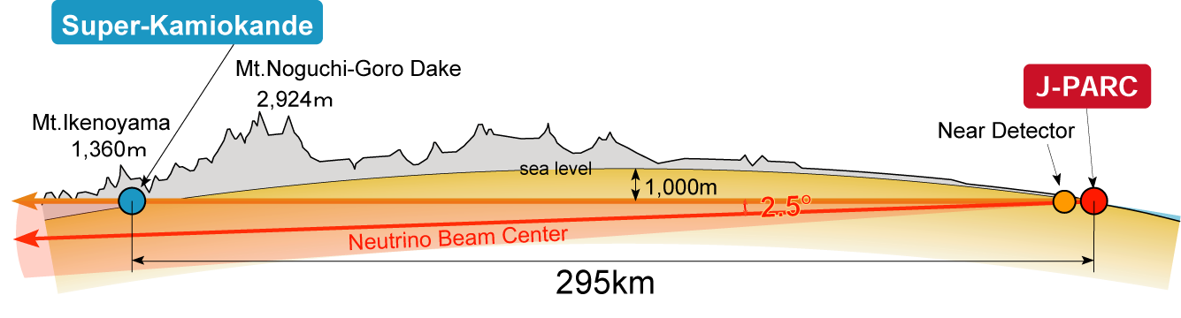
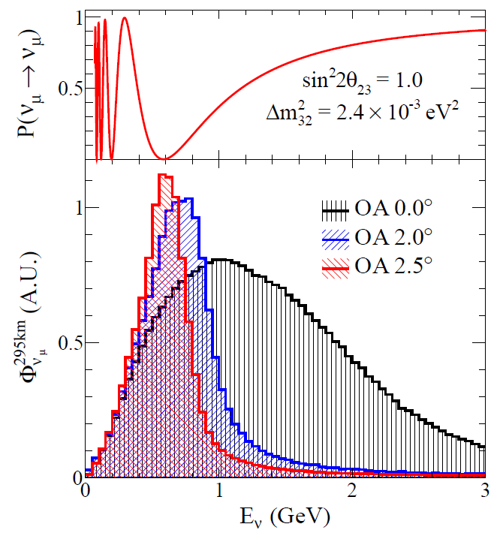
The T2K experiment
muon-monitor
Near
detectors
p
π
ν
Oscillation
Maximum
off-axis
on-axis
2.0~2.5º
Decay volume
0m
120m
280m
295 km
Conventional “horn-magnet-focused” ν beam
  30GeV Protons on a graphite target
  daughter π⁺ → μ⁺+ν_{μ} (π⁻ → μ⁻+ν_{μ} )
  Anti-neutrino production by inverse polarity
First application of Off-Axis(OA) beam: 2.0~2.5º wrt. the far detector direction
  Low-energy narrow-band beam
  peak tuned to oscillation maximum
  Small high-energy tail: reduce inelastic bkgs

Slide 13
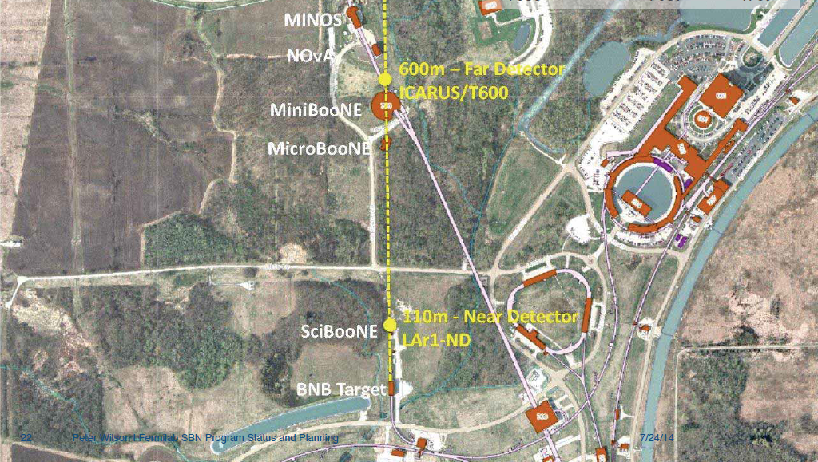
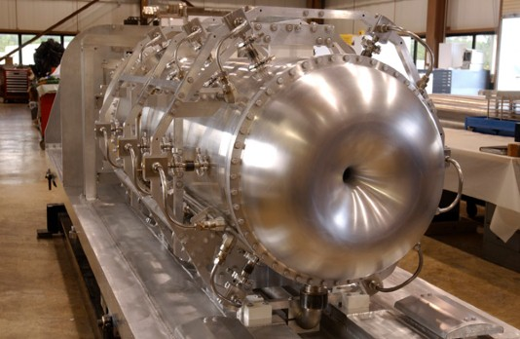
Booster Neutrino Beam (BNB)
Uses 8 GeV beam from the Fermilab Booster, operating since 2002
  Up to ~ 30 kW of beam (5e12 ppp)
Beryllium target integrated with single focusing horn
Services a suite of experiments at Fermilab: the Short Baseline Neutrino (SBN) program

Slide 14
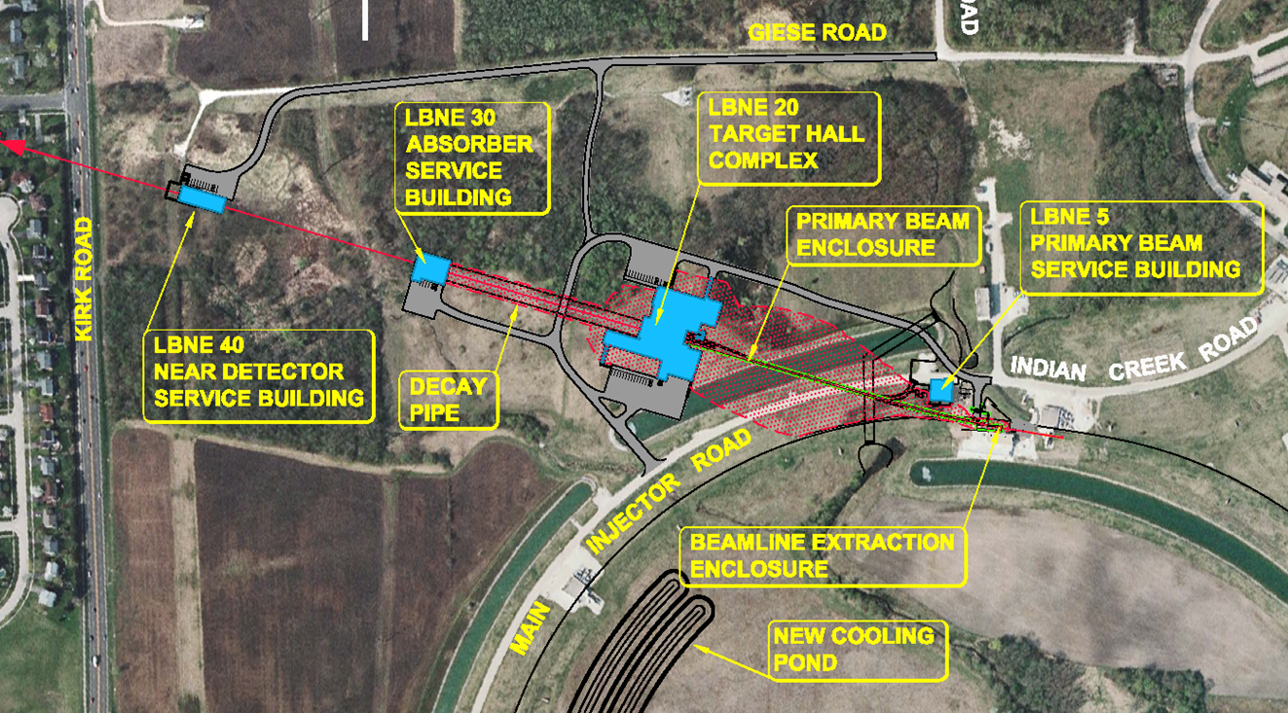
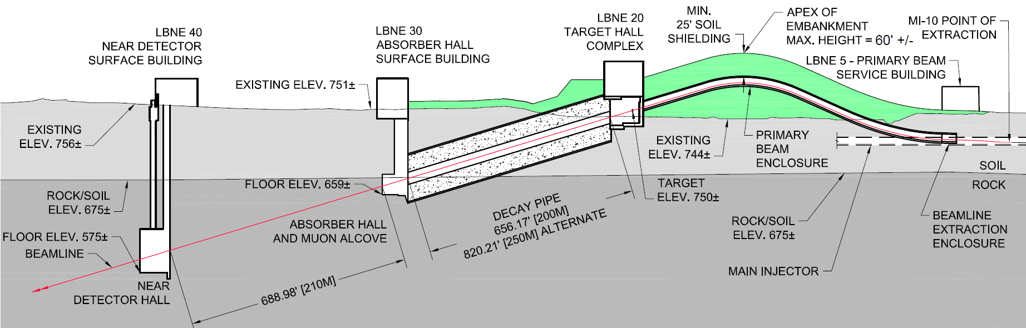
DUNE: Deep Underground Neutrino Experiment
LBNF: Long-Baseline Neutrino Facility

Slide 15
Timeline of High-Power Target Stations at Fermilab
Station | Design Power | Period | Comments
BNB | 30 kW | 2002 – 2027 (?)
NuMI | 700 kW – 1 MW | 2004 – 2027 | Megawatt Upgrade in progress.
AP-0 / Muon g-2 | 20 kW | 2017 – 2023 (?) | Using legacy targets & lenses from Antiproton Source.
Mu2e | 8 kW | 2027 (?) - | Very challenging high-Z, radiatively cooled target, even with low power.
LBNF/DUNE | 1.2 MW | 2031 (?) - | Challenging, but achievable devices. Rate of production may be greatest challenge.
Three operating stations, two in various stages of design & construction

Slide 16
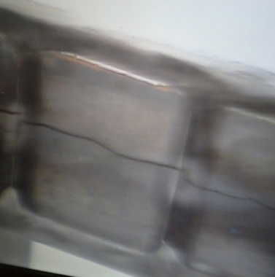
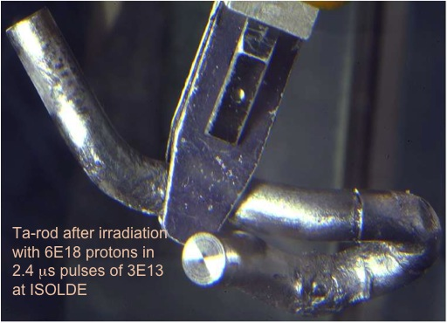
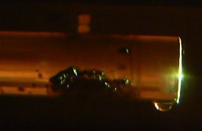
What we don’t want

Slide 17
Timeline of High-Power Target Stations
Station | Design Power | Period | Comments
BNB | 30 kW | 2002 – 2027 (?)
NuMI | 700 kW – 1 MW | 2004 – 2027 | Megawatt Upgrade in progress.
AP-0 / Muon g-2 | 20 kW | 2017 – 2023 (?) | Using legacy targets & lenses from Antiproton Source.
Mu2e | 8 kW | 2027 (?) - | Very challenging high-Z, radiatively cooled target, even with low power.
Mu2e-II | 100 kW | 2030s (?) - | “Impossible” Target
LBNF/DUNE | 1.2 MW | 2031 (?) - | Challenging, but achievable devices. Rate of production may be greatest challenge.
LBNF w/ ACE-MIRT | 2+ MW | 2034 (?) - | Challenging

Slide 18
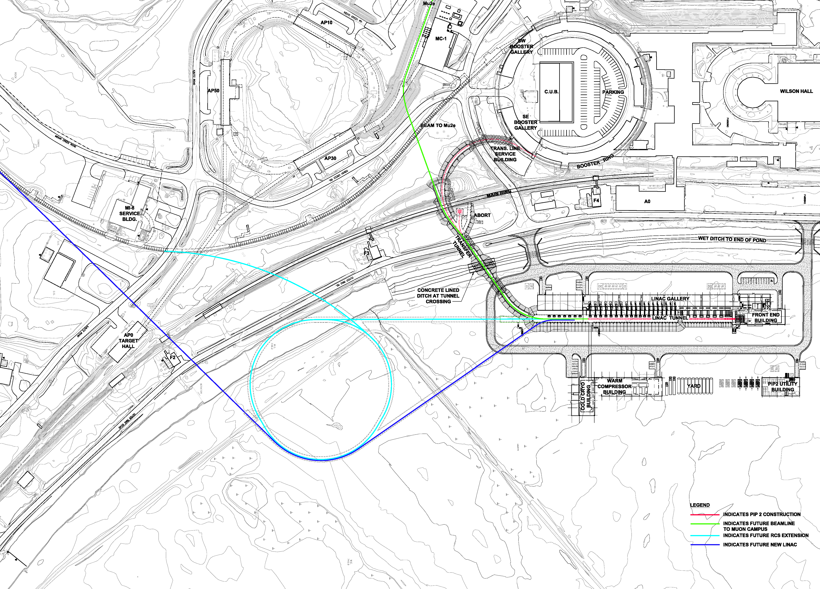
PIP-II + Possibilities
Numbers are examples, not official
PIP-II itself is a blowtorch of an accelerator
  Capable of 2 mA CW @ 800 MeV -> 1.6 MW
  One could reasonably expect experiments with that beam…
Future accelerators adds even more
  Linac option of 8 GeV?
    16 Megawatt beam
  Linac + RCS
    4 MW @ 2 GeV
    700 kW @ 8 GeV
PIP-II
PIP-III
 | Present | PIP-II | New RCS
MI
Beam Energy[GeV] | 120 | 120 | 120
Cycle Time[s] | 1.33 | 1.2 | 1.45
Protons per pulse[1e12] | 49 | 75 | 190
Power[MW] | 0.7 | 1.2 | 2.5
Proton Source
Injection Energy[GeV] | 0.4 | 0.8 | 0.8-2.0
Extraction Energy[GeV] | 8 | 8 | 8
Protons per Pulse[1e12] | 4.3 | 6.4 | 32
Beam Power to MI [kW] | 38 | 82 | 168

Slide 19
Timeline of High-Power Target Stations
Stations | Design Power | Period | Comments
BNB | 30 kW | 2002 – 2027 (?)
NuMI | 700 kW – 1 MW | 2004 – 2027 | Megawatt Upgrade in progress.
AP-0 / Muon g-2 | 20 kW | 2017 – 2023 (?) | Using legacy targets & lenses from Antiproton Source.
Mu2e | 8 kW | 2027 (?) - | Very challenging high-Z, radiatively cooled target, even with low power.
Mu2e-II | 100 kW | 2030s (?) - | “Impossible” Target
LBNF/DUNE | 1.2 MW | 2031 (?) - | Challenging, but achievable devices. Rate of production may be greatest challenge.
LBNF w/ ACE-MIRT | 2.5 MW | 2034 (?) - | Challenging
800 MeV Exp’t(s) | 1.6 MW | 2030s (?) -
2 GeV Exp’t(s) | 4 MW | 2030s (?) -
8 GeV Exp’t(s) | 0.8 – 16 MW | 2030s (?) -
Bonus
The Multi-Megawatt
Frontier

Slide 20
High Power/Intensity Targetry Challenges
Target Material Behavior
  Radiation damage
  Thermal “shock” response
  Highly non-linear thermo-mechanical simulation
Targetry Technologies (System Behavior)
  Remote handling
  Target system simulation (optimize for physics & longevity)
  Rapid heat removal
  Radiation protection
  Radiation accelerated corrosion
  Manufacturing technologies
Additional Neutrino Beam Challenges:
Primary beam handling and instrumentation
Accuracy and consistency of all beam inputs, particularly alignment
Focusing elements
Beam-based alignment
Secondary beam instrumentation
Radiation transport modeling
Hadron production
The high statistics from high-power beams require an emphasis on precision

Slide 21
Nu HPT R&D Materials Exploratory Map
Uncharted Territory
Future Nu 4 MW
NuMI-MINOS Target NT-02 (damaged)
NuMI-NOvA Target TA-01 (survived)
NT-07
NT-04
LBNF-2.4 MW Tau Nu
NT-06
NT-05
NT-03
NT-01
Thermal Shock Severity (p/cm²/pulse)
LBNF-2.4 MW (Ideal)
LBNF-1.2 MW (CDR)
LBNF-2.4 MW (CDR)
T2K First Target
SNS range for 1.4 MW operation for 1 year
Radiation Damage Severity
(damage equivalent fluence, p/cm²)

Slide 22
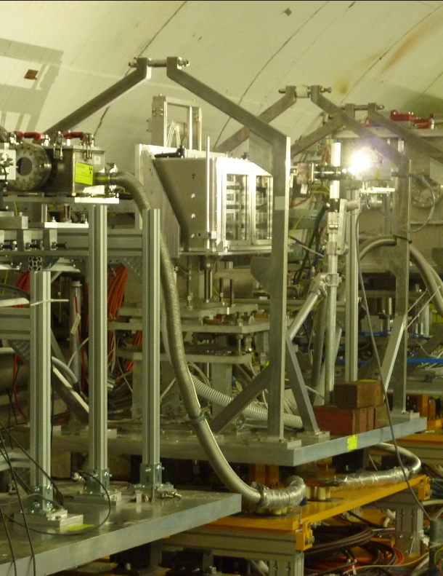
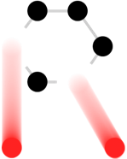
High Power Targetry: Materials R&D
Multi-MW Neutrino Targets & Beam Windows Materials:
Graphite (target core material) studies:
  Swelling/fracture studies
  Preparing for HE proton irradiation at BLIP (2020) to confirm elevated temperature annealing
Beryllium (beam window material) studies:
  Examination of BLIP irradiated Be specimens underway
  Helium implantation studies show bubble formation at irradiation temperatures above 360 ˚C
Titanium Alloys (beam window material) studies:
  Examination of BLIP irradiated specimens underway
  World first high cycle fatigue testing of
  irradiated titanium underway at FNAL
Benefits to multi-MW targets e.g. LBNF):
alloy/grade choice
cooling system design
tolerable beam intensities
expected lifetimes
In-beam thermal shock testing of BLIP irradiated Be and Ti alloys at CERN
RaDIATE

Slide 23











RaDIATE
Collaboration
Radiation Damage In Accelerator Target Environments
www-radiate.fnal.gov
Broad aims are threefold:
to generate new and useful materials data for application within the accelerator and fission/fusion communities
to recruit and develop new scientific and engineering experts who can cross the boundaries between these communities
to initiate and coordinate a continuing synergy between research in these communities, benefitting both proton accelerator applications in science and industry and carbon-free energy technologies

Slide 24
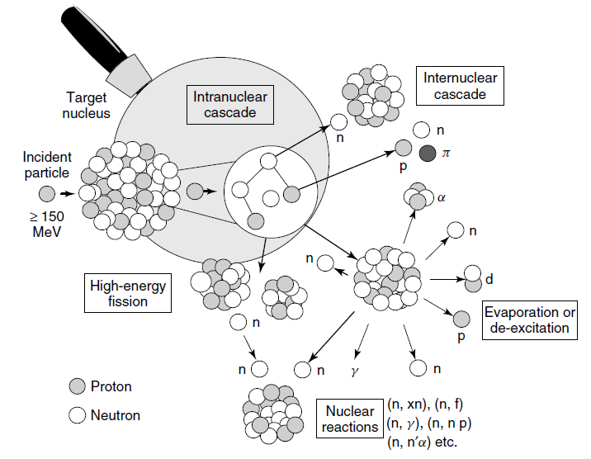
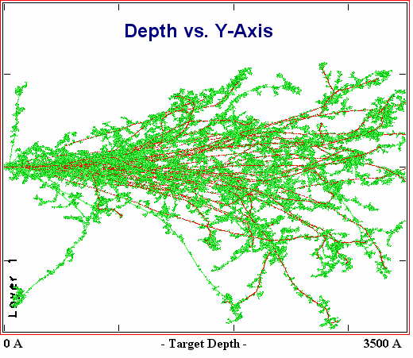
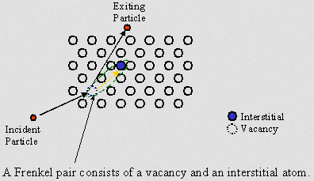
Radiation Damage Disorders Microstructure
Microstructural response:
creation of transmutation products;
atomic displacements (cascades)
  average number of stable interstitial/vacancy pairs created = DPA (Displacements Per Atom)
Gas production (hydrogen / helium)
From D. Filges, F. Goldenbaum, in:, Handb. Spallation Res., Wiley-VCH Verlag GmbH & Co. KGaA, 2010, pp. 1–61.
Slide prepared by V. Kuksenko (Oxford)

Slide 25






RaDIATE BLIP irradiation summary
Consisted of 9 capsules from 6 RaDIATE institutions with over 200 material specimens relevant to beam intercepting devices in various current/future accelerator facilities
181 MeV incoming protons used for RaDIATE irradiation
Irradiation campaign executed in 3 phases with different target box configurations
  6 capsules in target box during each irradiation phase
Total protons on target: 4.57E21 (154 µA avg)

Slide 26
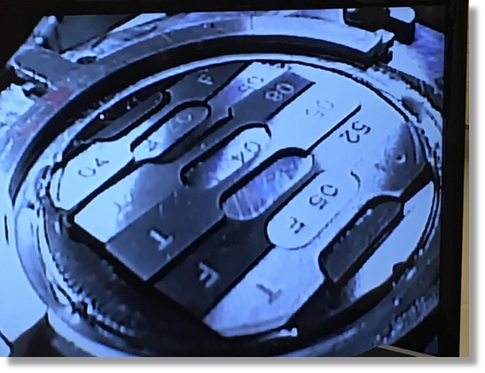
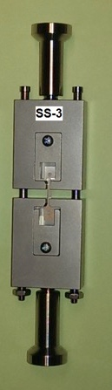
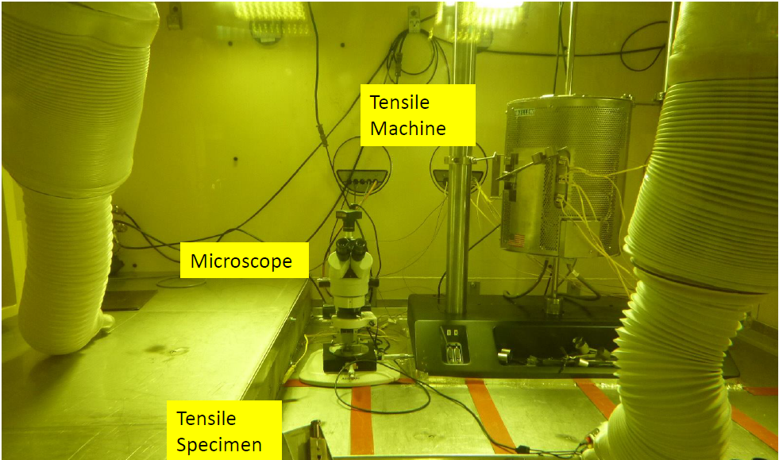
BLIP Irradiation Examinations
Significant hardening at low dose in Be and Ti
  Less hardening in higher temperature specimens
First ever fatigue study on irradiated Ti alloys begun
  Indicates about 10% reduction in fatigue strength
Microstructural examinations
Irradiation hardening of S-65F Be
Reduction of strain to failure
Increased strength
Custom Fatigue Testing Machine for Irradiated Materials (FNAL)

Slide 27
X-ray diffraction – Swelling in BLIP irradiated graphite
Simos et al
Impact: Allows confidence to use reactor data for lattice swelling of graphite in HE proton regime for future target facilities
W. Bollmann. “Electron-microscopic observations on radiation damage in graphite” Phil. Mag., 5(54):621-624, June 1960.

Slide 28
Neutron irradiated graphite dimensional changes
B.J. Marsden, “Irradiation Damage in Graphite due to fast neutrons in fission and fusion systems,” IAEA-TECDOC-1154, 2000
Big change in c-axis growth ~250 ˚C
Impact: Correlation informs target choice of operating temperature (cooling system design)

Slide 29
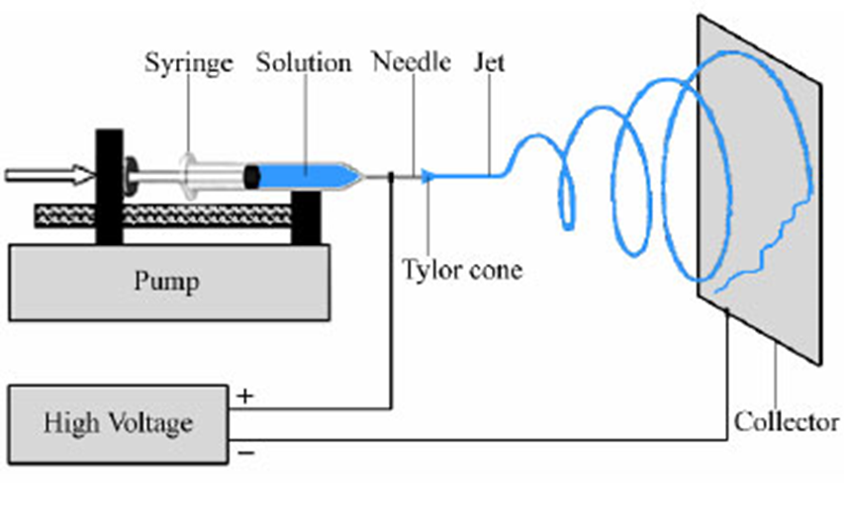
In-Beam Thermal Shock Test: BeGrid2 (HRMT43)
Primary Objectives:
Compare thermal shock response between non-irradiated and previously irradiated material specimens from BNL BLIP (Be, C, Ti, Si)
  First/unique test with activated materials at HiRadMat
Explore novel materials such as metal foams (C, SiC) and electrospun fiber mats (Al₂O₃, ZrO₂) to evaluate their resistance to thermal shock and suitability as target materials
Electrospinning concept
SEM: as-spun Al₂O₃

Slide 30
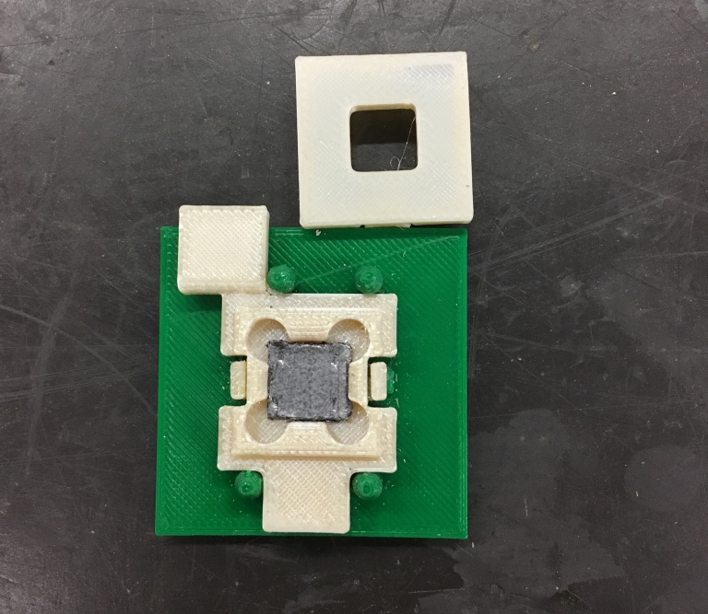
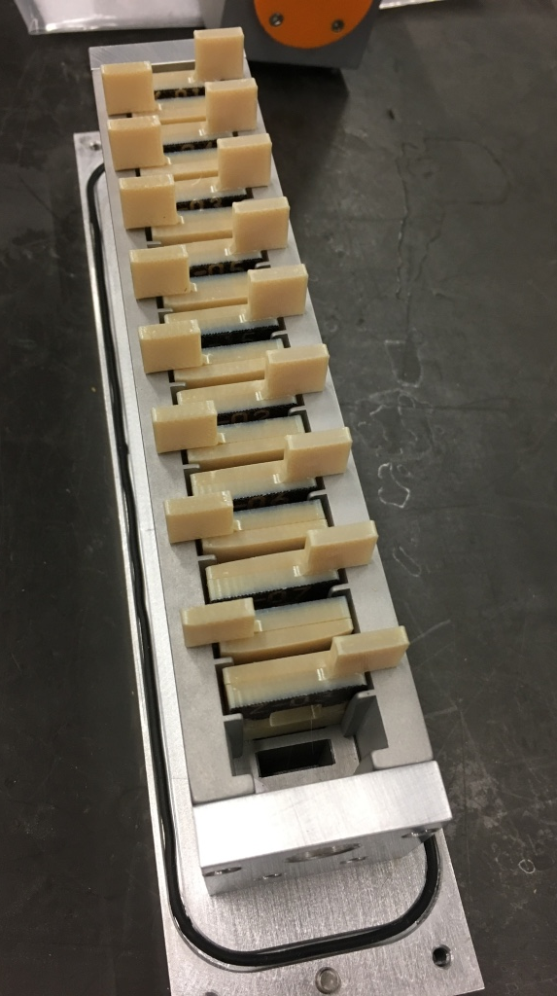
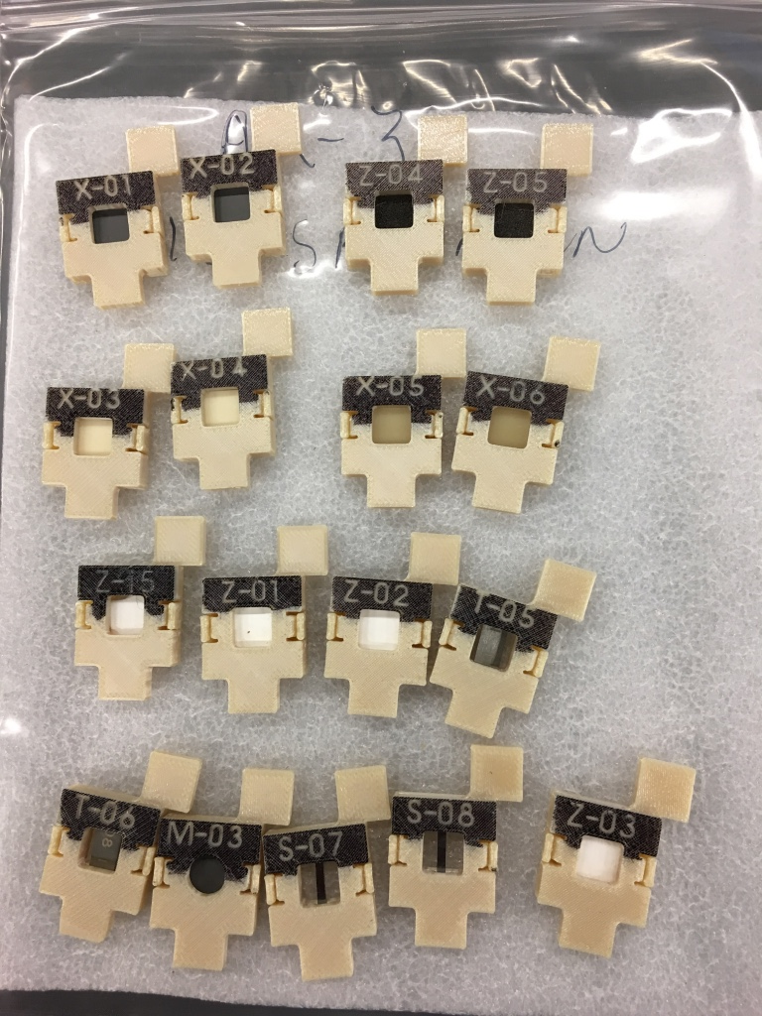
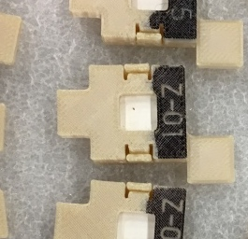
BeGrid2 (HRMT43) – 3-D printed specimen holders

Slide 31
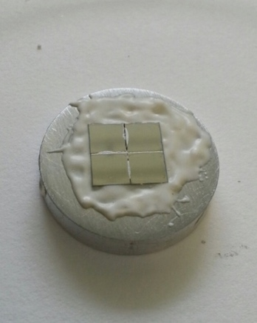
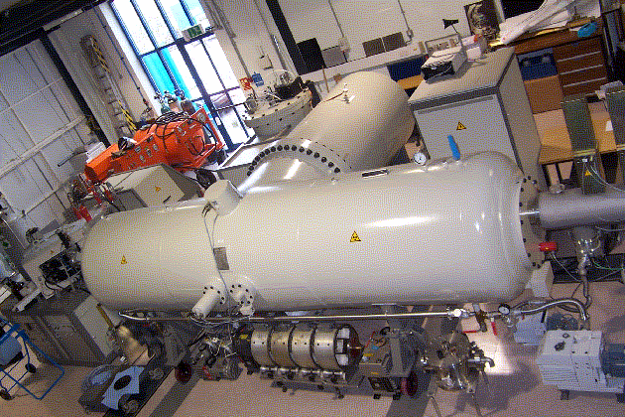
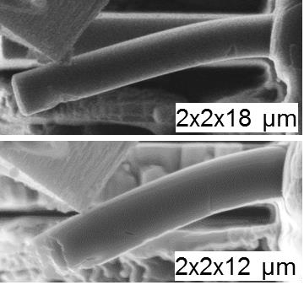
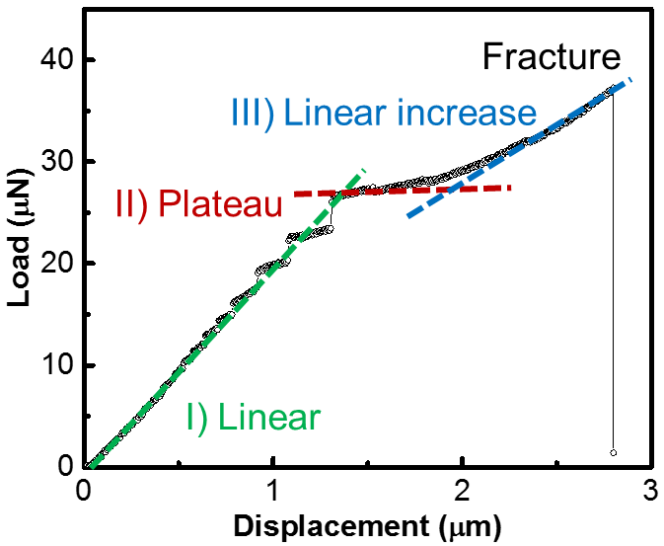
MIMiC - Methods of Irradiated Material Characterization
Replicating proton beam interaction damage with minimal residual activity
        The current routes for high-energy proton irradiations are expensive, long in duration, and lack control of testing conditions and schedule.
        Low-energy ion irradiations are attractive because they allow study of the evolution of the micro-structure during irradiation without activating the specimens, are relatively low cost, and can achieve high dose in very short durations.
        Micro-mechanics and meso-scale testing are potential enabling technologies to overcome some of the limitations of low-energy irradiations as well as to drastically reduce specimen size requirements (which also reduces activity of specimens).
        Ion irradiations and micro-mechanics have been used in the RaDIATE studies on beryllium.

Slide 32
Nu HPT R&D Materials Exploratory Map
Uncharted Territory
HiRadMat Beam Test - 2
Thermal Shock Test (planned) MIMiC
Future Nu 4 MW
HiRadMat Beam Test - 1
Graphite Fin Studies
NT-02
LBNF-2.4 MW Tau Nu
NT-04
NT-07
NT-06
NT-05
NT-03
TA-01
NT-01
LBNF-2.4 MW (CDR)
LBNF-2.4 MW IDEAL
NuMI Be Beam Window
Thermal Shock Severity (p/cm²/pulse)
T2K-1
LBNF-1.2 MW (CDR)
BLIP Irradiation - 1
BLIP Irradiation – 2
Ion Irradiation (planned) MIMiC
Radiation Damage Severity
(damage equivalent fluence, p/cm²)

Slide 33
A few notes for Muon Collider Targets
Most comparable configuration is Mu2e – challenging at 8 kW @ 8 GeV.
  Extrapolation to Mu2e-II (100 kW @ 1 GeV) has no present solution
  Cannot Extrapolate to historical Muon Collider (4 MW @ few GeV)
Higher proton beam energy is better for the target (less power deposited in target for the same beam power)
Separating target from optics is very beneficial
  Has the capacity to allow rotation and more robust support systems
  Can more forward production from higher-energy protons be used?
Muon collider requirements on precision may be less strict
Machine Protection is vitally important at high power. Targets and facilities must have this built in from the beginning.
Attempt to avoid liquid targets. Enormous investment and R&D, many risks. SNS, ESS, J-PARC have all decided against liquid targets for new target stations

Slide 34
Summary
There is broad experience in targets at Fermilab and elsewhere.
Targets are challenging and can be the performance-limiting factor of a facility
There is active development of new targets, and an active R&D program
Muon Collider targets are beyond state-of-the-art; the facility could benefit from choices that allow more buildable targets

Slide 35
Target Technology
Robert Zwaska, Fermilab
Muon Collider Accelerator School
6 August 2025

