Slide 1
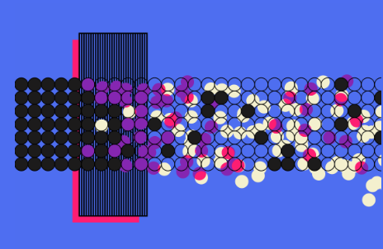
Magnet Technology
Aug 06, 2025
Inaugural US Muon Collider Accelerator School
Karie Badgley - Fermilab

Slide 2
Outline
Magnet Basics
Magnet types
Fields
Conductors
Resistive
LTS
HTS
Muon Collider Magnet Needs
Target, capture, and decay solenoids
Cooling channel
Acceleration and collider ring

Slide 3
Magnet Basics

Slide 4
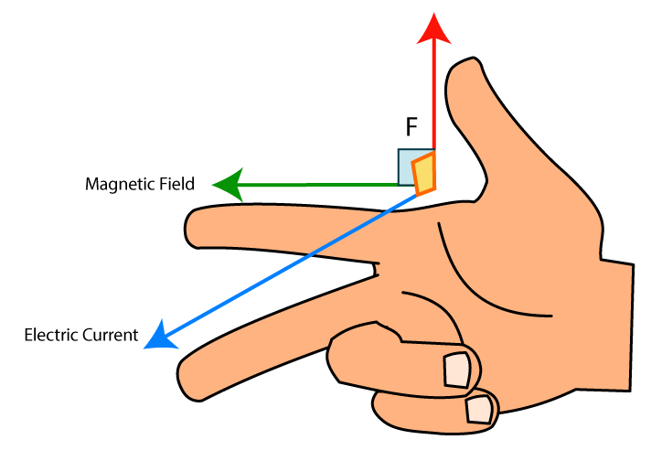
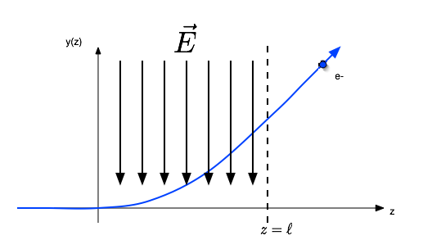
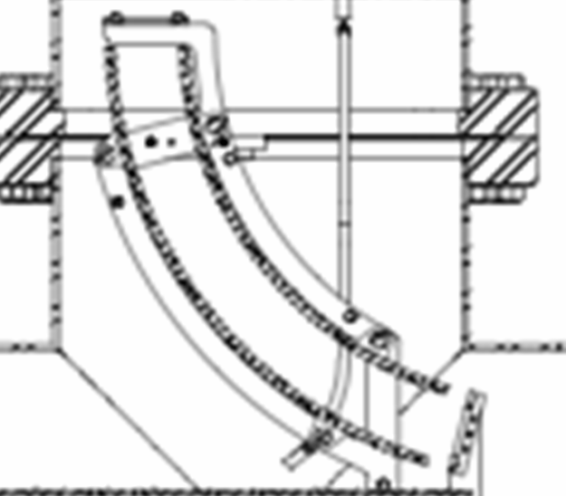



Force on charged particles: steer, bend, correct
Lorentz Force:
$$F=q \left(E+v×B\right)$$
F : force q : charge v : charge velocity B : magnetic field
Motion through static Electric Field (B=0)
Motion through Magnetic Field (E=0)
For relativistic speeds:
1 T equivalent would require 3x10⁸ V/m
Magnet Rigidity:
$$Bρ=\frac{p}{q}$$
$$F=q v×B$$
Notes:
At relativistic speed E=cB 1T equivalent would require 3x108 V/m, not very feasible. WORK

Slide 5
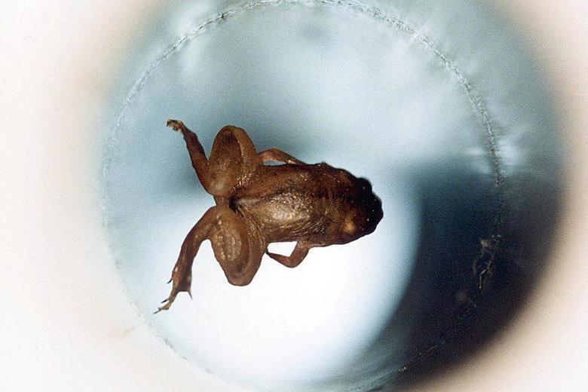
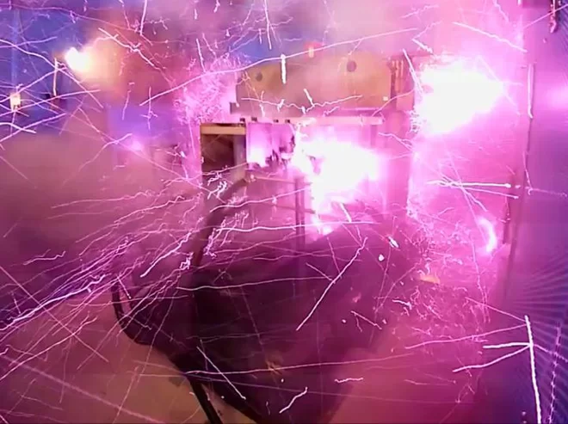
Magnitude of Magnetic Fields
1 T = 10,000 G
Value | Item
0.1 - 1.0 pT | Human brain magnetic field
31-58 µT | Strength of Earth's magnetic field at 0° latitude (on the equator)
0.5 mT | Suggested exposure limit for cardiac pacemakers by American Conference of Governmental Industrial Hygienists (ACGIH)
5 mT | Strength of a typical refrigerator magnet
0.15 T | the magnetic field strength of a sunspot
1 T to 2.4 T | Coil gap of a typical loudspeaker magnet
1.25 T | Strength of a modern neodymium-iron-boron (Nd2Fe14B) rare earth magnet.
1.5 T to 3 T | Strength of medical magnetic resonance imaging systems in practice, experimentally up to 8 T
9.4 T | Modern high resolution research magnetic resonance imaging system
11.7 T | Field strength of a 500 MHz NMR spectrometer
16 T | Strength used to levitate a frog
36.2 T | Strongest continuous magnetic field produced by non-superconductive resistive magnet
45 T | Strongest continuous magnetic field yet produced in a laboratory (Florida State University’s NHMFL)
100.75 T | Strongest (pulsed) magnetic field yet obtained non-destructively in a laboratory (NHMFL, Los Alamos)
730 T | Strongest pulsed magnetic field yet obtained in a laboratory, destroying the used equipment, but not the laboratory itself (Institute for Solid State Physics, Tokyo)
2.8 kT | Strongest (pulsed) magnetic field ever obtained (with explosives) in a laboratory (VNIIEF in Sarov, Russia, 1998)
1 to 100 MT | Strength of a neutron star
Notes:
Water is diamagnetic

Slide 6
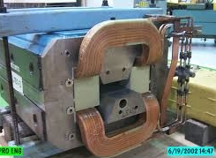
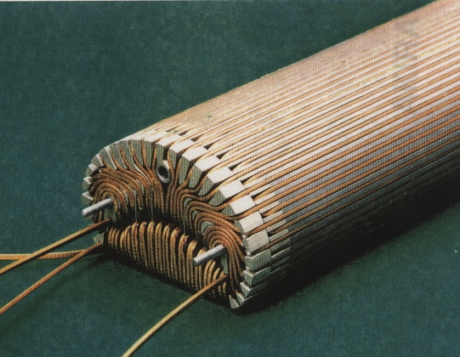
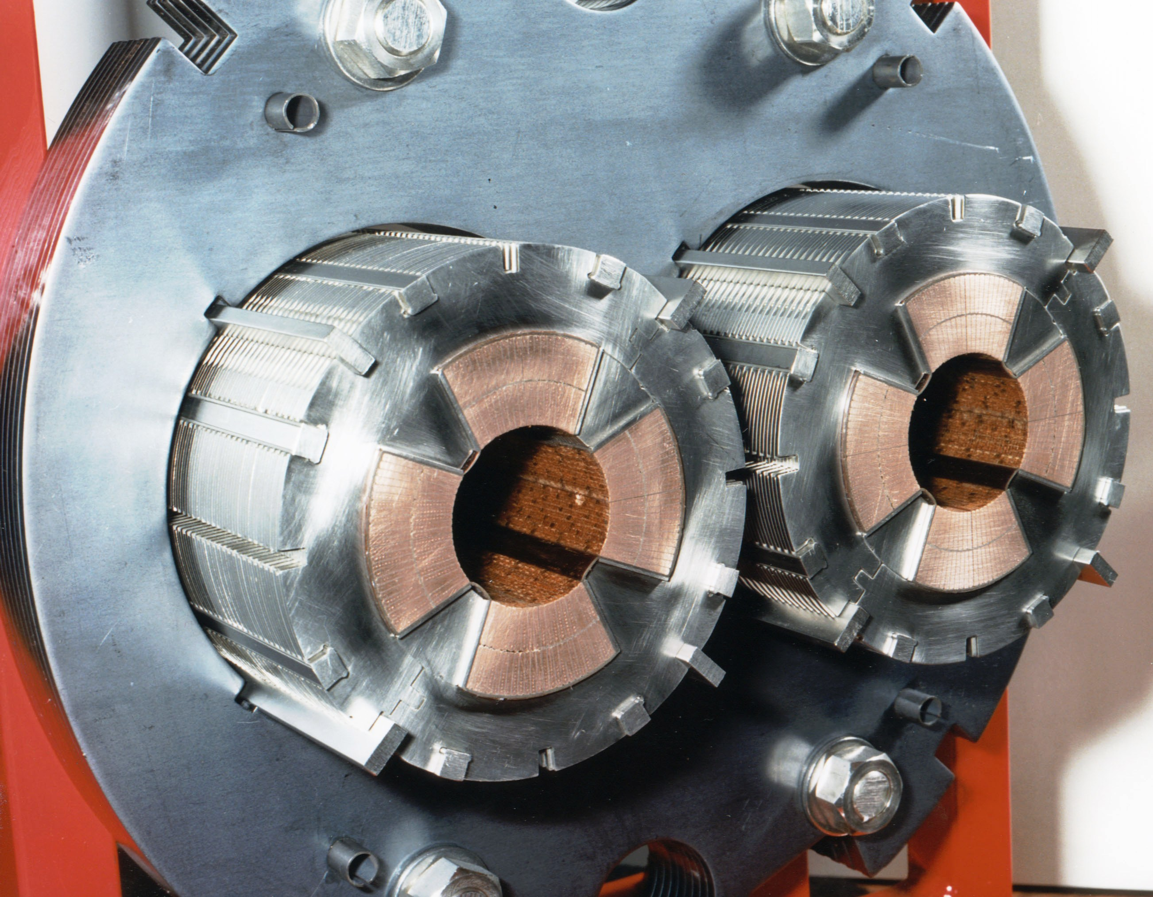
Sources of Magnetic Field
  Iron-dominated- field shaped by the iron
  Coil-dominated- field shaped by coil placement
  Superferric-combination of both
Dipole, FNAL

Slide 7
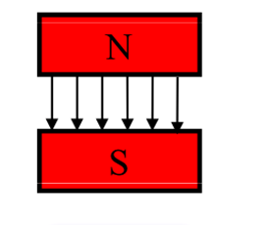
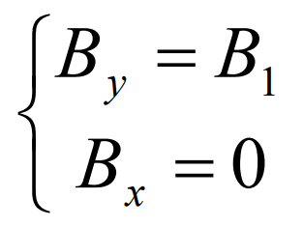
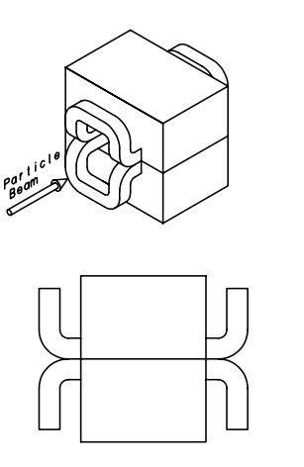
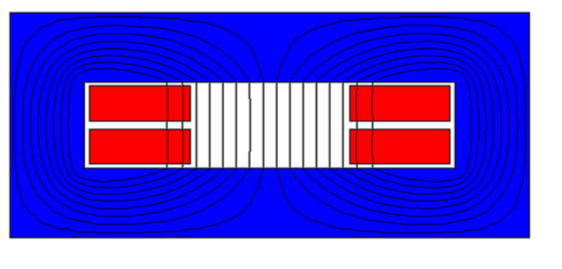
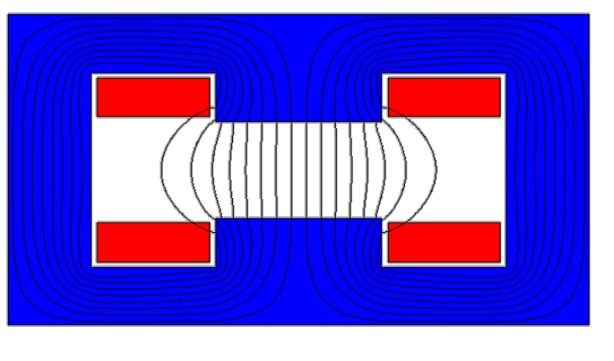
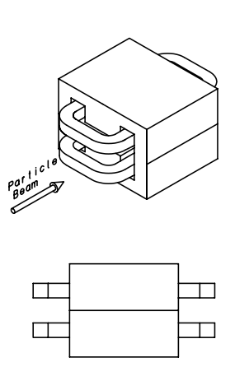
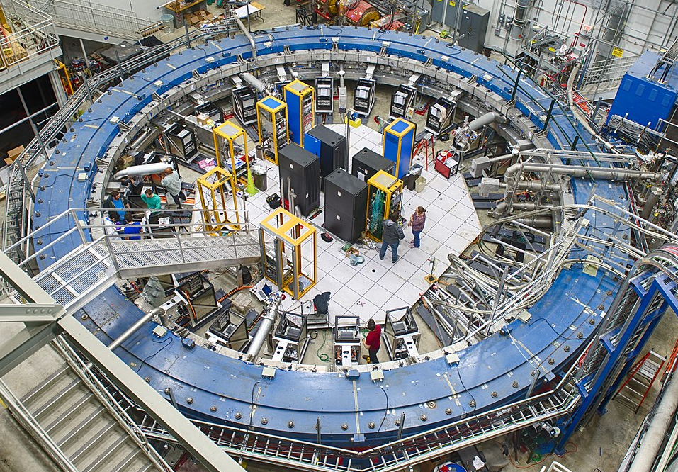
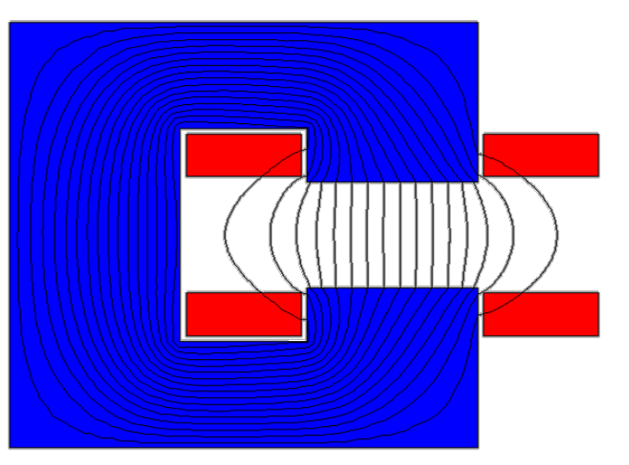
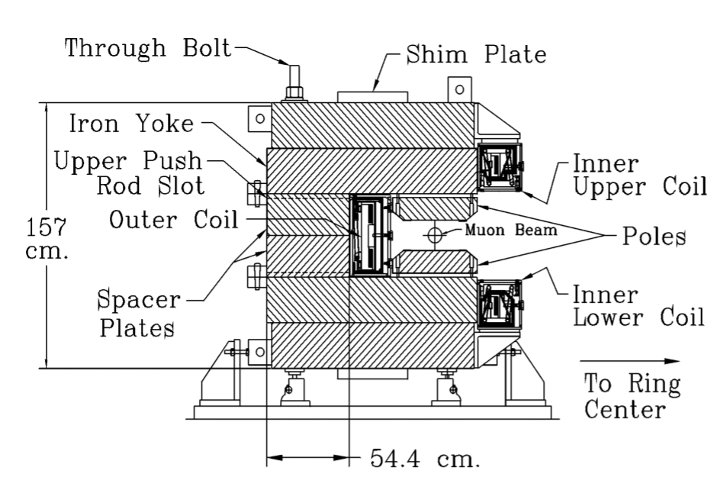
Types of magnets – Dipole (two-pole)
Used for bending(one plane), energy selection,…
Constant magnetic field
Window frame
  Wound from two pancake coils
  Ends must be bent out of beam path
“H” dipole
  Recessed pancakes
“C” dipole
Muon g-2

Slide 8
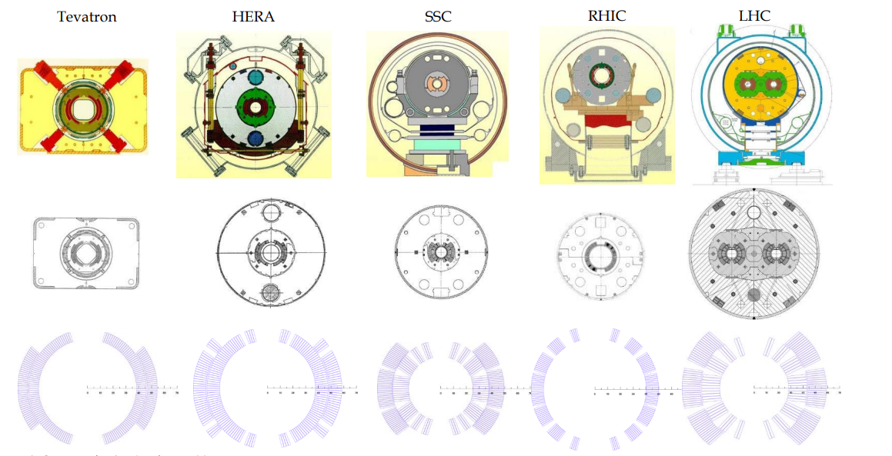

Types of magnets – Dipole (two-pole)
Cos θ dipole
  Current density follows cos
$$θ_{ }$$
Not to scale
E. Todesco et al

Slide 9
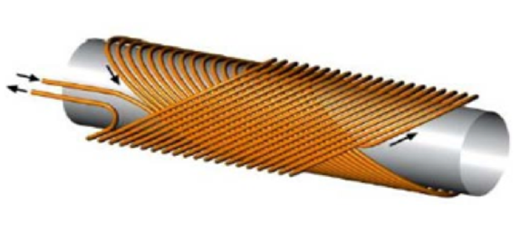
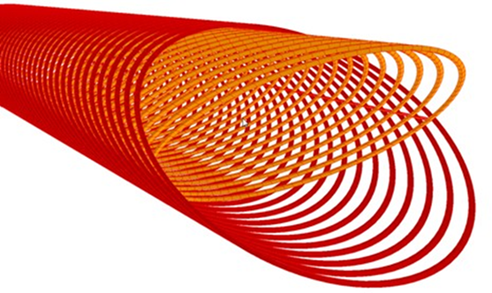


Types of magnets – Dipole (two-pole)
Canted Cos θ dipole
$$B=$$
$$=$$
+

Slide 10
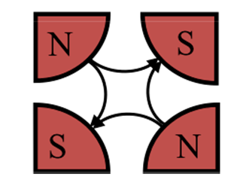
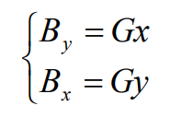
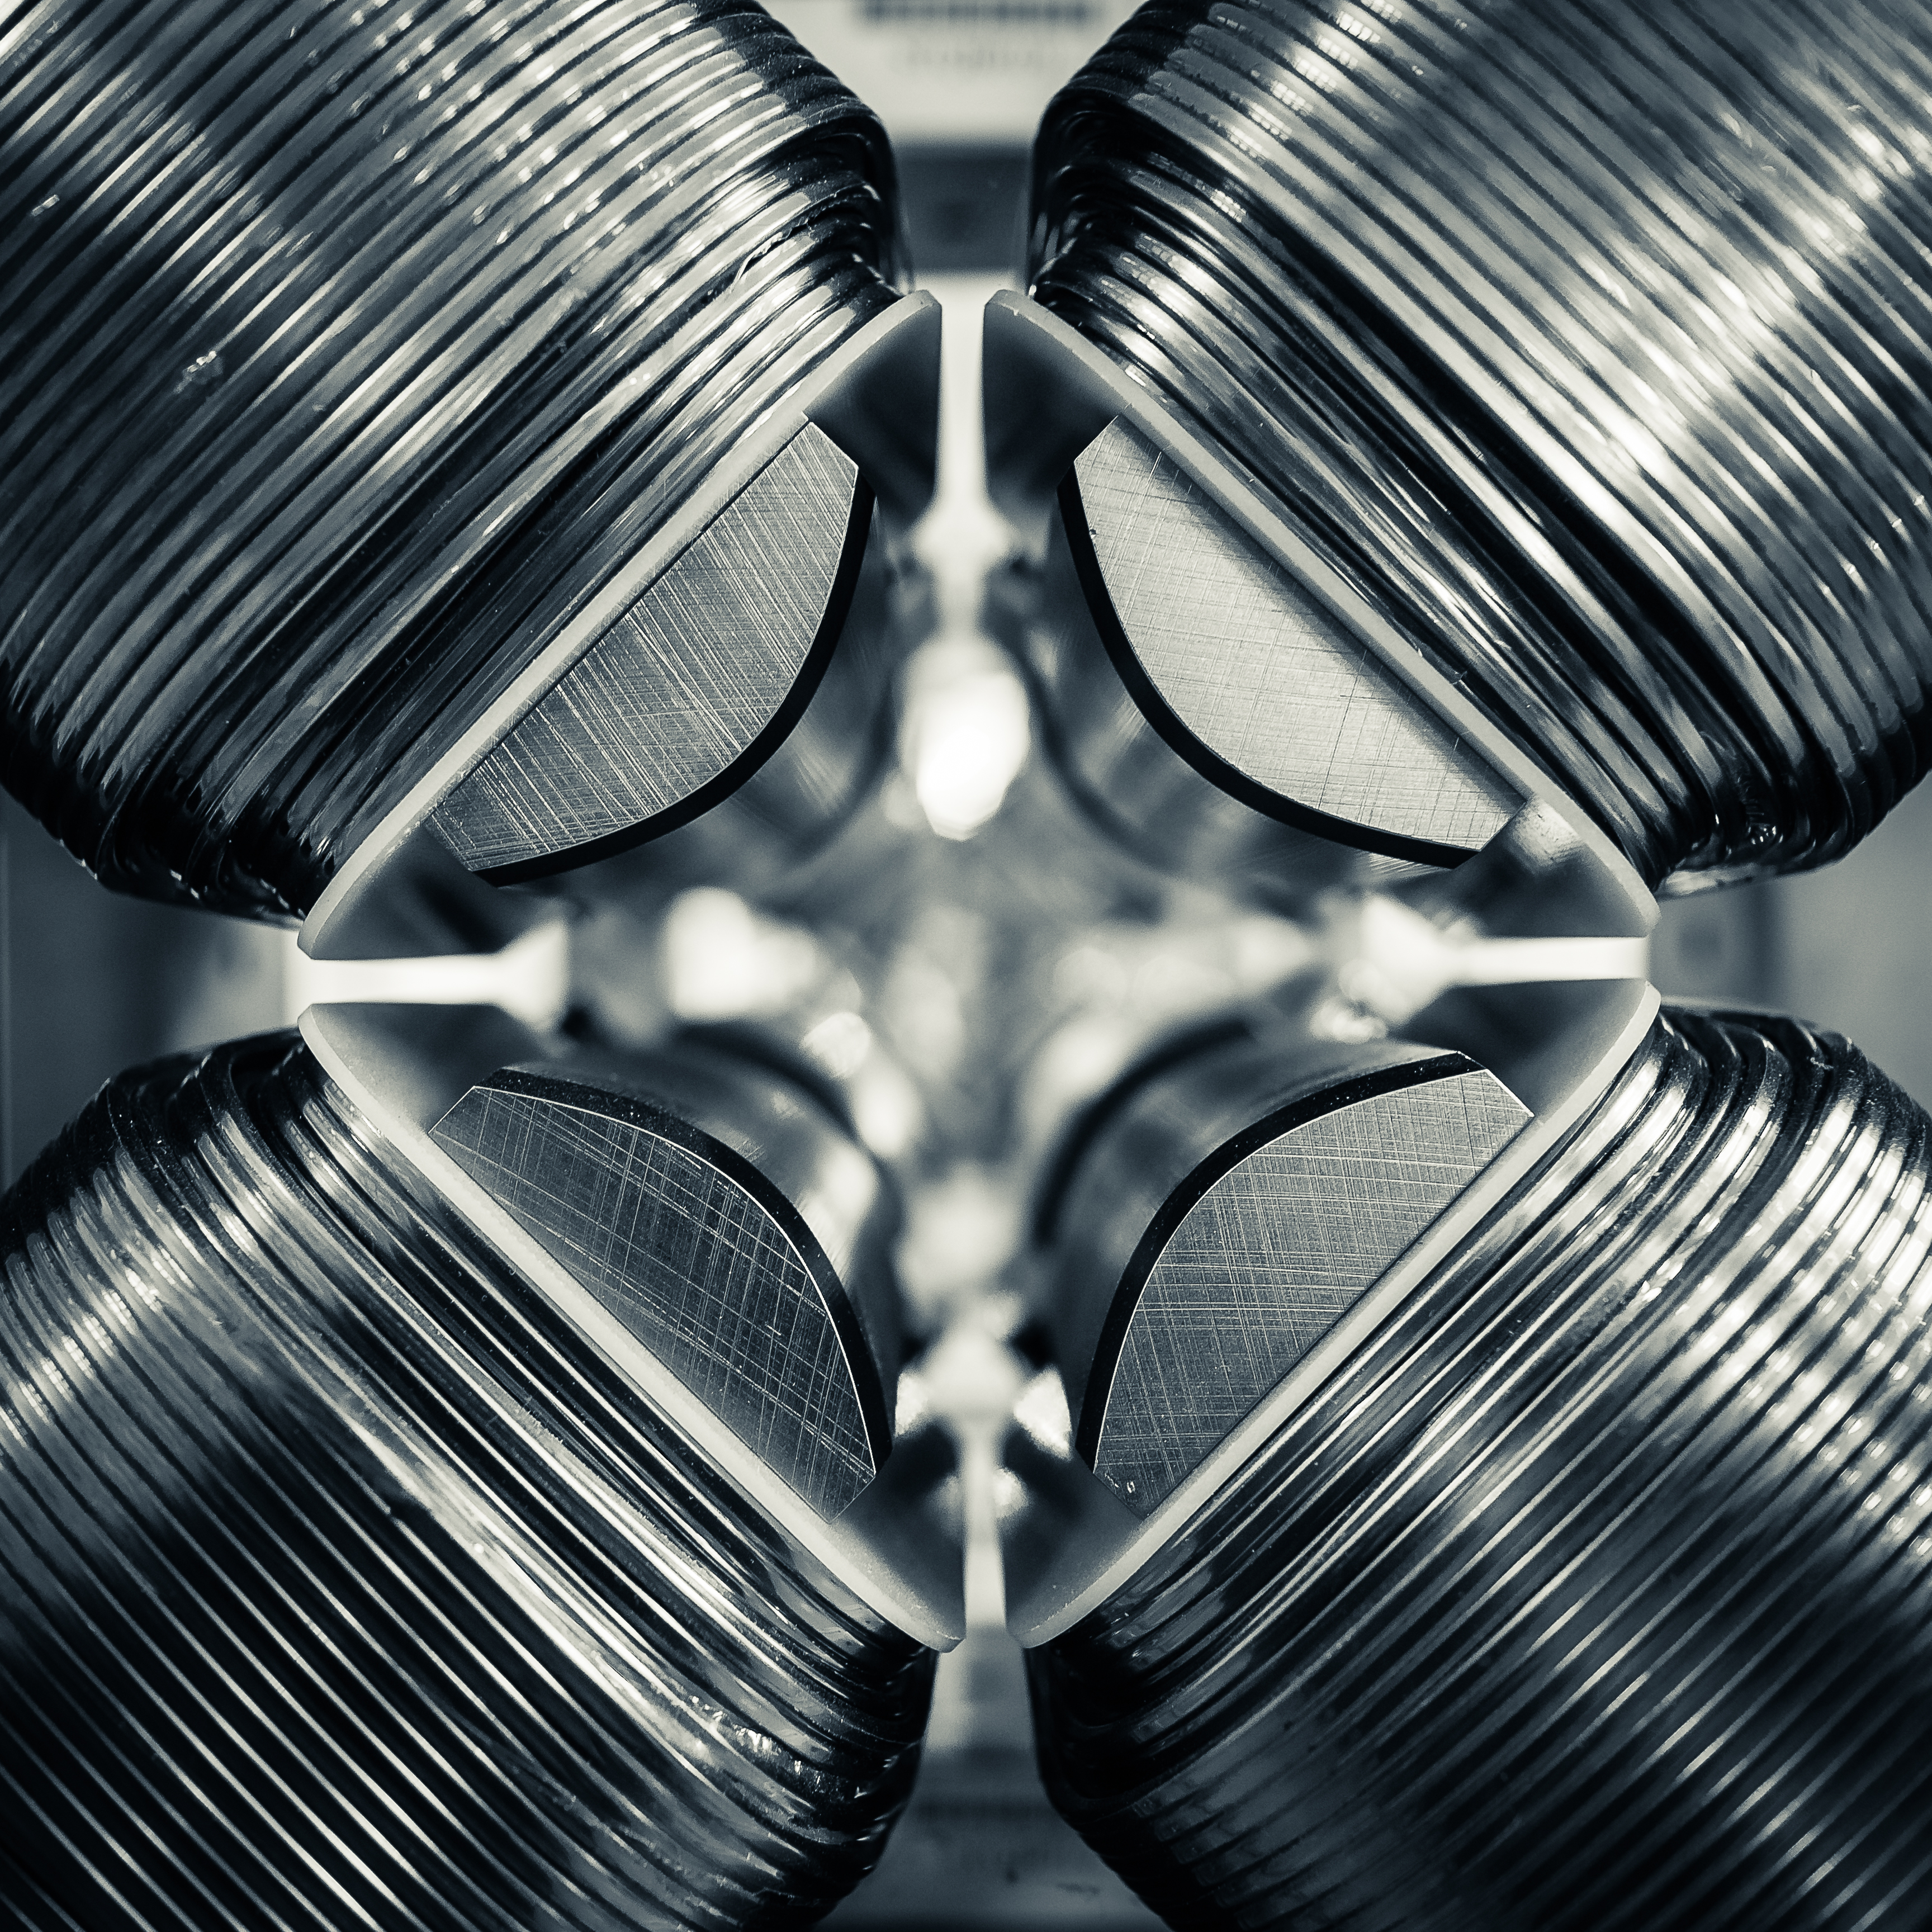
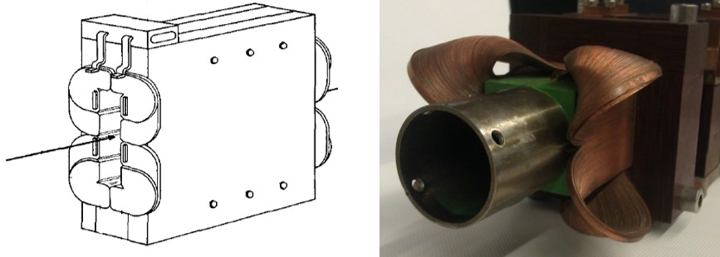
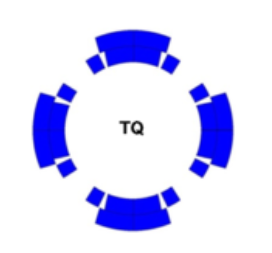
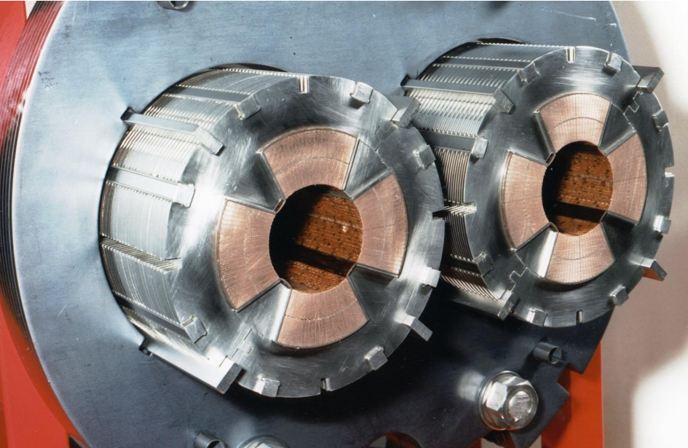
Types of magnets – Quadrupole (four-pole)
Field varies linearly with distance from the center
Used for focusing
  Focusing in one direction and defocusing in the other
Panofsky Quad
Cos 2θ
LHC Quads

Slide 11
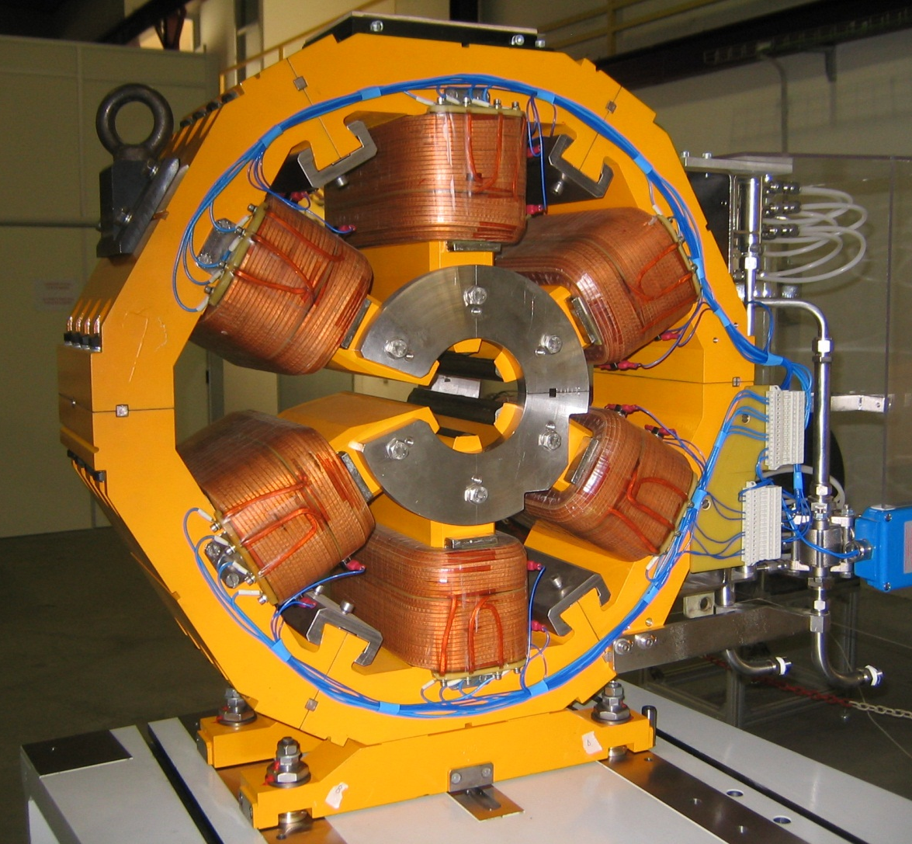
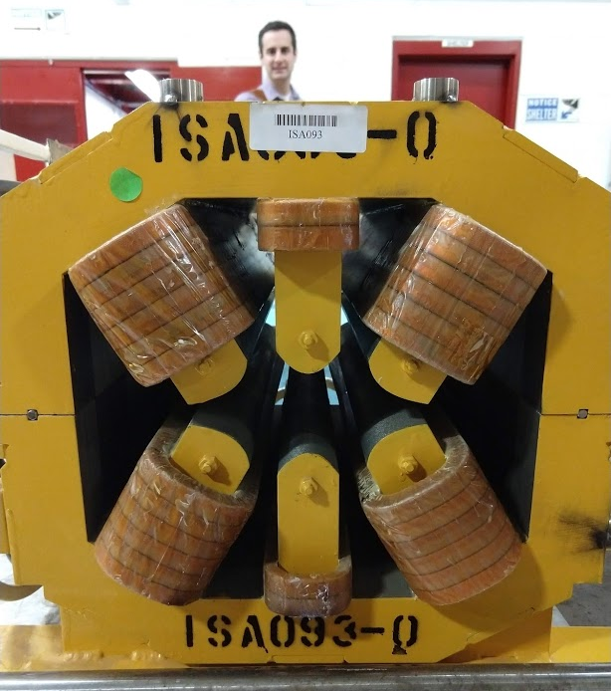
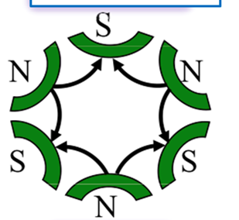
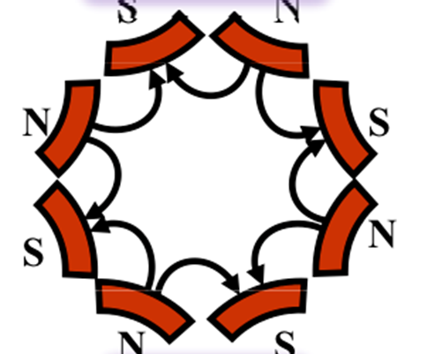
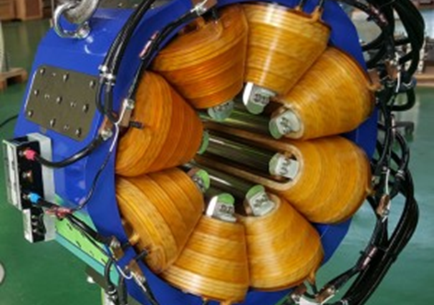
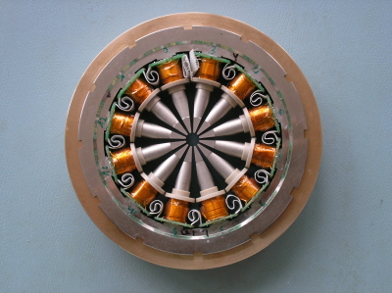
Types of magnets – higher order poles
Sextupoles (six-pole)
  field varies quadratically with the distance from the magnet center
  Used to correct beam edges
    Chromaticity
Octopoles (eight-pole)
Higher order poles

Slide 12
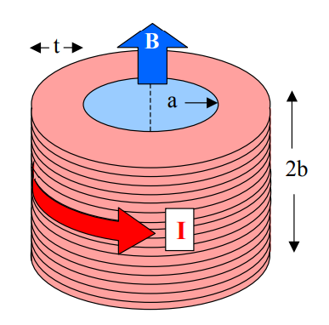
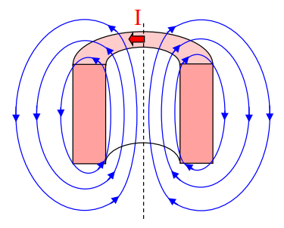
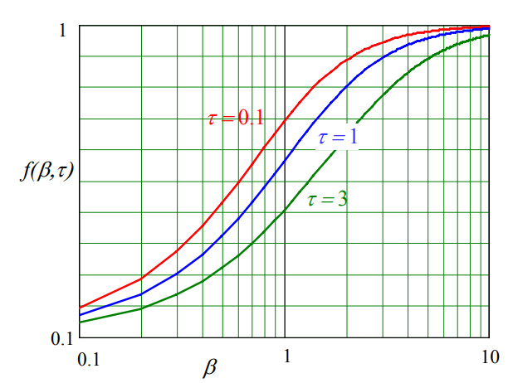






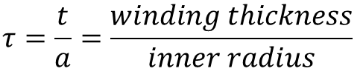
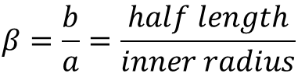
Types of magnets- Solenoids
For an ideal infinitely long solenoid
Finite length solenoid
$$B=μ_{0}nI=μ_{0}J_{e}t$$
$$n=number of turns per length$$
$$J_{e}=Engineering current density$$
$$t=winding thickness$$
$$B_{axis}=μ_{0}J_{e}tf(β,τ)$$
$$β=\frac{b}{a}=\frac{half length}{inner radius}$$
$$τ=\frac{t}{a}=\frac{winding thickness}{inner radius}$$
Image from Martin Wilson lecture
$$f is typically \sim 0.8$$

Slide 13
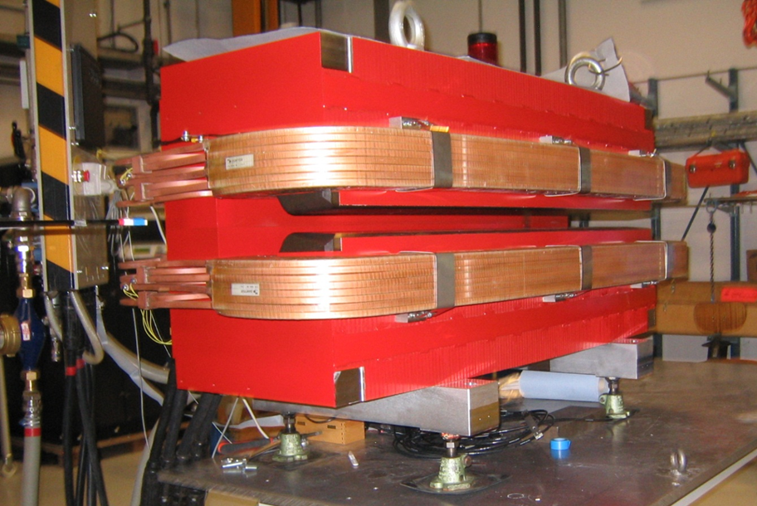

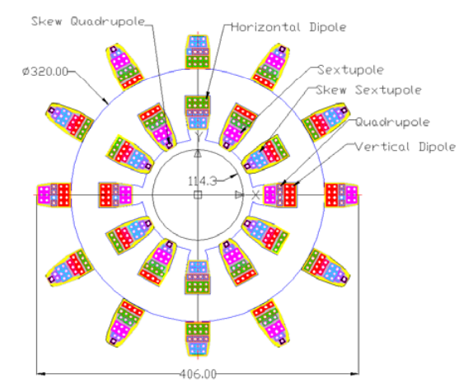
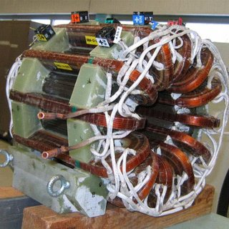
Types of magnets - Other
Combined function – combination of the previous
Septa, kickers, correctors, and other more exotic magnets….

Slide 14
Conductors
02

Slide 15
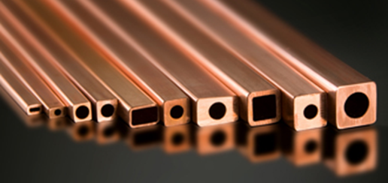
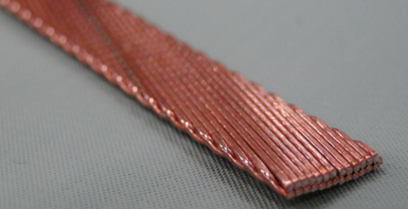
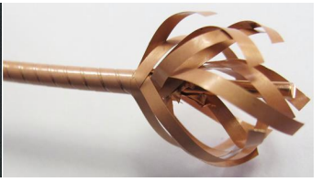
Conductors for Accelerator Magnets
Magnet strength driven by conductor
Resistive/normal conducting
  Typically copper
  ~10 A/mm² with cooling
Superconducting (fields > ~2T)
  LTS ( Liquid He)
    Nb-Ti, MgB₂,Nb₃Sn
  HTS (Liquid N2)
    Bi₂Sr₂CaCu₂O₈ (Bi-2212 or BSCCO)
    Bi₂Sr₂Ca₂Cu₃O₁₀ (Bi-2223)
    REBa₂Cu₃O₇ (REBCO)

Slide 16
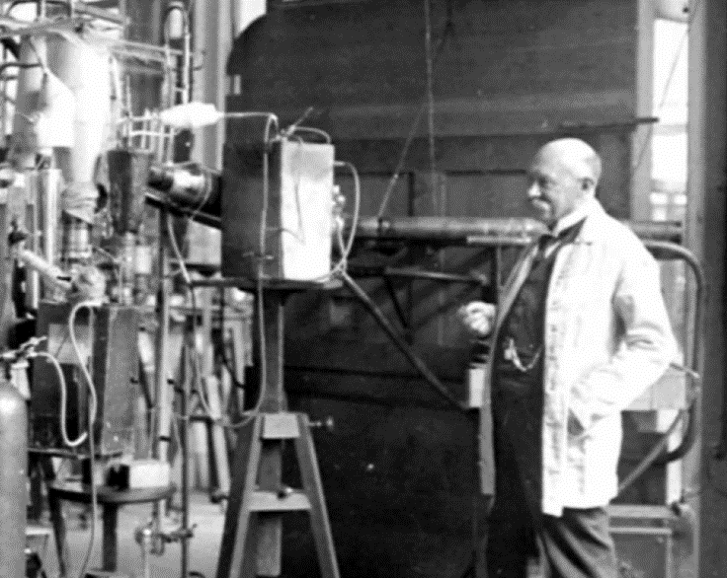
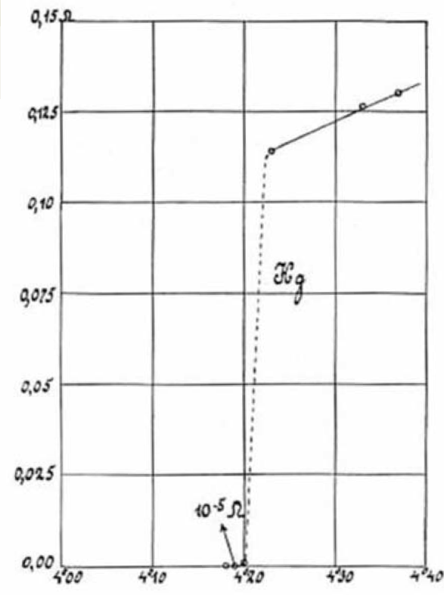
Superconductivity
Below a certain critical temperature T_{c} a phase transition occurs and the resistivity drops to zero
R (Ω)
Heike Kamerlingh Onnes
1908 – Successfully liquified helium (4.2 K)
1911 – Discovered the superconductivity while measuring the conductivity of Mercury as function of temperature
1913 – Nobel prize
Temperature (K)

Slide 17
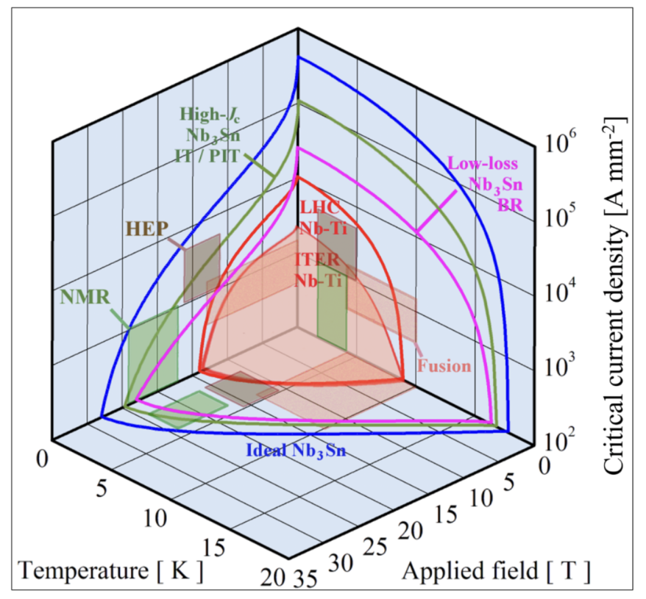
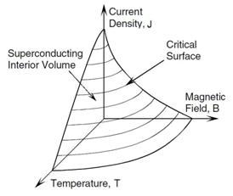
Properties of Superconductors
Superconducting under the critical surface
  Critical temperature Tc
  Critical upper field Bc
  Critical current Jc
Operate at a margin below the surface
https://atap.lbl.gov/news/niobium-tin-superconductors-fabrication-and-applications/

Slide 18

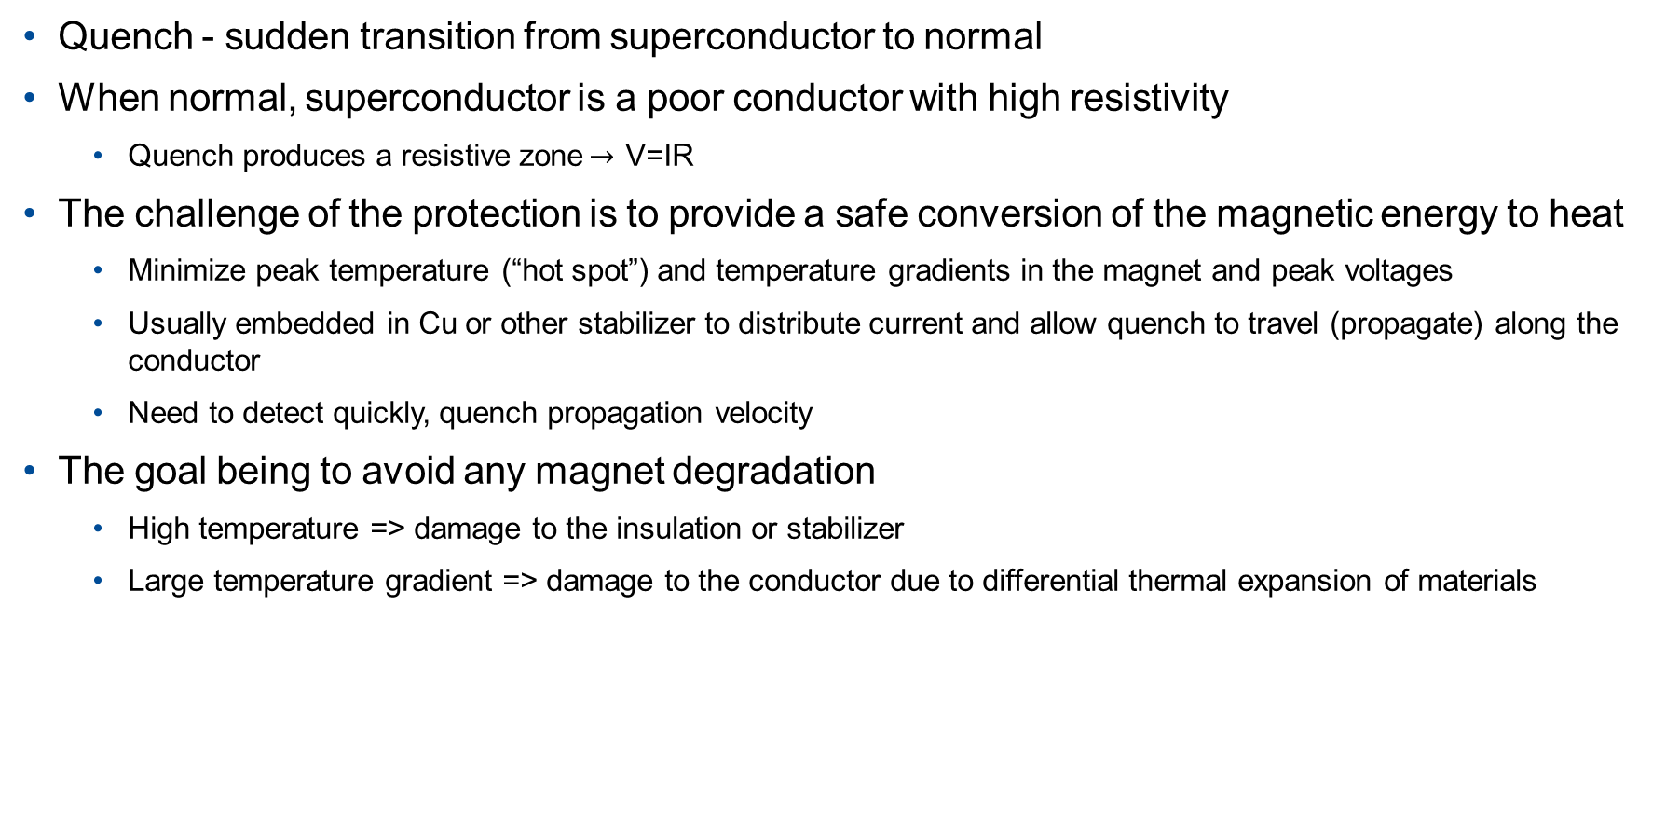



Quench Detection/Protection
Quench - sudden transition from superconductor to normal
When normal, superconductor is a poor conductor with high resistivity
  Quench produces a resistive zone$→$ V=IR
The challenge of the protection is to provide a safe conversion of the magnetic energy to heat
  Minimize peak temperature (“hot spot”) and temperature gradients in the magnet and peak voltages
  Usually embedded in Cu or other stabilizer to distribute current and allow quench to travel (propagate) along the conductor
  Need to detect quickly, quench propagation velocity
The goal being to avoid any magnet degradation
  High temperature => damage to the insulation or stabilizer
  Large temperature gradient => damage to the conductor due to differential thermal expansion of materials
$$I$$
$$voltage taps$$
$$no detectable voltage$$
$$voltage detected$$

Slide 19


Current Density
Engineering current density often used to compare superconductors
Start with Jc of Superconductor
  Nb-Ti ~ 3,000 A/mm2 @ 5T and 4.2K
  Nb3Sn ~ 3,000 A/mm2 @ 12T and 4.2K
Add copper/non-Superconductor – Typically ~50%
Cable compaction ~88%
Insulation – order of 100 microns (X2) compared to ~2 mm cable thickness
Filling factor $k$= (Nwire Asc)/Ains_cable
Engineering current density defined as Je = $k$Jc
  Typically on the order of 1,000 A/mm²
$$J_{e}=\frac{Current in Strand}{Area of the Strand}$$

Slide 20


Nb-Ti
Used in all superconducting accelerator magnets to date*
First large-scale accelerator application was the Tevatron
Ductile, small bend radius
React then wind
Quench propagation ~m/s
T_{c} 10 K, B_{c} 15 T
Practical magnet limit ~8 T

Slide 21




Strand to Rutherford Cable
Monofilament rods bundled to create a billet
Billet is extruded and drawn out
Final filament diameter is chosen to reduce flux jumps

Slide 22




Strand to Rutherford Cable
Strands are wound on spools mounted on a rotating drum
Strands are twisted around a conical mandrel into an assembly of rollers which produce the rectangular shape
The strands are twisted to reduce interstrand coupling currents and provide mechanical stability

Slide 23
Goal
Plot maintained by National High Magnetic Field Lab

Slide 24

MgB₂
T_{c} 39 K, B_{c} 74 T
Not as ductile as Nb-Ti, but still can be produced and then wound
Higher Tc could allow for LHe free magnet, cryogenic cost saving
Better suited non-high field magnet applications, such as motors, generators, and MRI
Hypertech

Slide 25
MgB₂

Slide 26



Nb₃Sn
LTS, max practical field ~15 T at 1.8 K
T_{c} 18 K, B_{c} 30 T
Requires a reaction heat treatment ~650-700 °C
Rutherford cable must be wound around mandrel to form coil before heat treatment, wind-and-react
  Becomes very brittle and strain sensitive
  Volumetric change during heat treatment
  Limits materials for insulation and mandrel
Discovered in 1954 (7 years before Nb-Ti)
First use in an accelerator will be for HL-LHC
First HL-LHC magnet sent to CERN

Slide 28

Bi-2212
Powder-in-tube (PIT) process with silver matrix
  Still required wind-and-react
  High heat treatment temperature 890 °C
  Heat treatment performed with background pressure of Argon and Oxygen, 50-100 atm
  High T and oxidation further limits materials for insulation and mandrel
T_{c} 85 K, B_{c} ~120 T
Only HTS in round filament form, allows for Rutherford cable production
Even more sensitive to strain than Nb₃Sn

Slide 30


Rare Earth Barium Copper Oxide (REBCO)
Thin film deposition
  Difficult to scale to lengths needed for superconducting magnet
YBCO
  T_{c} 92 K, B_{c} ~100 T
High temp, possible liquid free cooling
Slow quench propagation, hard to protect
  Quench propagation ~cm/s
Anisotropic critical current
  Prefer parallel plane of crystal structure
Currently very expensive, but the cost is being driven down by the interest from Fusion
Roebel Cable
Similar transposition as Rutherford cable
Used in 1914 on copper wire for AC machines
  Rutherford design in 1972
https://www.advancedconductor.com/

Slide 31





Rare Earth Barium Copper Oxide (REBCO)
Conductor on round core (CORC) Cable
  Multilayer of helically wound REBCO tapes
  Improved mechanical performance in recent years

Slide 32



Rare Earth Barium Copper Oxide (REBCO)
Z. Hartwig et al, MIT
VIPER
VPI solder of REBCO stacks to copper former
  Mechanical strength
  Thermal Stability
  Electrical connectivity

Slide 34

Strain
van der Laan et al

Slide 35
Magnets for the Muon Collider
03

Slide 36




Magnet Challenges
Target Solenoids
  20 T
  High radiation and heat environment
  Large bore defined by target size and required shielding
Capture and Decay Solenoids
  Field decays down to 2 T
~23 Coils
Large bore- higher stored energy, forces, and cost
https://doi.org/10.1016/j.cryogenics.2024.103972

Slide 37


Magnet Challenges
6 D Cooling Solenoids
  ~826 cooling cells needed
  Cell consists of absorber, RF cavity, and 2-6 solenoids
  Fields reverses causing huge repulsive forces
Phys. Rev. Special Topics-Accelerators Beams, vol. 18, no. 3, 2015

Slide 38

Magnet Challenges
6 D Cooling Solenoids
  ~826 cooling cells needed
  Cell consists of absorber, RF cavity, and 2-6 solenoids
  Fields reverses causing huge repulsive forces
  12 cell types
Phys. Rev. Special Topics-Accelerators Beams, vol. 18, no. 3, 2015

Slide 39

Magnet Challenges
Final Cooling Solenoids
  Field >40 T, ideally 60 T
  50 mm bore
  Length ~500 mm (x17)
Proposed design
  56 REBCO pancake coils
  Current density ~650 A/mm²
  Within reach of current tape performance

Slide 40
Solenoids beyond state-of-the-art
Field vs Bore of Superconducting Solenoids Worldwide
Plot from Mark Bird with minor modifications
MC Final Cooling
MagLab 40 T
State-of-the-Art
MC Target, decay, & capture 20 K
MC 6D Cooling
LTS = Low Temperature Superconductors (NbTi, Nb₃Sn)
HTS = High Temperature Superconductors (REBCo, Bi-2223, Bi-2212)

Slide 41




Mu2e Solenoids
66 Superconducting (NbTi) solenoids
4.2 T down to 1 T
Large forces from neighboring coils/magnets

Slide 42

Magnet Challenges
Accelerator Ring
  Field +/- 1.8 T (NC), <10 T (SC)
  Ramp rate of 400 Hz (NC)
  100 mm x 30 mm bore
  3 to 5 m (x1500)
  Main challenge is management of power in resistive dipoles

Slide 43



Magnet Challenges
Collider Ring Magnets
  Field of 16 T peak (IR 20T)
  150 mm bore
    Large bore for heat and radiation load
  10-15 m (x700)
  Radiation dose 20-40 MGy
Higher operating temperature to reduce cryogenic load

Slide 44

Summary
Magnet needs for muon collider
  Dipoles up to 20 T
  Solenoids >40 T
  Large aperture
  Fast ramping
  High radiation and heat load environment
Challenging but exciting time for muon collider magnets
This is a huge topic, impossible to fully cover here!
Great starting resources:
  USPAS US Particle Accelerator School https://uspas.fnal.gov/
  CERN Accelerator School https://cas.web.cern.ch/

Slide 45
Bonus Slides

Slide 46


Slide 47



National High Magnetic Field Lab
Hybrid magnet
32 T (15 T LTS, 17T two REBCO coils)
32 mm bore user facility

Slide 48





Fusion - First Large-Scale High-Field REBCO Magnet
Toroidal Field Model Coil 20T
40kA, 20K
270 km of tape
SPARC- Smallest possible ARC Reactor

Slide 49




Fusion –International Thermonuclear Experimental Reactor (ITER)
Central Solenoid
4.3 m diameter, 3 m long
Cable in conduit design
13 T Nb₃Sn
45 kA

Slide 50


Slide 51



Fermilab - Future Solenoid Test Facility?
Use existing cryostat, originally for MICE, then Mu2e transport solenoid testing

