Slide 1
The Fermilab Accelerator Complex
Robert Zwaska, Fermilab
Muon Collider Accelerator School, 2025
6 August 2025

Slide 2
Summary
Fermilab Accelerators have run for decades and are now at a turning point
  Decades-long plans are being put into action
  New Challenges and opportunities emerge on an almost daily basis
The Long Shutdown is approaching in ~ 2027
  Install LBNF & PIP-II
  Retire Linac & NuMI
  Integrate improvements to the complex: ACE-MIRT, AIPs, UIP, ACORN
Planning for the Future
  R&D into accelerator physics and technology
  Complex upgrades for new experiments, and perhaps a collider

Slide 3
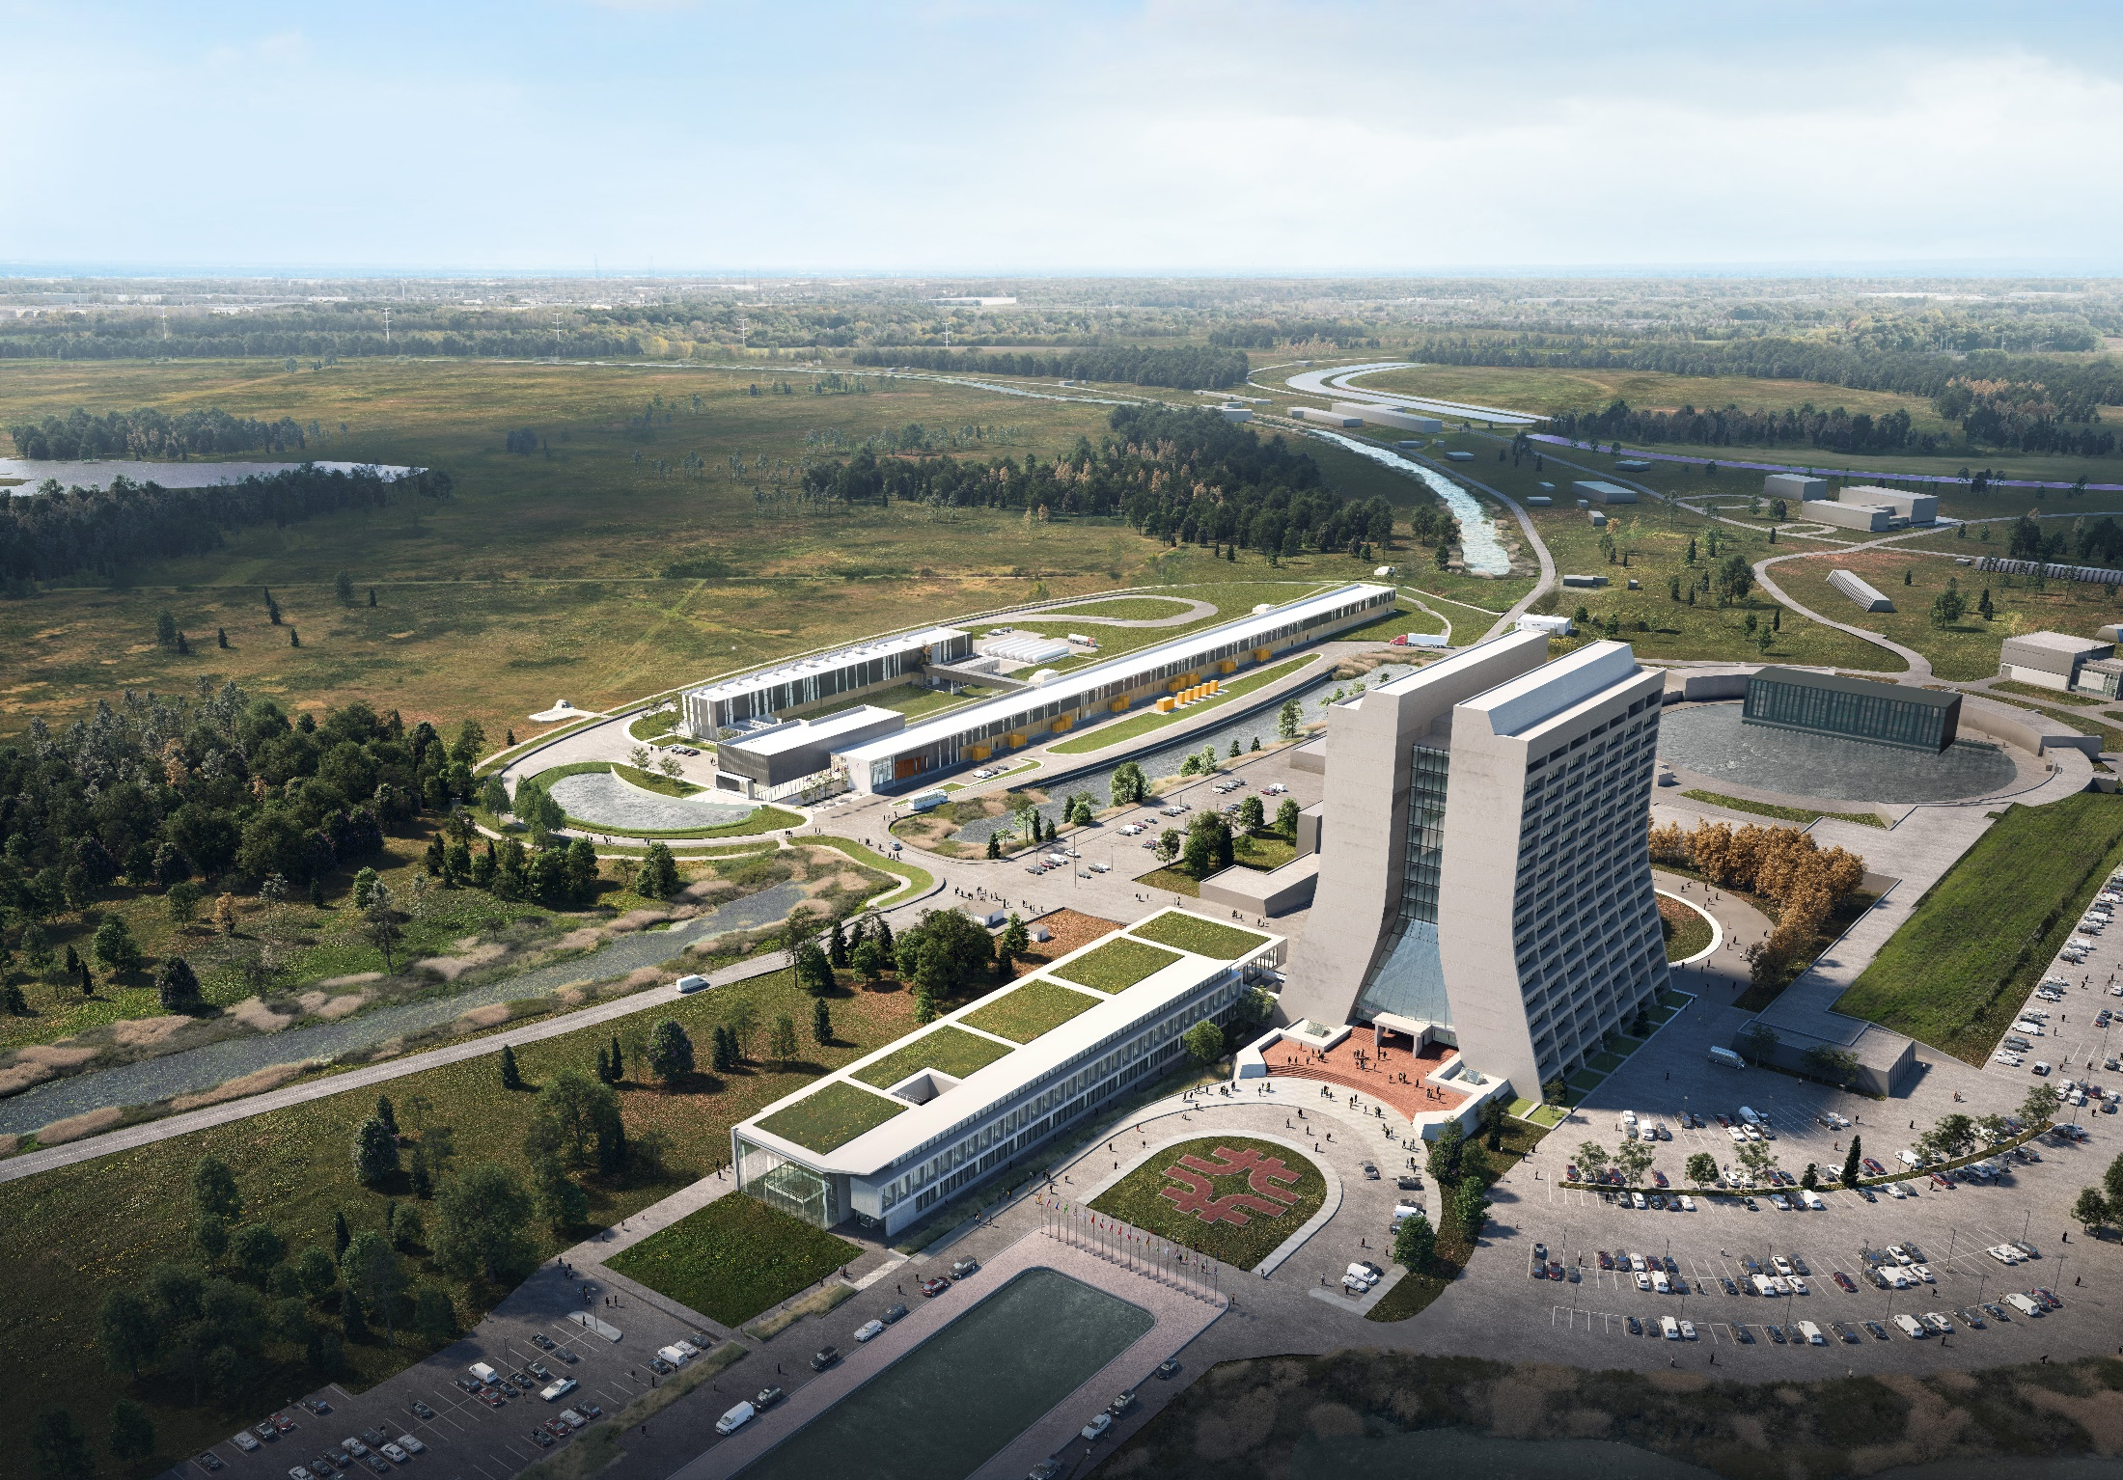
Fermilab at a Glance
America's particle physics and accelerator laboratory
Operates the largest US particle accelerator complex
~1,900 staff and ~$600M/year budget
6,800 acres of federal land
Facilities used by 4,000 scientists from >50 countries
As Fermilab moves into its second 50 years, its vision remains to solve the mysteries of matter, energy, space, and time for the benefit of all.

Slide 4
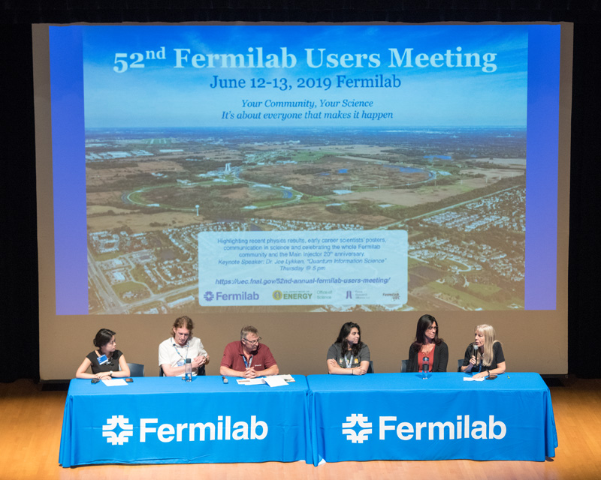
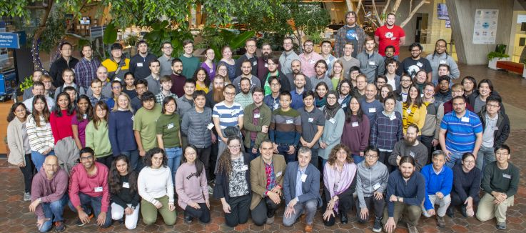

  The Fermilab research community
More than 4,000 scientists in 55 countries use Fermilab and its particle accelerators, detectors and computers for their research
More than 2,200 scientists from 175 U.S. universities and labs in 41 states
Fermilab is attracting and training the next generation of a diverse HEP scientific workforce: 114 postdocs, 273 graduate students, 52 undergraduate interns
Fermilab scientists also work at CERN, Sanford Underground Research Facility (SURF), SNOLAB, Cerro Tololo Inter-American Observatory, South Pole Telescope, NOvA Ash River Laboratory, Matter-wave Atomic Gradiometer Interferometric Sensor

Slide 5
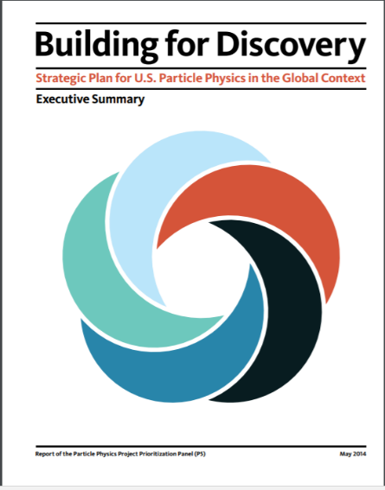
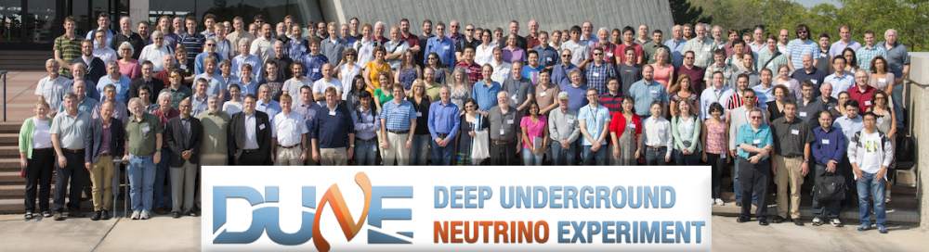

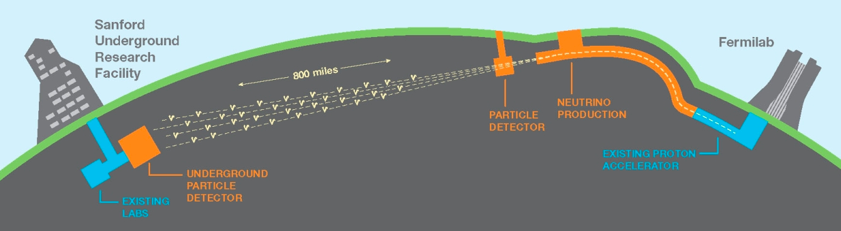
  Fermilab follows the P5 strategy
  The flagship projects LBNF/DUNE/PIP-II, HL-LHC anchor the program and will take many years to realize
  Fermilab simultaneously pursues a broad research effort in HEP
  The goal is a continuous stream of exciting results that attract/build/retain a diverse user community and scientific workforce
  2014 → 2023

Slide 6
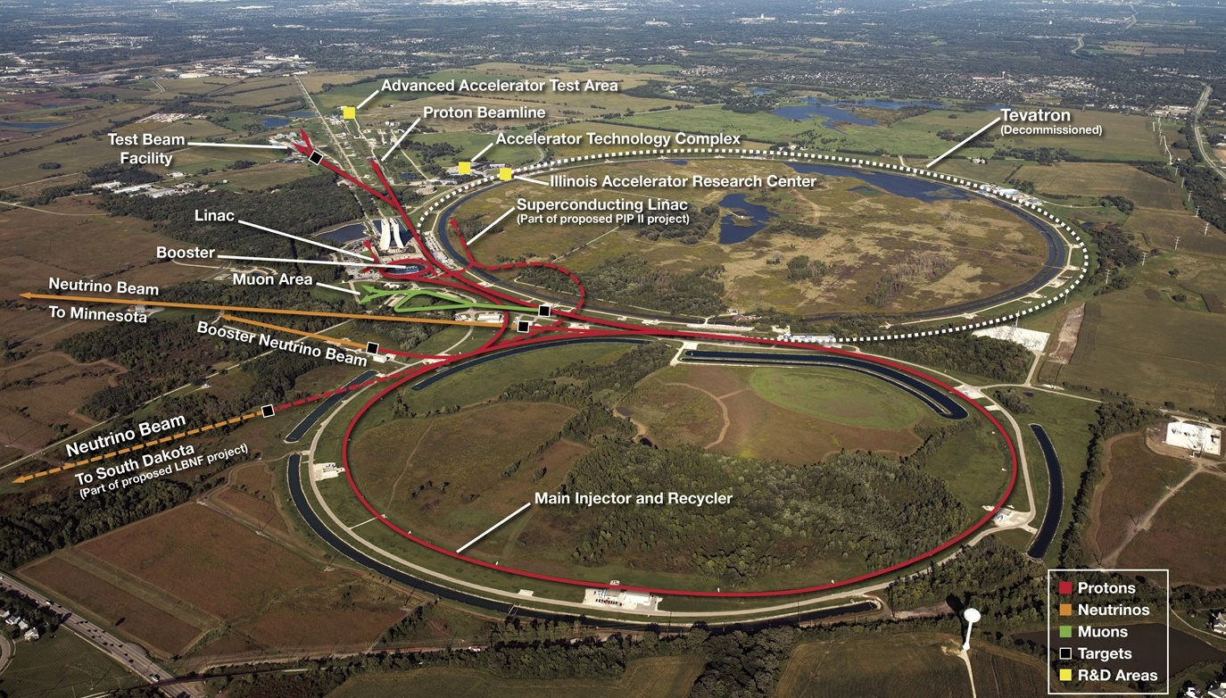
Fermilab Accelerator Complex

Slide 7
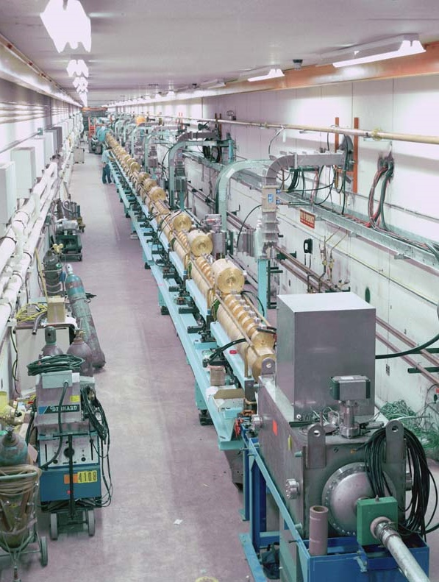
The Fermilab Linac
Linear (copper) Accelerator
Accelerates H⁻ ions
  750 keV → 400 MeV
    Thousands to millions of volts
Beam bunched at 200 MHz
  ~ 1.5 Billion ions / bunch
RF of 200 & 800 MHz
  Distance between drift tubes changes with beam velocity
Pulse length of ~ 80 μs
  Many particles for short periods of time – more efficient operation
To be retired Jan. 2028

Slide 8
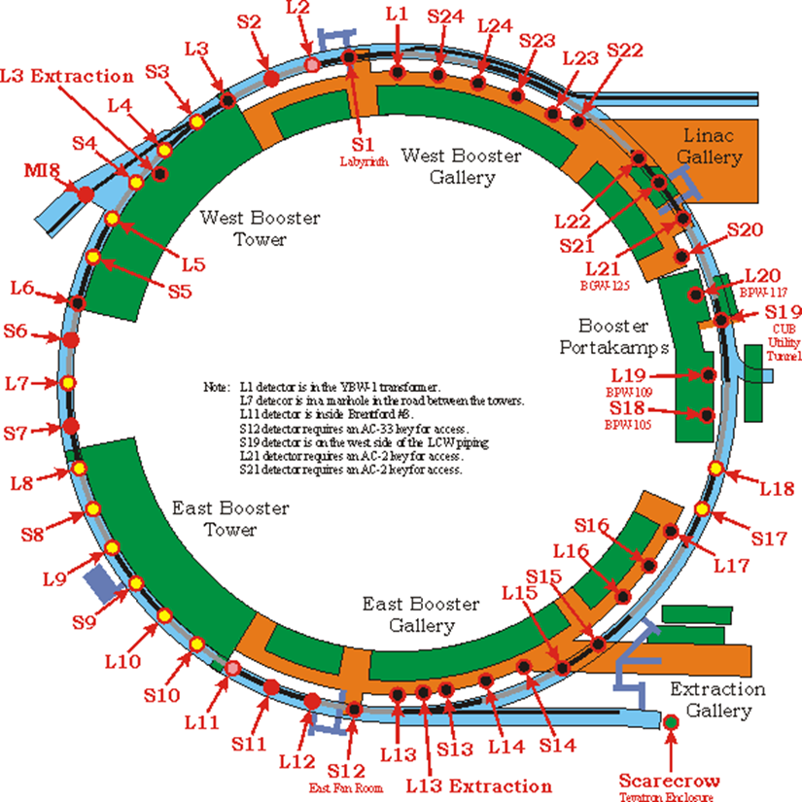
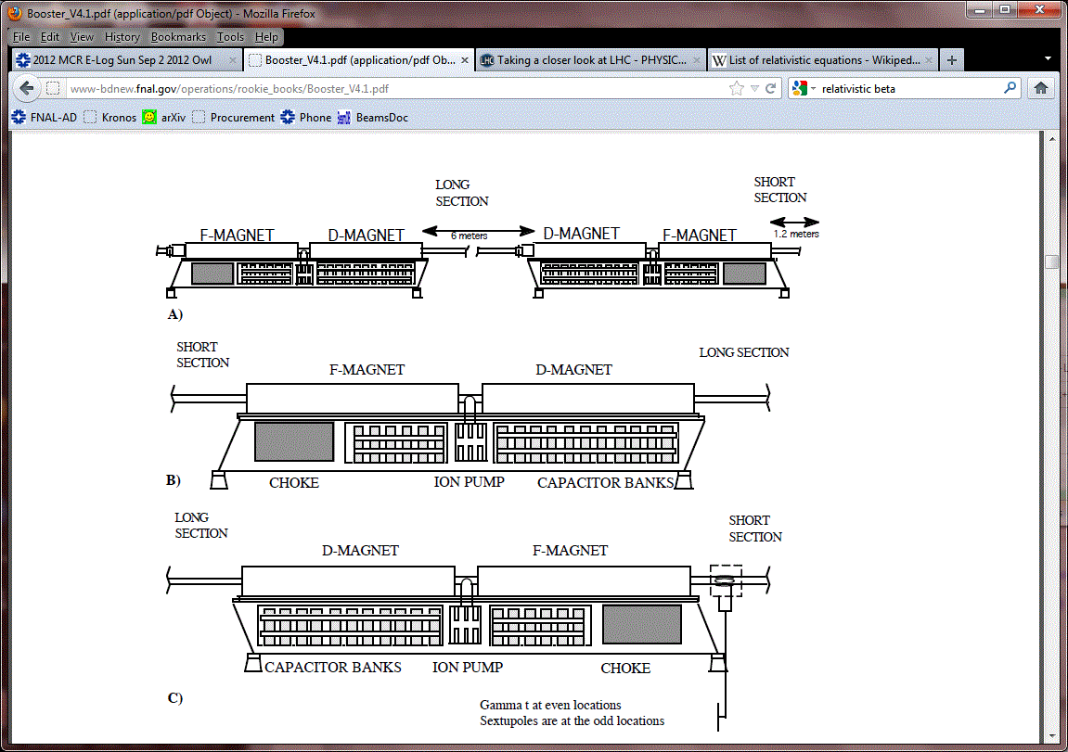
Booster Overview
H⁻ ions stripped and multi-turn injected onto the Booster
Protons are accelerated from 400 MeV to 8 GeV in 33 msec
Fast cycling synchrotron
  Fast magnet ramping
  Frequency of 15 Hz
Single turn extraction
Many pulsed devices requiring upgrade
Booster
Booster
Circumference (m) | 474
Harmonic Number | 84
Kinetic Energy (GeV) | 0.4 - 8
Momentum (GeV/c) | 0.954 - 8.9
Revolution period (μsec) | τ_{(inj)} 2.77 – τ_{(ext)} 1.57
Frequency (MHz) | 37.9 - 52.8
Batch size | 4.5 E12
Focussing period | FDooDFo (24 total)
Combined Function Magnets

Slide 9
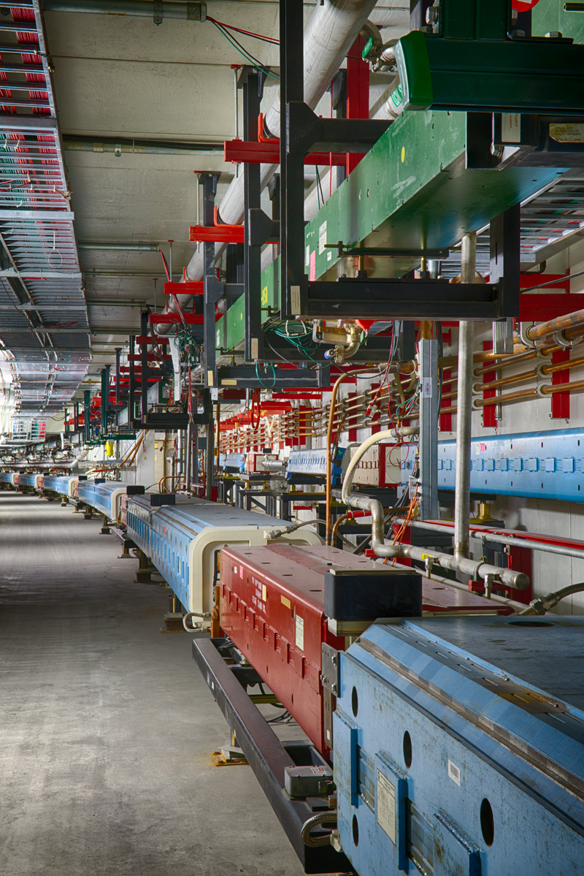
Main Injector & Recycler
Main Injector: 120 GeV Fast-cycling synchrotron
360 main dipole magnets
200 main quadrupole magnets
108 sextupoles, 66 octupoles, corrector dipoles/ quads, specialty injection and extraction magnets
Twenty 53-MHz RF cavities to accelerate beam
170 DC and 360 ramped magnet supplies with total of 140 MVA, 40 specialty pulsed magnet supplies
Recycler: 8 GeV Storage Ring
Originally built for antiproton storage, repurposed for proton stacking
Combined function, permanent magnets
RF cavities for stacking proton beams

Slide 10
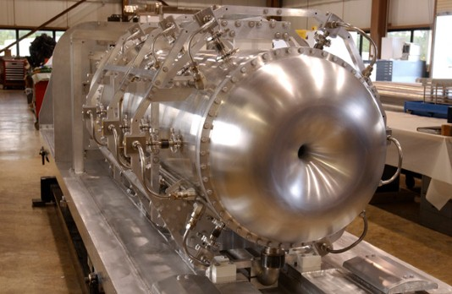
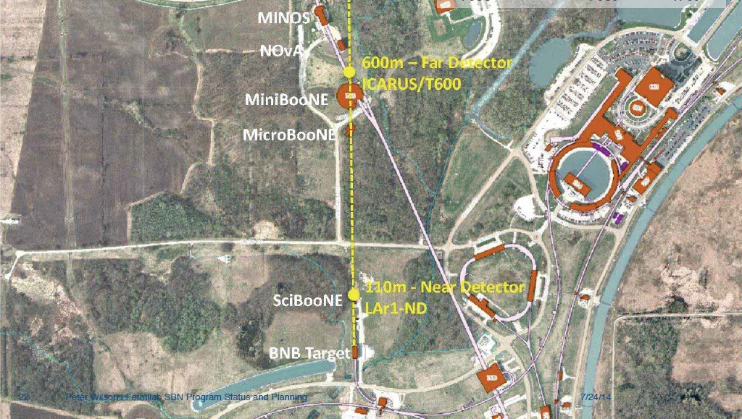
Booster Neutrino Beam (BNB)
Uses 8 GeV beam from the Fermilab Booster, operating since 2002
  Up to ~ 30 kW of beam (5e12 ppp)
Beryllium target integrated with single focusing horn
Services a suite of experiments at Fermilab: the Short Baseline Neutrino (SBN) program
BNB capability with PIP-II will be preserved after the long shutdown

Slide 11
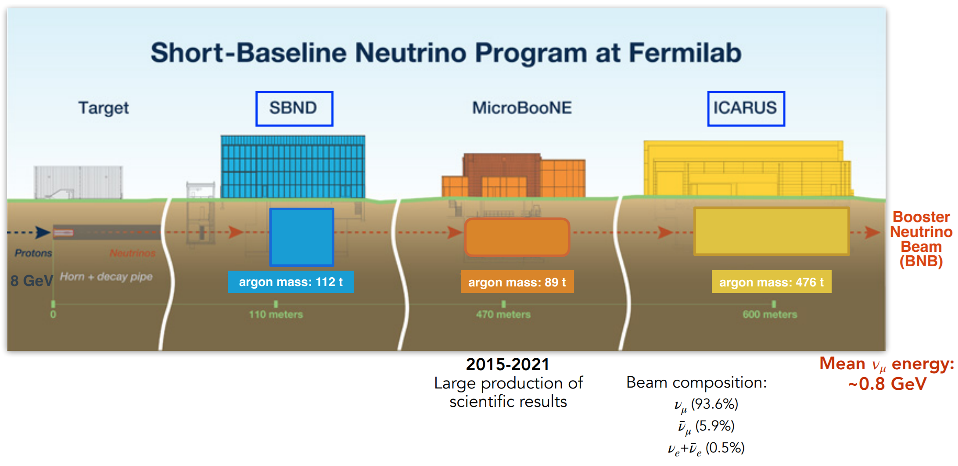
SBN Program

Slide 12
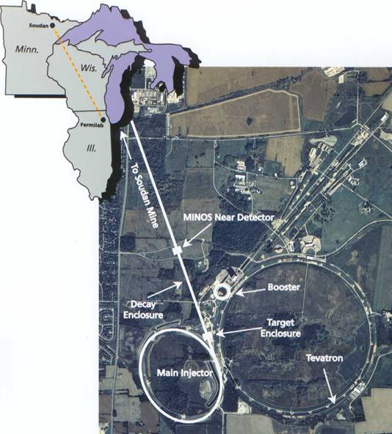
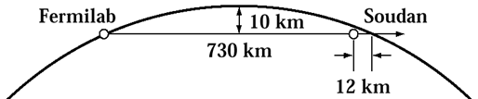
The NuMI Facility: “Neutrinos (ν –> Nu) at the Main Injector”
Intense muon-neutrino beam directed towards Minnesota
Main Injector supplies 50–70e12 120GeV protons every 1.2 seconds
  Designed for 400 kW, operated up to 900 kW
  Multiple upgrade projects to 1 MW
Each pulse produces about 2x10¹⁴ ν _{μ}
  ~ 20,000,000 Pulses per year
  Direct beam 3º down
Commissioned in 2005, expect to run to ~ 2027
“Long-baseline”
Neutrino beam
Near Detectors
Far Detectors: 5400 tons &
14000 tons
5

Slide 13
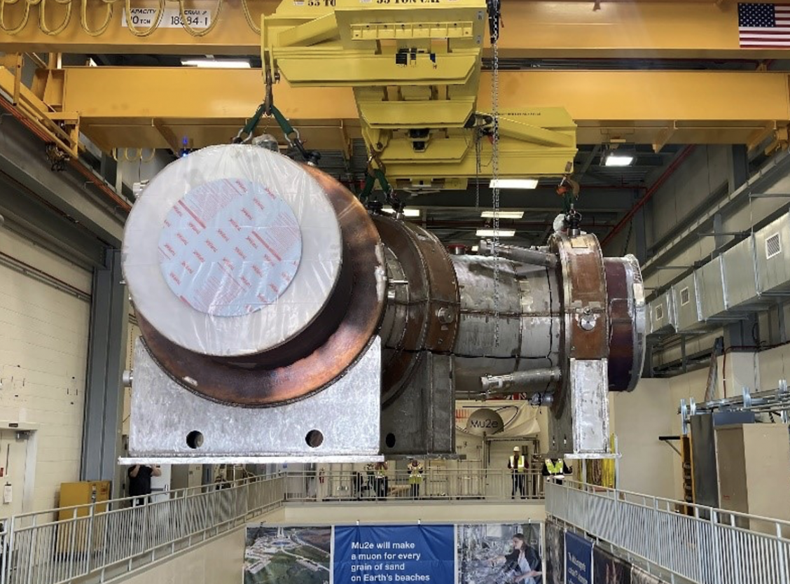
Mu2e: Muon to Electron Conversion Experiment
Two transport solenoids were installed into the Mu2e experimental hall
  Production Solenoid just installed
Beamline has been commissioning
  Electrostatic septa built & installed
  AC Dipoles ready to commission
  Goals for 2026:
    Establish efficiency slow extraction
    Develop extinction methods
  Considering options for upgraded targets
Plan to have a 6-9 month physics run before the long shutdown

Slide 14
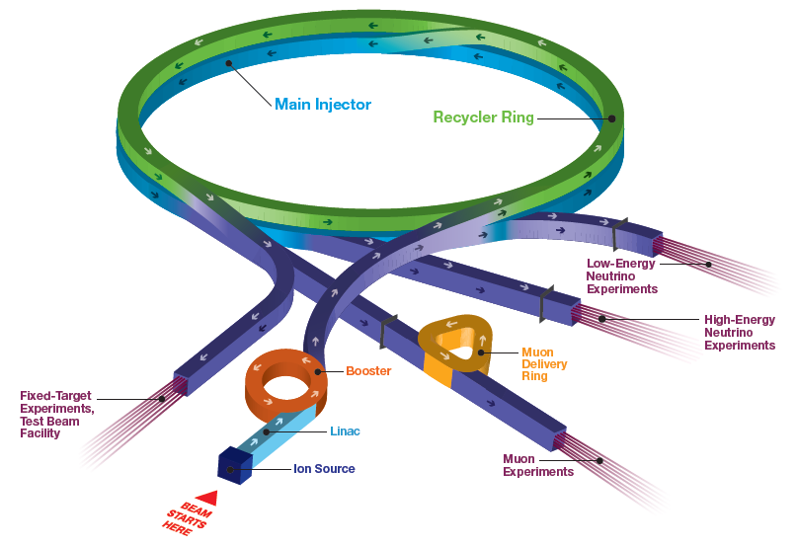
Fermilab Accelerator Complex – National Users Facility
1998
1998
(parts 1970)
1970
1970
2012

Slide 15
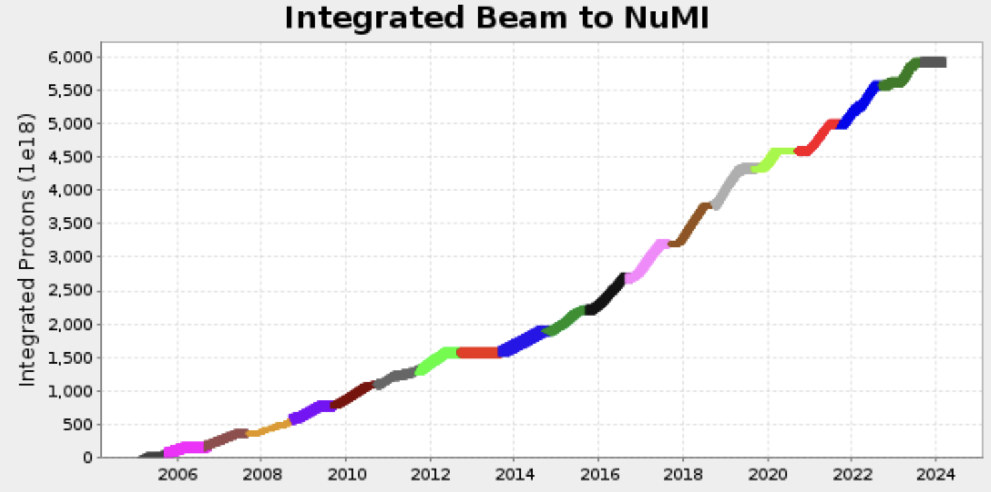
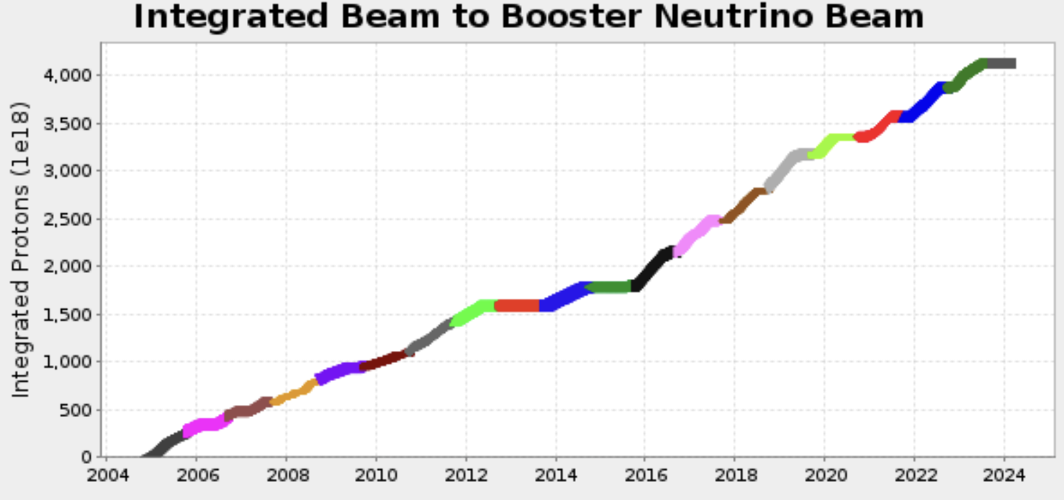
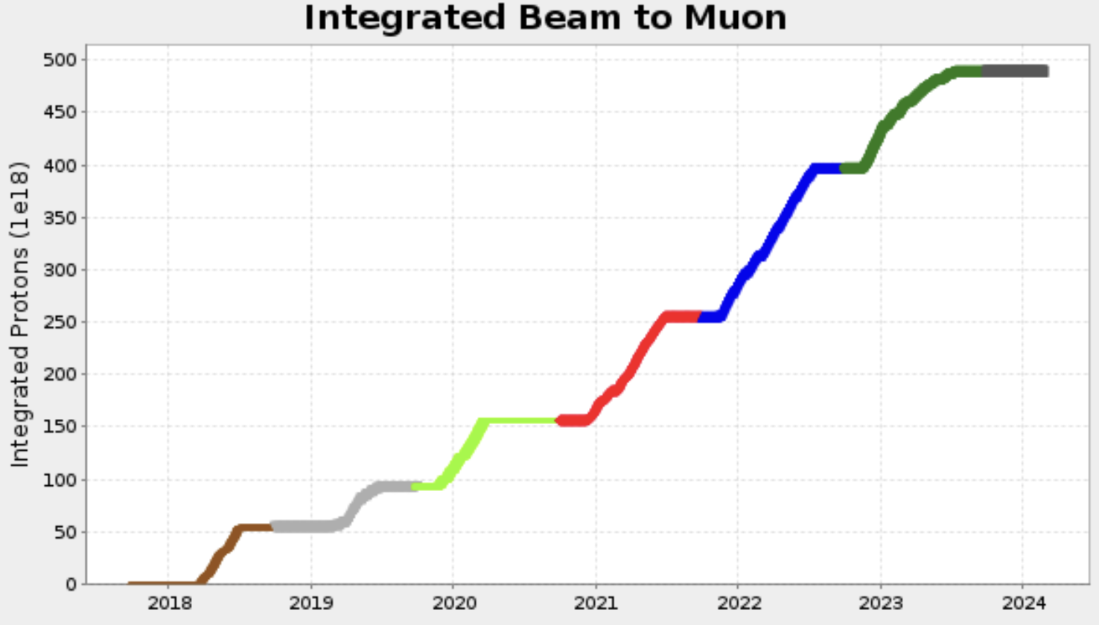
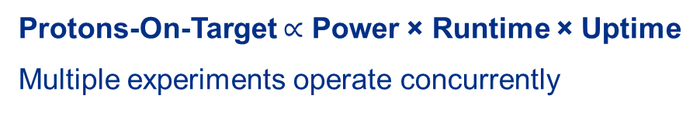
Accelerator Complex function - beam delivery to science users
Protons-On-Target $∝$ Power × Runtime × Uptime
Multiple experiments operate concurrently

Slide 16
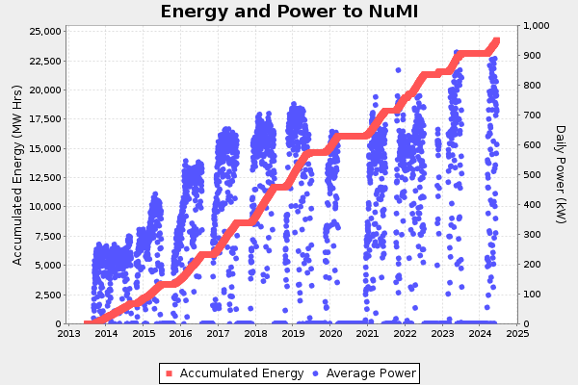

Slide 17
NuMI Beam Power Evolution
Started at 250 kW in the Tevatron operation
  Increased to 400 kW with Slip Stacking
NOVA / ANU upgrades incorporated Recycler to allow 700 kW beam
Proton Improvement Plan (PIP) increased reliability and capability
  Allowed BNB and Muon to operate simultaneously with NOvA @ 700 kW
  True Booster pulsing of 15 Hz
Intensity increases and MI ramp tweaks pushed towards 1 MW
  Needed a target station capable

Slide 18
NuMI Megawatt Accelerator Improvement Project (AIP): 2018-2021
Originally designed for 400 kW beam power, then upgraded to 700 kW with NOvA/ANU
Megawatt AIP (Accelerator Improvement Project)
  Upgrade of target, horns, and supporting systems to be capable of accepting 1 MW beam power through 2025
  Completed in 2021 after 3 annual accelerator shutdowns to replace components
 | NuMI Design | NOvA | 1 MW upgrade
Proton beam energy | 120 GeV
Beam power (kW) | 400 | 700 | 1 MW
Energy Spectrum | Low Energy | Medium Energy
Cycle time (s) | 1.87 | 1.33 | 1.2
Protons per spill | 4.0 x 10¹³ | 4.9 x 10¹³ | 6.5 x 10¹³
Spot Size (mm) | 1.0 | 1.3 | 1.5
Beam pulse width | 10 microsec

Slide 19
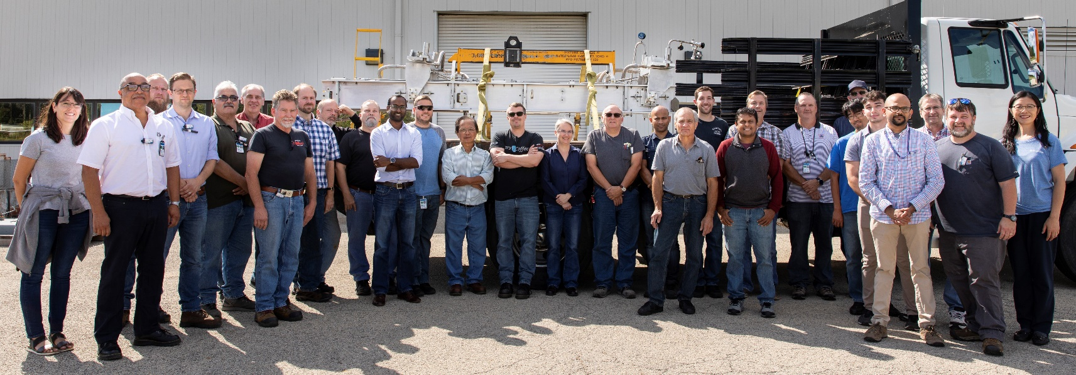
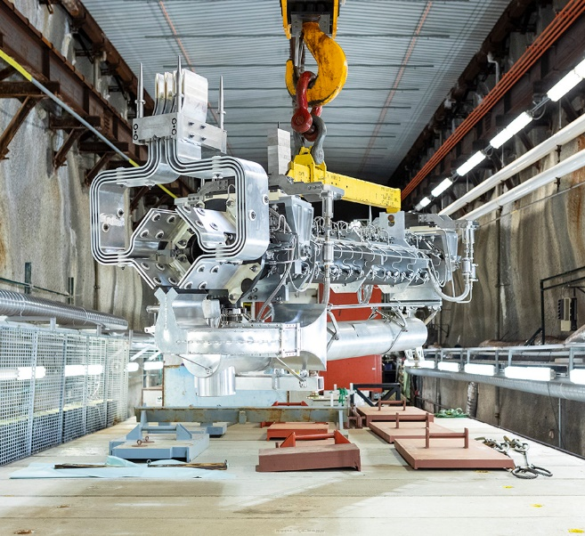
NuMI Target Systems Accelerator Improvement Plan (AIP):
Target Station Upgraded for 1-MW Beam Operation
Objective reached: capable of accepting 6.5E13 protons/spill at 120 GeV, 1.2 sec cycle time
Project scope: improve and replace Target Hall components / support systems
Tasks completed in 2019 – 2022
Upgrade for 1 MW | Reliability / Lifetime Extension
MARS / FEA simulations for all beamline components 1 MW target 1 MW horn 1 Stripline air diverter T-block & HVAC ductwork Target & Horn 1 RAW system Target chase cooling and air handling system | Horn 1 module drive mechanism changeout Absorber intermediate cooling system HX MI-65 condensate rerouting Target chase supplemental shielding Hadron monitor and gas system Target module drive mechanism MINOS surface dry cooler
NuMI Team
1-MW Horn-1 Installation

Slide 20
1 MW Test Run: June 26, 2024
AD was granted an 8-hr window for up to 4-hr of running exceeding One Megawatt
Summer temperatures necessitated work during a cool and calm period
  4am June 26 was chosen, with June 27 as backup
Individual machines pushed their capabilities to near-MW the few days before
Full operations & machine teams reported at 4am along with technical department personnel at the appropriate locations
  Security opened the East Gate early for this occasion
At 6:53 machine conditions stabilized to allow 1 MW running, so the 4-hr period started at 5:53 am
  Improvements were made over the next few hours and 1.018 MW (1-hr average) was achieved at 8:21 am.
  BNB ran at full intensity in this period. Experiment concluded at 9:30 am
Much was learned from the run in terms of machine tuning and vulnerabilities.

Slide 21
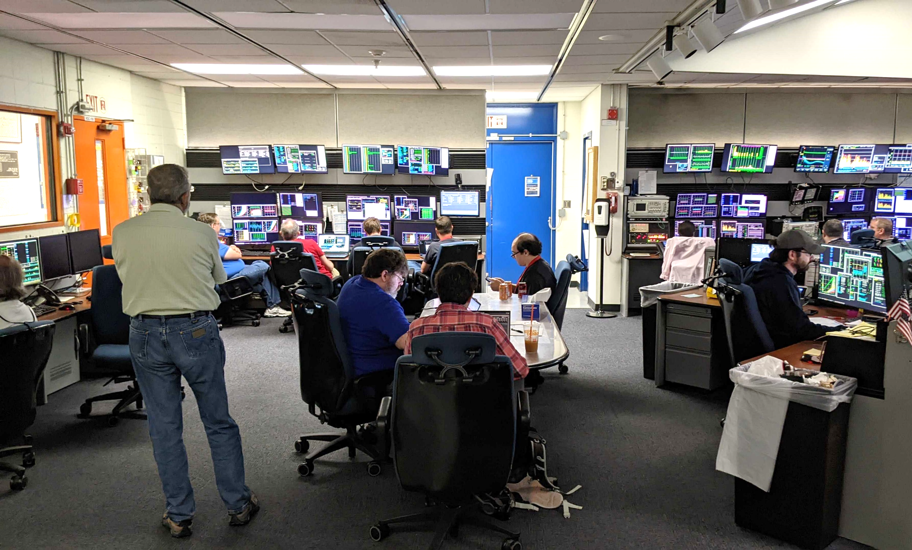
1.018 MW

Slide 22
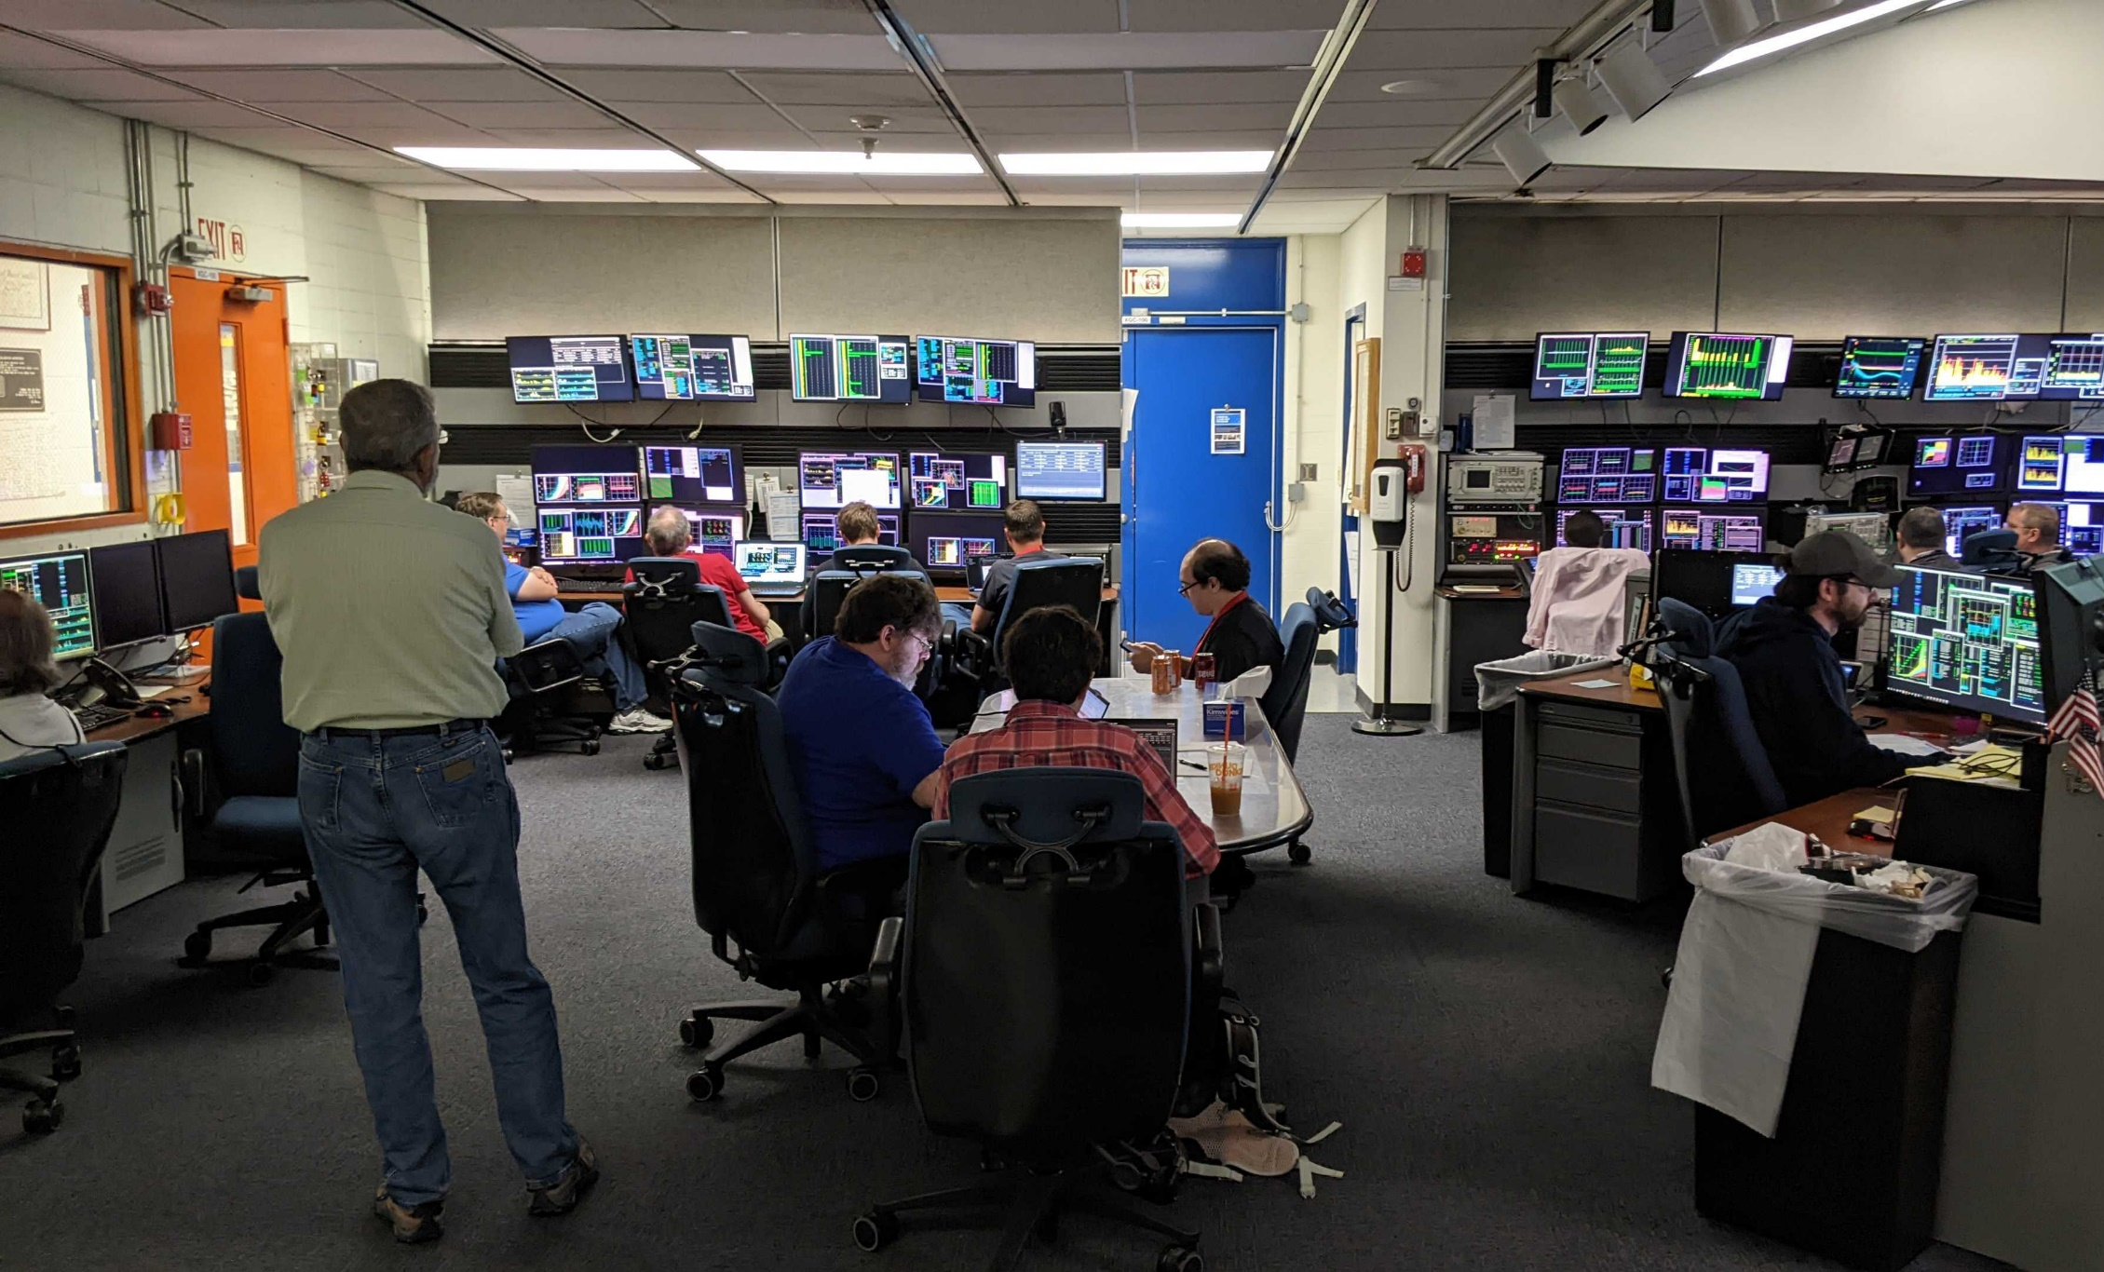
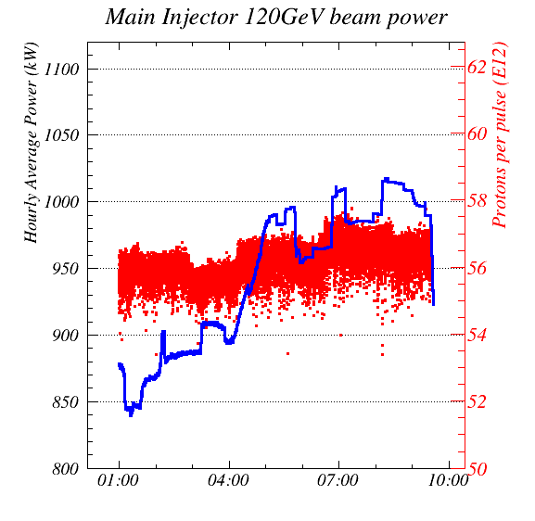
1.018 MW
  1.018 MW POWER RECORD

Slide 23
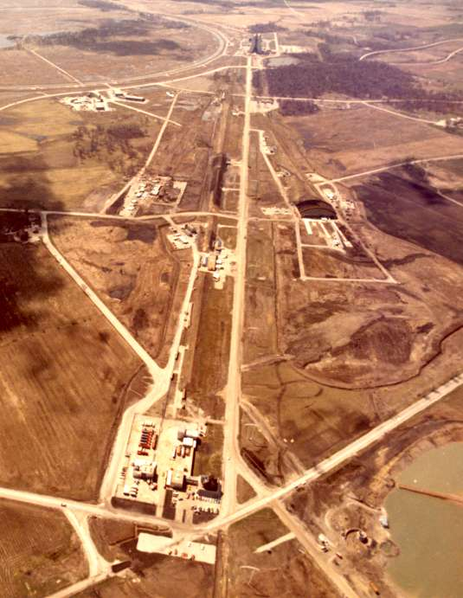
Fixed Target
Original experimental purpose of Fermilab
Beam directed onto stationary targets
Results in a large shower of particles, useful for making beams of unstable particles
Can give a very large number of interactions
Resulted in the discover of the Upsilon and tau neutrinos, ampng many other results

Slide 24
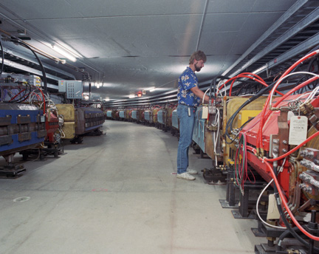
PBar – the Antiproton Source
120 GeV protons impact a Ni target
  ~ 1.6 x 10⁻⁵ usable antiprotons per proton
Debuncher ring captures and cools antiprotons
  Takes ~ 2 seconds
  Collects the 8 GeV antiprotons
Accumulator ring stores and further cools antiprotons
  Stores them for hours, or even days
“Stack” of antiprotons can get as large as ~ 10¹³
Further stored in the Recycler and cooled with electrons
Major goal at Fermilab for years was to maximize antiproton production

Slide 25
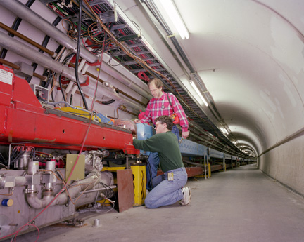
The Tevatron
Highest-energy collider for ~ 20 years
  Likely the last proton-antiproton collider
Superconducting magnets
  Cooled with Liquid He
  Field of 5 Tesla
Collides counter-rotating beams of protons and antiprotons in a single beam tube
  CoM energy of 1.96 TeV
  Significantly more than fixed target
Produces most everything
  All the quarks (inc. top)
  Z, W, all the leptons
  Even the Higgs

Slide 26
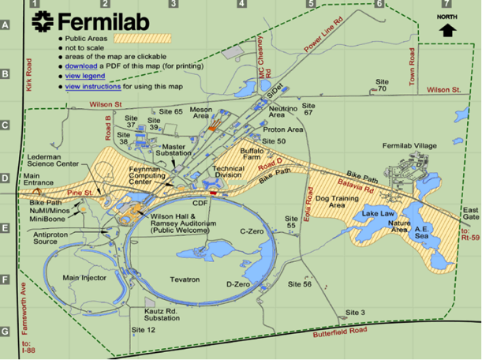
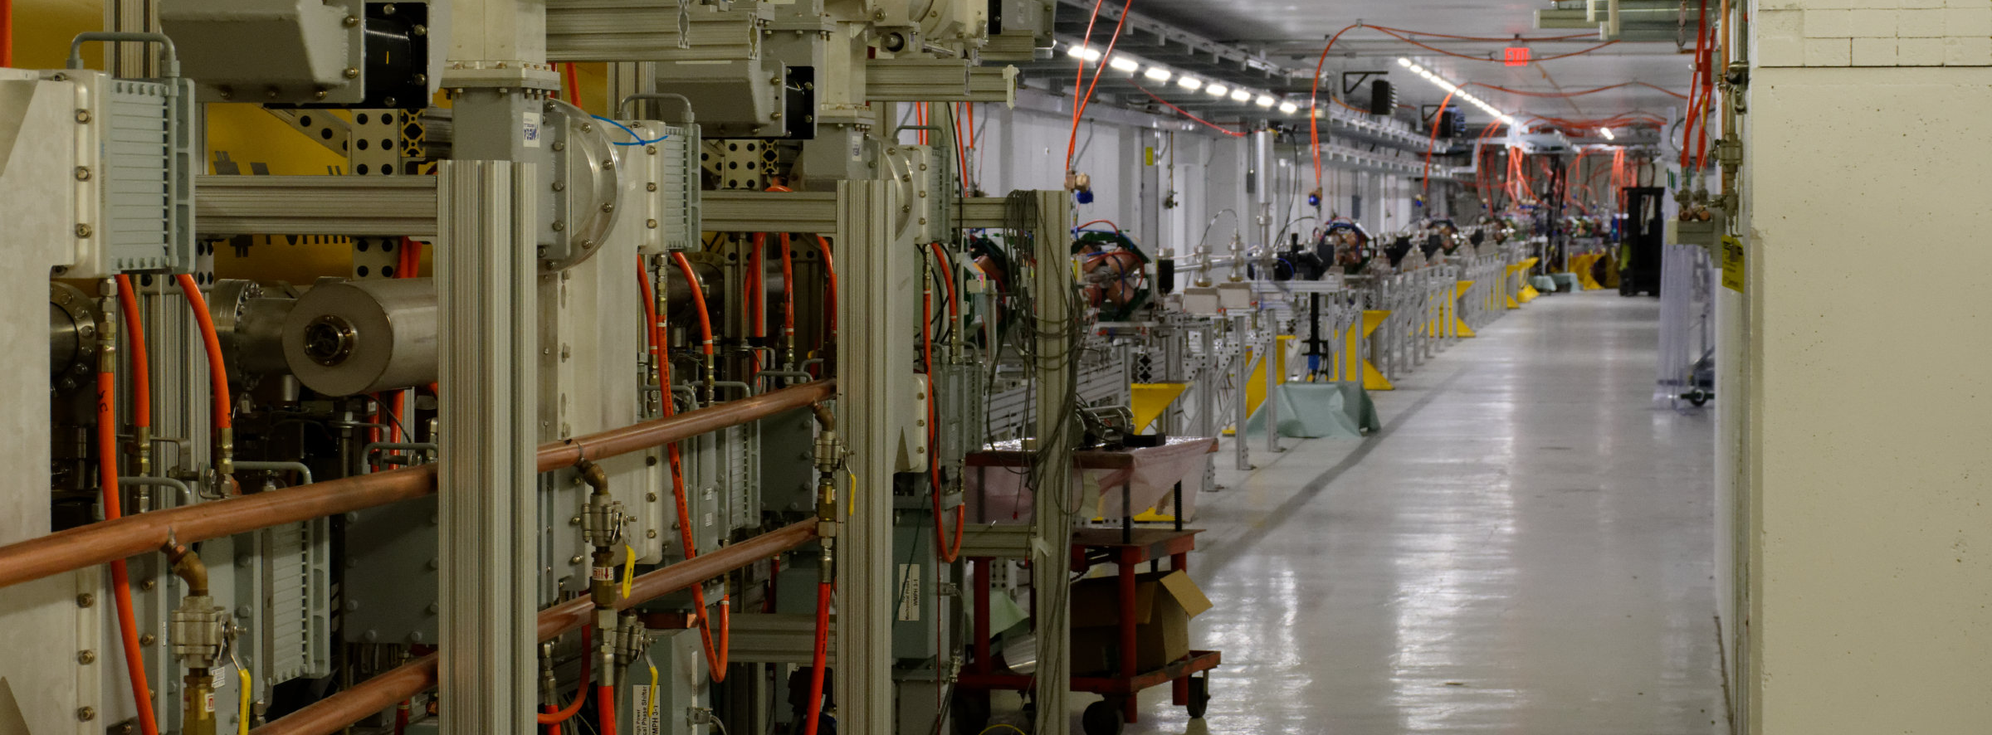
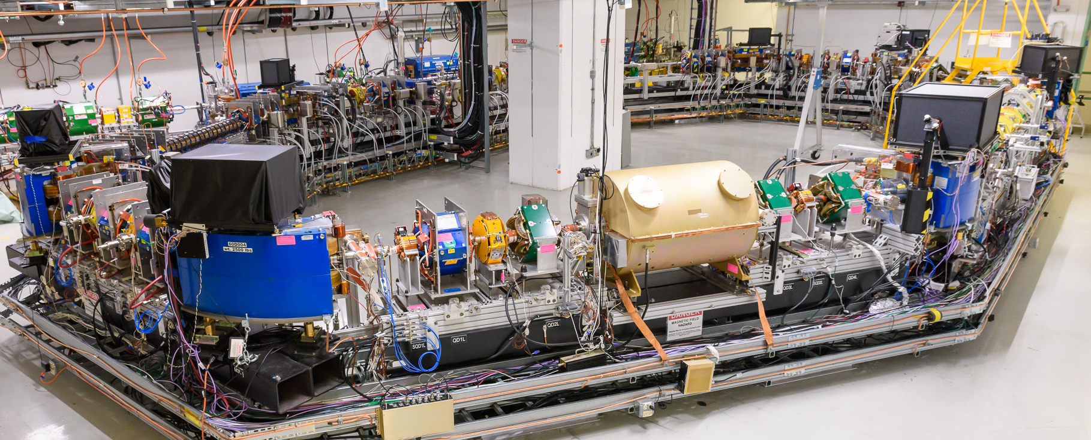
Fermilab Accelerator Science and Technology (FAST) facility
FAST SRF Linac
Integrable Optics Test Accelerator (IOTA) ring

Slide 27


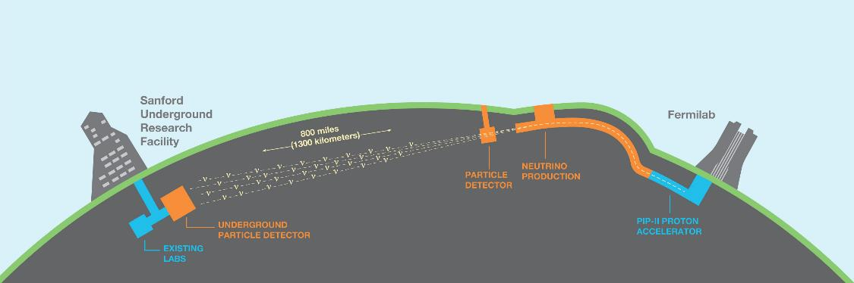
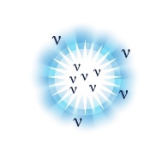

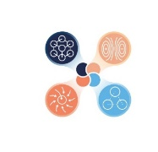
DUNE Deep Underground Neutrino Experiment
  Origin of matter. Investigate leptonic CP violation. Are neutrinos the reason the universe is made of matter?
  Neutron star and black hole formation. Ability to observe neutrinos from supernovae events and perhaps watch formation of black holes in real time.
  Unification of forces. Investigate nucleon decay, advance unified theory of energy and matter.
The LBNF/DUNE project will be the first internationally conceived, constructed, and operated mega-science project hosted by the Department of Energy in the United States” – DOE

Slide 28
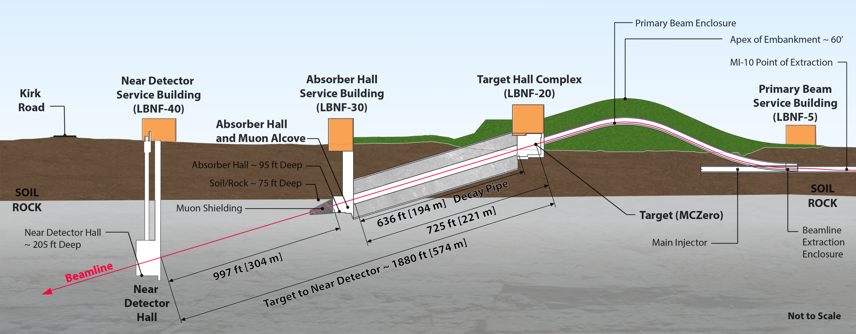
The LBNF Beam
Facility designed for initial beam power of 1.2 MW, upgradeable to 2.4 MW

Slide 29
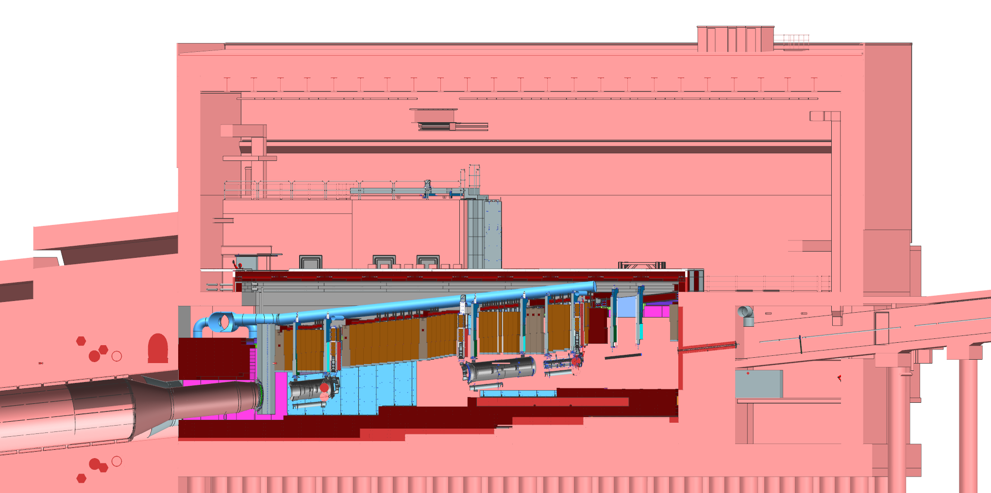
Section View of Target Complex – Target Hall
Target Hall
Work Cell
Hatch Covers
←Beam
Primary Beam Enclosure
N₂ Gas
He Gas
Decay Pipe
Primary Beam Window
Decay Pipe Upstream Window
Horn A with Target
Cooling
Panels
Steel Shielding
Horn B
Baffle
Horn C

Slide 30
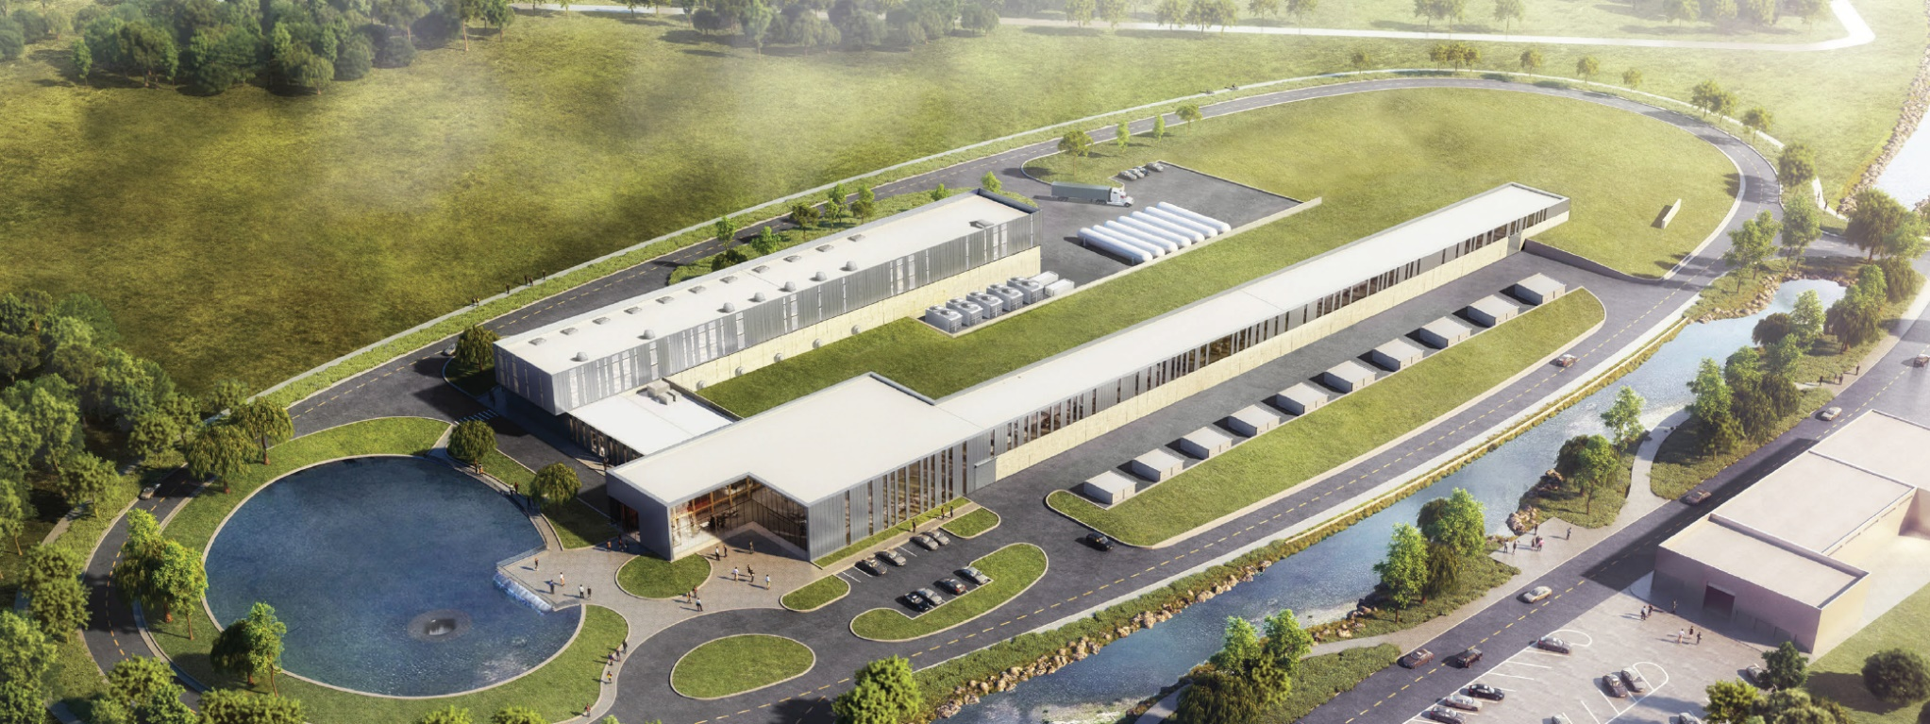
Proton Improvement Plan II (PIP-II)
Increase Main Injector beam power to 1.2 MW.
  Replace the existing 400 MeV linac with a new 800 MeV superconducting linac => increase in Booster intensity.
    Provide a platform to increase LBNF power to 2.4 MW
  Provide path for a 100 kW Mu2e-II
  Provide capability for 1.6 MW at 800 MeV, CW beam
  Platform for high duty-factor / power operations to multiple experiments

Slide 31
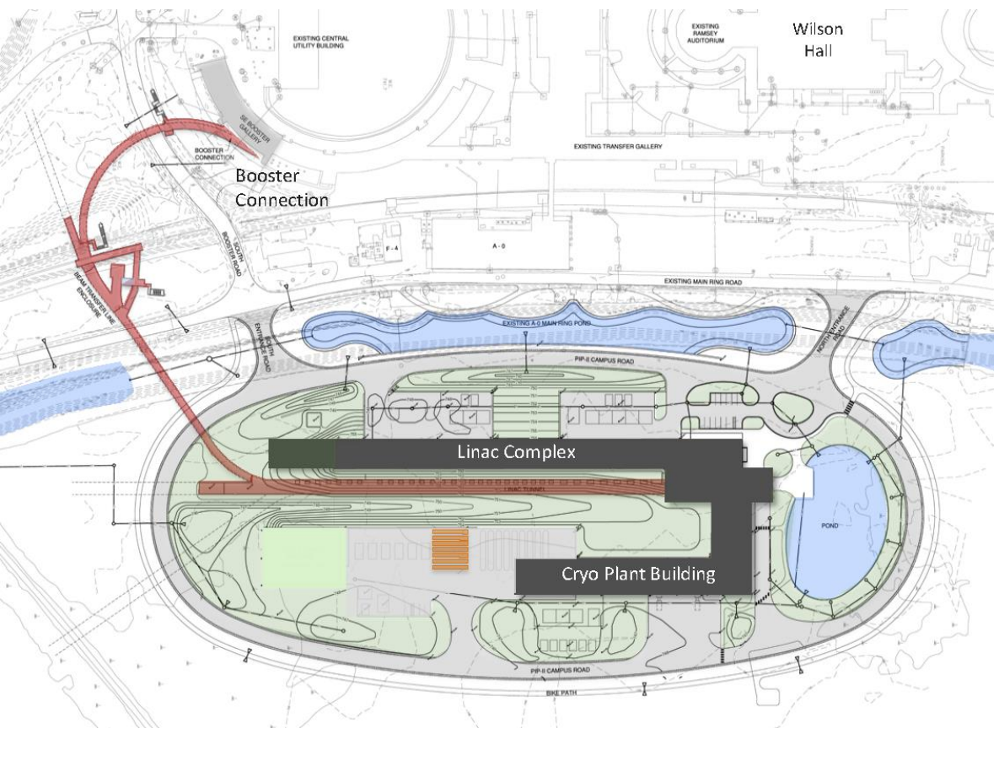
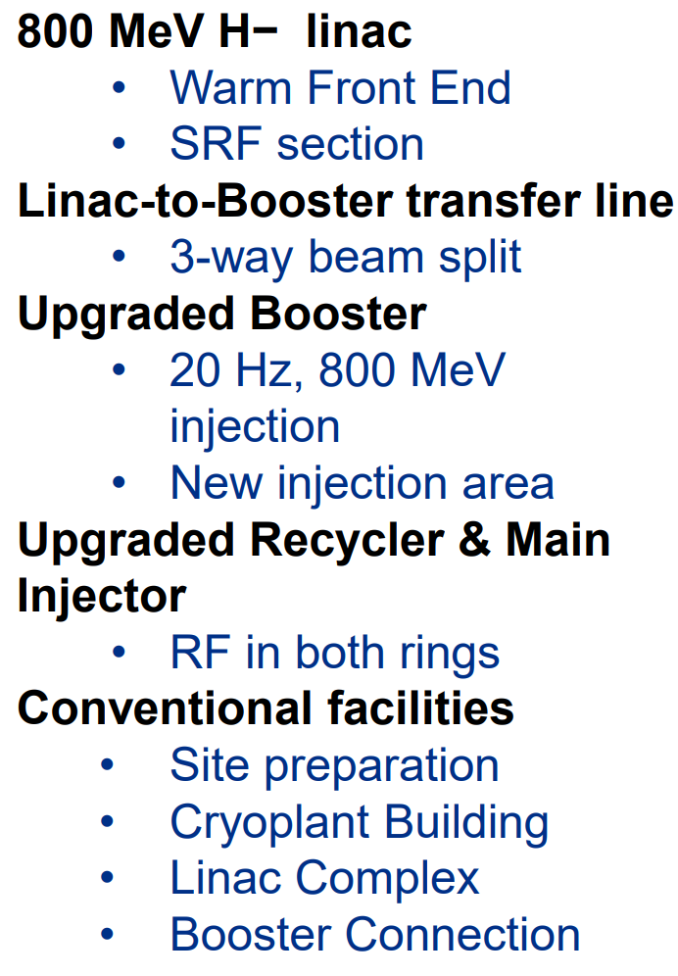
31
31
PIP-II Linac & Upgrades (1.2 MW power on target)
Project started in 2016 (CD-0)
First beam in Booster: 2029 (plan)
MI 1.2 MW beam on target: 2031 (plan)
Notes:
31
31
31
31
31
31

Slide 32
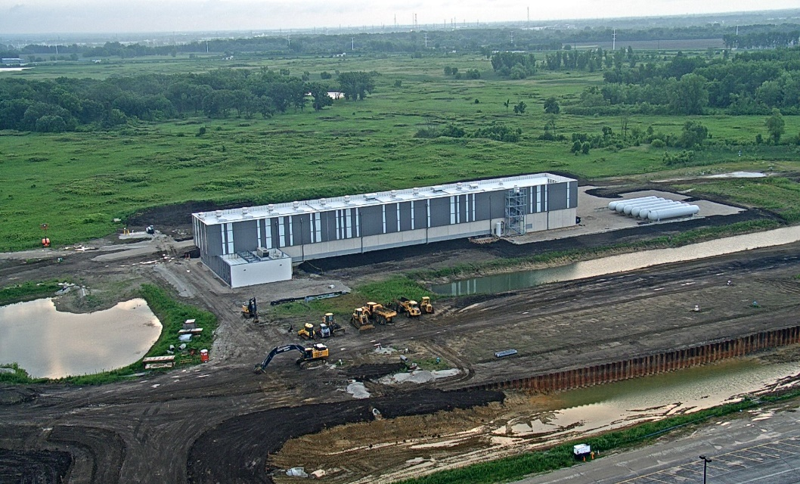
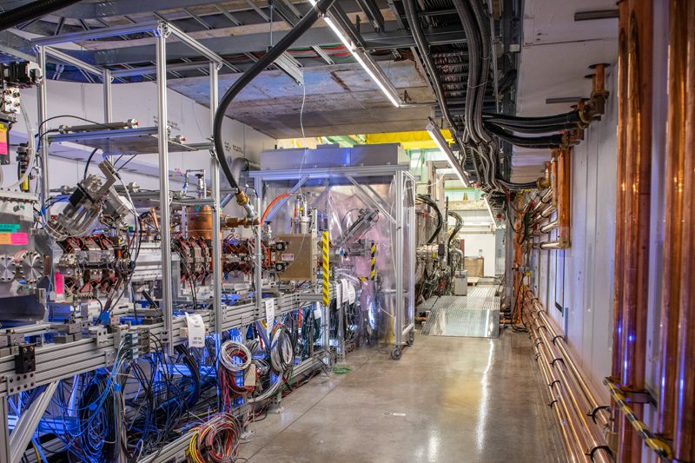
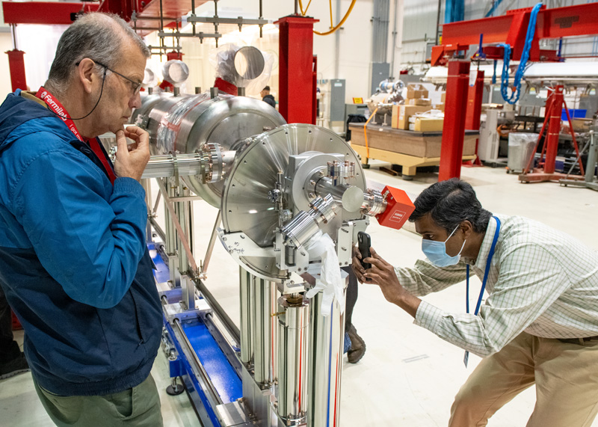


PIP-II Project construction
PIP-II received DOE CD-3 approval for start of construction/execution on April 18, 2023
  Linac complex construction is actively underway
Front end of PIP-II linac constructed and successfully tested with beam
PIP-II cryoplant building complete
Extensive in-kind and partner contributions arriving
Magnets provided by
PIP-II is the first particle accelerator built in the U.S. with significant international contributions

Slide 33
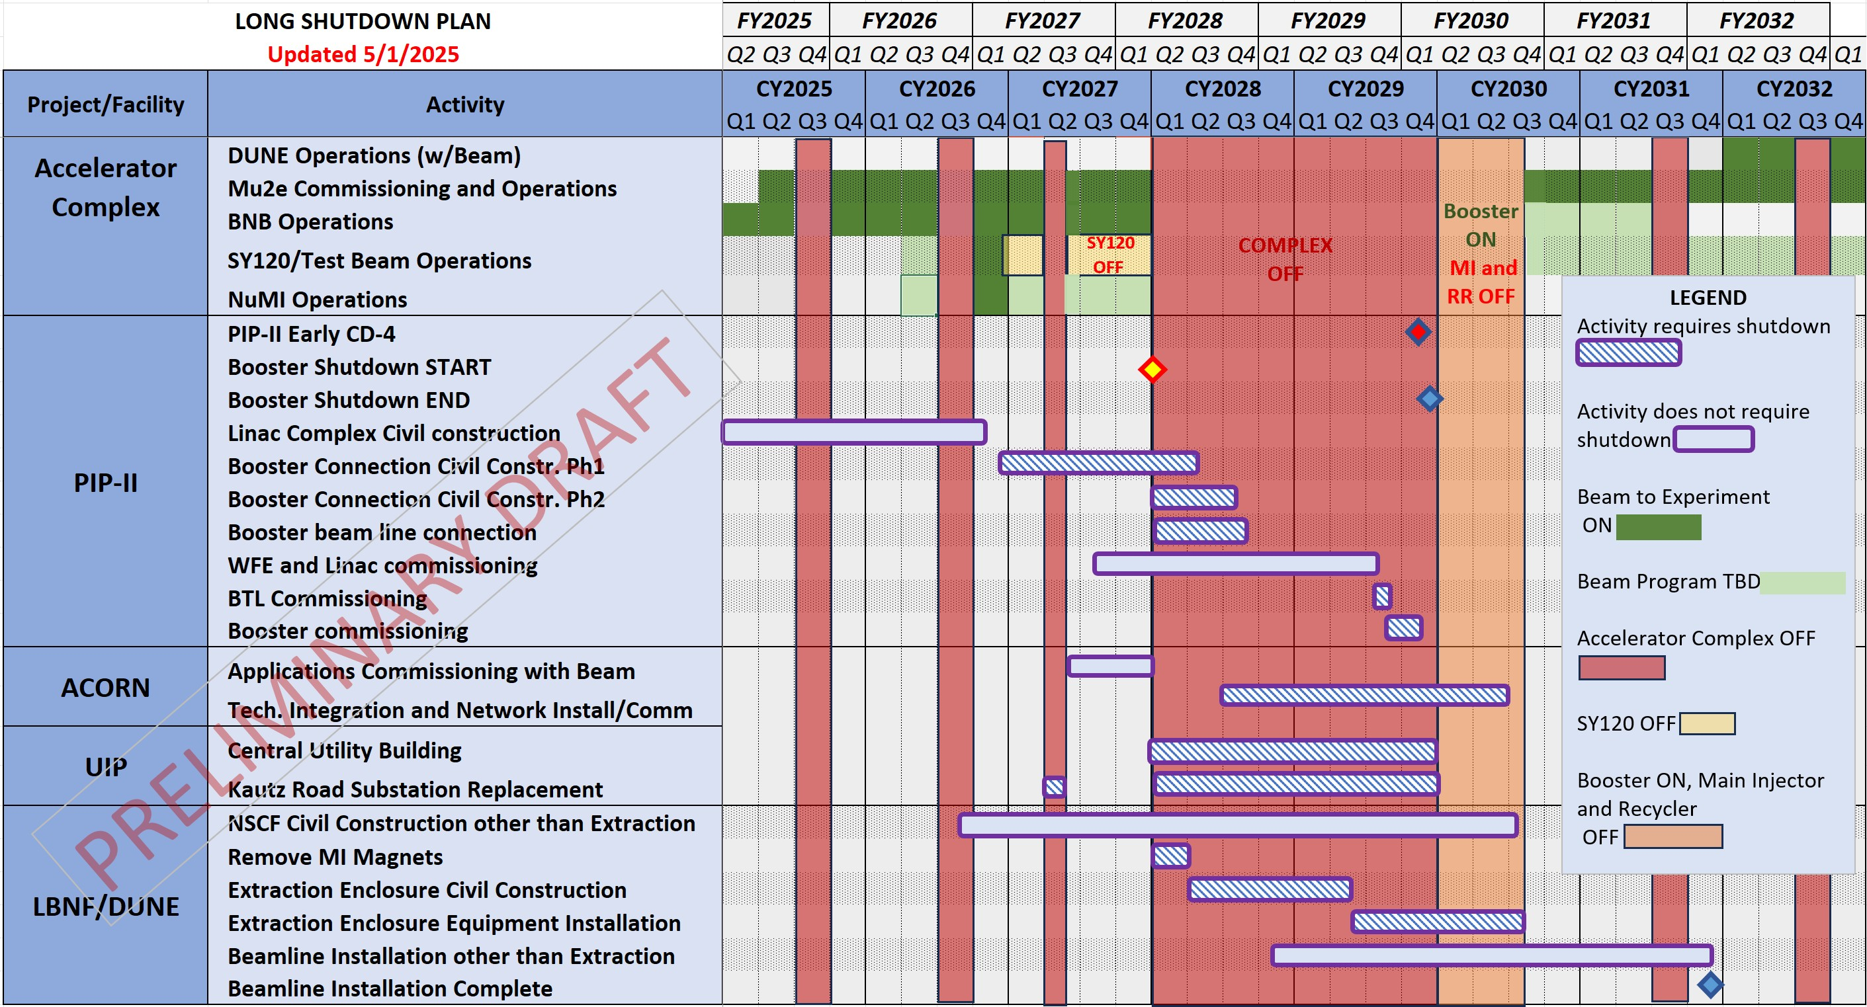
Mid-Term Accelerator Plans

Slide 34
Lessons from long-term High-Power operations
2014-2019 investments in capability (PIP and operations investments) and strong Ops team enabled growth of peak power ×3 (0.3-1 MW)
To realize full physics potential, sufficient run time allocation is essential
Recent decrease in reliability is concerning

Slide 35
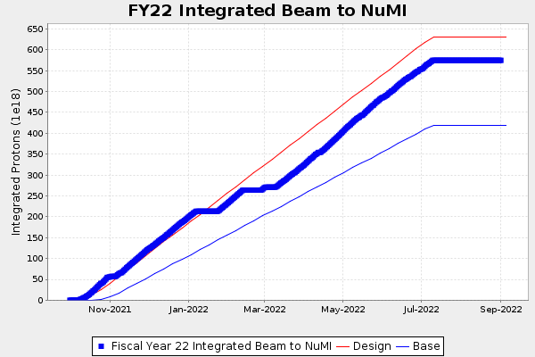
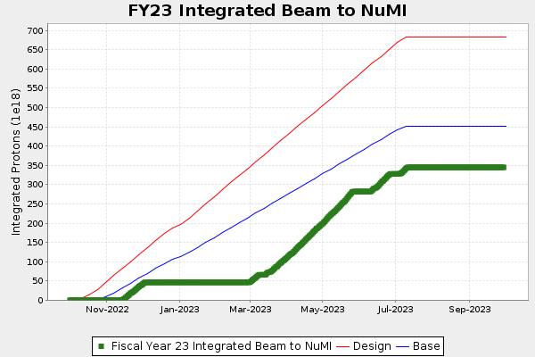
Physics output and Ops efficiency
  Uptime = [run time]/[scheduled time]
    – FY22 69% ➜ 80% LBNF/DUNE
  Runtime = [scheduled time]/[CYear]
    – FY22 77% ➜ 80% LBNF/DUNE
  Sustained power fraction= <P>/Pmax
    – FY22 76% ➜ 90% LBNF/DUNE
MI quad failure
Efficiency
  Machine capability Pmax
Capability
Horn Stripline failure
physics
= Pmax × Runtime × Uptime × Sustained power f
Investments in reliability and loss mitigation yield significant returns in physics, must be maintained over experiment run. Present efficiency 40-45% ➜ >57% DUNE

Slide 36
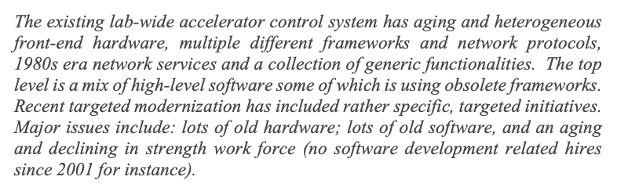

Accelerator Controls Operations Research Network (ACORN) Project
ACORN received CD-0 ESAAB approval Aug. 28, 2020. CD-1 expected in 2025.
The Project will modernize the Fermilab’s accelerator control system and replace end-of-life accelerator power systems.
The control system and power systems are critical components needed to reliably accelerate beam from PIP-II through the entire accelerator chain and deliver it to LBNF/DUNE.
The Fermilab Accelerator Advisory Committee summarized their findings in Dec. 2018:

Slide 37
UIP: Utilities Infrastructure Project
SLI Project
  Science Laboratories Infrastructure
Rebuild the Central Utilities Building
Modernize the Kautz Road Substation
  Master Substation was rebuilt ~ 10 years ago
Addresses a subset infrastructure issues
Expect CD-1 within the next few months
To be completed during PIP-II / LBNF Shutdown

Slide 38
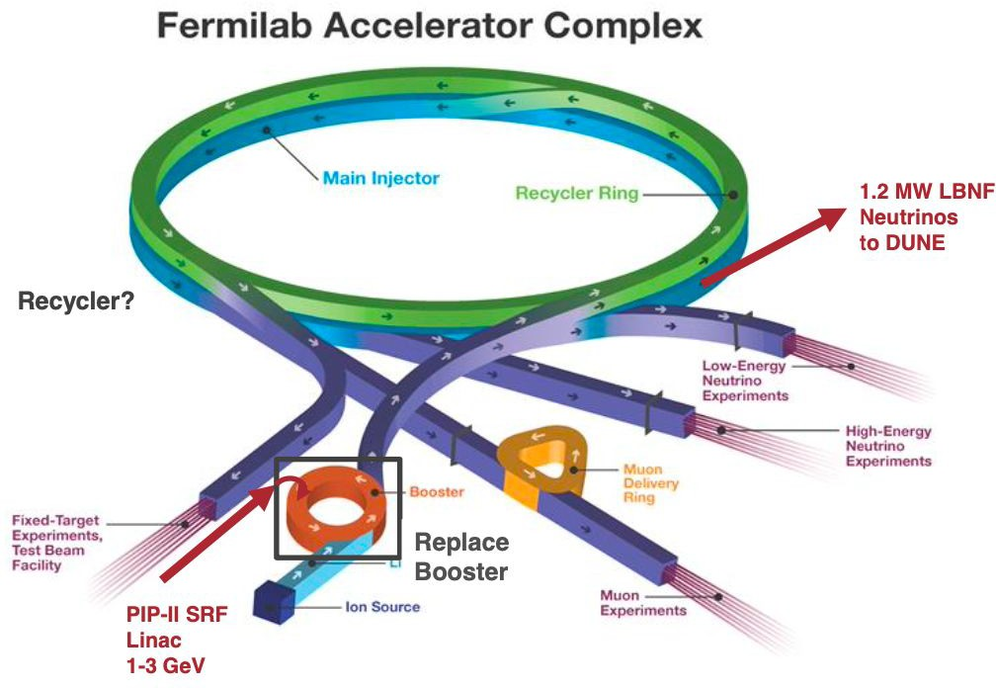

Replacing the Booster
2014 P5 Recommendation: Provide 2.4 MW to DUNE
  Now ~ 0.9 MW max
  With PIP-II can reach ~ 1.2 MW
  Main bottleneck is the Booster synchrotron
  Intensity can be improved but not enough to reach 2.4 MW
Many studies, going back almost 25 years.
2023 P5 Recommendation: accelerate realization of 2+ MW with “MIRT”
  Plan for future complex evolution, NOT replacing the Booster (at first)

Slide 39

ACE-MIRT scope to enable 2+ MW
Accelerator Complex Evolution
This component of ACE plan aims to develop the Fermilab accelerator complex capabilities beyond PIP-II, without new accelerator construction.
  Overall efficiency and reliability of operations
    Implement improvements aiming to reduce losses, radioactive activation
    Task 1) Improve MI reliability by replacing quadrupole magnets with robust design
  Machine capability: Maximum proton flux produced by the accelerator
    Task 2) Upgrade MI ramp power system to enable faster cycle time (1.2$→$0.6s)
    Task 3) Upgrade MI RF acceleration system to allow for more beam flux
  Ability of target station to convert protons to neutrinos
    Task 4) Upgrade LBNF Target and Horns to reliable 2+ MW capability

Slide 40
Accelerator Complex Evolution (ACE) plan – beyond 1.2 MW
Our vision is centered on the ACE plan that has two components
The Main Injector reliability improvements, cycle time shortening, and target systems upgrade to be carried out through the 2020’s called ACE-MIRT – without construction of new machines after PIP-II
  Will accelerate the achievement of the DUNE science goals with respect to the original PIP-II plan
  Improve reliability and safety of the key machines for the future of accelerator complex
Further, design a Next Accelerator Upgrade that builds upon the existing complex and enables Muon Collider R&D, and potentially a path to the collider
  Enables the next set of experiments (beyond DUNE and Mu2e)
  Capability of Muon Collider R&D, including a demonstrator facility
  Provide a robust and reliable platform for the future evolution of the Fermilab accelerator complex
2+ MW
Multi-MW

Slide 41
Summary
Fermilab accelerator operations continues to enable the particle physics mission by delivering proton beams to science users
The accelerator complex is transitioning from steady-state operations to integrating the PIP-II upgrade in preparation for the DUNE experiment
Campaign of upgrades, modernization, and investments into for making the machines of accelerator complex compatible with PIP-II
  Infrastructure projects, modernization (UIP, ACORN)
  ACE-MIRT program
Planning for future opportunities
  New facilities and experiments with PIP-II
  Continuing Accelerator Complex Evolution
  Test Facilities and Demonstrators for future machines

Slide 42
The Fermilab Accelerator Complex
Robert Zwaska, Fermilab
Muon Collider Accelerator School, 2025
6 August 2025

