Slide 1
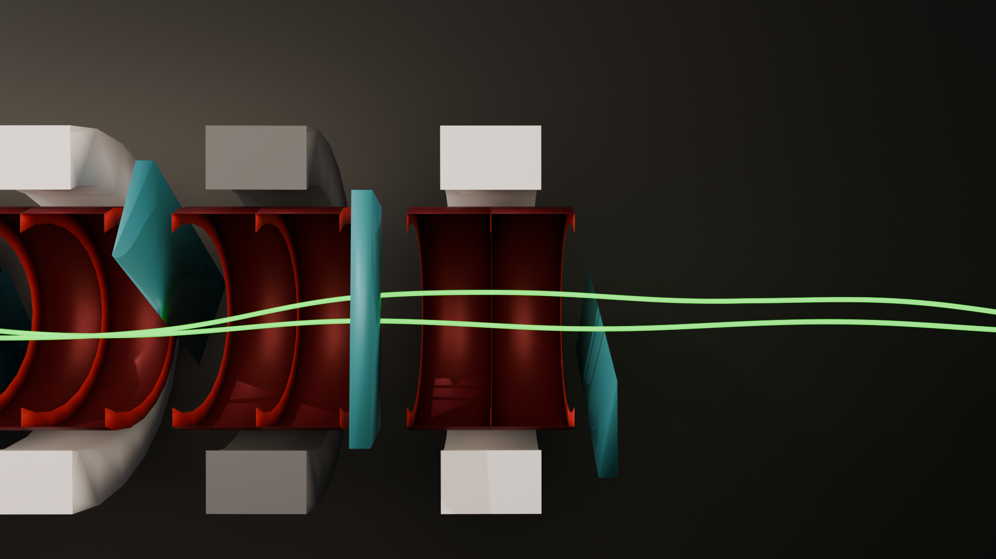
Progress on the HFOFO Snake Channel for 6D Muon Cooling
USMCC Annual Meeting 2025
Caroline Riggall¹, Rithika Ganesan¹, Katsuya Yonehara², Lawrence Lee¹, Tova Holmes¹, David Neuffer², Diktys Stratakis²
¹ University of Tennessee; ² Fermilab

Slide 2
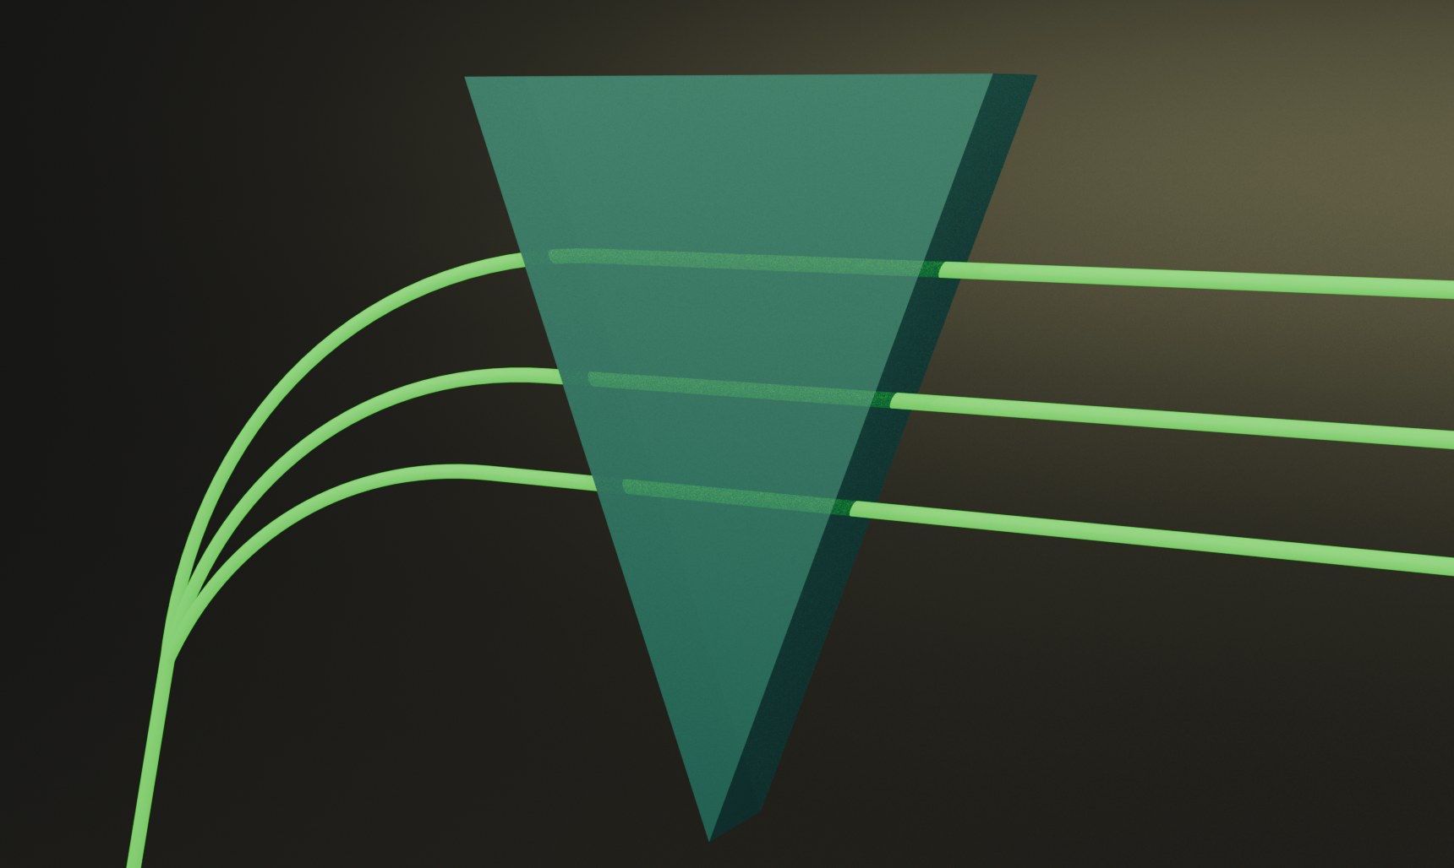




Ionization Cooling
$$p+δp$$
Induce dispersion via dipole field
$$p$$
Pass higher-momentum particles through more absorber material
Emittance exchange:
$$p−δp$$
$$\frac{dε_{n}}{ds}=−\frac{1}{β^{2}}\frac{dE_{μ}}{ds}\frac{ε_{n}}{E_{μ}}+\frac{1}{β^{3}}\frac{β_{⊥}(0.014)^{2}}{2E_{μ}m_{μ}X_{0}}$$
(Cooling)
(Heating)
2

Slide 3
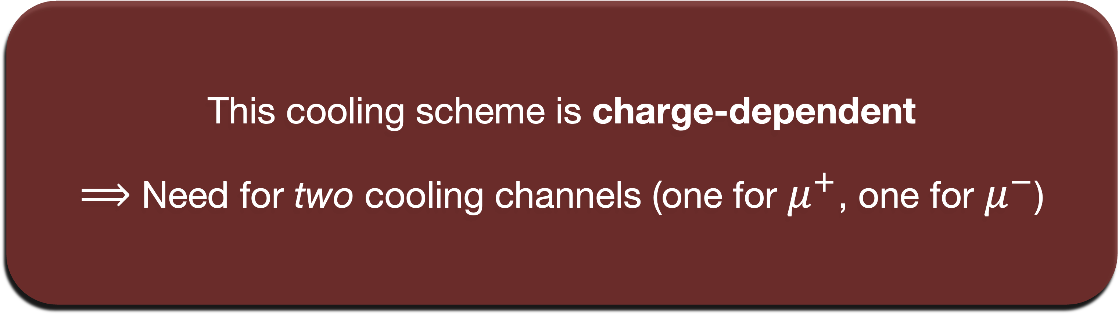
Ionization Cooling
This cooling scheme is charge-dependent
$⟹$ Need for two cooling channels (one for $μ^{+}$, one for $μ^{−}$)
3

Slide 4

Introducing: HFOFO
Presented here is the Helical FOFO Snake (HFOFO) design:
Yuri Alexahin’s concept from the MAP era
Charge-agnostic dispersion generation $⟹$ simultaneous cooling of both signs
HFOFO would enable a single initial cooling channel!

Slide 5
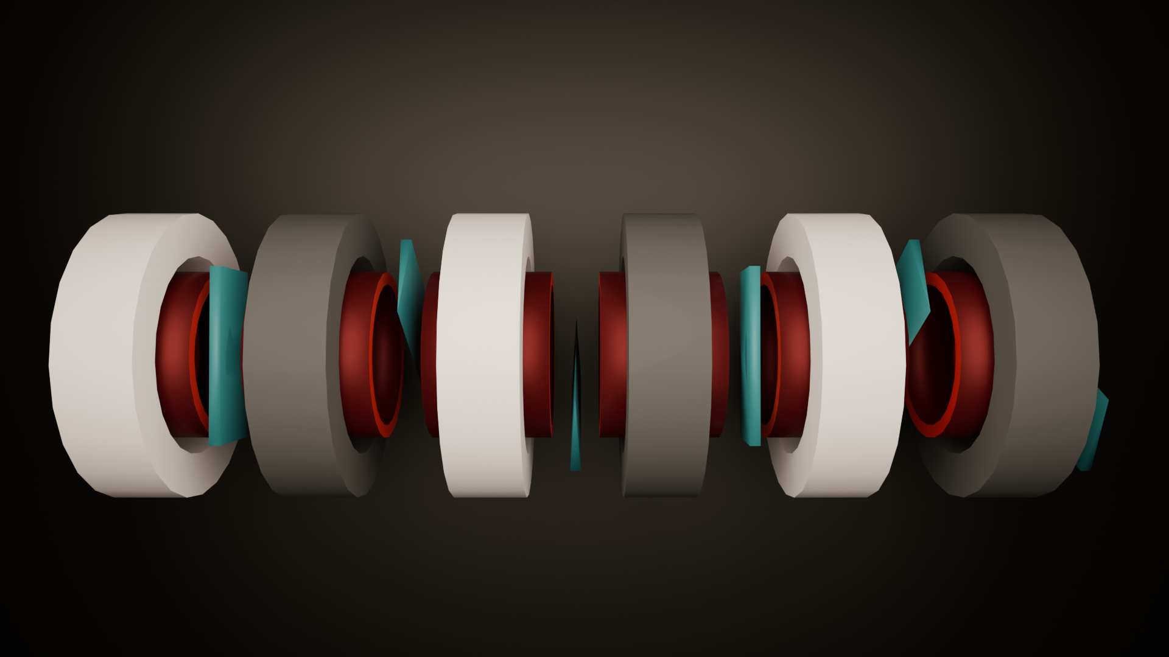
Introducing: HFOFO
Negative solenoids
Positive solenoids
5

Slide 6
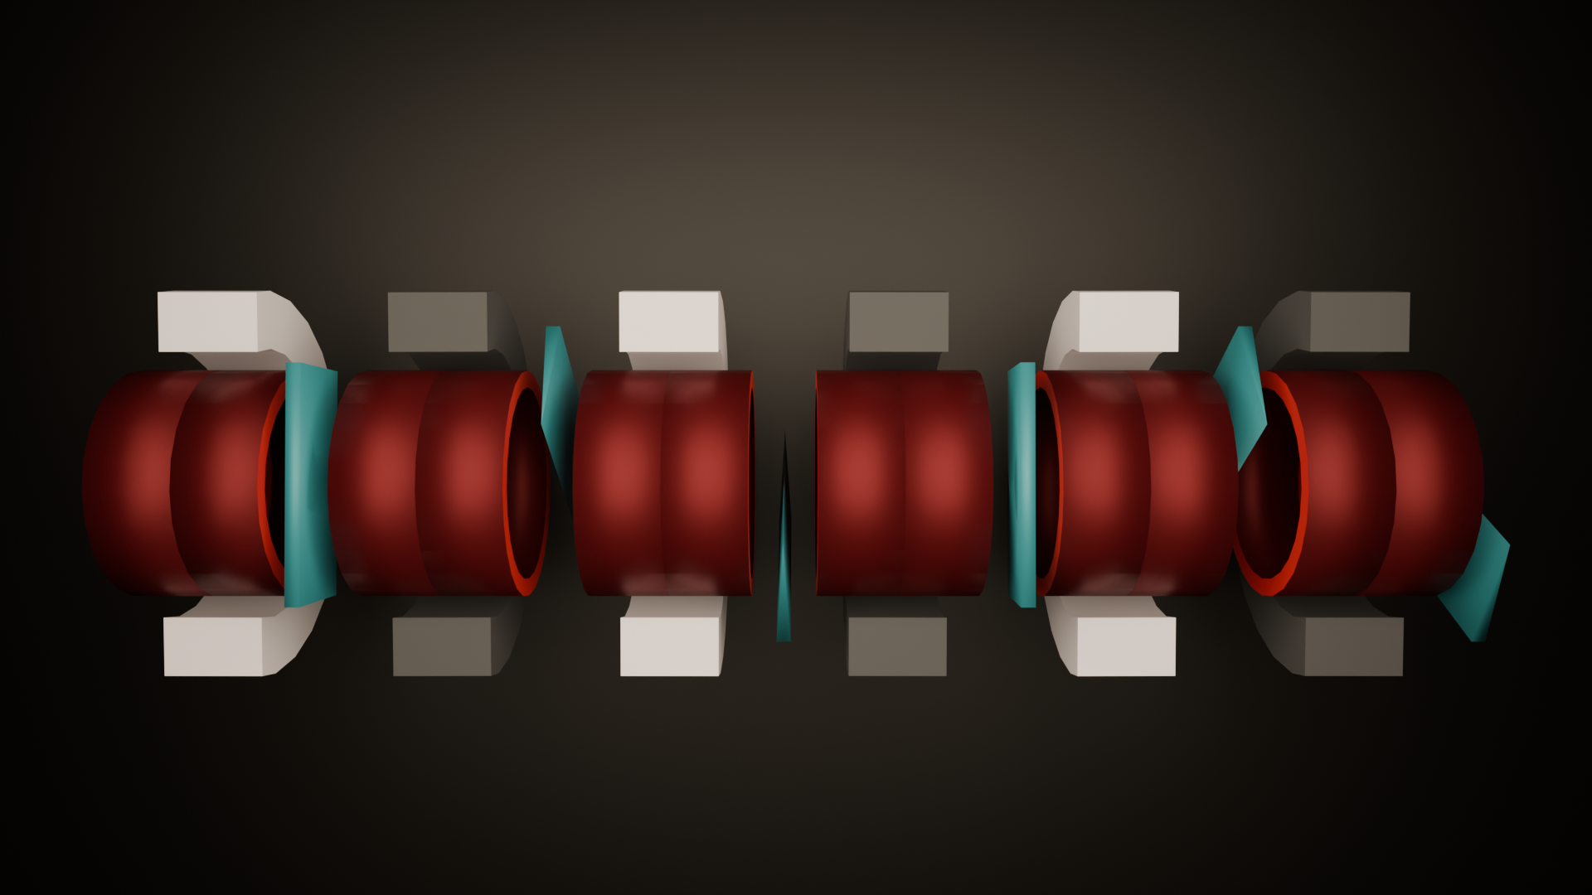
Introducing: HFOFO
6 solenoids = 1 period (4.2 m)
Full channel = 30 periods
Negative solenoids
LiH absorbers
Positive solenoids
RF cavities
6

Slide 7
Basic Principles
HFOFO operates on 3 basic principles:
Alternating solenoid focusing
Focus independently of charge
Periodic rotating dipole fields
Generate dispersion for both signs
Resonant dispersion generation
Increase localized path lengthening

Slide 8
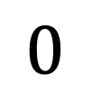

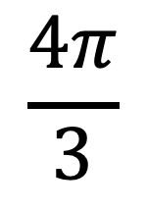

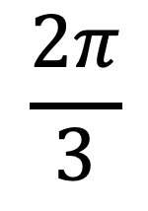
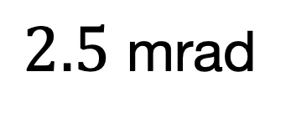
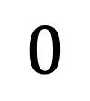
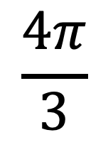

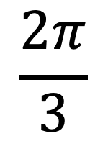
Solenoid Lattice Design
$$+$$
$$−$$
$$+$$
$$−$$
$$+$$
$$−$$
FOFO lattice (alternating-polarity solenoids for focusing)
  Does not depend on muon sign
Solenoids are periodically inclined to create rotating dipole field
$2.5$ mrad
$$0$$
$$\frac{2π}{3}$$
$$\frac{4π}{3}$$
$$0$$
$$\frac{2π}{3}$$
$$\frac{4π}{3}$$
$μ^{+}$ and $μ^{−}$ have same orbit but with a half-period longitudinal offset

Slide 9
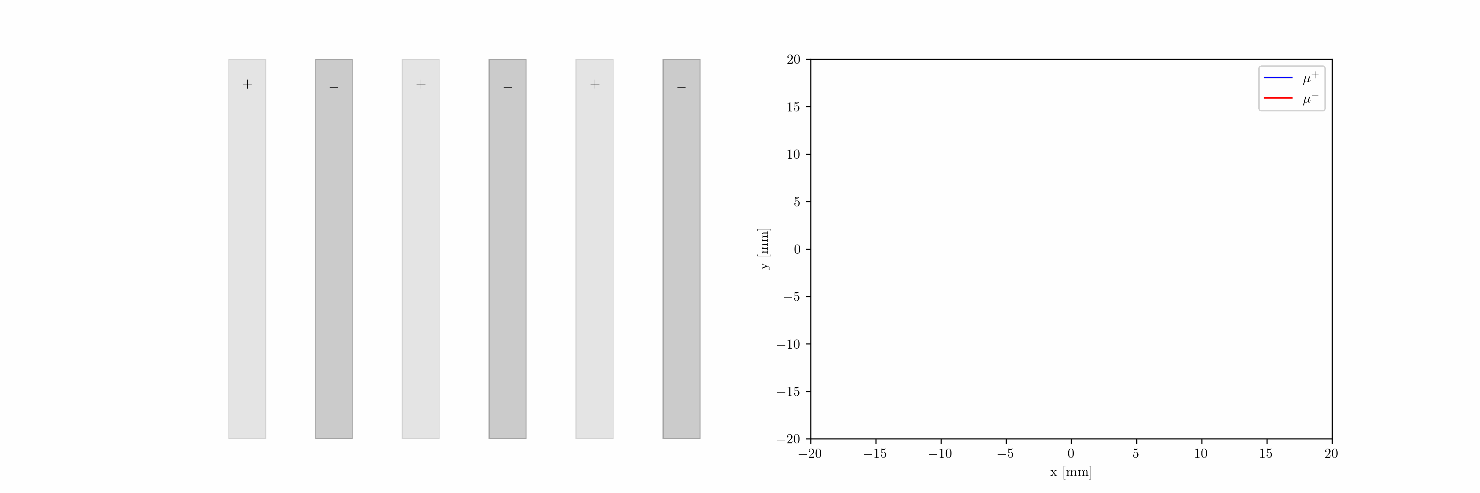

Periodic Helical Orbit
$μ^{+}$ and $μ^{−}$ orbits along single period (animation)

Slide 10
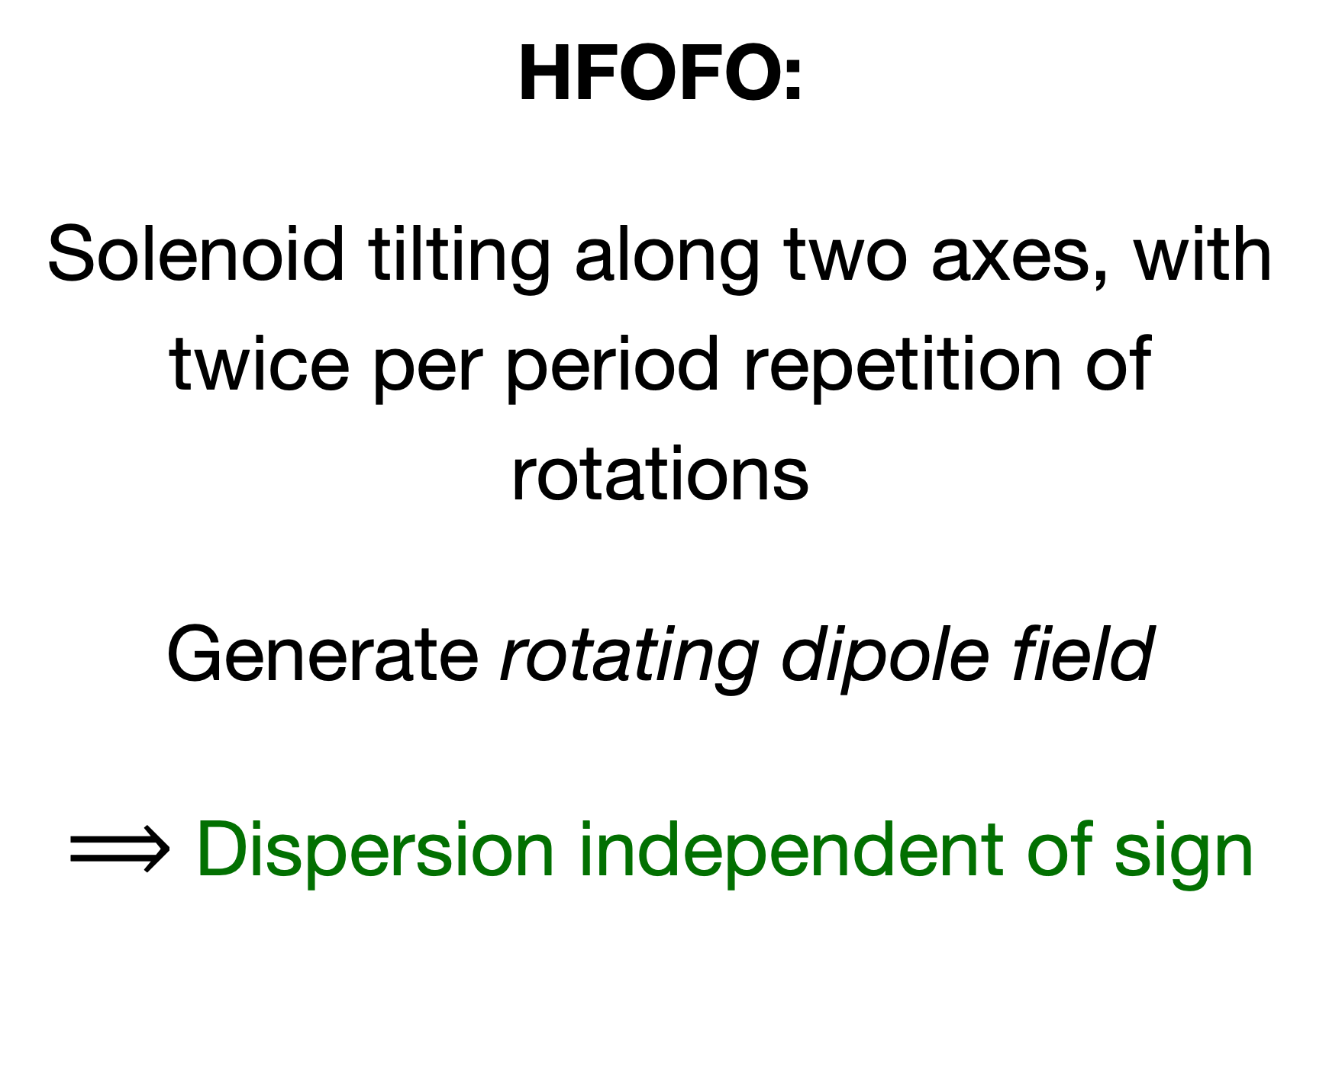
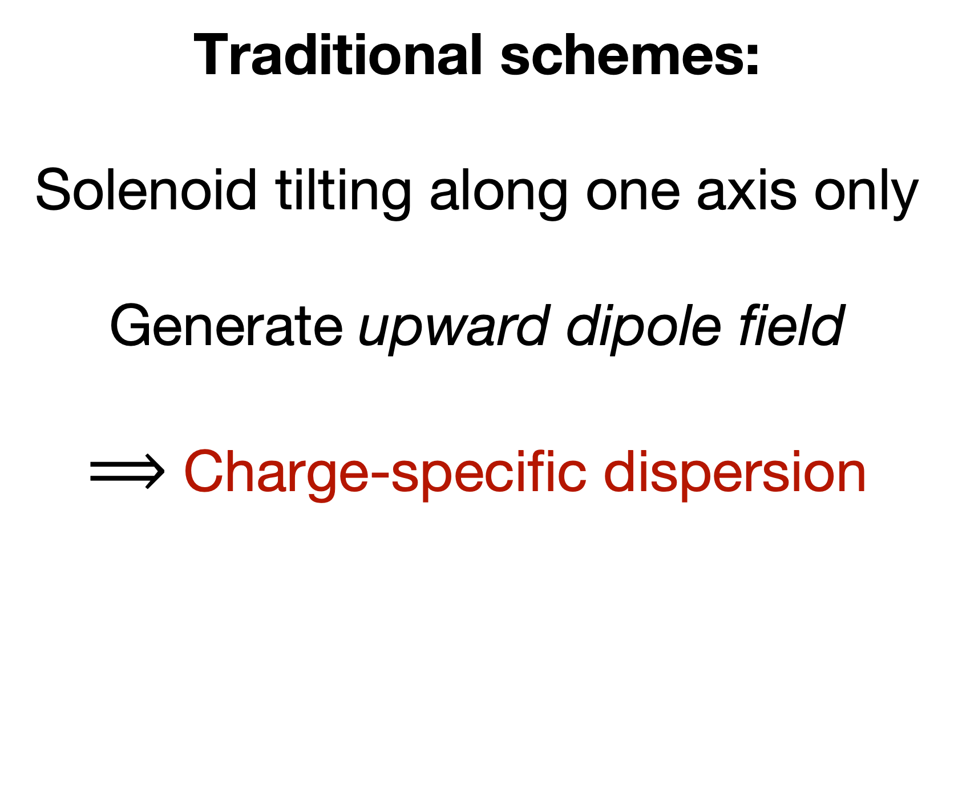
A Dispersion Scheme for Both Signs
Traditional schemes:
Solenoid tilting along one axis only
Generate upward dipole field
$⟹$ Charge-specific dispersion
HFOFO:
Solenoid tilting along two axes, with twice per period repetition of rotations
Generate rotating dipole field
$⟹$ Dispersion independent of sign

Slide 11
Lattice Periodicity
Groups of 3 focusing units with same solenoid and absorber orientations repeated twice per period to treat both signs
11

Slide 12

Resonant Dispersion Generation
Beta tune near resonance $⟹$ momentum compaction is positive:
$$α_{c}=\frac{ΔL/L}{Δp/p}>0$$
$∴$ Higher-momentum particles travel longer paths
Having near-resonance conditions allows for large dispersion — ideal for cooling!

Slide 13
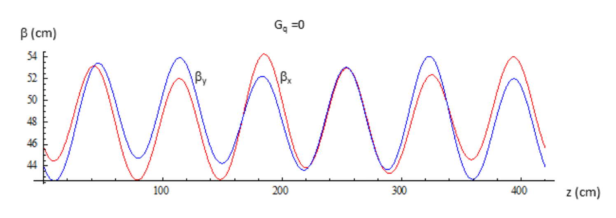
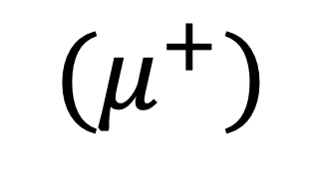
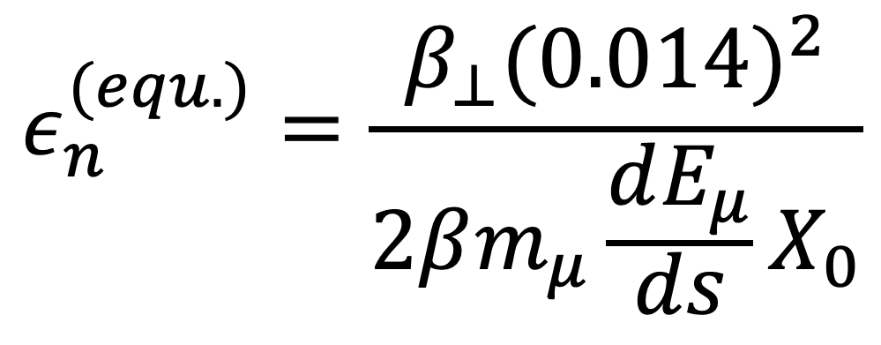
Beta Function
Wedge absorbers placed at minima of beta function (between solenoids)
$$ε_{n}^{(equ.)}=\frac{β_{⊥}(0.014)^{2}}{2βm_{μ}\frac{dE_{μ}}{ds}X_{0}}$$
$$(μ^{+})$$
Y. Alexahin (1806.07517)

Slide 14
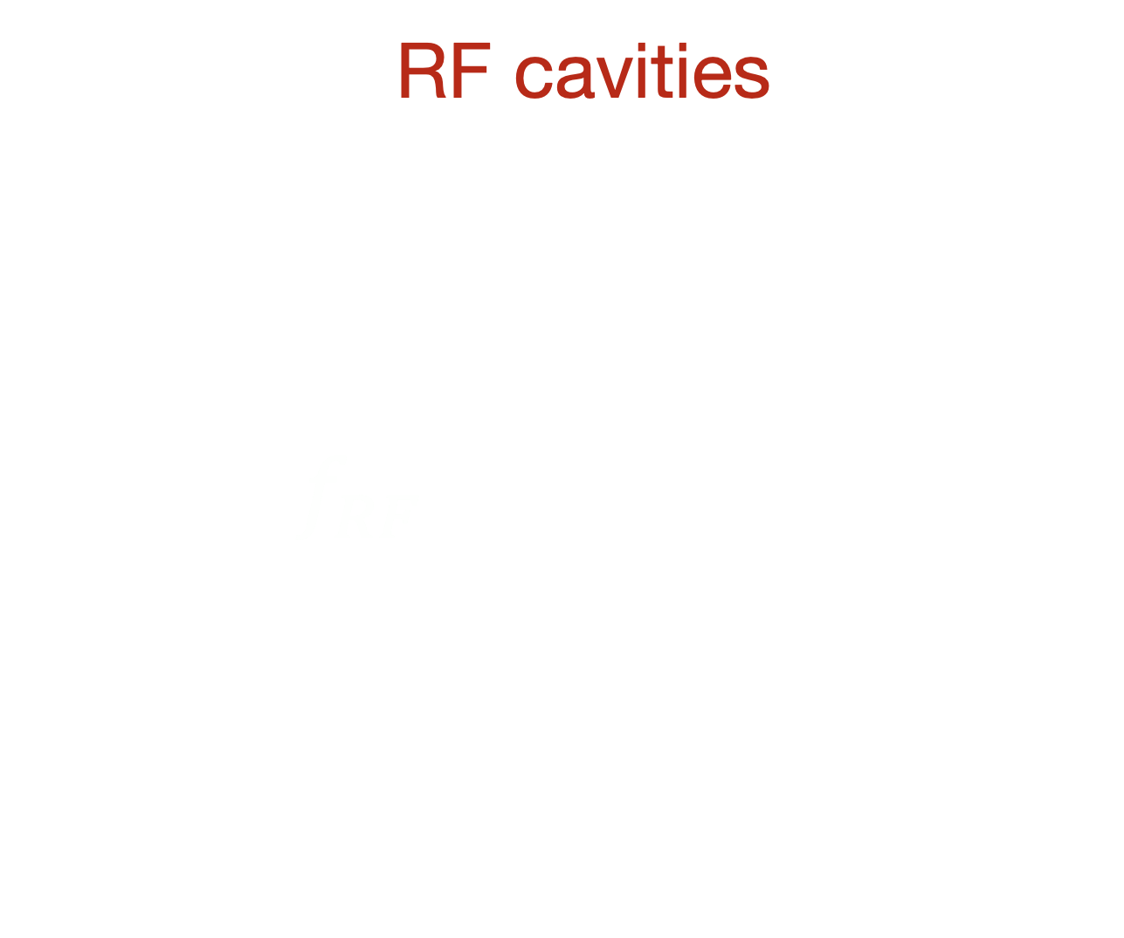
RF Cavities
Use RF cavities for longitudinal energy restoration
$f_{RF}$ = 325 MHz
GH2 enables higher RF gradient and contributes to cooling
14

Slide 15
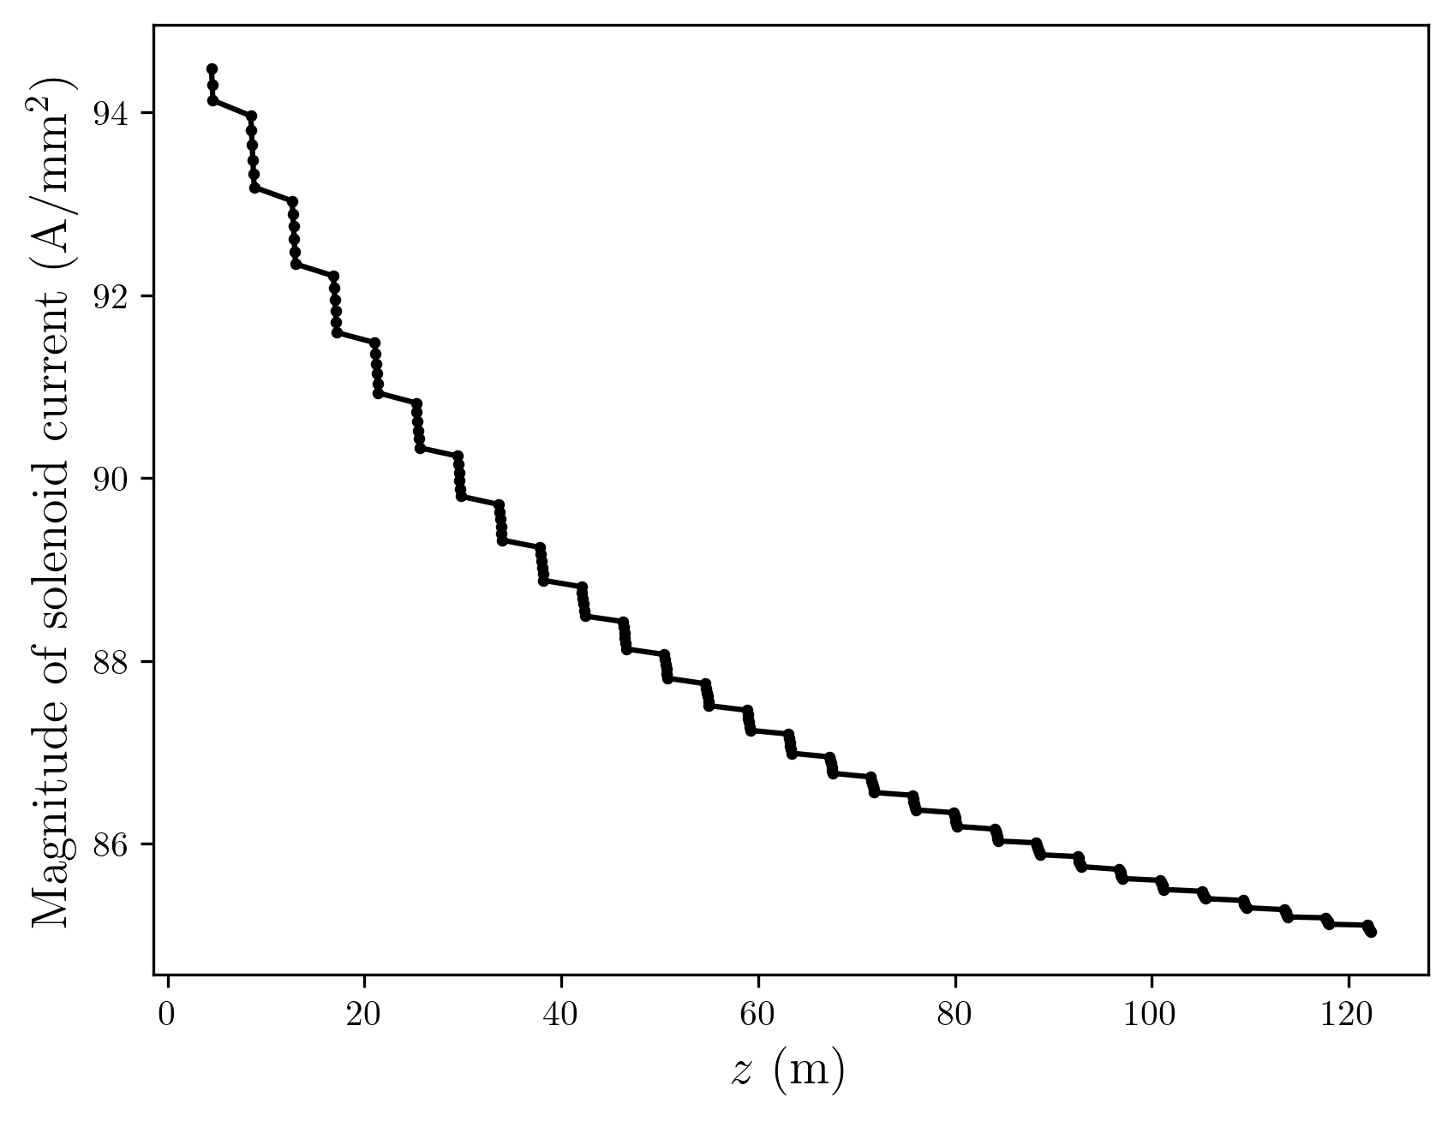
Momentum Evolution
Average front-end momentum is ~250 MeV/c
Momentum is degraded along channel to ~200 MeV/c
  Ideal for ionization cooling
Achieved by reducing solenoid current and adjusting RF phase with z

Slide 16
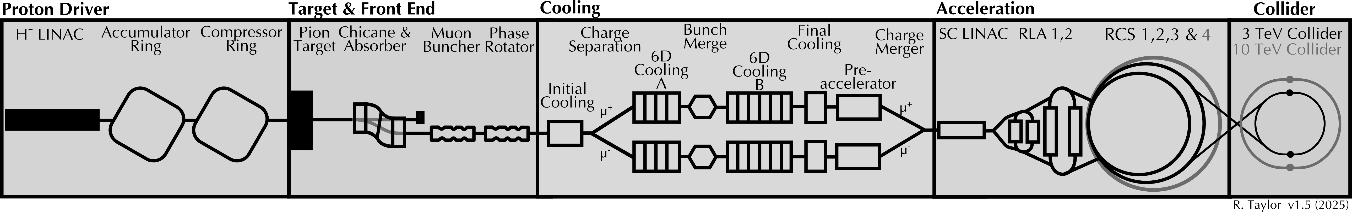
HFOFO as a Matching Section
Not only would HFOFO provide initial cooling before charge separation (perhaps requisitely)
… It would also act as a de-facto matching section to prime the remainder of the cooling channel!

Slide 17
Current Performance

Slide 18
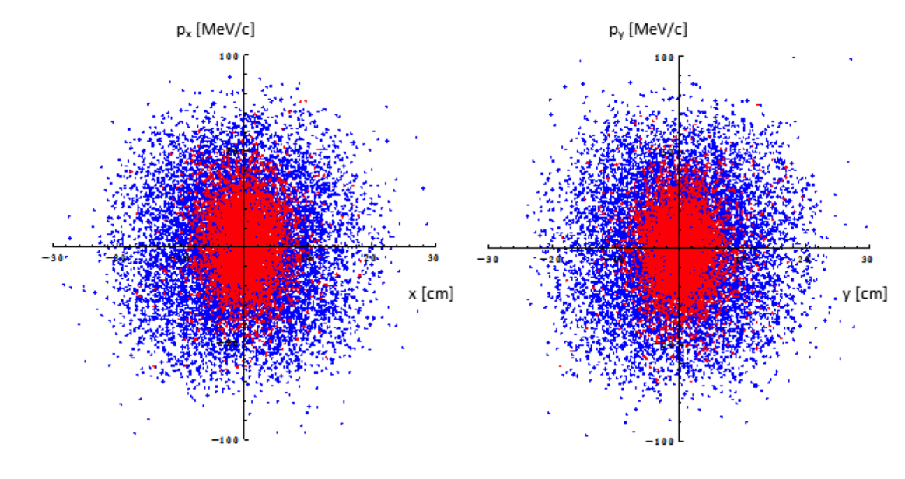

Yuri’s Results
Initial and final phase space distributions ($μ^{+}$)
Y. Alexahin (1806.07517)

Slide 19
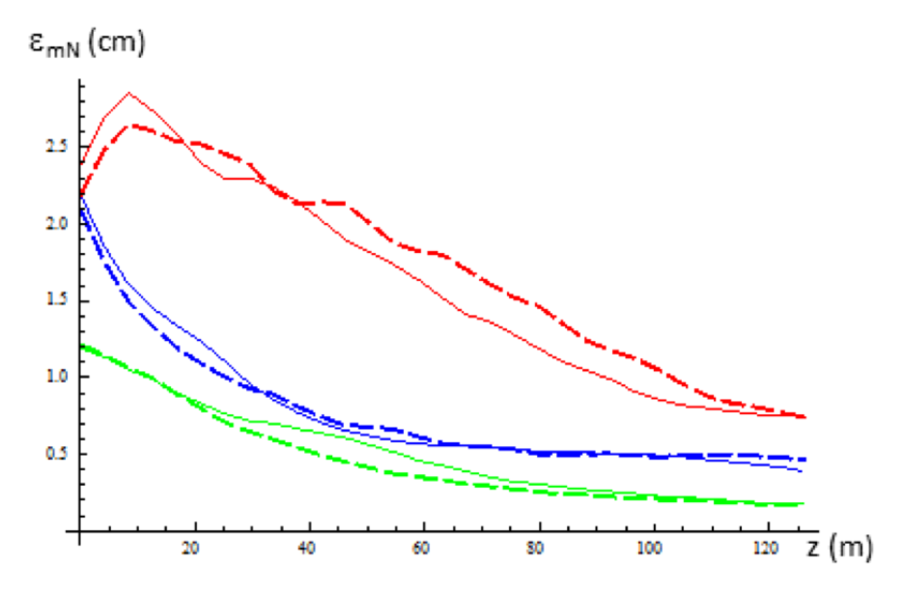
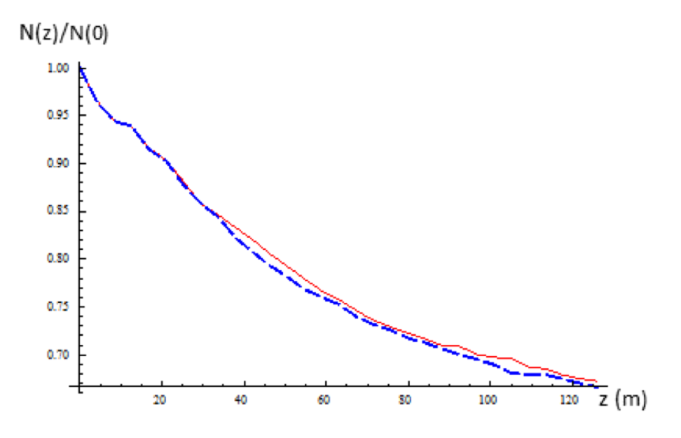
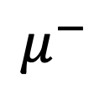
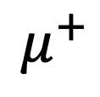
Yuri’s Results
Normal mode emittances and beam intensity along channel
$$μ^{+}$$
$$μ^{−}$$
Factor of 112.8 6D emittance reduction!
36.4 transverse, 3.1 longitudinal
65% transmission rate
Y. Alexahin (1806.07517)

Slide 20
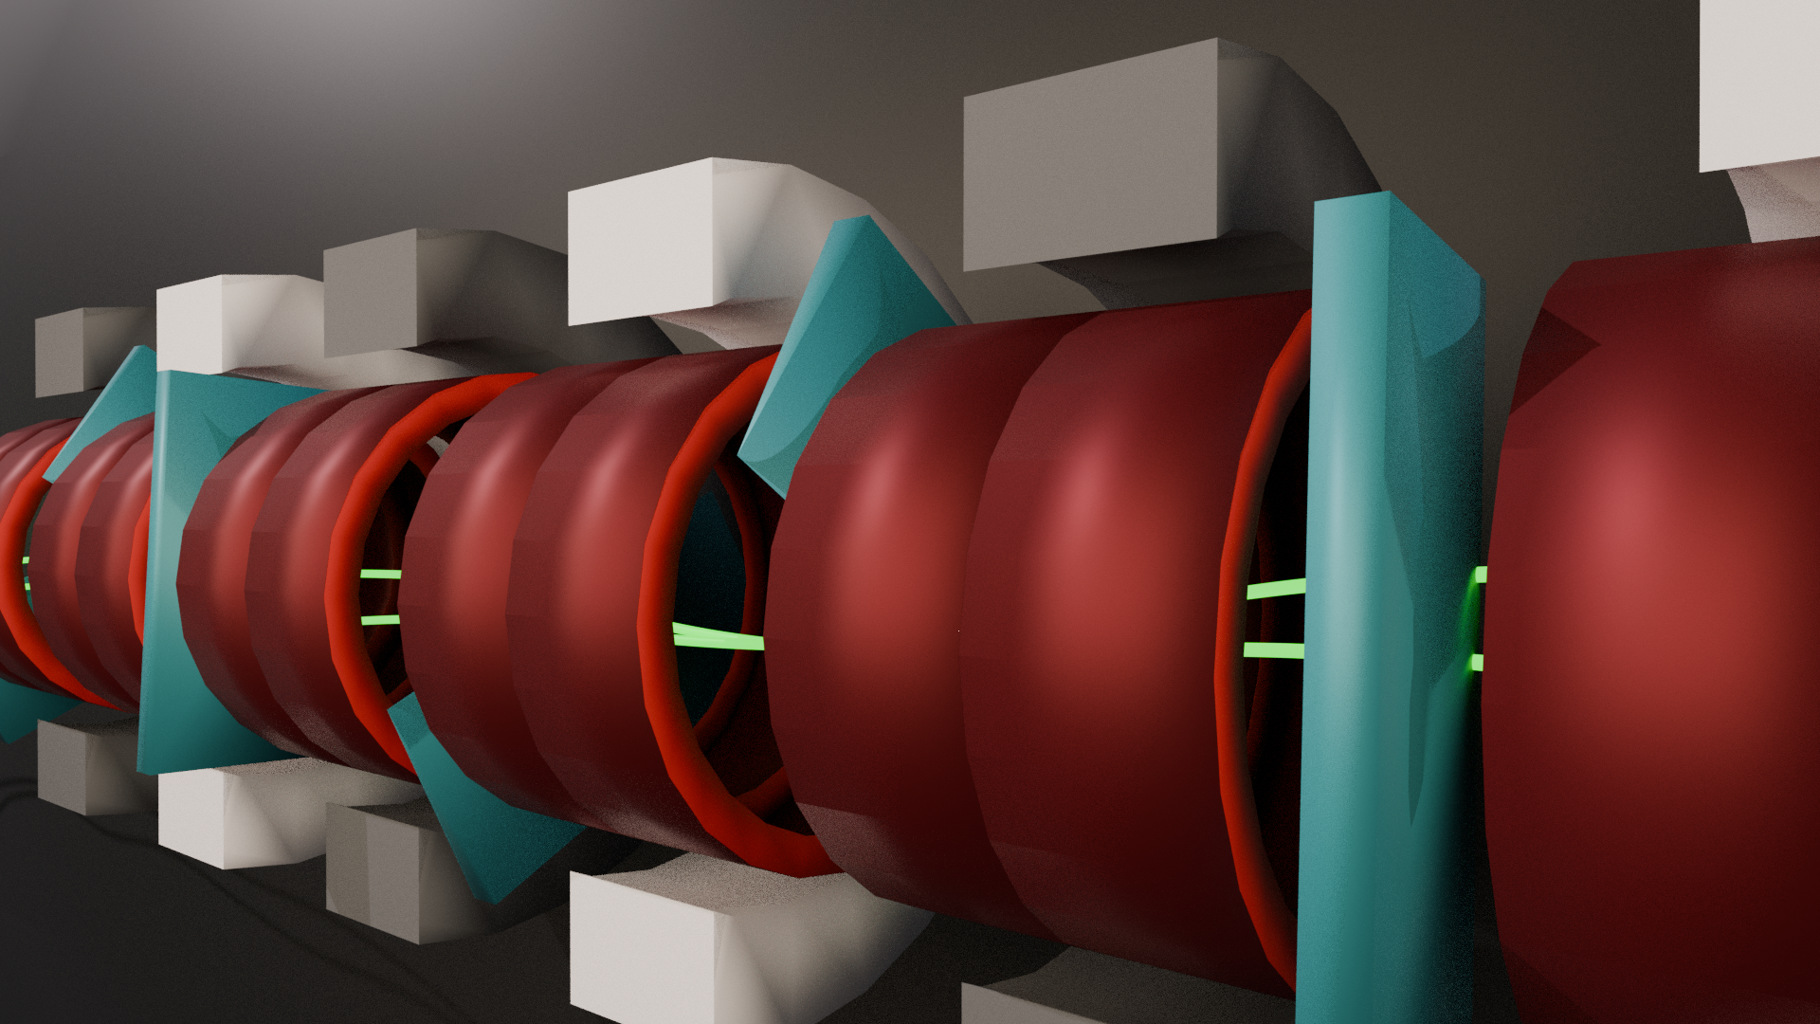
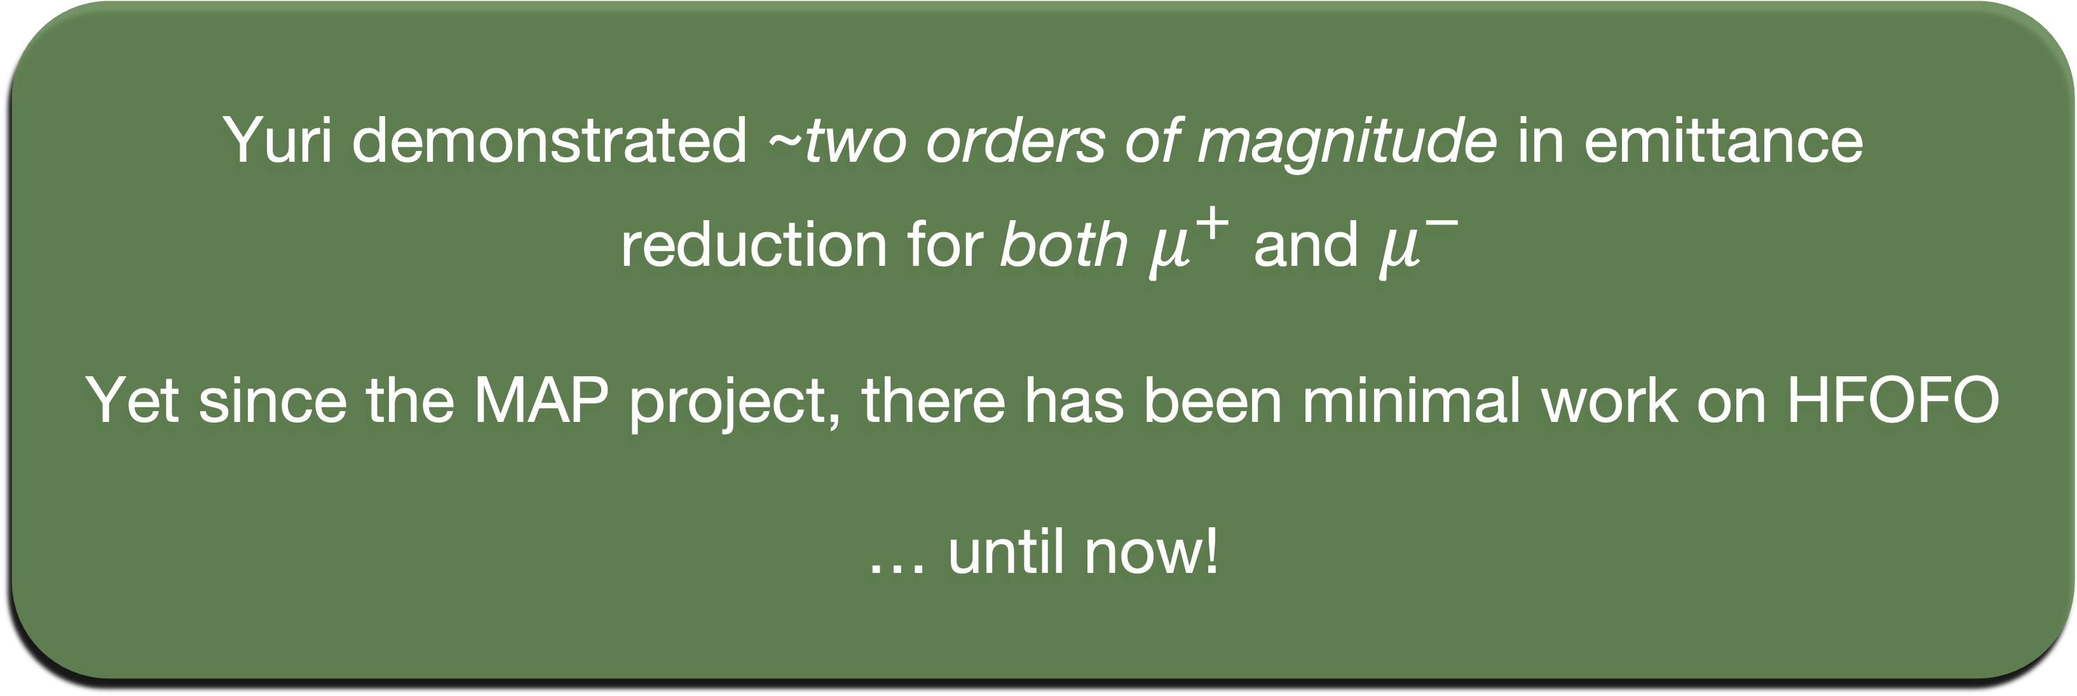
What is Next?
Yuri demonstrated ~two orders of magnitude in emittance reduction for both $μ^{+}$ and $μ^{−}$
Yet since the MAP project, there has been minimal work on HFOFO
… until now!
20

Slide 21
Present and Future Work

Slide 22
Our Work
Yuri’s design is highly nontrivial, so we are rebuilding HFOFO from the basics
Goal: study simplified channel, then iteratively add complexity
Study beam optics in constant-momentum channel
Replicate Yuri’s results with RF and cooling
Optimize

Slide 23
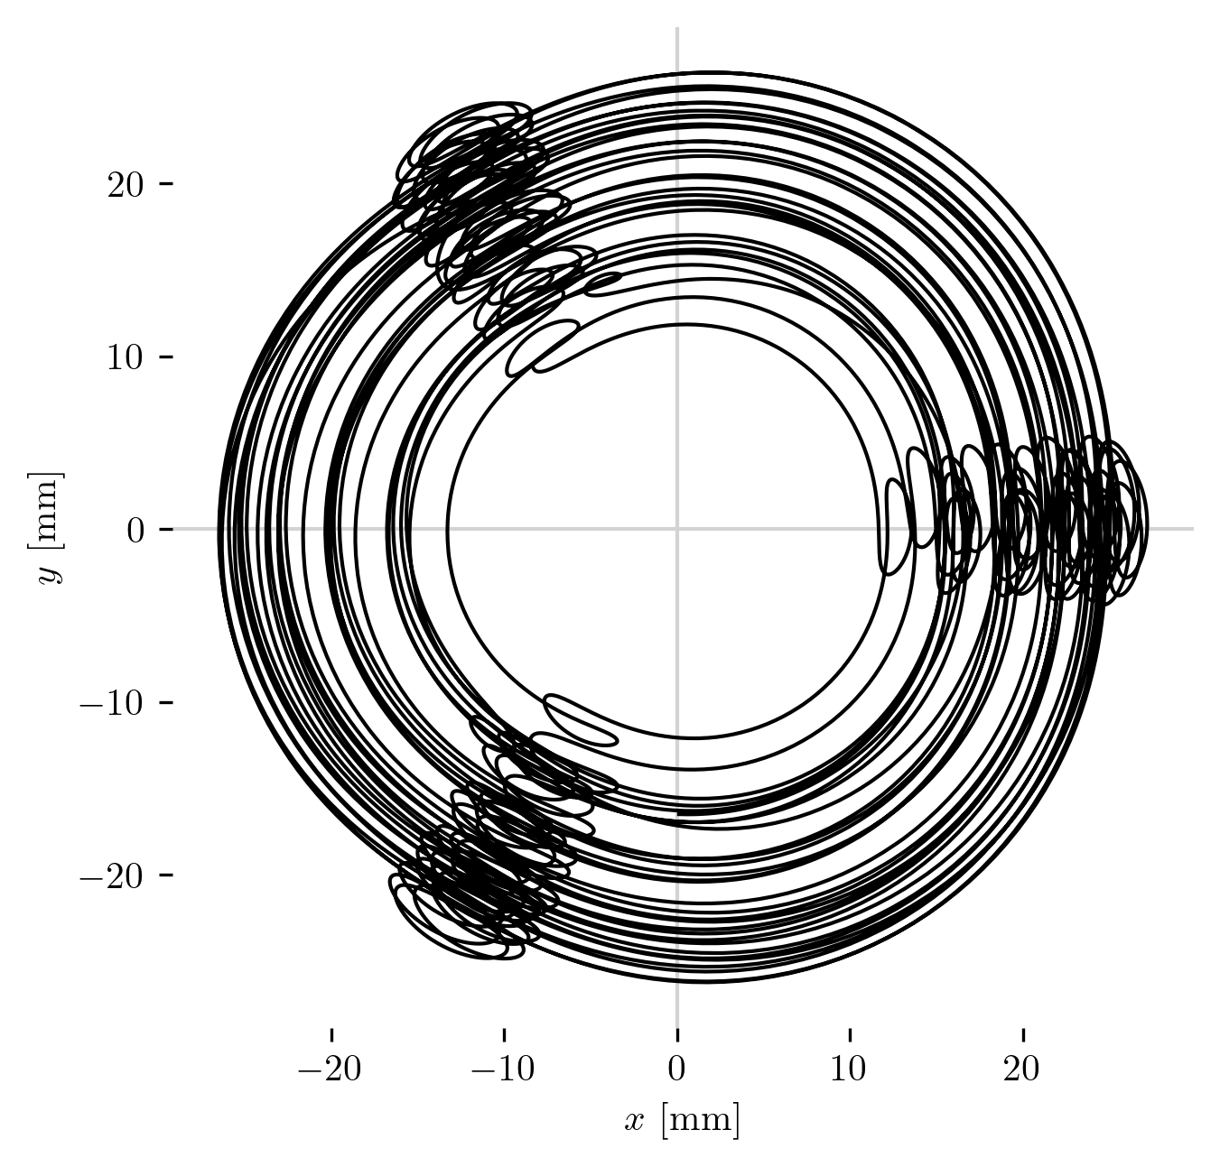
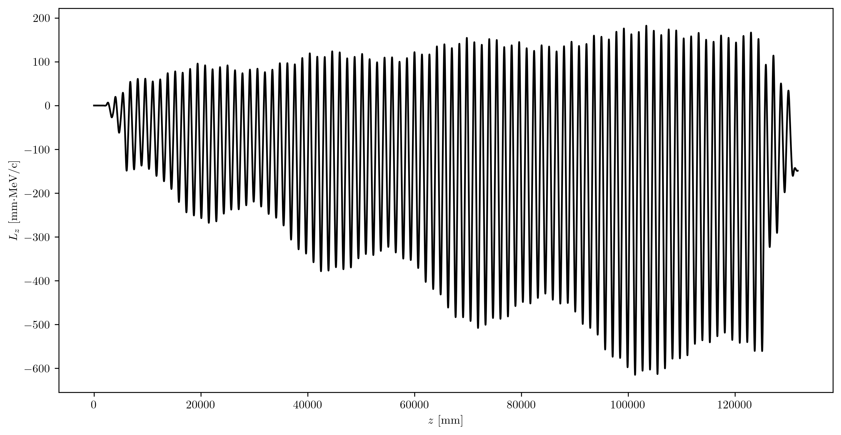

Our Work
Reference orbit ($μ^{+}$) in original channel design

Slide 24
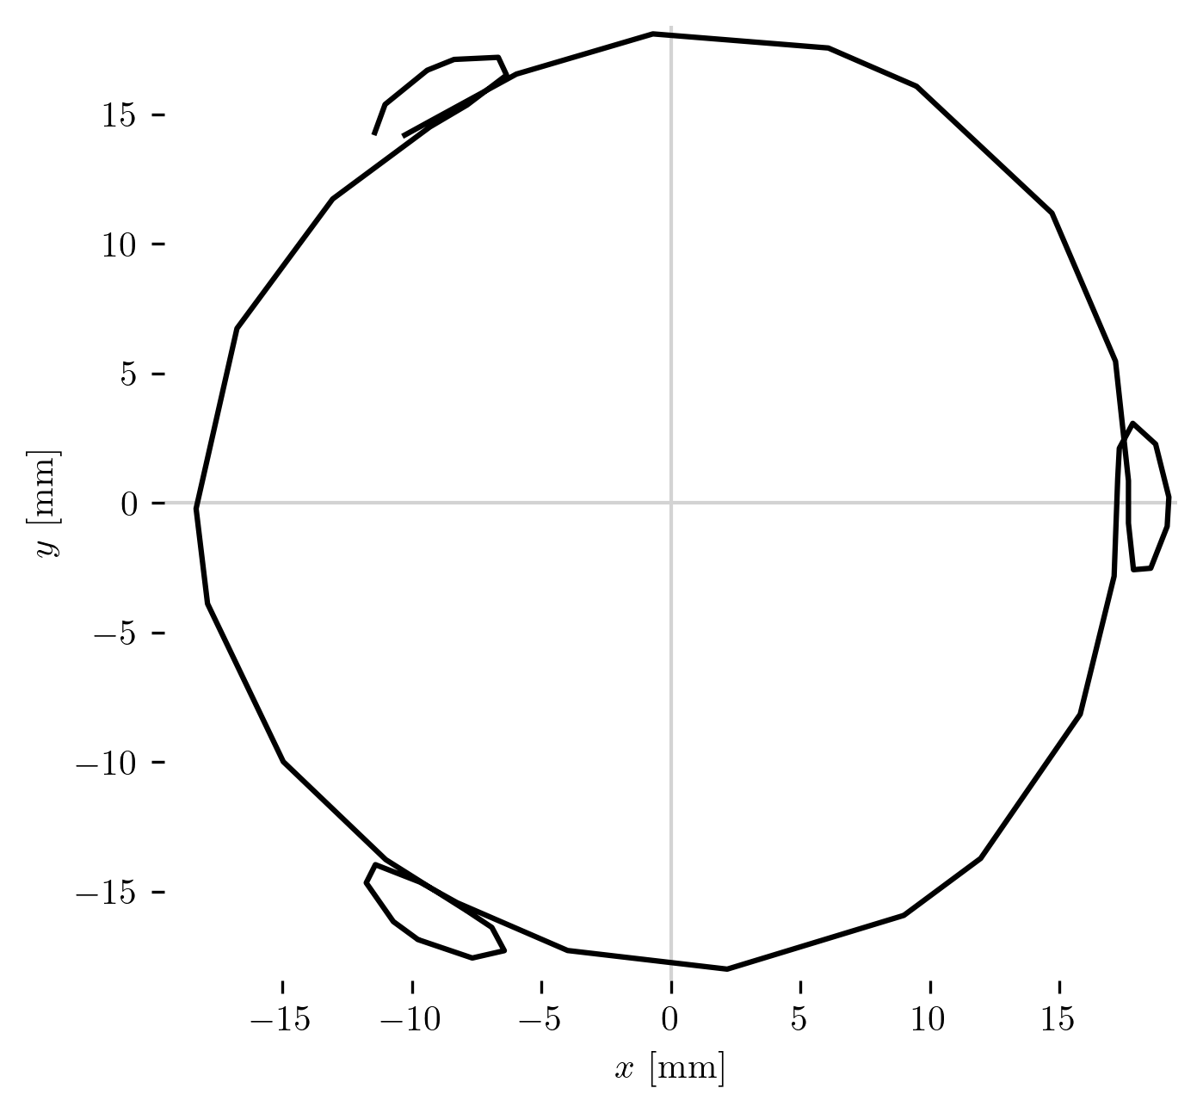
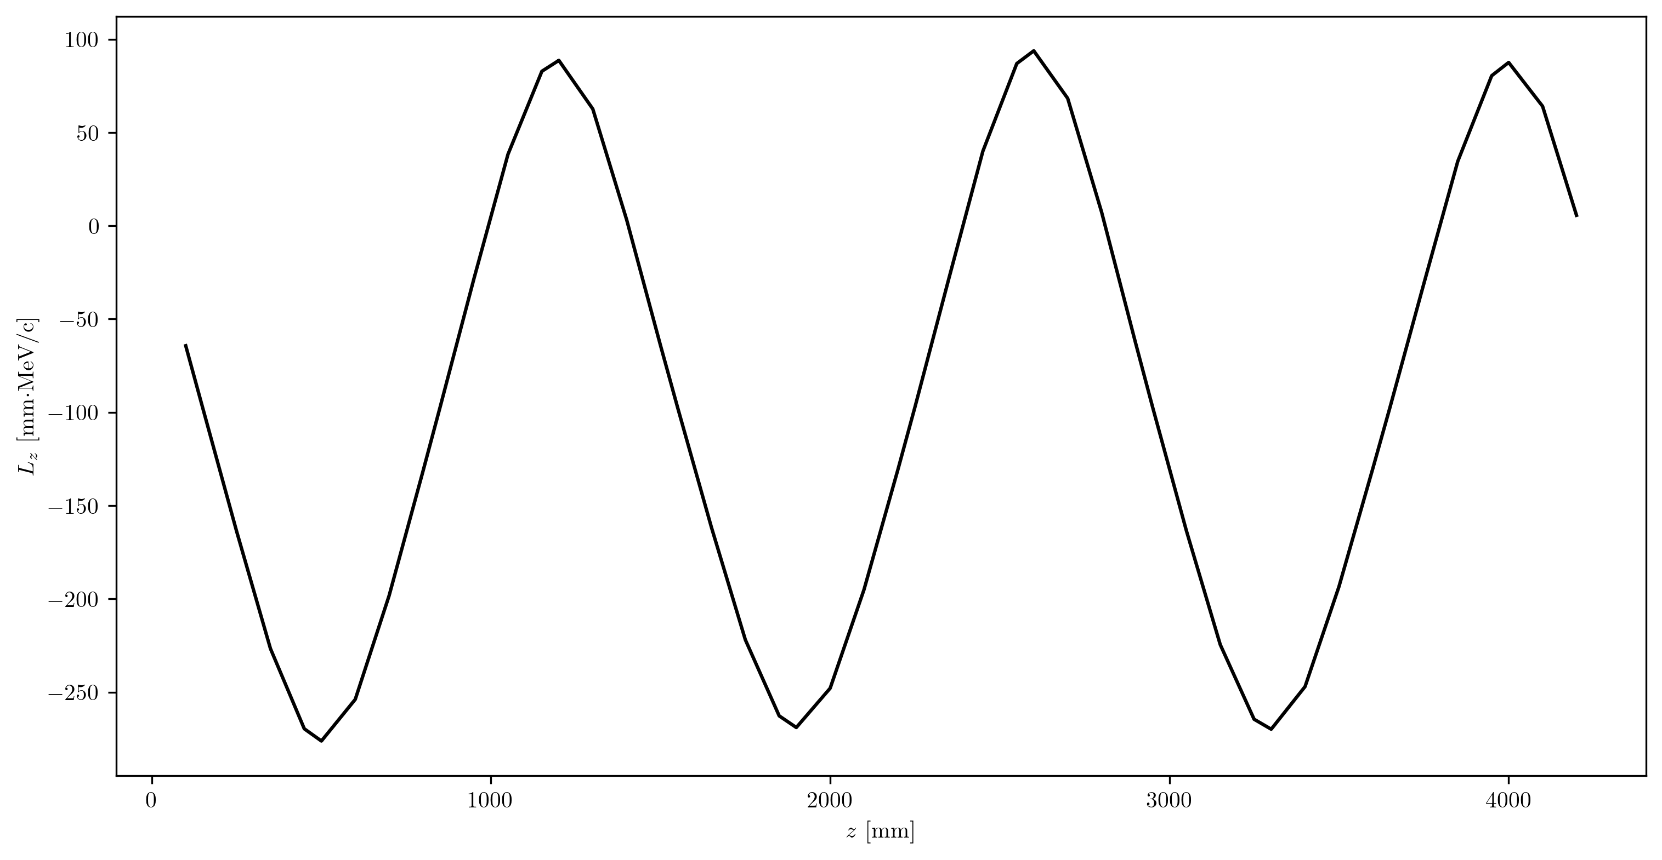

Our Work
200 MeV/c reference orbit ($μ^{+}$) for single period in constant-current channel

Slide 25
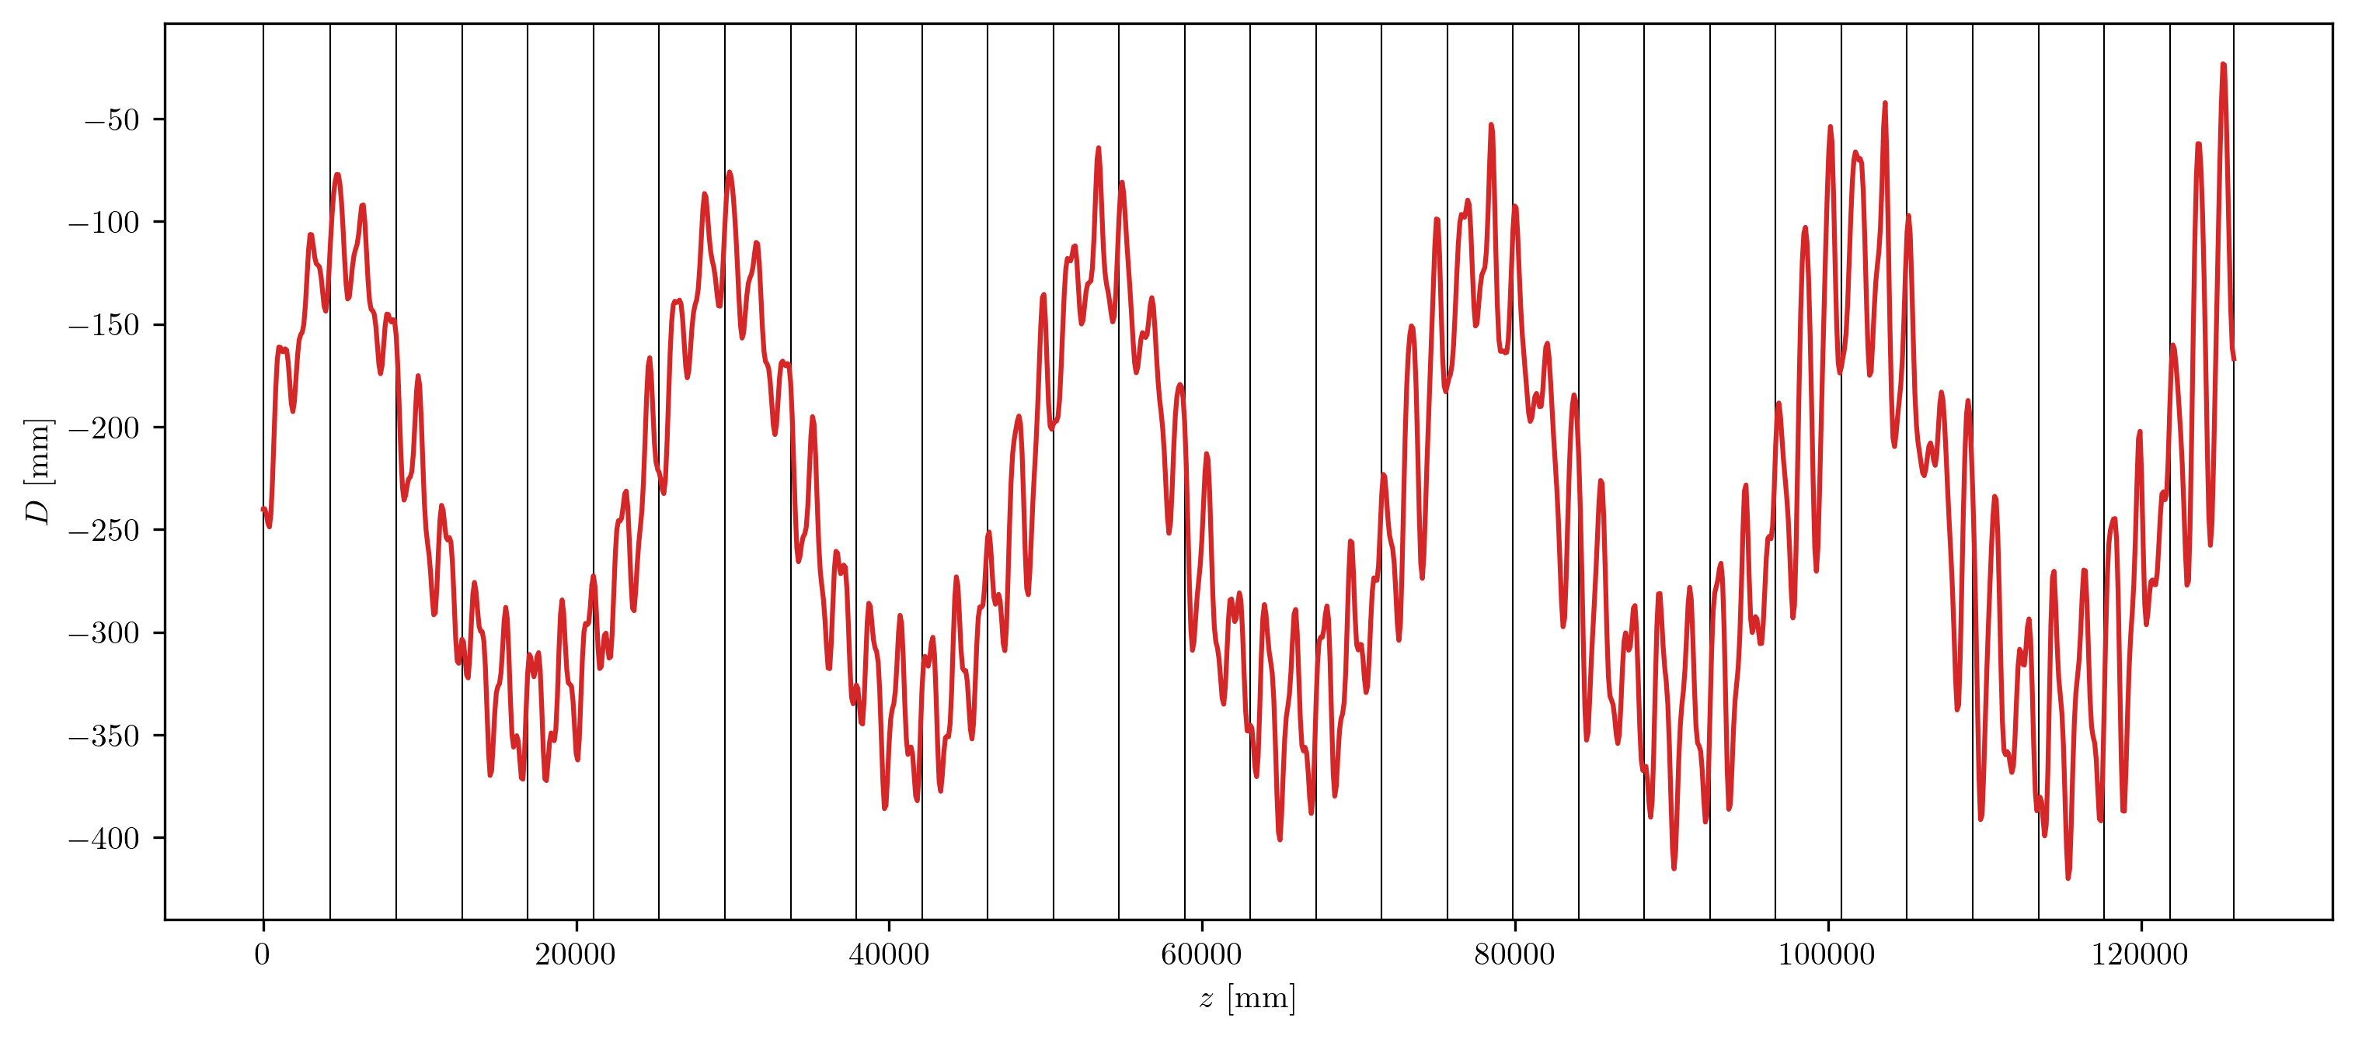

Our Work
Dispersion along full constant-current channel ($μ^{+}$)

Slide 26
Our Work
Study beam optics in constant-momentum channel
Replicate Yuri’s results with RF and cooling
Optimize
Understand solenoid lattice design
Quantify dispersion, beta function, multipole field components, etc.
Quantify cooling
Achieve similar performance to Yuri’s final results
Understand momentum degradation along channel
Improve 6D emittance reduction and maximize transmission rate
Ensure design is physically realizable
Starting in the fall!
Concluding characterization and beginning to write technical report by end of the summer

Slide 27
Optimization Ideas
Reduce length of lattice elements along channel (and increase solenoid current to preserve transverse beta tune)
Increase betatron phase advance for each focusing unit (nominally 74°) to reduce beta function at minima
Other ideas?
Y. Alexahin (1806.07517)

Slide 28
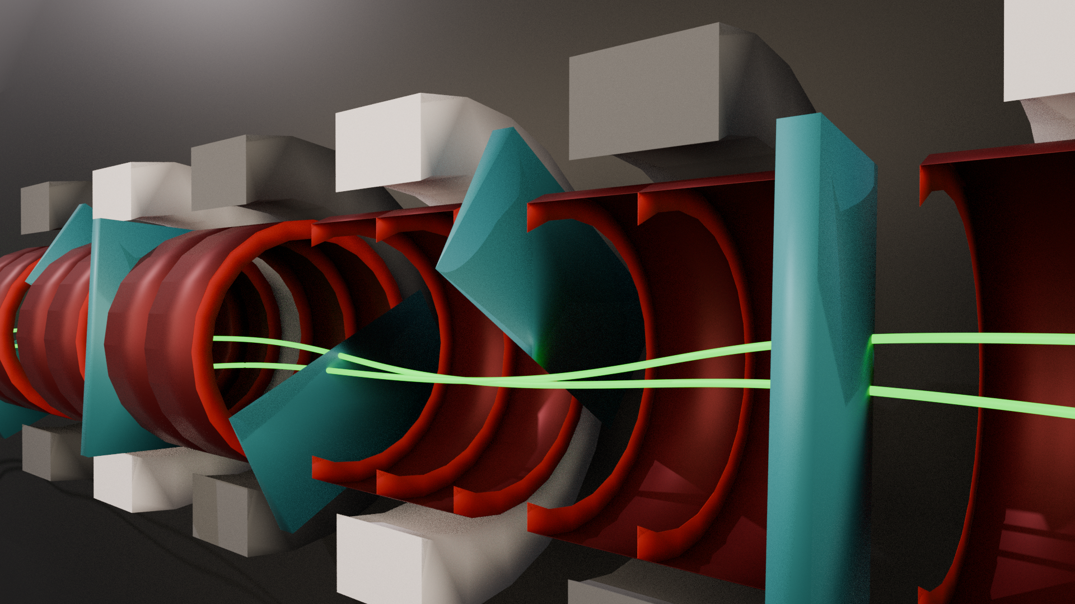




Thank You
Also see Rithika’s poster for more on the characterization of the HFOFO matching section
This work has been supported by the Research Corporation for Science Advancement under a Cottrell Scholar Award and by Brookhaven National Lab.

Slide 29
Supplementary

Slide 30
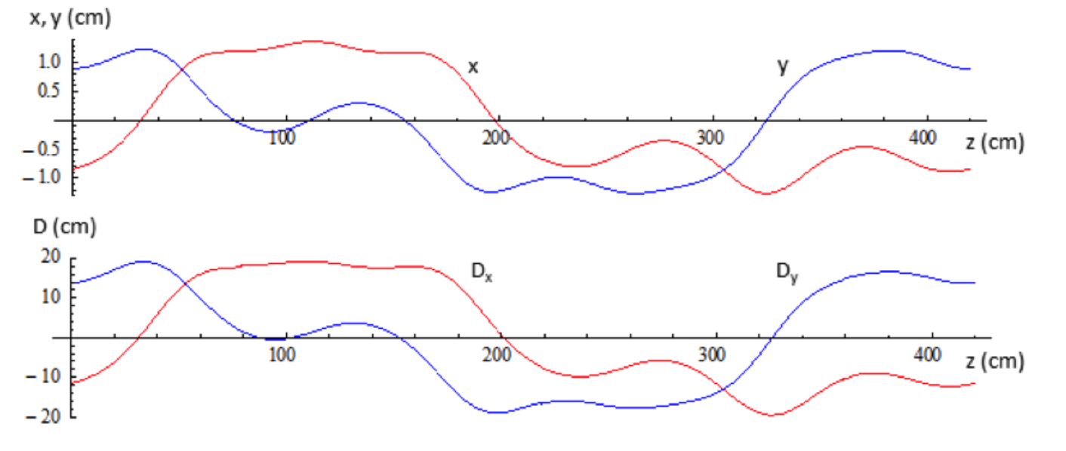
Yuri’s Results
Trajectory and dispersion in transverse plane
Y. Alexahin (1806.07517)

Slide 31
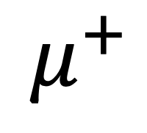
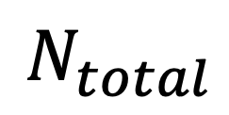


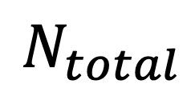



Yuri’s Results
Initial | 11755 | 1.19 | 2.19 | 2.38 | 6.22
Final | 5378 | 0.19 | 0.36 | 0.76 | 0.051
$$N_{total}$$
$ε_{mN}$ (cm)
$ε_{6D}$ (cm³)
$$μ^{+}$$
Initial | 12396 | 1.22 | 2.10 | 2.19 | 5.59
Final | 5896 | 0.16 | 0.46 | 0.72 | 0.051
$$N_{total}$$
$ε_{mN}$ (cm)
$ε_{6D}$ (cm³)
$$μ^{−}$$
Y. Alexahin (MAP 2015 Spring Meeting)

Slide 32



Beam Momentum Distributions
Initial and final total momentum distributions ($μ^{+}$)
Our work:
Yuri’s work:
Y. Alexahin (1806.07517)

Slide 33



Beam Distribution in Phase Space
Phase space distributions ($μ^{+}$) at the start and end of the channel

Slide 34



Reference Orbit in Phase Space
Phase space orbits of 200 MeV/c reference particle ($μ^{+}$) in constant-current channel

Slide 35

Eigenemittances
Longitudinal and transverse emittances along the channel, from ICOOL’s emitcalc

Slide 36

Performance with Various Front-End Simulations
R. Ganesan

Slide 37















Field Components in Tilted Solenoids
$$z=−200$$
$$z=0$$
$$z=200$$

Slide 38
Transverse Field in HFOFO
Magnitude of transverse B field along a few periods in the channel

