Slide 1
Muon Collider Target System
August 7, 2025
Katsuya Yonehara
USMCC 2nd Annual Meeting at University of Chicago

Slide 2
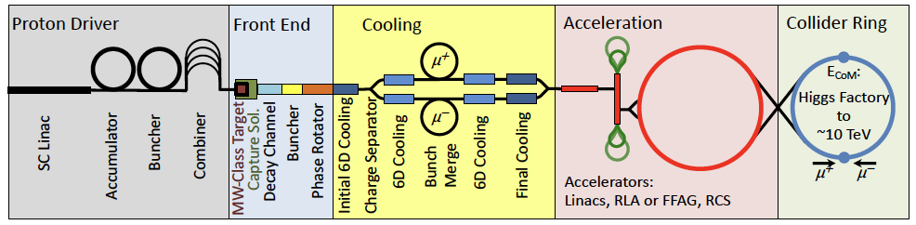
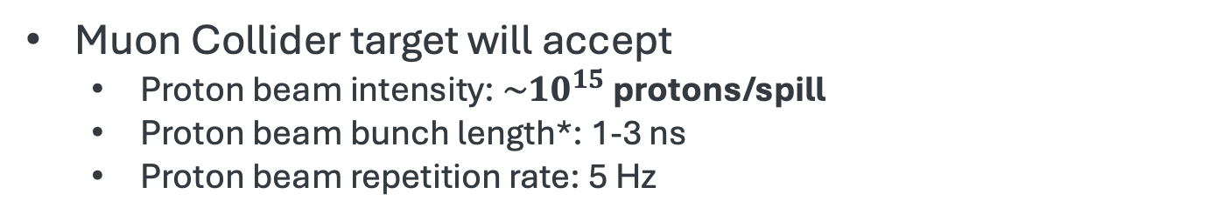
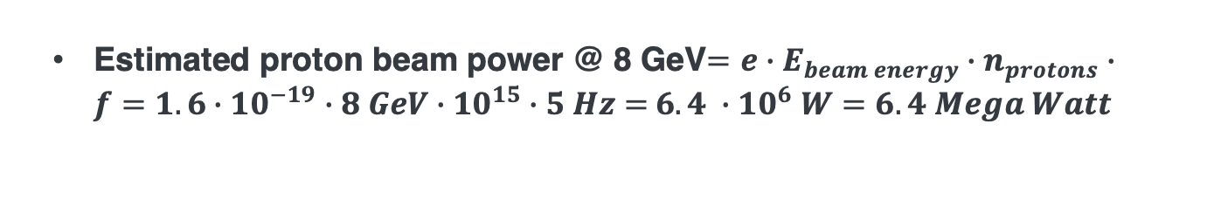
Design Value of Muon Collider Target System
Proton beam based muon collider
Muon Collider target will accept
  Proton beam intensity: $\sim {10}^{15}$ protons/spill
  Proton beam bunch length*: 1-3 ns
  Proton beam repetition rate: 5 Hz
* Short bunch length is required for capturing muons into RF buckets
Estimated proton beam power @ 8 GeV$=e∙E_{beam energy}∙n_{protons}∙f=1.6∙{10}^{−19}∙8 GeV∙{10}^{15}∙5 Hz=$ $6.4 ∙{10}^{6} W=6.4 Mega Watt$

Slide 3

Design goal of the “target system”
Mission 3:
Maintain performance → Diagnostic system required
Produce secondary/Tertial beams
(Pions, Kaons, Muons)
Primary beam
(Proton)
Target: Typically, 1~2$λ$
Mission 1:
Convert proton beam into pion/kaon/muon beams → Target required
Collection/Focusing magnet
Mission 2:
Collect/focus pions/kaons/muons particles → Collection/Focusing magnets required

Slide 4
Key Considerations in Designing a Target System
Primary inputs:
Proton beam parameters
Performance of collection magnets
Cost
Size
Physics output
Muon yield
Muon phase space
Engineering considerations
Safety/Maintenance
requirements
Stress analysis
Mechanical property degradation due to radiation damage
Lifetime/Tolerance
Replacement
AI/ML could be well-suited for optimizing complex, high-dimensional target system designs(?)

Slide 5
Challenges
Limited experimental data for selecting target material
  Most pion production data come from thin-target experiments and may not apply to thick target
  Material property changes due to irradiation
Insufficient understanding of intensity effects in materials
  Beam-induced plasma formation and nonlinear material responses have not been fully explored
No robust design to eliminate contaminations in muon phase space
  How can primary protons be effectively separated from muons?
  How can other charged particles with overlapping momentum be suppressed?
Lack of design framework for optimizing target geometry
  There are no analytical or semi-analytical models available to guide design optimization
High radiation tolerance needed for systems near the target
  Target and beam diagnostic systems
  Shielding & remote handling systems
  Infrastructures including cooling manifold, gas manifold, support structure, etc

Slide 6

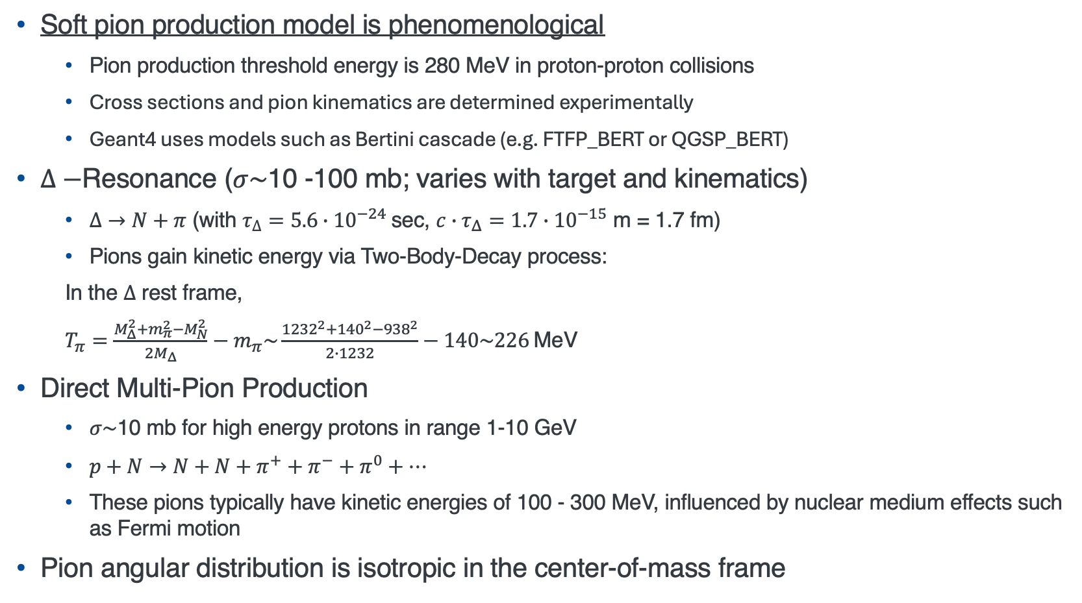
Soft Pion Production
Soft pion production model is phenomenological
  Pion production threshold energy is 280 MeV in proton-proton collisions
  Cross sections and pion kinematics are determined experimentally
  Geant4 uses models such as Bertini cascade (e.g. FTFP_BERT or QGSP_BERT)
$Δ−$Resonance ($σ\sim$10 -100 mb; varies with target and kinematics)
  $Δ→N+π$ (with $τ_{∆}=5.6∙{10}^{−24}$sec, $c∙τ_{Δ}=1.7{∙10}^{−15}$ m = 1.7 fm)
  Pions gain kinetic energy via Two-Body-Decay process:
  In the $Δ$ rest frame,
  $T_{π}=\frac{M_{Δ}^{2}+m_{π}^{2}−M_{N}^{2}}{2M_{Δ}}−m_{π}\sim \frac{{1232}^{2}+{140}^{2}−{938}^{2}}{2∙1232}−140\sim 226$MeV
Direct Multi-Pion Production
  $σ\sim$10 mb for high energy protons in range 1-10 GeV
  $p+N→N+N+π^{+}+π^{−}+π^{0}+…$
  These pions typically have kinetic energies of 100 - 300 MeV, influenced by nuclear medium effects such as Fermi motion
Pion angular distribution is isotropic in the center-of-mass frame
NB: Unit reference
Size of nucleon: $r\sim 1$ fm
Size of nuclei: $r\sim 1.2A^{1/3}$ fm
barn = ${10}^{−24}$ cm² = ${\left(10 fm\right)}^{2}$
mb = ${10}^{−27}$ cm²

Slide 7
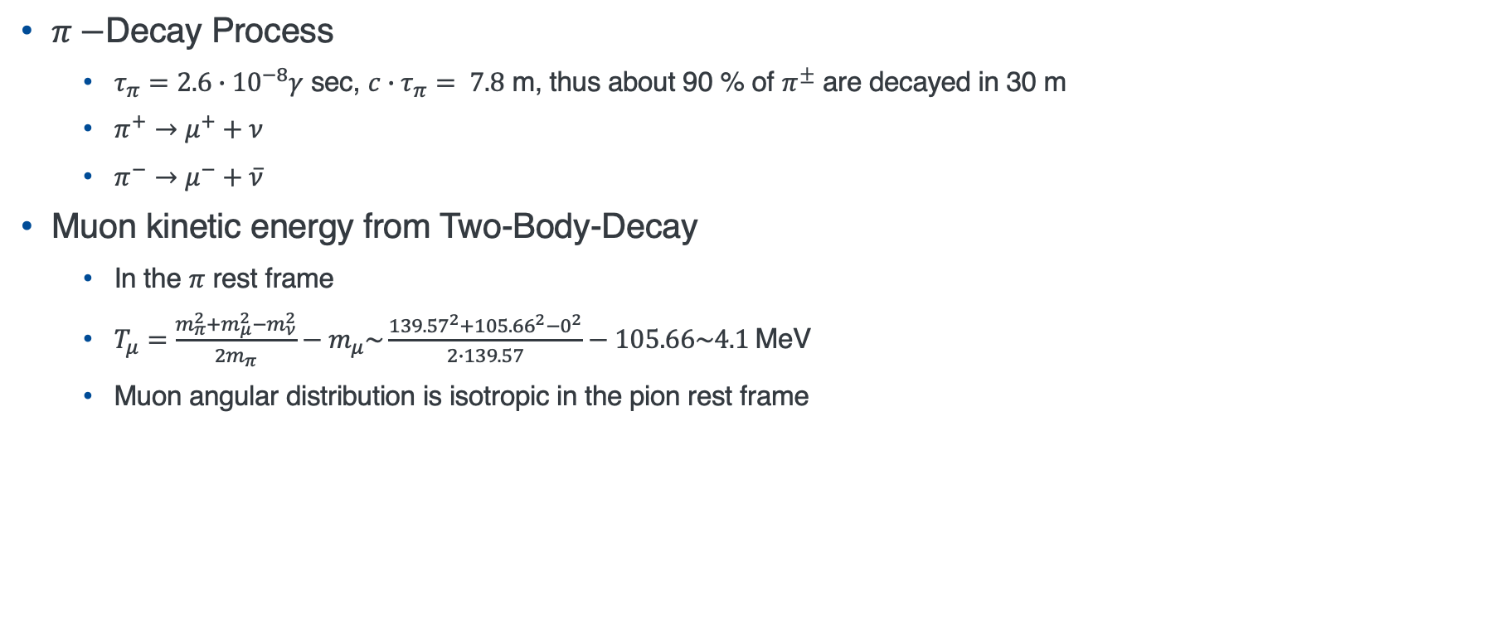
Muon Production
$π−$Decay Process
  $τ_{π}=2.6∙{10}^{−8}γ$ sec, $c∙τ_{π}= 7.8$ m, thus about 90 % of $π^{±}$ are decayed in 30 m
  $π^{+}→μ^{+}+ν$
  $π^{−}→μ^{−}+\overline{ν}$
Muon kinetic energy from Two-Body-Decay
  In the $π$ rest frame
  $T_{μ}=\frac{m_{π}^{2}+m_{μ}^{2}−m_{ν}^{2}}{2m_{π}}−m_{μ}\sim \frac{{139.57}^{2}+{105.66}^{2}−0^{2}}{2∙139.57}−105.66\sim 4.1$MeV
  Muon angular distribution is isotropic in the pion rest frame
Pion Kinetic energy: < 300 MeV
Muon Kinetic energy: 4 MeV
Maybe there is a way to cool pions?
Short lifetime
Strong interactions
Initial muon phase space is predominant by pion energy spread

Slide 8


Uncertainty in Multiplicity for Thick Targets
Simulations of pion production in thick targets (multiple interaction lengths) often yield inaccurate pion yields and phase space distributions
  Interaction length quantifies the probability of hadronic interaction per unit length
Neutrino production targets, like the NuMI graphite target, typically span several interaction lengths (e.g. ~2.5$λ$)
  Yield prediction uncertainty are on the order of ~10 % in the GeV range
Experimental validation (e.g. HARP, NA49, NA61) is essential to constrain models
$p+A→π^{±}+A$ (primary channel)
$π+A→π+π+A$
$$π+A→A^{∗}→π+A$$
Error associated with each event propagates through multiple processes, and amplifying the overall uncertainty in the multiplicity

Slide 9
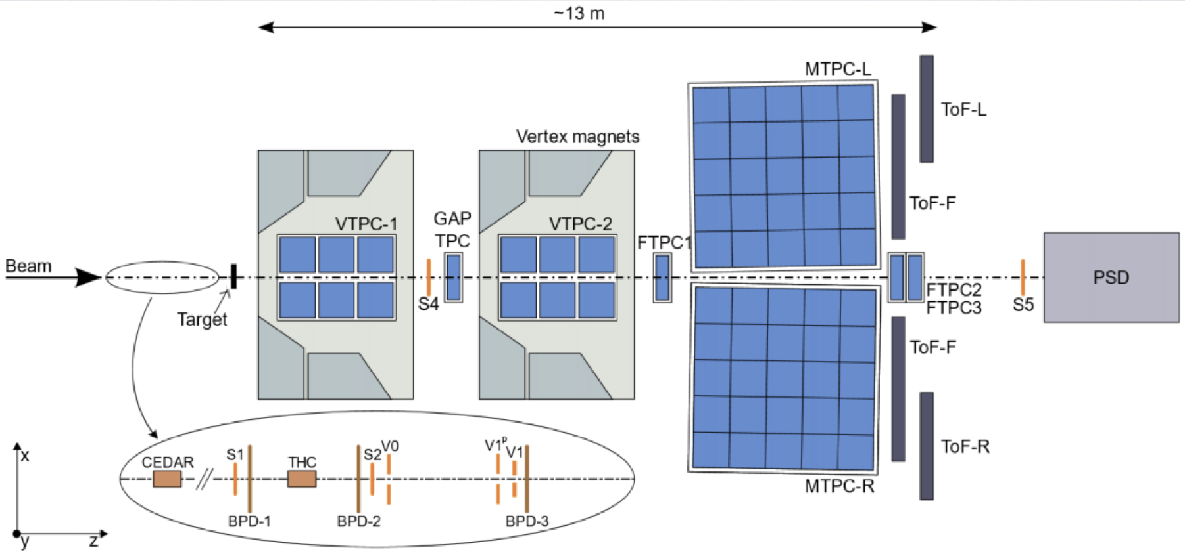
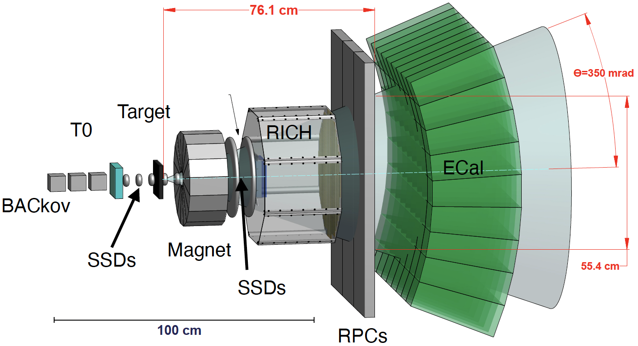
Propose Pion Production Measurement with Thick Targets
NA61/SHINE at CERN
EMPHATIC at Fermilab
Pion production measurements with muon collider targets may be needed to improve the accurate of production model

Slide 10
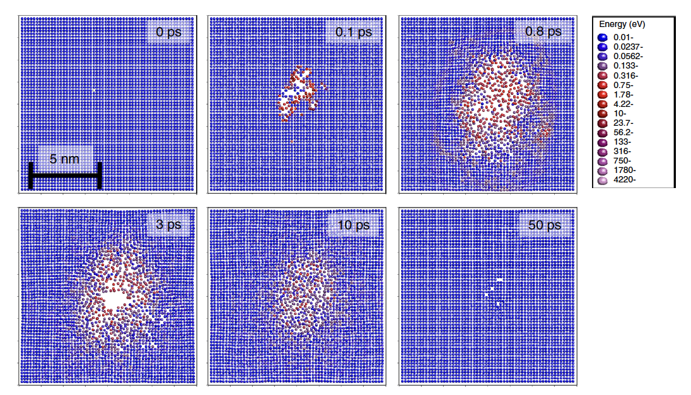
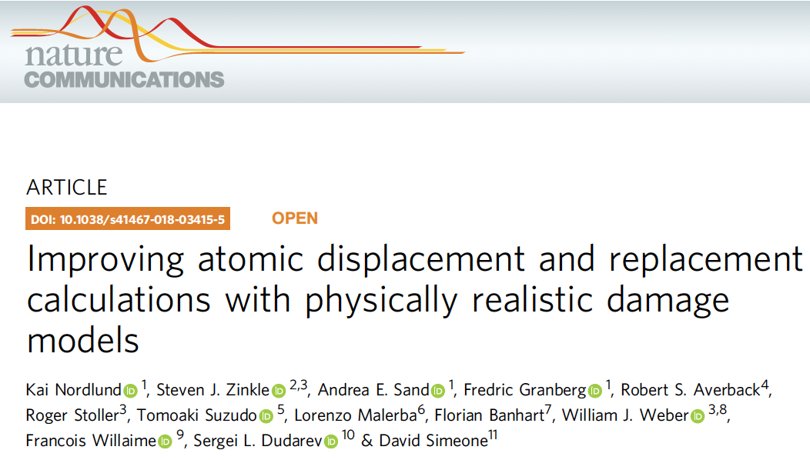
Radiation damage (simulation)
10-keV Primary Knock-on Atom (PKA) in Au
PKA (start point)
Most displacement atoms refills a vacant point after 50 pico second
Displacement Per Atom (DPA) is a conceptual variable which is determined by the parameter of incident particles (species, energy, etc)

Slide 11
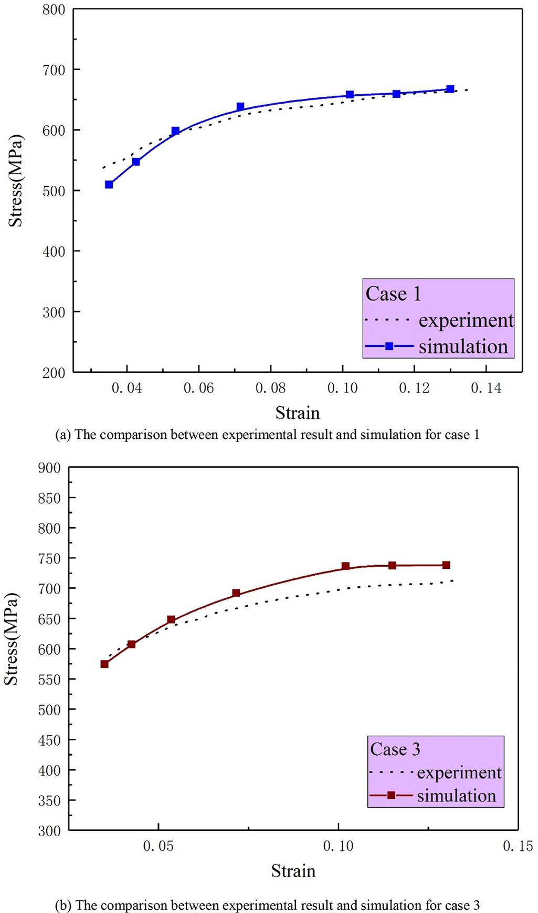
Mechanical Property Degradation by Radiation
Stress-strain curve for irradiated materials (Beryllium)
Irradiation hardening of S-65F Be
Reduction of strain to failure
Increased strength
Simulation tool to predict the mechanical property degradation are still under development
Some prediction models work quite well
Stress-Strain curve in simulation model and compare with measurement

Slide 12
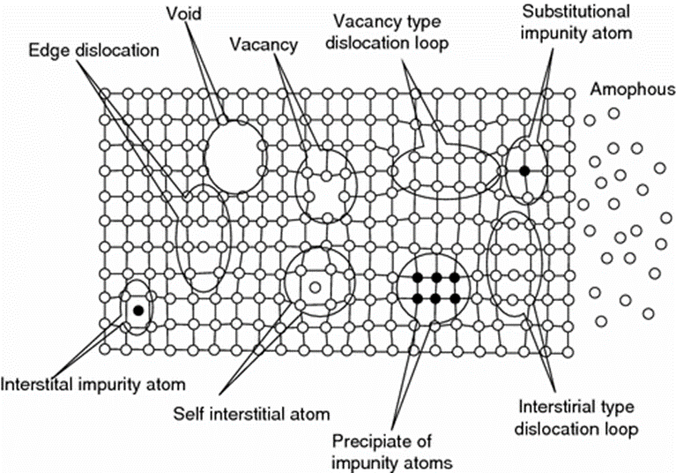
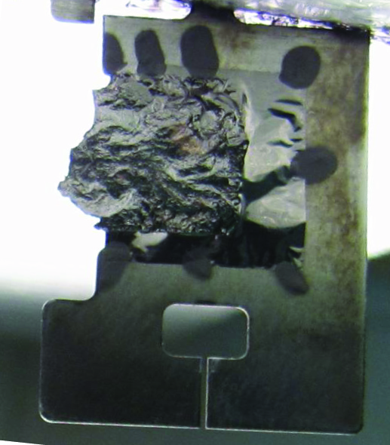
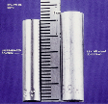
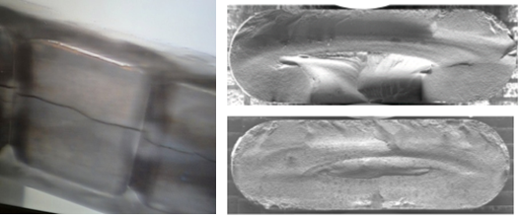
More Degradation Issue
Displacements in crystal lattice expressed as Displacements Per Atom (DPA)
  Hardening and embrittlement
  Creep and swelling
  Fracture toughness reduction
  Thermal/electrical conductivity reduction
  Coefficient of thermal expansion
  Ductility
  Transmutation products
  (H, He gas production can cause void formation and embrittlement)
  Radiation Accelerated corrosion
F. Marti et al., LINAC2010, Tsukuba, Japan, TUP105, 2010.
D.L. Porter and F. A. Garner, J. Nuclear Materials, 159, p. 114 (1988)
Be window embrittlement (FNAL)
MINOS NT-02 target failure: radiation-induced swelling (FNAL)
H embrittlement from accelerated corrosion(FNAL)

Slide 13
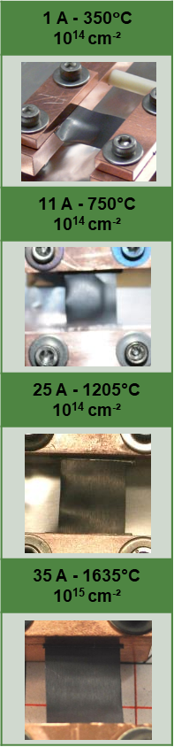
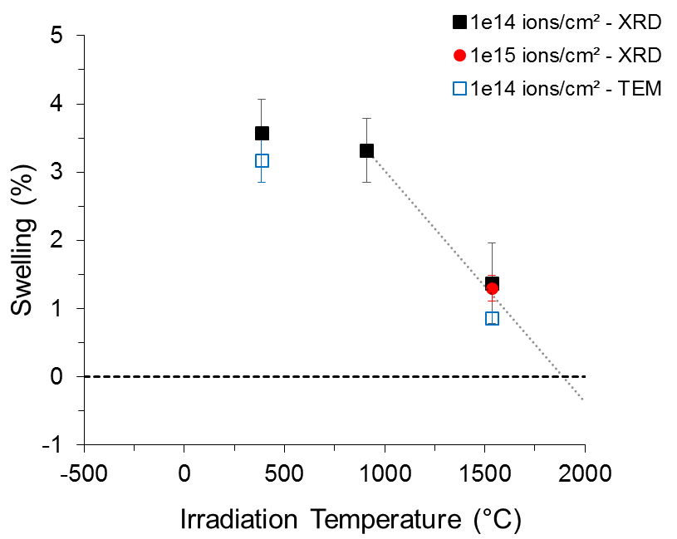
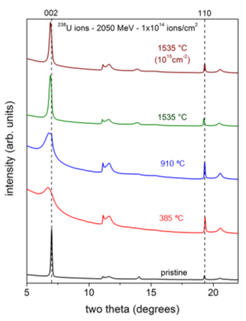
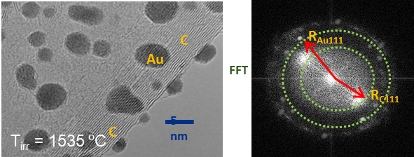



Annealing of Damage at High Temperature
X-Ray Diffraction analyses
TEM analyses
Swelling is completely recovered at 1900°C
F. Pellemoine et al., NIMB 365 (2015) 522-524

Slide 14
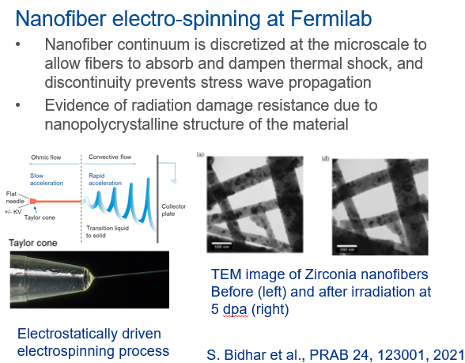
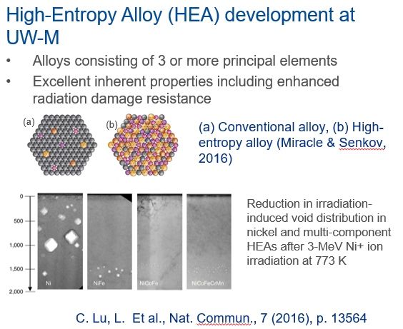
Development of Radiation Resistance Materials
With conventional materials already limiting the scope of experiment it is crucial to investigate novel materials

Slide 15
Liquid/Fluidized Target Study
Thermal shock is is one of the most critical concerns for the high-power solid targets
This issue is significantly mitigated in liquid and fluidized targets
  Li, Mercury, Pb-Bi, Molten target, Fluidized W, etc
Many neutron spallation sources are used liquid mercury
  Issue: Cavitation, Corrosion/radiochemistry, radioactive waste, charging-up, erosion management, powder handling
R&D required
  Need to find potential beam facilities
  May integrate pion production measurement spectrometer

Slide 16
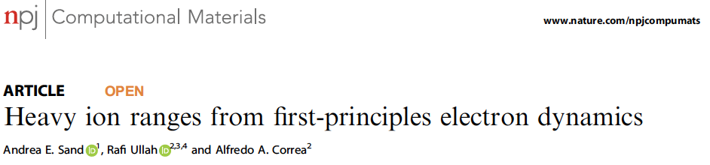
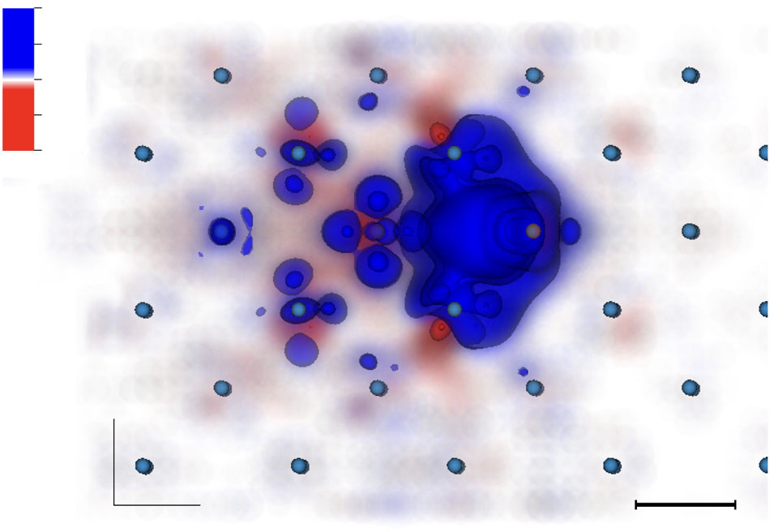
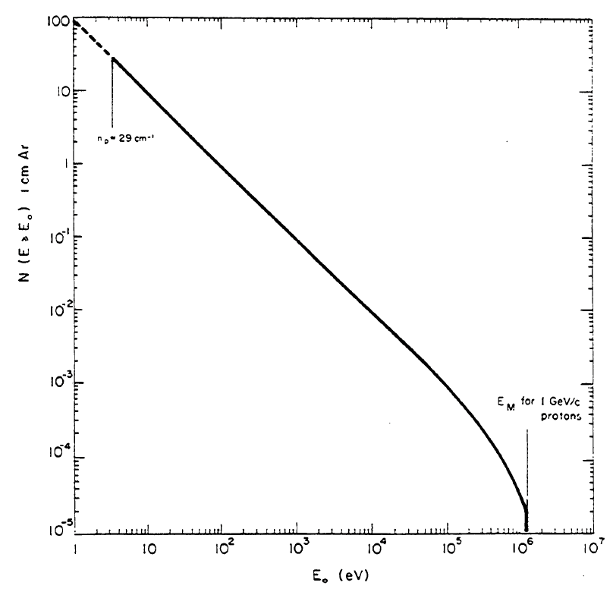
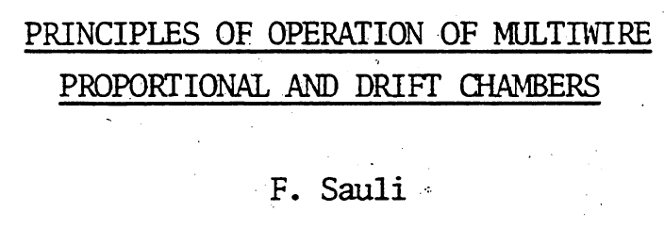
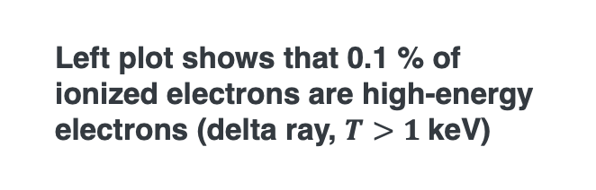
Consider Particle Interactions in Solid Metals
Metals have a lattice structure
Low-energy electrons occupy states in the conduction band
Time dependent density function theory (TD-DFT) can be used to evaluate plasma formation in metals
High-energy electrons generate cascades until they are fully thermalized
Left plot shows that 0.1 % of ionized electrons are high-energy electrons (delta ray, $T>1$keV)

Slide 17
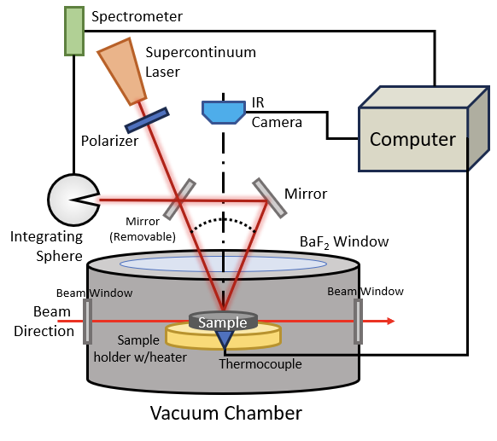
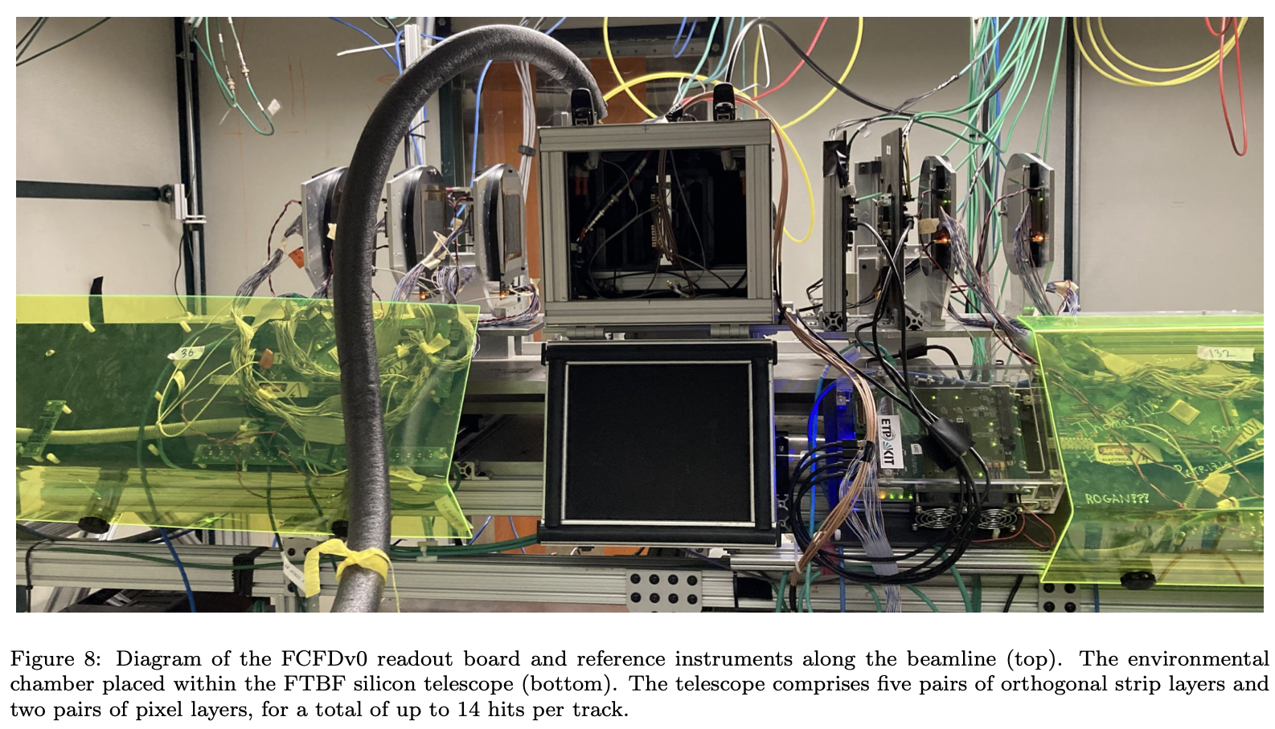
Diagnostic System for severe environments
Typically, beam instrumentation is avoided near the target to prevent pion absorption in the system
New non-contact, high-speed radiation damage sensor has been developed using Fermilab LDRD
Rad-hardened beam detectors are also required to monitor the primary beam and measure secondary and tertiary particle yields
LGADs are potential candidates for detecting secondary particles

Slide 18
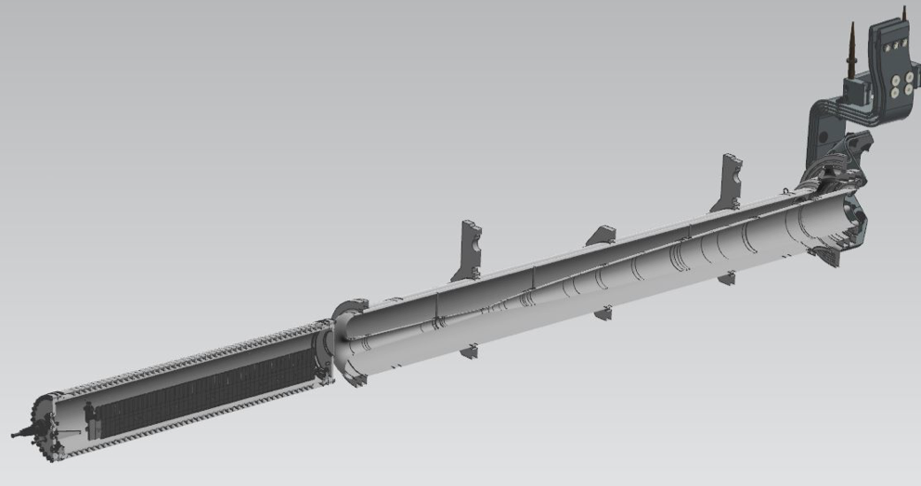
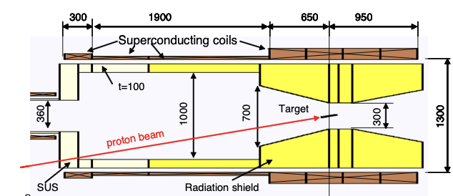
Collection magnet
NuMI magnetic horn (just first horn)
Mu2e 5-Tesla pion production solenoid
The solenoid magnet can capture low-energy pions of both charges, whereas the magnetic horn is charge-selective
It has been found that a magnetic horn can be configured in a FODO structure to capture both-charges
Additionally, the magnetic horn is a well-developed technology for mega-watt class beams, whereas the solenoid magnet faces intrinsic challenges for radiation damage

Slide 19
Summary
Identify challenges in designing a muon collider target system
  Break the problem into three key domains, Physics output, Engineering considerations, and Safety/Maintenance requirements
  Consider using AI/ML for optimization once a well-defined interface among three domains is established
Propose simulation studies
  Predict material property degradation from radiation damage
  Model intensity effect from beam-induced plasma formation
Propose designing concepts for the pion collection system
  Comparative study of solenoid vs magnetic horn systems

Slide 20
Extra slides

Slide 21
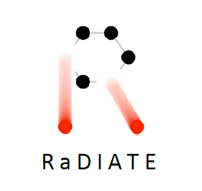
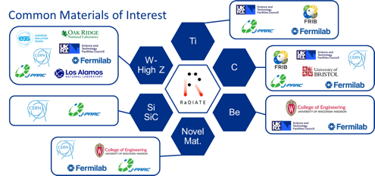
RaDIATE Collaboration
Radiation Damage In Accelerator Target Environment
RaDIATE collaboration created in 2012, with Fermilab as the leading institution. The collaboration has grown up to 20 institutions over the years
Objectives
  Harness existing expertise in nuclear materials and accelerator targets
  Generate new and useful materials data for application within the accelerator and fission/fusion communities
Activities include
  Analysis of materials taken from existing beamline new irradiations of candidate target materials at low and high
  energy beam facilities
  In-beam thermal shock experiments

Slide 22
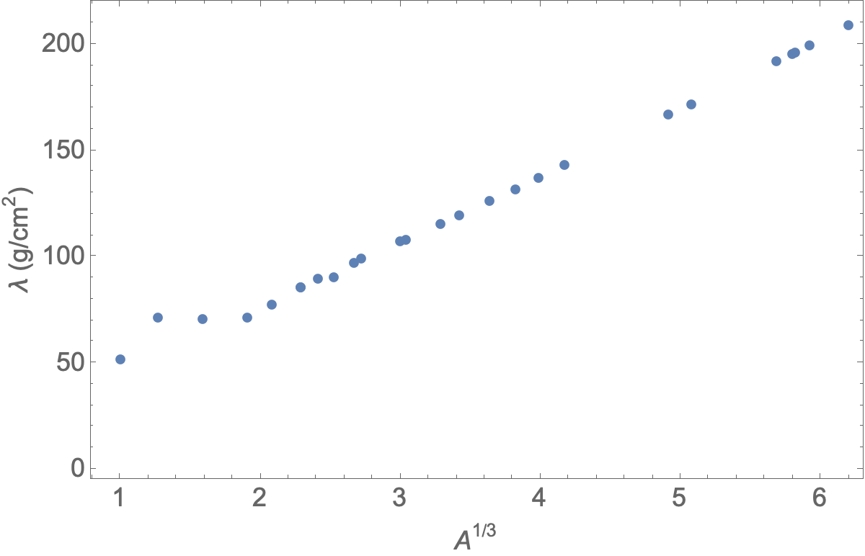
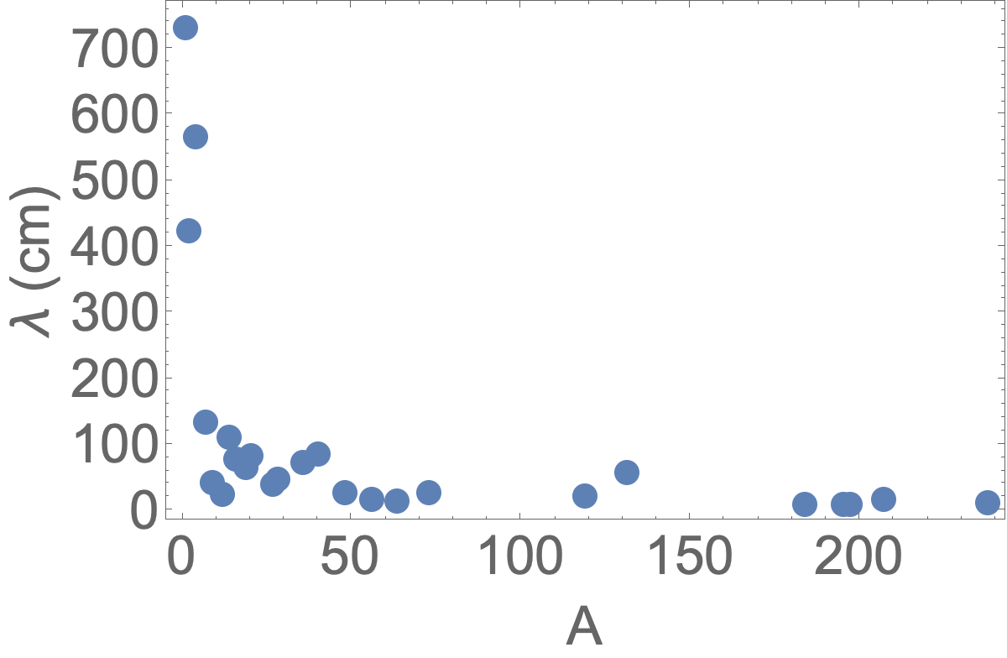
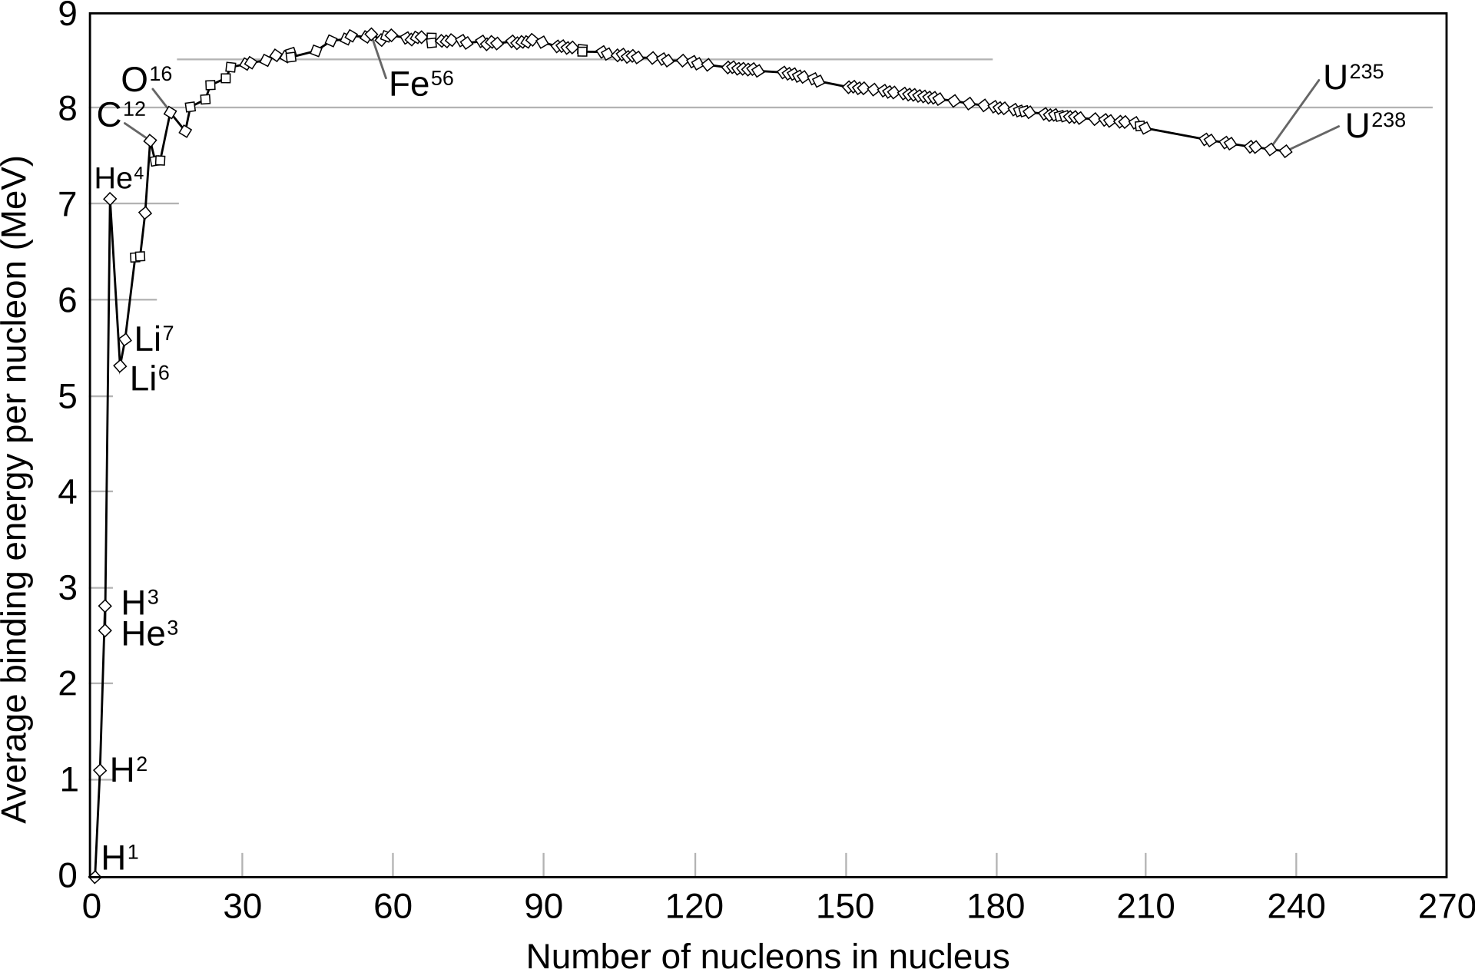
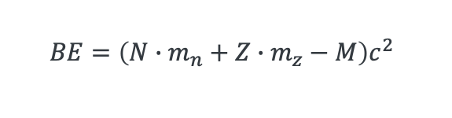
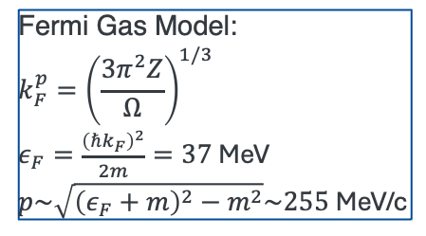


Review of nuclear physics
U
$$λ∝A^{1/3}$$
Nuclear size: $r=r_{0}A^{1/3}$, $r_{0}\sim 1.2$ fm
  Determined from electron scattering
  Most nuclei is sphere shape
  Nuclear interaction length: $λ∝A^{1/3}\sim \frac{A}{r^{2}}$
Nucleon binding energy (see bottom right plot)
Nucleons in Nuclei follows Fermi Gas model
  Nuclei has strange behavior since kinetic energy is larger than binding energy!
Nuclear has shell structure, similar as atom
  Nucleon can be excited
  Emit gamma rays when nucleon are de-excited
D
He
Li
H
Fermi Gas Model:
$$k_{F}^{p}={\left(\frac{3π^{2}Z}{Ω}\right)}^{1/3}$$
$ε_{F}=\frac{{\left(ℏk_{F}\right)}^{2}}{2m}=37$MeV
$p\sim \sqrt{{\left(ε_{F}+m\right)}^{2}−m^{2}}\sim 255$MeV/c
$$BE=\left(N∙m_{n}+Z∙m_{z}−M\right)c^{2}$$

Slide 23
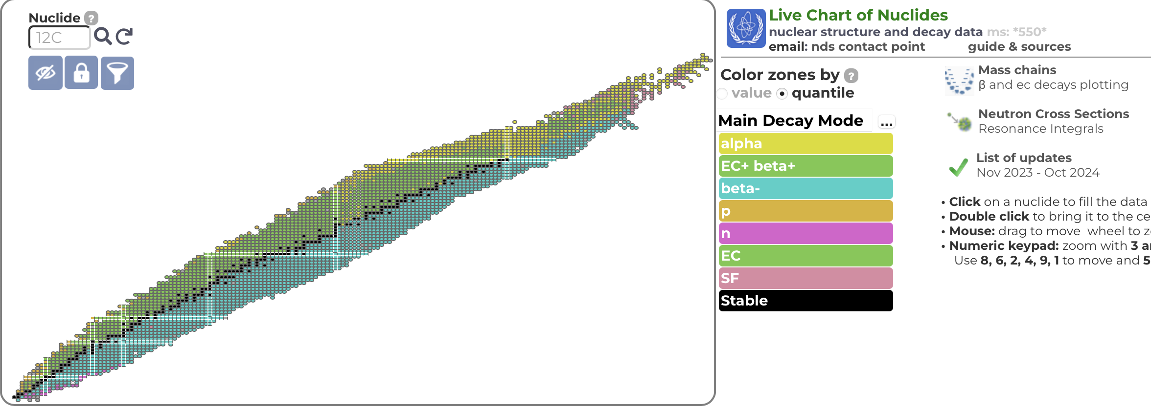

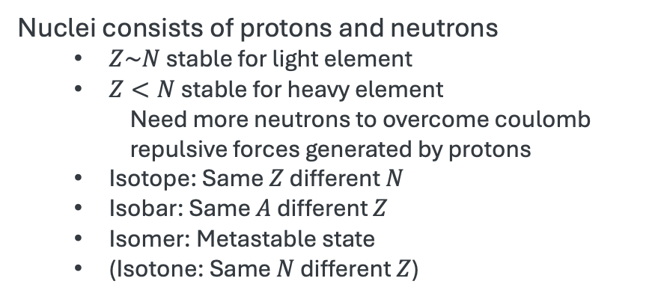
Table of Nuclides
https://www-nds.iaea.org/relnsd/vcharthtml/VChartHTML.html
$A$: Atomic mass
$Z:$ Atomic number (number of protons)
$N:$ Number of neutrons
$$A\sim Z+N$$
Z
Proton rich
Nb, Mo, Zr, Y
etc
W
Magic number (Z or N)
=2, 8, 20, 28, 50, 82, 126
Fe, Ti, V, Co,
Mn, etc
Neutron
N
Neutron rich
Nuclei consists of protons and neutrons
  $Z\sim N$ stable for light element
  $Z<N$ stable for heavy element
    Need more neutrons to overcome coulomb repulsive forces generated by protons
  Isotope: Same $Z$ different $N$
  Isobar: Same $A$ different $Z$
  Isomer: Metastable state
  (Isotone: Same $N$ different $Z$)
Proton
Nuclei

