Slide 1



Recent Developments in RF Cavities with Beam Windows for the Future Muon Collider Ionization Cooling Channels
Dillon Merenich (NIU), Tianhuan Luo (LBNL), Xueying Lu (NIU/ANL)
8 August 2025

Slide 2
Overview
Motivation
Emittance Dilution Trade Study
Breakdown Resilience of Different Materials
Wakefield Studies of Enclosed Cavities
Conclusions
Future Plans

Slide 3
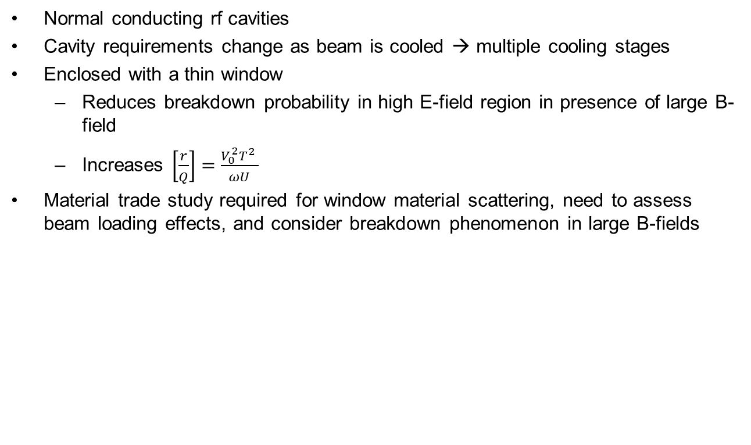
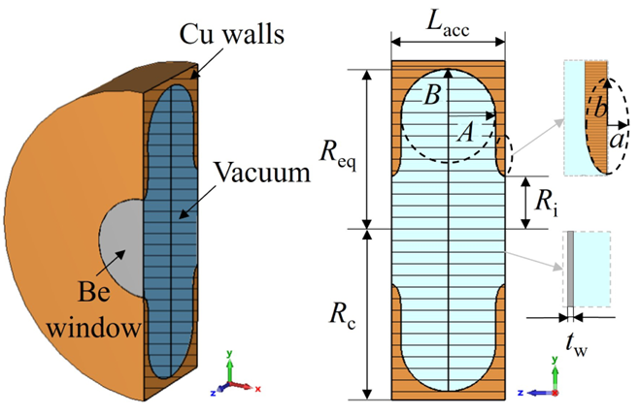
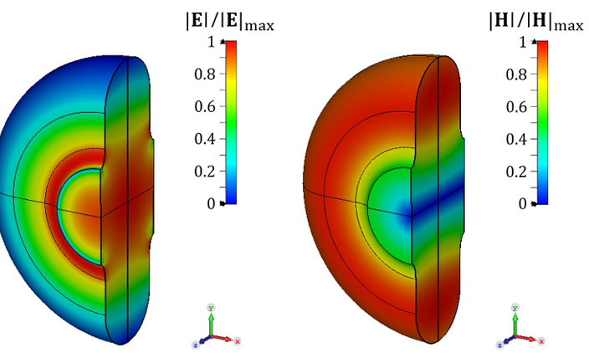
Cooling Channel RF Cavities
Example cavity design from CERN
https://cds.cern.ch/record/2913567/files/document.pdf

Slide 4
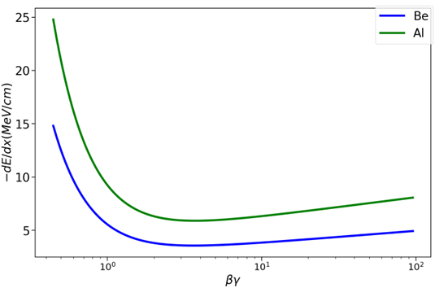
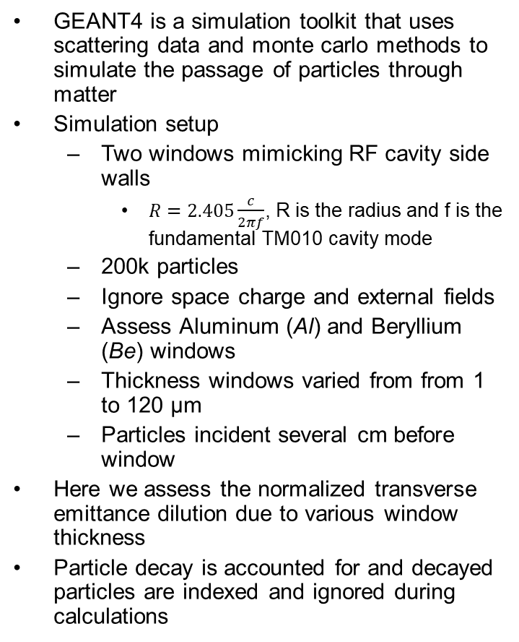
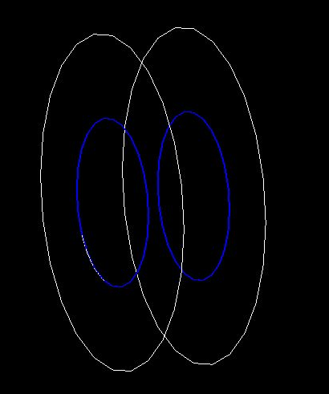

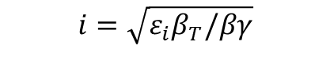

Scattering Simulation Setup Using GEANT4
$i=x,y$

Slide 5
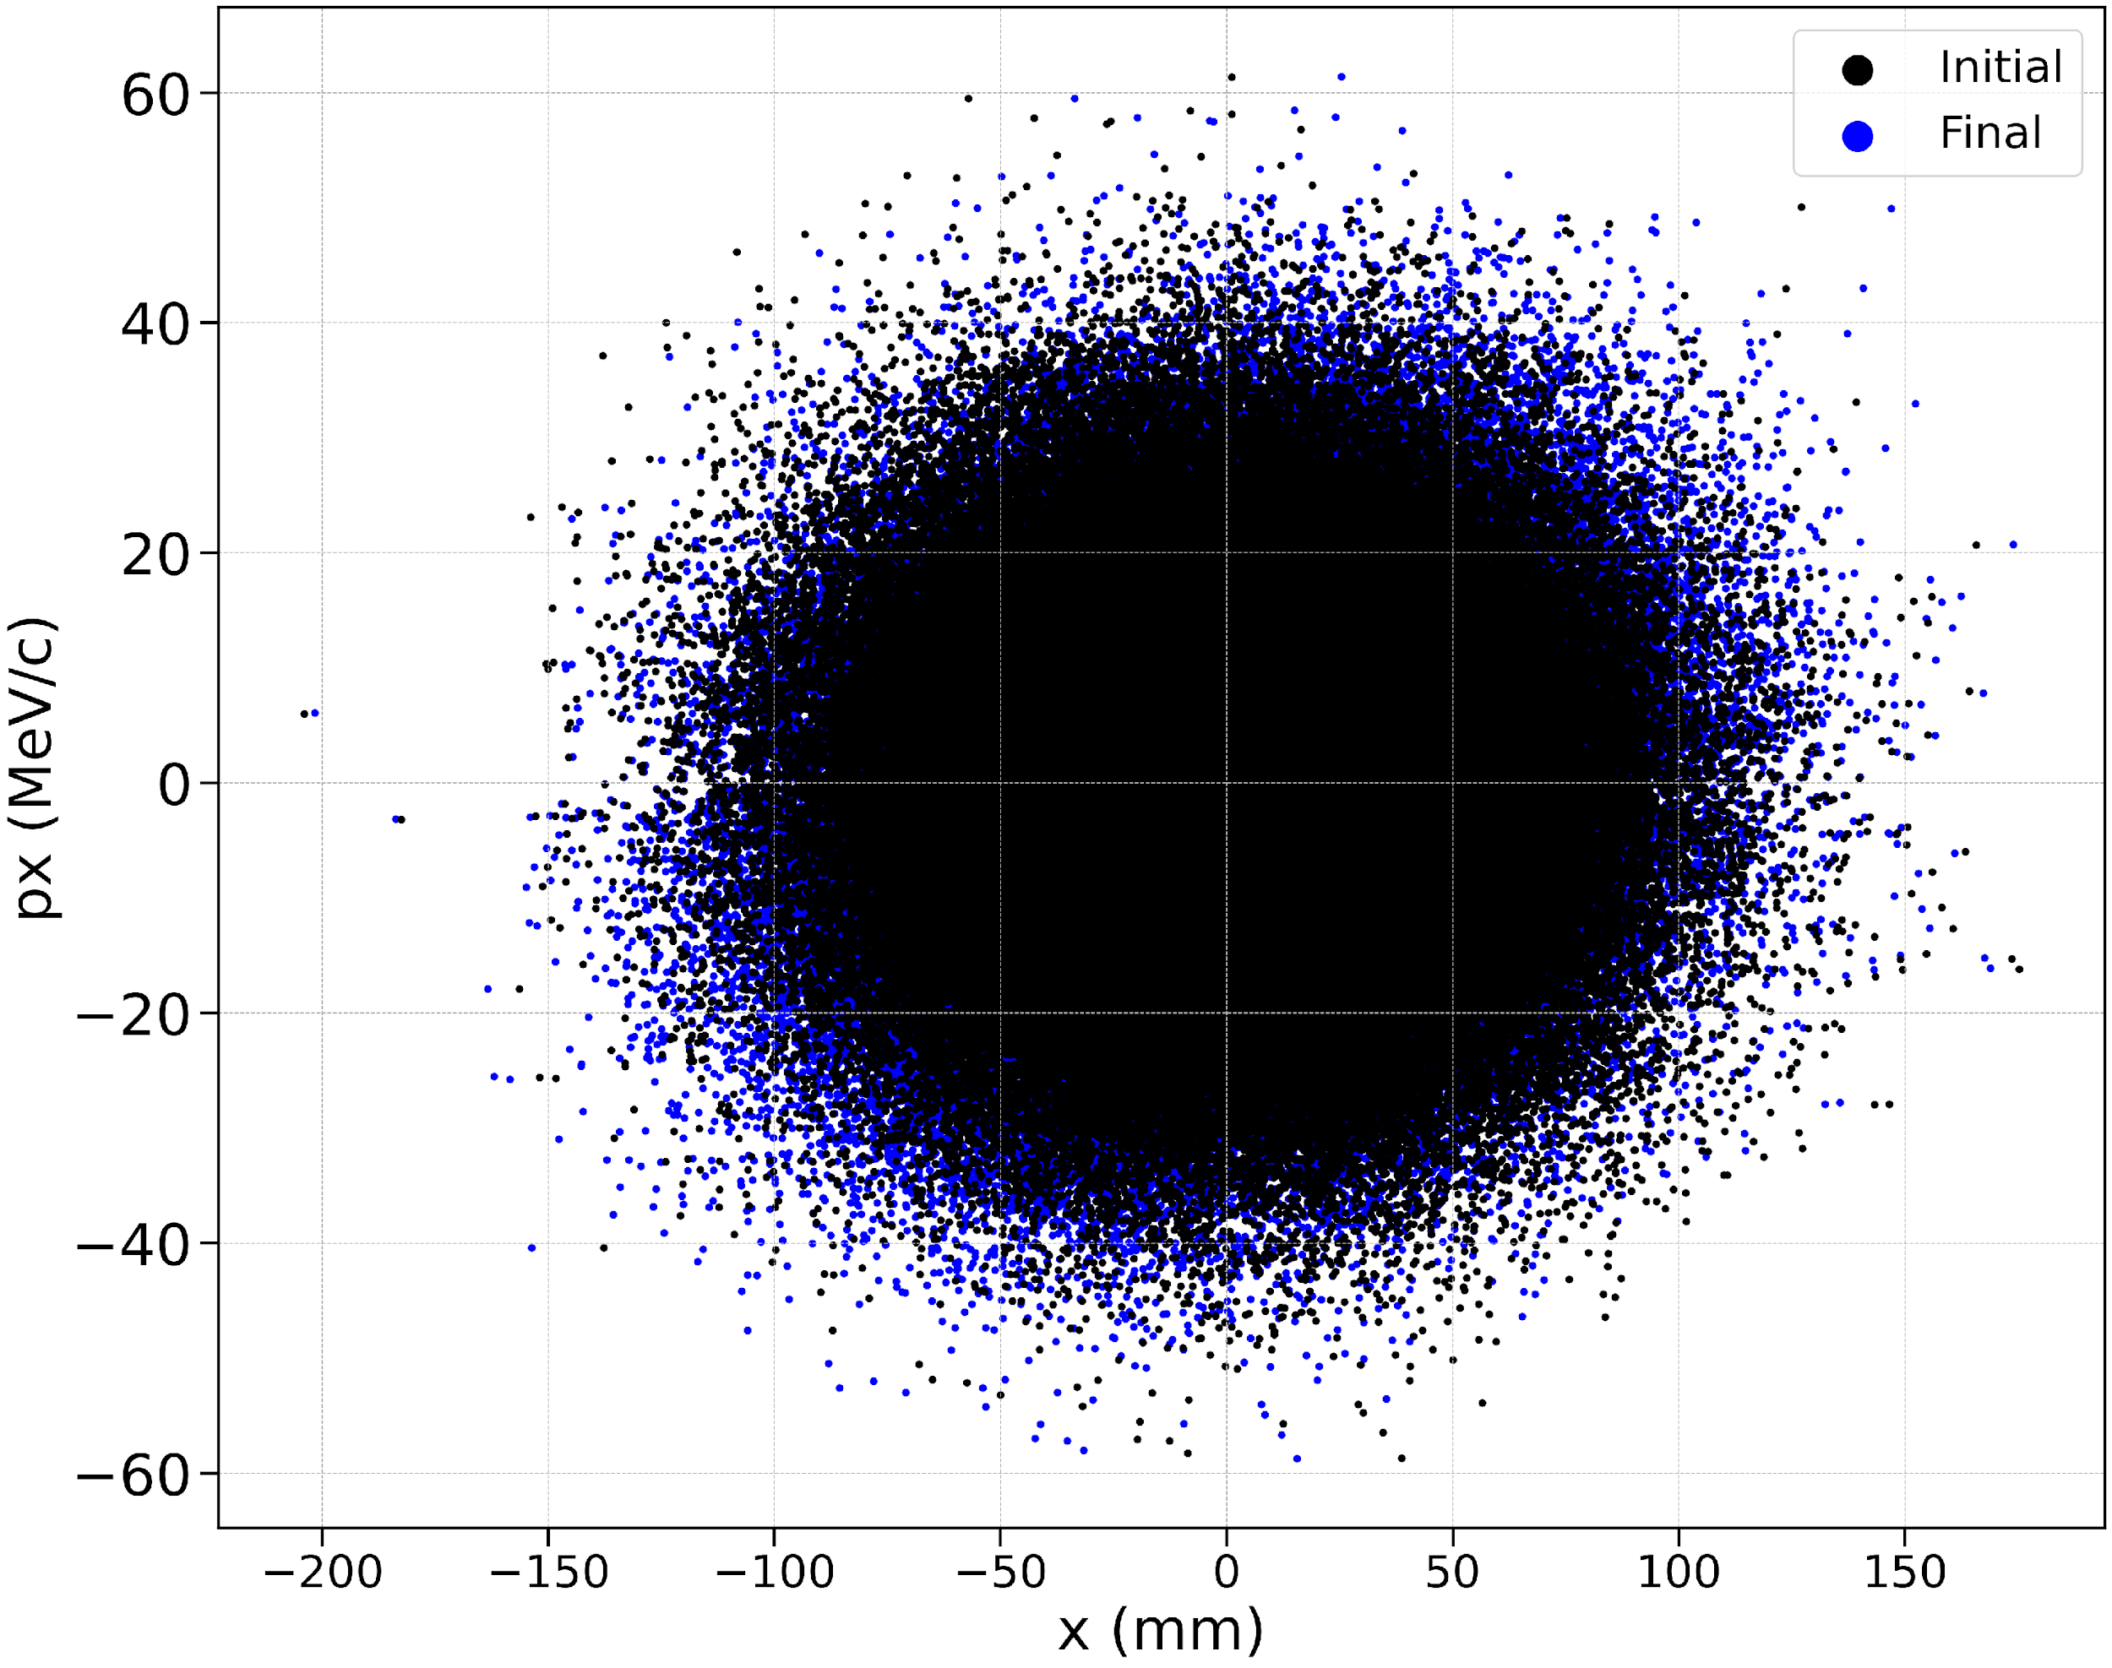
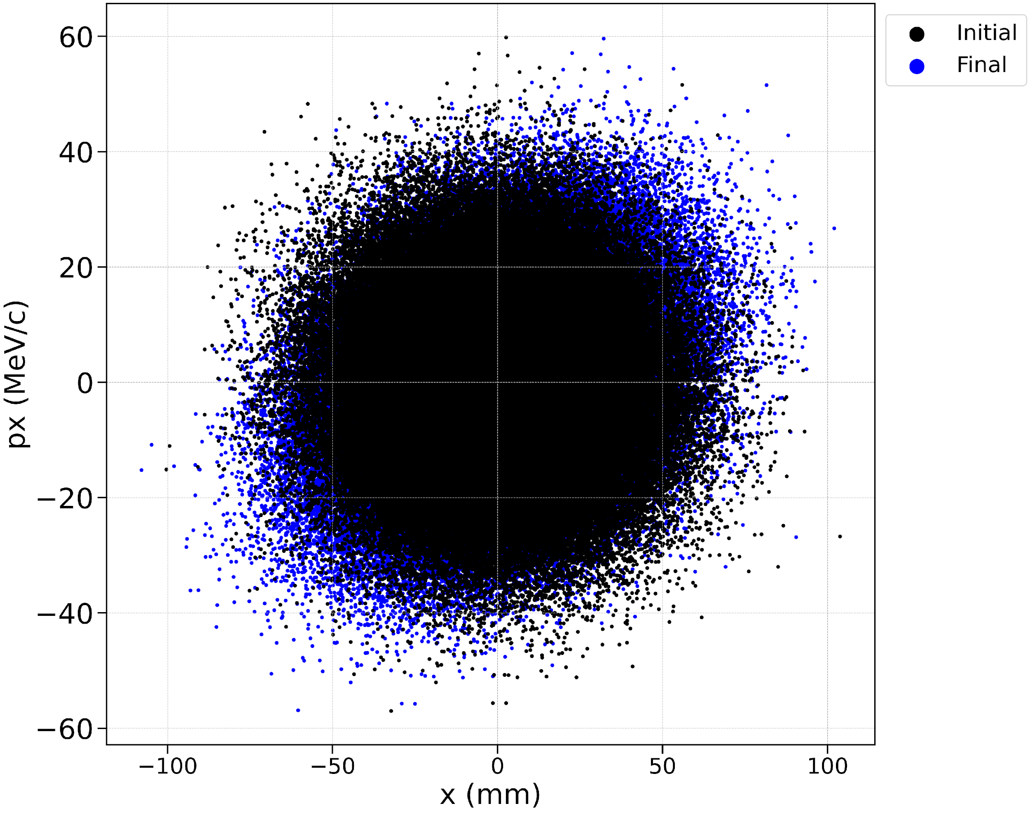
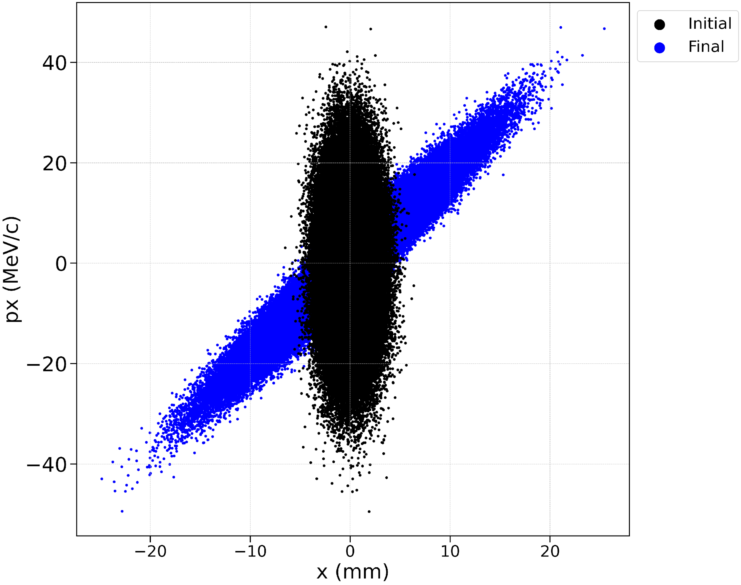
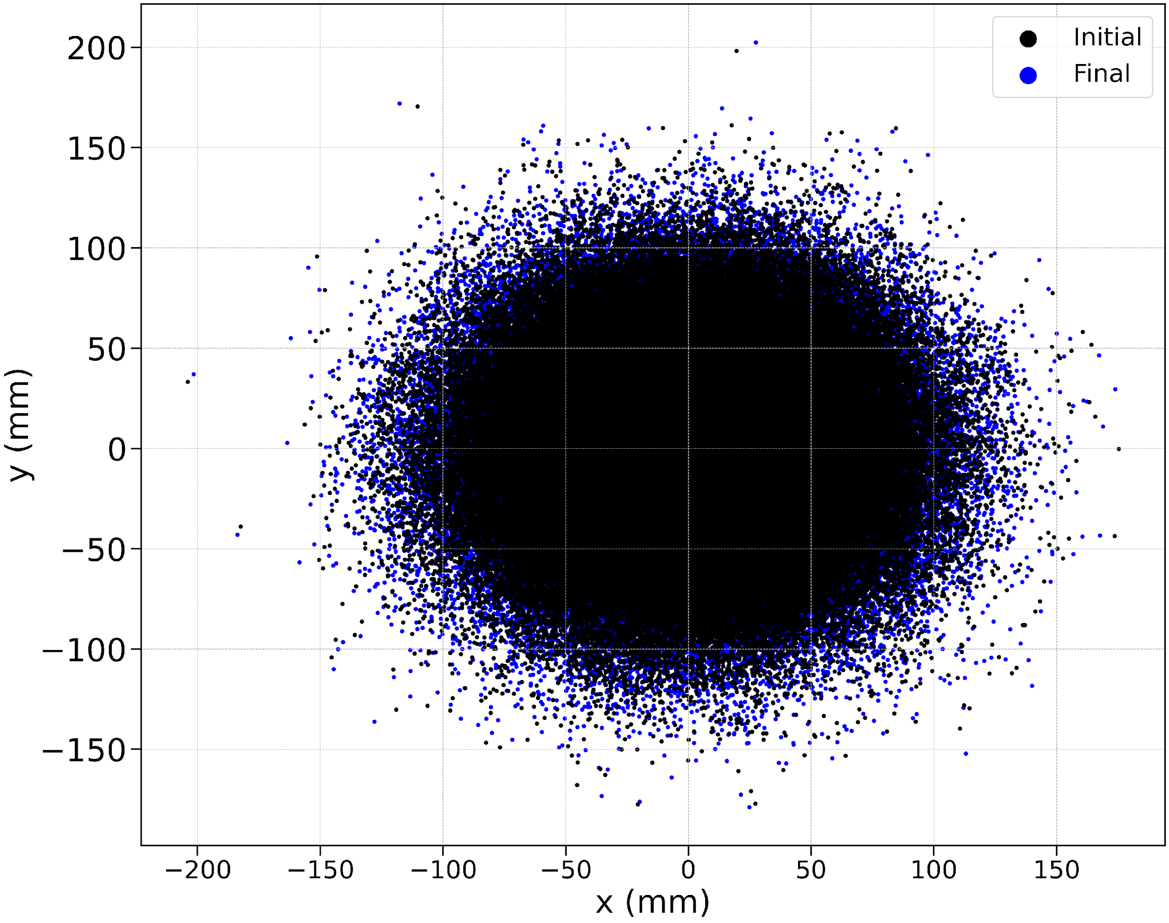
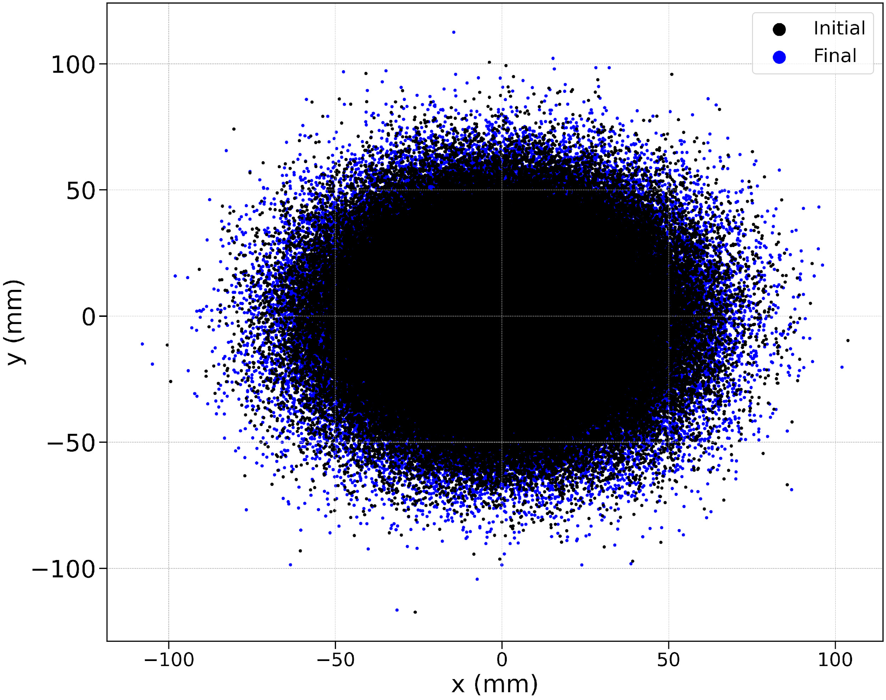
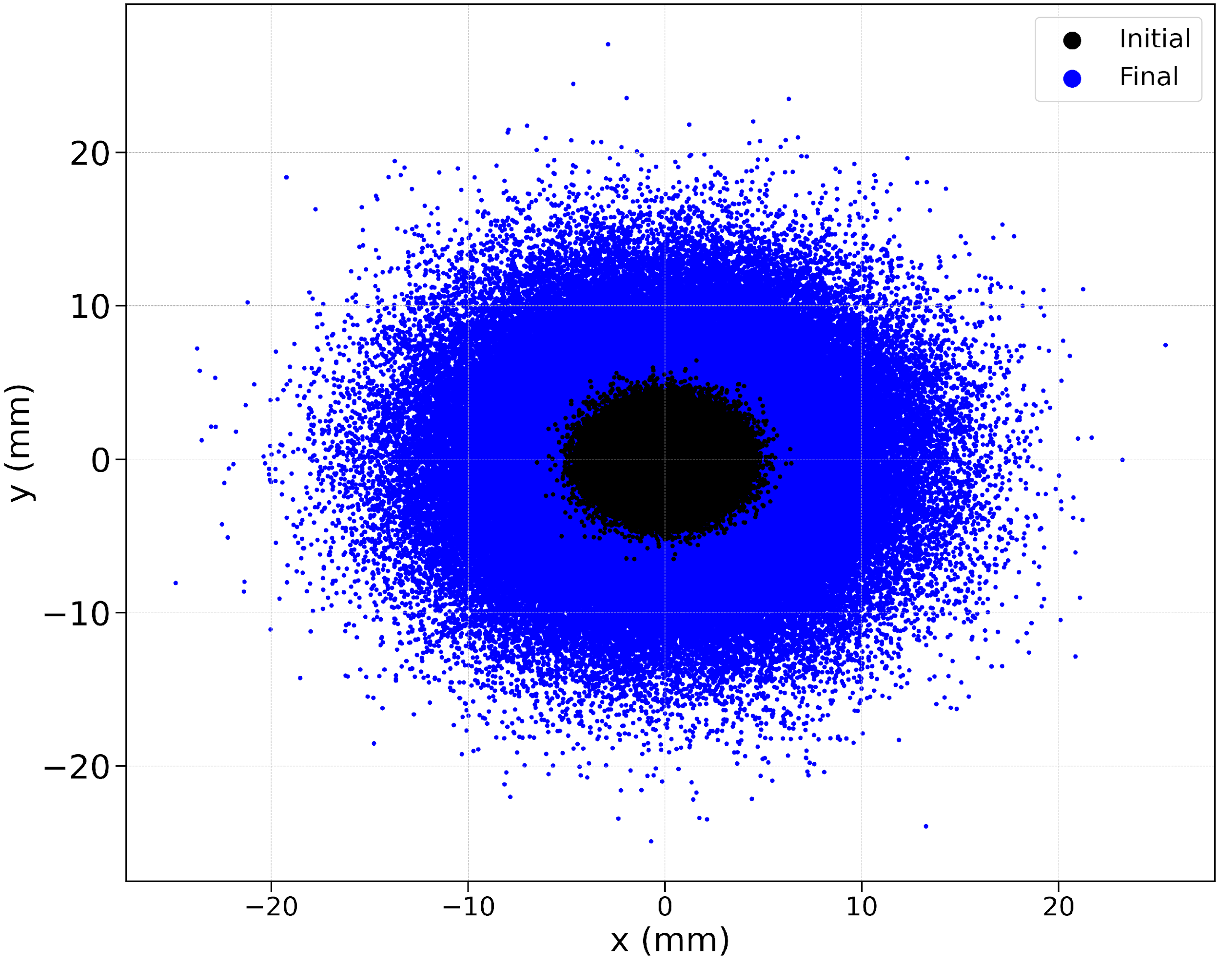
Phase Space Samples for Muon Collider Stages
Stages considered: A1, B1, and B10
Particle loss is negligible
px(MeV/c)-
x(mm)
y(mm)-
x(mm)
A1 Be phase spaces scattered on 3 μm
B1 Be phase spaces scattered on 3 μm
B10 Be phase spaces scattered on 3 μm

Slide 6
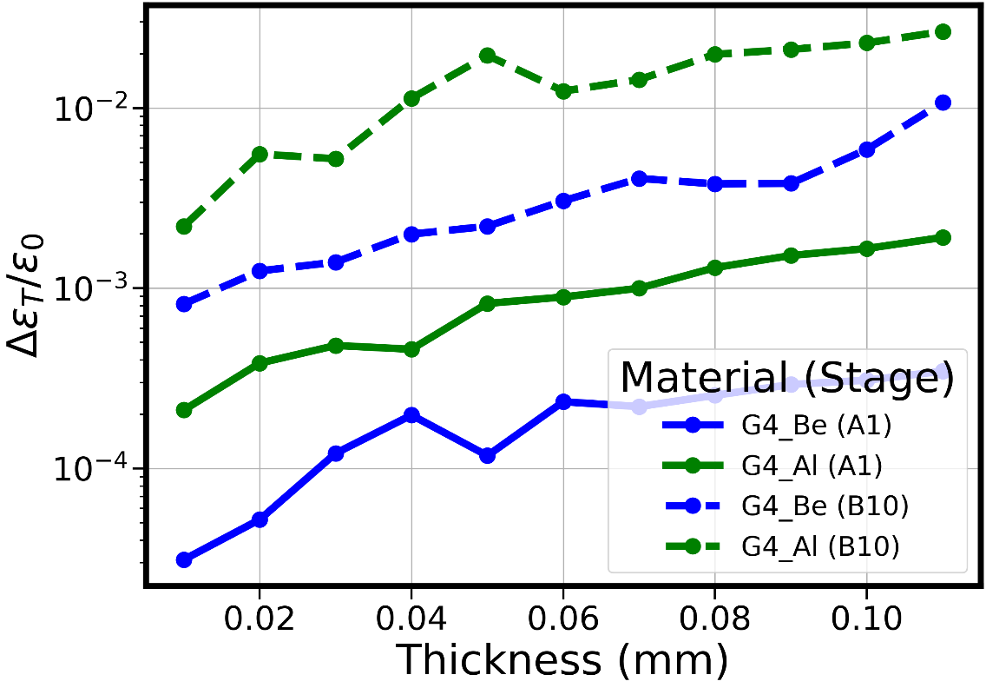
Emittance Dilution Comparison Between Early and Late Stages
As expected, earlier stages have larger emittance, so the emittance dilution effect is small
At later stages, Al will require ¼ thickness to achieve similar emittance dilution as Be
Although changes are small, multicell channels will scale these effects by number of cavities

Slide 7
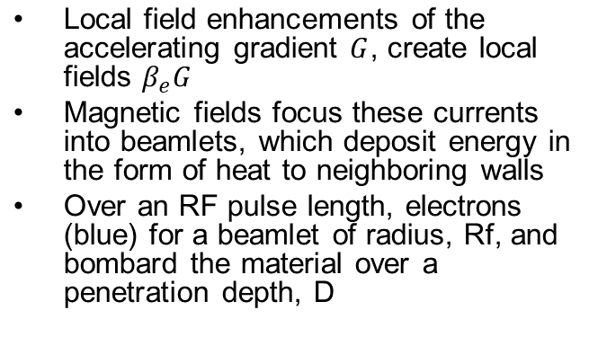

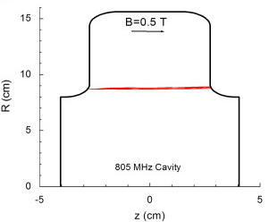
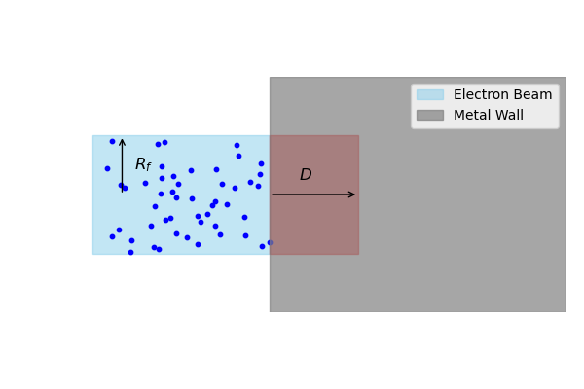
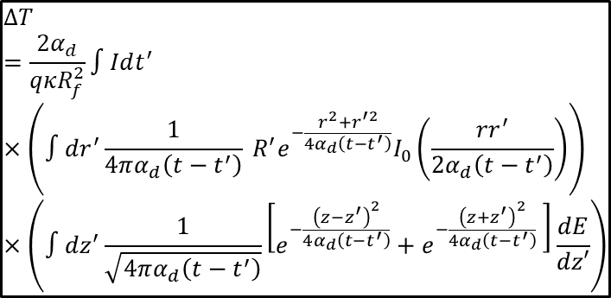

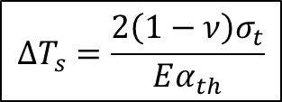
Temperature Dependent Breakdown Model in a Magnetic Field
FN Current density
Temperature Rise
D. Stratakis et.al 2010
Temperature change threshold
Heat conduction
Effects of external magnetic fields on the operation of high-gradient accelerating structures - ScienceDirect

Slide 8
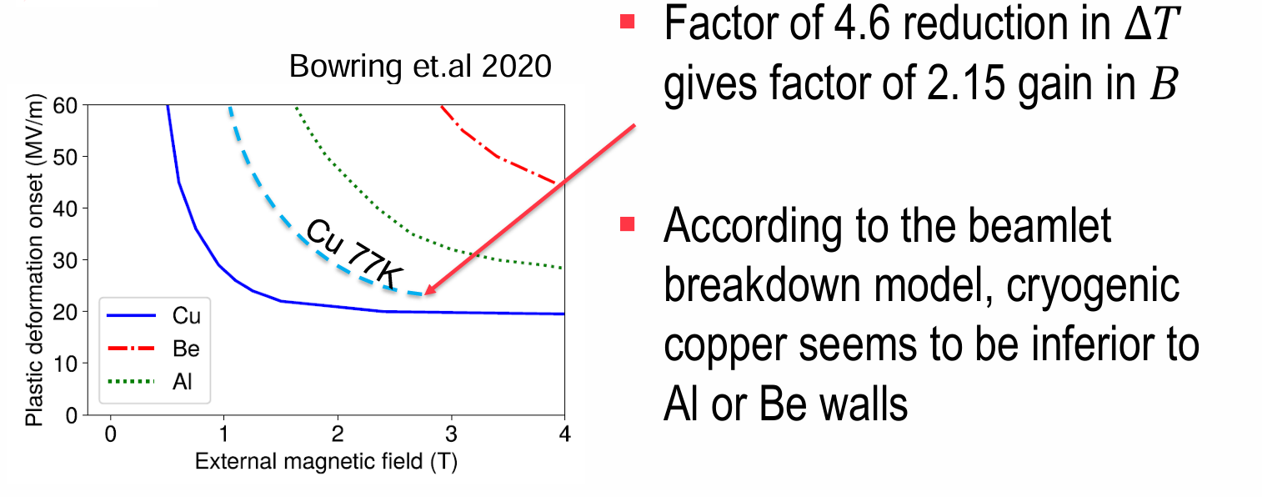
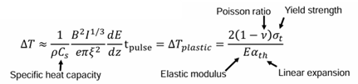
Previous Studies of the Breakdown Threshold
Previous studies assess results for Be, Al, and Cu 🡪 Be shows dominance due to its low density and large temperature threshold
Inspired by recent scaling studies 🡪 alluded to cold copper with limited improvement
Sergey Arsenyev 2021
https://indico.cern.ch/event/1043014/contributions/4382434/attachments/2255971/3827989/Scalings_with_T_and_f.pdf

Slide 9
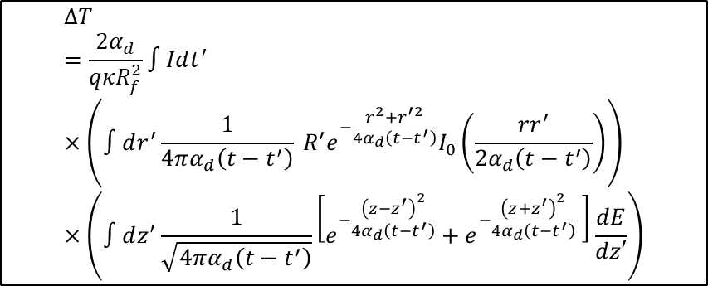
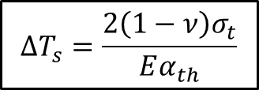
This Work: Adding thermal diffusion and Thermal-mechanical changes
Investigate the effects of both thermal and reduced current changes for cold Cu
  Thermal diffusivity, thermal conductivity, and thermal expansion
805 MHz cavity assumed
Higher magnetic fields
Note: all results evaluate at r,z = 0

Slide 10
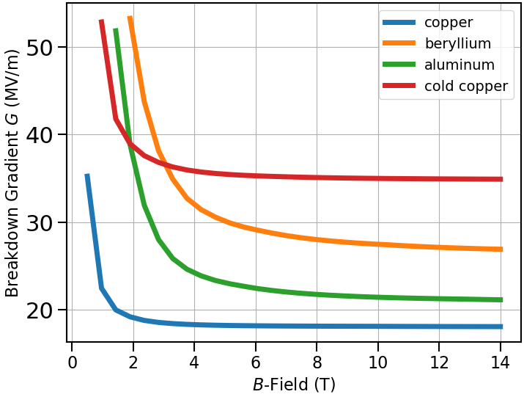
Cold Copper Temperature Dependent Breakdown Resilience
When considering thermal changes and the reduced current, cold copper has better resilience at higher magnetic fields
  Be and Al have higher temperature rise thresholds 🡪 when low power is deposited, they outperform
  At high magnetic fields, cold Cu’s reduced field emission and enhanced diffusivity provides resilience to temperature change, and thus BD

Slide 11
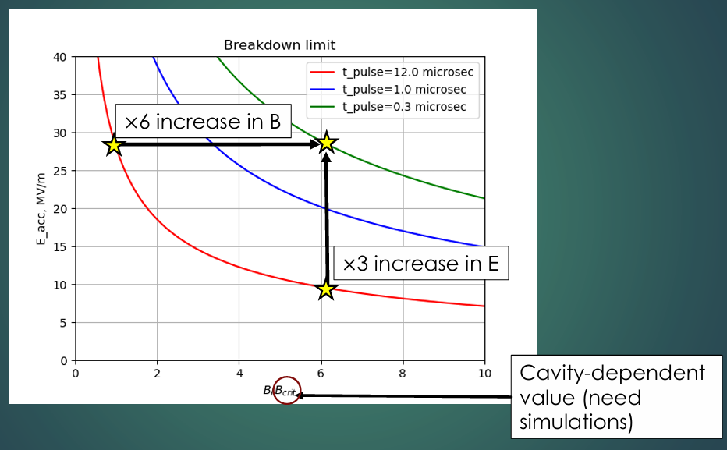
Previous Study Pulse Lengths Effects on Breakdown
Pulse length reduction shown to mitigate effects of breakdown
Temperature rise scales linearly without diffusion
Sergey Arsenyev 2021
https://indico.cern.ch/event/1034749/contributions/4345479/attachments/2243084/3803574/02%20-%20Overcoupled%20cavity%20v4.pdf

Slide 12
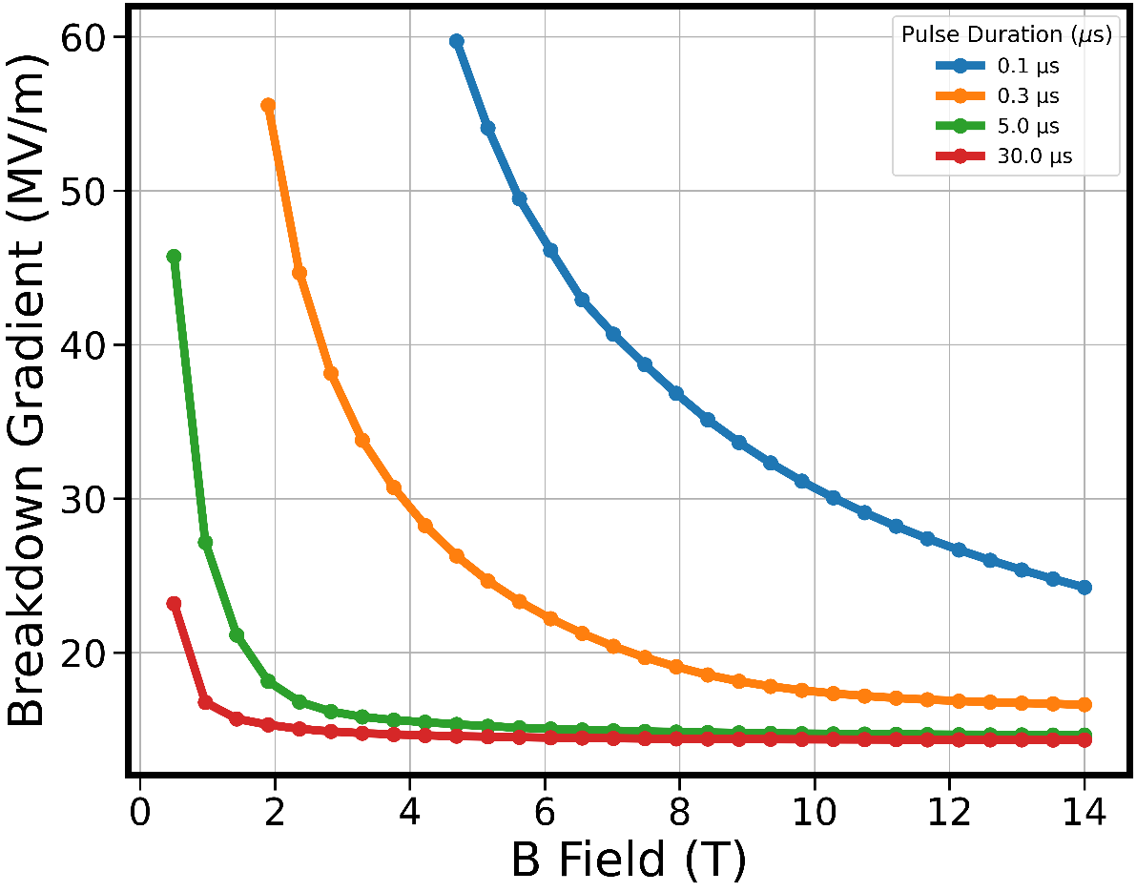
Pulse Length Effects of room temp copper
At large magnetic fields, the pulse lengths required to avoid diffusion are very small
To increase diffusion limits at large magnetic fields
  Use material with enhanced diffusivity
  Decrease pulse lengths at larger magnetic fields

Slide 13
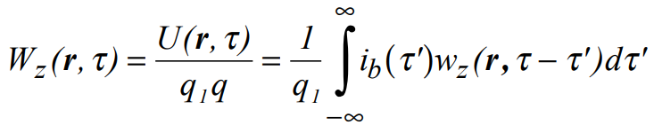
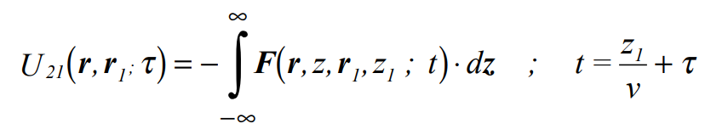
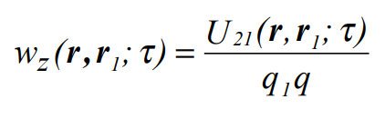
Beam Loading Overview
Wake function describes the energy loss per trailing charge per bunch charge
    Couples to high R/Q modes
    Combination of cavity modes and space charge effects
    Green’s function of wake potential for bunch distribution
  Decomposition of fields due to linear addition of particle and structure fields
    MuC particle beta ~ 0.9 🡪 space charge relevant
Single Particle
Particle Bunch
Wakefield Decomposition
https://arxiv.org/pdf/physics/0309023

Slide 14
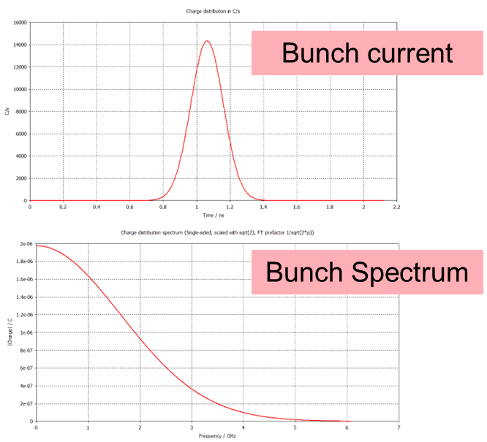
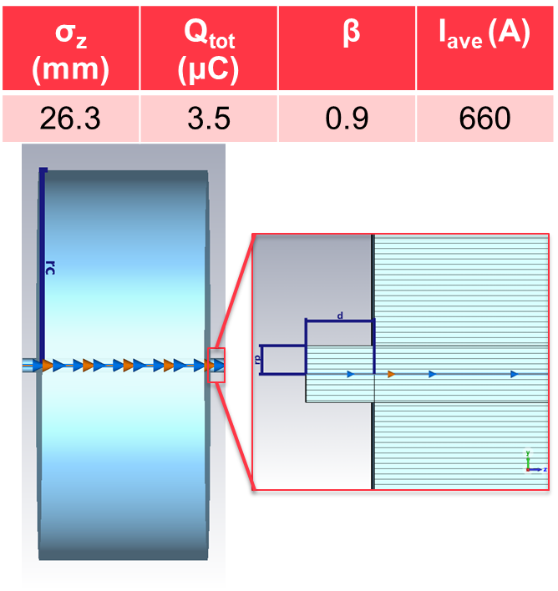
Wakefield Simulations in a Simple Pillbox with Beam Pipe
C/s
ns
C
GHz

Slide 15
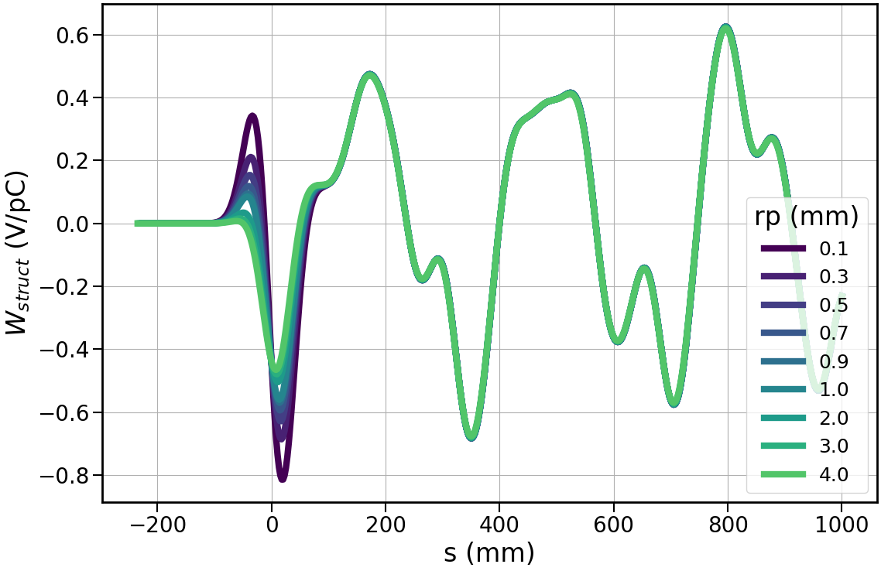
Wakefields in a Simple Pillbox with Beam Pipe
Pipe insertion does impact the resulting beam loading effects

Slide 16
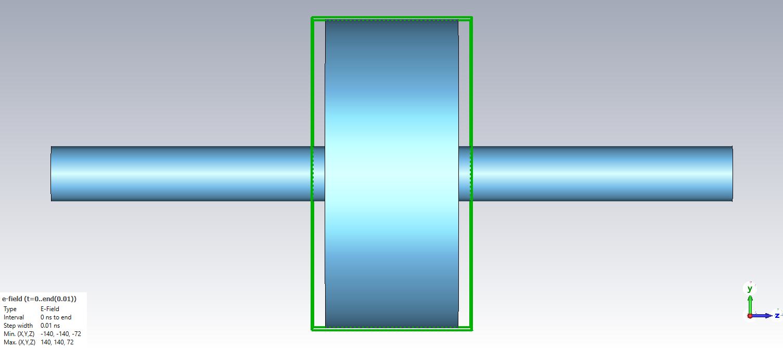
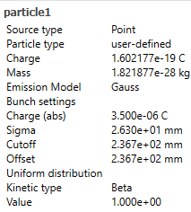
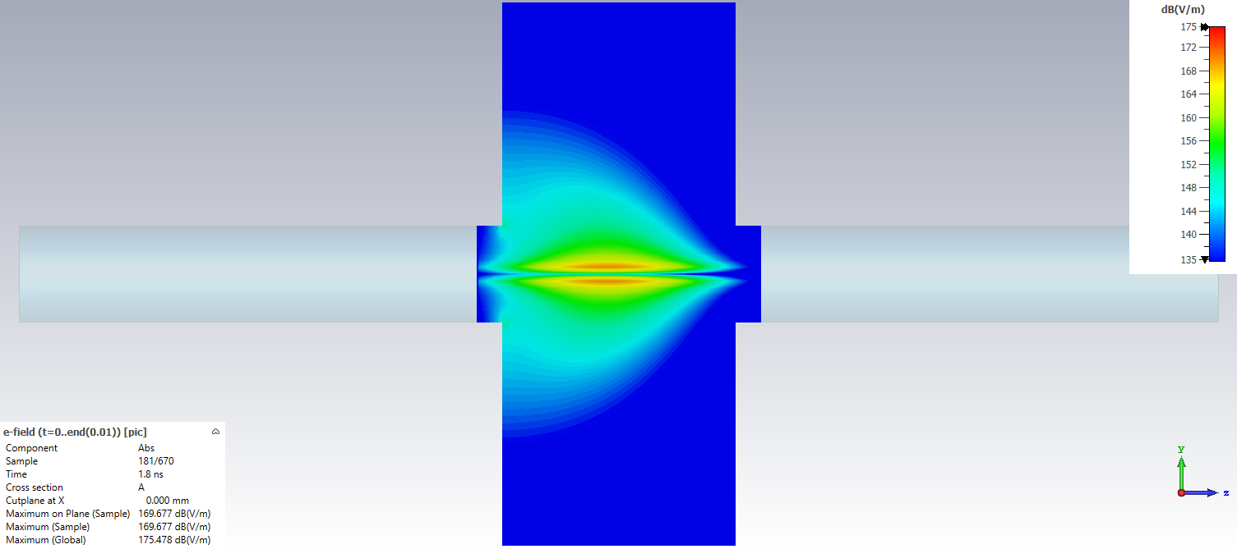
CST PIC Solver - Setup
Mimic bunch charge from wakefield solver
Extend pipe to remove edge effects, valid since wakefield solver uses open bounds
Resolve fields and export
Calculate wake potential in post processing w/ Python
PIC model
Beam center

Slide 17
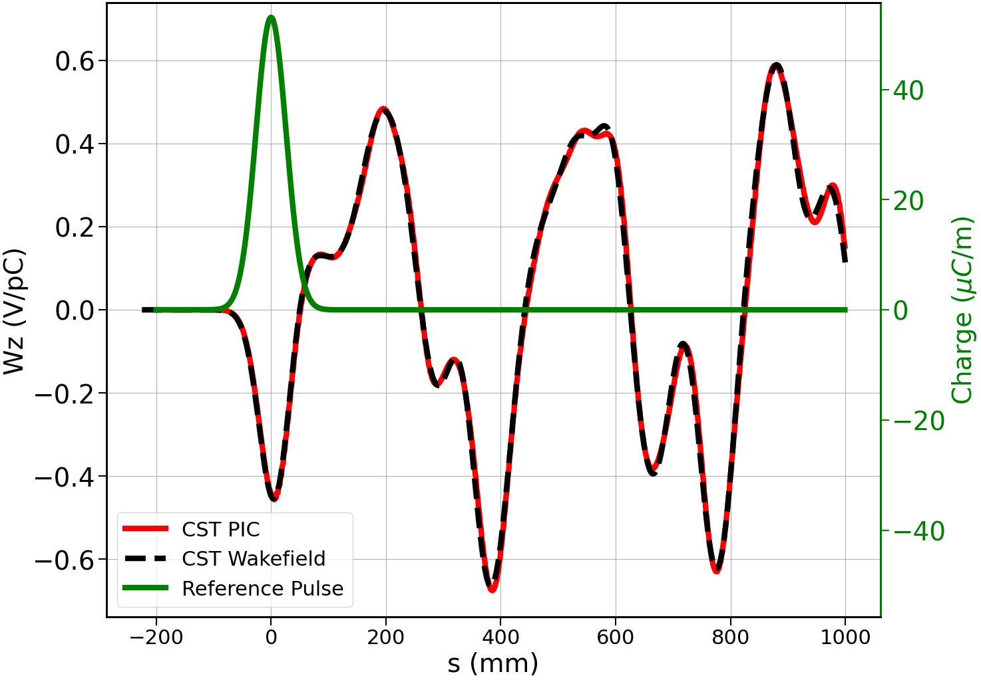
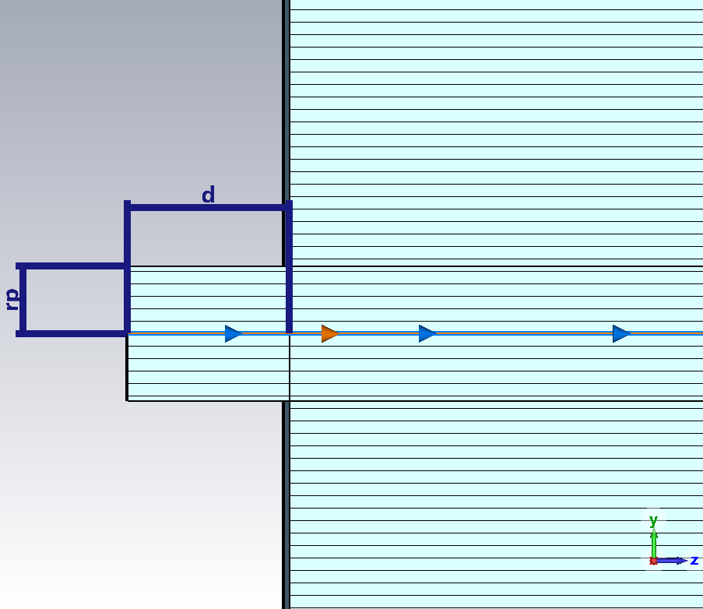
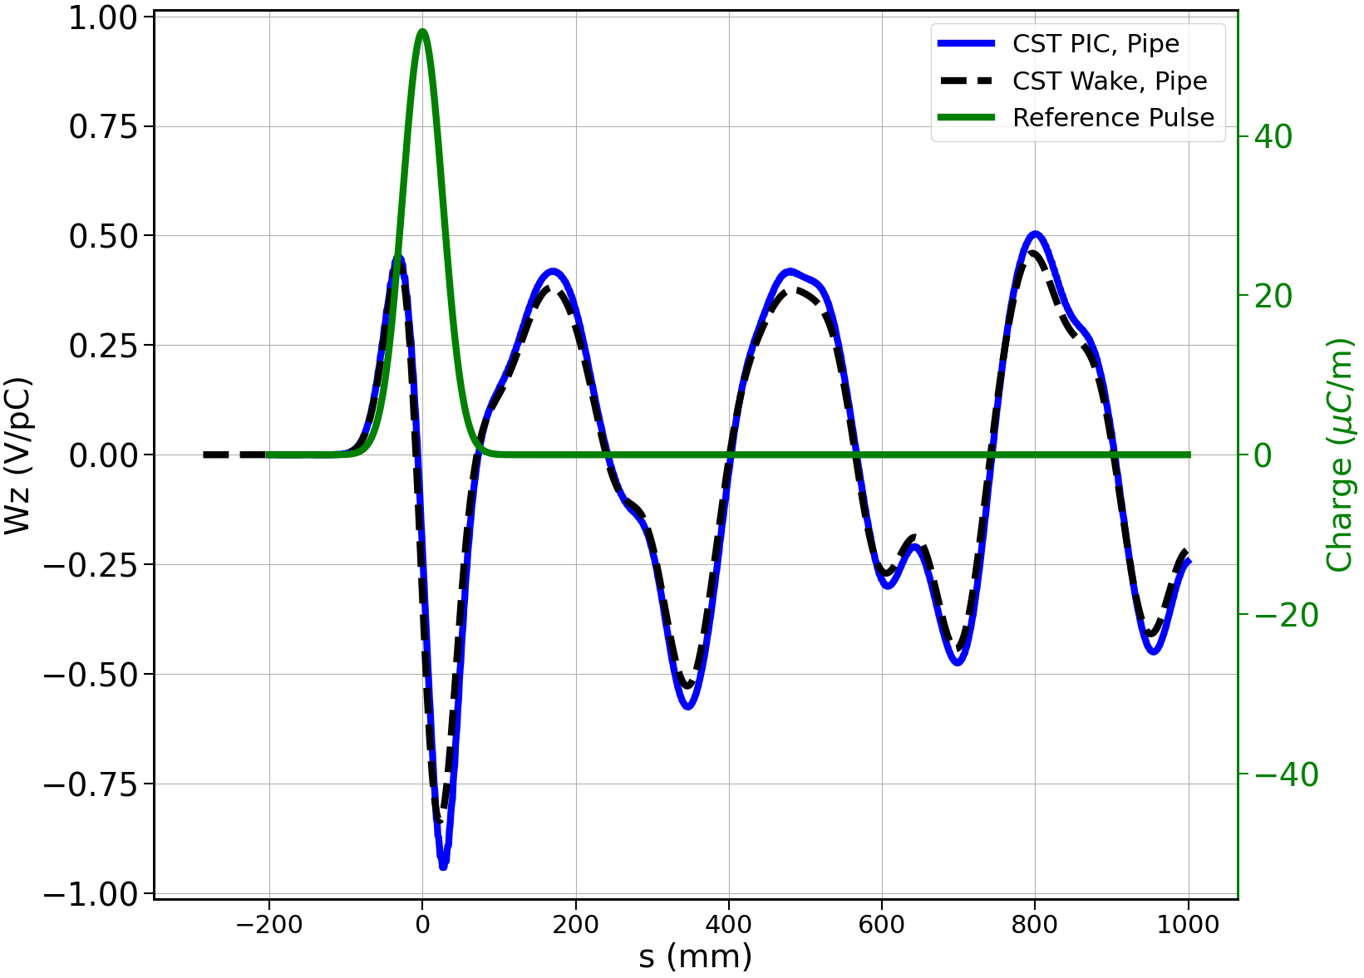
Wakefield Results Using CST PIC – Pillbox with a Pipe
Wakefield model
β=1
rp=25mm, d=12mm
β=0.9
Perfect agreement between postprocessing and Wakefield Solver

Slide 18
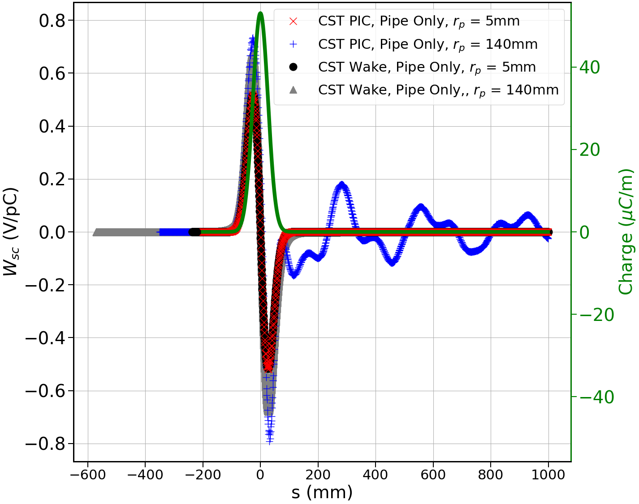
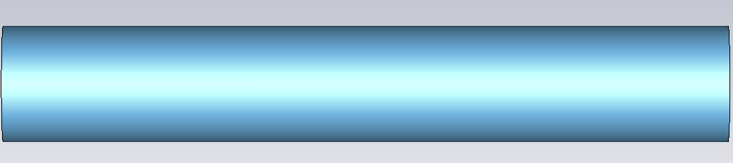
Space Charge Wake Reflections
At larger radii, the space charge wakes from a smooth pipe are reflected at the open boundaries

Slide 19
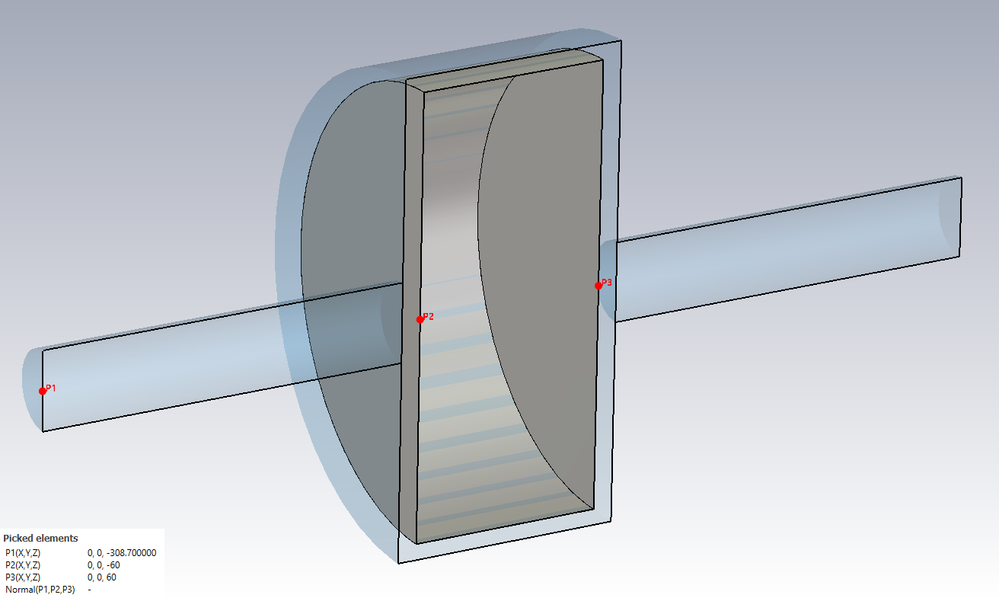
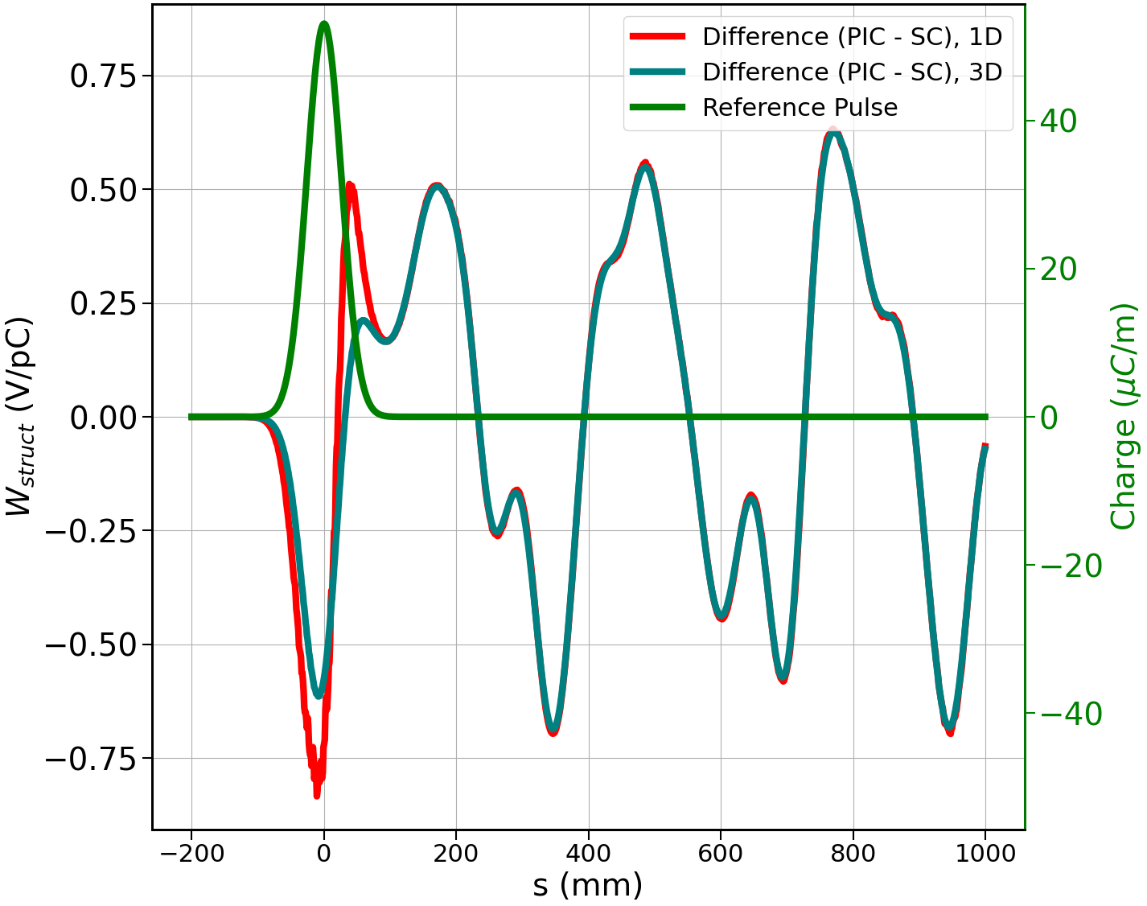
PIC Results of An Enclosed Pillbox
3-segmented PIC setup
Wakefield Results

Slide 20
Conclusions
Scattering Studies
  Assessed emittance dilution for Al and Be
  Al needs to be ~1/4 the thickness of Be to achieve same emittance values
Breakdown Studies
  Cold copper shows strong breakdown resilience due to its enhanced diffusivity
  Pulse length reduction can improve breakdown resilience within diffusion limits
Wakefields studies
  CST Wakefield solver is not sufficient to study beam loading for enclosed cavities 🡪 beam pipe is required
  CST PIC solver with post processing can resolve wakefields for specific cases but there are instabilities with boundaries
    Anticipated wakes on the order of MV/m, comparable to beam gradients

Slide 21
Future Plans
Simulate vacuum vessel changes for Wakefield studies
Assess copper alloys (e.g. CuAg) to mitigate breakdown
Test true RF pulse envelopes (rise, flattop, and decay)

Slide 22
Acknowledgements
Dr. Omkar Ramachandran (NIU) for discussions regarding code developments
Dr. Carmelo Barbagallo (CERN) for helpful discussions and collaborative insights on wakefield studies
IMCC-RF working group
Funded by the DoE SCGSR program contract number DE‐SC0014664, DoE Contract No. DE-AC02-05CH11231,and DoE Awards DE-SC0021928 and DE-SC0022010.

Slide 23
Thank You!
Questions or comments?

Slide 24
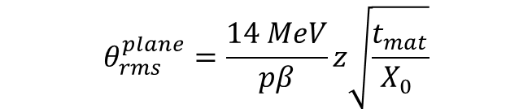
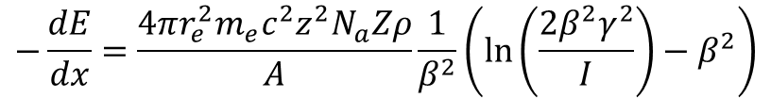
Material Dependence of Scattering in Thin Windows
Charged particles incident upon a material interact with the atoms inside of the material 🡪 transverse spreading and energy loss
Parameters relevant for this study are material and particle energy dependent
  Material density
  Atomic mass and mass numbers
  Particle energy
Plane rms scattering angle
Bethe-Bloche energy loss due to scattering

Slide 25
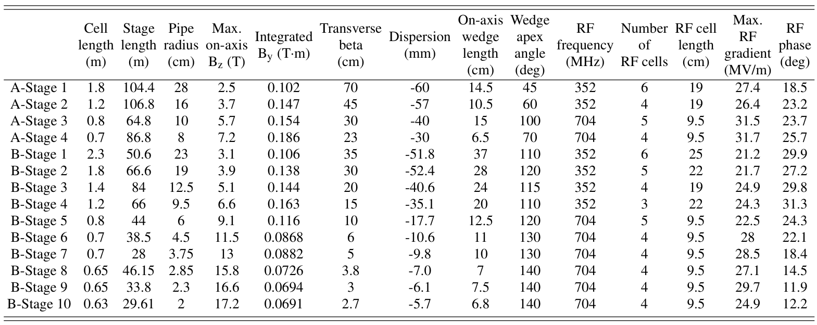
Backup: MuC Stages
https://arxiv.org/pdf/2409.02613v1

Slide 26
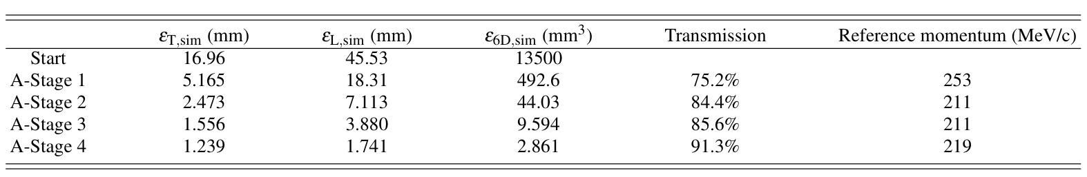
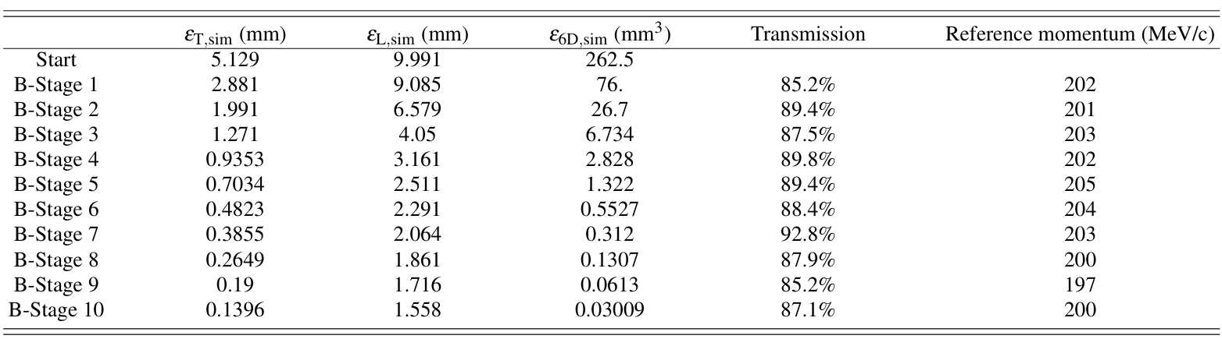
Parameters for Muon Collider Stages
Stages considered: A1, B1, and B10
Average particle losses for all stages ~ 17+-3

Slide 27
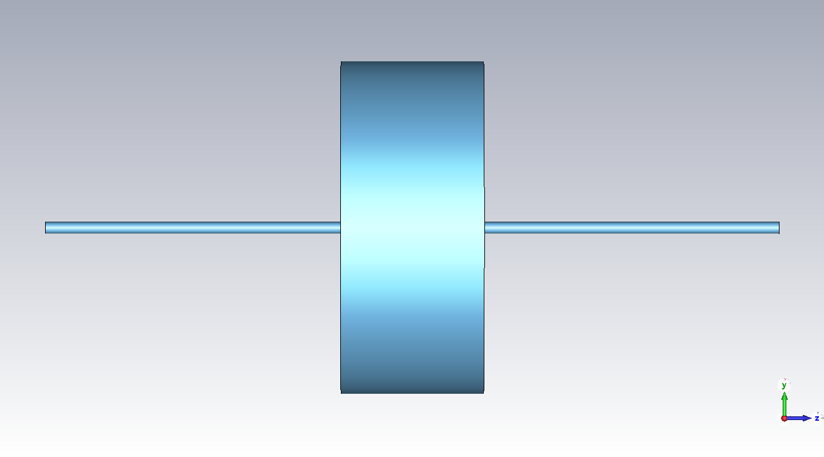
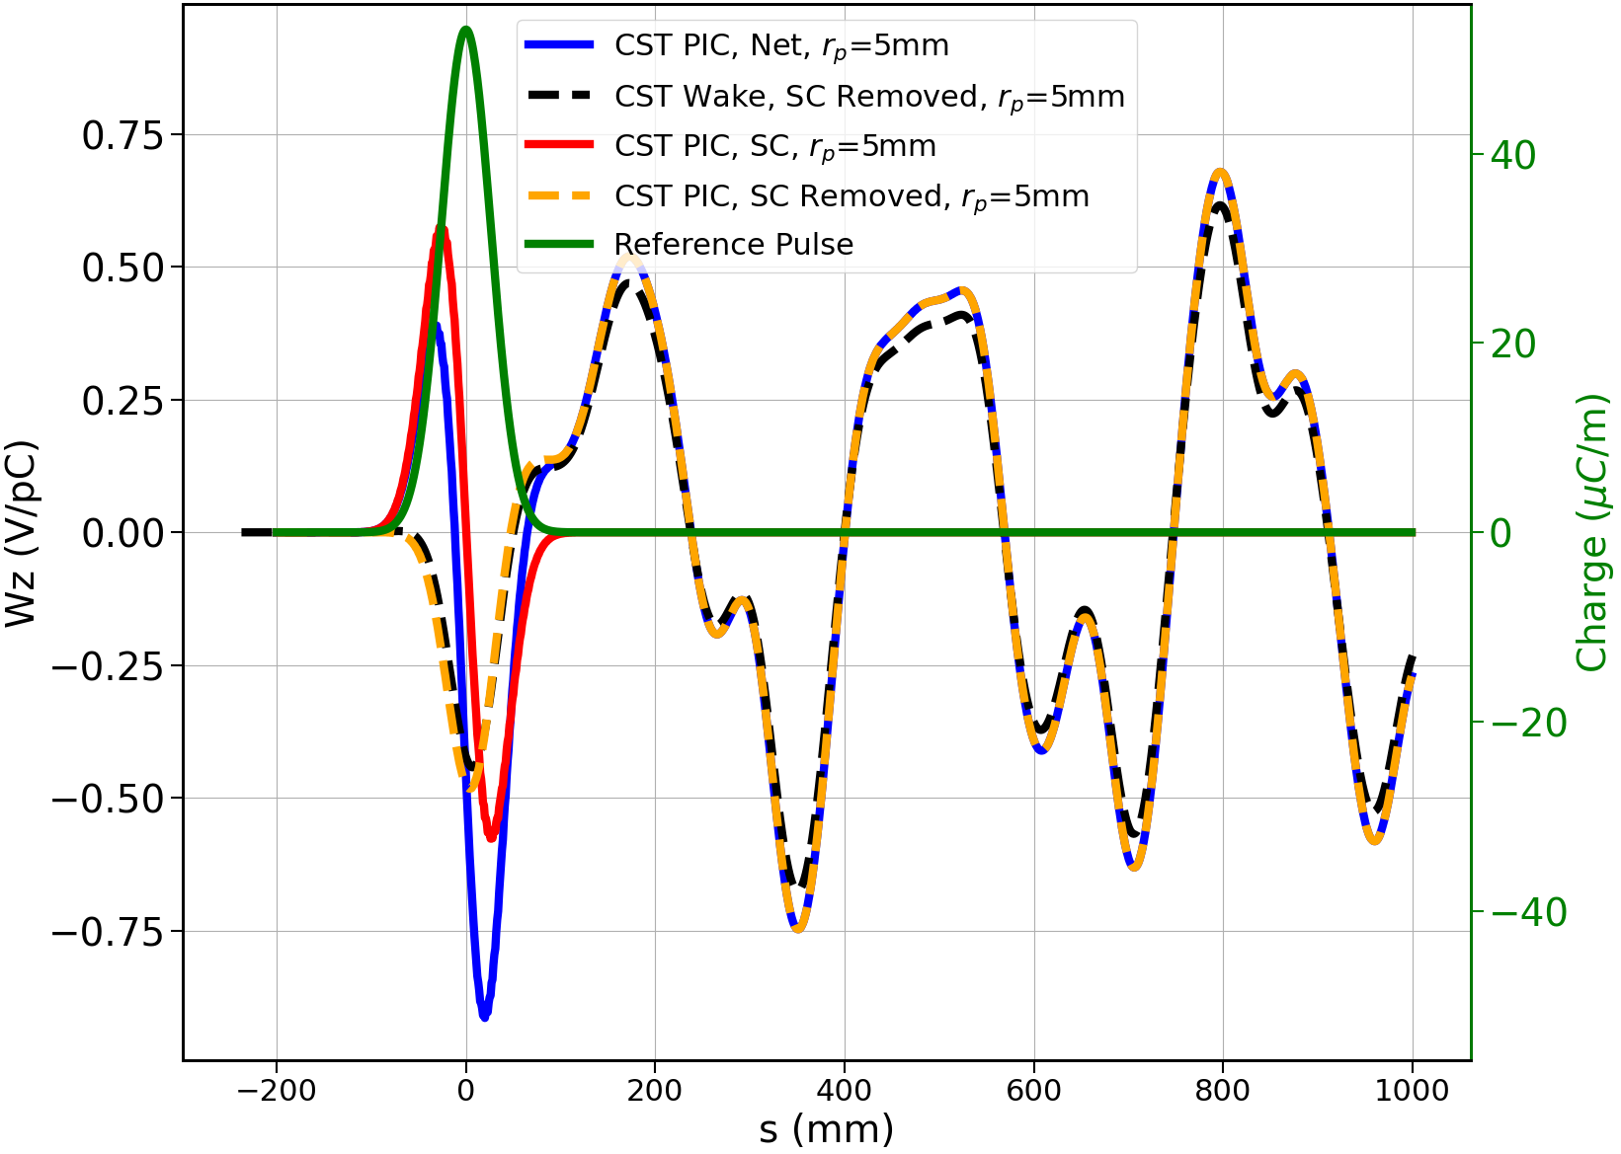
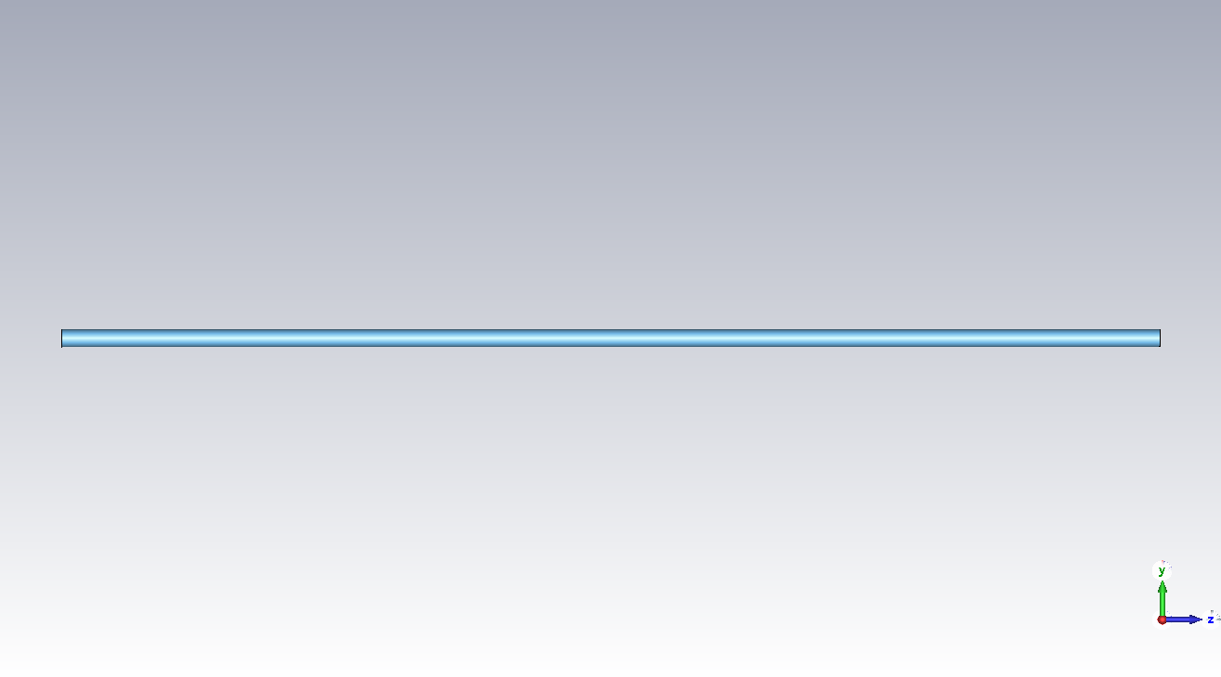
1D Bunch Wake Validation, radius = 5 mm

Slide 28



1D Bunch Wake Validation, radius = 25 mm

Slide 29



1D Bunch Wake Validation, radius = 50 mm

Slide 30



1D Bunch Wake Validation, radius = 120 mm

Slide 31






Muon Collider Stages Comparison to Theory
Strong agreement with theory 🡪 discrepancy from averaging over all energies and statistical variation
In all cases, from a pure scattering angle perspective, Al windows need to be about 1/4 to that of the Be

Slide 32






Backup: BD in a Field
FN Current density
Heat/unit area
Final radius
Heat conduction
Temperature Rise
Temperature threshold
Effects of external magnetic fields on the operation of high-gradient accelerating structures - ScienceDirect

Slide 33



Previous Studies Ignore Temperature Dependent Properties
Yield strength changes negligible
Therm. exp. and Cp changes cancel
https://indico.cern.ch/event/1043014/contributions/4382434/attachments/2255971/3827989/Scalings_with_T_and_f.pdf

Slide 34

Previous Studies Considered Reduced Current at low T
Field enhancement correlates to factor ~100 current reduction at 77k
https://indico.cern.ch/event/1043014/contributions/4382434/attachments/2255971/3827989/Scalings_with_T_and_f.pdf

Slide 35

Cold Copper Superior Breakdown Resilience w/o B-field
Cold copper shows higher breakdown resilience in recent SLAC experiments at X-band
High gradient experiments with -band cryogenic copper accelerating cavities | Phys. Rev. Accel. Beams

Slide 36





Backup: Breakdown Threshold
System is constrained to strain values are 0
Solving for an individual sigma yields

Slide 37

Breakdown in a B-Field
Here we investigate the effects of both thermal and reduced current changes for cold Cu
We also look into higher magnetic fields

Slide 38




BackUp: Cold Cu Temps

Slide 39


BackUp: Temps

Slide 40

BackUp: All SOG

Slide 41



Diffusion Limit of Solution
At early time steps, the heat from early sources has not spread (r, z = 0)
  Linear growth region

Slide 42




Decay of Temperature after pulse length

