Slide 1
Multi-physics Approach in the Design and Optimization of
Muon Cooling Cavity
Zenghai Li, SLAC
2nd Annual US Muon Collider Collaboration Meeting, August 7-8, 2025
University of Chicago, Illinois

Slide 2
Outline
SLAC’s past involvement in the muon collider program
ACE3P multiphysics modeling suite
805-MHz cavity design improvement using ACE3P
805 MHz modular cavity design and Multiphysics analysis
ACE3P newly added modeling capabilities
Outlook

Slide 3
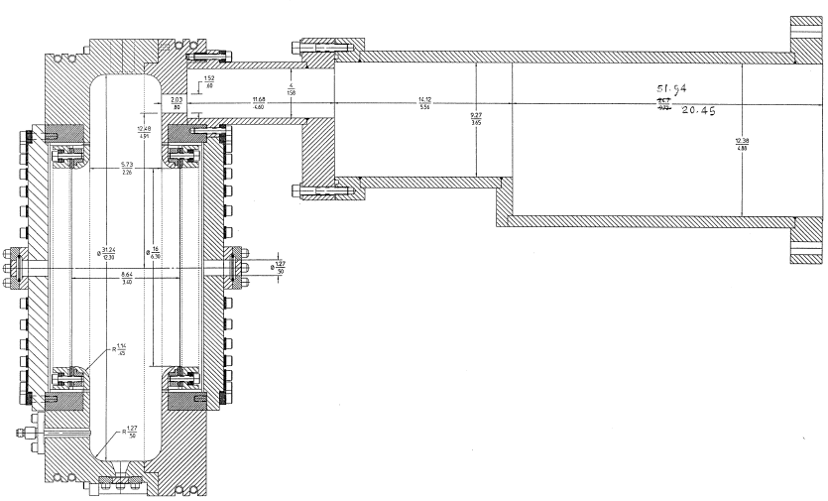
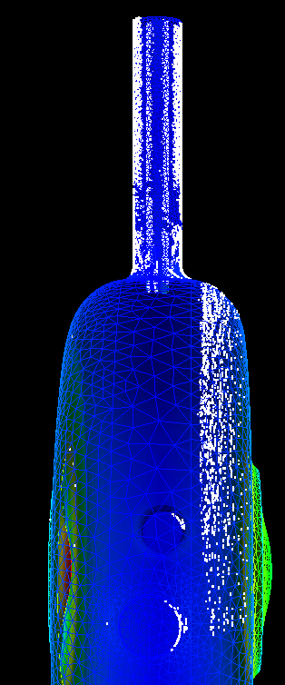
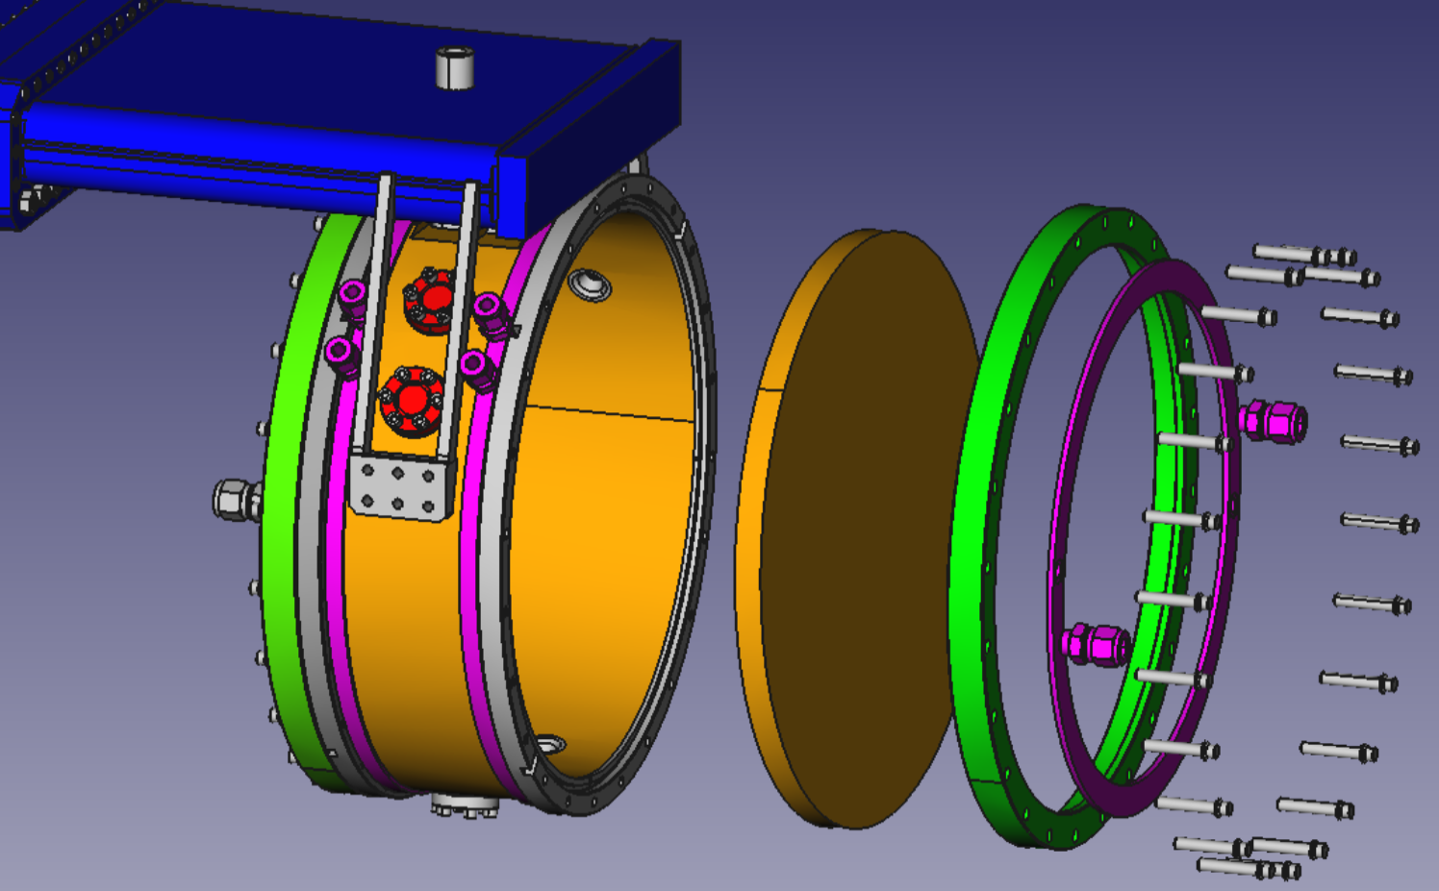
SLAC’s Past Involvement in MAP
Cavity operates under strong magnetic fields
Issues
Significant surface damage due to field emission and multipacting currents
Approach
Analyze field emission and MP
RF design mitigation
Tools - ACE3P
Omega3P
S3P
Track3P
805 Pillbox cavity
201 MHz cavity
805 MHz modular cavity

Slide 4
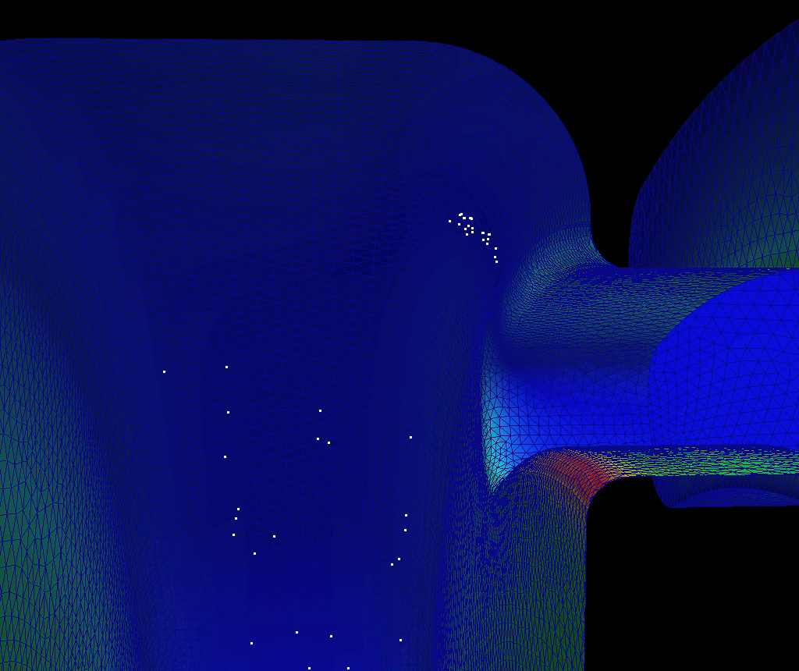
Electron Trajectories Under Strong External Magnetic Field
Electron trajectories follow external magnetic field

Slide 5
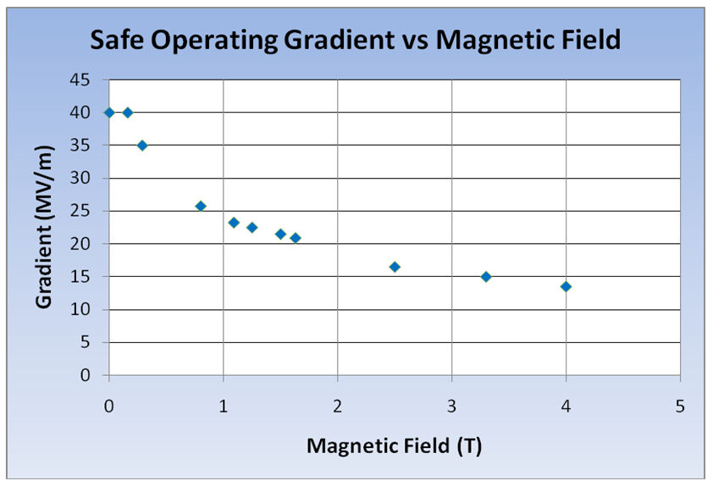
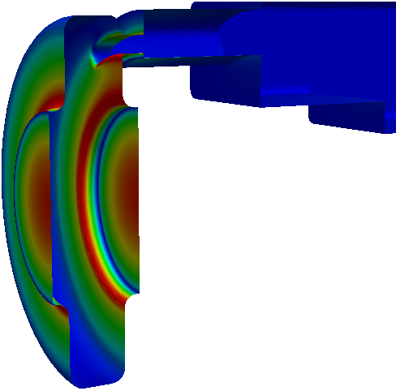
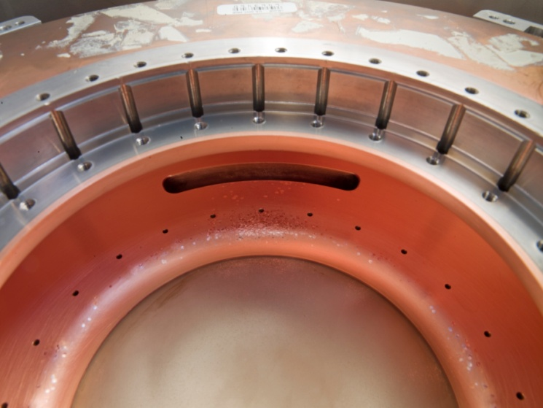
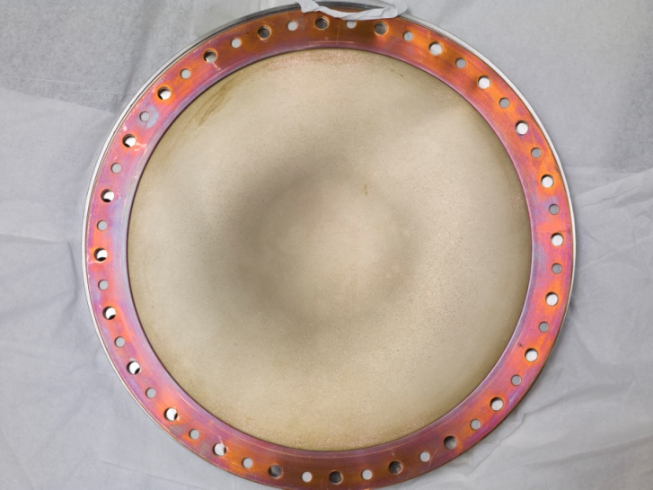
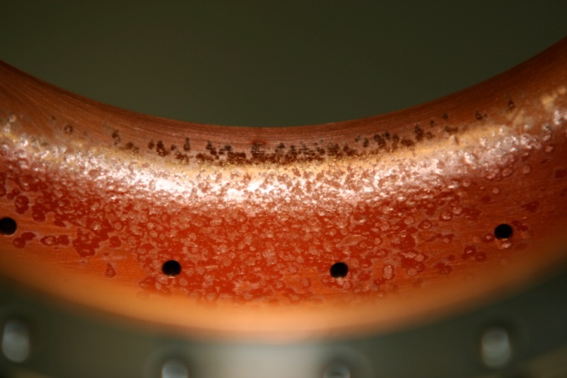
RF Challenge – 805 MHz cavity
Significant degradation in maximum stable operating gradient with applied B field
E field
805 Pillbox Post-Mortem
Significant damage observed
  Iris
  RF coupler
However
  No damage to Be window

Slide 6
Motivation and Approach
  to better understand potential impacts of surface fields on performance under a strong external magnetic field
  massively parallel computing using finite element ACE3P tools on NERSC supercomputers

Slide 7
ACE3P Modules and Multiphysics Modeling Capabilities
Omega3P (Frequency domain)
Track3P (Particle tracking)
T3P/Pic3P (Time domain)
  Real eigenmodes in lossless or periodic cavities
  Complex eigenmodes in lossy or externally loaded cavities
  Mode damping in dielectric and ferrite materials
  Linear, quadratic and nonlinear eigensolvers
  Periodic, absorbing and PML boundary condition
  Particle tracking code in external rf and static fields
  Multipacting and dark current in rf cavities and components
  Surface physics for field and secondary emissions
  Enhancement counter for multipacting
  Transient and wakefield from source excitation
  Moving window technique for broadband pulse and short beam propagation
  Absorbing and PML boundary conditions for far fields
  Impedance boundary condition for thin coating and lossy conductor walls
  Nonlinear materials
  Self consistent particle-in-cell (PIC)
  User-specified particle emission model
S3P (Frequency domain)
TEM3P (Thermal & Mechanical)
Gun3P (Static PIC)
  S-parameters of rf components and open structures
  Dipole excitation
  Dielectric and ferrite materials
  Effects due to surface impedance on conductor walls
  Absorbing and PML boundary condition
  Boundary condition for thin coating layer
  Integrated EM, thermal and mechanical effects
  Nonlinear thermal and electrical conductivities
  Convective boundary conditions
  Shell elements for surface coating
  Mechanical eigen and harmonic solvers
  Transient analysis
  DC gun modeling at steady state
  Space-charge limited emission
  Electrostatic solver
  Magnetostatic solver
  Particle tracking in external and self static fields
Recent developments

Slide 8


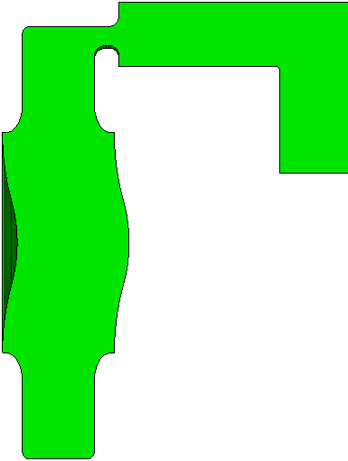
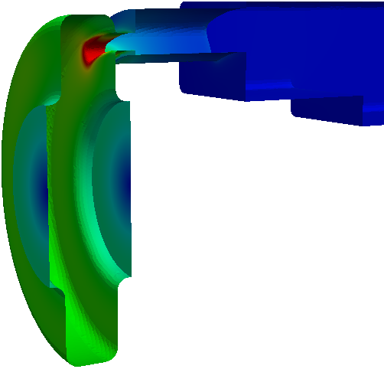
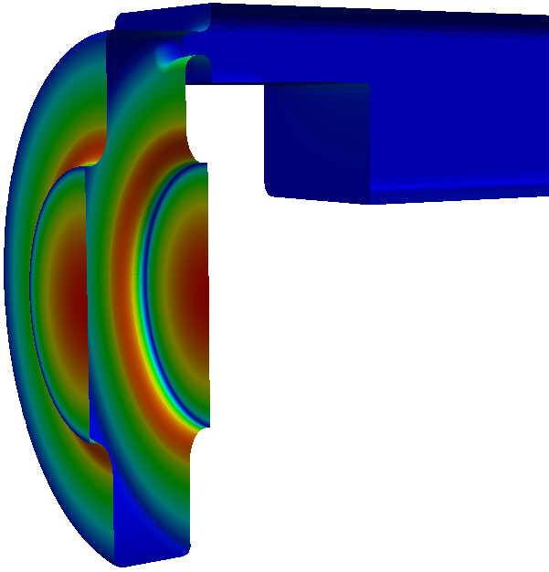
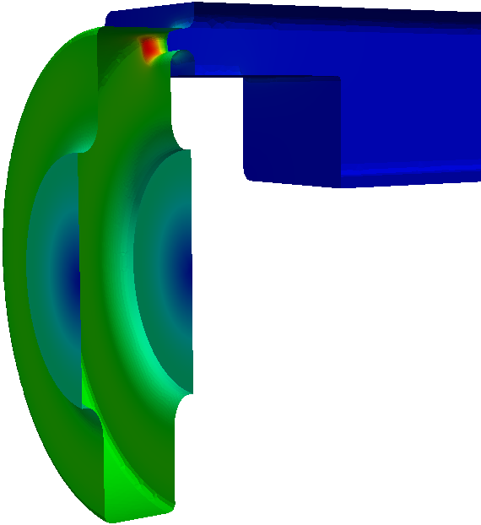
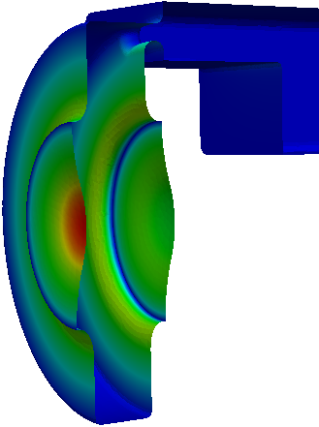
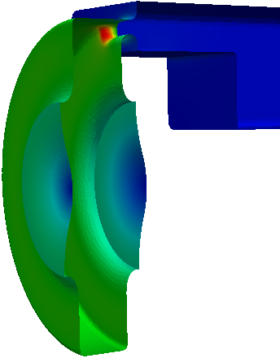
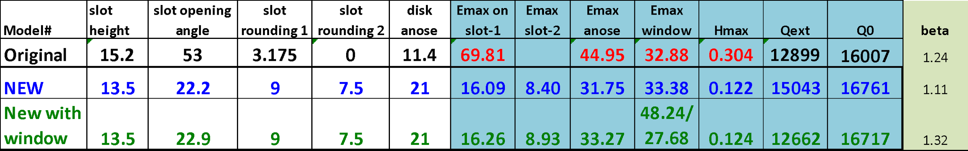
805 MHz Cavity Design Improvement – Omega3P
Slot 1
slot 2
anose
end bp
Original
New low field design
New with window
E
B
E
B
E
B
Low Surface Field

Slide 9
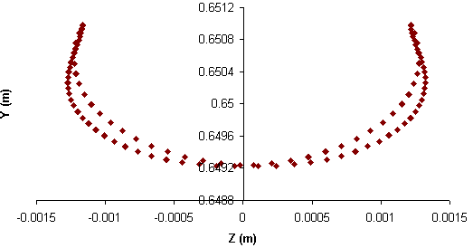
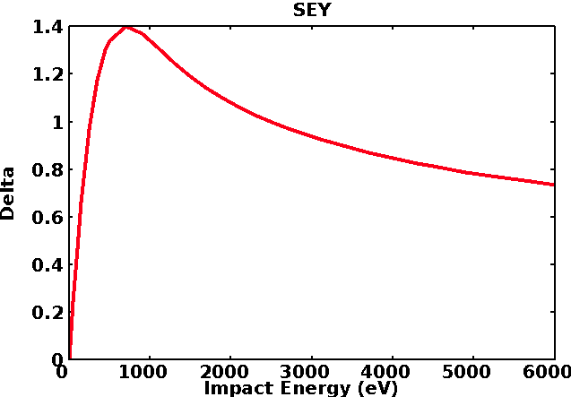
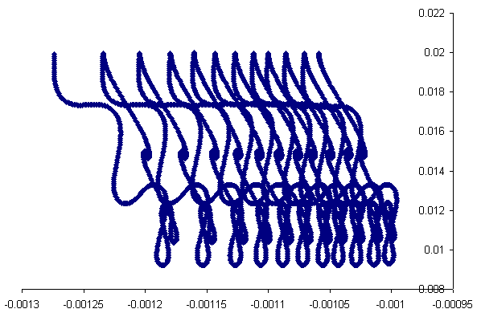
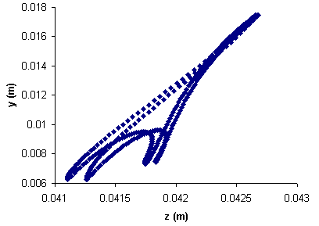
Multipacting and Field Emission Simulation - Track3P
3D parallel high-order finite-element particle tracking code for dark current and multipacting simulations
MP simulation process
Electrons are launched from specific surfaces over a full RF period.
Track electrons for a specified number of RF cycles
Identify resonant trajectories, determine the multipacting order (#cycles/impact) and type (#impact positions/MP cycle)
Calculate enhancement counter or using SEY curve to determine MP strength
Sample MP trajectories in various RF components
TTF-III coupler between window and inner conductor
Copper SEY curve
Coax line with partial standing wave
Equator of elliptical cavity

Slide 10
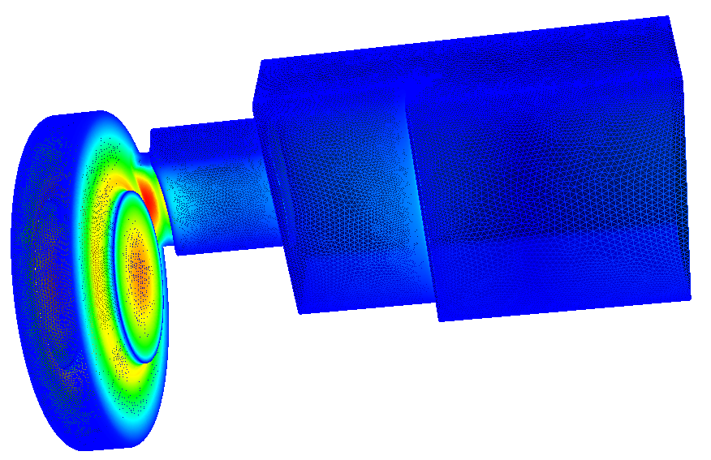
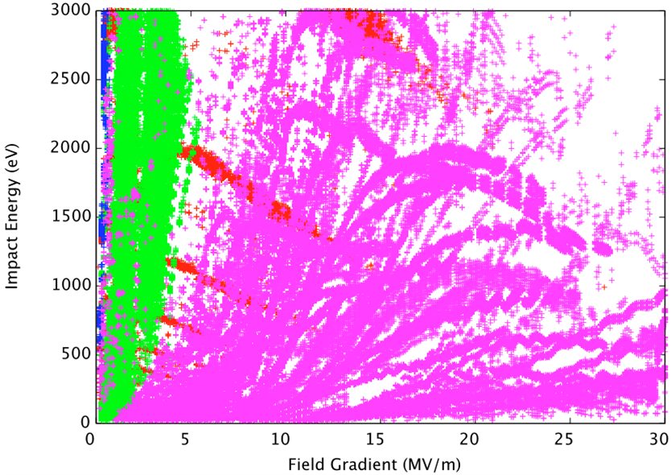
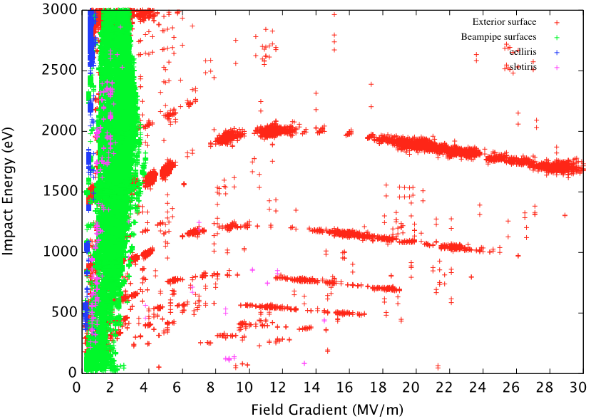
Multipacting Analysis with External Magnetic Field – Track3P
850 MHz pillbox cavity
Field level scan: 0.1MV/m – 30MV/m, interval 0.1MV/m
Initial Particles distributed on all exterior surface
Each field level ran 50 RF cycles
3 Tesla
Original Design
New Design
Window
Disk rounding
Coupling iris
Other

Slide 11
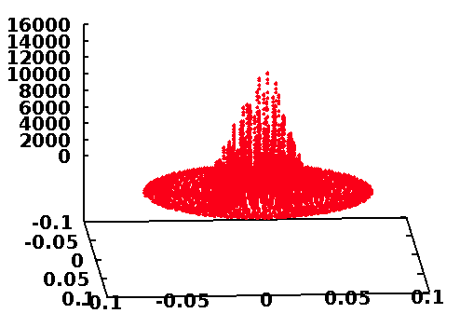
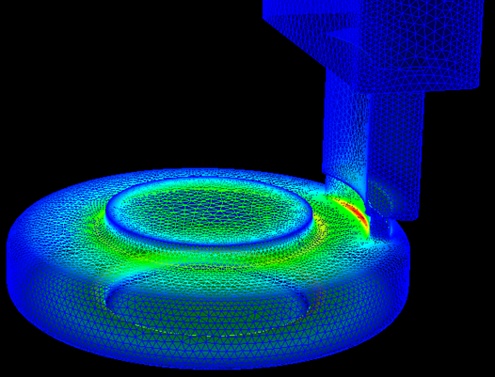
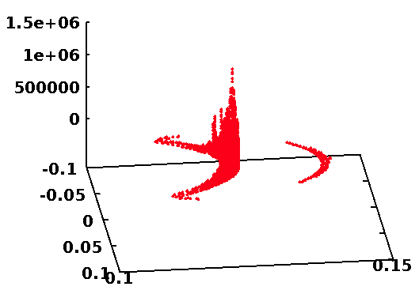
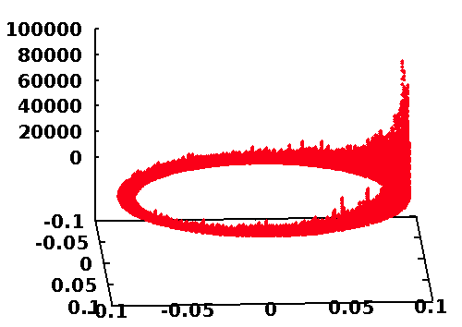
Field Emission Dark Current Analysis – Track3P
Window
Coupling iris
Disk rounding
Field emission current corresponding to surface E field

Slide 12
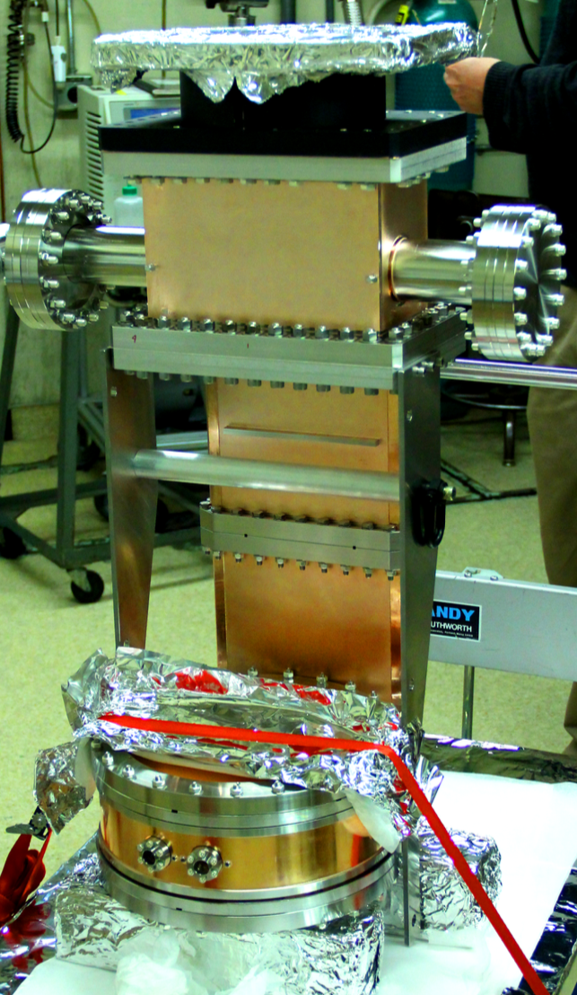
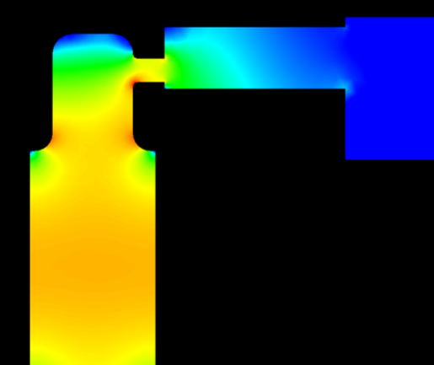
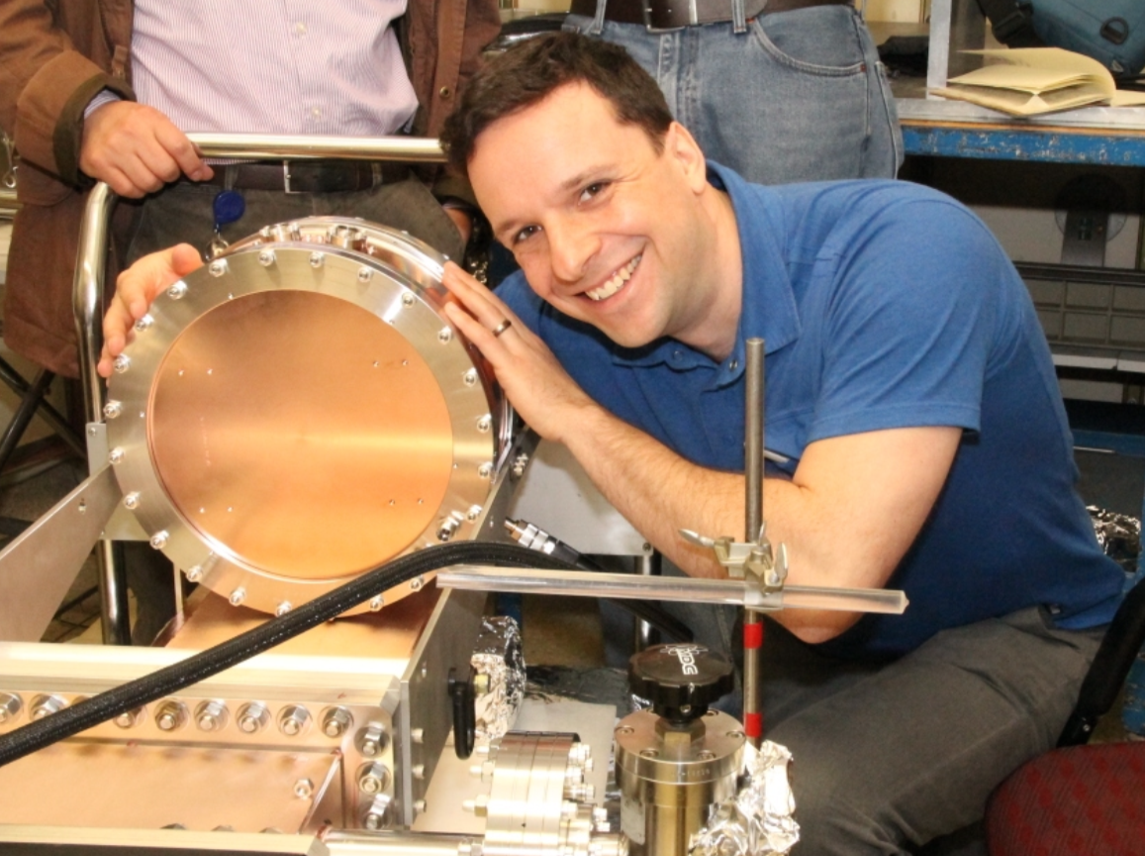
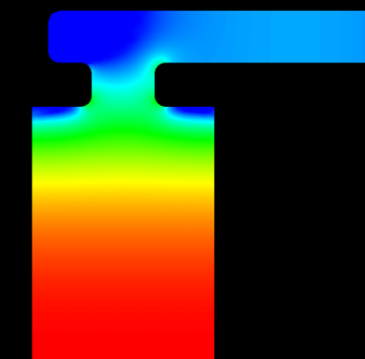
Modular Cavity
Modular Cavity (2013)
Pillbox Cavity
[Daniel Bowring]
Modular
Cavity

Slide 13
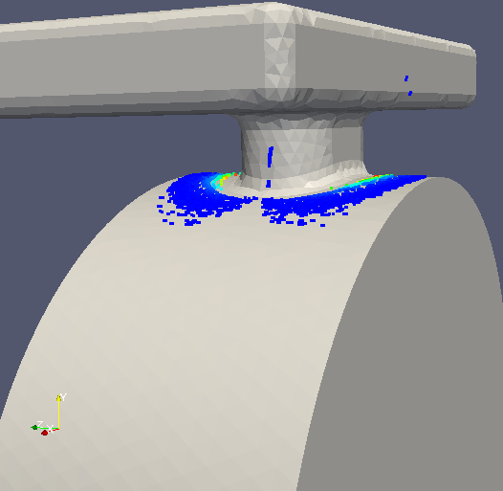
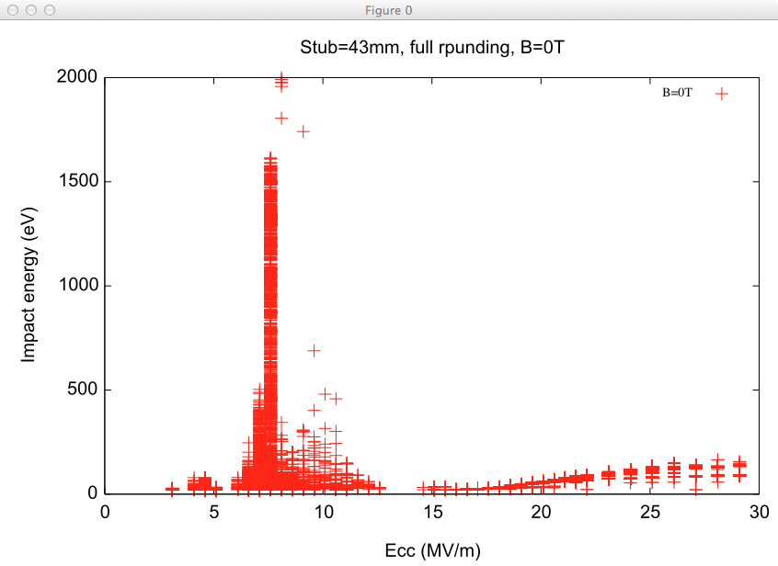
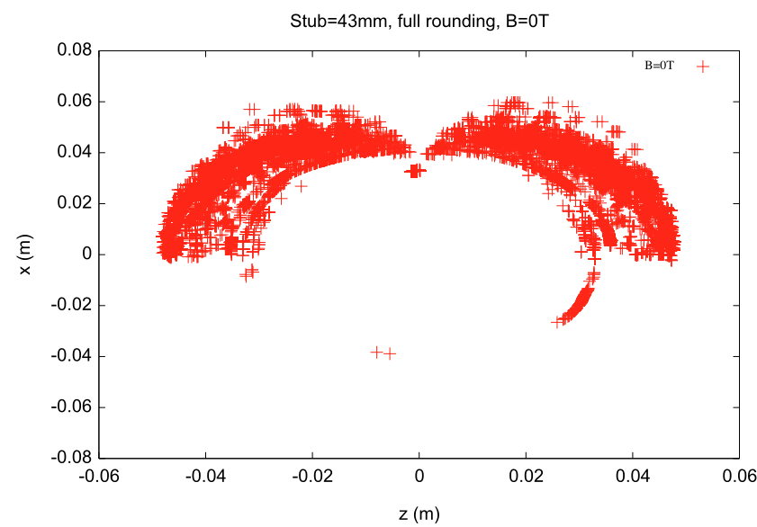
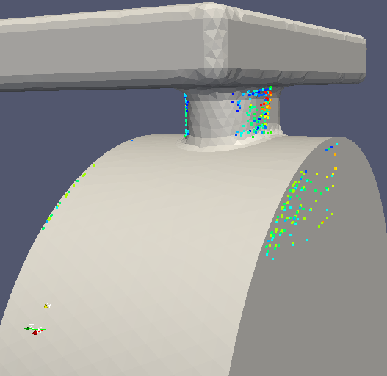
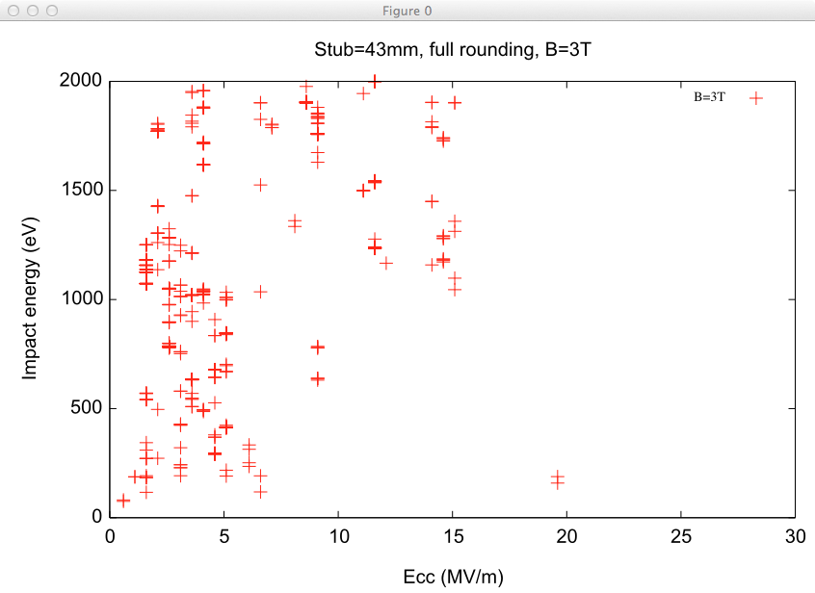
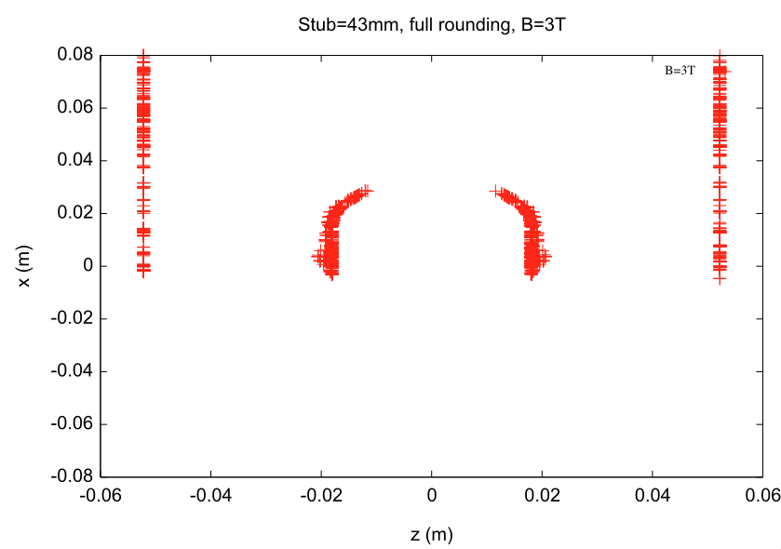
Modular Cavity Design and MP Mitigation – Omega3P/S3P/Track3P
Coating Area
B=0T
cavity outer wall
coupler neck
B=3T

Slide 14
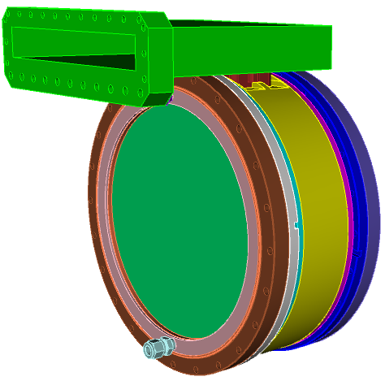
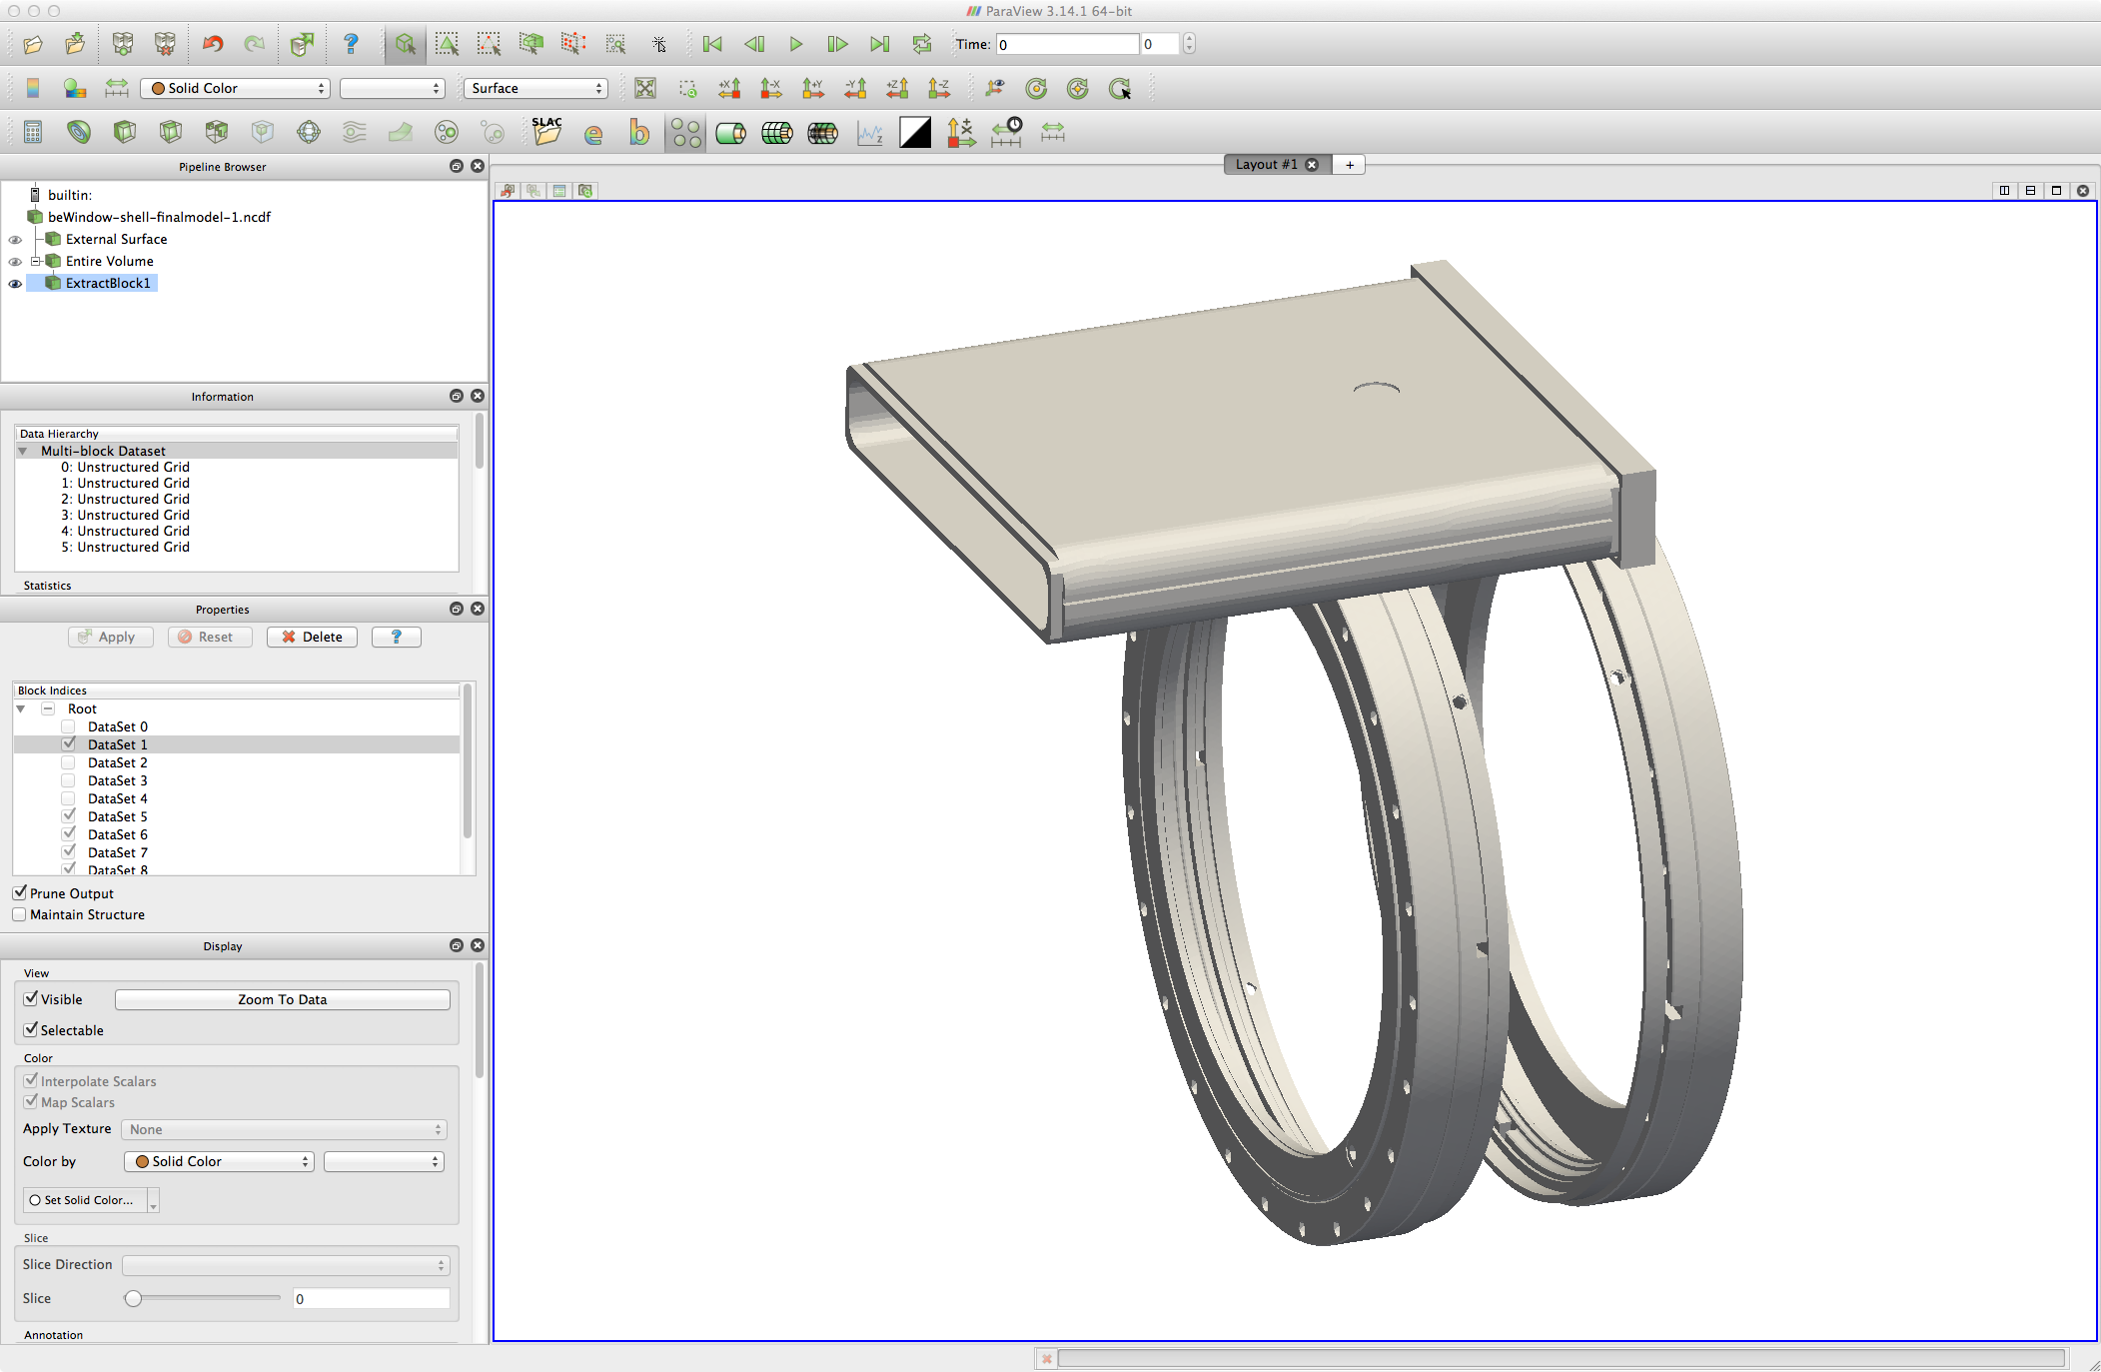
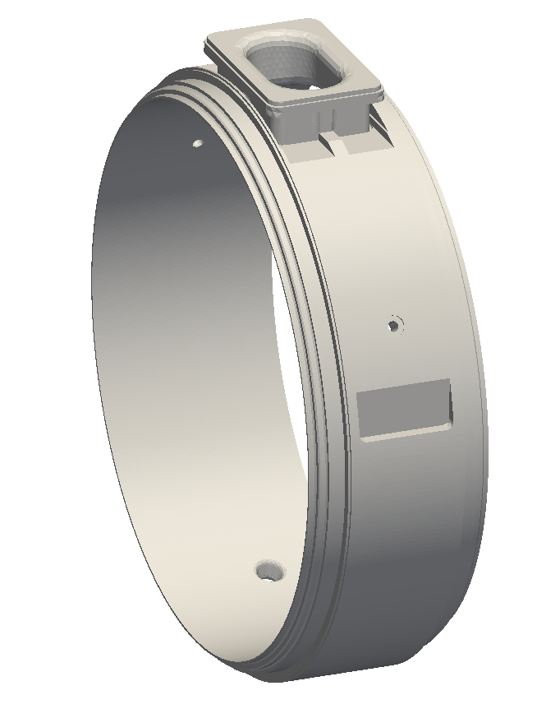
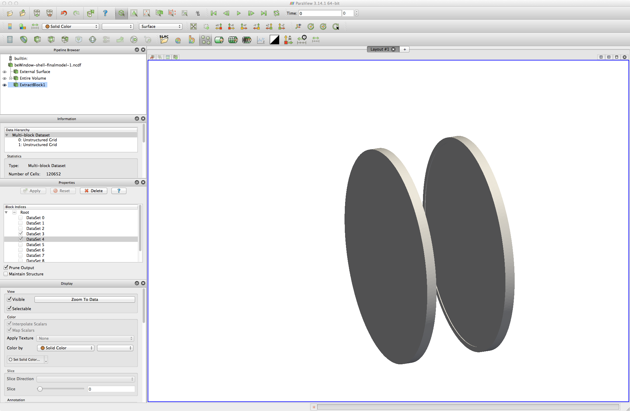
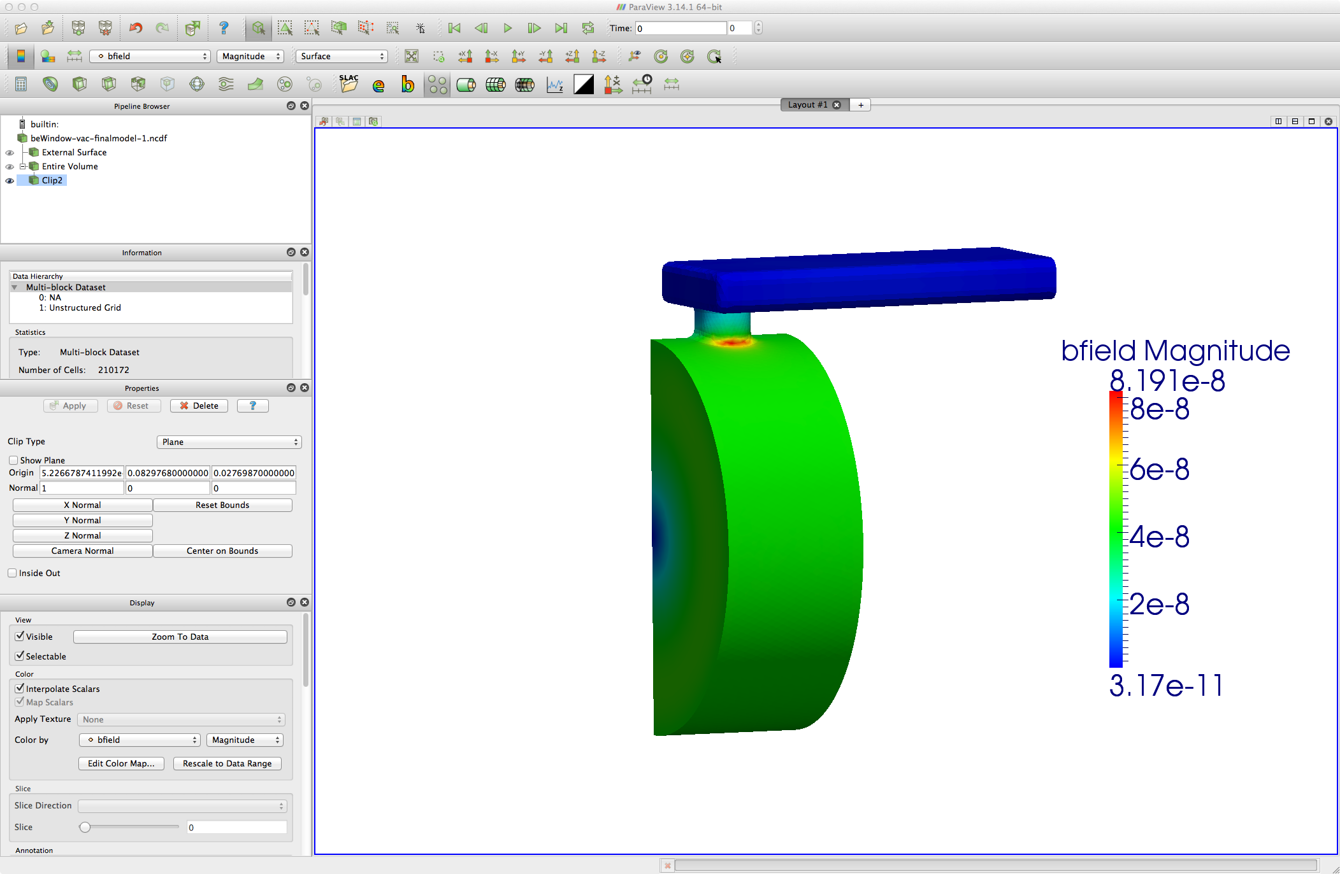
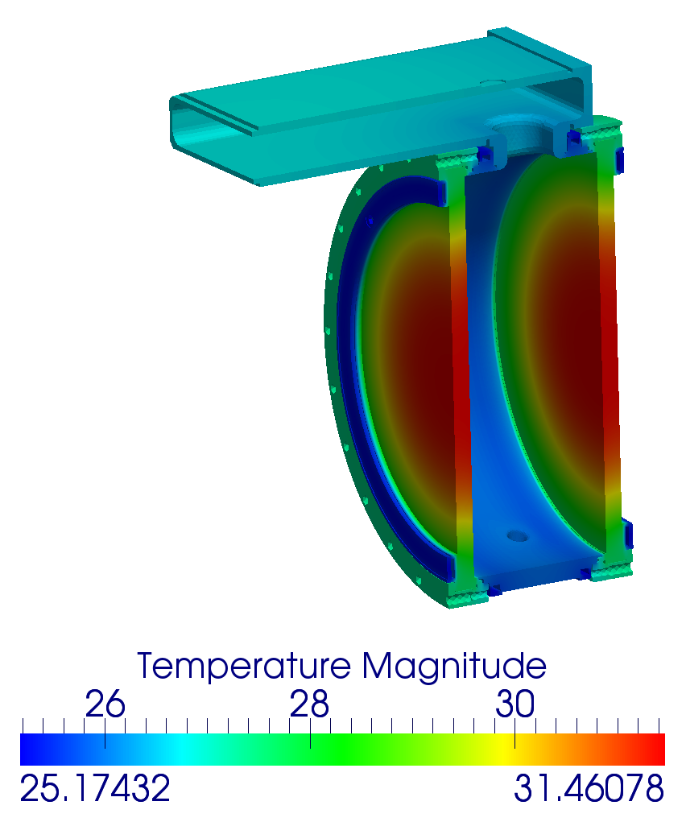
Modular Cavity Thermal & Stress Analysis – TEM3P
Stainless steel with copper coating inside
Stainless Steel
Copper ring
Beryllium wall
 | E_{max} | σ for Beryllium | Duty Factor | Cooling channel Temperature | ΔT on Be Window
Case 1 | 25 MV/m | 2.33e7 S/m | 0.001 | 25 °C | ~4 °C
B Field
(RF heating only, beam heating not included)

Slide 15
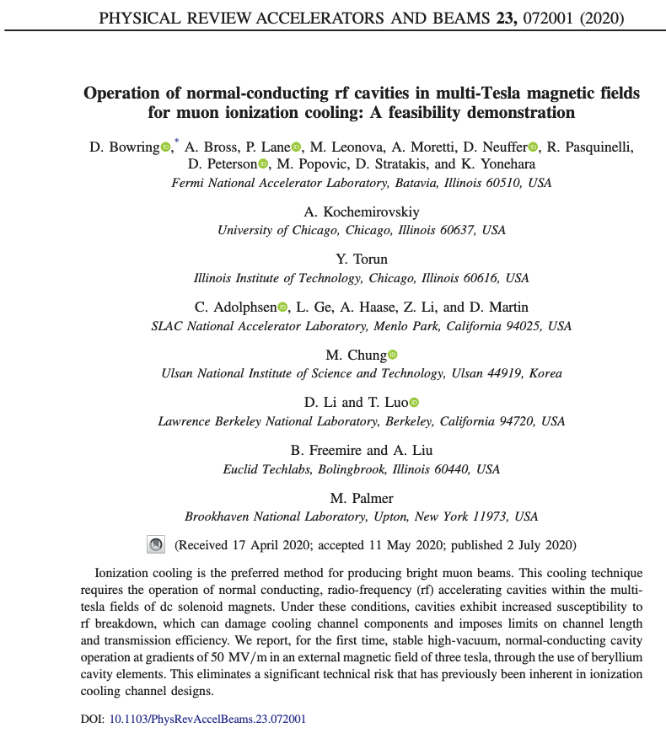
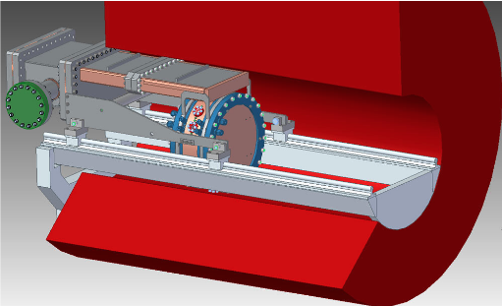
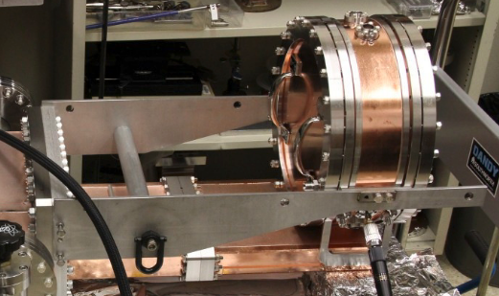
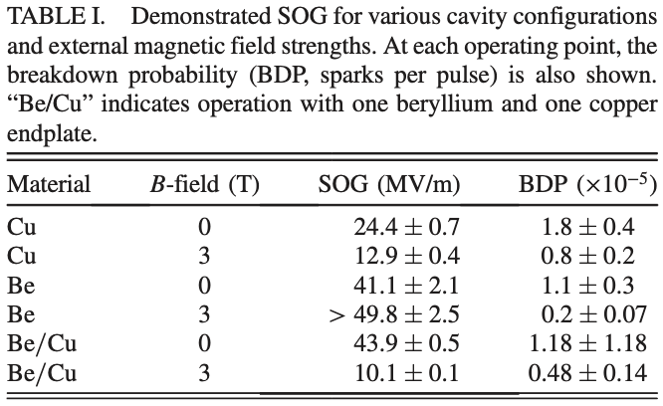
Modular Cavity High Power Test (Daniel Bowring)

Slide 16
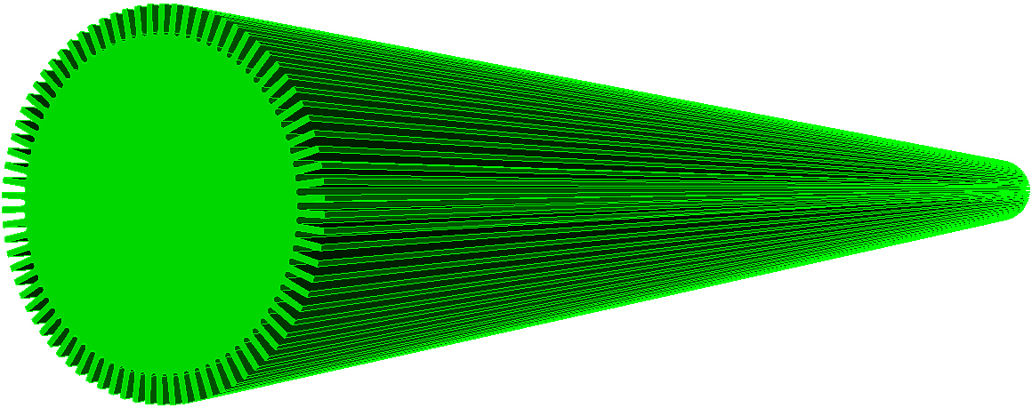
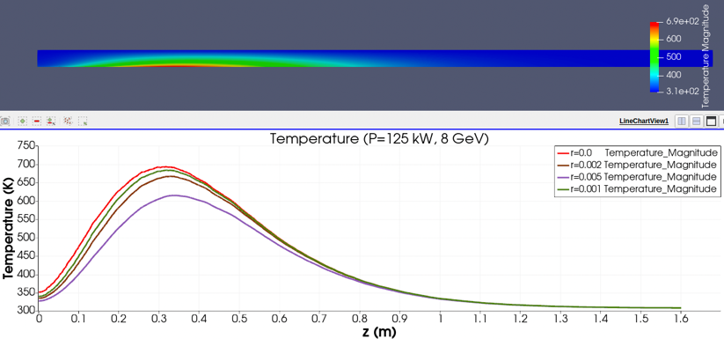
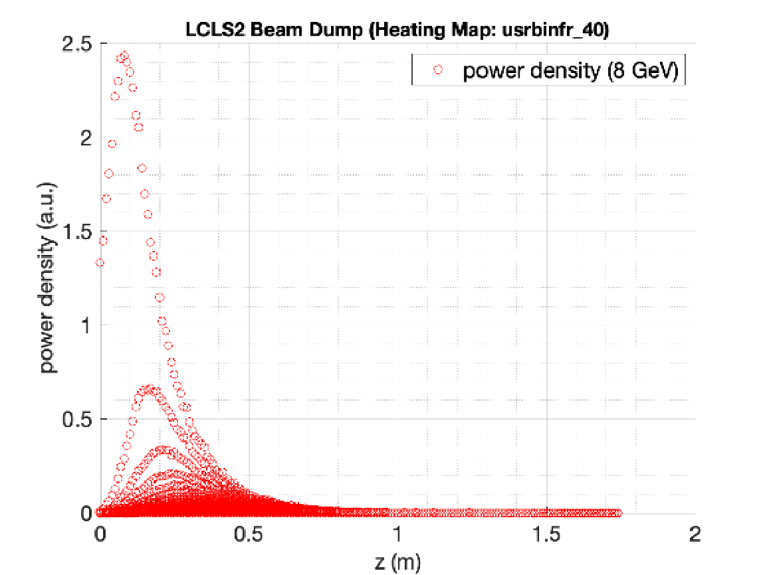

Radiation Heating Modeling – TEM3P
Volume radiation heating integrated to TEM3P for
Evaluating Radiation Effect on Cavity and surrounding materials
LCLS-II Beam Dump
beam
Temperature
FLUKA or Geant4 dose map
Stress

Slide 17




Dark Current and Radiation Analysis - ACE3P/Geant4 Integration
Developed an integration simulation tool of ACE3P and Geant4 for dark current radiation analysis.
Implemented a particle data transfer scheme from ACE3P into Geant4
KEK measurement
Track3P
Dark current at downstream Faraday cup
Field emission particle trajectories from Track3P
Radiation pattern from Geant4
Geant4
KEK measurement
HEP US-Japan Science and Technology Cooperation Program (2022 -2025)
In collaboration with KEK

Slide 18


LUME-ACE3P Workflow for Design Optimization
LUME - an ecosystem of open-source software tools and standards to enable large-scale start-to-end simulations from particle generation through experimental analysis
LUME-ACE3P - python-based manager for ACE3P workflows, configured for parameter sweeping or optimization
demo_s3p_sweep.yaml
User Inputs
LUME-ACE3P Outputs
workflow_parameters :
'mode' : 'parameter_sweep'
'module' : 's3p'
'cubit_input' : 'bend-90degree.jou'
'ace3p_input' : 'bend-90degree.s3p'
'ace3p_tasks' : 32
'ace3p_cores' : 4
'ace3p_opts' : '--cpu-bind=cores'
'workdir' : 'lume-ace3p_s3p_workdir'
'workdir_mode' : 'auto'
'sweep_output' : True
'sweep_output_file' : 's3p_sweep_output.txt’
input_parameters :
'cornercut' :
'min' : 12.0
'max' : 16.0
'num' : 5
'rcorner2' :
'min' : 4.0
'max' : 16.0
'num' : 3
Inner corner radius
Run LUME-ACE3P Workflow
LUME-ACE3P config. input file (.yaml)
Optional postprocess file (.rfpost)
ACE3P input file (.s3p or .omega3p)
Cubit journal file (.jou)
Individual workflow folders
Corner chamfer length
Formatted sweep output file
Python-based data visualization
Values swept to create folders and update files

Slide 19



Computational Tools for Rapid RF Source Design
Othman, Mohamed
Refinement of HPC tools for rapid RF source design. ACE3P is an excellent platform. We are developing an all-in-one code suite with:
  Electrostatic model (for HV standoff)
  Magnetostatic model (for magnet/solenoid design)
  Particle tracking (for gun design)
  Electromagnetic model (for cavity cold testing / tuning)
  Self-consistent Electromagnetic PIC (for large-signal performance)
  Utilization of large machines (HPCs with GPU support)
SLAC Publications on Early-Stage Computational Tools
IEEE Journal on Multiscale and Multiphysics Computational Techniques 4 (2019): 245-259.
Physical Review Applied, 16 (2021): 044040
“Recent Advances in the Accelerator Electromagnetic Code ACE3P,” Proc. 25th IVEC, Monterey, CA (2024)
RF gun model for HEIOT
75XP4 Klystron DC gun
Continue to benchmark, add diagnostics to ACE3P for RF source design, and validate by distributing to the community

Slide 20








Novel Design and Large-scale Computing Capability
LHC Crab
HE11 Cavity (LDRD)
RF Gun
C³ Structure
(distributed coupling, cold copper)
10M DOF
64M DOF
12M DOF
36M DOF

Slide 21


High Performance Computing (HPC) for Solution Speedup
National Energy Research Scientific Computing Center
Perlmutter: Cray EX
3072 CPU nodes
1792 GPU nodes
2.2 petabytes of memory
Omega3P w/ 12M DOF’s
T3P w/ 130M DOF’s
ACE3P has built a broad capabilities for RF design and optimizations that would benefit muon accelerator R&D
New capabilities can be integrated into ACE3P to address new design requirements

Slide 22
Outlook - What Can We Contribute
RF Cavity design
Mitigation of field emission dark current and multipacting
Thermal and Mechanical Analysis – beam, radiation and RF heating
High power testing – new structure and materials [Emma’s talk]

Slide 23
Acknowledgement
Computational Electrodynamics Department
  High performance computing code development
  Multiphysics cavity modeling slides (Cho Ng, Lixin Ge, David Bizzozero, Liling Xiao and Mohamed Othman)
  Computing used DOE NERSC computing facilities

Slide 24





Development Area for Future RF Sources
Othman, Mohamed
Complex Material Systems
Nonlinear materials, frequency Conversion and saturation
Modeling of ceramic windows is instrumental in predicting the nascent stages of operational failures.
Dispersive Media and Time-Dependent material response.
Advanced Beam Dynamics and Mode Composition
Fully self-consistent 3D beam transport and dynamics in output structures, including the effects of periodic permanent magnet (PPM) stacks
Reduction of numerical noise through various techniques
Mode Extraction and Model Reduction
Virtual tuning of klystron cavities for ease of manufacturing tolerancing
Use Dynamic Mode Decomposition (DMD) to reduce complexity and simulation time
Large Signal Models for high power RF Sources
Iterative Tuning for Cavity Optimization
The AI/ML Frontier
Convolutional neural networks (CNNs) to compute
space charge effects and accelerate simulation time.
Nonlinear material response in both transient and PIC solver
Frequency dependent material response
CNN model of high charge density beam in confined magnetic field including space charge
Eigenmode of output structure calculated through DMD
Beam loading calculation in input cavity through PIC simulation

