Slide 1
(Highlights of) US Muon Collider Activities
Sergo Jindariani (Fermilab)
On behalf of the USMCC Leadership Team: T. Holmes (UTK), K. Kennedy (Princeton), P. Meade (Stony Brook), S. Pagan-Griso (LBNL), D. Stratakis (Fermilab)
2nd USMCC meeting, University of Chicago, August 2025

Slide 2
Outline
USMCC Formation and Next steps
Engagement with IMCC and ESPPU process
Recap of challenges, R&D plan and US activities
Upcoming meetings and outreach activities
Summary

Slide 3
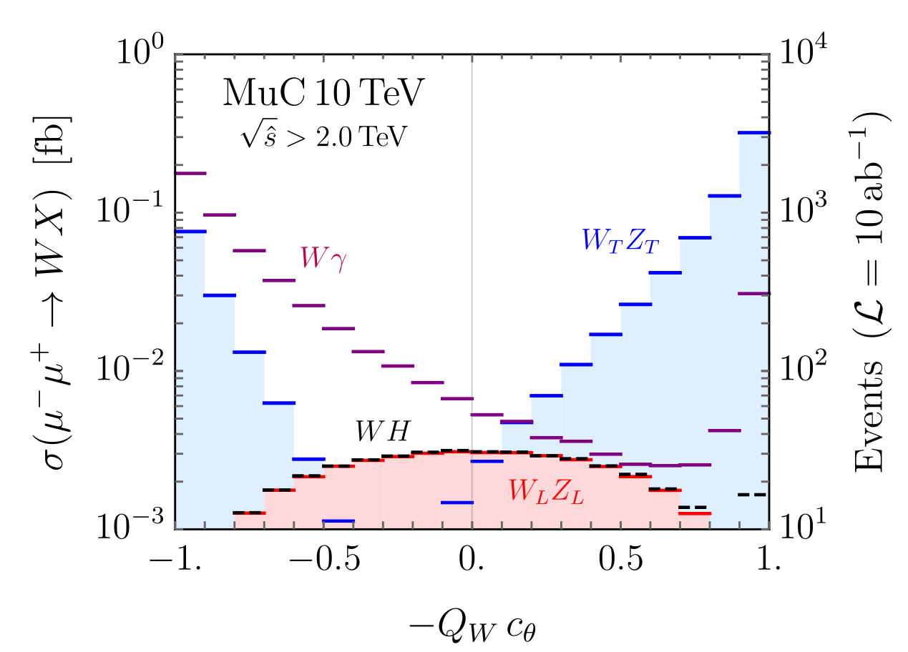
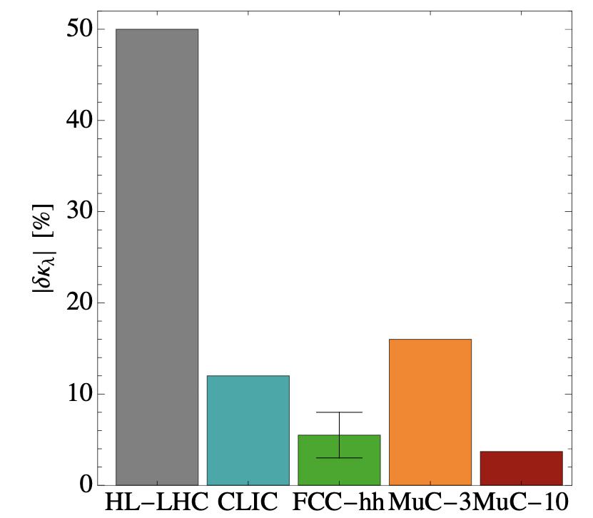
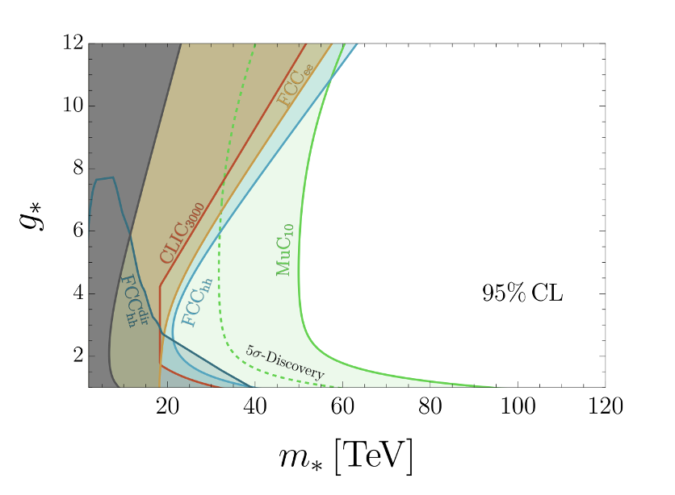
Highlights of Muon Collider Physics
More in Liantao’s talk
Unprecedented reach for New Physics due to combination of energy+precision
ESPPU Muon Collider Report
Arxiv: 2504.21417
Opens door for studies of new SM phenomena such EWK symmetry restoration
Multi-Higgs Factory
ESPPU Muon Collider Report
Arxiv: 2504.21417
R. Capdevilla, T. Han
Arxiv: 2412.12336

Slide 4
Statements from the P5 and NAS panel reports
P5: Although we do not know if a muon collider is ultimately feasible, the road toward it leads from current Fermilab strengths and capabilities to a series of proton beam improvements and neutrino beam facilities, . . . . At the end of the path is an unparalleled global facility on US soil… This is our muon shot
NAS EPP Recommendation 1: The United States should host the world’s highest-energy elementary particle collider around the middle of the century. This requires the immediate creation of a national muon collider research and development program to enable the construction of a demonstrator of the key new technologies and their integration.

Slide 5
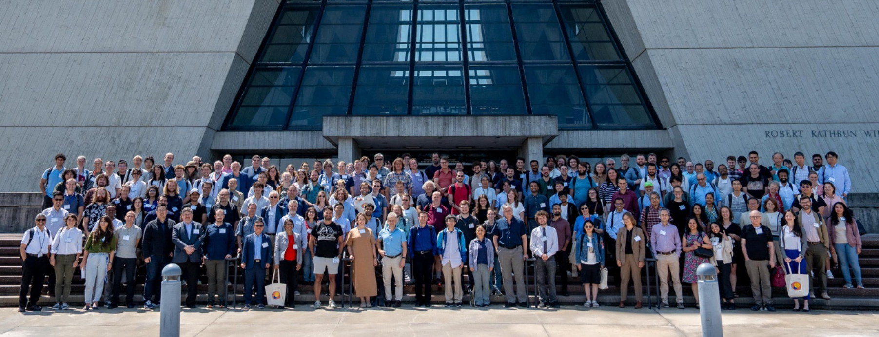

The USMCC
Connections
Core Purposes
  Define necessary work for mid-P5 panel
  Design a US demonstrator
  Engage with the international community
  Create a long-term vision for Fermilab that leads to a muon collider
  Build on a theory-driven physics case
  Ratified a charter on May 8, 2025
  Elected Leadership on July 31
5

Slide 6
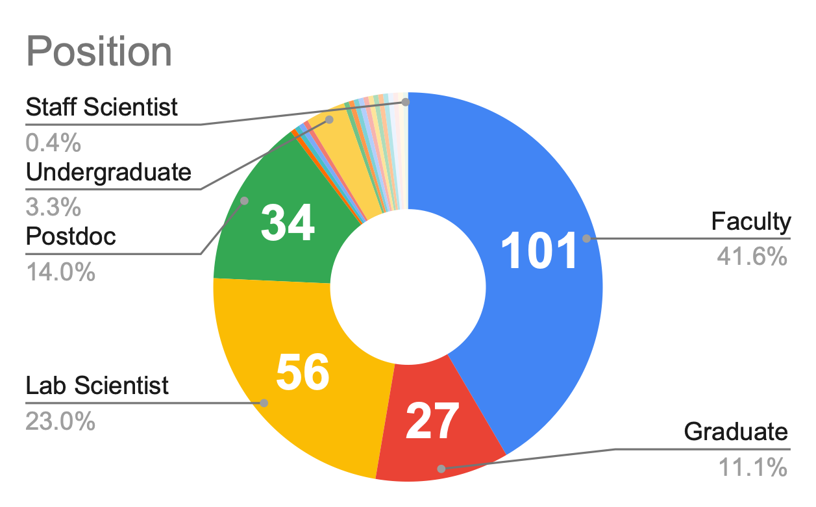
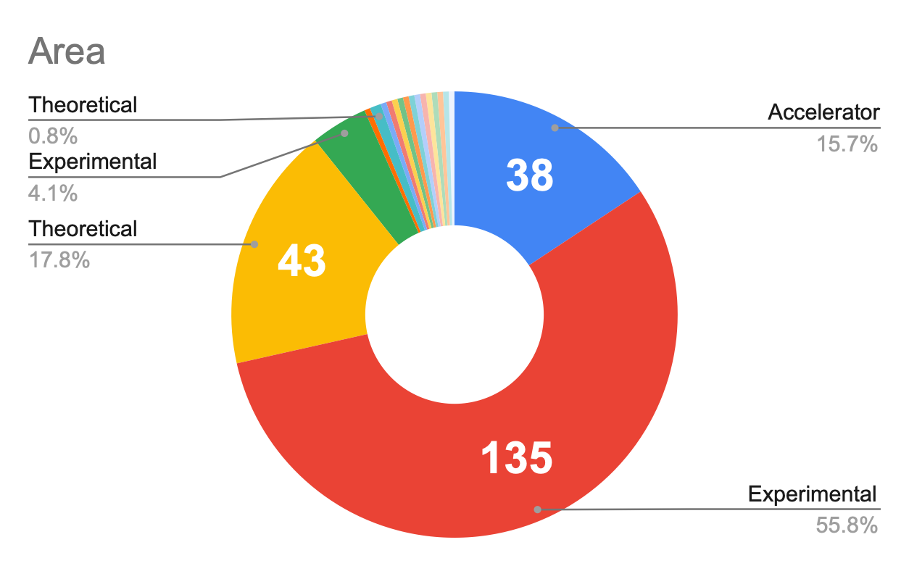
USMCC Demographics
Currently have 244 members from 81 institutions
Please join - email Sergo+Tova

Slide 7
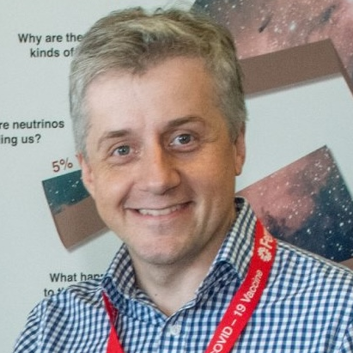

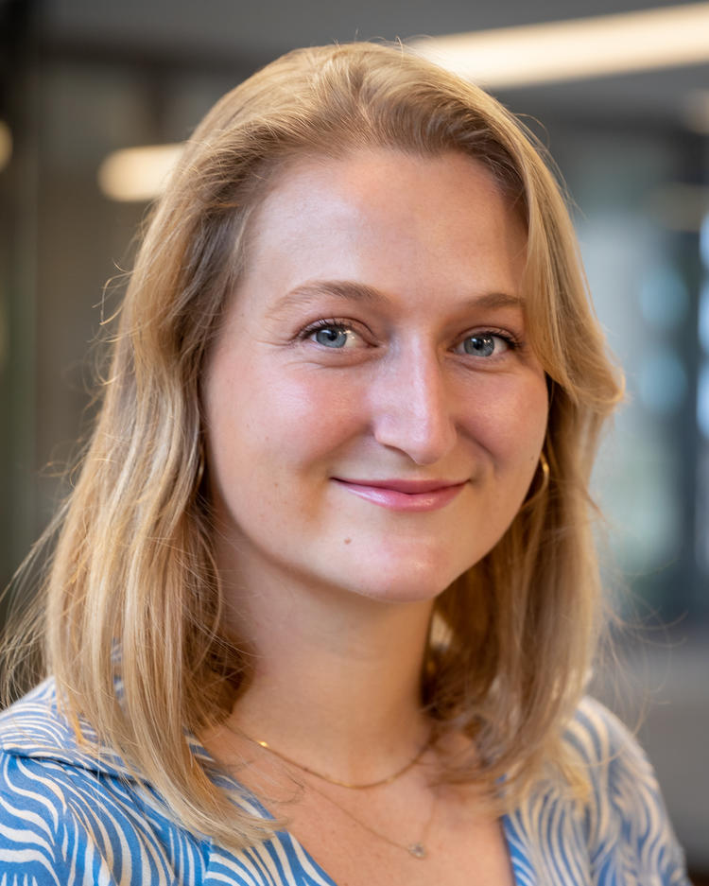
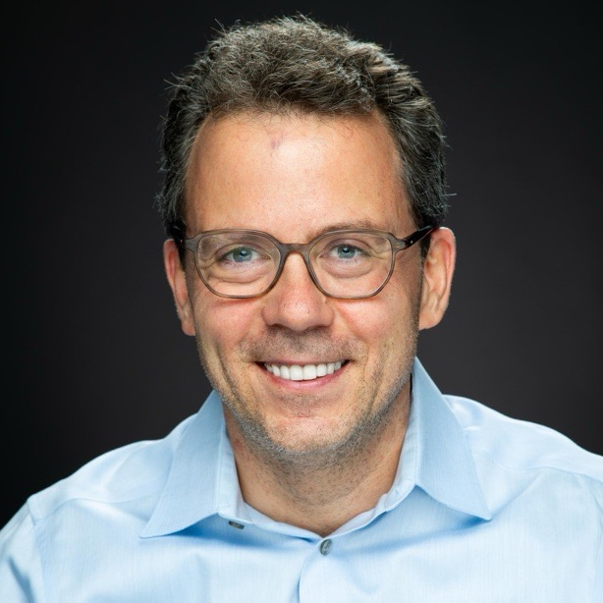
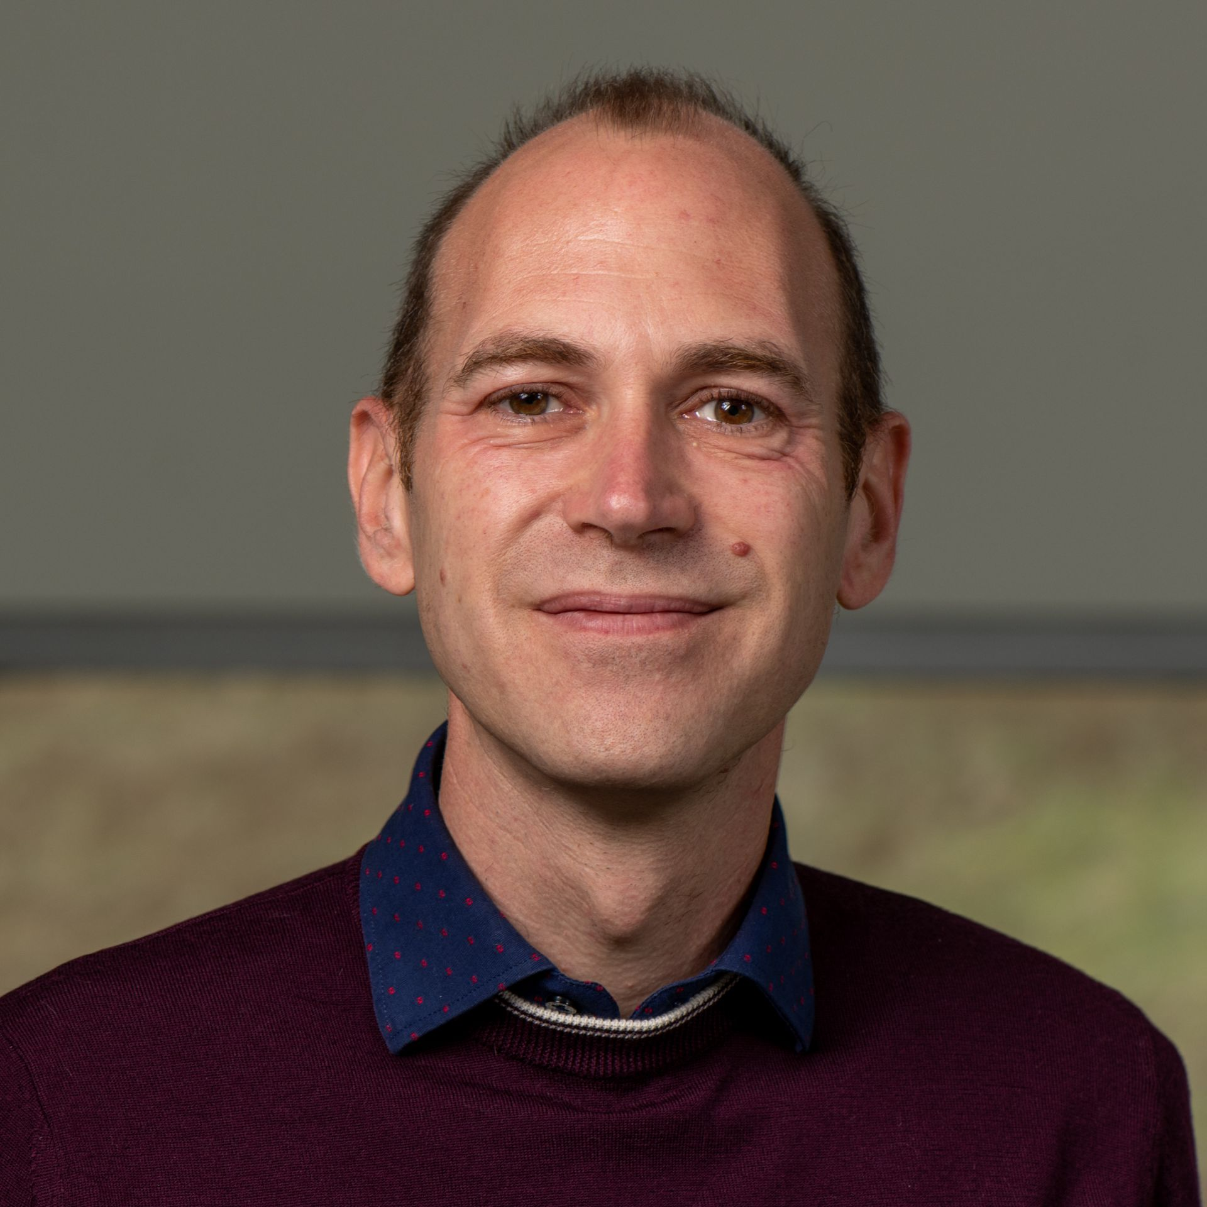

USMCC Elected Leadership
Chair
Vice Chair
Communications
Formation of a broader Leadership Strategy Group (LSG)
Welcome feedback from the collaboration about how we can serve you better LINK
Sergo Jindariani (FNAL)
Tova Holmes (UTK)
Kiley Kennedy (Princeton)
Accelerator
Experiment
Theory
Diktys Stratakis (FNAL)
Simone Pagan Griso (LBNL)
Patrick Meade (SBU)

Slide 8





USMCC Communications Plans and Priorities
Broad Public Outreach
  Active social media (follow muoncollider.us !)
  Programs/curricula for QuarkNet, AAPT
  Presentations/demos at schools, especially in local Fermilab area
Government Relations and Advocacy
  Develop and update advocacy materials
  Expand participation in the annual HEP DC Trip
  Continued close collaboration with agencies
Cross-Disciplinary Communication
  Clear communication across technical areas (theory/accel/exp)
  Strengthen partnerships with industry
  Bolster physics case that appeals to non-collider/non-HEP physicists
If you are interested in getting involved, please reach out to Kiley & Larry (kileykennedy@princeton.edu, Lawrence.Lee.Jr@cern.ch)

Slide 9
Thank you!
To everybody who helped us to guide the US effort from Snowmass/P5 to this stage: D. Acosta (Rice), G. Apollinari (Fermilab), A. Apresyan (Fermilab), S. Belomestnykh (Fermilab), M. Begel (BNL), S. Berg (BNL), P. Bhat (Fermilab), K. Black (Wisconsin), P. Chang (Florida), C. Cesarotti (MIT), N. Craig (UCSB), M. Convery (Fermilab), S. Cousineau (ORNL), A. De Gouvea (NW), K. DiPetrillo (Chicago), J. Eldred (Fermilab), P. Ferracin (LBNL), M. Franklin (Harvard), M. Garcia-Sciveres (LBNL), S. Gessner (SLAC), S. Gourlay (Fermilab), T. Han (Pittsburgh), Matheus Hostert (Iowa), W. Hopkins (ANL), M. Kumar (BNL), L. Lee (UTK), Z. Liu (Minnesota), T. Luo (LBNL), N. Mokhov (Fermilab), E. Nanni (SLAC), S. Nagaitsev (BNL), M. Neubauer (UIUC), I. Ojalvo (Princeton), M. Palmer (BNL), K. Pedro (Fermilab), F. Pellemoine (Fermilab), S. Prestemon (LBNL), E. Prebys (UC Davis), Ben Rosser (Chicago), L. Sexton-Kennedy (Fermilab), E. Snively (SLAC), Z. Tabrizi (Pittsburgh), C. Tully (Princeton), R. Yohay (FSU), K. Yonehara (Fermilab), D. Wood (Northeastern), and many others …
We look forward to continuing to work with you !

Slide 10






Current Funding
At the labs
At the universities
  Fermilab demonstrator (LDRD)
  Fermilab future collider software (LDRD)
  Brookhaven collider R&D - RCS design and cooling cell (LDRD)
  LBNL future collider detectors (LDRD)
  SLAC high-field RF test stand (GARD)
  Princeton/Chicago/Tennessee Acc+Exp for MuC (Simons Foundation)
  Tennessee Fellowships (Cottrell x2, Sloan)
  UCSB/Princeton/Northeastern/UTK Interdisciplinary Seminar Series (Kavli Foundation)
  + start-ups, internal funding, and fractions of base grants/ECAs/CAREERs
also at labs
constrained by lack of significant R&D funding from gov’t agencies

Slide 11
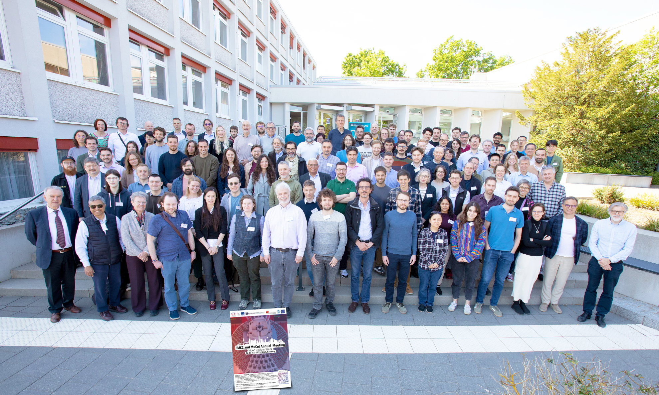
IMCC and US Engagement
More in Taylor’s talk
International Muon Collider R&D activities are led and coordinated by IMCC
  Very active community since 2020
  Over 50 institutions signed MoC
  Funding in Europe comes from CERN + EU grant + smaller pots from member institutions
US physicists have been actively engaged with IMCC
  US representatives in IMCC leadership
  7 Universities signed MoC, more in the pipeline, we encourage you to sign it!
  DOE – CERN collaborative agreement in progress, that will enable labs to official join
Will revisit IMCC organization in the future, following ESPPU and USMCC ramp up
2025 IMCC Annual meeting @DESY
181 contributions showing new results across accelerator, experiment, theory
20% US participants

Slide 12
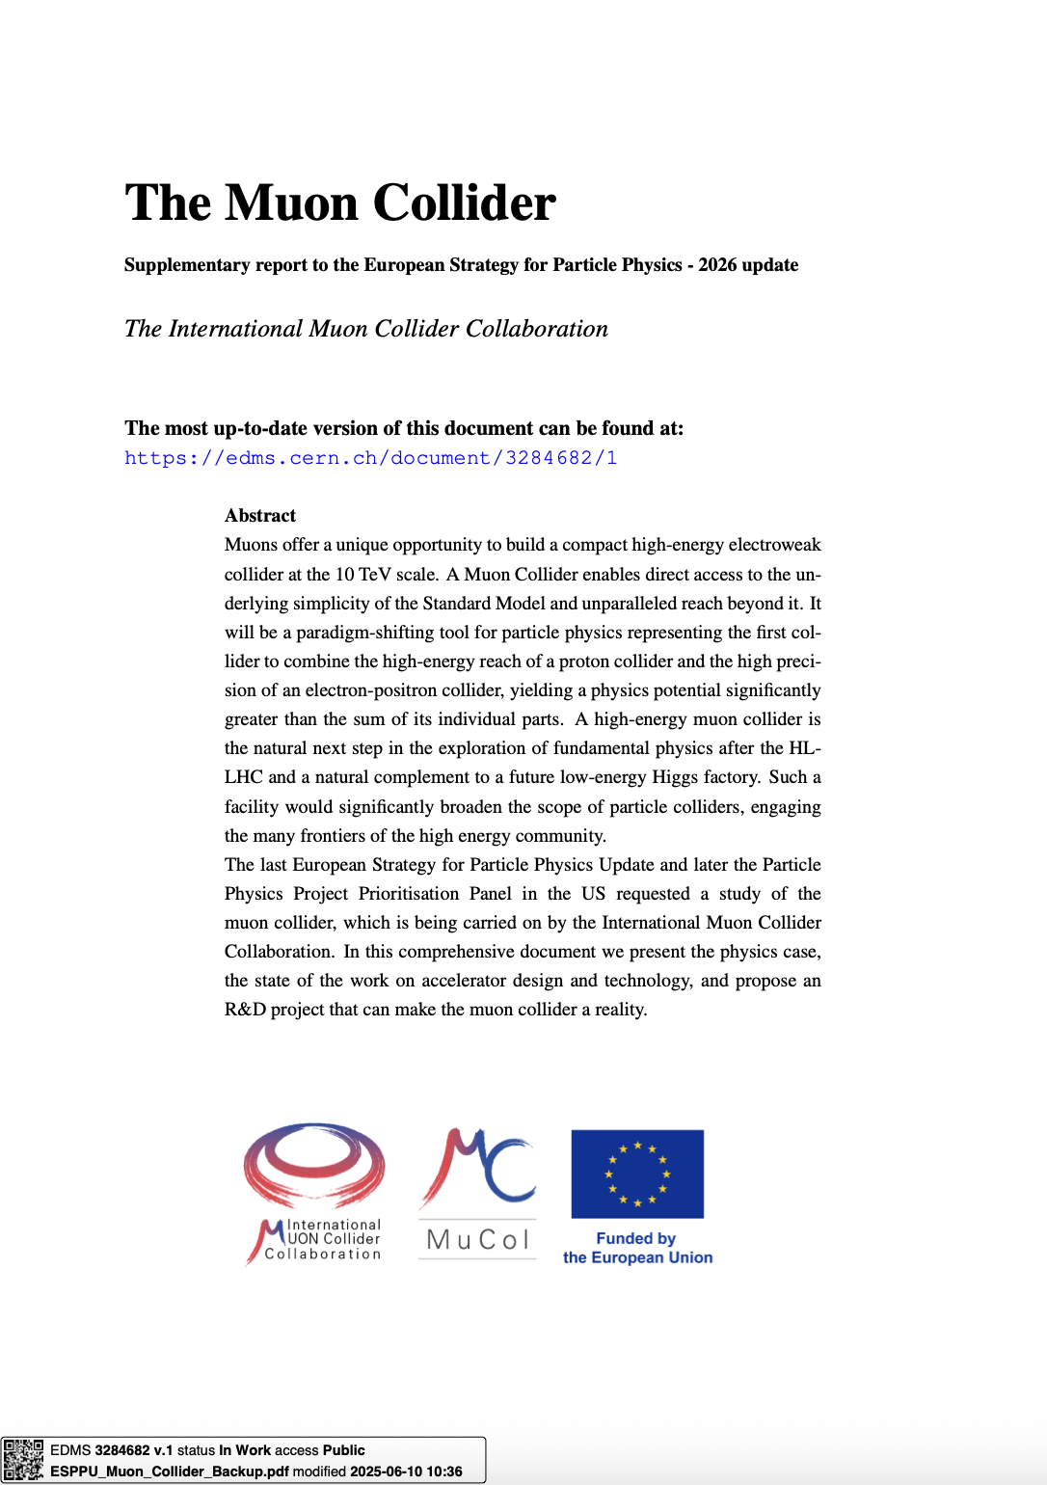
IMCC Input to European Strategy Process
arxiv:2504.21417
The IMCC submitted input to the European Strategy Process
  A comprehensive document (over 400 pages) summarizing technical progress made, future R&D plans, and timeline towards the collider realization
  While IMCC is currently focusing on the green-field design, both US and CERN sites for the demonstrator and the final facility are mentioned and discussed
The US is heavily involved in this effort:
  Core editorial team for IMCC: Federico Meloni (chair), Chris Rogers (deputy chair), Kevin Black, Christian Carli, Steve Gourlay, Sergo Jindariani, Roberto Losito, Donatella Lucchesi, Patrick Meade, Elias Metral, Simone Pagan Griso, Nadia Pastrone, Daniel Schulte, Diktys Stratakis, Rebecca Taylor, Andrea Wulzer
  Many additional chapter authors from US: Artur Apresyan, Sergey Belomestnykh, Scott Berg, Nathaniel Craig, Andre de Gouvea, Karri DiPetrillo, Jeff Eldred, Spencer Gessner, Eliana Gianfelice, Timon Heim, Tova Holmes, Walter Hopkins, Sergei Nagaitsev, Emilio Nanni, Mark Palmer, Kevin Pedro, Katsuya Yonehara

Slide 13
US Muon Collider Submission to ESPPU
A short 10-pager summarizing US plans and strategy
  Over 300 signatories
  arxiv: 2503.23695
Main messages:
  Close collaboration between the two regions regardless of where the machine is eventually realized (no region can do it alone!)
  Advocates for strong and sustained support for Muon Collider efforts in Europe
  Expresses interest in hosting the demonstrator and potentially the collider in the US
  Outlines goals for USMCC and how it interfaces with international efforts
  Supports DOE-CERN collaborative agreement on Muon Collider R&D
The main messages were propagated to the DPF national input document

Slide 14
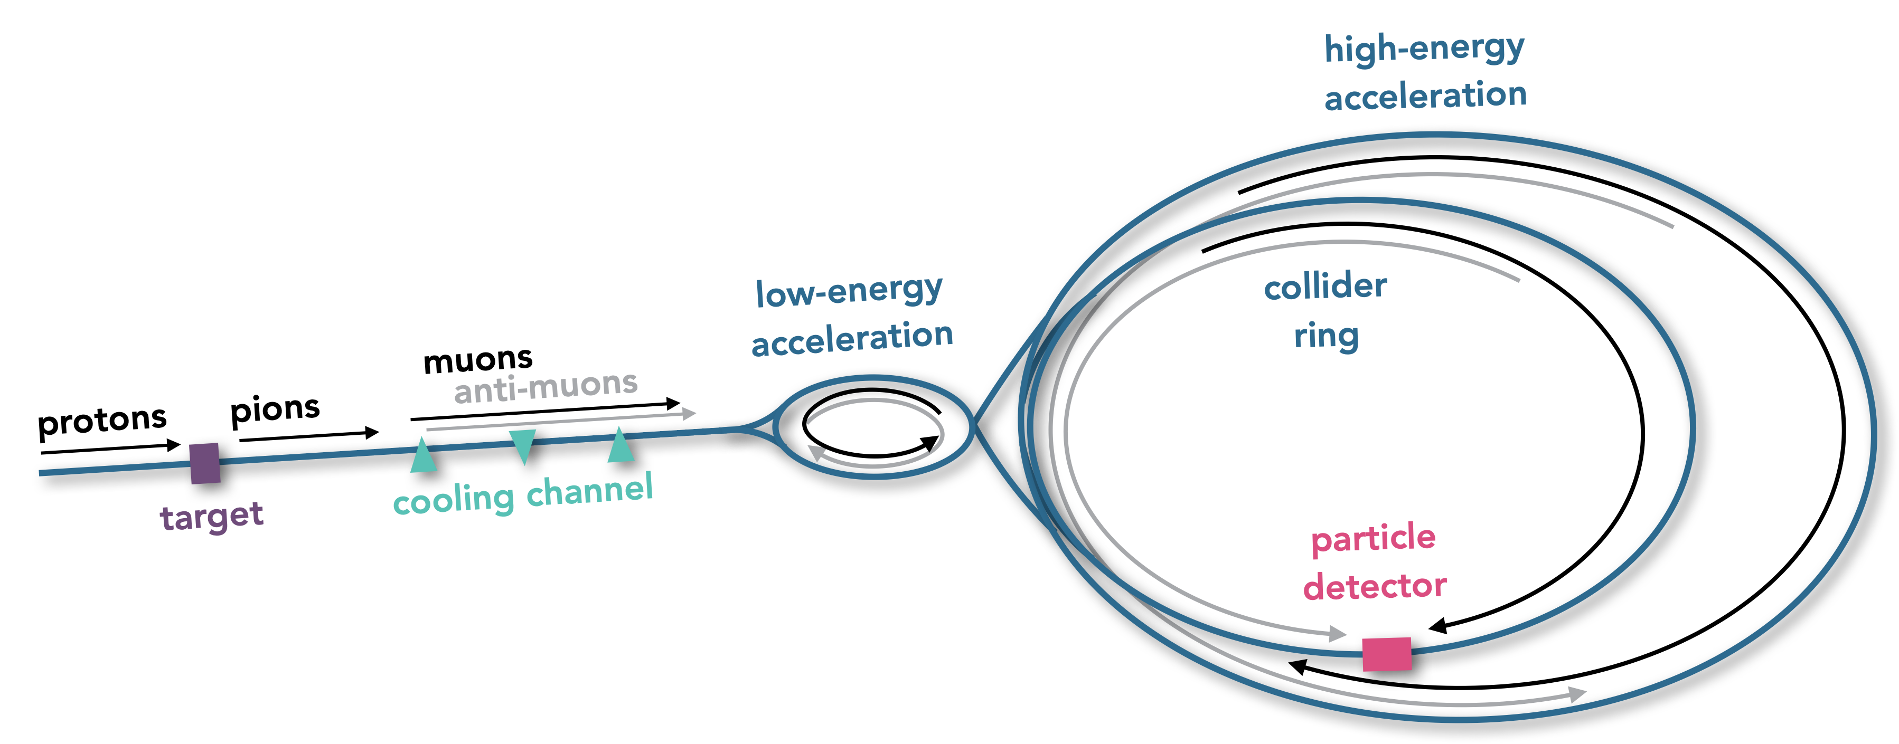
The Machine Concept at ~10 TeV
The goal is to get to 10 TeV center-of-mass energy with L ~ 10³⁵ cm⁻² s⁻¹
Staging in energy (e.g. 3→10 TeV) or in luminosity (a la LHC→HL-LHC) are possible and being studied

Slide 15
Muon Accelerator Challenges
More in Valdimir’s talk
Challenging magnets in many places
Dense neutrino flux needs to be mitigated
Many technical challenges in designing the muon source (proton driver, target, cooling channel, etc)
Beam-induced background in the detectors
High-gradient RF for fast acceleration
These challenges should not be seen as show-stoppers but rather luminosity and cost risks

Slide 16
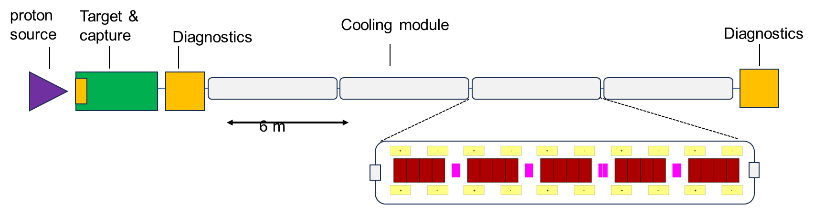
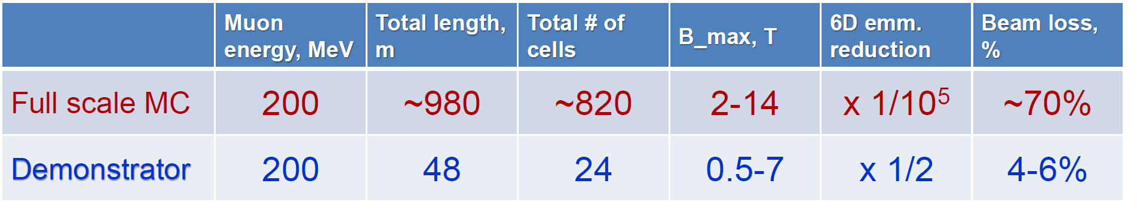
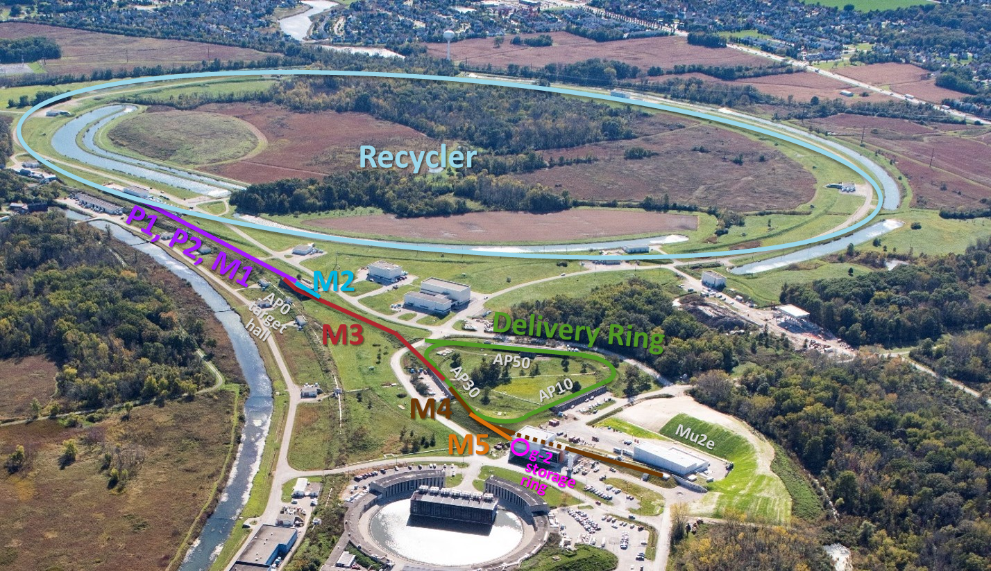
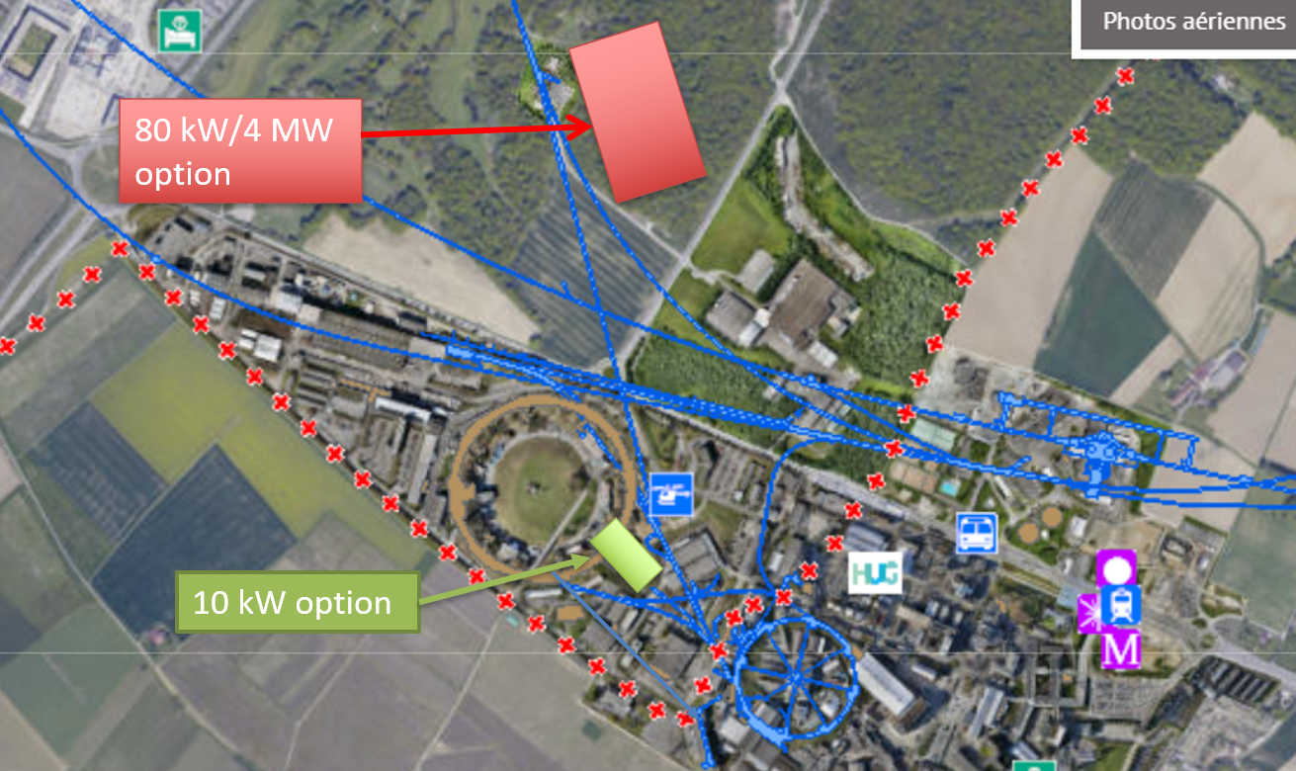
Ionization Cooling Demonstrator
More in Diktys’s talk
Demonstrator, example configuration:
  Potential sites being explored:
Fermilab
CERN

Slide 17
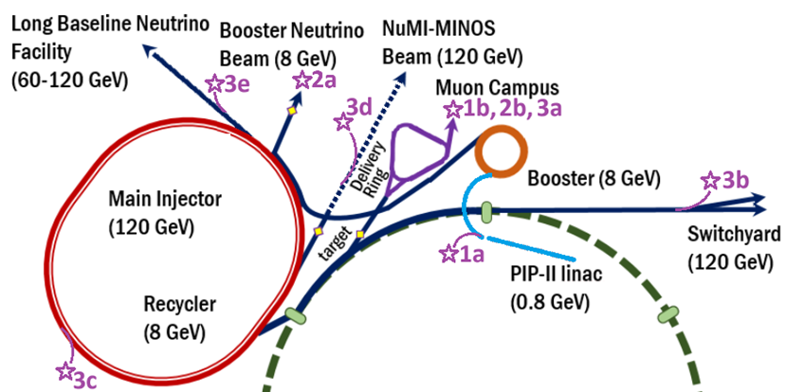
Demonstrator Site exploration
1 0.8- 2GeV protons from the PIP-II linac
2 8 GeV protons from the Booster
3 120 GeV protons from the Main Injector
GOAL: Explore candidate sites for a Muon Ionization Cooling Technology Demonstrator within Fermilab. Compare available beam parameters, location, existing and needed infrastructure for each site.
Two-year Fermilab LDRD approved to do this work!

Slide 18
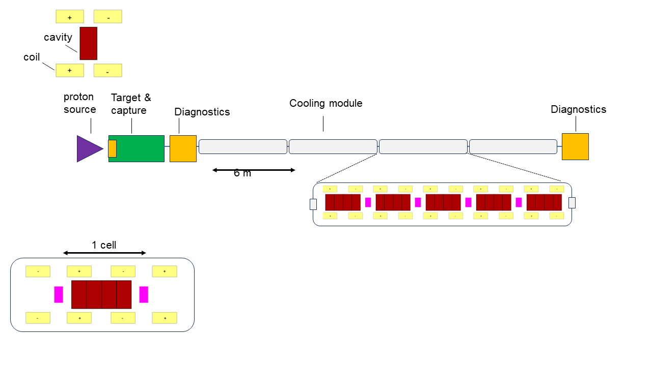
Demonstrator staging
More in Diktys’s talk
  RF studies in B-fields
  Material studies & cryogenics
  600-800 MHz NC cavity, with coils making 10-14 T on axis
Phase-I
  Cell integration studies
  Cell resembles late 6D cooling stages
  Reuse components from Phase I
Phase-II
  Full demonstrator with beam
  Coils producing 7-10 T axial fields
  Potential to achieve 50% 6D cooling
Phase-III
Parameters may need to be adjusted
Needs design studies for HTS coils under extreme forces (BNL LDRD, M.Palmer et al)
Design of specialized RF cavities for the cooling channel – more in talk by Dillon

Slide 19
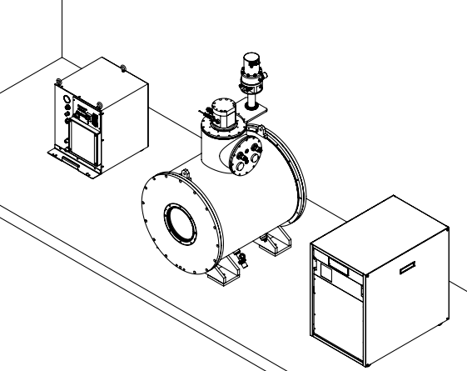
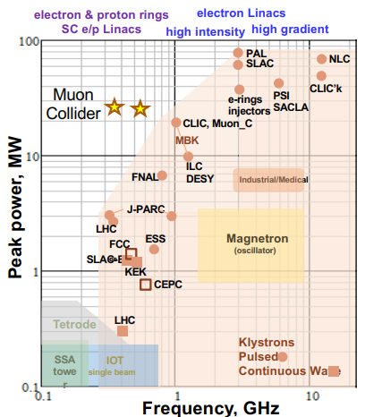
Testing RF Cavities in B field at SLAC
More in Emma’s talk
Extending SLAC’s high power RF testing capabilities to include external magnetic fields
Unique RF Source and Power Handling Requirements for MC
Measurements of the field emission and associated damage will be used to benchmark our simulated field emission in SLAC’s ACE3P code suite.
Test cavity geometries and materials relevant to muon cooling channel
Leverage SLAC expertise in design and fabrication of a wide range of rf sources
Drawing of 5 T solenoid from Cryomagnetics to be delivered to SLAC by January 2026
Design and production of rf cavities, rf sources and rf components leading up to a future demonstrator
Benchmark high gradient results for frequency scaling with measurements at S-band and L-band available at NLCTA
Additional beam dynamics expertise could be engaged for Machine Design

Slide 20

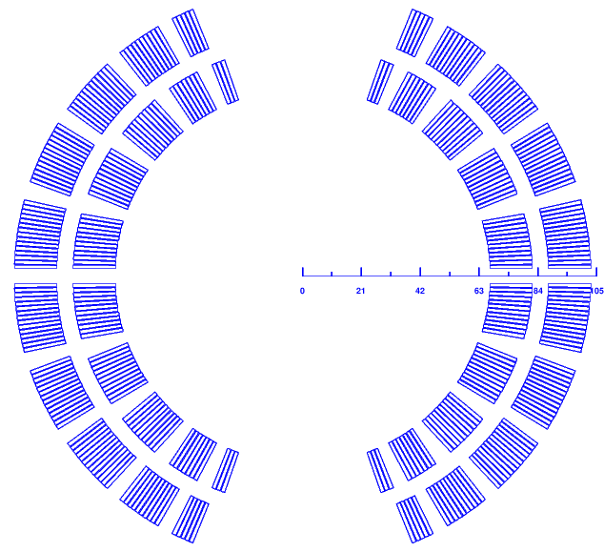
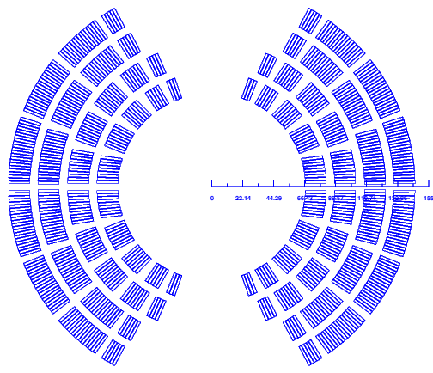
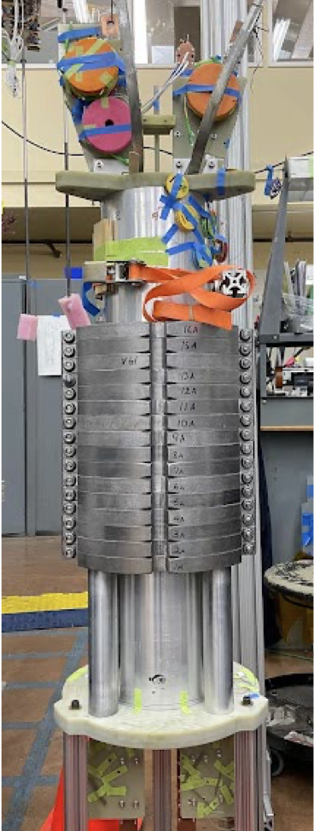
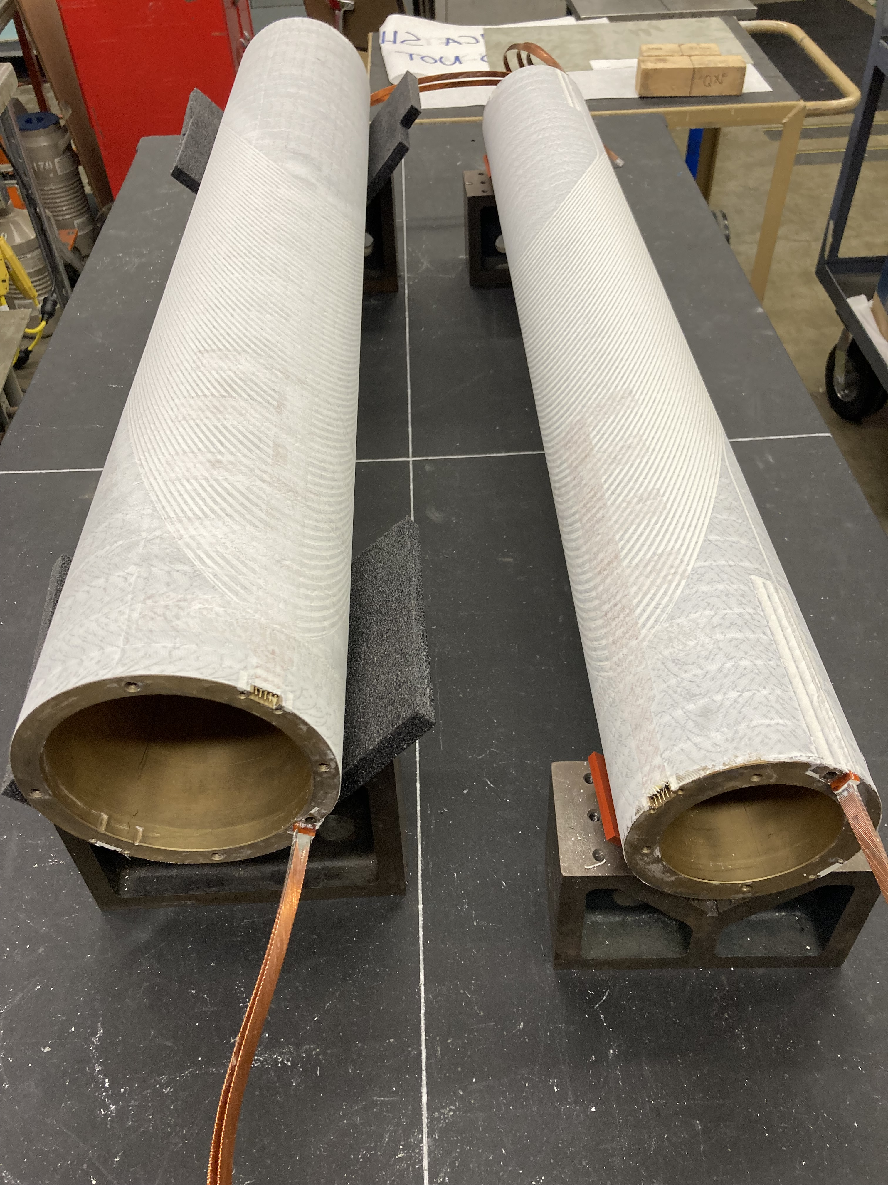
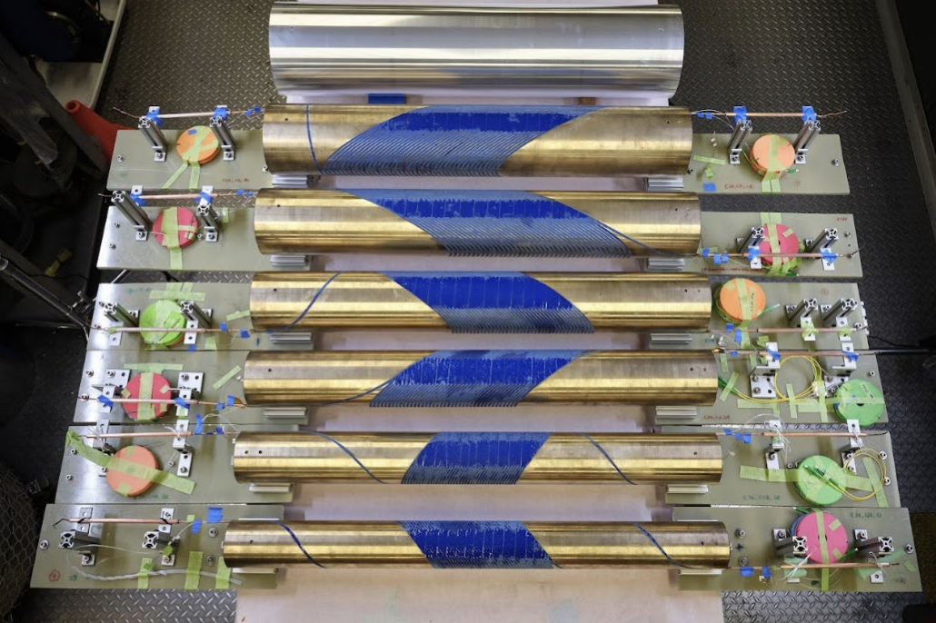
Magnet Developments
More in talks by Luca (Europe) and Ramesh (US)
Developing technology relevant to a future Muon Collider
Combined function or
higher field dipole
World Record Field for an HTS (ReBCO) Dipole Magnet
Bo=11 T
ID=123 mm
Bo=15/12 T
ID=125 mm
Muon collider territory!
Major breakthrough in reducing training in Nb₃Sn magnets
Training & operating margin are major cost drivers
Particularly relevant for future colliders

Slide 21
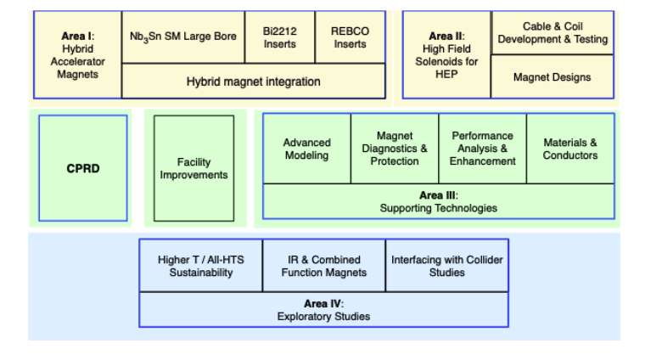
US MDP Program Structure
New Area
Improve integration for hybrid magnets
Strengthen linkage between technologies and magnets

Slide 22
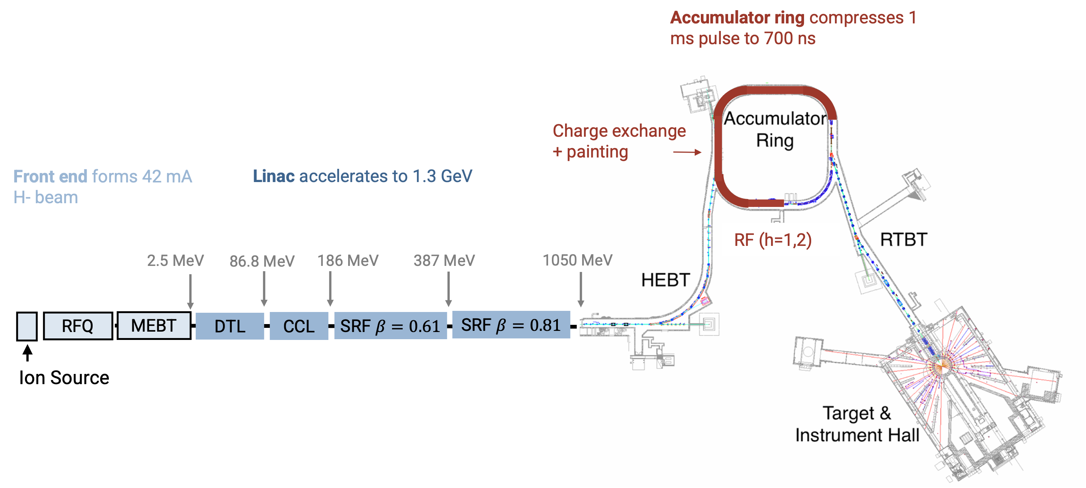
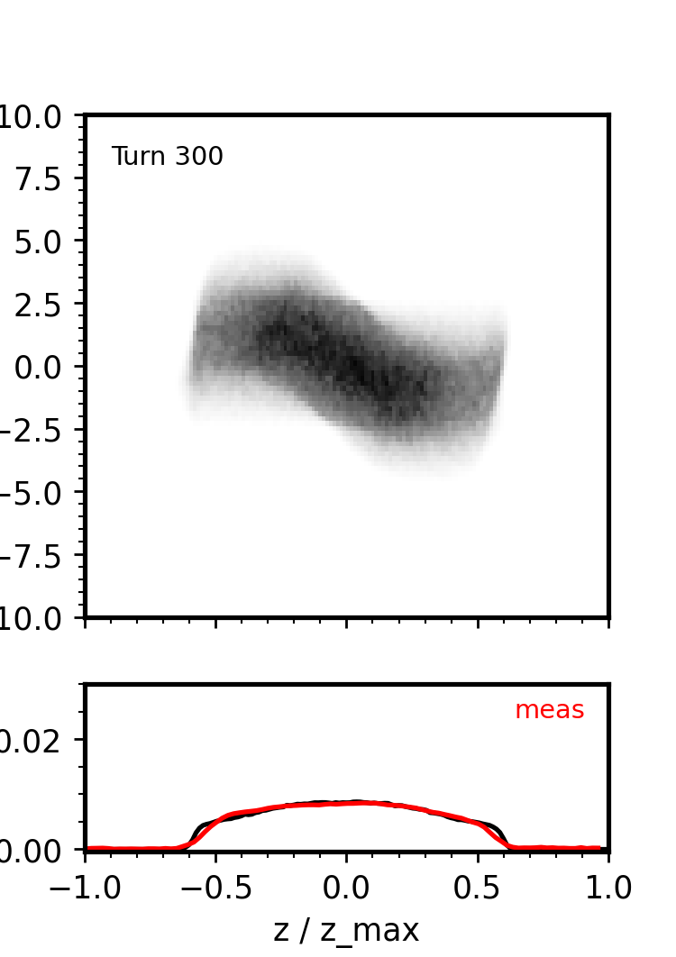
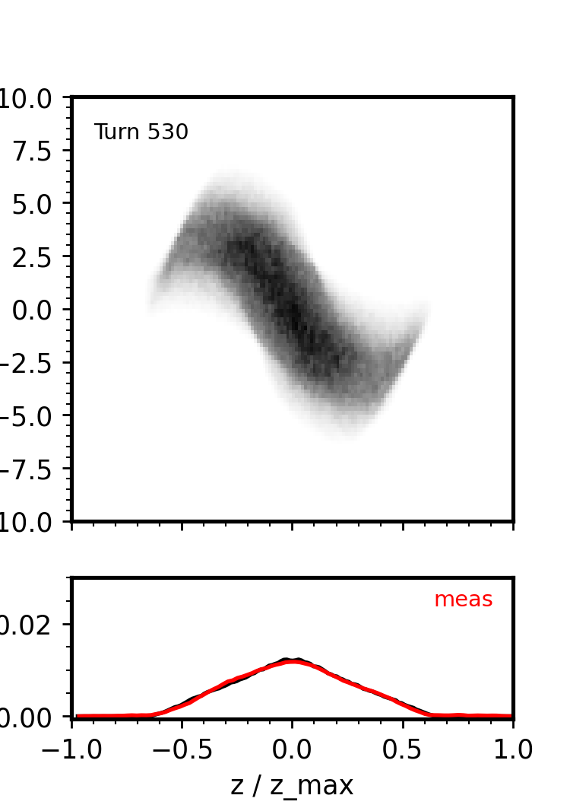
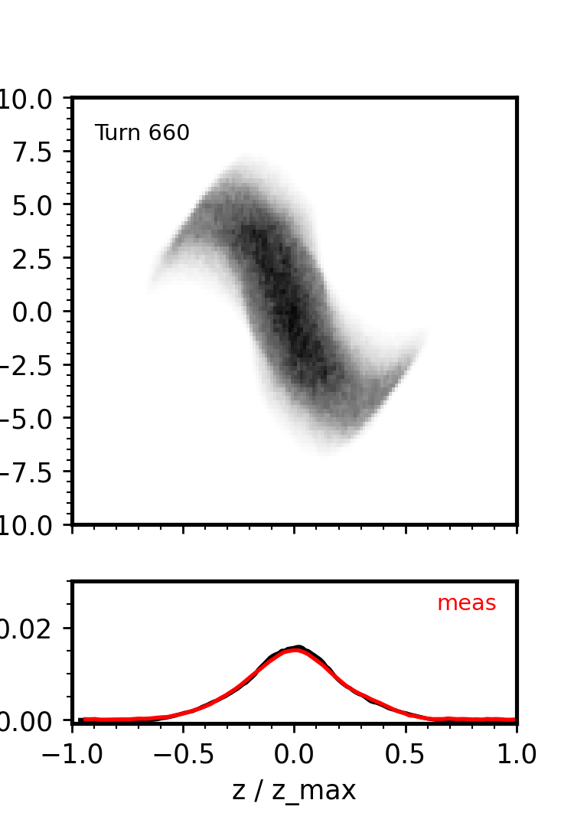
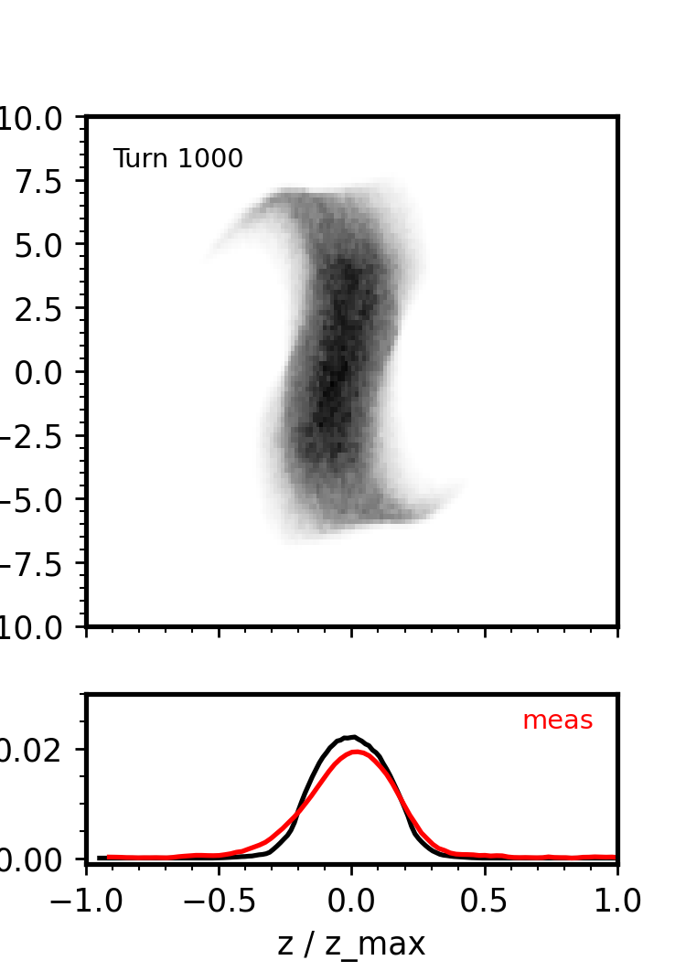


Bunch Compression Studies at SNS
More in talk by Austin
ORNL SNS resembles proton driver and could probe relevant space charge regime.
Experiments will test hardware limits, explore modifications for bunch compression.
Initial experiment at low charge + simulation benchmark are shown on the slide.
$ΔE$ [MeV]
$$z/z_{max}$$

Slide 23
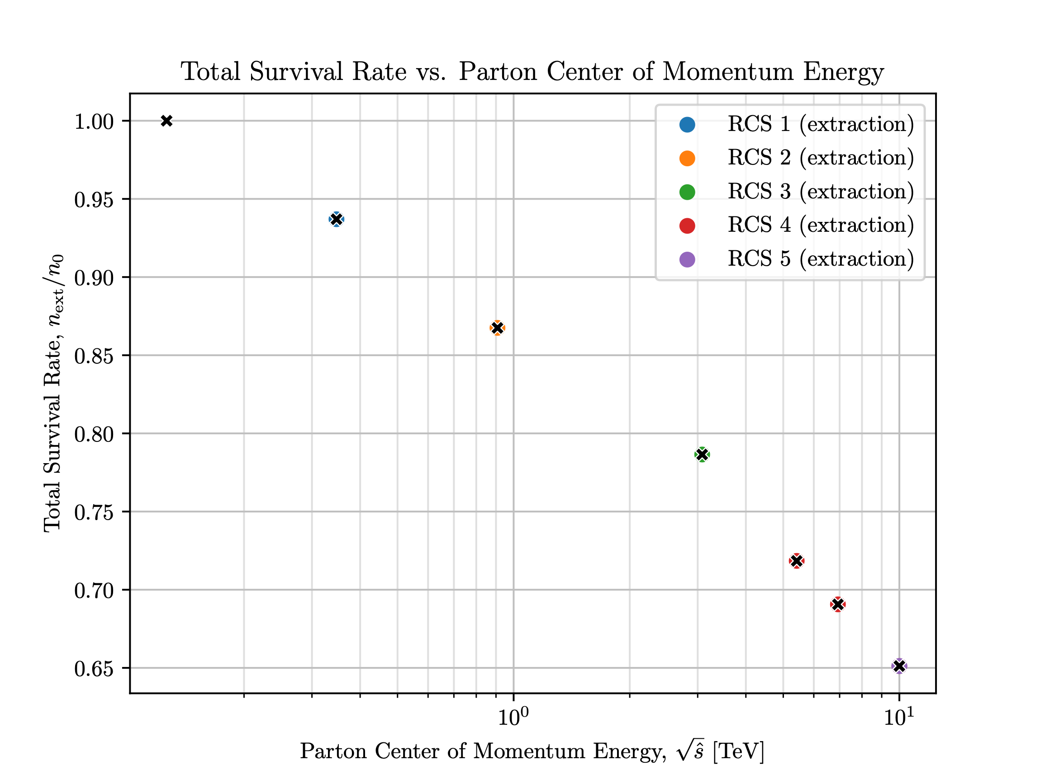
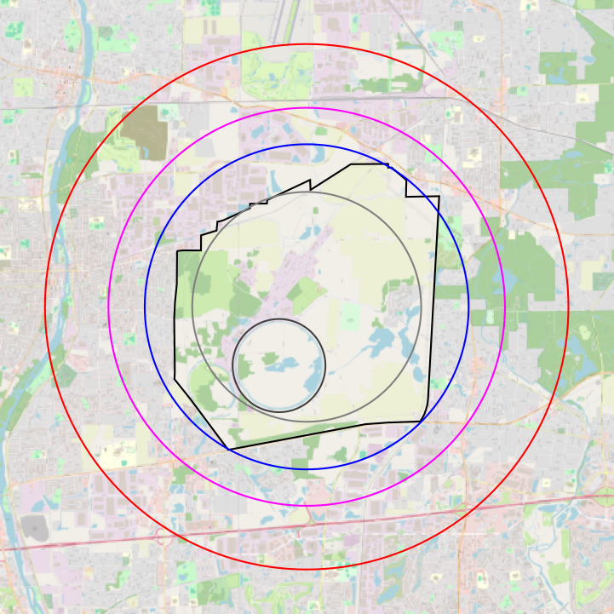
Fermilab Sited RCS Studies
More in talk by Kyle
BNL LDRD Includes Two Muon Collider Thrusts:
  Rapid Cycling Synchrotron studies for the Fermilab siting option
  Cooling Demonstrator module design studies (mentioned earlier)
  RCS design for FNAL site
  Highest current E w/i FNAL site is 5.42 TeV
  Smallest current max ring size for 10 TeV is 21.9 km

Slide 24
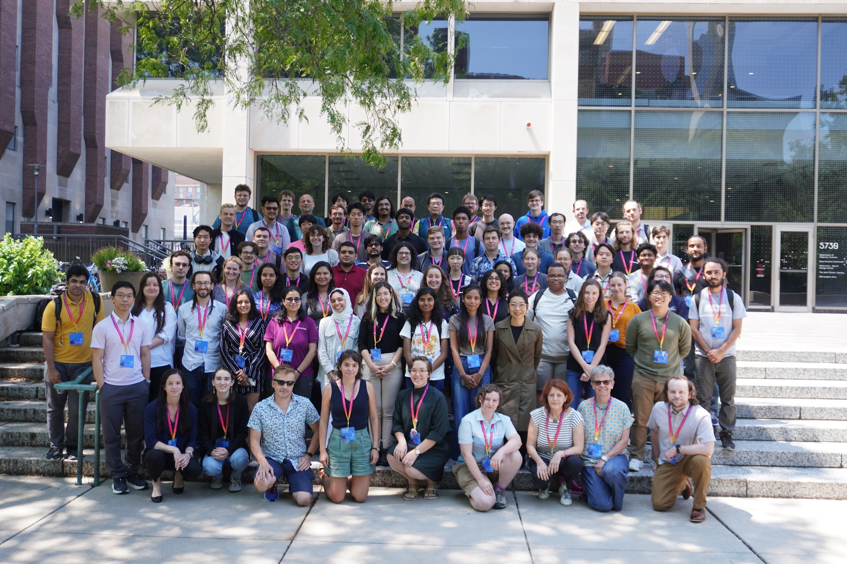
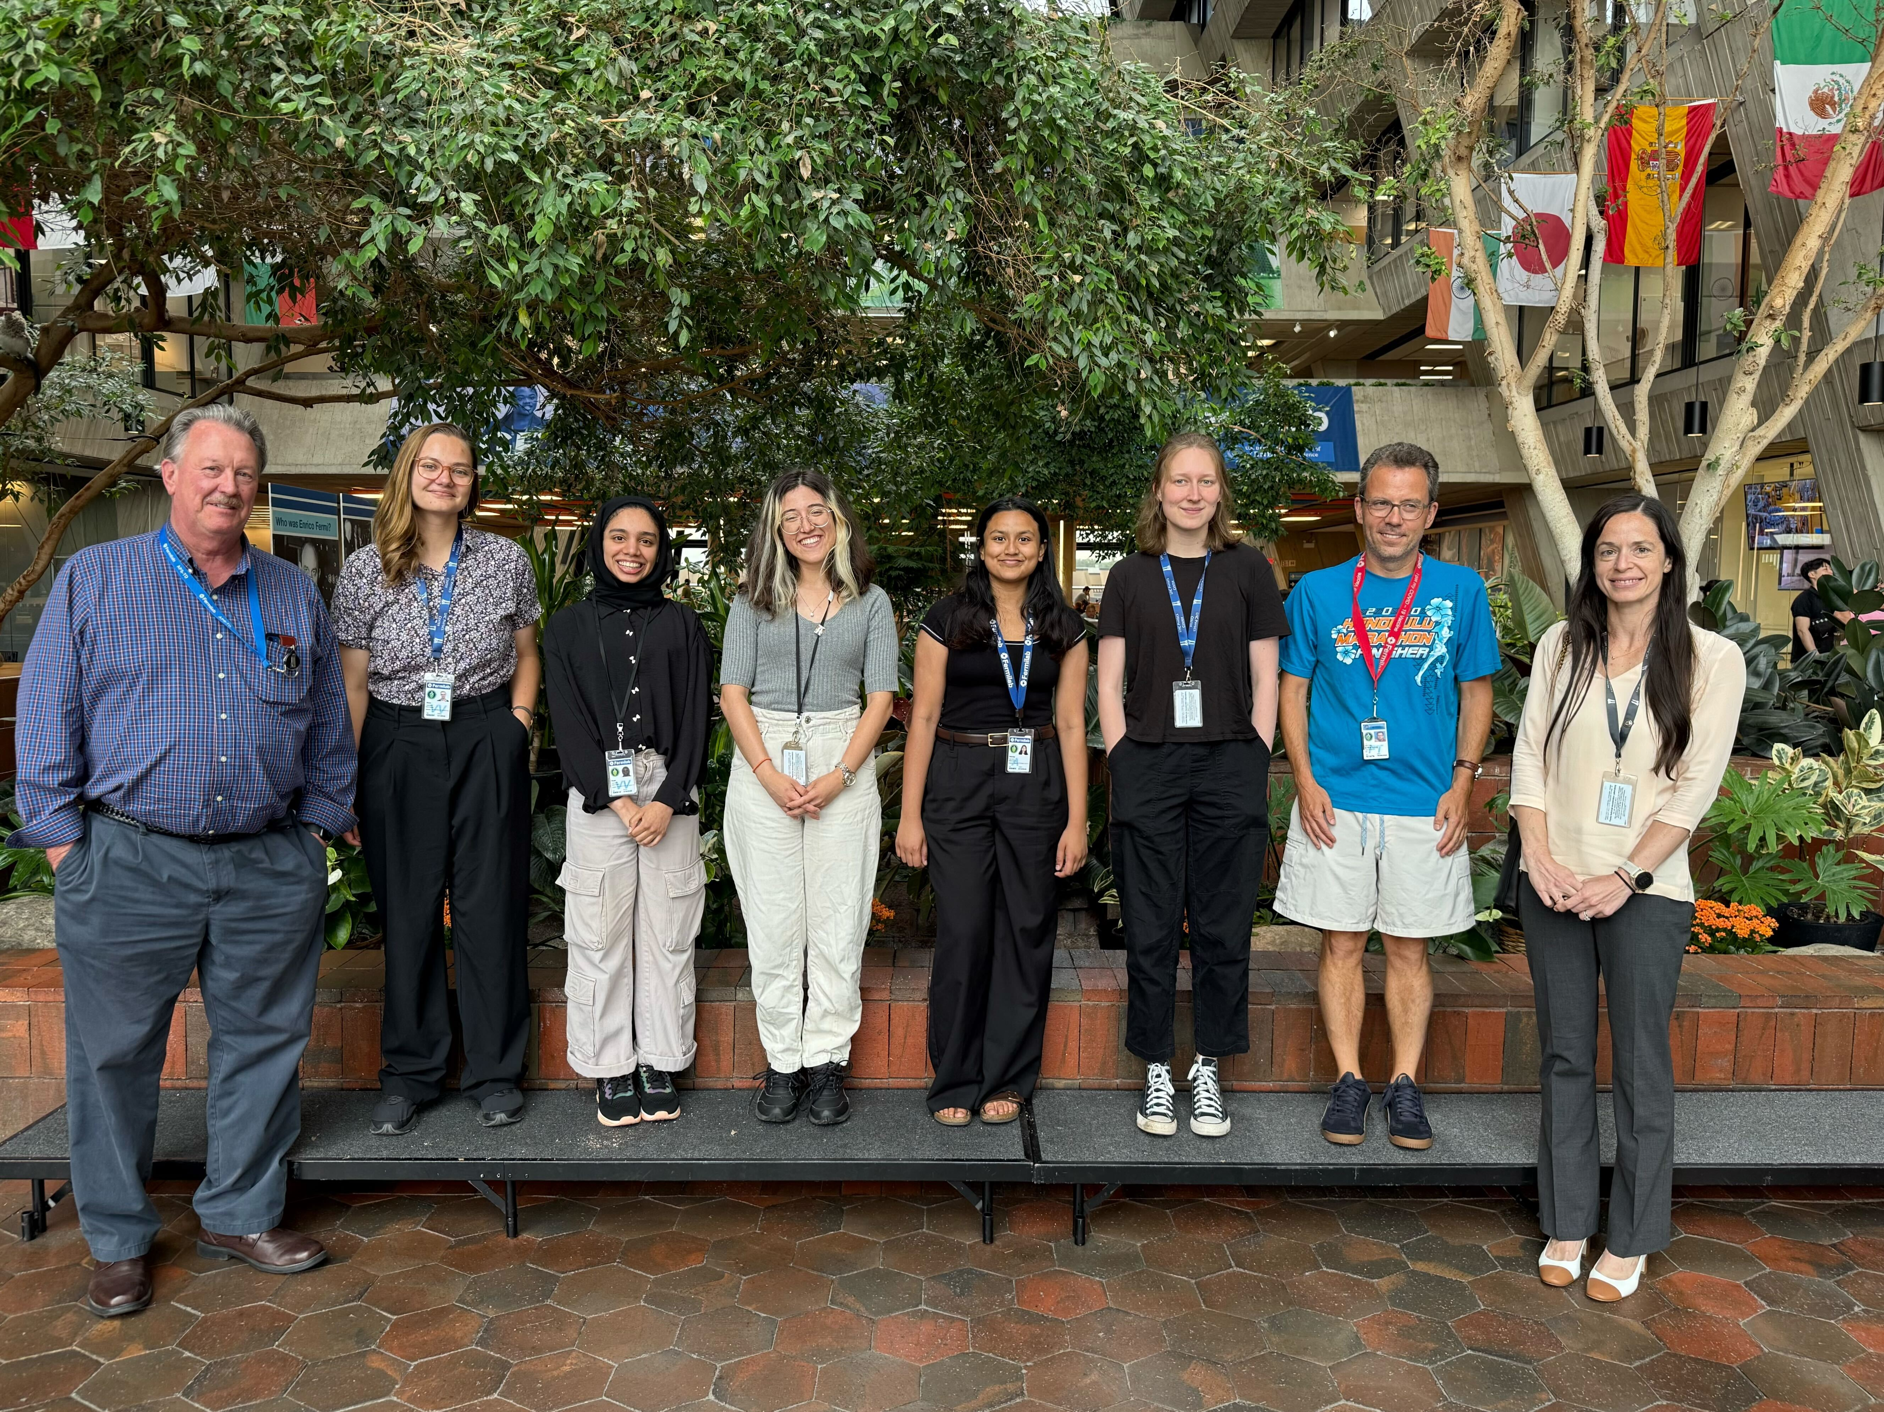





Training new Generation of Accelerator Experts
Please attend Poster session
Successful 3+ day Accelerator school this week with 70+ students
Training clusters of new students in muon collider accelerator R&D, e.g.:
  6 students based at FNAL for the summer (Princeton, U Chicago, Wisconsin, Tennessee)
  4 students incorporated into BNL LDRD (Stony Brook, Princeton, Tennessee)
Interested in expanding summer program in future years — needs funding for student and expert time!
Muon Collider is an excellent motivator attracting a new generation to accelerator

Slide 25
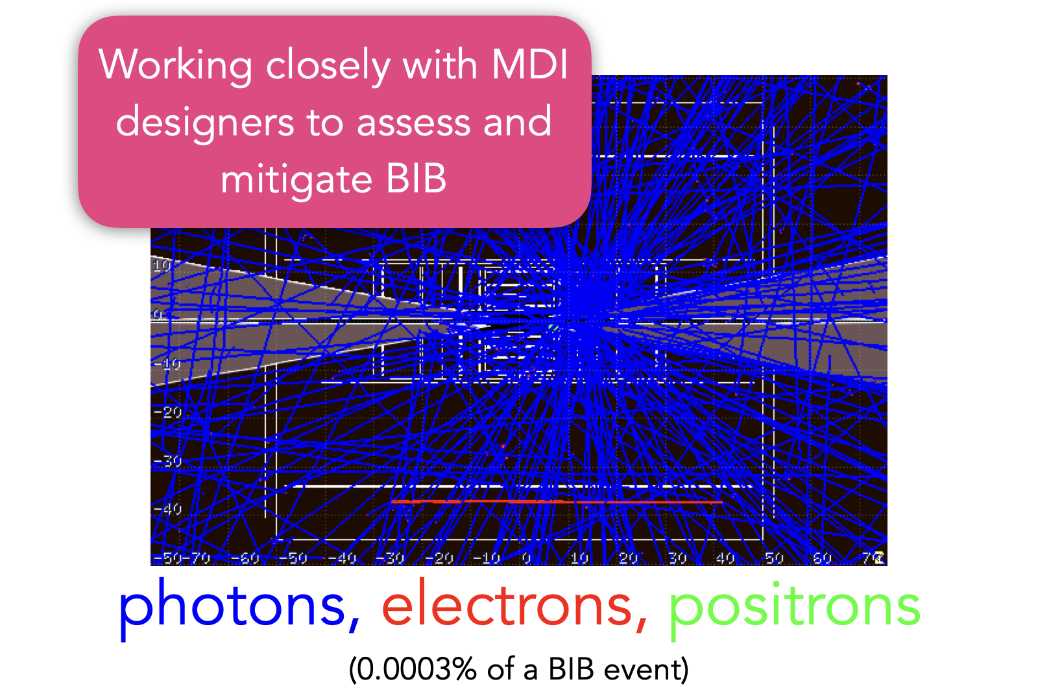
Experimental Challenge
Exp. Parallel and Poster Sessions
Beam-Induced Backgrounds dictate detector design and technologies
Major progress in suppressing the backgrounds:
  Improving the Interaction Region design
  Optimizing shielding nozzles in forward region
  4D detector technologies and developing novel algorithms
Fundamentally reducible: unlike pp the backgrounds are out-of-time and largely not from the IP
  Can be mitigated with precision spatial and timing detectors and advanced algorithms

Slide 26

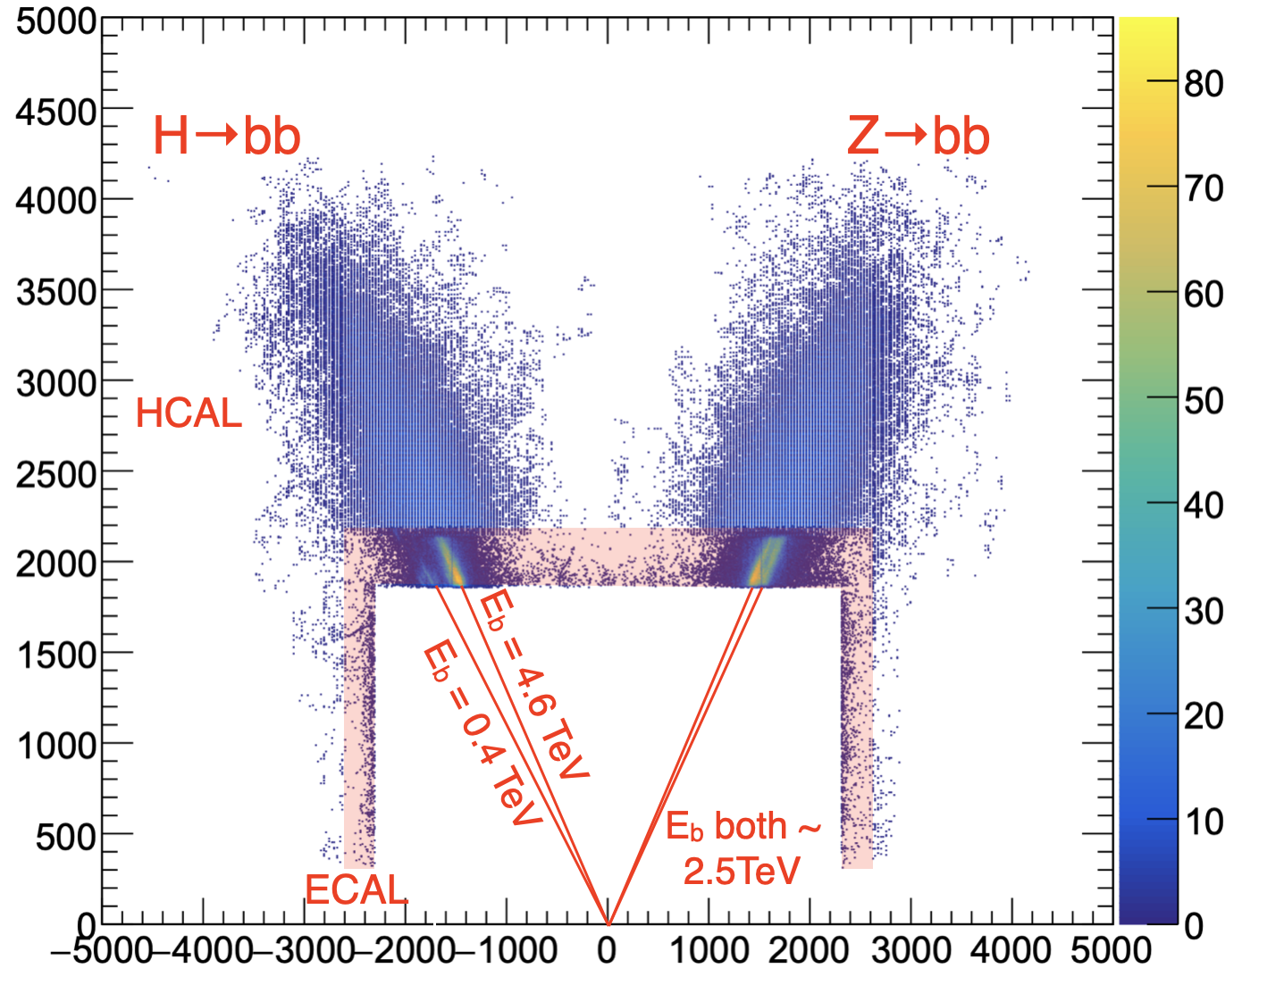
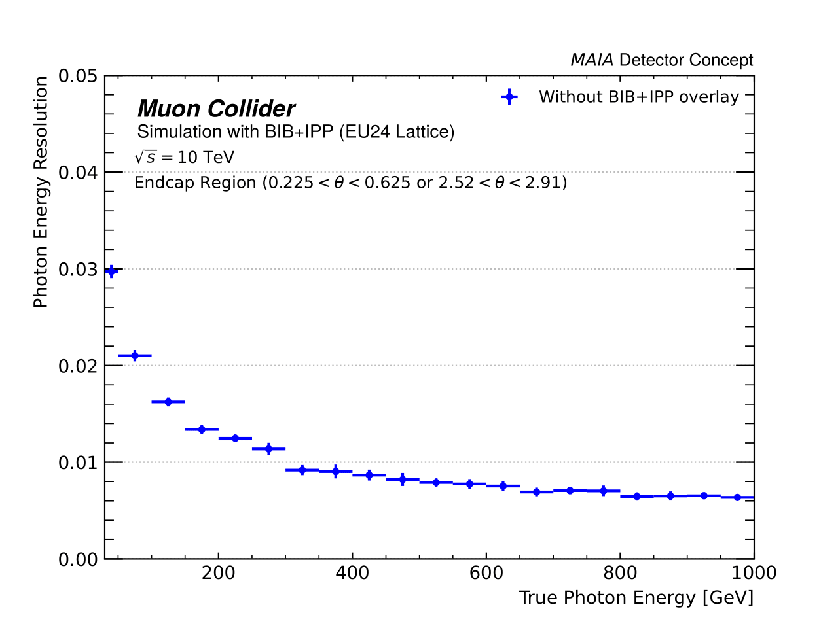
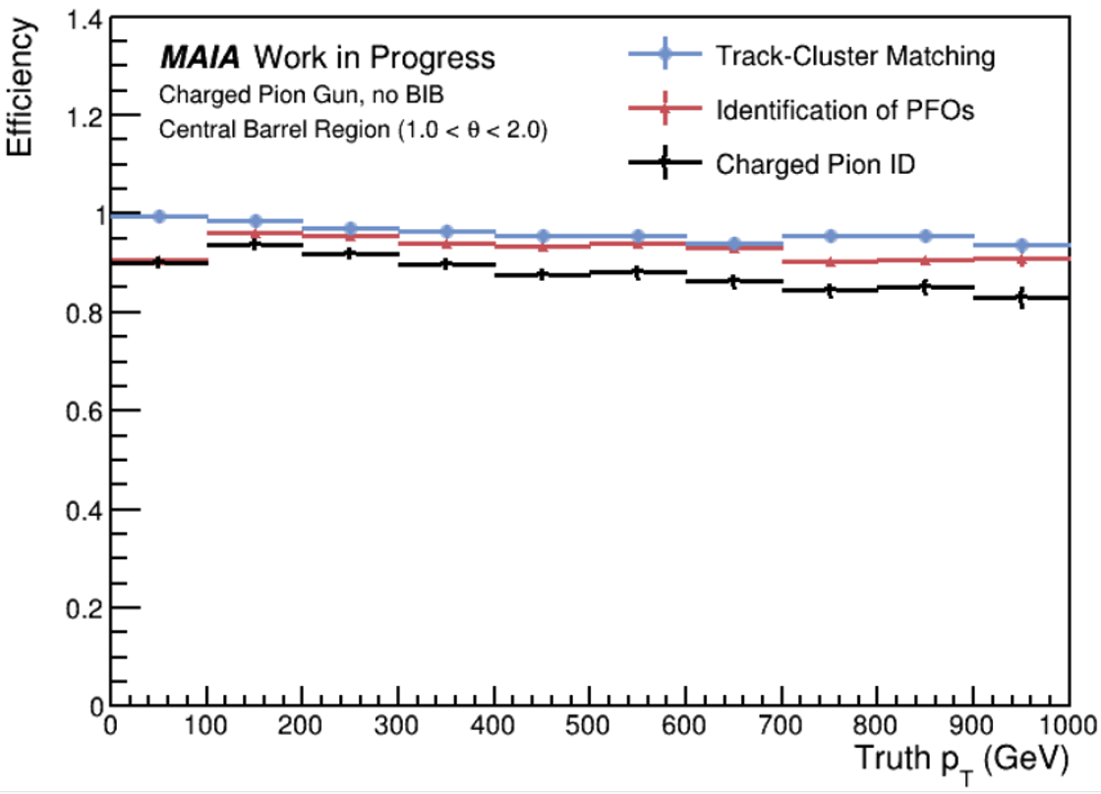
Detector Development
Talk by Simone
[2502.00181]
Two design concepts (MAIA and MUSIC) for a 10 TeV detector:
  Good physics performance achievable with both
  One (MAIA) primarily developed by US institutions
Modern and Flexible Software and Computing is Crucial!
Detector R&D needed:
  With investment, should be ready to maximize physics potential by the time accelerator technology is ready
  5 TeV hadronic boson decays!
P. Chang
  photon
  charged pion
R. Powers
G. Penn

Slide 27
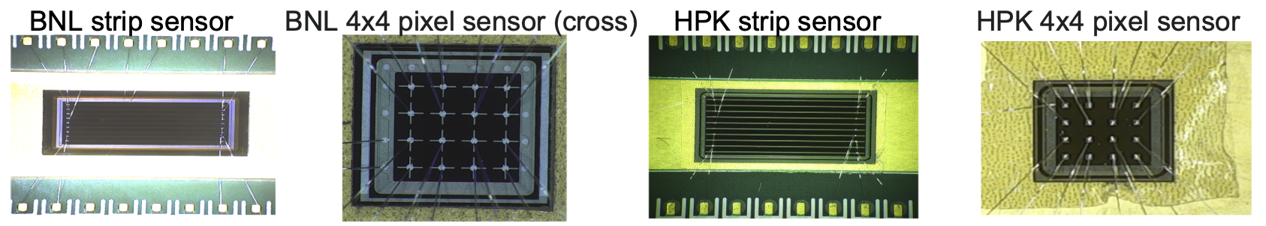
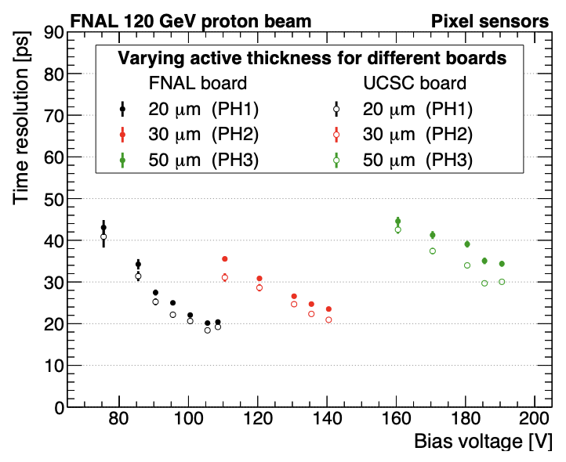
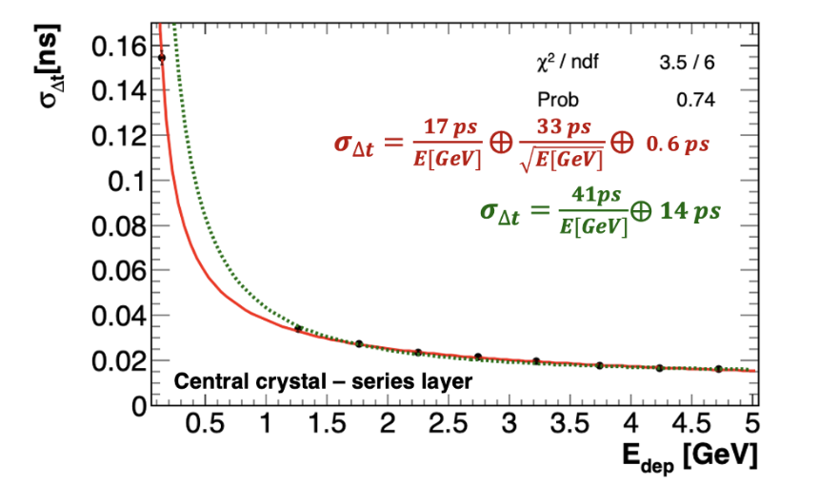
Detector Technologies
Talks by Nadia and Cristian
Identify promising technologies
Silicon based Sensor Technologies - very rapidly developing area – from LGADs to Quantum detectors
PF and Dual Readout Calorimetry
Novel DAQ architectures
Many opportunities for contributions:
  ASIC and Magnet need long lead time
  Power Distribution
  Readout
  Mechanics and Assembly
  Forward detector, Luminosity, PID
G. Penn
Notes:
Details about MAIA progress
Baseline objects ➞ more complex
Working with changing MDI
From Simone:
* we have established two baseline 10 TeV detectors and proven with full simulation we can extract the needed physics observables the accuracy needed for our physics program
* we need next to identify and down-select technologies that best suit the requirements and provide possibly even better performance
* BIB rejection is still in its infancy and new techniques, nozzle and detector designs can likely heavily further improve the situation (examples from the Crilin studies with detailed digi or studies that were done on the tracker)

Slide 28
Muon Accelerator Synergies
Talks by Cari, Matheus, Ryuichiro and others
Muon Beam Dump
CLFV Program
Proton Beam Dump
Precision Meson
Short- and long- baseline neutrino programs
Very high energy neutrino physics

Slide 29
Upcoming Muon Collider Meetings
International Muon Collider Demonstrator workshop:
  University of Milan, Italy, Nov 5-7th 2025, Indico will be available soon
2026 IMCC Annual Meeting:
  CERN, June 22-26th , 2026
2026 US MCC Meeting:
  planned at SLAC, dates TBD
2026 Muon Collider Accelerator School just starting to discuss – lessons learned from the school this week
Will also plan detector and generator tutorials in 2026

Slide 30
Summary
Muon Collider complex offers amazing physics opportunities.
Requires significant global R&D program – US community is ramping up
Big challenges to solve across accelerator/theory/experiment - need people, resources, creative ideas – please join the effort
Stay in touch:
    Self subscribe to the mailing list
    Join the SLACK channel

Slide 31
Backup

Slide 32
Theory progress since last year
Community focus was on the European Strategy Update
  Many US theory participants were editors, chapter authors, PPG response contributors for IMCC submission
Continued exploration of BSM models at energy frontier and precision EW studies – extending to exploration of phenomena tied to e.g. “EW restoration”
Exploration of new opportunities specific to muon collider
  Flavor physics isn’t just tied to muon-phillic operators but can be a powerful probe for generic flavor operators by combining energy with precision
  High energy neutrinos with forward experiments could provide exquisite sensitivity for CKM elements (even compared to FCC-ee) and unparalleled PDF measurements at moderate to large x
Many studies in progress adding more detailed background studies that will allow better benchmarking for detector development

Slide 33
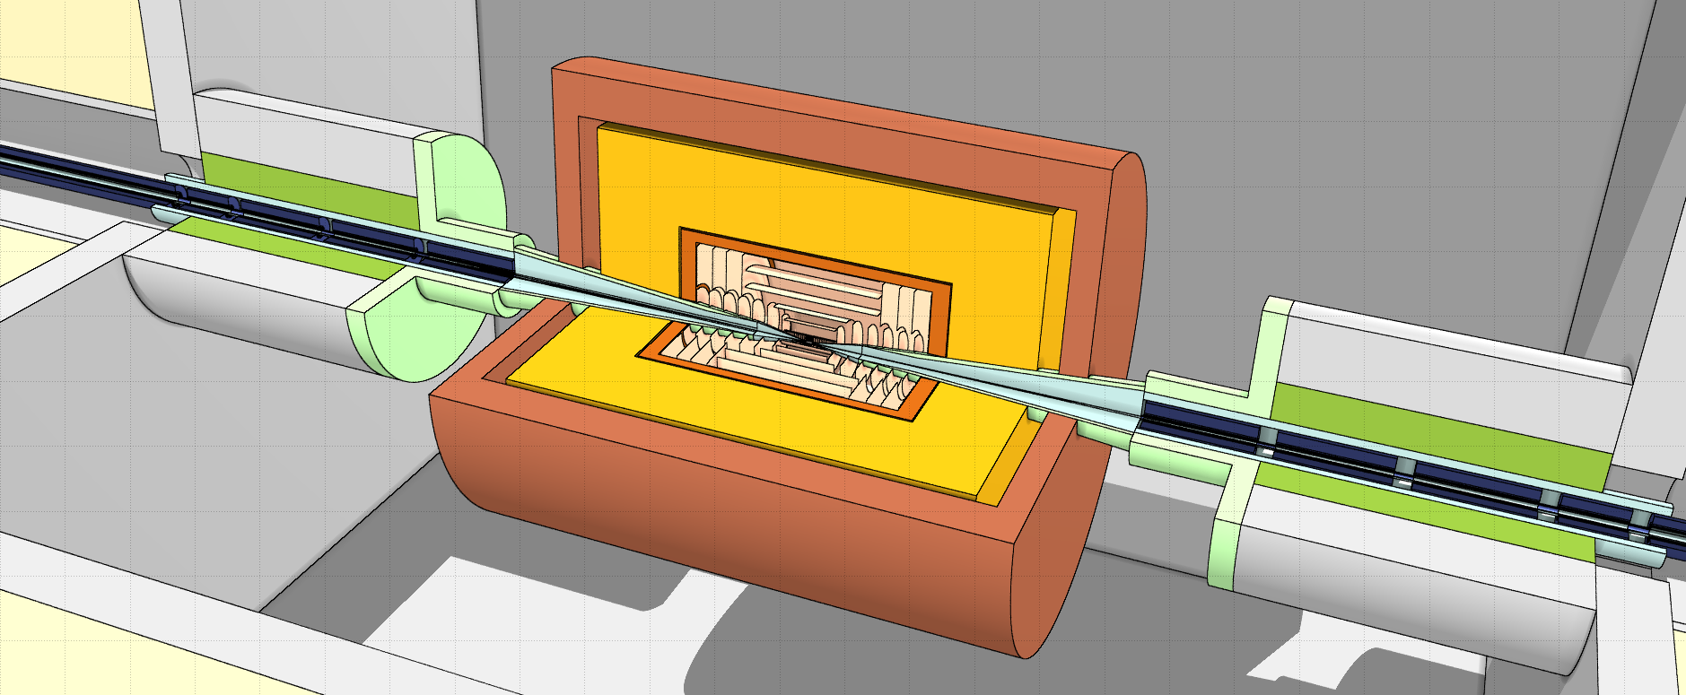
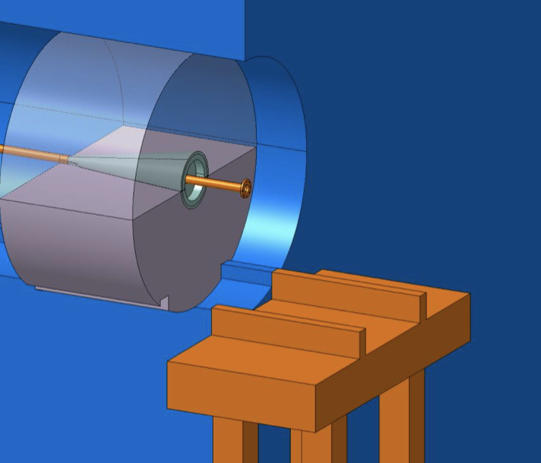
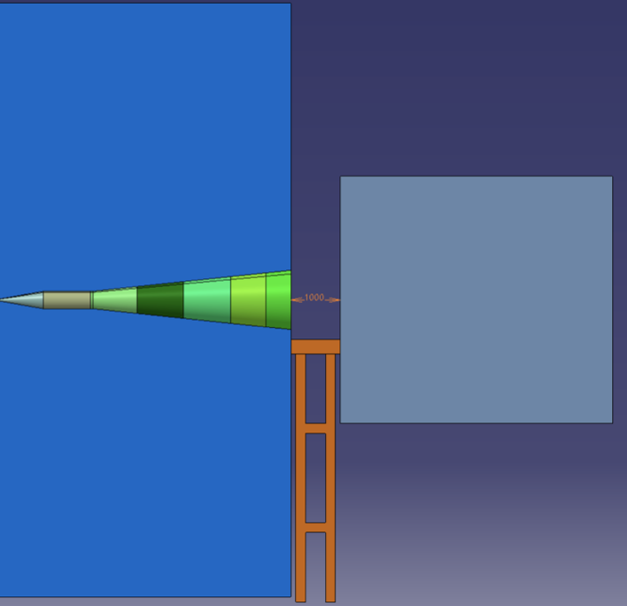
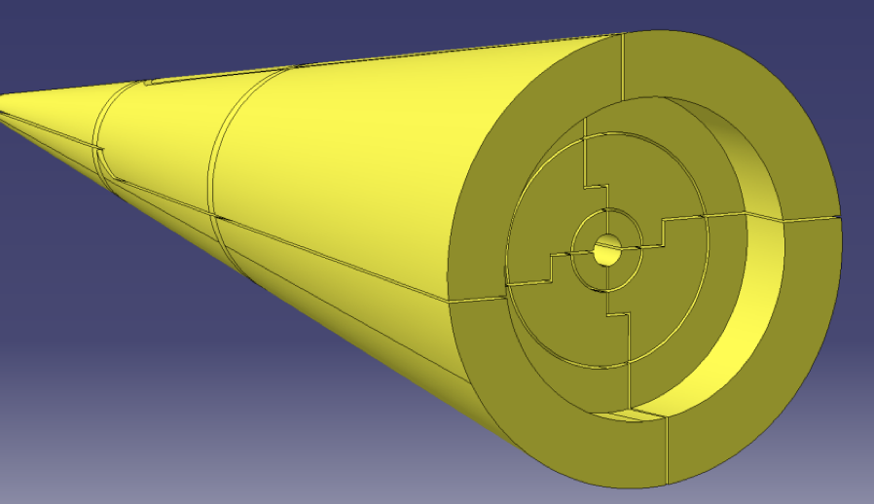
MDI Challenges
Very challenging lattice design:
  Key points: momentum acceptance, alignment requirements for IR magnets, IR magnet apertures vs achievable field strength
Combined optimization of the interaction region, the nozzles and the detector
Design, assembly, support, integration and alignment of the nozzles and central beam chamber
Important to start with global MDI integration studies in order to define space requirements and interfaces

Slide 34
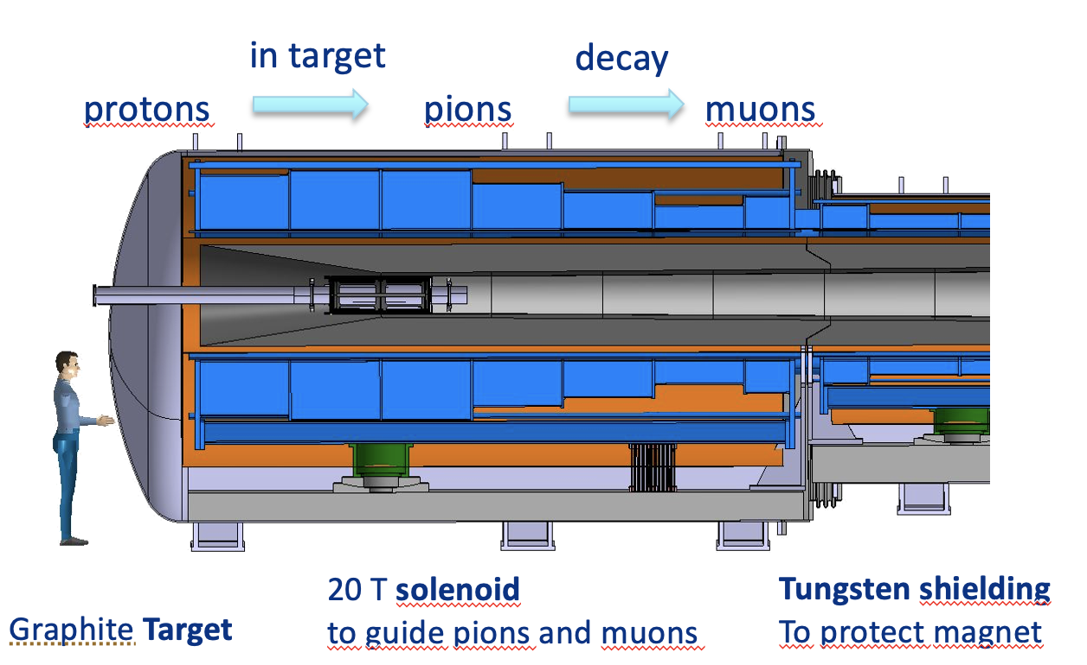
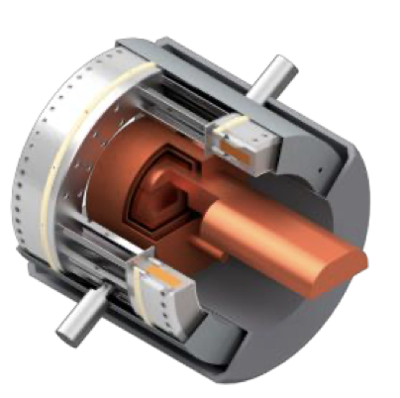
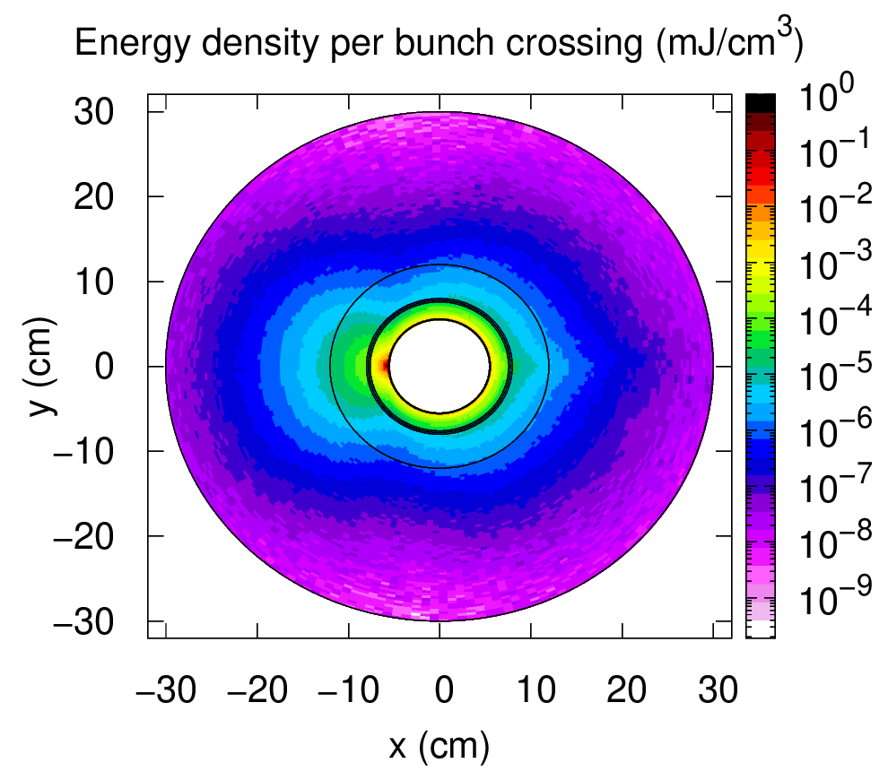
Muon Collider Needs: Accelerator Technology
Optimal performance of a Muon Collider requires significant development in several areas of accelerator technology, including:
  High Power Targets and Capture systems
    Ability to withstand large thermal and structural shock
    Large B superconducting magnets in high radiation environment
  RF cavities:
    High gradient NC cavities for cooling that have to operate in multi-T fields
    High gradient SC cavities for acceleration that tolerate muon decay products
  A variety of different Magnets:
    High-field solenoids for the Cooling channel
    Fast ramping dipoles for the muon acceleration
    High-aperture and field dipoles and quadrupoles in the collider ring
Shielding
Coil

Slide 35
Muon Collider Needs: Accelerator End-to-end Design
Muon Collider accelerator complex includes ~10 different sub-systems that are tightly interconnected due to non-stable nature of the colliding particles
Designs for various sub-systems exist:
  Developed by Muon Accelerator Program
  Refined or revisited by IMCC, considering new ideas and evolution of accelerator technologies
A full end-to-end simulation framework which puts all the sub-systems together in a coherent fashion is necessary in the next 5 for the “reference” design
  Pin down performance of the machine in simulation
  Study and compare various configurations and trade-offs for further developments

Slide 36




Muon Collider Needs: Ionization Cooling
$$L=\frac{N_{+}N_{−}n_{C}f}{4πσ_{x}σ_{y}}$$
Need to cool muons to achieve target luminosity!
Each cell reduces emittance by ~10%. Repeat O(100) times = cooling channel
…
Not all cells identical

Slide 37


Fermilab Accelerator Complex Evolution (ACE)
Fermilab accelerator provides a variety of different beams to the user experiments
Modernization and upgrades of the complex are ongoing or planned (more in Sasha’s talk)

Slide 38



Can ACE provide the Proton Source?
Proton beam ranges for optimal performance :
  1-4 MW @ 5-20 GeV,
  Narrow bunches 1-3 ns
  5-10 Hz frequency
Requires work to study bunch accumulation, compression and collective effects to convert ranges into specific set of parameters

Slide 39

PIP-II as part of the Muon Collider Proton Driver
PIP-II Project provides
New SRF linac for injection into Booster at 800 MeV (present 400 MeV)
New Beam Transfer Line (BTL) from Linac to 8 GeV Booster,
Booster cycle rate upgraded to 20 Hz from 15 Hz
Increased proton beam intensity at 8 GeV for 1.2 MW beam power from MI
The present PIP-II linac current appears too low for the MC Proton Driver
There are ideas on how to adopt/adjust the PIP-II linac design, but requires a detailed study

Slide 40

New Booster as part of the Muon Collider Proton Driver
Past Booster Replacement designs focused almost entirely on DUNE needs
Muon Collider adds a new goal for the ACE-BR design choices
Need to evaluate compatibility with potential modifications for the PIP-II linac
Sketches of potential configurations for ACE-BR

Slide 41

Potential US timeline shown to P5
The timeline is slightly shifted (but not inconsistent) with IMCC timeline due to US specific budgetary and resource constraints

Slide 42


Resource Request to P5 – R&D Phase (first 7 year)
Accelerator Labor
M&S ramp up to at least ~5M/year for the accelerator and ~1.5M/year for detector R&D
Assumed equal contribution from Europe to maintain the current R&D plan
Detailed profile for the Demonstrator Phase (2030+) was not provided, only top-down estimates were made
Work is ongoing with IMCC to develop such profile
Year: 1 2 3 4 5 6 7
Physics and Detector Labor
Year: 1 2 3 4 5 6 7

Slide 43


Acceleration of Muons
DC field
Pulsed from ${−B}_{w}$ to ${+B}_{w}$
  Rapid Cycling Synchrotron accelerators
  Fast ramping magnets (up to 1000 T/s) accompanied with 16 T DC magnet
  Design of efficient energy sources with good power management (10s of GW) for pulsed magnets is the key

Slide 44

Collider Ring Needs
IR region (high-B quads)
bend region (high-B dipoles)
  Dipoles with strong field (12-16 T for 10 TeV) and large aperture
  Quadrupoles with strong fields for the IR (15-20 T for 10 TeV)
  Power loss due to muon decay 500 W/m → requires tungsten shielding + cooling
Shielding
Coil

Slide 45





Slide 46

in target
decay
protons
pions
muons
20 T solenoid
to guide pions and muons
Tungsten shielding
To protect magnet
Graphite Target
  Thermal and structural shock on the target due 2-4 MW and short proton bunches
  Study different materials, shapes, size optimization, advanced target concepts
  Focusing magnet is challenging due to field strength, size and radiation load

Slide 47


Cooling Cells
Early cell (“easy”) – 2T peak
Late cell ( “hard”) – 14 T peak
  Large bore solenoidal magnets: From 2 T (500 mm IR), to 14 T (50 mm IR)
  Normal conducting RF that can provide high-gradients within a multi-T fields
  Absorbers that can tolerate large muon intensities
  Need to further optimize the design considering engineering constraints

Slide 48


BIB Challenges
Beam background is one of the unique features/challenges of Muon Colliders
  10⁶ muon decays per meter Simulating the BIB is a computational challenge
Machine-Detector Interface requires careful design optimization and engineering studies
Next step in evolution of detectors, hybrid of LHC and Higgs Factory needs. Requires novel detectors - opportunities for innovative detector designs and technology!

Slide 49


BIB Suppression
The BIB is mostly low energy, out of time and not pointing to the Interaction Point
Some similarities with LHC pileup - can build on that experience!

Slide 50


Detector Design – radiation environment

Slide 51



Tracker Challenges
Occupancy per layer with 1% target directly translates into feature size and timing resolution
On detector data suppression is important

Slide 52

Calorimeter Design
High granularity and shorter integration windows
Hit time measurement O(100ps)
Longitudinal segmentation
Perfect application for AI-based clustering and reconstruction algorithms

Slide 53


Performance Examples
Track relative momentum resolution
BIB effects are small
Few % Photon Energy Resolution
Improvements possible at low E_{T}

Slide 54

Possibilities during the ACE-MIRT phase
The PIP-II proton accelerator will provide the intensity sufficient to power a new generation of high energy facilities at Fermilab
  Proton flux at 8 GeV increases during PIP-II era
  The 12-24 kW available for 8 GeV program would be suitable for a muon cooling demonstrator
  Other options at lower or higher energies should be explored

Slide 55

Site at Fermilab: Muon Campus
Designed to provide beam for the Muon g-2 and Mu2e experiments
  Capable to deliver 8 kW beam at 8 GeV to the Mu2e production target
  Available tunnel space to run the demonstrator without interfering with Mu2e
  Production target is similar to the MuC target
Excellent opportunity to examine targets under 5 T field

Slide 56
Muon Collider Challenges and Progress
Challenge | Progress | Future work
Multi MW proton sources with short bunches | Multi-MW proton sources have been and are being produced for spallation neutron sources and neutrino sources (SNS, ESS, J-PARC, Fermilab) | Refine design parameters, including proton acceleration to 5-10 GeV. Accumulation and compression of bunches.
Multi MW targets | Neutrino targets have matured to 1+MW. RADIATE studies of novel target materials and designs aim at 2.4MW. | Develop target design for 2 MW and short muon collider bunches. Produce a prototype in 2030s.
Production solenoid | ITER Nb3Sn central solenoid with similar specifications and rad levels produced | Study cryogenically stabilized superconducting cables and validate magnet cooling design. Investigate possibility of HTS cables.
Cooling channel solenoids | Solenoid with 30+T field now exists at NHMFL. Plans to design 40+T solenoids in place. | Extend designs to the specs of the 6D cooling channel, fabrication for the demo experiment
Ionization cooling | MICE transverse cooling results published. Longitudinal cooling via emittance exchange demonstrated at g-2. | Optimize with higher fields and gradients. Demonstrate 6D cooling with re-acceleration and focusing
RF in magnetic field | Operation of up to 50 MV/m cavity in magnetic field demonstrated, results published | Design to the specs of the 6D demo, experiment; fabrication

Slide 57
Muon Collider Challenges and Progress
Challenge | Progress | Future work
Fast Ramping Magnets | Demonstrated with 290 T/s up to 0.5T peak field at FNAL. Ramps up to 5000 T/s demonstrated with small magnets. | Design and demonstration work to achieve higher ramp rates (up to 1000 T/s) and peak fields of ~2T with large magnets
Very Rapid Cycling Synchrotron Dynamics | Lattice design in place for a 3 TeV accelerator ring | Develop lattice design for a 5 TeV accelerator ring
Neutrino Flux Effects | Mitigation strategies based on placing the collider ring at 200m and introducing beam wobble has been shown to achieve necessary reduction up to 10-14 TeV | Study mechanical feasibility, stability and robustness of the mover's system and impact on the accelerator and the beams
Detector shielding and rates | Demonstrated to be manageable in simulation with next generation detector technologies | Further develop and optimize 3 and 10 TeV detector concepts and MDI. Perform detector technology R&D and demonstration.
Open aperture storage ring magnets | 12-15T Nb3Sn magnets have been demonstrated | Design and develop larger aperture magnets 12-16T dipoles and HTS quads
Low-beta IR collider design and dynamic aperture | Lattice design in place for a 3 TeV collider with optics and magnet parameters within existing technology limits | Develop lattice design for a 10 TeV collider

Slide 58
Muon Collider Synergies
Facility/Experiment | Physics Goals | Synergy
nuStorm | Short baseline neutrino program, including searches for sterile neutrino and cross section measurements | 100kW proton source, muon production and collection, storage ring operation
Neutrino Factory (e.g. nuMax) | Better CP, mixing angles, mass splitting, non-standard interactions | MW class proton source, muon production and collection, 6D partial cooling and muon acceleration (up to ~5 GeV)
Dark Sector searches | Searches for particles from Dark Sectors produced in fixed target experiments using high intensity proton beam | MW class high-intensity proton beams
Charged Lepton Flavor Violation (e.g. AMF) | Searches for rare lepton flavor violating proceses (mu2e, mu2eg, mu3e, etc) | MW class proton source, muon production and collection, storage ring
Beam dump experiments | Searches for exotic particles (dark photons, Lmu-Ltau, etc) in muon beam dump experiments | 100kW – MW proton source, muon production and collection, partial cooling and acceleration
Neutrinos from collider beam muon decays | DIS in neutrino-nucleus interactions, better nuclear PDF, atmospheric neutrinos FASERν like experiment with smaller flux uncertainties | Everything up to multi-TeV energy collider beams
Muon Ion Collider | A broad program addressing many fundamental questions in nuclear and particle physics | Everything up to multi-TeV energy collider beams

