Slide 1
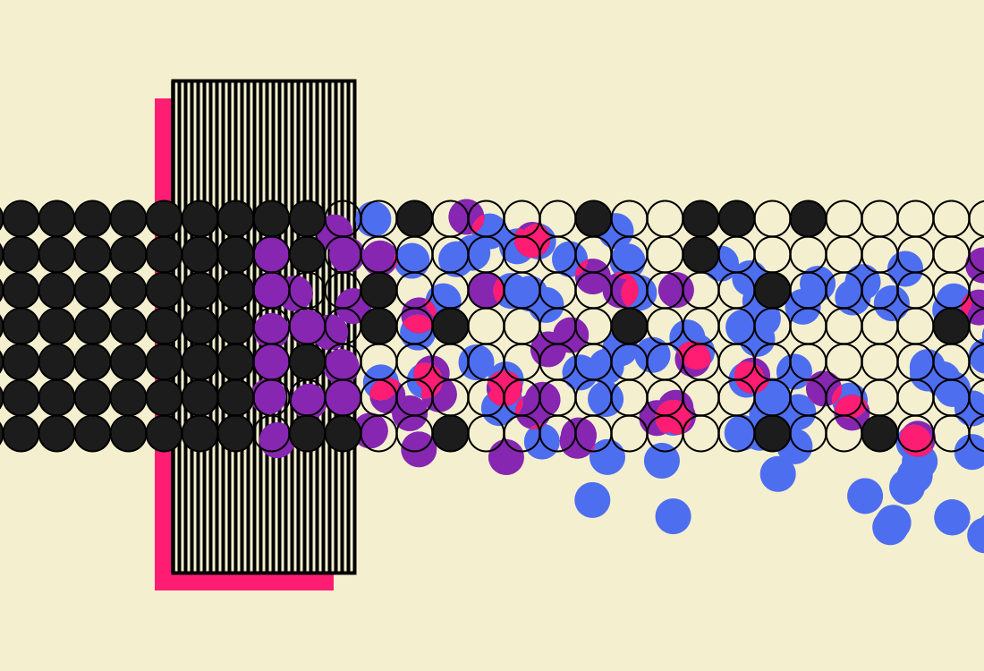
Detector and Accelerator Synergies
What can an experimental particle physicist do to advance muon collider project, besides promoting physics case and detector development?

Slide 2
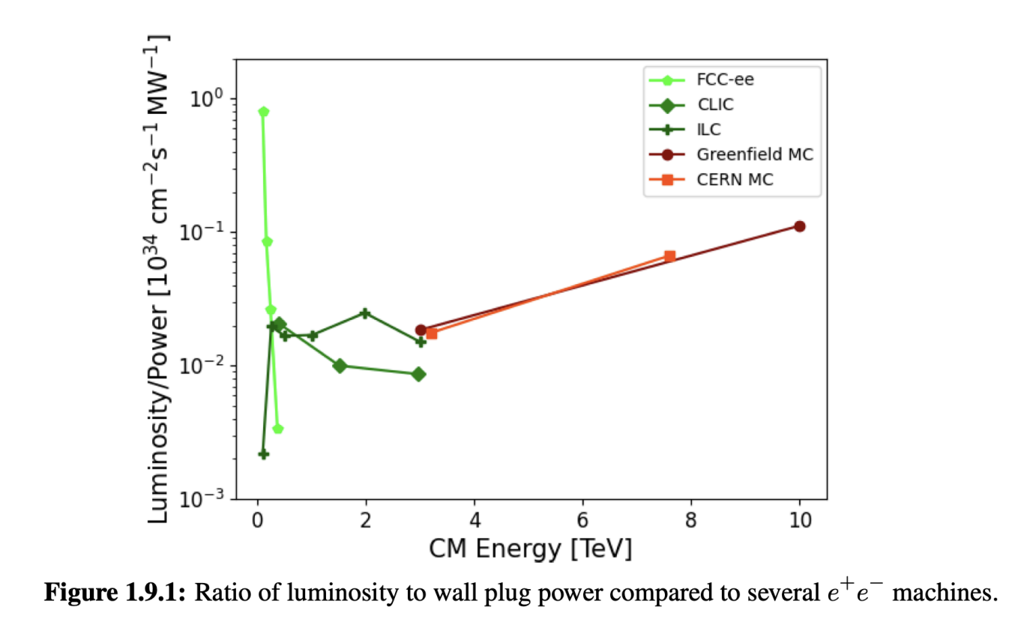
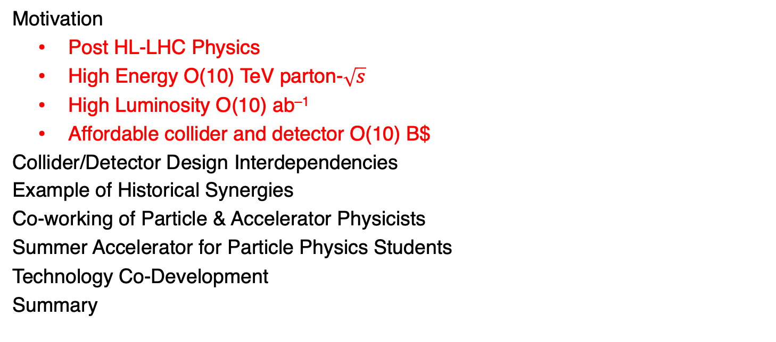
Outline
Motivation
  Post HL-LHC Physics
  High Energy O(10) TeV parton-$\sqrt{s}$
  High Luminosity O(10) ab^{–1}
  Affordable collider and detector O(10) B$
Collider/Detector Design Interdependencies
Example of Historical Synergies
Co-working of Particle & Accelerator Physicists
Summer Accelerator for Particle Physics Students
Technology Co-Development
Summary

Slide 3
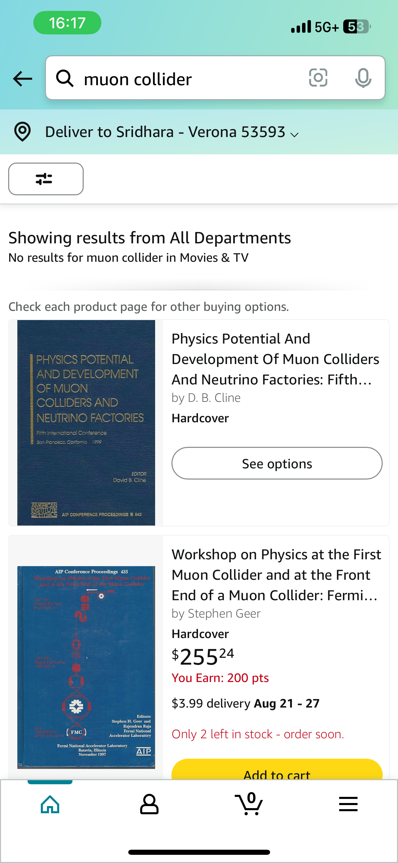
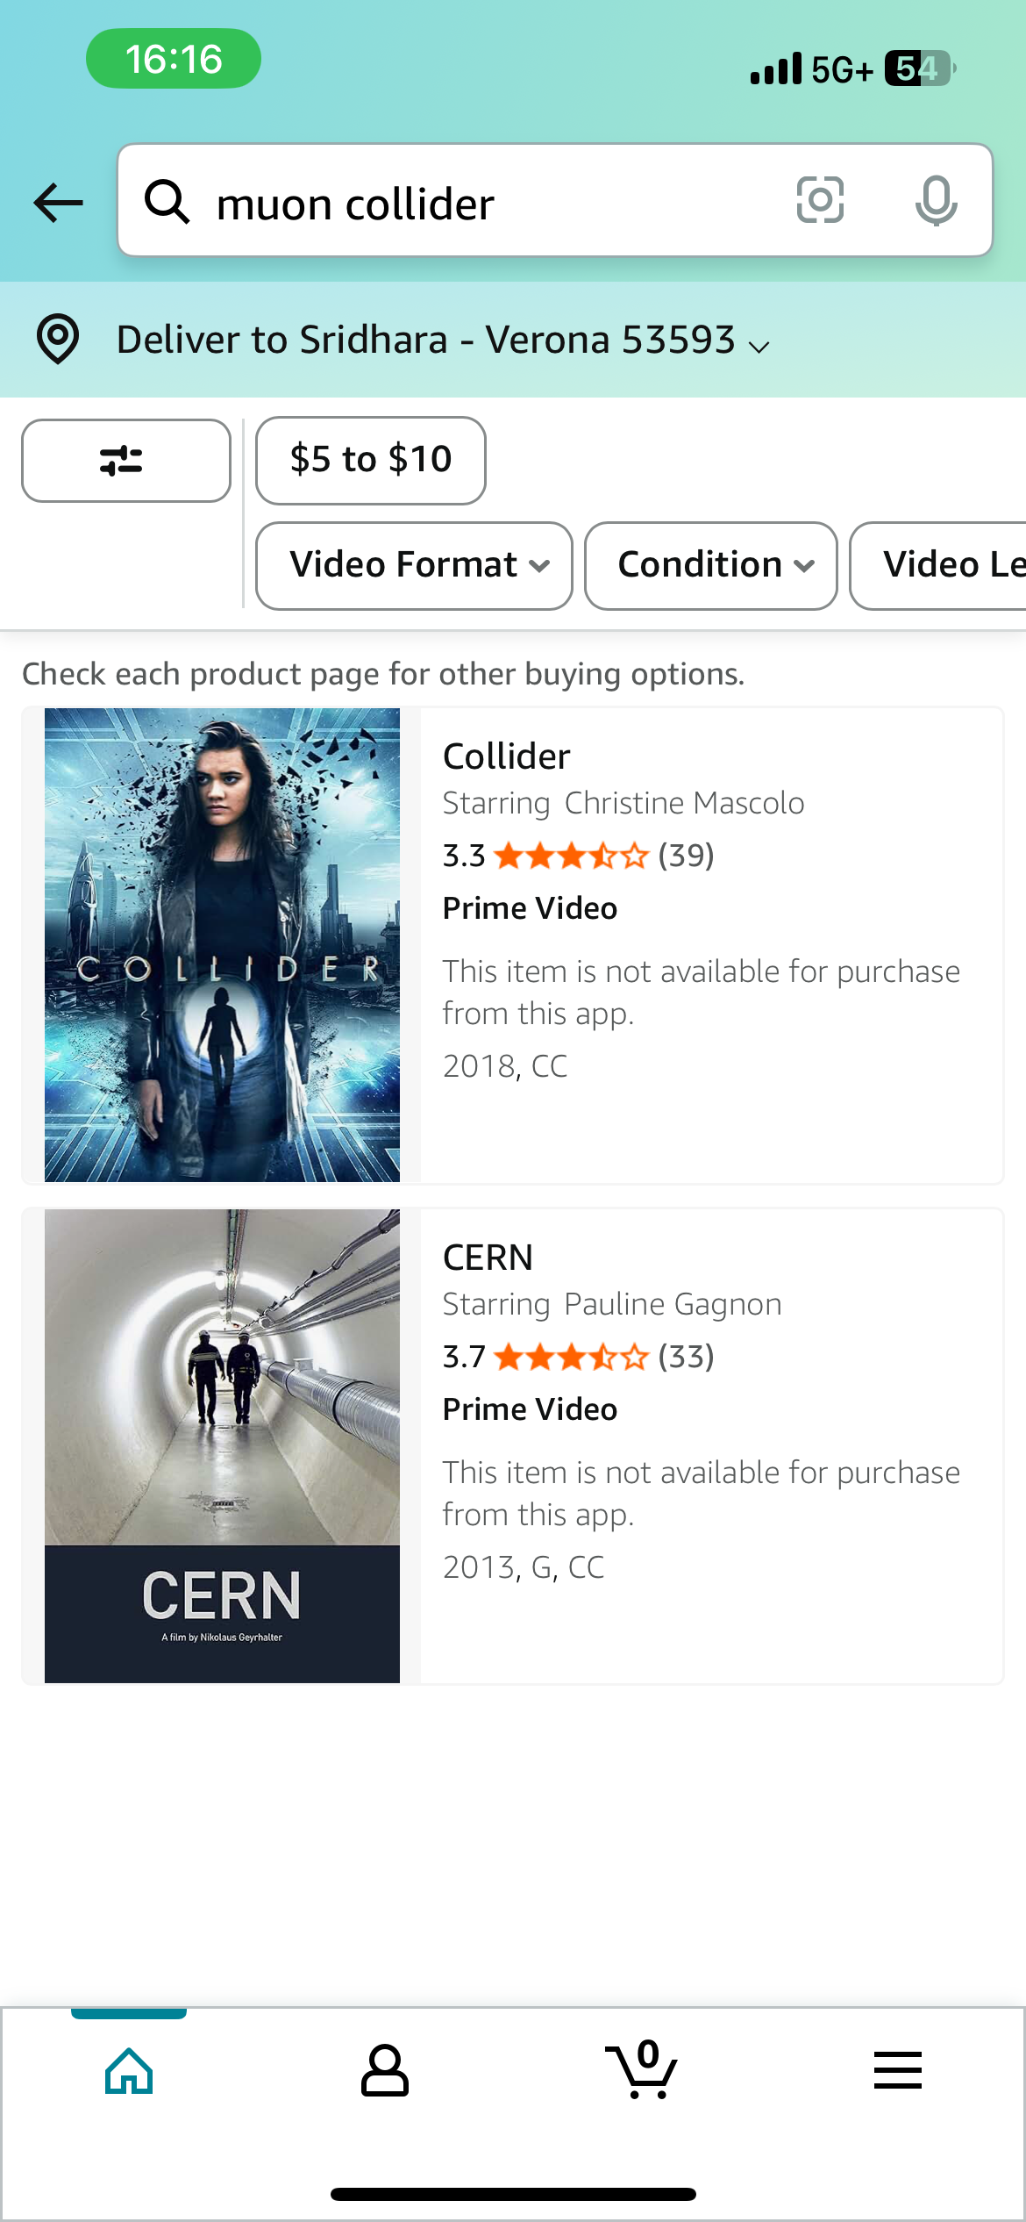
Motivation is Strong!
We need to get 10-TeV scale soon!
Muon Collider Needs are Unique
  Muon beam production
    High power proton beam, Target, Beam cooling
  Muon lifetime
    Fast beam processing to retain produced muons
  Decay remnant backgrounds
    Superconducting magnet shielding
    Detector shielding
    Detector occupancy mitigation
      On-detector background hit filtering
    Radiation hazards mitigation
+ All the usual particle beam diagnostics, luminosity measurement, …
  Multitude of opportunities for detector and accelerator communities to work in unison!
3

Slide 4
Design Interdependencies
Physics need – High Energy O(10) TeV – High Luminosity O(10) ab^{–1}
  Muon collider shines at higher energies
  Challenges (Physics 🔄 Accelerator 🔄 Detector)
    Produce large numbers of muons and bunch them; target issues; high B fields
    Cool muon bunch down to micron size as quickly as possible; high B fields – RF in B
      Single large colliding bunch to maximize luminosity; no pileup issue
    Accelerate them quickly to highest energies; fast ramp magnets
    Manage to live with high-energy electrons from muon decays
      Shielding structures take up angular acceptance – forward muon acceptance?
      Detectors that tolerate large low energy particles shower remnants
        Smart frontend electronics; AI on a chip?
    Mitigate radiation hazards; High energy νs – perhaps, some useful physics?
Many issues to study – Physics – Accelerator – Detector interplay – integrated development

Slide 5
Historical Synergies
Example of SLC / SLD
  SLC was unique - required particle physicist input
    Special polarized electron source development
    Polarimeters to measure beam polarization
  SLC startup was difficult - Several particle physicists put on different hats and helped get SLC to work well enough to produce world-class results
    Beam dynamics studies through the “complex” arcs
      Help limit emittance growth to get sufficient luminosity
    Improved polarization of electrons
      Worked with condensed matter physicists to design strained AlGaAs crystals to increase electron polarization from 40→80%
    Improved beam diagnostics and monitoring
      Everything from new instrumentation to databases/software

Slide 6
Historical Synergies
Example of Linear Collider Physics Environment
  Electron - Positron Energy and Luminosity
    Early realization that at very high energies energy-luminosity profile is more complicated than at lower energy machines on resonances due to ISR
      Careful studies – new programs for ISR
      High intensities – beam-beam interactions
      Particle physics input was necessary
  Beam diagnostics; monitoring and control
    Final focus is complicated
    Much collaboration amongst accelerator and particle physics community
  Beam polarization
    Beyond the SLC strained lattice sources
    Possible positron polarization retention in damping rings …

Slide 7
Co-working of
Particle & Accelerator Scientists
Both USMCC & IMCC include theory/experiment/accelerator people
  Accelerator design work is aplenty – need to get to 50 FTE in a few years
  Workforce limitations (even given funding), especially in the USA a concern
    Need to grow accelerator workforce
    We need to evolve to 100s of accelerator physicists to design and build the machine : demonstrator → the full machine
  Need student and postdoc participation in accelerator development
    Wholistic student program
      HL-LHC Particle Physics ←→ Muon Collider Design Studies
      University ←→ National Laboratory Partnership
    Can we actually accomplish this?

Slide 8
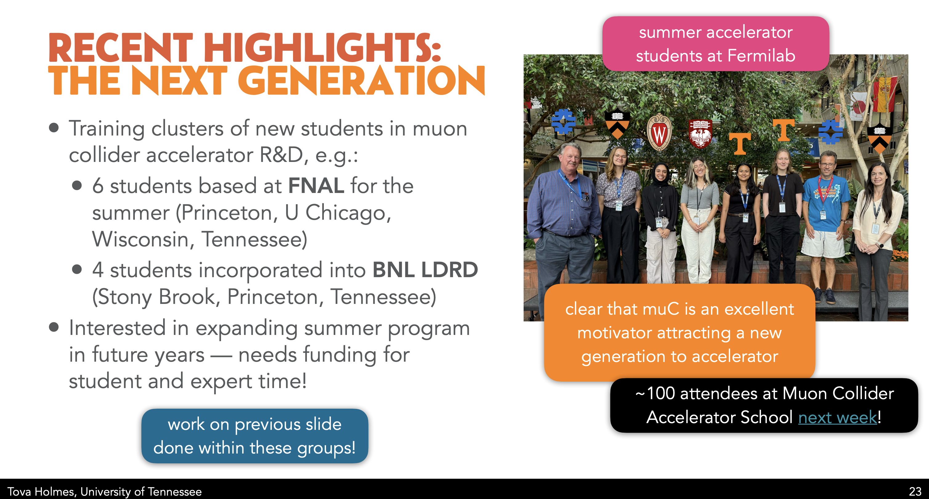
Summer Accelerator for
Particle Physics Students

Slide 9
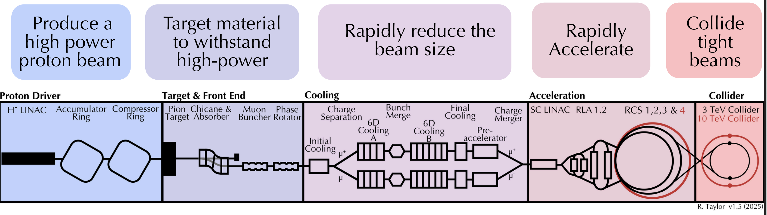
Building Synergies
Summer start from “scratch” – new students and FNAL accelerator experts
  What can be accomplished in a few months? Few years?
Cheng-Hsu Nee
Ruaa Alharthy
Prateek Rao
Caroline Rigalli
Inci Karaaslon
Rithika Ganesan
Kyle Capobianco-Hogan
HTS Magnets Materials: Rose Powers & Beam Instrumentation: Cecilia Hanna

Slide 10
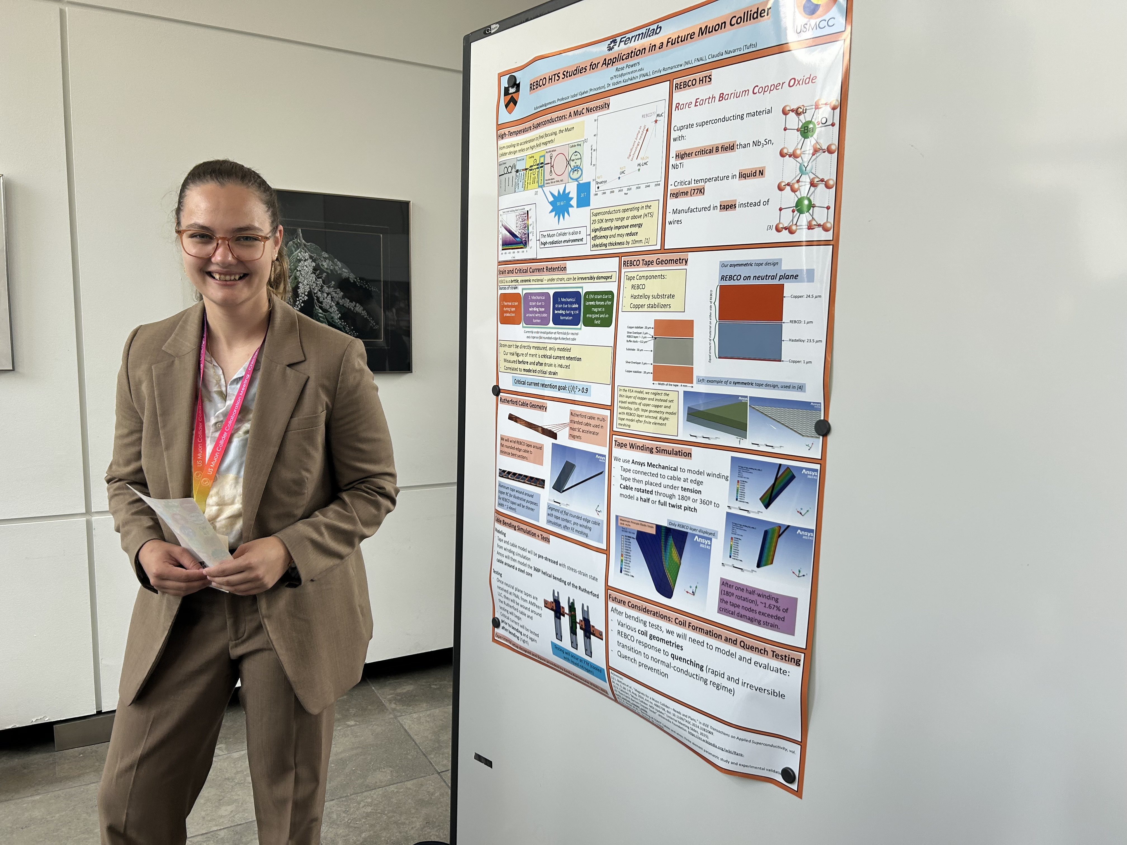
High Field Magnets
Rose Powers / Princeton
Working with Steve Gourlay
  Investigating REBCO for HTS magnet designs
  Key to get to 10-TeV!

Slide 11
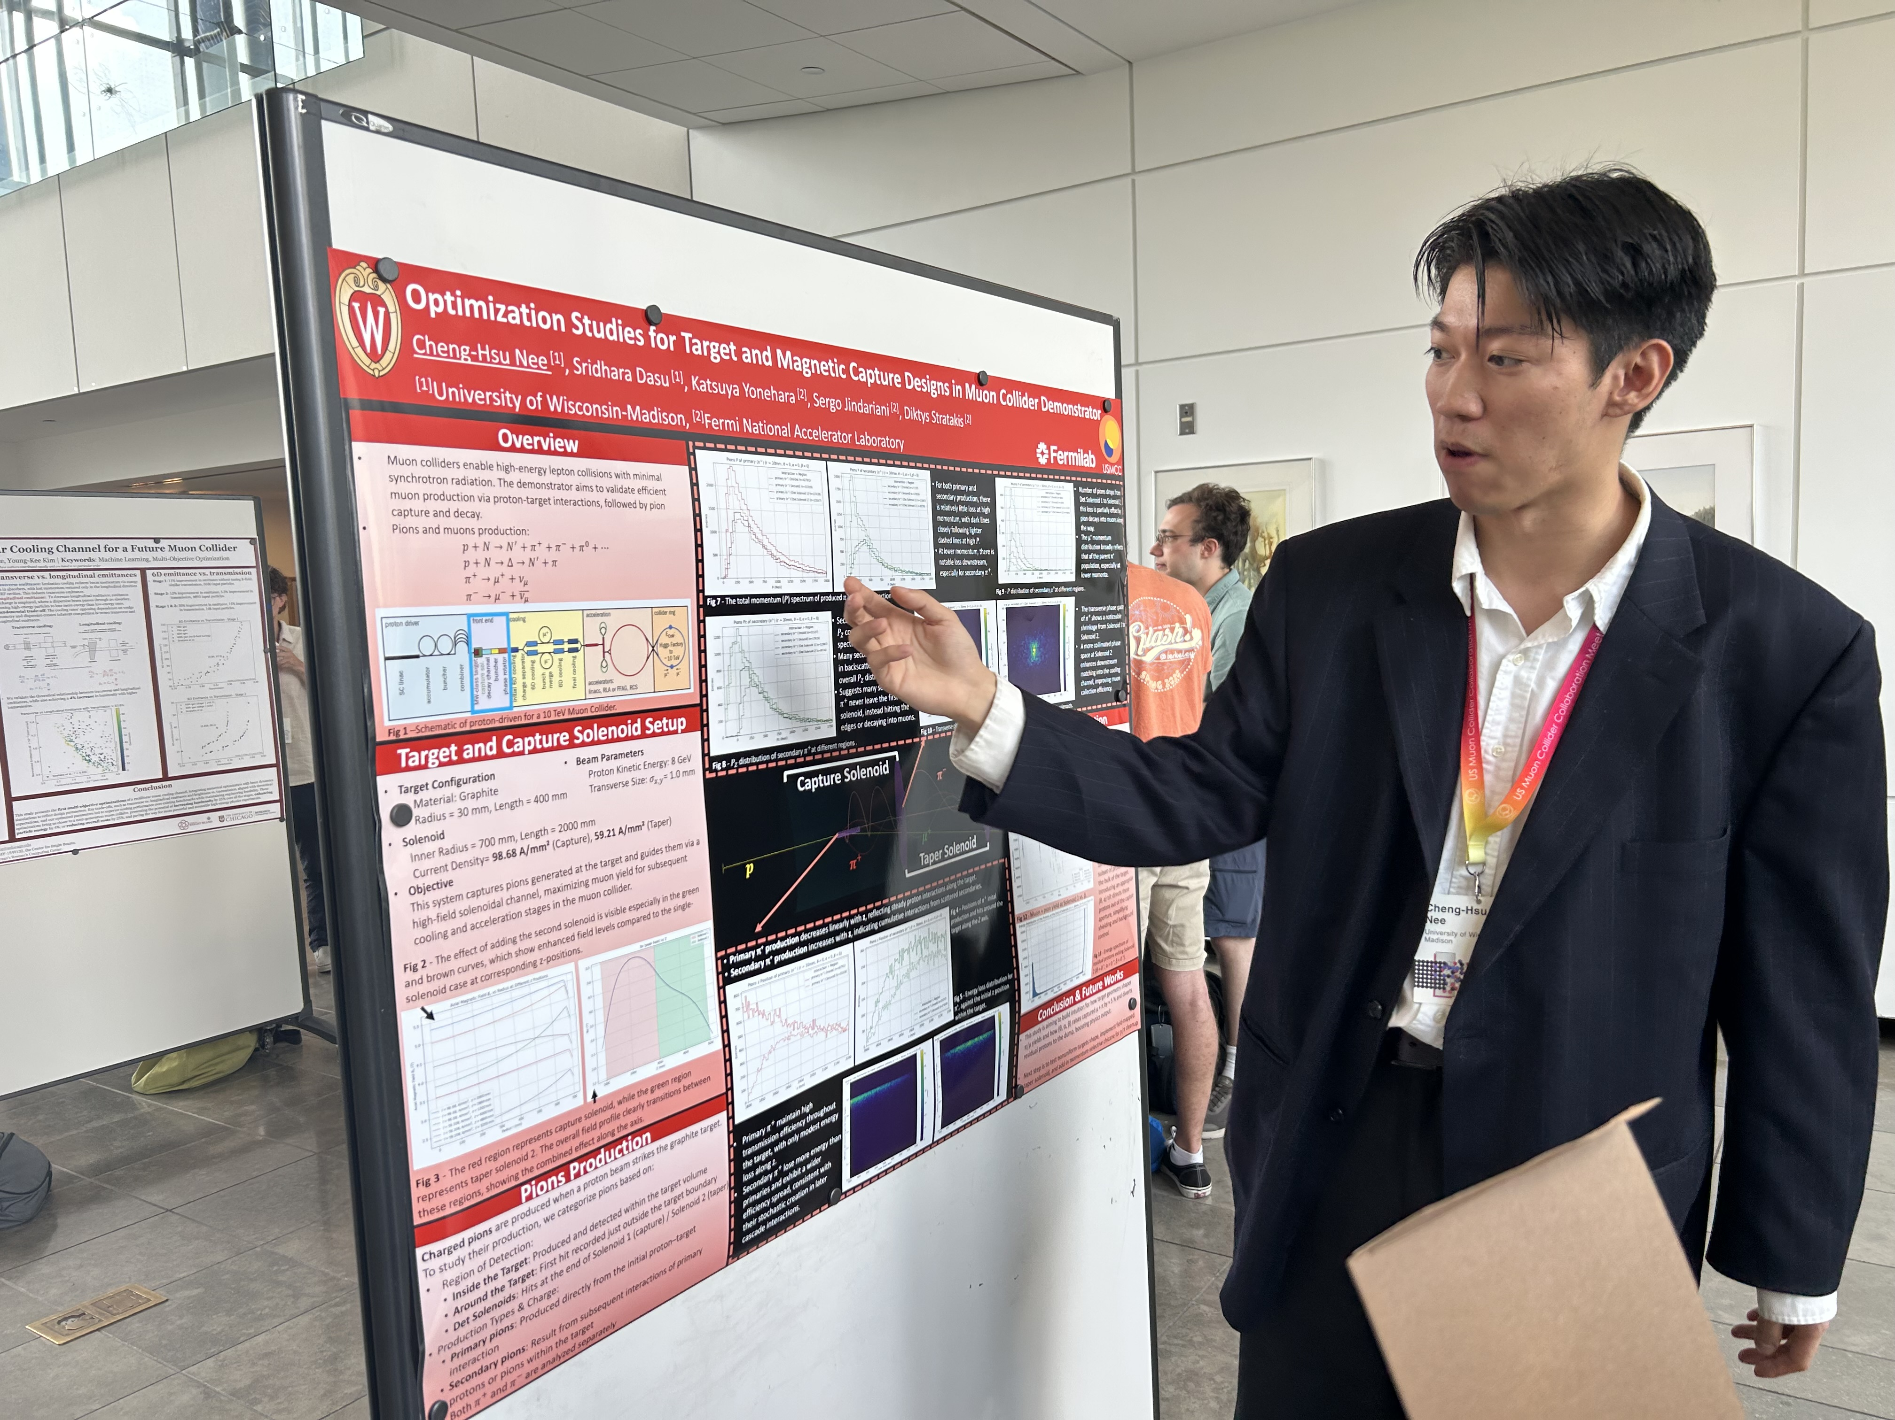
FNAL Demonstrator Target / Solenoid
Cheng-Hsu Nee / Wisconsin
Working with Diktys/Katsuya/Sergo
  Using G4Beamline to estimate pion/muon production rates
  Investigating target solenoid parameter choices
  Investigating target dimensions and geometry

Slide 12
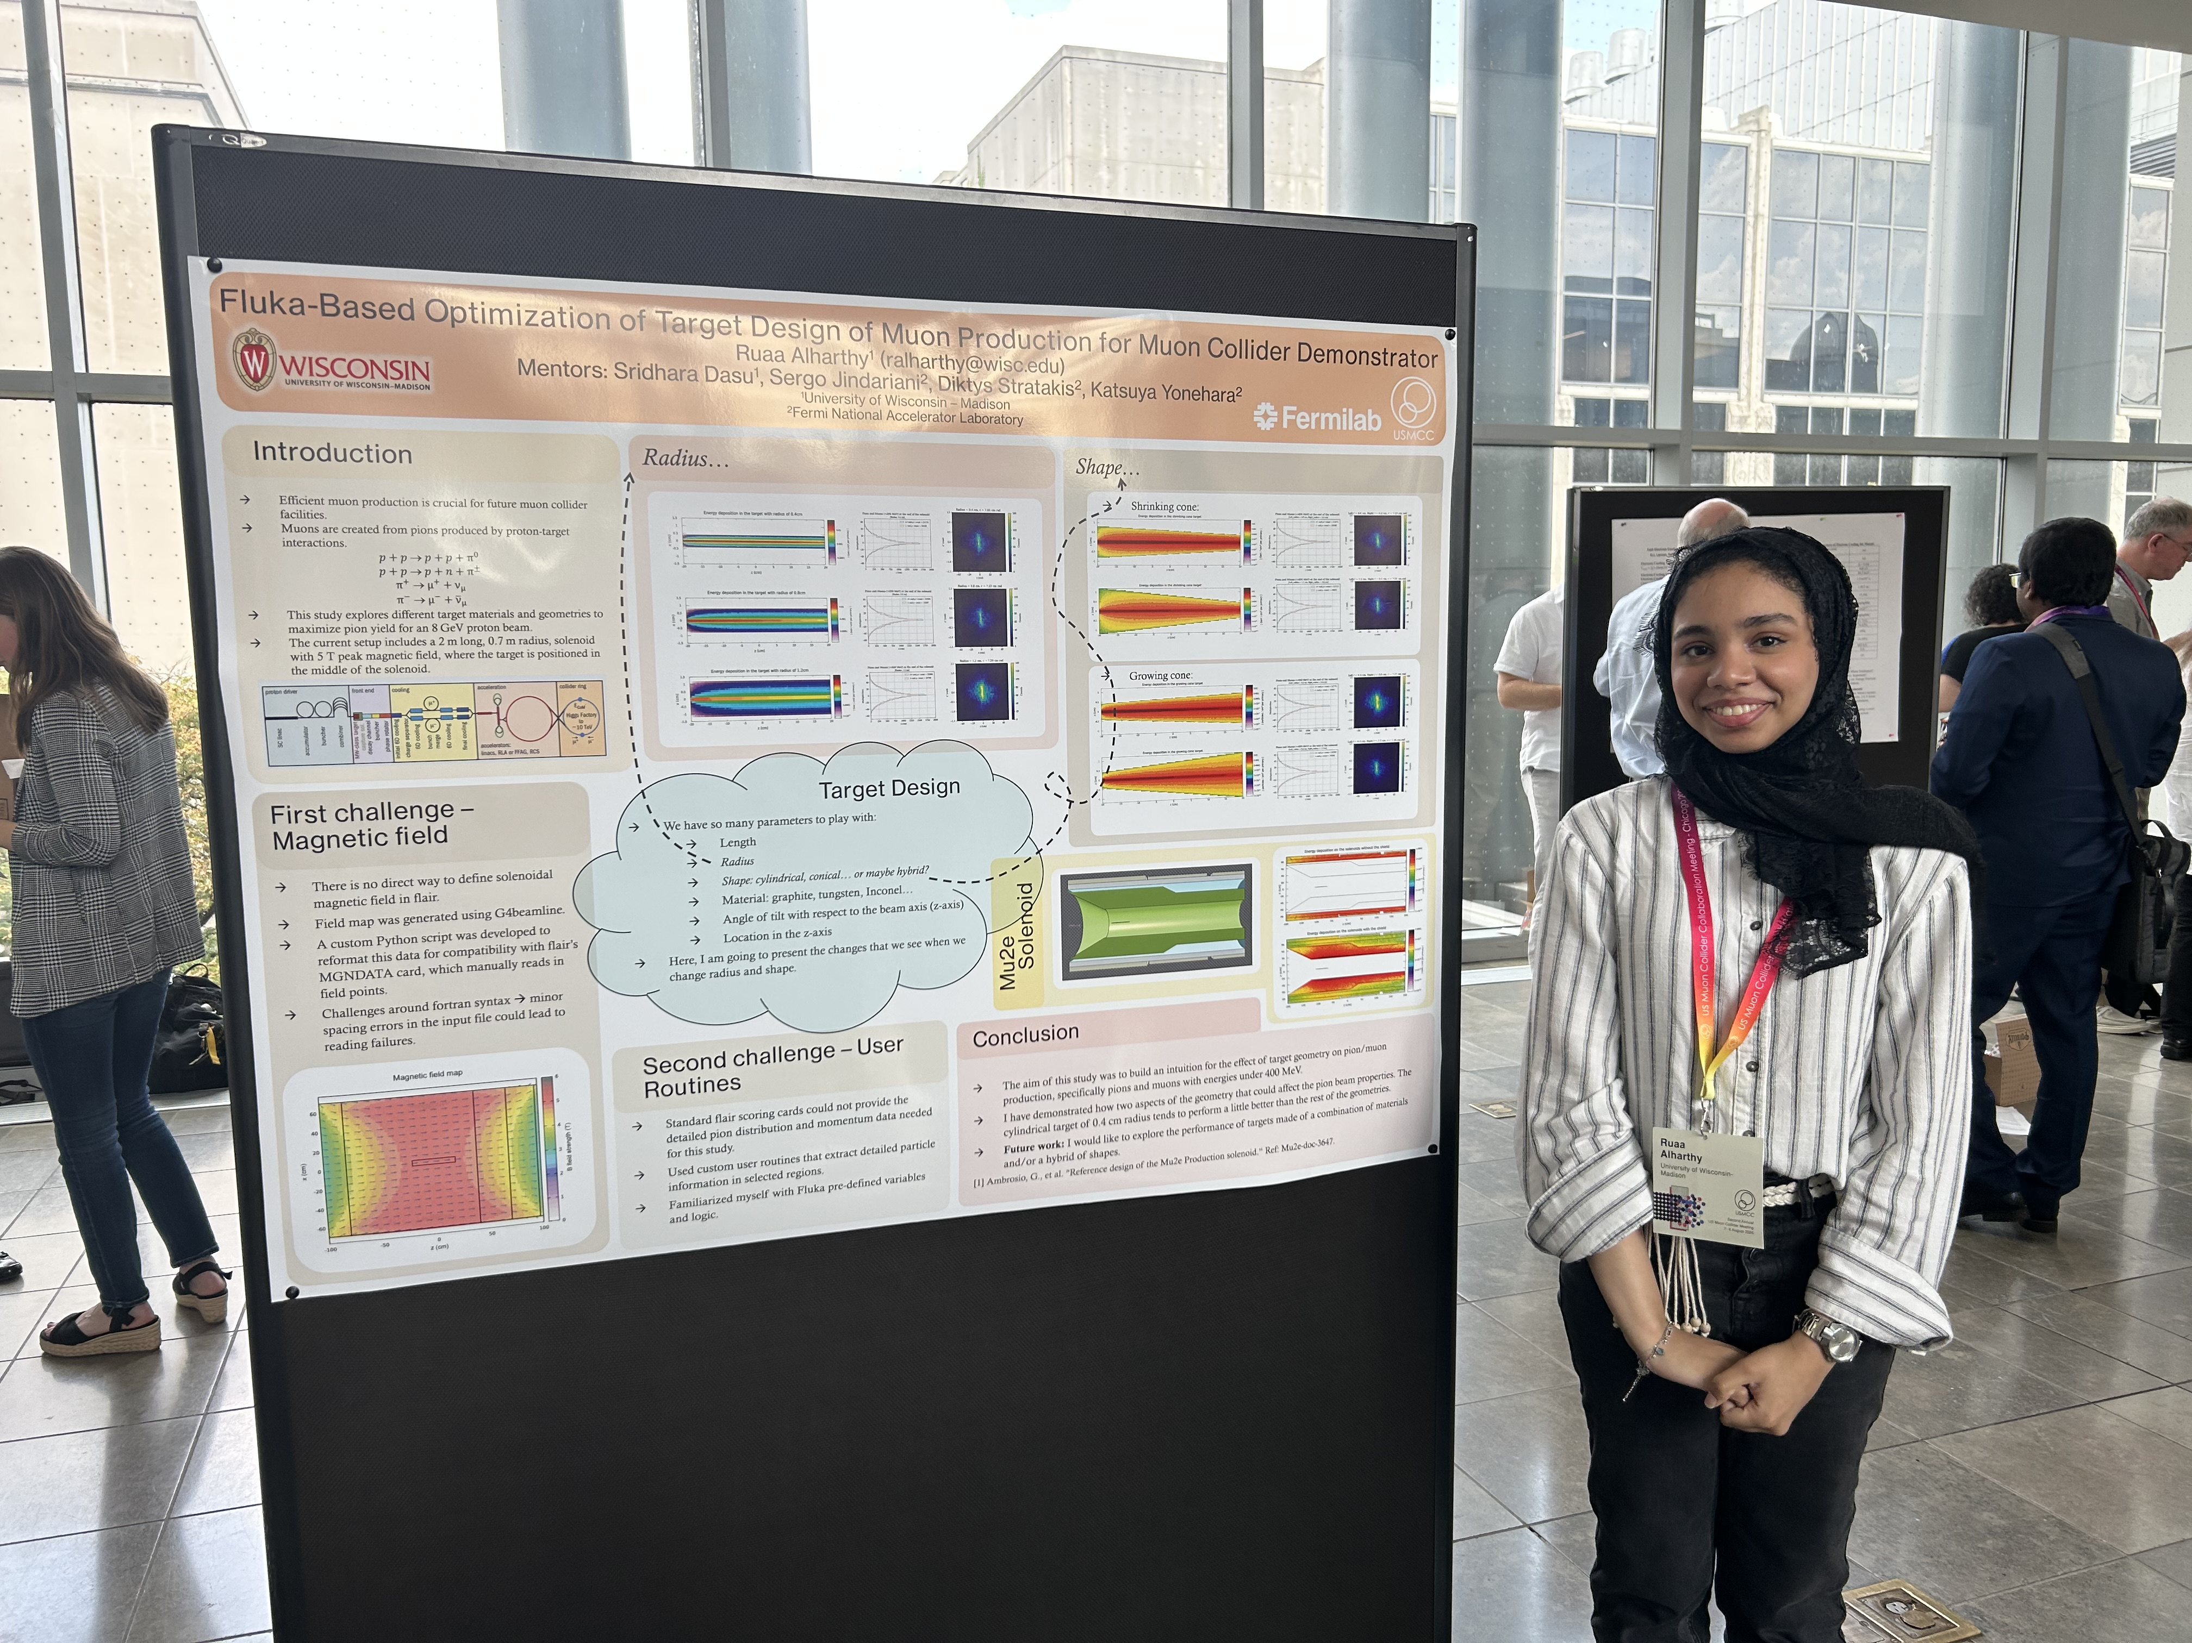
FNAL Demonstrator Target / Solenoid
Ruaa Alharthy / Wisconsin
Working with Diktys/Katsuya/Sergo
  Learned to use FLUKA
  Cross comparing particle production FLUKA and G4Beamline rates
  Investigating fluences and energy deposition for solenoid shielding

Slide 13
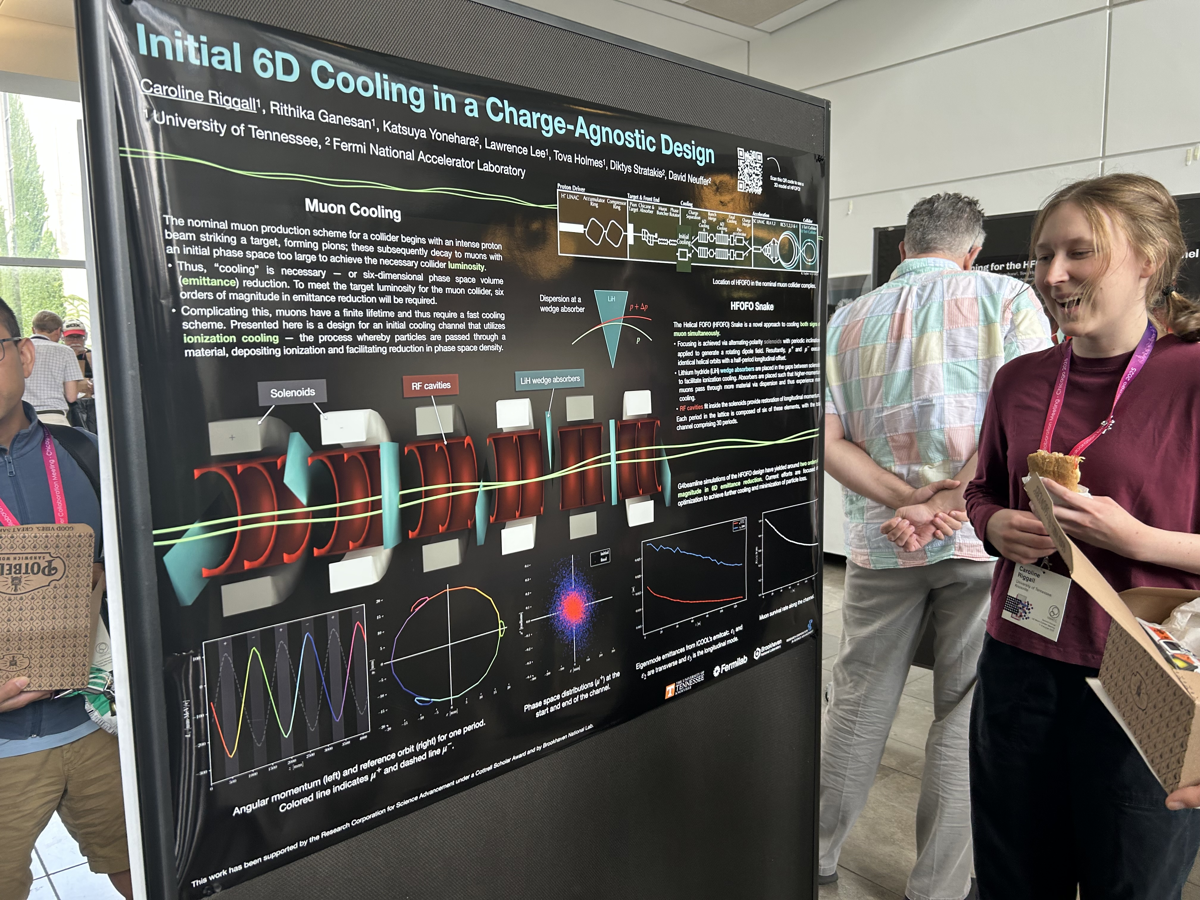
Initial 6D Cooling Channel
Caroline Rigalli / Tennessee
Working with Katsuya/Diktys/Neuffer
  Cool both beam charges
  Helical FOFO Snake
  Alternating solenoid polarities
    Rotating dipole field to achieve offset helical paths for the two beam charges
  LiH wedges for ionization cooling between solenoids

Slide 14
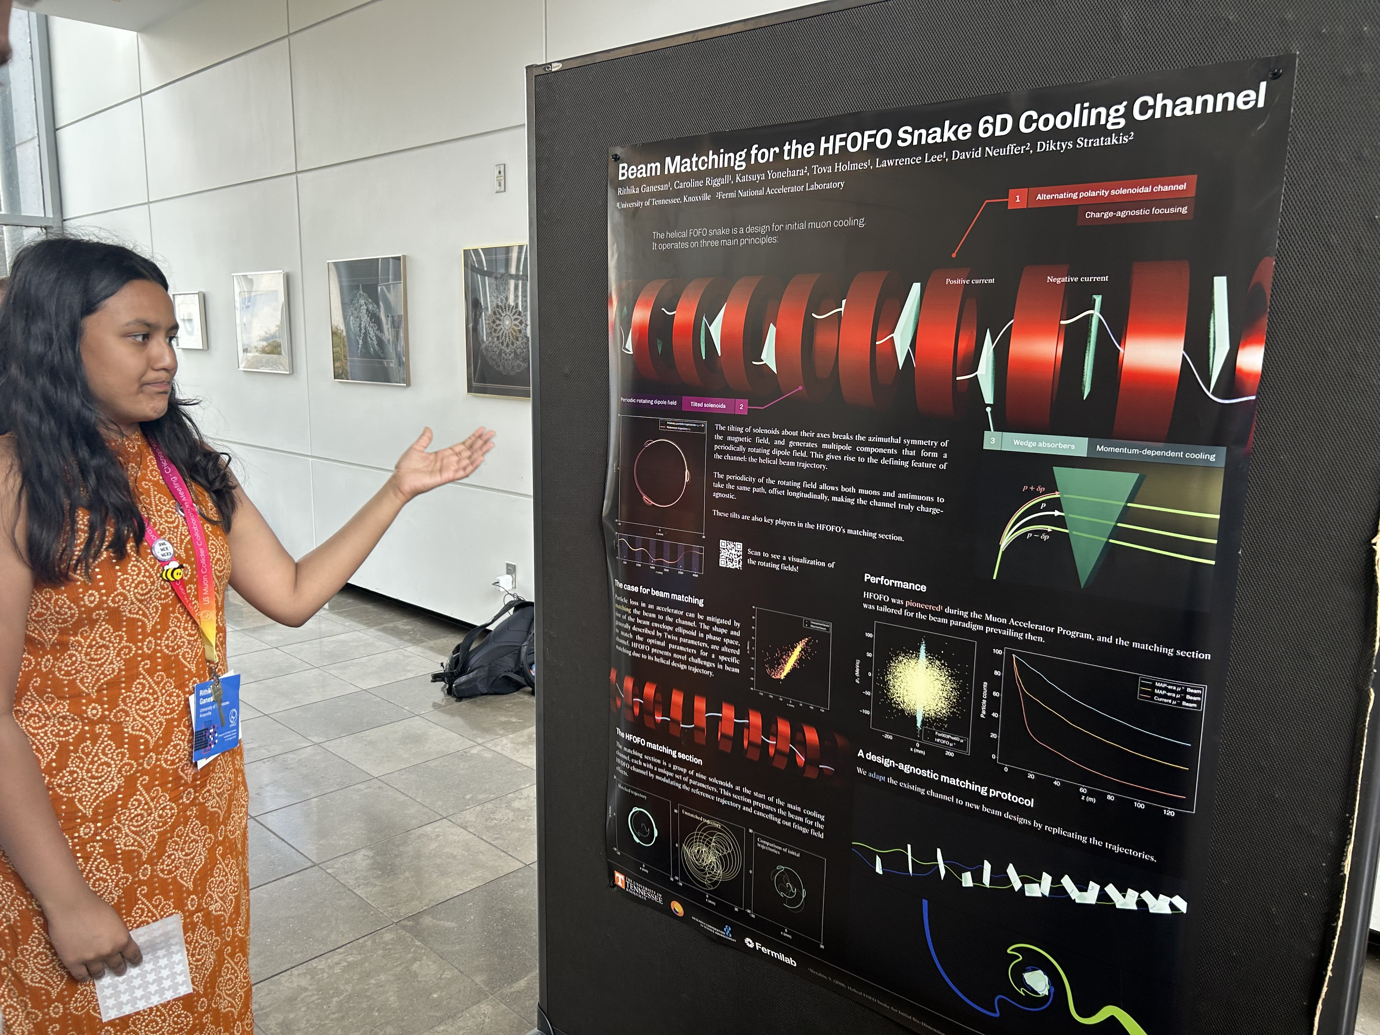
6D Cooling Channel
Rithika Ganesan / Tennessee
Working with Katsuya/Diktys/Neuffer
  Beam matching for Helical FOFO Snake
  Beam envelope ellipsoid in phase space optimally matched to the channel

Slide 15
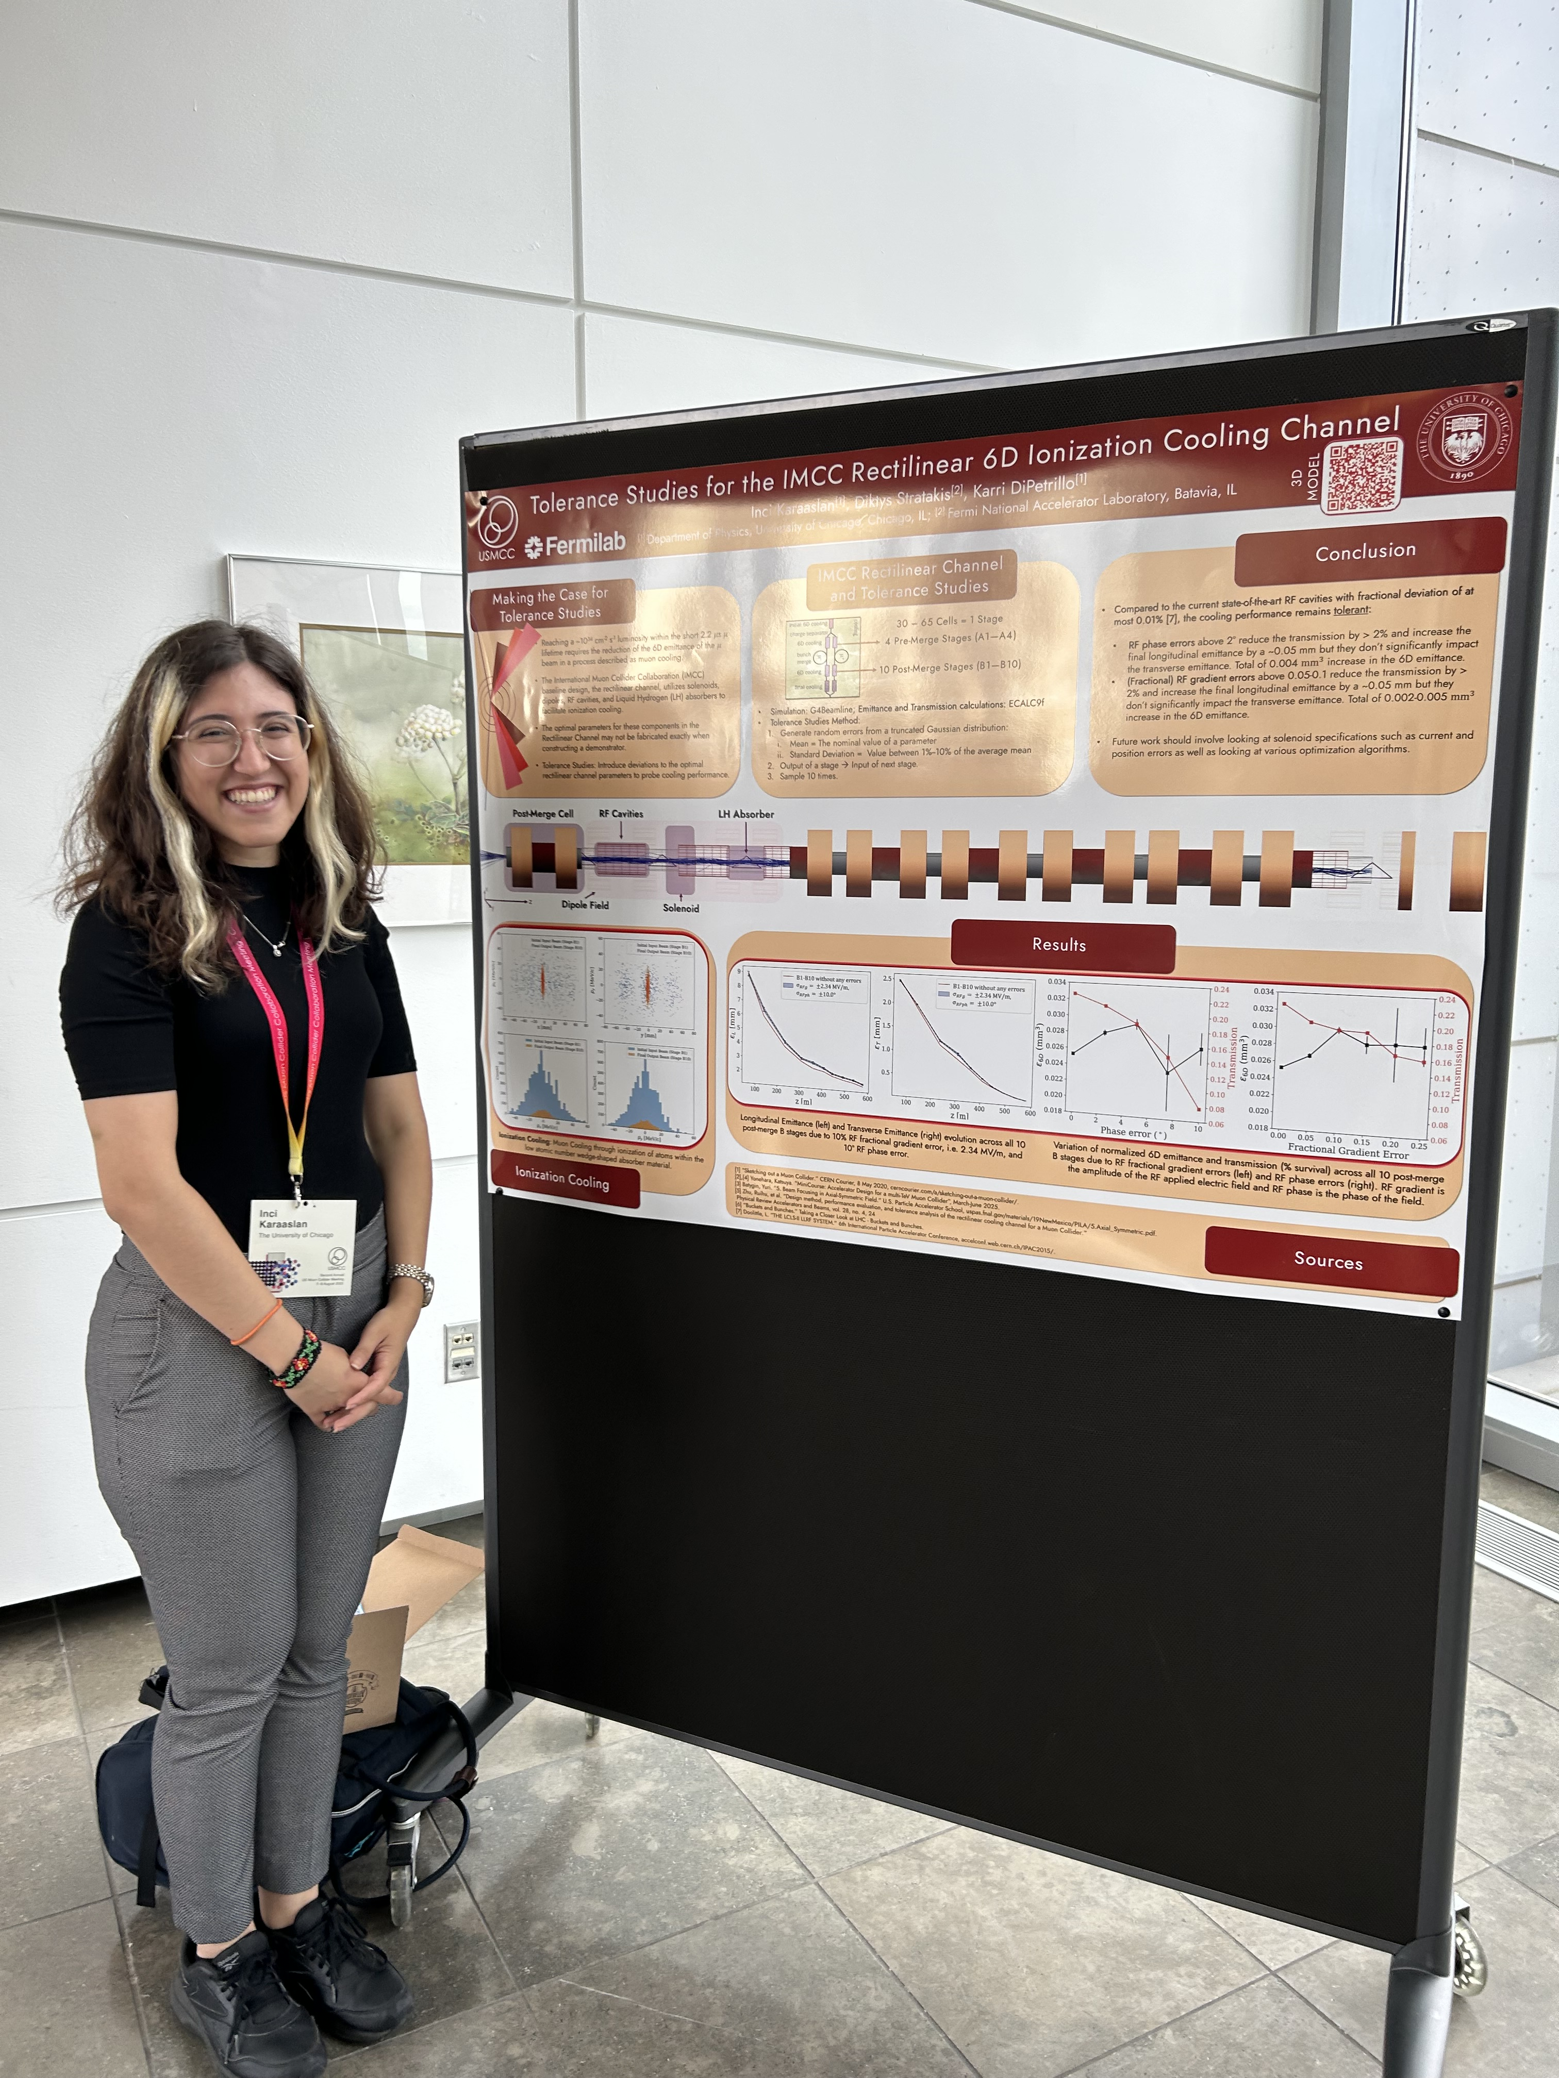
6D Cooling Channel Tolerance Studies
Inci Karaaslan / Chicago
Working with Diktys Stratakis
  Estimate tolerance of RF gradient and phase variations
  Using G4Beamline
  Simulate deviations from the optimal parameters of the elements of the cooling channel and study their effects on the performance

Slide 16
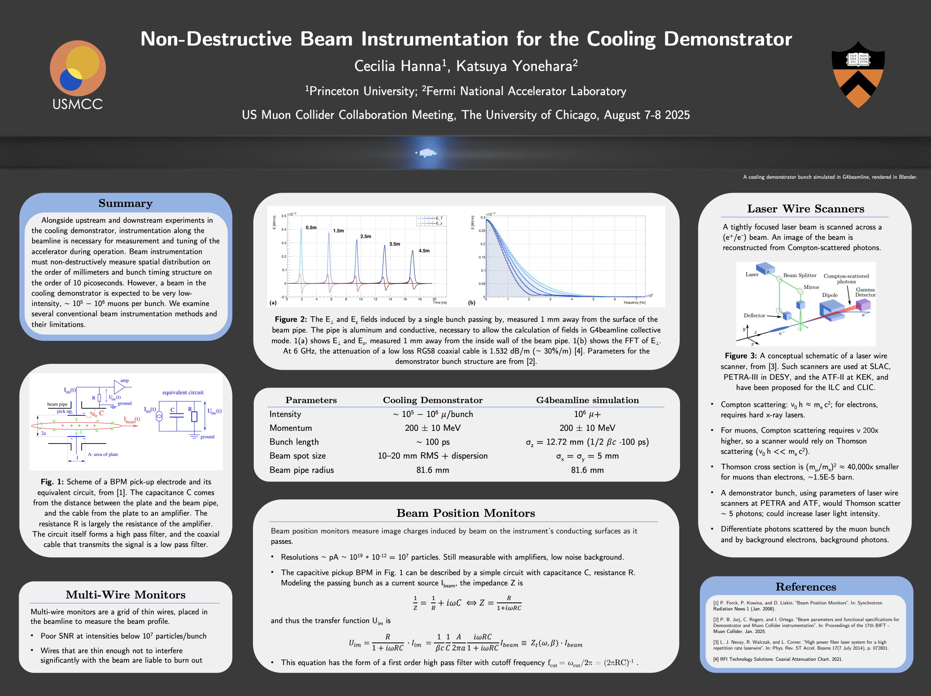
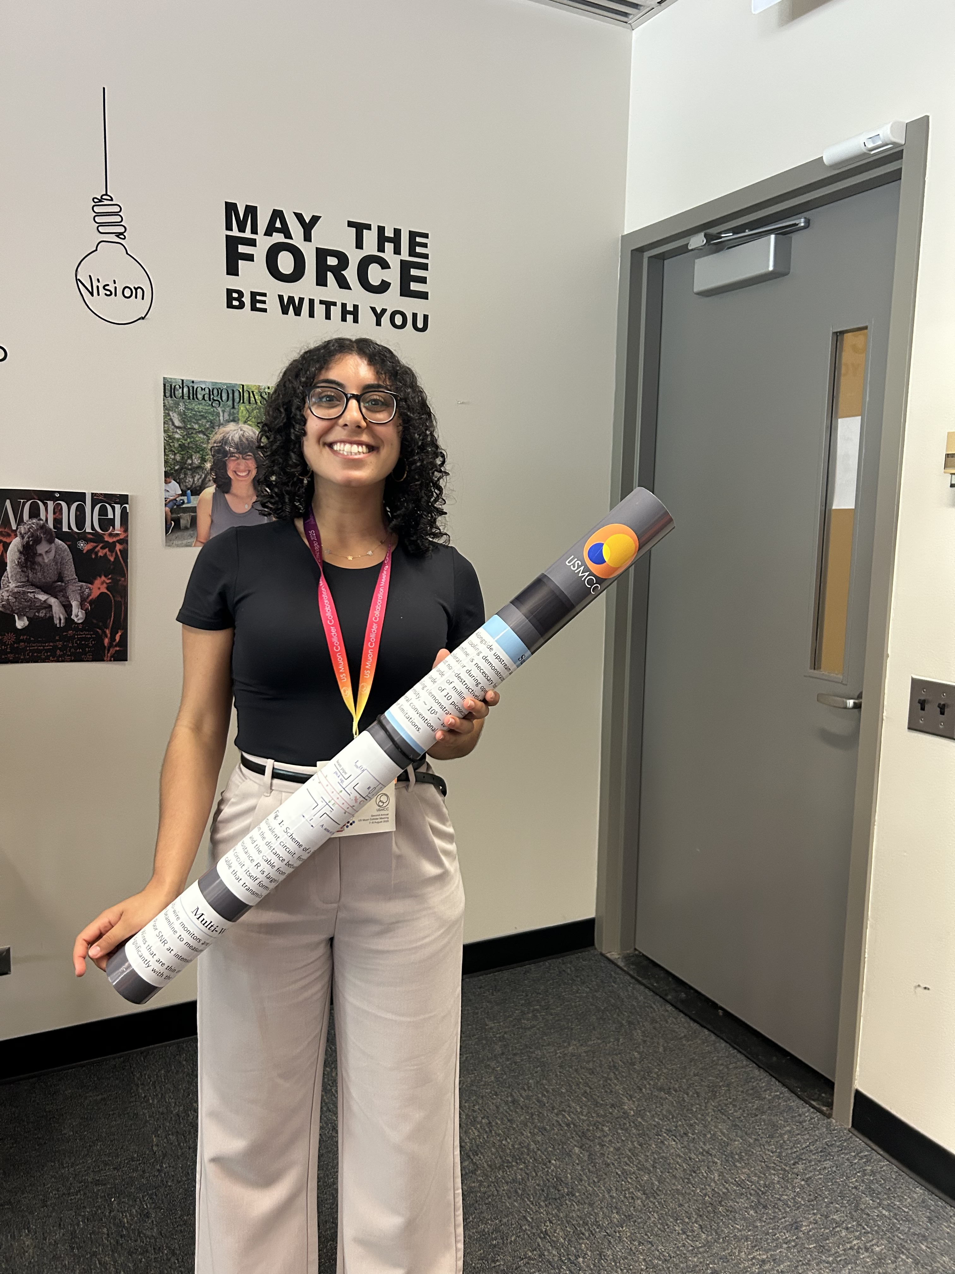
Instrumentation for the Demonstrator
Cecilia Hanna / Princeton
Working with Katsuya
  Non-destructive instrumentation is needed in cooling channel to measure spatial and temporal distribution
  Beam position monitors
  Multi-wire monitors
  Laser scanners
Opportunities for future projects:
Smart chips to get beam profiles
ML based simulations for designs …

Slide 17
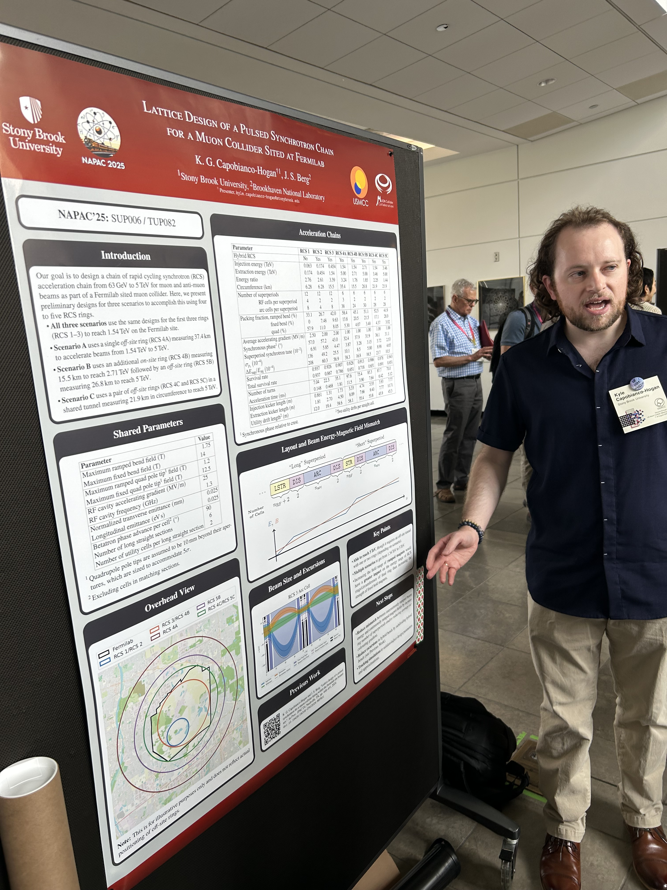
Lattice Design Studies for RCSs
Kyle Capobianco-Hogan/ Stony Brook
Working with Scott Berg / BNL
  Has several RCS simulations built
  Working towards a PhD in this area
We need to evolve to 50 FTE in the coming years
Think permanent jobs!

Slide 18
Summary
We are off to a great start on the muon collider work
  Detector and accelerator communities are setup to work in unison
    Both IMCC & USMCC are organized for exploiting synergy
  US needs to catch up – needs workforce especially in accelerator
    Summer program at FNAL and BNL involving university students is off to a great start
    Evidenced by the excellent & informative posters!!
  Thanks to all who participated in the school Mon-Wed
    We will welcome you to more synergistic muon collider work!
    Apply for laboratory internships, visitor scholarships, …

