Slide 1
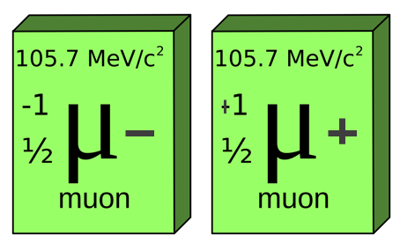
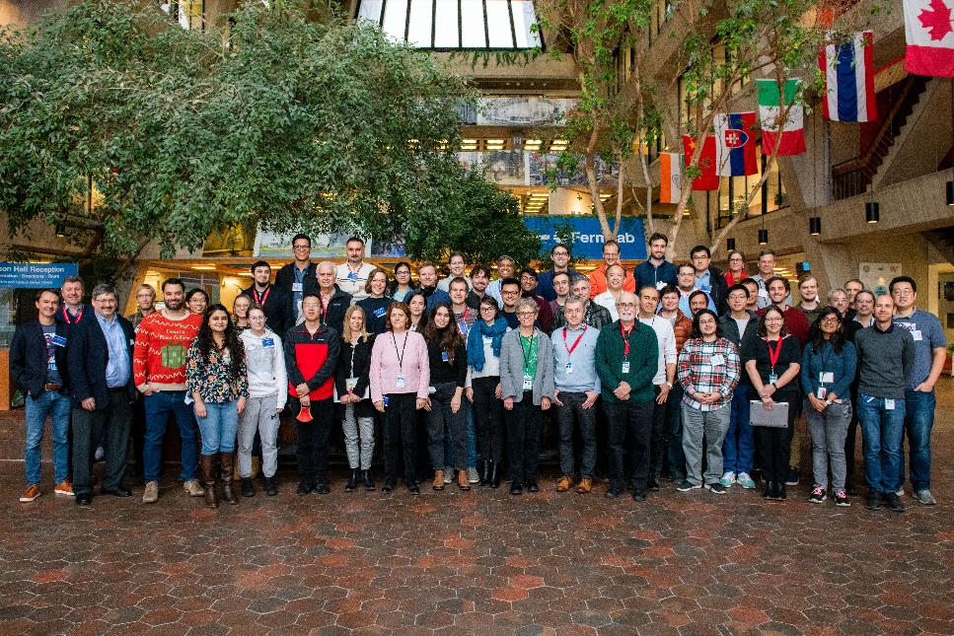
MUON COLLIDER:
(An Attempt at) Design Sensitivities
Vladimir SHILTSEV
2nd US MCC Workshop · August 8, 2025 · University of Chicago

Slide 2
Part I: Reminder of 2024
Few slides from 2024 US MCC Workshop, FNAL
Goals of This Study
A bit more detail assessment of MuColl risks

Slide 3
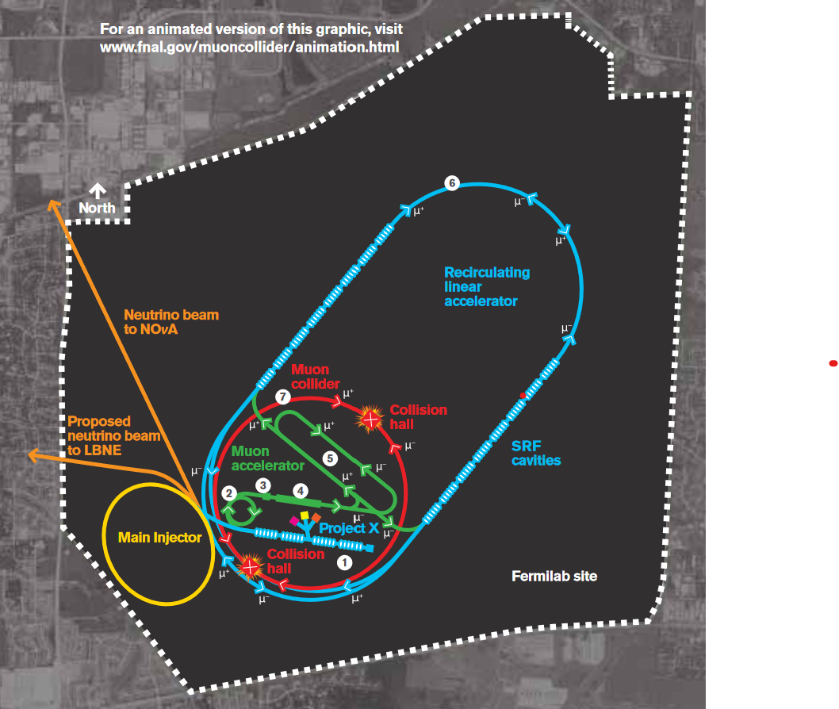
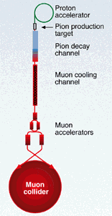
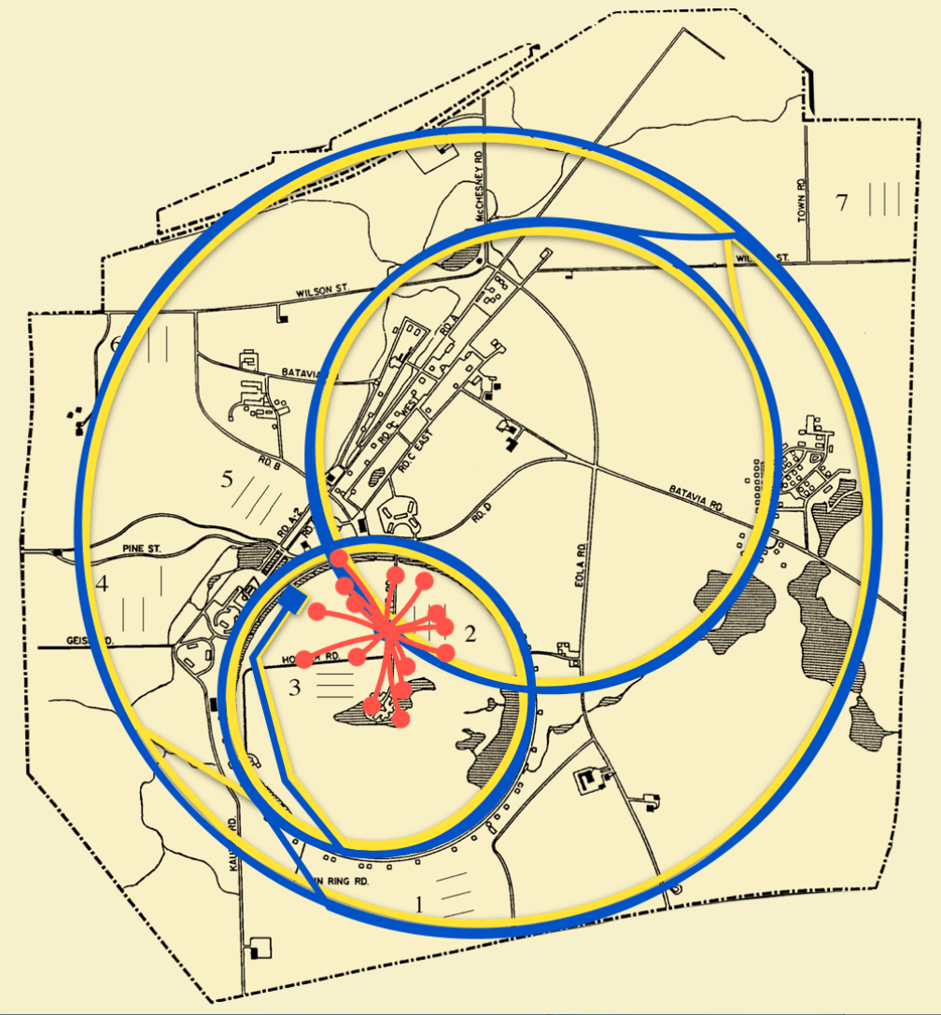
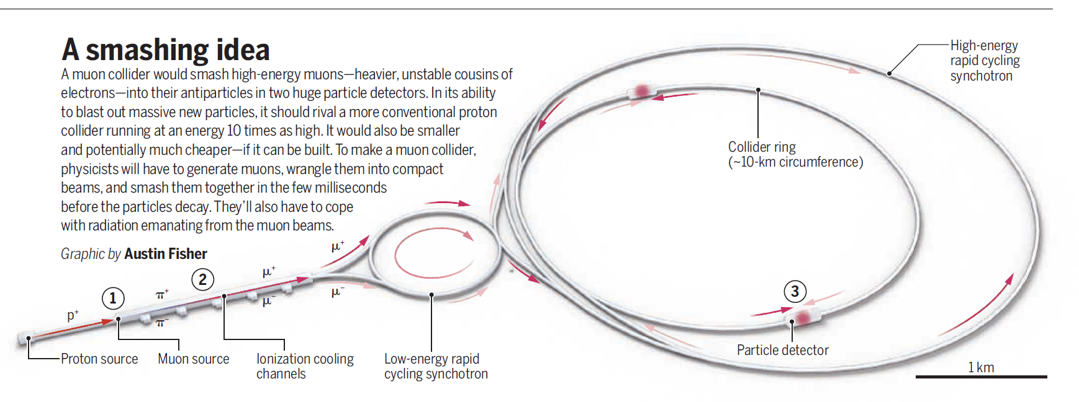
The Machine *2024
SCIENCE, Jan 8 1998
here we are today, Aug 7 2024
Physicists Dream of a Muon Shot
Symmetry, Oct 2010
SCIENCE, Mar 20 2024
The Dream Machine

Slide 4

Subsystems: Costs and Risks *2024
 | Approx. % of the Total Cost | Approx. Luminosity Risk Factor
Proton Driver and Targetry | 15 - 20 % | 10 ¹ ⁻ ²
Muon Cooling | 10 - 15 % | 10 ^{3 – 4}
Acceleration | 30 - 60 % | 10 ^{1 – 2}
Collider | 25 - 40 % | 10 ^{0 – 1}
TOTAL | 12 - 18 B$ ^{*ITF?} | 10 ⁵ ⁻ ⁹

Slide 5
Subsystems: Costs and Risks *2024
 | Approx. % of the Total Cost | Approx. Luminosity Risk Factor
Proton Driver and Targetry | 15 - 20 % | 10 ¹ ⁻ ²
Muon Cooling | 10 - 15 % | 10 ^{3 – 4}
Acceleration | 30 - 60 % | 10 ^{1 – 2}
Collider | 25 - 40 % | 10 ^{0 – 1}
TOTAL | 12 - 18 B$ ^{*ITF?} | 10 ⁵ ⁻ ⁹

Slide 6
Risk Registry Approach
There are many parameters {P_{n}} and design choices
Many of them affect KPIs – Energy, or Luminosity, or Cost or all the above
  e.g. Lumi via N, σ_{r},or f_coll; Cost via corresponding sub-subsystem costs
For each parameter P_{n}, we will:
  Define a “realistic” range of variation (from ±10% …to a factor of x3 or x10)
  Estimate the sensitivity ϰ (exponent): (d KPI / KPI) ≈ ϰ (dP_{n}/P_{n})
          assuming all other parameters fixed (intact)
  From the above, calculate max and avg effect on the KPI of the subsystem
Will do that for each (of four) main subsystems
  Using IMCC parameters set as “default” https://arxiv.org/pdf/2411.02966

Slide 7
Evaluation Basis
Accelerator complex systems and main challenges of Energy and Luminosity :
  C.Ankenbrandt, et al PRSTAB 1999
  R.Palmer, RAST 2014
  “Default” IMCC parameters https://arxiv.org/2411.02966
  Publications on various topics/subsubsystems
Cost analysis
  Snowmass’21 ITF Report, JINST 2023
  European Strategy inputs, 2025
  Models by Shiltsev, JINST 2011, B.Strauss, M.Green, IEEE Appl.Sci. 2008,...

Slide 8
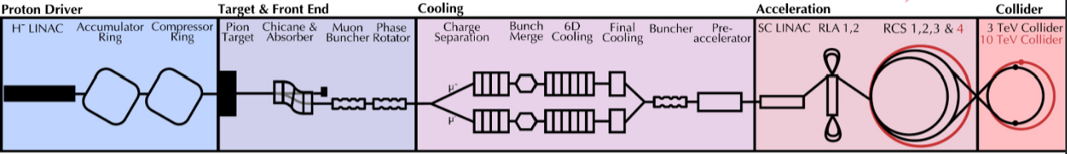
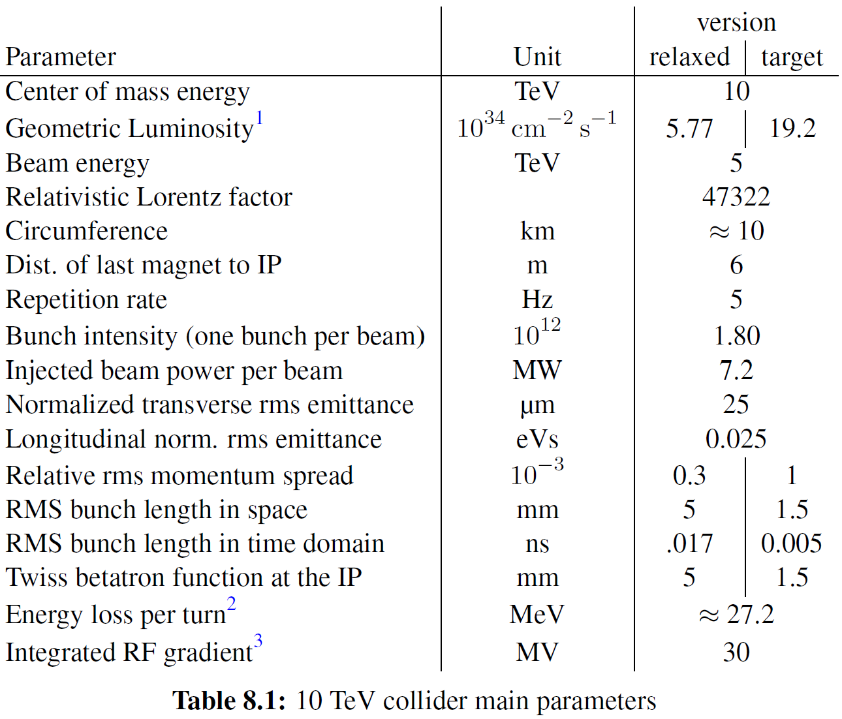
Let’s start with the Collider Ring…
Challenges:
500 W/m loss, magnet strength, lattice design with beta 1.5-5 mm, 0.1% beam energy spread, efficient collimation /protection/ MDI, beam-beam effects and stability, cost of magnets/cryo and tunnel, negligible neutrino flux …

Slide 9
#1 : Collider Ring
Parameters affecting max cme energy E:
  Max dipole field B, default 14T, range ±10-30%, ϰ=1.0 → dE/E ≈ ±10-30%
  Circumference C, default ~10km, range ±10-30%, ϰ=1.0 → dE/E ≈ ±10-30%
Note these parameters also affect Cost:
  B, for max ±30%, if magnets ~35% of total cost of collider ring cost and ϰ=1.3 → dCost_{CR}/Cost_{CR} ≈ 35% · ϰ · (±30%) ≈ ±15%
  C, for max ±30%, if civil ~35% of total cost of collider ring cost and ϰ=0.5 → dCost_{CR}/Cost_{CR} ≈ 35% · ϰ · (±30%) ≈ ±5%
Many parameters affect Luminosity, see next slide:

Slide 10

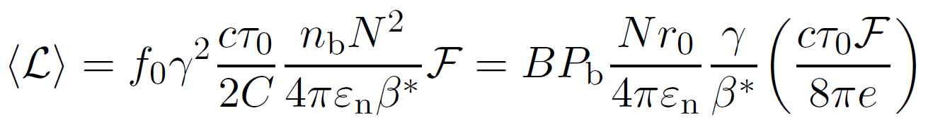
Limits on MuColl Luminosity (1)
General Equation
  muons decay →
each muon makes ~300B[T] turns in a ring with average field B
Rep. rate of injection
Ring circum-ference
Emittanceat
IPs
Optics
at
IPs
~1 only if
σ_{z} < β*
~B only if
C varies
This is beam-beam ξ
Yes, this factor grows with energy… but optics β* is a challenge

Slide 11


Limits on MuColl Luminosity (2)
General Equation
  avg. beam power

Slide 12

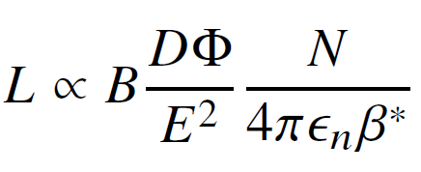
Limits on MuColl Luminosity (3)
General Equation
  μ→ν radiation dose
flux dilution factor
Of note: experience shows that there’s rarely 1:1 effect – many parameters intertwined in Lumi..

Slide 13
#1 Collider Ring: Risk Registry
 | Range % | ϰ_{Energy} | ϰ_{Cost} | ϰ_{Lumi} | Lumi Risk
Field B | 10 - 30 % | 1.0 | 1.3 x 0.35 | -
Circumf. C | 10 - 30 % | 1.0 | 0.5 x 0.35 | -1.0 | x 2/3
Apert_{magn} | 30 - 60 % | - | 1.3 x 0.35 | - | -
Optics/IR/DA | 10 - 100 % | - | 0.5 x 0.1 | -1.0 | x 1/3
Dynamics/ξ | x (1 - 3) | - | - | -0.5 | x 1/3
Collim/ν-Flux | x (3 - 10) | - | 0.5 x 0.05 | -0.5 | x ½
Power Infr. | 30 - 60 % | - | 0.5 x 0.15 | -1.0 | x 2/3
Combined Risk (avg-max) |  | 30-60% | 10-20% |  | 1/10-1/50
of the subsystem

Slide 14
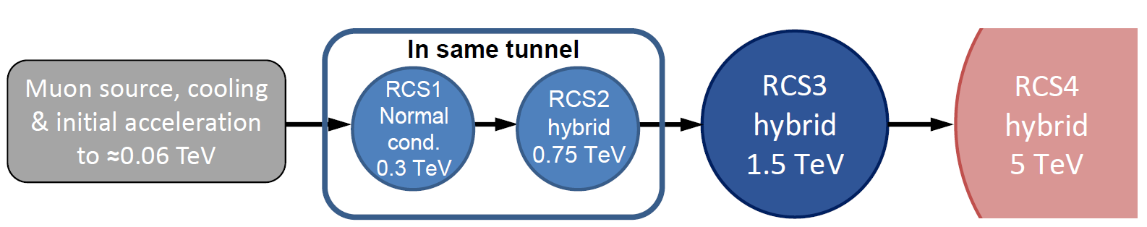
#2 : Accelerators (RCSs)
Parameters affecting max cme energy E:
  Max SC dipole B_{SC}, default 10-16T, range ±10-30%, ϰ=0.7 → dE/E ≈ ±5-20%
  Max pulsed field B_{p}, default 1.8T, range ±10%, ϰ=0.3 → dE/E ≈ ±3%
  Circumference C, default 16-35 km, range ±10-30%, ϰ=1.0 → dE/E ≈ ±10-30%
Challenges:
Uses fast-pulsed normal magnets
5 Hz pulses of O(1-10ms)
6-35 km circumference, muons decay
A lot of RF, SC and NC magnets, costs
Recover energy from magnetic field
High bunch charge
Maintain beam quality

Slide 15
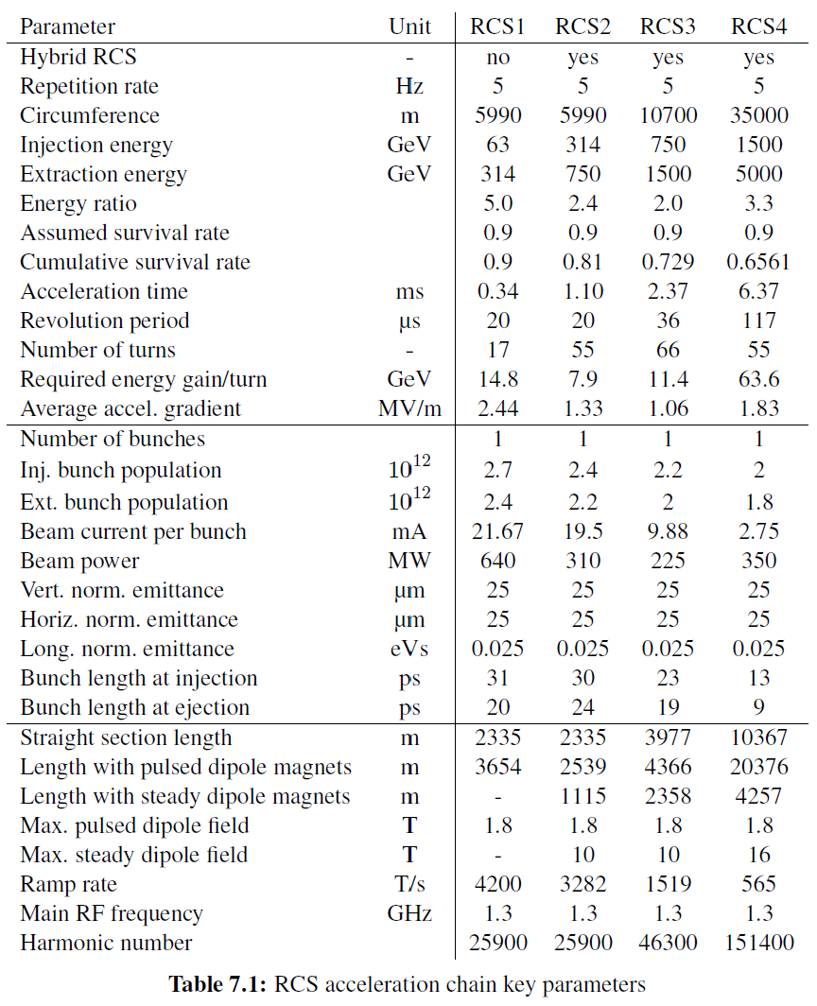
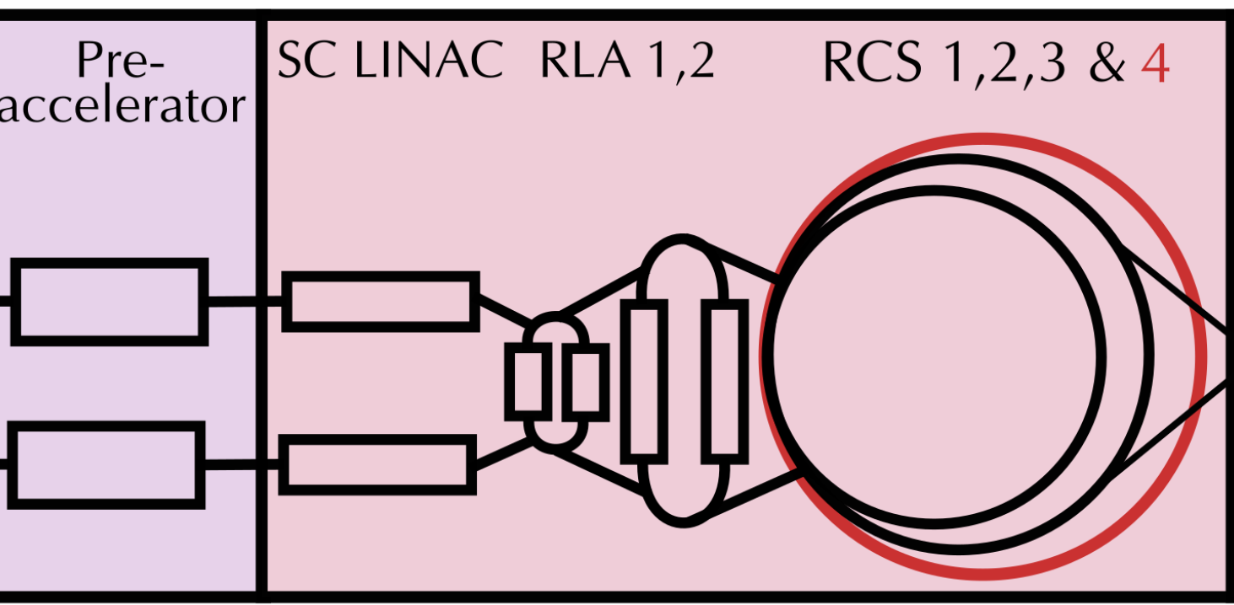
# 2 : Accelerators (for ref)
see arXiv:2411.02966v1
and Rebecca’s talk

Slide 16
#2 Accelerator (RCSs): Risk Registry
 | Range % | ϰ_{Energy} | ϰ_{Cost} | ϰ_{Lumi} | Lumi Risk Factor
Field SC B_{SC} | 10 - 30 % | 0.7 | 1.3 x 0.2 | -
Pulsed B_{P} | 10 % | 0.3 | 1.3 x 0.1 | -
Circumf. C | 10 - 30 % | 1.0 | 0.5 x 0.2 | -1.0 | x 2/3
RF volt/power | 10 - 30 % | - | 0.8 x 0.25 | 1.0 | x 2/3
Magn PS,dB/dt | 30 - 100 % | - | 0.8 x 0.23 | 1.0 | x 1/3
Optics/collim. | 10 - 100 % | - | 0.5 x 0.02 | -0.5 | x 2/3
Dynamics | x (1 - 3) | - | - | -0.5 | x 1/3
Combined Risk (avg-max) |  | 20-50% | 20-40% |  | 1/10-1/40
of the subsystem

Slide 17
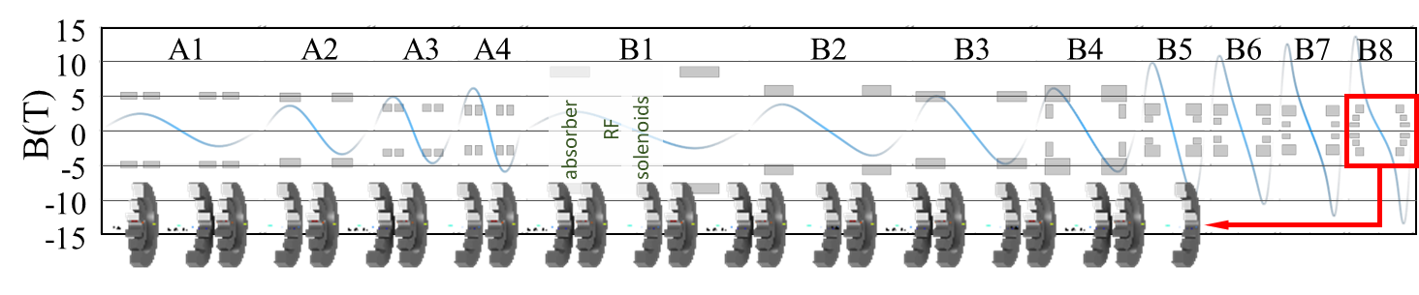

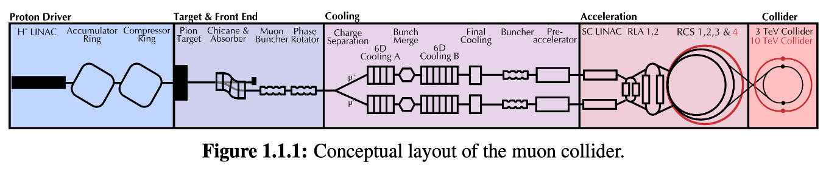
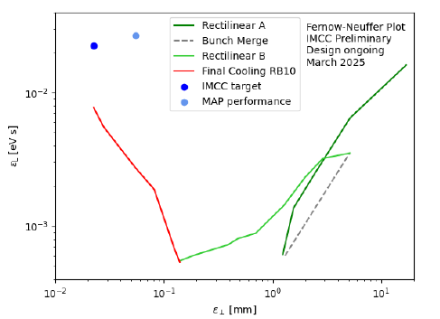
#3 : Cooling
Previous design (MAP)
Goal
Challenges:
Novel, complex lattice with cavities and absorbers in solenoids to achieve design transv and long emittances
Critical: transmission efficiency depends in B, RF gradients, length
NC RF in high magnetic field (2.5-17 T), two RF frequencies
Collective effects
Final cooling 45 T solenoids, 10 different RF frequencies
Achieved
better
better

Slide 18
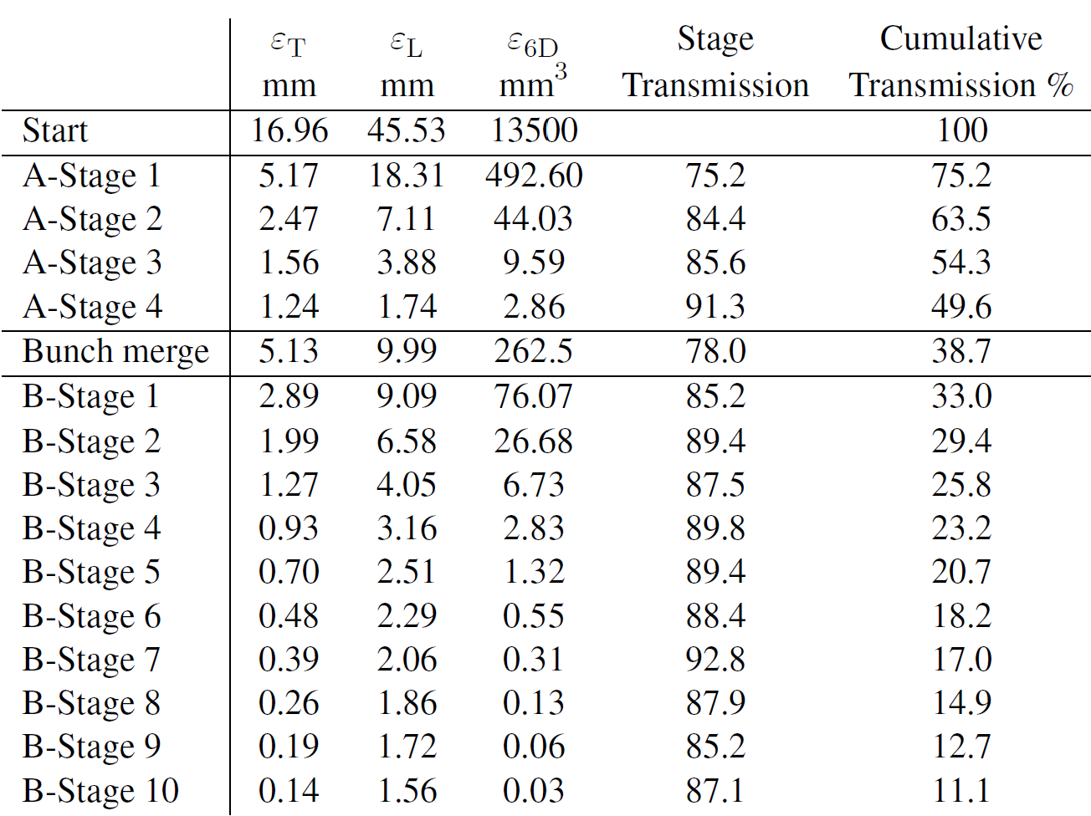
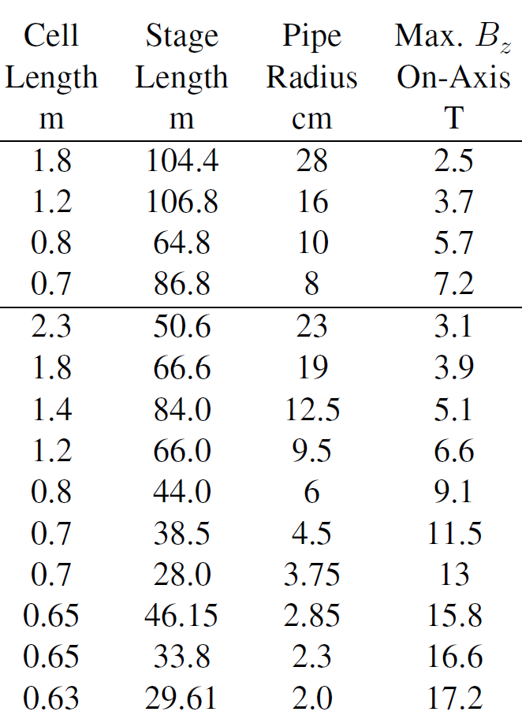
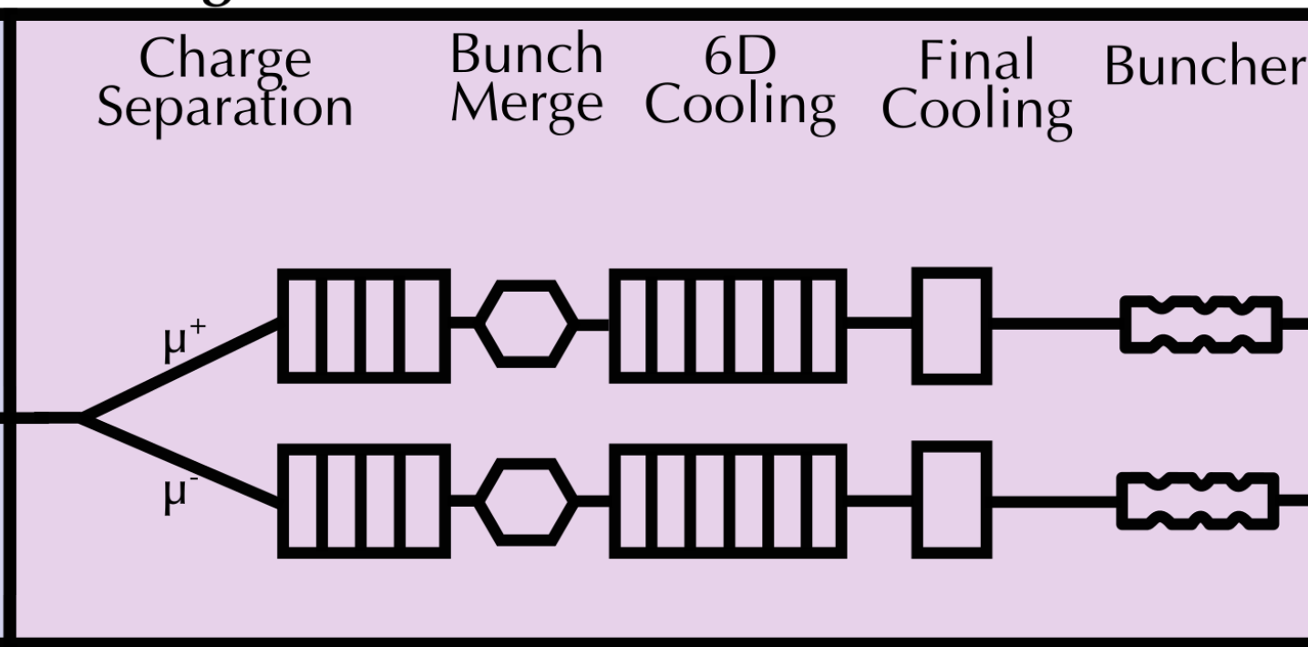
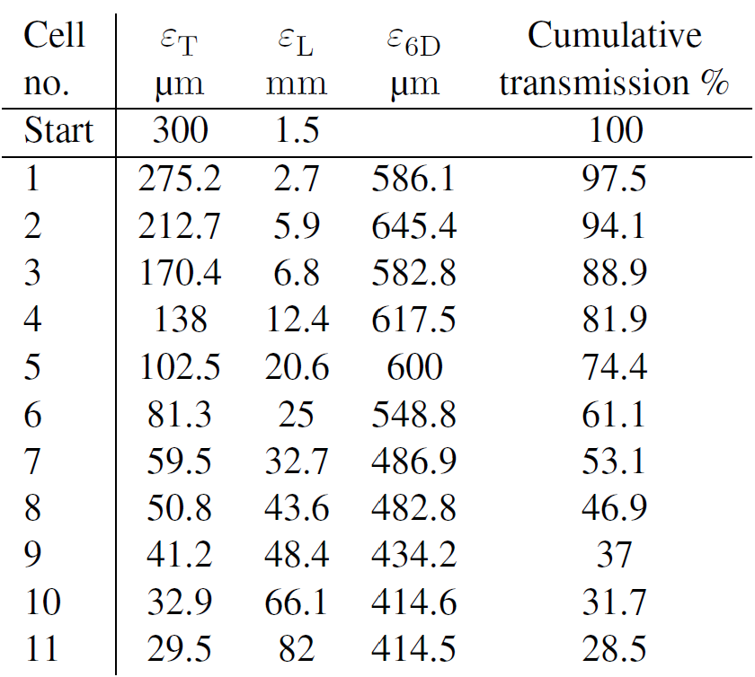
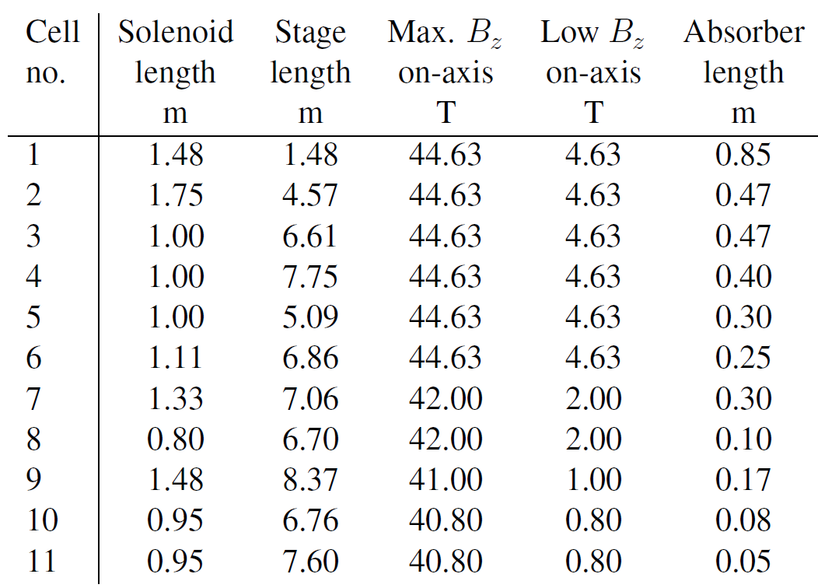
# 3 : Cooling
(for reference)
about 1000 m long, >800 cells, ~15 GeV of total RF (energy restored in ~160 MeV beams), 2-17 (50)T solenoids, ~6 orders of magnitude 6D emittance reduction, 80-90% of muons decayed/ lost
see arXiv:2411.02966v1
Diktys PRL paper and talk, Rebecca’s talk

Slide 19
#3 Muon Cooling : Risk Registry
 | Range % | ϰ_{Energy} | ϰ_{Cost} | ϰ_{Lumi} | Lumi Risk Factor
6D solen. B_{RL} | 10-30 % | - | 1.3 x 0.3 | 2.0 | x 1/2
Final cool B_{FC} | 30-100 % | - | 1.3 x 0.15 | 1.0 | x 1/2
Magn apertures | 10 - 30 % | - | 0.8 x 0.45 | 2.0 | x 1/2
RF grad/power | 30 % | - | 0.8 x 0.45 | 3 | x 1/3
Absorbers | 10 % | - | 0.8 x 0.05 | - | -
Optics/transm. | 30 - 100 % | - | 0.5 x 0.05 | -5 | x 1/30
Dynamics | x (1 - 3) | - | - | -1 | x 1/3
Combined Risk (avg-max) |  | - | 20-50% |  | 1/50-1/3000
of the subsystem

Slide 20
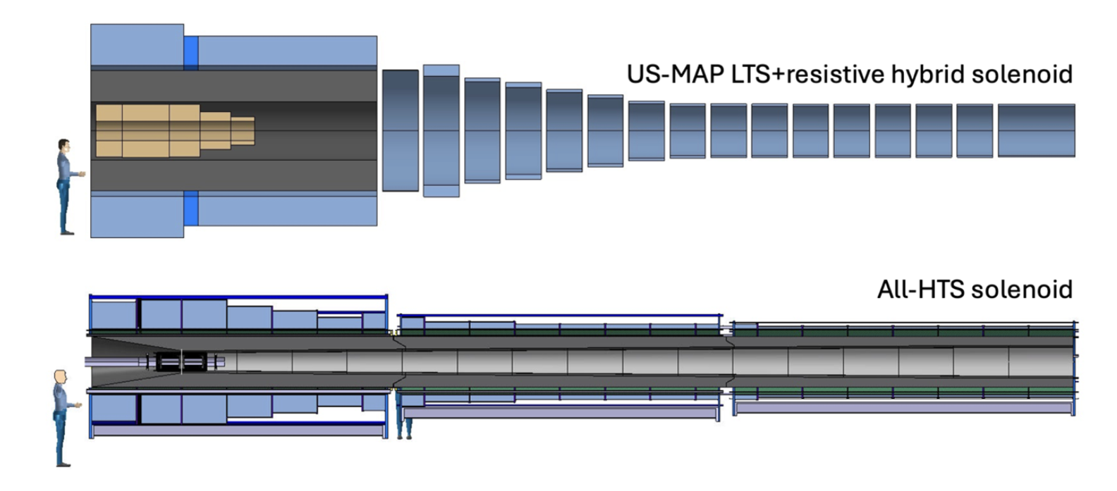
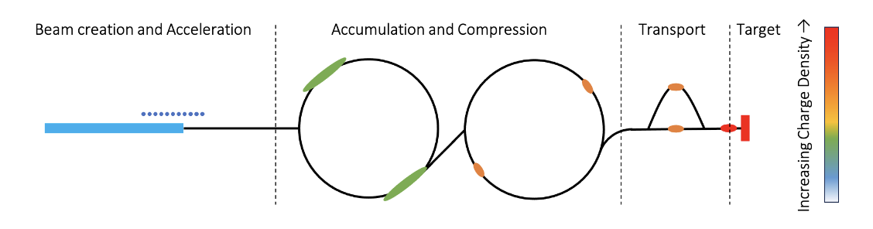
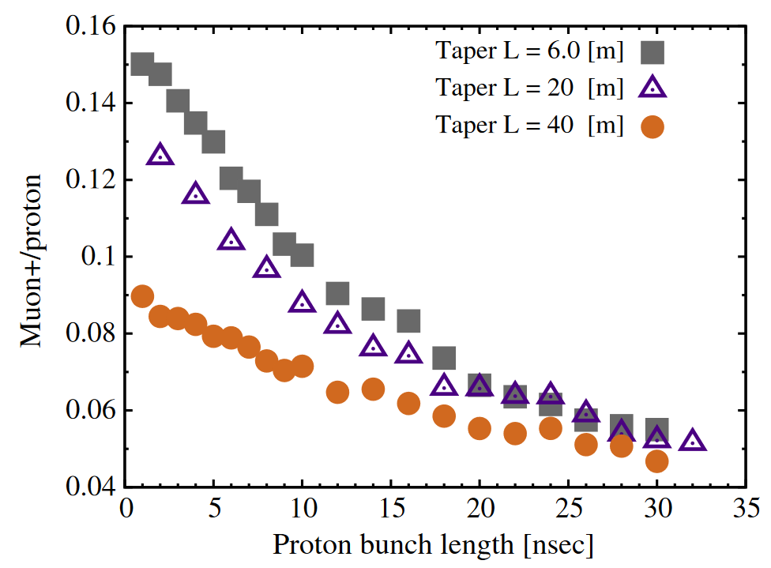
#4 : Proton Source & Targetry
Challenges:
2 MW, 5-8 GeV, 5 Hz, 5 x 10¹⁴ protons/pulse
H- ion loss from black body radiation in beamline
Proton pulse Accumulator: H- stripping, instabilities
Combiner Ring: space-charge effects, instabilities, losses
Best bunch combiner system
400 MJ/pulse target : mercury or graphite?
Optimal yield/collection vs HTS vs LTS solenoids, magnet shielding, target stress, cooling, radiation, etc

Slide 21
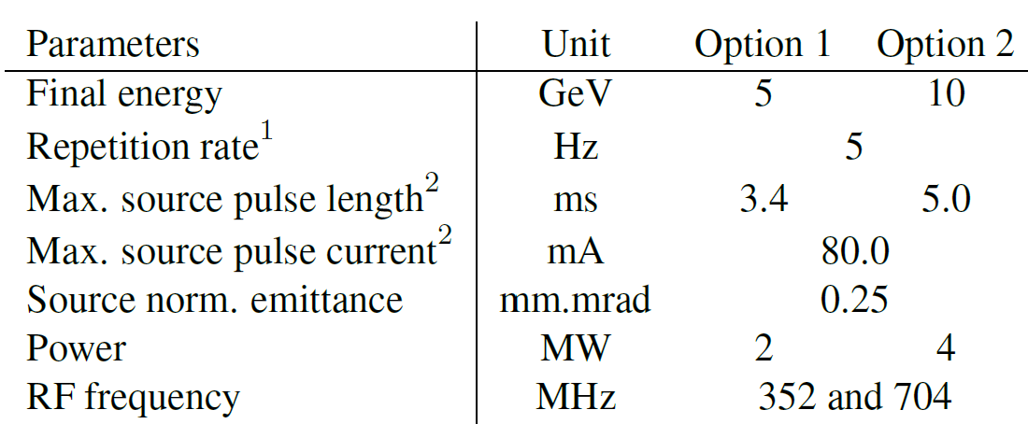
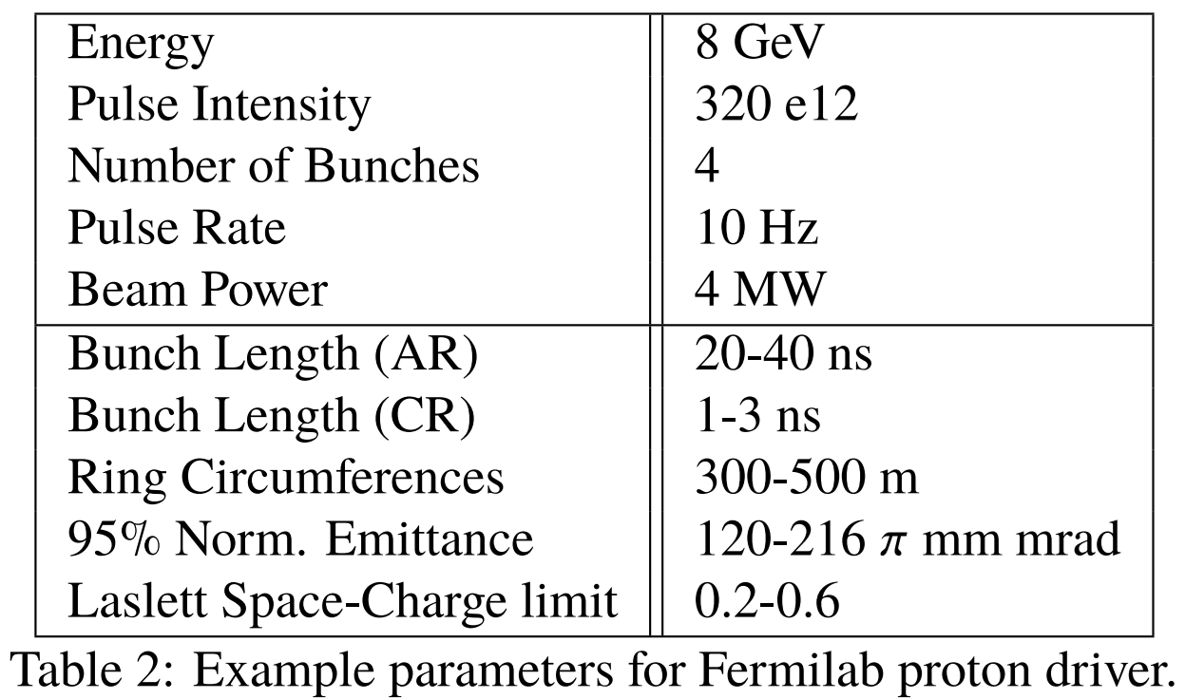
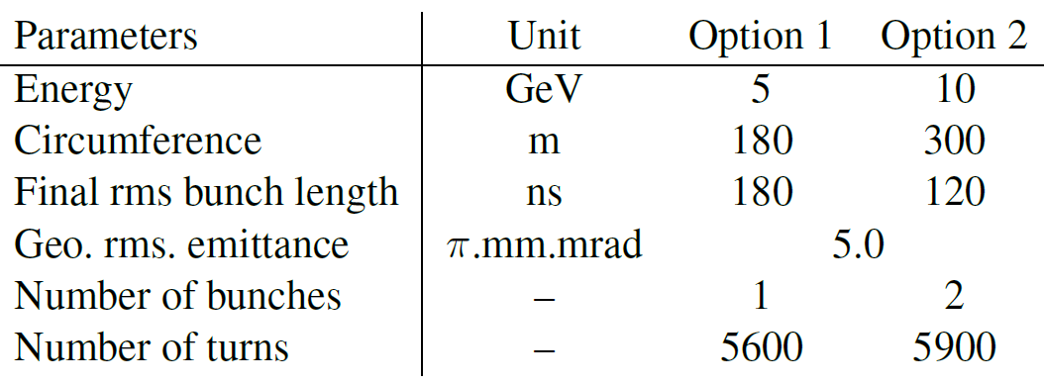
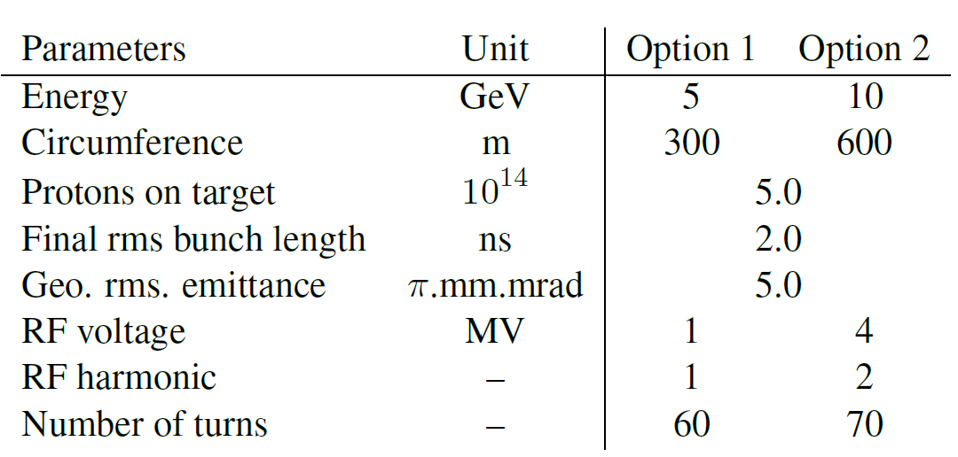
# 4 : Proton Source
(for reference)
arXiv:2411.02966v1 (IMCC)
Jeff Eldered (FNAL)

Slide 22
P-Source and Targetry: Risk Registry
 | Range % | ϰ_{Energy} | ϰ_{Cost} | ϰ_{Lumi} | Lumi Risk factor
H- linac E_{beam} | 30-100 % | - | 0.7 x 0.5 | - | -
H- linac P_{beam} | 30-100 % | - | 0.3 x 0.5 | 2.0 | x 1/4
H- linac f_{rep} | 30-100 % | - | 0.3 x 0.5 | 1.0 | x 1/2
AR/CR circumf. | 30-100 % | - | 0.7 x 0.2 | - | -
AR/CR aperture | 30-100 % | - | 0.5 x 0.2 | - | -
AR/CR dynamics | x (1 - 3) | - | 0.5 x 0.1 | -2 | x 1/10
Target/B_{z}/length | 30-100 % | - | 1.0 x 0.2 | 2 | x 1/4
Combined Risk (avg-max) |  | - | 40-100% |  | 1/20-1/300
of the subsystem

Slide 23
Subsystems: Costs and Risks *2025
 | Approx. %* Total Cost | Subsystem Cost Risk | Collider Energy Risk | Avg. Risk Luminosity
p-Driver&Targetry | 15 - 20 % | ~40 % | - | x 1/20
Muon Cooling | 10 - 15 % | ~20 % | - | x 1/50
Acceleration | 30 - 60 % | ~20 % | ~20% | x 1/10
Collider | 25 - 40 % | ~10 % | ~30% | x 1/10
TOTAL | 17±4 BCHF ^{*IMCC} | ±30% ^{*IMCC} | ~30 % | 10 ^{2.5 - 5}
TOTAL* (2024) | 12 - 18 B$ ^{*ITF?} | - | - | 10 ⁵ ⁻ ⁹

Slide 24
Summary (1)
We have attempted an overview and analysis of MuCol Risks:
  by major subsystems (~ 7 factors each)
  broken into risks on c.m. Energy, Luminosity, Cost (of the subsystem)
  Combined the risks: max (worst possible) and avg~ SQRT(max)
On the Energy:
  major Energy risks will be in the Collider and Accelerator (RCS chain) magnets (B_{max}) and circumference, and in the Accelerator SRF gradients
  Overall MuCol Energy risk is about 25-30%

Slide 25
Summary (2)
On the Luminosity (it is expected that):
  By far the largest risk will come from dynamics in the Cooling channel, next one is p-Source/Target and pulsed dB/dt in Accelerator
  Overall, average MuCol Luminosity risk will be about a factor of 1/300 or so
On the Costs (it is expected that):
  the largest cost will be of the Accelerator (RCS chain), then Collider
  Major cost risks will be in the pulsed magnets’ PSs, Collider and RCS SC magnets, SRF H- linac
  Overall MuCol cost risk will be about 25-30%
These Risk Registries should help to guide the MuCol R&D program

Slide 26
Thanks for your attention!
Questions?

Slide 27
#1 Collider Ring: Risk Registry
 | Range % | ϰ_{Energy} | ϰ_{Cost} | ϰ_{Lumi} | Lumi Risk
Field B | 10 - 30 % | 1.0 | 1.3 x 0.35 | -
Circumf. C | 10 - 30 % | 1.0 | 0.5 x 0.35 | -1.0 | x 2/3
Apert_{magn} | 30 - 60 % | - | 1.3 x 0.35 | - | -
Optics/IR/DA | 10 - 100 % | - | 0.5 x 0.1 | -1.0 | x 1/3
Dynamics/ξ | x (1 - 3) | - | - | -0.5 | x 1/3
Collim/ν-Flux | x (3 - 10) | - | 0.5 x 0.05 | -0.5 | x ½
Power Infr. | 30 - 60 % | - | 0.5 x 0.15 | -1.0 | x 2/3
Combined Risk (avg-max) |  | 30-60% | 10-20% |  | 1/10-1/50
of the subsystem

Slide 28
#2 Accelerator (RCSs): Risk Registry
 | Range % | ϰ_{Energy} | ϰ_{Cost} | ϰ_{Lumi} | Lumi Risk Factor
Field SC B_{SC} | 10 - 30 % | 0.7 | 1.3 x 0.2 | -
Pulsed B_{P} | 10 % | 0.3 | 1.3 x 0.1 | -
Circumf. C | 10 - 30 % | 1.0 | 0.5 x 0.2 | -1.0 | x 2/3
RF volt/power | 10 - 30 % | - | 0.8 x 0.25 | 1.0 | x 2/3
Magn PS,dB/dt | 30 - 100 % | - | 0.8 x 0.23 | 1.0 | x 1/3
Optics/collim. | 10 - 100 % | - | 0.5 x 0.02 | -0.5 | x 2/3
Dynamics | x (1 - 3) | - | - | -0.5 | x 1/3
Combined Risk (avg-max) |  | 20-50% | 20-40% |  | 1/10-1/40
of the subsystem

Slide 29
#3 Muon Cooling : Risk Registry
 | Range % | ϰ_{Energy} | ϰ_{Cost} | ϰ_{Lumi} | Lumi Risk Factor
6D solen. B_{RL} | 10-30 % | - | 1.3 x 0.3 | 2.0 | x 1/2
Final cool B_{FC} | 30-100 % | - | 1.3 x 0.15 | 1.0 | x 1/2
Magn apertures | 10 - 30 % | - | 0.8 x 0.45 | 2.0 | x 1/2
RF grad/power | 30 % | - | 0.8 x 0.45 | 3 | x 1/3
Absorbers | 10 % | - | 0.8 x 0.05 | - | -
Optics/transm. | 30 - 100 % | - | 0.5 x 0.05 | -5 | x 1/30
Dynamics | x (1 - 3) | - | - | -1 | x 1/3
Combined Risk (avg-max) |  | - | 20-50% |  | 1/50-1/3000
of the subsystem

Slide 30
#4 p-Source and Targetry: Risk Registry
 | Range % | ϰ_{Energy} | ϰ_{Cost} | ϰ_{Lumi} | Lumi Risk factor
H- linac E_{beam} | 30-100 % | - | 0.7 x 0.5 | - | -
H- linac P_{beam} | 30-100 % | - | 0.3 x 0.5 | 2.0 | x 1/4
H- linac f_{rep} | 30-100 % | - | 0.3 x 0.5 | 1.0 | x 1/2
AR/CR circumf. | 30-100 % | - | 0.7 x 0.2 | - | -
AR/CR aperture | 30-100 % | - | 0.5 x 0.2 | - | -
AR/CR dynamics | x (1 - 3) | - | 0.5 x 0.1 | -2 | x 1/10
Target/B_{z}/length | 30-100 % | - | 1.0 x 0.2 | 2 | x 1/4
Combined Risk (avg-max) |  | - | 40-100% |  | 1/20-1/300
of the subsystem

Slide 31
Subsystems: Costs and Risks *2025
 | Approx. %* Total Cost | Subsystem Cost Risk | Collider Energy Risk | Avg. Risk Luminosity
p-Driver&Targetry | 15 - 20 % | ~40 % | - | x 1/20
Muon Cooling | 10 - 15 % | ~20 % | - | x 1/50
Acceleration | 30 - 60 % | ~20 % | ~20% | x 1/10
Collider | 25 - 40 % | ~10 % | ~30% | x 1/10
TOTAL | 17±4 BCHF ^{*IMCC} | ±30% ^{*IMCC} | ~30 % | 10 ^{2.5 - 5}
TOTAL* (2024) | 12 - 18 B$ ^{*ITF?} | - | - | 10 ⁵ ⁻ ⁹

