Slide 1
Accelerator Summary
Steve Gourlay and Diktys Stratakis (Fermilab)
US Muon Collider Annual Meeting
August 8, 2025

Slide 2
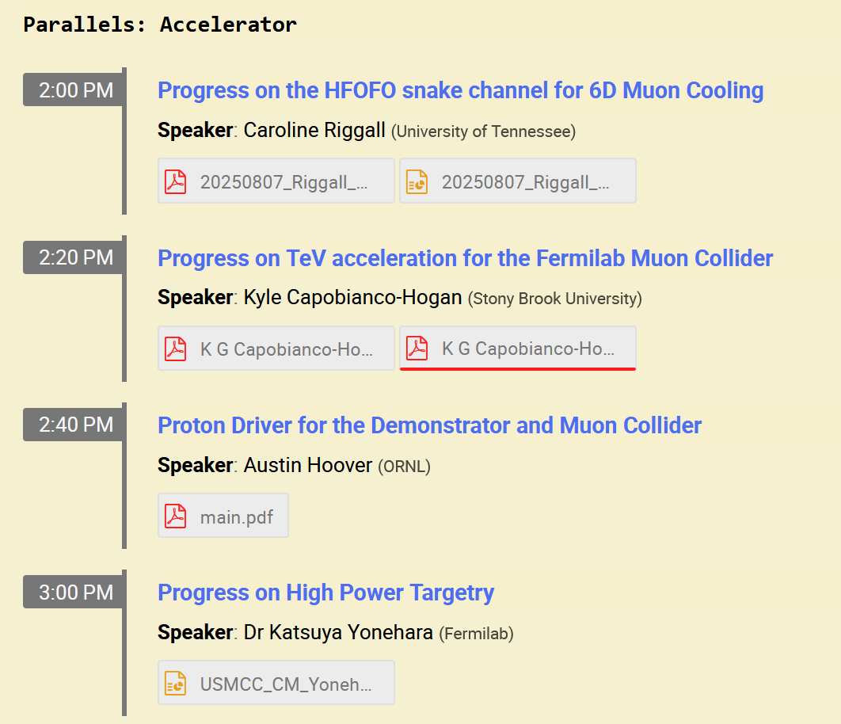
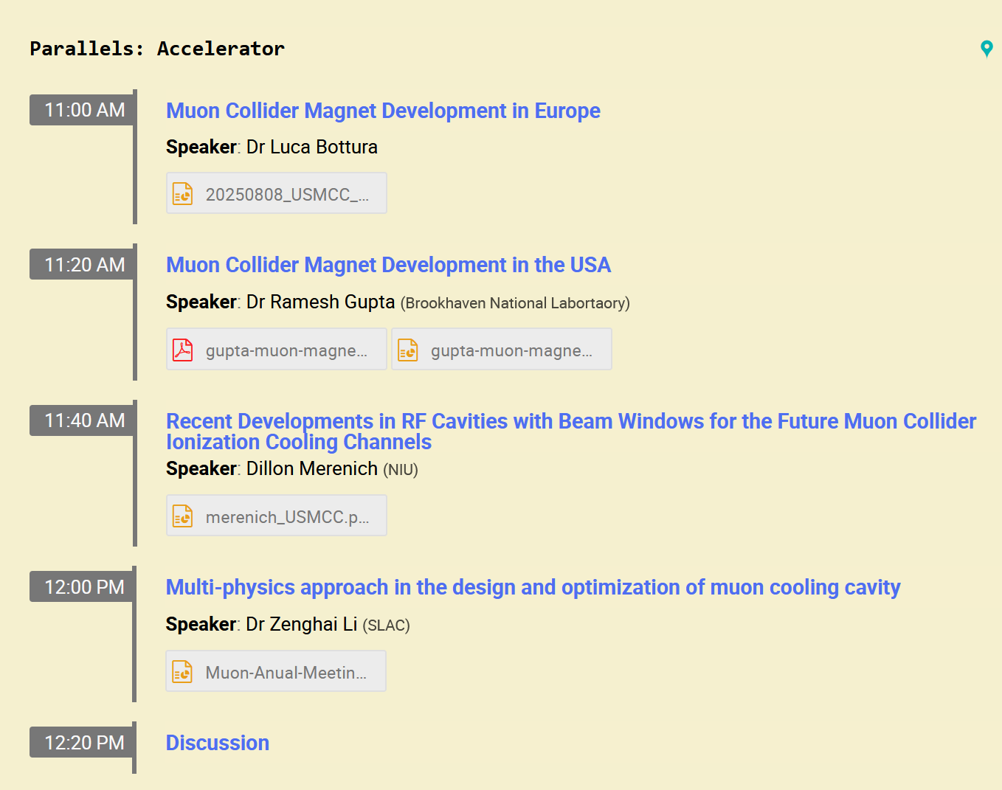
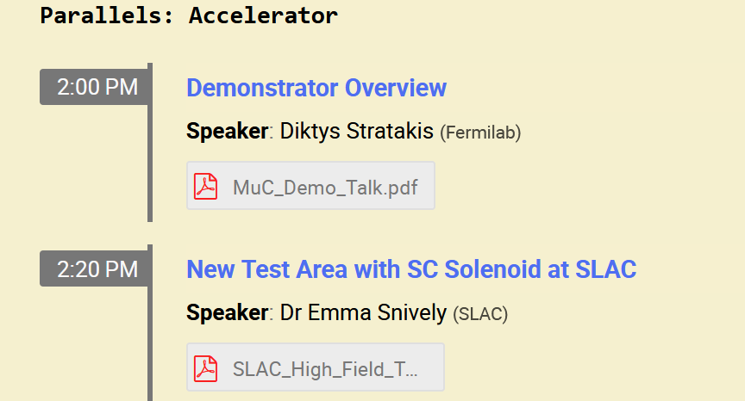
Many interesting topics during parallel session….Thank you!

Slide 3
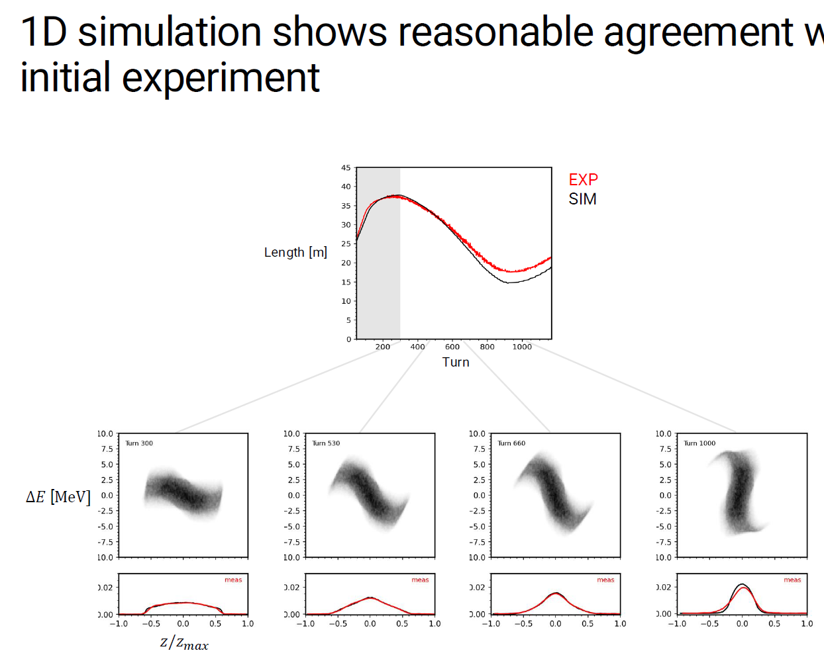
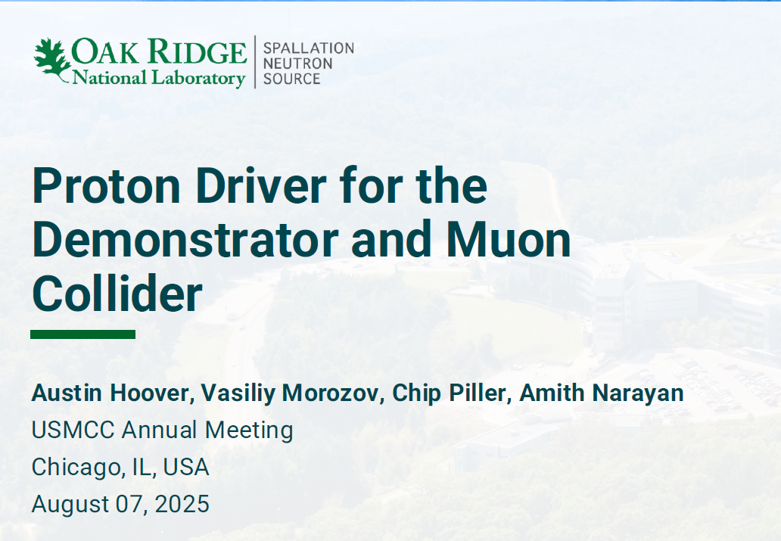
Proton Driver Studies (Hoover et al)
Bunch compression experiments ongoing at SNS
Experiments will test hardware limits, explore modifications for bunch compression.
Initial experiment at low charge + simulation benchmark are shown on the slide.

Slide 4

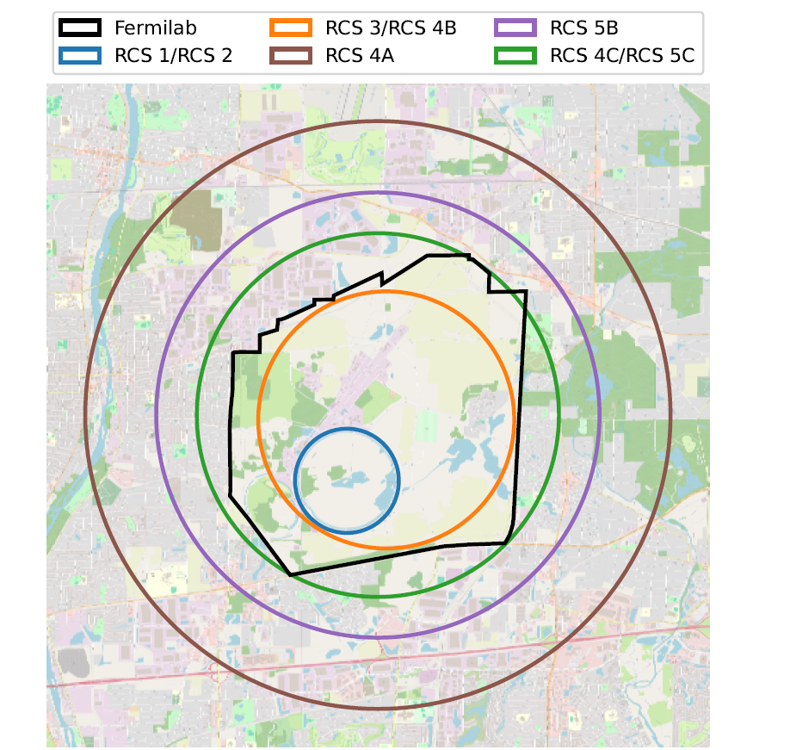
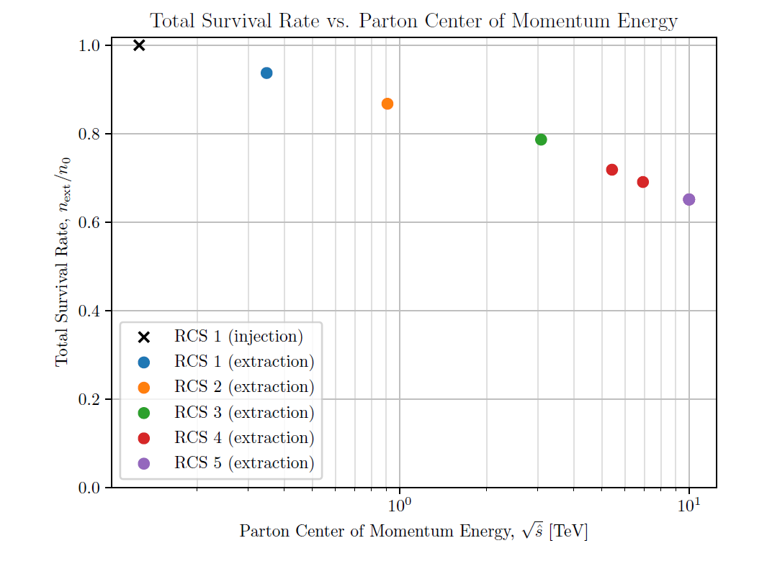
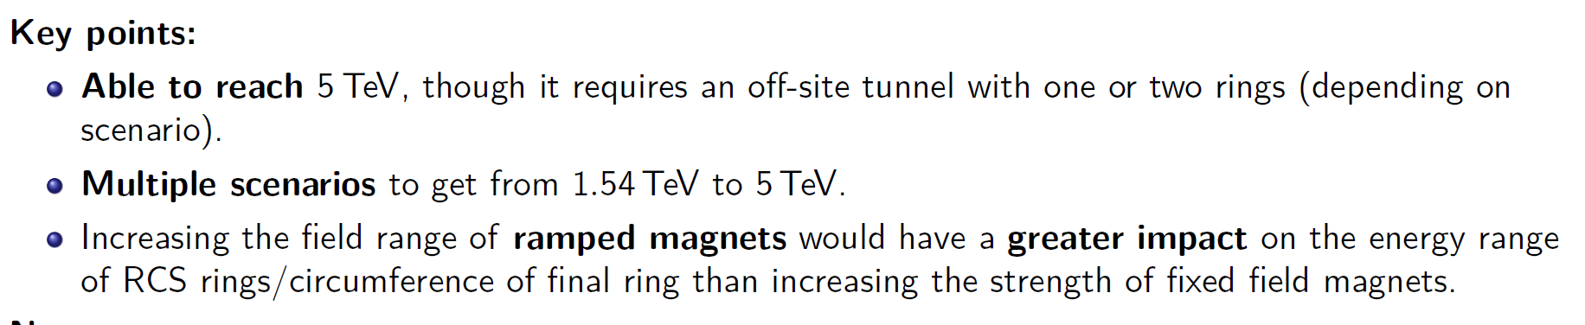
TeV acceleration for Fermilab MuC ( Hogan et al)

Slide 5
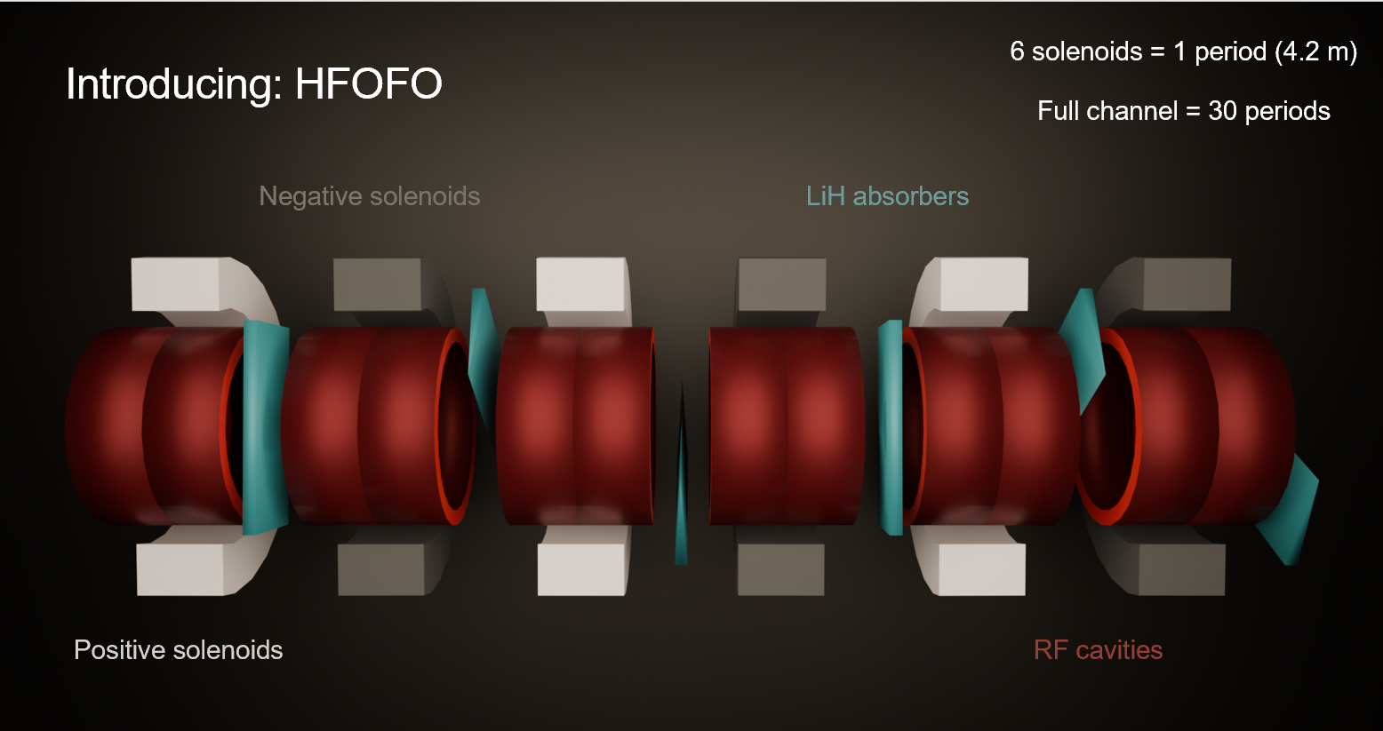
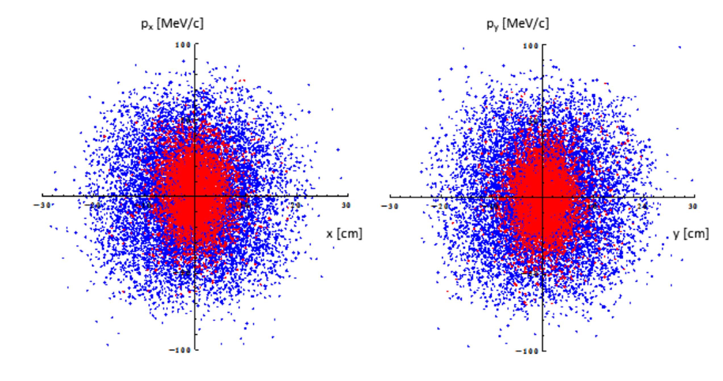
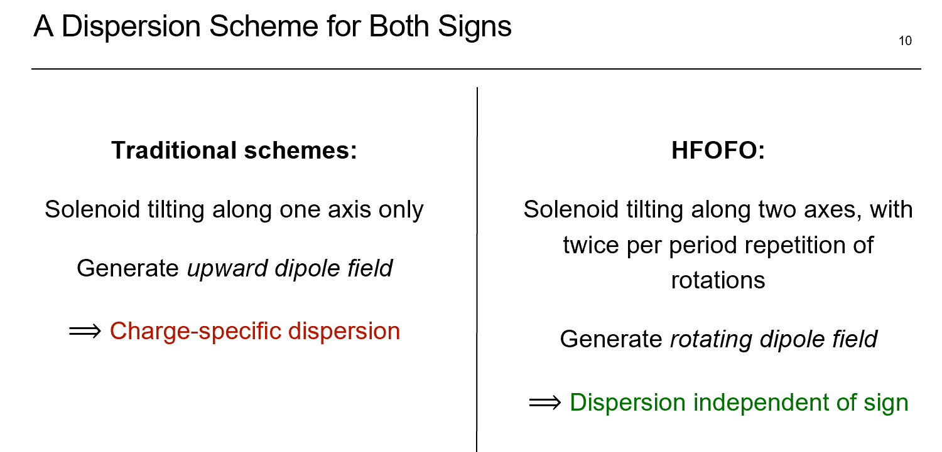
Cooling both signs (Riggall et al)

Slide 6
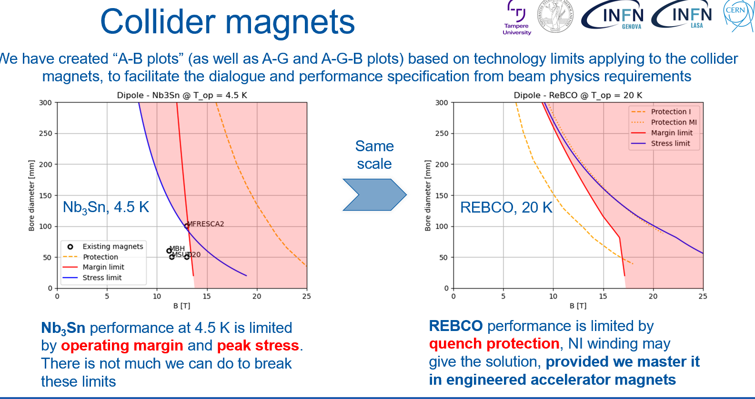
Magnets (Bottura et al.)

Slide 7
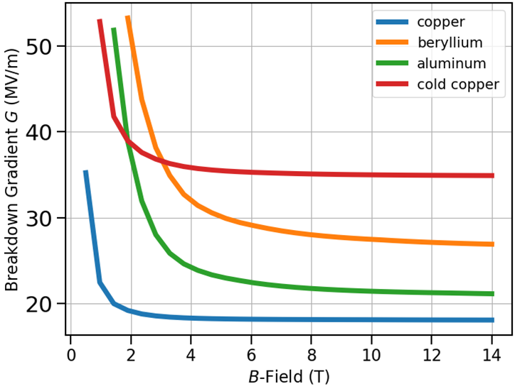
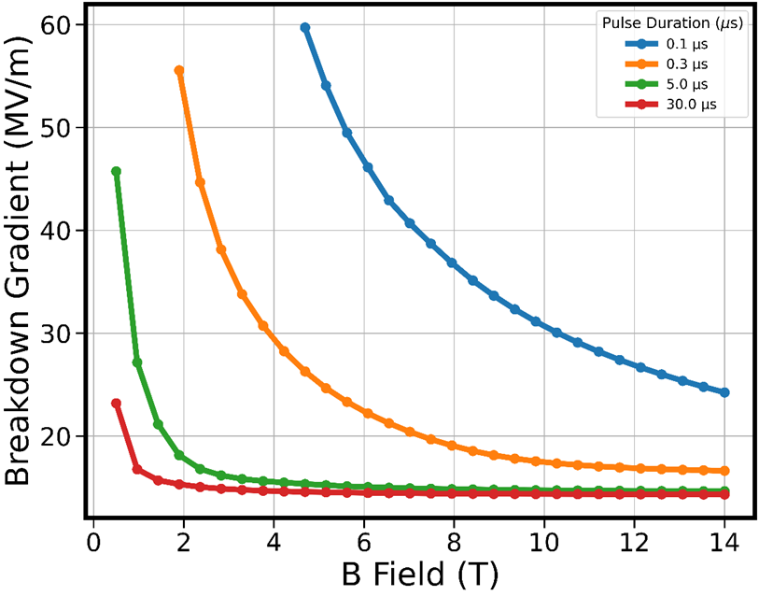
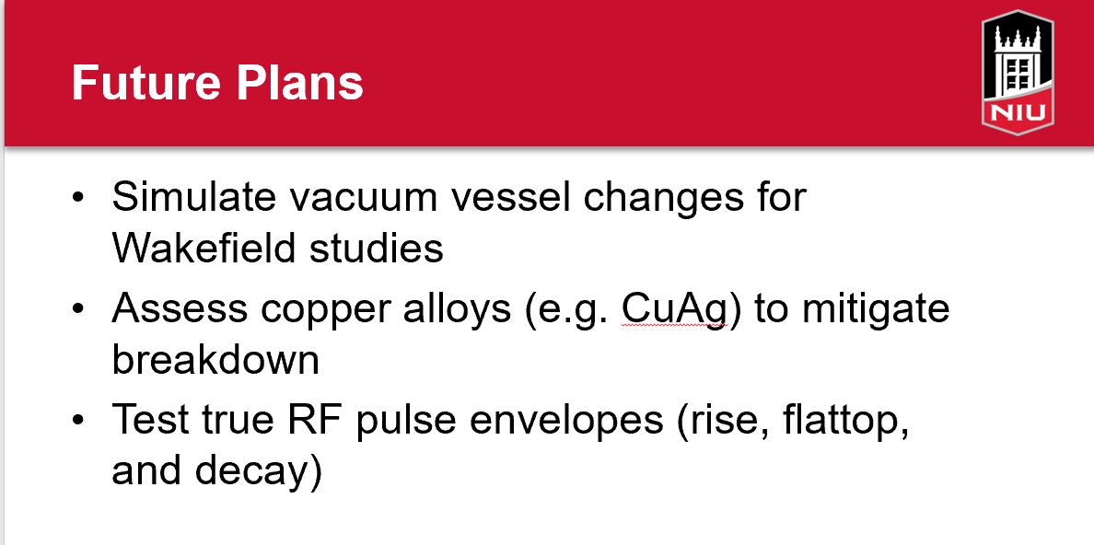
Cavities in B-fields (Merenich et al.)
Breakdown Studies
  Cold copper shows strong breakdown resilience due to its enhanced diffusivity
  Pulse length reduction can improve breakdown resilience within diffusion limits

Slide 8
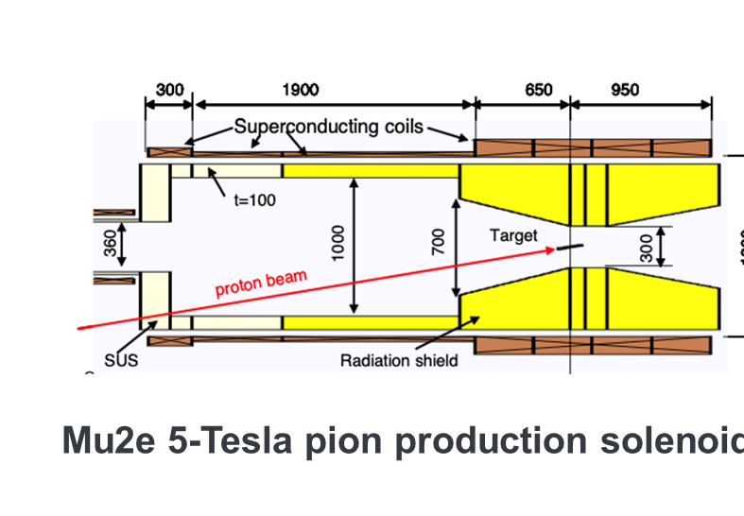
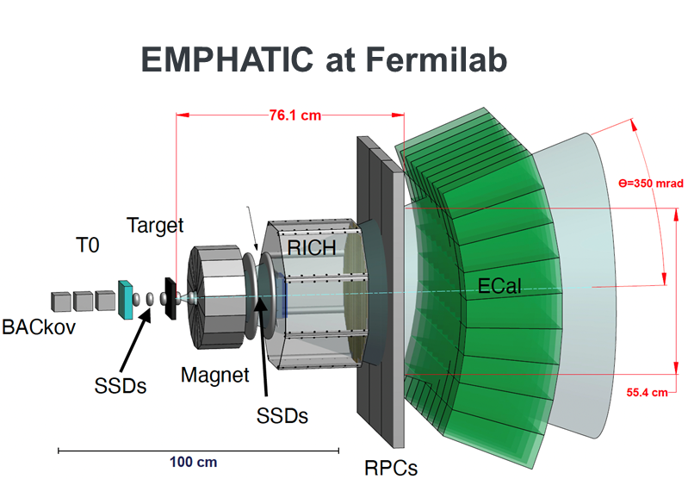

Targets (Yonehara et al.)
NuMI magnetic horn (just first horn)
Pion production measurements with muon collider targets may be needed to improve the accurate of production model
Designing concepts for the pion collection system (demonstrator):
Comparative study of solenoid vs magnetic horn systems needed

Slide 9
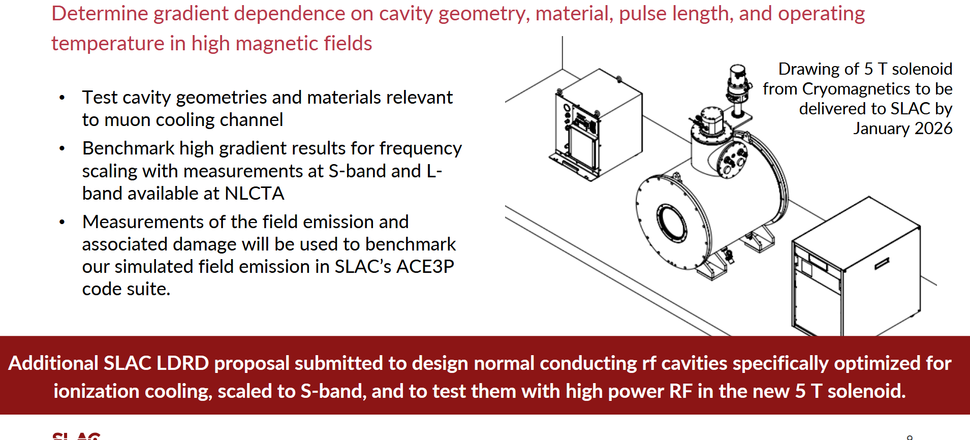
RF Testing in Magnetic Fields (Snively, Li et al.)

Slide 10
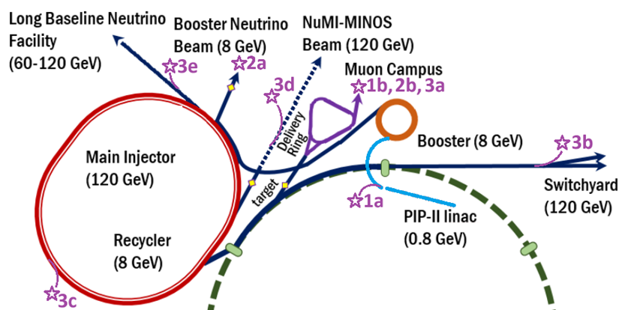
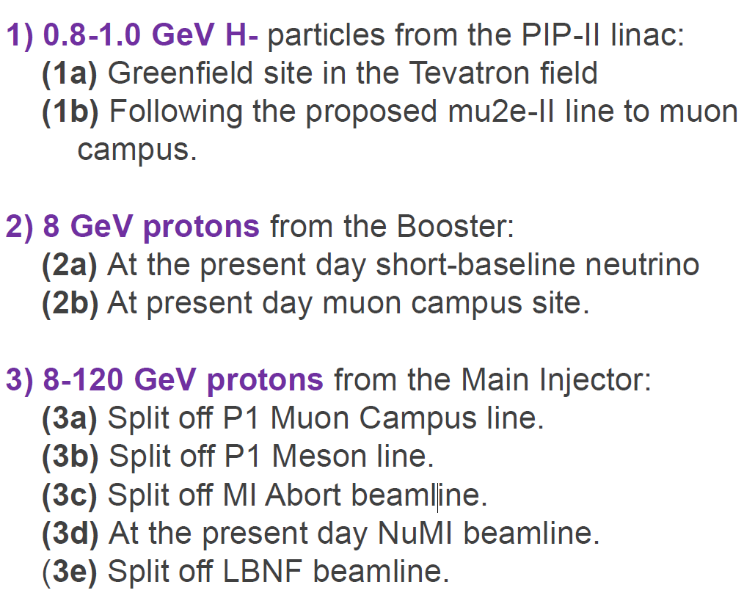
Demonstrator at Fermilab (Stratakis et al.)

