Slide 1



Calibration challenges in the MAIA calorimeters
Rose Powers (Princeton University)
2nd Annual USMCC Meeting
7 August 2025

Slide 2
Outline
Introduction
The MAIA calorimetry system and solenoid
Particle behavior in the solenoid
Analytical calibration approach
2D calibration matrix – benefits and challenges
Conclusion and next steps

Slide 3
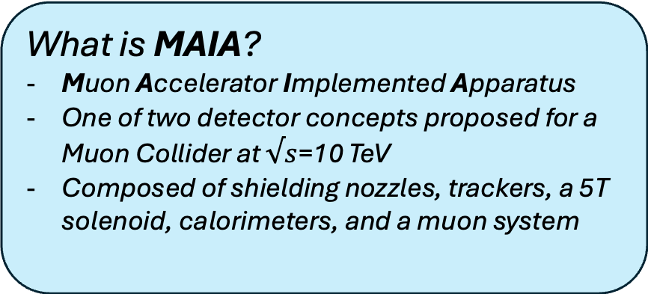
Introduction
What is MAIA?
Muon Accelerator Implemented Apparatus
One of two detector concepts proposed for a Muon Collider at $√s$=10 TeV
Composed of shielding nozzles, trackers, a 5T solenoid, calorimeters, and a muon system
Why are calorimeters important?
The electromagnetic and hadronic calorimeters are designed to stop EM and hadronic particles, respectively, and measure their energy
5D calorimetry—information about energy, timing, and position
Why and how do we calibrate our calorimeters?
Accurate energy measurements are crucial to reconstruction
  Particle ID
  Identifying missing energy
  Finding resonances
We can assess the calorimeters’ performance with the simplest neutral objects (photons and neutrons) as standard candles

Slide 4
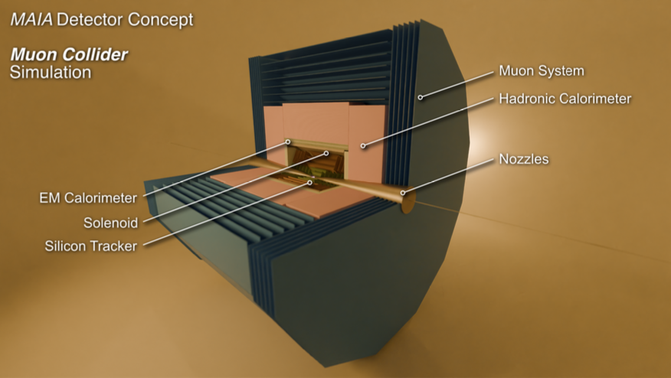
MAIA Calorimeters
[1] arXiv:2502.00181
Cross-section of the first quadrant of the MAIA detector in the RZ plane, focusing on the solenoid and calorimeters.
ECAL:
Silicon and Tungsten
5x5 mm² cells
50 layers
HCAL:
Iron and scintillator
30x30 mm² cells
75 layers
Tracking Detectors
Interaction Point

Slide 5
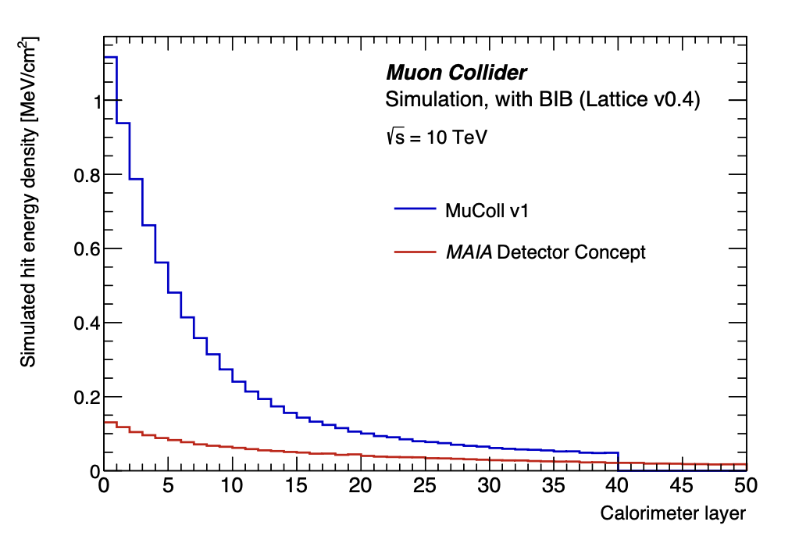
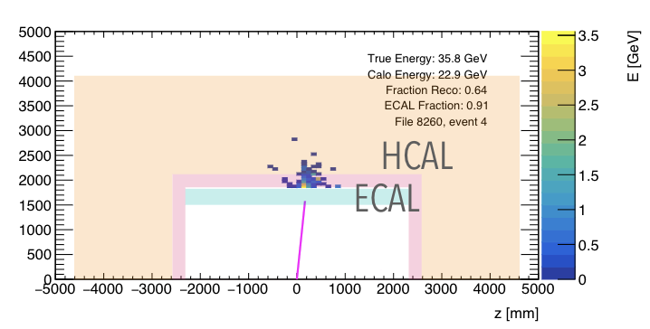
The solenoid: BIB bodyguard or black box?
The solenoid adds approximately 265 mm of aluminum between the trackers and the calorimeters. Two interpretations…
265 mm of additional shielding, drastically reducing BIB occupancy in the calorimeters!
265 mm of detector-free material where particles interact and lose energy.
Comparison of BIB energy density deposition in ECAL for different solenoid placements.
[1] arXiv:2502.00181
Event display showing a pion showering in the solenoid. Plot courtesy of Tova Holmes.

Slide 6
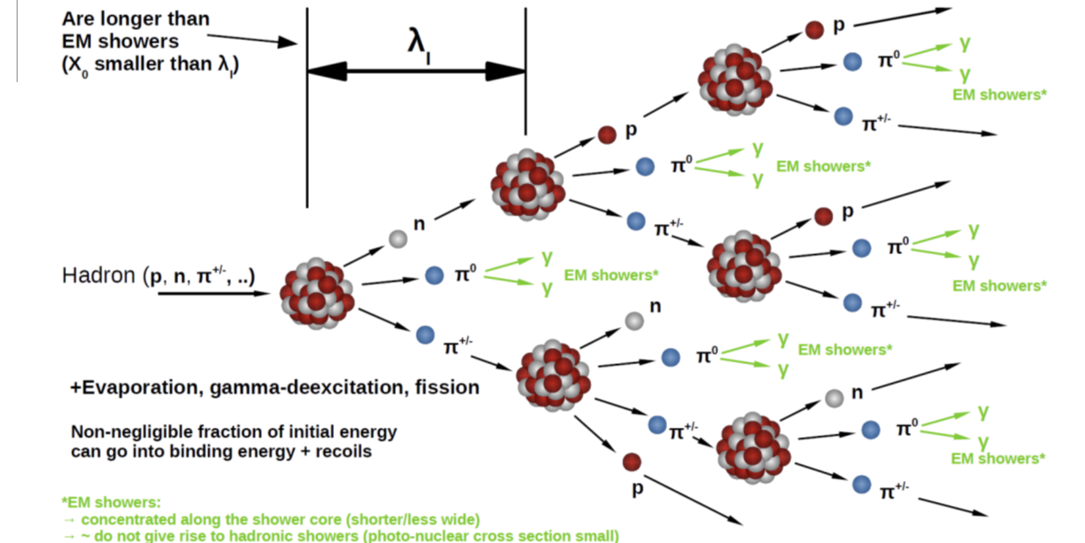






Material interactions in the solenoid
$$γ$$
Photons lose energy via electromagnetic showers
  Cascade of pair production, Bremsstrahlung, and e+/e- annihilation
Neutrons lose energy via hadronic showers
  Cascade of nuclear processes, collisions,
  and EM showers
e⁻
e⁺
$$γ$$
e⁻
$$γ$$
e⁺
e⁺
e⁻
e⁺
$$γ$$
e⁻
$$γ$$
e⁺
$$γ$$
e⁺
e⁻
e⁻
$$γ$$
e⁻
e⁺
Both EM particles and hadrons can shower in aluminum, resulting in energy loss between the trackers and the calorimeters.
Figure from [2]

Slide 7

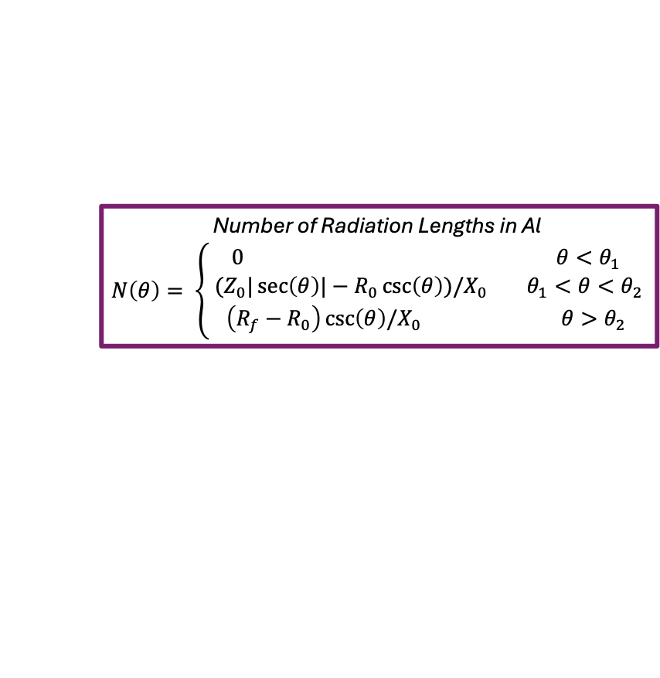


Analytical energy loss function
Let’s take an analytical approach to EM showering
  Much simpler to model than hadronic showering
We derive energy response shape as a function of:
  Geometric parameters of detector
  Photon polar angle
Z₀
R_{f}
Radiation length X₀ = 8.89 cm
Number of Radiation Lengths in Al
$$N\left(θ\right)= \left\{\begin{aligned}0 θ<θ_{1} \\ { (Z}_{0}|\sec\left(θ\right)|−R_{0}\csc\left(θ\right))/X_{0} θ_{1}<θ<θ_{2} \\ \left(R_{f}−R_{0}\right)\csc\left(θ\right)/X_{0} θ>θ_{2}\end{aligned}\right.$$
R₀
$$E_{0}/E_{f}∝2^{N(θ)}$$
$$θ_{2}$$
$$θ_{1}$$

Slide 8
Indeed, the theta-dependence of photonic energy response follows this form…
… but theta-dependence is not the whole story.
Response is also energy dependent—higher-energy particles lose fractionally less energy in the material.

Slide 9




Stochasticity of showering
Unlike geometric theta dependence, energy dependence of response is highly nontrivial to model.
Our $2^{N(θ)}$ functional form assumes immediate showering
At high energies, may see MIP-like behavior or stochastically delayed showering
(a)
(b)
(c)
$$X_{0}$$
$${2X}_{0}$$
$${3X}_{0}$$
Cartoon of three particles beginning to shower at (a) the entrance to the solenoid, (b) after two interaction lengths, and (c) not at all.
Bottom line: we cannot rely on a realistic analytical calibration.

Slide 10

2D response as calibration function
In lieu of an analytical calibration, we can use the response plots themselves as calibration matrices.
For instance, a photon reconstructed with 350 GeV < E < 400 GeV and 2.1 < $θ$ < 2.2 would be multiplied by the value of this bin.
Photon energy response as a function of reconstructed energy and azimuthal angle.
Analogous plot for neutrons.

Slide 11
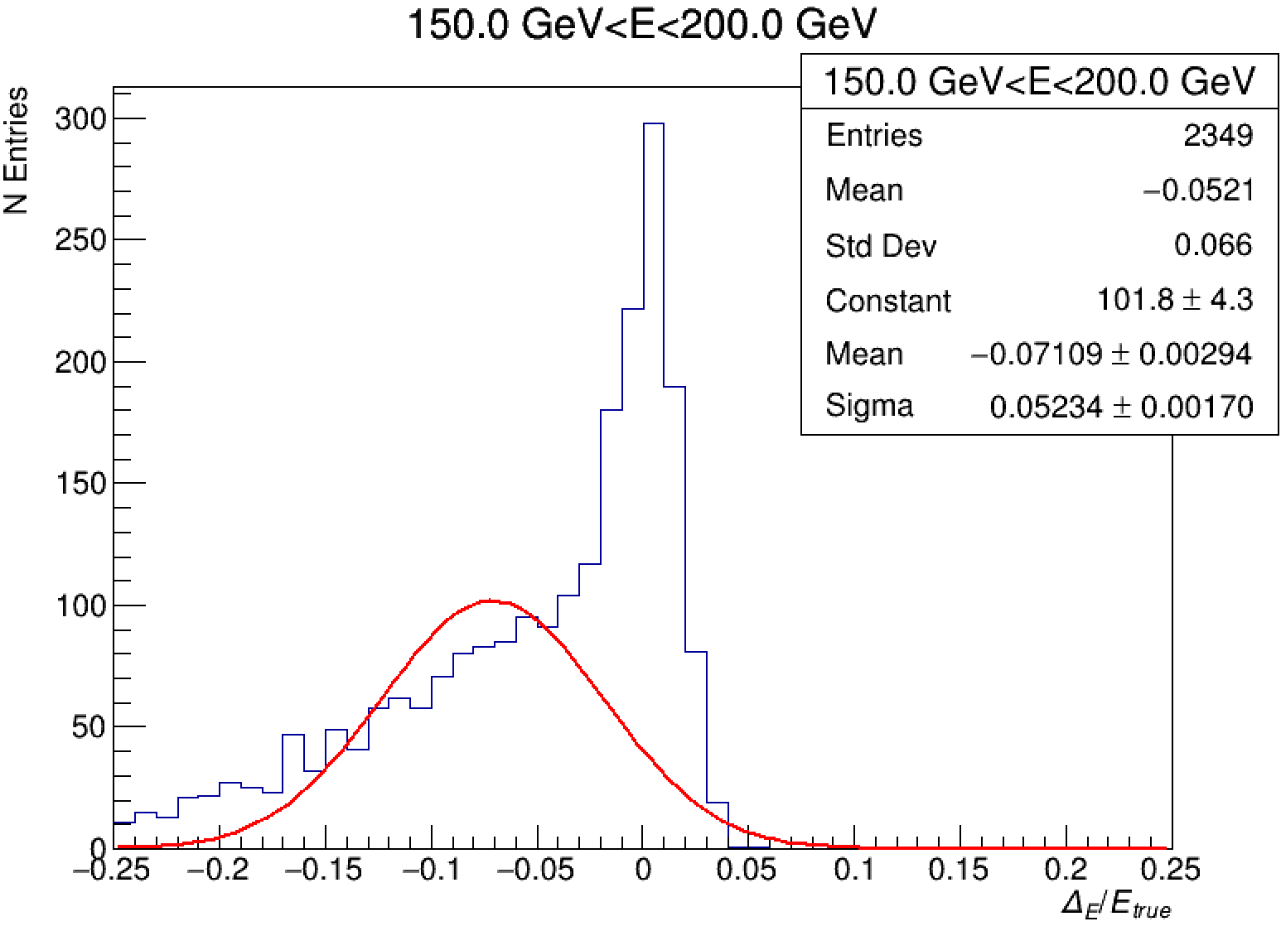
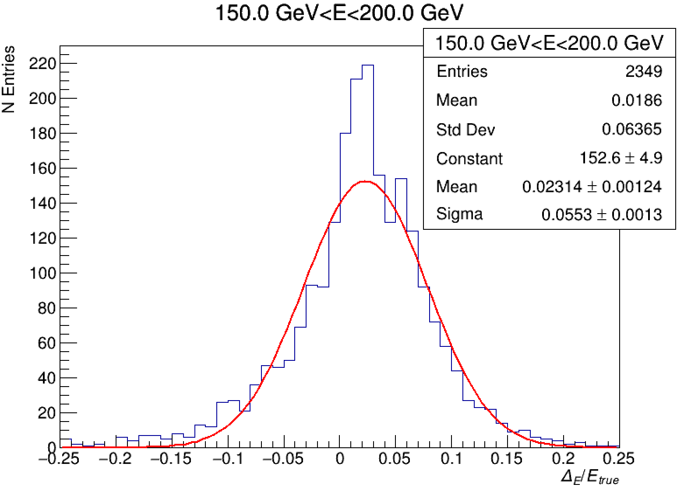
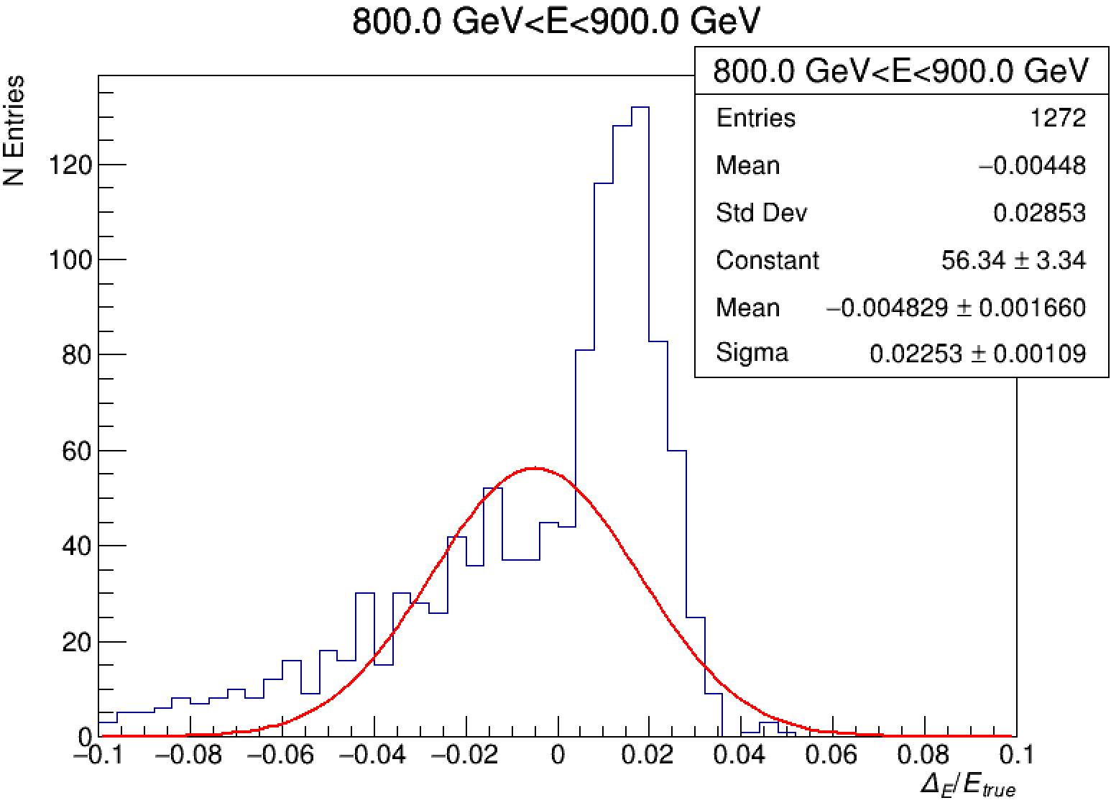
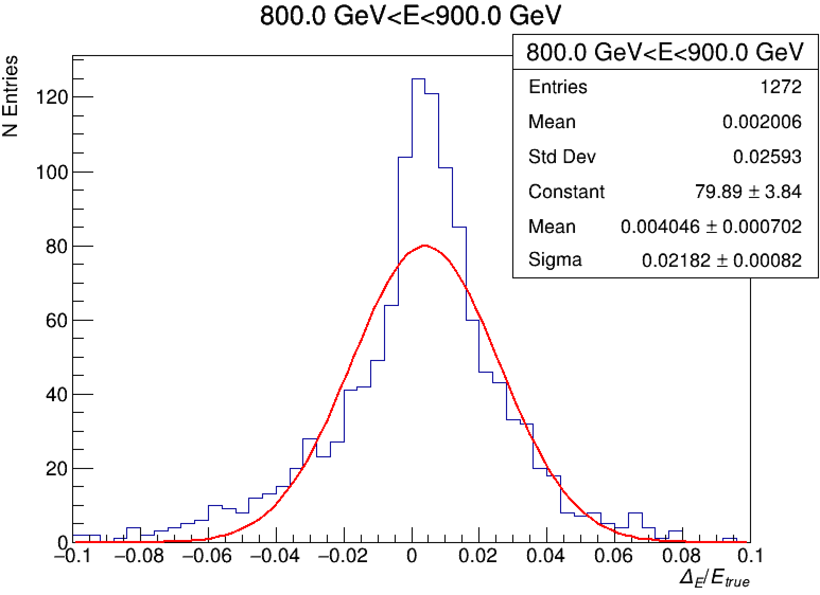
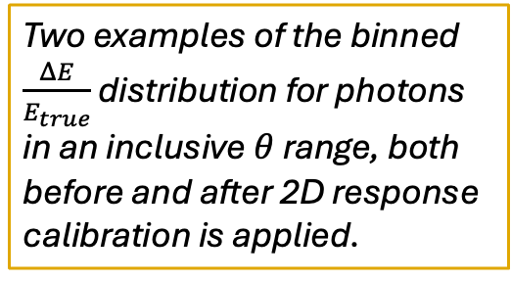
Calibrated fractional response
Two examples of the binned $\frac{ΔE}{E_{true}}$ distribution for photons in an inclusive $θ$range, both before and after 2D response calibration is applied.
Calibration effectively eliminates bimodality due to geometric effects.

Slide 12
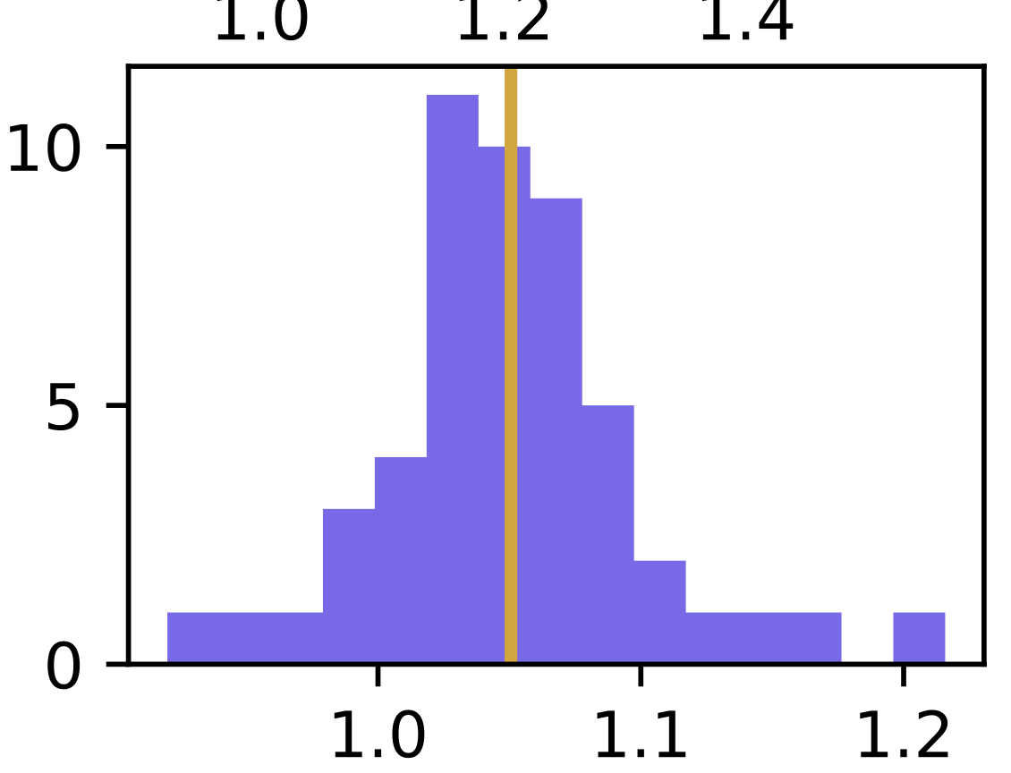
But is this really a valid approach?
These response plots take the arithmetic mean in each bin
  Works well in bins with Gaussian distributions…
Endcaps
Transition
Central barrel
10
Mean
25
Mean
50
75
100
125
150
E_{true}/E_{reco}
175
Reconstructed Neutron Energy [GeV]
200
225
250

Slide 13
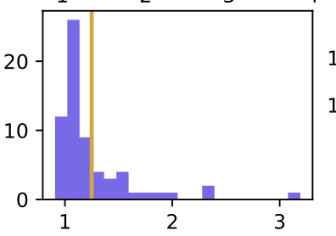
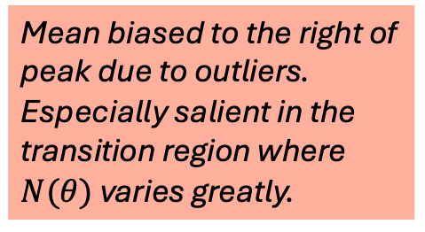
But is this really a valid approach?
These response plots take the arithmetic mean in each bin
  However, is susceptible to outliers
  Especially troublesome in low-N or wide-range regions
Endcaps
Transition
Central barrel
10
25
Mean
50
75
100
125
150
E_{true}/E_{reco}
Mean biased to the right of peak due to outliers. Especially salient in the transition region where $N(θ)$ varies greatly.
175
Reconstructed Neutron Energy [GeV]
200
225
250

Slide 14
Alternative methods
A robust calibration method should not be susceptible to the influence of outliers.
Fitting binned response distributions
  Many bins exhibit near-Gaussian peaks: fitting those peaks would give a more stable mean
A dedicated large-statistics calibration dataset
  Could also stabilize and allow us to bin calibration matrix more finely
A detailed study of particles’ interactions in the solenoid
  Might make an interesting tangential investigation with applications in detector performance studies→opportunities here to get involved!

Slide 15
Conclusions and outlook
Calibration cannot completely remove stochastic broadening of energy response due to the solenoid.
However, a 2D response-based calibration can mitigate the most salient geometrical and energetic dependencies
A more nuanced assessment of binned response may further improve accuracy of calibration
While the solenoid adds challenges to the calibration process, these challenges can largely be mitigated and are far outweighed by the solenoid’s BIB reduction efficacy

