Slide 1



R&D and applications of low-gain avalanche diodes
Jennifer Ott
Summarizing many others’ work
ottjenni@hawaii.edu
US Muon collider workshop, August 7-8, 2025

Slide 2
LGAD sensor technology and challenges
HL-LHC: separate LGAD timing layers in CMS ETL and ATLAS HGTD
Future colliders: 4D / 5D tracking
  LGAD sensors
  ‘standard’ DC-LGAD
  AC-LGAD
  TI-LGAD
  DJ-LGAD
  LGAD-CMOS
  iLGAD
  LGADs in other semiconductors: SiC, diamond
Factors to be considered in application
  Radiation hardness
  Timing resolution
  Spatial resolution
  (Energy resolution)
  Fill factor
  Cost; production at-scale
  Purpose: pileup rejection, tracking, particle ID...

Slide 3
Radiation hardness
The main challenge for silicon tracking sensors in the LHC and HL-LHC era
Benchmarks: radiation hard to...
>1e14 n_{eq}cm⁻² for LHC
2e16 n_{eq}cm⁻² in pixel sensors of Phase-2 upgrades in ATLAS and CMS
Showstopper for monolithic active pixel sensors / CMOS pixels so far
Shift in constraints at lepton colliders: fluence at LHC levels or below; material budget and spatial resolution have higher priority
Fundamental R&D – potentially towards FCC-hh – is approaching fluences of 1e17 cm⁻²

Slide 4
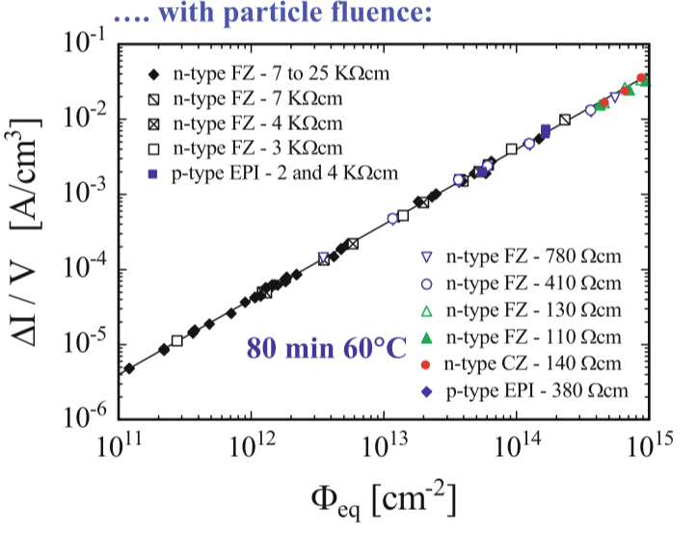
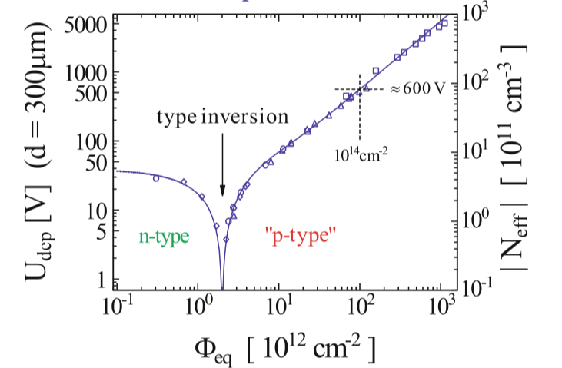
Radiation damage in LGADs
LGADs (regardless of what structural variant) suffer from degradation of the gain due to deactivation of acceptors
Radiation damage has traditionally been quantified through non-ionizing energy loss: generation of bulk defects, increase in leakage current, increase of depletion voltage
Not the most relevant definition for LGADs
Prior scaling factors do not apply
Increased leakage current and all other phenomena in silicon bulk will still be present!
M. Moll, 1999

Slide 5
Radiation damage in LGADs
LGADs (regardless of what structural variant) suffer from degradation of the gain due to deactivation of acceptors
Can be addressed to some extent by gain layer and defect engineering
Different dopant: e.g. Ga instead of B
  Not successful
Carbon co-doping
  Successful at reducing gain layer deactivation
Partially activated boron
  More recent; very mixed results for different vendors
Gain layer doping reduced
Increasing number of defects in bulk

Slide 6
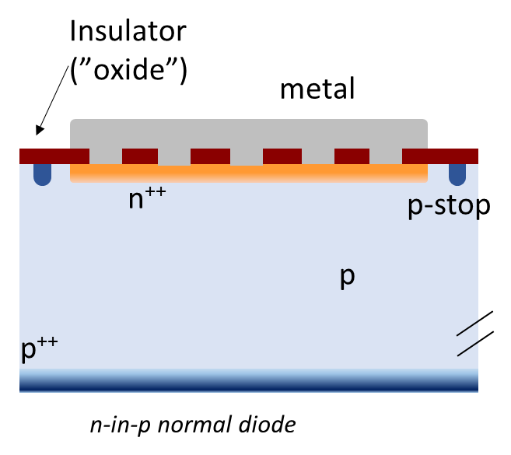
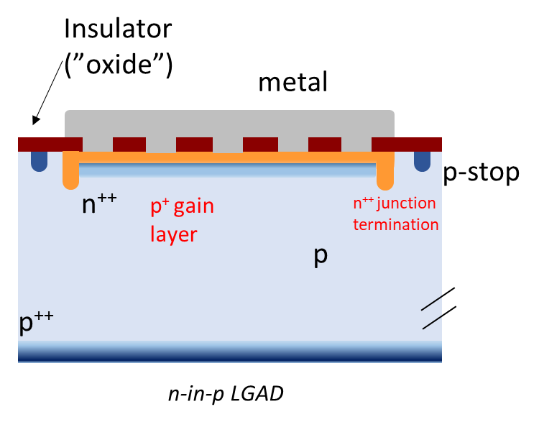
Spatial & timing resolution
Spatial resolution is related to the fill factor of the sensor
Standard DC-LGADs feature a junction termination extension n-type implant to terminate the high electric field at the edges of each pad
  Plus p-spray and p-stop insulation between pads
Reducing the sensor’s active area, limiting the pad size

Slide 7
Spatial & timing resolution
Spatial resolution is related to the fill factor of the sensor
Standard DC-LGADs feature a junction termination extension n-type implant to terminate the high electric field at the edges of each pad
  Plus p-spray and p-stop insulation between pads
Reducing the sensor’s active area, limiting the pad size
Timing resolution: adjustment of gain layer; thinning of sensors to lower Landau fluctuations
Electronics play a large role as well
HL-LHC LGAD sensors have pad lengths of 1.3 mm
Need different sensor variants to improve this for future colliders

Slide 8
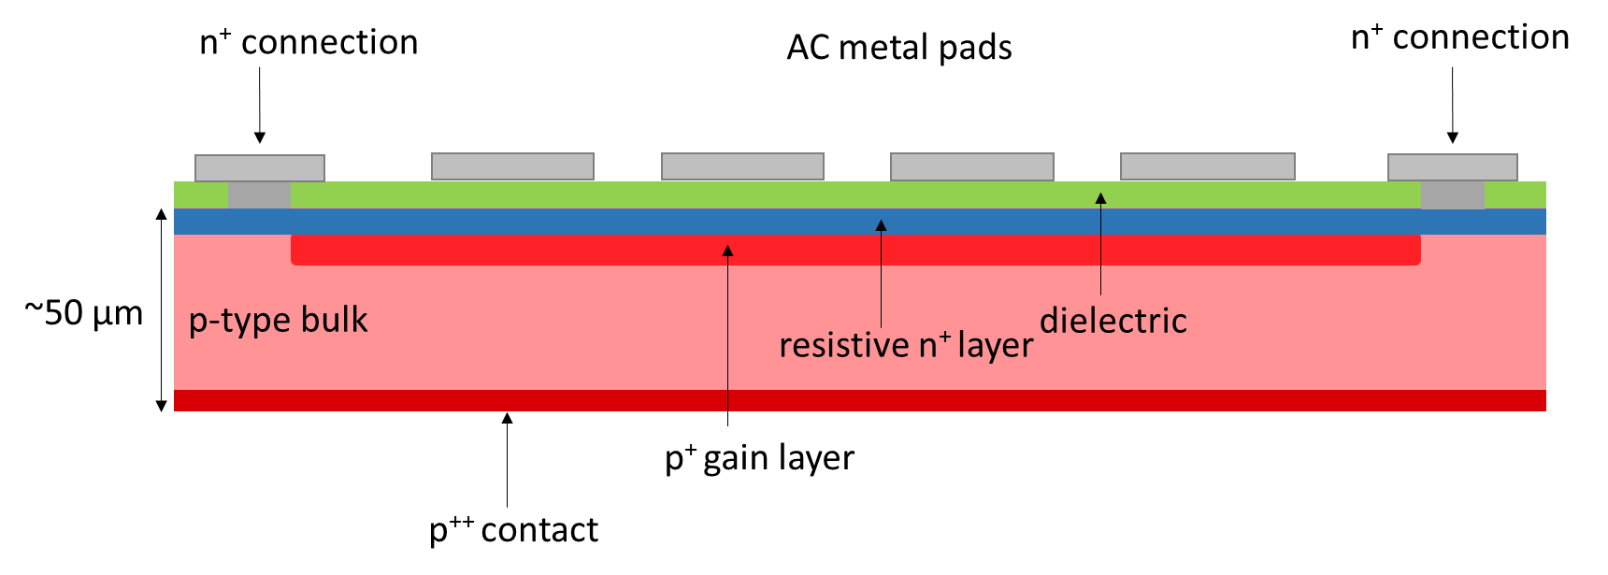
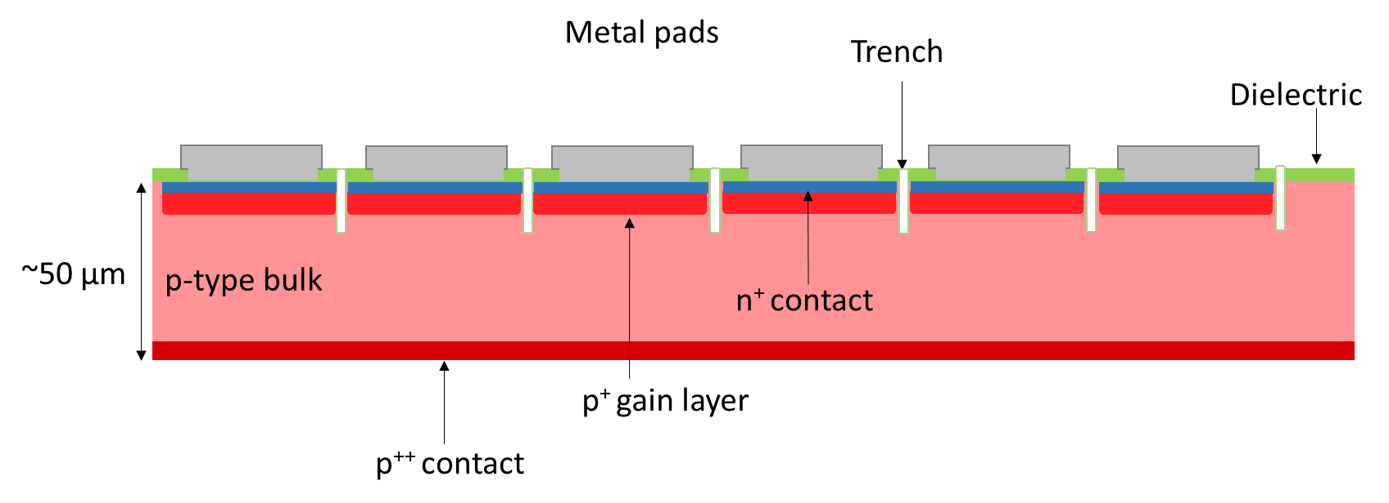
Optimizing the fill factor
  AC-LGADs (Resistive Silicon Detectors)
  Common n+ electrode, gain layer and insulation: signal charge is capacitively coupled to metal readout electrodes
  Interpolation of hit by exploiting signal sharing between electrodes
  Combination of two new concepts: resistive n+ layer, AC-coupling of signal
    Could also separate these aspects: ‘DC-RSD’ with resistive n+ layer, but direct contact
Trench-insulated LGADs
  Insulation between pads is provided by an etched trench, which can be ‘filled’ with a dielectric
  Similarly to 3D sensors: gas phase process, reactive ion etching
    Balance density of trenches with respect to wafer thickness to avoid instabilities
  First large(r) sensors of >1 cm strip length are being fabricated

Slide 9
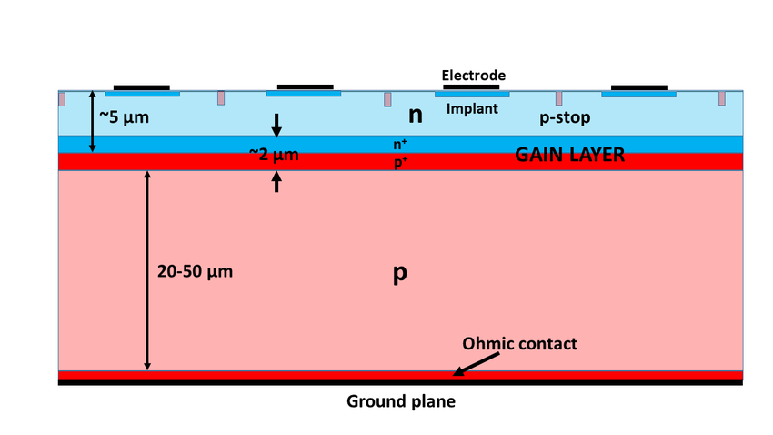
LGADs in industrial Si processes
Integration of gain layer into silicon CMOS process
Successfully demonstrated by University of Geneva PicoAD detector: IHP 130 nm SiGe process
  Long and extensive work together with manufacturer
  Beginning efforts for industry-scale silicon CMOS integration in the US by FNAL and SLAC
Deep-junction LGADs: uniform gain layer situated deeper in the bulk – no need for junction termination extension, less sensitive to radiation effects
  Challenge: very deep implant or wafer-wafer bonding, not trivial to find industrial partner

Slide 10
Summary
Considering the muon collider baselines, requirements, aspirations: neither spatial resolution nor timing resolution are overly strenuous
  30-60 ps are being achieved with DC-LGADs developed for the HL-LHC, assuming high radiation levels!
Using precision timing to identify vertices and reconstruct tracks, separate collision data from beam backgrounds is tempting (required) – but keep in mind that this is being done in software, the detector itself will still experience the full hit rate
  E.g. resistive silicon detectors will not do well in a high-occupancy environment
Consider the big picture and operational constraints: availability of detector process lines, uniformity of large sensors, ...
Further specify (through simulations and modelling) critical performance parameters to select or develop the optimal semiconductor sensor technology

Slide 11
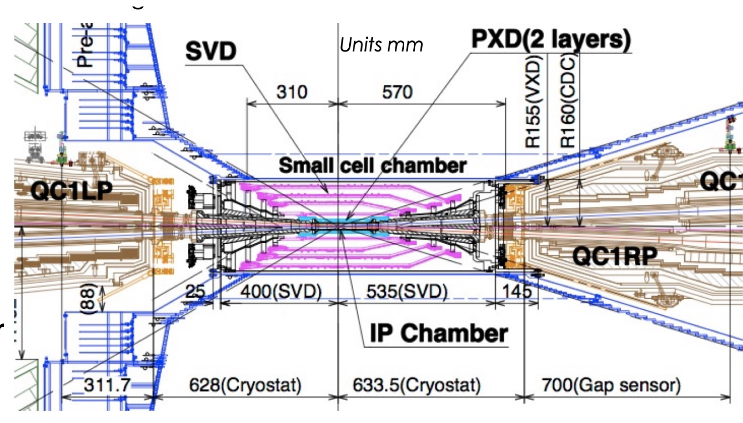
Timing layer for Belle II?
With Yubo Han and Peter Lewis (UH)
The Belle II detector employs DEPFET pixels and a drift chamber
The drift chamber is likely to be retreating to larger r because of high backgrounds
new volume available between ca. r = 17cm and 34 cm
Could add a TOF detector for triggering and particle ID??

Slide 12
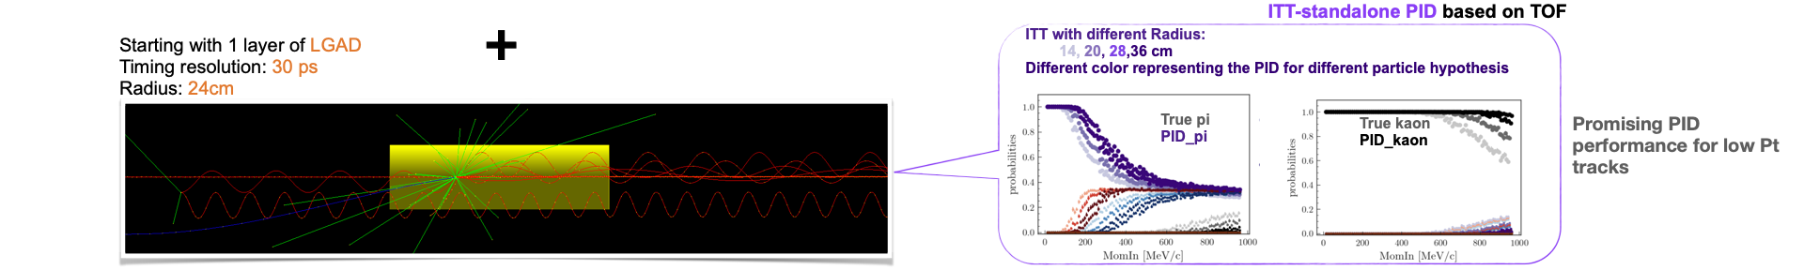
A timing layer for Belle II?
With Yubo Han and Peter Lewis (UH)
Could add a TOF detector for triggering and particle ID??
Assuming e.g. 30ps resolution:
Allows PID down to pT~100MeV for muons instead of ~500MeV, increasing effective luminosity for many analyses that use low-p tracks
Could replace triggering role of CDC, particularly for small-pT tracks
Separation of beam backgrounds?
VERY PRELIMINARY RESULTS

Slide 13

Thank you
Mahalo

