Slide 1

Forward Muon Detection
& Luminosity Measurement
Darin Acosta, O. Miguel Colin, L. Fernandes, A. Rosene, K. Yang,
T.W. Bonner Nuclear Laboratory

Slide 2
Outline
Physics cases for forward muon detection with a muon collider, and synergies with muon-ion collider program
Need for forward muon detectors for a luminosity measurement from Bhabha scattering
Straw design for a forward muon spectrometer design based on toroids
Initial thinking of the muon detector layout
Summary

Slide 3
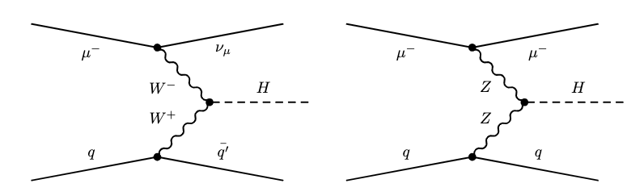
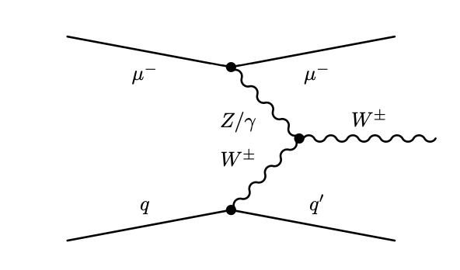
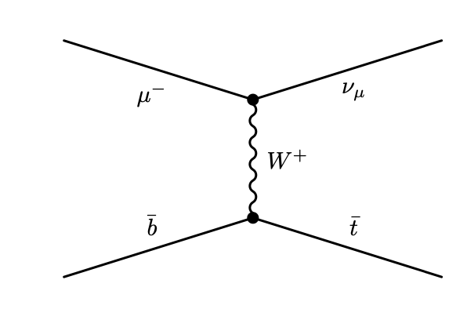
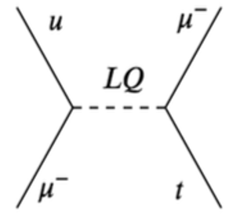
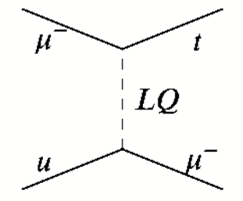
Motivation for Forward Muon Detection
Lepton (and lepton-hadron) colliders
are Vector Boson Fusion colliders at
high energy
Deep inelastic μp collisions
Luminosity measurement at lepton
colliders is traditionally measured
through Bhabha scattering
  Lepton scatters at small angles in all cases
μ/q
μ/q
μ/q
μ/q
μ/q
μ/q
μ−
V
q
q'
μ−
μ−
μ−
μ+
μ+
μ+
μ+

Slide 4
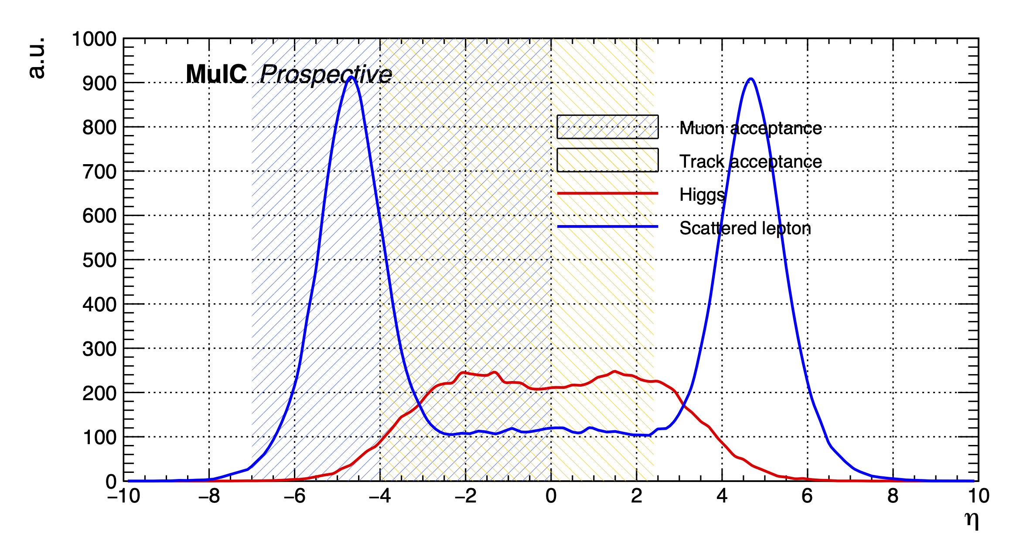
VBF Higgs Production for a 10 TeV μ⁺μ⁻ Collider
Pseudorapidity distribution for the scattered lepton in VBF Higgs production to tag NC processes (and potentially measure invisible Higgs decays)
5 x 5 TeV:
Scattered muons are in far backward and forward regions, 3 < |η| < 6
Other interesting μμ physics processes also could lead to forward muons
μ+
μ+
η

Slide 5
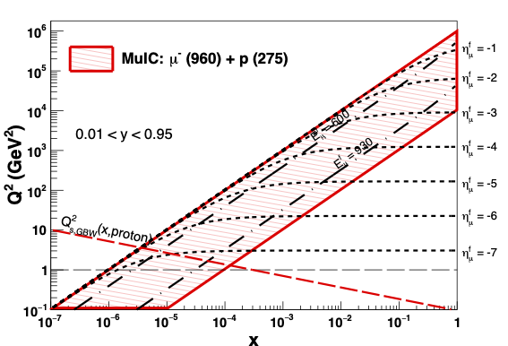
Muon-Proton DIS Kinematics (E,η in Q² - x plane)
E_{μ}=1 TeV E_{p}=0.3 TeV → √s = 1 TeV
Scattered muon
Backward tagging of muons to η= −7 (2 mrad)
1 TeV Muon-Ion Collider:
Acosta, Li, NIM A 1027 (2022) 166334

Slide 6
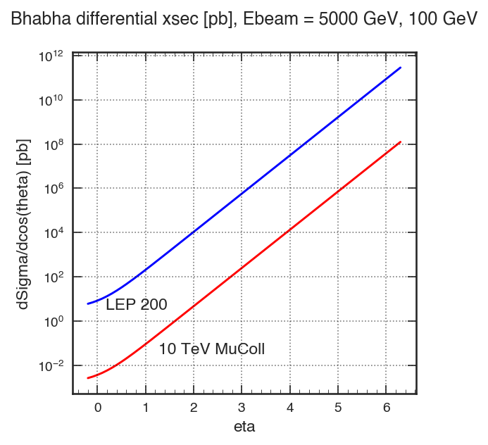
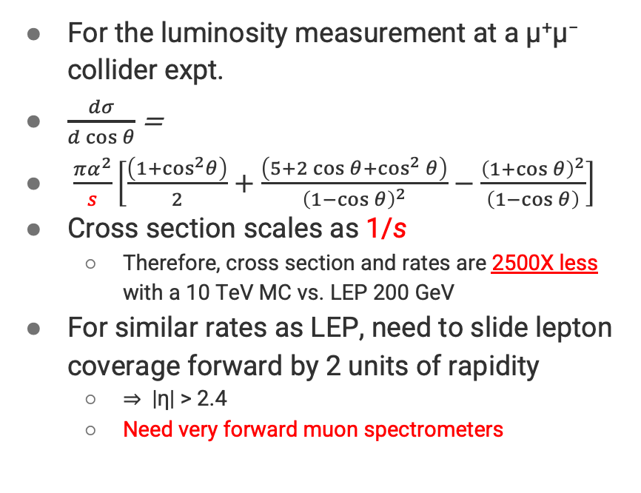
Bhabha Scattering for μ⁺μ⁻ Luminosity Measurement
For the luminosity measurement at a μ⁺μ⁻ collider expt.
$\frac{dσ}{d\cos{θ}}$ =
$\frac{πα^{2}}{s}\left[\frac{\left(1+\cos^{2}θ\right)}{2}+\frac{\left(5+2\cos{θ+\cos^{2}{θ}}\right)}{{\left(1−\cos{θ}\right)}^{2}}−\frac{{\left(1+\cos{θ}\right)}^{2}}{\left(1−\cos{θ}\right)}\right]$
Cross section scales as 1/s
  Therefore, cross section and rates are 2500X less with a 10 TeV MC vs. LEP 200 GeV
For similar rates as LEP, need to slide lepton coverage forward by 2 units of rapidity
  ⇒ |η| > 2.4
  Need very forward muon spectrometers

Slide 7
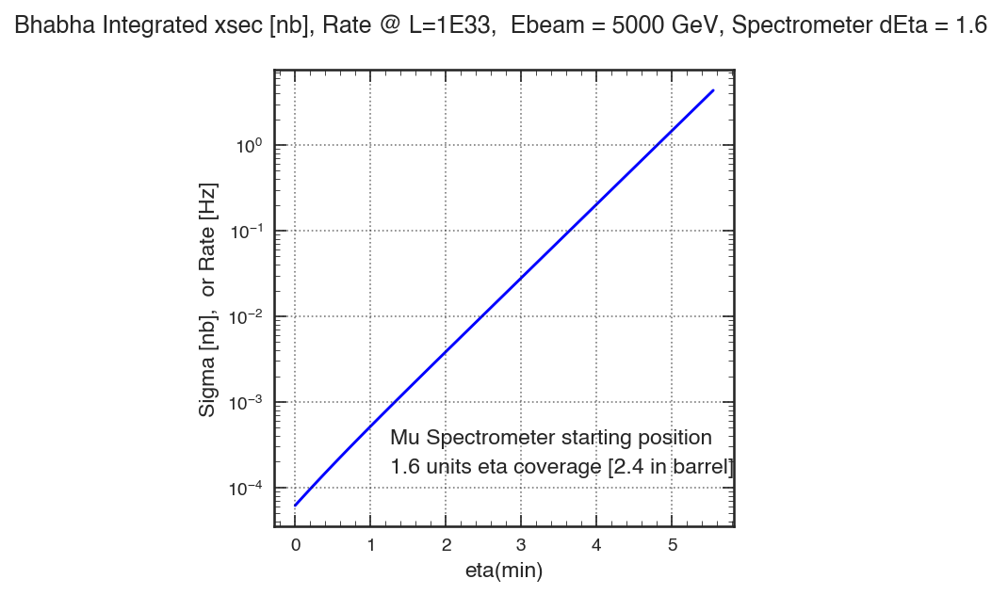
Bhabha Scattering Integrated Cross Section @10TeV
For a luminosity measurement, need reasonable rates online (~Hz) for prompt feedback
← Integrated cross section in nb for a muon spectrometer (Δη = 1.6)
  Same as rate in Hz for L=1E33
Only central muon coverage with |η|<2.4:
  L=10³³ Hz/cm²: 0.35 mHz (45 min per event!)
  L=10³⁵ Hz/cm² : 0.035 Hz (30s per event)
Need forward muon coverage…

Slide 8
Bhabha Scattering Integrated Cross Section @10TeV
For a luminosity measurement, need reasonable rates online (~Hz) for prompt feedback
Spectrometer locations with
Δη = 1.6 coverage
Forward coverage with 5.6<|η|<7.2
  L=10³³ Hz/cm²: 4.8 Hz
  L=10³⁵ Hz/cm²: 480 Hz
Forward coverage with 4.0<|η|<5.6
  L= 10³³ Hz/cm² : 0.2 Hz (5s per event)
  L= 10³⁵ Hz/cm² : 20 Hz (0.05s per event)
Forward coverage with 2.4<|η|<4.0
  L=10³³ Hz/cm²: 8.5 mHz (2 min per event!)
  L= 10³⁵ Hz/cm² : 0.85 Hz (1.3s per event)
Same as VBF coverage

Slide 9
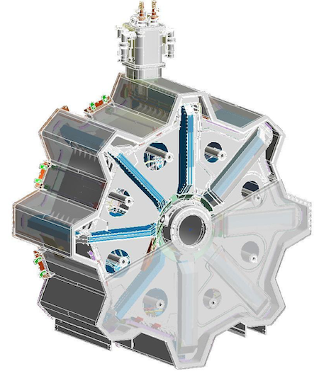
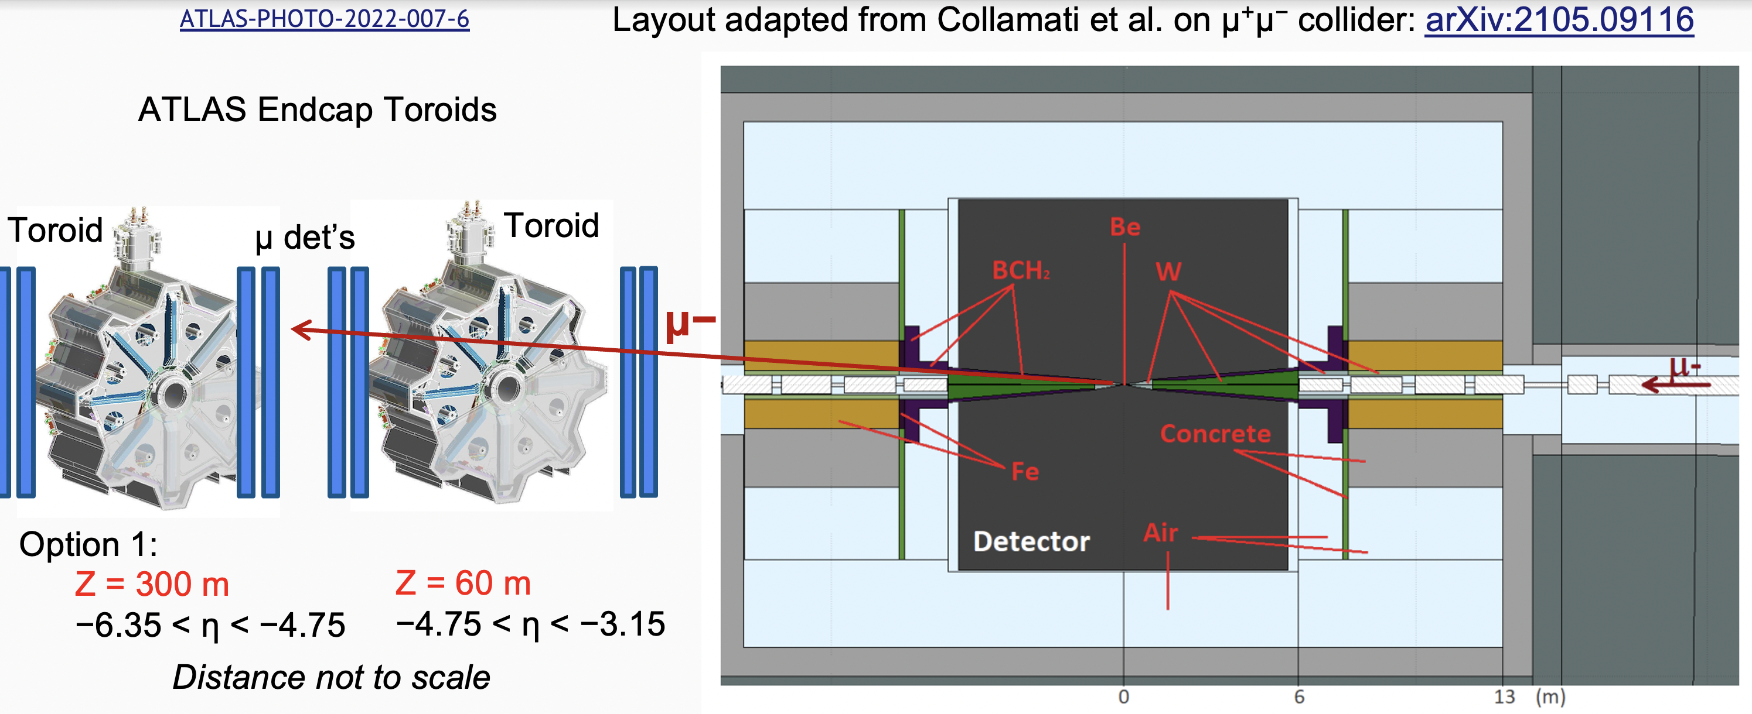
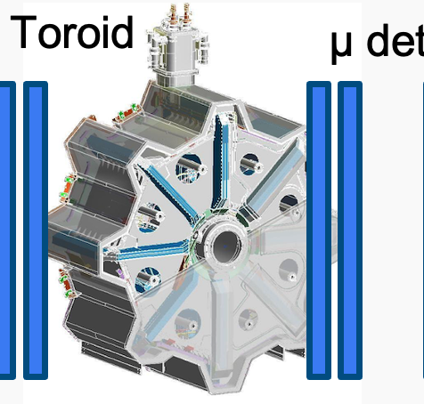

A Far Forward Muon Spectrometer Design Study
To begin to address some of the feasibility questions, we initiated a GEANT-4 feasibility study of a downstream muon spectrometer
  In contrast to instrumenting the nozzle (challenging with BIB!), and to provide magnetic bending
  Also studied TeV muon scattering and energy loss in the tungsten shielding cone (covers |η|>2.4)
Explored using an (ATLAS) endcap toroidal magnet design as a realistic strawman design
  Largish opening to accommodate beam line components, and with less B field impact on beam
  Study muon tagging and momentum measurements, and the impact on physics measurements
$R_{in}=$ 1.05 m
$R_{out}=$5.1 m
L = 4.5 m
$B_{in}=4.1$T
$∫B⋅dl=$ 4−18 T・m
Z= 660m Z= 140m Z=28m
7.2>|η|>5.6 5.6>|η|>4.0 4.0>|η|>2.4
Small angles require large distances from IP

Slide 10
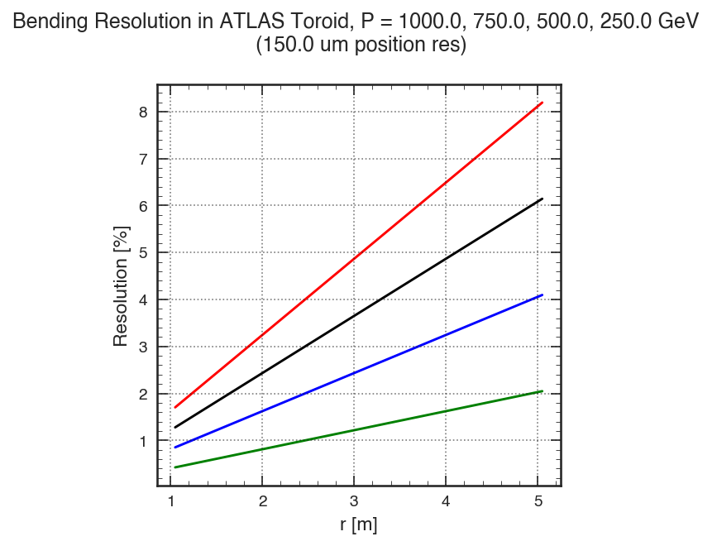
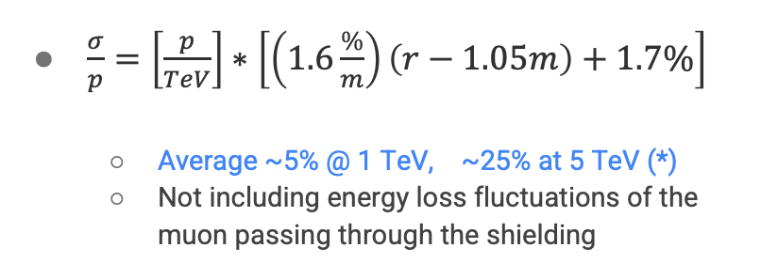
Straw Momentum Resolution with Ideal Toroid
Assuming ~150 μm detector resolution in front and behind toroid.
Idealized model, i.e. take with a grain of salt
Studies of a realistic toroidal system in Geant-4 with reconstruction are in progress
Will have field map incorporated, and G4 hit readout
$\frac{σ}{p}=\left[\frac{p}{TeV}\right]∗\left[\left(1.6\frac{\%}{m}\right)\left(r−1.05m\right)+1.7\%\right]$
  Average ~5% @ 1 TeV, ~25% at 5 TeV (*)
  Not including energy loss fluctuations of the muon passing through the shielding
Resolution linear with R
(*) Would prefer < 10% for invisible Higgs decay measurements at μμ collider [arXiv:2303.14202]

Slide 11
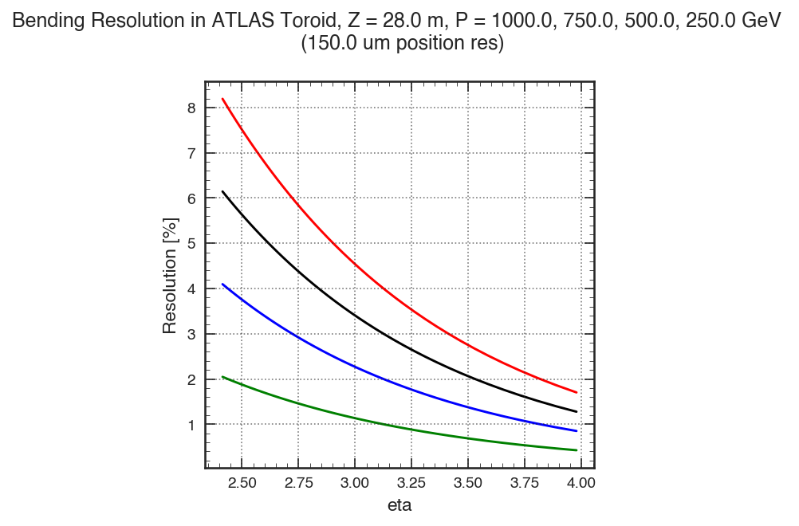
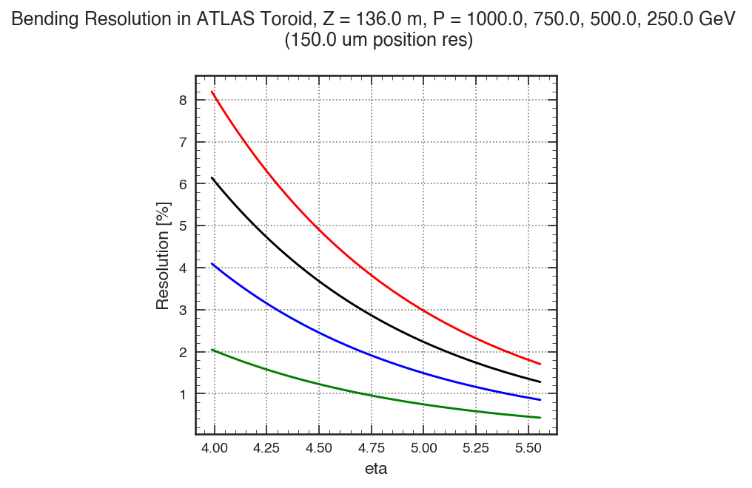
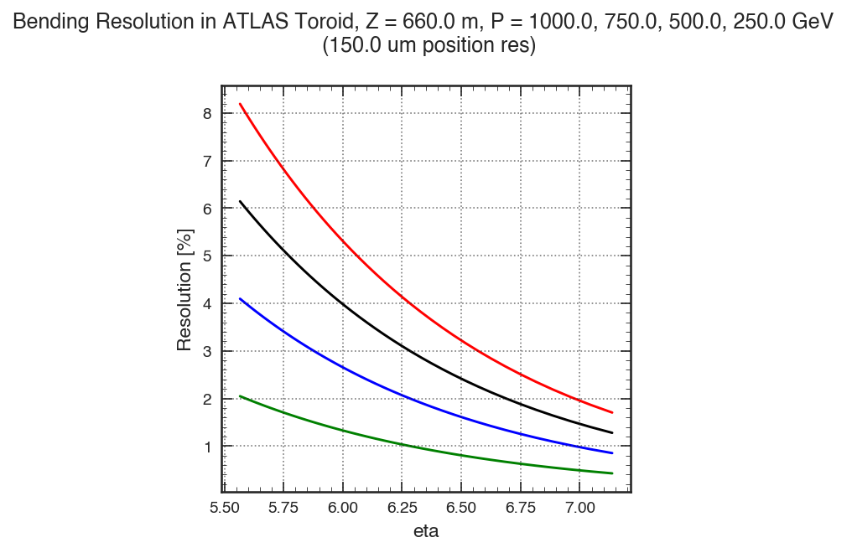
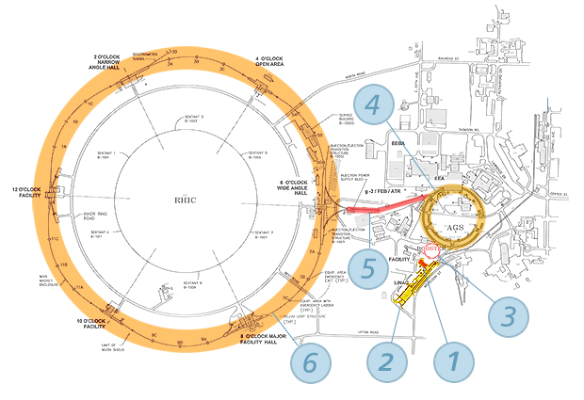
Momentum Resolution with 3 Toroids for Full η Coverage
2.4 < |η| < 4.0 (Z=28m) →
4.0 < |η| < 5.6 (Z=140m) →
5.6 < |η| < 7.2 (Z=660m) ^{(*)}
0.25 – 1.0 TeV
Full eta coverage requires 3 spectrometers, far downstream for highest η
  One station might be sufficient for Bhabhas and VBF tagging
  ^{(*)} Could cover higher η, without magnetic bending, in a closer station if that
  closer station is outside the collider ring beam line

Slide 12
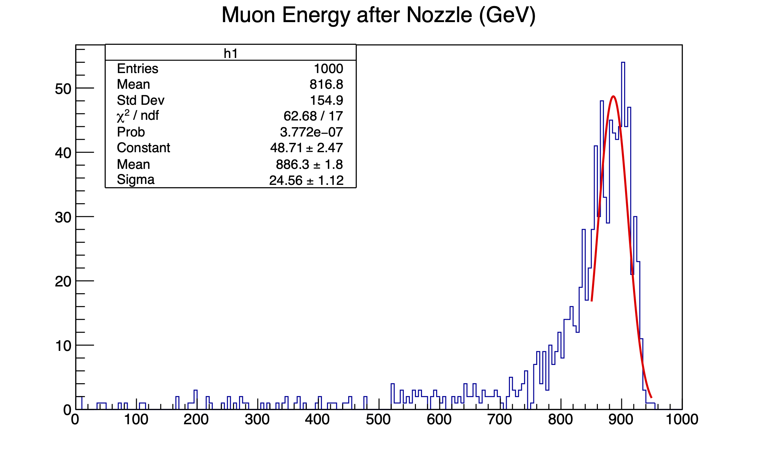
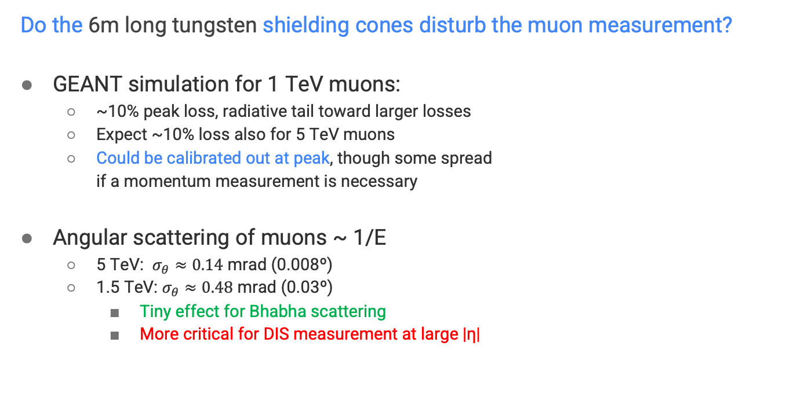
Muon Energy and Angle Measurements
Do the 6m long tungsten shielding cones disturb the muon measurement?
GEANT simulation for 1 TeV muons:
  ~10% peak loss, radiative tail toward larger losses
  Expect ~10% loss also for 5 TeV muons
  Could be calibrated out at peak, though some spread
  if a momentum measurement is necessary
Angular scattering of muons ~ 1/E
  5 TeV: $σ_{θ}≈0.14$ mrad (0.008º)
  1.5 TeV: $σ_{θ}≈0.48$ mrad (0.03º)
    Tiny effect for Bhabha scattering
    More critical for DIS measurement at large |η|
→ Should be able to tag Bhabhas downstream even through shielding cones

Slide 13
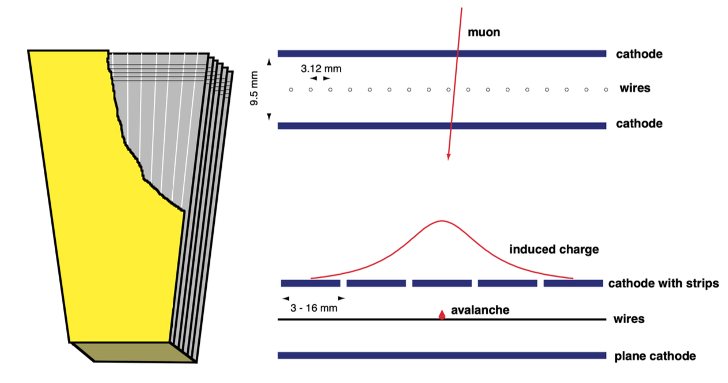
Straw Detector Design: Cathode Strip Chambers
Of course, other technologies exist, e.g. GEM, MM
Works for LHC experiments with high pileup backgrounds
Basic principle:
⇐ Wire view
⇐ Rotate 90º for strip view
O(100μm) precision variable

Slide 14
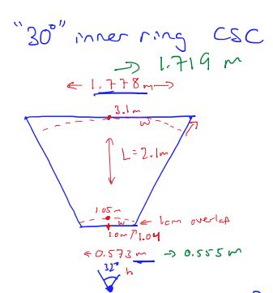
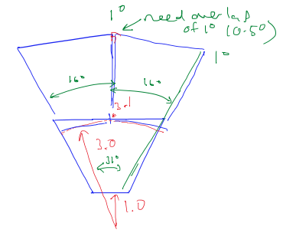
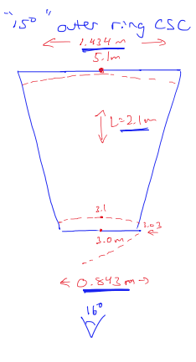
Traditional Trapezoidal CSC Layout
2 rings of CSCs with overlap in φ and η
  Inner ring of “30º” CSCs (31º with overlap)
    L = 210 cm
    W_{in} = 55.5 cm
    W_{out} = 171.9 cm
    Area: 2.4 m²
  Outer ring of “15º” CSCs (16º with overlap)
    L = 210 cm
    W_{in} = 84.3 cm
    W_{out} = 143.4 cm
    Area: 2.4 m²
Lengths, widths, areas are on par with
CSCs produced for the CMS experiment
Volumes were implemented in a G4 simulation, but still need to add realistic detector simulation of strips and wires (so nothing CSC specific yet)
2 Types
36 CSCs in total per disk (24+12)

Slide 15
UV Strips for Higher Occupancy Tolerance
Parallel strip option (a là CMS)
  6 layers of strips (S) parallel to top and bottom edges
    10 mm spacing
  But unlike CMS, the wires run lengthwise, not the strips,
  as η (or r) is the important bending variable, not φ
Stereo strip option
  Resolves ghost hit combinations in high occupancy environment with 3 views
  Alternating 3 layers of one set of strips (U) rotated 15º from edge with another 3 layers of strips (V) rotated −15º from first set (30º angle between them)
    10 mm spacing
Wires arranged perpendicular to top and bottom edges, running lengthwise
    6 layers of wires with 3.2 mm spacing
    Read out in groups of 5 wires
strips
r
wires
strips, strips
wires

Slide 16

Or Perhaps a Universal Hexagonal CSC with UV Strips ?
Dimensions
  Side length: 1.0m
  Height, width: √3 s = 1.73 m
  Area: 2.6 m²
Stereo strips:
  Alternating layers of one set of strips (U) parallel to a side, and another set of strips (V) rotated 30º from first set
    10 mm spacing
Wires (W) arranged perpendicular to U strips
    3.2 mm spacing
6 planes of wires and strips
Possible to manufacture?

Slide 17
































Possible Arrangement of Hexagons
Strips aligned for precision radial (η) measurement
CSCs can be all identical, just rotated for optimal reconstruction
36 CSCs in total per disk

Slide 18
Summary
A MC luminosity measurement based on Bhabha scattering is going to have a very low rate without forward muon detection ☹
Tagging/measuring VBF processes also requires forward muon detection
Synergistic also with measurements for muon-ion collisions
A straw toroidal magnet spectrometer design presented
  Would require several stations at increasing distances along beam line for full η coverage
  BIB impact on potential detectors would need study (maybe most distant stations can be shielded)
Next steps would be to implement a detailed simulation, develop a reconstruction algorithm, measure performance, optimize…

Slide 19
Acknowledgements
This work is in part supported by the Department of Energy, United States grant numbers DE-SC0010103, DE-SC0023351 (D.A.), DE-SC0005131 (W.L.)

Slide 20
Backup

Slide 21
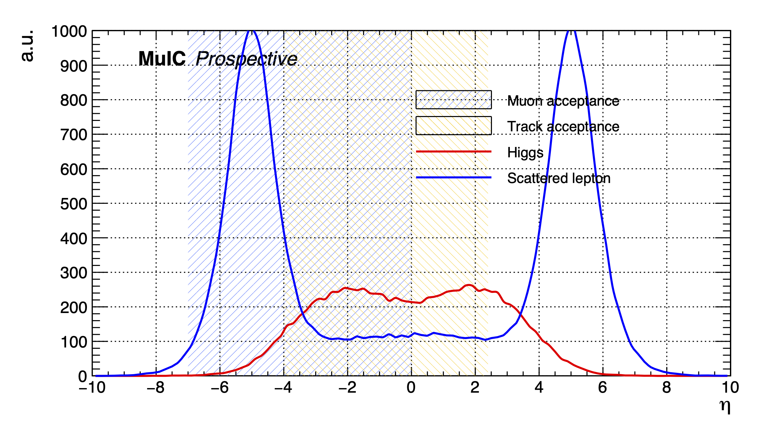
VBF Higgs Production for μ⁺μ⁻ Collider
Pseudorapidity distribution for scattered lepton in VBF Higgs production
7 x 7 TeV
Scattered muons in far backward and forward regions

Slide 22
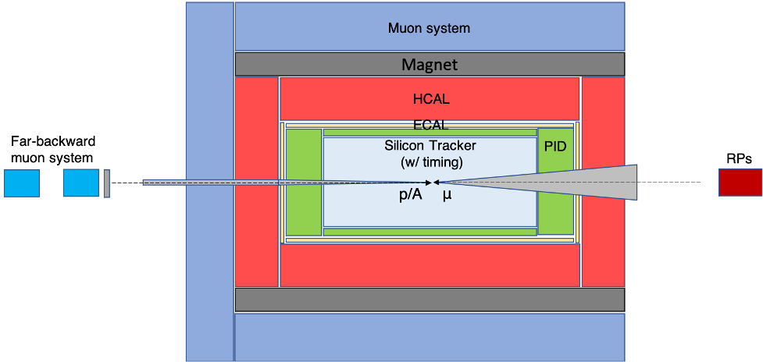
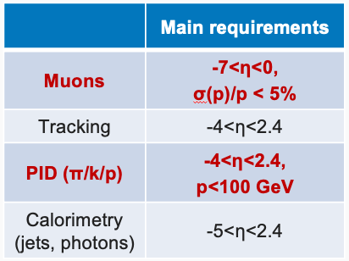

Detector Considerations and Challenges
Starting point: μ⁺μ⁻ conceptual detector design
Hadron PID over a wide phase space, with good timing measurements to reduce BIB
Measurement of muons at high |η|→7 (far-backward) up to TeV scale
  Useful also for an experiment at a μ⁺μ⁻ collider to measure luminosity from Bhabha scattering
  and to tag/veto NC VBF processes
For MuIC, ideally would remove one shielding nozzle, keeping only on incoming muon side, but would need study.
  But coexistence with μ+μ− collisions in the same experiment requires keeping it
“Wish list”
$$η∈(−7,−2.4)$$
p→
←μ
−5<η<2.4

Slide 23
Challenge: Luminosity Measurement for Muon-proton Collisions?
Luminosity measurement via the μp → μpγ process (analog to HERA and EIC measurement) would be challenging at a MuIC with the large BIB
  May already have a large γ flux even if all other charged particles are swept away
Need another normalization process?

